Slide 1
Describing people and talking about what they do
Revision and test practice
Strong vowels together
Y9 Spanish
Term 1.2 - Week 4 - Lesson 21
Pete Watson / Louise Caruso / Amanda Izquierdo Artwork: Mark Davies
Date updated: 08/07/21
Notes:
Artwork by Mark Davies. All additional pictures selected are available under a Creative Commons license, no attribution required.
With thanks to Rachel Hawkes for her input on the lesson material and Blanca Román for native teacher feedback.
Learning outcomes (lesson 1):
Revision of grammar from 8.3.2.4 – 9.1.2.3 including:
2nd persons singular and plural of estar (estás, estáis)
Present continuous of ar/er/ir verbs (from Y8)
Reflexive pronoun ‘se’ vs personal ‘a’ (contrast self-directed and other-directed actions)
Plural direct object pronouns los, las
- Strong vowels [consolidation], [ao], [oa], [ee], [oo]
Frequency rankings of vocabulary revisited this week (1 is the most common word in Spanish)
hablar [90]; estudiar [281]; llevar [75]; cenar [3087]; pintar [1329]; describir [1272]; subir [410]; sufrir [505]; volver [112]; discutir [1310]; conducir [998]; blanco [372]; azul [260]; amarillo [262]; rápido [870]; despacio [3383]; ya [39]; coche [1190]; ciencia [738]; inglés [583]; historia [186]; guerra [282]; noticia [859]; periodista [1235]; mientras [127]; realidad [260]; camisa [1873]; bolsa [1581]; falda [2743]; apenas [486]; mamá [675]; papá [865]; tío [988]; tía [1205]; abogado [1211]; abogada [1211]; según [237]; juntos [149], juntas [149]; árbol [748]; sin [54]; ropa [782]; limpiar [1713]; suelo [552]; solo [181]; sola [181]; plato [1808]; equipo [373]; barato [2164]; barata [2164]; caro [2179]; cara [2179]; cumpleaños [3372]; un [6]; una [6]; chino [1349]; y [4]; bajar [484]; marca [1274]; red [744]; salud [613]
Source: Davies, M. & Davies, K. (2018). A frequency dictionary of Spanish: Core vocabulary for learners (2nd ed.). Routledge: London
The frequency rankings for words that occur in this PowerPoint which have been previously introduced in NCELP resources are given in the NCELP SOW and in the resources that first introduced and formally re-visited those words.
For any other words that occur incidentally in this PowerPoint, frequency rankings will be provided in the notes field wherever possible.

Slide 2
Un día largo
Persona A lee su versión del texto.
Persona B escucha y toma apuntes*.
¿Cuáles son las diferencias?
hablar
bajar
falda
volver
tío
ciencia
Hoy va a ser un día muy largo. Antes de la escuela, debo lavar el suelo. Mi camisa blanca está sucia y necesito comprar otra camisa más barata. Normalmente mi mamá me lleva a la escuela en coche pero hoy no puede porque debe ver a un periodista. Entonces debo subir las calles a pie sin amigos.
Tengo muchas clases hoy. Voy a trabajar mucho. En la clase de arte vamos a pintar un paisaje y en la clase de historia debemos escribir sobre una guerra. Luego tengo dos clases de francés. Voy a llegar a casa muy tarde. Quizás voy a comer con mi tía en un restaurante caro.
conducir
cara
noticia
describir
platos
limpiar
inglés
mientras que
sola
papá
hablar
Which other words did you need to change?
estudiar
abogado
chino
amarillo
*apuntes = notes
Notes:
Timing: 12 minutes (2 slides) Aims: i) to review the homework task set last week (9.1.2.3).
ii) to develop fluency in decoding by reading aloud the student versions, including pronunciation of words with final syllable stress (quedé, levanté, pasé, después, comí, bebí, leí, habitación, está). iii) to listen attentively, noting differences in the original text. iv) to make judgements about the replacements made by a peer, and engage in peer feedback. Procedure: 1. Student A reads his/her adapted HW text. 2. Student B follows along with the original and makes a note of any substituted words s/he hears (on his/her copy of the HW sheet)
3. Swap roles.
4. Compare and contrast the two versions. Scrutinise any differences and offer opinions about the correctness of the choices.
5. Move to the next slide, which has a possible answer version, using all of the viable words. Note: the HW task set a time limit and asked students to try to replace at least ten of the words, so it’s to be expected that they might not have got them all.
Frequency of unknown language:
apunte [4865]

Slide 3
Un día largo
Persona A lee su versión del texto.
Persona B escucha y toma apuntes*.
¿Cuáles son las diferencias?
hablar
bajar
falda
tío
falda
volver
tío
bajar
volver
ciencia(s)
ciencia
Hoy va a ser un día muy largo. Antes de la escuela, debo lavar el suelo. Mi camisa blanca está sucia y necesito comprar otra camisa más barata. Normalmente mi mamá me lleva a la escuela en coche pero hoy no puede porque debe ver a un periodista. Entonces debo subir las calles a pie sin amigos.
Tengo muchas clases hoy. Voy a trabajar mucho. En la clase de arte vamos a pintar un paisaje y en la clase de historia debemos escribir sobre una guerra. Luego tengo dos clases de francés. Voy a llegar a casa muy tarde. Quizás voy a comer con mi tía en un restaurante caro.
conduce
conducir
cara
cara
falda
noticia
noticia
describir
describir
los platos
platos
limpiar
limpiar
inglés
inglés
mientras que
mientras que
sola
sola
papá
papá
hablar
hablar
Which other words did you need to change?
estudiar
abogado
amarilla
estudiar
abogado
chino
amarillo
chino
Notes:
Procedure: 1. On successive clicks the bold words are underlined and then the appropriate substitute word is highlighted. If a change is needed to its form, or an article is needed, this is highlighted in bold. 2. Note that sometimes changes are needed to other words in the sentence. All of these changes revisit previously taught grammar, which teachers can elicit and/or explain as needed.
3. When concluded, students see that 20 replacements were possible.
4. Note that alternative substitutions are possible. Teachers should make this clear and elicit students’ suggestions. In this case papa and tío are interchangeable, as could be inglés and chino. Additionally, before cara, más could feasibly be changed to menos. Other changes may be possible.

Slide 4
Fonética
Escucha. Escribe las palabras que faltan.
escuchar/escribir
1
Mi tío, Diego Ochoa, es de Bilbao como mi mamá y papá.
_____
_____
My uncle, Diego Ochoa, is from Bilbao like mum and dad.
Ahora vive solo en Lisboa, cerca del zoo donde estudia la ciencia de los animales.
2
______
_____
__
Now, he lives alone in Lisbon, near the zoo, where he studies animal science.
Cree que no tiene el tiempo para cenar así que prepara la comida barata en el microondas.
3
___
__________
He believes that he has no time to eat dinner, so he prepares cheap food in the mircowave.
_________
En las barbacoas de sus amigos, evita el alcohol porque debe conducir el coche para volver a casa y estudiar.
4
______
At his friends BBQs, he avoids alcohol because he must drive the car to get home and study.
5
______
_______________
En casa bebe un chocolate caliente con el cacao latinoamericano mientras ve las noticias .
At home he drinks a hot chocolate with latinamerican cocoa whilst he watches the news.
__
6
Antes de dormir, lee libros sobre la historia y las guerras de Hispanoamérica.
_________________ .
Before going to sleep, he reads books about the history and wars of Hispanic America.
Notes:
Timing: 5 minutes Aims:
i) to consolidate aural recognition of two strong vowels together (ao, oa, ee, oo).
ii) to consolidate the knowledge of accurate sound-spelling relationships by transcribing words previously taught words in Y7/8. Note: some words are known and others are unknown, making this a hybrid vocabulary/sounds of the language task.
Procedure:
1. Students listen to each sentence and write the missing words.
2. Click to reveal the correct spellings.
Elicit the English meaning of the full sentence. Note that unknown words are not glossed. Where they are not cognates, students are encouraged to use their knowledge of the surrounding words to predict their meaning, e.g. barbacoa.
Where a sentence has a (near) cognate, students are asked to pronounce them with the correct stress.
Click to show the stressed syllables.
Transcript
Mi tío Diego Ochoa es de Bilbao como mi mamá y papá.
Ahora vive solo en Lisboa, cerca del zoo donde estudia la ciencia de los animales.
Cree que no tiene el tiempo para cenar, así que prepara la comida barata en el microondas.
En las barbacoas de sus amigos evita el alcohol porque debe conducir el coche para volver a casa y estudiar.
En casa bebe un chocolate caliente con el cacao latinoamericano mientras ve las noticias.
Antes de dormir lee libros sobre la historia y las guerras de Hispanoamérica.
Word frequency of unknown or cognate words (1 is the most frequent word in Spanish):
barbacoa [>5000]; alcohol [2296]; zoo [>5000]; hispanoamérica [>5000]; mircoondas [>5000];
Source: Davies, M. & Davies, K. (2018). A frequency dictionary of Spanish: Core vocabulary for learners (2nd ed.). Routledge: London

Slide 5
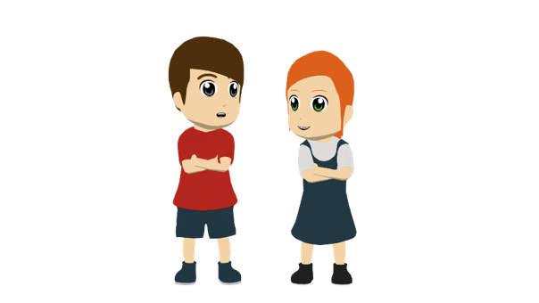
Vocabulario
escuchar
Lucía and Daniel are doing an online escape room.
Listen to the clues to find the code to unlock the door.
 | 1 | 2 | 3 | 4
 | estudiar | describir | bajar | llevar
 | despacio | solo | caro | apenas
 | realidad | cumpleaños | guerra | falda
 | equipo | abogada | tía | red
 | flor | bolsa | suelo | árbol
 | discutir | cenar | volver | subir
 | barata | blanco | azul | amarillo
 | historia | chino | inglés | mientras
1
1
3
2
2
3
¡correcto!
4
1
5
4
6
2
7
2
8
3
Notes:
Timing: 5 minutes Aim: to revisit 24 of this week’s vocabulary items. Procedure: 1. Click on the action buttons to hear the definitions.
2. Students decide if the answer is in column 1, 2, 3 or 4.
3. Click to reveal the answers (the code) along the door.
4. When all the correct answers have been revealed, the door will open.
Transcript:
Hacer trabajo para la escuela
Costar mucho dinero
Hoy es un día para celebrar
Personas juntas en un grupo
Una planta muy grande
Comer por la noche
El color de la leche
El idioma de Inglaterra

Slide 6
Talking about ‘you’ Estar in 2nd person singular & plural
gramática
‘to be’
state
‘Estar’ means _______ and is used to express a ______ or a location.
estás
To say ‘you are’ for one person, use ______ .
1
You are with your mum.
Estás con tu mamá.
‘Estar’ has the same –áis ending as other -ar verbs.
estáis
To say ‘you are’ for two or more people, use ______ .
2
You (all) are together.
Estáis juntos/juntas.
Remember, the final syllable is stressed, so there is an accent on the ‘a’.
Notes:
Timing: 2 minutes
Aim: to recap the meaning, use and formation of ‘estar’ in the second person singular and plural.
Procedure:
Click to bring up the explanation.
Elicit translations of examples from students.
Audio is also provided to model the pronunciation. A callout highlights the stress position on the 2nd person plural form (final syllable stress).

Slide 7
Talking about what’s happening now: Present continuous: –ar , –er and –ir verbs
gramática
estar
-ando
For an ongoing event in the present, you can use ______ with an –ar verb ending in ‘_______’.
You are speaking Chinese.
Estás hablando chino.
You (all) are studying history.
Estáis estudiando historia.
The –ando ending (and –ing in English) is called the ‘__________________’.
present participle
-iendo
For –er and –ir verbs, the present participle is different. Remove ‘er’ or ‘ir’ and add ‘_______’.
You are driving.
Estás conduciendo.
You (all) are returning by car.
Estáis volviendo en coche.
Notes:
Timing: 2 minutes
Aim: to recap the formation and meaning of the present continuous tense with –ar, –er and –ir verbs. Examples are given that elicit both singular and plural forms of ‘you’, which will be used in the next activity.
Procedure:
Click to go through the slide and explanation.
Gaps are left for teachers to elicit answers from students, which are then revealed on the next click.

Slide 8
Actividades en casa
Escucha las preguntas de Ana.
escuchar / leer
¿La pregunta es para Diego o es para Lucía y Daniel?
Luego, completa la traducción en inglés.
 | Diego (one ‘you’) | Lucía y Daniel (more than one ‘you’)
¿Estáis estudiando ciencias?
¿Estás cenando ya?
¿Por qué estás volviendo a esta hora?
¿Estáis limpiando el suelo?
¿Por qué estás subiendo a un árbol?
¿Estáis discutiendo sobre las noticias?
1
studying
Are you ___________ science?
2
having dinner
Are you _____________ already?
returning
3
Why are you _________ at this time?
cleaning
4
Are you __________the floor?
5
going up/
climbing
Why are you ______________ a tree?
6
arguing
Are you _________ about the news ?
Notes:
Timing: 6 minutes
Aim:
i) to practise understanding the meanings conveyed by the verb endings –as and –áis (singular ‘you’ and plural ‘you’)
ii) to consolidate the understanding of key verbs in the present continuous.
Procedure:
Students listen to each sentence and decide who is being addressed (singular ‘you’ or plural ‘you’), depending on the verb ending that they hear.
Students then listen again to complete the English translation of each question.
Show the answers and give feedback.
Note: to create differentiated challenge, alter the animation sequence.
As it stands, students can listen again ‘blind’ and write the full sentences. (= most challenging). Alternatively, they can complete items one-by-one with feedback, with a prompt gapped sentence provided each time. (= most supported) To create a mid level of challenge, change the animations so that all the gapped sentences appear at once and students complete them all, with feedback at the end. A further adaption would be to made the 2nd stage a reading task. To do this, reveal all the audio sentences in written form first.
Transcript:
¿Estáis estudiando ciencias?
¿Estás cenando ya?
¿Por qué estás volviendo a esta hora?
¿Estáis limpiando el suelo?
¿Por qué estás subiendo a un árbol?
¿Estáis discutiendo sobre las noticias?

Slide 9
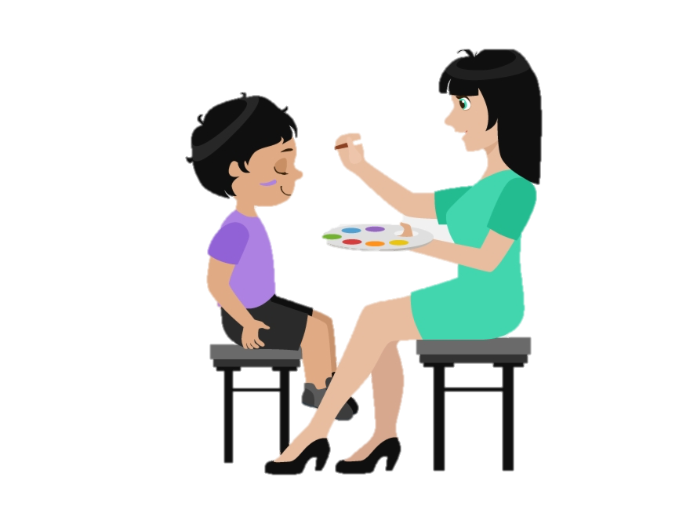
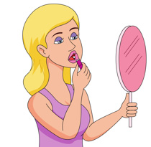
Doing something to ‘herself’/’himself’: Reflexive pronoun ‘se’
gramática
When the ’doer’ (subject) and ‘receiver’ (object) of the verb are not the same person, we use an ‘a’ after the verb:
Pinta al niño.
S/he paints the child.
When the ‘doer’ (subject) and ‘receiver’ (object) of an action are the same person we use a reflexive pronoun. For example:
S/he paints himself/herself.
To mean ‘herself’ or ‘himself’ in Spanish, use ‘se’ before a verb.
Se pinta.
S/he paints himself/herself.
Notes:
Timing: 2 minutes
Aim:
to revisit the reflexive pronoun ‘se’.
to recap the function of reflexive pronouns.
Procedure:
Teacher goes through the grammar explanation with students, revealing each new sentence on a mouse click.

Slide 10
Lee unas frases sobre las actividades de Lucía durante el fin de semana. ¿Cuál es la opción correcta? Escucha y comprueba.
leer / escuchar
¿Qué significan las frases?
1 | Despierta... | a su mamá temprano. temprano para estudiar.
2 | Se levanta... | para bajar al jardín. a su hermano.
3 | Pone... | una camisa blanca. una camisa al perro.
4 | Se presenta... | un amigo a su tía. en el equipo nuevo de fútbol.
5 | Se sienta... | y ve las noticias con su papá. a su prima en la silla.
6 | Mira... | en el espejo. a una periodista famosa en la tele.
 | Las frases en inglés
1
2
3
4
5
6
1
She wakes up
______________ her mother early.
2
She gets up
____________to go down to the garden.
3
She puts
_________ a t-shirt on the dog.
4
She introduces herself
_____________________ to the new football team.
5
She sits
________ down and watches the news with her dad.
She looks
6
__________ at a famous journalist on TV.
Notes:
Timing: 6 minutes
Aim:
to practise the difference between doing an action to someone else (using the personal ‘a’) and doing an action to oneself (using the reflexive pronoun ‘se’).
to understand the vocabulary in the sentences.
Procedure:
Students read each phrase and decide which is the correct option depending on the presence or the absence of the reflexive ‘se’.
Student listen to each sentence and check their answers.
Students complete the start of each question in English.

Slide 11
Saying who or what receives the action using ‘los’ & ‘las’ in object-first sentences
gramática
Remember, to mean ‘them’ when referring to a plural feminine object, use ____ before a verb.
las
Llevo las faldas.
→ I wear the skirts.
Las llevo.
→ I wear them.
los
To mean ‘them’ for a plural masculine object, use use ____ before a verb.
Limpia los coches.
→ S/he cleans the cars.
¡Ojo! ‘Los’ and ‘las’ also mean ‘the’ before a noun!
→ S/he cleans them.
Los corta.
Notes:
Timing: 1 minute
Aim: to recap the direct object pronouns ‘las’ and ‘los’.
Procedure:
Click to bring up explanation and examples.

Slide 12
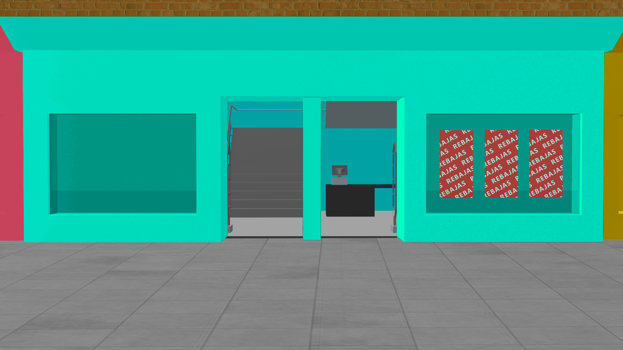
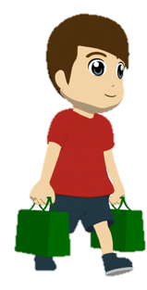
Daniel va de compras
leer / escuchar
[1/2]
 |  |  | La parte subrayada
1. Busca | unas camisas | azules y los encuentra en una tienda barata. | He ______________________ ______.
 | unos pantalones
1
finds them in a cheap
shop
 |  |  | La parte subrayada
2. Mira | unas tarjetas | y las compra para el cumpleaños de Nadia. | He___________________________________.
 | unos juegos
2
buys them for Nadia’s
birthday.
 |  |  | La parte subrayada
3. Necesita | unos relojes | porque siempre las olvida en casa. | He _________________________.
 | unas bolsas
3
he forgets them at home
Notes:
Timing: 8 minutes
Aim: to practise understanding the meaning of the feminine and the masculine direct object pronouns (‘las’ and ‘los’ for ‘them’) with reference to the preceding noun.
Procedure:
Students write 1-6 in their books. For each sentence, they will need to write the missing noun (by paying attention to the pronoun) and to translate the underlined part of the sentence.
Students listen to each sentence.
Click to show answers item by item. The correct noun first appears, and then the English translation of the underlined text.
Notes:
1. The activity could be adapted for different levels of ability by increasing or decreasing the amount of text that students are required to translate.

Slide 13
Daniel va de compras
leer / escuchar
[2/2]
 |  |  | La parte subrayada
4. Recoge | unos billetes | y las comparte con sus amigos. | He_________________________________.
 | unas entradas
shares them with his
4
friends
 |  |  | La parte subrayada
5. Ve | unas tapas | a buen precio pero los prueba primero. | He ______________________.
 | unos platos
5
tries them first
 |  |  | La parte subrayada
6. Elige | unas bebidas | para una fiesta y los lleva en la bolsa nueva. | He _______________________ ____.
 | unos zapatos
6
carries them in the new
bag
Notes:
Slide 2/2

Slide 14
Deberes
Vocabulary Learning Homework (Y9, Term 1.2, Week 5)
This week’s homework is four vocabulary mashups from 8.3.2.4 to 9.1.2.3
Y9 Spanish Term 1.2 Week 5 - mashup A
Y9 Spanish Term 1.2 Week 5 - mashup B
Y9 Spanish Term 1.2 Week 5 - mashup C
Y9 Spanish Term 1.2 Week 5 - mashup D
Notes:
Timing: 1 minute

Slide 15
Weekend activities
Revision and test practice
Strong vowels together
Y9 Spanish
Term 1.2 - Week 4 - Lesson 22
Pete Watson / Louise Caruso / Amanda Izquierdo
Artwork: Mark Davies
Date updated: 12/08/22
Notes:
Artwork by Mark Davies. All additional pictures selected are available under a Creative Commons license, no attribution required.
With thanks to Rachel Hawkes and Nick Avery for their input on the lesson material and Blanca Román for native teacher feedback.
Learning outcomes (lesson 1):
Revision of grammar from 8.3.2.4 – 9.1.2.3 including:
Possessive adjective su
Indirect object pronouns me, te, le, les, direct object pronouns lo, la
Gustar-type verbs and indirect object pronouns (me, te)
- Strong vowels [consolidation], [ao], [oa], [ee], [oo]
Frequency rankings of vocabulary revisited this week (1 is the most common word in Spanish)
hablar [90]; estudiar [281]; llevar [75]; cenar [3087]; pintar [1329]; describir [1272]; subir [410]; sufrir [505]; volver [112]; discutir [1310]; conducir [998]; blanco [372]; azul [260]; amarillo [262]; rápido [870]; despacio [3383]; ya [39]; coche [1190]; ciencia [738]; inglés [583]; historia [186]; guerra [282]; noticia [859]; periodista [1235]; mientras [127]; realidad [260]; camisa [1873]; bolsa [1581]; falda [2743]; apenas [486]; mamá [675]; papá [865]; tío [988]; tía [1205]; abogado [1211]; abogada [1211]; según [237]; juntos [149], juntas [149]; árbol [748]; sin [54]; ropa [782]; limpiar [1713]; suelo [552]; solo [181]; sola [181]; plato [1808]; equipo [373]; barato [2164]; barata [2164]; caro [2179]; cara [2179]; cumpleaños [3372]; un [6]; una [6]; chino [1349]; y [4]; bajar [484]; marca [1274]; red [744]; salud [613]
Source: Davies, M. & Davies, K. (2018). A frequency dictionary of Spanish: Core vocabulary for learners (2nd ed.). Routledge: London
The frequency rankings for words that occur in this PowerPoint which have been previously introduced in NCELP resources are given in the NCELP SOW and in the resources that first introduced and formally re-visited those words.
For any other words that occur incidentally in this PowerPoint, frequency rankings will be provided in the notes field wherever possible.

Slide 16
Vocabulario
Traduce las palabras al español.
hablar
1
the cheap brand
according to my Dad
I want to eat dinner together (f).
I must wear a shirt and skirt.
to return slowly
to drive a fast car
Mum is already here.
a journalist and a lawyer (f)
to paint with yellow and blue
to suffer alone (m)
to go down to the floor
She wants to discuss the network.
la marca barata
2
según mi papa
3
Quiero cenar juntas.
4
Debo llevar una camisa y una falda.
5
volver despacio
6
conducir un coche rápido
7
Mamá ya está aquí.
8
un periodista y una abogada
9
pintar con azul y amarillo
10
sufrir solo
11
bajar al suelo
12
Quiere discutir la red.
Notes:
Timing: 8 minutes (if task repeated) Aim: to practise oral production of some of this week’s revisited vocabulary in short phrases and sentences. Note: this is similar to part of the speaking achievement tests. Procedure: 1. Students produce the answers, chorally.
2. Teacher clicks to give item-by-item feedback.
3. Students repeat the task with all items 1-12 to develop fluent recall.
4. Teachers click to provide feedback again.

Slide 17
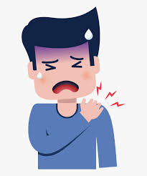
Vocabulario 1/7
leer
¿Cuál es la definición correcta para la palabra en inglés?
a | conducir despacio
b | pintar
c | pensar que ya es demasiado
d | sufrir mucho
to agonise
Notes:
Timing: 5 minutes (7 slides) Aim: to revisit more of this week’s vocabulary items.
Note: the English words chosen are not on the vocab list – students don’t know this anchor word but they do know all the words in the definitions! This task mirrors a task type we used in the Y8 summer term assessments.

Slide 18
Vocabulario 2/7
leer
¿Cuál es la definición correcta para la palabra en inglés?
a | limpiar las manos
b | escuchar a tu mamá
c | poner comida sobre el plato
d | escribir una noticia
to sanitise

Slide 19
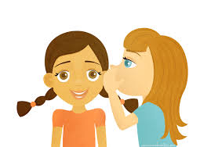
Vocabulario 3/7
leer
¿Cuál es la definición correcta para la palabra en inglés?
a | tener mala salud
b | hablar casi en silencio
c | llevar una falda
d | subir el ruido
to whisper

Slide 20
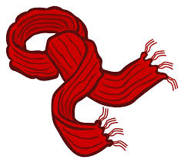
Vocabulario 4/7
leer
¿Cuál es la definición correcta para la palabra en inglés?
a | una camisa para el verano
b | una marca barata
c | un tipo de ropa para el invierno
d | una bolsa de mi papá
scarf

Slide 21
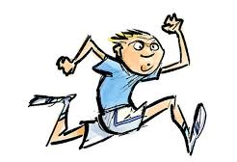
Vocabulario 5/7
leer
¿Cuál es la definición correcta para la palabra en inglés?
a | el hijo de un tío
b | un periodista de deportes
c | estar juntas
d | un hombre muy rápido
sprinter

Slide 22
Vocabulario 6/7
leer
¿Cuál es la definición correcta para la palabra en inglés?
a | describir una historia
b | ciencia que estudia los animales
c | una casa sin perros
d | un equipo de científicos
zoology

Slide 23
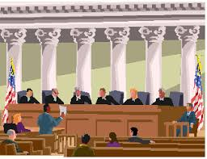
Vocabulario 7/7
leer
¿Cuál es la definición correcta para la palabra en inglés?
a | un coche
b | el suelo de una tienda
c | lugar donde trabaja un abogado
d | un director según los periodistas
court

Slide 24
Fonética
hablar / escuchar
Persona A lee y traduce. Persona B escucha. Luego
Persona A
Persona B
No sé qué llevar para el cumpleaños de Joaquín.Vamos a cenar al restaurante chino que se llama “Oasis”, donde hacen platos extraordinarios. Vamos juntos con los amigos de su equipo. No quiero ir a la ciudad ahora – hay siempre una gran caos.
¿Crees que puedo
encontrar una falda amarilla y una camisa azul de una marca buena en la red? Según mi tía, bajan los precios de los productos en la red. Ayer compró cinco toallas* para diez euros.
[to wear]
[birthday]
[yellow skirt]
[to dine]
[chinese]
[blue shirt]
[brand]
[net]?
[According to]
[dishes]
[they lower]
[together]
[net].
[team].
[a]
*la toalla - towel
Notes:
Timing: 5 minutes Aim: to practise oral productive recall of 17 of this week’s vocabulary set; to practise reading aloud for fluency; to practise pronouncing cognates and near cognates with the correct stress. Procedure: 1. Partner A reads the first part of the text aloud, translating the English words into Spanish.
2. Partner B listens and gives feedback on word recall, pronunciation and word stress.
3. Swap roles for the second part of the text.
Word frequency of unknown or cognate words (1 is the most frequent word in Spanish):
caos [3474]; extraordinario [1346]; oasis [>5000}; toalla [4242]; Source: Davies, M. & Davies, K. (2018). A frequency dictionary of Spanish: Core vocabulary for learners (2nd ed.). Routledge: London

Slide 25
Saying who is affected by an action Indirect object pronouns ‘le’ and ‘les’
gramática
Remember, object pronouns (e.g., him) indicate the person or thing that is affected by the verb.
To refer to one person or thing indirectly affected by an action, use ___.
le
Le mando mensajes.
I send him/her/it messages.
I send messages to him/her/it.
If more than one person or thing is indirectly affected, use ___.
les
Les mando mensajes.
‘Les’ can refer to all male, all female or mixed groups.
I send them messages.
In Spanish, these pronouns go before / after the verb.
Notes:
Timing: 1 minute
Aim: to recap the use of indirect object pronouns ‘le’ and ‘les’
Procedure:
Go through the grammar explanation with students, revealing each new sentence on a mouse click.

Slide 26
Saying who is affected by an action Object pronouns ‘me’ and ‘te’
gramática
¡Atención! Escucha la pronunciación:
1
If the person affected by the action is ‘me’, use ____.
me
Me compran ropa.
They buy me clothes.
They buy clothes for me.
If the person affected by the action is ‘you’, use ___.
te
Te traen comida para la fiesta.
They bring you food for the party.
They bring food to you for the party.
Notes:
Timing: 1 minute
Aim: to recap the use of indirect object pronouns ‘me’ and ‘te’
Procedure:
Go through the grammar explanation with students, revealing each new sentence on a mouse click.
Draw students’ attention to the pronunciation of ‘me’, which is different from the English ‘me’. Click on the orange button to hear a native speaker say the word.

Slide 27
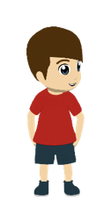
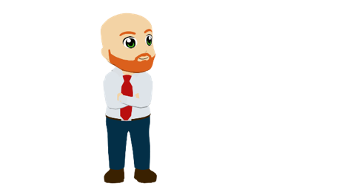
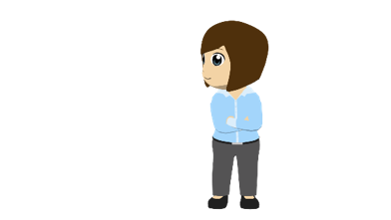
¿Qué hace Diego los sábados?
El abuelo
(‘you’)
escuchar
Lucía
(‘me’)
Lucía describe las actividades de Diego los sábados.
¿Qué significa la frase? Elige la opción correcta (‘A’ o ‘B’).
Daniel
(‘him’)
A
B
1
He makes breakfast.
He makes me breakfast.
2
He buys him clothes.
He buys clothes.
Daniel & Ana
(‘them’)
3
He leaves them food on the table.
He leaves food on the table.
4
He sends you a lot of photos.
He sends a lot of photos.
Notes:
Timing: 5 minutes
Aims:
i) to familiarise students with one type of question from the achievement test.
ii) to consolidate understanding of indirect object pronouns (me, te, le, les).
iii) to understand how the presence or absence of a pronoun affects the meaning of the sentence.
Procedure:
Go through instructions with students.
Click the orange action button to play the audio. Students will hear two sentences with a pronoun and two sentences without a pronoun.
When checking answers afterwards, ask students how they would say the other sentence (e.g. in item 1, they heard ‘A’, but how would they say ‘B’?). One reason for this is to ensure that the meanings of all four pronouns (me, te, le and les) are covered as part of the activity, including in questions items where the pronoun is not heard.
Transcript:
Me prepara el desayuno.
Compra ropa.
Les deja comida en la mesa.
Envía muchas fotos.

Slide 28
Saying how things make people feel Verbs like gustar
gramática
As you know, in Spanish an infinitive can be used as the subject in a sentence.
Bailar es divertido.
Dancing is fun.
You can also do this in sentences with verbs like gustar.
Bailar me gusta.
Dancing pleases me (I like dancing).
Me gusta bailar.
Remember, the subject (‘bailar’) can either come at the start of the sentence or after the gustar-type verb.
Remember, when the infinitive is used as a subject, we refer to it as ‘it’, so must use the (-a) ending for –ar verbs in the present.
Te alegra bailar.
Dancing makes you happy.
Notes:
Timing: 2 minutes
Aim: to recap the use of gustar-type verbs in sentences where the infinitive is used as the subject.
Procedure:
Go through the grammar explanation with students, revealing each new sentence on a mouse click.

Slide 29
Daniel tiene una amiga en Madrid. Él le pregunta sobre esta ciudad. ¿Cómo termina la frase? Lee y marca la opción correcta.
leer
1
¿Te gusta…?
4
¿Te molesta…?
... visitar sus parques?
... sus parques?
... las temperaturas altas en verano?
... salir a la calle en verano?
2
¿Te preocupan…?
5
¿Te alegran…?
... los problemas sociales?
... ver los problemas sociales?
... los conciertos allí?
... ir a los conciertos allí?
3
¿Te importa…?
6
¿Te interesan…?
... los precios altos?
... pagar precios altos?
... sus plazas antiguas?
... ir a sus plazas antiguas?
Notes:
Timing: 6 minutes
Aims:
i) to familiarise students with one type of question from the achievement test.
ii) to revisit the use of the 3rd person singular form of modal verbs (those ending in –a) in two-verb constructions (e.g. gustar + infinitive). This is contrasted with the 3rd person plural (-an) form, which is used with a plural noun.
iii) to revisit ‘su’ with the meaning ‘its’
Procedure:
Students read the sentence starters and decide which option, a or b, correctly completes the sentence.
Note: before starting the activity, it may help to remind students of the meaning of ‘su’ (‘its’, in this context) and when ‘sus’ is used (when the possession is a plural noun). This possessive adjective is included as it is one of the features that will appear in the test.

Slide 30
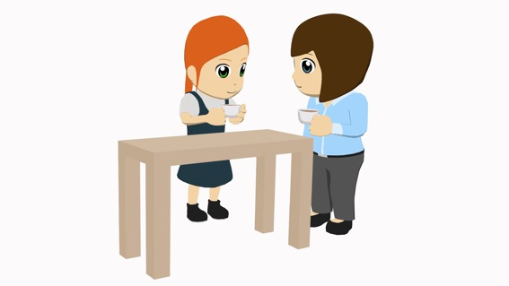
Lucía habla con Ana. Las dos preparan unas cosas. Lee y escucha el diálogo. Debes decir otras palabras posibles.
leer / escuchar
1
4
Mamá, Nadia me invita a dormir en su casa este fin de semana porque es su cumpleaños. ¿Me dejas ir?
¡Ah! Claro, muy bien. Pero, entonces, ¿no limpias tu habitación?
¡La limpio casi todos los días!
¿Seguro? Bueno, no vamos a discutir ahora. ¿Te ayudo con tu bolsa?
Pues sí, gracias. ¿Qué ropa me llevo? Mi camisa favorita está sucia.
Mmm... Si quieres la lavo, es rápido. ¿Te preparo un plato de comida?
No, no lo necesito porque voy a cenar en casa de Nadia. Oye*, ¿me prestas tu falda azul? La quiero para la fiesta.
Vale, también te presto mi camisa blanca. ¿Y tu libro de historia?
No lo cojo porque no tengo deberes.
¿No tienes deberes? ¡Qué raro! Bueno, lo guardo.
¡Ah! ¿Y ¿me das dinero para comprar un regalo a Nadia?
Vaaale. Te doy 20 euros. Podemos ir a la tienda juntas. ¿Me acompañas primero a la casa de tu tía? Y después te llevo a casa de Nadia en coche.
¡Perfecto!
2
5
3
6
7
*Oye = Hey
Notes:
Timing: 10 minutes
Aims:
to help students to connect the spoken and written forms of the language more securely.
to consolidate vocabulary and grammar knowledge by eliciting suggested changes to the text.
Procedure:
Click on the audio button to play the text. Read and listen.
Note: There is a full version of the audio top right with a player. Alternatively, the audio is in 6 sections with a pause just after the words 1-5 in bold in the transcript below, to facilitate easy stop/start.
To support segmentation, stop the audio and ask students to say: a) the next word b) the previous word
In addition, to develop understanding, vocabulary and grammar knowledge, pause at key points and ask students to suggest an alternative word that could replace the next word. This is a chance to draw on previously taught grammar and vocabulary knowledge.
Transcript:
Mamá, Nadia me invita a dormir en su casa este fin de semana porque es su cumpleaños. ¿Me dejas ir?
¡Ah! Claro, muy bien. Pero, entonces, ¿no limpias tu (1) habitación?
¡La limpio casi todos los días!
¿Seguro? Bueno, no vamos a discutir ahora. ¿Te ayudo con tu (2) bolsa?
Pues sí, gracias. ¿Qué ropa me (3) llevo? Mi camisa favorita está sucia.
Mmm... Si quieres la lavo, es rápido. ¿Te preparo un plato de comida?
No, no lo (4) necesito porque voy a cenar en casa de Nadia. Oye*, ¿me prestas tu falda azul? La quiero para la fiesta.
Vale, también te presto mi camisa blanca. ¿Y tu libro de historia?
No lo (5) cojo porque no tengo deberes.
¿No tienes deberes? ¡Qué raro! Bueno, lo guardo.
¡Ah! Y ¿me das dinero para comprar un regalo a Nadia?
Vaaale. Te doy 20 euros. Podemos ir a la tienda juntas. ¿Me acompañas primero a la casa de tu tía? Y después te (6) llevo a casa de Nadia en coche.
¡Perfecto!
Suggestions for posible changes: 1) bicicleta, cama, mesa, ventana... 2) tarea, ropa, regalo, vestido... 3) pongo, compro, quito, prestas, regalas, das... 4) quiero, como, tomo... 5) llevo, necesito, quiero, pongo (en la bolsa)... 6) acompaño, llamo, sigo, ayudo...
Frequency of unknown words or cognates:
oye [oír] [254]

Slide 31
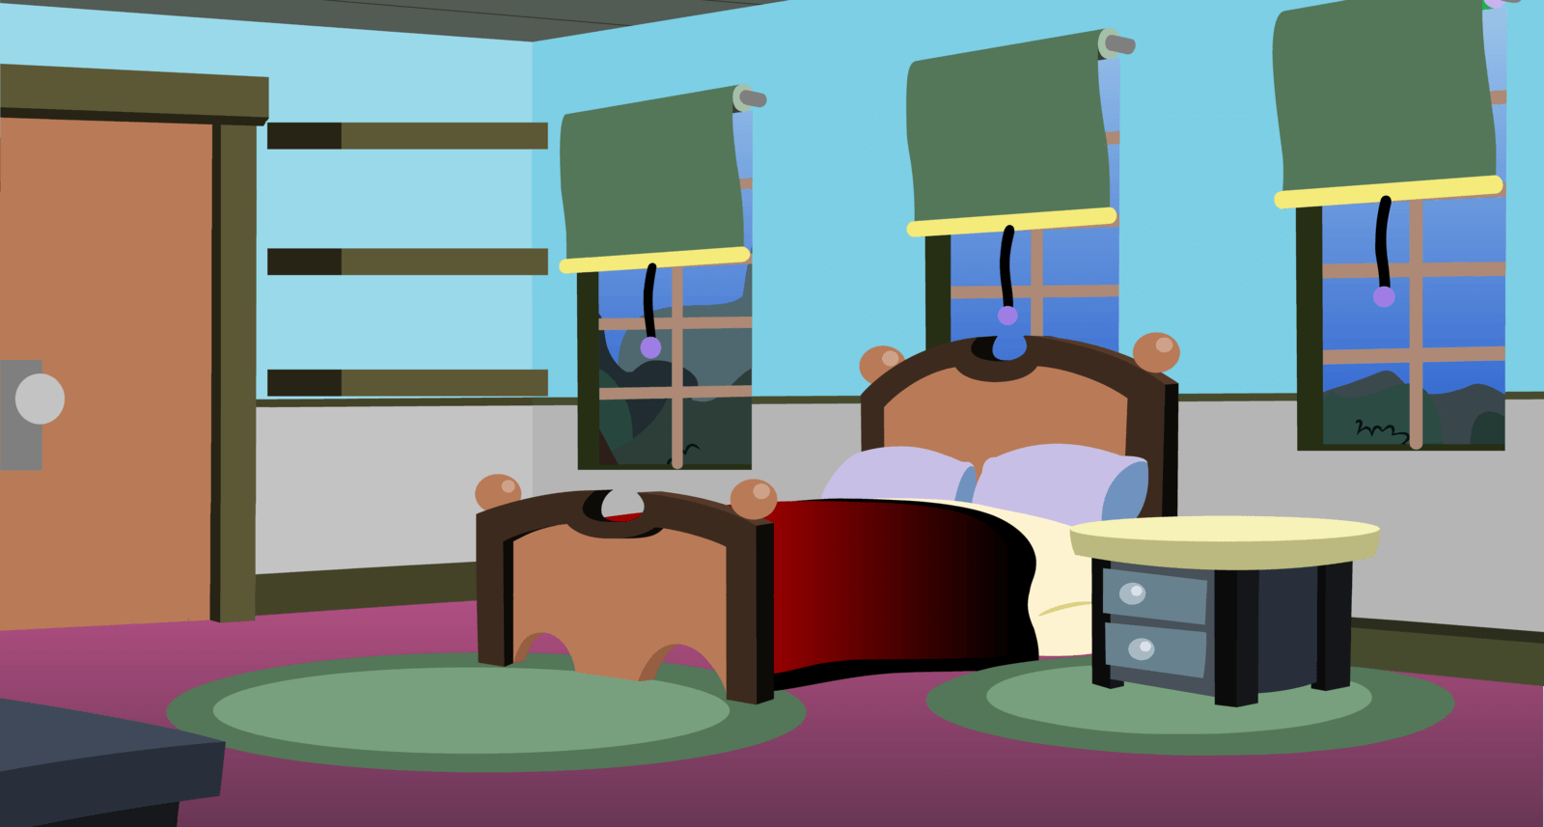
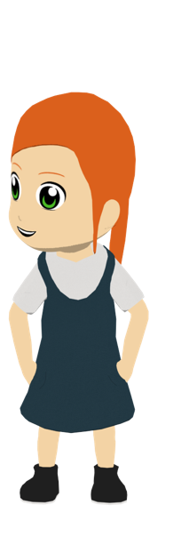
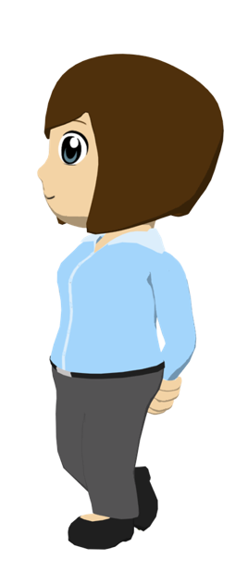
Ahora intenta completar este diálogo en español:
escribir
Entonces, ¿no limpias _______________?
Then, don’t you clean your bedroom?
1
1
tu habitación
I clean it every day!
___ ________ todos los días?
2
La
limpio
2
Do I help you with your bag?
3
¿___ _______ con tu bolsa?
Te
ayudo
3
Vale. Which clothes do I take with me? My favourite shirt is dirty.
Ok ¿Qué ropa me llevo? ___________________ está sucia.
4
Mi camisa favorita
4
If you want I wash it, es rápido.
Si quieres ___ _____, es rápido.
la
lavo
5
5
Notes:
[1/2]
Timing: 7 minutes
Aim:
to practise producing the possessives and the direct and indirect object pronouns in a written dialogue
to also produce other aspects of the language, including vocabulary items
Procedure:
Students read the dialogue and write the translation in Spanish.
Teacher clicks to bring up each missing part of the translation.
Notes:
See slide 33 for a version of the activity for higher-ability groups.

Slide 32
Ahora intenta completar este diálogo en español:
escribir
Entonces, ¿no limpias tu habitación?
Then, don’t you clean your bedroom?
1
1
I clean it every day!
2
¡La limpio todos los días!
2
Do I help you with your bag?
3
¿Te ayudo con tu bolsa?
3
Vale. Which clothes do I take with me? My favourite shirt is dirty.
Ok ¿Qué ropa me llevo? Mi camisa favorita está sucia.
4
4
If you want I wash it, es rápido.
Si quieres la lavo, es rápido.
5
5
Notes:
ALTERNATIVE VERSION – HIGHER ABILITY
Activity as described on the previous slide, but this time requiring a full translation of the dialogue.
Note that the dialogue has been modified very slightly to ensure that all language produced is part of existing productive knowledge or glossed.
It is likely to take longer than the 6 minutes envisaged for the version on the previous slide, given that it requires more writing.

Slide 33
Deberes
Vocabulary Learning Homework (Y9, Term 1.2, Week 5)
This week’s homework is four vocabulary mashups from 8.3.2.4 to 9.1.2.3
Y9 Spanish Term 1.2 Week 5 - mashup A
Y9 Spanish Term 1.2 Week 5 - mashup B
Y9 Spanish Term 1.2 Week 5 - mashup C
Y9 Spanish Term 1.2 Week 5 - mashup D

