Slide 1
Session 2: Vocabulary
Joanna Cairns
HOD and Specialist Teacher
Archbishop Temple School
Stephanie Schmitt
2nd in Department and Specialist Teacher
St James School
20/11/20
“Without grammar, very little can be conveyed; without vocabulary, nothing can be conveyed”. (David Wilkins, 1972)
Notes:
What’s in a word?
Every languages teacher knows that vocabulary teaching and learning is vital. Learners can’t understand, say or write anything without knowing some words. So what is there to know?
Quotation: Wilkins, David A. (1972). Linguistics in language teaching. Edward Arnold, London. p.111-112
British Professor (Linguistics) Emeritus Reading University

Slide 2

Session Outline
Why is vocab learning important?
How many words?
Which words?
The NCELP approach to vocabulary and practical resources
Q and A
Notes:
Opening sequence: Slides 1-6. 10 minutes
Let’s start with something that confronts us with some of the issues…!
This question (the 2nd easiest on the Foundation Writing paper – aimed at Grade 2/3 (old Grade E, bottom of D) required learners to know these four words (as well as the word ‘college’ of course).
It’s easy to spot the words which caused problems for many foundation candidates in June 2018!

Slide 3
Why is vocabulary learning important?

Slide 4
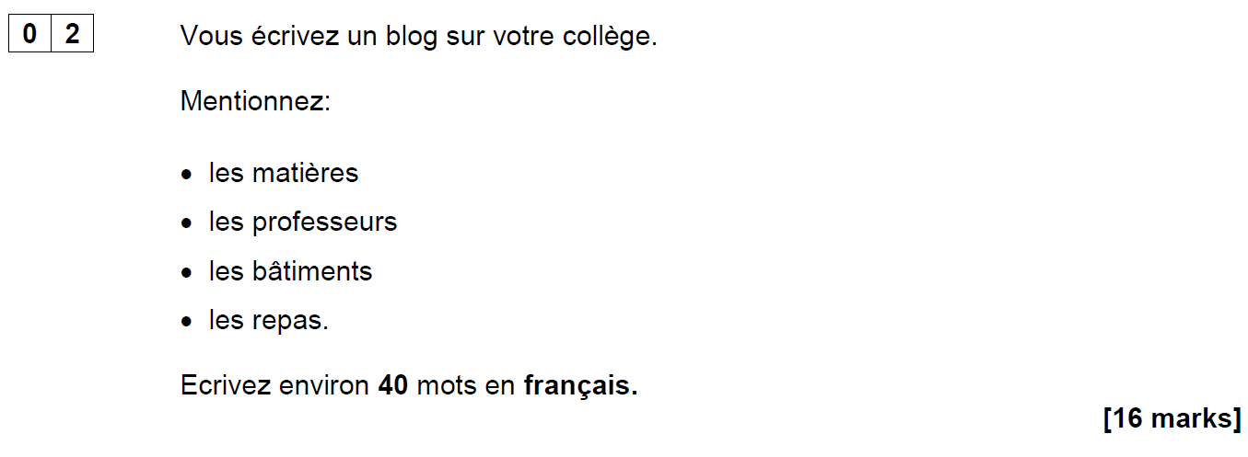
AQA French Foundation Writing Paper Q2 (June 2018)
Notes:
Opening sequence: Slides 1-6. 10 minutes
Let’s start with something that confronts us with some of the issues…!
This question (the 2nd easiest on the Foundation Writing paper – aimed at Grade 2/3 (old Grade E, bottom of D) required learners to know these four words (as well as the word ‘college’ of course).
It’s easy to spot the words which caused problems for many foundation candidates in June 2018!

Slide 5


Are all these words…
on a list of 2000 most frequently-occurring French words?
on the AQA Foundation French Core Vocabulary list?
in the most popular French Foundation GCSE textbook?
les matières
les professeurs
les bâtiments
les repas
562
1150
1952
2948
Notes:
Let’s look in detail at those 4 items of vocabulary - What do we think? Do all these words…
Do they come into the top 2000 most frequent words in French? Well, three of them are in the most frequent 2000 words, and one, ‘les repas’ has a rating closer to 3000.
Do they appear on the AQA Foundation French Core Vocabulary list? Well yes they do (along with nearly 1400 others, many of which are multi-word phrases!)
appear in the most popular GCSE textbook? Well yes they do, they all feature in the Studio textbook
OK – given that we’ve said ‘yes’ to b) and c), why do we think many students just didn’t know or recognise them?

Slide 6
Possible reasons…
an over-reliance on cognates for comprehension?
vocabulary knowledge is too context-dependent?
(Macaro & Erler, 2008)
“Vocabulary listed under a particular theme should be considered transferable, as appropriate, to the other themes.” AQA-8658-Specification 2016 French, p.22.
Notes:
Possible reasons to consider:
1) Some learners’ comprehension is limited by an over-reliance on cognates. If the word is not similar to English, it is more effort to acquire it (even receptively) and some learners, after five years, acquire relatively few non-cognate words.
(Reference for this: Raising the Achievement of Young-beginner Readers of French through Strategy Instruction. (Macaro,E. & Erler, L., 2008). Applied Linguistics 29/1: 90–119.
So, when we set out to improve the breadth of learners’ vocabulary, we need perhaps to consider focusing on the ‘harder to acquire’ non-cognates?
2) Two of these words (batiments and repas) are not listed in the topic of school/education on the AQA vocabulary list (they are in Home town, neighbourhood etc.. and Free time activities, respectively).
The AQA vocabulary guidance states very clearly that words learnt in one topic context may be expected to be tested in another!
“Vocabulary listed under a particular theme should be considered transferable, as appropriate, to the
other themes.” p.22 AQA-8658-Specification 2016 French

Slide 7
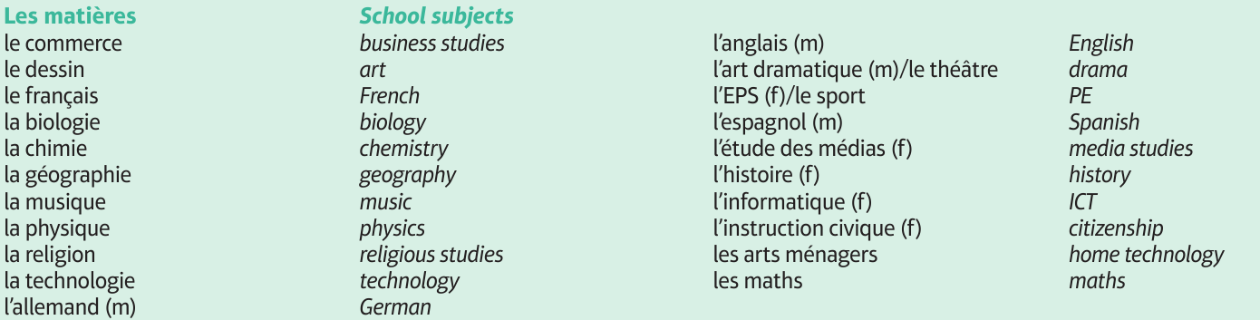
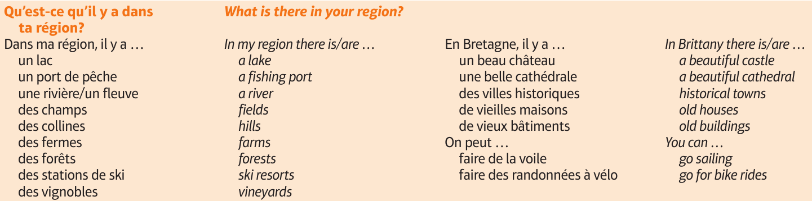
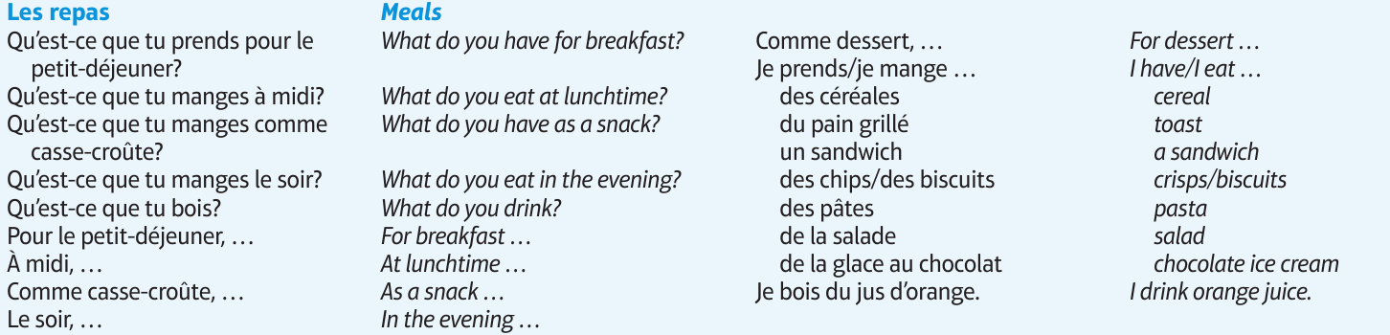
Studio AQA GCSE French Foundation (Pearson)
Module 6 p.132
Module 4 p.90
Module 3 p.70
Notes:
In the text book, they are also learnt in contexts other than school
If learners encounter the words in one context only they may find it much harder to recognise the word in a different context. Their knowledge of certain words is too context-dependent.
The other important point is that, in two cases here, the key words are the ‘category’ words, rather than the specific content words – it can be the case that these words are sometimes overlooked (or at least ‘under-worked’) in our teaching – if they are both non-cognates and category words, they are often not known by less-proficient learners.
So we know that students will try to keep vocabulary in contexts and yet we know the end exam will force them to understand vocabulary in different contexts from that where it is originally encountered. Vocabulary clearly matters for exams in all modes and modalities so let’s consider….

Slide 8
Possible reasons…
an over-reliance on cognates for comprehension?
vocabulary knowledge is too context-dependent?
absence of additional contextual clues?
(Macaro & Erler, 2008)
“Vocabulary listed under a particular theme should be considered transferable, as appropriate, to the other themes.” AQA-8658-Specification 2016 French, p.22.
The words appear as individual items in a list, without the support of other words in a sentence to aid understanding.
Notes:
And onto our final possible reason now, these words appear as individual words in a list, without the support of a sentence to give additional contextual clues.
This suggests that we need also to work on the depth of vocabulary knowledge – at least with respect to developing learners’ ability to know the meaning of words (readily) when they appear in a variety of different thematic contexts, but also when there are limited contextual clues – i.e. when words are presented in isolation, as individual words in a list, without the support of a sentence.

Slide 9
How many words do learners need to know?

Slide 10
What’s in a number….?
Number of words on AQA Spanish Higher Minimum Core Vocabulary list
98%
1772
5-10
lexical coverage needed for comfortable comprehension of a text?
number of new words learners might be expected to learn on average each lesson?
lexical frequency of the verb SER in Spanish
3
2000
4222
size of vocab needed to function adequately at CEFR Threshold B1 level
lexical frequency ranking of the noun POULET in French
lexical frequency ranking of the verb SEIN in German
8
Notes:
So let’s look at some numbers to challenge our thinking about vocabulary,
Click each item in turn

Slide 11
'According to standard frequency lists, the first 1000 words make up approximately 75% word tokens of a text, and the first 2000 approximately 85% (Meara, 2005, cited in Häcker, 2008:215).
Materials produced for the The Common European Framework of References for Language Learning and Teaching (CEFR) suggest a vocabulary of around 1000 words for its second level, A2 (‘Waystage’), and around 2000 words for its third level, B1 (‘Threshold’) (Milton, 2006).
Notes:
This first quote was taken from Eleven pets and 20 ways to express one's opinion: the vocabulary learners of German acquire at English secondary schools. (Häcker, M. (2008). Language Learning Journal, 36:2, 215-226.
It challenges our conception of vocabulary choice and suggests that in order to help our pupils reach proficiency and thereby succeed we need to be more judicious in our choice of vocabulary and ensure the words we focus on are amongst the 2000 most frequent words in the language.
The second reference is to CEFR suggested vocabulary sizes as outlined by Milton, at a conference in 2006. His sources were the original wordlists produced to accompany the CEFR Waystage and Threshold materials in the late 1980s and early 1990s.
Original references
Meara, P. (2005) Lexical Frequency Profiles: A Monte Carlo Analysis, Applied Linguistics 26/1: 32–47
https://www.llas.ac.uk/resources/paper/2715 (Milton) says this:
The original Threshold level materials (Van Ek and Trim, 1990; Coste et al 1987) contained wordlists for French, and other languages at B1 level. The French list contains just under 2000 words, and the EFL list just over 2000 words, for example. The A2, Waystage materials for French and English (for example, Van Ek, 1990) both contain wordlists of about 1000 words.
Coste, D., Courtillon, J., Ferenczi, V., Martins-Baltar, M. and Papo, E. (1987) Un Niveau Seuil. Paris; Editions Didier
Van Ek, J.A. and Trim, J.L.M. (1990) Threshold 1990. Strasbourg: Council of Europe Publishing.
Van Ek, J.A. (1990) Waystage English. London; Pergamon Press
This paper was originally presented at the conference: Crossing frontiers: languages and the international dimension, 6-7 July 2006.

Slide 12
Actually, I have _____ my mind and heart for what I _____ to say to you today. I have asked myself what I _____ I had known at my own _____, and what important _____ I have learned in the number of years that have _____ between that day and this.
I have come up with two answers on this _____ day, when we are _____ together to _____ your _____ success. I have decided to talk to you about the benefits of _____; and, as you stand on the _____ of what is sometimes called real life, I want to _____ the _____ _____ of _____.
Words ≥ 1K removed (85.0% coverage)
Notes:
So to illustrate this point this is J. K. Rowling – Harvard Commencement Address, 2011:
The Fringe Benefits of Failure and the Importance of Imagination. Words with frequency ratings of over 1000 in English have been removed and you can see we’re left with around 85% of the text. Even so – how much of the meaning of this text can we understand now?

Slide 13


Full text: J. K. Rowling – Harvard Commencement Address, 2011:
The Fringe Benefits of Failure and the Importance of Imagination.
Actually, I have wracked my mind and heart for what I ought to say to you today. I have asked myself what I wish I had known at my own graduation, and what important lessons I have learned in the number of years that have expired between that day and this.
I have come up with two answers on this wonderful day, when we are gathered together to celebrate your academic success. I have decided to talk to you about the benefits of failure; and, as you stand on the threshold of what is sometimes called real life, I want to extol the crucial importance of imagination.
Word frequencies based on the
Corpus of Contemporary American English.
Notes:
Even a relatively small number of unknown words can interfere with comprehension.
So, on the one hand, our goal must be for learners to learn as many words as possible in their 5-year (9-year with KS2) learning to GCSE, whilst on the other hand we must be mindful that, the GCSE reading sets out to include some unknown words (or at least, some words which are not on the Minimum Core Vocabulary list!).
We will return to this aspect later….

Slide 14
Which words do learners need to know? And why?
Notes:
So let’s consider which words do learners need to know and why?

Slide 15
Which words?
Vocabulary to be taught should be informed by frequency of occurrence in the language, and special attention should be paid to common verbs in the early stages... A consequence of not attending to frequency of occurrence in vocabulary choice is pupils realising that they cannot say or understand basic things in the language.
Anon. 2016. Modern Foreign Languages Pedagogy Review. A review of modern foreign languages teaching practice in key stage 3 and key stage 4. (Chair: Ian Bauckham). Teaching Schools Council.
Vocabulary lists, rationale and uses
https://resources.ncelp.org/concern/resources/t722h880z?locale=en
Notes:
Vocabulary
We start from the Pedagogy Review recommendation about ‘frequency’ and ‘common verbs’.
Ask ‘So how do we do this?’ Do we know the frequency of the words we are teaching? Do we have any way of knowing?
What determines our vocabulary choice currently? The text book at KS3/4, the GCSE specification vocabulary list?
Do we know what informs the vocabulary choices in these resources?

Slide 16
En la ciudad [in town]
¿Qué hay en tu ciudad? |  | What is there in your town?
Hay… | There is… | En… | In…
un castillo | a castle | mi barrio | my neighbourhood
un centro comercial | a shopping centre | mi ciudad | my town/city
un estadio | a stadium | mi pueblo | my village/town
un mercado | a market | No hay museo. | There isn’t a museum.
un museo | a museum | No hay nada. | There’s nothing.
un parque | a park | unos museos | some museums
una piscina | a swimming pool | unas tiendas | some shops
una plaza | a square | muchos museos | a lot of museums
un polideportivo | a sports centre | muchas tiendas | a lot of shops
un restaurante | a restaurant
una tienda | a shop
una universidad | a university
 | Word | Frequency ranking | Part of speech
1 | la plaza | 806 | noun
2 | la iglesia | 437 | noun
3 | el teatro | 605 | noun
4 | ser | 7 | verb
5 | grande | 66 | adjective
6 | pequeño/a | 202 | adjective
7 | estar | 21 | verb
8 | cerca (de) | 1042 | adverb
9 | lejos (de) | 833 | adverb
10 | el museo | 1114 | noun
Notes:
So, it’s the notion that the first introductory lesson to a new theme, topic would not be one ‘verb starter’ and 12 nouns but instead a set of mixed word class vocabulary.
Later, as appropriate, more nouns would be added from the same semantic field (more places in the town for example) but the core words would be these, as ultimately pupils can express more and varied meanings with these, than they can with ‘Hay’ and a set of places in the town.
This is the slide of 10 words pupils are going to learn.
Note the mixed word class selection, and the frequency (all well within the top 2000 more frequently occurring words in Spanish).

Slide 17
Mixed word class sets
Y7 French, T1.1, Week 1
Y7 German, T1.1, Week 1
Y7 Spanish, T1.1, Week 1
sein [3] ist [3] das Heft [3598] das Fenster [634] der Tisch [494] die Tafel [3660] die Flasche [1762] wo? [94] hier [71] da [35] der, die, das [1] Hallo! [1375] Tschüs! [>4034]
estar [21]; estoy; estás; está; norte [624]; sur [661];
Inglaterra [proper noun - N/A]; España [proper noun - N/A]; ¿dónde? [161] en [5];
¡hola! [1245], ¡hasta luego! [N/A]; deberes [2187]
être [5], suis, es, est,
je [22], tu [112], il [13], elle [38], anglais [784], français [251],
grand [59], petit [138], et [6],
au revoir [1274], bonjour [1972],
oui [284], non [75]
1 verb, 4 pronouns, 4 adjectives,
1 conjunction, 4 other
1 verb, 5 nouns, 1 pronoun,
2 adverbs, 3 articles, 2 other
1 verb, 3 nouns, 2 proper nouns,
1 adverb, 1 preposition, 2 other
Sources: A Frequency Dictionary of French (Londsale & Le Bras, 2009), A Frequency Dictionary of Spanish(2nd ed.) (Davies, M. & Davies, K., 2018),
A frequency dictionary of German (Jones, R.L. & Tschirner, E., 2006). All published by Routledge.
Notes:
Mixed word class sets
There is some research evidence that teaching vocabulary in topic-based lists of words with a single word class (e.g. a list of just nouns) is not optimal (Häcker, 2008).
Teaching mixed word class sets provides the means for learners to encounter words in sentences, as well as individually, at present stage, but without running the risk of cognitive overload if too much language (new and previously taught) is presented at once.
Working with words in context is identified by Schmitt as an important strategy for embedding and developing word knowledge.
As mentioned previously, NCELP has been tasked with KS3 pedagogy, but given the very mixed picture of provision nationally, has had to start from a position of ‘ab initio’ learner in its curriculum planning. However, were there to be a KS2 SOW it is likely not only that the same overarching principles would apply, but also that some of the Y7 SOW could be repurposed for earlier years.
Here are just examples of a week’s vocabulary set from each of the three languages, Fr, Gm and Sp, showing the mixed word class composition.

Slide 18
Word Class Summary
Updated 06.1.20
 | adj | adv | conj | prep | noun (m) | noun (f) | other | pron | verb | Total | %
1.1 | 22 | 0 | 3 | 0 | 20 | 16 | 11 | 10 | 11 | 93 | 25%
1.2 | 8 | 3 | 2 | 4 | 17 | 19 | 0 | 4 | 24 | 81 | 22%
2.1 | 5 | 7 | 1 | 1 | 15 | 10 | 14 | 0 | 13 | 66 | 18%
2.2 | 0 | 1 | 0 | 5 | 3 | 5 | 6 | 1 | 17 | 38 | 10%
3.1 | 5 | 3 | 1 | 3 | 11 | 4 | 1 | 0 | 22 | 50 | 14%
3.2 | 10 | 8 | 0 | 0 | 8 | 8 | 0 | 0 | 8 | 42 | 11%
Total | 50 | 22 | 7 | 13 | 74 | 62 | 32 | 15 | 95 | 370
% | 14% | 6% | 2% | 4% | 20% | 17% | 9% | 4% | 26%
Across Y7 the rough proportions are, as follows:
Nouns: |  |  |  | 37%
Verbs: |  |  |  | 26%
Adjectives: |  |  |  | 14%
Adverbs, conjunctions, prepositions, pronouns: |  |  |  | 15%
Other: |  |  |  | 9%
SOW French Year 7 (UK): https://resources.ncelp.org/collections/6q182k249?locale=en
SOW German Year 7 (UK): https://resources.ncelp.org/concern/resources/gt54kn19s?locale=en
SOW Spanish Year 7 (UK): https://resources.ncelp.org/concern/resources/3197xm241?locale=en
Rachel Hawkes / Emma Marsden
Notes:
Here we can see exemplar coverage of the Year 7 SOW and how that correlates with words of different classes so we can see nouns are not super dominant and there is proportionate coverage of verbs, adjectives, adverbs, conjunctions, prepositions and pronouns plus other forms of language

Slide 19
Which words?
In the early stages of a language course, particular attention should be paid to the planned building of pupils’ verb lexicon, focussing on the meaning of the stem or infinitive form of common verbs. A strong basic verb lexicon has been found to relate positively to pupils’ ability to effectively manipulate those verbs at later stages.
Anon. 2016. Modern Foreign Languages Pedagogy Review. A review of modern foreign languages teaching practice in key stage 3 and key stage 4. (Chair: Ian Bauckham). Teaching Schools Council.
Rachel Hawkes / Emma Marsden
Notes:
Whilst we are considering which words, its also important to spend a moment considering the verb lexicon and how verbs themselves need to be taught as lexical items, as pieces of vocabulary

Slide 20
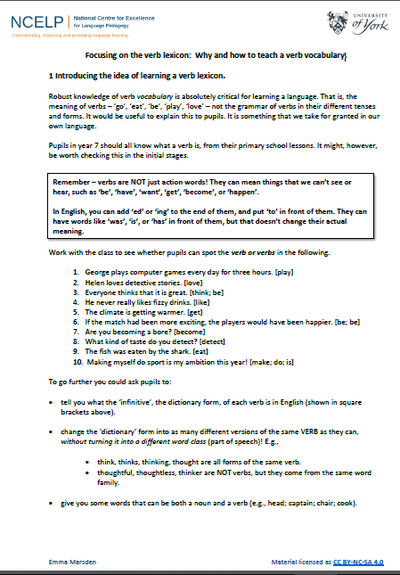
Why and how to teach a verb vocabulary?
Robust knowledge of verb vocabulary is absolutely critical for learning a language. That is the meaning of verbs “go”, “eat”, “play”, “love” – not the grammar of the verbs in their different tenses and forms.
https://resources.ncelp.org/concern/resources/cj82k728n?locale=en
Notes:
Why are verbs so important? Well there’s the meaning as well as the grammar of verbs to consider
• Without understanding verbs, learners can’t work out how two nouns relate to each other (e.g, The girl “??” French – could be hates, loves, studies, speaks).
• Without productive knowledge of a verb, learners cannot create their own sentences. Research has shown that learners in year 9 and 10 can still produce ‘verbless utterances’ as they don’t have a bank of verbs that they can rely on when under pressure during oral communication.
• Analysis of textbooks and observations has shown that language lessons (everywhere) tend to focus on teaching nouns, adjectives and adverbs; verbs, as lexical items, tend to get forgotten.
• Rote-learned, fixed phrases (‘Je ne comprends pas …’) can be useful, but an over-reliance on them doesn’t help learners to ‘analyse’ them and find out which parts can work in new contexts. We need to help learners identify and isolate verbs in the input that they hear and read.
• There is good evidence that the more verb vocabulary learners know, the more likely they are to learn grammar. Knowing a verb lexicon gives learners ‘hooks’ onto which they can peg the grammar, such as different verb endings. They can then also ‘strip out’ the endings, and find the core verb meaning.
• Knowing that different versions of verbs have the same core meaning is really important. So, the verb resource slides (search ’25 most common verbs’ and ’15 high-frequency prototype verbs’) aim to help learners know that different forms of a verb word are related (e.g.,‘veut’ is the same meaning as ‘vouloir’).

Slide 21
Which verbs and verb forms should we focus on?
25 highest frequency verbs
15 high frequency prototype verbs
Long form (infinitive) and short form (3rd person singular)
Sentences (revisiting high frequency (phonics) vocabulary)
NB: these are for first encounters with these important verbs. Further practice and gradual extension to working with further pairs of forms/meanings would follow (e.g. next step - 1st and 2nd person singular)
Notes:
Which verbs should we focus on?
NCELP is providing a suggested sequence of verbs, based on:
the verbs that are the most highly frequently used in the language (the ’25 most common’ verbs, according to a carefully selected word frequency list,
b) frequent and regular verbs that depict actions (’15 high-frequency prototype verbs’).
Which verb forms should we focus on?
- We have chosen at the start to introduce two forms. This decision aims to focus learners on the meaning of the verb, rather than the complex changes verb forms can undergo.
- The infinitive is clearly useful in many contexts and it is essential learners recognise its form, especially for highly irregular verbs. It is also a building block for dictionary use.
- The 3rd person singular is sometimes considered to be the "default short form". Research has found that learners find this form very useful when they don't yet have a full grammar system in place.
This default short form provides a very useful "core" that can then, at later stages, be manipulated (e.g., for 1st and 2nd person singular).
In addition, it is a highly frequent form as it is used with a wide range of subjects: he, she, it, full nouns.
Furthermore, 3rd person singular is useful for the French 'on' and so also expresses first person plurality; and for French, Spanish and German, the impersonal meanings of 'on', 'se', and ‘man’.
There tends to be strong emphasis on 1st person singular in current teaching, so this approach will ensure 3rd person is not neglected.

Slide 22

être
avoir
faire
aller
trouver
5
8
25
53
83
to be| being
to have | having
to do, to make | doing, making
to go| going
to find| finding
est
a
fait
va
trouve
is
has
does, makes | is doing, is making
goes | is going
finds | is finding
venir
passer
donner
dire
prendre
88
90
45
37
43
to come| coming
to spend (time) | spending (time)
to give | giving
to tell, say| telling, saying
to take | taking
vient
passe
donne
dit
prend
comes | is coming
spends (time) | is spending (time)
gives | is giving
tells, says | is telling, is saying
takes | is taking
mettre
porter
80
rester
penser
27
105
demander
100
116
to put | putting
to wear, carry | wearing, carrying
to ask | asking
to stay | staying
to think | thinking
met
porte
demande
reste
pense
puts | is putting
wears, carries | is wearing, is carrying
asks | is asking
stays | is staying
thinks | is thinking
pouvoir
vouloir
devoir
voir
savoir
20
57
39
69
67
to be able | being able
to want | wanting
to have to | having to
to see | seeing
to know | knowing
peut
veut
doit
voit
sait
is able, can
wants
has to, must
sees | is seeing
knows | is knowing
tenir
108
parler
falloir
104
montrer
106
68
95
comprendre
to hold | holding
to show | showing
to speak | speaking
to be necessary
to understand | understanding
tient
montre
parle
faut
comprend
holds | is holding
shows | is showing
speaks | is speaking
is necessary
understands | is understanding
25 most common French verbs
Source: A Frequency Dictionary of French (Londsale & Le Bras, 2009), published by Routledge.]
Notes:
Here is a poster of the 25 most common verbs

Slide 23
219
1338
429
1820
960
jouer
manger
écouter
chanter
étudier
to play | playing
to eat | eating
to listen | listening
to sing | singing
to study | studying
joue
mange
écoute
chante
étudie
plays | is playing
eats | is eating
listens | is listening
sings | is singing
studies | is studying
425
382
327
1836
290
regarder
écrire
apprendre
dormir
travailler
to watch, look | watching, looking
to write | writing
to learn | learning
to sleep | sleeping
to work | working
regarde
écrit
apprend
dort
travaille
watches | is watching
writes | is writing
learns | is learning
sleeps | is sleeping
works | is working
201
413
309
1447
1532
préparer
aider
sortir
courir
marcher
to prepare | preparing
to help | helping
to go out | going out
to run | running
to walk | walking
prépare
aide
sort
court
marche
prepares | is preparing
helps | is helping
goes out | is going out
runs | is running
walks | is walking
15 high-frequency prototype French verbs
Source: A Frequency Dictionary of French (Londsale & Le Bras, 2009), published by Routledge.]
Notes:
and another poster of 15 other high-frequency ‘prototype’ verbs

Slide 24
faire
[to do, make | doing, making]
fait
[does, makes | is doing, is making]
Notes:
Within lesson resources, the meanings of verbs are taught explicitly as we can see with this example both in the long form (the infinitive) and the short form (3ps)

Slide 25
fait
[does, makes | is doing, is making]
Zara fait le lit.
[Zara makes | is making the bed.]
Notes:
Examples are given of both the short form in a sentence and there are various slides to drill how this form is used

Slide 26
faire
[to do, make | doing, making]
Zara aime faire le lit.
[Zara likes making the bed.]
Notes:
And in the longer form with more repetition and drilling of how this longer form might be encountered

Slide 27
GCSE frequency lists
https://resources.ncelp.org/
Frequency data have been added to AQA GCSE vocabulary lists for French, German and Spanish
[Sources: A Frequency Dictionary of Spanish: Core Vocabulary for Learners (Davies & Davies, 2018); A Frequency Dictionary of German (Jones & Tschirner, 2006) and A Frequency Dictionary of French (Londsale & Le Bras, 2009), published by Routledge.]
The lists are available in a variety of formats: Excel (full list), Word – A-Z, by topic, by parts of speech
Teachers may use the frequency data to:
  inform the SOW design
  stimulate interest amongst pupils (and teachers!)
  teach multiple meanings of the same word
  teach vocabulary in multiple word class clusters
  teach relations between words within word families
  teach cognate patterns
  highlight differences between high frequency words and awarding body lists
Notes:
So NCELP have cross referenced AQA GCSE vocabulary lists with the frequency ratings and these have been added to the vocabulary specification lists and are available to download. The full excel list is available and then they can be filtered via different options be that topic, parts of speech etc. Teachers can use this data to:
inform the SOW design
stimulate interest amongst pupils (and teachers!)
teach multiple meanings of the same word
teach vocabulary in multiple word class clusters
teach relations between words within word families
teach cognate patterns
highlight differences between high frequency words and awarding body lists

Slide 28
What do we know about vocabulary learning?

Slide 29
What the research tells us:
There is no single, best strategy for learning vocabulary
Errorless teaching techniques (when pupils are unambiguously told the meaning of a new word) are effective…
providing they are followed by opportunities to use the new words in comprehension, and then productively.
The more times a pupil is required to recall a word, the more securely it will move into the long-term memory.
Production tasks in which pupils use new words in sentences they compose themselves serve to strengthen vocabulary knowledge.
Genuine information gap activities are very helpful in assisting memorisation.
Plentiful opportunities to encounter words in multiple contexts deepen vocabulary knowledge
Careful, planned use of ICT can be effective.
Rachel Hawkes / Robert Woore

Slide 30
How can learners best learn vocabulary?
Initial form-meaning mapping
L1 translation can be efficient for this
This could be done at home, even in advance of a lesson (‘flipped learning’) and mediated by technology (e.g. Memrise, Quizlet)
Consolidating and extending word knowledge
Seeing and hearing words in context then becomes important to develop depth of knowledge (collocation, shades of meaning, etc.).
Building fluency
Multiple exposures and use are important to develop fluency – anywhere between 5 and 20 encounters with a word. (Nation, 2001:81)
Notes:
Direct translation L2-L1 appears to be an effective way to establish the initial form-meaning link – more so than pairing L2 with pictures (as these can be very vague or subjective) (Lotto & de Groot, 1998) or even pairing L2 with based context or meanings (Prince, 1996; Ramachandran & Rahim, 2004).
This process could be done at home, even in advance of a lesson (‘flipped learning’) and mediated by technology (e.g. Memrise, Quizlet)
2) Once the link is established, attention can be given to learning more contextualised types of word knowledge, and it becomes important to encounter the new lexical items in L2 contexts. [click]
An important finding is that reading-while-listening is generally superior to reading-only in promoting vocabulary learning (Amer, 1997; Brown, Waring & Donkaewbua, 2008)
Where a word is often used across different topics, we should be careful to build these links explicitly, building depth – ensuring that learners recognise them readily in more than one topic area.
A useful approach here is to use a range of texts of different styles (literary extracts, poems, songs) which provide additional exposures in less familiar contexts, allowing the form-meaning link to strengthen.
3) Vocabulary knowledge develops incrementally. There are many different aspects of word knowledge: spoken form, written form & meaning; receptive and productive use; depth of knowledge (shades of meaning, collocations, etc.), fluency…
Multiple encounters are needed for knowledge of a word to develop
Nation suggests 5-20 encounters with words to consolidate knowledge and develop fluency, this is quite some range - It is not straightforward to say how many repeated encounters with a given word are necessary to learn it.
Using a word appropriately in a spoken or written sentence is a useful ‘rule of thumb’ for mastery (although development continues past this point).

Slide 31

How can learners best learn vocabulary?
Image: https://en.wikipedia.org/wiki/File:Recycling_symbol2.svg
Mastery through planned repetition
Systematic revisiting and recycling is crucial
This requires more planning and monitoring than a space-limited textbook course can display on its pages.
Spontaneous oral interaction in the target language and wider reading (beyond topics) ‘automatically’ recycle high frequency words
Recycling is necessary, and if it is neglected, many partially learned words will be forgotten, wasting all the effort already put into learning them ... Recycling has to be consciously built into vocabulary learning programs, and teachers must guard against presenting lexical items once and then forgetting about them, or else their students will likely do the same. (Schmitt, 2008:343)
Notes:
4) Maximising sustained engagement with the lexical items is key to a successful vocabulary acquisition. So recycling of language is crucial, if it is not to be forgotten. Most forgetting occurs soon after the learning session, so the first recyclings are particularly important and need to occur quickly (Baddeley, 1990).
Schmitt suggests we think in terms of 8-10 exposures. Planning for and monitoring this is important.
For high-frequency words, spontaneous target language interaction and ‘reading for interest’ may help with this.

Slide 32
Stages of vocabulary learning
Introduction
(i.e. first encounters with new words, and initial memorisation routines)
Consolidation
(i.e. speed of retrieval building, controlled production, e.g. sentence-building)
Developing use
(i.e. revisiting across different contexts, modalities, synthesising with previously-learnt language)
Assessment
Victoria Hobson
Notes:
Different tasks are needed to develop different aspects of vocabulary learning (that is breadth, depth, fluency and automaticity).
These categories are not to be seen as fixed: you practise when you are establishing knowledge for the first time, and you consolidate as you develop.
Many activities can be repeated for different purposes, depending on how well the vocabulary is already embedded.
However, this list of ways of working with words should give us ideas and broaden our thinking about the range of opportunities we give learners in and outside of the classroom.

Slide 33
The NCELP approach

Slide 34
NCELP approach to vocabulary learning
Teaching of ten new words, on average, per week (assuming a curriculum model of two lessons per week)
Words selected on the basis of word frequency
Words chosen different parts of speech (not noun lists)
Most common verbs included each week
Word choice also supports the grammar features
Vocabulary revisited systematically within a week, a month, a term, a year
Strategic, planned use of CALL (quizlet / audio learning homework)
Aim of around 360 words end Y7, around 1000 end Y9, around 1700 end Y11

Slide 35
A typical NCELP vocabulary learning cycle
- The NCELP SOW assumes approx. 30 minutes of prior vocabulary learning each week, before the lesson takes place.
- The vocabulary activities at the start of lessons aim to re-visit the new words the students have learnt at home in order to consolidate the new knowledge.
- Subsequently pupils will be required to practise the weekly grammatical point in reading and listening tasks which include the new vocabulary, therefore contributing to deepening the knowledge of the words learnt.
- Then the pupils will use the target grammar feature and new vocabulary in productive tasks.
- Lessons also systematically recycle previously taught vocabulary (from several weeks earlier). Where possible, activities integrate new and previously taught vocabulary. Otherwise, separate tasks ensure that all necessary vocabulary taught in previous weeks is revisited.
Vocabulary activities

Slide 36
Example of a lesson
Spanish Year 7 SOW Term 1 Week 6
Notes:
Note in the following slides how the vocabulary is introduced, consolidated and its use developed.

Slide 37
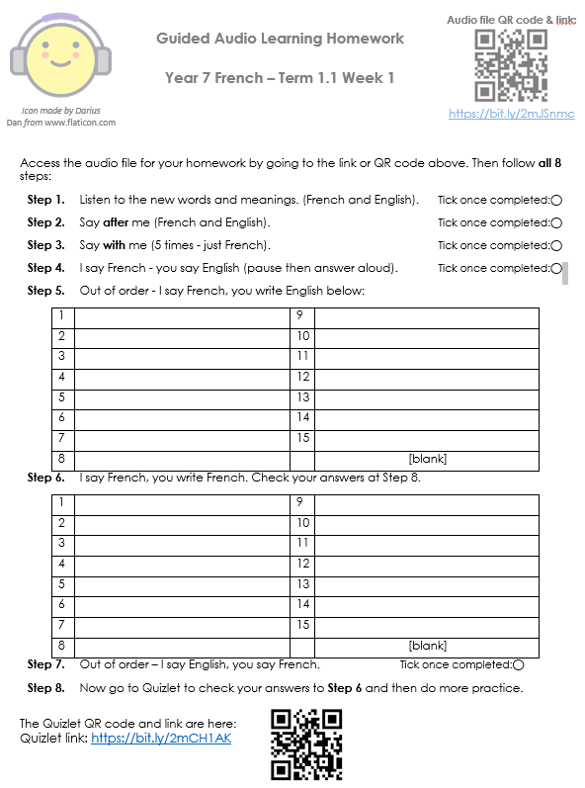



Quizlet
https://quizlet.com/NCELP
Pre-learning
Vocabulary
Homework to
introduce and
establish the
vocabulary
knowledge
Notes:
First we have our introductory phase using Quizlet and the audio home learning homework.
Pupils are meeting the words for the first time with their L1 translation and are practising connecting the spoken and written forms of new words to their meaning using different memorisation techniques
The pre-learning vocabulary homework includes a lot of audio input to support students to make secure and accurate sound-writing connections. This is particularly important in the early stages of the course, when students have not been taught all of the sound-spelling correspondences.

Slide 38
Vocabulario
 | Word | English meaning
1 | ¿quién? | who?
2 | hablar | to speak, speaking
3 | comprar | to buy, buying
4 | bailar | to dance, dancing
5 | llegar | to arrive, arriving
6 | escuchar | to listen, listening
7 | una amiga | a friend (female)
8 | música | music
9 | tarde | late
10 | temprano | early
11 | bien | well
12 | con | with
60
Quiz to refresh/
consolidate
knowledge
of the
pre-learnt
vocabulary
This task is made more challenging by being done against the clock.
0
INICIO
Notes:
Given the pre-lesson focus on the sounds of the words, we can expect students often to start the lesson either working by themselves or in pairs, reading out the words and studying their English meaning (1 minute), to refresh their knowledge of the new vocabulary.
This task builds in challenges, as in subsequent rounds, the English meanings are removed and students try to recall them, looking at the Spanish (1 minute).
Then the Spanish meanings are removed and they to recall them, looking at the English (1 minute)
Further rounds of learning can be facilitated by one student turning away from the board, and his/her partner asking him/her the meanings. This activity can work from L2 → L1 or L1 → L2.
Note that words and meanings are presented directly – not open to misinterpretation

Slide 39
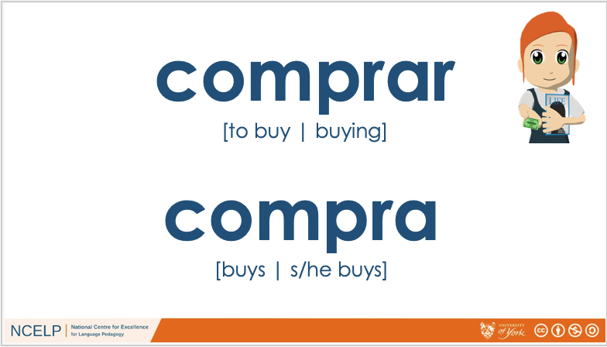
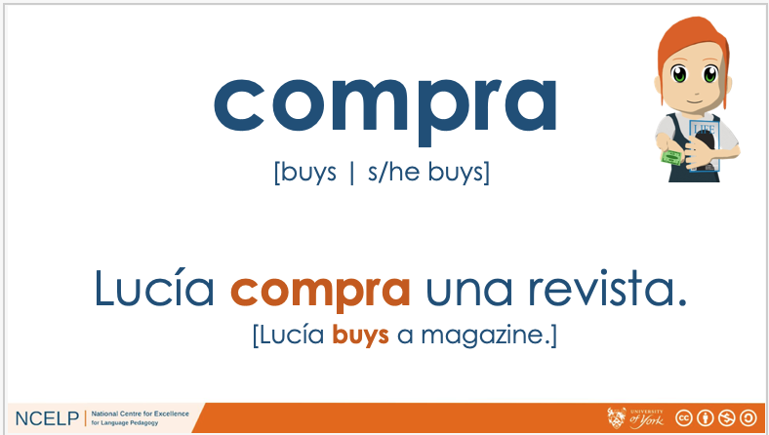

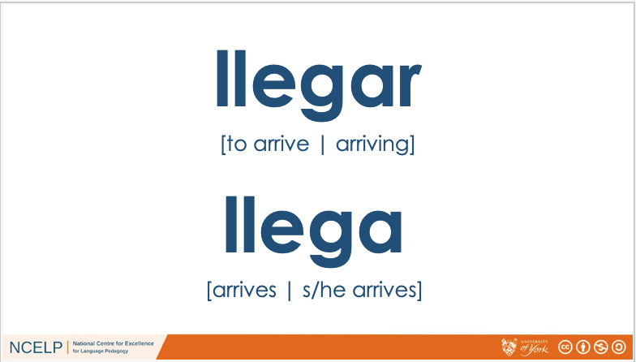

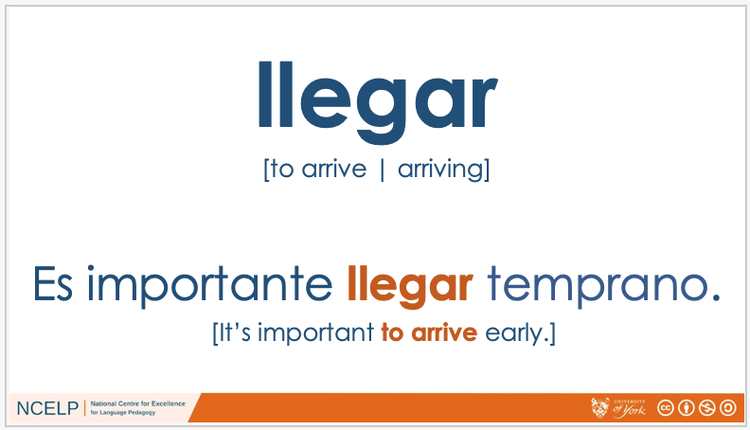
Verb lexicon - verbs are taught and practised as lexical items at word/sentence level
Notes:
Here we are back to the Introducing / establishing the vocabulary knowledge stage with a focus on the verb lexicon.
Verbs are being presented as lexical items in both the short and long form and practised at word/sentence level to embed the knowledge in context.

Slide 40
llegar
una amiga
bailar
¿quién?
hablar
Vocabulary practice in a variety of typical
ways
música
escuchar
comprar
temprano
tarde
llegar
bien
con
to arrive
llegar
Again, unambiguous English translations are provided.
Notes:
We are now practising and consolidating the vocabulary again.
In this task pupils must recognise the Spanish word corresponding to the English. This can also elicit pronunciation of the new language.
By speeding up word recognition and recall, we aim here to develop pupils fluency and automaticity

Slide 41



The dog ate your Spanish homework! What do the text pieces talk about?
leer
the action in general | someone does the action
1
habla con un amigo
2
llega tarde
3
bailar salsa
compra un libro
4
escuchar en clase
Grammar input activity with a varied lexicon – deepening knowledge of new and previously taught vocabulary
5
6
comprar una casa
7
olvida una palabra
8
hablar con José
9
llega tarde
10
baila con Alejandra
Notes:
Here we have an example of grammar input activity.
Pupils are asked to practise the new vocabulary in a reading task, in which they are challenged to spot the 3rd person singular verbs in contrast with the infinitive form.
You will notice that the new vocabulary is used throughout with occasional extra vocabulary items from previous lessons – this way deepening the knowledge of the lexicon

Slide 42





Vocabulario
escuchar
Listen to what Lucía does. Write 1 – 5.
Listen and match the action verb you hear to the picture.
C
B
A
1
A
2
C
Grammar input activity with a varied lexicon – deepening knowledge of new and previously taught vocabulary)
3
D
E
D
E
4
[arrives]
¡Hola!
5
B
Notes:
Following on from that, pupils are then completing a listening activity.
Again this task combines the key grammar point of the lesson with both this week’s and previously taught vocabulary – strengthening new and prior knowledge.
The focus here is on the meanings of the lexical verbs in isolation. Pupils match the action to the picture

Slide 43

Now listen to the whole sentence about Lucía.
Write down what you hear. Afterwards, translate the sentences
escuchar
Baila en un barco.
Escucha en clase.
1
6
She dances in a boat.
She listens in class.
Compra una revista.
Llega temprano.
2
She buys a magazine.
7
She arrives early.
Grammar input activity with a varied lexicon – deepening knowledge of new and previously taught vocabulary)
Escucha música.
Habla con una amiga.
3
8
She speaks with a (female) friend.
She listens to music.
Llega tarde.
Baila en una casa.
4
She arrives late.
9
She dances in a house.
Habla con un amigo.
Compra un libro.
5
She speaks with a (male) friend.
10
She buys a book.
Notes:
In this follow up task students are listening to the same verbs but this time in sentence constructions.
They have to transcribe & translate the verbs as shown in the correction on the slides.
Note how the numbers of questions have increased from the previous activity as well as the difficulty of the task. The knowledge is stretched and reinforced as pupils are practising the lexicon in a repetitive cycle.

Slide 44

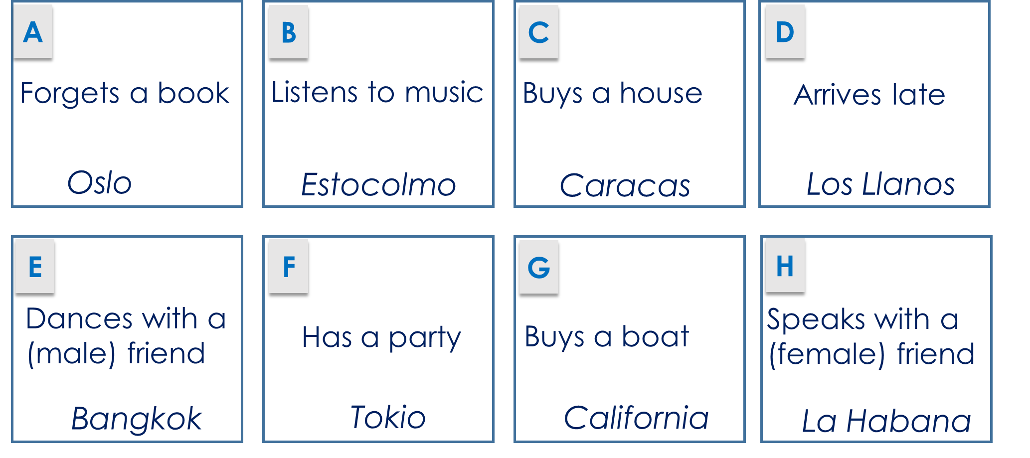
Paula’s trip was so good that she does it again!
This time she goes to the places in a different order.
escuchar / hablar
Student A: Tell the story on your prompt cards!
Student B: Listen and take notes. What happens and in what order?
Then swap roles.
Persona A
Output activity to help learners establish and practise accessing knowledge (grammar and vocabulary) after the input practice.
Notes:
Finally, we are entering the developing stage of the vocabulary learning, with an information gap activity, in which the vocabulary and grammar are essential.
This is a paired task and the objective is to recount a narrative.
Both pupils have a card with different activities and places – as shown on the screen here.
Student A tells, in order, the 8 actions that are written on their prompt card.
Student B listens and takes notes of what happens in English then they swap roles.
At the end of the task, the students compare their answers.
They could focus specifically on either where Paula journey starts, ends or in which order of places to visit would be better.
This style of output activity help learners establish and access both their grammatical and vocabulary knowledge from their short and long term memory.

Slide 45
More vocabulary activities
Vocabulary checklist
Word patterns
Sentence level practice activities
Dictogloss
Segmentation task
Text exploitation
Dictionary skills
Rachel Hawkes

Slide 46
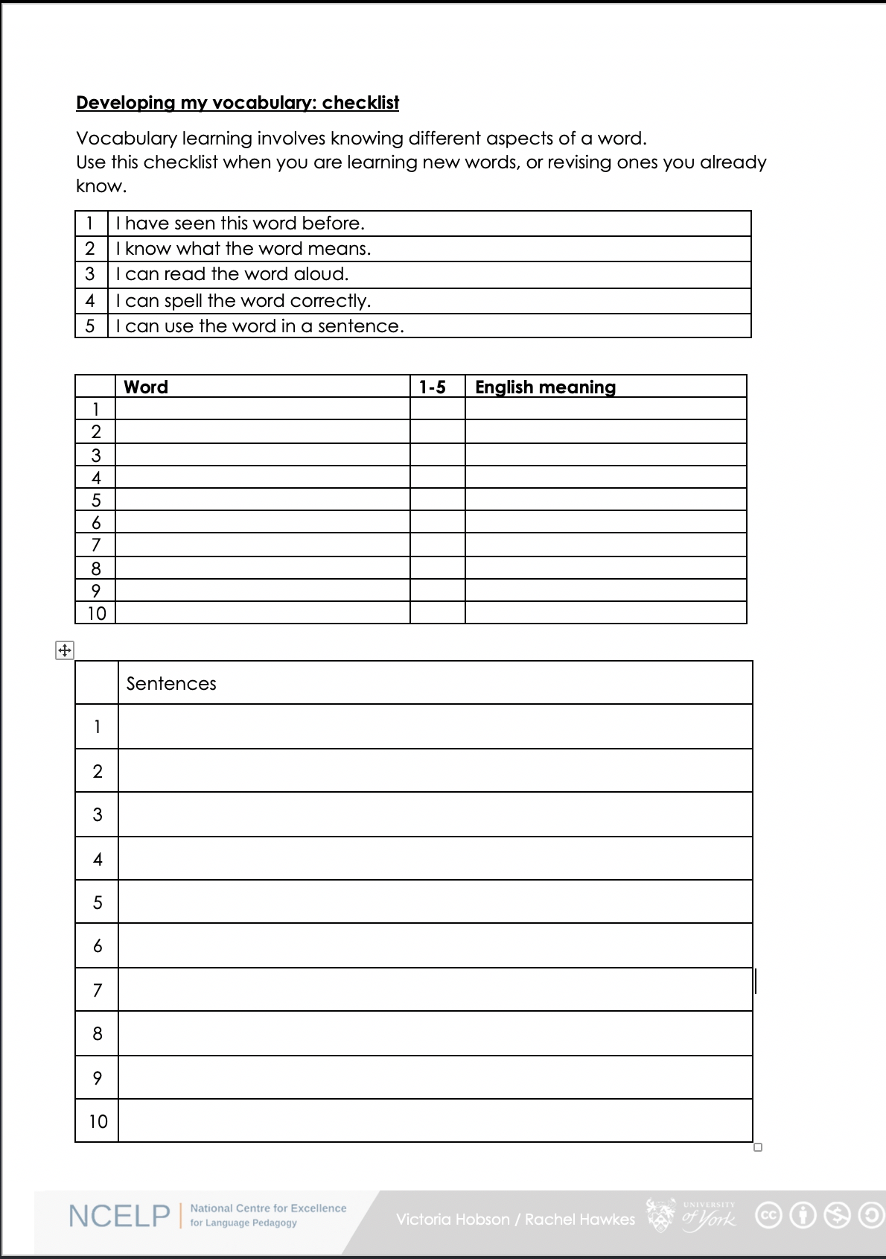
Vocabulary checklist
1. I have seen this word before.
2. I know what the word means.
3. I can read the word aloud.
4. I can spell the word correctly.
5. I can use the word in a sentence.
6. For nouns, I know the gender and the correct word for ‘the’
Notes:
Students can use this checklist to assess what they know, when they are learning new words, or revising ones they already know. This sheet could be completed as part of a homework task or used in class as a vocabulary quiz and we suggest giving students a print out of the template so they can refer to it throughout the year. The template is available on the resource portal.
https://resources.ncelp.org/concern/resources/gf06g264k?locale=en

Slide 47
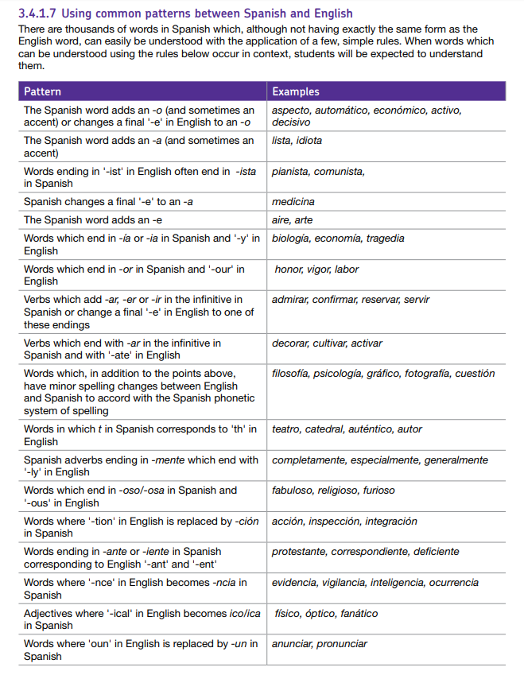
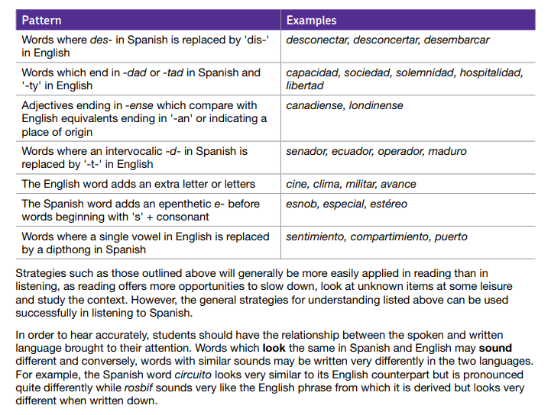
Common word patterns
“When words that can be understood using these rules occur in context, students will be expected to understand them.”
AQA Specification section 3.4.1.17
https://resources.ncelp.org/concern/resources/bc386j21m?locale=en
Notes:
We have to remember that the exams will include forms of words that learners may not have met, and are not on the prescribed vocabulary list. Therefore learners will need the ability to spot patterns and identify variations from words they do know, but still link them back to the meaning.
This is a considerable challenge but if we train our students from the early stage of their language journey to be more inquisitive about the form of words, this will have a positive impact on their ability to deal with more unpredictable language both in real life context and in exam condition.

Slide 48


Be a language detective!
Images: https://pixabay.com/no/vectors/detective-etterforskning-mann-311684/; https://www.publicdomainpictures.net/en/view-image.php?image=155227&picture=light-bulb
MODERN GERMAN
MODERN ENGLISH
Pfeffer
pepper
You can see this same pattern in lots of other word pairs!
pf…
p…
So… what do you think the following German words might mean?
Pfeife | 2. Pfund | 3. Pflanze | 4. Pfefferminze
5. pfefferig | 6. Krampf | 7. Pflaster | 8. Pfannkuchen
Can you find any other pairs of German and English words that follow this pattern?
Notes:
Here is an example of awareness raising of patterns from the German collection.
To start with pupils are shown two words to compare.
This is followed by a clear explanation of the pattern.
Then students have a chance to apply the new knowledge with unknown words.
They are also challenged to make other connections with previously learnt/seen vocabulary.

Slide 49

English → German → English
English ‘c’ can be German ‘z’ (as well as ‘k’).
When English ‘c’ is hard, German is‘k’. When English ‘c’ ist soft, German is often ‘z’.
The principle is special.
das Prinzip ist speziell.
What would the following words be in German?
social
central
concept (nt)
Choose one and write a sentence in German.
Translate these sentences.
1. Die Polizei ist hier wichtig.
2. My concentration is good.
Notes:
These types of activities are great because they provide opportunities to:
- make connections and understand patterns between TL and English
- practise those links by translating TL → English and English → TL
pupils are consolidating their SSC (phonics) knowledge by reading the words or sentences aloud
and their knowledge of spelling and pronunciation rules are reinforced (e.g. single vs double consonants in writing and syllable stress in speaking)

Slide 50
Sentence level comprehension
1
church – to be [permanent] - small
4
town square – to be [location] - near
La iglesia es pequeña.
La plaza está cerca.
2
museum – to be [location] - far
5
church – to be [location] in the square
El museo está lejos.
La iglesia está en la plaza.
3
theatre – to be [permanent] - big
6
museum – to be [permanent] - small
El teatro es grande.
El museo es pequeño.
Notes:
Let’s have a look now at a sentence level comprehension task, where pupils are asked to reconstruct a whole sentence in Spanish.
In this activity, pupils are given a set of cards displaying the week’s vocabulary in the target Language on one side and the matching English on the reverse side. Verbs will only be given in their infinitive forms.
Spanish side up, pupils hear sentences in the target language with 2-3-4 of the items in them and they place them down in order – this might sound easy, but remember they will only be seeing the infinitive as they are hearing the short form, so there is still some significant processing to do (plus the fact that you will have several items together in an order, so not as easy as it might seem).
Following on, pupils could be set to play a bingo game to focus on the meaning of single lexical items.
Pupils place 6 of their cards English side up in a 3 x 2 formation and they turn them to Spanish when they hear the word called. Winner is i) a complete row then ii) a full house.
For more practice, the first word ordering task can be repeated but changing the language on the cards that pupils can see. This time, English side up, pupils listen to the set of sentences containing 2-4 of the items and have to put them in order.
E.g. La plaza esta cerca (they would need to place ‘town square’, then ‘to be(location)’ then ‘near’.
This is challenging - sentences will be slow and careful.
It would be useful to have the sentences recorded at 3 different speeds to prompt quicker recalls and therefore some automaticity.

Slide 51
¿SER o ESTAR?
1
está
1. El teatro ________ cerca de la iglesia.
2
es
2. La plaza ________ muy pequeña.
3
está
3. ¿Dónde _________ la plaza?
4
es
4. El museo no __________ aburrido.
5
es
está
5. La iglesia, que ________ grande, _________ en la plaza mayor.
6
está
es
6. La plaza, que _____ en el centro, ______ pequeña.
Notes:
This task here is another that focuses pupils’ attention on the two verbs ‘to be’.
A sound effect obscures the verb and pupils have to fill in their choice of ‘es’ or ‘está’

Slide 52
Sentence-level production tasks
en la plaza
grande pequeño/a aburrido/a interesante
en la calle González
a la derecha
a la izquierda
lejos cerca
viejo/a nuevo/a
al lado del parque
1 | la iglesia | 1 | es
2 | el museo | 2 | está
3 | la plaza | 3 | es
4 | el teatro | 4 | está
5 | el parque | 5 | es
6 | la oficina de correos | 6 | está
Notes:
Another sentence level production task now, involving the use of a dice.
Students work in pairs.
Player A rolls the dice to generate 1) a place and 2) a verb.
They then choose a word from the oval to finish their sentence.
Each word from the oval can only be used once.
Players keep a tally of their correctly formed sentences.
Once a word is used it can be crossed out.
As the number of possible words decreases, players may have to signals if there is no appropriate word to finish their sentence. In this case, play passes to their partner.
The player who is able to make the most sentences within the time or until all the words run out is the winner.
You could use more places by using 2 dice together and the sheets could be laminated so that players could cross out the words, but then wipe-clean the sheets and re-use.
Again, here pupils need to attend to both the meaning and the form of the language to ensure that clear communication is established

Slide 53
Dictogloss
¿Cómo es tu ciudad?
Mi ciudad no es grande. Hay una plaza pequeña en el centro. La iglesia está en la plaza y el museo está cerca de la iglesia. También hay un teatro pequeño. El teatro está lejos de la plaza pero cerca de mi casa.
Notes:
Now let’s have a closer look at a dictogloss activity.
What the pupils would do is : hear the audio an appropriate number of times, as the teacher would decide, and as they're listening, they can make any notes they like. They could note the TL words they hear or they could make notes in English.
Then, after the listening, they can ask questions to the teacher.
For example, they might have heard the word “hay" and not be sure what it means, so they might ask "what does ‘hay' mean?", "Como se dice ‘hay' en ingles?".
They might have heard the word “tambien" but not be sure how to spell it so they might ask "Como se escribe ‘tambien'?".
Their task in pairs or small groups is to try to reconstruct as closely and as accurately as possible the exact text that they heard. Obviously then you can go through and give feedback on that.
Such task presents some really interesting opportunities to feedback, to look at the errors pupils have made, to see what they have and haven’t been able to hear, and also to think about strategies for listening in the future.

Slide 54
Segmentation task
¿Cómo es tu ciudad?
Mi ciudad no es grande. Hay una plaza pequeña en el centro. La iglesia está en la plaza y el museo está cerca de la iglesia. También hay un teatro pequeño. El teatro está lejos de la plaza pero cerca de mi casa.
Notes:
The same text could otherwise be used as a segmentation task.
Initially students listen and follow the text.
The teacher pauses the audio (or stops reading) and asks students to either say the next word, or the previous word.
Then the teacher reads the text again and this time, when s/he stops on a word, students have to suggest alternatives to what is there in the text.
So, for example, the teacher could pause at the following points:
1. Mi ciudad no es… (students supply an adjective)
2. Hay una (students supply a feminine noun)
3. La iglesia está (any adverb relating to location)
4. También hay un (students supply a masculine noun)

Slide 55
Text exploitation
L'homme qui te ressemble
J'ai frappé à ta porte
J'ai frappé à ton cœur
pour avoir bon lit
pour avoir bon feu
pourquoi me repousser?
Ouvre-moi mon frère!...
Pourquoi me demander
si je suis d'Afrique
si je suis d‘ Amérique
si je suis d'Asie
si je suis d'Europe?
Ouvre-moi mon frère!...
Pourquoi me demander
la longueur de mon nez
l'épaisseur de ma bouche
la couleur de ma peau
et le nom de mes dieux?
Ouvre-moi mon frère!...
Ouvre-moi ta porte
Ouvre-moi ton cœur
car je suis un homme
l'homme de tous les temps
l'homme de tous les cieux
l'homme qui te ressemble!...
René Philombé
Je ne suis pas un noir
je ne suis pas un rouge
je ne suis pas un blanc
mais je ne suis qu'un homme
Ouvre-moi mon frère!...
Notes:
Another way of developing and practising vocab knowledge can be to use authentic, challenging, interesting, engaging texts, perhaps literary texts, and poems, like this one here. L’homme qui te ressemble from Rene Philombe.
- ALL literature wiki.
NCELP resource portal
There's a lot of value in doing several tasks based on the same piece of literature or poem, because as familiarity with it increases, pupils get more and more exposure to the language.

Slide 56

Text exploitation
Text title | L’homme qui te ressemble
Author | René Philombe
Suggested teaching slot | Year 7 Term 3 Week 7
Number of lessons | Two lessons of 50 - 60 minutes
Text composition
Total number of words (including words that are repeated) | 136
% known words (if following NCELP SOW) | 80%
% words in most frequent 1000 words* | 85%
% words in most frequent 2000 words* | 91%
% words in most frequent 3000 words* | 95.3%
% words outside of most frequency 5000 words* | 4.7%
*Word-frequency data source: Londsale, D., & Le Bras, Y. (2009).
A Frequency Dictionary of French: Core vocabulary for learners London: Routledge.
Notes:
Many of the words in this text have been previously introduced and learnt and 85% of them are amongst the most frequent 1000 words.
This was a predominant factor in the choice of this text for this point in the scheme of work.
Other words in the text are introduced as part of the weekly vocabulary routine prior to this lesson being delivered.
A few words, however, do not fall into either of the above categories and they will be the focus of a more specific dictionary skill task – see next slide

Slide 57
L’homme qui te ressemble
Dictionary skills
Look up the orange words in a dictionary (or using WordReference) and list their English meaning and part of speech.
J’ai frappé à ta porte
J’ai frappé à ton cœur
Pour avoir (un) bon lit
Pour avoir (un) bon feu
Pourquoi me repousser ?
Ouvre-moi, frère !...
Pourquoi me demander
Si je suis d’Afrique
Si je suis d’Amérique
Si je suis d’Asie
Si je suis d’Europe ?
Ouvre-moi, mon frère !...
  The dictionary has different possible meanings of a word, with examples. The third meaning listed for repousser in WordReference is the right one for the context of the poem!
feu nm fire
repousser vtr reject
ouvrir vtr open (up)
moi pron me
Notes:
Students need to look up the four orange words using a dictionary online, practising the skills introduced earlier in this sequence.
This task is very interesting from a vocabulary learning point of view as it reinforces the idea that words have multiple meanings and that context is important for word usage.

Slide 58

Vocabulaire
lire
blanc, blanche
avoir
ouvre
demander
suis
le cœur
Type of word:
frapper
noir
adjective
conjunction
noun
ressembler
verb
preposition
si
le temps
Coche les 2 mots qui sont aussi ce type de mot.
pour
Notes:
First students identify the part of speech of the known vocabulary (represented in blue), and then they associate the new words that belong to this category (these words are the ones listed in orange on the right)
There is also an opportunity to check the pronunciation here by eliciting the answers with the class.
This task is very rich:
it serves to reactivate students’ knowledge of the previously taught vocabulary that features in the poem
it allows the teacher to check understanding of the pronunciation and form of the vocabulary introduced this week
and it extends the dictionary skills work on part of speech to L2 vocabulary, priming students for additional dictionary work as necessary while understanding the text

Slide 59
Different rates of learning
A focus on high-frequency vocabulary, particularly verbs helps all learners, but particularly those who take longer to learn and find it more difficult to retain and retrieve.
Pre-lesson learning gives learners control over the initial learning (i.e. they can learn at their own pace and without any time pressure)
Peer presentation and consolidation methods – strategic seating can give a ‘lead’ role to more able students, initially, but changing partners to repeat then ensures that all are challenged (i.e. start with HPA/LPA pairs, then move to HPA/HPA and LPA/LPA pairs).
Self-made flashcards offer differentiation - Higher-attaining pupils can move more quickly to working from L1 to L2.
Information gap tasks can be tweaked to have differentiated levels of challenge in the pairings; tasks then repeated with equal challenge pairs.
Open-ended tasks, e.g. sentence-creation from given words, give pupils the opportunity for stretch.
Rachel Hawkes

Slide 60

Session 2: Vocabulary
Q&A
Joanna Cairns
HOD and Specialist Teacher
Archbishop Temple School
Stephanie Schmitt
2nd in Department and Specialist Teacher
St James School
20/11/20

Slide 61
Vocabulary
Davies, M, & Davies, K.H. (2018). A Frequency Dictionary of Spanish: Core Vocabulary for Learners. Routledge.
Häcker, M. (2008). Eleven pets and 20 ways to express one's opinion: the vocabulary learners of German acquire at English secondary schools, The Language Learning Journal, 36:2, 215-226.
Jones, R.L. & Tschirner, E. (2006). A frequency dictionary of German: core vocabulary for learners. Routledge.
Lonsdale, D. & Le Bras, Y. (2009) A Frequency dictionary for French. Routledge.
Meara, P. (2005) Lexical Frequency Profiles: A Monte Carlo Analysis, Applied Linguistics 26/1: 32–47
Milton, J. (2006). Language Lite? Learning French Vocabulary in School. Journal of French Language Studies, 16,187-205.
Milton, J. (2009). Measuring second language vocabulary acquisition. Multilingual Matters
Milton, J. (2013). Measuring the contribution of vocabulary knowledge to proficiency in the four skills. Eurosla Monographs Series 2, 57-78.
http://www.eurosla.org/monographs/EM02/Milton.pdf
Schmitt, N. (2008). Review Article. Instructed second language vocabulary learning. Language Teaching Research, 12(3), 329–363. https://doi.org/10.1177/1362168808089921
Swan, M. (2008). Talking Sense about Learning Strategies, RELC, Vol 39(2), 262-273.
Without grammar very little can be conveyed,
without vocabulary nothing can be conveyed.
David Wilkins
Notes:
What’s in a word?
Every languages teacher knows that vocabulary teaching and learning is vital. Learners can’t understand, say or write anything without knowing some words. So what is there to know?
This session sets out to address all the Ws and the Hs of vocabulary learning – Why is vocabulary so important? What does it mean to know a word? Which words do learners need to know? How many words do they need to know? How can they best learn those words? Answers come from research and practice, and include (freely available) resources for the classroom.
Why is vocabulary so important? What does it mean to know a word? Which words do learners need to know? How many words do they need to know? How can they best learn and retain those words?
Quotation: Wilkins, David A. (1972). Linguistics in language teaching. Edward Arnold, London. p.111-112
British Professor (Linguistics) Emeritus Reading University

