Slide 1
Phonics
SSC [j]
Y7 German
Term 3.2 - Week 1 - Lesson 61-2
Rachel Hawkes / Natalie Finlayson
Date updated: 21/05/20
Notes:
Introduction and consolidation of SSC [j]

Slide 2
j
j
ja
Notes:
Source word: ja [27]
1. Present the letter and say the [j] sound first, on its own. Students repeat it with you. 2. Bring up the word ‘‘ja” on its own, say it, students repeat it, so that they have the opportunity to focus all of their attention on the connection between the written word and its sound.
3. A possible gesture for this would be to mime yes by nodding your head quickly twice, as you say ”ja”. Establish the meaning of the word in English, clearly, i.e., ‘yes’. 4. Roll back the animations and work through 1-3 again, but this time, dropping your voice completely to listen carefully to the students saying the [j] sound, pronouncing “ja” and, if using, doing the gesture.
Introduce and elicit the pronunciation of the individual SSC ‘j’ and then present and practise the pronunciation of the source word ‘ja’.
A possible gesture for this would be to

Slide 3
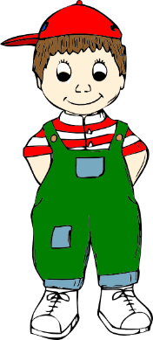
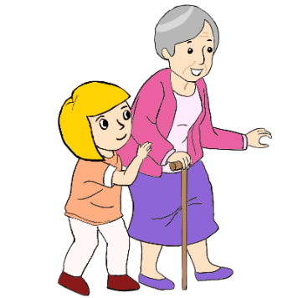
j
Junge
Jahr
2019
ja
jung
jemand
[someone]
jetzt
[now]
Notes:
Introduce and elicit the pronunciation of the individual SSC [j] and then the source word again (with gesture, if using). Then present and elicit the pronunciation of the five cluster words. The cluster words have been chosen for their high-frequency, from a range of word classes, with the SSC (where possible) positioned within a variety of syllables within the words (e.g. initial, 2nd, final etc.) Additionally, we have tried to use words that build cumulatively on previously taught SSCs (see the Phonics Teaching Sequence document) and do not include new SSCs. Where new SSCs are used, they are often consonants which have a similar symbol-sound correspondence in English.
Word frequency rankings (1 is the most common word in German): ja [27]; Junge [630] Jahr [51]; jemand [397]; jetzt [62]; jung [184]. Source: Jones, R.L. & Tschirner, E. (2006). A frequency dictionary of German: core vocabulary for learners. Routledge

Slide 4
j
Junge
Jahr
ja
jung
jemand
jetzt
Notes:
With sound and no pictures to focus all attention on the sound-symbol correspondence.

Slide 5
j
Junge
Jahr
ja
jung
jemand
jetzt
[no]
Notes:
Without sound to elicit pronunciation (without first hearing the teacher).
Teacher to elicit pronunciation by asking “Wie sagt man …”

Slide 6
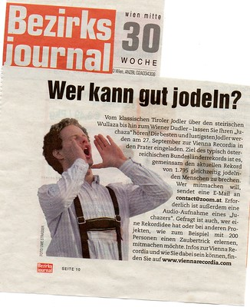
Wie sagt man das?
hören
Some German words starting with [j] come from other languages.
Some are like English words starting with ‘Y’. Others are pronounced with an English ‘J’ sound.
1 | 7
2 | 8
3 | 9
4 | 10
5 | 11
6 | 12
German ‘J’
English ‘J’
ja
English ‘Y’
Jeans
Jacht
Job
Junge
Jo-Jo
Jazz
jeden Tag
Joghurt
jodeln
joggen
jetzt
Notes:
Note: There is a less challenging version of this task, with picture prompts, on the following slide.
Image: https://creativecommons.org/licenses/by-nc-nd/2.0/
In this exercise, students listen and organise the words they hear into the three categories. Sometimes students will need to write them down and read them before they can decide where to place them, so encourage them to do this. The first one can be done as an example with the class. It is one of the trickier ones. Tell students there are four words in each category, and that the four German ‘J’ words are known to them already. Transcript (with English meanings given in brackets) Jacht (yacht) Jeans (jeans) ja (yes) Junge (boy) Jo-Jo (yo-yo) Joghurt (yoghurt) Job (job) Jazz (jazz) jeden Tag (every day) joggen (jogging) jetzt (now)
jodeln (yodel)
Note: students may not recognise ‘yodel’. Give them a definition and context, e.g., yodelling started off as a form of communication between people living in remote mountain locations. The quick modulations from normal to falsetto (high) voice make the sound carry for long distances. Click for an image. Click on the player to hear an example of recreational yodelling from a Stammtisch in Graz, Austria (48 seconds). Tell students that Stammtisch (lit. regular table) is a general word for a regular (usually weekly) meeting of a group of friends often for the pursuit a particular hobby.
Word frequency rankings: Jacht[>4034], Jeans [4942 (2019 list)]; ja[27]; Junge [630]; Jo-Jo [>4034]; Joghurt [>4034]; Job [1090]; Jazz [3467]; jeden Tag[88/108]; joggen [>4034]; jetzt [62] jodeln [>4034]

Slide 7
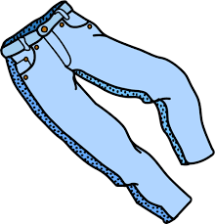
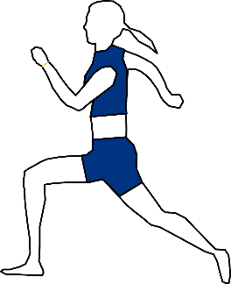
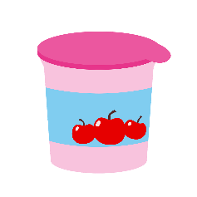
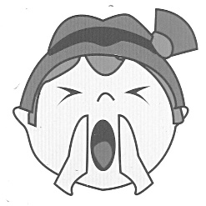
Wie sagt man das?
hören
Some German words starting [j]come from other languages.
Some are like English words starting with ‘Y’. Others are pronounced with an English ‘J’.
1 | 7
2 | 8
3 | 9
4 | 10
5 | 11
6 | 12
German ‘J’
English ‘J’
10. joggen
2. Jeans
3. ja
4. Junge
English ‘Y’
5. Jo-Jo
1. Jacht
8. Jazz
6. Joghurt
11. jetzt
7. Job
[now]
9. jeden Tag
12. jodeln
[every day]
Notes:
Note: There is a more challenging version of this task, without picture prompts, on the previous slide.
Image: https://creativecommons.org/licenses/by-nc-nd/2.0/
In this exercise, students listen and organise the words they hear into the three categories. They can simply write the number into the correct part of the Venn OR they can also try to write the full word (or a mixture). Sometimes students will need to write them down and read them before they can decide where to place them, so encourage them to do this. The first one can be done as an example with the class. It is one of the trickier ones. Tell students there are four words in each category, and that the four German ‘J’ words are known to them already. Transcript (with English meanings given in brackets) Jacht (yacht) Jeans (jeans) ja (yes) Junge (boy) Jo-Jo (yo-yo) Joghurt (yoghurt) Job (job) Jazz (jazz) jeden Tag (every day) joggen (jogging) jetzt (now)
jodeln (yodel)
Note: students may not recognise ‘yodel’. Give them a definition and context, e.g., yodelling started off as a form of communication between people living in remote mountain locations. The quick modulations from normal to falsetto (high) voice make the sound carry for long distances. Click for an image. Click on the player to hear an example of recreational yodelling from a Stammtisch in Graz, Austria (48 seconds). Tell students that Stammtisch (lit. regular table) is a general word for a regular (usually weekly) meeting of a group of friends often for the pursuit a particular hobby.
Word frequency rankings: Jacht[>4034], Jeans [4942 (2019 list)]; ja[27]; Junge [630]; Jo-Jo [>4034]; Joghurt [>4034]; Job [1090]; Jazz [3467]; jeden Tag[88/108]; joggen [>4034]; jetzt [62] jodeln [>4034]

Slide 8
Wie sagt man das?
sprechen
Remember! Only the true cognates are pronounced with English ‘J’.
45
 | ja
 | jetzt
 | der Job
 | das Jahr
 | die Jeans
 | das Jahrhundert
 | die Jugend [youth]
 | jedoch [however]
 | jeden Tag
 | der Jazz
 | der Junge
 | der/die Jugendliche
Sekunden
0
[century]
[young person]
LOS!
Notes:
In this exercise, students work in pairs to practise pronouncing a set of words containing SSC [j] in a given time. The set contains previously taught, phonics source and cluster, cognate and new words. The speech bubble reminds students that only the cognates are pronounced with an English ‘j’ sound. Only the meaning of the new words are provided.
NB: This is one of a set of three slides with different timer settings. The speed of the exercise can be chosen to match the ability level of the class, or the teacher may wish to start with the slowest speed and increase gradually.
1/ Teacher clicks ‘los’.
2/ Student A reads the list of words out loud to student B. Student B listens carefully to their partner’s pronunciation, and stops Student A if the [j] sound is pronounced wrongly.
3/ Students count how many words Student A managed to say correctly.
4/ Students swap roles. The student with the most points at the end is the winner.
5/ After two rounds, the teacher plays the correct pronunciation by clicking on the audio. Students repeat.
For this task, only words in the top 2000 and true cognates have been used, as the repeated exposure to these words will aid incidental vocabulary learning.
Word frequency rankings: Jeans [4942 (2019 list)]; ja [27]; Junge [630]; Job [1090]; Jazz [3467]; jeden Tag[88/108]; jetzt [62] Jahr [51] jedoch [191] Jahrhundert [447] Jugend [1627] Jugendliche [932]

Slide 9
Wie sagt man das?
sprechen
Remember! Only the true cognates are pronounced with English ‘J’.
30
 | ja
 | jetzt
 | der Job
 | das Jahr
 | die Jeans
 | das Jahrhundert
 | die Jugend [youth]
 | jedoch [however]
 | jeden Tag
 | der Jazz
 | der Junge
 | der/die Jugendliche
Sekunden
0
[century]
[young person]
LOS!
Notes:
In this exercise, students work in pairs to practise pronouncing a set of words containing SSC [j] in a given time. The set contains previously taught, phonics source and cluster, cognate and new words. The speech bubble reminds students that only the cognates are pronounced with an English ‘j’ sound. Only the meaning of the new words are provided.
NB: This is one of a set of three slides with different timer settings. The speed of the exercise can be chosen to match the ability level of the class, or the teacher may wish to start with the slowest speed and increase gradually.
1/ Teacher clicks ‘los’.
2/ Student A reads the list of words out loud to student B. Student B listens carefully to their partner’s pronunciation, and stops Student A if the [j] sound is pronounced wrongly.
3/ Students count how many words Student A managed to say correctly.
4/ Students swap roles. The student with the most points at the end is the winner.
5/ After two rounds, the teacher plays the correct pronunciation by clicking on the audio. Students repeat.
For this task, only words in the top 2000 and true cognates have been used, as the repeated exposure to these words will aid incidental vocabulary learning.
Word frequency rankings: Jeans [4942 (2019 list)]; ja [27]; Junge [630]; Job [1090]; Jazz [3467]; jeden Tag[88/108]; jetzt [62] Jahr [51] jedoch [191] Jahrhundert [447] Jugend [1627] Jugendliche [932]

Slide 10
Wie sagt man das?
sprechen
Remember! Only the true cognates are pronounced with English ‘J’.
15
 | ja
 | jetzt
 | der Job
 | das Jahr
 | die Jeans
 | das Jahrhundert
 | die Jugend [youth]
 | jedoch [however]
 | jeden Tag
 | der Jazz
 | der Junge
 | der/die Jugendliche
Sekunden
0
[century]
[young person]
LOS!
Notes:
In this exercise, students work in pairs to practise pronouncing a set of words containing SSC [j] in a given time. The set contains previously taught, phonics source and cluster, cognate and new words. The speech bubble reminds students that only the cognates are pronounced with an English ‘j’ sound. Only the meaning of the new words are provided.
NB: This is one of a set of three slides with different timer settings. The speed of the exercise can be chosen to match the ability level of the class, or the teacher may wish to start with the slowest speed and increase gradually.
1/ Teacher clicks ‘los’.
2/ Student A reads the list of words out loud to student B. Student B listens carefully to their partner’s pronunciation, and stops Student A if the [j] sound is pronounced wrongly.
3/ Students count how many words Student A managed to say correctly.
4/ Students swap roles. The student with the most points at the end is the winner.
5/ After two rounds, the teacher plays the correct pronunciation by clicking on the audio. Students repeat.
For this task, only words in the top 2000 and true cognates have been used, as the repeated exposure to these words will aid incidental vocabulary learning.
Word frequency rankings: Jeans [4942 (2019 list)]; ja [27]; Junge [630]; Job [1090]; Jazz [3467]; jeden Tag[88/108]; jetzt [62] Jahr [51] jedoch [191] Jahrhundert [447] Jugend [1627] Jugendliche [932]

