Slide 1
Grammar
Adjectives following the noun
Using ‘tienes’ (revisited)
Adjective agreement (revisited)
Y7 Spanish
Term 2.1 - Week 3 - Lesson 33/34
Nick Avery / Rachel Hawkes
Date updated: 30/03/2019

Slide 2
Adjectives following the noun
escuchar
In English the adjective comes before the noun.
In Spanish, many adjectives follow the noun:
un profesor nervioso
a nervous male teacher
un director tranquilo
a calm male director/headteacher
una autora importante
an important female author
una flor blanca
a white flower
Notes:
The four nouns here are from the 1.2.2 vocabulary set, which has just been revised.

Slide 3
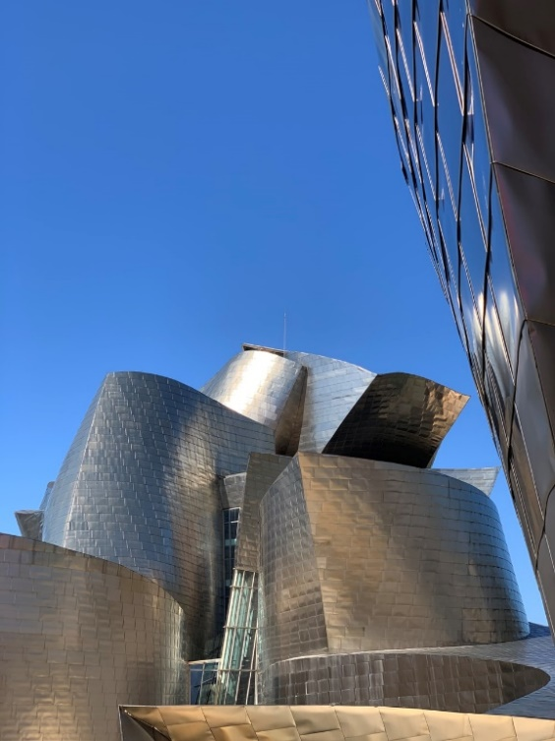
escuchar
Hay ocho personas allí.
En Bilbao, hay un museo famoso.
Escucha. ¿Quiénes son las personas, y cómo son?
Escribe la persona y el adjetivo en inglés.
1
tall mother
5
important female author
A _______________
An __________________________
6
interesting male teacher
2
short father
An _____________________________
A ______________
nervous male director/headteacher
3
silly sister
7
A ______________
A _____________________
El Guggenheim, Bilbao
cheerful female director/headteacher
4
nice brother
8
A _____________________
A ________________
Notes:
Images retrieved from clker.com and unsplash.com (free to use).
All nouns here are recycled from vocabulary sets revisited this week in the NCELP Y7 Spanish SoW.
Ask the students to write 1-8 in their books and to write down in English the noun and the adjective that they hear. This will help to practice both retrieval of vocabulary and processing of the word order change from Spanish to English.
Answers:
1/ a tall mother; 2/ a short father; 3/ a silly sister; 4/ a nice brother; 5/ an important (female) author; 6/ an interesting (male) teacher; 7/ a nervous (male) director, headteacher; 8/ a cheerful (female) director
Transcript
una madre alta
un padre bajo
una hermana tonta.
un hermano simpático
una autora importante
un profesor interesante
un director nervioso
una directora alegre

Slide 4
Organiza los adjetivos y completa las tres frases.
The ending changes when the noun is masculine/feminine
The ending is the same for a masculine/feminine noun
baja
importante
alto
tonta
interesante
simpático
nervioso
alegre
When referring to a singular masculine noun (e.g. padre), these adjectives end in _______
When referring to a singular feminine noun (e.g. madre), these adjectives end in _______
Adjectives ending in ______ or a consonant have the same ending for a masculine/feminine noun.
-o
-a
-e
Notes:
Revision of adjectival gender agreement: Students have to arrange the adjectives in the two different categories (both were previously taught in the NCELP SoW). They will need to use adjective gender agreement for this week’s classes. Once the words are arranged, ask them to complete the rule (this aims to further raise awareness of the grammar feature.
Afterwards, ask the learners to read out their answers to the previous listening activity but to change them back to Spanish. This is a translation activity which pushes them to reverse the order of the noun and the adjective from English and to also practice gender agreement and pronunciation of the adjectives. They could do this first as a whole class together, and then once they have the correct answers, to their partner.

Slide 5
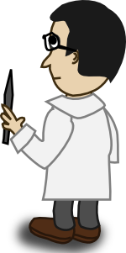
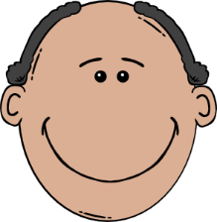
escribir
Estás en una plaza. Describe a las personas allí.
Combine the nouns and adjectives below to make your own sentences.
¡Importante! Make sure the adjective and noun agree, when necessary.
Hay…
[sister]
interesante
[father]
simpático
una h_ _ _ _ _ _ _
bajo
un p_ _ _ _
importante
una d_ _ _ _ _ _ _
un p_ _ _ _ _ _ _
[mother]
nervioso
alto
[brother]
[female author]
una m_ _ _ _
tonto
alegre
un h_ _ _ _ _ _ _
un d_ _ _ _ _ _ _
una a_ _ _ _ _ _
Notes:
To push the learners to recall the nouns that were reviewed on the last slide, we only provide the first letter.

Slide 6
tengo
[I have]
tienes
[you have]
Notes:
OPTIONAL: brief revision of tengo vs tienes (previously taught in NCELP SoW) before the next speaking/listening activity, in which these are needed.

Slide 7
tengo
[I have]
tienes
[you have]
Notes:
OPTIONAL: brief revision of tengo vs tienes before the next speaking/listening activity
Cycle through the 1st & 2nd person singular forms again.

Slide 8
tengo
[I have]
Tengo un padre alegre.
[I have a cheerful father.]
Notes:
OPTIONAL: brief revision of tengo vs tienes before the next speaking/listening activity
Revisit the 1st person singular form in a sentence.
Note that the example includes a post-nominal adjective, so you can prompt students to think once more about the word order difference between English and Spanish.

Slide 9
tienes
[you have]
Tienes una madre alta.
[You have a tall mother.]
Notes:
OPTIONAL: brief revision of tengo vs tienes before the next speaking/listening activity
Revisit the 2nd person singular form in a sentence.
Note that the example includes a post-nominal adjective, so you can prompt students to think once more about the word order difference between English and Spanish.

Slide 10
hablar / escuchar
You’re chatting to a friend (your partner) about people in your family and at school.
Use your cards to
a) tell him/her who you have
b) ask who they have.
¡Importante! Give the full sentence or you will have to start again!
Your partner will also ask you. Take turns.
Un ejemplo:
Persona A (pregunta):
¿Tienes un profesor alto?
Sí, tengo un profesor alto.
Persona B (contesta):
Persona A
Ask your partner if s/he has a…
(Circle the ones s/he has):
Persona B
When asked, say you have these:
[a tall male teacher]
[a tall male teacher]
Notes:
In this activity, students will be drawing on previous taught features
Tengo / tienes
Yes/no questions with raised intonation
Adjectival gender agreement
They should also now be using adjectives in post-nominal position. This may be challenging.

Slide 11
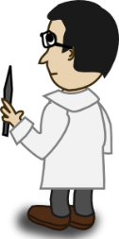
Persona A
Persona A
Persona A
When asked, say you have these:
Ask your partner if s/he has a…
(Circle the ones s/he has):
[nice male teacher]
[silly sister]
[nervous brother]
[short male headteacher]
[interesting female teacher]
[short mother]
[important mother]
[cheerful father]
[cheerful male teacher]
[tall female headteacher]
[important brother]
[calm father]
Notes:
DO NOT DISPLAY
A printable version of these speaking cards is available in Word format.

Slide 12
Persona B
Persona B
Persona B
When asked, say you have these:
Ask your partner if s/he has a…
(Circle the ones s/he has):
[nice male teacher]
[cheerful sister]
[nervous brother]
[tall male headteacher]
[important female teacher]
[short mother]
[cheerful male teacher]
[important mother]
[silly father]
[tall female headteacher]
[calm father]
[interesting brother]
Notes:
DO NOT DISPLAY
A printable version of these speaking cards is available in Word format.

Slide 13
Persona A - respuestas
Persona A
Persona A
When asked, say you have these:
Ask your partner if s/he has a…
(Circle the ones s/he has):
[nice male teacher]
[silly sister]
[nervous brother]
[short male headteacher]
[interesting female teacher]
[short mother]
[important mother]
[cheerful father]
[cheerful male teacher]
[tall female headteacher]
[important brother]
[calm father]
Notes:
ANSWERS – DO NOT DISPLAY DURING ACTIVITY

Slide 14
Persona B - respuestas
Persona B
Persona B
When asked, say you have these:
Ask your partner if s/he has a…
(Circle the ones s/he has):
[nice male teacher]
[cheerful sister]
[nervous brother]
[tall male headteacher]
[important female teacher]
[short mother]
[cheerful male teacher]
[important mother]
[silly father]
[tall female headteacher]
[calm father]
[interesting brother]
Notes:
ANSWERS – DO NOT DISPLAY DURING ACTIVITY

Slide 15
Grammar [2]
Adjectives following the noun
Using ‘tenemos’ and ‘tienen’ (revisited)
Adjective agreement (revisited)
Y7 Spanish
Term 2.1 - Week 3 - Lesson 33/34
Nick Avery / Rachel Hawkes
Date updated: 30/03/2019

Slide 16
Daniel talks to a friend from his country, Spain, about the beautiful things they have there.
leer
He also says what his Peruvian friends have in theirs.
They have
We have
Escribe la frase completa en inglés.
“Tenemos ríos hermosos.”
We have beautiful rivers.
“Tienen flores rojas.”
They have red flowers.
“Tienen unas ciudades grandes.”
They have some big cities.
“Tenemos naturaleza diversa.”
We have diverse nature.
“Tienen pájaros verdes.”
They have green birds.
“Tenemos lugares interesantes.”
We have interesting places.
“Tienen árboles bastante antiguos.”
They have quite old trees.
“Tenemos montañas altas”
We have high mountains.
“Tenemos playas muy grandes”
We have very big beaches.
“Sólo tienen islas bonitas”
They only have pretty islands.
Notes:
This activity revisits the two forms of tener that were introduced last week.
It also focuses students on the word order change from Spanish to English when translating adjectives that follow nouns.
In addition to the new vocabulary, several previously taught words and phonics words are included: montaña [1464], alto [231], isla [810], bonito [891], hermoso [980], flor [739], playa [1475].
‘Diversa’ was chosen as it is an English-Spanish cognate.

Slide 17
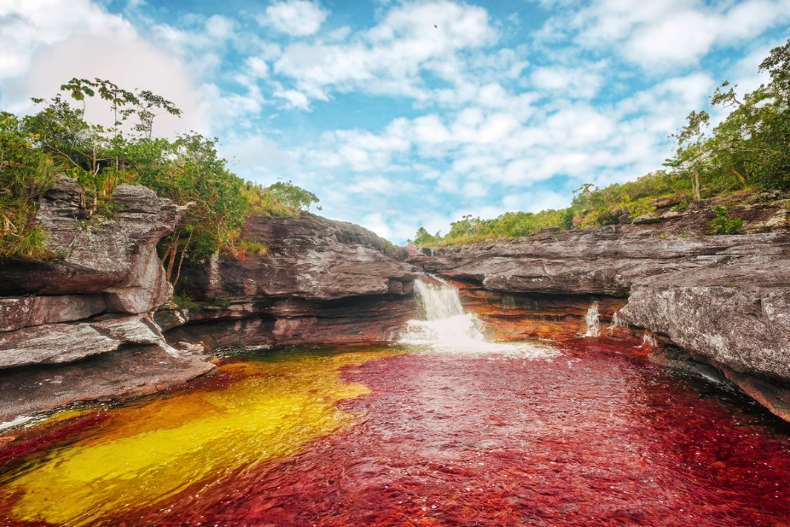
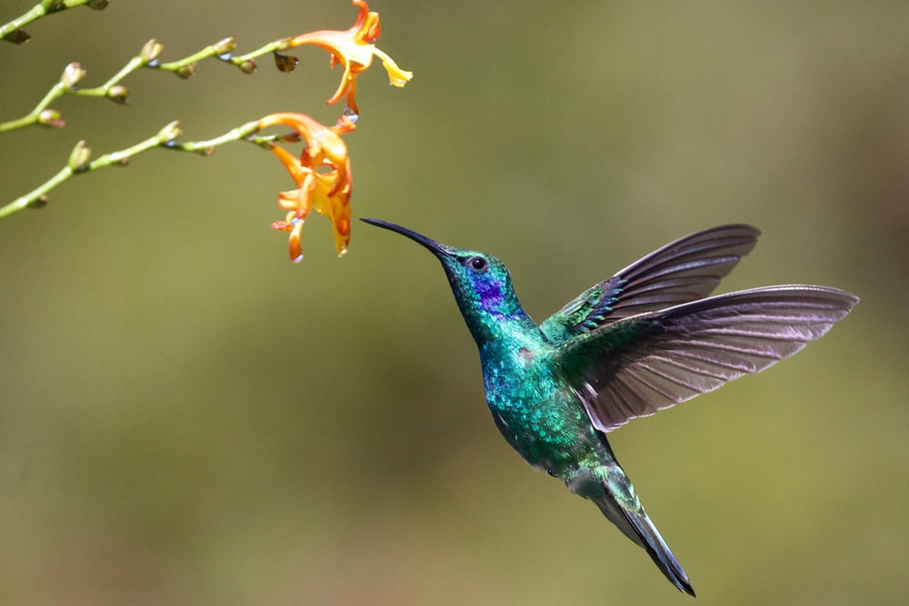
Caño Cristales: un lugar espectacular
leer
Caño Cristales es un río hermoso en el centro de Colombia. Está en un parque nacional cerca de Los Andes y lejos de las ciudades grandes.
El río es muy especial porque es de cinco colores: rojo, verde, azul, amarillo, y negro. Es un lugar perfecto para* tomar fotos de la naturaleza.
No hay cosas feas allí; sólo plantas, flores, árboles, animales, y también pájaros pequeños.
El pájaro azul y verde en la imagen es una especie nativa: el ‘colibrí’. ¿Cómo se dice en inglés? Hummingbird!
* para = for
* la especie = species
Notes:
Picture credit: Mario Carvajal CC by 4.0; photo by James Wainscoat on Unsplash
This text can be exploited in different ways:
Grammatical awareness – students read text and identify how many examples of the ‘adjective following noun’ they can find. Answer: 7 (río hermoso, parque nacional, ciudad grande, lugar perfecto, cosas feas, pájaro azul y verde; especie nativa). The title ‘un lugar espectacular’ includes another example of this.
Phonics revision – listen to the text and write the missing words (see next slide), which contain words with challenging SSCs.
Paired read aloud with prompts to force production of post-nominal adjective (see slide 38).
Two words that haven’t been previously taught are included as a gloss: ‘para and ‘especie’. Students will be taught the bsaic meaning of ‘para’ in next week’s class. They will learn ‘para’ + infinitive in the Year 8 Spanish scheme of work

Slide 18
Caño Cristales: un lugar espectacular
escuchar
Caño Cristales es un río _________ en el centro de Colombia. Está en un parque nacional cerca de Los Andes y ______ de las ciudades grandes.
El río es muy especial porque es de cinco colores: rojo, verde, _____, _______, y negro. Es un lugar perfecto para tomar fotos de la naturaleza.
No hay cosas feas allí; sólo plantas, flores, árboles, animales, y también pájaros _____________.
El pájaro en la ____________ es una especie nativa: el ‘colibrí’. ¿Cómo se dice en inglés? Hummingbird!
Notes:
Phonics revision: students write the missing words. The text has been adapted slightly to not give away the answers by repeating key words.
The missing words were selected because they contain a range of previously taught SSCs that can sometimes be challenging for students.
hermoso – SSC [silent ‘h’]
lejos – SSC [j]
azul – SSC [z]
amarillo – SSC [ll]
pequeños – SSC [ñ]
imagen – SSC [ge]

Slide 19
En parejas. Read the text aloud to your partner, translating into Spanish when necessary.
hablar
Caño Cristales es un ………………………….en el centro de Colombia. Está en un ……………………….. cerca de Los Andes y lejos de las ciudades grandes.
El río es muy especial porque es de cinco colores: rojo, verde, azul, amarillo, y negro. Es un ……………………………para tomar fotos de la naturaleza.
No hay………………..…..allí; sólo plantas, flores, árboles, animales, y también pájaros pequeños.
El …………………………….en la imagen es una ………..…………..: el ‘colibrí’. ¿Cómo se dice en inglés? Hummingbird!
beautiful river
national park
perfect place
ugly things
blue and green bird
native species
* nacional = national
* especie = species
Notes:
Students take turns to read the text aloud with English prompts to force production of post-nominal adjective in Spanish.
Students haven’t previously learnt ‘especie’, ‘nativa’ or ‘nacional’ as vocabulary items so make sure these words are understood from the original text. All 3 are near-cognates but students might not be sure of the spoken form. ‘Especie’ and ‘nacional’ are provided as a gloss to support practice.

