Slide 1
Describing what people can / are able to do
Using modal verb ‘poder’
SSC [u]
Y7 Spanish
Term 2.2 - Week 2 - Lesson 41
Amanda Izquierdo / Nick Avery Artwork: Mark Davies
Date updated: 16/08/21
Notes:
Artwork by Mark Davies. All additional pictures selected are available under a Creative Commons license, no attribution required.
Learning outcomes (lesson 1):
Consolidation of SSC [u]
Introduction of PODER in singular persons (puedo, puedes, puede) and its use in negative statements
Word frequency (1 is the most frequent word in Spanish):
7.2.2.2 (introduce) poder [32]; puedo; puedes; puede; jugar [356]; participar [593]; preguntar [220]; pedir [218], material [690]; cambiar [256]; favor [517]; compañero/a [551]; ¿puedo ir a los servicios?
7.2.1.4 (revisit) ¿cuándo? [57]; ¿cuánto? [580]; ¿cuál? [445]; hacer [26]; hago; haces; hace; deporte [1489]; deberes [2187]; actividad [344]; dibujo [1726]; noche [164]; tarde [392]; mañana [402]; para [16]
7.1.2.6 (revisit) pueblo [244]; equipo [373]; trabajo [152]; edificio [857]; plato [1808]; familia [233]; película [543]; vista [408]; isla [810]; grande [66]; interesante [616]; de [2]
Source: Davies, M. & Davies, K. (2018). A frequency dictionary of Spanish: Core vocabulary for learners (2nd ed.). Routledge: London
The frequency rankings for words that occur in this PowerPoint which have been previously introduced in NCELP resources are given in the NCELP SOW and in the resources that first introduced and formally re-visited those words.
For any other words that occur incidentally in this PowerPoint, frequency rankings will be provided in the notes field wherever possible.

Slide 2
u
universo
Notes:
Introduce and elicit the pronunciation of the individual SSC ‘U’ and then present and practise the pronunciation of the source word ‘universo’.
A possible gesture for this source word would be to extend your arms over your head and then out to the sides in a single motion

Slide 3
u
universo
Notes:
Repeat the sound and elicit the source word.

Slide 4
u
universo
Notes:
Repeat the sound and elicit the source word.

Slide 5
u
mundo
mucho
un
lugar
universo
[a; an]
[place]
nunca
[never]
Notes:
Introduce and elicit the pronunciation of the individual SSC ‘u’ and then the source word again (with gesture, if using). Then present and elicit the pronunciation of the five cluster words.
The cluster words have been chosen for their high-frequency, from a range of word classes, with the SSC (where possible) positioned within a variety of syllables within the words(e.g. initial, 2nd, final etc..) and additionally, we have tried to use words that build cumulatively on previously taught SSCs (see the Phonics Teaching Sequence document) and do not include new SSCs. Where new SSCs are used, they are often consonants which have a similar symbol-sound correspondence in English.

Slide 6
u
mundo
mucho
un
lugar
universo
nunca
Notes:
Without the images, students focus this time again closely on the SSC and the cluster words.

Slide 7
u
mundo
mucho
un
lugar
universo
nunca
Notes:
Without the images or sound, students have to pronounce the words themselves.

Slide 8
Escucha. ¿Cuántas veces escuchas el sonido ‘u’?
escuchar / escribir
1
2
3
escuchar / escribir
Escucha otra vez. Escribe las frases en español.
1
Hay un mercado.
2
Escuchar música es fantástico.
3
El mundo es grande.
4
Estudia mucho en la escuela.
5
El lugar está cerca.
6
Tiene la respuesta.
7
El pueblo antiguo está lejos.
8
El pájaro azul está en la naturaleza.
9
¿Solo hay un universo?
10
Hay un museo en la ciudad.
Notes:
Phonics and vocabulary
Timing: 7 minutes
Aim: to raise awareness of the SSC [u] in different words
Procedure:
Students listen out for how many times they can listen to the sound ‘u’, 1, 2 or 3 times.
Students listen again and write the whole sentence.
Notes:
Higher-achieving groups may be able to write the whole sentence the first time they listen. Writing the sentence will help students to check their initial decision about how many times ‘u’ appears.
There is some phonological variation in the SSC ‘u’ in several of these words. It can be useful to make students aware that ‘u’ can vary in sound, depending on the letters that come before or after it. (For example, it is followed by a vowel in respuesta, pueblo and antiguo and so sounds different.) Students may recognise other previously taught SSCs, e.g. ‘cu’ in escuchar.
Students have already met cuánto/cuantos in lesson 2.1.4, but have not seen its feminine form or ‘vez’, yet. Ensure that the meaning of this word is clear to them when giving task instructions.
Transcript:
Hay un mercado.
Escuchar música es genial.
El mundo es grande.
Estudia mucho en la escuela.
El lugar está cerca.
Tiene la respuesta.
El pueblo antiguo está lejos.
El pájaro azul está en la naturaleza.
¿Sólo hay un universo?.
Hay un museo en la ciudad.

Slide 9
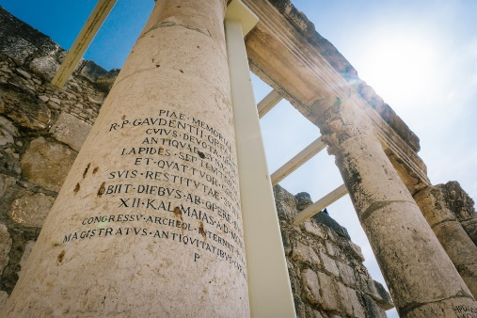
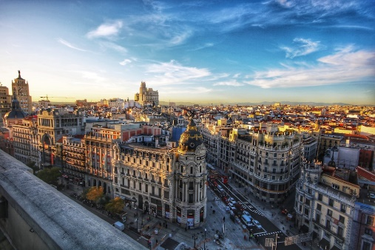
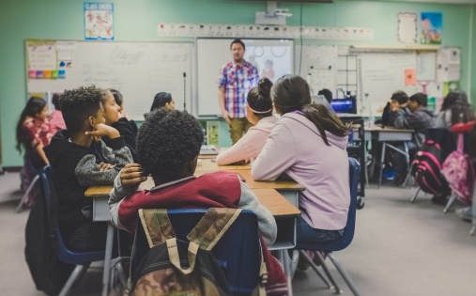
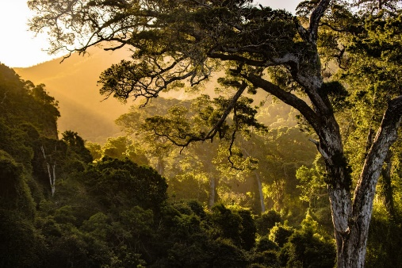
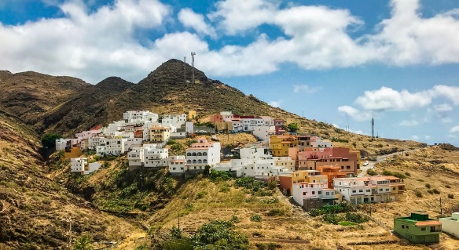
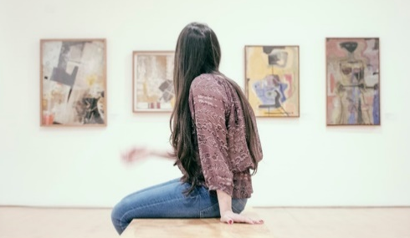
Identifica la imagen y escribe la letra correcta.
C
[world]
A
[old]
B
[city]
naturaleza
E
F
azul
F
escuchar
H
E
[blue]
museo
I
D
[school]
G
escuela
D
mundo
C
[nature]
pueblo
J
J
[town]
antiguo
H
I
A
ciudad
B
respuesta
G
[to listen]
[museum]
Notes:
OPTIONAL
Timing: 4 minutes.
Aim: to focus on the meaning of the words used for SSC practice.
Procedure:
Students write the words in their books and write the corresponding letter next to the word.
Teacher elicits the letter in Spanish to practise letters of the alphabet. Alternatively, the teacher can say the letter in Spanish and students will say the corresponding word.

Slide 10
¿Cómo se dice en español?
activity
night
interesting
to do, to make
job, work
big
team
morning
dish, plate
of
film
view
island
building
town
la actividad
la noche
interesante
hacer
el trabajo
grande
el equipo
la mañana
el plato
de
la película
la vista
la isla
el edificio
el pueblo
la mañana
la isla
el plato
interesante
la vista
la actividad
el pueblo
de
hacer
la noche
grande
el edificio
la película
el equipo
el trabajo
¿Cómo se dice en español?
I do, I make
you do, you make
s/he (or it) does, s/he makes
Notes:
Timing: 5 minutes
Aim: to recap this week’s revisited vocabulary.
Procedure:
The teacher clicks to bring up the English word.
Students say the word in Spanish out loud.
The teacher clicks again to make the correct Spanish word move next to it.

Slide 11
Vocabulario
60
 | Español | Inglés
1 | poder | can, to be able to
2 | puedo | I can, I am able to
3 | puedes | you can, you are able to
4 | puede | s/he can, s/he is able to
5 | participar | to participate, participating
6 | preguntar | to ask, asking
7 | pedir | to ask for, asking for
8 | jugar | to play (e.g. a game), playing
9 | el material | material
10 | cambiar | to change, changing
11 | el favor | favour
Asking a question? Use “preguntar”
Segundos
Asking for something? Use “pedir”
0
INICIO
Notes:
Timing: 3 minutes
Aim: to practise vocabulary introduced this week.
Procedure:
Students either work by themselves or in pairs, reading out the words and recapping their English meaning (1 minute).
Then the English meanings are removed and they try to recall them, looking at the Spanish (1 minute).
Then the Spanish meanings are removed and they to recall them, looking at the English (1 minute)
Further rounds of learning can be facilitated by one student turning away from the board, and his/her partner asking him/her the meanings. This activity can work from L2 → L1 or L1 → L2.
Note: Lesson 2 will present ; compañero [551]; ¿puedo ir a los servicios?

Slide 12
Talking about what people can do Using the modal verb ‘poder’
Use the verb ‘poder’ to say what people can (or are able to) do.
To say ‘I can’, use ‘puedo’:
Use a verb infinitive (e.g. hablar) after ‘poder’.
Remember, the infinitive refers to the general meaning of the verb. It often ends in –ar, –er and –ir.
Puedo preguntar.
I can ask.
To say ‘s/he can’, use ‘puede’:
Puede hablar en clase.
S/he can speak in class.
Notes:
Timing: 2 minutes
Aim: to explain the meaning of ‘poder’; to present the 1st and the 3rd person singular forms of this new modal verb.
Procedure:
Go through the grammar explanation with students, revealing each new sentence on a mouse click.

Slide 13
poder
[can | to be able to]
puede
[s/he can | is able to]
Notes:
[1/6]
Timing: 3 minutes.
Procedure:
Teacher brings up the word ‘poder’ on its own, say it, students repeat it, and remind them of the phonics.
Teacher elicits the meaning from the students.
Teacher brings up the English translations.
Teacher brings up the 3rd person form ‘puede’, say it, students repeat it.
Teacher elicits the meanings from the students.
Note: Deber is one of the NCELP 25 most frequent verbs in Spanish. Both the 1st and 3rd person singular are introduced in order to familiarise students over the next few slides.

Slide 14
poder
[can | to be able to]
puede
[s/he can | is able to]
Notes:
[2/6]
Timing: 3 minutes
Aim: to introduce the 3rd person singular of the verb ‘poder’.
Procedure:
1. Teacher and students cycle through the long and short form again.

Slide 15
puede
[s/he can | is able to]
La profesora puede cambiar los deberes.
[The teacher can change the homework.]
Notes:
[3/6]
Timing: 3 minutes
Aim: to introduce the short form in a sentence.
Procedure:
Teacher introduces the short form in a sentence.
Teacher elicits the meaning of the sentence from the students.
Teacher shows the translation in English.

Slide 16
poder
[can | to be able to]
Poder preguntar en clase es normal.
[To be able to ask in class is normal.]
Notes:
[4/6]
Timing: 3 minutes
Aim: to introduce the long form in a sentence.
Procedure:
Teacher introduces the long form in a sentence.
Teacher elicits the meaning of the sentence from the students.
Teacher shows the translation in English.

Slide 17
puede
[s/he can | is able to]
La profesora puede cambiar los deberes.
[The teacher can change the homework.]
Notes:
[5/6]
Timing: 3 minutes
Aim: to introduce the short form in a sentence.
Procedure:
Teacher shows the sentence without the verb.
Teacher elicits the short form from the students.
Teacher shows the translation in English.

Slide 18
poder
[can | to be able to]
Poder preguntar en clase es normal.
[To be able to ask in class is normal.]
Notes:
[6/6]
Timing: 3 minutes
Aim: to introduce the long form in a sentence.
Procedure:
Teacher shows the sentence without the verb.
Teacher elicits the long form from the students.
Teacher shows the translation in English.

Slide 19
leer
Oh no! Someone put your Spanish homework through the shredder.
leer
¿Qué significa?
Marca la opción correcta. Luego, escribe la acción en inglés.
‘can’, ‘to be able to’ (the action in general) | someone can / is able to
to ask
to participate
to change
to help
to give
to study
to speak
to write
¿Qué acción? (en inglés)
1
poder preguntar
2
poder participar
3
puede cambiar
4
poder ayudar
5
puede dar
6
puede estudiar
7
puede hablar
8
poder escribir
Notes:
Timing: 7 minutes
Aim: to help learners understand the difference in meaning between ‘puede’ and ‘poder’, to provide students with the opportunity to re-visit many high-frequency verb infinitives.
Procedure:
Students read the sentences and tick the correct column depending on the meaning of the verb.
Students write the action in English.
Note: students have seen ‘ayuda’ but not ‘ayudar’ in the scheme of work. We included ‘ayudar’ given its similarity in form and meaning to ‘ayuda’.

Slide 20
leer / escribir
You find six more pieces in the shredder!
leer / escribir
Escribe seis frases completas en español.
Usa una frase de ‘A’ y una frase de ‘B’.
B
poder pedir ayuda
A
es importante
el profesor
poder preguntar en clase
es bueno
es normal
puede pedir silencio
Hugo
la chica
puede comprar material
poder hablar español
Escribe las frases en inglés.
Un ejemplo:
puede cambiar la respuesta
“It’s important to participate in class.”
Notes:
OPTIONAL
Timing: 5 minutes
Aim: to improve students’ awareness of the compatibility of ‘poder’ and ‘puede’ with other elements in a sentence.
Procedure:
Students read the 12 sentence fragments and try to write grammatical combinations by matching fragments from A and B.
Teacher asks students about the meaning of the sentences and asks them which sentence combinations seem most and least likely.

Slide 21
puedo
[I can / I am able to]
Notes:
[1/2]
Timing: 1 minute
Aim: to revisit the 1st person singular of ‘poder’.
Procedure:
1. Teacher and students cycle through the 1st of ‘poder’.

Slide 22
I can
[I can / I am able to]
Puedo pedir material.
[I can ask for material.]
Notes:
[2/2]
Timing: 1 minute
Aim: to introduce the 1st person singular of ‘poder’ in a sentence.
Procedure:
Teacher introduces the 1st person singular in a sentence.
Teacher elicits the meaning of the sentence from the students.
Teacher shows the translation in English.

Slide 23
Tienes un amigo en una escuela diferente. You’re telling the teacher what you can do in your school and what he can do in his school.
escuchar
Completa la tabla en inglés.
 | I can | He can
Yo (“I can”)
Mi amigo (“he can”)
1
talk with friends in class
ask in class
2
3
share materials
take magazines
4
ask for favours
ask for help
5
6
study art
arrive late
7
8
Notes:
Timing: 8 minutes
Aim: to understand the difference in meaning between ‘puedo’ and ‘puede’.
Procedure:
Students listen to each sentence and tick the first column, ‘I can’, if they hear ‘puedo’ and the second column, ‘he can’, if they hear ‘puede’.
Students listen again and complete the table in English, highlighting the difference between the first and the third person.
Transcript
1) Puedo preguntar en clase.
2) Puede hablar con amigos en clase.
3) Puedo compartir los materiales
4) Puede llevar revistas.
5) Puede pedir ayuda
6) Puede llegar tarde.
7) Puedo pedir favores.
8) Puedo estudiar arte.

Slide 24
hablar / escuchar
You’re chatting to your partner about what your Spanish friend can do where s/he lives.
hablar / escuchar
Use your cards to
ask what your partner’s friend can do.
say what your friend can and can’t do.
¡Importante! Say “sí puede” or “no puede” depending on what you can see on your card.
Your partner will also ask you. Take turns.
Un ejemplo:
Persona A (pregunta):
¿Puede ir a la escuela en bicicleta?
* to go = ir
Sí puede.
Persona B (contesta):
Persona A
Ask your partner if his/her friend can… (Tick the things s/he can do and cross out what s/he can’t do):
Persona B
When asked, say your friend can ( ) or can’t ( )do the following:
[go to school by bike]
[go to school by bike]
Notes:
Timing: 12 minutes
Aim: to practise the use of puede + verb infinitives and negative ‘no’; to revisit vocabulary drawn from previous weeks.
Procedure:
Student A asks questions with the information in English on their card.
Student B answers ‘sí puede’ if the question is represented in their card and ‘no puede’ if on their card there is no reference to what’s being asked.
Student A writes a tick if the answer is positive or a cross if it’s negative.
Note: Students haven’t formally learnt ‘ir’ [34], so a gloss is provided in this example.

Slide 25
Persona A
Persona A
Persona A
When asked, say your friend can ( ) or can’t ( )do the following:
Ask your partner if his/her friend can…
(Tick the things s/he can do and cross out what s/he can’t do):
[arrive home late]
[buy expensive products]
[walk to the city]
[walk to school]
[have animals at home]
[study English]
[work with animals]
[use the phone in school]
[participate in the theatre]
[speak in English with friends]
[study science]
[play in the square]
Notes:
DO NOT DISPLAY
Answers:
caminar a la escuela
tener animales en casa
estudiar inglés
trabajar con animales
usar el teléfono en la escuela
participar en el teatro
estudiar ciencias
caminar a la ciudad
hablar en inglés con amigos
jugar en la plaza
comprar productos caros
llegar tarde a casa / llegar tarde a casa

Slide 26
Persona B
Persona B
Persona B
When asked, say your friend can ( ) or can’t ( )do the following:
Ask your partner if his/her friend can…
(Tick the things s/he can do and cross out what s/he can’t do):
[study science]
[walk to the city]
[speak in English with friends]
[participate in the theatre]
[use a phone in school]
[study English]
[play in the square]
[buy expensive products]
[arrive home late]
[walk to school]
[work with animals]
[have animals at home]
Notes:
DO NOT DISPLAY
Answers:
estudiar ciencias
caminar a la ciudad
hablar en inglés con amigos
jugar en la plaza
Comprar productos caros
llegar tarde a casa / llegar tarde a casa
participar en el teatro
usar el telefóno en la escuela
estudiar inglés
caminar a la escuela
trabajar con animales
Tener animales en casa

Slide 27
Persona A
Persona A
Persona A
When asked, say your friend can ( ) or can’t ( )do the following:
Ask your partner if his/her friend can…
(Tick the things s/he can do and cross out what s/he can’t do):
[arrive home late]
[buy expensive products]
[walk to the city]
[walk to school]
[have animals at home]
[study English]
[work with animals]
[use the phone in school]
[participate in the theatre]
[speak in English with friends]
[study science]
[play in the square]
Notes:
ANSWER KEY - DO NOT DISPLAY DURING ACTIVITY

Slide 28
Persona B
Persona B
Persona B
When asked, say your friend can ( ) or can’t ( )do the following:
Ask your partner if his/her friend can…
(Tick the things s/he can do and cross out what s/he can’t do):
[study science]
[walk to the city]
[speak in English with friends]
[participate in the theatre]
[use a phone in school]
[study English]
[play in the square]
[buy expensive products]
[arrive home late]
[work with animals]
[walk to school]
[have animals at home]
Notes:
ANSWER KEY - DO NOT DISPLAY DURING ACTIVITY

Slide 29
Describing what people can / are able to do [2]
Using modal verb ‘poder’
SSC [u]
Y7 Spanish
Term 2.2 - Week 2 - Lesson 42
Amanda Izquierdo / Nick Avery Artwork: Mark Davies
Date updated: 16/08/21
Notes:
Artwork by Mark Davies. All additional pictures selected are available under a Creative Commons license, no attribution required.
Learning outcomes (lesson 2):
Consolidation of SSC [u]
Consolidation of PODER in singular persons (puedo, puedes, puede) and introduction of its use for requests
Word frequency (1 is the most frequent word in Spanish):
7.2.2.2 (introduce) poder [32]; puedo; puedes; puede; jugar [356]; participar [593]; preguntar [220]; pedir [218], material [690]; cambiar [256]; favor [517]; compañero/a [551]; ¿puedo ir a los servicios?
7.2.1.4 (revisit) ¿cuándo? [57]; ¿cuánto? [580]; ¿cuál? [445]; hacer [26]; hago; haces; hace; deporte [1489]; deberes [2187]; actividad [344]; dibujo [1726]; noche [164]; tarde [392]; mañana [402]; para [16]
7.1.2.6 (revisit) pueblo [244]; equipo [373]; trabajo [152]; edificio [857]; plato [1808]; familia [233]; película [543]; vista [408]; isla [810]; grande [66]; interesante [616]; de [2]
Source: Davies, M. & Davies, K. (2018). A frequency dictionary of Spanish: Core vocabulary for learners (2nd ed.). Routledge: London
The frequency rankings for words that occur in this PowerPoint which have been previously introduced in NCELP resources are given in the NCELP SOW and in the resources that first introduced and formally re-visited those words.
For any other words that occur incidentally in this PowerPoint, frequency rankings will be provided in the notes field wherever possible.

Slide 30
¿A, e, i, o, u?
hablar / escuchar / escribir
Persona A
✄
Persona B
Mi ciudad es interesante y bonita. Hay tiendas, un mercado, un museo, una iglesia y dos bancos. También tiene naturaleza: hay un río entre árboles muy verdes. Mi _sc_ _la es m_y b_en_, p_ed_ p_rtic_par en d_p_rt_s en gr_p_ y t_mbién p_ _d_ _st_diar c_ _nc_a y _rt_. P_ _d_ camin_r a l_ _sc_el_ o ir _n b_c_clet_ p_rqu_ _stá c_rca.
M_ c_ _dad es int_resant_ y b_nit_. H_y t_ _ndas, un m_rc_d_, un m_s_ _, una igl_s_ _ y dos b_nc_s. T_mb_én t_ _n_ n_t_ral_za: hay un rí_ _ntr_ árb_l_s m_y v_rd_s. Mi escuela es muy buena, puedo participar en deportes en grupo y también puedo estudiar ciencia y arte. Puedo caminar a la escuela o ir en bicicleta porque está cerca.
- - - - - - - - - - - - - - - - - - - - - - - - - - - - - - -
Notes:
Do not display during the activity.
Phonics and vocabulary Timing: 5 minutes.
Aim: To revisit SSCs [a], [e], [i], [o], [u].
Procedure:
Student A reads out the text to their partner .
Students B listens out for the missing vowels and fills in the gaps.
Notes:
Some students might be able to complete some of the words on their own (i.e. from memory of how the word is spelled, and using the context), but most will need the input from their partner reading the full text aloud to be able to complete all the words.
More vowels can be deleted to make it more challenging, depending on the level of the group.
All the vocabulary used here has been seen in previously taught vocabulary sets or phonics practice, and words have also been included from the sets of words to be revisited during this week. Also, the form “puedo” has been purposely used to allow an opportunity for teachers to focus students on this verb, which was taught in lesson 1.

Slide 31
Vocabulario
¿cuál?
el deporte
el dibujo
para
¿cuándo?
¿cuánto?
los deberes
la tarde
J
N
homework
L
How much? How many?
sport
Q
Which?
M
for
A
drawing
P
When?
K
afternoon/evening
Notes:
Timing: 5 minutes
Aim: to revise vocabulary from one of this week’s revisited sets (2.1.4)
Procedure:
Teacher elicits the vocabulary from students by asking questions. Suggested routine:
Teacher: ¿Qué es ‘K’? Students: el dibujo Teacher: ¿Qué es ‘M’? Students: ¿cuándo?
2. Teacher clicks on the letter to trigger the lines to connect the word to the English translation.
Notes:
This means that students are practising their understanding of another set of alphabet letters at the same time.
The teacher chooses which order to ask the letters in – clearly, it would be easy to ask in alphabetical order, but this would be what students would naturally expect, so it reduces the need for them to listen attentively to them.

Slide 32
Vocabulario
jugar
preguntar
participar
cambiar
pedir
puede
favour
el favor
el compañero
el material
en clase
Notes:
[1/10]
Timing: 5 minutes.
Aim: to recap of vocabulary seen last lesson; to introduce a new word this week.
Procedure:
1. Students read the word in English in the centre of the slide and say the equivalent word in Spanish.
Notes:
The new word compañero [551] will be the last one to appear.
Each word is crossed out every time it has been said in order to facilitate introduction of the new word at the end of the activity.

Slide 33
Vocabulario
jugar
preguntar
participar
cambiar
pedir
to change
puede
el favor
el compañero
el material
en clase
Notes:
[2/10]

Slide 34
Vocabulario
jugar
preguntar
participar
cambiar
pedir
puede
to play
el favor
el compañero
el material
en clase
Notes:
[3/10]

Slide 35
Vocabulario
jugar
preguntar
participar
cambiar
pedir
in class
puede
el favor
el compañero
el material
en clase
Notes:
[4/10]

Slide 36
Vocabulario
jugar
preguntar
participar
cambiar
pedir
to ask
puede
el favor
el compañero
el material
en clase
Notes:
[5/10]

Slide 37
Vocabulario
jugar
preguntar
participar
cambiar
pedir
puede
to ask for
el favor
el compañero
el material
en clase
Notes:
[6/10]

Slide 38
Vocabulario
jugar
preguntar
participar
cambiar
pedir
puede
material
el favor
el compañero
el material
en clase
Notes:
[7/10]

Slide 39
Vocabulario
jugar
preguntar
participar
cambiar
pedir
to participate
puede
el favor
el compañero
el material
en clase
Notes:
[8/10]

Slide 40
Vocabulario
jugar
preguntar
participar
cambiar
pedir
puede
s/he can
el favor
el compañero
el material
en clase
Notes:
[9/10]

Slide 41
Vocabulario
jugar
preguntar
‘el compañero’ = classmate (boy)
‘la compañera’ = classmate (girl)
participar
cambiar
pedir
puede
classmate
el favor
el compañero
el material
en clase
Notes:
[10/10]

Slide 42
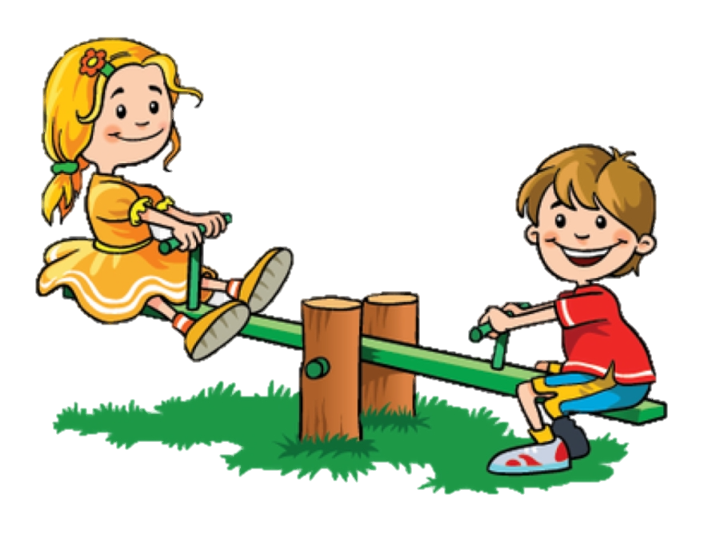
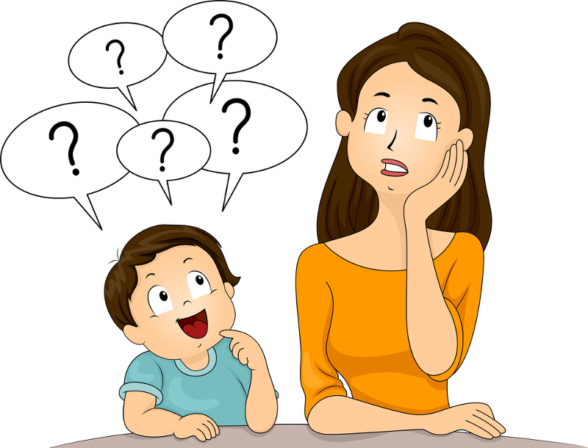
¿Cuál es la palabra en español?
vocabulario
to participate, participating
s/he can
to change, changing
favour
to ask for, asking for
el favor
cambiar
participar
[to play, playing]
puede
pedir
[to ask, asking]
[material]
[classmate]
[in class]
preguntar
jugar
el compañero, la compañera
el material
en clase
Notes:
Timing: 3 minutes
Aim: to orally produce the same words that were revisited receptively on slides 29-38.
Procedure:
Students say out loud the word in Spanish corresponding to the English word or image that appears on screen.
The teacher shows each answer with a further click.

Slide 43
poder
[can| to be able to]
puede
[s/he can| s/he is able to]
Notes:
[1/4]
Timing: 3 minutes.
Aims:
to revisit ‘poder’ and ‘puede’, which were seen in the previous lesson.
Procedure:
Teacher brings up the word ‘poder’ on its own, say it, students repeat it, and remind them of the phonics.
Teacher elicits the meaning from the students.
Teacher brings up the English translations.
Teacher brings up the 3rd person form ‘puede’, say it, students repeat it.
Teacher elicits the meanings from the students.
Note: Deber is one of the NCELP 25 most frequent verbs in Spanish. Both the 1st and 3rd person singular are introduced in order to familiarise students over the next few slides.

Slide 44
poder
[can| to be able to]
puede
[s/he can| s/he is able to]
Notes:
[2/4]
Timing: 3 minutes
Aim: to revisit ‘poder’ and ‘puede’, which were seen in the previous lesson.
Procedure:
1. Teacher and students cycle through the long and short form again.

Slide 45
puedo
[I can / I am able to]
puedes
[you can / you are able to]
Notes:
[3/4]
Timing: 3 minutes.
Aims:
to revisit ‘puedo’, which was seen in the previous lesson; to introduce ‘puedes’.
Procedure:
Teacher brings up the word ‘puedo’ on its own, say it, students repeat it, and remind them of the phonics.
Teacher elicits the meaning from the students.
Teacher brings up the English translations.
Teacher brings up the 3rd person form ‘puedes’, say it, students repeat it.
Teacher elicits the meanings from the students.
Note: Deber is one of the NCELP 25 most frequent verbs in Spanish. Both the 1st and 3rd person singular are introduced in order to familiarise students over the next few slides.

Slide 46
puedes
[you can | you are able to]
¿Puedes trabajar con un compañero?
[Can you work with a classmate?]
Notes:
[3/4]
Timing: 3 minutes
Aim: to introduce the 2nd person singular in a sentence.
Procedure:
Teacher introduces the 2nd person singular in a sentence.
Teacher elicits the meaning of the sentence from the students.
Teacher shows the translation in English.

Slide 47
“Poder” used for requests
“Poder” is also used for making requests and asking permission:
¿Puedes llevar el regalo a la chica?
Can you take the gift to the girl?
¿Puedes comprar el periódico?
Can you buy the newspaper?
¿Puedo usar el teléfono?
Can I use the phone?
¿Puedo ir a los servicios?
Can I go to the toilet?
Notes:
Timing: 2 minutes
Aim: to recap of the verb ‘poder’; to contrast the forms ‘puedes’ and ‘puedo’, pointing out the use of these forms for requests and for asking permission.
Procedure:
Go through the grammar explanation with students, revealing each new sentence on a mouse click.

Slide 48
La profesora pregunta en clase. Lee y marca la opción correcta. ¿Las frases son verdaderas o falsas?
leer
 | The teacher asks... | V | F
1 | Can you change the activity?
2 | Can you ask where the material is?
3 | Can s/he ask for a drawing?
4 | Can s/he do the homework in the morning?
5 | Can you participate with the classmates?
6 | Can you work in a team?
¿Puedes cambiar la actividad?
¿Puede preguntar dónde está el material?
1
2
¿Puedes pedir un dibujo?
¿Puede hacer los deberes por la mañana?
3
4
¿Puede participar con los compañeros?
¿Puedes trabajar en un equipo?
5
6
Notes:
Timing: 7 minutes
Aim: to differentiate between ‘puedes’ and ‘puede’ in requests ('Can you...?’ and 'Can s/he...?’)
Procedure:
Students read the speech bubbles.
Students read the sentences in English and decide whether they are true or false.
During feedback, the teacher can elicit the form of the verb needed if the English statement is false. This will reinforce the connection between the verb ending and the person referred to.
Note:
Students need to focus on the verb ending, which is the only element that could make the question true or false.
The teacher can remove all the item numbers and change the order of the questions in the chart to make it more challenging. This way, students first have to search for the speech bubble with the vocabulary mentioned in the question.

Slide 49
escuchar
La profesora está en clase. Escucha las preguntas.
Who is talking, the teacher (¿puedes…?) or the student (¿puedo…?).
escuchar
 | The teacher “Can you…?” | The student “Can I…?”
Completa la tabla en inglés.
The teacher
(“Can you… ?”)
The student
(“Can I…?”)
1
2
speak to the headteacher
use the dictionary
3
change the word
use the phone in class
4
5
take the book
to the classroom
do the homework with a classmate
6
7
read the phrase again
go to the toilet
8
Notes:
Timing: 8 minutes
Aim: to understand the difference in meaning between ‘puedo’ and ‘puedes’, as used in an oral request
Procedure:
Students listen to the requests and tick the first column ‘Can you’, if they hear ‘puedes’ and the second column, ‘Can I’, if they hear ‘puedo’.
Students listen again and complete the table in English. They will need to write the rest of the sentence in English in the correct column.
Transcript
1) ¿Puedes hablar con el director?
2) ¿Puedes cambiar la palabra?
3) ¿Puedo usar un diccionario?
4) ¿Puedo usar el teléfono en clase?
5) ¿Puedes llevar el libro a la clase?
6) ¿Puedo hacer los deberes con un compañero?
7) ¿Puedo ir a los servicios?
8) ¿Puedes leer la frase otra vez?

Slide 50
hablar / escuchar
Un amigo prepara una tarde en el campo. Your friend is giving everyone tasks. Listen to your partner and tick the right box. Is it “puedes” (you can) or “puede” (s/he can)?
hablar / escuchar
Use your card to
read out the tasks to your partner.
tick and write your partner’s tasks in English.
Persona B: (escucha, marca la columna correcta y escribe):
Un ejemplo:
Persona A (habla):
Puedes llevar la cámara.
Lee las tareas
1 - Puedes llevar la cámara.
 | You can | S/he can | Escribe la frase en inglés.
1 |  |  | You can carry/take the camera.
Notes:
Timing: 12 minutes
Aim: to practise understanding ‘puedes’ and ‘puede’ + infinitive and revisited vocabulary in the oral modality
Procedure:
Student A reads their sentences to their partners.
Student B ticks the corresponding column (‘you can’ or ‘s/he can’ and also writes the meaning in English in the last column).
Students swap roles.
Note: The objective for the speaker is to gain confidence by reading out sentences aloud in Spanish. If teachers wish to challenge students more, prompts could be given in English so that students have to produce the Spanish themselves.

Slide 51
Persona A
 | You can | S/he can | Escribe la frase en inglés.
1
2
3
4
5
Lee las frases
1 - Puedes preparar la comida.
2 - Puede comprar cosas.
3 – Puedes usar la cámara.
4 - Puedes buscar el río.
5 - Puede jugar con el caballo.
Notes:
DO NOT DISPLAY DURING ACTIVITY
Person A speaking cards/listening grid
Student A:
Puedes preparar la comida.
Puede comprar cosas.
Puedes usar la cámara.
Puedes buscar el río.
Puede jugar con el caballo.
Student B:
Puede hacer un plan.
Puede pedir ayuda.
Puedes llevar dos bicicletas.
Puede preguntar dónde está el norte.
Puedes buscar una vista bonita.

Slide 52
Persona B
 | You can | S/he can | Escribe la frase en inglés.
1
2
3
4
5
Lee las frases.
1 – Puede hacer un plan.
2 – Puede pedir ayuda.
3 - Puedes llevar dos bicicletas.
4 – Puede preguntar dónde está el norte.
5 – Puedes buscar una vista bonita.
Notes:
DO NOT DISPLAY DURING ACTIVITY
Person B speaking cards/listening grid
Student A:
Puedes preparar la comida.
Puede comprar cosas.
Puedes usar la cámara.
Puedes buscar el río.
Puede jugar con el caballo.
Student B:
Puede hacer un plan.
Puede pedir ayuda.
Puedes llevar dos bicicletas.
Puede preguntar dónde está el norte.
Puedes buscar una vista bonita.

Slide 53
Persona A
Respuestas
Frases de Persona B
 | You can | S/he can | Escribe la frase en inglés.
1 |  |  | S/he can make a plan.
2 |  |  | S/he can ask for help.
3 |  |  | You can take two bikes.
4 |  |  | S/he can ask where the north is.
5 |  |  | You can look for a beautiful view.
Lee las frases
1 - Puedes preparar la comida.
2 - Puede comprar cosas.
3 – Puedes usar la cámara.
4 - Puedes buscar el río.
5 - Puede jugar con el caballo.
Notes:
ANSWERS - DO NOT DISPLAY DURING ACTIVITY
Student A:
Puedes preparar la comida.
Puede comprar cosas.
Puedes usar la cámara.
Puedes buscar el río.
Puede jugar con el caballo.
Student B:
Puede hacer un plan.
Puede pedir ayuda.
Puedes llevar dos bicicletas.
Puede preguntar dónde está el norte.
Puedes buscar una vista bonita.

Slide 54
Persona B
Respuestas
Frases de Persona A
 | You can | S/he can | Escribe la frase en inglés.
1 |  |  | You can prepare food.
2 |  |  | S/he can buy things.
3 |  |  | You can use the camera.
4 |  |  | You can look for the river.
5 |  |  | S/he can play with the horse.
Lee las frases
1 – Puede hacer un plan.
2 – Puede pedir ayuda.
3 - Puedes llevar dos bicicletas.
4 – Puede preguntar dónde está el norte.
5 – Puedes buscar una vista bonita.
Notes:
ANSWERS - DO NOT DISPLAY DURING ACTIVITY
Student A:
Puedes preparar la comida.
Puede comprar cosas.
Puedes usar la cámara.
Puedes buscar el río.
Puede jugar con el caballo.
Student B:
Puede hacer un plan.
Puede pedir ayuda.
Puedes llevar dos bicicletas.
Puede preguntar dónde está el norte.
Puedes buscar una vista bonita.

Slide 55
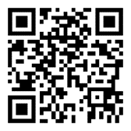
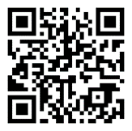
Deberes
Vocabulary Learning Homework (Term 2.2, Week 3)
Days of the week
Other vocabulary
Audio file
Audio file
Audio file QR code:
Audio file QR code:
Student worksheet
Student worksheet
Quizlet link
Quizlet link
In addition, revisit: Term 1.2 Week 7

