Slide 1
What is it like? [4] Comparing things
regular feminine adjective agreement
(-sse, -nne, -lle)
SSCs [om] and [on]
Y8 French
Term 3.1 - Week 1 - Lesson 49
Natalie Finlayson / Stephen Owen
Artwork by: Chloé Motard
Date updated: 18/03/21
Notes:
Artwork by Chloé Motard. All additional pictures selected are available under a Creative Commons license, no attribution required.
Native teacher feedback provided by Sarah Brichory.
Learning outcomes (lesson 1):
Consolidation of feminine adjective agreement patterns -e and -euse
Introduction of feminine adjective agreement patterns -sse, -nne and -lle
Consolidation of SSCs [om] and [on]
Word frequency (1 is the most frequent word in French):
8.3.1.1 (introduce) plus [19], moins [62], aussi² [44], que³ [9], dangereux [713], gentil, gentille [2832], gros [419], grosse [419], italien, italienne [1474], meilleur [194], mince [3570], pire [743], sûr [270], Italie
8.2.2.1 (revisit) choisir [226], définir [916], remplir [751], réussir [279], blanc² [701], cahier [4001], examen [1448], lycée [2816], note [1161], alors [81]
8.1.2.5 (revisit) gérer [1354], espace [870], goût [1829], langue², [712], plat [2167], recette [1709], repas [2948] d'abord [326], puis [230], par [21], puisque [528], Noël [>5000], réveillon [>5000]
Source: Londsale, D., & Le Bras, Y. (2009). A Frequency Dictionary of French: Core vocabulary for learners London: Routledge.
The frequency rankings for words that occur in this PowerPoint which have been previously introduced in NCELP resources are given in the NCELP SOW and in the resources that first introduced and formally re-visited those words.
For any other words that occur incidentally in this PowerPoint, frequency rankings will be provided in the notes field wherever possible.

Slide 2
om
Nathalie
Lefèvre
nom
Notes:
Timing: 1 minute
Aim: To consolidate SSC [om]
Procedure: 1. Present the letter(s) and say the [om] sound first, on its own. Students repeat it with you. 2. Bring up the word ”nom” on its own, say it, students repeat it, so that they have the opportunity to focus all of their attention on the connection between the written word and its sound.
3. A possible gesture for this would be to point at yourself. 4. Roll back the animations and work through 1-3 again, but this time, dropping your voice completely to listen carefully to the students saying the [om] sound, pronouncing ”nom” and, if using, doing the gesture.
Word frequency (1 is the most frequent word in French):
nom [171]
Source: Londsale, D., & Le Bras, Y. (2009). A Frequency Dictionary of French: Core vocabulary for learners London: Routledge.

Slide 3
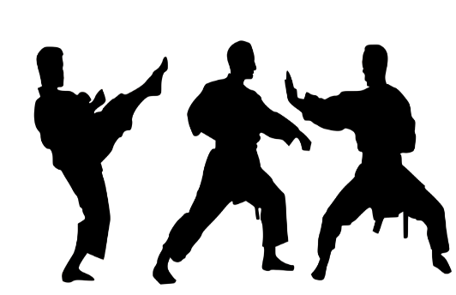
om
ombre
combat
Nathalie
Lefèvre
nom
comprendre
tomber
[to understand]
compte
[fall]
[account]
Notes:
Timing: 1 minute
Aim: To consolidate SSC [om]
Procedure:
Introduce and elicit the pronunciation of the individual SSC [om] and then the source word again ‘nom’ (with gesture, if using). Then present and elicit the pronunciation of the five cluster words. The cluster words have been chosen for their high-frequency, from a range of word classes, with the SSC (where possible) positioned within a variety of syllables within the words (e.g. initial, 2nd, final etc.). Additionally, we have tried to use words that build cumulatively on previously taught SSCs (see the Phonics Teaching Sequence document) and do not include new SSCs. Where new SSCs are used, they are often consonants which have a similar symbol-sound correspondence in English.
Word frequency (1 is the most frequent word in French): nom [171]; comprendre [95]; compte [254]; tomber [547]; combat [1062]; ombre [2001]. Source: Londsale, D., & Le Bras, Y. (2009). A Frequency Dictionary of French: Core vocabulary for learners London: Routledge.

Slide 4
on
non!
Notes:
Timing: 1 minute
Aim: To consolidate SSC [on]
Procedure: 1. Present the letter(s) and say the [on] sound first, on its own. Students repeat it with you. 2. Bring up the word ”non” on its own, say it, students repeat it, so that they have the opportunity to focus all of their attention on the connection between the written word and its sound.
3. A possible gesture for this would be to shake ones head whilst waggling one’s index finger, to indicate ‘no!’ 4. Roll back the animations and work through 1-3 again, but this time, dropping your voice completely to listen carefully to the students saying the [on] sound, pronouncing ”non” and, if using, doing the gesture.
Word frequency (1 is the most frequent word in French):
onze [2447]
Source: Londsale, D., & Le Bras, Y. (2009). A Frequency Dictionary of French: Core vocabulary for learners London: Routledge.

Slide 5
on
onze
continuer
[to continue]
non!
monde
au fond
montrer
[at the back]
[to show]
Notes:
Timing: 1 minute
Aim: To consolidate SSC [on]
Procedure:
1. Introduce and elicit the pronunciation of the individual SSC [on] and then the source word again ‘non’ (with gesture, if using). 2. Then present and elicit the pronunciation of the five cluster words.
The cluster words have been chosen for their high-frequency, from a range of word classes, with the SSC (where possible) positioned within a variety of syllables within the words (e.g. initial, 2nd, final etc.). Additionally, we have tried to use words that build cumulatively on previously taught SSCs (see the Phonics Teaching Sequence document) and do not include new SSCs. Where new SSCs are used, they are often consonants which have a similar symbol-sound correspondence in English.
Word frequency (1 is the most frequent word in French): onze [2447]; continuer [113] monde [77]; montrer [108]; au fond [553]; non [72]. Source: Londsale, D., & Le Bras, Y. (2009). A Frequency Dictionary of French: Core vocabulary for learners London: Routledge.

Slide 6
Phonétique
écouter
 |  | nasal | oral + m/n
 | plafond [roof]
 | promettre [to promise]
 | concentrer [to concentrate]
 | domaine [field/domain]
 | dont [of which]
 | raconter [to tell]
 | moment [time]
 | nombreux [plentiful]
1
2
3
Remember!
[om] and [on] are oral sounds before a vowel, and nasal sounds before a consonant.
4
5
6
7
8
Notes:
Timing: 5 minutes
Aim: Aural recognition of nasal and non-nasal vowels [om], [on], open [o] and closed [o] in unknown words.
Procedure:
1. Practise saying SSCs [om], [on], open [o] and closed [o] aloud, in isolation. Students should notice a vibration in the nose when they produce the nasal sounds, but not when they produce the oral sounds.
2. Click the numbers to play the audio.
3. Students write 1-8 and decide if the letters in bold represent a ‘nasal’ or ‘non-nasal’ vowel sound.
4. Click to reveal the answers.
5. Click to bring up the reminder about spelling rules introduced last week (8.2.2.1) and demonstrate its applicability here.
Transcript:
1. plafond
2. promettre
3. concentrer
4. domaine
5. dont
6. raconter
7. moment
8. nombreux
Word frequency (1 is the most frequent word in French): plafond [2823] promettre [854] concentrer [856] nombreux [366] formation [831] dont [74] raconter [890] moment [148]
Source: Londsale, D., & Le Bras, Y. (2009). A Frequency Dictionary of French: Core vocabulary for learners London: Routledge.

Slide 7
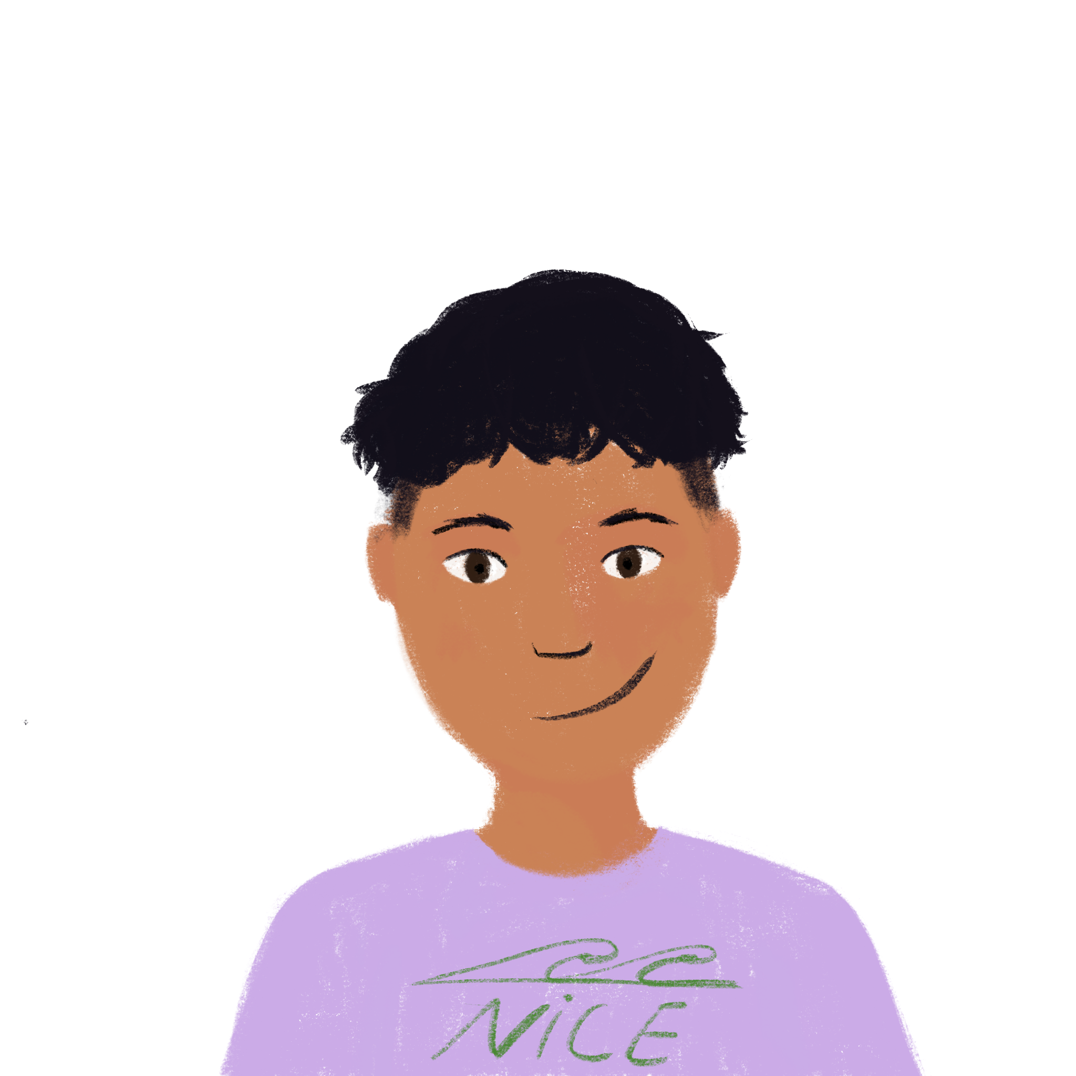
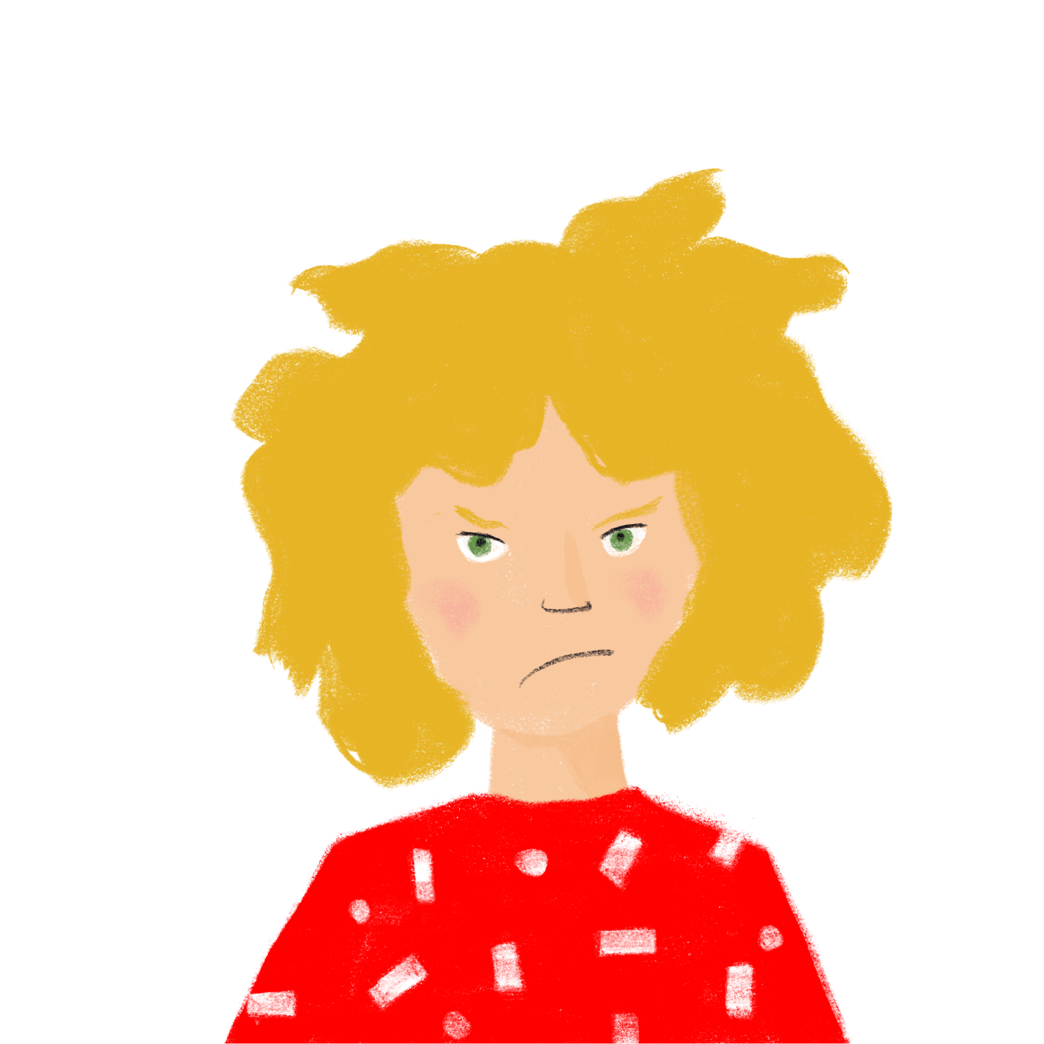
Deux semaines différentes
mince – pire – triste – difficile mauvaise – méchant – dangereux
lire
Amir a passé une semaine excellente !
Mais Léa a des problèmes à l’école.
Définis les mots en orange et remplis les blancs avec le contraire.
Salut Léa ! Je suis heureux aujourd’hui. Le professeur a donné les notes à la classe pour l’examen d’italien et j’ai réussi ! Océane a une bonne note aussi, mais ma note est meilleure ! Il est gentil, ce professeur ! On doit remplir les blancs dans cet examen, c’est facile. Je veux aller au lycée en Italie alors ! Bon, je dois sortir le chien – il devient gros. Je vais au parc puisque c’est un lieu* très sûr. Amir
Salut Amir, Je suis triste aujourd’hui. Le professeur a donné les notes à la classe pour l’examen d’allemand et je n’ai pas réussi ! Sophie a une mauvaise note aussi, mais ma note est pire ! Il est méchant, ce professeur ! Je ne sais pas remplir les blancs dans cet examen, c’est difficile. Bon, je dois nourrir le chat – il devient mince . Je ne vais pas au parc – c’est un peu dangereux. - Léa
[1]
[2]
[3]
[4]
* le lieu (m.)
= place
[5]
[6]
[7]
Notes:
Timing: 6 minutes
Aim: Written recognition of the adjectives in this week’s new vocabulary set. Items from the first of this week’s revisited sets (8.2.1.1) feature in the surrounding context.
Procedure:
1. Students read Amir’s message. Clarify understanding, especially of new words introduced this week.
2. Using the words in the box at the top of the screen, students complete Léa’s text by writing 1-7 and the opposite of the word in orange.
3. Answers revealed on clicks.
Word frequency of unknown words and cognates used (1 is the most frequent word in French): orange [3912], lieu [117]
Source: Londsale, D., & Le Bras, Y. (2009). A Frequency Dictionary of French: Core vocabulary for learners London: Routledge.

Slide 8
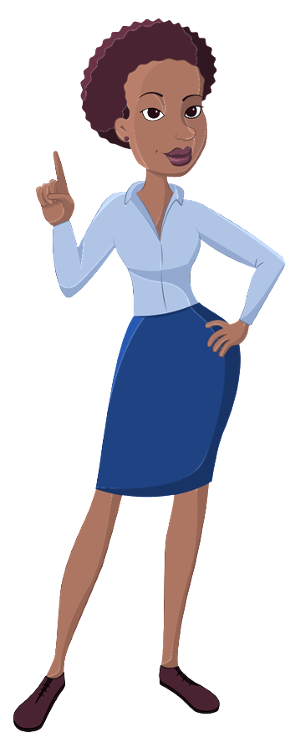
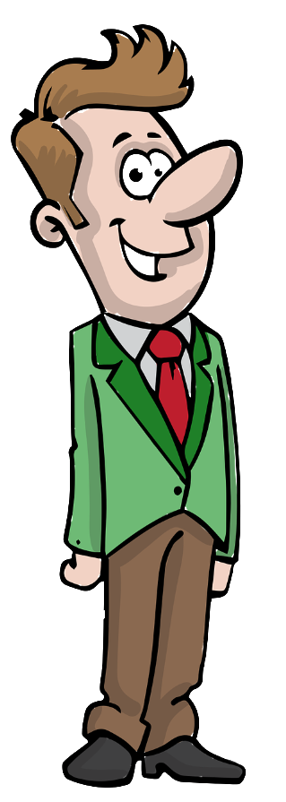
Emplois et adjectifs
C’est qui ?
écouter
Écoute. C’est quelle lettre?
kind
kind
fat
fat
Italian
Italian
Algerian
Algerian
3
A
B
4
C
1
D
good
good
dangerous
dangerous
1
2
3
4
5
E
2
F
G
5
H
Notes:
Timing: 3 minutes
Aim: Aural recognition of the masculine and feminine forms of nouns and adjectives in this week’s vocabulary set.
Procedure:
1. Go over the vocabulary, which students should have pre-learned. Click on a picture to hear the word pronounced by a native speaker. Students repeat. Pay close attention to the end of the words which show the gender.
2. Click on a number to hear a recording. Students listen and follow the pathway specified in each according to the masculine or feminine nouns mentioned.
3. The answers are animated and appear on clicks.
Transcript: 1. directrice, gentil, algérienne (answer: D)
2. directeur, grosse, bon (answer: F)
3. directrice, gentille, italienne (answer: A)
4. directrice, gentil, algérien (answer: C)
5. directeur, gros, dangereuse (answer: H)

Slide 9
C’est à vous !
C’est qui ?
écouter
Travaille avec un(e) partenaire.
Écoute et parle. C’est quelle lettre ?
kind
kind
fat
fat
Italian
Italian
Algerian
Algerian
A
B
C
D
good
good
dangerous
dangerous
E
F
G
H
Notes:
Timing: 3 minutes
Aim: To practise production (spoken modality) of the masculine and feminine forms presented on the previous slide.
Procedure:
Check students understand the task instructions. See if they can work out the idiomatic usage of à vous, meaning ‘your turn’.
Students take turns to narrate a pathway as for the previous listening exercise. Students can choose their pathways, or teachers can give out rolecards with letters on so that students do not ‘play it safe’/pick similar pathways each time!
Partners try to name the correct destination point.

Slide 10
La féminisation des adjectifs
grammaire
You already know various ways to make a masculine adjective feminine:
masculin féminin
1. add –e: sûr sûre
2. no change: mince mince
3 irregular forms: beau belle
4. change –eur to –euse travailleur travailleuse
5. change –eux to –euse heureux heureuse
Here is another rule:
6. Some short masculine adjectives ending in –n, –l or –s double the last letter before adding –e: italien italienne
gentil gentille
gros grosse
If the masculine form already ends in
–a or –e,
it does not change for the feminine!
You already know
bon (bonne), which is like this!
Notes:
Timing: 3 minutes
Aim: To revise ways of making a masculine adjective feminine using previously-met vocabulary and introduce the new rule.
NB: If a student asks for a definition of ‘short’, one or two syllables is a useful rule of thumb.

Slide 11
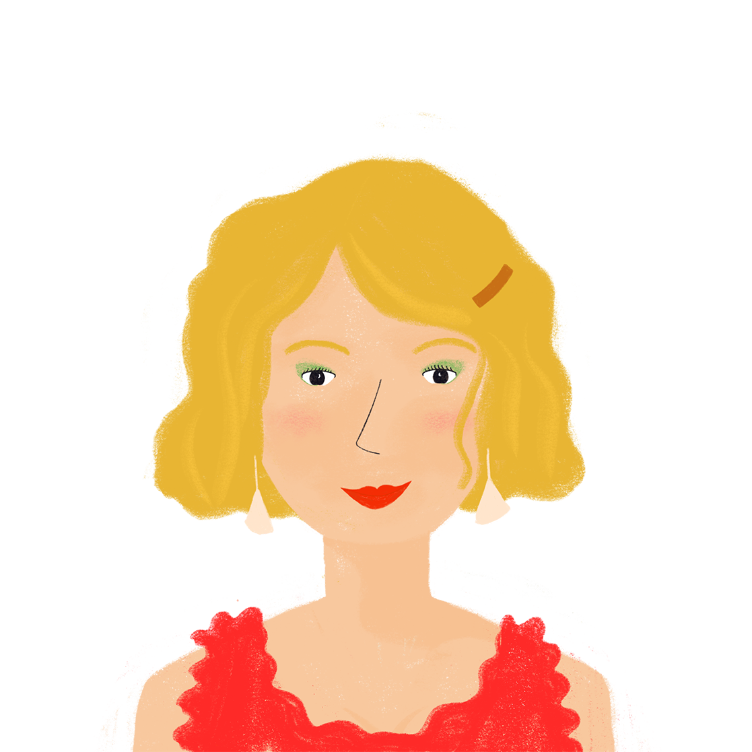
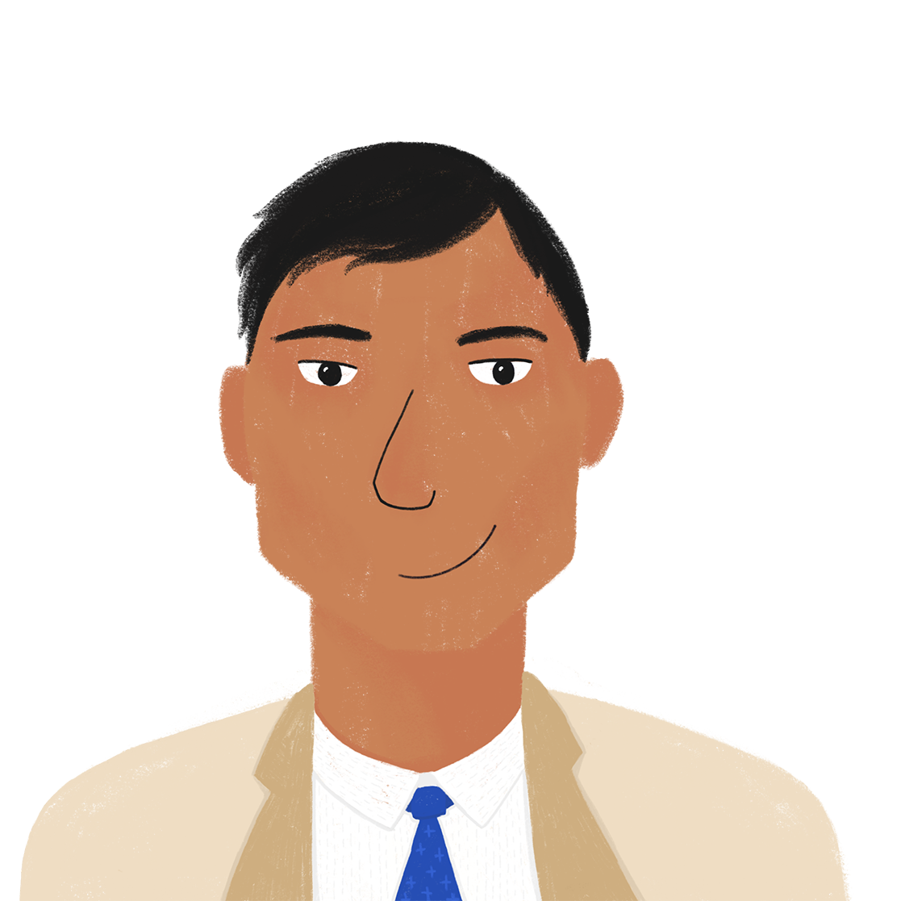
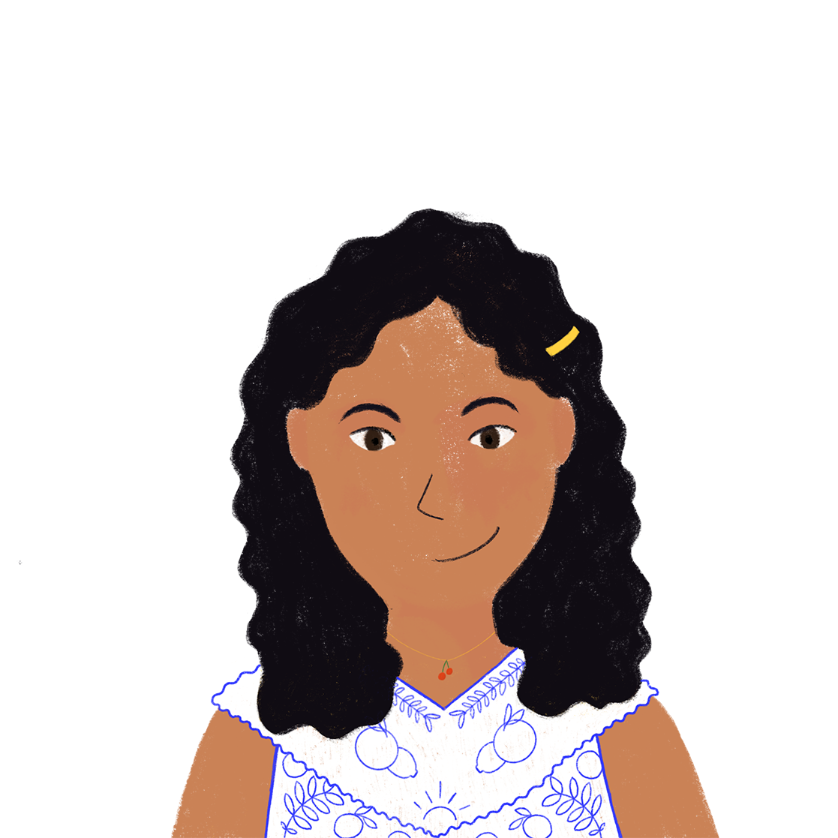
Au restaurant
*brûlé = burned
*la fourchette
= fork
lire
Amir va au restaurant avec sa famille. Ils parlent beaucoup ! Ils discutent de quoi ?
1. | D’abord, je prends _____ traditionnel. | un plat | une recette
2. | Puis, je veux _____ européen. | une soupe | un repas
3. | C’est _____ délicieuse par le grand chef ! | une recette | un menu
4. | Tu manges _____ français ? | un repas | une soupe
5. | Non, c’est _____ indienne. J’aime bien le goût. | un plat | une recette
6. | _____ est gentille et gère très bien le service. | la serveuse | le serveur
7. | La soupe a brûlé* ma langue! Je veux _____ italienne ! | une glace | un dessert
8. | Ce pigeon est délicieux. C’est __ gros _____ ! | un oiseau | une créature
9. | Noura, ne joue pas avec _____ . C’est dangereuse! | la fourchette* | le feu
10. | _____ est bon. On revient ici pour le réveillon de Noël ? | l'experience (f) | le restaurant
Notes:
Timing: 6 minutes
Aim: Written recognition of masculine and feminine adjective forms. Items from this week’s revisited vocabulary sets feature in the surrounding context.
Procedure:
1. Students read each sentence and choose the correct noun to fill the gap from the two options presented, according to the form of the adjective used.
2. Click to animate the answers.
Word frequency of unknown vocabulary introduced this week (1 is the most frequent word in French):
discuter [737], délicieux [>5000], pigeon [>5000], creature [4407], indien [1679], fourchette [>5000], européen [445], service [203], brûler [1930], soupe [4563], restaurant [2336], expérience [679], menu [3470], dessert [>5000]
Source: Londsale, D., & Le Bras, Y. (2009). A Frequency Dictionary of French: Core vocabulary for learners London: Routledge.

Slide 12
Au téléphone
écouter
 | un restaurant | une cafétéria
 | le serveur | la serveuse
 | la viande | un plat
 | le repas | la recette
 | un plat | une pizza
 | la cuisine | le fromage
 | un repas | une recette
 | une recette | un plat
Amir téléphone à Océane pour parler de son expérience. Que dit-il ?
1
2
3
4
5
6
7
8
Notes:
Timing: 5 minutes
Aim: Aural recognition of masculine and feminine adjective forms and connecting these with meaning.
Procedure:
1. Click on a number to hear the audio with the noun obscured.
2. Students listen to each sentence and choose the correct noun to replace the beep on the recording from the two options presented, using their knowledge of masculine and feminine adjective agreements to help them.
3. Click to animate the answers.
4. Listen to answers on next slide.
Transcript (the words in brackets are obscured):
1) Salut Océane ! Je suis dans [un restaurant] intéressant en ce moment.
2) [La serveuse] est gentille.
3) J’ai mangé [un plat] indien.
4) [Le repas] est bon, mais ...
5) Je veux manger [une pizza] italienne.
6) En général, je préfère [la cuisine] européenne.
7) Mais à la maison, nous mangeons [un repas] algérien chaque samedi.
8) Je dois dire que c’est [une recette] délicieuse.
Word frequency (1 is the most frequent word in French): expérience [679], pizza [>5000] indien [1679], européen [445]
Source: Londsale, D., & Le Bras, Y. (2009). A Frequency Dictionary of French: Core vocabulary for learners London: Routledge.

Slide 13
Amir parle à Océane
écouter
 | un restaurant | une cafétéria
 | le serveur | la serveuse
 | la viande | un plat
 | le repas | la recette
 | un plat | une pizza
 | la cuisine | le fromage
 | un repas | une recette
 | une recette | un plat
Amir téléphone à Océane pour parler de son expérience. Que dit-il ?
1
2
3
4
5
6
7
8
Notes:
Answers for the activity on the previous slide. Full audio, including nouns, plays on number clicks.
Transcript:
1) Salut Océane ! Je suis dans un restaurant intéressant en ce moment.
2) La serveuse est gentille.
3) J’ai mangé un plat indien.
4) Le repas est bon, mais ...
5) Je veux manger une pizza italienne.
6) En général, je préfère la cuisine européenne.
7) Mais à la maison, nous mangeons un repas algérien chaque samedi.
8) Je dois dire que c’est une recette délicieuse.
Word frequency (1 is the most frequent word in French): pizza [>5000] indien [1679]
Source: Londsale, D., & Le Bras, Y. (2009). A Frequency Dictionary of French: Core vocabulary for learners London: Routledge.

Slide 14
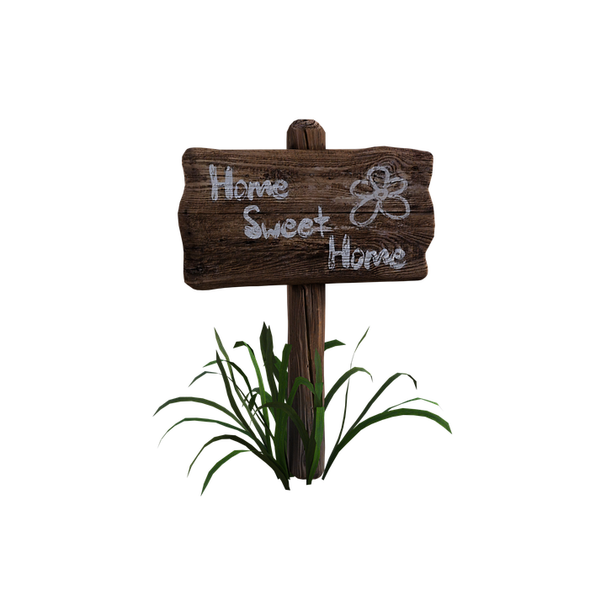
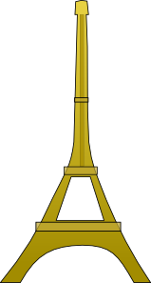
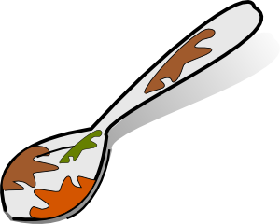
Les adjectifs au féminin
écrire
Quel est le masculin ?
1
2
3
innocent
________
_________
_________
culturel
chaleureux
innocente
culturelle
chaleureuse
[welcoming]
4
5
6
________
sale
gras
canadien
_______
_________
canadienne
sale
[dirty]
grasse
[fatty]
Notes:
Timing: 8 minutes for 2 slides
Aim: Written production of masculine and feminine forms of adjectives.
Procedure:
1. Students work ‘backwards’ from the masculine adjective shown on the screen.
2. Click to animate the answers.
3. Clarify the meanings of these unknown words.
3. Students close their books and repeat the activity orally, helping automisation of the process.
Word frequency of unknown vocabulary used (1 is the most frequent word in French):
innocent [2059] culturel [1495] sale [2906], gras [4018] chaleureux [4103] canadien [>5000]
Source: Londsale, D., & Le Bras, Y. (2009). A Frequency Dictionary of French: Core vocabulary for learners London: Routledge.

Slide 15
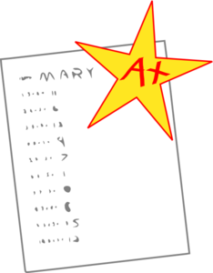
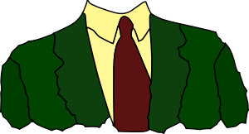
Les adjectifs au masculin
écrire
Quel est le féminin ?
7
8
9
gratuit
formel
merveilleux
gratuite
_________
________
formelle
merveilleuse
_________
10
11
12
aérien
individuel
unique
aérienne
________
individuelle
_________
_________
unique
Notes:
This is the continuation of the activity on the previous slide – this time students work from the masculine to the feminine form.
Word frequency of unknown vocabulary used (1 is the most frequent word in French):
merveilleux [2209] formel [2505] gratuit [2470] aérien [1675] individuel [1812] unique [409]
Source: Londsale, D., & Le Bras, Y. (2009). A Frequency Dictionary of French: Core vocabulary for learners London: Routledge.

Slide 16
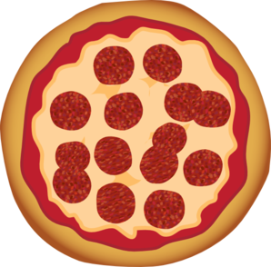
Nice et Paris
À Milan
écouter / parler
Partner A
J’ai mangé italienne.
?
un plat
une pizza
Partner B
J’ai choisi traditionnel.
?
un repas
une recette
Notes:
Timing: 8 minutes for 5 slides
Aim: Oral production of adjectives in the masculine and feminine forms.
Procedure:
1. Print the student rolecards on slide 23.
2. Use this slide to model the task with students. Partner A says the beginning and end of the sentence. Partner B completes the sentence with the noun that matches the adjective they hear. Students then swap roles for the second example.
3. Distribute rolecards to students. Make it clear that students will not see their partner’s sentences, so they need to listen carefully.
Students now work in their pairs, one reading the start and end of each sentence on their sheet, the other selecting the appropriate noun from their sheet to complete it, based upon the gender of the adjective they hear.
4. Use slides 19-22 to reveal the answers.

Slide 17
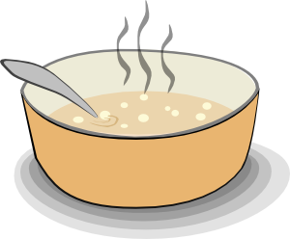
Nice [Réponses]
Partner B (réponses)
écouter / parler
1
J’ai mangé algérien.
?
un plat
une soupe
2
Je veux traditionnelle.
?
une pizza
un repas
Notes:
DO NOT DISPLAY. These slides should not be displayed during the exercise, but are animated to reveal the correct answers.
Home learning – the audio for each complete French sentence is accessible upon clicking the button.
Transcript
1. J’ai mangé un plat algérien.
2. Je veux une pizza traditionnelle.
Word frequency of unknown cognates used (1 is the most frequent word in French):
soupe [4563]
Source: Londsale, D., & Le Bras, Y. (2009). A Frequency Dictionary of French: Core vocabulary for learners London: Routledge.

Slide 18
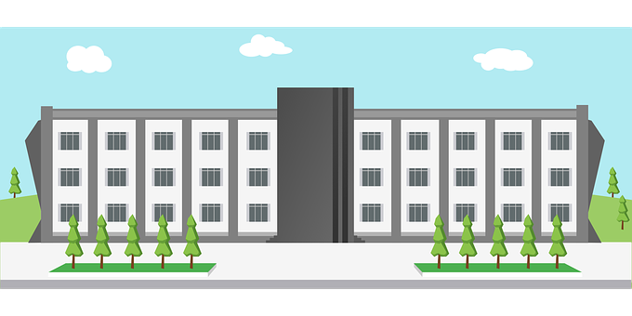
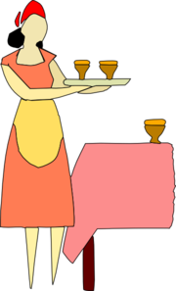
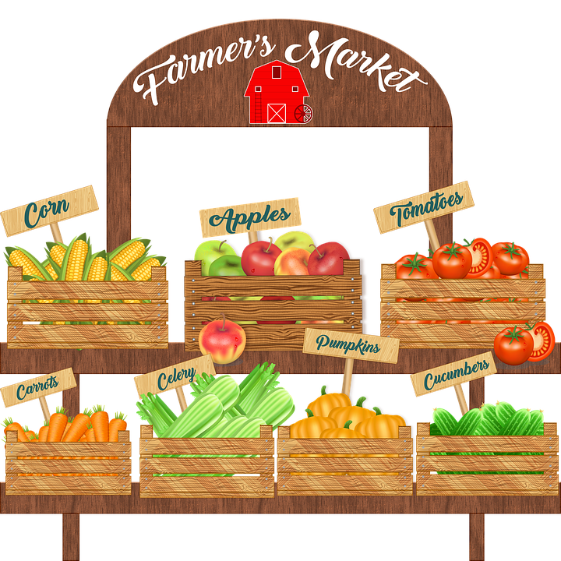
Nice [cont’d]
écouter / parler
Partner B (réponses)
3
Il y a intéressant.
?
un restaurant
une lycée
4
est algérienne.
?
la serveuse
le marché
Notes:
Transcript
3. Il y a un restaurant intéressant.
4. La serveuse est algérienne.

Slide 19
Paris [Réponses]
Partner A (réponses)
écouter / parler
5
Je veux français.
?
un plat
une recette
6
C’est algérien.
?
le restaurant
la viande
Notes:
Transcript
5. Je veux un plat français.
6. C’est le restaurant algérien.

Slide 20
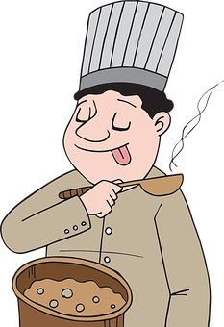
Paris [cont’d]
écouter / parler
Partner A (réponses)
7
Il y a gentil.
?
un serveur
une serveuse
8
est très bonne.
?
le goût
la cuisine
Notes:
Transcript
7. Il y a un serveur gentil.
8. La cuisine est très bonne.

Slide 21
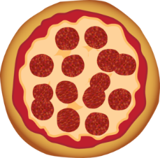
Paris [cont’d]
En vacances en Italie
PARTNER A
Say these sentences to your partner. Don’t say the noun in brackets. | Listen to your partner’s sentence and say the missing noun.
1. J’ai mangé [un plat] algérien. | 5.
2. Je veux [une pizza] traditionnelle. | 6.
3. Il y a [un restaurant] intéressant. | 7.
4. [La serveuse] est très bonne. | 8.
PARTNER B
Listen to your partner’s sentence and say the missing noun. | Say these sentences to your partner. Don’t say the noun in brackets.
1. | 5. Je veux [un plat] français.
2. | 6. C’est [le restaurant] algérien.
3. | 7. Il y a [un serveur] gentil.
4. | 8. [La cuisine] est très bonne.
un plat
une recette
un plat
une soupe
le restaurant
la viande
une pizza
un repas
un serveur
une serveuse
un restaurant
une lycée
le goût
la cuisine
la serveuse
le marché
Notes:
Printable rolecards for the activity on slides 18-22.

Slide 22
What is it like? [4] Comparing things
adjectives: comparative forms and structures (plus…que, moins…que, aussi…que)
SSC [on] and [om] before a vowel
Y8 French
Term 3.1 - Week 1 - Lesson 50
Natalie Finlayson / Stephen Owen
Artwork by: Chloé Motard
Date updated: 04/10/21
Notes:
Artwork by Chloé Motard. All additional pictures selected are available under a Creative Commons license, no attribution required.
Native teacher feedback provided by Sarah Brichory.
Learning outcomes (lesson 2):
Introduction of comparative forms of adjectives
Introduction of comparative structures with adjectives (plus…que, moins…que, aussi…que)
Introduction of SSC [om] and [on] before a vowel
Word frequency (1 is the most frequent word in French):
8.3.1.1 (introduce) plus [19], moins [62], aussi² [44], que³ [9], dangereux [713], gentil, gentille [2832], gros [419], grosse [419], italien, italienne [1474], meilleur [194], mince [3570], pire [743], sûr [270], Italie
8.2.2.1 (revisit) choisir [226], définir [916], remplir [751], réussir [279], blanc² [701], cahier [4001], examen [1448], lycée [2816], note [1161], alors [81]
8.1.2.5 (revisit) gérer [1354], espace [870], goût [1829], langue², [712], plat [2167], recette [1709], repas [2948] d'abord [326], puis [230], par [21], puisque [528], Noël [>5000], réveillon [>5000]
Source: Londsale, D., & Le Bras, Y. (2009). A Frequency Dictionary of French: Core vocabulary for learners London: Routledge.
The frequency rankings for words that occur in this PowerPoint which have been previously introduced in NCELP resources are given in the NCELP SOW and in the resources that first introduced and formally re-visited those words.
For any other words that occur incidentally in this PowerPoint, frequency rankings will be provided in the notes field wherever possible.

Slide 23
[om], [on]
écouter / écrire
Normally, SSCs [om] and [on] are nasal vowels.
However, [om] and [on] sound different before a vowel.
Can you think of any examples in words you already know?
before a consonant: before a vowel:
montrer national
contre une promenade
le monde fromage
comprendre le roman
(to show)
These sounds are nasal vowels [om], [on].
(national)
These sounds are oral vowels open [o] and closed [o] + m / n.
(against)
(a walk)
(world)
(cheese)
(to understand)
(novel)
Notes:
Timing: 2 minutes
Aim: revising the spelling rules governing pronunciation changes in SSCs which are normally nasal vowels, and applying these to [om] and [on].
Procedure: 1. Cycle through the information on the slide using the animation sequence.

Slide 24
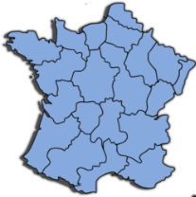
Phonétique
parler
économique
[economic]
contre
monde
[against]
formation
[course]
concentrer
nombreux
[plentiful]
comité
domaine
région
[committee]
[field/domain]
monter
promettre
[to go up]
omission
[to promise]
disponible
[oversight]
[available]
moment
dont
long
[of which]
Notes:
Timing: 5 minutes
Aim: applying awareness of the pronunciation rules governing SSCs [om], [on], and long and short [o] to the production of words containing these letter combinations.
Procedure:
1. Student read the words and decide based on the presence or absence of a vowel after letter ‘m’ or ‘n’ whether a nasal is needed or not.
2. Click to check.
3. Now, students are challenged to pronounce the words correctly. Students should work in pairs and monitor each other for this.
4. Students try to say the words out loud. Teacher corrects.
5. Click the words to hear pronunciation.
Word frequency (1 is the most frequent word in French): disponible [1205] domaine [539] comité [651] promettre [854] omission [>5000] moment [148] économique [261] concentrer [856] nombreux [366] monter [853] formation [831] dont [74] monde [77] contre [121] long [202] région [241]
Source: Londsale, D., & Le Bras, Y. (2009). A Frequency Dictionary of French: Core vocabulary for learners London: Routledge.

Slide 25
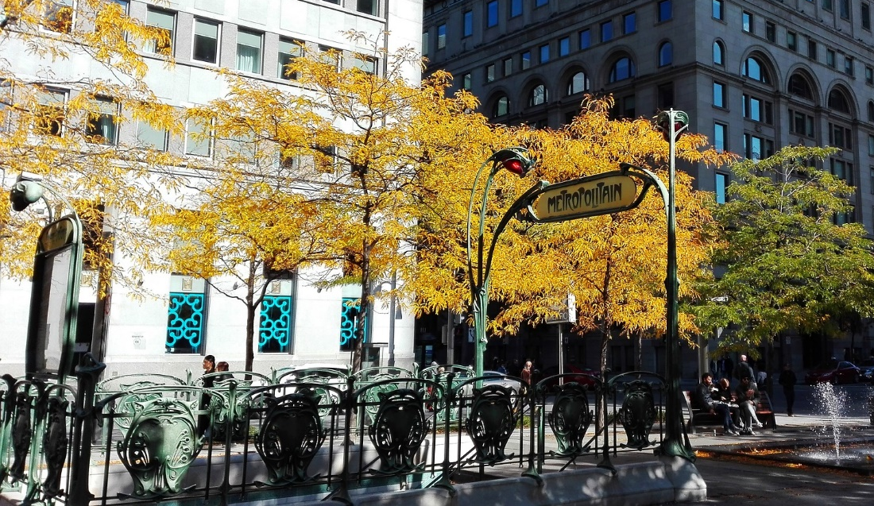
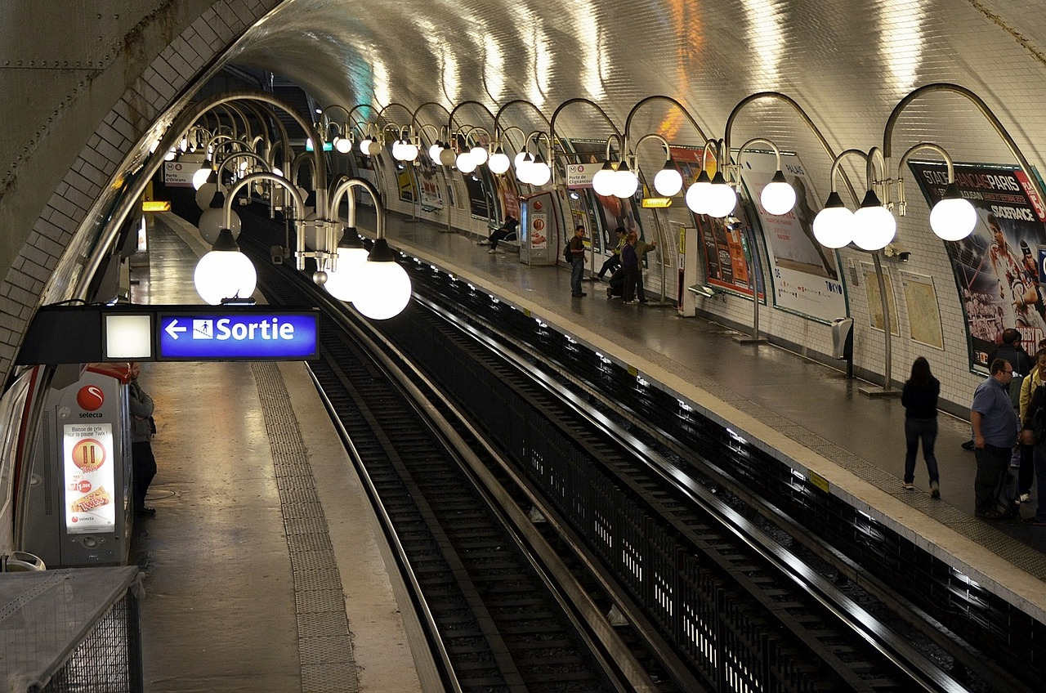
Phonétique
lire / parler
À Paris on peut prendre le métro pour vite se déplacer*.
Le métro est un train souterrain**.
* to get around
** underground
Notes:
Timing: 1 minute
Aim: To introduce students to the context of the phonics activity which follows.
Procedure:
1. Ask student to read the slide.
2. Ensure understanding by taking feedback.
Word frequency of unknown words used (1 is the most frequent word in French): se déplacer [714]; souterrain [4544]
Source: Londsale, D., & Le Bras, Y. (2009). A Frequency Dictionary of French: Core vocabulary for learners London: Routledge.
Word frequency of cognates used (1 is the most frequent word in French): métro [3227]
Source: Londsale, D., & Le Bras, Y. (2009). A Frequency Dictionary of French: Core vocabulary for learners London: Routledge.

Slide 26
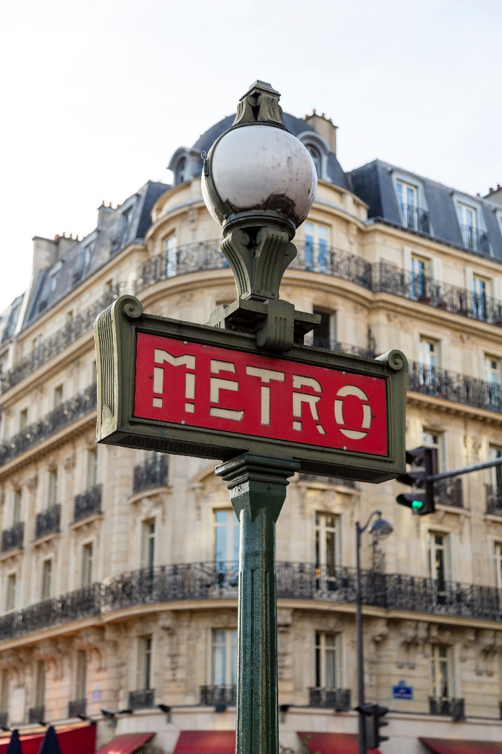
Phonétique
A→Z
Z→A
lire / parler
Des stations de métro à Paris.
Europe
Église d’Auteuil
Marie de Montreuil
Porte d’Auteuil
Pasteur
Pont-Neuf
Richelieu-Drouot
Notes:
Timing: 3 minutes
Aim: spoken practice of SSCs [eu] and [-euil/euill].
Procedure:
1. Partners take it in turns to say the station names in alphabetical order (A-Z). Partner A starts.
2. Partners take it in turns to say the station names in reverse alphabetical order (Z-A). Partner B starts.
3. Partners repeat to improve fluency of production.
4. Circulate to listen in to students’ pronunciation.

Slide 27
En français ? A
Trouve le contraire ! (A)
parler / écrire
best
1
3
safe (m)
fat (m)
5
dangerous (f)
2
more
fat (f)
4
6
Notes:
Timing: 6 minutes for 4 slides
Aim: Written recall of words in this week’s vocabulary set. Strengthening semantic connections between vocabulary items by recalling words with the opposite meaning.
Procedure:
1. Students work together to build a bilingual bridge! Student A faces the board, student B sketches the grid and turns away.
2. On clicks, English words appear one by one. Student A says the number followed by the word in French.
3. Student B writes the word with the opposite meaning in the yellow shape to the right (in the same form m/f as the word they hear).
4. When all boxes are complete, student B turns around and on the next slide the answers are revealed so they can see how successful they were!
5. Bring up slide 30. Students swap roles. repeat.
Word frequency (1 is the most frequent word in French):
contraire (619)
Source: Londsale, D., & Le Bras, Y. (2009). A Frequency Dictionary of French: Core vocabulary for learners London: Routledge.

Slide 28
En français ? A
Réponses (A)
parler / écrire
better meilleur(e)
1
3
safe (m)
fat (m)
5
pire
mince
dangereux
gros
sûr
dangerous (f)
2
more
fat (f)
4
6
sûre
moins
mince
plus
grosse
dangereuse
Notes:
This slide provides the answers to the activity on the previous slide.

Slide 29
En français ? A
Trouve le contraire ! (B)
parler / écrire
safe (f)
1
3
less
dangerous (m)
5
thin (m)
2
thin (f)
worst
4
6

Slide 30
En français ? A
Réponses (B)
parler / écrire
safe (f)
1
3
less
dangerous (m)
5
sûre
dangereuse
sûr
plus
dangereux
moins
thin (m)
2
thin (f)
worse
4
6
mince
gros
grosse
meilleur
mince
pire

Slide 31
Comparative adjectives
grammaire
To compare two people or things in French, we say one is more or less ‘something’ than another. In English, we do this by adding –er to the adjective. We cannot do this in French!
Ce cahier est grand. This exercise book is big.
Ce cahier est plus grand. This exercise book is bigger. [literally: more big]
Ce cahier est moins grand. This exercise book is less big.
How could we express the same idea in another way?
→ Ce cahier est plus petit. This exercise book is smaller. [literally: more small]
Bon and mauvais have special forms:
Ma note est bonne. My mark is good.
Ta note est meilleure. Your mark is better.
Ma note est mauvaise. My mark is bad.
Ta note est pire. Your mark is worse.
This is like English! Good and bad have special comparative forms, too.
Notes:
Timing: 3 minutes
Aim: To introduce the concept and form of comparative adjectives and draw cross-linguistic comparisons with English.
Word frequency of cognates used (1 is the most frequent word in French):
village [1295]
Source: Londsale, D., & Le Bras, Y. (2009). A Frequency Dictionary of French: Core vocabulary for learners London: Routledge.

Slide 32
Comparing adjectives
grammaire
To compare one person or thing with another, we use que (than):
La ville est plus grande que le village. The town is bigger than the village.
Le village est moins grand que la ville. The village is less big than the town.
We can also use aussi (as) with que to say one person or thing is as ‘something’ as another:
Le village est aussi grand que la ville. The village is as big as the town.
So, the three ways to compare two things/people are:
plus ... que more ... than
moins ... que less ... than
aussi ... que as ... as
Notes:
Timing: 2 minutes
Aim: To introduce use of comparative adjectives with plus/moins/aussi que.

Slide 33
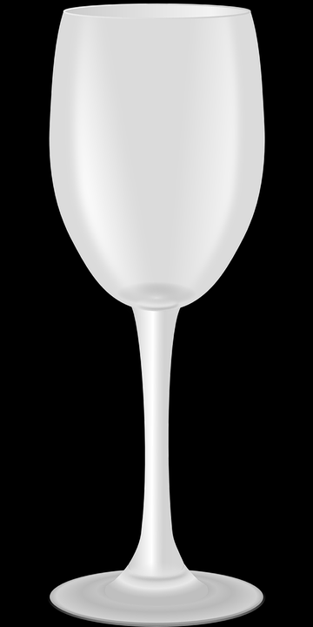
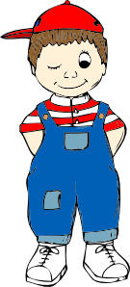
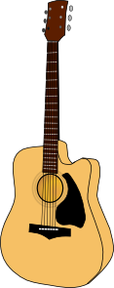
Un puzzle !
* l’indice (m.)
= clue
écouter
Les images ne sont pas en ordre ! Écoute les indices* pour trouver l’ordre correct.
C
E
F
A
D
B
< moins grand------------------------------------------------ plus grand >
1
2
3
Notes:
Timing: 3 minutes
Aim: Aural comprehension of comparative sentences.
Procedure:
1. Ensure students understand that the task is to put the images in order according to the scale shown (smallest to largest). Explain that the pictures are not to scale, and that they will not be able to rely on assumptions of size to complete the task!
2. Students listen to the description and decide upon the order.
3. The answer is revealed upon the next slide.
Transcript:
1. L’enfant est moins grand que le chat, mais plus grand que le chien.
2. La guitare est plus grande que l’enfant, mais plus petite que le chat.
3. Le verre est plus petit que le chien, mais plus grand que le poisson.
Word frequency of cognates and unknown vocabulary used (1 is the most frequent word in French):
puzzle [>5000], indice [2138], ordre [197], image [659], correct [2617]
Source: Londsale, D., & Le Bras, Y. (2009). A Frequency Dictionary of French: Core vocabulary for learners London: Routledge.

Slide 34
Un puzzle ! (solution)
* l’indice (m.)
= clue
écouter
Les images ne sont pas en ordre ! Écoute les indices* pour trouver l’ordre correct.
C
F
A
E
D
B
< moins grand------------------------------------------------ plus grand >
Notes:
This is the solution to the activity on the previous slide.

Slide 35
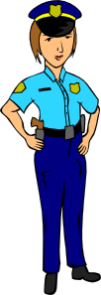
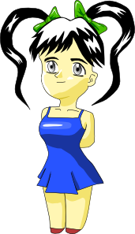
Complète la phrase comparative !
Où est plus/aussi/moins ?
Où est que ?
parler 1/8
lire
2
A
Elle est plus grande que l’enfant.
1
3
B
Il est aussi gros que son frère.
4
Elle est moins petite que le médecin.
C
5
6
Notes:
Timing: 4 minutes
Aim: Noticing the position of the elements of a comparative adjective construction.
Procedure:
1. Students write down A-F, with the numbered items for each. A1 = , A2 =.
2. Using the picture prompts, they then decide, for each statement, which word will be under each numbered ‘splodge’. Draw attention to the fact that the elements of the comparative structure surround the adjective.
3. Answers: ‘splodges’ disappear one by one on clicks. Teachers can elicit the answers from students in French, asking ‘A1, c’est quoi?’
4. The task continues on the next slide.

Slide 36
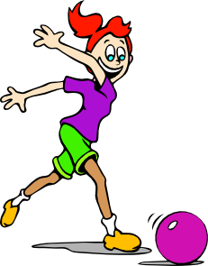
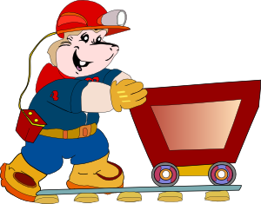
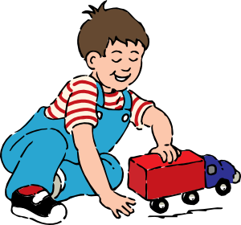
Complète la phrase comparative !
Où est plus/aussi/moins ?
Où est que ?
parler 1/8
lire
2
Il est plus sympa que son frère.
D
1
4
E
Elle est moins active que son amie.
3
F
Il est plus travailleur que l’enfant.
5
6
Notes:
This is the continuation of the activity on the previous slide.
Word frequency of cognates used (1 is the most frequent word in French):
actif [1219]
Source: Londsale, D., & Le Bras, Y. (2009). A Frequency Dictionary of French: Core vocabulary for learners London: Routledge.

Slide 37
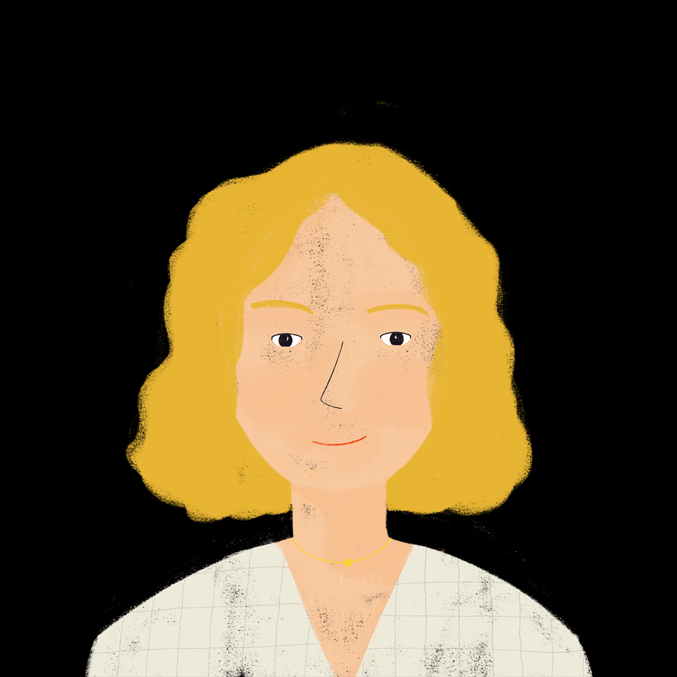
Ne … pas ou _ ?
parler 1/8
lire
C’est une comparaison ?
Aurélie parle de sa maison et de sa famille.
Lis et décide le reste de la phrase. Choisis ‘1’ ou ‘2’.
Le chat est aussi grand… | …et mince. | …qu’un chien.
Amir est aussi grand... | …et intelligent. | …que Léa.
La table est chère… | …que l’ordinateur. | …, mais belle.
Les livres sont aussi vieux… | …que l’appartement. | …et intéressants.
Bilal est aussi gentil... | …qu’Abdel | …comme son père.
Noura est intelligente… | …comme sa professeure. | …qu’Amir.
Le piano est nouveau … | …que le guitare. | …et sympa.
Les fenêtres sont minces … | …et blanches. | … que les portes.
A
1
2
B
1
2
C
1
2
D
1
2
E
1
2
F
1
2
G
1
2
H
1
2
Notes:
Timing: 8 minutes
Aim: Written recognition of comparative structures.
Procedure
1. Students consider the beginning of each statement (A-F) and consider whether a comparative adjective structure is indicated, choosing the appropriate ending (with or without que) accordingly. NB: To clearly illustrate the grammar point, only structures with aussi…que are included in this activity as structures with plus…que and moins…que could take either ending (as exemplified on the next slide). Before beginning the task, remind students of placement rules for aussi with its first meaning ‘also’ (at the end of a sentence/clause) as this information is crucial in completing the task correctly.
2. The answers are isolated in order upon successive clicks of the mouse.
Word frequency of cognates and unknown vocabulary used (1 is the most frequent word in French):
comparaison [2244]
Source: Londsale, D., & Le Bras, Y. (2009). A Frequency Dictionary of French: Core vocabulary for learners London: Routledge.

Slide 38
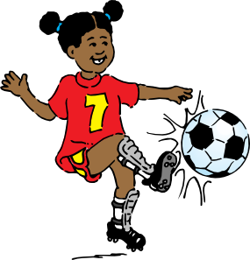
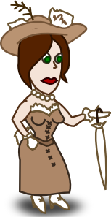
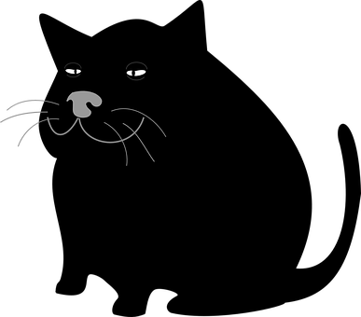
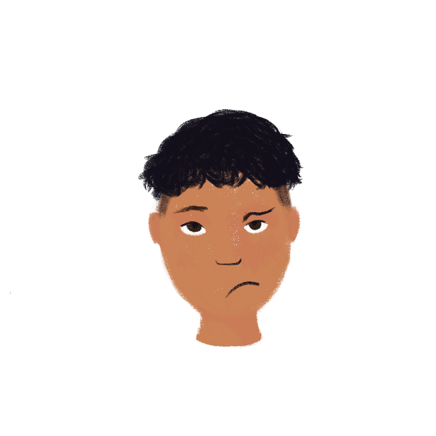
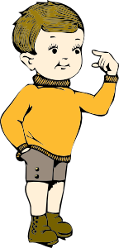
C’est vrai?
écrire
Ils sont comment ?
Réponses:
Écris une description comparative.
1
4
Sarah – grande – Lisa
Zoë – rapide – Carine
Sarah est plus grande que Lisa.
Zoë est moins rapide que Carine.
2
5
Patrick – gros – Pierre
Sophie – jeune – Isabelle
Patrick est aussi gros que Pierre.
Sophie est plus jeune qu’Isabelle.
3
6
Paul – petit – Thomas
Abdel – content – Amir
Paul est moins petit que Thomas.
Abdel est plus content qu’Amir.
Notes:
Timing: 7 minutes
Aim: Written production of comparative sentences.
Suggested procedure
1. Students use the words given in the box, together with a consideration of the pictures, to write an appropriate comparative sentence in each case.
[N.B. the pictures are meant to go with the names with which they are aligned.] The sentences should start with the name of the person on the left in each case.
2. Suggested answers appear one by one upon successive clicks of the mouse.
Word frequency of cognates and unknown vocabulary used (1 is the most frequent word in French):
description [2779], comparatif [>5000]
Source: Londsale, D., & Le Bras, Y. (2009). A Frequency Dictionary of French: Core vocabulary for learners London: Routledge.

Slide 39
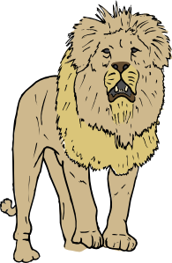
C’est qui ?
parler
Exemple:
A: C’est plus grand que le chien ?
B: Oui, c’est plus grand.
A: C’est plus rapide que la vache?
B: Oui, c’est plus rapide.
A: C’est plus dangereux que la girafe ?
B: Oui, c’est plus dangereux.
le lion
A: C’est le guépard ?
B: Non, c’est le lion !
Notes:
Timing: 6 minutes
Aim: Oral production of questions using comparative adjectives. The slide following this one should be displayed during the activity.
Procedure:
1. Go through the pronunciation of each animal on the following slide before pairwork begins. Students try to say the names of the animals using their SSC knowledge. Teacher demonstrates, students repeat. Ensure student understanding of guépard (a cheetah, rather than a leopard).
2. Student B selects an animal, without revealing which one.
3. Student A asks questions such as those shown in the examples on this slide, and using the previously-met adjectives displayed at the bottom of the following slide: rapide – grand – haut – gros – dangereux – intelligent – petit - calme. By asking questions about whether the animal is more/less quick, dangerous, intelligent, etc., than another, Student A can try to home in on the identity of the chosen animal.
4. Student B responds to each question.
5. Students must ask three questions, before making a guess, at which point their partner reveals the correct answer.
6. Students swap roles and play again.
Word frequency (1 is the most frequent word in French):
girafe [>5000] guépard [>5000] lion [>5000] vache [2768]
Source: Londsale, D., & Le Bras, Y. (2009). A Frequency Dictionary of French: Core vocabulary for learners London: Routledge.

Slide 40
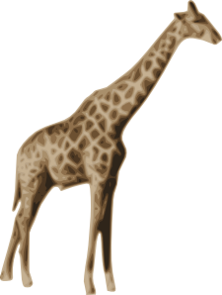
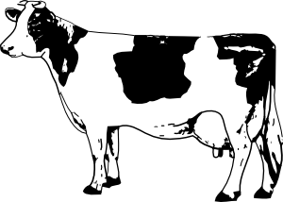
le lion
la baleine
le dauphin
le guépard
le chien
le chat
la girafe
l’éléphant
le gorille
le hamster
la vache
le poisson
rapide – grand – haut – gros – dangereux – intelligent – petit - calme
Notes:
Display this slide during the activity.
Word frequency (1 is the most frequent word in French):
baleine [>5000] dauphin [>5000] éléphant [>5000] gorille [>5000] hamster [>5000] poisson [1616] girafe [>5000] guépard [>5000] lion [>5000] vache [2768]
Source: Londsale, D., & Le Bras, Y. (2009). A Frequency Dictionary of French: Core vocabulary for learners London: Routledge.

Slide 41
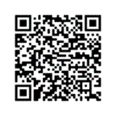
Devoirs
Vocabulary Learning Homework (Y8, Term 3.1, Week 2)
Quizlet link: Y8 Term 3.1 Week 2
Quizlet QR code:
In addition, revisit: Y8 Term 2.2 Week 2
Y8 Term 1.2 Week 6
Notes:
The answer sheet for the Y8, Term 3.1, Week 2 vocabulary learning HW is here: https://resources.ncelp.org/concern/resources/2j62s565w?locale=en

