Slide 1
Vocabulary
Y7 German
Term 1.2 - Week 7
Author name(s): Inge Alferink / Rachel Hawkes
Date updated: 10/12/2019

Slide 2
bekommen
[to get / receive | getting / receiving]
bekommt
[gets / receives | is getting / receiving]
Notes:
Students should know the meaning of this verb already, as it was set as (audio and quizlet) homework. It is re-presented here in the infinitive and short form to deepen students’ knowledge and model the use of both forms in sentences.
Introducing the verb [bekommen] more explicitly. Both long form (infinitive) and short form (3rd person singular) are introduced in order to familiarise students with various forms of the same verb.
Bring up the word [bekommen] on its own, say it, students repeat it, and remind them of the phonics. Draw attention to [the short o sound]
Try to elicit the meaning from the students.
Bring up the picture, and, if using gestures, a possible gesture would be to put your hands together, palms facing up, and open and close like a book.,
Then bring up the English translations. Emphasise the two meanings for the infinitive.
Bring up the short form [bekommt], say it, students repeat it. .
Try to elicit the meaning from the students. Emphasise the two meanings for the short form.
NB: note the false friend potential as bekommt is not becomes.
Note: Students have had explicit teaching that the present tense in German communicates two different present tense meanings in English. This reinforces that learning. Emphasise the two meanings for the short form, reminding students that German only has one form and does not have a direct equivalent of the grammar for ‘is + ing’, the continuous form (as covered in previous weeks).

Slide 3
bekommen
[to get /receive | getting / receiving]
bekommt
[gets / receives | is getting / receiving]
Notes:
Cycle through the long and short form again.

Slide 4
bekommt
[gets / receives | is getting / receiving]
Die Frau bekommt ein Buch.
[The woman gets | is getting a book.]
Notes:
Introduce the short form in a sentence.

Slide 5
bekommen
[to get / receive | getting / receiving]
Die Frau kann ein Buch bekommen.
[The woman can get a book.]
Notes:
Introduce the long form in a sentence.

Slide 6
bekommt
[gets / receives | is getting/ receiving]
bekommt
Die Frau _________ ein Buch.
[The woman gets | is getting a book.]
Notes:
Cycle through the short form in context again.

Slide 7
bekommen
[to read | reading]
bekommen
Die Frau kann ein Buch ___________.
[The woman can get a book.]
Notes:
Cycle through the long form in context again.

Slide 8
Vokabeln
schön
Notes:
The vocab has been pre-learnt, so the pictures appear first, to elicit responses, if known, using standard ‘Was ist das?’ prompt. The text appears on the 2nd click, and can be practised by all, as necessary.
schön [164]

Slide 9
Vokabeln
früh
05:30!!!
Notes:
früh [322]

Slide 10
Vokabeln
spät
Notes:
spät [171]

Slide 11
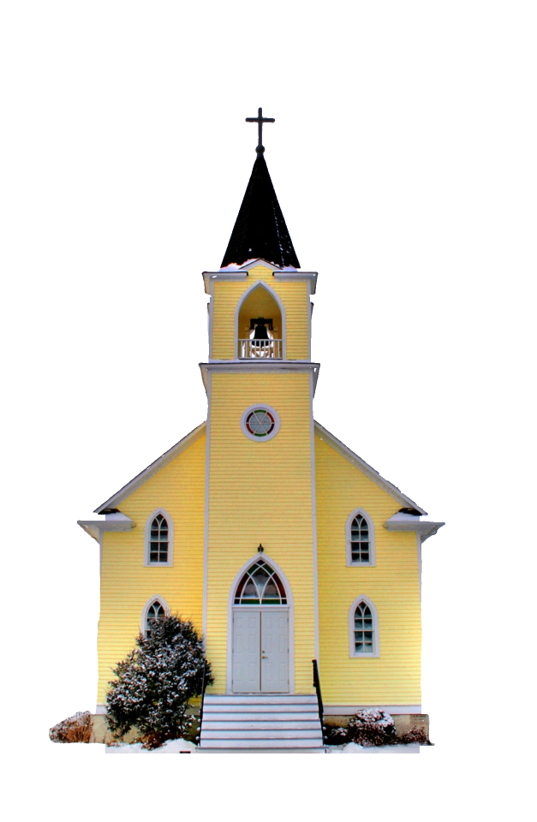
Vokabeln
die _______
die Kirche
Notes:
3] Grammar practice
Some examples of feminine nouns
Introduce the word.
Ask students to supply the plural using the rules they have just learnt.
Note: Kirche / Idee / Woche / Familie are on the vocabulary list for this week. The other words are broadly Christmas-themed words or other HF words from the phonics clusters that we are not expecting students to learn, at this time. However, depending on the level of the class, it might work well to do this activity as a written activity, relying on students’ working memory from having briefly seen the singular written form. If done like this the activity would have the following instructions:
1. Schreib 1-9. 2. die Singularform ansehen (support this instruction with a gesture of ‘looking’ as you model this first one, die Kirche) 3. Dann die Pluralform schreiben. 4. OK. Nummer zwei….
Kirche / Kirchen [519] Familie / Familien [310]
Idee / Ideen [641]
Woche / Wochen [209]
Liste / Listen [1975]
Million / Millionen [206]
Kerze / Kerzen [3985]
Glocke / Glocken [>5000]
Kugel / Kugeln [3618]

Slide 12
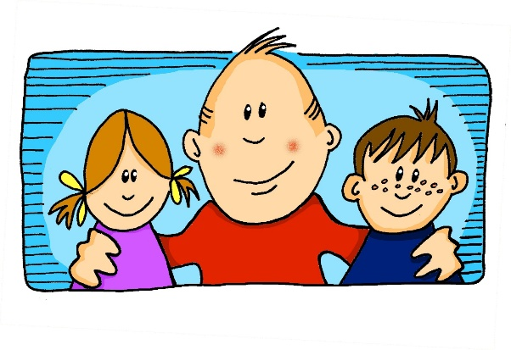
Vokabeln
die Familie
die _______

Slide 13
Vokabeln
die Idee
die _______

Slide 14
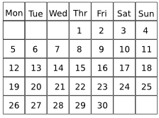
Vokabeln
X
X
X
die Woche
die _______

Slide 15
Vokabeln
_________
_________
_________
_________
_________
_________
_________
_________
_________
_________
_________
_________
_________
_________
_________
_________
_________
_________
die _______
die Liste

Slide 16
Vokabeln
die Million
die _______

Slide 17
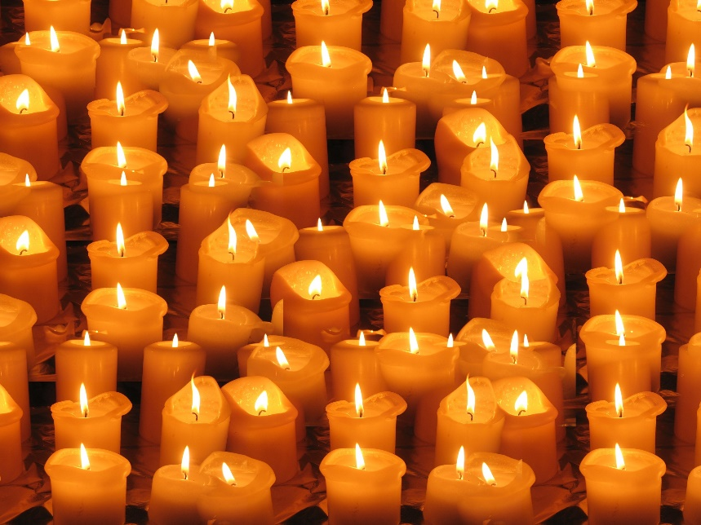
Vokabeln
die _______
die Kerze

Slide 18
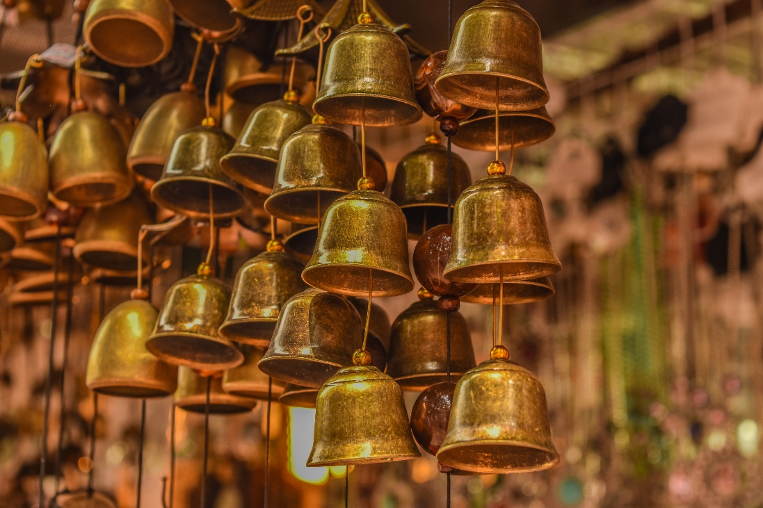
Vokabeln
die Glocke
die _______

Slide 19
Vokabeln
die _______
die Kugel

Slide 20
Vokabeln
Antworten
die _______
die Kirchen
Notes:
Antworten
Was ist die Antwort? (Die Antwort is in the vocab revisit list, elicit the meaning from students). Note: If students have done the suggested written version of the activity, then the oral feedback provides an opportunity for them to read aloud their own answers. As a few of these words have not been previously taught, this provides practice in applying SSC knowledge. Teachers can listen out for the ‘z’ in Kerzen, and the ‘u’ in Kugeln, in particular.
Kirche / Kirchen [519] Familie / Familien [310]
Idee / Ideen [641]
Woche / Wochen [209]
Liste / Listen [1975]
Million / Millionen [206]
Kerze / Kerzen [3985]
Glocke / Glocken [>5000]
Kugel / Kugeln [3618]

Slide 21
Vokabeln
die _______
die Familien

Slide 22
Vokabeln
die Ideen
die _______

Slide 23
Vokabeln
X
X
X
die Wochen
die _______

Slide 24
Vokabeln
_________
_________
_________
_________
_________
_________
_________
_________
_________
_________
_________
_________
die Listen
die _______

Slide 25
Vokabeln
die _______
die Millionen

Slide 26
Vokabeln
die Kerzen
die _______

Slide 27
Vokabeln
die Glocken
die _______

Slide 28
Vokabeln
die _______
die Kugeln

Slide 29
Antworten
Welt
Wort
Freunde
Fußball
Haus
1
VIELE
Lehrer
Lehrer
Haustiere
Familie
Ideen
Notes:
Revising vocabulary with a focus on plural forms. The articles have been left out to focus on the noun form.
Word appears and students say whether it is 1 oder viele (singular or plural).
Click to see the answer
NB: Lehrer could be singular or plural. Without the article we don’t know.
die Antwort / die Antworten
der Lehrer / die Lehrer
der Fußball / die Fußbälle
der Freund / die Freunde
das Haustier / die Haustiere
die Welt / die Welten
das Wort / die Wörter
das Haus / die Häuser
die Familie / die Familien
die Idee / die Ideen

Slide 30
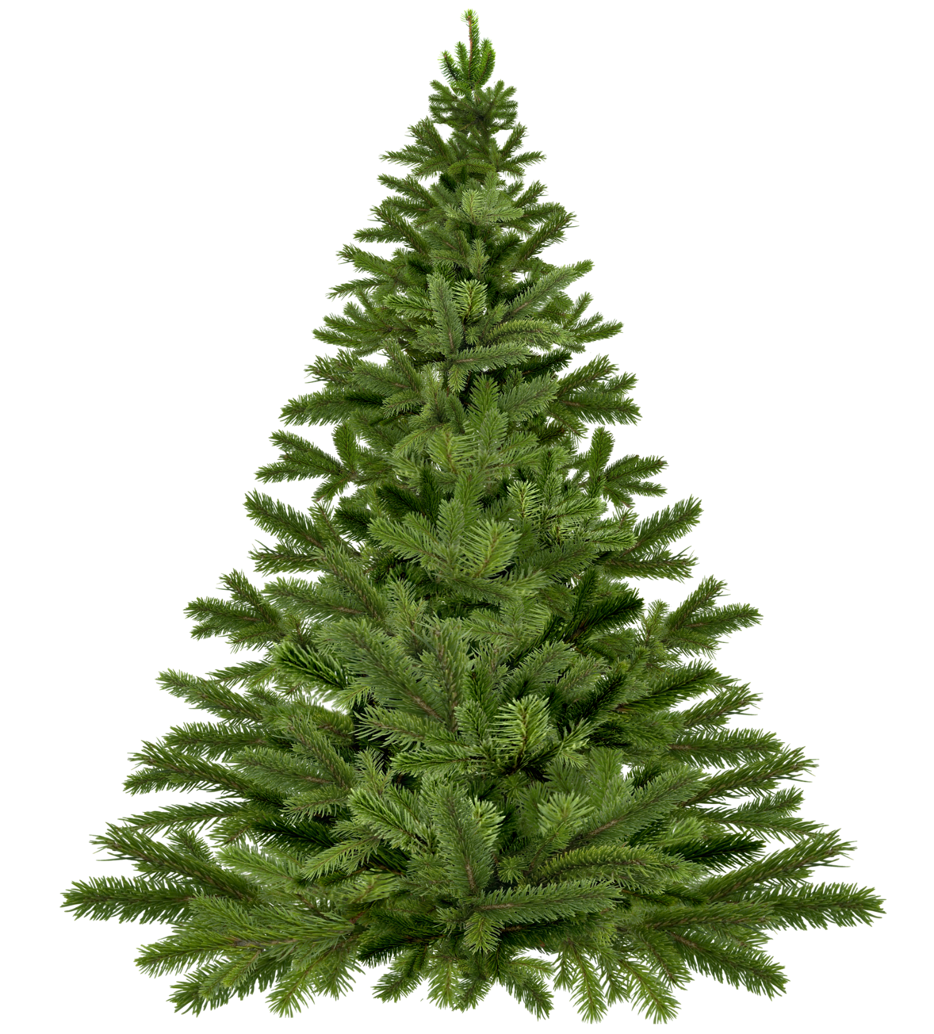
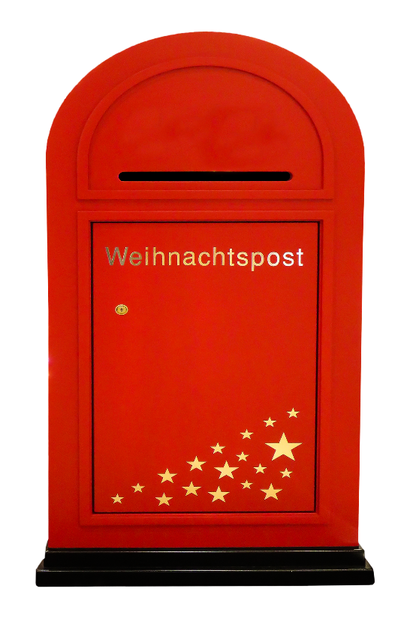
Vokabeln
A
B
A
B
C
C
i
h
3
c
3
D
3
E
F
D
E
F
G
H
I
J
G
J
w
ü
n
h
e
1
3
5
s
c
7
2
1
10
H
I
K
L
M
K
M
L
m
i
r
6
3
3
Notes:
Starter - Revisiting vocab that is not included in the lesson otherwise (includes some items from week 6).
- Ask students to write down A to M in their notebooks.
- Click on a bauble to hear the word twice. Repeat if necessary.
- Students write down the German words they hear.
- number on the bauble that appear next to the tree will tell you which letter you need from the word.
- All the letters together spell: ich wünsche mir, which introduces the theme for the lesson, which we’ll come back to after the phonics introduction.
zeigen → ich (3)
nicht wahr → ich (3)
zuhören → ich (3)
wiederholen → wünsche (1)
früh → wünsche (3)
haben → wünsche (5)
hat → wünsche (1)
ich weiß nicht → wünsche (10)
das Wasser → wünsche (7)
wer? → wünsche (2)
manchmal → mir (6)
kein → mir (3)
freiwillig → mir (3)

