Slide 1
Describing school
present tense -ar, -er & -ir verbs [revisited]
penultimate syllable stress and spelling rules [revisited]
Y8 Spanish
Term 3.2 - Week 2 – Lesson 63
Amanda Izquierdo / Pete Watson / Nick Avery Artwork: Mark Davies
Date updated: 30/06/21
Notes:
Artwork by Mark Davies. All additional pictures selected are available under a Creative Commons license, no attribution required.
Learning outcomes (lesson 1):
Consolidation of regular -ar, -er, -ir verbs in 3rd person singular and plural (-a, -an, -e, -en)
Consolidation of negative ‘no’
Consolidation of penultimate syllable stress and spelling rules
Word frequency (1 is the most frequent word in Spanish):
Revisit a subset of the Y7 vocabulary:
hombre [97]; mujer [120]; inglés [583]; ciencia [738]; español [262]; arte [208]; silencio [518]; bolígrafo [>5000]; palabra [192]; pregunta [507]; tarea [995]; pareja [892]; papel [393]; letra [977]; frase [1036]; silla [1271]; escuela [424]; respuesta [488]; trabajo [152]; deporte [1489]; dibujo [1726]; tiempo [80]; chino [1349]; mañana [215]; ordenador [2624]; material [689]; película [543]; opción [1175] ; entiendo [229]; lee [leer 209]; dar [42]; doy [dar 42]; das [dar 42]; da [dar 42]; quiero [querer 58]; quieres [querer 58]; quiere [querer 58]; debo [deber 71]; debes [deber 71]; debe [deber 71]; marca [marcar 993]; fuerte [435]; verdadero [558]; falso [1599]; listo [1684]; correcto [1467]; electrónico [1619]; perdón [1729]
Source: Davies, M. & Davies, K. (2018). A frequency dictionary of Spanish: Core vocabulary for learners (2nd ed.). Routledge: London
The frequency rankings for words that occur in this PowerPoint which have been previously introduced in NCELP resources are given in the NCELP SOW and in the resources that first introduced and formally re-visited those words.
For any other words that occur incidentally in this PowerPoint, frequency rankings will be provided in the notes field wherever possible.

Slide 2
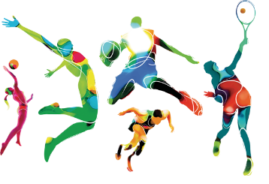
Vocabulario del año pasado
hablar
escuchar
el bolígrafo
7.
el b_ _ _ _ _ _ _ _
[pen]
la pareja
pair
1.
la p_ _ _ _ _
word
la p_ _ _ _ _ _
8.
la palabra
el d_ _ _ _ _ _
[sport]
2.
el deporte
la pregunta
question
9.
la p_ _ _ _ _ _ _
la e_ _ _ _ _ _
3.
la escuela
[school]
la tarea
el inglés
10.
la t_ _ _ _
el i_ _ _ _ _
English
4.
f_ _ _ _ _
la c_ _ _ _ _ _
fuerte
la ciencia
11.
5.
[strong]
el silencio
entiendo
6.
el s_ _ _ _ _ _ _
[silence]
12.
e_ _ _ _ _ _ _
I understand
Notes:
Vocabulary recall activity
Timing: 5 minutes
Aim: to recall previously taught vocabulary in the oral modality.
Procedure:
Ask students to try to say the word in Spanish represented by each image. To encourage learners to recall this vocabulary in Spanish, only the first letter of each word is provided.
Notes (ideas for differentiation):
More letters could be added to each word by the teacher to support students’ recall, if appropriate.
Similarly, the starting letter could also be removed for a greater test.
This slide could be copied and used for receptive recall (i.e., Spanish words given, with English meaning missing). This could be done before the current slide, if teachers think students are unlikely to remember the words in the L2 without support.

Slide 3
Fonética
escuchar
Remember: penultimate = second-last
escuchar
Remember that for words ending in a vowel, ‘n’, or ‘s’:
if the stress is on the _______ syllable, the accent is needed (e.g. balcón).
if the stress is on the _____________ syllable, an accent isn’t needed (e.g. examen).
final
penultimate
Escucha: ¿qué palabras necesitan una tilde?
lunes
adiós
adios
sistema
razon
1
2
3
4
razón
[Monday]
[goodbye]
[system]
[reason]
programa
condicion
cafe
conocimiento
5
6
condición
7
café
8
[programme]
[condition]
[coffee, café]
[knowledge]
Notes:
Timing: 3 minutes
Aim: to apply spelling rules based on the position of the stress (penultimate or final syllablle) and the final letter in each word.
Procedure:
1. Students listen to the recordings (which are played by clicking on the orange buttons) and write the accent on the words that need it. Some words have final syllable stress and others have penultimate syllable stress.
2. The teacher shows the answers by clicking.
3. The teacher can then ask students for translations of the words. The meanings will then appear one by one with each click. Of the new words, ‘programa’, ‘sistema’ and ‘condición’ are cognates. Students already know ‘conocer’ and may possibly be able to work out the meaning ‘conocimiento’. It could also be worth teachers telling students that ‘programa’ and ‘sistema’ are masculine nouns, despite ending in ‘a’.
Notes: Some of these words are new, with the purpose of testing the students’ understanding of accent rules rather than relying on knowledge of the words.
Frequency of unknown words/cognates (1 is the most frequent word in Spanish):
programa [339]; sistema [221]; condición [418]; conocimiento [565]

Slide 4
La escuela
* comprueba = check
leer
Lucía habla sobre cómo es su escuela.
Lee el mensaje y completa con las palabras correctas. Después, escucha y comprueba* las respuestas.
Las palabras
el bolígrafo
la pareja
la tarea
la ciencia
la escuela
entiendo
la palabra
la pregunta
fuerte
el inglés
el deporte
el silencio
En mi 1) _________ los estudiantes tienen muchas 2) _______. Normalmente cada estudiante trabaja en 3) ________ , pero también hacen actividades en 4) ________ . En general, siempre escriben con un 5) _________ negro o azul. En la clase de 6) ________ cuando no 7) ____________ una 8) ________ y tengo una 9) _________ el profesor siempre responde. En la clase de 10) ________ la profesora enseña cosas sobre la naturaleza. ¡También debo hacer 11) _________ porque quiero estar 12) ________ !
escuela
[school]
tareas
[tasks]
[silence]
silencio
parejas
[pairs]
[pen]
[English]
bolígrafo
inglés
[I understand]
[word]
entiendo
palabra
[question]
pregunta
[science]
ciencia
[sport]
[strong]
deporte
fuerte
Notes:
Timing: 7 minutes
Aim: to practise recognition or recall (see notes) of 12 words from this week’s revisited vocabulary.
Procedure: 1. Students read the message and try to fill in the gaps with the corresponding words from the column.
2. The teacher plays the audio and students check their answers.
3. The teacher reveals the answers with further clicks.
4. Students are encouraged to discuss the meaning of the text orally.
Note: Depending on class ability, some or all English words could be removed so students have to consider which is the most suitable word for that specific gap, considering the context.
Alternatively, to create a productive recall task, teachers might remove the column of Spanish words, or provide them with first letter prompts, only. There is, of course, the most challenging option, i.e., to remove some / all English and Spanish words. Note: if the Spanish words are removed, the ‘listen and check’ also acquires more challenge, as students may also engage in some transcription.
Frequency of unknown words/cognates (1 is the most frequent word in Spanish):
comprobar [1301]

Slide 5
Saying what people do Regular verbs in the present [revisited]
gramática
-a
To mean ‘s/he’ or ‘it’ with an –ar verb, use the verb ending ____.
S/he studies in silence.
Estudia en silencio.
-an
To mean ‘they’ with an –ar verb, use the verb ending ____.
They buy the material.
Compran el material.
-e
To mean ‘s/he’ or ‘it’ with an –er or –ir verb, use the verb ending ____.
S/he reads books.
Lee libros.
-en
To mean ‘they’ with an –er or –ir verb use the verb ending ____.
They write with a blue pen.
Escriben con un bolígrafo azul.
Notes:
Timing: 2 minutes
Aim: to recap previously taught rules on subject verb agreement
Procedure:
Click to reveal each new sentence.
Gaps are also left so that the verb endings and Spanish examples can be elicited from students.

Slide 6
¿Cómo es la escuela en España?
leer
hablar
Lee cada frase, ¿es verdadera o falsa?
1
En España los niños empiezan la educación primaria cuando tienen 4 años.
2
El colegio no da el material. Las familias deben comprar los libros.
3
Si no estudias suficiente debes hacer el mismo año otra vez.
4
Un/a estudiante puede ir a la universidad, si quiere, cuando tiene 16 años.
5
Todos los estudiantes deben llevar la misma ropa.
6
En los colegios de España los profesores no enseñan arte.
Notes:
Timing: 4 minutes
Aim: to make predictions about the content of the text on the next slide.
Procedure 1. Students read each statement and decide if they think it’s true or false.
2. Students read the information on the next slide to check if they were right.
Note: on the next slide, students will be checking whether their predictions are true or false. In order to do this, they will need to cross-reference the information with the six sentences above. This slide could either be printed or students could be asked to translate the 6 sentences into English so that they have these to hand when they begin the next slide.

Slide 7
leer
Leemos sobre la educación en España.
leer
En España los niños empiezan la educación primaria* cuando tienen 6 años y terminan cuando tienen 12 años.
Las familias deben comprar los libros, el papel, los bolígrafos, y más cosas porque el colegio no da el material.
En el colegio los estudiantes pueden llevar ropa diferente, en general no hay normas* sobre la ropa como en Inglaterra.
Una cosa importante: si no estudias suficiente debes hacer el mismo año otra vez.
Después del colegio los estudiantes van al instituto*. Aquí los estudiantes pueden elegir si quieren estudiar arte, ciencias, idiomas y otras opciones. Cuando el o la estudiante tiene 16 años decide si quiere estudiar dos años más para después ir a la universidad.
Finalmente, cuando los estudiantes tienen 18 años deben hacer unos exámenes importantes para entrar a la universidad.
In Spain, ‘el instituto’ is a state secondary school for pupils aged 12-16.
primaria = primary
el examen = exam
la norma = rule
Notes:
Timing: 8 minutes.
Aim: to learn about the education system in Spain
Procedure: 1. Students read the text, which is set out as bullet points.
2. Students check if their predictions from the previous slide are true or false.
Answers:
Children start primary school at 4 – false (answer: 6)
The families must buy the books – true
If you don’t study you must repeat the year – true
You can go to university at 16 – false (answer: you have to take exams when you are 18 to be able to go to university)
All students must wear the same uniform – false (answer: generally there are no rules about clothing)
Teachers don’t teach art (false: art is mentioned as one of the things that you can study)
3. Alternatively, to check understanding of the information in the text, the teacher could do one of the following or use another preferred task: i. whole class oral English translation, phrase by phrase ii. individual summary of the text, with the instruction – Note three key facts about the education system in Spain. ii. ask direct questions to elicit the key information. 1. At what age do children start primary education? 2. At what age do they finish? 3. Do they have to wear uniform? 4. Do schools give the stationery? 5. What happens if a student does not study enough?
Frequency of unknown words/cognates (1 is the most frequent word in Spanish):
*primario [2030]; *norma [1174]; *instituto [1558]; universidad [387]

Slide 8
leer / escuchar
Lucía habla de cómo es un día normal en un colegio en España.
Escucha y marca: ¿quién es? Escribe qué hace/n en inglés.
escuchar / escribir
 |  | ¿Quién?
 | el verbo | ‘s/he’ | ‘they’ | ¿Qué? Escribe en inglés.
En tu opinión, ¿cuál es el sujeto de cada frase? ¿Es 1 o 2?
1. estudiante(s)
2. profesor(es)
1
empieza
starts studying at 9 in the morning
2
compran
buy books and all the materials
3
enseñan
teach things about science and art
4
da
gives answers to students’ questions
5
debe
must be in school when s/he is 6
6
reads phrases/sentences to the students on the computer
lee
7
hacen
do exams before going to university
8
ofrecen
offer help with the homework
Notes:
Timing: 8 minutes
Aims: 1) to practise transcription of verbs; 2) to consolidate understanding of –ar, -er and –ir verb endings in the present tense 3rd person singular and plural; 3) to also understand the vocabulary.
Procedure: 1. Students listen to each sentence and first write the verb that they hear. They also decide on the subject of the sentence (s/he or they), depending on the verb ending that they hear. By transcribing the verb, students will have some time to think about the the person that the ending refers to.
2. Students listen again. This time they write what the person or people do in English.
3. Answers appear item by item. Each tick or text box is animated to appear separately.
4. After the three answers are revealed for each row, students can also be asked whether they think the sentence refers to a student (or students) or a teacher (or teachers). This is an opportunity to engage more with the meaning of the sentences. This interaction could take place in Spanish (e.g. students say ‘Creo que es el/la estudiante’ or ‘Pienso que son los profesores’). In one or two cases, the subject could plausibly be a teacher or student (e.g. item 8).
Note: The four features being practised here have been revisited multiple times since their introduction early in Year 7. They were initially practised in pairs and are now revisited as part of a larger group of features. The transcription of the verb aims to give students time to reflect on the meaning of the verb ending so that the task does not become too difficult.
Transcript
Empieza a estudiar a las 9 de la mañana.
Compran los libros y todos los materiales.
Enseñan cosas sobre ciencias y arte.
Da respuestas a las preguntas de los estudiantes.
Debe estar en la escuela cuando tiene seis años.
Lee frases a los estudiantes en el ordenador.
Hacen exámenes antes de entrar a la universidad.
Ofrecen ayuda con los deberes.

Slide 9
hablar
Ahora tú hablas. En parejas, un estudiante dice un número y el otro estudiante dice la frase completa en español.
hablar
escuchar
[S/he starts]
[nine]
¿Necesitas ayuda?
1
1
Empieza
nueve
*to go to university
entrar a la universidad
_________ a estudiar a las _______ de la mañana.
[They buy]
[the materials]
2
2
Compran
los materiales
__________ los libros y todos _______________.
[They teach]
[science]
[art]
3
3
Enseñan
ciencias
arte
__________ cosas sobre __________ y ______.
4
[S/he gives]
[the questions]
4
Da
las preguntas
____ respuestas a ________________ de los estudiantes.
[They enter, go*]
[to do; doing]
5
5
Entran
hacer
_______ a la universidad después de ________ unos exámenes.
Notes:
Speaking activity (oral sentence completion)
Timing: 5 minutes
Aim: to consolidate verb endings for present tense –ar verbs in 3rd person singular and plural (–a vs –an endings) in oral production.
Procedure: 1. In pairs, student A says a number and student B says the full sentence back in Spanish.
2. Student B gives peer feedback, telling student A if s/he said the sentence correctly and offering suggestions if not.
3. One click reveals the beige action buttons, which have full sentence audio. The teacher can use these to help students check that their own oral production was correct. The animation sequence also reveals the missing words, for additional reinforcement.
Notes:
1. This activity could also be teacher-led, with the teacher calling the numbers and the class producing the full sentence together orally.
2. Additional words could be removed, to increase difficulty, if appropriate for the group.
3. It could be pointed that it would also be correct to say, in item 5, ‘después de hacer exámenes’ (in English we would also omit the article here).
Transcript
Empieza a estudiar a las 9 de la mañana.
Compran los libros y todos los materiales.
Enseñan cosas sobre ciencias y arte.
Da respuestas a las preguntas de los estudiantes.
Entran a la universidad después hacer unos exámenes.

Slide 10
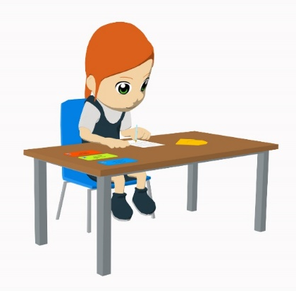
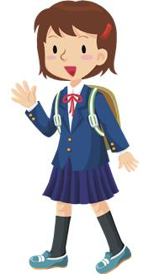
¡Y ahora tú escribes!
escribir
escribir
¿Cómo es tu escuela?
Escribe 4 frases verdaderas sobre tu propia escuela.
Escribe 4 frases falsas sobre tu propia escuela.
Debes usar las palabras en español:
a lot
little (not much)
boys / girls / boys and girls
*uniform
many students
books
material
help
computers
*exams
homework
offer(s)
read(s)
learn(s)
write(s)
want(s)
do
does
has
have
the student(s)
the school
the teacher(s)
the headteacher(s)
*uniform = el uniforme
*exam = el examen
Notes:
Timing: 10 minutes
Aim: to consolidate the present tense verb endings –e and –en (3rd person singular and plural) in the written modality. This includes practice of ‘hacer’ and ‘tener’ which follow this pattern of endings.
Procedure:
1. Students write 4 sentences that are true and 4 sentences that are false about their own school using the Spanish for the prompts in the three different boxes.
2. The teacher circulates around the classroom and helps students with their sentences.
3. The teacher can then at the end of the activity ask students to volunteer some of their sentences and ask the rest of the class which ones are true and which are false, thereby adding some speaking and listening practice to the activity.
Frequency of unknown words/cognates (1 is the most frequent word in Spanish):
uniforme [2796]; examen [2005]

Slide 11
Describing school [2]
present simple for ongoing events [revisited]
present tense -ar, -er & -ir verbs [revisited]
Y8 Spanish
Term 3.2 - Week 2 – Lesson 64
Amanda Izquierdo / Pete Watson / Nick Avery Artwork: Mark Davies
Date updated: 30/06/21
Notes:
Artwork by Mark Davies. All additional pictures selected are available under a Creative Commons license, no attribution required.
Learning outcomes (lesson 2):
Consolidation of present tense –ar, –er and –ir verbs in the following forms:
1st person singular (-o)
2nd person singular (-as, -es)
1st person plural (-amos, -emos, -imos)
Consolidation of present simple for ongoing events (e.g. hablo – I am speaking)
Consolidation of penultimate and final syllable stress
Word frequency (1 is the most frequent word in Spanish):
Revisit set of Y7 vocabulary:
hombre [97]; mujer [120]; inglés [583]; ciencia [738]; español [262]; arte [208]; silencio [518]; bolígrafo {>5000]; palabra [192]; pregunta [507]; tarea [995]; pareja [892]; papel [393]; letra [977]; frase [1036]; silla [1271]; escuela [424]; respuesta [488]; trabajo [152]; deporte [1489]; dibujo [1726]; tiempo [80]; chino [1349]; mañana [215]; ordenador [2624]; material [689]; película [543]; opción [1175] ; entiendo [229]; lee [leer 209]; dar [42]; doy [dar 42]; das [dar 42]; da [dar 42]; quiero [querer 58]; quieres [querer 58]; quiere [querer 58]; debo [deber 71]; debes [deber 71]; debe [deber 71]; ¿Puedo ir a los servicios? [servicio 310]; marca [marcar 993]; fuerte [435]; verdadero [558]; falso [1599]; listo [1684]; correcto [1467]; electrónico [1619]; perdón [1729]
Source: Davies, M. & Davies, K. (2018). A frequency dictionary of Spanish: Core vocabulary for learners (2nd ed.). Routledge: London
The frequency rankings for words that occur in this PowerPoint which have been previously introduced in NCELP resources are given in the NCELP SOW and in the resources that first introduced and formally re-visited those words.
For any other words that occur incidentally in this PowerPoint, frequency rankings will be provided in the notes field wherever possible.

Slide 12
Fonética
hablar / escribir
En parejas, leemos las palabras.
Say the word and emphasise the correct syllable. Does it need an accent?
Estudiante A lee
(Estudiante B debe poner las tildes)
Estudiante B lee
(Estudiante A debe poner las tildes)
Remember that for words ending in a vowel, ‘n’, or ‘s’:
1) if the stress is on the ____________ syllable, an accent is needed.
2) if the stress is on the ____________ syllable, an accent isn’t needed.
dibujo
silencio
estacion
detras
mensaje
opcion
animal
opinion
dibujo
silencio
estación
detrás
mensaje
opción
animal
opinión
letra
silla
ingles
rico
movil
dinero
perdon
quien
letra
silla
inglés
rico
móvil
dinero
perdón
quién
final
penultimate
Notes:
Timing: 3 minutes
Aim: to practise using the written accent to accurately read aloud and spell words with penultimate and final syllable stress
Procedure:
The teacher explains to students that they will be working in pairs.
Student A reads words aloud from their speaking cards, taking care to stress the correct syllable.
Student B listens and decides if the word needs an accent (these are displayed on the board without accents during the activity), based on the stress position.
Students swap roles.
One click reveals the answers for Student A. Another reveals the answers for student B.
Note: it may be possible for some students to recall whether these words have an accent or not, given that they were taught in Year 7. In this sense, the activity doubles up as vocabulary revisiting. To give students a greater challenge, high-frequency unknown words could also be used in the activity.

Slide 13
Speaking cards
Persona A
dibujo
silencio
estación
detrás
mensaje
opción
animal
opinión
Persona B
letra
silla
inglés
rico
móvil
dinero
perdón
quién
Notes:
DO NOT DISPLAY DURING ACTIVITY
A printable version of these cards is available with the resource.

Slide 14
Vocabulario
escuchar
escuchar
1
j
7
e
a
b
c
d
phrase, sentence
2
k
8
I (L)
[woman]
[letter]
3
a
9
c
4
h
10
i
e
f
g
h
g
I give
tomorrow
5
11
b
6
f
12
d
i
j
k
L
job, work
drawing
[man]
[time]
Notes:
Timing: 3 minutes
Aim: to revisit Y7 vocabulary receptively and productively in the oral modality
Procedure 1. Students write 1-12 in their exercise books. They listen to the recording and write the letter of the words that they hear in the order that they hear them.
2. Answers are shown by clicking.
3. Then, students work in pairs, one student says a letter corresponding to one of the pictures and the other student produces that word aloud in Spanish. This will ensure that students also practise productive oral recall.
Transcript:
el trabajo
el tiempo
la mujer
mañana
la pelicula
doy
el ordenador
el dibujo
la silla
el hombre
la letra
la frase

Slide 15
Saying what people do Regular present tense verbs [revisited]
gramática
Remember, the verb ending changes depending on who the verb refers to.
It also depends on the ending of the infinitive: –ar, –er or –ir.
In the present tense, to mean...
‘I’ with any verb, remove the ending and add ___.
–o
–as
‘you’ with –ar verbs, remove –ar and add ___.
‘you’ with –er and –ir verbs, remove –er or –ir and add ____.
–es
Notes:
Timing: 2 minutes
Aim: to recap 1st person and 2nd singular forms of present tense with –ar, –er and –ir verbs.
Procedure:
Go through the grammar explanation with students, revealing each new sentence on a mouse click.

Slide 16
Saying what people do Regular present tense verbs [revisited]
gramática
To mean ‘we’, we have a different ending for every type of infinitive:
In the present tense, to mean...
–amos
‘we’ with –ar verbs, remove –ar and add ________.
–emos
‘we’ with –er verbs, remove –er and add ________.
‘we’ with ––ir verbs, remove –ir and add ________.
–imos
Notes:
Timing: 2 minutes
Aim: to recap 1st person plural forms of present tense with –ar, –er and –ir verbs.
Procedure:
Go through the grammar explanation with students, revealing each new sentence on a mouse click.

Slide 17
Routine vs ongoing events
gramática
Remember that in Spanish the same verb in the present can have two meanings:
Hacemos tareas cada día.
We do tasks each/every day.
routine event
Hacemos tareas en este momento.
We are doing tasks at the moment.
ongoing event (in progress)
The adverbs of time will tell you which English tense to use.
With a routine event, in Spanish we use adverbs and time markers such as:
generalmente, normalmente, siempre, los lunes, nunca, etc.
With an ongoing event we use adverbs and time markers such as:
en este momento, hoy, esta mañana, esta tarde, ahora, etc.
Notes:
Timing: 2 minutes
Aim: to recap the use of present tense in Spanish to express routine events vs ongoing events (events in progress)
Procedure:
Go through the grammar explanation with students, revealing each new sentence on a mouse click.

Slide 18
Un día especial en la escuela
leer
Vas a escuchar un audio sobre un día especial en la escuela de Lucía.
Antes, lee unas partes del audio y marca quién hace cada acción.
Pongo el dinero en la caja*.
Aprendo inglés y arte.
Empezamos las clases a las nueve.
*caja = box, till
 | Who... | ‘I’ | ‘you’ | ‘we’
1 | learns/is learning English and art
2 | starts/is starting at 9
3 | puts/is putting the money in the till
4 | sells/is selling the books
5 | publishes/is publishing a poem
6 | reads/is reading stories
Vendes los libros.
Publicas un poema.
Leemos y escribimos historias.
Notes:
Timing: 5 minutes
Aim: to consolidate understanding of the 2nd person singular and 1st person singular and plural in present tense –ar, –er and –ir verbs; to support students’ understanding of the language that they will encounter in the listening activity on the next slide.
Procedure:
Students read some extracts from the following listening activity and tick whether the verb refers to ‘I’, ‘you’ or ‘we’.
Answers are shown by clicking one by one.
Notes:
A range of features are brought together for practice here (rather than a single ‘pair’ that is ) as they have been practised extensively since Year 7 and early Year 8.
The speech bubbles aren’t numbered, so students need to look carefully at the vocabulary in order to decide if it matches the question.
A gloss is given for ‘caja’ as the word is known, but used here with a new meaning.

Slide 19
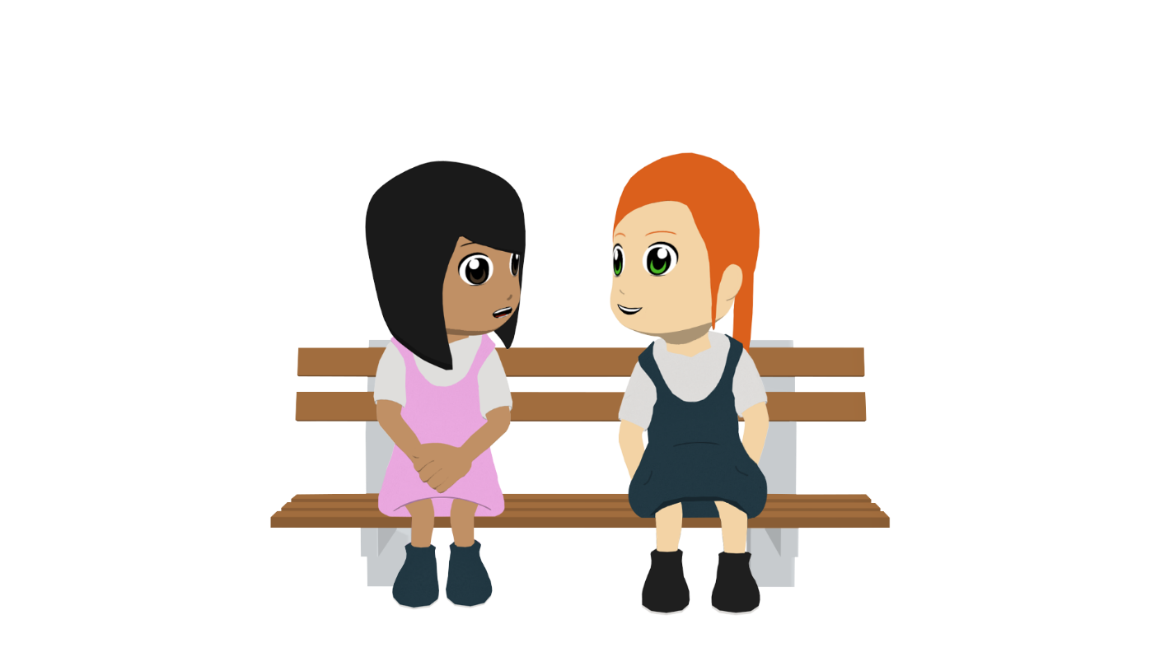
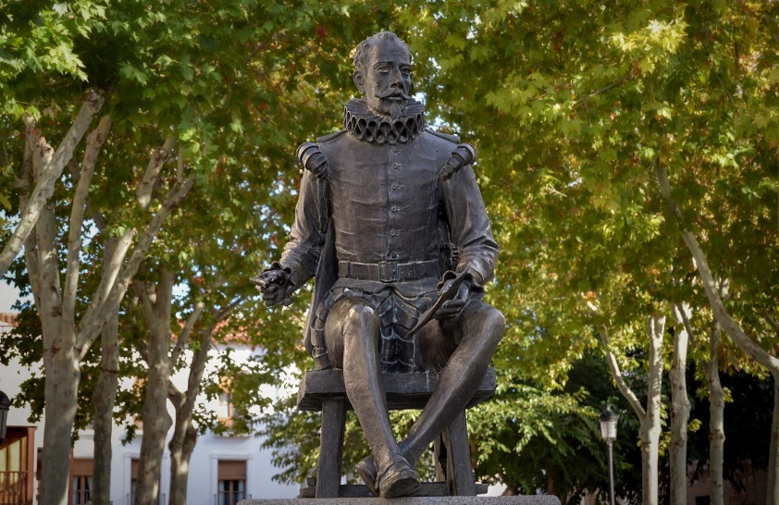
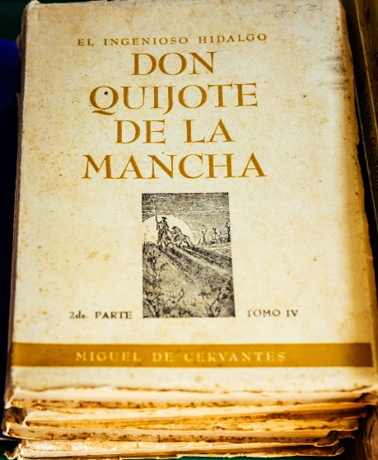
Un día especial en la escuela
escuchar
Lucía habla de un día especial en la escuela: el Día del Libro.
Escucha y escribe el orden correcto de las frases.
Miguel de Cervantes (1547-1616)
Cervantes es el Shakespeare español, un autor muy famoso. Escribió una novela muy conocida: «Don Quijote de la Mancha».
1
2
3
4
5
6
a) talks about organising something
b) talks about sharing a piece of writing
c) talks about when classes start
d) talks about some school subjects
e) talks about the jobs that each person does
f) talks about a reading and writing
Celebramos el Día del Libro el 23 de abril por autores como Cervantes y Shakespeare.
c
a
d
e
f
b
Notes:
Timing: 7 minutes
Aim: to show understanding of the broad meaning of the text by putting the sentences in chronological order.
Procedure:
Students listen to the text and write the letter of the sentence in the order in which they hear the actions. Students can just write the numbers 1-10 in their books, and then the letter.
Answers are shown by clicking.
After the last answer is shown, the next click shows a callout about Cervantes.
Optionally, the text could be played again and more detailed questions could be asked about the text. For example, 1. What are they organising? 2. Which school subjects are mentioned? 3. Which jobs/tasks are mentioned? 4. What gets published and where?
Transcript:
En la escuela normalmente empezamos las clases a las nueve de la mañana, pero hoy celebramos un día especial, el Día del Libro, así que en este momento organizamos un mercado.
Cada lunes estudias ciencia y chino y yo aprendo inglés y arte, aunque esta mañana dividimos unas tareas: ahora tú vendes los libros y yo pongo el dinero en la caja. Generalmente, en el Día del Libro leemos y escribimos historias. ¡Siempre publicas un poema en el periódico de la escuela!
Frequency of unknown words/cognates (1 is the most frequent word in Spanish):
orden [421]
Picture of Cervantes statue by Angeles Balaguer, free from https://pixabay.com/es/photos/cervantes-estatua-escultura-4823925/
Picture of Don Quijote book by Gayatri Malhotra, free from https://unsplash.com/photos/mkqrjhXgrCI

Slide 20
Un día especial en la escuela
escuchar
Escucha otra vez: ¿cuál es la traducción correcta?
Palabras importantes:
cada lunes
siempre
en este momento
normalmente
esta manana
ahora
generalmente
hoy
 | A | B
1 | we start the classes | we are starting the classes
2 | we celebrate a special day | we are celebrating a special day
3 | we are organising a market | we organise a market
4 | you are studying science and Chinese | you study science and Chinese
5 | we divide up some tasks | we are dividing up some tasks
6 | you are selling the books | you sell the books
7 | we read and write stories | we are reading and writing stories
8 | you are publishing a poem | you publish a poem
Verbos
dividimos
empezamos
vendes
celebramos
pongo
organizamos
leemos y escribimos
estudias
aprendo
publicas
Notes:
Timing: 7 minutes
Aim: to understand whether the present tense is used for routine or ongoing/unfinished actions by paying attention to temporal adverbs; to also practise transcription of verbs
Procedure:
Students listen to the same text again and decide which is the most accurate translation of each verb in English by paying attention to the temporal adverbs (normalmente etc.). Teachers then click to show the answers.
The temporal adverbs and time markers are included in a box on the right hand side, for support, but this could be removed for a higher ability group.
Students listen one final time and transcribe each verb. Because students are listening the whole text here, it may be necessary for the teacher to pause after each word is said, to allow students enough time to write. The box in the bottom right hand corner provides the answers to this, in order. Students could be asked how many verbs are –ar (5), -er (4) and –ir (2).
Transcript:
En la escuela normalmente empezamos las clases a las nueve de la mañana, pero hoy celebramos un día especial, el Día del Libro, así que en este momento organizamos un mercado.
Cada lunes estudias ciencia y chino y yo aprendo inglés y arte, aunque esta mañana dividimos unas tareas: ahora tú vendes los libros y yo pongo el dinero en la caja. Generalmente, en el Día del Libro leemos y escribimos historias. ¡Siempre publicas un poema en el periódico de la escuela!

Slide 21
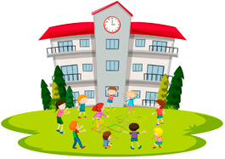
hablar
Una escuela rara
hablar
Estás en una escuela rara donde no pasan cosas normales.
Hablamos en parejas.
El estudiante A lee frases en inglés y habla en español.
El estudiante B escucha y escribe.
Ejemplo:
Hoy enseñas la clase.
Estudiante A
Estudiante B
 |  | who? | it happens regularly | it’s happening now
1 | teach ______________
1. Today you are teaching the class.
you
the class
Notes:
Timing: 10 minutes
Aim: to consolidate productive use of present tense verbs with –o, –as and –amos ending; to consolidate understanding of temporal adverbs and time markers.
Procedure:
Teachers hand out the student cards before the activity explanation to help with the process. The teacher should explain that verbs used here will need one of 3 endings: –o, –as or –amos. All endings were taught in Year 7 and have had extensive receptive and productive practice in the SoW, so are brought together here.
Student A reads out sentences in Spanish to student B. It may be necessary to do this a couple of items, as there are three pieces of information to fill in.
Student B completes the table.
Students swap roles.
The answer slides for this activity are slides 24 and 25.

Slide 22
hablar
Estudiante A
hablar
Say these sentences in Spanish:
Normally you organise the classes.
This afternoon I am listening to songs in class.
Now you are dancing on the table.
Generally we start at 10 in the morning.
Today I am teaching Chinese.
Sometimes we buy pens in school.
 |  | who? | it happens regularly | it’s happening now
1 | teach _________________
2 | work _________________
3 | speak _________________
4 | write _________________
5 | study _________________
6 | participate _________________
Notes:
DO NOT SHOW DURING ACTIVITY

Slide 23
hablar
Estudiante B
hablar
Say these sentences in Spanish:
At the moment, I am teaching science.
Sometimes we work in silence.
Now you are speaking in Chinese.
Normally I write many emails.
Generally we study without chairs.
Today you are participating in a market.
 |  | who? | it happens regularly | it’s happening now
1 | organize _________________
2 | listen to _________________
3 | dance _________________
4 | start _________________
5 | teach _________________
6 | buy _________________
Notes:
DO NOT SHOW DURING ACTIVITY

Slide 24
hablar
Respuestas: Estudiante A
hablar
Say these sentences in Spanish:
Normally you organise the classes.
This afternoon I am listening to songs in class.
Now you are dancing on the table.
Generally we start at 10 in the morning.
Today I am teaching Chinese.
Sometimes we buy pens in school.
 |  | who? | it happens regularly | it’s happening now
1 | teach _________________
2 | work _________________
3 | speak _________________
4 | write _____________________
5 | study _________________
6 | participate _________________
science
I
in silence
we
in Chinese
you
many emails
I
without chairs
we
in a market
you
Notes:
ANSWER SLIDE: DO NOT SHOW DURING ACTIVITY

Slide 25
hablar
Respuestas: Estudiante B
hablar
Say these sentences in Spanish:
At the moment, I am teaching science.
Sometimes we work in silence.
Now you are speaking in Chinese.
Normally I write many emails.
Generally we study without chairs.
Today you are participating in a market.
 |  | who? | it happens regularly | it’s happening now
1 | organise _________________
2 | listen to _________________
3 | dance _________________
4 | start _________________
5 | teach _________________
6 | buy _________________
the classes
you
songs in class
I
on the table
you
at 10 in the morning
we
Chinese
I
pens in school
we
Notes:
ANSWER SLIDE: DO NOT SHOW DURING ACTIVITY

Slide 26
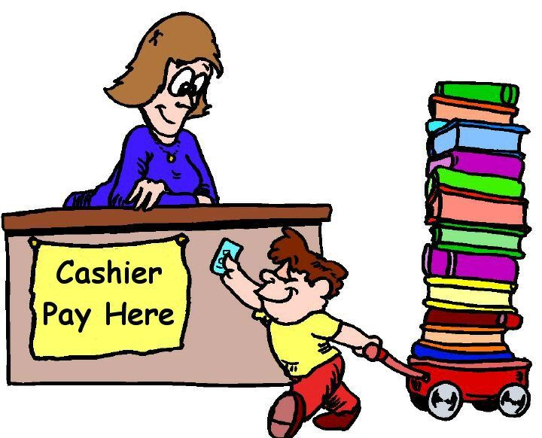
El Día del Libro en el periódico
escribir
¡Queremos celebrar el Día del Libro! Escribes un artículo para organizar unas actividades en el periódico electrónico de la escuela. Das información sobre el día y quieres dar a un/a compañera/a la oportunidad de ganar un premio.
Día del Libro
Explica las actividades posibles y escribe ideas para participar.
Celebramos el Día del Libro
Notes:
Timing: 9 minutes
Aim: to translate accurately into Spanish using–er verbs in 2nd person singular (-es) and 1st person plural (-emos). There are two options, as shown on the next two slides, that can be chosen depending on time available and class ability.
Procedure:
Teachers explain the context of the writing task using this introductory slide. In this activity students will use the present simple tense for both routine and unfinished actions.
There are two options: a standard slide, which involves text completion, and a more challenging version which requires full text completion. In the former, the focus is limited to –er verbs in 2nd person singular (-es) and 1st person plural (-emos). In the latter, a range of endings practised this week are used.

Slide 27
El Día del Libro en el periódico
escribir
Celebramos el Día del Libro
A special day in school
Do you read books and (do you) write poems? Do you want to win a prize? This year we are celebrating Book Day, so we are organising some activities.
If you enjoy books and stories you can participate.
We are offering cheap books and magazines
and at the moment (we are) collecting* poems for a prize.
We are preparing a fun day. We are ready! Are you?
Un día especial en la escuela
¿ __________ libros y ___________ poemas?
¿ __________ ganar un premio?
Este año celebramos el Día del Libro, así que organizamos unas actividades.
Si disfrutas los libros y las historias __________ participar.
___________ libros baratos y __________ y en este momento ____________ poemas para un __________. Preparamos un ___ __________. ¡Estamos __________! ¿Y tú?
Lees
escribes
Quieres
puedes
Ofrecemos
revistas
recogemos
premio
día
divertido
listos
*to pick up, collect - recoger
Notes:
OPTION 1 – scaffolded text completion
Each missing Spanish word is revealed on a mouse click.
Notes:
‘Recoger’ was previously taught as ‘pick up’. However, this wouldn’t be an appropriate English translation to give in this context, so a gloss is given to avoid any confusion.
It might be useful to explain to students that, in this context, the final two words translate most naturally from English to Spanish when English uses a verb (‘y tú’ for ‘are you?’).
Unknown words/cognates:
poema [1430]

Slide 28
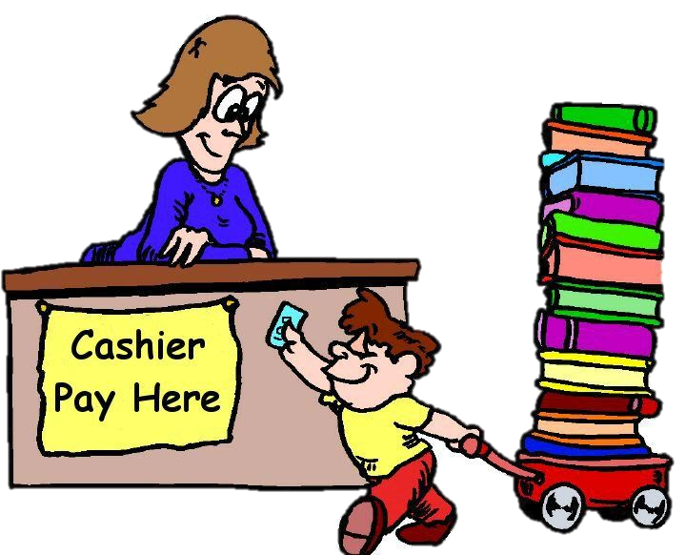
El Día del Libro en el periódico
*to pick up, collect – recoger
escribir
*poem – el poema
Escribe en español el texto para el periódico electrónico de la escuela:
Celebramos el Día del Libro
A special day in school
Do you read books and (do you) write poems?
Do you want to win a prize? This year we are celebrating
Book Day, so we are organising some activities.
If you enjoy the books and stories here, you can participate.
We are offering cheap books and magazines
and at the moment I am collecting poems for a prize.
We are preparing a fun day!
Un día especial en la escuela
¿Lees libros y escribes poemas?
Este año celebramos
¿Quieres ganar un premio?
el Día del Libro, así que organizamos unas actividades.
Si disfrutas los libros y las historias aquí, puedes participar.
Ofrecemos libros baratos y revistas
Día del Libro
y en este momento recojo poemas para un premio.
Preparamos un día divertido!
Notes:
OPTION 2 – full text translation
The Spanish translation of each line of the text is revealed on a mouse click.
Notes:
‘Recoger’ was previously taught as ‘pick up’. However, this wouldn’t be an appropriate English translation to give in this context, so a gloss is given to avoid any confusion.
The text has been modified slightly (compared to the text on the last slide) to avoid cross-linguistic complexity and untaught language. For example, ‘here’ was added as a prompt in line 5 so that students would have a natural context in Spanish and English to use the definite article (otherwise, only Spanish would use the article). The final two words from the last slide were also removed for similar reasons.
Students will know from the title that ‘Book Day’ is ‘el Día del Libro’ and so requires an article.
Unknown words/cognates:
poema [1430]

Slide 29
Gaming Grammar
Gaming Grammar
Gaming Grammar mini-game Verbs (present):1st and 3rd person singular/plural in the ‘Verb agreement (present)’ menu practices aspects of this week’s lessons.
Notes:
This slide links to Gaming Grammar login screen. The appropriate mission can then be selected from the menu page.
Students will progress through the game at their own rate; teachers should use the teacher interface to check progress. This will help to inform future lesson planning.

Slide 30
Deberes
Vocabulary Learning Homework
This week’s homework is one of the Y8 vocabulary mashups.
Y8 Spanish Term 3.2 Week 2 - mashup A
Y8 Spanish Term 3.2 Week 2 - mashup B
Y8 Spanish Term 3.2 Week 2 - mashup C

