Slide 1
Refugees in France [1]
Reflexive pronouns ‘me’ and ‘te’
SSCs [-gn-], [j/soft g]
Y9 French
Term 3.2 - Week 3 - Lesson 63
Author name: Catherine Salkeld / Louise Bibbey
Artwork by: Chloé Motard
Date updated: 08/08/22
Notes:
Artwork by Chloé Motard. All additional pictures selected are available under a Creative Commons license, no attribution required.
Native teacher feedback provided by Sarah Brichory.
With thanks to Rachel Hawkes for her input on lesson material.
Learning outcomes (lesson 1):
Consolidation of SSCs [-gn-] and [j/soft g]
Introduction of reflexive pronouns ‘me’ and ‘te’
Word frequency (1 is the most frequent word in French):
9.3.2.3: se demander [80], se lever [837], loger [3060], s’organiser [701], se sentir [536], se trouver [83], association [956], conflit [864], crise [765], actuel [584], grave [443], afghan [>5000], Afghanistan [>5000]
9.3.1.5 (revisit): annuler [2002], arriver2 à [172], continuer (de) [113], décider (de) [165], essayer (de) [303], voler2 [1610], bise [>5000], isolement [4033], masque [3856], pandémie [>5000], vaccin [>5000], vol2 [1531], impossible [652], interdit [4451], mondial [549], nécessaire [451]
9.2.2.1 (revisit): corriger [1639], durer [605], poser [218], compétence [1757], connaissance [806], contrôle [662], système [289], cinquième [2030], deuxième [427], quatrième [1603], primaire [2527], sixième [3124], troisième [506], longtemps [312]
Source: Lonsdale, D., & Le Bras, Y. (2009). A Frequency Dictionary of French: Core vocabulary for learners London: Routledge.
The frequency rankings for words that occur in this PowerPoint which have been previously introduced in NCELP resources are given in the NCELP SOW and in the resources that first introduced and formally re-visited those words.
For any other words that occur incidentally in this PowerPoint, frequency rankings will be provided in the notes field wherever possible.
The additional English meanings of the following words have been added to Quizlet since the creation of this resource:
grave – serious, grave

Slide 2
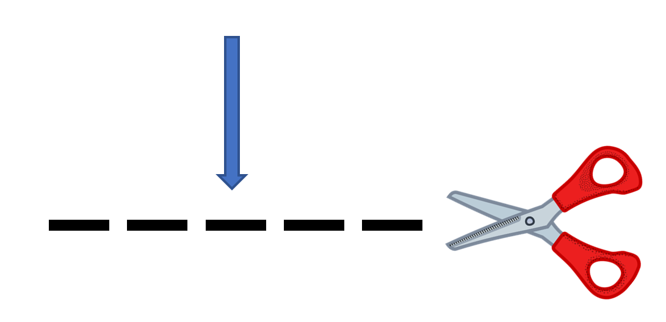
-gn-
ligne
Notes:
Timing: 1 minute
Aim: To consolidate SSC [-gn-]
Procedure: 1. Present the letter(s) and say the [-gn-] sound first, on its own. Students repeat it with you. 2. Bring up the word ”ligne” on its own, say it, students repeat it, so that they have the opportunity to focus all of their attention on the connection between the written word and its sound.
3. A possible gesture for this would be to draw a line in the air with your finger, 4. Roll back the animations and work through 1-3 again, but this time, dropping your voice completely to listen carefully to the students saying the [-gn-] sound, pronouncing ”ligne” and, if using, doing the gesture.
Word frequency (1 is the most frequent word in French):
ligne [342]
Source: Londsale, D., & Le Bras, Y. (2009). A Frequency Dictionary of French: Core vocabulary for learners London: Routledge.

Slide 3
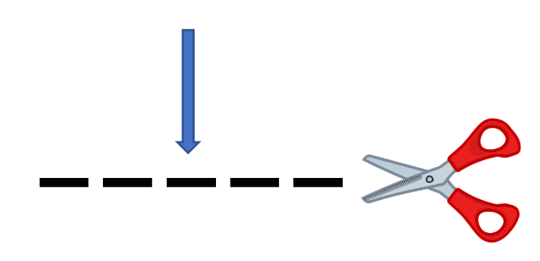
-gn-
gagner
montagne
[to win]
espagnol
ligne
Allemagne
ignorer
[to not know]
Notes:
Timing: 2 minutes
Aim: To consolidate SSC [-gn-]
Procedure:
Introduce and elicit the pronunciation of the individual SSC [-gn-] and then the source word again ‘ligne’ (with gesture, if using). Then present and elicit the pronunciation of the five cluster words. The cluster words have been chosen for their high-frequency, from a range of word classes, with the SSC (where possible) positioned within a variety of syllables within the words (e.g. initial, 2nd, final etc.). Additionally, we have tried to use words that build cumulatively on previously taught SSCs (see the Phonics Teaching Sequence document) and do not include new SSCs. Where new SSCs are used, they are often consonants which have a similar symbol-sound correspondence in English.
Word frequency (1 is the most frequent word in French): ligne [342]; gagner [258]; ignorer [639]; espagnol [1666]; montagne [1734]; Allemagne [N/A]. Source: Londsale, D., & Le Bras, Y. (2009). A Frequency Dictionary of French: Core vocabulary for learners London: Routledge.

Slide 4
j/soft g
X
jour
Notes:
Timing: 1 minute
Aim: To consolidate SSC [j/soft g]
Procedure: 1. Present the letter(s) and say the [j/soft g] sound first, on its own. Students repeat it with you. 2. Bring up the word ”jour” on its own, say it, students repeat it, so that they have the opportunity to focus all of their attention on the connection between the written word and its sound.
3. A possible gesture for this would be to mime waking up at daybreak, by stretching out ones arms and yawning. 4. Roll back the animations and work through 1-3 again, but this time, dropping your voice completely to listen carefully to the students saying the [j/soft g] sound, pronouncing ”jour” and, if using, doing the gesture.
Word frequency (1 is the most frequent word in French):
jour [78].
Source: Londsale, D., & Le Bras, Y. (2009). A Frequency Dictionary of French: Core vocabulary for learners London: Routledge.

Slide 5
j/soft g
j’ai
génial
[I have]
X
jour
sujet
jamais
[subject]
[never]
déjà
[already]
Notes:
Timing: 2 minutes
Aim: To consolidate SSC [j/soft g]
Procedure:
1. Introduce and elicit the pronunciation of the individual SSC [j/soft g] and then the source word again ‘jour’ (with gesture, if using). 2. Then present and elicit the pronunciation of the five cluster words.
The cluster words have been chosen for their high-frequency, from a range of word classes, with the SSC (where possible) positioned within a variety of syllables within the words (e.g. initial, 2nd, final etc.). Additionally, we have tried to use words that build cumulatively on previously taught SSCs (see the Phonics Teaching Sequence document) and do not include new SSCs. Where new SSCs are used, they are often consonants which have a similar symbol-sound correspondence in English.
Word frequency (1 is the most frequent word in French): j’ai [8 - avoir]; génial [3872] sujet [353]; déjà [58]; jamais [179]; jour [78]. Source: Londsale, D., & Le Bras, Y. (2009). A Frequency Dictionary of French: Core vocabulary for learners London: Routledge.

Slide 6
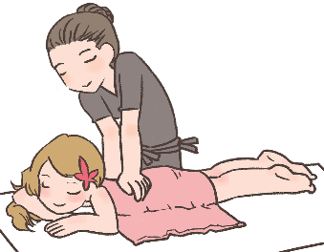
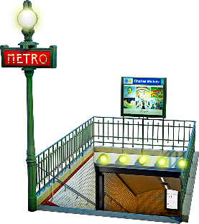
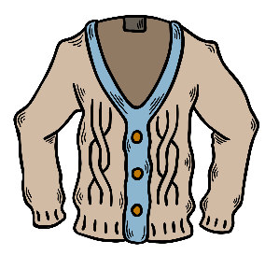
Hard [g] and soft [g]/[j]
info
Remember that hard [g] is pronounced like the [g] in ‘goldfish’.
[g] is hard when it comes before a, o, u or r, l, m.
Soft [g] and [j] are pronounced like the [g] in ‘massage’.
[g] is soft when it comes before e, i, or y.
la gare
[station]
le gilet
[cardigan]
nous plongeons
[we are diving]
la blague
[joke]
hard [g]
soft [g]/[j]
soft [g]/[j]
hard [g]
Notes:
Timing: 2 minutes
Aim: To revise spelling rules governing the pronunciation of hard and soft [g] in preparation for the listening activity that follows.
Procedure:
1. Click to bring up information.
2. Students predict the pronunciation of the four target words.
3. Click on pictures to hear words said aloud by a native speaker.
4. Students repeat.
Transcript:
la gare, le gilet, nous plongeons, la blague
Word frequency of unknown words used (1 is the most frequent word in French): gare [2581], gilet [>5000], plonger [1958], blague [4822]
Source: Lonsdale, D., & Le Bras, Y. (2009). A Frequency Dictionary of French: Core vocabulary for learners London: Routledge.

Slide 7
La crise des réfugiés*
*la crise des réfugiés = the refugee crisis
lire/parler
Lis les mots et pratique les SSC hard [g] et soft [g/j].
1
Un pays d’origine de beaucoup de réfugiés est l’Afghanistan.
[One country of origin of many refugees is Afghanistan.]
2
Les réfugiés se retrouvent dans des situations graves.
[The refugees find themselves in serious situations.]
Ils sont obligés de quitter leurs villages avec leurs bagages.
3
[They are obliged to leave their villages with their baggage.]
Les réfugiés doivent bien s’organiser pour rejoindre leurs familles.
4
[The refugees must organise themselves well to rejoin their families.]
5
Ils sont très fatigués et fragiles après des voyages dangereux.
[They are very tired and fragile after dangerous journeys.]
Notes:
Timing: 4 minutes
Aim: To practise identifying words with hard [g] or soft [g/j] through reading/speaking.
Procedure:
Click to reveal each sentence with its translation.
Ask individual students to read a sentence, focusing on the correct pronunciation of the hard [g] and soft [g/j]
Click on the numbers to hear the sentences spoken by a native speaker to verify pronunciation.
Transcript:
Un pays d’origine de beaucoup de réfugiés est l’Afghanistan.
Les réfugiés se retrouvent dans des situations graves.
Ils sont obligés de quitter leurs villages avec leurs bagages.
Les réfugiés doivent bien s’organiser pour rejoindre leurs familles.
Ils sont très fatigués et fragiles après des voyages dangereux.
Ils cherchent la justice contre ceux qui commettent le génocide.
Word frequency of unknown words (1 is the most frequent word in French): grave [443], rejoindre [1007], ceux [>5000], fatigué [>5000], commettre [1196] Source: Lonsdale, D., & Le Bras, Y. (2009). A Frequency Dictionary of French: Core vocabulary for learners London: Routledge.
Word frequency of cognates (1 is the most frequent word in French): origine [709], réfugié [>5000], Afghanistan [>5000], village [1295], bagage [3566], justice [637], obligé [2265], fragile [2107], génocide [4148]
Source: Lonsdale, D., & Le Bras, Y. (2009). A Frequency Dictionary of French: Core vocabulary for learners London: Routledge.

Slide 8
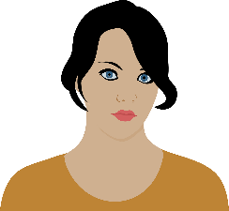
Vocabulaire
Écoute et traduis les mots en anglais.
écouter
5
3
to wonder, to ask oneself
6
1
se demander
s’organiser
se sentir
to organise oneself, organising oneself
to feel, feeling
to have (somebody) to stay, having (somebody) to stay
4
loger
se trouver
se lever
to be located, to find oneself
to stand up, get up
2
10
Afghan
afghan
8
crisis
la crise
9
12
grave
7
serious, grave
l’association (f)
association
conflict
le conflit
Afghanistan
l’Afghanistan (m.)
13
current
actuel
11
Notes:
Timing: 3 minutes
Aim: Recognition of this week’s new vocabulary and translation into English.
Procedure:
Click on the shapes to hear the French word.
Elicit translation into English from students (this can be done on mini-whiteboards).
Click to reveal answers.
Transcript:
se sentir
se lever
s’organiser
se trouver
se demander
loger
le conflit
la crise
l’association
afghan
l’Afghanistan
grave
actuel

Slide 9
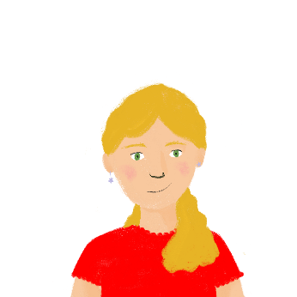
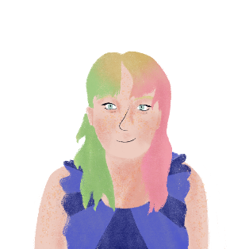
Vocabulaire
écouter / écrire
Léa et Stéphanie jouent à un jeu de vocabulaire, Connect 6. Léa dit trois mots. Stéphanie dit le thème.
Quel est le thème ?
le système scolaire | les examens
l’aéroport | la pandémie
l’isolement | l’école
annuler,
le vol,
voler
les amis,
la connaissance,
la compétence
1
4
durer,
le contrôle, corriger
mondial,
le masque,
le vaccin
2
5
longtemps, nécessaire, interdit
troisième, quatrième, cinquième
3
6
Notes:
Timing: 4 minutes
Aim: To revise previously learnt vocabulary in the oral modality. Time is constrained to compel learners to comprehend words more quickly, a valuable component in vocabulary practice that speeds up the process of recall.
Procedure:
1. Write 1-6 in books. 2. Listen to each set of three words and write the most appropriate category word. Note: It may be useful to write all the words down to have more time to review them and select the most appropriate category word. 3. Answers (including a written version of the three words in each set) appear on mouse clicks. 4. Check all meanings are known.
Transcript:
annuler, le vol, voler
durer, le contrôle, corriger
longtemps, nécessaire, interdit
les amis, la connaissance, la compétence
mondial, le masque, le vaccin
cinquième, quatrième, troisième

Slide 10
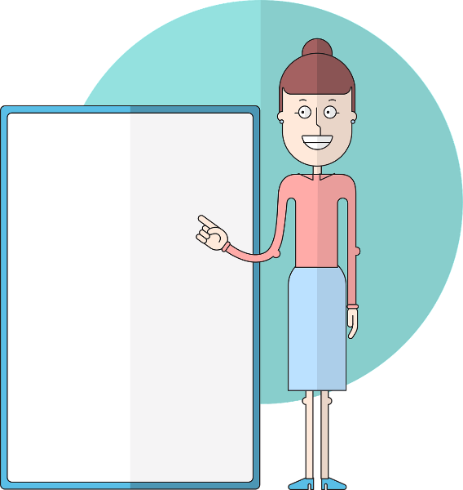
Direct object pronouns ‘me’ and ‘te’
grammaire
Remember, when ‘me’ or ‘you’ is the direct object of a verb, we use the direct object pronouns me and te.
Le professeur me corrige.
The teacher corrects me.
Je te respecte.
I respect you.
Je te corrige.
The direct object pronoun goes before the verb.
Notes:
Timing: 2 minutes
Aim: Recap direct object pronouns me and te
Procedure:
1. Click to reveal examples and explanations, eliciting English where possible.
2. Ensure understanding.

Slide 11
Un message d’Afghanistan
La mère de Stéphanie lit un message de son frère, qui habite
en Afghanistan. Remplis les blancs.
lire
Ma chère sœur,
Tu me soutiens toujours et je te respecte beaucoup. Aujourd’hui je te demande d’aider mes enfants. Peux-tu loger Max et Nina en France pendant cette crise ? L’armée afghane m’oblige à rester ici pour aider dans le conflit, et je veux aider mon pays d’adoption, mais la situation actuelle est grave. Les soldats du régime taliban ont beaucoup de pouvoir en Afghanistan. Les enfants me demandent si c’est dangereux ici, et Nina veut savoir pourquoi les talibans l’empêchent d’aller à l’école. Ma femme ne peut pas laisser ses parents malades en ce moment, mais une association m’aide à envoyer les enfants au Pakistan. J’ai un ami à Peshawar, mais peuvent-ils venir chez toi du Pakistan? Tu m’aides ? Merci mille fois, Joseph
actuelle
grave
1
loger
2
3
conflit
4
crise
5
6
association
7
afghane
Afghanistan
8
Notes:
Timing: 8 minutes [slide 1/2]
Aim: Recognition of new vocabulary in context and revision of direct object pronouns me and te
Procedure:
1. Students write 1-8 and choose the correct words to fill the gaps.
2. Click to reveal answers.
3. Display the next slide. Students translate the phrases in bold into English.
4. Click to reveal answers.
5. Discuss choice between simple present and present continuous in English.
Note: l’Afghanistan is masculine, but we use en to say ‘in Afghanistan’ because the country name begins with a vowel.
Word frequency of unknown words used (1 is the most frequent word in French):
Word frequency of cognates used (1 is the Afghanistan most frequent word in French):
adoption [2321]
Source: Lonsdale, D., & Le Bras, Y. (2009). A Frequency Dictionary of French: Core vocabulary for learners London: Routledge.

Slide 12
Un message d’Afghanistan
Traduis les phrases en gras en anglais.
lire
1. You support me
Ma chère soeur,
[1] Tu me soutiens toujours et [2] je te respecte beaucoup. Aujourd’hui [3] je te demande d’aider mes enfants. Peux-tu loger Max et Nina en France pendant cette crise ? [4] L’armée afghane m’oblige à rester ici pour aider dans le conflit, et je veux aider mon pays d’adoption, mais la situation actuelle est grave. Les soldats du régime taliban ont beaucoup de pouvoir en Afghanistan. [5] Les enfants me demandent si c’est dangereux ici, et Nina veut savoir pourquoi [6] les talibans l’empêchent d’aller à l’école. Ma femme ne peut pas laisser ses parents malades en ce moment, mais [7] une association m’aide à envoyer les enfants au Pakistan. J’ai un ami à Peshawar, mais peuvent-ils venir chez toi du Pakistan? [8] Tu m’aides ?
Merci mille fois, Joseph
2. I respect you
3. I’m asking you
4. The Afghan army is forcing me
5. the children are asking me
6. the Taliban are preventing her
7. an association is helping me
8. (will) you help me?
Notes:
Slide 2/2

Slide 13
Reflexive pronouns ‘me’ and ‘te’
grammaire
Sometimes, the ‘doer’ (subject) and the ‘receiver’ (object) of a verb is the same person.
I organise myself.
You ask yourself.
Words like ‘myself’ and ‘yourself’ are called reflexive pronouns.
Remember, me and te are shortened to m’ and t’ before verbs that begin with a vowel or h muet.
In French, we use me and te as reflexive pronouns.
Je m’organise.
Tu te demandes.
Notes:
Timing: 2 minutes
Aim: Introduction of reflexive use of me and te and recap of contraction of the pronouns me and te before verbs beginning with a vowel or h muet
Procedure:
1. Click to reveal explanations and examples.
2. Ensure understanding.
3. Click to reveal reminder of contraction of me and te before verbs beginning with a vowel or h muet.
4. Ensure understanding.

Slide 14
Le cousin de Stéphanie
écouter
Stéphanie appelle son cousin, Max. Coche la bonne traduction.
 | A | B | C
 | Hi, Max! Where do you find me? | Hi, Max! Where are you? | Hi, Max! Where do you find your bag?
 | A family friend is having me to stay in Peshawar in Pakistan. | A family friend is staying with me in Peshawar in Pakistan. | I’m at home in Afghanistan.
 | I’m asking you if you’re scared. | I’m asking you to be scared. | I wonder if you’re scared.
 | I feel safe here, but sad. | I feel that you are safe, but sad. | You feel that I’m safe here, but sad.
1
2
3
4
Notes:
Timing: 8 minutes
Aim: Aural recognition of reflexive pronouns me and te
Procedure:
1. Click the buttons to play the audio.
2. Students tick the correct translation.
3. Tick to reveal answers.
4. Discuss which is the odd one out. (Number 8, since te is used as a direct object pronoun, and not reflexively.
Transcript:
Salut, Max ! Tu te trouves où ?
Un ami de la famille me loge à Peshawar au Pakistan.
Je me demande si tu as peur.
Je me sens en sécurité ici, mais triste.
Tu te prépares pour le voyage en France ?
Je me lève tôt tous les jours et je m’organise.
Tu t’achètes un billet d’avion ?
Oui, et je me prépare.

Slide 15
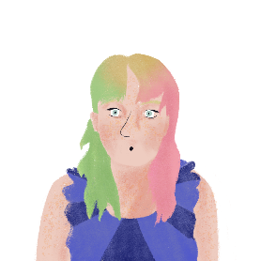
Le cousin de Stéphanie
écouter
Stéphanie appelle son cousin, Max. Coche la bonne traduction.
 | A | B | C
 | I’m getting ready for the journey to France. | Are you preparing your bag for the journey to France? | Are you getting ready for the journey to France?
 | I get up early every day and I organise my bag. | You get up early every day and organise my things. | I get up early every day and get organised.
 | Are you buying me a plane ticket? | Are you buying yourself a plane ticket? | Am I buying you a plane ticket?
 | Yes, and you’re preparing yourself. | Yes, and I’m preparing myself. | Yes, I’ll prepare you.
5
6
7
8
Notes:
Slide 2/2

Slide 16
Using reflexive pronouns
grammaire
Reflexive pronouns usually go before the verb.
This is different from English.
Je me demande.
I ask myself.
Tu te prépares.
You prepare yourself.
Notes:
Timing: 2 minutes
Aim: Introduction of preverbal position of reflexive pronouns me and te
Procedure:
1. Click to reveal explanations and examples.
2. Ensure understanding.

Slide 17
La conversation de Stéphanie et Max
écrire
Écris la conversation de Stéphanie et Max en français.
Hi, Max! Where are you?
A family friend is having me to stay in Peshawar in Pakistan.
I wonder if you’re scared.
I feel safe here, but sad.
Are you getting ready for the journey to France?
I get up early every day and get organised.
Are you buying yourself a plane ticket?
Yes, and I’m preparing myself.
Salut, Max ! Tu te trouves où ?
Un ami de la famille me loge à Peshawar au Pakistan.
Je me demande si tu as peur.
Je me sens en sécurité ici, mais triste.
Tu te prépares pour le voyage en France ?
Je me lève tôt tous les jours et je m’organise.
Tu t’achètes un billet d’avion ?
Oui, et je me prépare.
Notes:
Timing: 8 minutes
Aim: Written production of reflexive pronouns me and te
Procedure:
1. Students translate the sentences to recreate the dialogue between Stéphanie and Max.
2. Click to reveal suggested answers.

Slide 18
Refugees in France [1]
Reflexive pronouns ‘me’ and ‘te’
SSCs [-gn-], [j/soft g]
Y9 French
Term 3.2 - Week 3 - Lesson 64
Author name(s): Catherine Salkeld / Louise Bibbey
Artwork by: Chloé Motard
Date updated: 08/08/22
Notes:
Artwork by Chloé Motard. All additional pictures selected are available under a Creative Commons license, no attribution required.
Native teacher feedback provided by Sarah Brichory.
With thanks to Rachel Hawkes for her input on lesson material.
Learning outcomes (lesson 2):
Consolidation of SSCs [-gn], [j/soft g]
Consolidation of reflexive pronouns me and te
Word frequency (1 is the most frequent word in French):
9.3.2.3: se demander [80], se lever [837], loger [3060], s’organiser [701], se sentir [536], se trouver [83], association [956], conflit [864], crise [765], actuel [584], grave [443], afghan [>5000], Afghanistan [>5000]
9.3.1.5 (revisit): annuler [2002], arriver2 à [172], continuer (de) [113], décider (de) [165], essayer (de) [303], voler2 [1610], bise [>5000], isolement [4033], masque [3856], pandémie [>5000], vaccin [>5000], vol2 [1531], impossible [652], interdit [4451], mondial [549], nécessaire [451]
9.2.2.1 (revisit): corriger [1639], durer [605], poser [218], compétence [1757], connaissance [806], contrôle [662], système [289], cinquième [2030], deuxième [427], quatrième [1603], primaire [2527], sixième [3124], troisième [506], longtemps [312]
Source: Lonsdale, D., & Le Bras, Y. (2009). A Frequency Dictionary of French: Core vocabulary for learners London: Routledge.
The additional English meanings of the following words have been added to Quizlet since the creation of this resource:
grave – serious, grave

Slide 19
-gn-
ligne
Notes:
Timing: 1 minute
Aim: To consolidate SSC [-gn-]
Procedure: 1. Present the letter(s) and say the [-gn-] sound first, on its own. Students repeat it with you. 2. Bring up the word ”ligne” on its own, say it, students repeat it, so that they have the opportunity to focus all of their attention on the connection between the written word and its sound.
3. A possible gesture for this would be to draw a line in the air with your finger, 4. Roll back the animations and work through 1-3 again, but this time, dropping your voice completely to listen carefully to the students saying the [-gn-] sound, pronouncing ”ligne” and, if using, doing the gesture.
Word frequency (1 is the most frequent word in French):
ligne [342]
Source: Londsale, D., & Le Bras, Y. (2009). A Frequency Dictionary of French: Core vocabulary for learners London: Routledge.

Slide 20
j/soft g
X
jour
Notes:
Timing: 1 minute
Aim: To consolidate SSC [j/soft g]
Procedure: 1. Present the letter(s) and say the [j/soft g] sound first, on its own. Students repeat it with you. 2. Bring up the word ”jour” on its own, say it, students repeat it, so that they have the opportunity to focus all of their attention on the connection between the written word and its sound.
3. A possible gesture for this would be to mime waking up at daybreak, by stretching out ones arms and yawning. 4. Roll back the animations and work through 1-3 again, but this time, dropping your voice completely to listen carefully to the students saying the [j/soft g] sound, pronouncing ”jour” and, if using, doing the gesture.
Word frequency (1 is the most frequent word in French):
jour [78].
Source: Londsale, D., & Le Bras, Y. (2009). A Frequency Dictionary of French: Core vocabulary for learners London: Routledge.

Slide 21
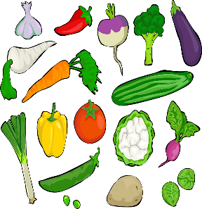
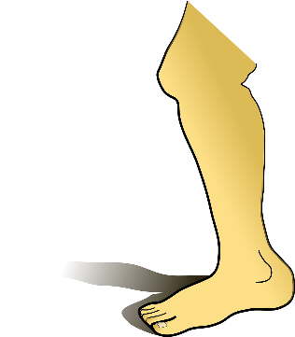
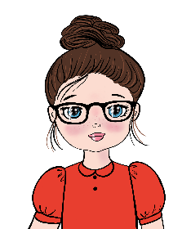
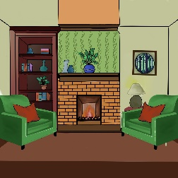
C’est hard [g], soft [g/j] ou [gn]?
écouter
beignet
[gn]
[donut]
singe
[j/soft g]
[monkey]
genou
[j/soft g]
[knee]
champignon
[gn]
[mushroom]
poignet
[gn]
[wrist]
légumes
[hard g]
[vegetables]
manège
[j/soft g]
[carousel]
gâteau
[hard g]
[cake]
bague
[hard g]
[ring]
gomme
[hard g]
[eraser]
joue
[j/soft g]
[cheek]
bougie
[j/soft g]
[candle]
magique
[j/soft g]
[magic]
chignon
[gn]
[hair bun]
justice
[j/soft g]
[justice]
vigne
[gn]
[vine]
gare
[hard g]
[station]
girafe
[j/soft g]
[giraffe]
guêpe
[hard g]
[wasp]
oignon
[gn]
[onion]
séjour
[j/soft g]
[lounge]
goûter
[hard g]
[snack]
châtaigne[gn]
[chestnut]
araignée
[gn]
[spider]
Notes:
Timing: 3 minutes
Aim: To consolidate aural recognition of [hard g], [j/soft g] and [gn]
Procedure:
Click on the pictures to hear the word spoken
Ask students to identify if they hear the SSC [hard g], [j/soft g] or [gn]
Click again to reveal the word, the correct SSC and the English translation.
Transcript:
beignet
gâteau
magique
girafe
guêpe
oignon
chignon
bague
singe
genou
champignon
gomme
justice
séjour
goûter
châtaigne
vigne
joue
poignet
légumes
manège
bougie
gare
araignée
Word frequency of unknown words (1 is the most frequent word in French): beignet [>5000], gâteau [4845], guêpe [>5000], chignon [>5000], bague >5000], singe [4739], genou [2967], champignon [>5000], gomme [>5000], séjour [2007], goûter [4441], châtaigne [>5000], vigne [>5000], joue [3932], poignet [>5000], légumes [>5000], manège [>5000], bougie [>5000], gare [2582], araignée [>5000] Source: Lonsdale, D., & Le Bras, Y. (2009). A Frequency Dictionary of French: Core vocabulary for learners London: Routledge.
Word frequency of cognates (1 is the most frequent word in French): magique [3530], girafe [>5000], oignon [>5000], justice [637] Source: Lonsdale, D., & Le Bras, Y. (2009). A Frequency Dictionary of French: Core vocabulary for learners London: Routledge.

Slide 22
Vocabulaire
lire
Nina parle à Noura du système scolaire en France.
Remplis les trous.
2
Oui, Nina, j'aime apprendre et essayer de nouvelles activités. Ce n'est pas impossible de s'amuser à l'école !
1
Noura, je peux te poser une question ?
Est-ce que tu aimes l'école primaire ?
_______
_______
___________
____________
Oui, j’ai décidé de t’encourager à parler français tout le temps, donc tu peux continuer d’apprendre. Je te prépare pour être en sixième !
4
3
essayer poser
impossible sixième primaire
décidé de arriver
continuer de
Est-ce que je peux arriver à parler français à l'école ?
_________
__________
____________
_______
Notes:
Timing: 5 minutes Aim: Written recognition of revisited vocabulary Procedure: 1. Explain the procedure. Students read through the text use the relevant vocabulary
2. Ask students to fill in the gaps.
3. Click to reveal answers.

Slide 23
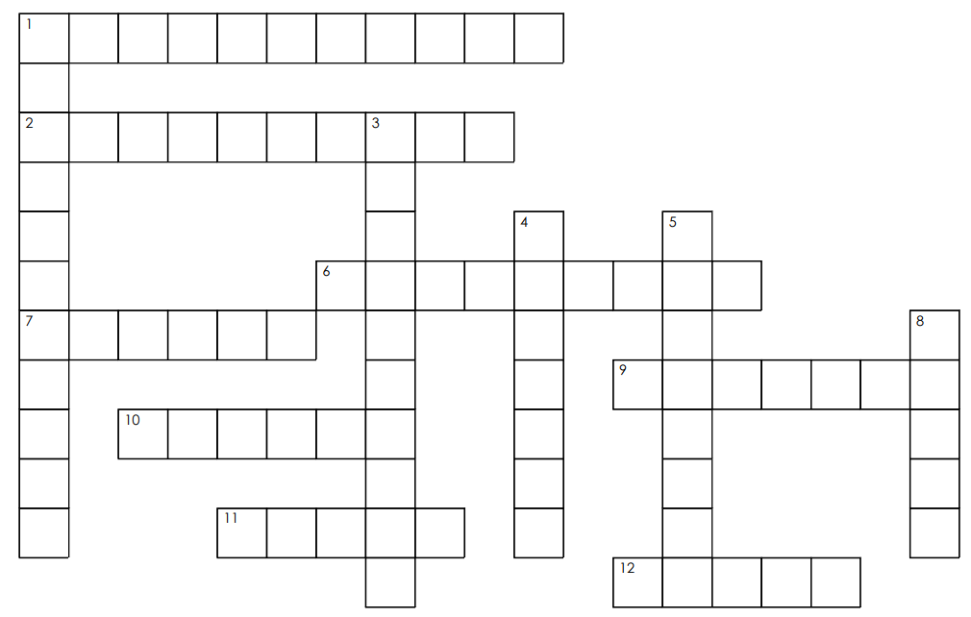
Mots croisés
écrire
Down:
1. association
3. to wonder / ask oneself
4. conflict
5. to feel
8. crisis
Across:
1. Afghanistan
2. to organise oneself
6. to find oneself
7. current
9. to stand up / get up
10. Afghan
11. to have (somebody) to stay
12. serious
A
F
G
H
A
N
I
S
T
A
N
S
S
O
R
G
A
N
I
S
E
R
O
E
C
D
C
S
I
S
E
T
R
O
U
V
E
R
A
C
T
U
E
L
M
N
S
C
T
A
F
S
E
L
E
V
E
R
I
A
F
G
H
A
N
L
N
I
O
D
I
T
S
N
L
O
G
E
R
T
I
E
R
G
R
A
V
E
Notes:
Timing: 5 minutes
Aim: Writing this week’s new vocabulary in a crossword puzzle.
Procedure:
Print the crossword handout for students to complete.
Click to reveal the answers.

Slide 24
Mots croisés
Down:
1. association
3. to wonder / ask oneself
4. conflict
5. to feel
8. crisis
Across:
1. Afghanistan
2. to organise oneself
6. to find oneself
7. current
9. to stand up / get up
10. Afghan
11. to have (somebody) to stay
12. serious
Notes:
Handout for printing

Slide 25
Differences in meaning
grammaire
Some verbs can mean different things when they’re used reflexively, or sometimes it sounds better to say it in a slightly different way in English.
Je prépare le repas.
Je me prépare.
I prepare the meal.
I prepare myself./I get ready.
Tu trouves ton sac.
Tu te trouves en France.
You find your bag.
You find yourself in France./You are in France.
Notes:
Timing: 2 minutes
Aim: Introduction to different meanings and translation when verbs are used reflexively and non-reflexively
Procedure:
1. Click to reveal explanations and examples, eliciting the English where possible.
2. Ensure understanding.

Slide 26
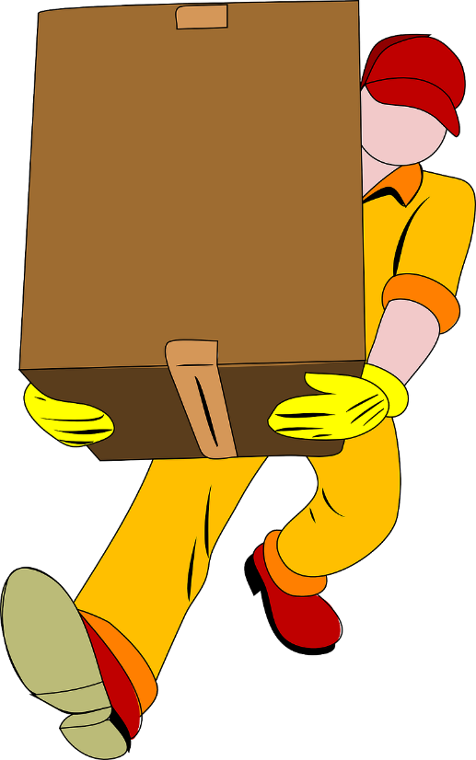
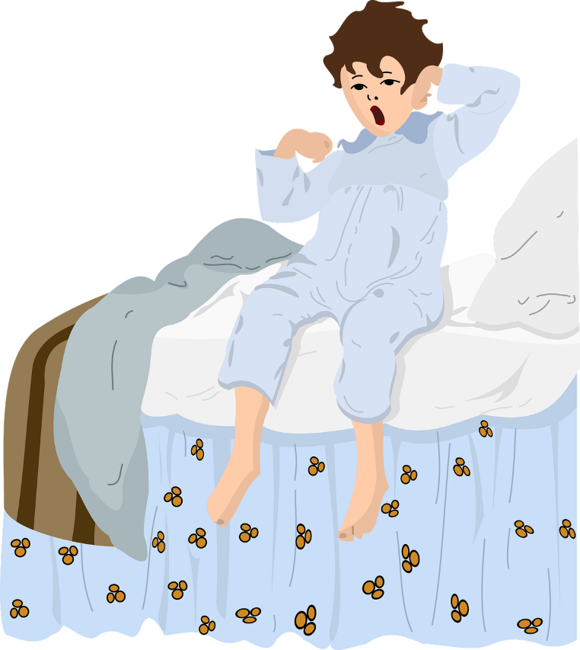
C’est quelle image ?
lire
je me lève
Notes:
Timing: 4 minutes [slide 1/4]
Aim: Recognition of different meanings and translation when verbs are used reflexively and non-reflexively
Procedure:
Students read the phrase and decide which picture it refers to.
Click to reveal answer.
Ensure understanding.

Slide 27
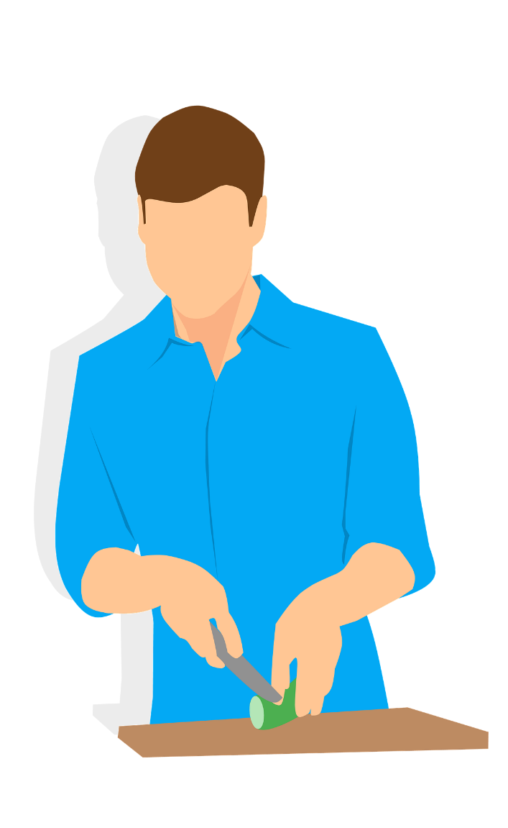
C’est quelle image ?
lire
je prépare
Notes:
Timing: 4 minutes [slide 2/4]
Aim: Recognition of different meanings and translation when verbs are used reflexively and non-reflexively
Procedure:
Students read the phrase and decide which picture it refers to.
Click to reveal answer.
Ensure understanding.

Slide 28
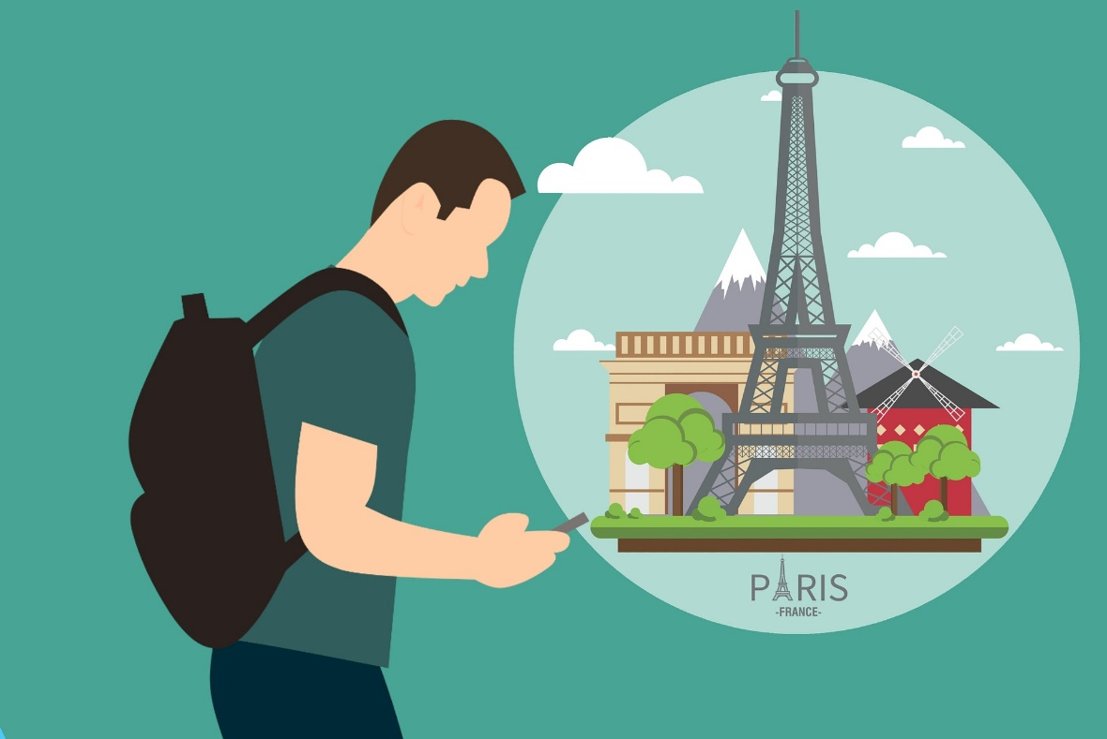
C’est quelle image ?
lire
je trouve
Notes:
Timing: 4 minutes [slide 3/4]
Aim: Recognition of different meanings and translation when verbs are used reflexively and non-reflexively
Procedure:
Students read the phrase and decide which picture it refers to.
Click to reveal answer.
Ensure understanding.

Slide 29
C’est quelle image ?
lire
je me demande
Notes:
Timing: 4 minutes [slide 4/4]
Aim: Recognition of different meanings and translation when verbs are used reflexively and non-reflexively
Procedure:
Students read the phrase and decide which picture it refers to.
Click to reveal answer.
Ensure understanding.

Slide 30
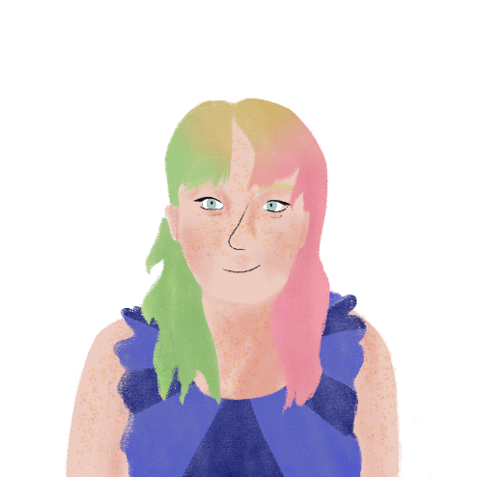
Un message pour Léa
Stéphanie envoie un message à Léa. On a besoin d’un pronom réfléchi ?
lire
Salut, Léa ! Peux-tu aider la semaine prochaine ? Mes cousins, Max et Nina viennent à Paris, et je me prépare. Ils sont d’Afghanistan et ils vont habiter chez nous. Je prépare une chambre. Je me demande si ton frère a des vêtements pour Max. Tu trouves un manteau de garçon ? Tu te lèves à quelle heure ce samedi ? Si tu te trouves au marché, tu aides avec les courses ? Je prépare un dîner spécial pour leur deuxième journée chez nous. Je me sens nerveuse mais contente !
Bises,
Stéphanie
1
2
3
4
5
6
7
8
*le pronom réfléchi = reflexive pronoun
Notes:
Timing: 8 minutes
Aim: Written comprehension of reflexive pronouns me and te
Procedure:
1. Students write 1-8 and choose the appropriate pronoun for each space. Point out that some spaces don’t need a pronoun.
2. Click to reveal answers.
3. Oral translation of text.
Word frequency of unknown words used (1 is the most frequent in French):
pronom [>5000], réfléchir [1058]
Word frequency of cognates used (1 is the most frequent word in French): cousin [3387], dîner [2365] , spécial [726]
Source: Lonsdale, D., & Le Bras, Y. (2009). A Frequency Dictionary of French: Core vocabulary for learners London: Routledge.

Slide 31
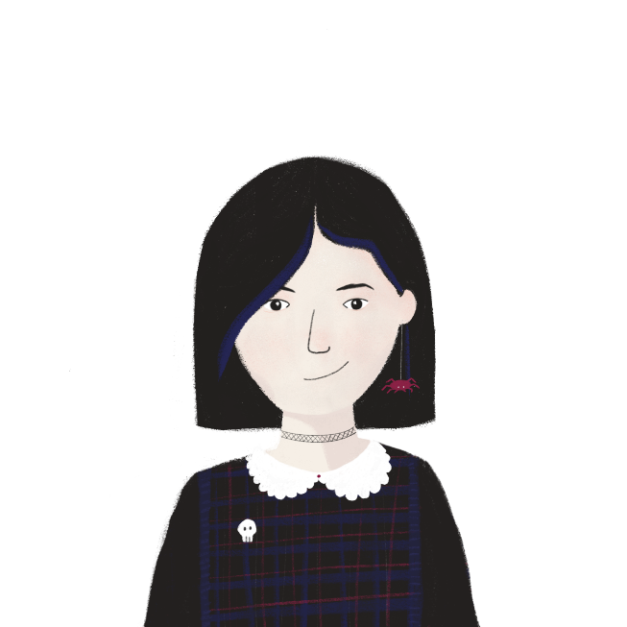
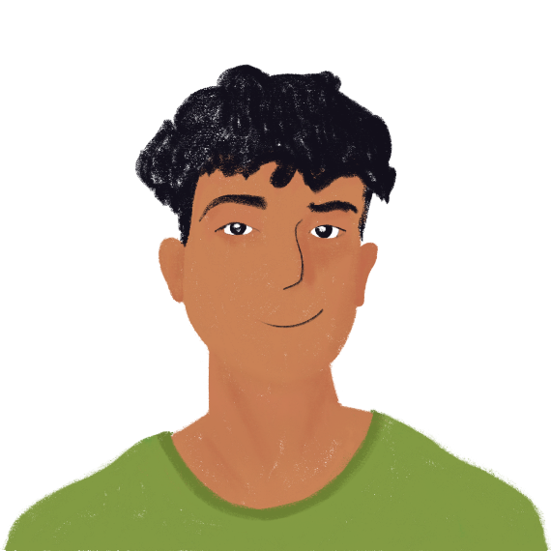
Une journée en vacances
parler
Tu parles à un(e) ami(e) qui est en vacances. Pose des questions.
Tu te prépares à quelle heure ?
Je me prépare à neuf heures.
[what time] get ready
[9:00] get ready
Notes:
Timing: 10 minutes
Aim: Oral production of reflexive pronouns me and te
Procedure:
1. Print the role cards.
2. Partner A asks Partner B questions to find the information listed.
3. Students swop roles.

Slide 32
Une journée en vacances
parler
Partenaire A
[where] [find yourself]
[what time] [get up]
[how] [organise yourself]
[with whom] get ready
[find myself] Nice
7:00 [get up]
quickly [organise myself]
sister [get ready]
Partenaire B
[where] [find yourself]
[what time] [get up]
[how] [organise yourself]
[with whom] get ready
[find myself] Spain
6:00 [get up]
slowly [organise myself]
friends [get ready]
Notes:
Timing: 10 minutes
Aim: Oral production of reflexive pronouns me and te
Procedure:
1. Print the role cards.
2. Partner A asks Partner B questions to find the information listed.
3. Students swop roles.

Slide 33
La vie à Paris
écrire
Écris un message à Max sur la vie à Paris.
Ask him:
where he is now
if he’s getting ready for living with Stéphanie
Tell him:
he’s going to go to your school
what time you get up
when you get organised for school
you’re wondering if he needs books
the teachers are nice, and they help you and encourage you
Notes:
Timing: 12 minutes
Aim: Written production of direct object pronouns me and te and reflexive pronouns me and te
Procedure:
1. Students write a message to Max, using the bullet points as prompts.
2. Suggested answer on next slide.

Slide 34
La vie à Paris
écrire
Salut, Max !
Tu te trouves où maintenant ? Tu te prépares pour ta vie chez Stéphanie ?
Tu vas aller à mon collège. Normalement je me lève à sept heures. Je m’organise pour le collège le soir. Je me demande si tu as besoin de livres. Les professeurs sont sympas. Ils t’aident et t’encouragent.
À bientôt !
Notes:
SUGGESTED ANSWER

Slide 35
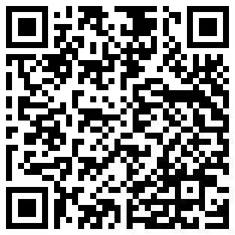
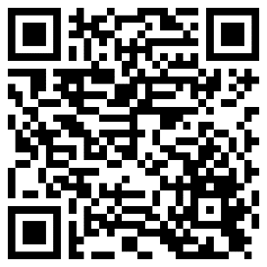
Devoirs
Vocabulary Learning Homework (Y9, Term 3.2, Week 4)
Audio Homework link
Audio Homework QR code:
Quizlet link
Quizlet QR code:
Student worksheet
In addition, revisit:
Y9, Term 2.2, Week 2
Y9, Term 3.2, Week 1
Notes:
The answer sheet for the 9.3.2.4 vocabulary learning homework is here: Resource | French SOW Y9 Term 3.2 Week 4 - vocabulary learning homework answers | ID: hd76s2386 | NCELP

