Slide 1
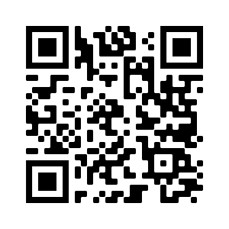
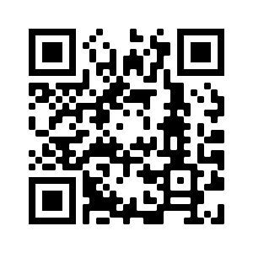
Deberes
Vocabulary Learning Homework (Term 2.2, Week 3)
Audio file 1 (days of the week):
Audio file 2 (other vocabulary):
QR code 1:
QR code 2:
Student worksheet 1
Student worksheet 2
Quizlet link
Quizlet link
In addition, revisit: Term 2.1, Week 5
Term 1.2, Week 7

