Slide 1
Ein Schulaustausch
Verbs with prepositions an, auf, für, vor
Revisit [-g-] [-g] [-ig]
Y9 German
Term 3.1 - Week 5 - Lesson 55
Heike Krüsemann / Rachel Hawkes
Artwork: Steve Clarke
Date updated: 12 / 10 / 21
Notes:
Artwork by Steve Clarke. All additional pictures selected are available under a Creative Commons license, no attribution required.
Native-speaker teacher feedback provided by Stephanie Cross.
Learning outcomes (lesson 1):
Consolidation of SSC [-g-] [-g] [-ig]
Introduction of verbs with prepositions an, auf, für, vor, reflexive and non-reflexive use
Word frequency (1 is the most frequent word in German):
9.3.1.5 (introduce) hoffen (auf) [689] interessieren [631] (sich) interessieren (für) [631] sich freuen (auf) [589] warnen (vor) [1337] Autor [723] Druck [558] Erfolg [541] Interview [931] Rede [759] morgen [752]
9.3.1.1 (revisit) ausgehen [483] begrüßen [1690] teilnehmen [1714] durfte, durftest [143] sollte, solltest [60] Bank2 [543] Lauf [1377] Müll [4506] Projekt [720] Zweck [1604] lokal [1981] sauber [2026]
9.1.2.6 (revisit) dich² [217] mich² [65] sich [14] anziehen [1436] fühlen [394] halten [155] nennen [191] waschen [2315] Bett [659] Stuhl [1661] verantwortlich [1042] gerade [159]
Source: Jones, R.L & Tschirner, E. (2019). A frequency dictionary of German: Core vocabulary for learners. London: Routledge.
The frequency rankings for words that occur in this PowerPoint which have been previously introduced in NCELP resources are given in the NCELP SOW and in the resources that first introduced and formally re-visited those words.
For any other words that occur incidentally in this PowerPoint, frequency rankings will be provided in the notes field wherever possible.

Slide 2
Phonetik
sprechen / hören
Remember that at the start or in the middle of words, German [g] is usually pronounced like the ‘g’ in English ‘go’, including in words that are written in a similar way to English words.
Sag die Wörter. Wie im Englischen oder anders?
anders
anders
 | digital
 | Original
 | Migration
 | religiös
 | Signal
 | organisch
 | intelligent
 | Figur
1
5
2
6
3
7
4
8
Notes:
Timing: 3 minutes Aim: to remind students of the similarities and differences in the English and German pronunciation of the SSC [g], using cognates and near-cognates, most of which have not been previously taught. The activity aims to show that while the pronunciation of this SSC changes in English, it is consistent in German. Procedure: 1. Students say the words aloud in German, (following the rule that [g] at the start or in the middle of words sounds like ‘g’ in ‘go’)
2. They compare how the words sound with the pronunciation of their English equivalents.
3. They note down for each whether the [g] sound is the same as in English or different.
4. Click to listen and check the German pronunciation.
Transcript: digital Original Migration religiös Signal organisch intelligent Figur Word frequency (1 is the most frequent word in German): digital [1291] Figur [1285] intelligent [3121] Migration [4123] organisch [1096] original [4279] religiös [1977] Signal [1545] Source: Jones, R.L. & Tschirner, E. (2019). A frequency dictionary of German: core vocabulary for learners. Routledge

Slide 3
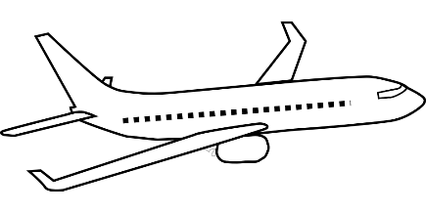
Phonetik
hören / sprechen
Remember that when you say the German [g] at the start or in the middle of a word, your vocal chords vibrate.
However, when [g] is the final sound in the word, it sounds more like ‘k’, and you don’t use your vocal chords.
Compare:
Flugzeug
Flugzeuge
The suffix –zeug often means –thing(s) in English. E.g., Flugzeug → flying thing!
Notes:
Timing: 1 minute Aim: to recap the different sound and physiology involved in the final [g] sound in German, comparing it to the initial and mid-word sound. This prepares for the pronunciation task on the next slide.
Procedure: 1. Students listen to each word.
2. They then touch their vocal chords and say the words again, hearing the difference between the two sounds, and feeling the difference between the voiced and unvoiced [g] sounds.
Transcript: Flugzeug Flugzeuge Word frequency (1 is the most frequent word in German): Flugzeug [1776] Source: Jones, R.L. & Tschirner, E. (2006). A frequency dictionary of German: core vocabulary for learners. Routledge

Slide 4
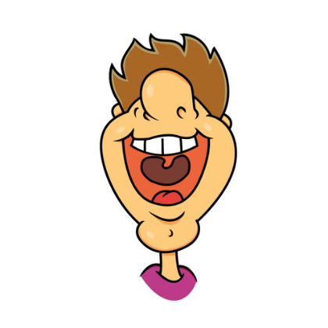
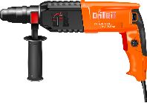
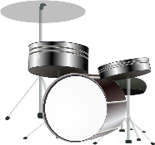
Phonetik
sprechen / hören
Sag die Wörter.
Singular
 | Singular | Plural | Was | Englisch
 | Fahrzeug | Fahrzeuge |  | vehicle
 | Spielzeug | Spielzeuge |  | toy
 | Werkzeug | Werkzeuge |  | tool
 | Schlagzeug | Schlagzeuge |  | drums
 | Feuerzeug | Feuerzeuge |  | lighter
 | Flugzeug | Flugzeuge |  | plane
1
________
________
2
__________
__________
3
________
________
Plural
4
__________
__________
5
________
________
6
__________
__________
Notes:
Timing: 4 minutes Aim: to practise pronunciation of two [g] sounds in German, consolidate knowledge of plural rule 1, and recall some known vocabulary. Picture prompts and/or English gloss are provided to support word recognition. Procedure: Students work in pairs to pronounce the words.
Transcript: Fahrzeug, Fahrzeuge Word frequency (1 is the most frequent word in German): Fahrzeug [1721] Feuerzeug {>5009] Schlagzeug [>5009] Spielzeug [>5009] Werkzeug [3681] Source: Jones, R.L. & Tschirner, E. (2019). A frequency dictionary of German: core vocabulary for learners. Routledge

Slide 5
Vokabeln
hören / schreiben
Hör zu und schreib die Wörter auf Deutsch und Englisch.
 | Deutsch | Englisch
 | der Autor | author
 | das Interview | interview
 | hoffen (auf) | to hope (for)
 | sich freuen (auf) | to look forward (to)
 | morgen | tomorrow
 | die Rede | talk, speech
1
2
 | Deutsch | Englisch
 | interessieren | to interest
 | sich interessieren (für) | to be/get interested (in)
 | der Druck | pressure
 | warnen (vor) | to warn (about)
 | der Erfolg | success
3
7
4
8
5
9
6
10
11
Notes:
Timing: 5 minutes
Aim: to recognise (and transcribe) this week’s new vocabulary in the oral and written modalities.
Procedure: 1. Click to hear the words in German. 2. Students write down the English meaning. 3. Click to reveal answers and transcriptions, one by one.
4. Click to cover the English.
5. Teacher now points at the German words in a random order.
6. Students say the English.
Transcript:
der Autor
das Interview
hoffen (auf)
sich freuen (auf)
morgen
die Rede
interessieren
sich interessieren (für)
der Druck
warnen (vor)
der Erfolg

Slide 6
Vokabeln
Person A dreht sich um. Person B sagt die Wörter auf Deutsch. Person A übersetzt ins Englische. Dann tauscht die Rollen.
hören / sprechen
warnen (vor)
die Rede
morgen
sich freuen (auf)
[to warn (about)]
[to look forward (to)]
[speech, talk]
[tomorrow]
interessieren
der Erfolg
sich interessieren (für)
[to be/get interested in]
[to interest]
[success]
der Druck
hoffen (auf)
der Autor
das Interview
[pressure]
[to hope (for)]
[author]
[interview]
Notes:
Timing: 5 minutes
Aim: to practise aural recognition and read aloud of this week’s new vocabulary.
Procedure: 1. Person A turns away from the board.
2. Person B calls the German words in any order.
3. Person A translates them orally into English. (Person B corrects translations, if necessary).
4. They swap roles and repeat.

Slide 7
Using verbs reflexively
Reflexive use: the ‘doer’ (subject) and ‘receiver’ (object) of the action are the same.
Grammatik
You know that many verbs can be used reflexively and non-reflexively:
[reflexive use]
Sie zieht sich an.
She dresses herself. (She gets dressed).
Sometimes English uses a different verb for reflexive and non-reflexive meanings.
[non-reflexive use]
Sie zieht die Jacke an.
She puts the jacket on.
Use German reflexive pronouns in place of another object, as in English:
Some verbs in German are used reflexively but non-reflexively in English:
[German reflexive use]
Ich fühle mich wohl.
[English non-reflexive use]
Ich feel well.
Notes:
Timing: 2 minutes Aim: to recap reflexive use of verbs in the present tense. Procedure: 1. Click through the animations to present the knowledge.
2. Where appropriate, elicit the English meanings from students.

Slide 8
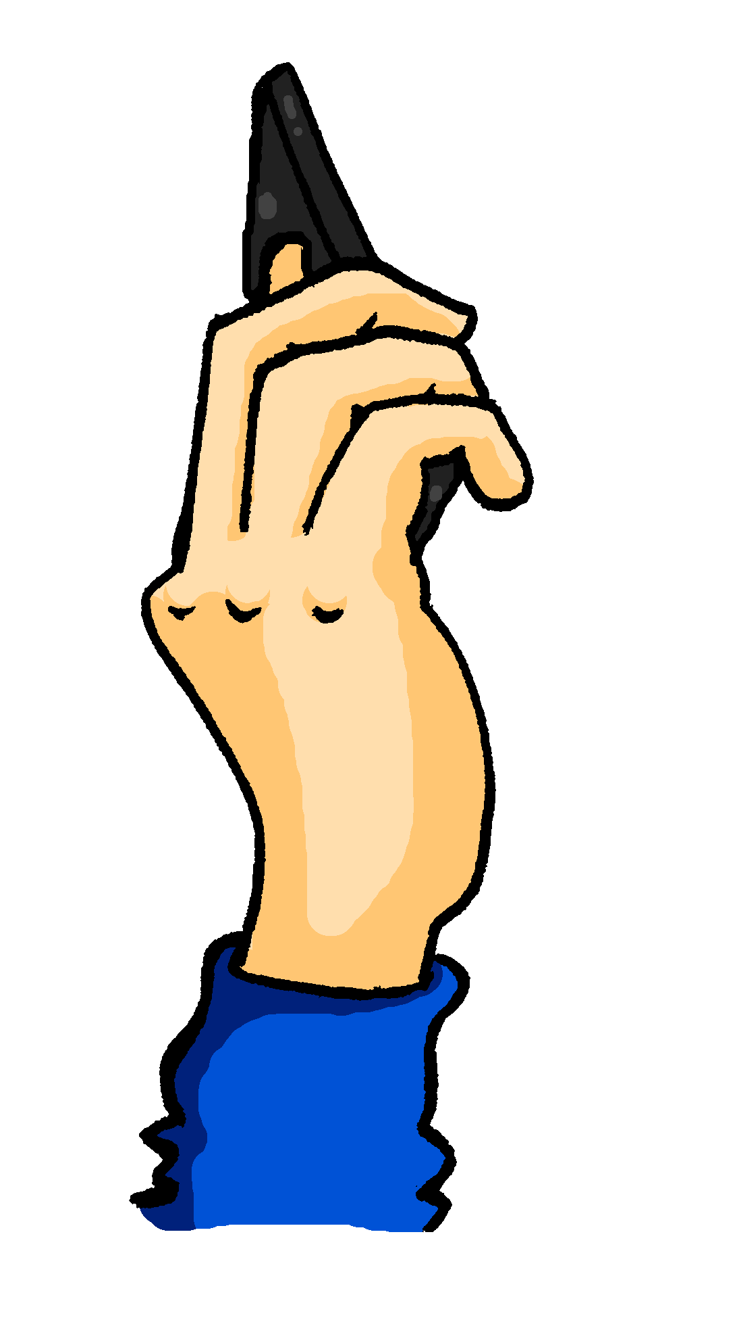
Mia an Wolf
Mia whatsappt Wolfgang über den Austausch. Ist das mich, dich, oder --?
lesen
 |  | mich | dich | --
1. | Ich wasche [ ] meine Tasche.
2. | Meldest du [ ] am Montagabend?
3. | Du sagst, du ziehst [ ] deine neue Kleidung an?
4. | Ich ziehe [ ] schon um 6 Uhr an.
5. | Du fühlst [ ] den Druck, ne?
6. | Ich interessiere [ ] für die Schule in Schottland.
7. | Du nennst [ ] Wolf statt Wolfgang, nicht wahr?
8. | Ich freue [ ] auf den Austausch.
[ -- ]
dich
[ -- ]
mich
[ -- ]
[ -- ]
dich
mich
Notes:
Timing: 7 minutes Aim: to identify reflexive and non-reflexive use of verbs and select the correct pronoun where appropriate. Procedure: 1. Students read items 1-8 and decide whether a pronoun is need and if so which one (mich or dich), or whether no pronoun is needed (where a direct object is involved).
2. Click through the animations for the answer ticks.
Word frequency (1 is the most frequent word in German): Source: Jones, R.L. & Tschirner, E. (2019). A frequency dictionary of German: core vocabulary for learners. Routledge

Slide 9
Mia an Alastair
Mia sitzt neben Wolfgang im Flugzeug und schickt Alastair Voicenachrichten. Ist das mich, dich, sich oder --?
hören
 |  | mich | dich | sich | --
 | Ich fühle mich verantwortlich.
 | Er schaut aus dem Fenster.
 | Du sagst, du wäscht die Bettwäsche?
 | Ich ziehe meine Jacke an.
 | Fühlst du dich gut?
 | Er nennt die Städte auf dem Reiseplan.
 | Ich setze mich auf den Sitzplatz.
 | Er fühlt sich müde.
1
2
3
4
5
6
7
8
Notes:
Timing: 7 minutes Aim: Similar to the above reading task but with added layer of 3rd person (sich). Students identify reflexive and non-reflexive use of verbs and select the correct pronoun (mich, dich, or sich) where appropriate. Procedure: 1. Click on audio button 1 to paly the recording with the pronoun or the “blank space” bleeped out.
2. Students select either mich, dich, sich, or no pronoun needed (where there is a direct object instead of reflexive verb use).
3. Click for answer tick to appear.
4. Elicit the whole item – click for words to appear. Double-check that students understand the meaning.
5. Continue for items 2-8.
Transcript:
1. Ich fühle [mich] verantwortlich.
2. Er schaut [ ] aus dem Fenster.
3. Du sagst, du wäscht [ ] die Bettwäsche?
4. Ich ziehe [ ] meine Jacke an.
5. Fühlst du [dich] gut?
6. Er nennt [ ] die Städte auf dem Reiseplan.
7. Ich setze [mich] auf den Sitzplatz.
8. Er fühlt [sich] müde.
Word frequency (1 is the most frequent word in German): Source: Jones, R.L. & Tschirner, E. (2019). A frequency dictionary of German: core vocabulary for learners. Routledge

Slide 10
Verbs with prepositions
Grammatik
Many verbs in German (and English) are followed directly by a noun:
Ich halte das Buch.
I hold / I’m holding the book.
Other verbs need a prepositions to link them to a noun:
Ich warte auf das Buch.
I wait / I’m waiting for/on the book.
German verbs often use different prepositions from those used in English:
Ich hoffe auf die Ferien.
I hope / I’m hoping for the holidays.
Notes:
Timing: 2 minutes Aim: to introduce the concept of verbs with prepositions. Procedure: 1. Click through the animations to present the knowledge.
2. Where appropriate, elicit the English meanings from students.

Slide 11
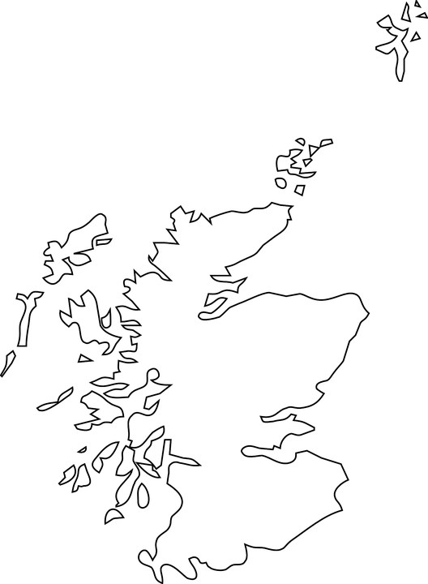
Wolfgang an Alastair
Wolfgang freut sich auf Schottland, und schreibt an Alastair. Schreib die Sätze fertig und übersetze. Ist die Preposition anders (a) als auf Englisch?
lesen
Lieber Alastair,
ich bin so glücklich, dass ich am Austausch mit Schottland teilnehmen kann! Ich interessiere mich für die Landschaft in Schottland, aber die Schule interessiert mich nicht so sehr. Ich freue mich auch besonders auf das Wandern in den Bergen, obwohl du vor schlechtem Wetter gewarnt hast. Ich hoffe trotzdem auf gutes Wetter für den Austausch!
…am Austausch teilnehmen kann.
1. Wolfgang ist glücklich, weil er…
to take part in – (a).
…sich für die Landschaft.
2. Wolfgang interessiert…
to be interested in – (a).
…sich auf das Wandern.
3. Er freut…
to look forward to – (a).
…vor schlechtem Wetter gewarnt.
4. Alastair hat…
to warn about – (a).
5. Wolfgang hofft trotzdem…
…auf gutes Wetter.
to hope for – (a).
Notes:
Timing: 9 minutes Aim: to practise this week’s vocabulary in the context of this lesson (German school trip (exchange) to Scotland). Procedure: 1. Students read Wolfgang’s letter/email to Alastair.
2. Students complete sentences 1-5 in German.
3. Click for correct sentence ending to appear for item 1.
4. Students identify the noun + preposition in the sentence ending and translate it. They write “a” (for anders) if the preposition used in German is different from the one used in English.
(Hint: all the prepositions used here are different from English!)
Word frequency (1 is the most frequent word in German): Source: Jones, R.L. & Tschirner, E. (2019). A frequency dictionary of German: core vocabulary for learners. Routledge

Slide 12
Ein Schulaustausch
Verbs with prepositions an, auf, für, vor
Revisit [-g-] [-g] [-ig]
Y9 German
Term 3.1 - Week 5 - Lesson 56
Heike Krüsemann / Rachel Hawkes
Artwork: Steve Clarke
Date updated: 12 / 10 / 21
Notes:
Artwork by Steve Clarke. All additional pictures selected are available under a Creative Commons license, no attribution required.
Native-speaker teacher feedback provided by Stephanie Cross.
Learning outcomes (lesson 2):
Consolidation of SSC [-g-] [-g] [-ig]
Introduction of verbs with prepositions an, auf, für, vor, reflexive and non-reflexive use
Word frequency (1 is the most frequent word in German):
9.3.1.5 (introduce) hoffen (auf) [689] interessieren [631] (sich) interessieren (für) [631] sich freuen (auf) [589] warnen (vor) [1337] Autor [723] Druck [558] Erfolg [541] Interview [931] Rede [759] morgen [752]
9.3.1.1 (revisit) ausgehen [483] begrüßen [1690] teilnehmen [1714] durfte, durftest [143] sollte, solltest [60] Bank2 [543] Lauf [1377] Müll [4506] Projekt [720] Zweck [1604] lokal [1981] sauber [2026]
9.1.2.6 (revisit) dich² [217] mich² [65] sich [14] anziehen [1436] fühlen [394] halten [155] nennen [191] waschen [2315] Bett [659] Stuhl [1661] verantwortlich [1042] gerade [159]
Source: Jones, R.L & Tschirner, E. (2019). A frequency dictionary of German: Core vocabulary for learners. London: Routledge.
The frequency rankings for words that occur in this PowerPoint which have been previously introduced in NCELP resources are given in the NCELP SOW and in the resources that first introduced and formally re-visited those words.
For any other words that occur incidentally in this PowerPoint, frequency rankings will be provided in the notes field wherever possible.

Slide 13
Phonetik [–ig]
Sag die Wörter.
hören
Remember that German [-ig] usually occurs at the end of a word. Whether you pronounce it with [ch] as in Germany or [k] as in Austria, you don’t use your vocal chords.
However, adding additional letters to adjectives ending in [-ig] changes its sound to a voiced [g].
Compare:
1
Das ist richtig!
Das ist eine richtige Antwort!
2
Notes:
Timing: 30 seconds Aim: to recap the difference between [-ig] and [-ig-] and prepare students for the next practice task.

Slide 14
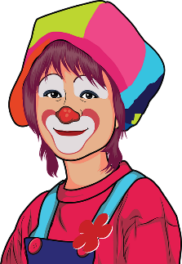
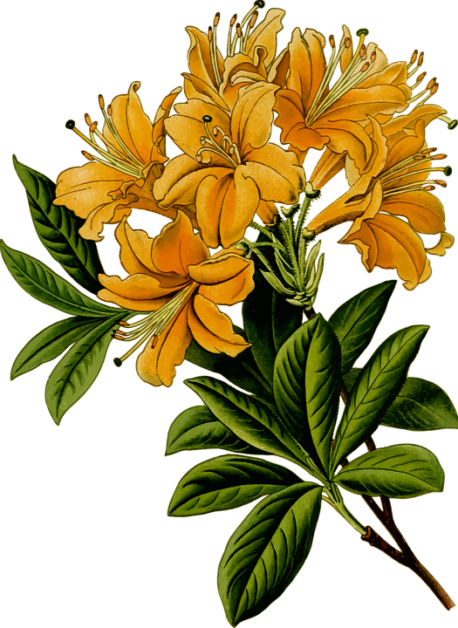
Phonetik 1
Person A
hören / schreiben
Person A liest 1-4, Person B dreht sich um und schreibt auf.
1. Ach, dieser Film ist sehr blutig. Ich will keinen blutigen Film sehen.
2. Ha ha! Sehr witzig! Du bist ein witziger Mensch.
3. Die Blumen für Alastairs Eltern haben Wasser nötig. Ich bringe ihnen das nötige Wasser.
4. Ich muss diese Woche für wichtige Tests lernen. Der Deutschtest ist ganz besonders wichtig!
Notes:
Timing: 8 minutes (two slides) – slide 1 of 2 Aim: to practise this week’s Phonics focus in a paired read-aloud and transcription task. Procedure: 1. Explain the task: Person A reads his/her four messages to Person B who is turned away from the board. Person B transcribes the messages. Then a 2nd slide with 4 x more messages to be transcribed as students swap roles. NB: the Phonics words (-g, -g-, -ig) are unknown words but that the other words in the sentences are all known, so that when the partner turns round to compare answers, an additional step is for the pair to work out what they think each adjective means.
2. Once Person B has turned away from the board, click for the messages to appear. Person A reads the messages and Person B transcribes.
3. When all four messages have been transcribed by Person B, they turn round again. Click on each speech bubble to play the recording, for checking.
4. The pair then discuss what they think the unknown words might mean.
5. Now click for the next slide, where students swap roles.
Word frequency (1 is the most frequent word in German):
blutig [4410] lebendig [2314] nötig {1038] witzig [4500] Source: Jones, R.L. & Tschirner, E. (2019). A frequency dictionary of German: core vocabulary for learners. Routledge

Slide 15
Phonetik 2
Person B
hören / schreiben
Person A liest 1-4, Person B dreht sich um und schreibt auf.
1. Alastairs Hund ist so winzig! Ich liebe so winzige Hunde.
2. Aber obwohl er winzig ist, ist er mutig. Toll, du winziger mutiger Hund!
3. Künftig will ich auch einen Hund haben. Mein künftiger Hund wird Fiffi heißen.
4. Winzige und mutige Hunde gibt es nicht so häufig. Häufiger sind große und mutige Hunde!
Notes:
slide 2 of 2
Aim: to practise this week’s Phonics focus in a paired read-aloud and transcription task. Procedure: 1. Explain the task: Person A reads his/her four messages to Person B who is turned away from the board. Person B transcribes the messages. Then a 2nd slide with 4 x more messages to be transcribed as students swap roles. NB: the Phonics words (-g, -g*) are unknown words but that the other words in the sentences are all known, so that when the partner turns round to compare answers, an additional step is for the pair to work out what they think each adjective means.
2. Once Person B has turned away from board, click for the messages to appear. Person A reads the messages and Person B transcribes.
3. When all four messages have been transcribed by Person B, they turn round again. Click on each speech bubble to play the recording, for checking.
4. The pair then discuss what they think the unknown words might mean.
Word frequency (1 is the most frequent word in German):
künftig [2332] mutig [3812] vorsichtig [1641] winzig [2219] Source: Jones, R.L. & Tschirner, E. (2019). A frequency dictionary of German: core vocabulary for learners. Routledge

Slide 16
Wie sagt man das?
1. Sag die Wörter laut.
sprechen / schreiben
2. Schreib die Wörter schnell auf.
der Müll
sauber
anziehen
rubbish
bank, bench
clean
to put on
die Bank
das Interview
teilnehmen
waschen
interview
to take part
to greet
to wash
begrüßen
die Rede
der Autor
der Erfolg
talk, speech
author
you were allowed
success
durftest
sich freuen (auf)
ausgehen
lokal
to look forward to
purpose, cause
der Zweck
to go out
local
Notes:
Timing: 5 minutes
Aim: to practise oral and then written production of this week’s new vocabulary and four previously taught words.
Procedure:
1. Click to start. The first box spins.
2. Students call out the German for that box before it stops spinning.
3. The German appears.
4. Repeat until all German words have been revealed. 5. Repeat the task, this time writing the German each time.

Slide 17
Verbs with prepositions
Grammatik
In R2 only the masculine article changes: der → den |ein → einen
Prepositions may change the article that follows.
Verbs + für are always followed by R2 (accusative):
Ich interessiere mich für den Autor.
I’m interested in the author.
Verbs + auf are usually followed by R2 (accusative):
Ich freue mich auf den Besuch.
I’m looking forward to the visit.
In R3 all articles change:
der/das → dem | ein → einem
Verbs + vor are always followed by R3 (dative):
Ich warne vor dem Druck.
I’m warning about the pressure.
die → der |eine → einer
Verbs + an are often followed by R3 (dative):
Ich nehme an der Rede teil.
I’m taking part in the talk.
Don‘t forget that an is followed by R2 when there is movement.
Notes:
Timing: 2 minutes Aim: to introduce the concept of verbs with prepositions. Procedure: 1. Click through the animations to present the knowledge.
2. Where appropriate, elicit the English meanings from students.

Slide 18
In Schottland
Mia und Wolfgang sind jetzt in Schottland.
lesen
Welcher Satzanfang passt?
 |  | Ende
1. | Ich freue mich auf / Ich habe Angst vor | der Party
2. | Alastair warnt vor / Alastair interessiert sich für | das Wandern
3. | Ich genieße das Teilnehmen an / Ich freue mich schon für nächstes Jahr auf | den Austausch
4. | Ich habe ein Geschenk für / Morgens warte ich auf meine Freunde vor | die Schule
5. | Der Austausch macht Druck auf / Alastairs Hund hat ein bisschen Angst vor | die Lehrerin
6. | Fürs Wochenende hoffe ich auf / Mutti warnt vor | eine Party
Notes:
Timing: 6 minutes Aim: to identify the correct sentence beginning from the ending – depending on the article of the noun in the sentence ending. Procedure: 1. Mia and Wolfgang are now in Scotland. how are they feeling? Based on the article of the noun under “Ende”, students select the correct sentence beginning (either using a R2 or a R3 preposition).
2. Click for the incorrect sentence beginning to disappear, leaving only the correct one.
Word frequency (1 is the most frequent word in German): Source: Jones, R.L. & Tschirner, E. (2019). A frequency dictionary of German: core vocabulary for learners. Routledge

Slide 19
Mia in Schottland
Mia spricht über den Austausch. Hör zu. Ist das Antwort 1 oder 2?
hören
 |  | Antwort 1 | Antwort 2
 | Ich habe Angst vor | dem Interview | den Lauf
 | Ich freue mich auf | die Party | dem Abend
 | Ich interessiere mich für | dem Essen | die Landschaft
 | Ich genieße das Teilnehmen an | der Aktivität | der Unterricht
 | Es gibt viel Druck auf | die Lehrerin | der Lehrer
 | Ich kaufe ein Geschenk für | dem Gastvater | die Gastmutter
 | Ich hänge das Gruppenfoto an | die Wand | der Tafel
 | Ich warte auf die Gruppe vor | das Haus | dem Schwimmbad
1
2
3
4
5
6
7
8
Notes:
Timing: 6 minutes Aim: to practise the same language knowledge as the reading above. Here, there is one sentence and the noun and article is bleeped out. Students choose between two answers. Procedure: 1. Click on the sound button for item 1 to play the recording.
2. Students listen and select either Antwort 1 or Antwort 2 – based on the preposition in the first half, and the article in the Antwort.
3. Click for answer tick to appear.
4. Click again for words to appear for checking for what was said.
5. Continue for times 2-8.
Transcript:
1. Ich habe Angst vor [dem Interview]
2. Ich freue mich auf [die Party]
3. Ich interessiere mich für [die Landschaft]
4. Ich genieße das Teilnehmen an [ der Gruppenaktivität]
5. Es gibt viel Druck auf [die Lehrerin]
6. Ich bringe ein Geschenk für [die Gastmutter]
7. Ich hänge das Gruppenfoto an [die Wand]
8. Ich warte auf die Gruppe vor [dem Schwimmbad].
Word frequency (1 is the most frequent word in German): Source: Jones, R.L. & Tschirner, E. (2019). A frequency dictionary of German: core vocabulary for learners. Routledge

Slide 20
Fragen an die deutschen Schüler
schreiben
Die Austauschschüler sind alle zusammen in Alastairs Schule. Die schottischen Schüler stellen Fragen auf Deutsch.
Schreibe deine eigenen Fragen, oder benutze die Hilfe 1-8.
1. Are you interested in the environment?
2. Are you afraid of the sea?
8. Are you warning about the bad weather?
6. Are you waiting for the holidays?
3. Are you looking forward to the party?
4. Are you taking part in the run?
5. Are you bringing a present for your partner?
7. Are you hoping for good grades?
Notes:
Timing: 10 minutes Aim: to practise the use of verbs with prepositions in the written modality (by writing questions). Procedure: 1. Students write eight yes/no questions each. They can use their own ideas or they can use the prompts on the post-it notes.
Word frequency (1 is the most frequent word in German): Source: Jones, R.L. & Tschirner, E. (2019). A frequency dictionary of German: core vocabulary for learners. Routledge

Slide 21
Fragen an die deutschen Schüler
sprechen
Benutze deine Notizen und stelle deinen Mitschülern* acht Fragen.
1. Are you interested in the environment?
2. Are you afraid of the sea?
8. Are you warning about the bad weather?
6. Are you waiting for the holidays?
3. Are you looking forward to the party?
4. Are you taking part in the run?
5. Are you bringing a present for your partner?
7. Are you hoping for good grades?
Mitschüler — other students in your class
Notes:
Timing: 10 minutes Aim: to role play the conversations prepared in the written task above. Procedure: 1. Students could go round the round the room talking to multiple others asking / answering at least 8 questions, or work in pairs.
Word frequency (1 is the most frequent word in German): Source: Jones, R.L. & Tschirner, E. (2019). A frequency dictionary of German: core vocabulary for learners. Routledge

Slide 22
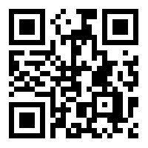
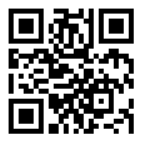
Hausaufgaben
Vocabulary Learning Homework (Y9, Term 3.1, Week 6)
Audio file QR code:
Audio file
Student worksheet
Quizlet QR code:
Quizlet link
In addition, revisit: Term 3.1 Week 3
Term 1.2 Week 7
Notes:
Student worksheet answers: https://resources.ncelp.org/concern/resources/z029p609k?locale=en

