Slide 1
Talking about the environment
–RE verbs (entendre, prendre, lire and écrire groups) (all persons), adjective forms
SSC revision
Y8 French
Term 3.2 - Week 2 - Lesson 63
Catherine Salkeld / Natalie Finlayson / Catherine Morris
Artwork by: Chloé Motard
Date updated: 11/10/22
Notes:
Artwork by Chloé Motard. All additional pictures selected are available under a Creative Commons license, no attribution required.
Native speaker feedback provided by Sarah Brichory.
With thanks to Rachel Hawkes and Emma Marsden for their input on the lesson material.
Learning outcomes (lesson 1):
Revision of SSCs Revision of –RE verbs (verbs like entendre, verbs like prendre, verbs like lire, verbs like écrire) Revision of adjective agreement patterns for gender (1-5) and number (1-3)
Word frequency (1 is the most frequent word in French):
calme [1731], content [1841], malade [1066], méchant [3184], triste [1843], chambre [633], idée [239], rapide [672], drôle [2166], fille [629], personne [84], garçon [1599], lit [1837], comme¹ [32], couleur [1211], ciel [1538], rêve [1313], vague [1493], voyage [904], numéro [766], mauvais [274], cocher [>5000], raison [72], exemple [259], préféré [preferer 597], histoire [263], tableau [1456], silence [1281], sage [2643], strict [1859], aussi [44], dans [11], problème [188], pour¹ [10], difficile [296], effort [388], d’accord [736], attention [482], île [1245], tuer [591], fils [735], guerre [266], contre [121], comme² [32], monde [77], politique [128], verité [907], erreur [612], facile [822], algérien, algérienne [4163], langue [712], combien [800], matière [562], science [1114], nom [171], parce que, bureau [273], équipe [814], sous [122], sur [16], derrière [805], devant [198], entre [55], rue [598], bâtiment [1952], haut [264], madame [294], monsieur [79], billet [1916], aider [413], désolé [>5000], cœur [568], temps [65], pour² [10], si¹ [34]
Source: Londsale, D., & Le Bras, Y. (2009). A Frequency Dictionary of French: Core vocabulary for learners London: Routledge.
The frequency rankings for words that occur in this PowerPoint which have been previously introduced in NCELP resources are given in the NCELP SOW and in the resources that first introduced and formally re-visited those words.
For any other words that occur incidentally in this PowerPoint, frequency rankings will be provided in the notes field wherever possible.

Slide 2
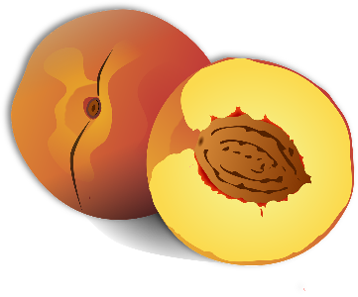
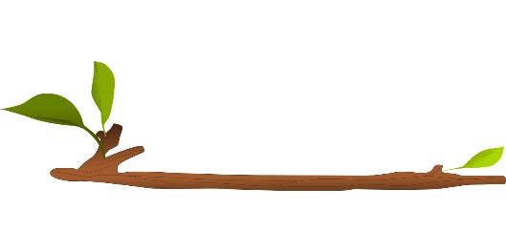
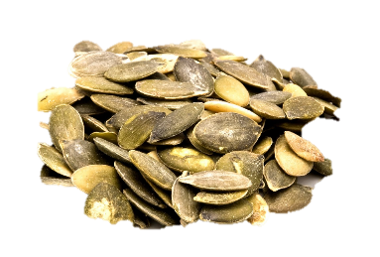
Les déchets (rubbish)
écouter
aéros _ l appar _ _ _ s électroniques b _ _ s b _ _ chon bout _ _ _ _ _ brind _ _ _ _ s graines de citr _ _ _ _ _ _ | épl _ chures f _ _ _ _ _ _ s m _ _ bles n _ _ aux de fruits p _ _ _ _ _ s p _ pier r _ cyclage
1
o
8
u
2
e i l
9
e u i l l e
3
o i
10
e u
4
o u
11
o y
5
e i l l e
12
a i l l e
6
i l l e
13
a
7
o u i l l e
14
e
Notes:
Timing: 5 minutes
Aim: Aural recognition and transcription of a selection of SSCs; to introduce students to the ‘environment’ theme of this lesson.
Procedure:
1. Click on the buttons to play audio.
2. Students listen and fill in the missing SSCs. As in the phonics test, the number of gaps tells students how many letters are missing.
3. Click to reveal answers (accepted alternatives given in the transcript below).
4. Click to hear the word again. Students repeat.
Transcript: [audio currently missing]
1. aérosol
2. appareils électroniques
3. bois
4. bouchon
5. bouteille
6. brindilles
7. graines de citrouille
8. épluchures
9. feuilles
10. meubles
11. noyaux de fruits
12. pailles
13. papier
14. recyclage
Word frequency (1 is the most frequent word in French): déchet [2882], aérosol [>5000], appareil [1420], électronique [2915], bois [1425], bouchon [>5000], bouteille [2979], brindille [>5000], graine [>5000], citrouille [>5000], épluchure [>5000], feuille [2440], meuble [3876], noyau [3832], paille [>5000], papier [951], recyclage [>5000]
Source: Londsale, D., & Le Bras, Y. (2009). A Frequency Dictionary of French: Core vocabulary for learners London: Routledge.

Slide 3
Dominos de phonétique
lire / parler
Trouve les paires !
pot
blé
⁻1
⁺1
Oui !
bain
don
taux
Non !
en
Notes:
Timing: 6 minutes. This is slide 1/6.
Aim: Written recognition and oral production of a range of vowel SSCs. Strengthening the connection between SSCs that are written differently but sound the same.
Procedure:
1. Explain to students that they will have to match words based on the vowel sounds (the relevant SSCs are in bold). Use this slide to demonstrate a correct placement and an incorrect one.
2. Click to reveal a domino.
3. Elicit pronunciation of the two words that appear side by side, pot and taux. Ask students if the words match/rhyme.
4. Click to reveal the answer.
5. Repeat for taux and don.
6. Proceed to the next five slides.
Note: the dominoes can rotate 90 degrees in either direction but they can’t be turned upside down!
Word frequency of unknown words used (1 is the most frequent word in French):
lot [3045], veau [>5000], pot [3648], blé [3265], seau [>5000], faim [1986], peau [2122], taux [700], nez [2661], clé [1200], dé [>5000], pin [>5000], rampe [>5000], hé [3871], bête [2591], né (naître) [667], nid [>5000], bain [3458], don [1800], daim [>5000], vent [1387], clin [>5000], fin [111], thon [>5000], tente [4336], haine [2277], style [1999], gant [>5000], champ [847], lampe [4699], mythe [2910], chaîne [1159], bai [>5000], gym [>5000], tri [>5000], lys [>5000]
Source: Lonsdale, D., & Le Bras, Y. (2009). A Frequency Dictionary of French: Core vocabulary for learners London: Routledge.

Slide 4
Dominos de phonétique
lire / parler
Trouve les paires !
1
2
nez
clé
dé
pin
clin
tête
clin
tête
bête
hé !
3
4
clin
tête
Notes:
This is slide 2/6.
Aim: Written recognition and oral production of a range of vowel SSCs. Strengthening the connection between SSCs that are written differently but sound the same.
Procedure:
1. Click through three dominoes. Elicit the pronunciation of the unknown words that appear. 2. Click to bring up a new domino in the game and some numbered outlines. 3. Ask students to think where it could go and to write down all the numbers that are possible. 4. Answers appear on next clicks. 5. Repeat for next four slides.
6. Proceed to slide 8 for printable dominoes allowing students to play a full game in pairs.
Word frequency of unknown words used (1 is the most frequent word in French):
lot [3045], veau [>5000], pot [3648], blé [3265], seau [>5000], faim [1986], peau [2122], taux [700], nez [2661], clé [1200], dé [>5000], pin [>5000], rampe [>5000], hé [3871], bête [2591], né (naître) [667], nid [>5000], bain [3458], don [1800], daim [>5000], vent [1387], clin [>5000], fin [111], thon [>5000], tente [4336], haine [2277], style [1999], gant [>5000], champ [847], lampe [4699], mythe [2910], chaîne [1159], bai [>5000], gym [>5000], tri [>5000], lys [>5000]
Source: Lonsdale, D., & Le Bras, Y. (2009). A Frequency Dictionary of French: Core vocabulary for learners London: Routledge.

Slide 5
Dominos de phonétique
lire / parler
1
2
pot
blé
hé !
bête
Trouve les paires !
né
3
hé !
bête
bai
gym
nid
hé !
bête
4
5
hé !
bête
Notes:
This is slide 3/6.

Slide 6
Dominos de phonétique
lire / parler
Trouve les paires !
2
1
bain
don
temps
lys
tri
mythe
fin
tri
lys
3
4
tri
lys
fils
tri
lys
5
tri
lys
Notes:
This is slide 4/6.

Slide 7
Dominos de phonétique
lire / parler
1
2
thé
bon
ton
haine
Trouve les paires !
hé !
bête
3
4
pot
blé
thé
bon
thé
bon
5
Notes:
This is slide 5/6.

Slide 8
Dominos de phonétique
lire / parler
1
seau
lot
veau
peau
nom
Trouve les paires !
blé
blé
pot
blé
pot
pot
faim
2
3
3
clin
bai
gym
tête
bai
gym
peau
nom
haine
ton
haine
ton
5
4
5
peau
nom
Notes:
This is slide 6/6.

Slide 9
Dominos de phonétique
lire / parler
lot
veau
pot
blé
seau
faim
peau
nom
taux
en
faux
aime
mot
lit
nez
clé
dé
pin
thé
bon
chez
rampe
hé !
bête
Notes:
Optional Extension or alternative to teacher-led activity on slides 4-8
Timing: 5 minutes. This is slide 1/3 for printing.
Aim: Written recognition and oral production of a range of vowel SSCs. Strengthening the connection between SSCs that are written differently but sound the same.
Procedure:
1. Print slides 8-10 to create one set of dominoes for each pair of students.
2. Each partner takes half of the dominoes at random.
3. Partner A places the first domino.
4. Partner B places a matching domino from their set and correctly pronounces the matching words aloud to get a point.
5. Continue until all dominos are used.
SSCs included:
closed [o]: lot, veau, pot, seau, peau, taux, faux, mot
[é/-er/-ez]: blé, nez, clé, dé, thé, chez, hé !, né
[ain/in], [aim/im]: faim, pin, pain, train, bain, daim, clin, fin
[on/om]: nom, bon, rampe, don, mon, thon, non, ton
[ai/ê/è]: aime, bête, tête, haine, vrai, ère, mai, bai
[i/y]: lit, nid, fils, style, mythe, gym, tri, lys
[en/em/an/am]: en, rampe, vent, tente, gant, champ, lampe, temps
Word frequency of unknown words used (1 is the most frequent word in French):
lot [3045], veau [>5000], pot [3648], blé [3265], seau [>5000], faim [1986], peau [2122], taux [700], nez [2661], clé [1200], dé [>5000], pin [>5000], rampe [>5000], hé [3871], bête [2591], né (naître) [667], nid [>5000], bain [3458], don [1800], daim [>5000], vent [1387], clin [>5000], fin [111], thon [>5000], tente [4336], haine [2277], style [1999], gant [>5000], champ [847], lampe [4699], mythe [2910], ère [3089], bai [>5000], gym [>5000], tri [>5000], lys [>5000]
Source: Lonsdale, D., & Le Bras, Y. (2009). A Frequency Dictionary of French: Core vocabulary for learners London: Routledge.

Slide 10
Dominos de phonétique
lire / parler
né
nid
pain
train
bain
don
daim
vent
clin
tête
fin
fils
mon
thon
non
tente
ton
haine
son
style
gant
champ
lampe
vrai
Notes:
This is slide 2/3 for printing.

Slide 11
Dominos de phonétique
lire / parler
temps
mythe
ère
mai
bai
gym
tri
lys
Notes:
This is slide 3/3 for printing.

Slide 12
Vocabulaire
écouter
 | when | calm | like | how much
 | ☐ | ☐ | ☐ | ☐
 | story | to choose | history | care
 | ☐ | ☐ | ☐ | ☐
 | reason | network | season | recipe
 | ☐ | ☐ | ☐ | ☐
 | without | alone | on | under
 | ☐ | ☐ | ☐ | ☐
 | for | in order to | first of all | then
 | ☐ | ☐ | ☐ | ☐
1
You will hear some French words.
Put a cross (x) under the English word or words that best match what you hear. Some have only one correct answer. Some have two correct answers. will hear each French word twice.
2
3
4
5
Notes:
Timing: 2 minutes
Aim: Aural recognition of revisited vocabulary and connecting it with meaning
Procedure:
1. Click the numbers to play audio.
2. Students tick the English that matches the word they hear.
3. Click to reveal answers.
Transcript:
1. calme
2. l’histoire
3. la raison
4. sous
5. pour

Slide 13
Vocabulaire
lire
Write the letter (a-f) of the word on the right that best matches the definition on the left.
1) | ___ mauvais ___ rapide ___ sage | a. beau b. vite c. pas bon d. facile e. difficile f. bon
c
b
f
Notes:
Timing: 1 minute
Aim: Written recognition of revisited vocabulary. Strengthening semantic networks by identifying synonymous words and phrases.
Procedure:
1. Students match the pairs of synonyms.
2. Click to reveal answers.

Slide 14
Les adjectifs
Gender rule 1: add -e
Gender rule 3: –x ➜ –se
Gender rule 4: –l ➜ –lle
Irregular form
Gender rule 1: add -e
Gender rule 2: no change with adjectives ending in -e
Plural rule 1: add -s
Plural rule 2: no change where masculine adjective ends in -s or -x
Plural rule 1: add -s
Plural rule 1: add -s
Plural rule 1: add -s
Plural rule 2: (no change where masculine adjective ends in -s or -x)
grammaire
Remember how adjectives change to agree with the noun they describe:
masculine singular | feminine singular | masculine plural | feminine plural
intelligent | intelligente | intelligents | intelligentes
heureux | heureuse | heureux | heureuses
gentil | gentille | gentils | gentilles
vieux | vieille | vieux | vieilles
local | locale | locaux | locales
triste | triste | tristes | tristes
Notes:
Timing: 3 minutes
Aim: Recap of patterns for adjectival agreement.
Procedure:
1. Click to reveal singular adjectives.
2. Elicit the missing masculine or feminine forms, paying special attention when/if there are differences in pronunciation.
3. Click to reveal the answers.
4. Click to reveal plural adjectives.
5. Elicit the missing masculine or feminine forms, paying special attention when/if there are differences in pronunciation.
6. Click to reveal answers.

Slide 15
Les adjectifs
grammaire
Adjectives usually come after the noun they describe, except adjectives that refer to:
An adjective that brags likes to come first! It pushes in front of the noun.
Rank describes how things compare to each other. It also includes même and autre:
les mêmes personnes the same people
l’autre bateau, une autre fille the other boat, another girl
Beauty
Rank
Age
Goodness
Size
une belle maison a beautiful house
le premier groupe the first group
Remember!
Plusieurs is like chaque – it doesn’t change form to match the noun
un vieux piano an old piano
une mauvaise idée a bad idea
plusieurs années several years
Notes:
Timing: 3 minutes
Aim: Recap of pre-nominal adjectives.
Procedure:
1. Click to reveal the explanations and examples, eliciting recall as far as possible.

Slide 16
Dans le garage (1)
écouter
Abdel et Bilal organisent le garage. De quoi parlent-ils ?
Écoute et coche les réponses possibles.
e.g. Je veux acheter [beep] anglais.
Je veux acheter le film/les journaux anglais en Algérie.
Q | le film | la recette | les journaux | R
1
1
2
2
3
3
4
4
5
5
Notes:
Timing: 3 minutes
Aim: Aural recognition of masculine, feminine, and plural forms of post-nominal adjectives and connecting these with meaning.
Procedure:
1. Explain the task using the example as a model. Ensure that the students understand that some adjectives sound the same in different forms, so there will be two possibilities for some answers.
2. Click the numbers on the left to play the audio with the noun obscured.
3. Students listen and tick which item(s) the adjective they hear could refer to.
4. Click to reveal answers.
5. Click the numbers on the right to play the full audio.
Transcript:
1. Je vais donner [les journaux] internationaux au collège.
2. Je veux prendre [la recette] italienne.
3. Je vais envoyer [les journaux] français à Abdel. Je vais envoyer [le film] français à Abdel.
4. Je veux montrer [la recette] algérienne à Maman. 5. Je veux étudier [le film] local. Je veux étudier [la recette] locale.

Slide 17
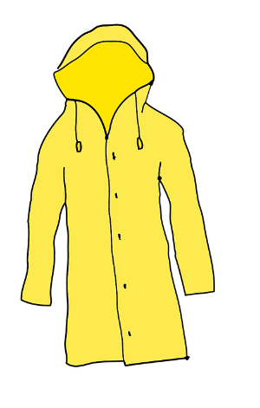
Dans le garage (2)
écouter
Abdel et Bilal organisent le garage. Abdel écrit une liste.
Remplis les blancs avec les mots possibles.
e.g. Je veux regarder […] petit […].
Je veux regarder le petit manteau.
le manteau
Je veux porter [...] vieille [……………] dans le jardin.
On peut utiliser […] vieux [……………] comme un lit pour le chien.
Noura peut jouer avec […] petite [……………].
On peut donner […] beau [……………] à un ami.
Je peux partager […] belle [……………] avec Noura.
Je vais envoyer plusieurs [……………] à Abdel.
Je ne veux pas utiliser […] autre [……………].
Noura veut porter […] même [……………] tout le temps.
la chemise
les journaux
Notes:
Timing: 5 minutes. This is slide 1/2.
Aim: Written recognition of masculine, feminine, and plural forms of pre-nominal adjectives and connecting these with meaning
Procedure:
1. Explain the task using the example as a model. Ensure that the students understand that some adjectives look the same in different forms, so there will be two possibilities for some answers.
2. Students write which item(s) the adjective could refer to, including the articles.
3. Check answers using the next slide.

Slide 18
Dans le garage (2)
écouter
le manteau
Je veux porter [...] vieille [……………] dans le jardin.
On peut utiliser […] vieux [……………] comme un lit pour le chien.
Noura peut jouer avec […] petite [……………].
On peut donner […] beau [……………] à un ami.
Je peux partager […] belle [……………] avec Noura.
Je vais envoyer plusieurs [……………] à Abdel.
Je ne veux pas utiliser […] autre [……………].
Noura veut porter […] même [……………] tout le temps.
la chemise
la vieille chemise
le vieux manteau/les vieux journaux
la petite chemise
le beau manteau
la belle chemise
plusieurs journaux
l’autre manteau/l’autre chemise
le même manteau/la même chemise
les journaux
Notes:
This is slide 2/2.

Slide 19
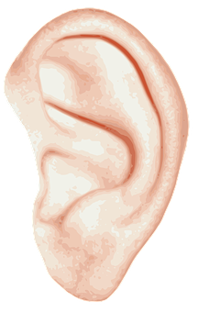
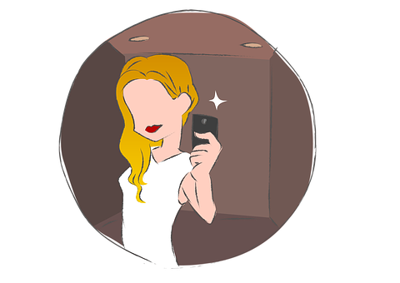
Les verbes en -RE
grammaire
Remember the endings for verbs like entendre:
I hear, am hearing | you (sing.) hear, are hearing | he/she/one hears, is hearing
j’entends | tu entends | il/elle/on entend
we hear, are hearing | you (pl./fml) hear, are hearing | they hear, are hearing
nous entendons | vous entendez | ils/elles entendent
Remember the endings for verbs like prendre:
I take, am taking | you (sing.) take, are taking | he/she/it takes, is taking
je prends | tu prends | il/elle/on prend
we take, are taking | you (pl./fml) take, are taking | they take, are taking
nous prenons | vous prenez | ils/elles prennent
Notes:
Timing: 2 minutes.
NB: Slide 20 provides a more challenging version of this activity, in which students are asked to provide the French in a random order.
Aim: To recap the formation of verbs like entendre and verbs like prendre for all persons
Procedure:
Click to reveal each part, eliciting the French.
N.B. This is the first time students have seen the full paradigm of these verbs from je to ils/elles. It is intended to be a quick-fire recap before working with the verbs in context.

Slide 20
Les verbes en -RE
grammaire
Verbs like entendre:
I hear, am hearing | you (sing.) hear, are hearing | he/she/one hears, is hearing
j’entends | tu entends | il/elle/on entend
we hear, are hearing | you (pl./fml) hear, are hearing | they hear, are hearing
nous entendons | vous entendez | ils/elles entendent
Verbs like prendre:
I take, am taking | you (sing.) take, are taking | he/she/it takes, is taking
je prends | tu prends | il/elle/on prend
we take, are taking | you (pl./fml) take, are taking | they take, are taking
nous prenons | vous prenez | ils/elles prennent
Notes:
This is the more challenging version of the activity on slide 19.
Aim: To recap the formation of verbs like entendre and verbs like prendre for all persons.
Procedure:
1. Click to reveal each part, eliciting the French. This time each part appears in a random order. A blue rectangle appears to indicate which part of the verb is required next.
N.B. This is the first time students have seen the full paradigm of these verbs from je to ils/elles. It is intended to be a quick-fire recap before working with the verbs in context.

Slide 21
Les verbes en -RE
grammaire
Remember the endings for verbs like lire:
Remember the exception:
vous dites = you (pl./fml) say)
I read, am reading | you (sing.) read, are reading | he/she/one reads, is reading
je lis | tu lis | il/elle/on lit
we read, are reading | you (pl./fml) read, are reading | they read, are reading
nous lisons | vous lisez | ils/elles lisent
Remember the endings for verbs like écrire:
I write, am writing | you (sing.)write, are writing | he/she/one writes, is writing
j'écris | tu écris | il/elle/on écrit
we write, are writing | you (pl./fml) write, are writing | they write, are writing
nous écrivons | vous écrivez | ils/elles écrivent
Notes:
Timing: 2 minutes.
NB: Slide 22 provides a more challenging version of this activity, in which students are asked to provide the French in a random order.
Aim: To recap the formation of verbs like lire and verbs like écrire for all persons
Procedure:
1. Click to reveal each part, eliciting the French.
N.B. This is the first time students have seen the full paradigm of these verbs from je to ils/elles. It is intended to be a quick-fire recap before working with the verbs in context.

Slide 22
Les verbes en -RE
grammaire
Verbs like lire:
I read, am reading | you (sing.) read, are reading | he/she/one reads, is reading
je lis | tu lis | il/elle/on lit
we read, are reading | you (pl./fml) read, are reading | they read, are reading
nous lisons | vous lisez | ils/elles lisent
Verbs like écrire:
I write, am writing | you (sing.)write, are writing | he/she/one writes, is writing
j'écris | tu écris | il/elle/on écrit
we write, are writing | you (pl./fml) write, are writing | they write, are writing
nous écrivons | vous écrivez | ils/elles écrivent
Notes:
This is the more challenging version of the activity on slide 21.
Aim: To recap the formation of verbs like lire and verbs like écrire for all persons.
Procedure:
1. Click to reveal each part, eliciting the French. This time each part appears in a random order. A blue rectangle appears to indicate which part of the verb is required next.

Slide 23
La pollution plastique à Melbou
Abdel et ses amis font un podcast. Écoute. Qui fait quoi ?
écouter
Nous parlons avec Karim. Karim est un garçon algérien. Il travaille avec ses amis pour aider les animaux. Il parle arabe*.
*l’arabe (m) = Arabic
Q | Activité | Karim [il] | Abdel et ses amis [nous] | The listeners [vous] | Karim et ses amis [ils] | R
 | hear the waves
 | go down to the beach
 | translate
 | take the bus
 | describe the war against pollution
 | understand the science
 | learn a lot
 | write down names of sick animals
 | understand the problem
 | ban plastic glasses
1
1
2
2
3
3
4
4
5
5
6
6
7
7
8
8
9
9
10
10
Notes:
Timing: 8 minutes
Aim: Aural recognition verbs like entendre, verbs like prendre, verbs like lire, and verbs like écrire in different persons.
Procedure:
1. Ensure students understanding which pronouns link with which people before the task.
Nous - Abdel and his friends, who are making a podcast
Il - Karim, the interviewee they are translating for (Click to reveal bubble introducing Karim. Bubble disappears on second click.)
Vous - the listeners
Ils - The team Karim is working with to help animals affected by plastic pollution.
2. Click the numbers on the left to play audio with a beep obscuring the pronoun.
3. Students tick who is doing each activity.
4. Click to reveal answers.
5. Click the numbers on the right to play the full audio.
Transcript:
1. Salut ! [Vous] entendez les vagues ?
2. [Nous] descendons à la plage de Melbou. Il y a beaucoup de plastique sur la plage, c'est triste.
3. Voici Karim, un garçon algérien. [Nous] traduisons pour Karim parce qu’il ne parle pas français.
4. [Karim] prend le bus le samedi pour travailler en équipe avec ses amis.
5. [Karim et ses amis] décrivent la guerre contre la pollution.
6. [Les amis] comprennent très bien la science de la pollution…
7. … et [Karim] apprend beaucoup sur la matière à l'université.
8. [Karim et ses amis] inscrivent les noms des animaux malades sur un tableau.
9. Alors, maintenant [vous] comprenez le problème.
10. [Nous] interdisons les verres en plastique dans les bâtiments de l'université.
Word frequency of unknown words used (1 is the most frequent word in French):
arabe [1994]
Word frequency of cognates used (1 is the most frequent word in French):
pollution [3073], plastique [2191], podcast [>5000]
Source: Lonsdale, D., & Le Bras, Y. (2009). A Frequency Dictionary of French: Core vocabulary for learners London: Routledge.

Slide 24
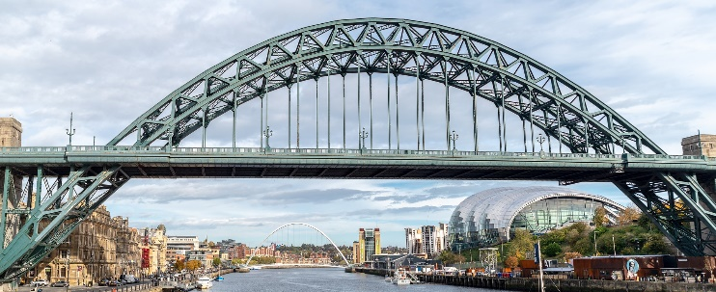
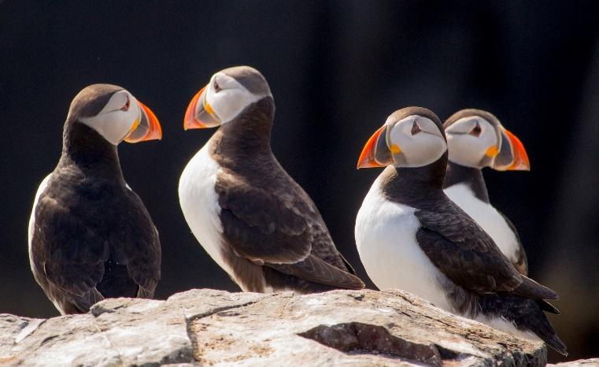
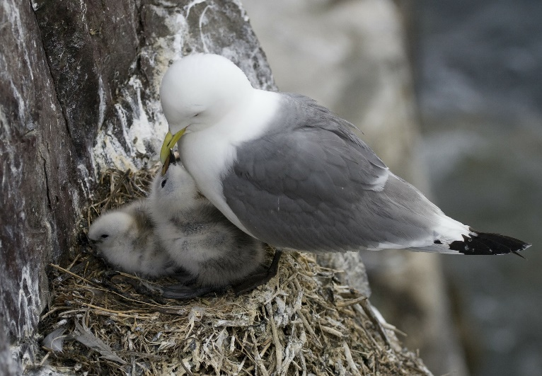
Un message pour Abdel
écrire
Tu écris un message pour Abdel. Traduis le message en français.
Hi Abdel!
We are listening to your podcast and we are reading articles at school in Newcastle in England. I don’t know Algeria, but we are learning a lot about examples of pollution in the world.
I want to help the animals! My father doesn’t drive, so we depend on the metro to go to the beach. We have to make the effort!
My friends are writing an article and they want to send the message to Algeria. Do you know how to translate from English without mistakes? You can give the article to Karim.
Bye!
Notes:
Timing: 10 minutes (two slides)
Aim: Written production of revisited vocabulary and verbs
Procedure:
1. Students translate the text into French.
2. Check the answers with the suggested translation on the next slide. Discuss any areas of difficulty or alternative translations.

Slide 25
Un message pour Abdel
écrire
Hi Abdel!
We are listening to your podcast and we are reading articles at school in Newcastle in England. I don’t know Algeria, but we are learning a lot about examples of pollution in the world.
I want to help the animals! My father doesn’t drive, so we depend on the metro to go to the beach. We have to make the effort!
My friends are writing an article and they want to send the message to Algeria. Do you know how to translate from English without mistakes? You can give the article to Karim.
Bye!
Salut Abdel !
Nous écoutons ton podcast et nous lisons des articles au collège à Newcastle en Angleterre. Je ne connais pas l’Algérie, mais nous apprenons beaucoup sur des exemples de la pollution dans le monde.
Je veux aider les animaux! Mon père ne conduit pas, alors nous dépendons du metro pour aller à la plage. Nous devons/Il faut faire l’effort !
Mes amis écrivent un article et ils veulent envoyer le message en Algérie. Tu sais traduire de l’anglais sans erreurs ? Tu peux donner l’article à Karim. Au revoir!
Notes:
Suggested translation

Slide 26
Talking about the environment
–IR verbs (sortir, venir and choisir groups) (all persons), comparative structures
SSC revision
Y8 French
Term 3.2 - Week 2 - Lesson 64
Catherine Salkeld / Natalie Finlayson / Catherine Morris
Artwork by: Chloé Motard
Date updated: 09/07/21
Notes:
Artwork by Chloé Motard. All additional pictures selected are available under a Creative Commons license, no attribution required.
Native speaker feedback provided by Sarah Brichory.
With thanks to Rachel Hawkes and Emma Marsden for their input on the lesson material.
Learning outcomes (lesson 2):
Revision of SSC
Revision of -IR verbs (verbs like sortir, verbs like venir, verbs like choisir) Revision of comparative structures with adjectives and adverbs
Word frequency (1 is the most frequent word in French):
calme [1731], content [1841], malade [1066], méchant [3184], triste [1843], chambre [633], idée [239], rapide [672], drôle [2166], fille [629], personne [84], garçon [1599], lit [1837], comme¹ [32], couleur [1211], ciel [1538], rêve [1313], vague [1493], voyage [904], numéro [766], mauvais [274], cocher [>5000], raison [72], exemple [259], préféré [preferer 597], histoire [263], tableau [1456], silence [1281], sage [2643], strict [1859], aussi [44], dans [11], problème [188], pour¹ [10], difficile [296], effort [388], d’accord [736], attention [482], île [1245], tuer [591], fils [735], guerre [266], contre [121], comme² [32], monde [77], politique [128], verité [907], erreur [612], facile [822], algérien, algérienne [4163], langue [712], combien [800], matière [562], science [1114], nom [171], parce que, bureau [273], équipe [814], sous [122], sur [16], derrière [805], devant [198], entre [55], rue [598], bâtiment [1952], haut [264], madame [294], monsieur [79], billet [1916], aider [413], désolé [>5000], cœur [568], temps [65], pour² [10], si¹ [34]
Source: Lonsdale, D., & Le Bras, Y. (2009). A Frequency Dictionary of French: Core vocabulary for learners London: Routledge.
The frequency rankings for words that occur in this PowerPoint which have been previously introduced in NCELP resources are given in the NCELP SOW and in the resources that first introduced and formally re-visited those words.
For any other words that occur incidentally in this PowerPoint, frequency rankings will be provided in the notes field wherever possible.

Slide 27
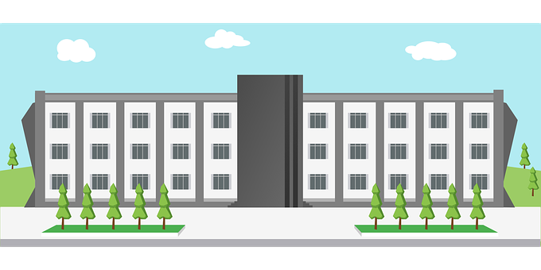
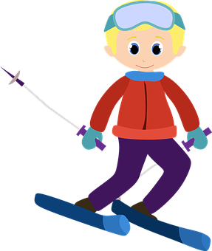
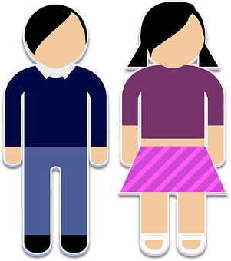
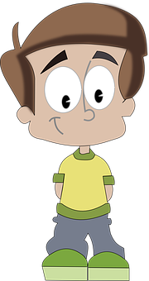
Phonétique : trouve l’intrus !
lire / parler
1.
a. maison
2.
poisson
3.
recette
b. treize
collège
ski
c. sœur
garçon
quand
?
Notes:
Timing: 3 minutes This is slide 1/2.
NB: Slides 29-30 provide a more challenging version/optional extension of this activity which uses unknown words.
Aim: Written recognition and oral production of a range of consonantal SSCs. Strengthening the connection between SSCs that are written differently but sound the same.
Procedure:
1. Students write 1-6 and choose which word (A-C) is the odd one out in each set, according to the pronunciation of the letters in bold. They may need some help with the cognate ‘ski’, which they have only encountered passively. Point out that the letter ‘k’ is rare in French, and normally only found in cognate words.
2. Students say the words to each other in pairs to check their answers.
3. Click to reveal the answers, eliciting the correct pronunciations.
Word frequency of cognates used (1 is the most frequent word in French):
ski [4571]
Source: Lonsdale, D., & Le Bras, Y. (2009). A Frequency Dictionary of French: Core vocabulary for learners London: Routledge.

Slide 28
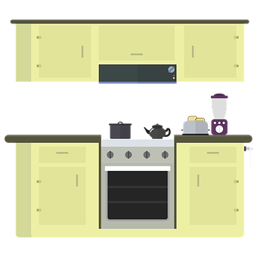
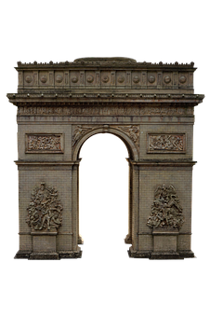
Phonétique : trouve l’intrus !
lire / parler
4.
thé
5.
a. ciel
6.
cuisine
national
b. intéressant
qui
[who?]
table
c. visite
merci
Notes:
Timing: 3 minutes This is slide 2/2.

Slide 29
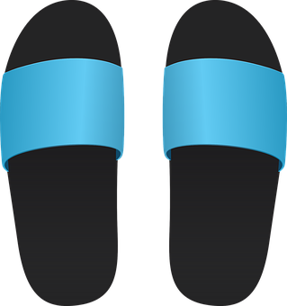
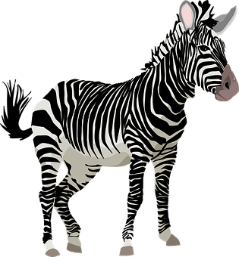
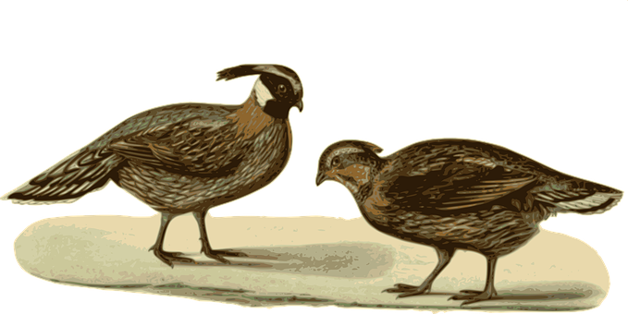
Phonétique : trouve l’intrus !
lire / parler
1.
soulier
2.
façon
3.
a. requin
[shoe, slipper]
[way]
zèbre
canette
b. cèpe
faisan
trousse
c. kangourou
[pheasant]
Notes:
Timing: 3 minutes This is slide 1/2.
NB: Slides 27-28 provide a less challenging version of this activity which uses known words.
Aim: Written recognition and oral production of a range of consonantal SSCs. Strengthening the connection between SSCs that are written differently but sound the same.
Procedure:
1. Students write 1-6 and choose which word (A-C) is the odd one out in each set, according to the pronunciation of the letters in bold.
2. Students say the words to each other in pairs to check their answers.
3. Click to reveal the answers, eliciting the correct pronunciations.
Word frequency (1 is the most frequent word in French):
soulier [>5000], faisan [>5000], façon [248], canette [>5000], trousse [>5000], zèbre [>5000], kangourou [>5000], cèpe [>5000]
Source: Lonsdale, D., & Le Bras, Y. (2009). A Frequency Dictionary of French: Core vocabulary for learners London: Routledge.

Slide 30
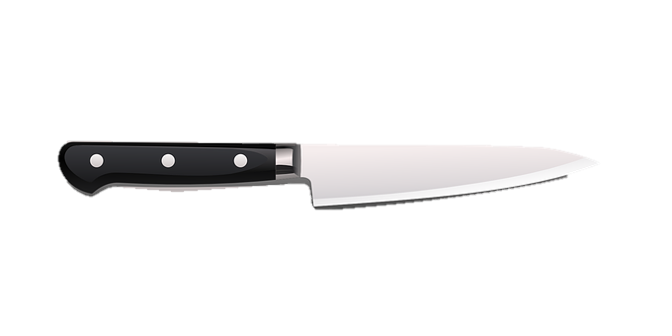
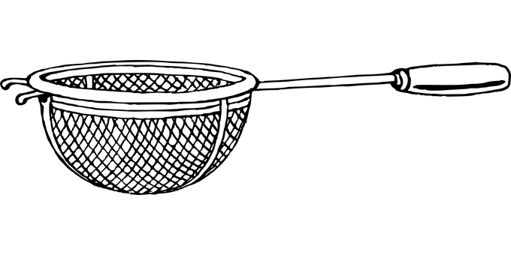
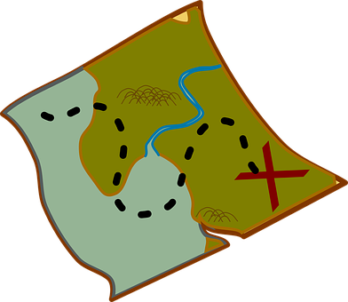
Phonétique : trouve l’intrus !
lire / parler
4.
sensation
5.
tissu
6.
couteau
[feeling]
[fabric]
athée
cétacé
ficelle
[string, twine]
[atheist]
[cetacean = aquatic mammal]
tamis
hasard
quête
[chance]
[sieve]
[quest]
Notes:
Timing: 3 minutes This is slide 2/2
Word frequency (1 is the most frequent word in French):
sensation [3415], athée [>5000], tamis [>5000], tissu [2696], cétacé [>5000], hasard [1882], couteau [3737], ficelle [>5000], quête [2672]
Source: Lonsdale, D., & Le Bras, Y. (2009). A Frequency Dictionary of French: Core vocabulary for learners London: Routledge.

Slide 31
Modes de transport écologiques
Où sont les liaisons ?
Où sont les SFCs ?
lire / parler
Je prends l’autobus pour aller au collège.
1
Je vais au collège à vélo.
2
Il y a deux aéroports à Paris.
3
Les voyages en avion sont mauvais.
4
Mais il faut prendre l’avion pour aller en vacances !
5
Mais non ! On peut prendre le train. C’est plus difficile, mais c’est possible.
6
Je suis désolée ! C’est impossible !
7
Je ne suis pas d’accord avec tes idées.
8
Notes:
Timing: 5 minutes
Aim: Written recognition and oral production of sentences containing examples of SFC and liaison.
Procedure:
1. Students write 1-8 and write down the letters in bold which they think enter into a liaison pattern.
2. Students read out the sentences in pairs.
3. Click on the numbers to hear the audio, listen and check answers.
4. Click to reveal one liaison at a time.
Transcript
1. Je prends l’autobus pour aller au collège.
2. Je vais au collège à vélo.
3. Il y a deux aéroports à Paris.
4. Les voyages en avion sont mauvais.
5. Mais il faut prendre l’avion pour aller en vacances !
6. Mais non ! On put prendre le train. C’est plus difficile, mais c’est possible.
7. Je suis désolée ! C’est impossible !
8. Je ne suis pas d’accord avec tes idées.
Word frequency of cognates used (1 is the most frequent word in French):
mode [>1137], transport [935], écologique [2406]
Source: Lonsdale, D., & Le Bras, Y. (2009). A Frequency Dictionary of French: Core vocabulary for learners London: Routledge.

Slide 32
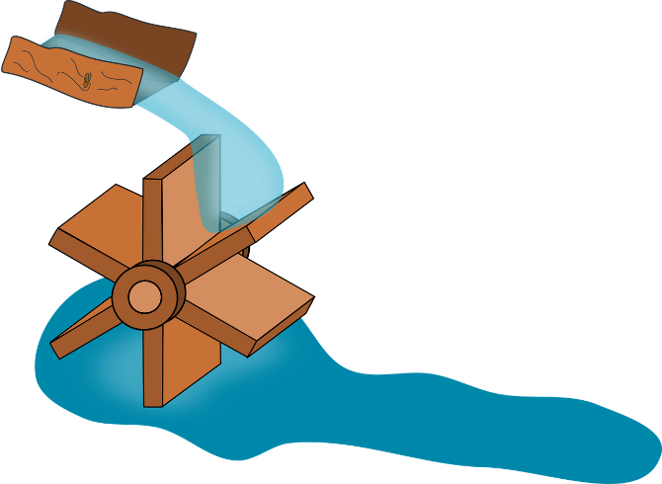
Syllables and stress
lire / parler
Remember!
Sound all the syllables fairly equally (emphasise the last one a bit more). Pronounce the vowels fully – don’t ‘reduce’ them!
Comment prononcer ces types d’éléctricité ?
l’énergie solaire | la biomasse
l’énergie éolienne | l’hydroélectricité
l’énergie nucléaire | la géothermie
1
4
2
5
3
6
Notes:
Timing: 3 minutes
Aim: Oral practice of stress syllabification
Procedure:
1. Use the bubble to recap stress syllabification.
2. Students read words in pairs to practice.
3. Check pronunciation as a class.
Word frequency of cognates used (1 is the most frequent word in French):
énergie [720], solaire [4653], nucléaire [1130], hydroélectricité [>5000]
Word frequency of unknown words used (1 is the most frequent word in French):
éolien [>5000], biomasse [>5000], géothermie [>5000], électricité [>5000], type [440]
Source: Lonsdale, D., & Le Bras, Y. (2009). A Frequency Dictionary of French: Core vocabulary for learners London: Routledge.

Slide 33
Vocabulaire
écouter
 |  | A | B | C | D
1 | a family member | ☐ | ☐ | ☐ | ☐
1
Put a cross (x) under the word (A, B, C or D) that is a good example of the category.
You will hear each set of French words twice.
 |  | A | B | C | D
2 | a room in the house | ☐ | ☐ | ☐ | ☐
2
 |  | A | B | C | D
3 | furniture | ☐ | ☐ | ☐ | ☐
3
 |  | A | B | C | D
4 | a nationality | ☐ | ☐ | ☐ | ☐
4
 |  | A | B | C | D
5 | a position | ☐ | ☐ | ☐ | ☐
5
Notes:
Timing: 3 minutes
Aim: Aural recognition of revisited vocabulary and connecting it with meaning.
Procedure:
1. Click the numbers to play the audio. After a 5 second gap, play the audio for a second time.
2. Students tick the word that fits the category.
3. Click to reveal the answers.
Transcript: 1. A. l’île, B. le fils, C. le billet, D. la main
2. A. la chambre, B. la place, C. la chance, D. la jambe
3. A. le lait, B. le plat, C. la bateau, D. le lit
4. A. mauvais, B. algérienne, C. sage, D. mais
5. A. méchant, B. important, C. devant, D. prudent

Slide 34
Association et collocation
lire
Put a cross (x) next to:
At least one word in column 1 with a meaning that is related to the word in bold on the left
At least one word in column 2 that could appear beside the word in bold in a sentence.
In total, you must put four crosses (x) for each question. You could tick two boxes in both columns, or you could tick three boxes in one column and one box in the other column!
 | Column 1 (has a closely related meaning) |  | Column 2 (could appear beside)
1) la couleur | a) vert | ☐ | e) difficile | ☐
 | b) mange | ☐ | f) belle | ☐
 | c) noir | ☐ | g) veut | ☐
 | d) écouter | ☐ | h) préférée | ☐
2) le ciel | a) l’oiseau | ☐ | e) gros | ☐
 | b) l’avion | ☐ | f) bleu | ☐
 | c) le chien | ☐ | g) fromage | ☐
 | d) le soleil | ☐ | h) pense | ☐
3) le billet | a) le collège | ☐ | e) sait | ☐
 | b) l’autobus | ☐ | f) coûte | ☐
 | c) la vague | ☐ | g) cher | ☐
 | d) le cinéma | ☐ | h) content | ☐
Notes:
Timing: 3 minutes
Aim: Written recognition of revisited vocabulary and connecting it with meaning
Procedure:
1. Students read the words in bold.
2. In column 1, they tick up to three words closely associated with the word in bold.
3. In column 2, they tick up to three words likely to appear on either side of the word in bold in a sentence.
Word frequency (1 is the most frequent word in French): association [596], collocation [>5000]
Source: Londsale, D., & Le Bras, Y. (2009). A Frequency Dictionary of French: Core vocabulary for learners London: Routledge.

Slide 35
Les comparatifs
grammaire
Remember, to make comparisons in French we use the following structures with adjectives and adverbs:
plus + grand + que = ‘more big than’ (bigger than)
moins + vite + que = ‘less fast than’ (slower than)
aussi + triste + que = ‘as sad as’
Some comparative forms are irregular:
bon (good) → meilleur (better) bien (well) → mieux (better)
mauvais (bad) → pire (worse) mal (badly) → pire (worse)
adjectives
adverbs
Notes:
Timing: 3 minutes
Aim: Recap of comparatives with adjectives
Procedure:
1. Click to reveal explanations and examples. Ensure understanding.

Slide 36
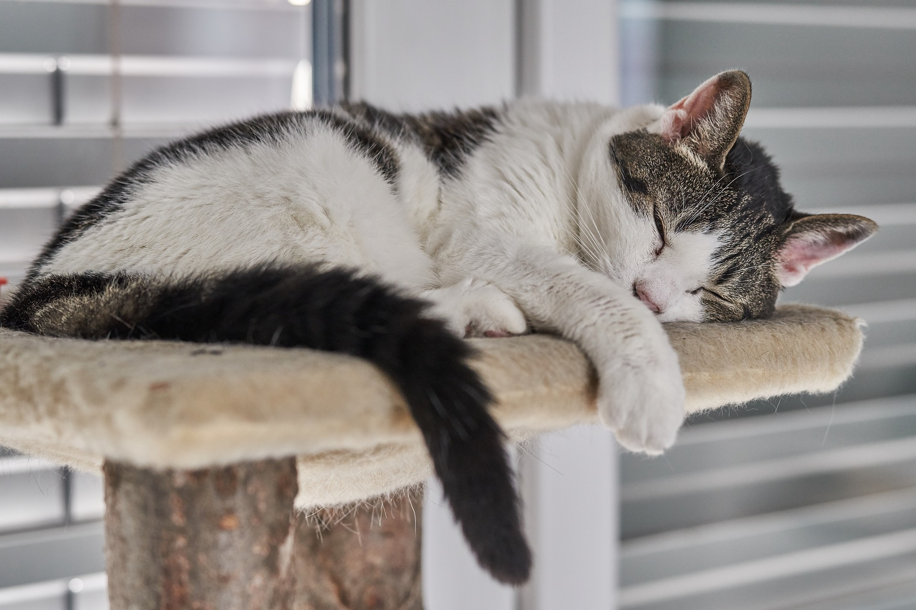
Les comparatifs
Écris une phrase comparative pour décrire les photos.
écrire
Le chien est plus travailleur que le chat./Le chat est moins travailleur que le chien.
dog – cat – hardworking
Notes:
Timing: 7 minutes. This is slide 1/7.
Aim: Written production of comparative sentences with adjectives and adverbs.
Procedure:
Students write a sentence to compare the two photos.
Click to reveal suggested answers.

Slide 37
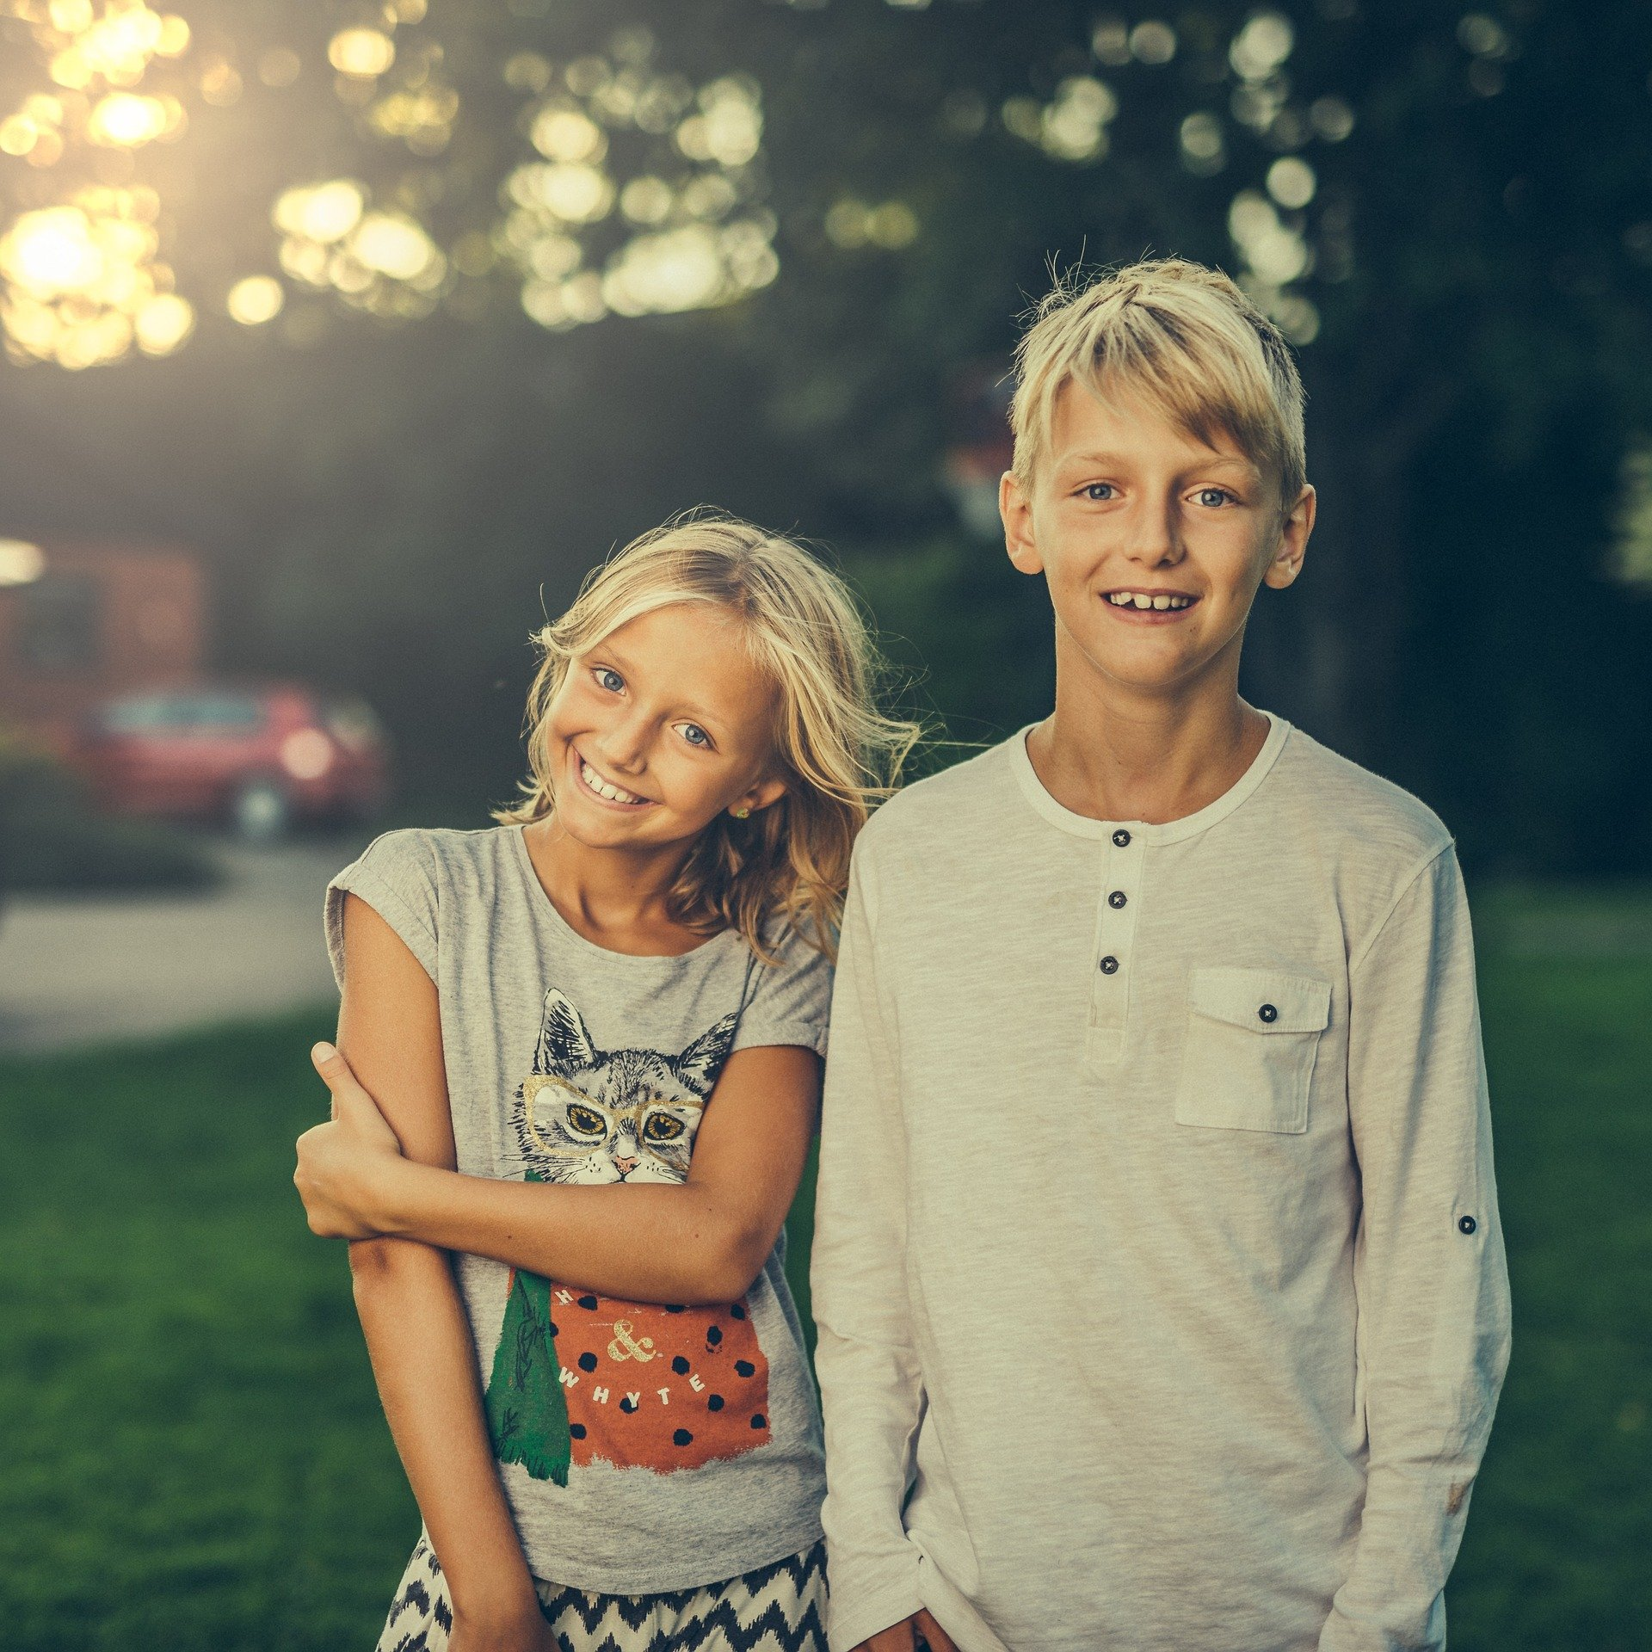
Les comparatifs
Écris une phrase comparative pour décrire les photos.
écrire
Le frère est plus grand que la sœur./La sœur est moins grande que le frère.
brother – sister – tall
Notes:
This is slide 2/7.

Slide 38
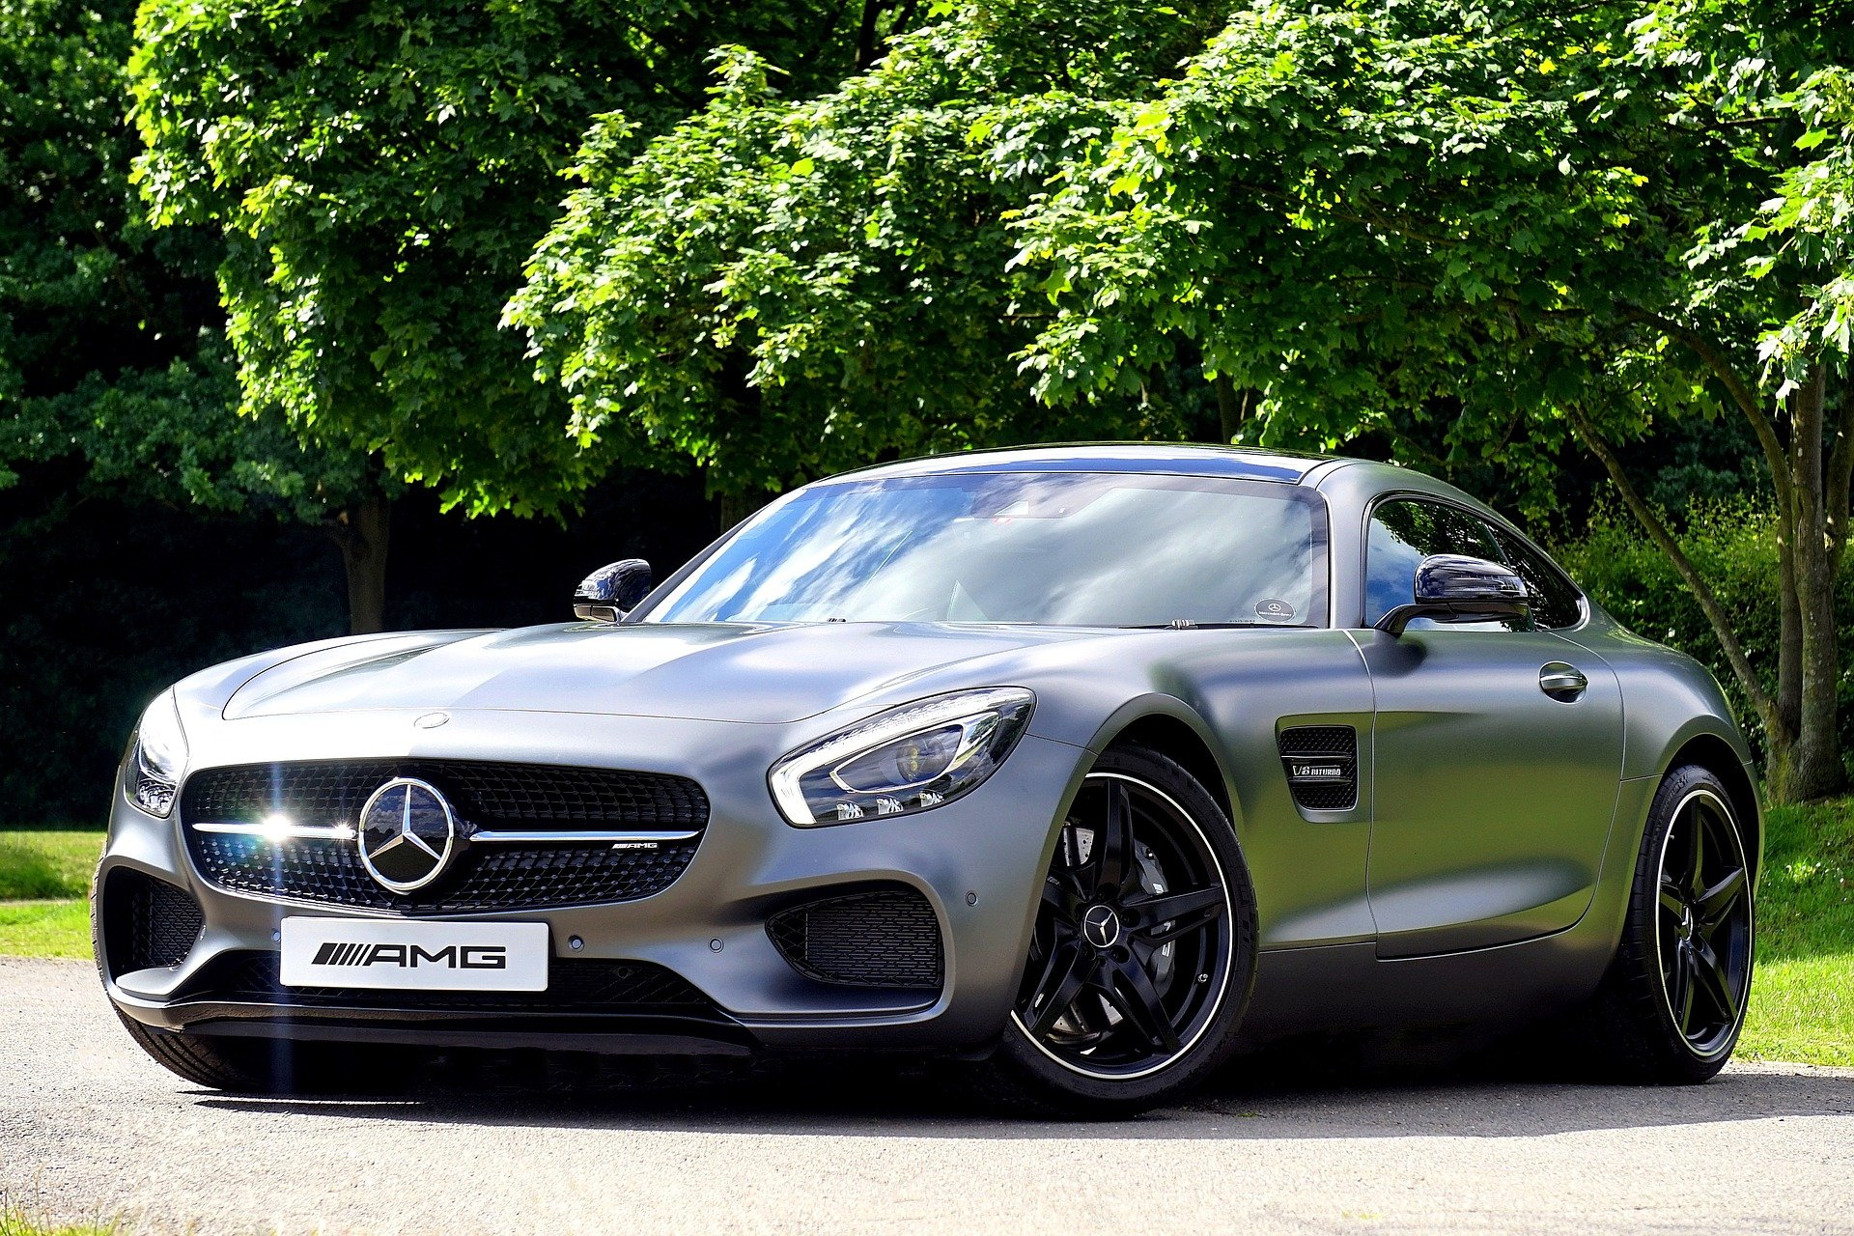
Les comparatifs
Écris une phrase comparative pour décrire les photos.
écrire
€€€
€
car – bike – expensive
La voiture est plus chère que le vélo./Le vélo est moins cher que la voiture.
Notes:
This is slide 3/7.

Slide 39
Les comparatifs
Écris une phrase comparative pour décrire les images.
écrire
La fille à droite danse plus vite que la fille à gauche .
La fille à gauche danse moins vite que la fille à droite.
girl on the right – dance – fast – girl on the left
Notes:
This is slide 4/7.

Slide 40
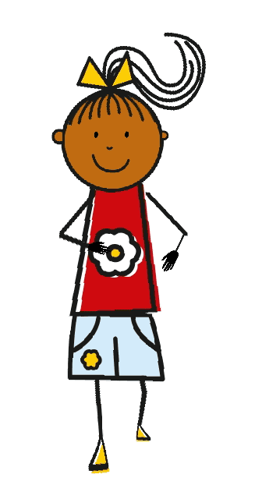
Les comparatifs
Écris une phrase comparative pour décrire les images.
écrire
La fille à droite marche plus lentement que la fille à gauche .
La fille à gauche marche moins lentement que la fille à droite.
girl on the left – walk – slowly – girl on the right
Notes:
This is slide 5/7.

Slide 41
Les comparatifs
Écris une phrase comparative pour décrire les images.
écrire
La fille à droite lit plus vite que la fille à gauche .
La fille à gauche lit moins vite que la fille à droite.
girl on the left – read – fast – girl on the right
Notes:
This is slide 6/7.

Slide 42
Les comparatifs
Écris une phrase comparative pour décrire les images.
écrire
La fille à droite dessine plus lentement que la fille à gauche .
La fille à gauche dessine moins lentement que la fille à droite.
girl on the left – draw (dessiner) – slowly – girl on the right
Notes:
This is slide 7/7.
Word frequency of unknown words used (1 is the most frequent word in French):
dessiner [2086]
Source: Lonsdale, D., & Le Bras, Y. (2009). A Frequency Dictionary of French: Core vocabulary for learners London: Routledge.

Slide 43
Plusieurs adjectifs
grammaire
When there is more than one adjective after the noun, we put “et ” in between. This is just like English.
Le garçon intelligent et amusant The boy (who is) intelligent and funny
When there is more than one adjective before the noun, we don’t need “et”.
La belle nouvelle guitare The beautiful new guitar
If the adjectives go in different positions, they surround the noun.
Le petit oiseau bleu The small blue bird
Notes:
Timing: 1 minute
Aim: Recap of using multiple adjectives
Procedure:
1. Click to reveal explanations and examples.

Slide 44
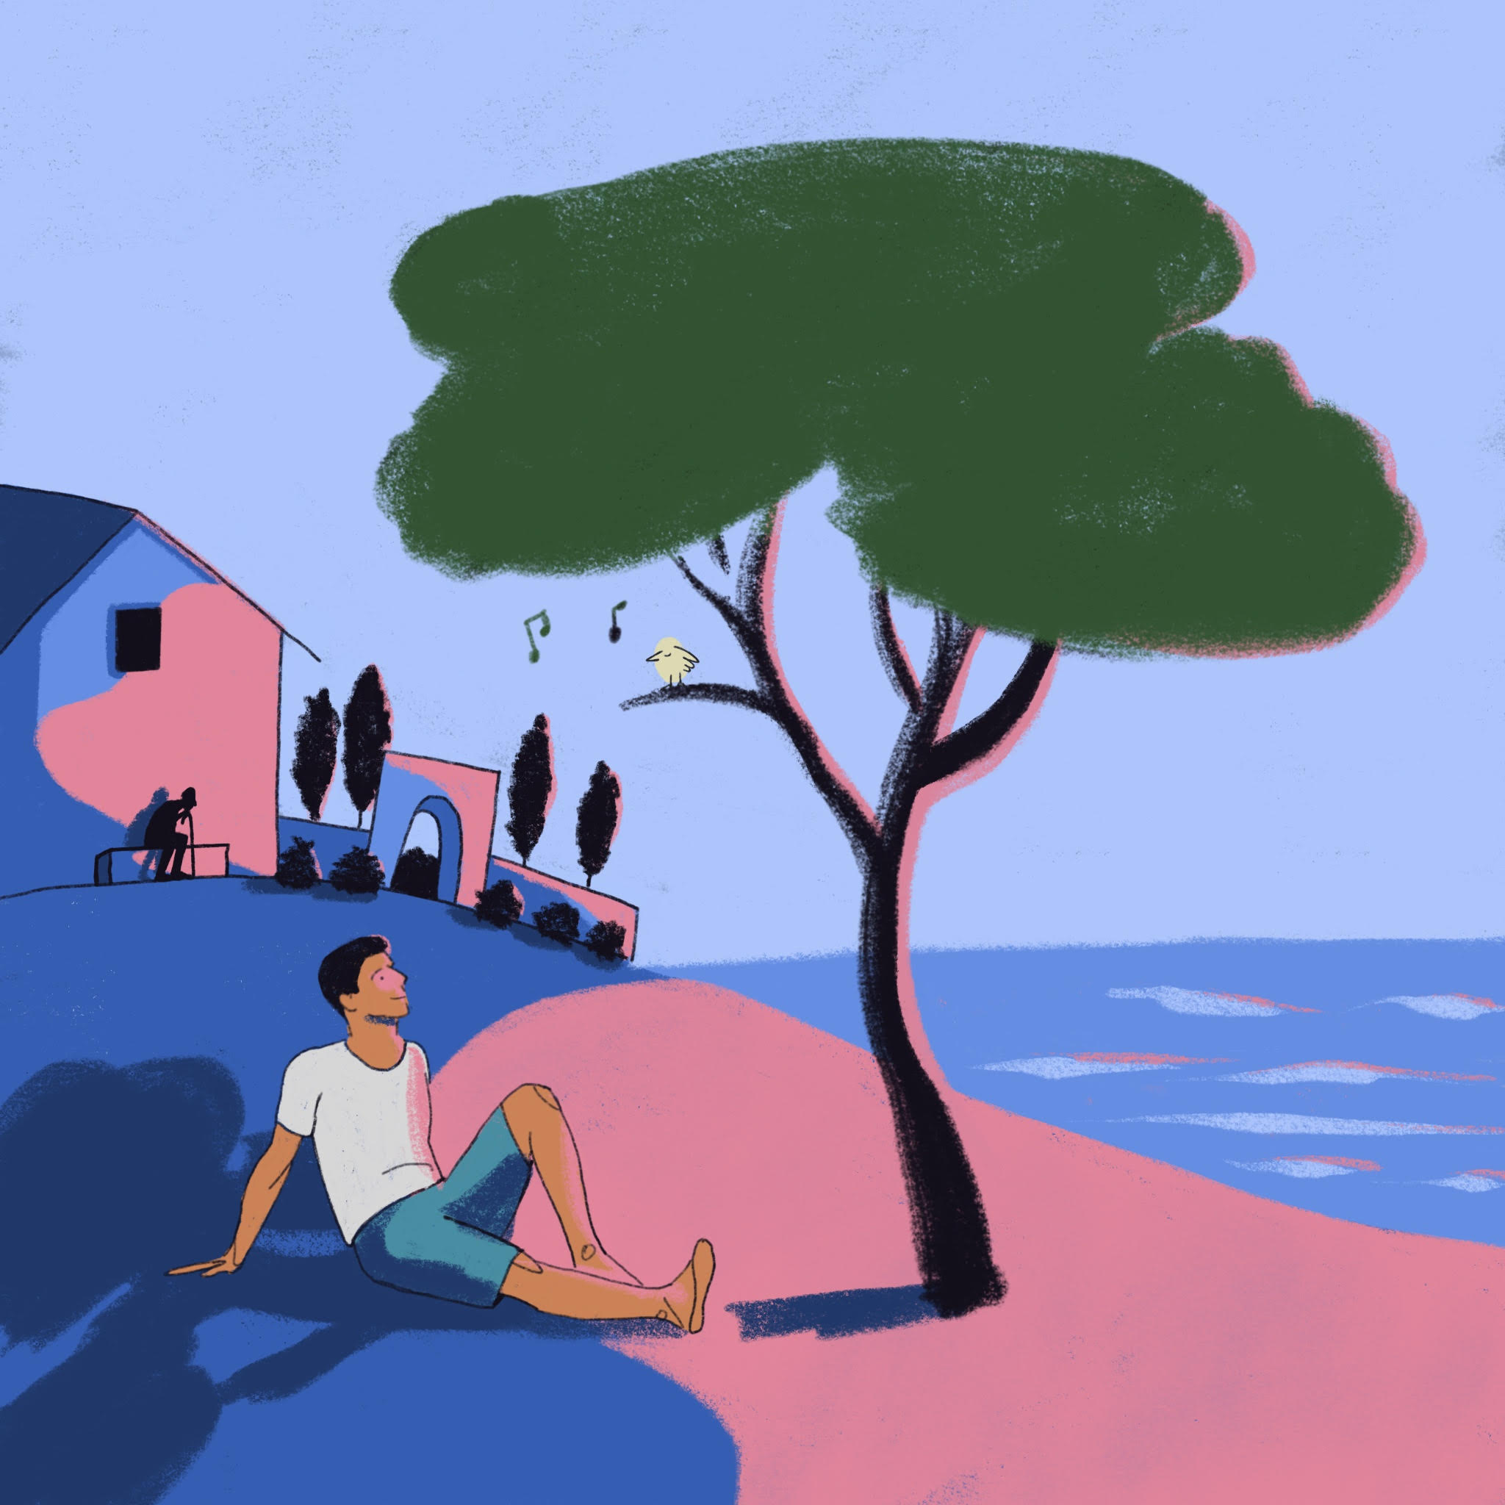
Chez Léa
Aux Îles Habibas
parler
Regarde l’image. Travaille avec un(e) partenaire et dis les phrases en français.
Partenaire A
Abdel is looking at a small yellow bird.
1
Abdel regarde un petit oiseau jaune.
The bird is in a big green tree.
2
L’oiseau est dans un grand arbre vert.
3
The tree is bigger than Abdel.
L’arbre est plus grand qu'Abdel.
4
Behind Abdel, the waves are arriving slowly.
Derrière Abdel, les vagues arrivent lentement.
5
The small blue waves are beautiful.
Les petites vagues bleues sont belles.
Notes:
Timing: 8 minutes. This is slide 1/2.
Aim: Guided oral production – picture description
Procedure:
1. Students work in pairs. Partner A says the sentences to describe the image on this slide, with Partner B giving corrections and feedback.
2. Partner B’s image and sentences are on the following slide. Answers are displayed on clicks.
DIFFERENTIATION: More advanced groups could try describing the picture without the prompts.

Slide 45
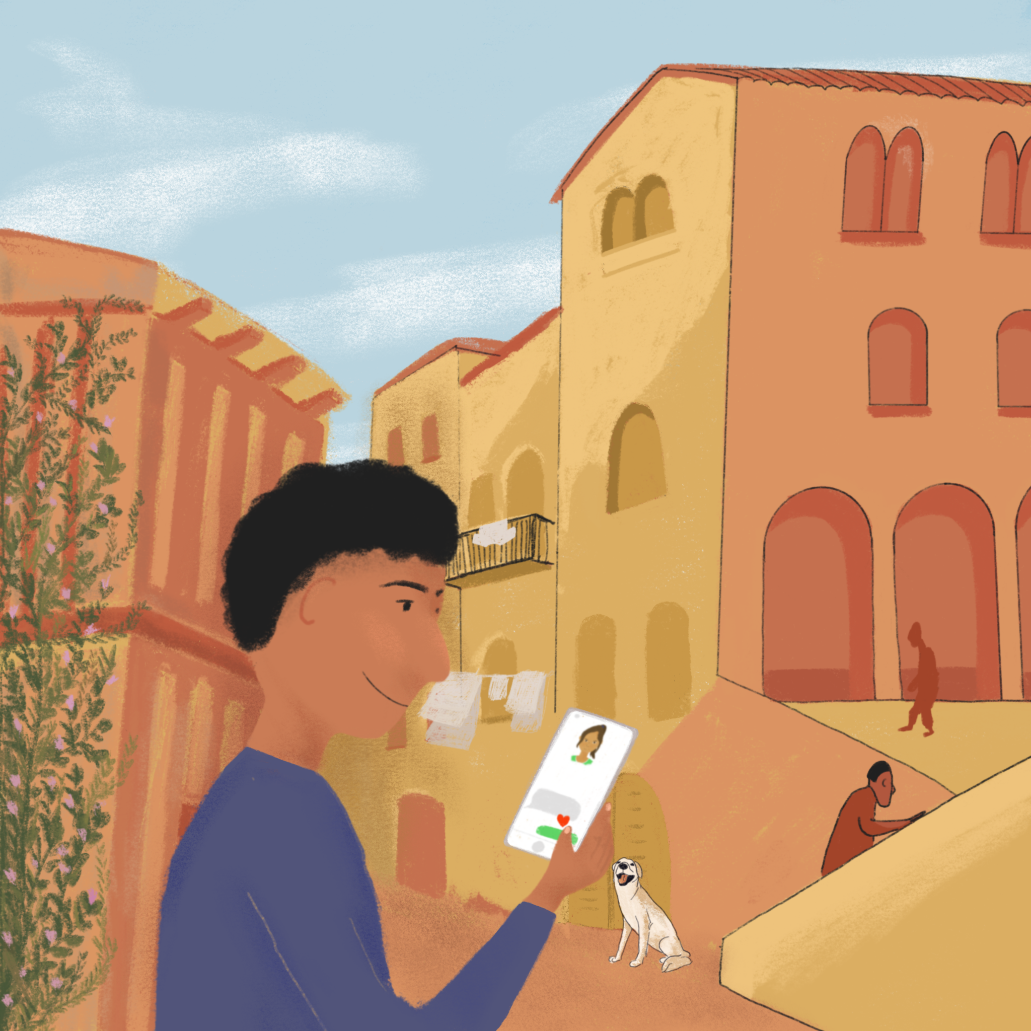
Chez Léa
Chez Léa
parler
Regarde l’image. Travaille avec un(e) partenaire et dis les phrases en français.
Partenaire B
Amir is in an old French street.
1
Amir est dans une vieille rue française.
The dog is between Amir and the high building.
2
Le chien est entre Amir et le haut bâtiment.
Amir is as happy as the big white dog.
3
Amir est aussi heureux que le grand chien blanc.
Amir is reading a funny message from Océane.
4
Amir lit un message amusant/drôle d’Océane.
There is a small red heart at the bottom.
5
Il y a un petit cœur rouge en bas.
Notes:
This is slide 2/2.

Slide 46
Les verbes en -IR
grammaire
Remember the endings for verbs like sortir:
I go out, am going out | you (sing.) go out, are going out | he/she/one goes/is going out
je sors | tu sors | il/elle/on sort
we go out, are going out | you (pl./fml) go out, are going out | they go out, are going out
nous sortons | vous sortez | ils/elles sortent
Remember the endings for verbs like venir:
I come, am coming | you (sing.) come, are coming | he/she/one comes, is coming
je viens | tu viens | il/elle/on vient
we come, are coming | you (pl./fml) come, are coming | they come, are coming
nous venons | vous venez | ils/elles viennent
Notes:
Timing: 2 minutes.
NB: Slide 47 provides a more challenging version of this activity, in which students are asked to provide the French in a random order.
Aim: To recap the formation of verbs like sortir and verbs like venir for all persons
Procedure:
Click to reveal each part, eliciting the French.
N.B. This is the first time students have seen the full paradigm of these verbs from je to ils/elles. It is intended to be a quick-fire recap before working with the verbs in context.

Slide 47
Les verbes en -IR
grammaire
Verbs like sortir:
I go out, am going out | you (sing.) go out, are going out | he/she/one goes/is going out
je sors | tu sors | il/elle/on sort
we go out, are going out | you (pl./fml) go out, are going out | they go out, are going out
nous sortons | vous sortez | ils/elles sortent
Verbs like venir:
I come, am coming | you (sing.) come, are coming | he/she/one comes, is coming
je viens | tu viens | il/elle/on vient
we come, are coming | you (pl./fml) come, are coming | they come, are coming
nous venons | vous venez | ils/elles viennent
Notes:
This is the more challenging version of the activity on slide 46.
Aim: To recap the formation of verbs like sortir and verbs like venir for all persons.
Procedure:
1. Click to reveal each part, eliciting the French. This time each part appears in a random order. A blue rectangle appears to indicate which part of the verb is required next.
N.B. This is the first time students have seen the full paradigm of these verbs from je to ils/elles. It is intended to be a quick-fire recap before working with the verbs in context.

Slide 48
Les verbes en -IR
grammaire
Remember the endings for verbs like choisir:
I choose, am choosing | you (sing.) choose, are choosing | he/she/one chooses, is choosing
je choisis | tu choisis | il/elle/on choisit
we choose, are choosing | you (sing.) choose, are choosing | they choose, are choosing
nous choisissons | vous choisissez | ils/elles choisissent
Notes:
Timing: 1 minute
NB: Slide 49 provides a more challenging version of this activity, in which students are asked to provide the French in a random order.
Aim: To recap the formation of verbs like choisir for all persons.
Procedure:
Click to reveal each part, eliciting the French.
N.B. This is the first time students have seen the full paradigm of these verbs from je to ils/elles. It is intended to be a quick-fire recap before working with the verbs in context.

Slide 49
Les verbes en -IR
grammaire
Verbs like choisir:
I choose, am choosing | you (sing.) choose, are choosing | he/she/one chooses, is choosing
je choisis | tu choisis | il/elle/on choisit
we choose, are choosing | you (sing.) choose, are choosing | they choose, are choosing
nous choisissons | vous choisissez | ils/elles choisissent
Notes:
This is the more challenging version of the activity on slide 48.
Aim: To recap the formation of verbs like choisir for all persons.
Procedure:
1. Click to reveal each part, eliciting the French. This time each part appears in a random order. A blue rectangle appears to indicate which part of the verb is required next.

Slide 50
L’éco-hôtel
*les déchets (mpl) = rubbish
*bac de recyclage = recycling bin
lire
Abdel fait une interview. Lis le texte et écris les pronoms je/tu/elle/nous/ils.
Ici aux Îles Habibas, nous dormons dans un hôtel. Je parle avec Madame Slimani, la directrice de l’hôtel, sur son rêve d’un hôtel vert.
Vous devenez très prudente avec les produits pour l’hôtel et le bureau. Les règles sont strictes?
Oui, je choisis toujours les produits verts. Ils viennent d’Algérie.
Aujourd’hui, nous sortons pour aller à la plage. C’est comment ?
Elle devient plus belle. Nous ne remplissons pas la plage avec des déchets* comme dans le passé.
Demain, je pars. Comment définissez-vous les projets pour l’avenir ?
Si tu reviens, tu peux utiliser les nouveaux bacs de recyclage* !
1
2
3
4
5
6
7
8
9
10
Notes:
Timing: 10 minutes. This is slide 1/4.
Aim: Written recognition of verbs like sortir, venir, and choisir.
Procedure:
1. Students read the text and write the missing pronouns.
2. Click to reveal answers
3. Discuss register: Abdel addresses Madame Slimani as vous, while she addresses him as tu.
4. Students translate the text into English. A ‘clean’ copy is available on the next slide.
5. Check answer with slides 3-4. Discuss choices of simple present/present continuous in English, and use of the present tense with future meaning.
Word frequency of unknown words used (1 is the most frequent word in French):
déchet [2882], bac [>5000]
Word frequency of cognates used (1 is the most frequent word in French):
interview [3186], environnement [945], recyclage [>5000]
Source: Lonsdale, D., & Le Bras, Y. (2009). A Frequency Dictionary of French: Core vocabulary for learners London: Routledge.

Slide 51
L’éco-hôtel
*les déchets (mpl) = rubbish
*bac de recyclage = recycling bin
lire
Traduis le texte en anglais.
Ici aux Îles Habibas, nous dormons dans un hôtel. Je parle avec Madame Slimani, la directrice de l’hôtel, sur son rêve d’un hôtel vert.
Vous devenez très prudente avec les produits pour l’hôtel et le bureau. Les règles sont strictes?
Oui, je choisis toujours les produits verts. Ils viennent d’Algérie.
Aujourd’hui, nous sortons pour aller à la plage. C’est comment ?
Elle devient plus belle. Nous ne remplissons pas la plage avec des déchets* comme dans le passé.
Demain, je pars. Comment définissez-vous les projets pour l’avenir ?
Si tu reviens, tu peux utiliser les nouveaux bacs de recyclage* !
Notes:
This is slide 2/4.

Slide 52
L’éco-hôtel
*les déchets (mpl) = rubbish
*bac de recyclage = recycling bin
lire
Traduis le texte en anglais.
Ici aux Îles Habibas, nous dormons dans un hôtel. Je parle avec Madame Slimani, la directrice de l’hôtel, sur son rêve d’un hôtel vert.
Vous devenez très prudente avec les produits pour l’hôtel et le bureau. Les règles sont strictes?
Oui, je choisis toujours les produits verts. Ils viennent d’Algérie.
Here in the Habibas Islands, we are sleeping in a hotel. I’m speaking to Madame Slimani, the manager of the hotel, about her dream of a green hotel.
You are becoming very careful with the products for the hotel and the office. Are the rules strict?
Yes, I always choose green products. They come from Algeria.
Notes:
This is slide 3/4.

Slide 53
L’éco-hôtel
*les déchets (mpl) = rubbish
*le bac de recyclage = recycling bin
lire
Traduis le texte en anglais.
Aujourd’hui, nous sortons pour aller à la plage. C’est comment ?
Elle devient plus belle. Nous ne remplissons pas la plage avec des déchets* comme dans le passé.
Demain, je pars. Comment définissez-vous les projets pour l’avenir ?
Si tu reviens, tu peux utiliser les nouveaux bacs de recyclage* !
Today, we are going out to go to the beach. What is it like?
It’s becoming more beautiful. We don’t fill the beach with rubbish like in the past.
Tomorrow, I’m leaving. How do you define the plans for the future?
If you come back, you can use the new recycling bins!
Notes:
This is slide 4/4.

Slide 54
Gaming Grammar
Gaming Grammar
Relevant mini game(s):
Verbs (present): 1st person singular/plural (Verb agreement (present))
Verbs (present): 2nd person singular/plural (Verb agreement (present))
Verbs (present): 3rd person singular/plural (Verb agreement (present))
Adjectives: Number (Adjective agreement)
Notes:
This slide links to Gaming Grammar login screen. The appropriate mission can then be selected from the menu page.
Students will progress through the game at their own rate; teachers should use the teacher interface to check progress. This will help to inform future lesson planning.

Slide 55
Devoirs
Click below to revise all new vocabulary learned since the last test!
Year 8 Term 3 test - Vocabulary Revision Mashup A
Year 8 Term 3 test - Vocabulary Revision Mashup B
Year 8 Term 3 test - Vocabulary Revision Mashup C

Slide 56
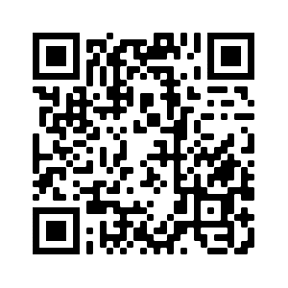
Devoirs
Vocabulary Learning Homework (Y8, Term 3.2, Week 4)
Quizlet link: Y8 Term 3.2 Week 4
Quizlet QR code:
In addition, revisit: Y8 Term 3.1 Week 5
Y8 Term 2.2 Week 2
Notes:
The answer sheet for the Y8, Term 3.2, Week 4 vocabulary learning HW is here: https://resources.ncelp.org/concern/resources/37720d59r?locale=en

