Slide 1
Authentic texts
O Tannenbaum
Term 1.2, Week 6

Slide 2
O Tannenbaum
Hör die Musik an.
Ist die Musik…
a. Popmusik
b. traditionell
c. klassisch
Was ist das Thema?
a. Liebe
b. Natur
c. Europa
Inge Alferink / Rachel Hawkes
Notes:
Setting the scene.
Just play one verse of an instrumental version. Link to instrumental versions: https://www.youtube.com/watch?v=KurqAmMi-bc (various instruments) https://www.youtube.com/watch?v=nxvJ1SIRdiI (piano only)
Alternatively, click on left hand tree, then right hand tree.
Link to versions with lyrics:
https://www.youtube.com/watch?v=OVSoZn66iC4 – a capella version, lyrics are fairly clear, there is only one verse https://www.youtube.com/watch?v=RJauT4IM1Y8 (choral version; pretty, but as there are a lot of voices, the individual sounds are not as clear– 3 verses, only play verse 1) https://www.youtube.com/watch?v=lS4wTuvR7Ik (single voice; quite clear sound – 3 verses, only play verse 1)

Slide 3
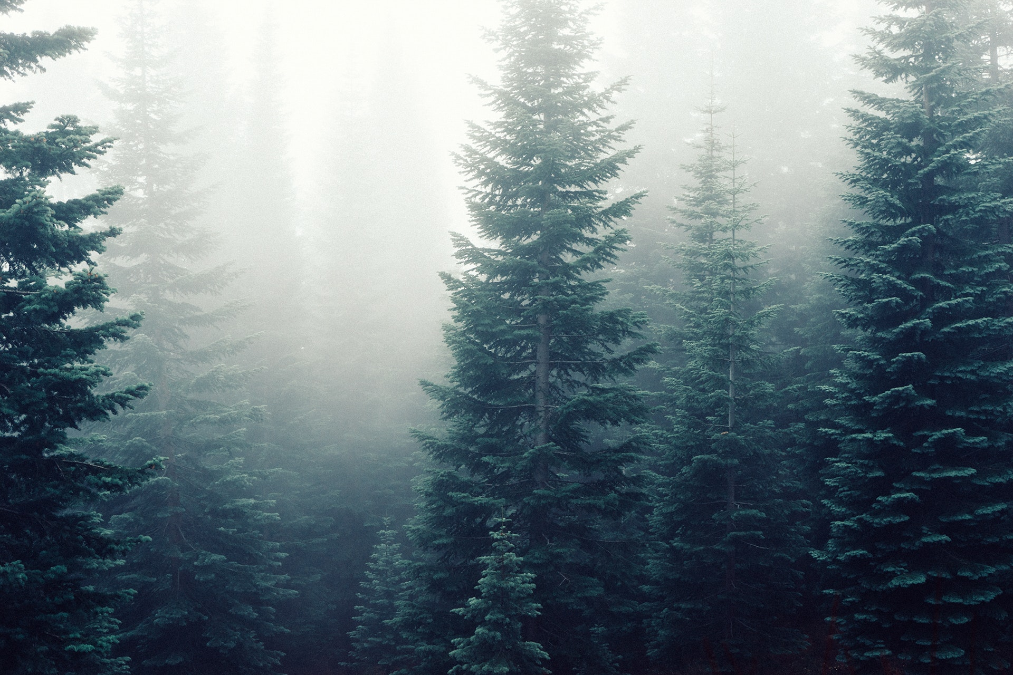
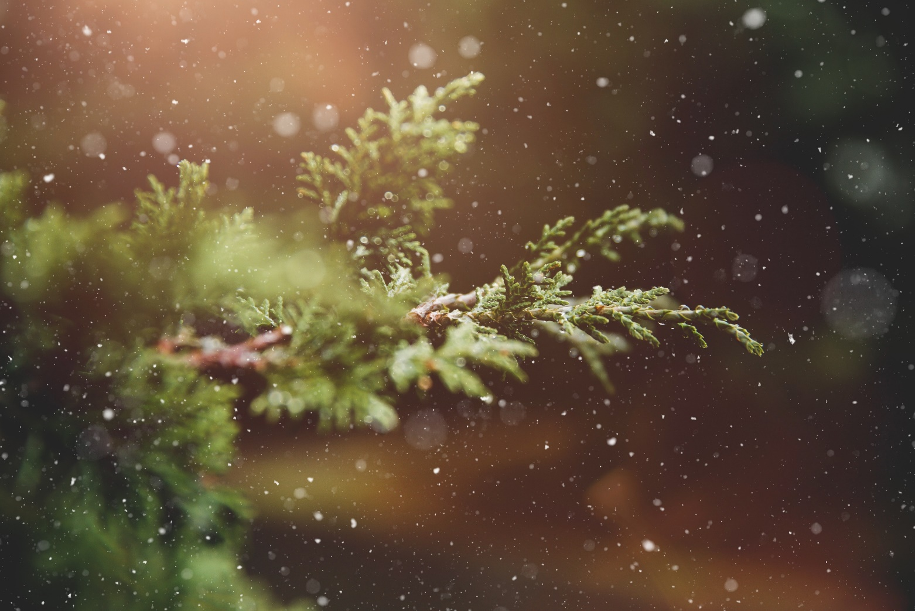
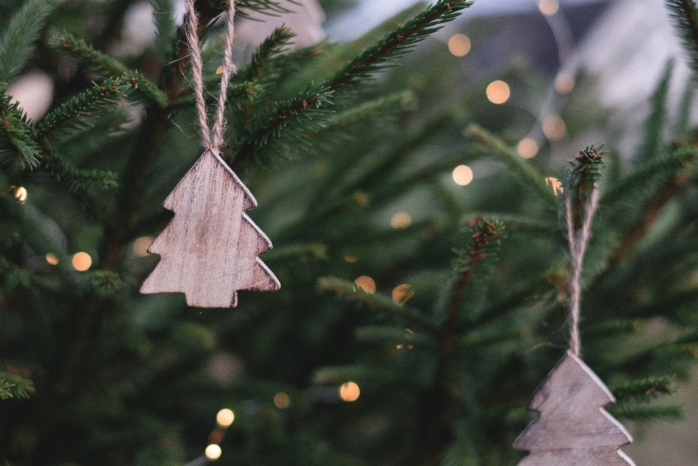
O Tannenbaum
Der Baum
O, Tannenbaum
Inge Alferink / Rachel Hawkes
Notes:
Setting the scene
The pictures emphasise the natural properties of the tree and not the decorative (Christmassy) aspect.
The top right picture might prime ‘snowing’ (wenn es schneit).
For teacher: Introduce the noun ‘der Baum’ [996] and invite the students to guess what type of tree a Tannenbaum might be. Note that students have not yet learnt the SSC ‘au’, but they have encountered some words with ‘au’ already (for example, das Haus). We return to this later in the lesson.

Slide 4
Geistesblitz - Vokabeln
60
Titel: O, Tannenbaum
60 Sekunden.
5 Wörter (Deutsch oder Englisch)
Inge Alferink / Rachel Hawkes
Notes:
Helping students to use their real-world knowledge and previous vocabulary knowledge in a new context.
Instructions: Der Title von diesem Lied /Song ist: O, Tannenbaum. In 60 Sekunden schreib 5 Wörter (Deutsch oder Englisch) für das Lied.
Some ideas with their word frequency: der Baum [996]; das Blatt [1330]; der Stamm [3500]; der Zweig/Ast [>4000]; die Wurzel [3047]; wachsen [482]; grün [556]; braun [2178]; die Erde [781]; die Sonne [953]; der Regen [1690]; der Sommer [704]; der Winter [1288]; der Schnee [2203].

Slide 5
‘U’ oder ‘Ü’?
O Tannenbaum, o Tannenbaum,
wie gr_n sind deine Blätter!
D_ gr_nst nicht n_r z_r Sommerszeit,
Nein auch im Winter, wenn es schneit.
O Tannenbaum, o Tannenbaum,
wie gr_n sind deine Blätter!
Inge Alferink / Rachel Hawkes
Notes:
Revisiting SSCs. In the NCELP SOW these SSCs have been introduced during week 12 (u) and 13 (ü). The O Tannenbaum activities will likely be done in week 13 or 14. This is repetition of a very recently introduced SSC. We use the pair as a contrast.
We include the source words and pictures as a refresher.
Play the song twice. Click on the fir tree in the top right hand corner. The text could also be read aloud if the recording seems too fast.
Alternatively, here is a link to a commercial version: https://www.youtube.com/watch?v=lS4wTuvR7Ik (single voice, but quite clear sound – 3 verses, only play verse 1)
Instructions:
Hör zu
Schreib ‘u’ oder ‘ü’

Slide 6
Antworten – u vs ü
O Tannenbaum, o Tannenbaum,
wie gr_n sind deine Blätter!
D_ gr_nst nicht n_r z_r Sommerszeit,
Nein auch im Winter, wenn es schneit.
O Tannenbaum, o Tannenbaum,
wie gr_n sind deine Blätter!
grün
Du
grünst
nur
zur
grün
Inge Alferink / Rachel Hawkes
Notes:
Answers

Slide 7
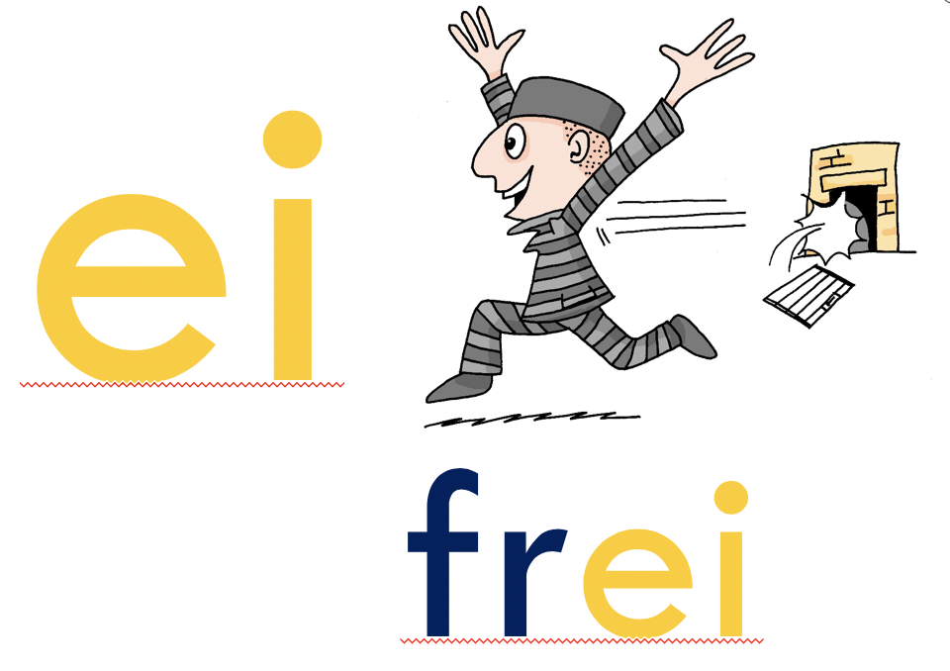
‘IE’ oder ‘EI’
O Tannenbaum, o Tannenbaum,
w__ grün sind d__ne Blätter!
Du grünst nicht nur zur Sommersz__t,
N__n auch im Winter, wenn es schn__t.
O Tannenbaum, o Tannenbaum,
w__ grün sind d__ne Blätter!
Inge Alferink / Rachel Hawkes
Notes:
Revisiting SSCs. In the NCELP SOW these SSCs have been introduced during week 3 (ei) and 7 (ie). The Oh Tannenbaum activities will likely be done in week 13 or 14. We are using these as a contrasting pair because of the spelling similarities.
We include the source words and pictures as a refresher.
Instructions:
Hör zu
Schreib ie oder ei

Slide 8
Antworten – ie vs ei
O Tannenbaum, o Tannenbaum,
w__ grün sind d__ne Blätter!
Du grünst nicht nur zur Sommersz__t,
N__n auch im Winter, wenn es schn__t.
O Tannenbaum, o Tannenbaum,
w__ grün sind d__ne Blätter!
wie
deine
Sommerszeit
Nein
schneit
wie
deine
Inge Alferink / Rachel Hawkes
Notes:
Answers

Slide 9
‘AU’ und ‘SCH’
AU
blau
das Haus
kaum
O Tannenbaum, o Tannenbaum,
wie grün sind deine Blätter!
Du grünst nicht nur zur Sommerszeit,
Nein auch im Winter, wenn es schneit.
O Tannenbaum, o Tannenbaum,
wie grün sind deine Blätter!
O Tannenbaum, o Tannenbaum,
wie grün sind deine Blätter!
Du grünst nicht nur zur Sommerzeit,
Nein auch im Winter, wenn es schneit.
O Tannenbaum, o Tannenbaum,
wie grün sind deine Blätter!
SCH
der Tisch
die Flasche
falsch
schreiben
in der Schule
Notes:
Before saying or singing the song out loud, there are two more sounds that have not been introduced formally (i.e. in a dedicated phonics session), but that pupils will have encountered already in other words: ‘au’ and ‘sch’.
The boxes on the right hand side give the sounds in words they have already been introduced to previously in the SOW.
Practise these new sounds separately (saying ‘au’ and ‘sch’) and relate them to the sounds in familiar words, before saying them in the new words.

Slide 10
Sprich es aus oder sing mit!
O Tannenbaum, o Tannenbaum,
wie grün sind deine Blätter!
Du grünst nicht nur zur Sommerszeit,
Nein auch im Winter, wenn es schneit.
O Tannenbaum, o Tannenbaum,
wie grün sind deine Blätter!
Inge Alferink / Rachel Hawkes
Notes:
Ask your students to practise saying the poem. Play the music and ask them to keep in time with the song to help word formation. Click tree on left for a slower instrumental version, tree on right for a quicker version.
Alternatively, students could sing the song.

Slide 11
Verbing nouns
Du grünst nicht nur zur Sommerzeit
https://www.gocomics.com/calvinandhobbes/1993/01/25
Inge Alferink / Rachel Hawkes
Notes:
What type of word do students think grünst is?
Clues:
verb ending
personal pronoun ‘Du’
can they deduce the meaning of grünen from the adjective grün?

Slide 12
Übersetzen
O Tannenbaum, o Tannenbaum, | O fir tree, o fir tree
wie grün sind deine Blätter | how green are your leaves!
Du grünst nicht nur zur Sommerzeit, | You are not just green in summer(time),
Nein auch im Winter, wenn es schneit. | No, also in the winter, when it snows.
O Tannenbaum, o Tannenbaum, | O fir tree, o fir tree
wie grün sind deine Blätter. | How green are your leaves!
Inge Alferink / Rachel Hawkes
Notes:
Ask your students to translate the verse using:
the words they already know
contextual expectations (Baum / Blätter / Grün )
cognates (Sommer & Winter)
generalisations (grünst)

Slide 13
Part 2 of this resource
We are in the process of obtaining copyright to use a modern adaptation of O Tannenbaum, which is the focus for a comparison in lesson 2. We anticipate that it will soon be published on the portal.

