Slide 1
Phonics
SSC [ch] [revisited]
Y7 French
Term 3.1 - Week 5
Kirsten Somerville / St James’ Hub / Natalie Finlayson
Date updated: 07/05/20
Notes:
Learning outcomes
Revisiting SSC [ch]

Slide 2
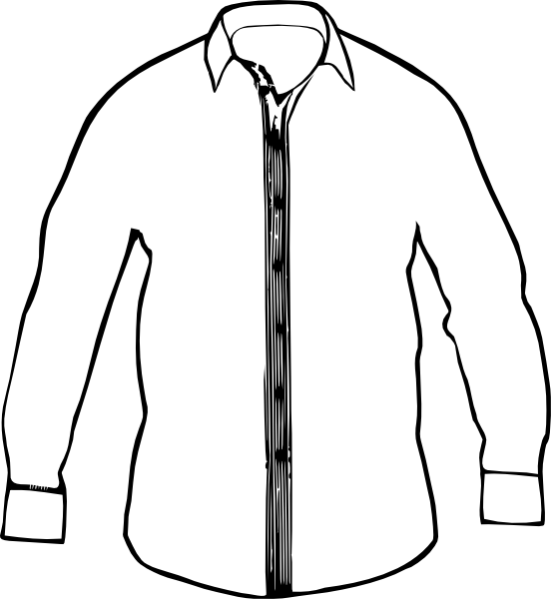
Phonétique
Dis les mots en français. Quelle est la SSC de la semaine ?
Notes:
Students work in pairs to work out the sound we are revisiting – first pair to put hands up have a go – must say all words correctly and work out the sound. Click the image to play the audio.
ANSWERS:
chien
cocher
chemise

Slide 3
ch
chercher
Notes:
Source word: chercher [336]
1. Present the letter and say the [ch] sound first, on its own. Students repeat it with you. 2. Bring up the word ”chercher” on its own, say it, students repeat it, so that they have the opportunity to focus all of their attention on the connection between the written word and its sound.
3. A possible gesture for this would be to mime looking for something everywhere. 4. Roll back the animations and work through 1-3 again, but this time, dropping your voice completely to listen carefully to the students saying the [e] sound, pronouncing ”chercher” and, if using, doing the gesture.

Slide 4
ch
chercher
Notes:
With sound and no pictures to focus all attention on the sound-symbol correspondence.

Slide 5
ch
chercher
Notes:
Without sound to elicit pronunciation (without first hearing the teacher).
Teacher to elicit pronunciation by asking “Comment dit-on …”

Slide 6
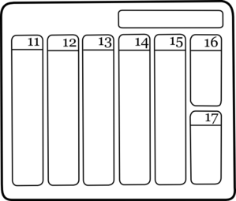
ch
dimanche
chanter
chercher
bouche
chat
champ
[field]
Notes:
Introduce and elicit the pronunciation of the individual SSC ‘ch’ and then the source word again (with gesture, if using). Then present and elicit the pronunciation of the five cluster words. The cluster words have been chosen for their high-frequency, from a range of word classes, with the SSC (where possible) positioned within a variety of syllables within the words (e.g. initial, 2nd, final etc.). Additionally, we have tried to use words that build cumulatively on previously taught SSCs (see the Phonics Teaching Sequence document) and do not include new SSCs. Where new SSCs are used, they are often consonants which have a similar symbol-sound correspondence in English.
Word frequency rankings (1 is the most common word in French): dimanche [1235]; chanter [1820] bouche [1838]; champ [847]; chat [3138]; chercher [336]. Source: Londsale, D., & Le Bras, Y. (2009). A Frequency Dictionary of French: Core vocabulary for learners London: Routledge.

Slide 7
ch
dimanche
chanter
chercher
bouche
chat
champ
Notes:
With sound and no pictures to focus all attention on the sound-symbol correspondence.

Slide 8
ch
dimanche
chanter
chercher
bouche
chat
champ
[field]
Notes:
Without sound to elicit pronunciation (without first hearing the teacher).
Teacher to elicit pronunciation by asking “Comment dit-on …”

Slide 9
En anglais et en français
lire / écouter
same [ch]
different [ch]
same [ch]
different [ch]
1
chef
6
champagne
2
avalanche
7
chocolat
3
touche
8
champion
4
brochure
9
moustache
5
charge
10
riche
Notes:
This activity highlights similarities and differences in the English and French pronunciation of the SSC [ch], using near-cognates which have not been previously taught. Images are provided to aid recognition. The activity aims to show that while the pronunciation of this SSC changes in English, it is consistent in French. Teachers to highlight that, where the sound is ‘sh’ in English, these words are “borrowed” from French (chef, brochure, champagne, moustache).
Students write 1-10 in their exercise books and decide if the [ch] in the French word sounds the same as in English, or different to the English. They then listen to the words and check their answers.
TRANSCRIPT:
chef
avalanche
touche
brochure
charge
champagne
chocolat
champion
moustache
riche
Frequency rankings of non-SOW (near-)cognates (1 is the most common word in French):
avalanche [4426], brochure [>5000], champagne [>5000], champion [2443], charge [849], chef [386], chocolat [4556], moustache [>5000], riche [599], touche [3775]
Source: Londsale, D., & Le Bras, Y. (2009). A Frequency Dictionary of French: Core vocabulary for learners London: Routledge

Slide 10
Remember ! Two pronunciations in English, one pronunciation in French!
parler
chef
champagne
avalanche
chocolat
touche
champion
brochure
moustache
charge
riche
Notes:
Students now practise saying the words in pairs, each choosing a word from a different side, then swapping sides. Students check each others’ pronunciation, trying to get the longest ‘rally’ of correct pronunciations. The teacher circulates to check that students are drawing on their existing knowledge of French SSCs to pronounce the words accurately and avoid L1 interference.
Before beginning the task, teacher to remind students: two pronunciations in English, one pronunciation in French.

