Slide 1
Describing places and locations
ESTAR - estoy, está for location
SSC [a]
Y7 Spanish
Term 1.1 - Week 1 - Lesson 1
Victoria Hobson / Nick Avery
Date updated: 27/09/20
Notes:
Learning outcomes (lesson 1):
Introduction of SSC [a]
Introduction of estar, estoy and está (for location)
Note: ‘estás’ will be introduced in the second lesson
Word frequency (1 is the most frequent word in Spanish):
1.1.1 (introduce) estar [21]; estoy; estás; está; norte [624]; sur [661]; Inglaterra [N/A]; España [N/A]; ¿dónde? [161] en [5]; hola [1245]; hasta luego [luego-150]
Source: Davies, M. & Davies, K. (2018). A frequency dictionary of Spanish: Core vocabulary for learners (2nd ed.). Routledge: London

Slide 2
¿Dónde está…?
Where is…?
Notes:
Timing: 2 minutes
Aim: To introduce three new vocabulary items (dónde, está and hola) and identify new students/classmates
Procedure:
Model ‘dónde‘ (with gesture/supported by picture, as preferred) and ‘está’ and the response of raising a hand.
Use “¿Dónde está + name of student?” to identify the new students in the Y7 group.
Say ‘hola’ and wave.
Then, having done the register, the teacher can continue with the next slide, having primed them thoroughly with 'está‘.
Notes:
We envisage that this is the first lesson with a new Y7 class, and that the teacher doesn’t know the students, and the students will likely not all know each other, either.
Teachers may choose to do this after they have got underway with the lesson material OR alternatively they may use this situation to introduce it.
This is an opportunity to use the L2 clearly and successfully for a communicative purpose.

Slide 3
estar
estar
[to be | being] (with location)
está
[is] (with location)
Notes:
Timing: 3 minutes for slides 3-8
Aim: to introduce the verb ‘estar’ more explicitly. ‘Estar’ is one of the 25 most frequently used verbs in Spanish. All 25 most frequent verbs will be introduced early on using the same format. Both long form (infinitive) and short form (3rd person singular) are introduced in order to familiarise students with various forms of the same verb.
Procedure
Bring up the word [estar] on its own, say it, students repeat it, and remind them of the phonics. Draw attention to [a].
Try to elicit the meaning from the students.
Then bring up the English translations. Emphasise the two meanings for the infinitive.
Bring up the short form [está], say it, students repeat it. Draw attention to [a].
Try to elicit the meaning from the students. Emphasise the two meanings for the short form.

Slide 4
estar
estar
[to be | being] (location, state)
está
[is] (location, state)
Notes:
Cycle through the long and short form again.

Slide 5
está
está
[is] (location, state)
Madrid está en España.
[Madrid is in Spain.]
Notes:
Introduce the short form in a sentence.
Note: this is unlikely to cause students any difficulty and is like to be confidence-building for them to translate the meaning so easily. Of course, should learners find it difficult, simply provide the English. The aim here is to provide concrete examples of ESTAR forms in use.

Slide 6
estar
estar
[to be | being] (location, state)
Pablo quiere estar en España.
[Pablo wants to be in Spain.]
Notes:
Introduce the long form in a sentence.
Note: ‘Quiere’ will be introduced in Term 1.2, Week 7. We don’t expect students necessarily to be able to guess its meaning here (though they may well), so continue to provide the English translation, swiftly.

Slide 7
está
está
[is] (location, state)
Madrid ___ en España.
está
[Madrid is in Spain.]
Notes:
Cycle through the short form in context again.
Note: Some students may be able to translate the whole English sentence. However, in case not, a staggered version is provided, whereby the sentence minus the verb is given (a sound effect is heard in place of the verb).

Slide 8
estar
estar
[to be | being] (location, state)
Pablo quiere ____ en España.
estar
[Pablo wants to be in Spain.]
Notes:
Cycle through the long form in context again.

Slide 9
a
nada
amar
∅
casa
alto
agosto
cama
Nick Avery
Notes:
Recap individual SSC ‘A’ and then the source word again (with gesture, if using). Then present and elicit the pronunciation of the five cluster words. The cluster words have been chosen for their high-frequency, from a range of word classes, with the SSC (where possible) positioned within a variety of syllables within the words(e.g. initial, 2nd, final etc..) and additionally, we have tried to use words that build cumulatively on previously taught SSCs (see the Phonics Teaching Sequence document) and do not include new SSCs. Where new SSCs are used, they are often consonants which have a similar symbol-sound correspondence in English. Word frequency rankings: alto [231]; nada [87]; casa [106] cama [609]; amar [700]; agosto [931] Source: Davies, M. & Davies, K. (2018). A Frequency Dictionary of Spanish: Core vocabulary for learners (2nd ed.) London: Routledge.
A note on L1:L2 word translations: these are supported in the research literature on vocabulary learning, and should only be avoided where meanings are transparent. If at any point in teaching, pupils are not clear about a meaning, teachers should not hesitate in giving the English meaning.

Slide 10
a
nada
amar
casa
alto
agosto
cama
Nick Avery
Notes:
Without the images, students focus this time again closely on the SSC and the cluster words.

Slide 11
a
nada
amar
casa
alto
agosto
cama
Nick Avery
Notes:
Without the images or sound, students have to pronounce the words themselves.

Slide 12
Fonética
leer / hablar
alto
agosto
60
nada
amar
Segundos
casa
cama
estar
0
INICIO
Notes:
Phonics practice activity: alphabetical read aloud
Timing: 1 min
Aim: To elicit the production of the SSC [a].
Procedure:
1. Click on ‘inicio’ to start the timer
2. Individually (but all at once) pupils read out the words but in alphabetical order.
3. Students keep going for one minute.
3. Teacher can circulate to listen into their SSC knowledge.
Note: the new vocabulary item ‘estar’ [21] is also included.
Word frequency (1 is the most frequent word in Spanish): alto [231]; nada [87]; casa [106] cama [609]; amar [700]; agosto [931]
Source: Davies, M. & Davies, K. (2018). A frequency dictionary of Spanish: Core vocabulary for learners (2nd ed.). Routledge: London

Slide 13
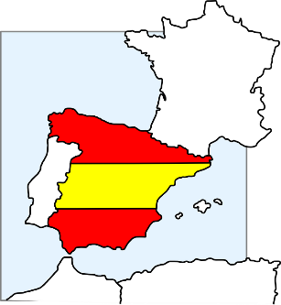
hablar
Está en Inglaterra.
¿Dónde está Granada?
Está en España.
Notes:
Timing: 5 minutes
Aim: 1) To extend practice of SSC [a] to names of cities; 2) to introduce the meaning of ‘está’ as used for ‘it is’ (see note below); 3) to introduce the two new vocabulary items ‘Inglaterra’ and ‘España’
Procedure:
This is a teacher-fronted activity. Teachers can respond chorally.
Ask the group ‘¿Dónde está…?’, with the name of the city. Answer will either be Inglaterra or España.
Note:
You could ask students to pronounce the English towns in a Spanish way - see what they come up with (a good way to assess some prior knowledge of phonics/Spanish).
A couple of the places aren't obvious, so there is genuinely new/surprising info added in here.
We need to deal explicitly with the fact that 'está' stands for two words in English, here - it and is. In the verb slides, we translate 'está' as 'is' and then show it with subjects Madrid and Pablo. Here we see it for the first time meaning 'it is‘.
Note that ‘rr’ and ‘ñ’ are new SSC. Some brief attention will need to be given to RR in Inglaterra and Ñ in España, before they are more formally introduced and practised. It can be quite fun for students to practise rolling the RR! And if students can say ‘lasagne’ they can say ‘España’.

Slide 14
hablar
¿Dónde está Córdoba?
Está en Inglaterra.
Está en España.

Slide 15
hablar
Está en Inglaterra.
¿Dónde está Camborne?
Está en España.
Notes:
After revealing the answer, ask students to pronounce Camborne in a Spanish way - see what they come up with (a good way to assess some prior knowledge of phonics/Spanish).

Slide 16
hablar
¿Dónde está Córdoba?
Está en Inglaterra.
Está en España.

Slide 17
hablar
Está en Inglaterra.
¿Dónde está Kendal?
Está en España.

Slide 18
hablar
Está en Inglaterra.
¿Dónde está Salamanca?
Está en España.

Slide 19
hablar
Está en Inglaterra.
¿Dónde está Aspatria?
Está en España.

Slide 20
hablar
Está en Inglaterra.
¿Dónde está Maldon?
Está en España.

Slide 21
hablar
Está en Inglaterra.
¿Dónde está Soria?
Está en España.

Slide 22
hablar
Está en Inglaterra.
¿Dónde está Cantabria?
Está en España.

Slide 23
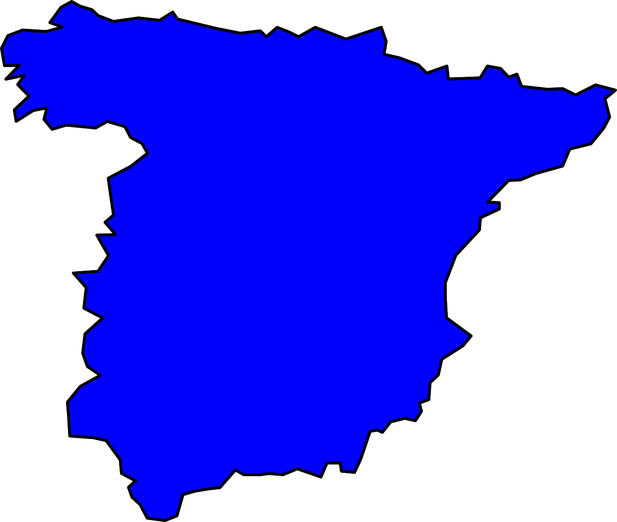
¿Dónde está el palacio Miramar?
Bilbao
San Sebastián
el museo Guggenheim
el palacio Miramar
Barcelona
Madrid
el camp Nou
el museo del Prado
la Sagrada Familia
el Bernabeu
Córdoba
la Mezquita-Catedral
Está en San Sebastián.
Granada
la Alhambra
Notes:
Timing: 5 minutes (slides 23-30)
Aim: for students to produce sentences with ‘está’ (with the meaning ‘it is’) and to develop further confidence and accuracy in producing [a]
Procedure:
1. Teacher reads aloud the question (which appears on click)
2. Students then have to identify the city and try to pronounce it, focusing on the ‘a’ sound. 3. Elicit choral responses (all students speaking at the same time) to give them more confidence
4. Reinforce the phonic awareness by re-stating the answer yourself when it appears.
Notes:
1. This activity also familiarises students with the landmarks which are referred to in the later listening and reading activities which follow.
2. Students may also want to tell you if they have visited these places and this task offers an independent learning opportunity for students to find out more about these (and other) famous places in Spain after the lesson.

Slide 24
¿Dónde está la Alhambra?
Bilbao
San Sebastián
el museo Guggenheim
el palacio Miramar
Barcelona
Madrid
el camp Nou
el museo del Prado
la Sagrada Familia
el Bernabeu
Córdoba
la Mezquita-Catedral
Está en Granada.
Granada
la Alhambra

Slide 25
¿Dónde está el Bernabeu?
Bilbao
San Sebastián
el museo Guggenheim
el palacio Miramar
Barcelona
Madrid
el camp Nou
el museo del Prado
la Sagrada Familia
el Bernabeu
Córdoba
la Mezquita-Catedral
Está en Madrid.
Granada
la Alhambra

Slide 26
¿Dónde está el museo Guggenheim?
Bilbao
San Sebastián
el museo Guggenheim
el palacio Miramar
Barcelona
Madrid
el camp Nou
el museo del Prado
la Sagrada Familia
el Bernabeu
Córdoba
la Mezquita-Catedral
Está en Bilbao.
Granada
la Alhambra

Slide 27
¿Dónde está el museo del Prado?
Bilbao
San Sebastián
el museo Guggenheim
el palacio Miramar
Barcelona
Madrid
el camp Nou
el museo del Prado
la Sagrada Familia
el Bernabeu
Córdoba
la Mezquita-Catedral
Está en Madrid.
Granada
la Alhambra

Slide 28
¿Dónde está el camp Nou?
Bilbao
San Sebastián
el museo Guggenheim
el palacio Miramar
Barcelona
Madrid
el camp Nou
el museo del Prado
la Sagrada Familia
el Bernabeu
Córdoba
la Mezquita-Catedral
Está en Barcelona.
Granada
la Alhambra

Slide 29
¿Dónde está la Mesquita-Catedral?
Bilbao
San Sebastián
el museo Guggenheim
el palacio Miramar
Barcelona
Madrid
el camp Nou
el museo del Prado
la Sagrada Familia
el Bernabeu
Córdoba
la Mezquita-Catedral
Está en Córdoba.
Granada
la Alhambra

Slide 30
¿Dónde está la Sagrada Familia?
Bilbao
San Sebastián
el museo Guggenheim
el palacio Miramar
Barcelona
Madrid
el camp Nou
el museo del Prado
la Sagrada Familia
el Bernabeu
Córdoba
la Mezquita-Catedral
Está en Barcelona.
Granada
la Alhambra

Slide 31
Estar: I am & he/she is
In Spanish, the verb estar means to be when describing location.
Estoy
I am
Está
he / she is
Estoy en España.
I am in Spain.
Está en España.
He / she is in Spain.
Notes:
Grammar explanation
Timing: 2 minutes
Aim: to highlight the difference in meaning between ‘estoy’ and ‘está’ by juxtaposing the verb forms
Note:
1. Make reference to that fact that está has just been practised to mean ‘is’ and ‘it is’. Now draw students’ attention to its translation as he/she is.
2. This is the first time in this lesson that students need to write. It is probably the best time to hand out exercise books. This may mean that one or two activities move from this lesson into the next.

Slide 32
Cartas postales
Read the postcards. Who is where? estoy (I am) or está (he/she is).
Write: 1. I am OR he/she is.
Notes:
Instruction slide for subsequent grammar (reading) activity

Slide 33
Gramática
leer
4)
1)
I am
I am
Está en el palacio
Miramar.
Estoy en el museo del
Prado.
s/he is
s/he is
2)
I am
5)
I am
Estoy en el museo
Guggenheim.
Estoy en el Bernabeu.
s/he is
s/he is
3)
I am
6)
I am
Está en La Alhambra.
Está en el Campo
Nou.
s/he is
s/he is
Notes:
Timing: 6 minutes
Aim: to practise attending to the meanings of the verbs ‘estoy’ and ‘está’ in reading comprehension
Procedure:
1. Ask students to write 1-6 in exercise books.
2. Ask them to read the sentence on each postcard and decide which person it must refer to. In their books they should write ‘I am’ or ‘s/he is’
3. Check answers item by item.

Slide 34
Gramática
escuchar
Sofia misses her boyfriend! She explains why.
Listen. Write ‘I am’ or ‘he is’
Listen again and write the city name.
I am | he is | City
1
Granada
2
Madrid
3
Barcelona
4
San Sebastián
5
Bilbao
6
Córdoba
7
Madrid
8
Barcelona
Notes:
Timing: 8 minutes
Aim: to practise attending to the meanings of the verbs ‘estoy’ and ‘está’ in listening comprehension and to practise transcribing city/place names with SSC [a]
Procedure:
1. Ask students to write 1-8 in their books.
2. Tell them that they will sentences using the verbs ‘estoy’ and ‘está’.
3. The first time they listen, they should write ‘I am’ or ‘he is’, depending on the verb.
4. The second time they listen, they should write the city.
Transcript:
Está en la Alhambra
Estoy en el museo del Prado
Estoy en el campo Nou
Está en el palacio Miramar
Estoy en el museo Guggenheim
Está en la Mesquita-Catedral
Está en el Bernabeu
Estoy en la Sagrada Familia

Slide 35
¡A hablar!
hablar
Partner A
(verb) + (city)
Granada
Está
en Granada.
Partner B
translation
He is in Granada.
Notes:
Speaking activity
Timing: 10 minutes
Aim: to use sentences with ‘estoy’ and ‘está’ in oral production
Procedure:
See separate set of cards (word doc) Students play the game as described below:
1 Separate the cards into two piles – verbs and cities.
2 Partner A picks a verb and then a city, says the Spanish sentence. 3 Partner B translates into English. 4 Players then swap roles. If pairs time themselves, they can then repeat the activity to see how quickly they can complete all the sentences and translations. With each new game, different sentences will be generated.
Note: Students could make these cards themselves i.e. fold A4 paper so it makes 12 rectangles - write 'I' x 3, he/she x 3, (this will be a cue/prompt to recall the correct verb in Spanish), then 6 cities that they remember. They could all do this so that they have 24 playing cards in total, when put together. This is good practice for spelling / memory / sounding out city names as they write them.

Slide 36
¡A hablar!
leer / hablar
Bilbao
Madrid
Barcelona
Valencia
Granada
San Sebastián
[I am]
[He is]
Está en Granada.
Está en Bilbao.
Estoy en Barcelona.
Estoy en San Sebastián.
Estoy en Valencia.
Está en Madrid.
Notes:
OPTIONAL - alternative speaking activity
Timing: 5 minutes
Aim: to correctly use the verbs ‘estoy’ and ‘está’ in oral production and further practise SSC [a]
Procedure:
Each click brings up a combination of prompts (one for the verb, one for the city)
Elicit the correct sentence from students.
In total, there are six sentences to produce.
Notes:
1. This may be more suitable for more remote learning than the previous activity as it does not require printing or a partner.

Slide 37
Describing places and locations
ESTAR – estoy / estás / está for location
SSC [o], SSC [a]
Y7 Spanish
Term 1.1 - Week 1 - Lesson 2
Victoria Hobson / Nick Avery
Date updated: 27/09/20
Notes:
Learning outcomes (lesson 2):
Consolidation of SSC [a]
Introduction of SSC [o] Consolidation of ‘estoy’ and ‘está’
Introduction of ‘estás’ for location
Word frequency (1 is the most frequent word in Spanish):
1.1.1 (introduce) estar [21]; estoy; estás; está; norte [624]; sur [661]; Inglaterra [N/A]; España [N/A]; ¿dónde? [161] en [5]; hola [1245]; hasta luego [luego-150]
Source: Davies, M. & Davies, K. (2018). A frequency dictionary of Spanish: Core vocabulary for learners (2nd ed.). Routledge: London

Slide 38
o
olvidar
dos
solo
yo
con
Con ketchup
poco
[little]
Nick Avery
Notes:
Introduce and elicit the pronunciation of the individual SSC ‘o’ and then the source word again (with gesture, if using). Then present and elicit the pronunciation of the five cluster words.
The cluster words have been chosen for their high-frequency, from a range of word classes, with the SSC (where possible) positioned within a variety of syllables within the words(e.g. initial, 2nd, final etc..) and additionally, we have tried to use words that build cumulatively on previously taught SSCs (see the Phonics Teaching Sequence document) and do not include new SSCs. Where new SSCs are used, they are often consonants which have a similar symbol-sound correspondence in English.

Slide 39
o
olvidar
dos
solo
yo
con
poco
Nick Avery
Notes:
Without the images, students focus this time again closely on the SSC and the cluster words.

Slide 40
o
olvidar
dos
solo
yo
con
poco
Nick Avery
Notes:
Without the images or sound, students have to pronounce the words themselves.

Slide 41
Fonética
leer / hablar
agosto
alto
60
olvidar
nada
dos
amar
Segundos
solo
yo
con
cama
poco
0
casa
INICIO
Notes:
Timing: 2 minutes
Aim: to practise pronouncing words with SSCs [a] and [o]
Procedure:
1. Pupils say words with [a] and [o] alternately out loud with a partner, building up speed, over 1 minute’s intensive practice.
2. They are not allowed to repeat the one they said in their last turn.
Note: If students can, they should do this without seeing the words. If not, the teacher could elicit the words before beginning the pairwork practice.
Word frequency (1 is the most frequent word in Spanish): alto [231]; nada [87]; casa [106] cama [609]; amar [700]; agosto [931]; yo [28]; olvidar [416]; dos [64]; solo [182] poco [76]; con [14]
Source: Davies, M. & Davies, K. (2018). A frequency dictionary of Spanish: Core vocabulary for learners (2nd ed.). Routledge: London

Slide 42
Vocabulario
60
 | Word | English meaning
1 | dónde | where
2 | estar | to be [location]
3 | estoy | I am
4 | estás | you are
5 | está | he / she / it is
6 | en | in
7 | Inglaterra | England
8 | España | Spain
9 | norte | north
10 | sur | south
Segundos
0
INICIO
Notes:
Vocabulary learning and revision activity
Timing: 1-4 minutes Aim: To reactivate and strengthen vocabulary knowledge. Procedure: Round 1: Look at the Spanish, recall the English meanings, saying them aloud. [1 minute] Round 2: Look at the English, recall the Spanish meanings, saying them aloud. [1 minute] Repeat for two further minutes, to speed up recall. Word frequencies:
dónde [161]; estar [21]; estoy; estás; está; en [5]; Inglaterra [proper noun - N/A]; España [proper noun - N/A]; el [1]; norte [624]; sur [661]

Slide 43
Estar: I am & you are
Estar means…
to be when describing location.
Está
it / he / she is
Estoy
I am
To say you are, use estás.
Estás
you are
Estás en España.
You are in Spain.
Estás en el norte.
You are in the north.
Notes:
Grammar recap and presentation slide
Timing: 2 minutes
Procedure:
The animations here enable teachers to elicit answers from students that revisit last lesson’s learning of ESTAR (
Then present the new verb form ‘estás’.
Elicit the translations of the examples from students.
Notes:
Students will not yet know ‘norte’ but it is a near-cognate and part of this week’s learning.
In this lesson, although 'norte' and sur' require 'el‘ here, try to avoid explaining the use of the definite article. This will be introduced in and practised frequently from term 1.2, week 5.

Slide 44
leer
You and your friend have a busy week ahead. Write where each one of you is each day in English. Use a ? when no info is given.
2019 | septiembre |  | septiembre
lunes | ……estoy en casa …estás en España… | viernes | …estás en Inglaterra ………………………… ………………………..
martes | .estás en Granada.. .estoy en el norte… | sábado | ………………….…….. ……estoy en Madrid
miércoles | …estoy en Valencia …estás en el sur… | domingo | .estoy en la cama… ………………………………………………
jueves | …estás en casa…… | Notas
6
10
You are
I am
Mon
Tues
Weds
Thurs
Fri
Sat
Sun
7
11
at home
in Spain
in the north
in Granada
in Valencia
in the south
?
at home
8
12
?
in England
in Madrid
?
9
İFiestas en
octubre!
in bed
?
Notes:
Grammar practice slide (reading comprehension)
Timing: 7 minutes
Aim: to practise distinguishing between ‘estoy’ and ‘estás’ and their meanings in reading
Procedure:
1. Students copy the table on the right-hand side into their books
2. They complete the table with the information that corresponds to each form of the verb.
Note:
1. casa and cama are cluster words for SSC [a] and will be known to students from their phonics learning for Week 1.
2. norte has been met on the previous slide. It is likely that students will work out the meaning of ‘sur’ as a result, but as they will need to write the English in this task, it will be apparent if they don’t know it.

Slide 45
escuchar
Sofia compares where she is on holiday and where her friend is. Listen.
Who is it: Sofia (‘I’) or her friend (‘you’)? Tick the person, then write where they are.
‘I am’
‘you are’
Sofia | friend | ¿Dónde?
1
Valencia
2
the north
3
Granada
4
the south
5
England
6
Spain
7
Madrid
8
Barcelona
Notes:
Grammar practice (listening comprehension)
Timing: 8 minutes
Aim: to practise distinguishing between ‘estoy’ and ‘estás’ and their meanings in listening
Procedure:
Ask students to copy the blank table down, with 1-8.
Go through the context, drawing attention to who the verbs are going to refer to (‘I’ and ‘you’)
Ask them to listen and tick the right person.
Listen again and write the place. Tell students that the Spanish cities will be spelt as they hear them (there is no ‘English’ word for them).
Accept answers written in Spanish for north/south/England/Spain.
TRANSCRIPT
Estoy en Valencia
Estás en el norte.
Estoy en Granada.
Estoy en el sur.
Estás en Inglaterra.
Estoy en España.
Estás en Madrid.
Estás en Barclona.

Slide 46
Gramática
escribir
1
Estás en España.
Notes:
Grammar activity (writing)
Timing: 5 minutes (slides 46-52)
Aim: to use pictures to elicit production of the verbs and vocabulary taught this week
Procedure:
Explain to students that they’ll be using the personal pronoun picture to decide if it’s ‘estoy’, ‘estás’ or ‘está’ and that the picture on the right will show where.
Students write the sentence (in books or on mini-whiteboards) in Spanish.
Note:
1. Because students have now had plenty of receptive (input-based) practice with the three verb forms across the two lessons, we can now bring them together in a final activity

Slide 47
Gramática
escribir
2
Estás en el norte.

Slide 48
Gramática
escribir
3
Estoy en Inglaterra.

Slide 49
Gramática
escribir
4
Madrid
Está en Madrid.

Slide 50
Gramática
escribir
5
S
Estoy en el sur.

Slide 51
Gramática
escribir
6
Granada
Estoy en Granada.

Slide 52
Gramática
escribir
7
Estás en Inglaterra.

Slide 53
Gramática
escribir
8
Está en España.

Slide 54
¡A hablar!
hablar
Partner A
(verb) + (location)
Estás
en el norte.
translation
Partner B
You are in the north.
Notes:
Speaking activity
Timing: 10 minutes
Aim: to practise using ‘estoy’ and ‘estás’ and the vocabulary items taught this week in speaking.
This works in a similar way to the speaking activity in lesson 1, but now with ‘estás’ and other vocabulary.
Procedure:
See separate set of cards (word doc) Students play the game as described below:
1 Separate the cards into two piles – verbs and cities.
2 Partner A picks a verb and then a city, says the Spanish sentence. 3 Partner B translates into English. 4 Players then swap roles. If pairs time themselves, they can then repeat the activity to see how quickly they can complete all the sentences and translations. With each new game, different sentences will be generated.
Note: Students could make these cards themselves i.e. fold A4 paper so it makes 12 rectangles - write 'I' x 3, ‘you’ x 3, (this will be a cue/prompt to recall the correct verb in Spanish), then 6 cities that they remember. They could all do this so that they have 24 playing cards in total, when put together. This is good practice for spelling / memory / sounding out city names as they write them.

Slide 55
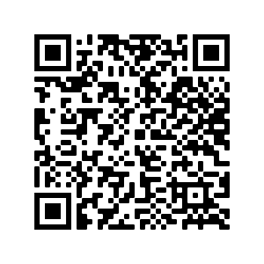
Deberes
Vocabulary Learning Homework (Term 1.1, Week 2)
Audio file
Audio file QR code:
Student worksheet
Quizlet link
Notes:
Take the opportunity to use ‘hasta luego’ at the end of the first class!

