Slide 1
Talking to ‘you’ vs more than one ‘you’: Verbs with ‘tú’ and ‘vosotros’

Slide 2
Talking to ‘you’ vs more than one ‘you’: Verbs with ‘tú’ and ‘vosotros’
Spanish uses different verb endings for tú (one ‘you’) and vosotros (more than one ‘you’).
Compare:
1. Escuchas
2. Escucháis
So, for regular Spanish verbs ending in –ar (e.g. hablar):
Remove –ar and add –as for one ‘you’
Remove –ar and add –áis for more than one ‘you’
→ you listen (one ‘you’)
→ you listen (more than one ‘you’)
Nick Avery / Emma Marsden / Rachel Hawkes

Slide 3
Listen to each verb. Tick if it is used for one ‘you’ or more than one ‘you’.
 | one ‘you’ | more than one ‘you’
1
2
3
4
5
6
7
8
9
10
1
✔ pasas
2
✔ llegáis
3
✔ dejas
4
✔ habláis
5
✔ llevas
6
✔ buscas
7
✔ pensáis
8
✔ llamas
9
✔ tomáis
10
✔ preguntáis
escuchar
Nick Avery / Emma Marsden / Rachel Hawkes
Notes:
Verb frequency rankings (1 indicates the most common word in Spanish): pasar [68]; llegar [75]; dejar [86]; hablar [90]; llevar [101]; buscar [179]; pensar [105]; llamar [122]; tomar [133]; preguntar [219].
Source: Davies, M. & Davies, K. (2018). A frequency dictionary of Spanish: Core vocabulary for learners (2nd ed.). London: Routledge.
Click on the orange number to hear the audio, once. Click again to repeat, as required. To complete the task, students can number 1-10 in their books, write the table headings at the top and complete by ticking in the correct column. Students can be encouraged to transcribe the verb form, too.
Transcript
pasas
llegáis
dejas
habláis
llevas
buscas
pensáis
llamas
tomáis
preguntáis

Slide 4
Look at the picture and read the speech bubble. Circle the correct verb.
¿Cantas / cantáis en un grupo?
1.
2.
¡Lleváis / llevas mucha ropa rosa!
leer
Nick Avery / Emma Marsden / Rachel Hawkes
Notes:
Verb frequency rankings: cantar [717]; llevar [101]

Slide 5
¿Celebras / celebráis mi cumpleaños?
3.
4.
¿Me acompañáis / acompañas?
leer
Nick Avery / Emma Marsden / Rachel Hawkes
Notes:
Verb frequency rankings: acompañar [606]; celebrar [886]

Slide 6
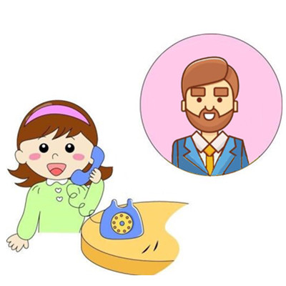
¿Bailas / bailáis conmigo?
¿Me llamáis / llamas luego?
5.
6.
leer
Nick Avery / Emma Marsden / Rachel Hawkes
Notes:
Verb frequency rankings: bailar [1323]; llamar [122]

Slide 7
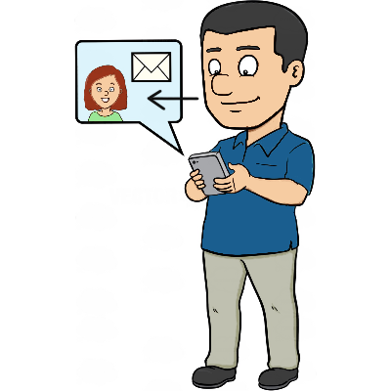
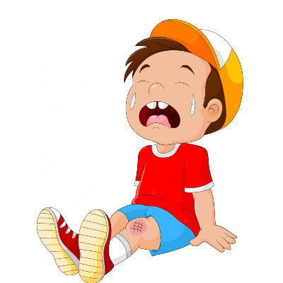
¿A qué hora entrás / entras al trabajo?
7.
8.
¿Por qué lloras / lloráis?
leer
Nick Avery / Emma Marsden / Rachel Hawkes
Notes:
Verb frequency ranking: entrar [207]; llorar [630]

Slide 8
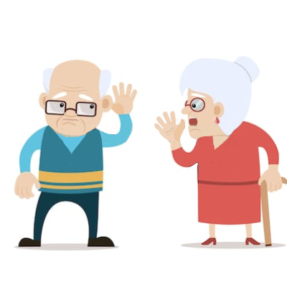
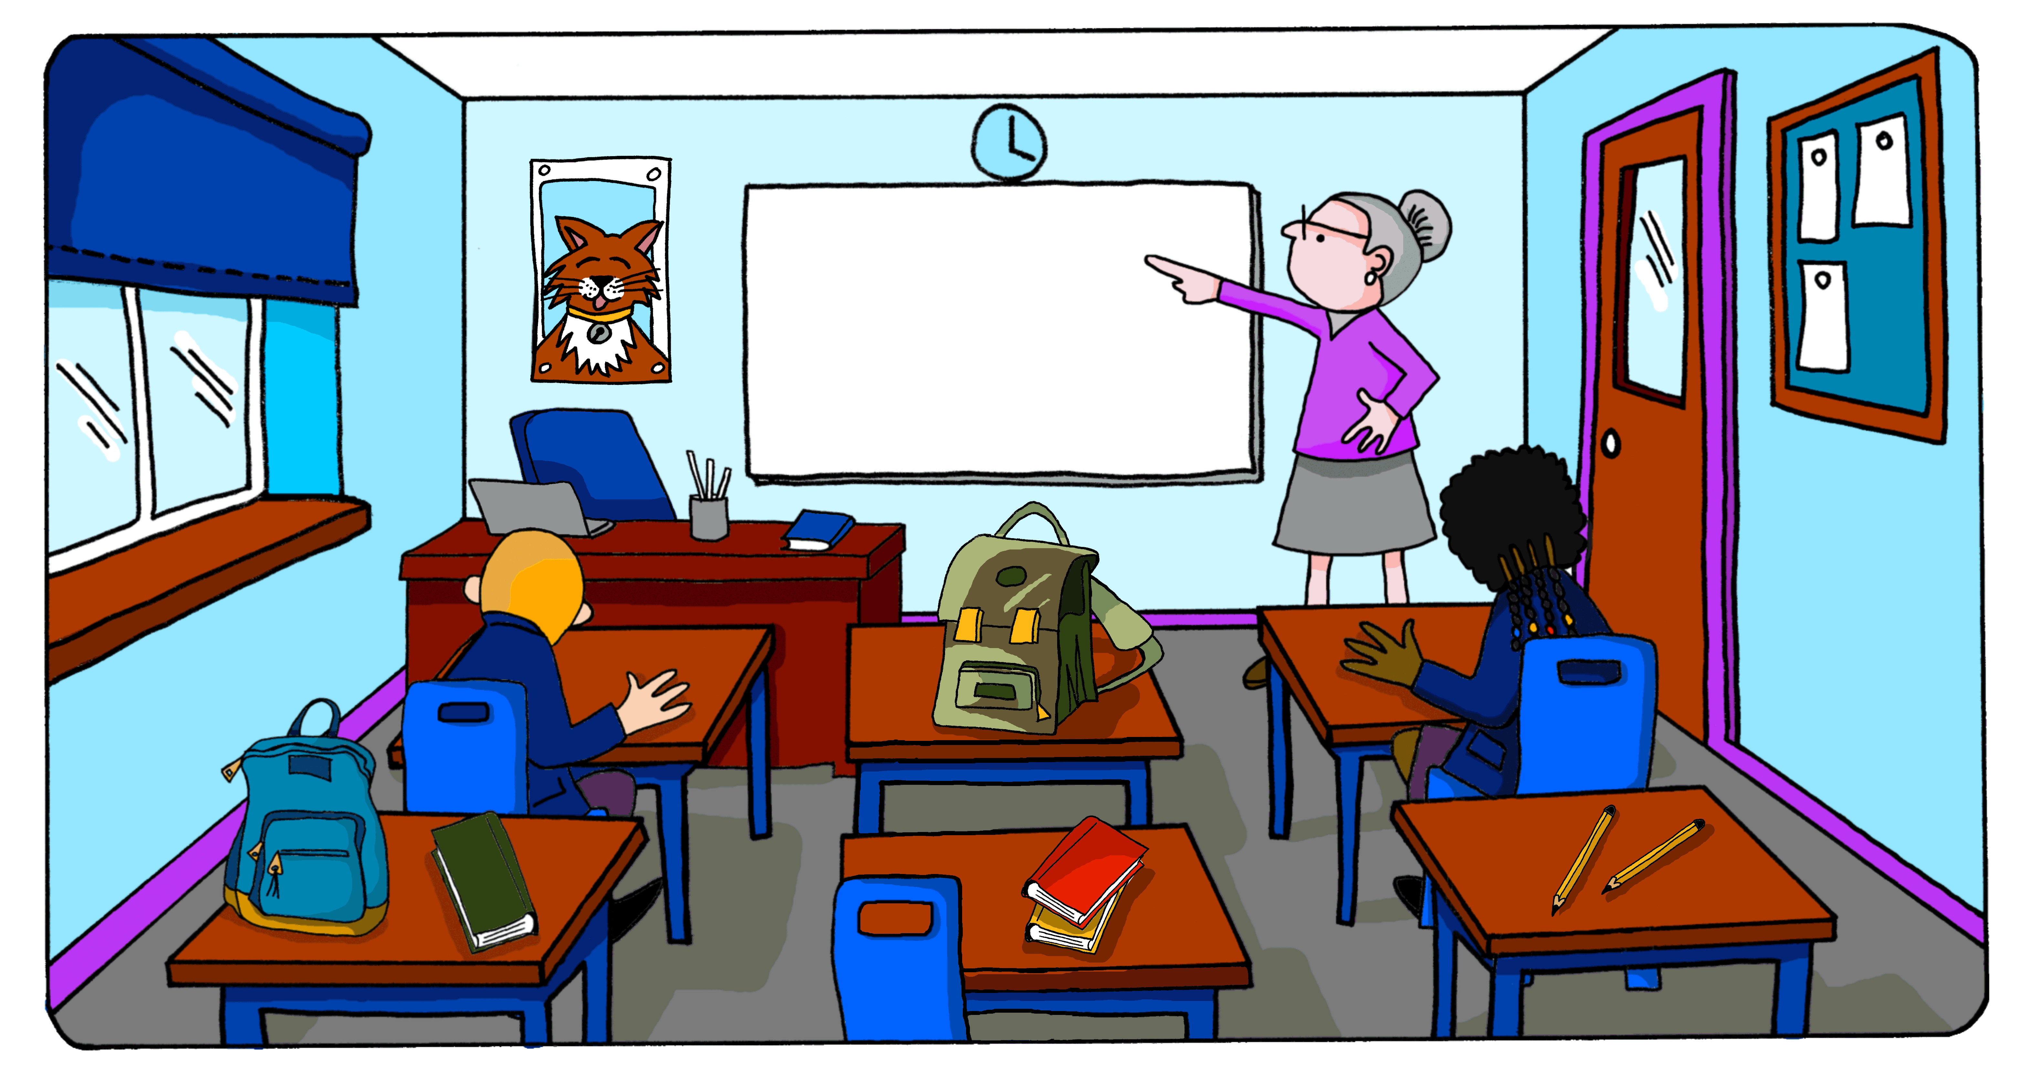
9.
10.
¿Me escucháis / escuchas?
Cortáis / cortas el papel así.
leer
Nick Avery / Emma Marsden / Rachel Hawkes
Notes:
Verb frequency ranking: escuchar [281]; cortar [755]

Slide 9
Poor teacher!
Oh dear. Your Spanish teacher has completely lost her voice.
Please help her to explain today’s activities to the class.
Be careful! Different students have different tasks.
Use the cards to give the right instructions to different student(s).
Your partner will listen and make a note of who does what.
hablar / escuchar
Nick Avery / Emma Marsden / Rachel Hawkes
Notes:
The instructions that students have to give are best imagined as an explanation (affirmative), even though they may also occur as commands (imperative).

Slide 10
1. listen to a song
2. draw an animal
5. work with a partner
3. finish the homework
4. look at the board
hablar / escuchar
Nick Avery / Emma Marsden / Rachel Hawkes
Notes:
Student A gives instructions, using verb endings in 2nd person based on singularity/plurality in the picture.
Student B listens and completes the grid on the next slide.
Ensure that Student A gives the instruction e.g. ‘cortas el papel’, ‘termináis los deberes’ without saying ‘tú’ or ‘vosotros’. This will direct Student B’s attention to the verb to understand if the instruction is for one person or more.
Verb frequency rankings: cortar [755]; terminar [253]; mirar [125]; trabajar [174]; dibujar [2218].

Slide 11
6. copy three texts
7. study in silence
10. rest for 15 minutes
8. prepare for the exam
9. pronounce words
hablar / escuchar
Nick Avery / Emma Marsden / Rachel Hawkes
Notes:
Now Student B speaks. Student A listens and completes the grid.
Verb frequency rankings: copiar [2836]; preparar [570]; estudiar [332]; pronunciar [1990]; descansar [1749].

Slide 12
Need help?
listen to a song – escuchar una canción
draw an animal – dibujar un animal
work with a partner – trabajar con una pareja
look at the board – mirar la pizarra
finish the homework – terminar los deberes
hablar / escuchar
Nick Avery / Emma Marsden / Rachel Hawkes
Notes:
Student A help slide
These could be shown briefly for a couple of minutes in a quick "revision and knowledge check" opportunity before the speaking activity. They would then be removed.

Slide 13
Need help?
copy three texts – copiar tres textos
prepare for the exam – preparar para el examen
study in silence – estudiar en silencio
pronounce words – pronunciar palabras
rest for 15 minutes – descansar (por) quince minutos
hablar / escuchar
Nick Avery / Emma Marsden / Rachel Hawkes
Notes:
Student B help slide
These could be shown briefly for a couple of minutes in a quick "revision and knowledge check" opportunity before the speaking activity. They would then be removed.

Slide 14
How many students… | one | more than one
have to listen to a Spanish song?
have to draw an animal?
have to finish their homework?
have to look at the board?
have to work with a partner?
hablar / escuchar
Nick Avery / Emma Marsden / Rachel Hawkes
Notes:
Student B grid - blank

Slide 15
ANSWERS
How many students… | one | more than one
have to listen to a Spanish song?
have to draw an animal?
have to finish their homework?
have to look at the board?
have to work with a partner?
✔
✔
✔
✔
✔
hablar / escuchar
Nick Avery / Emma Marsden / Rachel Hawkes
Notes:
Student B grid - answers

Slide 16
How many students… | one | more than one
have to copy three texts?
have to study in silence?
have to prepare for the exam?
have to pronounce new words?
have to rest for 15 minutes?!
hablar / escuchar
Nick Avery / Emma Marsden / Rachel Hawkes
Notes:
Student A grid - blank
An optional way to round off the activity: ask students to look at each other’s grids and decide together whose class will be most fun / who they would rather be: the one student or the rest of the group.

Slide 17
ANSWERS
How many students… | one | more than one
have to copy three texts?
have to study in silence?
have to prepare for the exam?
have to pronounce new words?
have to rest for 15 minutes?!
✔
✔
✔
✔
✔
hablar / escuchar
Nick Avery / Emma Marsden / Rachel Hawkes
Notes:
Student A grid - answers
An optional way to round off the activity: ask students to look at each other’s grids and decide together whose class will be most fun / who they would rather be: the one student or the rest of the group.

Slide 18
Use your prompt cards to write the instructions for your classmates.
If instructions are for the girl, use the tú form of the verb.
If instructions are for two people, use the vosotros form.
Invent the name(s)
Verb
1) ________________, ____________ una canción.
2) ________________, ____________ un animal.
3) ________________, ____________ los deberes.
4) ________________, ____________ la pizarra.
5) ________________, ____________ una pareja.
escribir
Nick Avery / Emma Marsden / Rachel Hawkes
Notes:
Blank writing – Student A
This one may require a little extra explanation. Students look at their cards and
invent the name of the girl (representing tú) or boy and girl (representing vosotros) in the first half of sentence – this is more fun than just being given a name and also requires some extra attention to singularity/plurality on the cards
write the verb in the correct form

Slide 19
Use your prompt cards to write the instructions for your classmates.
If instructions are for the girl, use the tú form of the verb.
If instructions are for two people, use the vosotros form.
Invent the name(s)
Verb
escuchas
1) ________________, ____________ una canción.
dibujas
2) ________________, ____________ un animal.
termináis
3) ________________, ____________ los deberes.
miráis
4) ________________, ____________ la pizarra.
trabajas
5) ________________, ____________ una pareja.
ANSWERS
escribir
Nick Avery / Emma Marsden / Rachel Hawkes
Notes:
Writing answers – Student A

Slide 20
Use your prompt cards to write the instructions for your classmates.
If instructions are for the girl, use the tú form of the verb.
If instructions are for two people, use the vosotros form.
Invent the name(s)
Verb
1) ________________, ____________ tres textos.
2) ________________, ____________ en silencio.
3) ________________, ____________ el examen.
4) ________________, ____________ palabras.
5) ________________, ____________ por quince minutos.
escribir
Nick Avery / Emma Marsden / Rachel Hawkes
Notes:
Blank writing – Student B
This one may require a little extra explanation. Students look at their cards and
invent the name of the girl (representing tú) or boy and girl (representing vosotros) in the first half of sentence – this is more fun than just being given a name and also requires some extra attention to singularity/plurality on the cards
write the verb in the correct form

Slide 21
Use your prompt cards to write the instructions for your classmates.
If instructions are for the girl, use the tú form of the verb.
If instructions are for two people, use the vosotros form.
Invent the name(s)
Verb
copiáis
1) ________________, ____________ tres textos.
estudiáis
2) ________________, ____________ en silencio.
preparáis
3) ________________, ____________ el examen.
pronuncias
4) ________________, ____________ palabras.
descansas
5) ________________, ____________ por quince minutos.
ANSWERS
escribir
Nick Avery / Emma Marsden / Rachel Hawkes
Notes:
Writing answers – Student B

