Slide 1
Phonics: SSC [e], [i] revisited
Y7 Spanish
Term 2.2 - Week 1
Author name(s): Ivan Luciano Avaca / Nick Avery
Date updated: 29/03/2020
Notes:
Learning outcomes
Revisiting of SSC : [e] [i]

Slide 2
¡A pronunciar!
e
e
profesor
Notes:
All pictures selected are available under a Creative Common license, no attribution required. At the start of this lesson, briefly revisit SSCs [e] and [i].
Introduce and elicit the pronunciation of the individual SSC [e] and then present and practise the pronunciation of the source word ‘profesor’, which was introduced in Term 1.2, week 2.

Slide 3
¡A pronunciar!
e
e
profesor
Notes:
Repeat the [e] sound and elicit the source word.

Slide 4
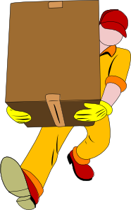
¡A pronunciar!
e
e
llevar
entre
[between]
profesor
naturaleza
querer
pero
[to want, wanting]
[but]
Notes:
Introduce and elicit the pronunciation of the individual SSC [e] and then the source word again (with gesture, if using). Then present and elicit the pronunciation of the five cluster words.
The cluster words have been chosen for their high-frequency, from a range of word classes, with the SSC (where possible) positioned within a variety of syllables within the words (e.g. initial, 2nd, final etc..)
To revisit [e], we have chosen a set of previously taught vocabulary items (rather than the original phonics/cluster words used in Term 1.1).
Word frequency rankings: profesor [501]; llevar [75]; querer [58]; entre [63]; naturaleza [712]; pero [30]
Source: Davies, M. & Davies, K. (2018). A Frequency dictionary of Spanish: Core vocabulary for learners (2nd ed.) London: Routledge.
Image Source : https://www.flaticon.com/

Slide 5
¡A pronunciar!
e
e
llevar
entre
profesor
naturaleza
querer
pero
Notes:
Without the images, students focus this time again closely on the SSC and the cluster words.

Slide 6
¡A pronunciar!
e
e
llevar
entre
profesor
naturaleza
querer
pero
Notes:
Without the images or sound, students have to pronounce the words themselves.

Slide 7
¡A pronunciar!
i
i
camisa
Notes:
Introduce and elicit the pronunciation of the individual SSC [i] and then present and practise the pronunciation of the source word ‘camisa’. This word was introduced in Term 1.1, Week 7.
A possible gesture for this source word would be to:
Pretend to put on a shirt
Pretend to button it

Slide 8
¡A pronunciar!
i
i
camisa
Notes:
Repeat the sound and elicit the source word.

Slide 9
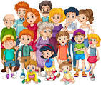
¡A pronunciar!
i
i
rico
familia
camisa
mirar
primo
activo
[male cousin]
[active]
Notes:
Introduce and elicit the pronunciation of the individual SSC [i] and then the source word again (with gesture, if using). Then present and elicit the pronunciation of the five cluster words.
The cluster words have been chosen for their high-frequency, from a range of word classes, with the SSC (where possible) positioned within a variety of syllables within the words (e.g. initial, 2nd, final etc..)
To revisit [i], we have chosen a set of previously taught vocabulary items (rather than the original phonics/cluster words used in Term 1.1).
Word frequency rankings: camisa [1873]; rico [398]; mirar [125]; activo [1278]; primo [1451]; familia [233] Source: Davies, M. & Davies, K. (2018). A frequency dictionary of Spanish: Core vocabulary for learners (2nd ed.) London: Routledge.
‘camisa’ picture source: http://www.clker.com
‘rico’ picture source: https://pixabay.com
‘mirar’ picture source: https://www.flaticon.com
‘familia’ picture source: http://clipart-library.com/

Slide 10
¡A pronunciar!
i
i
rico
familia
camisa
mirar
primo
activo
Notes:
Without the images, students focus this time again closely on the SSC and the cluster words.

Slide 11
¡A pronunciar!
i
i
rico
familia
camisa
mirar
primo
activo
Notes:
Without the images or sound, students have to pronounce the words themselves.

Slide 12
escuchar / escribir
¿E o I?
Escucha. Marca ‘E’ o ‘I’.
Escucha otra vez. Escribe la palabra
 | ‘E’ | ‘I’
1
camisa
2
activo
3
naturaleza
4
primo
5
llevar
6
pero
7
familia
8
entre
9
isla
10
grande
Notes:
Listening and writing (transcription) task.
No need to print off the slide, pupils can write the words on their notebooks.
Ask the students to listen to the word and to choose between ‘E’ and ‘I’. The target SSC sound is obscured. Play the word by clicking on the number. Repeat the word if needed. Ask the pupils to identify the correct SSC. (It’s possible that the pupils will recognise the word and be able to write the missing letter without hearing it.)
Optional: to challenge students more, ask them to listen again and to write the whole word.
Note
Two words not on previous slides are also included for practice: ‘isla’ (introduced in term 1.2, week 6) and ‘grande’ (introduced in term 1.2, week 6).
Transcript:
1. camisa; 2. active; 3. naturaleza; 4. primo; 5. llevar; 6. pero; 7. familia; 8. entre; 9. isla; 10. grande

Slide 13
¿E o I?
escuchar
Escucha. Escribe la letra correcta.
Letra
C
A
F
1
2
D
3
E
G
[between]
B
4
J
5
G
[cousin]
H
6
B
C
7
H
[active]
I
8
A
D
9
F
J
10
I
E
[but]
Notes:
Listening task.
Having focused on the SSCs, students now focus on the meaning of the words used in the previous activity. They must listen and decide which image/English word corresponds to the word they hear in Spanish, noting down the correct letter (e.g., 1=C).
No need to print off the slide. Students can write the answers directly on their notebooks.
Transcript:
1. primo; 2. naturaleza; 3. pero; 4. rico; 5. entre; 6. llevar; 7. mirar; 8. camisa; 9. familia; 10. activo

Slide 14
escuchar
¿Qué escuchas? ‘E’, ‘I’ o ‘E’ y ‘I’?
1
E
La señora compra una bolsa barata.
The lady buys a cheap bag.
Notes:
The lesson starts with phonics practice. This week SSCs [e] and [i] are revisited.
Students listen to the sentence and decide if they hear [e] or [i] or both. They are then shown the full sentence. The English translation can be elicited.
On the next slide, the same sentence appears with target SSCs missing. Students have to read the sentence aloud in chorus, recalling the missing SSCs as they read aloud.
All vocabulary used in the next slides has been previously taught in the scheme of work.

Slide 15
escuchar
La señora compra una bolsa barata.
e

Slide 16
escuchar
¿Qué escuchas? ‘E’, ‘I’ o ‘E’ y ‘I’?
2
E y I
Hay un regalo para la prima.
There is a gift for the (female) cousin.

Slide 17
escuchar
Hay un regalo para la pr ma.
e
i

Slide 18
escuchar
¿Qué escuchas? ‘E’, ‘I’ o ‘E’ y ‘I’?
3
E y I
¿Cuándo escuchas música?
When do you listen to music?

Slide 19
escuchar
¿Cuándo escuchas mús ca?
i

Slide 20
escuchar
¿Qué escuchas? ‘E’, ‘I’ o ‘E’ y ‘I’?
4
E y I
La autora lleva una camisa.
The (female) author wears a shirt.

Slide 21
escuchar
La autora lleva una camisa.

Slide 22
escuchar
¿Qué escuchas? ‘E’, ‘I’ o ‘E’ y ‘I’?
5
I
Doy comida a los caballos.
I give food to the horses.

Slide 23
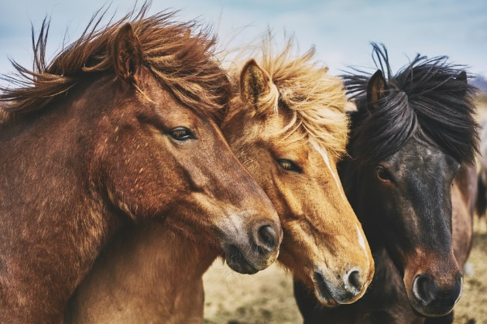
escuchar
Doy comida a los caballos.
¿Cómo se dice ‘the horses are beautiful’ en español?
Los caballos son hermosos.
Notes:
Photo from on Unsplash (images free to use for non-commercial purposes).
‘Son’ and ‘hermoso’ were taught in Term 1.2 Week 4, which is revisited in the scheme of work this week.

