Slide 1
Instructions for printing
Before printing, go to File - Export - Create pdf/xps Document and save it as a pdf. Then open the PDF in chrome and print from there. This way you will get a small and uniform border around the slide.

Slide 2
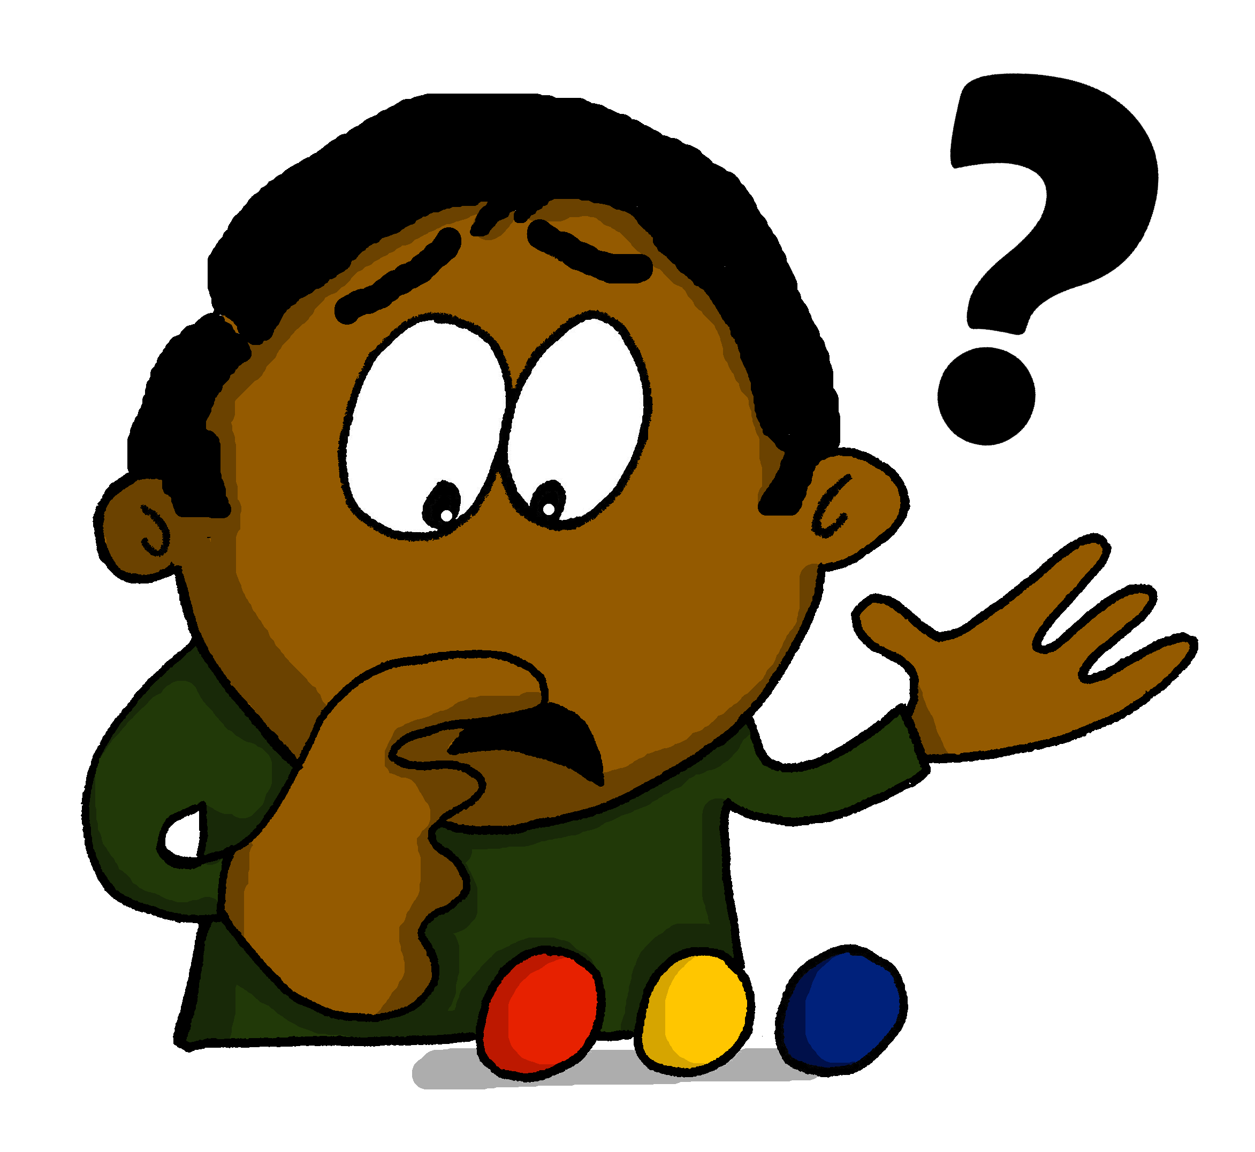
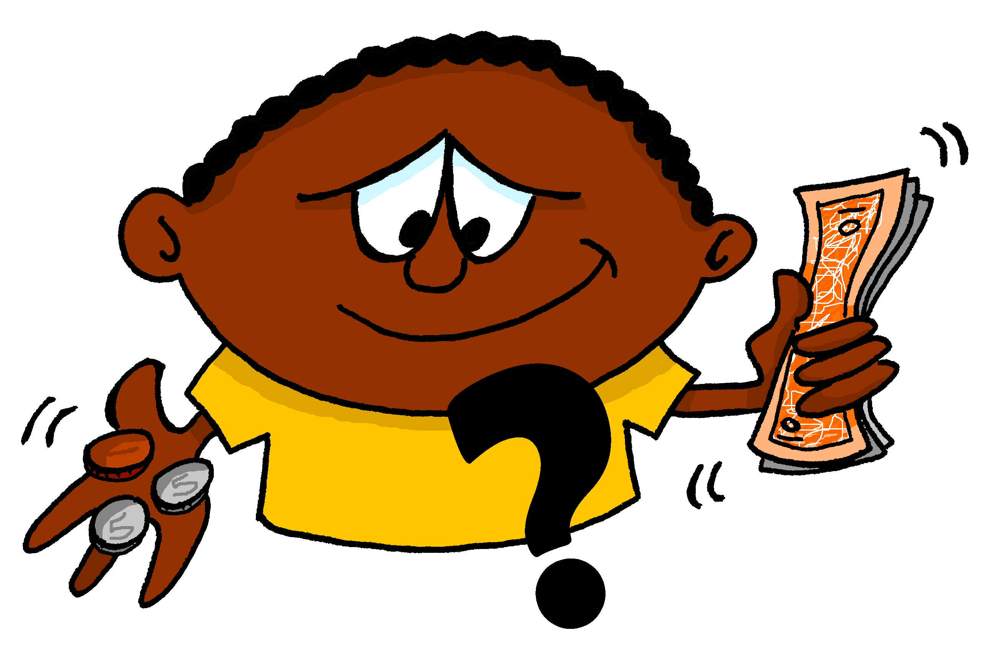
Images: Steve Clarke

Slide 3
[48]
[14]
[9]
où ?
qui ?
que ?
[119]
[237]
[193]
quand ?
comment ?
pourquoi ?
[146]
[800]
quel/quelle ?
combien ?
Images: Steve Clarke
Source: A Frequency Dictionary of French (Londsale & Le Bras, 2009), published by Routledge.
Notes:
Vocabulary frequency rankings (1 is the most common word in French): comment (237); où (48); quand (119); qui (14)’ que (9); pourquoi (193); quel/quelle (146); combien (800). Source: Londsale, D., & Le Bras, Y. (2009). A Frequency Dictionary of French: Core vocabulary for learners London: Routledge.

Slide 4
où ?
[48]
Images: Steve Clarke
Source: A Frequency Dictionary of French (Londsale & Le Bras, 2009), published by Routledge.
Notes:
Vocabulary frequency rankings (1 is the most common word in French): comment (237); où (48); quand (119); qui (14)’ que (9); pourquoi (193); quel/quelle (146); combien (800). Source: Londsale, D., & Le Bras, Y. (2009). A Frequency Dictionary of French: Core vocabulary for learners London: Routledge.

Slide 5
qui ?
[14]
Images: Steve Clarke
Source: A Frequency Dictionary of French (Londsale & Le Bras, 2009), published by Routledge.
Notes:
Vocabulary frequency rankings (1 is the most common word in French): comment (237); où (48); quand (119); qui (14)’ que (9); pourquoi (193); quel/quelle (146); combien (800). Source: Londsale, D., & Le Bras, Y. (2009). A Frequency Dictionary of French: Core vocabulary for learners London: Routledge.

Slide 6
que ?
[9]
Images: Steve Clarke
Source: A Frequency Dictionary of French (Londsale & Le Bras, 2009), published by Routledge.
Notes:
Vocabulary frequency rankings (1 is the most common word in French): comment (237); où (48); quand (119); qui (14)’ que (9); pourquoi (193); quel/quelle (146); combien (800). Source: Londsale, D., & Le Bras, Y. (2009). A Frequency Dictionary of French: Core vocabulary for learners London: Routledge.

Slide 7
quand ?
[119]
Images: Steve Clarke
Source: A Frequency Dictionary of French (Londsale & Le Bras, 2009), published by Routledge.
Notes:
Vocabulary frequency rankings (1 is the most common word in French): comment (237); où (48); quand (119); qui (14)’ que (9); pourquoi (193); quel/quelle (146); combien (800). Source: Londsale, D., & Le Bras, Y. (2009). A Frequency Dictionary of French: Core vocabulary for learners London: Routledge.

Slide 8
comment ?
[237]
Images: Steve Clarke
Source: A Frequency Dictionary of French (Londsale & Le Bras, 2009), published by Routledge.
Notes:
Vocabulary frequency rankings (1 is the most common word in French): comment (237); où (48); quand (119); qui (14)’ que (9); pourquoi (193); quel/quelle (146); combien (800). Source: Londsale, D., & Le Bras, Y. (2009). A Frequency Dictionary of French: Core vocabulary for learners London: Routledge.

Slide 9
pourquoi ?
[193]
Images: Steve Clarke
Source: A Frequency Dictionary of French (Londsale & Le Bras, 2009), published by Routledge.
Notes:
Vocabulary frequency rankings (1 is the most common word in French): comment (237); où (48); quand (119); qui (14)’ que (9); pourquoi (193); quel/quelle (146); combien (800). Source: Londsale, D., & Le Bras, Y. (2009). A Frequency Dictionary of French: Core vocabulary for learners London: Routledge.

Slide 10
quel/quelle ?
quels/quelles?
[146]
Images: Steve Clarke
Source: A Frequency Dictionary of French (Londsale & Le Bras, 2009), published by Routledge.
Notes:
Vocabulary frequency rankings (1 is the most common word in French): comment (237); où (48); quand (119); qui (14)’ que (9); pourquoi (193); quel/quelle (146); combien (800). Source: Londsale, D., & Le Bras, Y. (2009). A Frequency Dictionary of French: Core vocabulary for learners London: Routledge.

Slide 11
combien ?
[800]
Images: Steve Clarke
Source: A Frequency Dictionary of French (Londsale & Le Bras, 2009), published by Routledge.
Notes:
Vocabulary frequency rankings (1 is the most common word in French): comment (237); où (48); quand (119); qui (14)’ que (9); pourquoi (193); quel/quelle (146); combien (800). Source: Londsale, D., & Le Bras, Y. (2009). A Frequency Dictionary of French: Core vocabulary for learners London: Routledge.

