Slide 1
Cultural Collection French Y9 Term 3
Date updated: 10/05/22

Slide 2
Y9 T3.1 Week 1
culture
Slides 9: vocabulary, reading
Slide about the work of French Iranian comic Marjane Satrapi

Slide 3
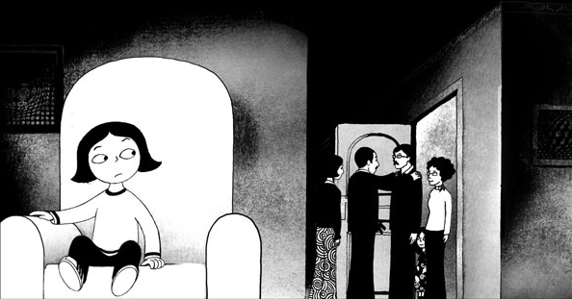
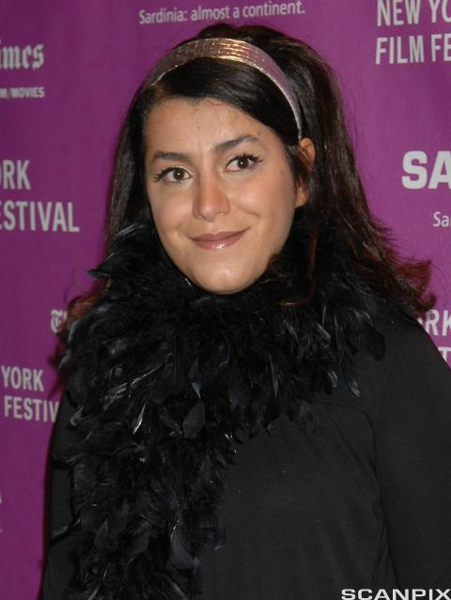
Persepolis
Traduis les verbes en gras en anglais.
vocabulaire
En 2000 Marjane Satrapi [1] crée une bande dessinée* pour [2] communiquer l’histoire de sa vie d’enfant en Iran pendant la révolution. Elle prend la décision d’[3] illustrer l’histoire pour [4] faciliter la compréhension. Elle [5] démontre l’idée de « lire » les images. Les images sont en noir et blanc pour ne pas [6] dominer la page : on peut [7] concentrer l’attention sur le texte et mieux [8] apprécier l’histoire. Elle ne veut pas [9] compliquer le roman. En 2007 elle [10] collabore avec Vincent Paronnaud pour faire un film du livre.
creates
communicate
illustrate
facilitate
demonstrates
dominate
concentrate
appreciate
complicate
collaborates
*la bande dessinée = comic, graphic novel
Notes:
Timing: 7 minutes
Aim: Written recognition of verbs that follow the –ate/-er word pattern
Procedure:
1. Students use the word pattern –ate/-er to help them translate the verbs in bold into English.
2. Click to reveal answers.
3. Elicit an oral translation of the text.
Word frequency of unknown words used (1 is the most frequent word in French): bande dessinée [977/2086]
Word frequency of cognates used (1 is the most frequent word in French):
communiquer [1514], Iran [>5000], révolution [1617], illustrer [1939], faciliter [1813], compréhension [2827], démontrer [1519], image [659], dominer [1648], page [434], concentrer [856], apprécier [1061], compliquer [1869], collaborer [2963]
Source: Lonsdale, D., & Le Bras, Y. (2009). A Frequency Dictionary of French: Core vocabulary for learners London: Routledge.
Persepolis by John Niedermeyer is licensed under CC BY-NC-SA 2.0
Marjane Satrapi is licensed under CC BY-NC-SA 4.0

Slide 4
Y9 T3.1 Week 5
culture
Slides 14-18; 31-38 : reading, listening, speaking, writing
Lesson about Covid-19 and law in France

Slide 5
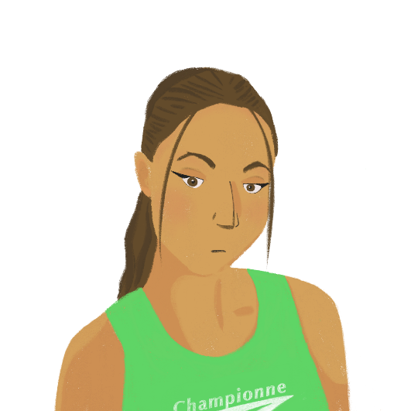
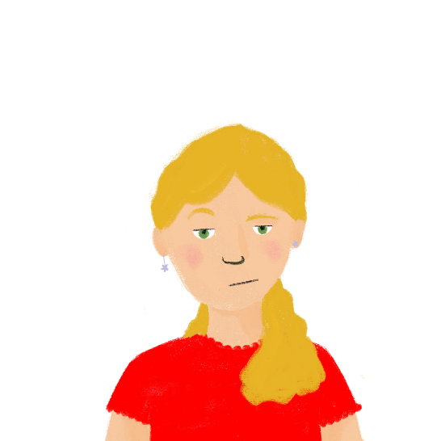
Les règles covid en France
*passe sanitaire = proof of vaccination or negative test *le couvre-feu = curfew
lire
Océane et Léa parlent des défis de la pandémie. Que disent-elles ? Complète les phrases. Quelles règles sont les mêmes qu’en Angleterre, et quelles règles sont différentes ?
1. Il est difficile de sortir en France en ce moment.
5. Il est interdit de manger ou boire dans le cinéma et dans le train.
1. On/il est difficile de
5. On/il est interdit de
On respecte une distanciation d’un mètre entre les personnes.
2. On/il est impossible de
6. On ne peut pas voyager.
6. On/il est important de
7. Il est nécessaire d’ annuler beaucoup de vols.
3. Il est possible de participer aux activités sociales avec un passe sanitaire*.
7. On/il est nécessaire d’
3. On/il est possible de
8. On
sait que les règles sont importantes, mais c’est une situation difficile.
8. On/il est essentiel de
4. Mais, on a un couvre-feu* à 18 heures.
4. Mais, on/il est bizarre d’
Notes:
Timing: 8 minutes
Aim: Written recognition of impersonal pronoun on + short form and impersonal expressions with il est + adjective + de + long form; listening comprehension; cultural awareness: similarities and differences between COVID laws in France and the UK.
Procedure:
1. Students read the non-bolded parts of the sentences and decide whether on or an impersonal expression must precede them, based on the verb form they see.
2. Answers revealed on clicks.
3. Students sketch two columns headed les mêmes and différentes. They re-read the sentences, decide whether the rules are have also been in place in England at some point, and write and English summary of each rule in the appropriate column.
4. Answers may be found on the next slide.
Word frequency of unknown words (1 is the most frequent word in French):
couvre-feu [>5000], sanitaire [4501]
Source: Lonsdale, D., & Le Bras, Y. (2009). A Frequency Dictionary of French: Core vocabulary for learners London: Routledge.
Word frequency of cognates (1 is the most frequent word in French):
certificat [3604], bizarre [2756], essentiel [675], mètre [1534], respecter [673], distanciation [>5000], passe [4295] Source: Lonsdale, D., & Le Bras, Y. (2009). A Frequency Dictionary of French: Core vocabulary for learners London: Routledge.

Slide 6
Les règles du covid en France
lire
les mêmes
différentes
not possible to travel
necessary to cancel a lot of flights
social distancing of 1 metre
possible to participate in social events with a passe sanitaire
18.00 curfew
eating and drinking in cinemas and trains is banned
Notes:
[2/2]
Answers revealed on clicks.

Slide 7
Bise ou pas bise ?
*la joue = cheek
écouter
La bise, c’est une salutation française. On fait une bise dans l’air à côté de la joue.*
Quel effet a la pandémie sur cette tradition ? Écoute, complète et réponds aux questions.
1
You can kiss someone’s cheeks to say both ‘hello’ and ‘goodbye’.
T
T
2
You often kiss the cheeks of friends and family.
F
3
You can’t kiss the cheeks of colleagues.
F
4
The number of kisses is the same all over France.
T
5
You must be at least one metre away from other people.
F
6
You can continue kissing people on the cheeks for now.
F
7
Kissing people on the cheeks is a recent craze in France.
F
8
People who have had the vaccine are going to stop doing ‘la bise’.
Notes:
Timing: 8 minutes [2/2]
Procedure:
1. Click on the numbers to hear the sentence read in full.
2. Students decide whether the accompanying statement is true or false.
3. Click to reveal answers.
Transcript:
1. En France, on fait la bise pour dire bonjour et au revoir.
2. Il est naturel de faire la bise plusieurs fois par jour avec sa famille et ses amis.
3. Parfois, on dit bonjour à ses collègues comme ça aussi.
4. En général, on fait deux bises, mais ça dépend de la région.
5. Pendant la pandémie, il est interdit d’être à moins d'un mètre des autres personnes.
6. Donc, il est impossible de continuer à faire des bises en ce moment.
7. Il est triste de penser qu’on perd cette vieille tradition.
8. Mais on croit que les personnes qui ont eu le vaccin vont recommencer à faire des bises.
Word frequency of unknown words (1 is the most frequent word in French):
joue [3932] Source: Lonsdale, D., & Le Bras, Y. (2009). A Frequency Dictionary of French: Core vocabulary for learners London: Routledge.
Word frequency of cognates (1 is the most frequent word in French):
salutation [>5000], effet [173], compléter [2034], normal [833], mètre [1534] Source: Lonsdale, D., & Le Bras, Y. (2009). A Frequency Dictionary of French: Core vocabulary for learners London: Routledge.

Slide 8
Les effets positifs de la pandémie
Remember! Adjectives in impersonal phrases are in the masculine form.
écrire
Noura essaie d’avoir une attitude positive. Elle écrit quoi ? Complète les phrases.
1. J’ai le temps de regarder des émissions intéressantes. (interesting)
2. On arrive à rester en contact. Il est facile de parler sur Zoom. (easy)
3. Je suis heureuse parce que mon papa travaille à la maison. (happy)
4. Il est bon de passer plus de temps avec sa famille. (good)
5. Il est nécessaire de devenir une élève plus indépendante. (necessary)
6. Nous apprenons des compétences importantes pour la vie. (important)
7. Il y a de grands avantages (m.) pour l’environnement. (big)
8. Il est intéressant de savoir qu’il y a moins de pollution maintenant. (interesting)
9. Je pense que les gens deviennent plus proches. (close)
10. Il est naturel d’aider les autres pendant une crise*mondiale. (natural)
___________
___________
______
______
________
__________
____
_______
__________
______
*crise = crisis
Notes:
Timing: 5 minutes
Aim: Written production of adjectives as noun complements and in impersonal phrases; revision of adjective agreement.
Procedure:
1. Remind students that all adjectives in impersonal phrases are in masculine form, whereas adjectives that describe a noun must agree with the gender and number of that noun.
2. Students read the sentences and decide which adjectives are part of impersonal phrases, and which are noun complements.
3. Students translate the orange adjectives into French, and add agreements where necessary.
4. Answers revealed on clicks.
5. Whole class translation.
Word frequency of unknown words (1 is the most frequent word in French): crise [765]
Source: Londsale, D., & Le Bras, Y. (2009). A Frequency Dictionary of French: Core vocabulary for learners London: Routledge.
Word frequency of cognates (1 is the most frequent word in French): contact [894], effet [173], compléter [2034], indépendant [954], avantage [900], environnement [945], pollution [3073]
Source: Londsale, D., & Le Bras, Y. (2009). A Frequency Dictionary of French: Core vocabulary for learners London: Routledge.

Slide 9
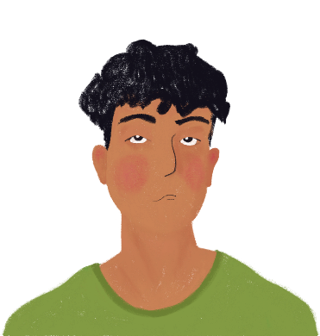
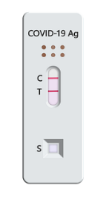
Amir est malade
*test antigénique = lateral flow test
*dédié = dedicated
*symptôme = symptom
écouter
Amir a fait un test antigénique* et le résultat est positif. Sa mère décide de téléphoner à un numéro dédié* aux questions sur covid-19. Parlent-ils Amir (il) or people in general (il est +adj + verb) ?
[-] / est important de
1
[-] / est possible de
2
[-] / est normal d’
3
[-] / est natural de
4
[-] / est triste de
5
[-] / est bon de
6
[-] / est nécessaire de
7
[-] / faut
8
Notes:
Timing: 8 minutes [1/2]
Aim: To distinguish orally between the verb in short form after il as a subject pronoun and long form after il as an impersonal pronoun; listening comprehension.
Procedure:
1. Demonstrate the pronunciation of written cognate symptôme (students have not yet encountered SSC [ym].
2. Click on a number to hear a sentence with a beep after il and before the verb.
3. Based on the verb form they hear (long or short) students decide whether the beep is covering an impersonal expression or not.
4. Answers revealed on clicks.
Transcript:
1. Il [-] a eu le vaccin ?
2. Oui, il a eu sa deuxième dose. Il [est possible de] devenir très malade ?
3. Il [est normal d’]avoir des symptômes.
4. Il [-] est faible ?
5. Oui, et il [-] a chaud et mal partout au corps.
6. D’accord. Il [-] peut prendre des médicaments pour ça.
7. Il [est nécessaire de] rester en isolement pendant combien de temps ?
8. Pendant dix jours, il [faut] téléphoner au SAMU dans une situation d'urgence.
Word frequency of unknown words (1 is the most frequent word in French):
SAMU [n/a], dédié [dédier - 4008]
Source: Lonsdale, D., & Le Bras, Y. (2009). A Frequency Dictionary of French: Core vocabulary for learners London: Routledge.
Word frequency of cognates (1 is the most frequent word in French):
résultat [428], test [1788], dose [4229], symptôme [4095], normal [833], antigénique [>5000] Source: Lonsdale, D., & Le Bras, Y. (2009). A Frequency Dictionary of French: Core vocabulary for learners London: Routledge.

Slide 10
Des lois* françaises bizarres
*la loi = law | *l’OVNI = UFO
Châteauneuf-du-Pape* = a French town
parler
Il y a beaucoup de vieilles lois bizarres en France!
Travaille avec un(e) partenaire pour trouver dix lois bizarres.
… conduire un OVNI à Châteauneuf-du-Pape !
Il est interdit de …
PARTENAIRE B
a) … conduire un OVNI* à Châteauneuf-du-Pape*
b) … mange des poissons rouges
PARTENAIRE A
1. Il est interdit de …
Notes:
Timing: 8 minutes [1/3]
Aim: Oral production and comprehension of impersonal structures with on + short form and il est + adjective + de + long form
Procedure:
1. Print and distribute the role cards on the following slide.
2. Explain to students that they are going to work together to match up sentence sections to reveal ten weird French laws. Use this slide to model the task.
3. Partner A begins by reading the beginning of a sentence.
4. Partner B decides, based on whether they hear pronoun on or il est + adjective + de, whether the second half of the sentence is the option which begins with the verb in long or short form and reads it aloud.
5. As a pair, students work out the meaning of the weird law.
6. Repeat steps 3-5 for four more weird laws.
7. Partners swap roles, and repeat steps 3-6.
8. The ten weird laws are presented in full on the last slide in this sequence.
Word frequency of unknown words (1 is the most frequent word in French):
loi [267], OVNI [n/a]
Source: Lonsdale, D., & Le Bras, Y. (2009). A Frequency Dictionary of French: Core vocabulary for learners London: Routledge.
Word frequency of cognates (1 is the most frequent word in French):
bizarre [2756] Source: Lonsdale, D., & Le Bras, Y. (2009). A Frequency Dictionary of French: Core vocabulary for learners London: Routledge.

Slide 11
Y9 T3.1 Week 6
culture
Slides 8-9; 19-20; 34-35: reading, listening, speaking, writing
Slides about Concord

Slide 12
Un projet anglo-français
*le Royaume-Uni = United Kingdom
l*ingénieur (m) = engineer *la vitesse du son = spend of sound
lire
En 1962, la France et le Royaume-Uni* ont décidé de travailler ensemble sur un projet qui a duré quarante ans.
Après la seconde guerre mondiale, des équipes d'ingénieurs* britanniques, françaises, allemandes et américaines ont commencé à construire des avions supersoniques. Ce sont des avions qui peuvent voler plus vite que la vitesse du son*. La construction d’un avion supersonique a coûté 100 M£.
Dans une atmosphère compétitive,
les équipes anglaises et françaises ont
décidé de combiner leurs plans pour partager les coûts. On a considéré ce développement très positif pour deux nations historiquement rivales.
1. For how long did the Anglo-French project last?
2. Which countries were building supersonic planes?
3. What is a supersonic plane?
4. Why did France and the UK decide to work together? 5. Why might this have been surprising?
40 years
UK, France, Germany and USA
A plane that can fly faster than the speed of sound
To share the costs (in a competitive environment)
Historically, the countries were rivals
Notes:
Timing: 5 minutes
Aim: Reading comprehension; cultural awareness: Anglo-French relations pre- and post-WW2. Note that reading comprehension will be practised throughout this resource in a series of longer rubrics in French, which both continue the story and explain the associated tasks.
Procedure: 1. Check students understand the introductory text in the rubric, which begins the Concorde story. Note that reading will mainly be practised in this resource through a series of longer rubrics in French, which both continue the story and explain the associated tasks.
2. Students read through the text. Draw attention to the following key features of the text that might be unfamiliar to students: the pronunciation of Royaume-Uni, and britannique, the second meaning of son, the meaning of 100 M£.
3. Click to reveal the questions. Check students understand the meaning of Anglo-French.
4. Students answer the questions.
5. Click to show and hide answers to each question.
Word frequency of unknown words (1 is the most frequent word in French): Royaume-Uni [>5000], britannique [1296]
Source: Lonsdale, D., & Le Bras, Y. (2009). A Frequency Dictionary of French: Core vocabulary for learners London: Routledge.
Word frequency of cognates (1 is the most frequent word in French): second [379], ingénieur [2848], américain [374], supersonique [>5000], vitesse [1065], construction [976], atmosphere [2493], compétitif [4173], combiner [2652], plan [164], considerer [255], nation [576], historiquement [>5000], rival [3758]
Source: Lonsdale, D., & Le Bras, Y. (2009). A Frequency Dictionary of French: Core vocabulary for learners London: Routledge.

Slide 13
Y9 T3.2 Week 1
culture
Slides 12; 14-22; 33-35: reading, listening, speaking, writing
Lesson based upon occupied France and the Vichy regime

Slide 14
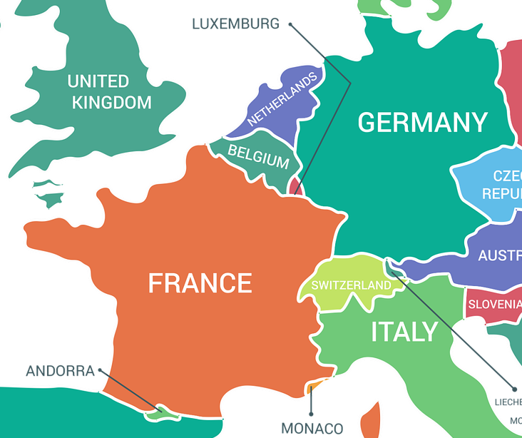
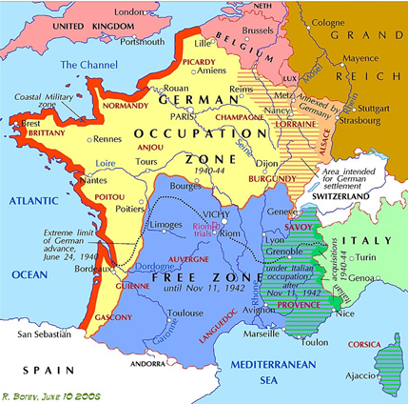
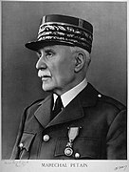
La bataille de France (1940)
*le Pays-Bas = the Netherlands *devenu = became | *jusqu'à = until
lire
Dix mois après le début de la Seconde Guerre mondiale, l'armée allemande a attaqué les Pays-Bas*, la Belgique, le Luxembourg et la France. L’attaque a pris les soldats français par surprise, et un mois après l’Allemagne nazie a réussi à prendre Paris. Le gouvernement français a capitulé et le pays est devenu* divisé en plusieurs zones. L’Allemagne a occupé les régions du Nord et de l’Ouest à côté de la mer. L’Italie a occupé une petite zone dans le Sud-Est. Le reste de la France est resté une « zone libre». C’est l'État français. Le leader, Maréchal Philippe Pétain, a établi son gouvernement à Vichy, au centre du pays. Pétain a établi un régime autoritaire et une collaboration avec Hitler. Il a fourni à l’Allemagne des soldats et des ressources jusqu'à* la fin du Régime de Vichy en 1944.
3. How long after the start of WW2 did Germany capture Paris? 11 months
2. How do we know that France was vulnerable? The attack took French soldiers by surprise
1. Which countries were attacked? The Netherlands, Luxembourg, Belgium and France
5. Describe the Vichy regime.
Authoritarian, collaboration with Hitler, supplied Germany with soldiers/resources, ended in 1944
4. Sketch a map of divided France following its defeat to Germany. Include Vichy.
Notes:
Timing: 8 minutes
Aim: Written recognition of this week’s new vocabulary; reading comprehension; cultural awareness: the Battle of France and subsequent occupation of France
Procedure:
1. Explain to students that they are going to learn about France during the Second World War in this resource. Little prior knowledge of Second World War history is assumed (here and elsewhere in this sequence of lessons), though teachers may wish to clarify the meaning of cognates nazi(e), capitulé and autoritaire and check students are aware that Hitler was the dictator of Germany at the time.
2. As students have not yet formally encountered the formation rule for past participles of verbs like sortir and choisir, explain to students that the verb forms ending in an orange –i are the past participle forms of known verbs.
3. Click to reveal questions one by one. Tell students the answers to the questions appear in order, so they can stop reading once they have located the answer to the question in the text. Allow one minute per question, and two minutes for the sketch. Students can use the first map to sketch the outline of France, and then add divisions according to the text.
4. Click to reveal answers.
5. Click to reveal another question.
6. Repeat steps 2-4 for a total of five questions.
Image Attribution Rostislav Botev, CC BY-SA 3.0 <https://creativecommons.org/licenses/by-sa/3.0>, via Wikimedia Commons
Unknown authorUnknown author, Public domain, via Wikimedia Commons; https://upload.wikimedia.org/wikipedia/commons/4/4d/Philippe_P%C3%A9tain.jpg
Word frequency of unknown words (1 is the most frequent word in French): Pays-Bas [n/a], devenu [devenir 162], jusqu’à [n/a]
Source: Londsale, D., & Le Bras, Y. (2009). A Frequency Dictionary of French: Core vocabulary for learners London: Routledge.
Word frequency of cognates (1 is the most frequent word in French): bataille [1303], second [379], attaquer [1018], Luxembourg [n/a], attaque [1655], surprise [1815], nazi [3053], capituler [>5000], divisé [diviser 1567], zone [860], occupier [159], reste [363], leader [1499], autoritaire [4661], collaboration [2037], ressource [852]
Source: Londsale, D., & Le Bras, Y. (2009). A Frequency Dictionary of French: Core vocabulary for learners London: Routledge.

Slide 15
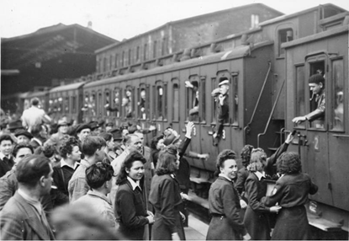
Le service du travail obligatoire
*la loi = the law
*c’était = it was | *le rôle = role
lire
écrire
Now, use your English notes to write answers to the questions in French.
Pourquoi il n'y avait pas suffisamment à manger ?
France supplied products to Germany
France fed the German people and the French people too
France did not succeed in feeding everyone well
Pourquoi la mère de Bastien a travaillé sur une ferme ?
Women worked (in traditionally masculine roles) because the men left
Pourquoi les frères de Bastien sont partis pour l’Allemagne ?
They did not choose to go to Germany
French men served in Germany because it was* the law*
France supplied Germany with almost 650,000 men
French people filled the German soldiers’ roles*)
Notes:
Aim: Written production of verbs like sortir and choisir in the perfect tense; reconstruction of a familiar text in French.
Procedure:
1. On clicks, suggested English answers to the comprehension questions on the previous slide are revealed.
2. Ask students what they think is happening in the picture. Explain that it is an image of French workers leaving for Germany from Paris (1943).
3. Click again to bring up the bubble with instructions for the text recreation task. Students try to recreate the key points in the text using their own notes and/or the English prompts on this slide. These prompts have been written so that students can recreate them using only known vocabulary, known grammar and the three glossed words. Note they will need the help of a dictionary to translate the parts in parenthesis. (6 minutes).
4. Suggested solutions appear on the next slide.
Word frequency of unknown words (1 is the most frequent word in French): loi [267], était [être 5]
Source: Londsale, D., & Le Bras, Y. (2009). A Frequency Dictionary of French: Core vocabulary for learners London: Routledge.
Word frequency of cognates (1 is the most frequent word in French): obligatoire [2524], rôle [371]
Source: Londsale, D., & Le Bras, Y. (2009). A Frequency Dictionary of French: Core vocabulary for learners London: Routledge.
Image attribution Bundesarchiv, Bild 183-J14405 / CC-BY-SA 3.0, CC BY-SA 3.0 DE <https://creativecommons.org/licenses/by-sa/3.0/de/deed.en>, via Wikimedia Commons

Slide 16
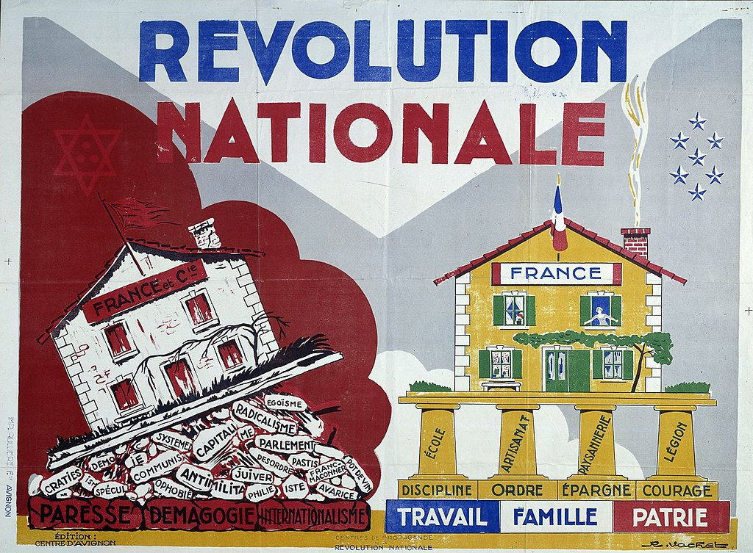
La Révolution nationale
*le droit de grève* = the right to strike la devise* = motto|*la patrie = homeland
info
Pétain a rejeté la devise* « Liberté, Égalité, Fraternité » et la démocratie. Il a choisi une nouvelle devise pour l’État français: « Travail, Famille, Patrie* ». C’est « la Révolution nationale ».
Pendant la Révolution, Pétain a interdit:
la liberté de la presse
le droit de grève*
le divorce
les partis politiques et le suffrage universel
Il a introduit et encouragé:
des lois* antisémites
une éducation traditionnelle et patriotique
une politique de collaboration avec l’Allemagne nazie
Notes:
Timing: 7 minutes [1/5]
Aim: Oral production of –ER verbs and verbs like sortir and choisir in the perfect tense; cultural awareness: La Révolution nationale.
Procedure:
1. Use this slide to introduce the concept of La Révolution nationale. Students look at the propaganda poster and consider the two mottos before suggesting some things Pétain likely did and didn’t value in society.
2. Click to reveal aspects of La Révolution nationale one by one. Ensure students understand the meaning of cognates suffrage universel and antisémite.
3. Explain that in this activity students are going to describe certain aspects of life during la Révolution nationale to one another using a mix of verb types in the perfect tense.
4. Print and distribute the role cards on slide 19.
5. Display slide 20. Partner B sketches 5 boxes in the positions shown on the slide. Partner A translates the first sentence on their role card into French. Partner B listens, and writes a number ‘1’ in the box that is next to the picture they think the sentence represents. NB: this activity can be made more or less challenging by varying the amount of English/French on the role cards, or, at higher levels, encouraging students to come up with their own novel descriptions.
6. Repeat step 5 for four further sentences.
7. Click to reveal answers. Highlight that one of the school subjects taught during the regime was religion. This might come as a surprise as students have learned about laïcité in a previous lesson. Draw attention to the importance of education and media in spreading propaganda.
8. Display slide 21. Ensure students understand the significance of the étoile jaune.
9. Students swap roles. Repeat steps 5-7. Draw attention to the importance of music in spreading propaganda.
10. Proceed to the last slide in this sequence for suggested French sentences.
Word frequency of unknown words (1 is the most frequent word in French): droit [143], grève [1803], devise [3429], loi [267], patrie [3661]
Source: Londsale, D., & Le Bras, Y. (2009). A Frequency Dictionary of French: Core vocabulary for learners London: Routledge.
Word frequency of cognates (1 is the most frequent word in French): rejeter [981], égalité [1891], fraternité [>5000], démocratie [1279], révolution [1617], presse [986], divorce [2561], parti [400], suffrage [3985], universel [1608], encourager [1434], antisémite [>5000], traditionnel [1574], patriotique [>5000], collaboration [2037], nazi [3053]
Source: Londsale, D., & Le Bras, Y. (2009). A Frequency Dictionary of French: Core vocabulary for learners London: Routledge.
Image attribution R. Vachet, Public domain, via Wikimedia Commons

Slide 17
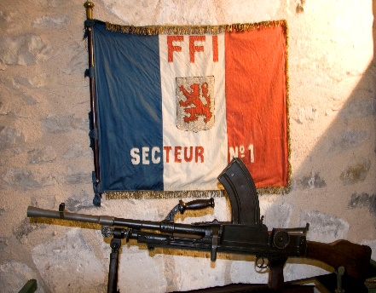
La Résistance française
*envahir = to invade *cacher = to hide
info
Après l’invasion des Allemands en France, beaucoup de personnes ont résisté.
Des groupes de jeunes Français ont attaqué les soldats allemands. Des familles ont caché* des personnes juives dans leurs maisons. D’autres personnes ont aidé des agents secrets anglais qui sont arrivés pour aider.
Mais, résister est dangereux. Beaucoup de résistants ont payé un prix considérable pour leurs efforts. Les Allemands ont arrêté*, blessé, tué ou déporté leurs ennemis.
Notes:
Timing: 1 minute
Aim: To provide key background information on the aims and activities of the French WW2 Resistance, which is the main topic of this lesson. Note that the text is unlikely to be parsed in a minute at most levels. It is intended to serve as background to the context of this lesson. It could be set as homework for pre-reading, and summarised in English at the beginning of the class.
Procedure:
1. Talk through the text with the students, pointing out the many verb cognates. Ensure students understand the meaning of déporter in this context.
Word frequency (1 is the most frequent word in French):
envahir [2566], cacher [914]
Source: Londsale, D., & Le Bras, Y. (2009). A Frequency Dictionary of French: Core vocabulary for learners London: Routledge.
Word frequency of cognates used (1 is the most frequent word in French): résister [>5000], attaquer [1018], arrêter [420], déporter [>5000]
Source: Londsale, D., & Le Bras, Y. (2009). A Frequency Dictionary of French: Core vocabulary for learners London: Routledge.

Slide 18
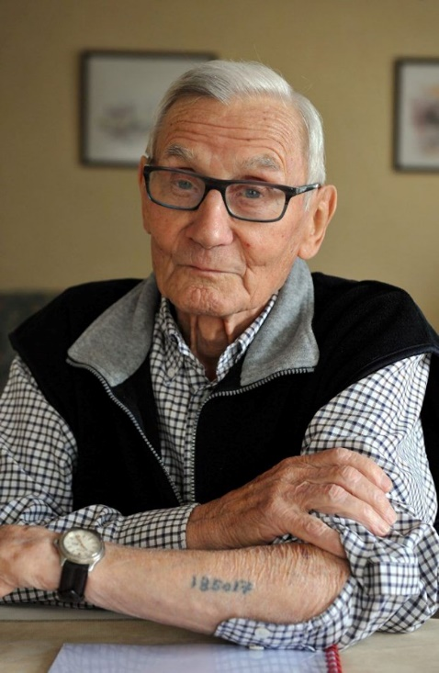
Témoins* de l’Holocauste
info
Jean Bascle a résisté aux Allemands.
Avec ses amis, il a volé des documents d’un bureau du Service du Travail Obligatoire.
Après, il a jeté les documents dans un fleuve.
Les Allemands ont arrêté et déporté Jean.
Le voyage de déportation, dans un train pour les animaux, a duré trois jours.
Il a passé un an dans un camp de concentration. Il a été témoin de l’arrivée et de la disparition* de familles juives dans le camp.
*témoin = witness,
*disparition = disappearance
Notes:
Timing: 1 minute
Aim: To provide key background information on the deportation of members of the French Resistance and introduce Jean Bascle, who is the subject of the activities that follow.
Procedure:
Click to go through information, clarifying the terms related to the Holocaust where necessary.
Attributions
Louise Bibbey (NCELP assistant resource developer) assisted director Martyn Cox on a project interviewing and filming members of the French Resistance as part of a wider project on veterans in the UK and France. Together they filmed around 25 interviews with male and female veterans, many of whom had been awarded the legion of honour or juste parmi les nations, including two concentration camp survivors. They twice hosted the BBC in France, helping with the production of two globally televised documentaries for BBC World.
They have a large archive of photos and documents, much of which is stored in the Archive of Resistance Testimony at the University of Sussex, under the leadership of Professor Rod Kedward, a leading academic in the field of French Resistance. They have kindly given NCELP to have full access to these and permission to use them in their resources.
Photograph: Louise Bibbey (with full publishing rights accorded by Jean Bascle in 2009).
Word frequency (1 is the most frequent word in French): témoin [1055], disparition [2077]
Source: Londsale, D., & Le Bras, Y. (2009). A Frequency Dictionary of French: Core vocabulary for learners London: Routledge.

