Slide 1
Cultural Collection
French Y7 Term 3
Pete Watson
Date updated: 18/05/21

Slide 2
7.3.1.2
Slide 36: phonics listening and speaking activity with information about Francophone countries in Africa.
Slide 53: speaking / listening activity with French celebrities.

Slide 3
-ien ou –ienne ?
-ien ou –ienne ?
écouter / parler
French is widely spoken in several countries in North and West Africa, including Algeria, Tunisia, Niger and Mali.
Les Nationalités
algérien
algérienne
tunisienne
tunisien
tunisien
tunisienne
nigérien
nigérienne
malien
nigérienne
nigérien
nigérienne
nigerien
nigérienne
malien
malien
malienne
malien
malien
malien
malien
malien
malienne
malienne
nigérien
malienne
malienne
malienne
malienne
malienne
A
C
E
G
I
K
M
O
B
D
F
H
J
L
N
P
Notes:
Timing: 5 minutes
Aim: Oral recognition of SSC [ien] in masculine adjective endings and SSC [è/ê] in feminine adjective endings.
Procedure:
Teacher to highlight the SSC change between masculine and feminine endings.
Then, the teacher reads aloud a ‘path’ between the two forms of each nationality, ending at a letter from A-P – check that students have arrived at the correct letter.
This can be repeated with different paths, before handing over to students to read aloud (in pairs and/or to the whole class).

Slide 4
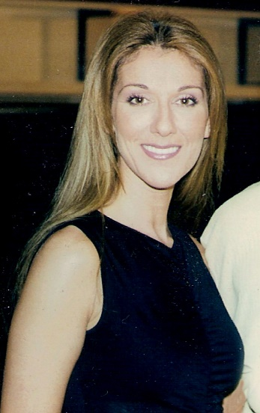
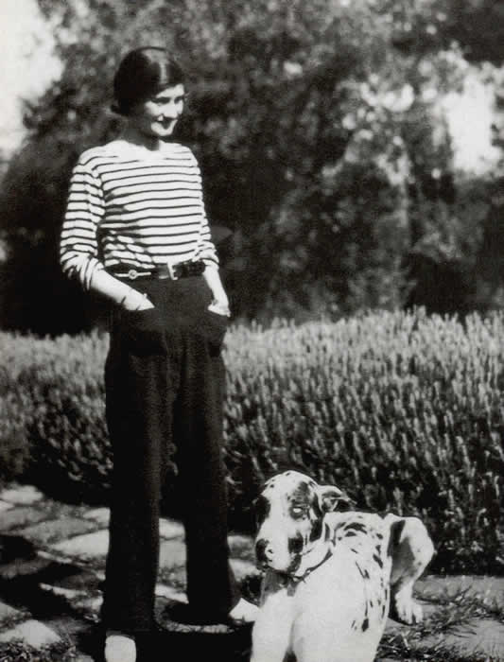
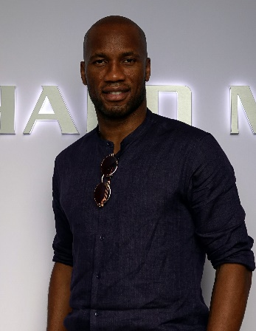
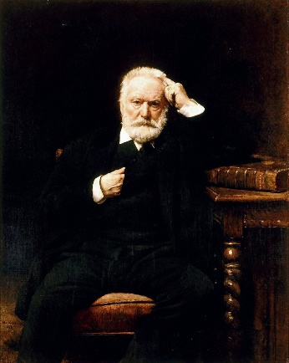
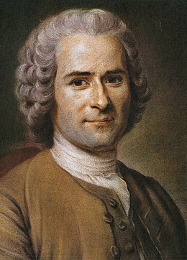
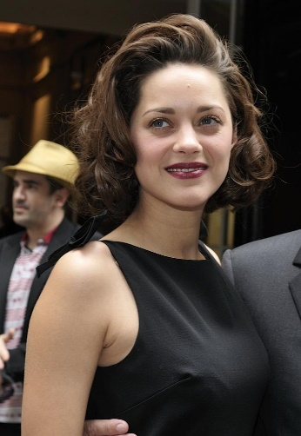
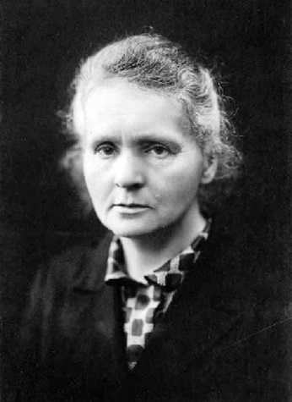
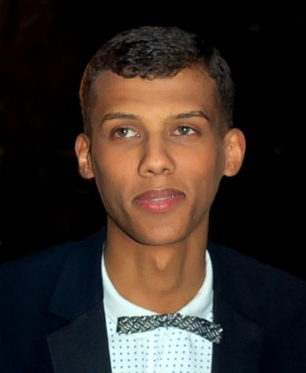
Qui fait quoi ?
Qui fait quoi ?
Exemple
Coco Chanel est-elle française ?
écouter / parler
Fais des questions avec:
être
venir
habiter
travailler
aimer
créer
changer
gagner
jouer
écrire
étudier
chanter
parler
…
Coco Chanel
Didier Drogba
Victor Hugo
Céline Dion
Jean-Jacques
Rousseau
Marion Cotillard
Marie Curie
Stromae
Notes:
Timing: 8 minutes
Aim: Oral production of subject repetition in inversion questions
Procedure:
Students ask yes/no questions in the 3rd person to try and recall as many facts as possible about the figures.
Having printed the bios single-sided (see 7.2.2.5 resource), distribute page 1 (the top row on this slide) to Partner A, and page 2 (the bottom row on this slide) to Partner B. Partner A asks a yes/no question about one of Partner B’s famous francophones. Partner B responds ‘oui’ if the question matches the information in the bio, or ‘non’ if it contradicts the bio, or if the information is not given in the bio. Swap roles after each question, moving onto a different celebrity each time. Each correct guess gets 1 point.
The level of difficulty can be varied according to the needs of the class, eg:
Students work purely from guesswork / their memory of the figures from 7.2.2.5.
Students have a limited amount of time to read the other partner’s bios (without taking notes) before the questioning stage.
Students have a limited amount of time to read the bios and take notes before the questioning stage.
4. The questioning stage could also be carried out in different ways, eg:
In groups, with two or more students sharing the ‘Partner A’ / ‘Partner B’ role.
In teams, with teams of students asking questions to the teacher and competing for points.
As a class, with all students asking questions to the teacher, non-competitively, to recall as much information as possible.
Images from: https://fr.wikipedia.org/

Slide 5
7.3.1.3
Slides 36-45: series of activities based around biographies of celebrities Shy’M and Pierre Gasly.

Slide 6
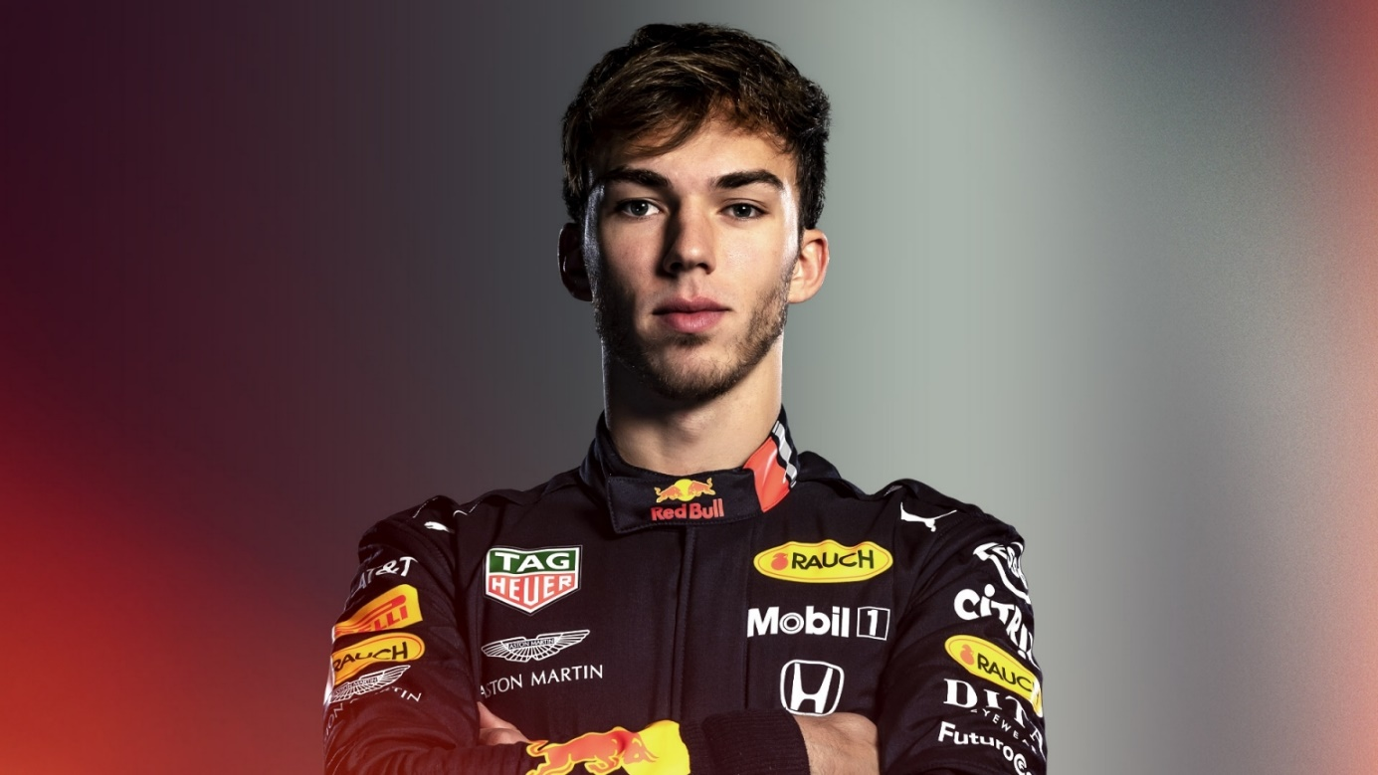
Deux personnes célèbres françaises
Deux personnes célèbres
lire / écrire / parler
Pierre Gasly
Shy’M
https://nvsc.fandom.com/wiki/Shy%27m
https://www.formula1.com/en/drivers/pierre-gasly.html
Notes:
Timing: 1 minutes
Aim: To introduce two French celebrities
Procedure:
1. Begin by asking students if they know who these people are. (Some students may recognise Pierre Gasly at least, but it does not matter if not.) 2. Explain that you are going to do a series of activities to find out more about them, bringing together lots of aspects of their learning so far, including the use of question words.

Slide 7
biographie
Shy’M
lire
Shy’M
Je suis une chanteuse française, souvent comparée à Rihanna.
J’ai des millions de vues sur YouTube parce que je suis très populaire en France !
Je chante et je danse chaque jour, je joue au tennis aussi.
Je mange des hamburgers chez McDo au déjeuner.
J’aime la musique. Je suis fan des Red Hot Chili Peppers et de Beyoncé.
Je passe les vacances en Martinique, une île française dans les Caraïbes.
Shy’M
https://nvsc.fandom.com/wiki/Shy%27m
Notes:
Timing: 10 minutes
Aim: Comprehension of a longer text, text summary
Procedure:
Split the class into two. Each half works on one of the biographies.
Students work in groups to translate the bullet points.
At the end of the activity, students present their facts in English to the other half of the class. Each group could feedback one or two of their sentences.
The teacher can offer feedback on the translations into English to check accuracy within the translators and correct understanding for the listeners.
Repeat for the second biography.
Transcript:
Word frequency of cognates used (1 is the most frequent word in French): comparée [comparer 1560], million [307], vue [191], populaire [1349], danser [2934], tennis [3867], hamburger [>5000], Martinique [n/a], Caraïbes [n/a]
Source: Londsale, D., & Le Bras, Y. (2009). A Frequency Dictionary of French: Core vocabulary for learners London: Routledge.

Slide 8
biographie
Pierre Gasly
lire
Pierre Gasly
Je suis pilote automobile français en Formule Un chez Alpha Tauri.
Je fais ça parce que j’aime le sport automobile. C’est une passion pour moi.
J’aime aller en vacances en février.
Mon compte Instagram a 461.5k followers et j’ai 55 273 likes sur Facebook.
J’ai quatre frères.
Je viens de Rouen en France.
Pierre Gasly
https://www.formula1.com/en/drivers/pierre-gasly.html
Notes:
Word frequency of cognates used (1 is the most frequent word in French): pilote [3002], automobile [2407], sport [2011], passion [1866], février [1136], compte [254]
Source: Londsale, D., & Le Bras, Y. (2009). A Frequency Dictionary of French: Core vocabulary for learners London: Routledge.

Slide 9
Deux personnes célèbres français
Deux personnes célèbres
lire
Shy’M
Je suis une chanteuse française, souvent comparée à Rihanna.
J’ai des millions de vues sur YouTube parce que je suis très populaire en France !
Je chante et je danse chaque jour, je joue au tennis aussi.
Je mange des hamburgers chez McDo au déjeuner.
J’aime la musique. Je suis fan des Red Hot Chili Peppers et de Beyoncé.
Je passe les vacances en Martinique, une île française dans les Caraïbes.
Pierre Gasly
Je suis pilote automobile français en Formule Un chez Alpha Tauri.
Je fais ça parce que j’aime le sport automobile. C’est une passion pour moi.
J’aime aller en vacances en février.
Mon compte Instagram a 461.5k followers et j’ai 55 273 likes sur Facebook.
J’ai quatre frères.
Je viens de Rouen en France.
Notes:
Timing: 10 minutes
Aim: Verb manipulation
Procedure:
Now that the students have a secure understating of the texts, ask students to pick out the verbs.
To challenge students, do this step initially without the support of the grid (next slide).
Teachers may wish for students to complete this activity in groups of four, so that collaborative working enables students a greater chance of success.
The second step is for students to change these verbs into 2nd person singular.
Actively encourage students to look back through their exercise books to find this information to aid the completion of this activity. Some verbs will not be as fresh in their minds.
Alternatively – teachers could provide the verbs in the second person for students to complete as a matching activity. (slide 37)

Slide 10
Les verbes
Les verbes
grammaire
First person singular | Second person singular
je suis
j’ai
je chante
je danse
je joue
je mange
j’aime
je passe
tu es
First person singular | Second person singular
je suis
j’aime
j’ai
je viens
tu as
tu chantes
tu es
tu aimes
tu danses
tu as
tu joues
tu viens
tu manges
tu aimes
tu passes
tu es tu as
tu aimes tu viens
tu es tu passes tu as
tu manges tu aimes tu chantes tu joues tu danses
Notes:
Answers to the activity on the previous slide.
Aim: ensure students have the correct 2nd person singular forms
Procedure:
Teachers can use this slide to ensure students have the correct 2nd person singular forms.
Students can then use this as a visual support when they come to construct their questions in the pair work to follow.
The text box at the bottom allows teachers the opportunity to conduct this part as a match-up, depending on the ability of the group. Delete as necessary.

Slide 11
Parler
Vérité ou mensonge ?
parler
Pierre Gasly
Shy’M
Vérité ou mensonge ?
Truth or lie?
Notes:
Timing: 10 minutes
Aim: Oral production of information question sing both intonation and inversion.
Procedure:
Explain to students you are now going to play a game of truth or lie.
In pairs, Partner A will formulate the questions for Shy’M and Partner B will formulate the questions for Pierre Gasly.
Picture prompts on the student worksheet (slide 44-45) indicate the question students should write.
Tell students to formulate questions 1-3 with SV inversion and question word at the beginning. 4-6 with rising intonation and question word after the verb.
Partners take it in turns to ask each other the questions. The person giving the answer can choose to give either the correct answer or a lie. The person listening must decide if they have been told the truth or a lie. After the text familiarization activities they should have enough knowledge of the figures to be able to remember!
NB – all the information in the texts is true – if the students wish to give a lie then they need to make it up!
Students can swap partners and celebrities and have multiple goes – making up some different facts each time.
If time is short, consider setting the question formation for HW (see slide 44), and starting the following lesson by checking the answers (slides 42-43) and doing the speaking task.
NB – cognates necessary for this task: sport
Words necessary to be used from the text: vues/pilote automobile/hamburgers/média social

Slide 12
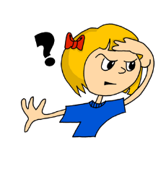
Les questions
Les questions
Shy’M
écrire
Que fais-tu ?
Combien de vues sur YouTube as-tu ?
Quel sport fais-tu ?
Tu manges des hamburgers quand ?
Tu es chanteuse pourquoi ? Tu chantes pourquoi ?
Tu vas en vacances où ?
Notes:
Ahead of the speaking teachers can use this slide (which gives the correct format of the questions in French) so students are working with correct questions.

Slide 13
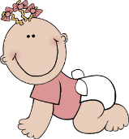
Les questions
Les questions
écrire
Pierre Gasly
Que fais-tu ?
Pourquoi es-tu pilote automobile ?
aimer ?
Aimes-tu aller en vacances ?
réseau
social
Tu as quel réseau social ?
Combien de frères et sœurs as-tu?
frères et sœurs
venir?
Tu viens d’où ?

Slide 14
parler
* réseau social = social media
Vérité ou mensonge ?
parler
Shy’M | Vérité ou
Pierre Gasly | Vérité ou mensonge?
Shy’M
Pierre Gasly
aimer ?
réseau
social
frères et sœurs
venir?
Notes:
Activity 3
Student worksheets
Partner A formulates the questions for Shy’M
Partner B formulates the questions for Pierre Gasly
Tell students to formulate questions 1-3 with SV inversion and question word at the beginning.
4-6 with rising intonation and question word after the verb.
Partners take it in turns to ask each other the questions. The person giving the answer can choose to give either the correct answer or a lie. The person listening must decide if they have been told the truth or a lie. After the text familiarisation activities they should have enough knowledge of the figures to be able to remember!
NB – all the information in the texts is true – if the students wish to give a lie then they need to make it up!
Students can swap partners and celebrities and have multiple goes – making up some different facts each time.
The next slide includes an alternative version adapted for independent study.
NB – cognates necessary for this task: sport
Words necessary to be used from the text: vues/pilote automobile/hamburgers/réseau social

Slide 15
parler
* réseau social = social media
Vérité ou mensonge ?
parler
Shy’M
Pierre Gasly | Vérité ou mensonge?
1
7
2
8
3
9
aimer ?
réseau
social
4
10
5
11
frères et sœurs
6
venir?
12
Notes:
Activity 3
In this version, students work independently, formulating questions for both celebrities, listening to the responses and deciding if they are true or false. Click the box to reveal the answer.

Slide 16
7.3.1.4
Slides 48-51: short series of activities about Angèle and Gims, speaking, listening and writing

Slide 17
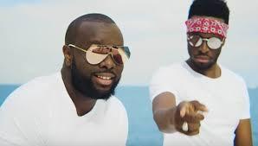
Elle est comment? Il est comment?
Il/Elle est comment ?
écrire / parler / écouter
Student A: Dis une description de l’artiste.
Exemples :
✓ + manger des carottes → Elle mange des carottes.
✗ + regarder la télé → Elle ne regarde pas la télé.
_________________________
_________________________
Student B: Ecoute, coche (✓) et écris la description. Exemples :
✓ + manger des carottes → Elle mange des carottes.
✗ + regarder la télé → Elle ne regarde pas la télé.
1. | manger des carottes | ✓ |  | Elle mange des carottes.
2. | regarder la télé |  | ✓ | Elle ne regarde pas la télé.
Notes:
In-class version (NB: a home-learning version of this activity can be found on slides 51-52).
Timing: 10 minutes
Aim: Oral production and aural comprehension of affirmative and negative sentences.
Procedure:
1. Print copies of the accompanying worksheet for this task, which can be found on the portal alongside this resource. Print once, cut widthways. Contents = two grids for describing, two grids for asking/writing. One top grid and one bottom grid for each student.
2. Student A says the appropriate positive or negative sentence in the 3rd person singular from the cues/phrases in the infinitive. Teacher can use this slide to practise eliciting sentences from a positive and negative prompt.
3. Student B listens, and ticks the correct information (i.e. puts a ✓ for affirmative and a ✗ for negative statements) and transcribes what Student A says. At more advanced levels, student B can transcribe the sentence in full. 4. Continue until all phrases are completed.
5. Swap roles.
6. Peer-correct answers.
7. Teacher displays whole sentence for whole class correction.
Word frequency of cognates used (1 is the most frequent word in French): sexisme [>5000]
Source: Londsale, D., & Le Bras, Y. (2009). A Frequency Dictionary of French: Core vocabulary for learners London: Routledge.
Disclaimer: all facts true to our knowledge, source: Wikipedia.fr

Slide 18
Elle est comment? Il est comment?
Il/Elle est comment ?
écouter / parler
Gims
Angèle
Elle est chanteuse.
Elle n’est pas française.
Elle vient de l’étranger.
Elle a un frère.
Elle est sur Instagram.
Elle n’aime pas le sexisme.
Elle travaille en France.
Elle est jeune.
Elle ne chante pas en Angleterre.
Il est chanteur.
Il chante le rap.
Il n’est pas jeune.
Il parle français.
Il n’est pas français.
Il n’habite pas à Londres.
Il habite à Paris.
Il écoute Eminem.
Il crée des vêtements.
Notes:
Answers to activity

Slide 19
Elle est comment? Il est comment?
parler
Il/Elle est comment ?
Check your pronunciation by clicking on the arrows.
Avec la liste de verbes, dis une description de l’artiste.
Exemples :
✓ + manger des carottes → Elle mange des carottes.
✗ + regarder la télé → Elle ne regarde pas la télé.
✓ être chanteuse
✗ être française
✓ venir de l’étranger
✓ avoir un frère
✓ être sur Instagram
✗ aimer le sexisme
✓ travailler en France
✓ être jeune
✗ chanter en Angleterre
Elle est chanteuse.
Elle n’est pas française.
Elle vient de l’étranger.
Elle a un frère.
Elle est sur Instagram.
Elle n’aime pas le sexisme.
Elle travaille en France.
Elle est jeune.
Elle ne chante pas en Angleterre.
Elle ne chante pas en Angleterre
Notes:
Home-learning version (NB: an in-class version of this activity can be found on slides 49-50).
Transcript:
Elle est chanteuse.
Elle n’est pas française.
Elle vient de l’étranger.
Elle a un frère.
Elle est sur Instagram.
Elle n’aime pas le sexisme.
Elle travaille en France.
Elle est jeune.
Elle ne chante pas en Angleterre.

Slide 20
Elle est comment? Il est comment?
Il/Elle est comment ?
écouter / écrire
1. Écoute et coche les descriptions de l’artiste.
2. Écris la description de l’artiste.
Now swap roles
 | ✓
 | ✓
 |  | ✓
 | ✓
 |  | ✓
 |  | ✓
 | ✓
 | ✓
 | ✓
être chanteur
chanter le rap
être jeune
parler français
être français
habiter à Londres
habiter à Paris
écouter Eminem
créer des vêtements
Il est chanteur.
Il chante le rap.
Il n’est pas jeune.
Il parle français.
Il n’est pas français.
Il n’habite pas à Londres.
Il habite à Paris.
Il écoute Eminem.
Il crée des vêtements.
__________________________
__________________________
__________________________
__________________________
__________________________
__________________________
__________________________
__________________________
__________________________
Notes:
Home-learning version (NB: an in-class version of this activity can be found on slides 49-50).
Transcript
Il est chanteur.
Il chante le rap.
Il n’est pas jeune.
Il parle français.
Il n’est pas français.
Il n’habite pas à Londres.
Il habite à Paris.
Il écoute Eminem.
Il crée des vêtements.

Slide 21
7.3.1.6
Slides 22-27: writing exercises on adjective position with nouns including attractions in Paris.
Slides 58-59: writing exercise including two other Parisian attractions

Slide 22
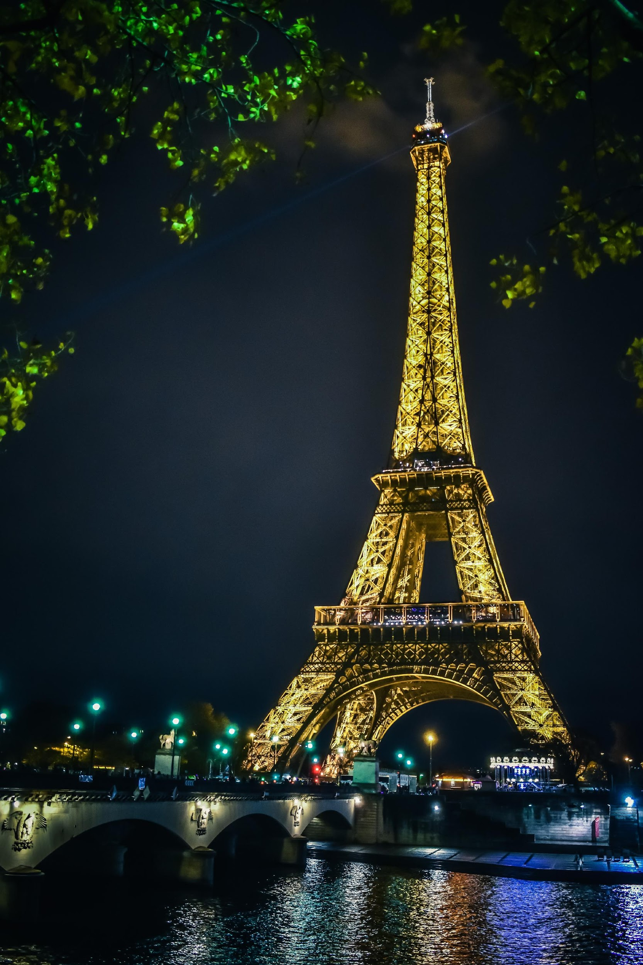
Comment est Paris? (1/6)
Comment est Paris ? (1/6)
écrire
Écris la réponse correcte:
tall
Salut Amir !
À Paris, il y a
un haut monument :
la Tour Eiffel.
____
The adjectives in this activity all come before the noun they describe!
Notes:
Timing: 5 minutes for 6 slides
Aim: Written production of masculine and feminine forms of the pre-nominal adjectives in this week’s vocabulary set.
Procedure:
Students fill the gap in the text with the correct form of the English adjective in bold.
Answer revealed on click.
Elicit oral translation of the full sentence, ensuring correct pronunciation of the buildings described.

Slide 23
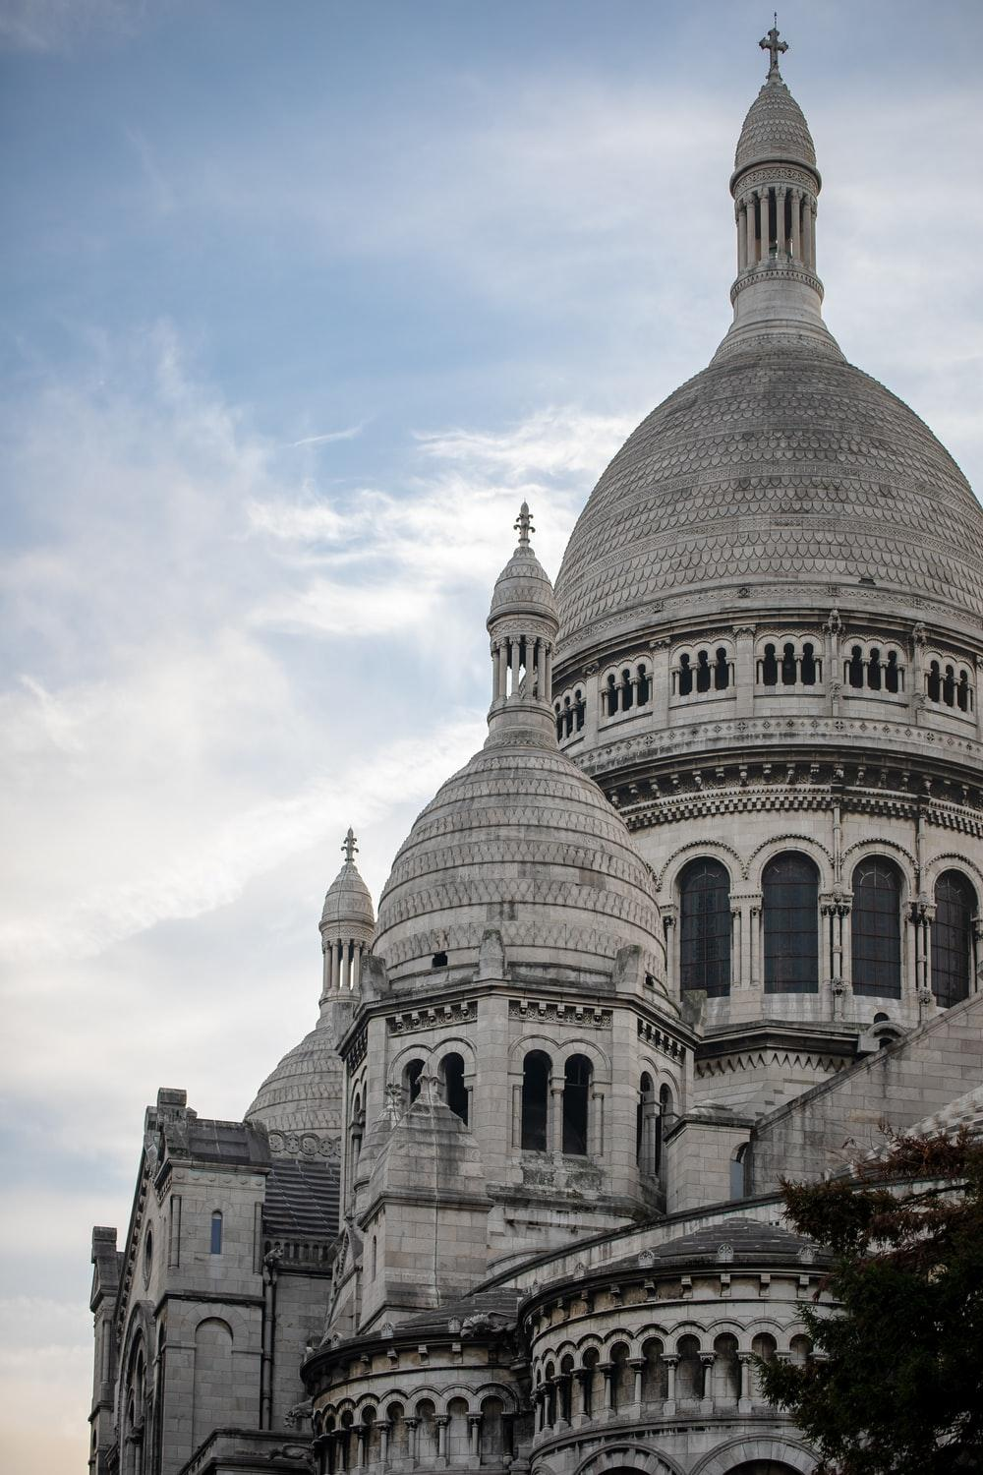
Comment est Paris? (2/6)
Comment est Paris ? (2/6)
Cœur is the French word for ‘heart’. What do you think the name of this church means?
écrire
Écris la réponse correcte:
beautiful
Il y a
une belle église :
le Sacré-Cœur.
____
Many of the adjectives in this activity have an irregular feminine form.

Slide 24
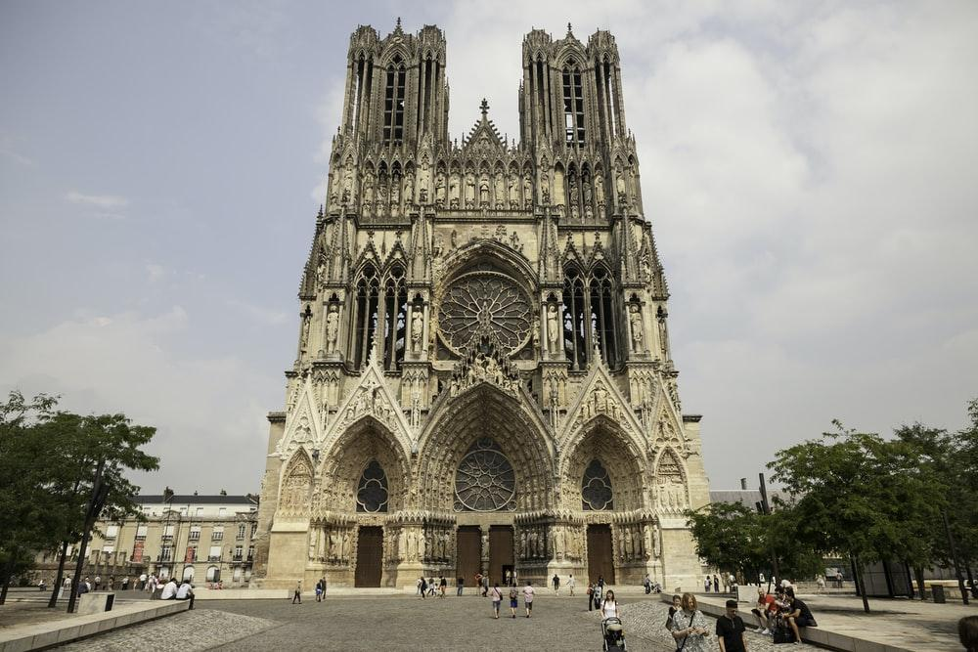
Comment est Paris? (3/6)
Comment est Paris ? (3/6)
écrire
Écris la réponse correcte:
old
Il y a
une vieille
cathédrale :
Notre-Dame.
____

Slide 25
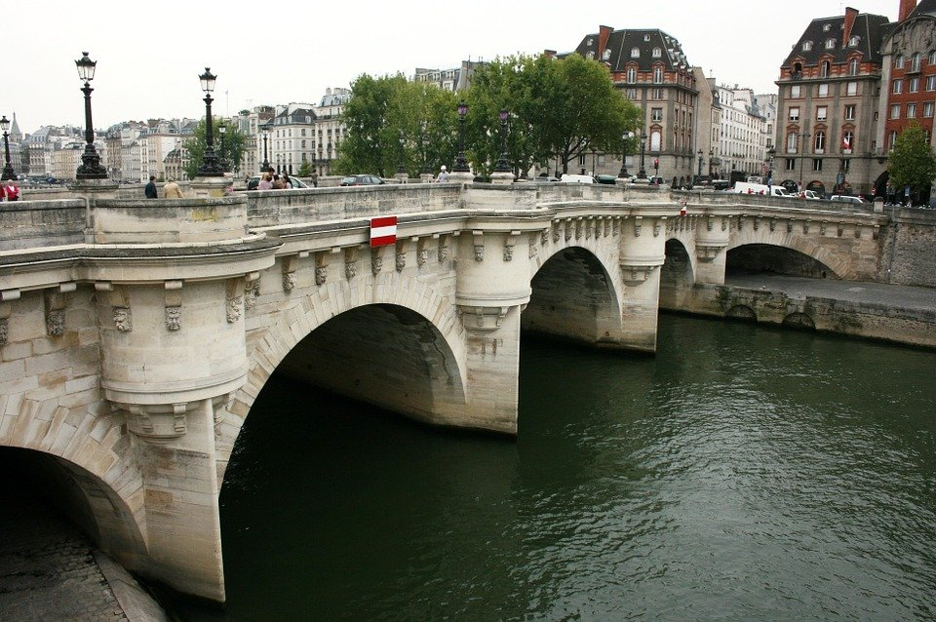
Comment est Paris? (4/6)
Comment est Paris ? (4/6)
écrire
Écris la réponse correcte:
beautiful
old
Il y a un beau pont :
le Pont Neuf.
C’est un vieux pont !
____
____

Slide 26
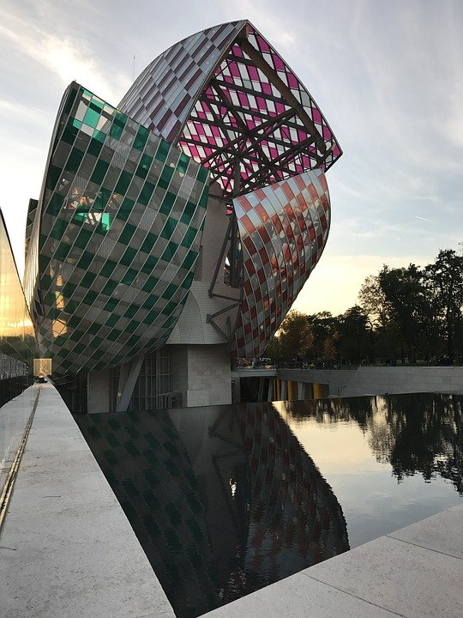
Comment est Paris? (5/6)
Comment est Paris ? (5/6)
écrire
Écris la réponse correcte:
new
Il y a un
nouveau bâtiment :
la Fondation
Luis Vuitton.
Une nouvelle idée !
________
_______

Slide 27
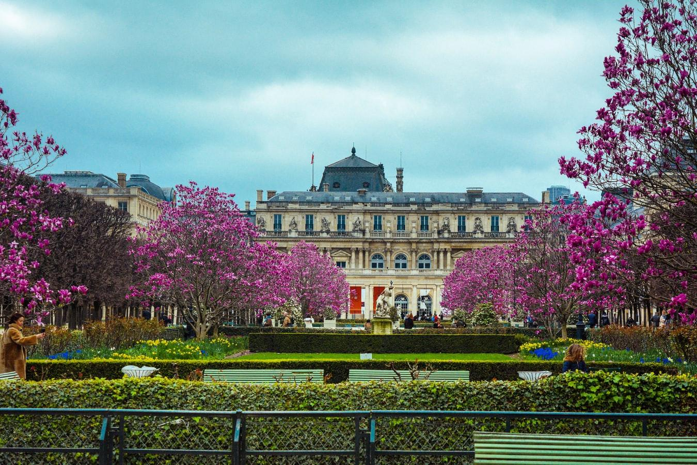
Comment est Paris? (6/6)
Comment est Paris ? (6/6)
écrire
Écris la réponse correcte:
beautiful
Et il y a un beau
jardin : le Jardin du
Luxembourg.
Bises,
Léa
____

Slide 28
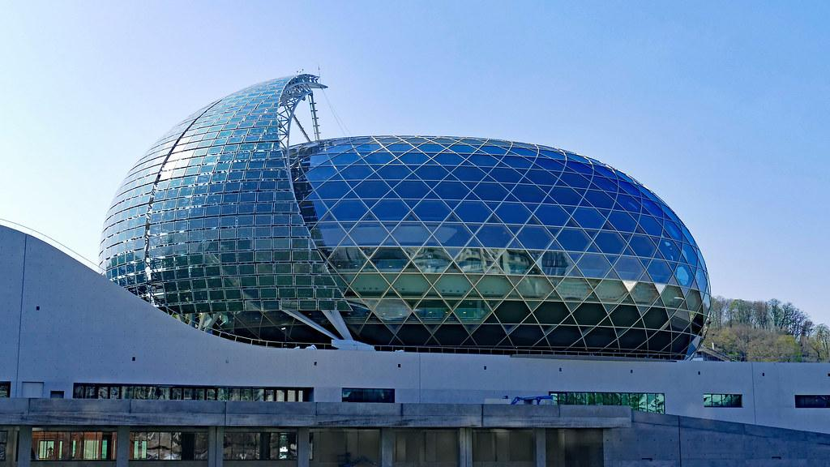
Utilise les cartes. Écris les 6 phrases.
Partenaire A
écrire
Remember!
- position
- agreement
1
C’est un nouveau bâtiment.
2
C’est une fille intelligente.
3
C’est un professeur drôle.
4
C’est une belle idée.
5
C’est une matière intéressante.
La Seine Musicale, Paris.
6
C’est une bonne question.
Notes:
Writing exercise with animated answers – Partner A.

Slide 29
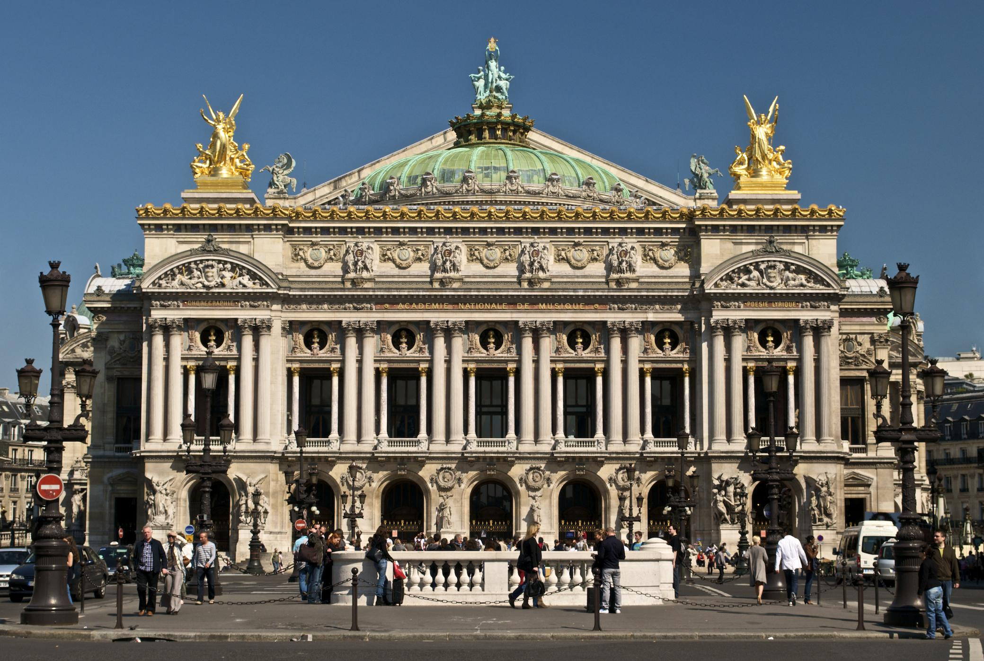
Utilise les cartes. Écris les 6 phrases.
Partenaire B
écrire
Remember!
- position
- agreement
1
C’est un beau bâtiment.
2
C’est une nouvelle fille.
3
C’est un professeur intéressant.
4
C’est une idée intelligente.
5
C’est une bonne matière.
C’est une question drôle.
Palais Garnier, Paris.
6
Notes:
Writing exercise with animated answers – Partner B.

Slide 30
7.3.2.1
Slides 21-22: speaking exercise (revision of SSCs) with French underground stations
Slides 25-32: reading exercise involving various Parisian attractions

Slide 31
Le métro : ligne 2
Le métro : ligne 2
parler
La famille prend le métro aujourd’hui.
Prononce le nom de chaque station. Fais attention à la SSC en orange.
Partenaire A :
Blanche
Anvers
Père Lachaise
Nation
Pigalle
Colonel Fabien
Avron
Notes:
Timing: 4 minutes for 2 slides
Aim: Oral production of a range of SSCs
Procedure:
1. Teacher may wish to give some background to the Paris metro before beginning.
2. The activity focuses on two lines (2 and 6): students work in pairs, taking it in turns to pronounce the station names and offer corrections. NB: the target SSC is in orange. Feedback should be given on the pronunciation of this SSC only.
3. Click on a station to hear its pronunciation.
Transcript:
Blanche, Pigalle, Anvers, Colonel Fabien, Père Lachaise, Avron, Nation
Word frequency (1 is the most frequent word in French): métro [3227], ligne [342], prononcer [706] nom [171] station [1399], orange [3912].
Source: Londsale, D., & Le Bras, Y. (2009). A Frequency Dictionary of French: Core vocabulary for learners London: Routledge.

Slide 32
Le métro : ligne 6
Le métro : ligne 6
parler
La famille prend le métro aujourd’hui.
Prononce le nom de chaque station. Fais attention à la SSC en orange.
Partenaire B :
Boissière
Saint-Jacques
Corvisart
Edgar Quinet
Glacière
Chevaleret
Notes:
Transcript:
Boissière, Edgar Quinet, Saint-Jacques, Glacière, Corvisart, Chevaleret

Slide 33
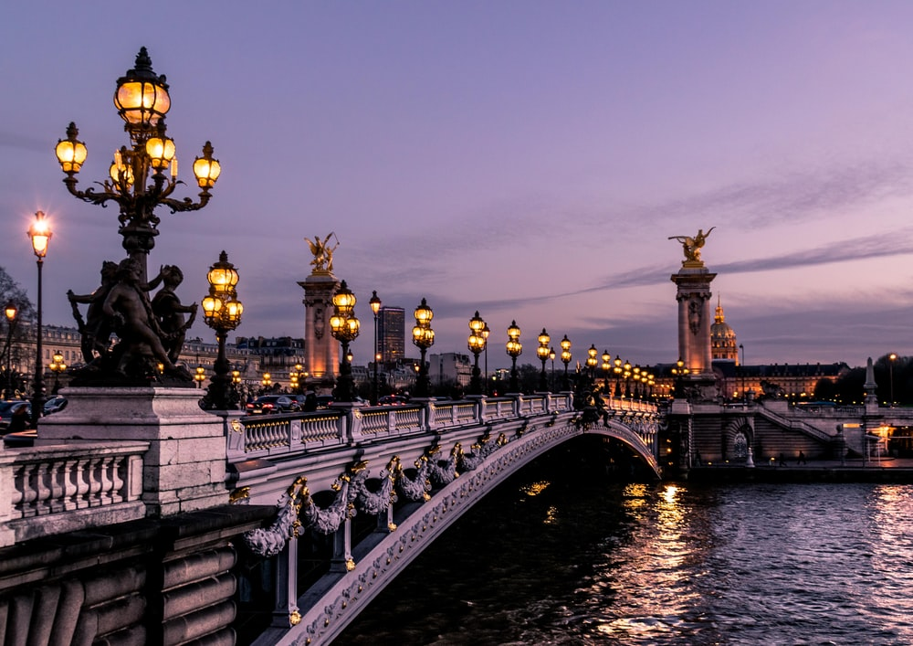
Le tour de Paris
Une visite de Paris
lire
C’est …
1
une grande rue
un bâtiment moderne
un beau parc
un pont important
une église intéressante
une vieille université
un café sympa
un bon cinéma
2
3
4
5
6
7
8
Alexandre-III
Notes:
Timing: 4 minutes for 8 slides.
Aim: Written recognition of vocabulary.
Procedure:
Students can either say the answers or write them on mini whiteboards.
Answers appear on clicks.

Slide 34
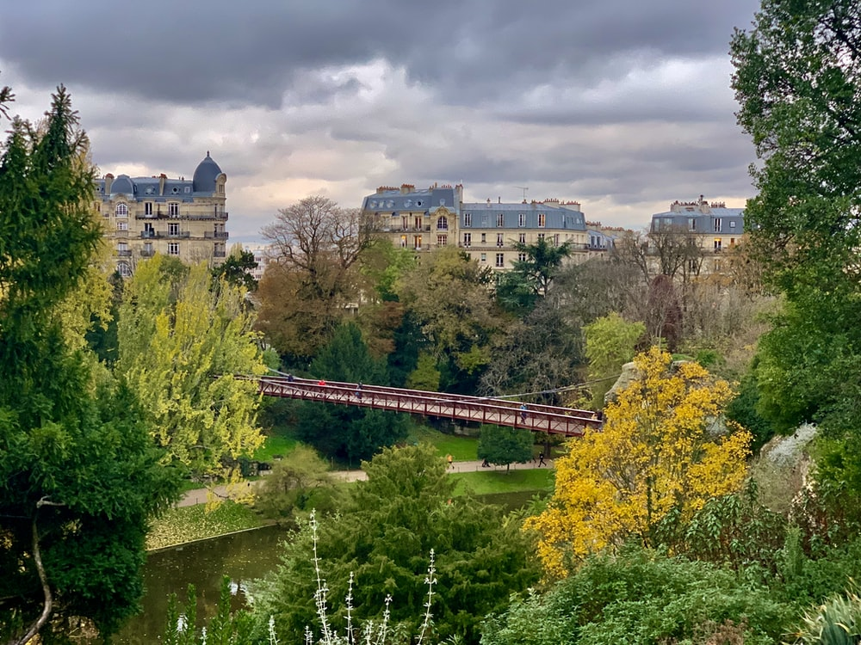
Le tour de Paris
Une visite de Paris
lire
C’est …
1
une grande rue
un bâtiment moderne
un beau parc
un pont important
une église intéressante
une vieille université
un café sympa
un bon cinéma
2
3
4
5
6
7
8
Buttes-Chaumont

Slide 35
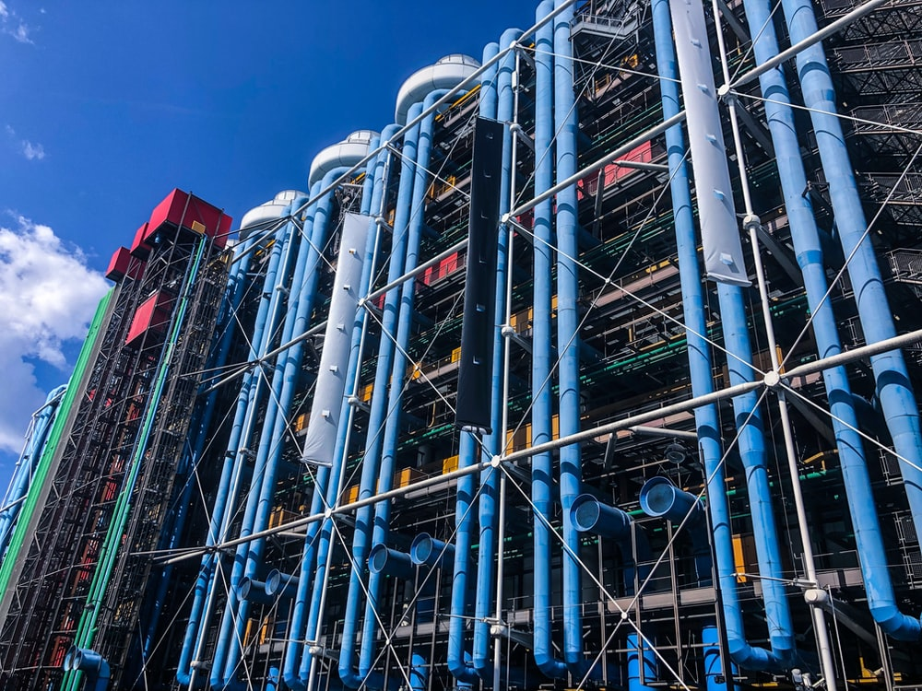
Le tour de Paris
Une visite de Paris
lire
C’est …
1
une grande rue
un bâtiment moderne
un beau parc
un pont important
une église intéressante
une vieille université
un café sympa
un bon cinéma
2
3
4
5
6
7
8
le Centre Pompidou

Slide 36
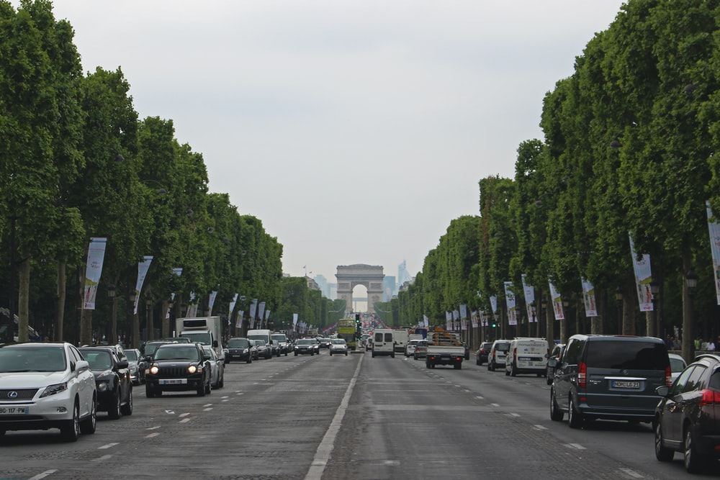
Le tour de Paris
Une visite de Paris
lire
C’est …
1
une grande rue
un bâtiment moderne
un beau parc
un pont important
une église intéressante
une vieille université
un café sympa
un bon cinéma
2
3
4
5
6
7
8
les Champs Élysées

Slide 37
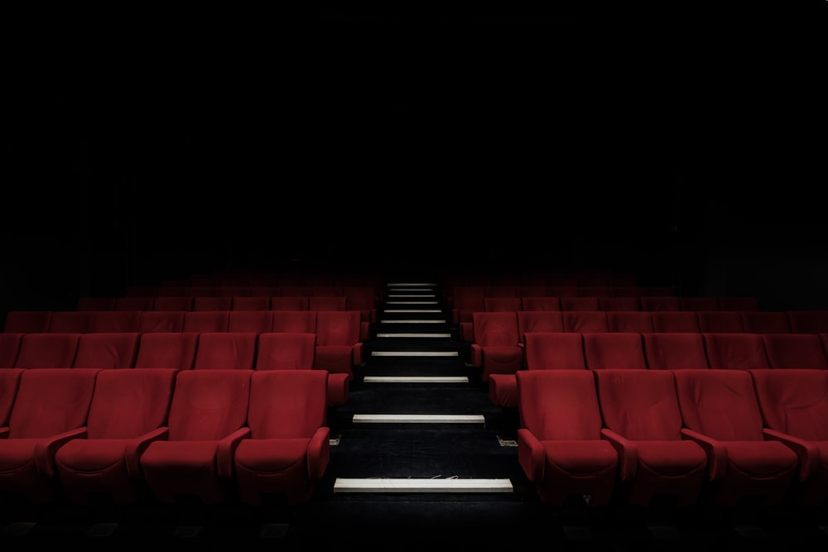
Le tour de Paris
Une visite de Paris
lire
C’est …
1
une grande rue
un bâtiment moderne
un beau parc
un pont important
une église intéressante
une vieille université
un café sympa
un bon cinéma
2
3
4
5
6
7
8
le film

Slide 38
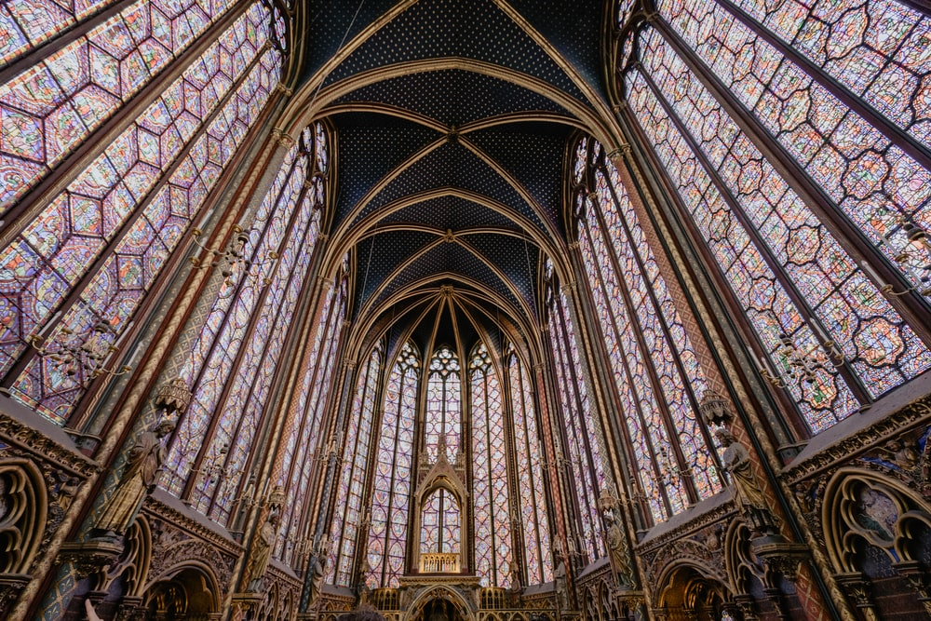
Le tour de Paris
Une visite de Paris
lire
C’est …
1
une grande rue
un bâtiment moderne
un beau parc
un pont important
une église intéressante
une vieille université
un café sympa
un bon cinéma
2
3
4
5
6
7
8
Sainte-Chapelle

Slide 39
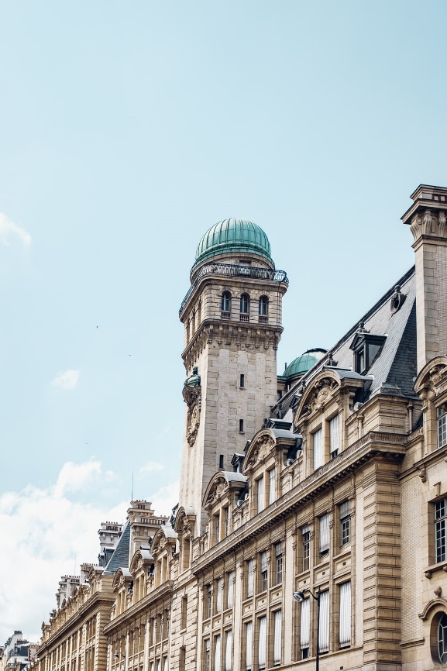
Le tour de Paris
Une visite de Paris
lire
C’est …
1
une grande rue
un bâtiment moderne
un beau parc
un pont important
une église intéressante
une vieille université
un café sympa
un bon cinéma
2
3
4
5
6
7
8
la Sorbonne

Slide 40
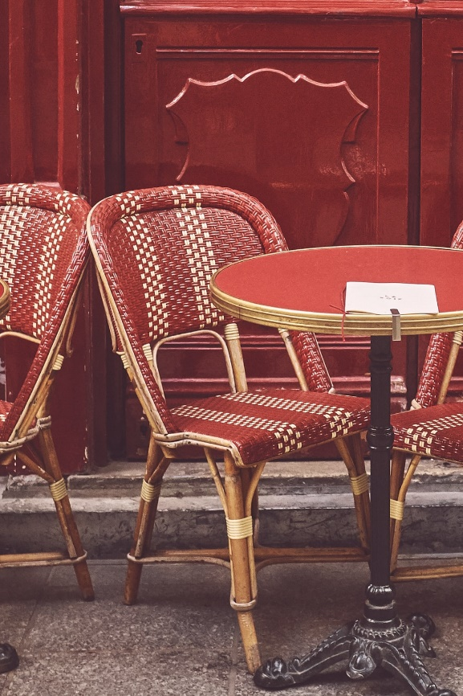
Le tour de Paris
Une visite de Paris
lire
C’est …
1
une grande rue
un bâtiment moderne
un beau parc
un pont important
une église intéressante
une vieille université
un café sympa
un bon cinéma
2
3
4
5
6
7
8
la terrasse

Slide 41
7.3.2.4
Slide 26: slide with callout about La Brioche Dorée chain in a listening activity with present vs simple future.

Slide 42
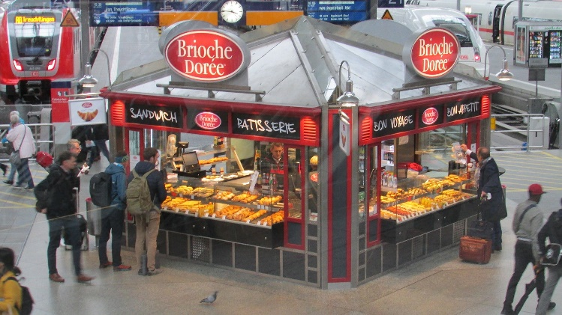
En ce moment ou demain?
parler 1/8
écouter
C’est samedi! Léa et Sophie passent le week-end ensemble. Que font-elles en ce moment? Que font-elles demain? Écoute et coche.
 |  | en ce moment | demain
 | vont aller
 | restent
 | font
 | vont prendre
 | vont lire
 | regardent
 | vont faire
 | font
1
La Brioche Dorée
2
3
4
5
C’est une chaîne française populaire. Elle propose des pâtisseries et des sandwichs.
6
7
8
Notes:
ANSWER SLIDE for activity on slide 20.
Full audio, including time phrases, plays on number clicks.
On a click, a transcription of the verb phrase first appears, which students can use to check their answers. On a second click, the answer appears.
Transcript
1. Demain, Léa et Sophie vont aller en ville.
2. En ce moment, elles restent à la maison.
3. En ce moment, elles font la cuisine.
4. Demain, elles vont prendre le déjeuner à la Brioche Dorée.
5. Demain, elles vont lire des livres.
6. En ce moment, elles regardent la télé.
7. Demain, elles vont faire des exercises en anglais.
8. En ce moment, elles font les devoirs de maths.
Word frequency (1 is the most frequent word in French): chaîne [1159], proposer [338], pâtisserie [>5000], sandwich [>5000]
Source: Londsale, D., & Le Bras, Y. (2009). A Frequency Dictionary of French: Core vocabulary for learners London: Routledge.

Slide 43
7.3.2.5
Slide 26: Callout about Parque Astérix in reading activity with modal verbs

Slide 44
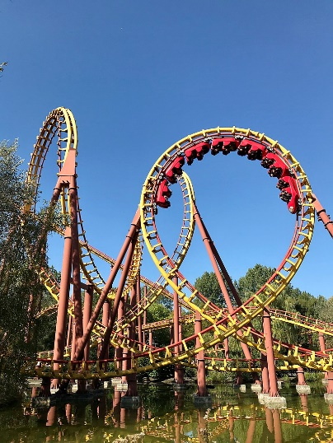
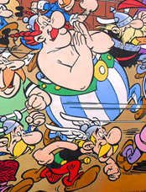
Rêve ou réalité ?
Le Parc Astérix est un parc d'attraction basé sur l'univers d'Astérix ! Il est situé à 50km de Paris.
lire
Amir rêve très souvent ! C’est la réalité ou un rêve ? Coche.
 |  | un rêve (veux) | la réalité (-)
1. | Je veux visiter Parc Astérix.
2. | Je regarde le Grand Prix de Monaco.
3. | Je veux apprendre une nouvelle langue.
4. | Je veux avoir un chien.
5. | Je suis dans le jardin.
6. | Je veux être dans ma chambre.
7. | Je comprends l’anglais.
8. | Je dis la verité!
____
____
____
____
____
____
____
____
Notes:
Timing: 8 minutes
Aim: Practice in connecting the long form of the main verb in a sentence with modality, in this case ‘wanting’ to do something.
Suggested procedure:
Check understanding of the scenario. Students have learned the noun rêve, so should be able to recognise the verb form used here.
Students write numbers 1-8 in their books.
Students decide whether Amir is talking about reality or a dream by looking at the form of the main verb.
Whole-class correction. Ask: ‘numéro 1, rêve ou réalité ?’
Oral translation of the sentences. Students read the full French sentence aloud, then provide an English gloss.
Word frequency of unknown words used in the task instructions and info bubble (1 is the most frequent word in French): attraction [>5000], basé [baser – 1712], rêver [1871], réalité [532], situé [situer - 815], univers [2112]
Source: Londsale, D., & Le Bras, Y. (2009). A Frequency Dictionary of French: Core vocabulary for learners London: Routledge.

Slide 45
7.3.2.7
Slides 27-40 and 42-49: series of activities based on L’homme que te ressemblee by René Philombé

Slide 46
Écoute !
écouter
[Verse 1 text here]
[Verse 2 text here]
Notes:
Please note: teachers to insert the full text of verses 1 and 2 of the poem in the text box.
Timing: 2 minutes approx.
Suggested teaching steps:
1. Teacher reads each line slowly, perhaps with gestures to support meaning. Each line is animated separately so that the teacher can time his/her reading to coincide with the appearance of the text. This supports attention and reduces the risk of cognitive overload. 2. Leave the text visible and listen/watch the video version.
This slide links to a reading of the poem on YouTube. The video is not embedded – teachers will need to be online to access this version of the poem. Play up to where the boy stops speaking – these are the first two verses. Stop video at 39 seconds.
https://www.youtube.com/watch?v=PYTqsC2L2VI Version with two children who do actions to support meaning – really nice reading.

Slide 47
Comment est le garçon qui parle ?
Il est….
calme
content
amusant
intéressant
sympa
Notes:
Timing: 1 minute approx.
The next lesson will give more opportunities for students to express their views on readings of the poem but it is a useful moment to elicit their reaction to the boy’s tone of voice/way he presents. These adjectives have been encountered previously.

Slide 48
Parle avec un(e) partenaire
1) Ce texte est ...
un article?
un poème?
une histoire?
2) Pourquoi ? Parce qu’il y a…
des répétitions
des rimes
des rythmes
Notes:
Timing: 1 minute approx.
Bring up the first question and options. Give students just a few seconds to confer in pairs and share their consensus. Then bring up question two. You may need to return to the text on slide 3. Students should conclude that there are repetitions and rhythms but no rhymes (they might suggest that Afrique and Amérique rhyme, but should certainly agree that whilst it’s a poem, it’s not a rhyming poem!).
The responses contain words which have not been learned previously, but are near-cognates which should be easy to work out from the context (frequency given below).
Word frequency rankings (1 is the most common word in French):
article [604], répétition [2804], rhythme [>5000], rime [>5000]
Source: Londsale, D., & Le Bras, Y. (2009). A Frequency Dictionary of French: Core vocabulary for learners London: Routledge.

Slide 49
L’homme qui te ressemble
Challenge 6
[Verse 1 text here]
[Verse 2 text here]
feu
repousser
ouvre
moi
Look up the orange words in a dictionary (or using WordReference) and list their English meaning and part of speech.
The dictionary has different possible meanings of a word, with examples. The third meaning listed for repousser in WordReference is the right one for the context of the poem!
feu nm fire
repousser vtr reject
ouvrir vtr open (up)
moi pron me
Notes:
Please note: teachers to insert the full text of verses 1 and 2 of the poem in the text box, highlighting the four words in orange in the text.
Timing: 2 minutes approx.
Many of the words in this text have been previously introduced and learnt (this was one factor in the choice of this text for this point in the scheme of work); others are introduced as part of the new vocabulary set for this week. However, a third group of words does not fall into either of the above categories. Four words are thus highlighted for students to look up, practising the skills introduced earlier in this sequence. It is pointed out that the dictionary user has to work his/her way down the examples of usage provided, in order to find the correct translation of a word for the context; in this case, the third meaning given in WordReference for repousser is the correct one.
N.B. The possessive forms mon and ton are not dealt with as a grammar point at this stage; we are only aiming for students to understand their meaning here. Possessive adjectives form part of the scheme of work grammar for Year 8 in the NCELP French scheme of work.

Slide 50
Vocabulaire
lire
blanc, blanche
avoir
ouvre
demander
suis
le cœur
Type of word:
frapper
noir
adjective
conjunction
noun
ressembler
verb
preposition
si
le temps
Coche les 2 mots qui sont aussi ce type de mot.
pour
Notes:
Timing: 5 minutes approx.
This vocabulary activity has several purposes:
Extending the dictionary skills work on part of speech to L2 vocabulary, priming students for additional dictionary work as necessary while understanding this week’s text
Reactivating knowledge of previously taught vocabulary that features in this week’s text
Checking understanding of the pronunciation and form of the vocabulary introduced this week (the meaning will be reinforced with picture aids in lessons 1 and 2)
The slides is animated so that the students first identify the part of speech of the known vocabulary, and then identify the new words in this category – pronunciation can be checked by eliciting the answers with the class.

Slide 51
Vocabulaire
lire
une porte
un lit
un frère
blanc, blanche
le cœur
la couleur
un homme
le ciel
frapper
Type of word:
noir
adjective
conjunction
noun
ressembler
si
verb
preposition
le temps
Coche les 2 mots qui sont aussi ce type de mot.
pour

Slide 52
Vocabulaire
lire
blanc, blanche
bon
rouge
jaune
le cœur
Type of word:
frapper
noir
adjective
conjunction
noun
ressembler
verb
preposition
si
le temps
Coche les 2 mots qui sont aussi ce type de mot.
pour

Slide 53
Vocabulaire
lire
blanc, blanche
et
mais
le cœur
Type of word:
frapper
adjective
conjunction
noun
noir
ressembler
verb
preposition
si
le temps
Coche le mot qui est aussi ce type de mot.
pour

Slide 54
Vocabulaire
lire
blanc, blanche
à
de
le cœur
Type of word:
frapper
adjective
conjunction
noun
noir
ressembler
verb
preposition
si
le temps
Coche le mot qui est aussi ce type de mot.
pour

Slide 55
Translating the preposition ‘à’
grammaire
The verbs frapper and ressembler are often followed by the preposition à + noun.
The English translation of à is different for each verb:
Je frappe à la porte
I’m knocking at the door
Le frère ressemble à la sœur
The brother looks like the sister
With ressembler, the preposition à is not translated into English.
Notes:
Timing: 1 minute approx.
Vocabulary extension: verbs + preposition à.

Slide 56
Vers 1
lire / parler
[Line 1]
[Line 2]
[Line 3]
[Line 4]
[Line 5]
[Line 6]
Notes:
Please note: teachers to insert the text of verse 1, line by line. Each line is animated with the accompanying audio.
Timing: 5 minutes approx.
Attribution: Please emoji
Twitter [CC BY 4.0 (https://creativecommons.org/licenses/by/4.0)] https://upload.wikimedia.org/wikipedia/commons/f/ff/Twemoji_1f64f.svg
Whole class opportunity to read verse 1 aloud with the teacher. Elicit meanings and clarify any unknown vocabulary that has not yet been understood – dictionary work can be encouraged here. Pay particular attention to the new vocabulary introduced this week – “frapper” and “cœur”.
The perfect tense will not be learnt until year 8, so at this stage the focus should be on meaning rather than form.
Give students another opportunity to read aloud the first verse in pairs, a line each. Encourage them to read expressively, thinking about the meaning.

Slide 57
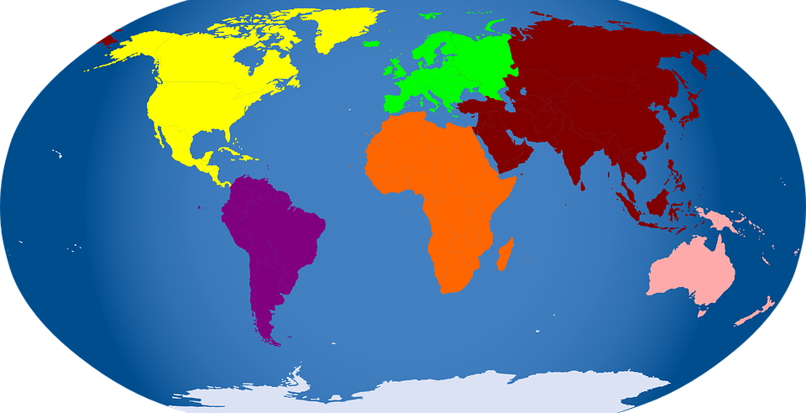
Vers 2
lire / parler
[Line 1]
[Line 2]
[Line 3]
[Line 4]
[Line 5]
[Line 6]
Notes:
Please note: teachers to insert the text of verse 2, line by line. Each line is animated with the accompanying audio.
Timing: 5 minutes approx.
Whole class opportunity to read verse 2 aloud with the teacher. Pay particular attention to the new vocabulary introduced this week – “si”. Attention should also be drawn to “d’” = “de” and that the meaning is “from” – the meaning “of” will be introduced in the next verse in lesson 2.

Slide 58
Biographie en questions
lire / écrire
Only 4 words are needed – there is one extra question word!
Lis les réponses et complète les questions.
1) René Philombé travaille __________ ?
le Cameroun (en Afrique)
2) Il travaille comme __________ ?
journaliste et poète
3) Il écrit des poèmes __________ ?
Il a un message: il est pour la diversité et le respect.
4) Il écrit ce poème __________ ?
1977
quoi
où
quand
comment
pourquoi
Notes:
Timing: 5 minutes approx.
This is an opportunity to find out a little about the poet, and to re-visit question words including ‘pourquoi’, which is introduced this week.
The students match the question word to the question – the answer given provides a clue. ‘Comment’ is included as a distractor to limit the process of elimination approach.
This activity includes previously taught vocabulary and near-cognates (for which the frequency is given below).
Word frequency rankings (1 is the most common word in French):
Afrique [N/A], Cameroun [N/A], diversité [2537], journaliste [1337], message [792], poème [3031], poète [2307], respect [818]
Source: Londsale, D., & Le Bras, Y. (2009). A Frequency Dictionary of French: Core vocabulary for learners London: Routledge.

Slide 59
L’homme qui te ressemble
lire / parler
[Verse 1 text here]
[Verse 2 text here]
Notes:
Please note: teachers to insert the full text of verses 1 and 2 of the poem in the text box.
Timing: 5 minutes approx.
Opportunity to revisit the first two verses of the poem. Students can be asked to read them aloud in pairs, taking it in turns to read a line each OR taking a verse each.
They should be encouraged to use tone of voice, variance of tempo/rhythm, and/or gesture to demonstrate their understanding.

Slide 60
L’homme qui te ressemble
écouter
1 | 2 | 3 | 4 | 5
1
c
e
d
a
b
Écoute. Écris l’ordre correct.
a | [Verse 4 text here]
b | [Verse 5 text here]
c | [Verse 1 text here]
e | [Verse 2 text here]
d | [Verse 3 text here]
Notes:
Please note: teachers to insert the full text of each verse in the appropriate cell.
Timing: 2 minutes approx.
This is the first time students hear/read the full text of the poem. They are now already familiar with two of the verses.
Here they listen to the whole text and put the verses in order.
A woman reads the poem fairly quickly, and without much emotion. Version 1: https://www.youtube.com/watch?v=vEessHNHzPQ

Slide 61
Vers 3
lire / parler
[Line 1]
[Line 2]
[Line 3]
[Line 4]
[Line 5]
[Line 6]
Notes:
Please note: teachers to insert the text of verse 3, line by line. Each line is animated with the accompanying audio.
Timing: 5 minutes approx.
Whole class opportunity to read verse 3 aloud with the teacher.
Elicit meanings and clarify any unknown vocabulary that has not yet been understood – again, encouraging dictionary use where appropriate. Give students another opportunity to read aloud the verse in pairs, a line each. Encourage them to read expressively, thinking about the meaning.

Slide 62
Vers 4
lire / parler
[Line 1]
[Line 2]
[Line 3]
[Line 4]
[Line 5]
[Line 6]
Notes:
Please note: teachers to insert the text of verse 4, line by line. Each line is animated with the accompanying audio.
Timing: 5 minutes approx.

Slide 63
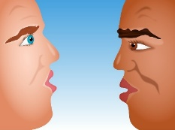
Vers 5
lire / parler
[Line 1]
[Line 2]
[Line 3]
[Line 4]
[Line 5]
[Line 6]
Notes:
Please note: teachers to insert the text of verse 5, line by line. Each line is animated with the accompanying audio.
Timing: 5 minutes approx.
Many words are repeated from earlier in the poem in different combinations in the final verse.
Pay particular attention to the vocabulary introduced this week – “temps” and “ressembler”.

Slide 64
Écris la réponse correcte
lire
René Philombé est un poète jeune / un poète français / un poète moderne.
Le poète est d’Amérique / d’Afrique/ d’Asie.
Le poète est un parent / un homme / un blanc.
Il parle à « mon frère » - le frère est un homme / un enfant / chaque homme.
Lis les messages. Écris l’ordre correct:
Chaque homme ressemble à chaque homme.
L’apparence physique n’est pas importante.
La couleur n’est pas importante.
Repousser les personnes est méchant.
L’origine géographique n’est pas importante.
Vers | Message
1
2
3
4
5
d
e
b
c
a
Notes:
Timing: 3 minutes approx.
This slide is animated to give students questions 1-4 to do independently, followed by whole class correction. Question 5 appears separately. It is anticipated that students will need to return to read the text again for question 6. Note: The lessons have been designed so that the only copying required will be one A4/5 copy of the poem text.
This activity mainly includes vocabulary that has been previously taught or encountered in this week’s activities, and some additional near-cognates (for which the frequency is given below).
Word frequency rankings (1 is the most common word in French):
apparence [2714], message [792], ordre [197], origine [709], géographique [3389], physique [1146]
Source: Londsale, D., & Le Bras, Y. (2009). A Frequency Dictionary of French: Core vocabulary for learners London: Routledge.

Slide 65
Quelle version aimes-tu ?
écouter / écrire
1
2
3
Écoute les trois versions différentes. Écris des phrases.
Version 1, c’est…
Version 2, c’est…
Version 3, c’est…
un homme
une femme
un enfant
amusant
calme
content
rapide
intelligent
intéressant
sympa
moderne
J’aime Version…
1
2
3
Remember!
Some adjectives are spelt differently if the noun is masculine or feminine.
Notes:
Timing: 5 minutes approx.
This slide allows the students to express their opinions on different versions of the poem, as well as practising adjectival agreement. The adjectives have all been learnt previously.
There are three versions to listen to/choose from: 1. A woman reads the poem fairly quickly, and without much emotion. This is the version students already heard from slide 41. Version 1: https://www.youtube.com/watch?v=vEessHNHzPQ 2. This version is the children’s version from lesson 1, but in its entirety. Version 2: https://www.youtube.com/watch?v=PYTqsC2L2VI 3. A man reads this version, with some music/percussion in the background, and with feeling. Version 3: https://www.youtube.com/watch?v=dNbSNWaPUGc

Slide 66
Télépathie!
lire / parler
Pourquoi me demander
Si je suis
Ouvre-moi, mon frère.
Je ne suis pas
Ouvre-moi, mon frère !...
Je ne suis qu'un homme
L'homme de
L'homme qui te ressemble !...
d’Afrique
d’Asie
d’Europe
ta porte
ton hôtel
ta chambre
4
1
J'ai frappé à
J'ai frappé à ton cœur
Pourquoi
Ouvre-moi,
un ennemi
un problème
un animal
5
m’ignorer ?
me repousser ?
me dire non ?
2
tous les temps
toutes les villes
tous les jours
ma sœur !...
mon ami !...
mon frère !...
6
3
Notes:
Timing: 10 minutes approx
In this slide, the students choose their own variation of the poem and practice reading it aloud with a partner.
Suggested classroom procedure:
1. Both students choose their optional versions and note them down (this is only for the purpose of avoiding any accusations of cheating, later) – Noting down the answers simply involves numbering 1 – 6 and next to each number putting one, two or three dots. 2. Partner A starts – s/he says “J’ai frappé a XXX”, choosing whichever noun s/he believes her partner has chosen. If s/he is correct, Partner B will nod to indicate s/he can continue to the next line. 3. As soon as Partner A gets an option wrong, Partner B gets a turn and in the same way, tries to predict his/her partner’s answers. 4. Every time a student goes wrong, you must go back to the beginning. 5. The task ends when the first student gets through the whole text correctly predicting all their partner’s answers in one turn.
This task has several purposes: 1. It practises reading aloud / pronunciation and decoding (there are some unknown near-cognates). 2. It works memory. To “win” students have to keep returning to the beginning every time they select a wrong option (i.e. an option that their partner has not secretly chosen). The aim is to be the first to read the whole text, correctly selecting your partner’s options. Whilst it is a game of chance to a degree, if you are not concentrating and remembering the options you have already correctly discovered, you give away the opportunity for your partner to have another go. Each time you go wrong, play passes to your partner. 3. It models some variations on the original poem, which prepares students for their own creation task, which is the next task, so acts as additional preparation for this.
This activity mainly includes vocabulary that has been previously taught or encountered in this week’s activities, and some additional near-cognates (for which the frequency is given below).
Word frequency rankings (1 is the most common word in French):
ignorer [639], ennemi [1715]
Source: Londsale, D., & Le Bras, Y. (2009). A Frequency Dictionary of French: Core vocabulary for learners London: Routledge.

Slide 67
À ton tour !
Écris un poème similaire :
ou
Présente le poème original. Fais une présentation :
mémorisée
dramatique/créative
avec un partenaire ou en groupe
J'ai frappé à …
J'ai frappé à…
Pourquoi me… ?
Ouvre-moi, … !... Pourquoi me demander Si je suis… ?(x 2-4) Je ne suis pas (x 2-4) Je suis… … de tous/toutes les… … qui te ressemble !...
Notes:
Timing: 10 minutes approx.
The idea is to offer some choice of task. Not all students enjoy writing their own poetry. Both options here involve engagement with the meaning of the language and spoken production.
TL instructions appears gradually, teacher elicits meaning bit by bit from students, to ensure that meaning is clear.

