Slide 1
Cultural Collection
French Y7 Term 2
Pete Watson
Date updated: 10/03/21

Slide 2
7.2.1.3
Slide 8: phonics, [au] SSC with place names
Slide 26: reading, monuments in Paris named.

Slide 3
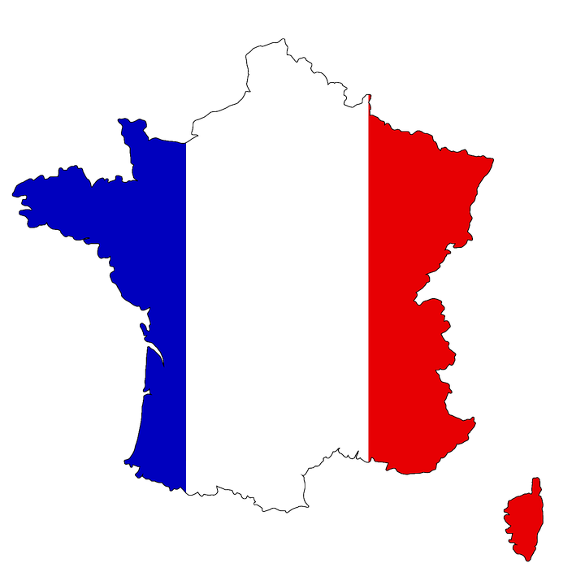
Phonétique
écouter / parler
Do these place names contain the sound [au]? Écoutez et cochez.
 |  | Oui | Non
 | Bordeaux
 | Gren o ble
 | C o rse
 | Beauvais
 | L au sanne
 | O rléans
 | Aix-en-Pr o vence
 | Monaco
1
____
2
____
3
____
4
____
The letter ‘o’ is sometimes (but not always!) pronounced like [au] too.
5
____
6
____
7
____
8
____
Notes:
Timing: 5 minutes
Aim: Oral recognition of SSC [au].
The exercise also provides an opportunity to review SFCs (Bordeaux, Beauvais, Orléans) and the previously studied SSCs [é] (Orléans), [en] (Aix-en-Provence) and [ai] (Beauvais, Aix-en-Provence).
Procedure:
1. The place names are heard on individual number clicks. To allow students to compare the sounds, it is recommended that the teacher cycles through the recordings (from 1-8) at least twice.
2. Teacher reveals answers on clicks. Teacher to highlights the fact that some place names, (Bordeaux, Monaco) contain both sounds, and that the letter ‘o’ is not always pronounced [au] (this will be explored further in Year 8). Teacher can illustrate this by giving examples of previously encountered words such as modèle, école, ordinateur …
3. Teacher elicits pronunciation by pointing at the word and asking ‘Comment dit-on numéro un, deux…’
4. Teacher plays each place name again, and students repeat chorally.
Transcript:
Bordeaux
Grenoble
Corse
Beauvais
Lausanne
Aix-en-Provence
Orléans
Monaco

Slide 4
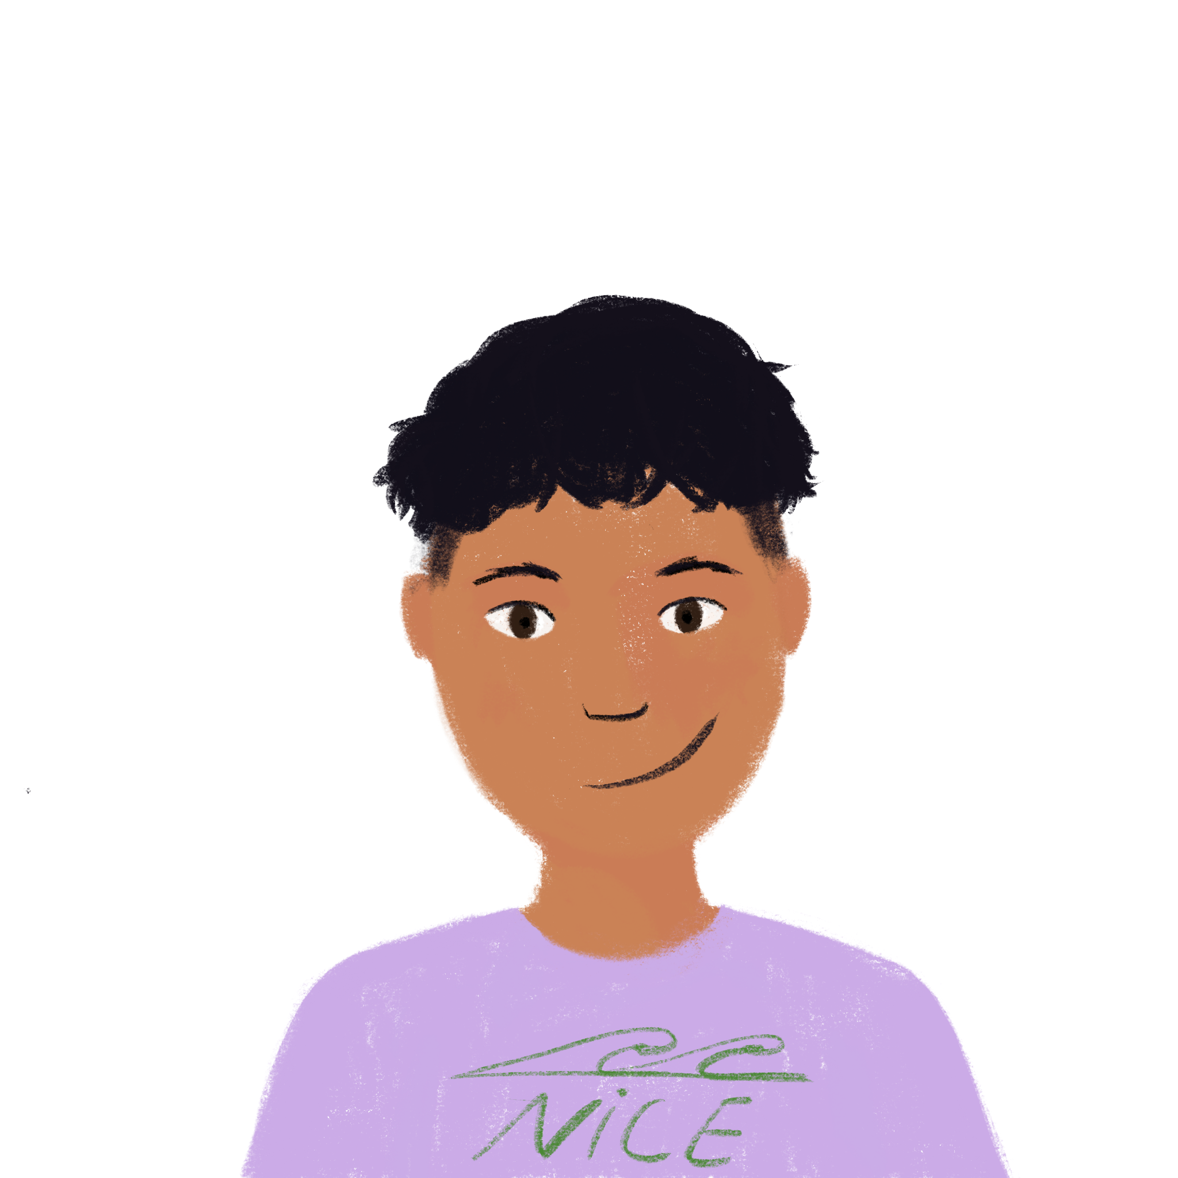
Deux villes françaises
Deux villes françaises
* d’accord - okay
lire
Students in Paris and Nice are chatting about their cities. Both groups think their city is best!
Who has what in their city? Lis et écris nous (we) ou vous (you pl.)
@6ème_paris: Nous avons la Tour Eiffel et l'Arc de Triomphe ici!
@6ème_nice: Oui, vous avez des monuments mais nous avons le ciel bleu ici!
@6ème_paris: D’accord*, vous avez la Méditerranée et des bateaux, mais nous avons une histoire riche!
@6ème_nice: OK, vous avez une culture unique. Mais nous avons les Alpes ici!
@6ème_paris: Bah … nous avons des restaurants excellents et des magasins modernes!
@6ème_nice: Euh … nous avons des restaurants excellents et des magasins modernes aussi!
______
______
______
______
______
______
______
______
______
Notes:
Timing: 5 minutes
Aim: Written recognition of the 1st and 2nd person plural forms of avoir.
Procedure:
1. Students complete the activity by simply writing nous, vous, nous etc. in their workbooks, using their knowledge of forms of avoir to guide them.
2. They address the ‘who has what?’ part of the question by writing the items down in English.
3. Answers revealed on individual clicks. Teacher elicits answers by pointing at a gap and asking ‘Nous ou vous?’ Then s/he elicits the English for ‘who has what’.
4. Teacher to draw attention to the following points:
Ville is a false friend – teacher to ask students what they think the word might mean, given the context, and correct/explain as appropriate. La ville [260] is introduced as a vocabulary item in 2.2.2.
French spelling/pronunciation of la Tour Eiffel, l’Arc de Triomphe and les Alpes.
6ème – touch briefly on structure of the French school system. Explain that these students will be around the same age as students in Year 7 in the UK.
Students have not yet encountered cognates riche, culture or unique, but should be able to infer the meanings.
Students have not yet encountered an irregular plural ending – point this out and the SFC in bateaux. Ask students what they think this word means. Explain that some nouns have irregular plural endings, and that further examples will be encountered in future weeks.
Answers: 1. Nous – Eiffel tower, Arc de Triomphe 2. Vous – monuments, nous – blue sky 3. Vous – sand, boats, nous – rich history 4. Vous – unique culture, nous – Alps 5. Nous – excellent restaurants and modern shops 6. Nous – excellent restaurants and modern shops
Note:
Last week, students were taught regular plural adjective agreement as complement to the verb être. They have previously been taught postnominal adjective agreement with singular nouns. (Week 1.1.4). Teacher to draw students’ attention to the spelling of ‘excellents’ and ‘modernes’ and elicit the reason for this.
Word frequency of cognates used (1 is the most frequent word in French): monument [4113], d’accord [736], Méditerranée [n/a], riche [599], culture [913], unique [402], restaurant [2336], excellent [1225]
Source: Londsale, D., & Le Bras, Y. (2009). A Frequency Dictionary of French: Core vocabulary for learners London: Routledge.

Slide 5
7.2.1.5
Slides 22-27: Speaking with mention of Audrey Tautou and Kylian Mbappé
Slides 29-30: phonics practice of various SSCs with French-speaking musicians / singers
Slide 38: reading exercise, il y a, a or est, involving mention of Charlotte Gainsbourg

Slide 6
Fais une interview
Fais une interview !
parler
Fais des questions avec qui ou quoi. Donne des réponses comme Léa et Amir.
Exemple 1 :
A : C’est qui ta personne préférée ?
B : Ma personne préférée est Sophie.
A : C’est quoi la raison ?
B : Elle est une personne ouverte.
 |  | qui / quoi ? | raison ?
A | personne
Remember to make the adjective agree if needed!
Sophie
ouverte
 |  | qui / quoi ? | raison ?
B | personne | Sophie | ouverte
Exemple 2 :
B : C’est quoi ton animal préféré ?
A : Mon animal préféré est le chien.
B : C’est quoi la raison ?
A : C’est un animal sage.
 |  | qui / quoi ? | raison ?
B | animal
le chien
sage
 |  | qui / quoi ? | raison ?
A | animal | le chien | sage
Notes:
In-class version (NB: a self-study version of this activity can be found on slides 25-27)
Timing: 10 minutes
Aim: consolidate the lesson’s work on agreement with possessive and other adjectives, whilst providing additional practise in adjective placement.
Procedure:
Print a rolecard (slides 22-23) for each student, working in pairs as A and B.
Partner A has Amir’s answers and Partner B has Léa’s answers – they ask questions in turn, following the examples provided, to complete the information about their partner.
To extend the activity, students complete the tables with their own answers and ask questions about each other.
Word frequency (1 is the most frequent word in French):
footballeur [>5000] and rappeur [>5000], interview [3186]
Source: Londsale, D., & Le Bras, Y. (2009). A Frequency Dictionary of French: Core vocabulary for learners London: Routledge.

Slide 7
Fais une interview
Fais une interview !
Partenaire A
parler
Fais un interview
 |  | qui / quoi ? | raison ?
 | chanteuse
 | actrice
 | magasin
 | numéro
1
2
3
4
 |  | qui / quoi ? | raison ?
 | footballeur | Kylian Mbappé | français
 | rappeur | Sofiane | rapide
 | livre | Kiffe kiffe demain | excellent
 | film | Moi, César | amusant
C’est qui ta chanteuse préférée ?
C’est quoi la raison ?
5
6
7
8
Notes:
Role card A

Slide 8
Fais une interview
Fais une interview !
Partenaire B
parler
Fais un interview
C’est qui ton footballeur préféré ?
C’est quoi la raison ?
 |  | qui / quoi ? | raison ?
 | chanteuse | Suzane | intelligent
 | actrice | Audrey Tautou | sympa
 | magasin | Zara | moderne
 | numéro | 7 | intéressant
1
2
3
4
 |  | qui / quoi ? | raison ?
 | footballeur
 | rappeur
 | livre
 | film
5
6
7
8
Notes:
Role card B

Slide 9
Fais une interview
Fais une interview !
parler
Fais un interview
Fais des questions avec qui ou quoi. Donne des réponses comme Léa et Amir.
Exemple 1 :
A : C’est qui ta personne préférée ?
B : Ma personne préférée est Sophie.
A : C’est quoi la raison ?
B : Elle est une personne ouverte.
 |  | qui / quoi ? | raison ?
A | personne
Remember to make the adjective agree if needed!
Sophie
ouverte
 |  | qui / quoi ? | raison ?
B | personne | Sophie | ouverte
Exemple 2 :
B : C’est quoi ton animal préféré ?
A : Mon animal préféré est le chien.
B : C’est quoi la raison ?
A : C’est un animal sage.
 |  | qui / quoi ? | raison ?
B | animal
le chien
sage
 |  | qui / quoi ? | raison ?
A | animal | le chien | sage
Notes:
Self-study version (NB: an in-class version of this activity can be found on slides 22-24)
Timing: 10 minutes
Aim: Consolidate the lesson’s work on agreement with possessive and other adjectives, whilst providing additional practice in adjective placement.
Procedure:
Students click numbers 1-4 to listen to the questions, and say their answers following the examples provided.
They then ask questions to complete the information about their partner, clicking numbers 5-8 to hear the answers.
Word frequency (1 is the most frequent word in Franch);
footballeur [>5000], rappeur [>5000], interview [3186]
Source: Londsale, D., & Le Bras, Y. (2009). A Frequency Dictionary of French: Core vocabulary for learners London: Routledge.

Slide 10
Fais une interview
Fais une interview !
parler
Fais un interview
C’est qui ton footballeur préféré ?
C’est quoi la raison ?
 |  |  | qui / quoi ? | raison ?
 |  | chanteuse | Suzane | intelligent
 |  | actrice | Audrey Tautou | sympa
 |  | magasin | Zara | moderne
 |  | numéro | 7 | intéressant
1a
1b
2a
2b
3a
3b
4a
4b
 |  |  | qui / quoi ? | raison ?
 |  | footballeur
 |  | rappeur
 |  | livre
 |  | film
5a
5b
6a
6b
7a
7b
8a
8b
Notes:
Transcript
a) C’est qui ta chanteuse préférée ? b) C’est quoi la raison ?
a) C’est qui ton actrice préférée ? b) C’est quoi la raison ?
a) C’est quoi ton magasin préféré ? b) C’est quoi la raison ?
a) C’est quoi ton numéro préféré ? b) C’est quoi la raison ?
a) Mon footballeur préféré est Kylian Mbappé. b) Il est un footballeur français.
a) Mon rappeur préféré est Sofiane. b) Il est un rappeur rapide.
a) Mon livre préféré est Kiffe kiffe demain. b) C’est un livre excellent.
a) Mon film préféré est Moi, César. b) C’est un film amusant.

Slide 11
Fais une interview
Fais une interview !
Réponses
parler
Fais un interview
C’est qui ton footballeur préféré ?
C’est quoi la raison ?
 |  |  | qui / quoi ? | raison ?
 |  | chanteuse | Suzane | intelligent
 |  | actrice | Audrey Tautou | sympa
 |  | magasin | Zara | moderne
 |  | numéro | 7 | intéressant
1a
1b
2a
2b
3a
3b
4a
4b
 |  |  | qui / quoi ? | raison ?
 |  | footballeur | Kylian Mbappé | français
 |  | rappeur | Sofiane | rapide
 |  | livre | Kiffe kiffe demain | excellent
 |  | film | Moi, César | amusant
5a
5b
6a
6b
7a
7b
8a
8b
Notes:
Answer slide: students click to hear what they should have said, and read Amir’s answers.
TRANSCRIPT:
a) Ma chanteuse préférée est Suzane. b) Elle est une chanteuse intelligente.
a) Mon actrice préférée est Audrey Tatou. b) Elle est une actrice sympa.
a) Mon magasin préféré est Zara. b) C’est un magasin moderne.
a) Mon numéro préféré est sept. b) C’est un numéro intéressant.
a) C’est qui ton footballeur préféré ? b) C’est quoi la raison ?
a) C’est qui ton rappeur préféré ? b) C’est quoi la raison ?
a) C’est quoi ton livre préféré ? b) C’est quoi la raison ?
a) C’est quoi ton film préféré ? b) C’est quoi la raison ?

Slide 12
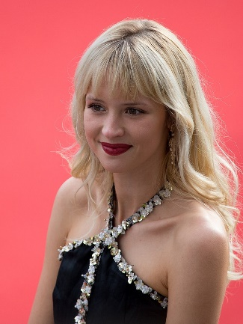
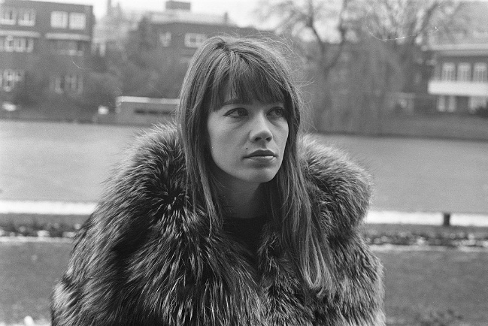
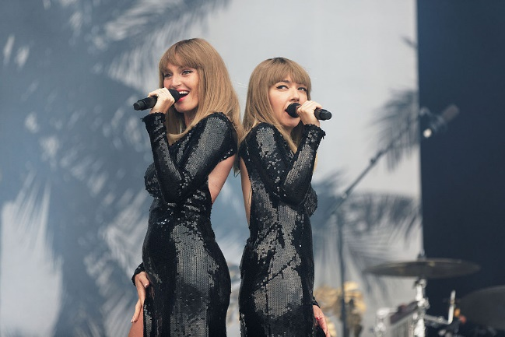
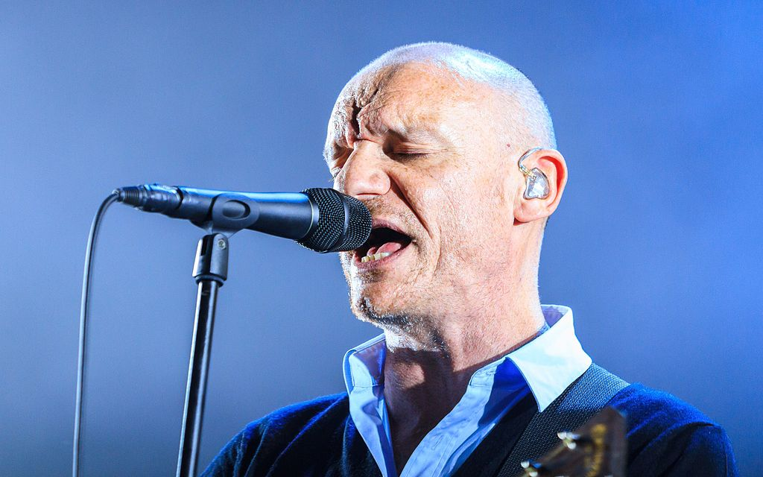
Mes artistes préférés
Mes artistes préférés
Partenaire A
parler
Prononce chaque nom en français. Fais attention à la SSC en orange.
Angèle
Françoise Hardy
Vanessa Paradis
Brigitte
Céline Dion
Louise Attaque
Notes:
Timing: 5 minutes
Aim: students revise a range of SSCs productively
Procedure:
Students work in pairs, taking it in turns to pronounce the names.
Offer corrections only to the pronunciation of the target SSC (in orange).
Click on a picture to hear pronunciation.
Word Frequency (1 is the most frequent word in French): prononcer [706] nom [171], orange [3912].
Source: Londsale, D., & Le Bras, Y. (2009). A Frequency Dictionary of French: Core vocabulary for learners London: Routledge.
Images:
Joan Hernandez Mir — https://www.flickr.com/photos/146461623@N05/47995094763, CC BY 2.0, https://commons.wikimedia.org/w/index.php?curid=79469317
Joost Evers / Anefo — http://proxy.handle.net/10648/ab86021e-d0b4-102d-bcf8-003048976d84, CC0, https://commons.wikimedia.org/w/index.php?curid=66998505
Georges Biard, CC BY-SA 3.0, https://commons.wikimedia.org/w/index.php?curid=49011495
Thesupermat — Travail personnel, CC BY-SA 4.0, https://commons.wikimedia.org/w/index.php?curid=45998589
Anirudh Koul — Flickr, CC BY 2.0, https://commons.wikimedia.org/w/index.php?curid=6709635
Clément Gruin (Wikimedia, CC-BY-SA 4.0), CC BY-SA 4.0, https://commons.wikimedia.org/w/index.php?curid=50987680

Slide 13
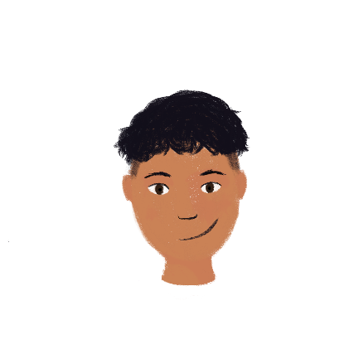
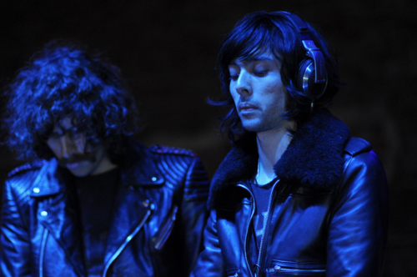
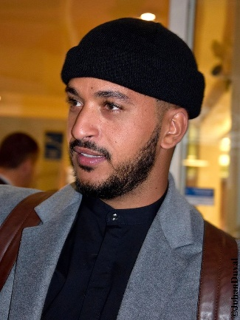
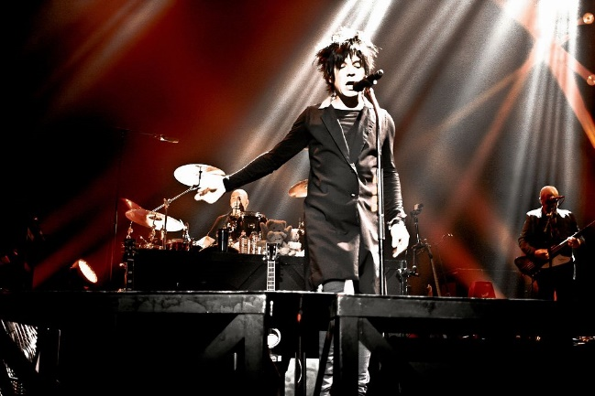
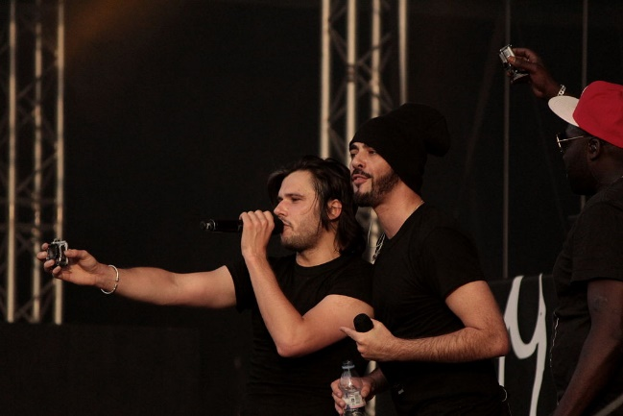
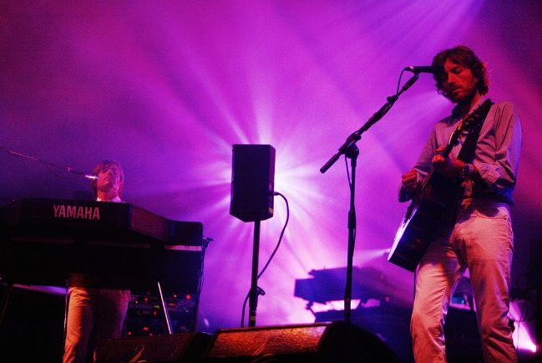
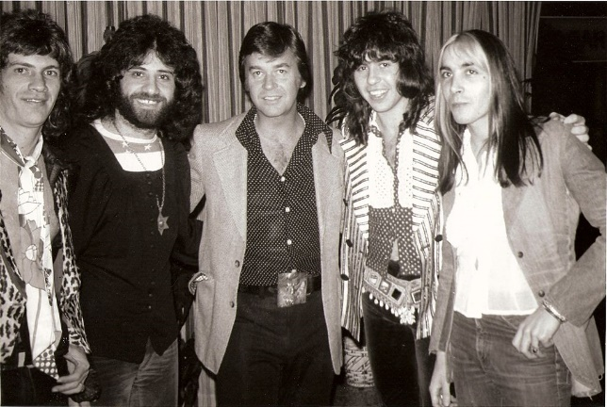
Mes artistes préférés
Mes artistes préférés
Partenaire B
parler
Prononce chaque nom en français. Fais attention à la SSC en orange.
Justice
Slimane
Indochine
Casseurs Flowters
Air
Les Variations
Notes:
Images:
Anime kitty45 — Travail personnel, CC BY-SA 3.0, https://commons.wikimedia.org/w/index.php?curid=17009631
Johan Duval — Travail personnel, CC BY-SA 4.0, https://commons.wikimedia.org/w/index.php?curid=51588890
Noesis-Kane - Image on Flickr, CC BY-SA 2.0, https://commons.wikimedia.org/w/index.php?curid=22699242
Amanda Hinault from Lannion, France — Casseurs Flowters, CC BY-SA 2.0, https://commons.wikimedia.org/w/index.php?curid=36745515
Rama — Travail personnel, CC BY-SA 2.0 fr, https://commons.wikimedia.org/w/index.php?curid=2347413
Yeagerprod — Travail personnel, CC BY-SA 3.0, https://commons.wikimedia.org/w/index.php?curid=15549065

Slide 14
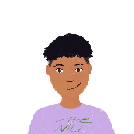
Il y a, a ou est ?
Il y a, a ou est ?
lire
Amir parle à Léa. Lis la conversation et écris il y a, a ou est.
Tu fais quoi aujourd’hui ?
Oui, je regarde le concert à la maison. Normalement, il y a des vidéos en ligne.
[4] _
En ce moment, il y a un concert dehors.
Je pense que Charlotte Gainsbourg a des parents français et anglais.
[1] _
[5] _
La chanteuse a un album en français et en anglais.
Le concert est excellent !
[2] _
[6] _
La chanteuse est Charlotte Gainsbourg ?
Oui, il y a une ambiance sympa.
[3] _
[7] _
Oui. Tu aimes Charlotte Gainsbourg aussi ?
La musique est cool !
[8] _
Notes:
Timing: 5 minutes
Aim: practise the distinction between il y a , a and est.
Procedure:
Students write 1-8 and choose the words to complete the sentence.
Answers are revealed on clicks.
English translations can also be elicited, to highlight the differences in verb use between the two languages.
Word frequency (1 is the most frequent word in French): concert [1697], album [2874], vidéo [2611], ligne [342], ambiance [4025], musique [1139], conversation [1747].

Slide 15
7.2.2.1
Slides 38-40, reading and listening involving French city names
Slide 59: listening with vais/va and cities in France

Slide 16
Qui va où ? (je/il)
lire
Léa writes where she is going and where Amir is going. C’est qui? Léa (je) ou Amir (il)?
 |  | je | il
 |  | je | il
1
vais à Paris.
5
va à Poitiers.
2
vais à Bordeaux.
6
va à Rouen.
3
va à Blois.
7
vais à Lyon.
4
vais à Deauville.
8
va à Calais.
Notes:
N.B. The use of ‘à’ meaning ‘to’ was introduced in 1.2.3.
Check students’ knowledge of the word.

Slide 17
Qui va où ? (je/elle)
écouter
Léa is now talking about where she is going and where her friend Sophie is going. C’est qui? Léa (je) ou Sophie (elle)?
 | je | elle
 | je | elle
1
5
2
6
3
7
4
8
Notes:
Audio (with pronoun obscured) plays on clicking individual numbers.
Answers revealed on clicks.
Transcript
[Elle] va à Trouville.
[Elle] va à Grenoble.
[Je] vais à Pau.
[Je] vais à Nancy.
[Je] vais à Strasbourg.
[Elle] va à Lille.
[Elle] va à Nantes.
[Je] vais à Dijon.

Slide 18
Qui va où ? (je/elle, réponses)
écouter
Léa is now talking about where she is going and where her friend Sophie is going. C’est qui? Léa (je) ou Sophie (elle)?
 |  | je | elle
 |  | je | elle
1
Elle va à Trouville.
5
Je vais à Strasbourg.
2
Elle va à Grenoble.
6
Elle va à Lille.
3
Je vais à Pau.
7
Elle va à Nantes.
4
Je vais à Nancy.
8
Je vais à Dijon.
Notes:
Audio (with pronoun included) plays on clicking individual numbers.
Answers revealed on clicks.
Transcript
[Elle] va à Trouville.
[Elle] va à Grenoble.
[Je] vais à Pau.
[Je] vais à Nancy.
[Je] vais à Strasbourg.
[Elle] va à Lille.
[Elle] va à Nantes.
[Je] vais à Dijon.

Slide 19
Qui va où ? (je/tu, réponses)
écouter
Je ou tu?
 |  | je | tu
 |  | je | tu
1
Tu vas à Paris.
5
Tu vas à Blois.
2
Je vais à Poitiers.
6
Tu vas à Lyon.
3
Je vais à Bordeaux.
7
Je vais à Deauville.
4
Je vais à Rouen.
8
Tu vas à Calais.
Notes:
Audio (with pronoun included) plays on clicking individual numbers.
Answers revealed on clicks.
Transcript
[Tu] vas à Paris.
[Je] vais à Poitiers.
[Je] vais à Bordeaux.
[Je] vais à Rouen.
[Tu] vas à Blois.
[Tu] vas à Lyon.
[Je] vais à Deauville.
[Tu] vas à Calais.

Slide 20
7.2.2.3
Slides 28-43: Series of activities exploiting the poem ‘Familiale’ by Jacques Prévert
Slides 61-67: More activities exploiting the poem

Slide 21
Fais des paires
Some of these words are new – try to work out the meaning!
lire
aller au cimetière
to do knitting
to do business
faire du tricot
faire des affaires
to go to war / make war
to go to the cemetery
faire la guerre
Notes:
Timing: 2 minutes
Aim: To introduce the key phrases in the poem.
NB: This slide contains two words which have not been pre-learned – cimetière [3583] and tricot [>5000] – these are not included the French SOW due to their low frequency. Encourage students to work in pairs, beginning with the familiar words and making an educated guess for the remaining two (cimetière is a near-cognate). It may be useful for them to write these key phrases in their books. Click the French phrase to ‘fly’ over the English.
The task instructions also contain the cognate paire [3926].

Slide 22
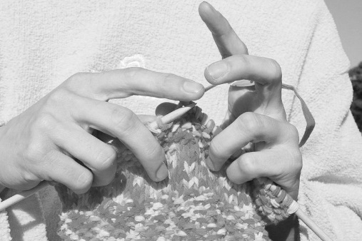
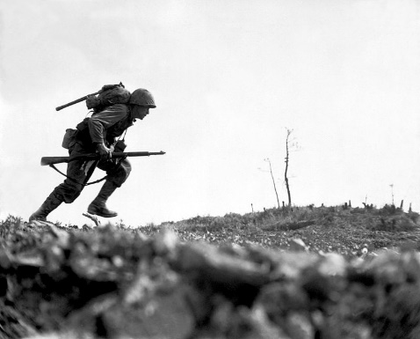
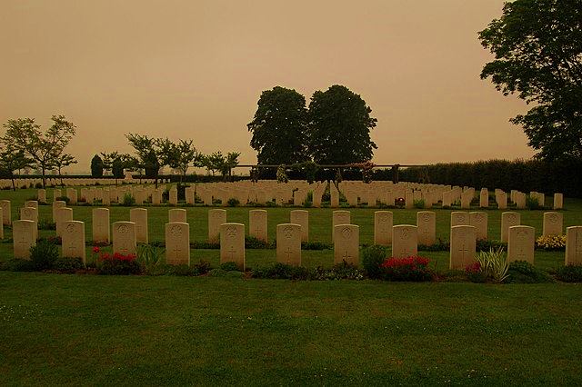
Choisis une image
écouter
a
b
1
c
2
a
3
d
4
b
c
d
Notes:
Timing: 2 minutes
Aim: Aural recognition of the key phrases in the poem.
Procedure:
1. Students write 1-4 and choose a-d for each.
2. Click the numbers to play the audio.
3. Answers are revealed on clicks.
Transcript:
Il fait des affaires
Elle fait du tricot
Ils vont au cimetière
Il fait la guerre
Word frequency of cognates used (1 is the most frequent word in French): choisir [226], image [659]
Source: Londsale, D., & Le Bras, Y. (2009). A Frequency Dictionary of French: Core vocabulary for learners London: Routledge.
Optional extension (depending on the class): 1. After checking answers by letter, the teacher could play the phrases again to elicit the full meaning of each phrase – (i.e. aural translation) 2. Further, students could be invited to recall any of the four phrases, orally.
Attribution:
Image a: Pink knitting in front of pink sweatshirt by Johntex under the Creative Commons Attribution-Share Alike 3.0 Unported license
Image b: Marine dashes through Japanese machine gun fire by Pvt. Bob Bailey is in the public domain
Image c: Business to Business Agreement by Onyxxo is licensed under the Creative Commons Attribution-Share Alike 4.0 International license
Image d: Headstones in Banville-la-Campagne war cemetery, Normandy by Londonclanger is licensed under the Creative Commons Attribution-Share Alike 4.0 International license

Slide 23
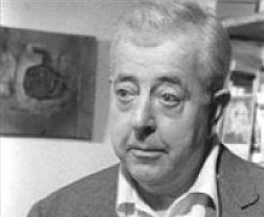
Des dates importantes
lire
Choisis la description correcte pour les dates.
1900 - 1977
Jacques Prévert écrit « Familiale » :
le poème
Jacques Prévert
1939 - 1945
b) Jacques Prévert – vie:
le poète
1946
c) la Seconde Guerre mondiale :
une période importante pour le poète
Notes:
Timing: 3 minutes
Aim: To present some key dates to provide background to the poem and the poet.
Procedure:
1. Students write the dates and choose a), b) or c). Answers are provided on the next slide.
NB: Not all vocabulary has been previously taught in the SOW, but much of it can be inferred by combining context with prior language knowledge.
Word frequency of cognates used (1 is the most frequent word in French): date [660], important [215], choisir [226], description [2779], correct [2617], second [379], mondial [549], période [407].
Source: Londsale, D., & Le Bras, Y. (2009). A Frequency Dictionary of French: Core vocabulary for learners London: Routledge.
Attribution – photo: Jacques Prévert by PRÉVERT Catherine is licensed under the Creative Commons Attribution-Share Alike 1.0 Generic license

Slide 24
Des dates importantes
lire
Réponses :
1900 - 1977
b) Jacques Prévert – vie :
le poète
Jacques Prévert
1939 - 1945
c) la Seconde Guerre mondiale :
une période importante pour le poète
1946
a) Jacques Prévert écrit « Familiale » :
le poème
Notes:
Answers slide.
Students could also be asked to describe Prévert based on what they have learnt about him and the vocabulary from the poem. (Comment est-il ? Est-il… heureux, triste, calme, amusant, intelligent… ?)

Slide 25
Des idées importantes
lire
Lis les idées. Tu penses que le poète est pour ou contre ?
Écris deux listes avec un(e) partenaire.
pour | contre
la liberté
la justice
l’autorité
la guerre
l’égalité
le nationalisme
Notes:
Timing: 3 minutes
Aim: To introduce students to some of the wider themes in Prévert’s work by exploring the poet’s values and concerns.
Procedure:
1. Students work in pairs to discuss the meaning of each word and decide if they think the poet agrees or disagrees with these values, based on what they have learnt about him and the vocabulary from the poem.
2. Answers fly to the correct column on clicks.
Word frequency of near-cognates used (1 is the most frequent word in French): liberté [320], autorité [783], égalité [1898], justice [637], nationalisme [>5000].
Source: Londsale, D., & Le Bras, Y. (2009). A Frequency Dictionary of French: Core vocabulary for learners London: Routledge.

Slide 26
Familiale
lire / parler
Lis le vocabulaire et parle avec un(e) partenaire.
Le sujet de « Familiale » est…
la famille ?
l’histoire ?
le travail ?
la violence ?
aller au cimetière
naturel
la mère
tuer
faire du tricot
faire des affaires
le fils
le père
faire la guerre
la vie
Notes:
Timing: 3 minutes
Aim: A final pre-text activity to review key vocabulary and try to predict the subject of the poem.
Procedure:
1. Bring up the questions and options.
2. Give students just a few seconds to confer in pairs and share their views. There is no right or wrong answer – the purpose is to raise their interest by anticipating what the poem might be about. Some may be able to use the information about the poet on the previous slide to give an answer. NB: students have not yet encountered the nominal for travail, but should be able to infer the meaning form the verb travailler.
Word frequency of unknown words used (1 is the most frequent word in French): travail [153], violence [602].
Source: Londsale, D., & Le Bras, Y. (2009). A Frequency Dictionary of French: Core vocabulary for learners London: Routledge.

Slide 27
Écoute le poème
écouter
https://www.youtube.com/watch?v=cV19CfuswyM&t=51s
Notes:
Timing: 3 minutes
Aim: The present the text without a transcript to focus students on the mood of the poem initially. The link in the slide has been suggested in order to convey the meaning of the poem ie the futility of war and the indifference/coldness of the mother and father, whose lives (knitting and business) just continue while the son loses his life in the war.
If you find the delivery too fast for students, alternatives are as follows:
https://www.youtube.com/watch?v=mvn6kBjWyf0
https://www.youtube.com/watch?v=MGytqDEXoGQ
Note that this last one is read by students (German L1) but conveys the poem’s meaning well.

Slide 28
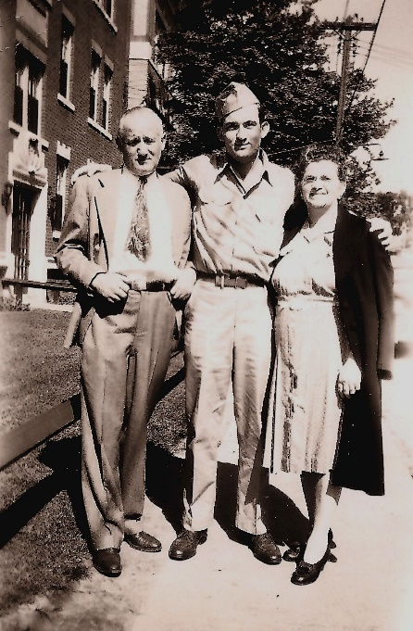
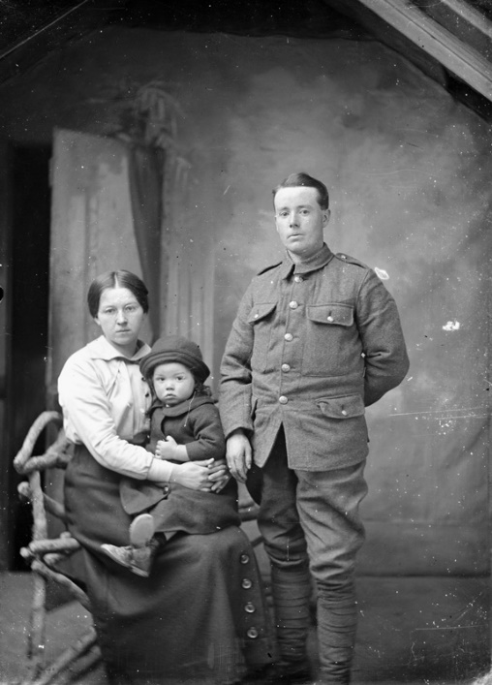
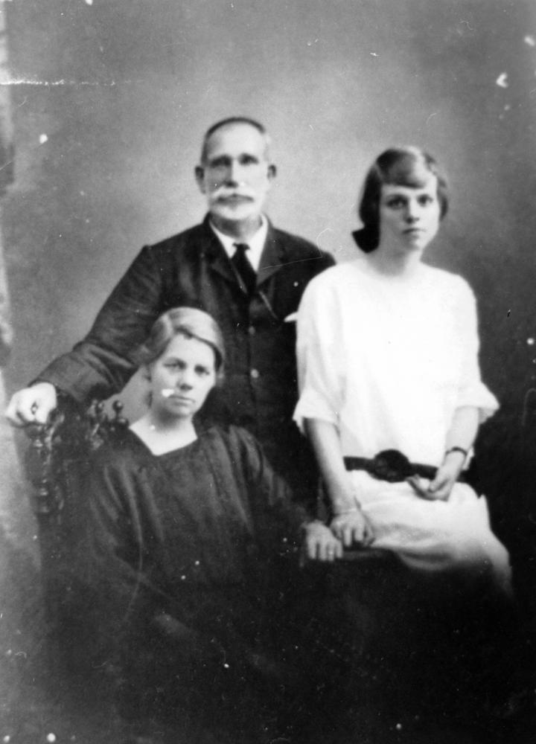
La famille
écouter
Choisis une image pour représenter la famille. Il y a qui ?
a)
b)
c)
Notes:
Timing: 2 minutes
Aim: This slide checks students’ initial global understanding by identifying the main characters in the poem.
Procedure:
1. Students say which photo they have chosen and why, re-using the vocab for family members in the poem.
2. The answer is revealed on a click.
Word frequency of cognates used (1 is the most frequent word in French): choisir [226], image [659], représenter [293].
Source: Londsale, D., & Le Bras, Y. (2009). A Frequency Dictionary of French: Core vocabulary for learners London: Routledge.
Attribution:
Image a: "Herbert Swadosh with his parents Ralph and Jennie, Hartford, CT, 1946" by Jswad is licensed under CC BY-NC-ND 2.0
Image b: Family portrait by Auckland Museum is licensed under CC BY 4.0
Image c: Robert Peut with his family, ca. 1935 by John Oxley Library, State Library of Queensland is in the public domain

Slide 29
La famille
écouter
Écoute le poème :
https://www.youtube.com/watch?v=cV19CfuswyM&t=51s
1
b)
2
a)
Choisis une image pour représenter…
(a) le fils
(b) la mère
(c) le père
(d) les deux parents
3
c)
4
d)
Notes:
Timing: 5 minutes
Aim: Focus on the role of each character in the poem.
Procedure:
1. Click the link to hear the poem.
2. Students may need to listen twice to answer the questions. Answers appear on clicks.
Answers:
2 – il fait la guerre
1 – elle fait du tricot
3 – il fait des affaires
4 – ils vont au cimetière
Word frequency of cognates used (1 is the most frequent word in French): choisir [226], image [659] and représenter [293].
Source: Londsale, D., & Le Bras, Y. (2009). A Frequency Dictionary of French: Core vocabulary for learners London: Routledge.
Attribution:
Image a: Pink knitting in front of pink sweatshirt by Johntex under the Creative Commons Attribution-Share Alike 3.0 Unported license
Image b: Marine dashes through Japanese machine gun fire by Pvt. Bob Bailey is in the public domain
Image c: Business to Business Agreement by Onyxxo is licensed under the Creative Commons Attribution-Share Alike 4.0 International license
Image d: Headstones in Banville-la-Campagne war cemetery, Normandy by Londonclanger is licensed under the Creative Commons Attribution-Share Alike 4.0 International license

Slide 30
Complète le poème
lire
[Line 15] [Line 16] [5]… [Line 17] [Line 18] [Line 19] [Line 20] [Line 21] [6]… [Line 22] [Line 23] [Line 24] [Line 25] [7]… [Line 26] [Line 27] [8]…
[Line 1] [1]… [Line 2] [Line 3] [2]… [Line 4] [Line 5] [3]… [Line 6] [Line 7] [Line 8] [Line 9] [Line 10] [Line 11] [4]… [Line 12] [Line 13] [Line 14]
cimitière affaires guerre
mère père fait fils vie
Notes:
Please note: teachers to insert the full text of the poem, replacing the missing words with the orange numbers in the lines indicated. See slide 24 for answers. Line breaks are indicated in the English translation on slides 27-28.
Timing: 6 minutes
Aim: Written recognition of key words in the poem.
Procedure:
1. Students complete the gap-fill with or without the gapped words showing (click to show the box of words).
2. Answers provided on the next slide.
Word frequency of cognates used (1 is the most frequent word in French): compléter [2034]
Source: Londsale, D., & Le Bras, Y. (2009). A Frequency Dictionary of French: Core vocabulary for learners London: Routledge.

Slide 31
Familiale
Réponses :
lire
[Line 1] fait [Line 2] [Line 3] mère [Line 4] [Line 5] affaires [Line 6] [Line 7] [Line 8] [Line 9] [Line 10] [Line 11] fils [Line 12] [Line 13] [Line 14]
[Line 15] [Line 16] père [Line 17] [Line 18] [Line 19] [Line 20] [Line 21] cimetière [Line 22] [Line 23] [Line 24] [Line 25] guerre [Line 26] [Line 27] vie
Notes:
Please note: teachers to insert the full text of the poem, with the missing words in orange.
Answers

Slide 32
lire
Français | Anglais
[Line 1] | The mother ___
[Line 2] | The ___ is fighting in the war
[Line 3] | The mother, she __this perfectly natural
[Line 4] | And the father, what is the father doing
[Line 5] | He is doing ______
[Line 6] | ___ wife is knitting
[Line 7] | ___ son is fighting in the war
[Line 8] | He is doing _____
[Line 9] | The father, he finds this perfectly natural
[Line 10] | And the ___, the ___?
[Line 11] | What does the son ____?
[Line 12] | The son, he thinks absolutely nothing
[Line 13] | The son his _____ knits
[Line 14] | His _____ does business he fights in the war
lire
Notes:
Please note: teachers to insert the full text of the poem, line by line, according to the English translation.
Timing: 8 minutes
Aim: Whole-class activity to elicit meaning and clarify any remaining unknown vocabulary, arriving at a working English translation by completing the gaps.
Pay particular attention to where the translation moves away from the literal (fait la guerre; trouve/think) and ask students why the translator might have done that. Draw out also the meaning of ‘son/sa’ and clarify the two forms seen here. Students have met ‘mon, ma, mes’ / ‘ton, ta, tes’ and should be encouraged to make the link and explain their understanding.

Slide 33
lire
Français | Anglais
[Line 15] | When the war is over
[Line 16] | He will do business ___ his father
[Line 17] | The ___ carries on
[Line 18] | The mother carries on knitting
[Line 19] | The father carries on doing business
[Line 20] | The son is killed he doesn’t _______
[Line 21] | The father and the mother go to the _____
[Line 22] | The father and the mother ____ it natural
[Line 23] | ____ carries on
[Line 24] | ____ with its knitting its war its business
[Line 25] | Business war knitting war
[Line 26] | Business business business
[Line 27] | Life with the _____
lire
lire
Notes:
Please note: teachers to insert the full text of the poem, line by line, according to the English translation.
Elicit meanings and clarify any unknown vocabulary that has not yet been understood, i.e. arrive at a working English translation orally with the whole class by completing the gaps.
Pay particular attention to where the translation moves away from the literal (fait la guerre; trouve/think; goes on knitting, doing business) and ask students why the translator might have done that. Draw out also the meaning of ‘son/sa’ and clarify the two forms seen here. Students have met ‘mon, ma, mes’ / ‘ton, ta, tes’ and should be encouraged to make the link and explain their understanding.

Slide 34
lire
Français | Anglais
[Line 1] | The mother _____
[Line 2] | The ___ is fighting in the war
[Line 3] | The mother, she _____this perfectly natural
[Line 4] | And the father, what is the father doing
[Line 5] | He is doing ________
[Line 6] | ___ wife is knitting
[Line 7] | ___ son is fighting in the war
[Line 8] | He is doing ________
[Line 9] | The father, he finds this perfectly natural
[Line 10] | And the ___, the ___?
[Line 11] | What does the son _____?
[Line 12] | The son, he thinks absolutely nothing
[Line 13] | The son his _______ is knitting
[Line 14] | His ______ is doing business he is fighting in the war
lire
is knitting
son
finds
business
His
His
business
son
son
think
mother
father
Notes:
Please note: teachers to insert the full text of the poem, line by line, according to the English translation.
ANSWER SLIDE

Slide 35
lire
Français_ | Anglais
[Line 15] | When the war is over
[Line 16] | He will do business ____ his father
[Line 17] | The ___ carries on
[Line 18] | The mother carries on knitting
[Line 19] | The father carries on doing business
[Line 20] | The son is killed he doesn’t ________
[Line 21] | The father and the mother go to the _________
[Line 22] | The father and the mother ____ it natural
[Line 23] | ___ carries on
[Line 24] | ___ with its knitting its war its business
[Line 25] | Business war knitting war
[Line 26] | Business business business
[Line 27] | Life with the _________
lire
lire
with
war
carry on
cemetery
find
Life
Life
cemetery
Notes:
Please note: teachers to insert the full text of the poem, line by line, according to the English translation.
ANSWER SLIDE

Slide 36
Réactions
lire
Le poème, c’est comment ?
C’est….
heureux triste tragique
pessimiste optimiste
sarcastique monotone bizarre
Notes:
Timing: 2 minutes
Aim: The next provides further opportunities for students to express their views on the poem but it is appropriate to end this lesson with a short paired/group discussion of students’ initial reactions to it. The slide suggests vocabulary but students may of course offer more/different adjectives/opinions.
Word frequency of cognates used (1 is the most frequent word in French): tragique [2042], pessimiste [4971], optimiste [2751], sarcastique [>5000], monotone [>5000], bizarre [2756], réaction [947].
Source: Londsale, D., & Le Bras, Y. (2009). A Frequency Dictionary of French: Core vocabulary for learners London: Routledge.

Slide 37
Prononce les mots
parler
60
mère | affaires | tricot | continue | tout
fait | trouve | absolument | naturel | fils
guerre | vie | cimetière | trouvent | père
secondes
0
Commencer
Notes:
Timing: 2 minutes
Aim: Oral production of key vocabulary from the poem.
Procedure:
1. Click ‘commencer’ to start the timer.
2. Students say the words aloud in pairs.
3. Teacher can circulate to listen out for pronunciation.

Slide 38
Familiale : la répétition
parler
mère | affaires | tricot | continue | tout
guerre | vie | cimetière | trouvent | père
[Line 22] [Line 23]
[Line 24] [Line 25] [Line 26] [Line 27]
La répétition, ça évoque … ?
la monotonie
la routine
l’indifférence
Notes:
Please note: teachers to insert lines 22-27 of the poem in the text box.
Timing: 2 minutes
Aim: To convey the monotony implied by the repetition in the poem. The poet uses this technique to suggest that society has become indifferent to war, which has become routine.
Procedure:
1. Read aloud the words in orange to the students and the last few lines of the poem.
2. Students will need to discuss the effect of the repetition in English, but provide them with the French (in text box) to express the key features.
Word frequency of cognates used (1 is the most frequent word in French): évoquer [1143], monotonie [>5000], routine [4120], indifférence [4176], répétition [2804]
Source: Londsale, D., & Le Bras, Y. (2009). A Frequency Dictionary of French: Core vocabulary for learners London: Routledge.

Slide 39
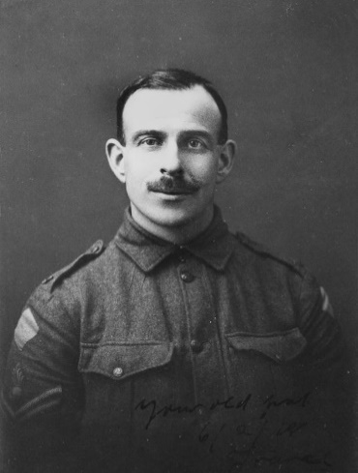
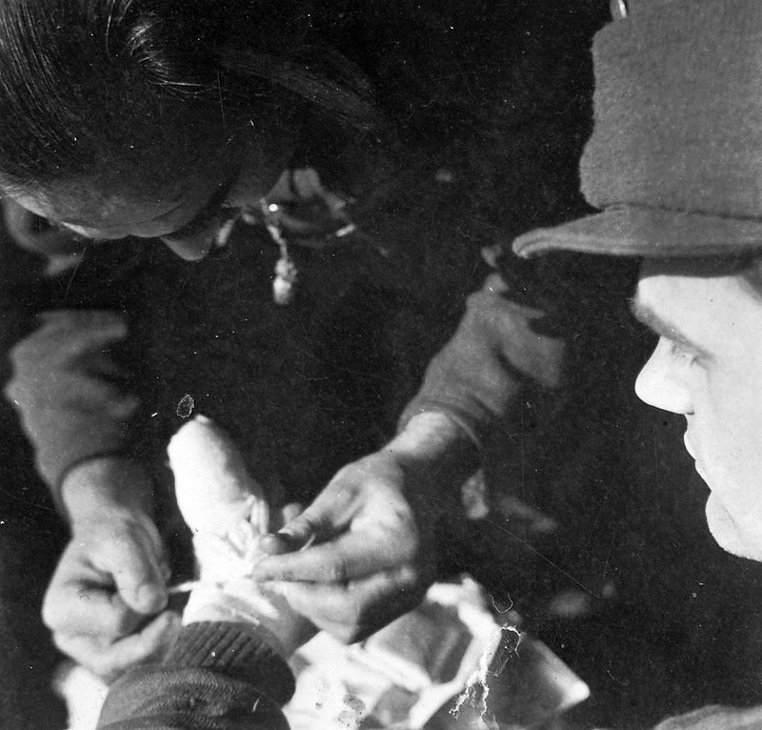
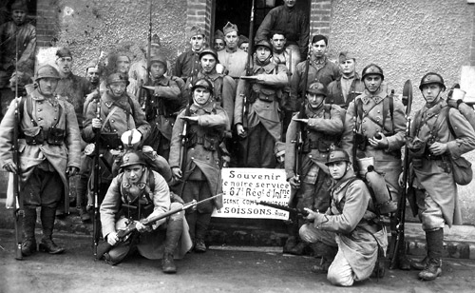
Familiale: le message
parler
Lis le poème. C’est quoi le message ?
Les hommes qui font la guerre…
(A) sont des héros
(B) sont des victimes
(C) sont courageux
La guerre…
(A) est nécessaire
(B) est une tragédie humaine
(C) est une chose naturelle
La société…
(A) accepte la guerre – c’est normale
(B) résiste la guerre
(C) est cruelle
Notes:
Timing: 5 minutes
Aim: Close reading of the poem to decipher its central message.
Procedure:
1. Students silently re-read the poem, silently, and decide what its central message is. There are no strictly right or wrong answers to the questions (and worth emphasising that these are the views of the poet), but the most likely ones are:
Les hommes qui font la guerre (B) sont des victimes
La guerre (B) est une tragédie humaine
La société (A) accepte la guerre – c’est normale
Word frequency of cognates used (1 is the most frequent word in French): message [792], héros [1883], victime [697], courageux [2198], nécessaire [451], tragédie [1910], humain [286], société [295], accepter [210], normal [833], résister [1611], cruel [3357]
Source: Londsale, D., & Le Bras, Y. (2009). A Frequency Dictionary of French: Core vocabulary for learners London: Routledge.
Attribution:
Soldier portrait by State Library of Queensland is licensed under Flickr API
Hungarian soldiers by FOTO:FORTEPAN / Saly Noémi is licensed under CC BY-SA 3.0
French soldiers from the 67th Infantry Regiment by Lafayette53 is licensed under CC BY-SA 4.0

Slide 40
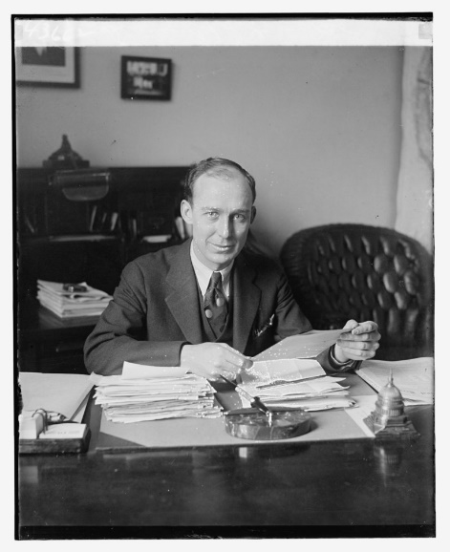
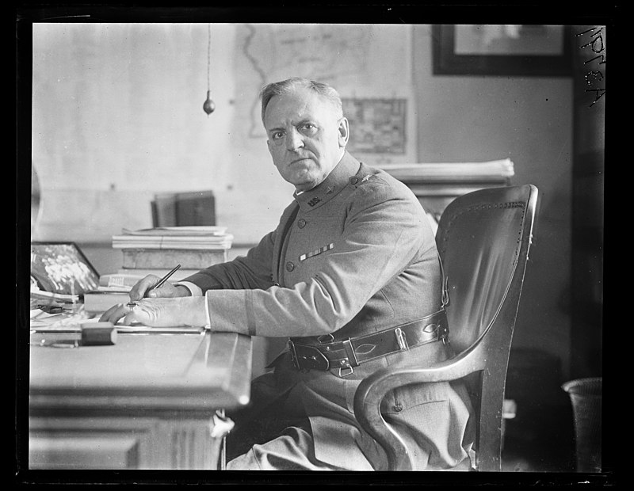
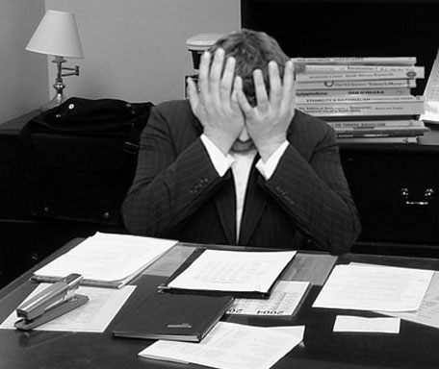
Le père et la mère
parler
Choisis une image pour représenter le père. Il est comment ?
a)
b)
c)
Le père est…
triste sympa indifférent strict affectueux heureux autoritaire
Et la mère ? Elle est comment ?
Notes:
Timing: 2 minutes
Aim: To express opinions in French based on interpretation of the text.
Procedure:
1. Students choose an image to represent the father and justify their choice.
2. Students describe the mother.
3. No right or wrong answer for either.
Word frequency of cognates used (1 is the most frequent word in French): image [659], représenter [293], indifférent [4151], affectueux [>5000], autoritaire [4661].
Source: Londsale, D., & Le Bras, Y. (2009). A Frequency Dictionary of French: Core vocabulary for learners London: Routledge.
Attribution:
Unidentified man by National Photo Company Collection is in the public domain
Frustrated man at a desk by LaurMG. is licensed under CC BY-SA 3.0
Military man at desk by Library of Congress, Prints & Photographs Division, photograph by Harris & Ewing, LCCN2016891032

Slide 41
Les versions différentes
écouter / parler
Écoute les trois versions différentes. Parle avec un(e) partenaire.
Version 1
Version 1, c’est…
Version 2, c’est…
Version 3, c’est…
amusant
triste
bizarre
rapide
monotone
intéressant
pessimiste
drôle
calme
moderne
J’aime version…
1
2
3
Version 2
Version 3
Notes:
Timing: 10 minutes
Aim: To express reactions/opinions of different versions heard in the links.
Procedure:
1. Play the video. There are three versions to listen to/choose from a) A man reads the poem, with dramatic images to represent the story/themes of the poem. This is the version students already heard from slide 6 Version 1: https://www.youtube.com/watch?v=cV19CfuswyM&t=51s b) An older-sounding man reads a version, without images. It is more light-hearted but perhaps does not convey so well the darker side of the poem. Version 2: https://www.youtube.com/watch?v=mvn6kBjWyf0 c) German students read this version, with music/images, and with efforts to convey the meaning of poem – monotony, banality of war, coldness of the parents. Version 3: https://www.youtube.com/watch?v=MGytqDEXoGQ
2. Give students time to discuss in pairs. The adjectives given are just suggestions based on cognates, words met/already known.
3. You might also draw attention to how in some versions the tone of the poem changes – it becomes more monotonous as it goes on, culminating in the last verse.
Word frequency of cognates used (1 is the most frequent word in French): bizarre [2756], monotone [>5000], pessimiste [4971]
Source: Londsale, D., & Le Bras, Y. (2009). A Frequency Dictionary of French: Core vocabulary for learners London: Routledge.

Slide 42
À ton tour !
parler
Lis le poème à haute voix. Fais attention à la répétition - exprime la monotonie, la routine et l’indifférence !
ou
Choisis une ou deux lignes que tu trouves importantes. Fais une présentation mémorisée et creative, avec un(e) partenaire ou en groupe.
Notes:
Timing: 10 minutes
Aim: Class read-aloud of the poem.
Procedure: Offer a choice of activities if possible:
1. Give students the opportunity to read the poem aloud (à haute voix will need to be explained in the instructions), either a line each at a time, or a verse each at a time. Encourage them to read expressively, thinking about the meaning and trying to convey the sense of monotony.
2. Ask them to choose the section of the poem that they think is most important and to memorise it so that they can perform it.
Word frequency of cognates used (1 is the most frequent word in French): haut [264], voix [414], répétition [2804], exprimer [466], monotonie [>5000], routine [4120], indifférence [4176], choisir [226], ligne [342], présentation [1723], mémorisé [>5000], créatif [>5000], groupe [187]
Source: Londsale, D., & Le Bras, Y. (2009). A Frequency Dictionary of French: Core vocabulary for learners London: Routledge.

Slide 43
En conclusion…
parler
Quand je lis le texte, je suis…
heureux/heureuse motivé(e) calme intéressé(e) amusé(e) … | indifférent(e) … | triste impatient(e) …
Notes:
Timing: 1 minute
Aim: Closing task allowing students to express their views on the poem.

Slide 44
7.2.2.4
Slide 29: reading exercise with French cities with aller in present tense
Slide 95; listening exercise with French cities with aller in present tense

Slide 45
Qui va où ? (je/nous)
lire
Léa écrit à Amir. Qui va où? Léa (je) ou Léa et Amir (nous) ?
 |  | je | nous
1
2
3
4
 |  | je | nous
5
6
7
8
allons à Paris.
allons à Poitiers.
vais à Bordeaux.
vais à Rouen.
vais à Blois.
allons à Lyon.
allons à Deauville.
allons à Calais.
Notes:
In this reading task, students use the form of the verb aller in each sentence to work out the subject pronoun in each case – je or nous - ticking the appropriate column. The answers are animated upon successive mouse clicks.

Slide 46
Qui va où ? (il/elle versus ils/elles)
écouter
Écoute les phrases. C’est qui ? Il/elle ou ils/elles ?
 |  | il/ elle | ils/ elles
 |  | il/ elle | ils/ elles
1
vont à Paris.
5
vont à Poitiers.
2
vont à Bordeaux.
6
va à Rouen.
3
va à Blois.
7
va à Lyon.
4
va à Deauville.
8
vont à Calais.
Notes:
In this listening task, students use the form of the verb aller heard in each sentence to work out the person of the verb in each case – il/elle or ils/elles - ticking the appropriate column. The answers, together with the words spoken on the recordings, are animated upon successive mouse clicks.
Transcript
1) [Ils/Elles] vont à Paris.
2) [Ils/Elles] vont à Bordeaux.
3) [Il/Elle] va à Blois.
4) [Il/Elle] va à Deauville.
5) [Ils/Elles] vont à Poitiers.
6) [Il/Elle] va à Rouen.
7) [Il/Elle] va à Lyon.
8) [Ils/Elles] vont à Calais.

Slide 47
7.2.2.5
Slides 8-15: phonics with French towns and cities, practising the SSCs [on], [eau], [au] and [o]
Slide 42: reading exercise with aller à/en with French-speaking places
Slide 47: Information about Algeria as a Francophone country
Slides 53-64: various exercises about famous French-speakers, including bibliographical details

Slide 48
Le poète en difficulté
Le poète en difficulté
écouter
Le poète fait des erreurs avec les SSC [on] et [au / eau / o].
Écoute le poème. La rime est bonne ou mauvaise ?
Je mange à Dijon
1
Menton
Tu manges à _______
La rime est bonne
La rime est mauvaise
Notes:
Timing: 5 minutes for 8 slides
Aim: oral recognition of this week’s SSC [on] in contrast to the similar-sounding SSC [au / eau / o]
Procedure:
First, check students’ understanding of the L2 instructions. Draw attention to the near-cognates “difficulté” and “erreurs”, which have not been previously encountered. “Poète” / “poème” and “rime” have been introduced previously, but may need some refreshing. The feminine “bonne” and “mauvaise” have not been encountered in this form, so encourage students to decode from the previously learnt “bon” and “mauvais”.
Students write 1-8 in their workbooks.
Click the number button to play the audio – the number of times may vary depending on the needs and level of the class.
Students draw a smiley face if the two lines rhyme (if the second line ends with [o]), or a sad face if they do not (if the second line ends with [au / eau / o] – no need to transcribe the missing word. Place names are used to limit reliance on vocabulary knowledge – the focus is simply on recognising the SSC.
The slides are animated so that the smiley or sad face is highlighted first, then the missing word appears on the next click. Pronunciation can be practised at this stage.
Transcript:
Je mange à Dijon. Tu manges à Menton.
Frequency information for non-SOW (near-)cognates:
difficulté [564], erreur [612], poème [3031], poète [2307], rime [>5000]
Source: Londsale, D., & Le Bras, Y. (2009). A Frequency Dictionary of French: Core vocabulary for learners London: Routledge.

Slide 49
Le poète en difficulté
Le poète en difficulté
écouter
Le poète fait des erreurs avec les SSC [on] et [au / eau / o].
Écoute le poème. La rime est bonne ou mauvaise ?
Je joue à Toulon
2
Bordeaux
Tu joues à _________
La rime est bonne
La rime est mauvaise
Notes:
Transcript:
2. Je joue à Toulon. Tu joues à Bordeaux.

Slide 50
Le poète en difficulté
Le poète en difficulté
écouter
Le poète fait des erreurs avec les SSC [on] et [au / eau / o].
Écoute le poème. La rime est bonne ou mauvaise ?
Je gagne à Soissons
3
Chaumont
Tu gagnes à __________
La rime est bonne
La rime est mauvaise
Notes:
Transcript:
3. Je parle à Soissons. Tu parles à Chaumont.

Slide 51
Le poète en difficulté
Le poète en difficulté
écouter
Le poète fait des erreurs avec les SSC [on] et [au / eau / o].
Écoute le poème. La rime est bonne ou mauvaise ?
Je marche à Mâcon
4
Tu marches à ______
Larrau
La rime est bonne
La rime est mauvaise
Notes:
Transcript:
4. Je marche à Mâcon. Tu marches à Larrau.

Slide 52
Le poète en difficulté
Le poète en difficulté
écouter
Le poète fait des erreurs avec les SSC [on] et [au / eau / o].
Écoute le poème. La rime est bonne ou mauvaise ?
Je reste à Montluçon
5
Tu restes à _________
Monaco
La rime est bonne
La rime est mauvaise
Notes:
Transcript:
5. Je reste à Montluçon. Tu restes à Monaco.

Slide 53
Le poète en difficulté
Le poète en difficulté
écouter
Le poète fait des erreurs avec les SSC [on] et [au / eau / o].
Écoute le poème. La rime est bonne ou mauvaise ?
Je chante à Avignon
6
Tu chantes à ________
Avallon
La rime est bonne
La rime est mauvaise
Notes:
Transcript:
6. Je chante à Avignon. Tu chantes à Avallon.

Slide 54
Le poète en difficulté
Le poète en difficulté
écouter
Le poète fait des erreurs avec les SSC [on] et [au / eau / o].
Écoute le poème. La rime est bonne ou mauvaise ?
Je pense à Briançon
7
Tu penses à __________
Besançon
La rime est bonne
La rime est mauvaise
Notes:
Transcript:
7. Je pense à Briançon. Tu penses à Besançon.

Slide 55
Le poète en difficulté
Le poète en difficulté
écouter
Le poète fait des erreurs avec les SSC [on] et [au / eau / o].
Écoute le poème. La rime est bonne ou mauvaise ?
Je travaille à Quiberon
8
Tu travailles à _____________
Concarneau
La rime est bonne
La rime est mauvaise
Notes:
Transcript:
8. Je travaille à Quiberon. Tu travailles à Concarneau.

Slide 56
Saying ‘to’ and ‘in’ in French
Remember!
The translation is different for verbs of movement and location.
lire
Saying ‘to’ and ‘in’
Lis les phrases. Coche la réponse correcte.
 |  | ‘in’ | ‘to’
1. | Je vais à Lausanne.
2. | Tu habites à Lille.
3. | Il arrive à Dakar.
4. | Elle va à Londres.
 |  | ‘in’ | ‘to’
5. | J’arrive en Angleterre.
6. | Tu vas en Écosse.
7. | Il va en Guadeloupe.
8. | Elle habite en Tunisie.
Notes:
Timing: 4 minutes
Aim: practise the different translation of the two prepositions with verbs of movement and location
Procedure:
Students tick whether they think à means ‘to’ or ‘in’
Answers revealed on clicks
Attention should be drawn to the fact that the same preposition can be translated differently depending on the context.

Slide 57
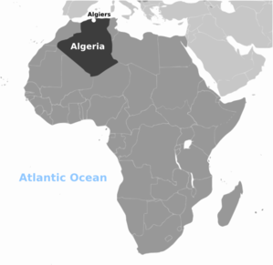
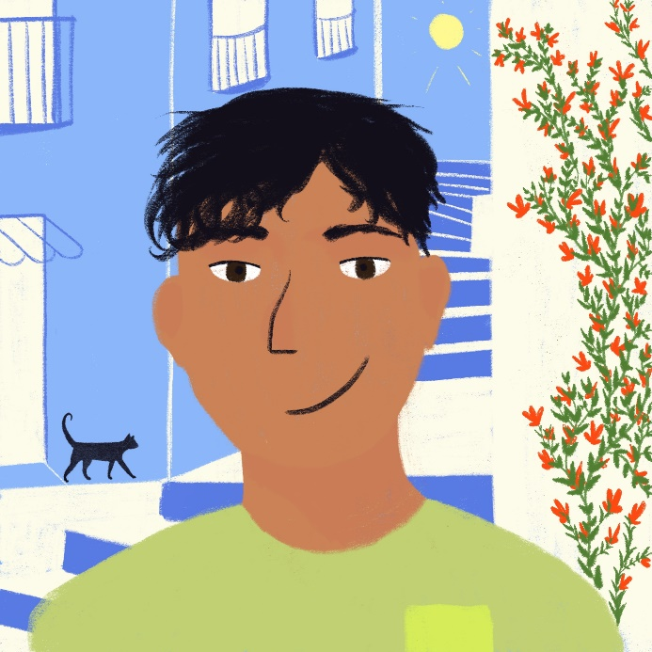
Abdel au téléphone
Abdel au téléphone
écouter / écrire / parler
France is not the only country where French is spoken! It is an official language in many countries, including Algeria.
Amir parle à un cousin, Abdel, en Algérie,
Écoute la conversation et fais des notes.
Notes:
Timing: 10 minutes
Aim: Dictagloss – Reconstruct a text from notes
Procedure:
Students write 1-10 in their notebooks with plenty of space for each point.
Students listen to the interview and take notes about each question and answer.
Play the interview again if necessary. How many times depends on the class and ability level and is up to the teacher’s judgment.
Based on the notes students reconstruct the dialogue (could be done in pairs).
In pairs students perform the dialogue, as read aloud from their own script.
Word frequency (1 is the most frequent word in French): conversation [1747], cousin [3387], note [1161], téléphone [1366]
Source: Londsale, D., & Le Bras, Y. (2009). A Frequency Dictionary of French: Core vocabulary for learners London: Routledge.

Slide 58
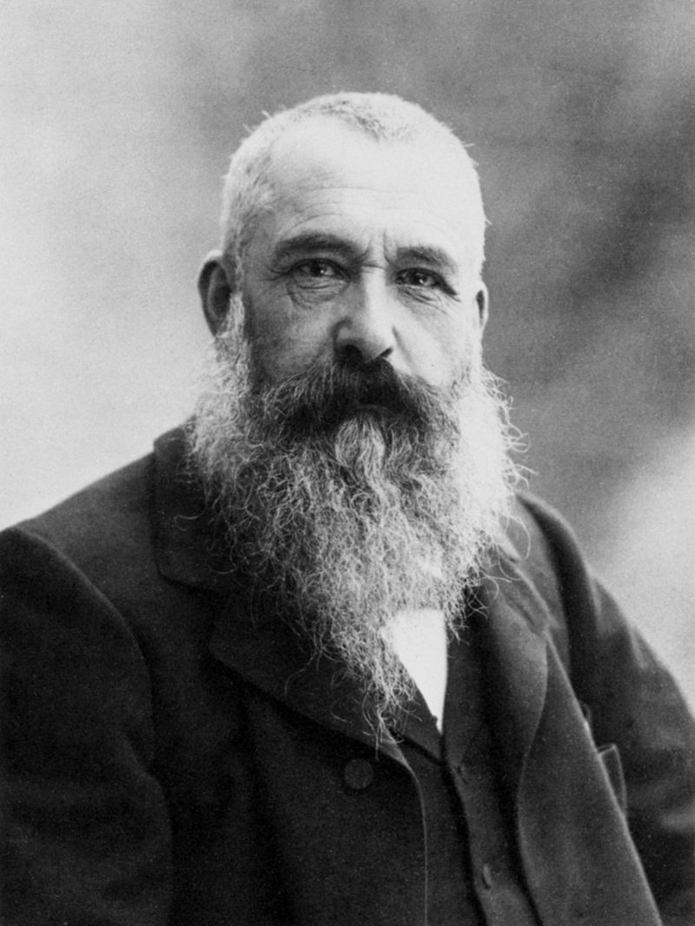
Je suis qui ? Exemple
Je suis qui ? Exemple
écouter / écrire / parler
Je suis qui ? Exemple
les temps
= time
Je suis Claude Monet et je suis un artiste français. J’aime la nature – souvent, je travaille dehors. À Paris, je crée le style « impressionniste » avec des amis. Aujourd’hui, j’habite à Giverny, et j’ai des problèmes de vision. Je passe le temps* avec la famille : j’ai une femme et deux enfants.
Claude Monet
Notes:
Timing: 10 minutes per biography
Aim: practise weak verbs in the present
Procedure:
Part 1: Je suis qui? - running dictation
Print the eight bios and put them around the classroom.
Introduce the example – go through it together for meaning and style and to explain part one of the task.
Students work in pairs (or small group depending on the number of students). Give 20 seconds each time. One person runs to his/her allocated text (the teacher will want to allocate the numbered texts to numbered pairs/groups to ensure that all texts are read and there are no ‘bottlenecks’ around one text. The student reads and holds as much information as s/he can in the 20 seconds and when time is up, s/he brings the information back and relays it as oral information in French as per the text (in the “je” form, first person). The other person writes down the information, also in French, so this is transcription. This repeats until the bio is complete.
Note: In this example, attention could be drawn to the orthographic conventions of using “guillemets” where inverted commas would be used in English (« impressionniste »), and of adding a space before a colon (Je passe le temps avec la famille : )
Image: https://fr.wikipedia.org/wiki/Claude_Monet
Word frequency (1 is the most frequent word in French):
Giverny [N/A], Paris [N/A], artiste [1797], nature [542], style [1999], vision [1505], impressionniste [>5000]
Source: Londsale, D., & Le Bras, Y. (2009). A Frequency Dictionary of French: Core vocabulary for learners London: Routledge.

Slide 59
Je suis qui ? Exemple
Je suis qui ? Exemple
écouter / écrire / parler
les temps
= time
Je suis Claude Monet et je suis un artiste français. J’aime la nature – souvent, je travaille dehors. À Paris, je crée le style « impressionniste » avec des amis. Aujourd’hui, j’habite à Giverny, et j’ai des problèmes de vision. Je passe le temps* avec la famille : j’ai une femme et deux enfants.
Il aime la nature
Il travaille dehors
…
…
Il habite à Giverny
Claude Monet
Notes:
Part 2: Je suis qui? - summary creation
Each pair (group) collaboratively writes a 3rd person summary.
Students create five 3rd person sentences about their celebrity. In the next part they will be presenting to the other students, who will have to guess which celebrity it is.
Note: Tell students to organise their summary information to make it as challenging as possible for the other teams to guess who it refers to – start with the hardest clue. Make sure they leave out the name! Also tell students not to include any reference to years in their sentences as it may make the clues too easy.
Word frequency (1 is the most frequent word in French):
Giverny [N/A], Paris [N/A], artiste [1797], nature [542], style [1999], vision [1505], impressionniste [>5000]
Source: Londsale, D., & Le Bras, Y. (2009). A Frequency Dictionary of French: Core vocabulary for learners London: Routledge.

Slide 60
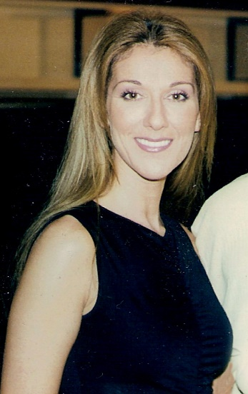
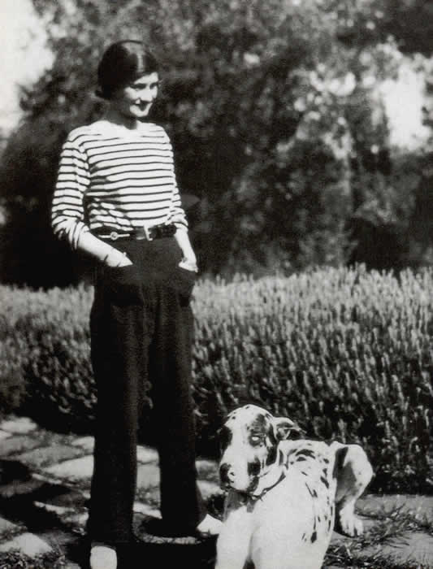
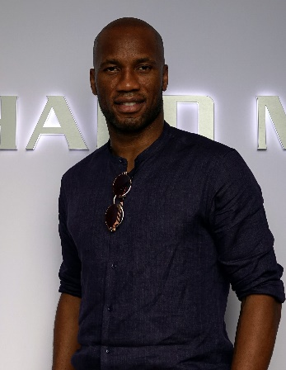
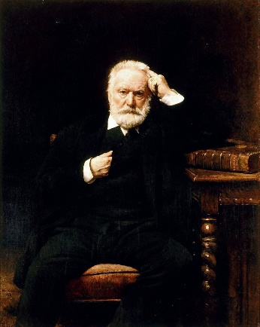
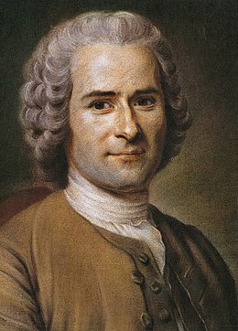
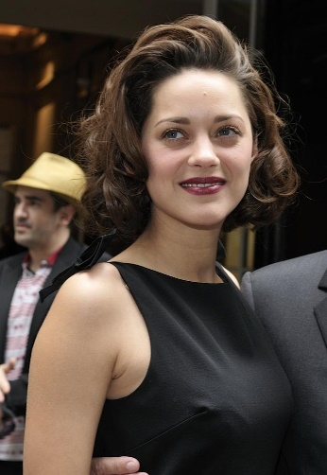
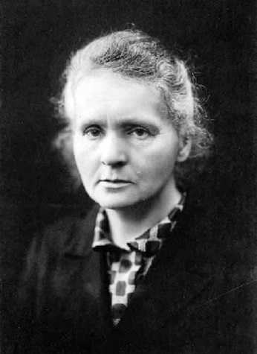
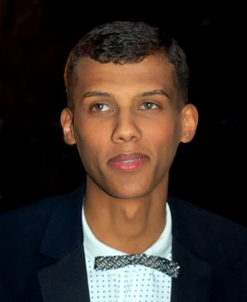
Je suis qui ?
Je suis qui ?
écouter / parler
Coco Chanel
Didier Drogba
Victor Hugo
Céline Dion
Jean-Jacques Rousseau
Marion Cotillard
Marie Curie
Stromae
Notes:
Part 3: Je suis qui? - listen and identify
Have all the pictures and names on the screen.
Students present their summary sentence by sentence, starting with the hardest clue.
After each sentence the other teams can guess who it might be.
If teachers want to run the activity with an element of competition, they can instigate a points system; the sooner the students guess the more points they win, but if they’re wrong they lose points.

Slide 61
Coco Chanel
Coco Chanel
ressembler à
= to look like
noir
= black
lire / parler
Pour la famille, je suis Gabrielle Chanel, mais pour le monde, c’est Coco ! J’habite à Paris et je suis entrepreneur. Je crée des vêtements simples pour les femmes, qui ressemblent* aux vêtements pour les hommes. Je pense que le confort, c’est important. Comme ça, je change le style féminin. J’aime la couleur noire*.
Notes:
Image: https://fr.wikipedia.org/wiki/Coco_Chanel
Note: In this example, attention could be drawn to the stylistic convention of using “ce” to refer back when giving more information about a noun. In English, “Je pense que le confort, c’est important” would be translated as “I think that comfort is important”.
Word frequency (1 is the most frequent word in French):
Paris [N/A], confort [4733], entrepreneur [2377], style [1999], simple [212]
Source: Londsale, D., & Le Bras, Y. (2009). A Frequency Dictionary of French: Core vocabulary for learners London: Routledge.

Slide 62
Didier Drogba
Didier Drogba
lire / parler
Je suis Didier Drogba et je suis Ivoirien. Je joue au foot, et pour ça j’habite en France, en Angleterre, en Chine, en Turquie, au Canada et aux États-Unis – six pays différents ! Je gagne souvent des prix comme « joueur de l’année ». Je crée une fondation pour financer un hôpital à Abidjan, en Côte d’Ivoire. Je travaille aussi pour l’organisation « Peace and Sport ».
Notes:
Image: https://fr.wikipedia.org/wiki/Didier_Drogba
Word frequency (1 is the most frequent word in French):
financer [1772], Abidjan [N/A], Canada [N/A], Chine [N/A], Côte d’Ivoire [N/A], France [N/A], Turquie [N/A], fondation [2414], foot [2602 (football)], hôpital [1308], joueur [2003], organisation [570], prix [310], Ivorien [>5000]
Source: Londsale, D., & Le Bras, Y. (2009). A Frequency Dictionary of French: Core vocabulary for learners London: Routledge.

Slide 63
Victor Hugo
Victor Hugo
lire / parler
Je suis Victor Hugo et je suis un poète et auteur français. J’écris des livres, comme Les Misérables et Notre-Dame de Paris, où je montre les problèmes de la société. Normalement, j’habite en France, mais je passe des années en exil (en Belgique et aux îles de Jersey et Guernesey). Je travaille aussi comme homme politique. J’aime la République française.
Notes:
Image: https://fr.wikipedia.org/wiki/Victor_Hugo
Word frequency (1 is the most frequent word in French):
Belgique [N/A], Guernesey [N/A], Jersey [N/A], Paris [N/A], auteur [762], dame [1983], exil [4010], misérable [>5000], poète [2307], république [1028], société [295], notre [73]
Source: Londsale, D., & Le Bras, Y. (2009). A Frequency Dictionary of French: Core vocabulary for learners London: Routledge.

Slide 64
Céline Dion
Céline Dion
lire / parler
Je suis Céline Dion et je suis chanteuse. Je suis Canadienne, mais j’habite aux États-Unis. Enfant, je chante avec la famille – j’ai neuf sœurs et quatre frères ! Je gagne l’Eurovision pour la Suisse. Je parle français et anglais, et je chante « My Heart Will Go On » pour le film Titanic. Je crée aussi des vêtements pour les enfants.
Notes:
Image: https://fr.wikipedia.org/wiki/C%C3%A9line_Dion
Word frequency (1 is the most frequent word in French):
Suisse [N/A], canadien [611]
Source: Londsale, D., & Le Bras, Y. (2009). A Frequency Dictionary of French: Core vocabulary for learners London: Routledge.

Slide 65
Jean-Jacques Rousseau
Jean-Jacques Rousseau
lire / parler
Je suis Jean-Jacques Rousseau. Enfant, j’habite à Genève. Adulte, j’habite normalement en France. Je suis philosophe : j’étudie les personnes et la société. J’écris un livre important, Du contrat social. Avec ce livre, je change les idées politiques de la France et influence la Révolution française.
Notes:
Image: https://fr.wikipedia.org/wiki/Jean-Jacques_Rousseau
Word frequency (1 is the most frequent word in French):
influencer [2498], Genève [N/A], adulte [1580], contrat [832], philosophe [3609], révolution [1617], société [295], social [301]
Source: Londsale, D., & Le Bras, Y. (2009). A Frequency Dictionary of French: Core vocabulary for learners London: Routledge.

Slide 66
Marion Cotillard
Marion Cotillard
lire / parler
Je suis Marion Cotillard. Je suis actrice et j’habite à Paris. Je joue le rôle de la chanteuse Édith Piaf pour un film biographique et je gagne un Oscar, un Golden Globe, un BAFTA et un César (un prix français). Je travaille aussi pour Dior. J’aime l’environnement et je suis activiste.
Notes:
Image: https://fr.wikipedia.org/wiki/Marion_Cotillard
Word frequency (1 is the most frequent word in French):
activiste [>5000], environnement [945], prix [310], rôle [371], biographique [>5000]
Source: Londsale, D., & Le Bras, Y. (2009). A Frequency Dictionary of French: Core vocabulary for learners London: Routledge.

Slide 67
Marie Curie
Marie Curie
lire / parler
Je suis Marie Curie. J’habite en Pologne quand je suis jeune, mais j’arrive à Paris pour aller à l’université, et je reste en France pour travailler. J’étudie la radioactivité et je gagne deux Prix Nobel. Je crée des « Instituts Curie » en France et en Pologne. Je travaille aussi comme professeur à l’université de Paris.
Notes:
Image: https://fr.wikipedia.org/wiki/Marie_Curie
Word frequency (1 is the most frequent word in French):
Pologne [N/A], radioactivité [>5000], institut [1372], prix [310]
Source: Londsale, D., & Le Bras, Y. (2009). A Frequency Dictionary of French: Core vocabulary for learners London: Routledge.

Slide 68
Stromae
Stromae
lire / parler
This is a type of French slang called verlan
(the reverse of l’envers, which means backwards!).
Je suis Paul Van Haver, mais comme rappeur, c’est Stromae (« maestro » en ordre inverse !). J’habite à Bruxelles en Belgique. Quand je rappe, les sujets sont sérieux, mais j’aime la musique électronique pour danser. Je travaille aussi comme producteur de musique et styliste. J’ai un style unique, et je porte souvent des vêtements multicolores.
Notes:
Image: https://fr.wikipedia.org/wiki/Stromae
Note: attention can be drawn to Stromae’s use of verlan, a common type of youth slang.
Word frequency (1 is the most frequent word in French):
danser [2934], Belgique [N/A], Bruxelles [N/A], maestro [>5000], musique [1139], ordre [197], producteur [1259], rapper [>5000], rappeur [>5000], style [1999], styliste [>5000], électronique [2195], inverse [2452], multicolore [>5000], sérieux [412], unique [402]
Source: Londsale, D., & Le Bras, Y. (2009). A Frequency Dictionary of French: Core vocabulary for learners London: Routledge.

Slide 69
Je suis qui ?
Je suis qui ?
lire / écrire
Traduis les phrases en anglais – comment traduire ‘de’ ?
Remember!
We don’t always translate ‘de’ directly into English. Sometimes, it sounds more natural to switch the nouns around.
Je gagne souvent des prix comme « joueur de l’année ».
Didier Drogba
→ I often win prizes like “player of the year”.
Je joue le rôle de la chanteuse Édith Piaf.
Marion Cotillard
→ I play the role of the singer Édith Piaf.
Je travaille à l’université de Paris.
Marie Curie
→ I work at the University of Paris.
J’écris des livres où je montre les problèmes de la société.
Victor Hugo
→ I write books where I show the problems of society / society’s problems.
Je change les idées politiques de la France.
Jean-Jacques Rousseau
→ I change the political ideas of France / France’s political ideas.
Je travaille comme producteur de musique.
Stromae
→ I work as a music producer.
Notes:
Timing: 10 minutes
Aim: recap some of the figures from the running dictation task
Procedure:
students have to try and identify the person from just one sentence (groups can’t answer for the person they wrote about!).
The second stage focuses on translating the sentences into English, particularly the translation of ‘de’. Students have learned the definition ‘of’, which is a natural direct translation for the first three examples. In the next two examples, ‘of’ is not the only possible translation, and in the final example it would sound unnatural.
Draw students’ attention to the feature of switching the nouns around in English, and reinforce that one word in French (especially highly frequent words) may have more than one possible translation into English, depending on the context.

