Slide 1
Cultural Collection
French Y7 Term 1
Pete Watson
Date updated: 09/02/21

Slide 2
7.1.2.1
15-24: A series of exercises to exploit the poem Sept Couleurs Magiques by Mymi Doinet
34-43: Continuation of lesson 1.

Slide 3
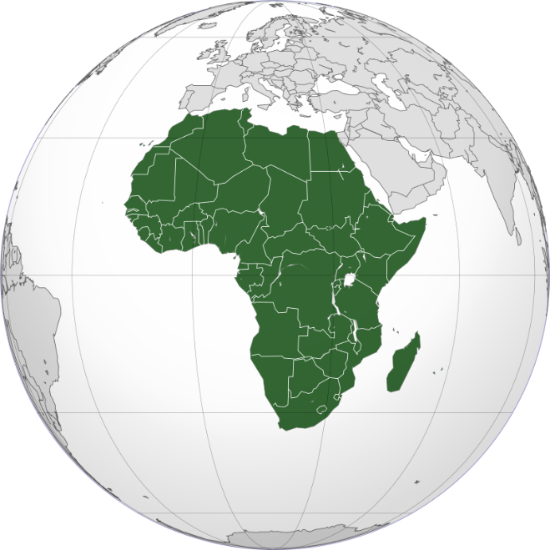
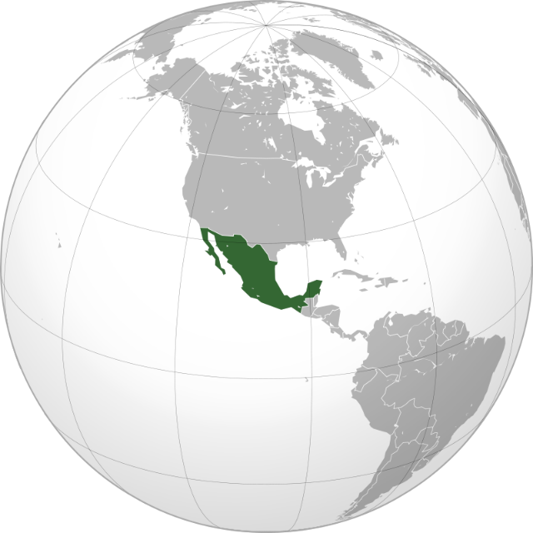
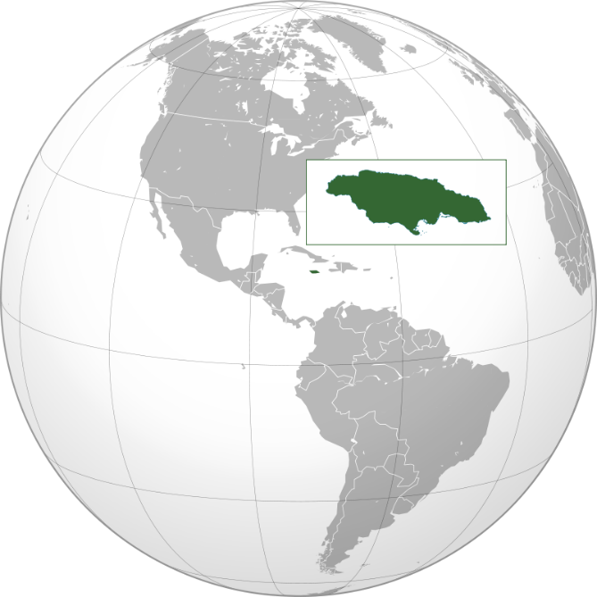
C’est où … ?
Une texte français
lire
Today we are going to read a short text in French. What kind of text is it?
C’est Afrique
C’est Mexique
C’est Jamaïque
Rouge comme un fruit du Mexique
Orange comme le sable d’Afrique…
C’est un poème !
Notes:
Timing: 3 minutes
Aim: To introduce the task and the text, and to engage students.
Procedure:
Ask students to look at the three globes and decide what the green areas are.
Give the French translation of the first area (Afrique), and ask students to guess what the translations of the two others may be, giving the hint that they rhyme with the first (Mexique, Jamaïque)
Then, present the first two lines of the poem and ask them to guess what sort of text it could be. Why do they think it’s a poem? (A rhyming couplet, repetition of ‘comme’ and of colours)
Word frequencies of unknown words used (1 is the most frequent word in French): texte [631], de [2], sable [3263]
Source: Londsale, D., & Le Bras, Y. (2009). A Frequency Dictionary of French: Core vocabulary for learners London: Routledge.

Slide 4
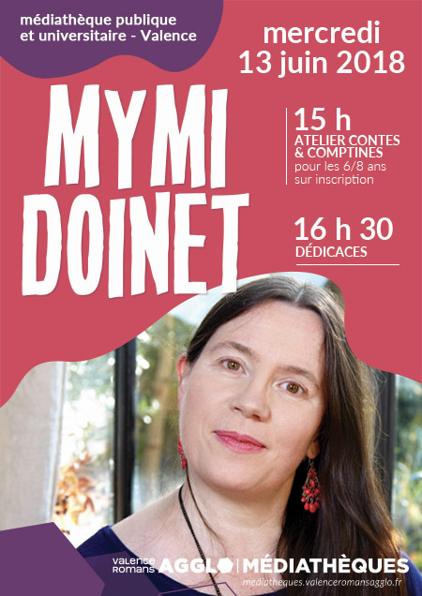
La poète: Mymi Doinet
Mymi Doinet (1958-)
Pays d’origine: France
Ville: Paris
Elle aime écrire pour les jeunes
Elle est blogueuse depuis 2010
Notes:
Timing: 5 minutes
Aim: Information gathering exercise using a short text composed of known and unknown words.
Suggested procedures:
Students could take notes in English based on the biographical information that is presented here.
It could be read aloud by the teacher simultaneously to present sound-spelling connections. In context, students should be able to guess the meaning of ‘ville’, ‘pays d’origine’, ‘depuis’ and ‘pour’.
Students could be asked how they think she feels in the photo (elle est calme/contente/indifférente)
Word frequencies of unknown words used (1 is the most frequent word in French): pays [114], de [2], origine [709], ville [260], aimer [242], pour [10], jeune [152], blogeuse [>5000], depuis [96]
Source: Londsale, D., & Le Bras, Y. (2009). A Frequency Dictionary of French: Core vocabulary for learners London: Routledge.
Advertisement featuring Mymi Doinet by Valences Romans Mediathiques is in the public domain.

Slide 5
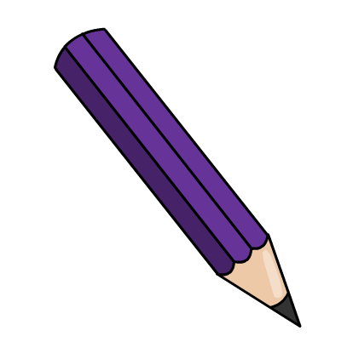
Les couleurs
Les couleurs
parler
You don’t know the French words for some of these colours, but they look similar to English!
E
D
F
B
A
violet
G
C
orange
indigo
Notes:
Timing: 5 minutes
Aim: Recall of some words in this weeks’ vocabulary set
Procedure
On clicks, the names of the three cognate colours appear for A-C. Have students sound them out using their SSC knowledge ([SFC], soft and gard [g], [an])
Then, students say the names of remaining colours, which they have pre-learned, aloud.
Word frequencies: orange [3912]; indigo [>5000]; violet [>5000]
Source: Londsale, D., & Le Bras, Y. (2009). A Frequency Dictionary of French: Core vocabulary for learners London: Routledge.

Slide 6
Les couleurs
lire
Colours can be used as adjectives. They agree with the noun they are describing.
What is being described below?
1. | ___________ est vert. | la chambre | le portable | could be either
2. | ___________ est bleue. | le lit | la voiture | could be either
3. | ___________ est jaune. | l’ordinateur | la chose | could be either
4. | ___________ est rouge. | la voiture | le modèle | could be either
5. | ___________ est bleu. | le ciel | la vague | could be either
6. | ___________ est verte. | le livre | la règle | could be either
7. | ___________ est orange. | la voiture | l’animal | could be either
8. | ___________ est violet. | le vélo | la chambre | could be either
Notes:
Timing: 5 minutes
Aim: To use knowledge of gender and adjective agreement to choose from pairs of masculine or feminine nouns.
Procedure
Remind students of adjective agreement rules learned so far (where possible, add an –e in feminine form).
Students write 1-8 and decide which noun is being described based on the form of the colour adjective. Remind them to watch out for the colours which end in –e in the masculine form.
Answers revealed on clicks.
Word frequencies: orange [3912]; violet [>5000]
Source: Londsale, D., & Le Bras, Y. (2009). A Frequency Dictionary of French: Core vocabulary for learners London: Routledge.

Slide 7
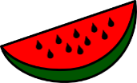
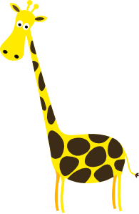
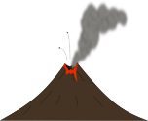
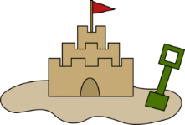
Listen and match the word to the writing.
Text exploitation
écouter / écrire
1
e
a
papillon
2
g
b
vague
3
d
c
arc aux sept couleurs
4
f
fruit
d
5
c
e
sorbet
6
h
girafe chic
f
7
a
g
volcan
8
b
sable
h
Notes:
Timing: 5 minutes
Aim: Practice in connecting the spoken and written forms of unknown words.
Procedure:
1. Tell students that they will hear and read a number of words that will appear in Doinet’s poem. 2. They need to listen and match the letter of the written word to the number of the word heard.
3. Note: where the words are not cognates, pictures are provided to give the meaning. Students will need a bit of help understanding the function of ‘aux’. 4. Answers appear on click.
Transcript:
1. sorbet
2. volcan
3. fruit
4. girafe chic
5. arc aux sept couleurs
6. sable
7. papillon
8. vague
Word frequency (1 is the most frequent word in French):
sorbet [>5000]; volcan [>5000]; fruit [896]; girafe [>5000], chic [>5000]; arc [>5000]; à [4], sept [905], couleur [1211] sable [3263]; papillon [>5000]; vague [1493].
Source: Londsale, D., & Le Bras, Y. (2009). A Frequency Dictionary of French: Core vocabulary for learners London: Routledge.

Slide 8
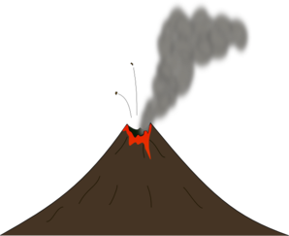
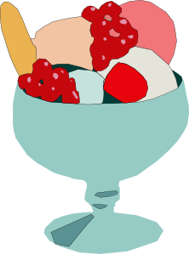
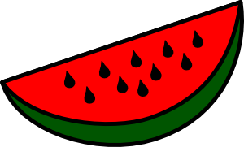
Listen and match the noun to the French word.
Text exploitation
écouter / écrire
1
D
2
A
C
B
A
3
H
D
4
B
5
F
6
G
H
7
F
E
F
G
8
C
Notes:
Timing: 5 minutes
Aim: Recall of the spoken forms of words introduced on previous slide. The written forms are removed so that students must try to recall the meaning, rather than looking at the form.
Procedure:
Tell students that they will hear a number of words that will appear in Doinet’s poem. These are depicted in Pictures A-H.
Listen and match the letter of the picture to the word heard.
Transcript:
1. sorbet
2. volcan
3. fruit
4. girafe chic
5. arc aux sept couleurs
6. sable
7. papillon
8. vague
Word frequency (1 is the most frequent word in French):
sorbet [>5000]; volcan [>5000]; fruit [896]; girafe [>5000], chic [>5000]; arc [>5000]; à [4], sept [905], couleur [1211] sable [3263]; papillon [>5000]; vague [1493].
Source: Londsale, D., & Le Bras, Y. (2009). A Frequency Dictionary of French: Core vocabulary for learners London: Routledge.

Slide 9
Text exploitation
Text exploitation
écouter / écrire
g_r_f_ ch_c
p_p_ll_n
v_g_ _
fr_ _t
v_lc_n
_rc _ _x s_pt
c_ _l_ _rs
s_bl_
s_rb_t
Notes:
Timing: 3 minutes
Aim: Practice in connecting the spoken and written forms of unknown words, with particular emphasis on reinforcing the sound and spelling of the vowels within each word.
Procedure:
Tell students that they will hear a number of words that will appear in Doinet’s poem. These are depicted in the pictures.
Click on the image to play the audio.
Students listen and complete the words with the correct vowels.
Note: See next slide for the answers

Slide 10
Text exploitation
Text exploitation
écouter / écrire
girafe chic
papillon
vague
fruit
volcan
arc aux sept
couleurs
sable
sorbet
Notes:
Answer slide.

Slide 11
Où … ?
écouter
C
1
B
Mexique
H
Afrique
D
D
E
Jamaïque
F
Pacifique
G
Tropique
C
H
Martinique
B
F
G
2
Notes:
Timing: 5 minutes
Aim: To practise listening to the target words now at sentence level within the full poem.
Note:
Play button 1 - top left: audio with full text
Play button 2 - bottom left: audio with text in which colours are obscured with wave sounds. This may be preferable to hearing the full text because students don’t listen out for the colour (they should be listening for the place name and noun).
Procedure:
Decide which version of the text to play (see above).
Click on the appropriate play button.
Students listen and decide which picture represents the noun associated with each place in the poem by writing the correct letter by the place.
Transcript:
Rouge comme un fruit du Mexique
Orange comme le sable d’Afrique
Jaune comme les girafes chics
Vert comme un sorbet Jamaïque
Bleu comme les vagues de Pacifique
Indigo comme un papillon de tropiques
Violet comme les volcans de Martinique
Qui donc est aussi fantastique?
Est-ce un rêve ou est-ce véridique?
C’est dans le ciel mangnifique
L’arc aux sept couleurs magique

Slide 12
Texte complet
lire
Rouge comme un fruit du Mexique C’est dans le ciel magnifique
Orange comme le sable d’Afrique L’arc aux sept couleurs magique
Jaune comme les girafes chics
Vert comme un sorbet Jamaïque
Bleu comme les vagues de Pacifique
Indigo comme un papillon de tropiques
Violet comme les volcans de Martinique
Qui donc est aussi fantastique?
Est-ce un rêve ou est-ce véridique?
Notes:
Full text for reference.

Slide 13
Prononce et organise les mots
fruit
orange
dans
é
SFC
an/en
véridique
violet
fantastique
les
volcans
sorbet
chics
Notes:
Timing: 5 minutes
Aim: To consolidate SSC knowledge of selected key words from the poem.
Procedure:
Students say out loud the word.
Students classify the word according to the categories within the Venn diagram.
Click on the words to reveal their position within the Venn diagram.

Slide 14
Sounds and spelling
 | I (and ‘QU’)
 | Mexique, Afrique, Pacifique, Tropique
 | OU
 | rouge, ou , couleurs
 | J (and GI)
 | rouge, orange, girafe , magique
Notes:
Timing: 2 minutes
Aim: To practise key sounds within target words from the poem and linking these to the spellings.
Procedure:
Elicit the SSCs [i] and [qu] from students.
Click to reveal the word containing the target SSCs and elicit the pronunciation from students, reinforcing correct pronunciation where necessary.
Repeat for SSCs: [ou], then [j] and [gi].

Slide 15
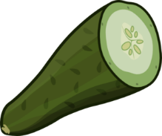
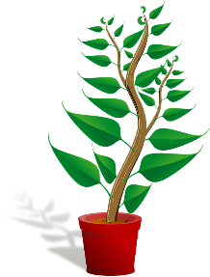
Vrai ou faux ?
Careful! What adjective ending do you need?
lire / écrire
1. Une rose est indigo. | C’est vrai / faux ! Une rose est rouge.
2. Une vague est violette. | C’est vrai / faux ! Une vague est bleue.
3. Une banane est jaune. | C’est vrai / faux ! Une banane est jaune.
4. Un concombre est violet. | C’est vrai / faux ! Un concombre est vert.
5. Une plante est indigo. | C’est vrai / faux ! Une plante est verte.
6. Une carotte est orange. | C’est vrai / faux ! Une carotte est orange.
_________
_________
_________
_________
_________
_________
Notes:
Timing: 5 minutes
Aim: Written recognition and production of the colour terms which form part of this week’s vocabulary set. Revision of ‘vrai’ and ‘faux’ which feature in this week’s revisited vocabulary set.
Procedure:
Students write 1-6 in their books.
They read the sentences and write vrai or faux in their books.
They then fill the gaps with the correct colour. Remind students that colours are adjectives, and they need to add an –e to the feminine form where necessary.
Answers appear on clicks.
Word frequency (1 is the most frequent word in French): rose [2671], banane [>5000], concombre [>5000], plante [2702], carotte [>5000]
Source: Londsale, D., & Le Bras, Y. (2009). A Frequency Dictionary of French: Core vocabulary for learners London: Routledge.

Slide 16
Les couleurs
parler
vert
F
E
indigo
C
jaune
A
violet
B
bleu
G
D
orange
rouge
Notes:
Timing: 2 minutes
Aim: To recap the pronunciation of colours ahead of the speaking activity.
Procedure:
1. In pairs students name the colours.
2. Elicit answers from students to clarify.

Slide 17
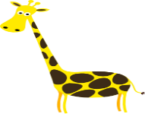
Vocabulaire
parler / lire
_______ comme un ________ du Mexique
_______ comme le __________ d’Afrique
_______ comme les __________ ______
_______ comme un __________ jamaïque
_______ comme les __________ de Pacifique
_______ comme un __________ de tropiques
_______ comme les _____________ de Martinique
Notes:
Timing: 3 minutes
Aim: To promote recall of key vocabulary from the poem in the oral modality plus meanings in English of the full sentences.
Procedure:
Use the pictures in the gaps to elicit the missing words.
A mixed word/picture-based read aloud task could then be done in pairs.
Ask students for the translations of the sentences into English.

Slide 18
‘Un’ ou ‘le’ ?
grammaire
Rouge comme un / le fruit du Mexique
Orange comme un / le sable d’Afrique
Vert comme un / le sorbet Jamaïque
Indigo comme un / le papillon de tropique
Notes:
Timing: 2 minutes
Aim: To clarify the difference between the use of the definite and indefinite article.
Procedure:
1. Elicit the correct word from students, offering additional explanations as necessary.

Slide 19
Abstract or concrete?
grammaire
honneur
justice
chambre
ordinateur
amour
montre
courage
liberté
vélo
voiture
Concrete noun | Abstract noun
Notes:
Optional task - abstract/concrete nouns
Timing: 3 mins
Aim: to highlight the different use in French and English of the definite article with abstract nouns. (Abstract nouns usually use definite articles in French, but no article in English.)
Procedure:
1. Introduce / recap (from literacy knowledge) the concepts of concrete and abstract noun.
2. Ask student to do a quick noun sort.
3. Give students the rule that abstract nouns usually use definite articles in French, but no article in English.
4. Reveal the answers (see next slide).
Word frequency (1 is the most frequent word in French):
amour [967]; justice [637]; liberté [320]; courage [1431]; honneur [1141]
Source: Londsale, D., & Le Bras, Y. (2009). A Frequency Dictionary of French: Core vocabulary for learners London: Routledge.
Note: The 5 concrete nouns are introduced in the French SoW in term 1.1. The 5 abstract nouns are (near-)cognates, except ‘amour’, and all high-frequency words.

Slide 20
Réponses correctes
grammaire
Concrete noun
Abstract noun
montre
liberté
chambre
justice
voiture
courage
vélo
honneur
ordinateur
amour
Notes:
Answer slide.
(Clarify meanings in English if necessary)

Slide 21
Quelles sont vos émotions?
Les émotions
parler
Je suis…
heureux (-euse)
calme
content(e)
indifférent(e)
triste
fâché(e)
intéressé(e)
Notes:
Timing: 2 minutes
Aim: To encourage further engagement with the text by asking students for their emotional response after they have finished reading the poem.
Procedure:
Use the French prompt to ask students how they feel.
Ask students to report back on how their partner feels (il est/elle est…)
Word frequency (1 is the most frequent word in French):
hereux(-euse) [764]; calme [1731]; content(e) [1841]; indifférent(e) [4151]; triste [1843]; fâché(e) [4413]; intéressé(e) [559].
Source: Londsale, D., & Le Bras, Y. (2009). A Frequency Dictionary of French: Core vocabulary for learners London: Routledge.

Slide 22
Écris un poème!
écrire
Now create your own poem!
Try to re-use the colours in the poem with ‘comme’
Remember to use un/une/le/la correctly
Notes:
Timing: 10 minutes
Aim: To practise correct use of the article according to intended meaning within a creative written production task.
Procedure:
1. Tell student their task is to research and writing their own poem.
2. Allow use of dictionaries for this, especially as they may want to include words that haven’t yet been taught.
3. Offer students feedback on their use of articles
Note:
This task can be given with or without the concrete/abstract nouns focus on the previous slide. Even without an explicit focus on the previous slide, it's possible that students will mix/match concrete and abstract e.g. Rouge comme l’amour
Bleu comme une voiture

