Slide 1
Narrating with nouns – using gender and words for 'the' correctly
Definite articles - singular
SSC [u]
Y7 German
Term 1.2 - Week 5 - Lesson 23
Leigh McClelland / Rachel Hawkes
Artwork: Steve Clarke
Date updated: 15/12/21
Notes:
Artwork by Steve Clarke. All additional pictures selected are available under a Creative Common license; no attribution required.
Learning outcomes (lesson 1):
Introduction of SSC [u]
Consolidation of singular definite articles
Word frequency (1 is the most frequent word in German):
7.1.2.5 (introduce) kommen [62] stehen [85] Junge [548] Kopf [250] Körper [488] Mädchen [602] Mutter [218] Nacht [325] Tür [375] Vater [232] dunkel [706]
7.1.2.2 (revisit) arbeiten [234] kochen [1481] putzen [3586] sitzen [231] Auto [361] Boden [536] Garten [1158] Liste [1792] Zimmer [665] nochmal [1984] ich verstehe nicht [n/a] zu Hause [n/a] Hausaufgaben [Haus+aufgabe]
7.1.1.3 (revisit) bin [4] ich [10] Ding [370] Form [307] Mensch [90] blau [948] gelb [1446] groß1 [67] gut [76] klein [110] rot [477] wie? [25] und [2] bitte [471] danke [877] ein, eine [5] wie geht's? [n/a]
Source: Jones, R.L. & Tschirner, E. (2019). A frequency dictionary of German: core vocabulary for learners. Routledge

Slide 2
Vokabeln
 |  | d |  |  |  |  |  |  |  |  | d
 |  | a |  |  |  |  |  |  |  | d | i |  |  | d
 |  | s | d |  | d |  |  |  |  | a | e |  |  | e
 |  |  | a |  | e | a |  |  |  | s |  |  |  | r
k |  | D | n |  | r | r | d | k |  |  | N | i | r
l | b | i | k |  |  | b | a | o |  | Z | a | c | o | M
__ | __ | __ | __ |  | __ | __ | __ | __ | __ | __ | __ | __ | __ | __
i | t | g |  |  | a | i |  | h | a | m | h |  |  | n
n | t |  |  |  | r | t | A | e | b | m | t | b |  | s
 | e |  |  |  | t | e | u | n | e | e |  | i |  | c
 |  |  |  |  | e | n | t |  | n | r |  | n |  | h
 |  |  |  |  | n |  | o
Vokabeln
e
i
n
e
G
e
s
c
h
i
c
h
t
e
Notes:
Timing: 5 minutes Aim: To share the context for the lesson (i.e. story), whilst revising previously-met vocabulary.
Procedure: 1. Students say the German words in turn from left to right, naming the missing letter in each.
These spell out ‘eine Geschichte’ – the theme for this lesson sequence.
2. When eliciting each word answer, elicit also the English meaning, to ensure that students remember it.
3. Answers appear on successive mouse click.

Slide 3
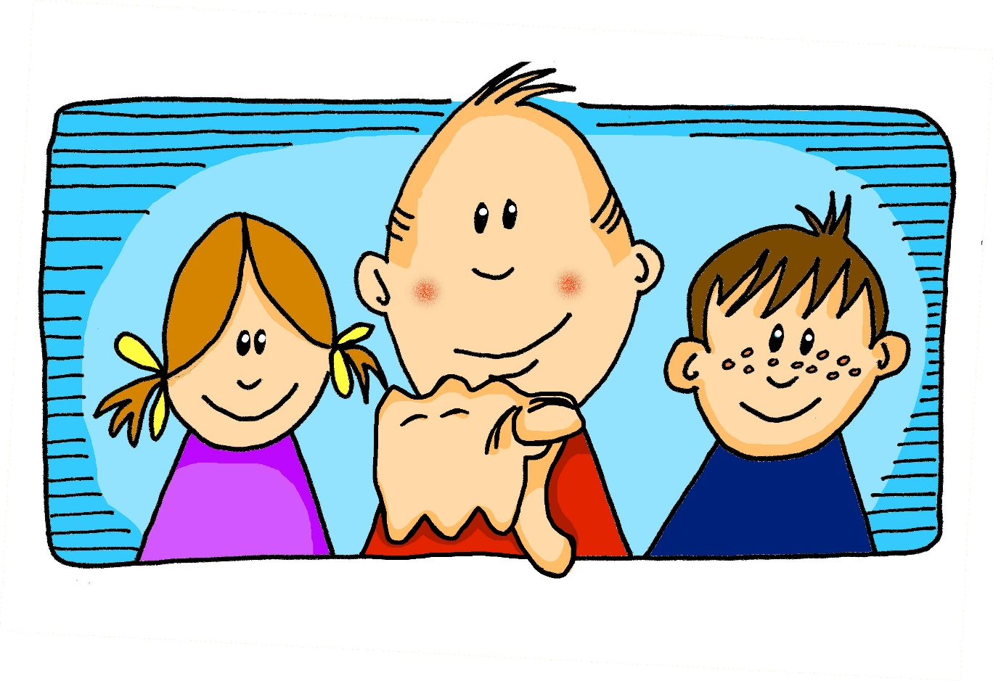
u
du
Notes:
Timing: 1 minute
Aim: To introduce/consolidate SSC [u]
Procedure: 1. Present the letter(s) and say the [u] sound first, on its own. Students repeat it with you. 2. Bring up the word ”du” on its own, say it, students repeat it, so that they have the opportunity to focus all of their attention on the connection between the written word and its sound.
3. A possible gesture for this would be to point out directly in front of you.
4. Roll back the animations and work through 1-3 again, but this time, dropping your voice completely to listen carefully to the students saying the [u] sound, pronouncing ”du” and, if using, doing the gesture. Word frequency (1 is the most frequent word in German): du [52]
Source: Jones, R.L. & Tschirner, E. (2006). A frequency dictionary of German: core vocabulary for learners. Routledge

Slide 4
u
du
Notes:
With sound and no pictures to focus all attention on the sound-symbol correspondence.

Slide 5
u
du
Notes:
Without sound to elicit pronunciation (without first hearing the teacher).
Teacher to elicit pronunciation by asking “Wie sagt man…”

Slide 6
u
absolut
gut
%
du
Minute
Schule
tun
[to do]
Notes:
Timing: 2 minutes
Aim: To introduce/consolidate SSC [u]
Procedure:
Introduce and elicit the pronunciation of the individual SSC [u] and then the source word again ‘du’ (with gesture, if using).
Then present and elicit the pronunciation of the five cluster words.
The cluster words have been chosen for their high-frequency, from a range of word classes, with the SSC (where possible) positioned within a variety of syllables within the words (e.g. initial, 2nd, final etc.). Additionally, we have tried to use words that build cumulatively on previously taught SSCs (see the Phonics Teaching Sequence document) and do not include new SSCs. Where new SSCs are used, they are often consonants which have a similar symbol-sound correspondence in English.
Word frequency (1 is the most frequent word in German): du [52]; absolut [993] gut [78]; Minute [361]; tun [140]; Schule [208].
Source: Jones, R.L. & Tschirner, E. (2006). A frequency dictionary of German: core vocabulary for learners. Routledge

Slide 7
u
absolut
gut
du
Minute
Schule
tun
Notes:
With sound and no pictures to focus all attention on the sound-symbol correspondence.

Slide 8
u
absolut
gut
du
Minute
Schule
tun
[to do]
Notes:
Without sound to elicit pronunciation (without first hearing the teacher).
Teacher to elicit pronunciation by asking “Wie sagt man…”

Slide 9
Definite articles
Grammatik
German nouns are divided up into two / three / four groups.
gender
the
Each group has a grammatical __________ and a different word for ______.
masculine | der | e.g. der Zug (the train)
feminine | die | e.g. die Familie (the family)
neuter | das | e.g. das Haus (the house)
definite articles
These words for the are called _________ _________.
learn
As you know, when you learn a German noun, you must ________ its grammatical gender.
Notes:
Timing: 2 minutes Aim: To provide an interactive reminder of the three genders in German.
Procedure: 1. Click to animate the explanation.
2. Each sentence (plus answers) is animated separately to allow the teacher to elicit responses from the class, and build the explanation interactively and collaboratively.
3. Ensure students’ understanding at each stage.
Note: Remember that these explanations by themselves do not make a huge impact on learning – it is practice that really has the biggest benefits. So it is not worth spending too much time on these explanations. Also, they are always ‘partial’ – we can’t communicate all the complexity at once.
Word frequency rankings:
Haus [159], Familie [310], Zug [613] Source: Jones, R.L & Tschirner, E. (2011). A frequency dictionary of German: Core vocabulary for learners. London: Routledge.

Slide 10
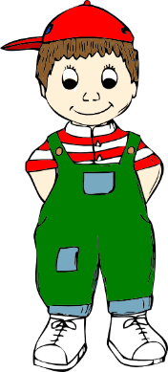
Vokabeln
Masculine nouns (der …)
der
Mann
der
Vater
der
Junge
Why?
der
Fußball
der
Kopf
der
Grund
Notes:
Timing: 2 minutes Aim: To revisit the concept of masculine gender with some known words that are used in the activities which follow.
Procedure: 1. Click to bring up each picture in turn.
2. Elicit the German word from the students.

Slide 11
Vokabeln
Feminine nouns (die …)
die
Hand
die
Mutter
die
Familie
die
Nacht
die
Tür
Notes:
Timing: 2 minutes Aim: To revisit the concept of feminine gender with some known words that are used in the activities which follow.
Procedure: 1. Click to bring up each picture in turn.
2. Elicit the German word from the students.

Slide 12
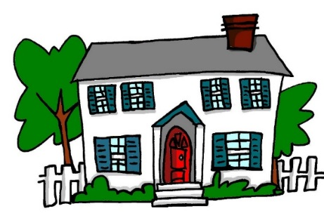
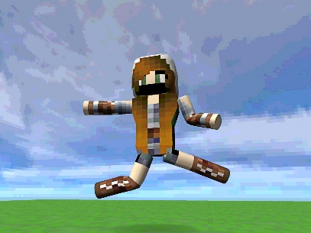
Vokabeln
Neuter nouns (das …)
das
Buch
das
Haus
das
Monster
das
Wasser
das
Mädchen
das
Computerspiel
Notes:
Timing: 2 minutes Aim: To revisit the concept of neuter gender with some known words that are used in the activities which follow.
Procedure: 1. Click to bring up each picture in turn.
2. Elicit the German word from the students.
3. You could point out that the noun ‘girl’ has a neuter gender. This just shows that ALL nouns have gender, and in German this is not always in ways that you expect. Gender on nouns is very ‘abstract’! It has to be learnt, and can’t really be guessed or worked out in German.

Slide 13
Vokabeln
der, die, oder das?
Mann
Familie
Monster
Fußball
Haus
Tür
Computerspiel
Buch
Hand
Nacht
Wasser
Junge
Grund
Kopf
Mädchen
Mutter
Vater
der
die
das
Notes:
Timing: 3 minutes Aim: To present/introduce the active nouns from the tasks that follow.
Procedure: 1. Students predict to which word for ‘the’ each noun will fly – der, die or das? 2. This slide has the words as text. The next slide has the nouns as pictures to stimulate recall of the words themselves as well as their gender.
3. Click to make each word appear; click again to make it fly to the correct category.
Note: It is anticipated that the meaning of many/most of these nouns will be known as many are included as phonics source/cluster words and will have been encountered and practised for pronunciation, but not with a focus on their gender/matching word for ‘the’.

Slide 14
Vokabeln
der, die, oder das?
Why?
der
die
das
Notes:
Timing: 3 minutes Aim: To present/introduce the active nouns from the tasks that follow (alternative/addition to the previous slide).
Procedure: 1. Students predict to which word for ‘the’ each noun will fly – der, die or das? 2. This slide has the has the nouns as pictures, to stimulate recall of the words themselves as well as their gender.
3. Click to make each picture appear; click again to make it fly to the correct category.
Note: It is anticipated that the meaning of many/most of these nouns will be known as many are included as phonics source/cluster words and will have been encountered and practised for pronunciation, but not with a focus on their gender/matching word for ‘the’.

Slide 15
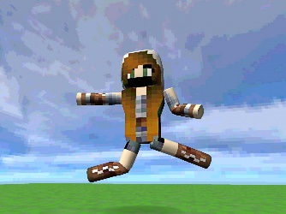
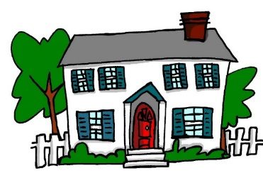
Vokabeln
Was passt nicht?
1.
4.
die
die
das
der
die
die
2.
5.
das
die
das
der
das
das
Why?
3.
6.
der
der
der
das
der
der
die
Notes:
Timing: 3 minutes Aim: To practise recall of nouns and their gender.
Procedure: 1. Students find the odd one out by identifying the gender of each noun.
2. Click to reveal the answers (confirming the genders at the same time) one by one.

Slide 16
ein Filmprojekt
lesen
Wie sagt man das auf Englisch?
Your German friend has a film project homework but has ripped up her notes in frustration. You rescue the scraps of paper and try to reconstruct her ideas for the opening scene.
Familie
Mädchen
Vater
1. Die / / macht ein Picknick im Garten.
The family is having a picnic in the garden.
Mädchen
Junge
Mutter
2. Die / / sitzt auf dem Gras.
The mother is sitting on the grass.
Mutter
Vater
Mädchen
3. Der / / hat ein Buch.
The father has a book.
Junge
Mädchen
Mutter
4. Die / / trinkt Wasser.
The mother is drinking water.
Mädchen
Junge
Familie
5. Das / / spielt Fußball mit einem Freund.
The girl is playing football with a friend.
Notes:
Timing: 5 minutes Aim: To practise matching nouns to their gender.
Procedure:
1. Students select the correct word according to the given gender (definite article).
2. Elicit the answers 1-5 (answers are animated to highlight the correct noun when you click on the mouse.)
3. After establishing the correct nouns, elicit the translations for each sentence, giving students 30-60 seconds to ‘think-pair-share’ before taking answers from students, in whole class feedback. 4. Encourage students to consider that this is a written set of ‘scene setting’ instructions. Ask them what sounds most natural as they translate. Note that students may first translate ‘macht’ as ‘does/is doing’ - prompt them to realise that we don’t say ‘does/is doing a picnic’ in English and to select a more natural translation ‘has/is having’. For scene-setting, we usually prefer the present continuous, so 1,2,4 and 5 are likely to be translated with the ‘ing’ form.
5. The most likely translations are animated to appear on each click.
Word frequency (1 is the most frequent word in German):
Familie [cluster 310], Fußball [cluster 1497], Vater [cluster 216], machen [cluster 49], Picknick [cognate ˃4034], Garten [959] Junge [cluster 630], Eltern [cluster 351], sitzen [cluster 261], Gras [cognate 3313] Mutter [cluster 227], Mädchen [cluster 537], haben [cluster 7], Buch [source 295]
trinken [608], Wasser [cluster 297] spielen [source 197], mit [cluster 13], Freund [cluster 327]
Source: Jones, R.L. & Tschirner, E. (2011). A frequency dictionary of German: core vocabulary for learners. Routledge

Slide 17
ein Filmprojekt [2]
lesen
Wie sagt man das auf Englisch?
The scene continues and the action starts!
Haus
Fußball
Mädchen
6. Der / / ist klein.
The football is small.
Mädchen
Mutter
Junge
7. Der / / geht ins Haus.
The boy goes into the house.
Vater
Fußball
Haus
8. Das / / ist groß.
The house is big.
Mutter
Junge
Eltern
9. Der / / kommt wieder aus dem Haus.
The boy comes out of the house again.
Familie
Fußball
Haus
10. Das / / explodiert!
The house explodes!
Notes:
Timing: 5 minutes Aim: To practise matching nouns to their gender (continuation of the activity on the previous slide).
Procedure:
1. Students select the correct word according to the given gender (definite article).
2. Elicit the answers 1-5 (answers are animated to highlight the correct noun when you click on the mouse.)
3. After establishing the correct nouns, elicit the translations for each sentence, giving students 30-60 seconds to ‘think-pair-share’ before taking answers from students, in whole class feedback. 4. Encourage students to consider that this is a written set of ‘scene setting’ instructions. Ask them what sounds most natural as they translate. Suggest to them that now things start to happen in the scene, they may find it more natural to use the present simple.
5. The most likely translations are animated to appear on each click.
Word frequency (1 is the most frequent word in German):
Haus [source 159], sein [2], klein [cluster 114], und [source 2], rund [cluster 316] gehen [69] groß [source 74], neu [cluster 80] kommen [61]
wieder [cluster 75] explodieren [cognate ˃4034]
Source: Jones, R.L. & Tschirner, E. (2011). A frequency dictionary of German: core vocabulary for learners. Routledge

Slide 18
ein Computerspiel
hören
Your German friend is on the phone describing the story of her new favourite computer game. You can’t hear because your dad is using the blender in the kitchen.
Choose the correct nouns to make sense of it all.
1
der/die/das | Mann / Nacht / Monster | ist sehr dunkel.
der/die/das | Mann / Familie / Monster | steht in einer Kirche.
der/die/das | Computerspiel / Nacht / Grund | ist nicht klar.
der/die/das | Familie / Mann / Monster | findet einen Körper! Was?!
der/die/das | Kopf / Monster / Hand | ist rot und blutig.
2
3
4
5
Notes:
Timing: 5 minutes Aim: To practise matching nouns to their gender and semantic context.
Procedure:
1. Students listen to the recording (the nouns are obscured) and read the text in the third column; based on the article heard (and considering the meaning) they select the correct noun from the three choices and indicate its gender (selecting the definite article).
2. Click to reveal the answers one by one.
Transcript:
Note: Recordings have blender noises inserted instead of the words in square brackets.
1. Die [Nacht] ist sehr dunkel.
2. Der [Mann] steht in einer Kirche.
3. Der [Grund] ist nicht klar.
4. Der [Mann] findet einen Körper! Was?!
5. Der [Kopf] ist rot und blutig.
Word frequency (1 is the most frequent word in German):
die Nacht [cluster 335], sehr [70], dunkel [cluster 819]
der Mann [cluster 131], stehen [cluster 210], Kirche [cluster 519]
der Grund [cluster 230], nicht [cluster 12], klar [cluster 255]
finden [source 110], der Körper [cluster 617], was [cluster 39]
der Kopf [source 279], sein [cluster 3], rot [cluster 381], blutig [cognate ˃2000]
die Hand [cluster 179], haben [7], keine [50], Finger [cognate 1034]
sehen [81], das Monster [cognate ˃2000], jetzt [62], Hilfe [cluster 737]
die Tür [source 400], offen [cluster 382]
das Monster [cognate ˃2000], kommen [cluster 61], plötzlich [source 459], Kirche [cluster 519]
das Programm [cognate 464], enden [cognate 1846]
Source: Jones, R.L. & Tschirner, E. (2011). A frequency dictionary of German: core vocabulary for learners. Routledge

Slide 19
ein Computerspiel [2]
hören
You keep listening to your friend, and start to make notes in English to try to make sense of the story.
article | noun | notes
 | Monster / Hand / Mann
 | Familie / Mädchen / Mann
 | Computerspiel / Mann / Tür
 | Familie / Mann / Monster
 | Nacht / Computerspiel / Familie
6
7
8
9
10
Notes:
Timing: 5 minutes Aim: To practise matching nouns to their gender and semantic context (continuation of the activity on the previous slide).
Note: this time the choices of definite article are not visible, forcing recall of these, and neither is the complement of the sentence (forcing students to listen for the semantic context).
Procedure:
1. Students listen to the recording (the nouns are obscured); based on the article heard they select the correct noun from the three choices and indicate its gender (writing in the definite article). They then make notes in English on the full meaning conveyed by each sentence.
2. The answers are revealed one by one on the following slide.
Transcript:
Note: Recordings have blender noises inserted instead of the words in square brackets.
6. Die[ Hand] hat keine Finger.
7. Der [Mann] sieht jetzt ein Monster. Hilfe!
8. Die [Tür] ist da.
9. Das [Monster] kommt plötzlich in die Kirche.
10. Das [Computerspiel] endet! O nein!
Word frequency (1 is the most frequent word in German):
die Nacht [cluster 335], sehr [70], dunkel [cluster 819]
der Mann [cluster 131], stehen [cluster 210], Kirche [cluster 519]
der Grund [cluster 230], nicht [cluster 12], klar [cluster 255]
finden [source 110], der Körper [cluster 617], was [cluster 39]
der Kopf [source 279], sein [cluster 3], rot [cluster 381], blutig [cognate ˃2000]
die Hand [cluster 179], haben [7], keine [50], Finger [cognate 1034]
sehen [81], das Monster [cognate ˃2000], jetzt [62], Hilfe [cluster 737]
die Tür [source 400], offen [cluster 382]
das Monster [cognate ˃2000], kommen [cluster 61], plötzlich [source 459], Kirche [cluster 519]
das Programm [cognate 464], enden [cognate 1846]
Source: Jones, R.L. & Tschirner, E. (2011). A frequency dictionary of German: core vocabulary for learners. Routledge

Slide 20
Antworten
article | noun | notes
 | Monster / Hand / Mann
 | Familie / Mädchen / Mann
 | Computerspiel / Mann / Tür
 | Familie / Mann / Monster
 | Nacht / Computerspiel / Familie
6
die
Hand – no fingers
7
der
Man sees monster
8
die
Door is there
9
das
Monster comes into the church
10
das
Computer game ends
Notes:
This slide provides the animated answers to the activity on the previous slide

Slide 21
Vokbeln
d_ _ J_ _ _ _
der Junge
d_ _ K_ _ _ _ _
k_ _ _ _ _
d_ _ _ _ _
s_ _ _ _ _
d_ _ V_ _ _ _
d_ _ N_ _ _ _
d_ _ M_ _ _ _ _
d_ _ M_ _ _ _ _ _
d_ _ T_ _
d_ _ K_ _ _
d_ _ C_ _ _ _ _ _ _ _ _ _ _ _
Notes:
Timing: 5 minutes (all 12 vocabulary slides in this sequence) Aim: To practise recall of this week’s vocabulary set (adding ‘Computerspiel’ as used in the previous acitivity).
Procedure: 1. Click once and picture appears.
2. Elicit the German from students.
Note: This could be done orally OR written on mini whiteboards/in books. 3. Click on the picture to check the answer / confirm the spelling.
4. Advance through all 12 slides in the same way.
Word frequency (1 is the most frequent word in German):
das Computerspiel [739/500]
Source: Jones, R.L. & Tschirner, E. (2011). A frequency dictionary of German: core vocabulary for learners. Routledge

Slide 22
Vokabeln
d_ _ J_ _ _ _
d_ _ K_ _ _ _ _
k_ _ _ _ _
d_ _ _ _ _
s_ _ _ _ _
d_ _ V_ _ _ _
d_ _ N_ _ _ _
d_ _ M_ _ _ _ _
d_ _ M_ _ _ _ _ _
d_ _ T_ _
d_ _ K_ _ _
d_ _ C_ _ _ _ _ _ _ _ _ _ _ _
der Kopf
Notes:
As for previous slide.

Slide 23
Vokabeln
d_ _ J_ _ _ _
d_ _ K_ _ _ _ _
k_ _ _ _ _
d_ _ _ _ _
s_ _ _ _ _
d_ _ V_ _ _ _
d_ _ N_ _ _ _
d_ _ M_ _ _ _ _
d_ _ M_ _ _ _ _ _
die Mutter
d_ _ T_ _
d_ _ K_ _ _
d_ _ C_ _ _ _ _ _ _ _ _ _ _ _
Notes:
As for previous slide.

Slide 24
Vokabeln
d_ _ J_ _ _ _
d_ _ K_ _ _ _ _
k_ _ _ _ _
d_ _ _ _ _
dunkel
s_ _ _ _ _
[dark]
d_ _ V_ _ _ _
d_ _ N_ _ _ _
d_ _ M_ _ _ _ _
d_ _ M_ _ _ _ _ _
d_ _ T_ _
d_ _ K_ _ _
d_ _ C_ _ _ _ _ _ _ _ _ _ _ _
Notes:
As for previous slide.

Slide 25
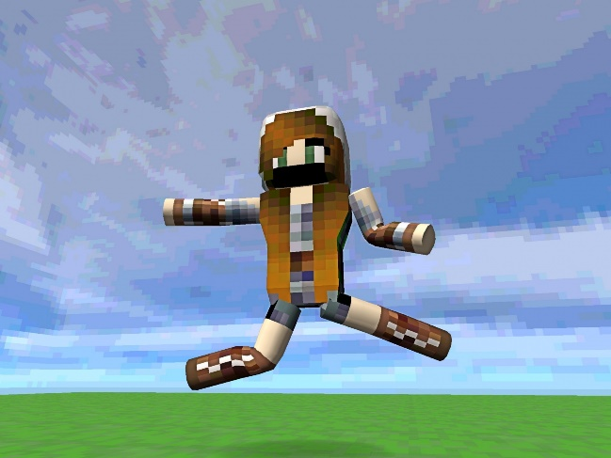
Vokabeln
d_ _ J_ _ _ _
d_ _ K_ _ _ _ _
k_ _ _ _ _
d_ _ _ _ _
s_ _ _ _ _
d_ _ V_ _ _ _
d_ _ N_ _ _ _
d_ _ M_ _ _ _ _
d_ _ M_ _ _ _ _ _
d_ _ T_ _
d_ _ K_ _ _
d_ _ C_ _ _ _ _ _ _ _ _ _ _ _
das Computerspiel
Notes:
As for previous slide.

Slide 26
Vokabeln
d_ _ J_ _ _ _
d_ _ K_ _ _ _ _
k_ _ _ _ _
d_ _ _ _ _
stehen
s_ _ _ _ _
[to stand]
d_ _ V_ _ _ _
d_ _ N_ _ _ _
d_ _ M_ _ _ _ _
d_ _ M_ _ _ _ _ _
d_ _ T_ _
d_ _ K_ _ _
d_ _ C_ _ _ _ _ _ _ _ _ _ _ _
Notes:
As for previous slide.

Slide 27
Vokabeln
d_ _ J_ _ _ _
d_ _ K_ _ _ _ _
k_ _ _ _ _
der Körper
d_ _ _ _ _
s_ _ _ _ _
d_ _ V_ _ _ _
d_ _ N_ _ _ _
d_ _ M_ _ _ _ _
d_ _ M_ _ _ _ _ _
d_ _ T_ _
d_ _ K_ _ _
d_ _ C_ _ _ _ _ _ _ _ _ _ _ _
Notes:
As for previous slide.

Slide 28
Vokabeln
d_ _ J_ _ _ _
kommen
d_ _ K_ _ _ _ _
k_ _ _ _ _
d_ _ _ _ _
s_ _ _ _ _
[to come]
d_ _ V_ _ _ _
d_ _ N_ _ _ _
d_ _ M_ _ _ _ _
d_ _ M_ _ _ _ _ _
d_ _ T_ _
d_ _ K_ _ _
d_ _ C_ _ _ _ _ _ _ _ _ _ _ _
Notes:
As for previous slide.

Slide 29
Vokabeln
d_ _ J_ _ _ _
d_ _ K_ _ _ _ _
k_ _ _ _ _
d_ _ _ _ _
s_ _ _ _ _
d_ _ V_ _ _ _
d_ _ N_ _ _ _
d_ _ M_ _ _ _ _
das Mädchen
d_ _ M_ _ _ _ _ _
d_ _ T_ _
d_ _ K_ _ _
d_ _ C_ _ _ _ _ _ _ _ _ _ _ _
Notes:
As for previous slide.

Slide 30
Vokabeln
d_ _ J_ _ _ _
d_ _ K_ _ _ _ _
k_ _ _ _ _
d_ _ _ _ _
s_ _ _ _ _
d_ _ V_ _ _ _
d_ _ N_ _ _ _
die Nacht
d_ _ M_ _ _ _ _
d_ _ M_ _ _ _ _ _
d_ _ T_ _
d_ _ K_ _ _
d_ _ C_ _ _ _ _ _ _ _ _ _ _ _
Notes:
As for previous slide.

Slide 31
Vokabeln
d_ _ J_ _ _ _
d_ _ K_ _ _ _ _
k_ _ _ _ _
d_ _ _ _ _
s_ _ _ _ _
der Vater
d_ _ V_ _ _ _
d_ _ N_ _ _ _
d_ _ M_ _ _ _ _
d_ _ M_ _ _ _ _ _
d_ _ T_ _
d_ _ K_ _ _
d_ _ C_ _ _ _ _ _ _ _ _ _ _ _
Notes:
As for previous slide.

Slide 32
Vokabeln
d_ _ J_ _ _ _
d_ _ K_ _ _ _ _
k_ _ _ _ _
d_ _ _ _ _
s_ _ _ _ _
d_ _ V_ _ _ _
d_ _ N_ _ _ _
d_ _ M_ _ _ _ _
d_ _ M_ _ _ _ _ _
die Tür
d_ _ T_ _
d_ _ K_ _ _
d_ _ C_ _ _ _ _ _ _ _ _ _ _ _
Notes:
As for previous slide.

Slide 33
Narrating with nouns – using gender and words for 'the' correctly
Definite articles - singular
SSC [u]
Y7 German
Term 1.2 - Week 5 - Lesson 24
Leigh McClelland / Rachel Hawkes
Artwork: Steve Clarke
Date updated: 15/12/21
Notes:
Artwork by Steve Clarke. All additional pictures selected are available under a Creative Common license; no attribution required.
Learning outcomes (lesson 2):
Consolidation of SSC [u]
Consolidation of singular definite articles
Word frequency (1 is the most frequent word in German):
7.1.2.5 (introduce) kommen [62] stehen [85] Junge [548] Kopf [250] Körper [488] Mädchen [602] Mutter [218] Nacht [325] Tür [375] Vater [232] dunkel [706]
7.1.2.2 (revisit) arbeiten [234] kochen [1481] putzen [3586] sitzen [231] Auto [361] Boden [536] Garten [1158] Liste [1792] Zimmer [665] nochmal [1984] ich verstehe nicht [n/a] zu Hause [n/a] Hausaufgaben [Haus+aufgabe]
7.1.1.3 (revisit) bin [4] ich [10] Ding [370] Form [307] Mensch [90] blau [948] gelb [1446] groß1 [67] gut [76] klein [110] rot [477] wie? [25] und [2] bitte [471] danke [877] ein, eine [5] wie geht's? [n/a]
Source: Jones, R.L. & Tschirner, E. (2019). A frequency dictionary of German: core vocabulary for learners. Routledge

Slide 34
Vowels
German vowels can be short or long.
Vowels are short when followed by more than one consonant, e.g., hundert, nutzen.
Vowels are long when:
there is a double vowel (no examples of ‘uu’ in German)
or when followed by the letter ‘h’, e.g., Uhr,
or by a single consonant, e.g., absolut.
Notes:
Timing: 2 minutes Aim: To recap what students were taught in Week 1 about the long/short [a] SSC.
Note: Here we include ‘hundert’ and ‘Uhr’, which students will be taught soon when they learn other SSC.
Procedure: 1. Click to animate the explanation.
2. Ensure students’ understanding at each stage.
Word frequency (1 is the most frequent word in German):
hundert [945] and Uhr [349]
Source: Jones, R.L. & Tschirner, E. (2011). A frequency dictionary of German: core vocabulary for learners. Routledge

Slide 35
‘U’: lang oder kurz?
Was passt nicht?
R.
und /
putzen /
du
U.
der Zug /
der Junge /
der Hund
S.
die Mutter /
der Hut /
der Grund
V.
der Bruder /
dunkel /
zu Hause
T.
die Uniform /
die Nummer /
gesund
Notes:
Timing: 6 minutes Aim: To practise distinguishing between the long and short ‘u’ sound.
Note: This task includes some unknown high-frequency words that will soon be appearing on the SOW, as well as a few known words.
Procedure: 1. Animations are staged to allow R and S to be worked through as examples.
2. Then T-V appear together, for students to have a few minutes to work on in pairs before whole class feedback of answers.

Slide 36
Schreib diese Filmszene auf Deutsch
1. The family is at home.
2. The house is small but the garden is big.
3. The father is sitting in the room and he is working.
4. The boy is standing and he is cooking.
5. The girl is writing a list and the mother is coming.
6. The night is dark. One person is not a human being…
Die Familie ist zu Hause.
Das Hause ist klein aber der Garten ist groß.
Der Vater sitzt im Zimmer und er arbeitet.
Der Junge steht und er kocht.
Das Mädchen schreibt eine Liste und die Mutter kommt.
Die Nacht ist dunkel. Eine Person ist kein Mensch…
Notes:
Timing: 12 minutes Aim: To practise writing sentences using the known vocabulary.
Note: this task cues German present tense using predominantly the present continuous in English (which fits the context for a set of stage/film directions describing a scene before the main action starts). This provides another opportunity to practise this important cross-linguistic difference in production, written modality. In the previous lesson we practised comprehension of the same. Students need repeated practice with this language feature. In addition, this task also practises noun gender, definite/indefinite article differentiation and the use of ‘kein’, which was introduced several weeks ago.
Procedure: 1. Students translate th sentences into German.
2. Click to reveal the suggested translations one by one.
Note: this task may be deemed too challenging for some groups. There are several ways to differentiate it to provide scaffolding / reduce the level of challenge. 1] Provide the language as an L2 → L1 translation. Students will still engage in mapping the meaning of English present continuous to German present tense. 2] Restructure the task as a jigsaw translation - Provide English and German versions of the text alongside each other, with different gaps. See the next slide for an example of this. 3] As above, but provide the first letter of each of the German words. This provides only limited support for the vocabulary retrieval but note that it does not allow for such a clear focus on the present continuous / German present tense comparison.
An alternative ‘jigsaw’ translation task format is to be found on the next slide.

Slide 37
Schreib diese Filmszene auf Deutsch
1. ___ ________ is at home.
2. ___ ______ is small ___ the garden ____ big.
3. ____ ______ is sitting ___ ___ _______ and ___ is working.
4. ____ ________ __ __________ and he is cooking.
5. ___ _________ is writing a list ___ ___ _________ is coming.
6. The _______ ___ dark. One ________ _____ not a human being…
1. Die Familie ____ ___ __________.
2. Das Haus ___ ______ aber ____ ________ ist _______.
3. Der Vater _________ im Zimmer ____ er __________.
4. Der Junge steht ___ ___ ___________.
5. Das Mädchen _________ _____ _______ und die Mutter _________.
6. ____ Nacht ist________. _____ Person ist _____ __________...
The family
ist zu Hause
The house
but
ist klein
der
is
Garten
groß
The father
in the room
sitzt
he
und
arbeitet
The boy
is standing
und
er
kocht
The girl
and
the
schreibt
eine
mother
Liste
kommt
night
is
Die
dunkel
Eine
person
is
kein
Mensch
Notes:
Alternative ‘jigsaw’ translation task format

Slide 38
Partnerarbeit
sprechen
Partner A
Say the sentence to your partner in German, but do not say the noun that is crossed out. Chose the German word for ‘the’ carefully (der, die or das). Your partner will choose between two pictures.
S/he will then write out the whole sentence in German – so give a moment to do this.
Partner B
Listen to your partner saying five sentences. For each, tick the noun that matches the word for the that your partner says.
Then try to write the spelling of each whole sentence that your partner has read out.
Notes:
Timing: 2 minutes Aim: To introduce and explain the paired speaking activity which follows.
Procedure: 1. Click to animate the explanation.
2. Ensure students’ understanding at each stage.

Slide 39
Partnerarbeit
Partner A
[The girl] spielt Fußball.
[The mother] trinkt Wasser.
[The door] ist offen.
[The monster] ist groß.
[The man] lächelt schön.
Das Mädchen spielt Fußball.
Die Mutter trinkt Wasser.
Die Tür ist offen.
Das Monster ist groß.
Der Mann lächelt schön.
Notes:
DO NOT DISPLAY THIS SLIDE DURING THE ACTIVITY
This is Partner A’s card, and should be printed out for use during the activity.
Note: The German support (on right) can be provided for students as necessary.
Timing: 6 minutes Aim: To practise matching nouns to their gender (definite article).
Procedure: 1. Partner A says the sentences in German, minus the crossed-out noun, as per the instructions on the previous slide.
2. Partner B chooses the correct noun from a choice of pictues, based on the gender of the article heard.

Slide 40
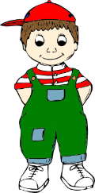
Partnerarbeit
Partner B
1.
2.
3.
4.
5.
Notes:
This is Partner B’s card, and should be printed out for use during the activity.
Procedure: 1. Partner A says the sentences in German, minus the crossed-out noun, as per the instructions on the previous slide.
2. Partner B chooses the correct noun from the choice of pictues, based on the gender of the article heard.
3. The answers are animated on the next slide.

Slide 41
Partnerarbeit
Partner B
1.
Das
Mädchen
spielt
Fußball.
2.
Die
Mutter
trinkt
Wasser.
3.
Die
Tür
ist
offen.
4.
Das
Monster
ist
groß.
5.
Der
Mann
lächelt
schön.
Notes:
This slide provides the animated answers to the paired speaking activity.

Slide 42
Partnerarbeit [2]
Now swap roles!
Partner B
Now say your five sentences to your partner in German, but do not say out loud the crossed out noun. Use the correct word for ‘the’ (der, die or das). Your partner will choose between two pictures. S/he will then write out the whole sentence in German – so give a moment to do this.
Partner A
Listen to your partner saying five sentences. For each, tick the noun that matches the word for the that your partner says. Then try to write the spelling of each whole sentence that your partner has read out.
Notes:
Partners now swap roles and repeat the exercise.
Timing: 2 minutes Aim: To introduce and explain the paired speaking activity which follows.
Procedure: 1. Click to animate the explanation.
2. Ensure students’ understanding at each stage.

Slide 43
Partnerarbeit
Partner B
[The book] ist nicht lang.
[The head] explodiert plötzlich.
[The family] macht ein Picknick.
[The house] kostet eine Million Euro.
[The hand] ist kalt.
Das Buch ist nicht lang.
Der Kopf explodiert plötzlich.
Die Familie macht ein Picknick.
Das Haus kostet eine Million Euro.
Die Hand ist kalt.
Notes:
DO NOT DISPLAY THIS SLIDE DURING THE ACTIVITY
This is Partner B’s card, and should be printed out for use during the activity.
Timing: 6 minutes Aim: To practise matching nouns to their gender (definite article).
Procedure: 1. Partner B says the sentences in German, minus the crossed-out noun, as per the instructions on the previous slide.
2. Partner A chooses the correct noun from a choice of pictues, based on the gender of the article heard.

Slide 44
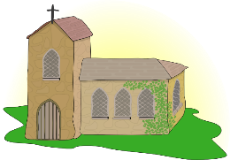
Partnerarbeit
Partner A
1.
2.
3.
4.
5.
Notes:
This is Partner A’s card, and should be printed out for use during the activity.
Procedure: 1. Partner B says the sentences in German, minus the crossed-out noun, as per the instructions on the previous slide.
2. Partner A chooses the correct noun from the choice of pictues, based on the gender of the article heard.
3. The answers are animated on the next slide.

Slide 45
Partnerarbeit
Partner A
1.
Das
Buch
ist
nicht
lang.
2.
Der
Kopf
explodiert
plötzlich.
3.
Die
Familie
macht
ein
Picknick.
4.
Das
Haus
kostet
eine
Million
Euro.
5.
Die
Hand
ist
kalt.
Notes:
This slide provides the animated answers for the second round of the exercise.

Slide 46
Schreib eine Filmszene
schreiben
Write sentences in German based on these words. You may add other words. Choose the words for the carefully.
Mann/trinkt
Haus/ist
Mädchen/spielt
Nacht/ist
Junge/liest
Mutter/spielt
Der Mann trinkt Wasser.
Das Haus ist klein/groß/neu/offen/schön.
Das Mädchen spielt Fußball (mit einem Freund).
Die Nacht ist lang und dunkel.
Der Junge liest ein Buch.
Die Mutter spielt Tennis.
Notes:
Timing: 14 minutes (including 2 minutes to set homework) Aim: To practise writing sentences using the vocabulary presented.
Procedure: 1. Students create sentences in German, based on the prompt words. They should add known source or cluster words if they want to add more detail.
2. Click to reveal some suggested sentences one by one, also eliciting students’ own examples/variations.

Slide 47
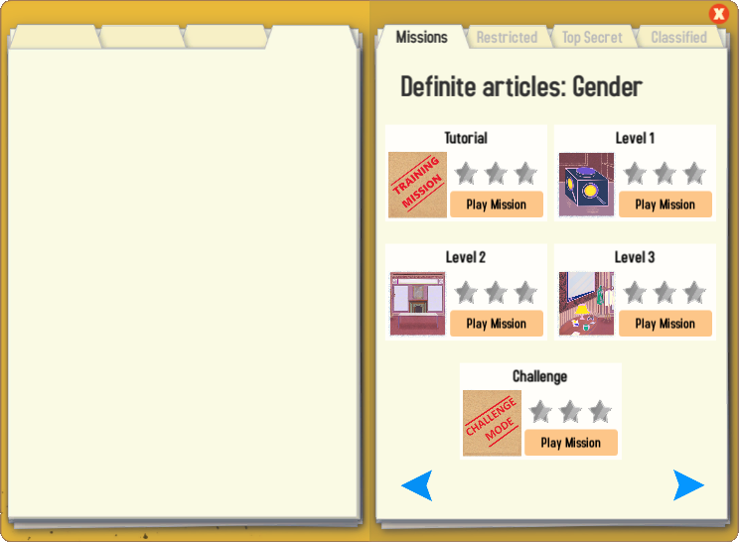
Gaming Grammar
Try the following Gaming Grammar missions to practise:

Slide 48
Hausaufgaben
Vocabulary Learning Homework (Term 1.2, Week 6)
Audio file
Audio file QR code:
Student worksheet
Quizlet
In addition, revisit: Term 1.2 Week 3
Term 1.1 Week 4
Notes:
Use this slide to set the homework.
Icon made by Darius from www.flaticon.com (freely usable image).

