Slide 1
I have 'the' vs I have 'a' Possession of the only one or one of many
Indefinite articles (singular) - Row 2 (accusative); HABEN / ich habe, du hast, er/sie hat
Y7 German
Term 1.1 - Week 6 - Lesson 11
Inge Alferink / Rachel Hawkes
Artwork: Steve Clarke
Date updated: 15/12/21
Notes:
Artwork by Steve Clarke. All additional pictures selected are available under a Creative Common license; no attribution required.
Learning outcomes (lesson 1):
Introduction of HABEN / ich habe, du hast, er/sie hat
Introduction of indefinite articles (singular) – Row 2 (accusative)
Word frequency (1 is the most frequent word in German):
7.1.1.6 (introduce) habe, hast [6] Beispiel [94] Erste [95] Frage [157] Frau1 [99] Grund [249] Hand [180] Herr [154] Problem [210] Schule [359]
Wer hat einen Grund / eine Frage / ein Beispiel / ein Problem? Wer ist der/die/das Erste?
7.1.1.3 (revisit) bin [4] ich [10] Ding [370] Form [307] Mensch [90] blau [948] gelb [1446] groß1 [67] gut [76] klein [110] rot [477] wie? [25] und [2] bitte [471] danke [877] ein, eine [5] wie geht's? [n/a]
Source: Jones, R.L. & Tschirner, E. (2019). A frequency dictionary of German: core vocabulary for learners. Routledge

Slide 2
haben
[to have | having]
hat
[has]
Notes:
Timing: 3 minutes for sequence of six verbs
Aim: To introduce the verb haben more explicitly.
Note: Haben is one of the 25 most frequently used verbs in German. All 25 most frequent verbs will be introduced early on using the same format. Both long form (infinitive) and short form (3rd person singular) are introduced in order to familiarise students with various forms of the same verb.
Procedure:
Bring up the word haben on its own, say it, students repeat it, and remind them of the phonics. Draw attention to the long [a].
Try to elicit the meaning from the students. Students have had explicit teaching that the present tense in German communicates two different present tense meanings in English. This reinforces that learning.
Then bring up the English translations. Emphasise the two meanings for the infinitive.
Bring up the short form hat, say it, students repeat it. Draw attention to the short [a].
Try to elicit the meaning from the students.

Slide 3
haben
[to have| having]
hat
[has]
Notes:
Cycle through the long and short form again.

Slide 4
hat
[has]
Markus hat ein Fahrrad.
[Markus has a bike.]
Notes:
Introduce the short form in a sentence.
Word frequency (1 is the most frequent word in German): das Fahrrad [1596] Source: Jones, R.L. & Tschirner, E. (2011). A frequency dictionary of German: core vocabulary for learners. Routledge

Slide 5
haben
[to have | having]
Markus muss ein Fahrrad haben.
[Markus must have a bike.]
Notes:
Introduce the long form in a sentence.
Word frequency (1 is the most frequent word in German): das Fahrrad [1596] Source: Jones, R.L. & Tschirner, E. (2011). A frequency dictionary of German: core vocabulary for learners. Routledge

Slide 6
hat
[has]
hat
Markus ____ ein Fahrrad.
[Markus has a bike].
Notes:
Cycle through the short form in context again.
Word frequency (1 is the most frequent word in German): das Fahrrad [1596] Source: Jones, R.L. & Tschirner, E. (2011). A frequency dictionary of German: core vocabulary for learners. Routledge

Slide 7
haben
[to have | having]
Markus muss ein Fahrrad_______.
haben
[Markus must have a bike.]
Notes:
Cycle through the long form in context again.
Word frequency (1 is the most frequent word in German): das Fahrrad [1596] Source: Jones, R.L. & Tschirner, E. (2011). A frequency dictionary of German: core vocabulary for learners. Routledge

Slide 8
Vokabeln
sprechen
die Frau
Notes:
Timing: 5 minutes (all 8 vocabulary slides) Aim: To introduce new vocabulary. Procedure: 1. Elicit German word suggsted by picture.
2. Click to bring up the German.
Word frequency (1 is the most frequent word in German): 7.1.1.6 (introduce) ich habe [8/7] du hast [52/7] Beispiel [89] Erste [91] Frage [152] Frau1 [103] Grund [230] Hand [179] Herr [187] Problem [189] Schule [208]
Source: Jones, R.L. & Tschirner, E. (2011). A frequency dictionary of German: core vocabulary for learners. Routledge

Slide 9
Vokabeln
sprechen
die Hand
Notes:
As for previous slide.

Slide 10
Vokabeln
sprechen
die Schule
Notes:
As for previous slide.

Slide 11
Vokabeln
sprechen
der Herr
Notes:
As for previous slide.

Slide 12
Vokabeln
sprechen
das Problem
[problem]
Notes:
As for previous slide.

Slide 13
Vokabeln
sprechen
das Beispiel
[example]
Notes:
As for previous slide.

Slide 14
Vokabeln
sprechen
die Frage
Notes:
As for previous slide.

Slide 15
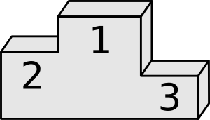
Vokabeln
sprechen
der / die / das Erste
Notes:
As for previous slide.

Slide 16
Vokabeln
B
A
C
D
E
F
G
H
10
I
J
K
L
Notes:
Timing: 5 minutes Aim: To recap vocabulary from previous weeks. Procedure: 1. Students write 1-12 in books.
2. Click / press enter to flash a picture. They will disappear after 3 seconds. Note that they do not appear in alphabetical order to keep the students on their toes.
3. Ask students to write down the German word before the picture has faded away. 4. Check answers by eliciting the German from students, with definite article.

Slide 17
Vokabeln
10
DER
DIE
DAS
Notes:
Timing: 5 minutes Aim: To consolidate knowledge of noun gender (via definite article) with known vocabulary. Procedure: 1. Click to bring up each item in turn.
2. Students say the colour of the correct gender box for the noun pictured.
3. Click to make the picture ‘fly’ to the correct box.

Slide 18
Vokabeln
Notes:
Timing: 5 minutes Aim: To consolidate understanding of the use of the definite or indefinite artile according to the concept -'the' one or just 'one/a' of several.
Procedure: 1. Teacher contrasts the definite and indefinite articles using the cards from the previous lesson. E.g. Showing the card with the bottle, s/he says 'Das ist die Flasche. Wer hat die Flasche?'
NB: at this point only 1 student has a card with a bottle --> ich habe die Flasche.
2. S/he checks again that students still understand the meaning of 'der, die, das'
3. S/he gives out several more cards with bottles and ask same question - this time the answer has to be: Ich habe eine Flasche. Clear modelling of concept -'the' one or just 'one/a' of several.
4. S/he checks again that students still understand the meaning of 'der, die, das' and 'ein/ein/eine'.

Slide 19
Vokabeln
10
EIN
EINE
EIN
Notes:
Timing: 5 minutes Aim: To consolidate knowledge of noun gender (via indefinite article) with known vocabulary. Procedure: 1. Click to bring up each item in turn.
2. Students say the colour of the correct gender box for the noun pictured.
3. Click to make the picture ‘fly’ to the correct box.

Slide 20
Grammatik
sprechen
PERSON A
Say the start of the sentence in German.
Say the correct word for ‘a’: ein or eine.
Do not say the noun!
PERSON B
Listen carefully.
E.g., ‘Das ist ein…’
or ‘Das ist eine…’)
Which picture is it?
Choose based on the noun’s gender.
E.g.
E.g. ‘Das ist eine …’
Notes:
Timing: 5 minutes Aim: To practise the indefinite article in the spoken modality. Procedure: 1. Using the cards on the next slide (do not display during the activity!), Person A provides the spoken prompt and person B ticks the corresponding picture.

Slide 21
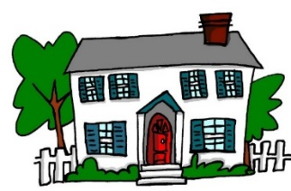
Grammatik
PERSON A
Das ist _____
2) Das ist _____
3) Das ist _____
4) Das ist _____
5) Das ist _____
PERSON B
2)
3)
4)
5)
10
Inge Alferink / Rachel Hawkes
Notes:
These cards are for use in the speaking activity explained on the previous slide.

Slide 22
einen = ‘a’ after a verb
Grammatik
As you know, German has three words for a:
masculine
feminine
neuter
ein Tisch
eine Flasche
ein Fenster
Only the masculine changes. Feminine and neuter words for ‘a’ stay the same!
After a verb the masculine word for a changes:
Niko hat einen Tisch
Niko hat einen Rucksack
Niko hat einen Mann
This change happens after all verbs except ‘to be/ is’
Notes:
Timing: 1 minutes Aim: To introduce the Row 2 (accusative) form of the indefinite article. Procedure: 1. Click to animate the explanation.
2. Check students’ understanding at each stage.

Slide 23
Grammatik
hören
 | other verb | to be
 | hat | ist
te | gewinnt | ist
 | hat | ist
 | hat | ist
 | hat | ist
 | gewinnt | ist
Listen.
Is the missing verb a form of to be or a different verb?
Remember: pay attention to the article.
1
2
3
4
5
6
Notes:
Timing: 3 minutes Aim: To practise 'indefinite' article - nominative R1 and accusative R2 - in the listening modality.
Procedure: 1. Click on the audio buttons to play the sentences.
2. Students tick the column of the missing verb in each case (considering the form of the definite article which follows).
3. Click to bring up the answers.
Transcript:
Jonah [hat] einen Freund.
Niko [gewinnt] einen Fußball.
Die Frau [hat] einen Tisch.
Julius [ist] ein Mann.
David [hat] einen Rucksack.
Eine Trophäe [ist] ein Preis.
Word frequency (1 is the most frequent word in German): die Trophäe [>5000] der Rucksack [3915] der Preis [438]
Source: Jones, R.L. & Tschirner, E. (2011). A frequency dictionary of German: core vocabulary for learners. Routledge

Slide 24
Grammatik
lesen
ein
Niko ist ______ Mann.
Das Tier hat _______ Fußball.
Jonah ist ______ Freund.
Wer hat ______ Tisch?
Die Frau ist _______ Gast.
David gewinnt _______ Preis.
Der Lehrer schreibt _______ Wort.
Das Lyzeum ist _______ Schule.
einen
Fill in the correct form of ‘a’.
Pay attention to the verb AND noun to decide which form to use.
ein
einen
ein
einen
ein
eine
Inge Alferink / Rachel Hawkes
Notes:
Timing: 5 minutes Aim: Continuing to practise 'indefinite' article nominative R1 and accusative R2.
Procedure: 1. Students fill in the correct form of the indefinite article. They use the verb and knowledge of the noun’s gender to determine which form to use.
2. Click to animate the answers. Word frequency (1 is the most frequent word in German): der Gast [675] der Preis [438] Source: Jones, R.L. & Tschirner, E. (2011). A frequency dictionary of German: core vocabulary for learners. Routledge

Slide 25
Grammatik
hören
ich habe
[I have]
Ich habe ein Fahrrad.
[I have a bicycle]
Notes:
Timing: 3 minutes (all 4 verb slides) Aim: Expanding the to have / having paradigm to include first person (I have / Ich habe) and second person (you have / du hast) singular. Procedure: 1. Click to animate the slide.
Word frequency (1 is the most frequent word in German): das Fahrrad [1596] Source: Jones, R.L. & Tschirner, E. (2011). A frequency dictionary of German: core vocabulary for learners. Routledge

Slide 26
Grammatik
hören
ich habe
habe
[I have]
Ich habe ein Fahrrad.
habe
[I have a bicycle]
Notes:
Procedure: 1. Click to animate the slide.
2. Elicit the English meaning and German verb form from students. Word frequency (1 is the most frequent word in German): das Fahrrad [1596] Source: Jones, R.L. & Tschirner, E. (2011). A frequency dictionary of German: core vocabulary for learners. Routledge

Slide 27
Grammatik
hören
du hast
[you have]
Du hast ein Fahrrad.
[you have a bicycle]
Notes:
Procedure: 1. Click to animate the slide.
Word frequency (1 is the most frequent word in German): das Fahrrad [1596] Source: Jones, R.L. & Tschirner, E. (2011). A frequency dictionary of German: core vocabulary for learners. Routledge

Slide 28
Grammatik
hören
du hast
hast
[you have]
Du hast ein Fahrrad.
hast
[you have a bicycle]
Notes:
Procedure: 1. Click to animate the slide.
2. Elicit the English meaning and German verb form from students. Word frequency (1 is the most frequent word in German): das Fahrrad [1596] Source: Jones, R.L. & Tschirner, E. (2011). A frequency dictionary of German: core vocabulary for learners. Routledge

Slide 29
Grammatik
hören
Frau Organisiert is organising for her husband, Herr Organisiert!
Who has what?
Write I have or you have.
I have
you have
 |  | Object
1
a football
2
a bottle
3
a pet
4
an exercise book
5
a house
6
a number
7
a bicycle
Notes:
Timing: 5 minutes Aim: Practising I have / you have in a listening activity.
Procedure: 1. Students write 1-7 in their books.
2. Click on the audio button to play each sentence. The pronouns have been obscured, so students have to pay attention to the verb endings.
3. Students tick the appropriate column, for ‘I have’ or ‘you have’.
4. Click to bring up the answers.
Word frequency (1 is the most frequent word in German): das Fahrrad [1596] Source: Jones, R.L. & Tschirner, E. (2011). A frequency dictionary of German: core vocabulary for learners. Routledge

Slide 30
Grammatik
lesen
Herr Organisiert wrote down his wife’s list, but spilt coffee on it. Who has what? Write I have or you have.
I have
you have
du hast einen Fußball.
du habe eine Flasche.
ich habe ein Haustier.
ich habe ein Heft.
du hast ein Haus.
ich habe eine Nummer.
du hast ein Fahrrad.
Notes:
OPTIONAL
Timing: 5 minutes Aim: Practising I have / you have in a reading activity.
Procedure: 1. Students write 1-7 in their books.
2. Students read each sentence. The pronouns have been obscured, so students have to pay attention to the verb endings.
3. Students tick the appropriate column, for ‘I have’ or ‘you have’.
4. Click to bring up the answers.
Word frequency (1 is the most frequent word in German): das Fahrrad [1596] Source: Jones, R.L. & Tschirner, E. (2011). A frequency dictionary of German: core vocabulary for learners. Routledge

Slide 31
Grammatik
schreiben
Du hast eine Flasche.
Notes:
OPTIONAL
Timing: 6 minutes (all 6 slides) Aim: Practising I have / you have, together with the Row 2 (accusative) forms of the definite article, in a writing activity. Procedure: 1. Students consider the picture and write the sentence in German.
2. Click to bring up the answer.

Slide 32
Grammatik
schreiben
Ich habe einen Fußball.
Notes:
As for previous slide.

Slide 33
Grammatik
schreiben
Ich habe ein Haustier.
Notes:
As for previous slide.

Slide 34
Grammatik
schreiben
Ich habe ein Wort.
Notes:
As for previous slide.

Slide 35
Grammatik
schreiben
Du hast einen Freund.
Victoria Hobson / Nick Avery
Notes:
As for previous slide.

Slide 36
Grammatik
schreiben
10
Du hast eine Nummer.
Notes:
As for previous slide.

Slide 37
I have 'the' vs I have 'a' Possession of the only one or one of many
Indefinite articles (singular) - Row 2 (accusative); HABEN / ich habe, du hast, er/sie hat
SSC Recap [a] [e] [ei] [z ] [w]
Y7 German
Term 1.1 - Week 6 - Lesson 12
Inge Alferink / Rachel Hawkes
Artwork: Steve Clarke
Date updated: 15/12/21
Notes:
Artwork by Steve Clarke. All additional pictures selected are available under a Creative Common license; no attribution required.
Learning outcomes (lesson 2):
Consolidation of HABEN / ich habe, du hast, er/sie hat
Consolidation of indefinite articles (singular) – Row 2 (accusative)SSC Recap [a] [e] [ei] [z ] [w]
SSC - Recap [a] [e] [ei] [z ] [w]
Word frequency (1 is the most frequent word in German):
7.1.1.6 (introduce) habe, hast [6] Beispiel [94] Erste [95] Frage [157] Frau1 [99] Grund [249] Hand [180] Herr [154] Problem [210] Schule [359]
Wer hat einen Grund / eine Frage / ein Beispiel / ein Problem? Wer ist der/die/das Erste?
7.1.1.3 (revisit) bin [4] ich [10] Ding [370] Form [307] Mensch [90] blau [948] gelb [1446] groß1 [67] gut [76] klein [110] rot [477] wie? [25] und [2] bitte [471] danke [877] ein, eine [5] wie geht's? [n/a]
Source: Jones, R.L. & Tschirner, E. (2019). A frequency dictionary of German: core vocabulary for learners. Routledge

Slide 38
Phonetik
hören / sprechen
sagen
geben
Welt
Zug
frei
kalt
denken
Notes:
Timing: 3 minutes Aim: To revise all the SSCs introduced so far: long and short a, long and short e, ei, W, Z.
Procedure: 1. Click on the word to play the audio. Repeat if necessary.
2. Students write the whole word in full in their exercise books.
3. The next slide allows removal of the ‘blots’ to reveal the missing SSCs.

Slide 39
Phonetik
hören / sprechen
sagen
geben
Welt
Zug
frei
kalt
denken
Notes:
Timing: 1 minute Aim: To reveal the answers to the activity. Procedure: 1. Click on the ‘blots to remove them individually and reveal the missing SSCs.

Slide 40
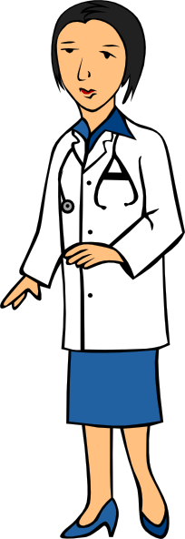
Phonetik
zehn
antworten
A
D
Zug
H
allein
C
E
Welt
klein
[alone]
Wasser
I
F
G
frei
B
Arzt
Notes:
Timing: 5 minutes Aim: To consolidate SSC knowledge
Ask students to write down which pictures go together (based on the obscured SSC).
The teacher can remind them of the source words they have just seen.
Clicking on the pictures will play the word if the students need an extra prompt.
Clicking on the paw prints will remove them.

Slide 41
Phonetik
Arzt
lesen / sprechen
antworten
60
zehn
Zug
allein
Sekunden
Welt
frei
klein
Wasser
0
LOS!
Notes:
Timing: 2 minutes (one minute per attempt) Aim: To consolidate SSC knowledge. Procedure: 1. Pupils read out the words but in alphabetical order. They keep going for one minute.
2. Teacher can circulate to listen into their SSC knowledge.
Word frequency (1 is the most frequent word in German): der Arzt [614] allein [258] Source: Jones, R.L. & Tschirner, E. (2011). A frequency dictionary of German: core vocabulary for learners. Routledge

Slide 42
Vokabeln
I
J
K
L
the human being
the problem
the table
the school
M
a woman
the example
the board
a friend (male)
N
an animal
a question
the place
a colour
O
Notes:
Timing: 5 minutes Aim: Revisiting known nouns with either indefinite or definite articles. Procedure: 1. This can be a whole class activity. Teams A/B (class halves) 2. Students nominate any ‘card’ giving coordinates e.g. ‘M-I’ 3. Teacher clicks the card to reveal the English prompt for 2 seconds and then again to hide the card.
4. Student tries to name the item, giving the correct article. e.g. das Problem.
5. If unable to do so, item is re-covered, play continues with Team B.
Note: The slide could be used for many other varieties of vocabulary retrieval, e.g. individual written production using mini whiteboards.

Slide 43
Grammatik
Wolfgang is donating some things. Mia asks him what he has.
hören
For each item check whether it is the only one or one of many.
1
2
3
4
5
Notes:
Timing: 3 minutes Aim: To consolidate knowledge of the meanings of the definite and indefinite articles. Procedure: 1. Click once to bring up the first set of pictures.
2. Click on the audio button to play the question.
3. Students tick whether the item mentioned is the only one, or one of many, by considering whether the definite or indefinite article is used to refer to it.
4. Click a second time to bring up the correct answer.
5. Repeat for the other questions in turn.
Transcript: 1. Hast du eine Flasche?
2. Hast du den Fußball?
3. Hast du einen Tisch?
4. Hast du die Tafel?
5. Hast du das Heft?

Slide 44
Grammatik
schreiben
Beispiel: 1. I have a bottle.
Ich habe eine Flasche.
I have a bottle.
You have the table.
What is the colour?
The woman has a boyfriend.
Where is the place?
Who is the guest?
The man has a football.
You are a human being.
Ich habe eine Flasche.
Du hast den Tisch.
Was ist die Farbe?
Die Frau hat einen Freund.
Wo ist der Ort?
Wer ist der Gast?
Der Mann hat einen Fußball.
Du bist ein Mensch.
Notes:
Timing: 10 minutes Aim: To practise the grammar and vocabulary taught, in the writing modality. Procedure: 1. Click to reveal the example sentence, then the translation.
2. Do the same for the first question, eliciting the answer from students.
3. Then bring up the rest of the questions one by one (to avoid overload).
4. Click to bring up the answers one by one.

Slide 45
Phonetik
hören / schreiben
1
ei
Der Mann sit_t all__n. ☹
z
2
e
a
Der Arzt d_nkt ’W_s?!’
3
ei
i
Der Gast hat __n Z_mmer.
4
Der Freund ge_ innt __n B_tt.
w
ei
e
5
ei
a
Die Frau h_t __nen G_st.
a
6
a
Der Lehrer s_gt ‘Hurr_’. ☺
a
Notes:
Timing: 5 minutes Aim: To consolidate all SSCs introduced so far in a written transcription activity. Procedure: 1. Click on the audio buttons to play the sentences.
2. Certain SSCs are missing from the transcript on the slide.
Students listen and write out the sentences in full.
3. Click to bring up the missing SSCs.
Transcript: As displayed on the slide. Word frequency (1 is the most frequent word in German): gewinnen [410] der Arzt [614] der Gast [675] das Zimmer [609] allein [258] Source: Jones, R.L. & Tschirner, E. (2011). A frequency dictionary of German: core vocabulary for learners. Routledge

Slide 46
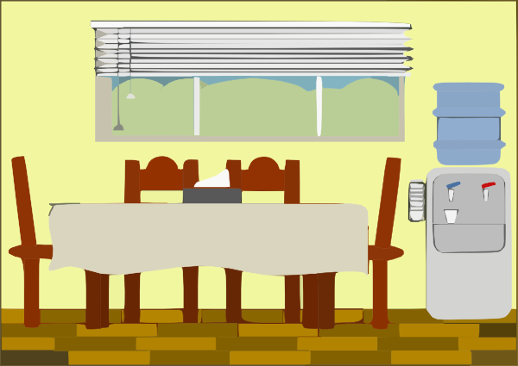
Phonetik
hören / sprechen
1
Der Mann sitzt allein. ☹
2
Der Arzt denkt ’Was?!’
3
der Artzt
Der Gast hat ein Zimmer.
4
Der Freund gewinnt ein Bett.
das Zimmer
5
Die Frau hat einen Gast.
6
Der Lehrer sagt ‘Hurra’. ☺
Notes:
Timing: 5-10 minutes Aim: To consolidate SSC and word knowledge in a listening and speaking activity. Procedure (alternatives): 1. Students read each sentence aloud, as a whole-class activity or in pairs.
2) Students translate the sentences into English (orally or in writing).
3) Students play a paired vocabulary tennis task (with gestures for the verbs)
Word frequency (1 is the most frequent word in German): gewinnen [410] der Arzt [614] der Gast [675] das Zimmer [609] allein [258] Source: Jones, R.L. & Tschirner, E. (2011). A frequency dictionary of German: core vocabulary for learners. Routledge

Slide 47
Phonetik
hören / sprechen
Eine kleine Meise geigt allein eine leise Weise, eine zweite schweigt leider.
Notes:
OPTIONAL TASK
Timing: 5 minutes Aim: To provide SSC practice in the form of a tonguetwister (Zungenbrecher).
Note: The target SSC is ei, but some of the others are covered too: W in Weise, Z in zweite, a in allein. Most of the other sounds that have not been covered so far are similar to English with the exception of sch, which should be pointed out and modelled more carefully.
Procedure: 1. Teacher reads out the whole sentence slowly and then takes the students through it word by word.
2. Teacher models word; students respond with word.
3. Discuss the meaning of the sentence.
4. Students practise saying the sentence individually.
5. They could then do a competition to see who can say it the fastest without tripping up.
Transcript:
As displayed on slide. Word frequency (1 is the most frequent word in German): geigen [>5000] schweigen [863] die Meise [>5000] die Weise [413] leise [1160] leider [642] Source: Jones, R.L. & Tschirner, E. (2011). A frequency dictionary of German: core vocabulary for learners. Routledge

Slide 48
Grammatik
Was ist die Ausnahme?
lesen /hören
1
sein / bist / hast / ist
2
___ Frage / ___ Tisch / ___ Nummer / ___ Farbe
3
A
B
C
D
4
ein Fenster / ein Wort / ein Paar / ein Freund
5
A
B
C
D
6
groß – rot – kalt - sagt
der Lehrer – der Freund – das Heft – die Frau
7
A
B
C
D
8
Notes:
Timing: 5 minutes Aim: To revisit some of the grammar, vocab, and phonics introduced over the past few weeks.
Procedure: 1. Students select the odd one out from the options presented.
2. For the audio items click the letter to play the sound.
3. Click to show the correct answers (see below for rationale).
Transcript/answers: 1. Sein / bist / hast / ist (not a form of sein)
2. die/eine Frage / der/ein Tisch / die/eine Nummer / die/eine Farbe (der/ein Tisch – it’s masculine)
3. frei / allein / Idee / klein (audio – long ‘e’ not ‘ei)
4. Ein Fenster / Ein Wort / Ein Paar / Ein Freund (masculine)
5. Geben / Welt / Leben / sehen (audio – short ‘e’ not long ‘e’)
7. groß / rot / kalt / sagt (verb not adjective)
9. Der Lehrer / Der Freund / Das Heft / Die Frau (thing not person)
10. Wasser / klar / haben / Paar (audio – long ‘a’ not long ‘a’)

Slide 49
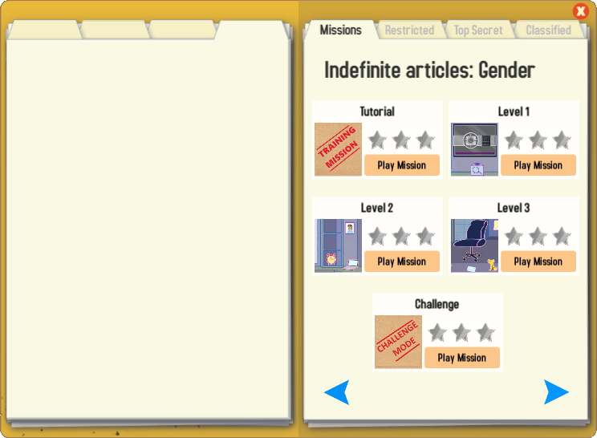
Gaming Grammar
Try the following Gaming Grammar missions to practise:

Slide 50
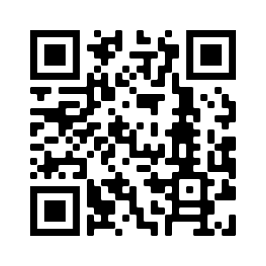
Hausaufgaben
Vocabulary Learning Homework (Y7, Term 1.1, Week 7)
Audio file
Audio file QR code:
Student worksheet
Quizlet link
In addition, revisit: Term 1.1 Week 3
Notes:
Use this slide to set the homework.

