Slide 1
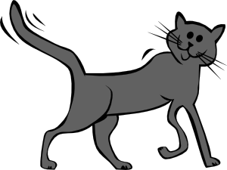
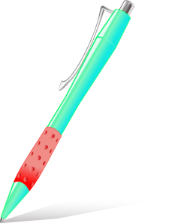
Masculine nouns (un = a)
Vocabulario
un
gato
un
barco
un
bolígrafo
un
libro
Victoria Hobson / Nick Avery
Notes:
Presentation/introduction to the active nouns in the tasks that follow.
Here, all the masculine nouns are introduced. All nouns to be taught this week have regular gender marking (i.e. -o ending with masc nouns; -a ending with feminine nouns). This makes the gender recognition easier for students’ first encounter with the concept of gender of nouns. You could point this out to students, but also so that this is not always the case. Some nouns have other endings (e.g. elefante).
Frequency ranking: barco [1384]; bolígrafo [>5000 –in AQA]; gato [1728]; libro [230]
Source: Davies, M. & Davies, K. (2018). A Frequency Dictionary of Spanish: Core vocabulary for learners (2nd ed.) London: Routledge

Slide 2
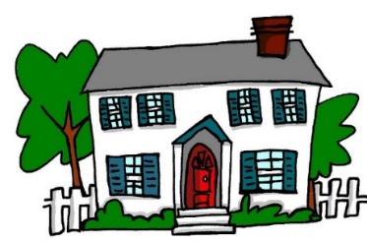
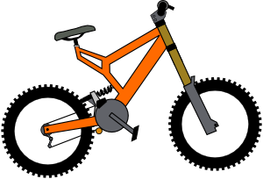
Feminine nouns (una = a)
Vocabulario
una
casa
una
cama
una
cámara
una
bicicleta
una
moneda
Victoria Hobson / Nick Avery
Notes:
Presentation/introduction to the active nouns from the tasks that follow.
Here, all the feminine nouns are introduced.
Frequency ranking: moneda [1577]; cama [609]; casa [106]; cámara [903]; bicicleta [3684];
Source: Davies, M. & Davies, K. (2018). A Frequency Dictionary of Spanish: Core vocabulary for learners (2nd ed.) London: Routledge

Slide 3
Vocabulario
un
una
Victoria Hobson / Nick Avery
Notes:
Students have to predict which pacman will eat the object depending on the noun’s gender.

Slide 4
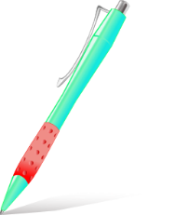
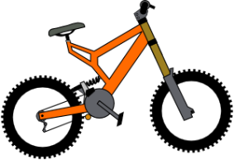
Vocabulary introduction
İPilla al intruso!
Vocabulario
1.
4.
un
un
una
una
una
un
2.
5.
un
una
un
una
un
un
3.
6.
der
una
una
un
una
una
un
Victoria Hobson / Nick Avery
Notes:
Presentation/introduction to the active nouns from the tasks that follow.
Here, pupils find the odd one out by identifying the gender of each noun.

Slide 5
Vocabulario: Semana 4
60
 | Word | English meaning
1 | una moneda | a coin
2 | una cama | a bed
3 | una casa | a house
4 | una cámara | a camara
5 | una bicleta | a bike
6 | un libro | a book
7 | un barco | a boat
8 | un bolígrafo | a pen
9 | un gato | a cat
10 | nuevo | new
Segundos
0
INICIO
Victoria Hobson / Nick Avery
Notes:
Vocabulary practice slide Pupils either work by themselves or in pairs, reading out the words and studying their English meaning (1 minute). Then the English meanings are removed and they try to recall them, looking at the Spanish (1 minute). Then the Spanish meaning are removed and they to recall them, looking at the English (1 minute) Further rounds of learning can be facilitated by one pupil turning away from the board, and his/her partner asking him/her the meanings. This activity can work from L2 → L1 or L1 → L2.
Vocabulary for week 4:
tener [19]; tengo; tiene; tienes; moneda [1577]; cama [609]; casa [106]; cámara [903]; bicicleta [3684]; radio [933]; barco [1384]; bolígrafo [>5000 –in AQA]; gato [1728]; ¿qué? [50]; nuevo [94]; un/a [6]
Note: Students may be able to do this activity very quickly as they have had input on the nouns from the indefinite article grammar point.

Slide 6
un gato
un barco
un bolígrafo
una casa
una cama
una cámara
una moneda
una bicicleta
Victoria Hobson / Nick Avery
Notes:
Teachers may wish to use this slide to reinforce the vocabulary for Week 4, depending on how fresh the words are in students’ minds from the indefinite article work. Alternatively, progress straight on to the tener grammar explanation. Return to vocab recap at a later point should you wish.
Pictures appear in order: teacher says them, students repeat.
Words remain only - students pronounce chorally without teacher support
Question icons elicit the English meanings, one by one.
Pictures slowly appear eliciting Spanish (on next series of slides.)

Slide 7
una cámara
Victoria Hobson / Nick Avery

Slide 8
un gato
Victoria Hobson / Nick Avery

Slide 9
una casa
Victoria Hobson / Nick Avery

Slide 10
una bicicleta
Victoria Hobson / Nick Avery

Slide 11
un bolígrafo
Victoria Hobson / Nick Avery

Slide 12
un barco
Victoria Hobson / Nick Avery

Slide 13
una moneda
Victoria Hobson / Nick Avery

Slide 14
una cama
Victoria Hobson / Nick Avery

