Slide 1
Identität: falsche Ideen
Y10 Term 1.1 Week 5 Lesson 3
Janine Turner / Hilary Potter / Rachel Hawkes
Artwork: Steve Clarke
Date updated: 17/10/22
Notes:
Learning outcomes
Introduce different functions of es gibt vs da ist, da sind Introduce jemanden, niemanden
Revisit: Es gibt, pronouns man, jemand, niemand
Revisit: Subject pronouns 'it' and 'they' (R1, nom.) er, sie, es, sie Revisit: Relative clauses (R1, nom.); relative pronouns der, die, das, die Revisit: WO3 Revisit: Historic/narrative present
Phonics: SSC: [-d] vs [-d-] [link to grammar: jemand, jemanden] [z] and [-tion][link to specific vocabulary]
New vocabulary verändern [500] jemanden [330] niemanden [362] Frau² [99] Gruppe [369] Möglichkeit [379] hart [728] negativ [817] positiv [516] wahrscheinlich [493] darstellen (H) [402] spüren (H) [750] Gesellschaft¹ (H) [363] Herausforderung (H) [1191] Kraft (H) [458] Lage¹ (H) [555] Opfer (H) [1007] Verantwortung (H) [1103] aktuell (H) [568] menschlich (H) [811]
Revisited vocabulary: Bayern [624] Bodensee [n/a] Donau [n/a] Köln [n/a] München [n/a] Ostsee [n/a] Rhein [n/a] Schnitzel [n/a] U-Bahn [n/a] Volk [1032] Weise [468] Wurst [3923] national [891] Minderheit (H) [4256] bayrisch (H) [1383] berliner (H) [1190] speziell (H) [815] ursprünglich (H) [1332]
Thematic revisited vocabulary bekommen [212] schaffen [285] setzen; sichacc. setzen [228] Frau1 [99] Jahrhundert [492] Mädchen [602] Stimme [399] lieb [897] riesig [1075] schwarz [474] tief [442] da [48] diesmal [1384] hier [68] immer [64] entstehen (H) [264] trennen (H) [936] unterscheiden (H) [607] wirken (H) [401] Druck (H) [558] Zweck (H) [1604] dünn (H) [1739]
Revisited function words: es gibt, jemand, niemand, man, er, sie, es, sie, der, die, das, die, nach

Slide 2
Dan Stevens
When you use können, remember the 2-verb rule.
lesen
Dan Stevens ist berühmt für seine Rolle als Matthew Crawley in Downton Abbey. Dan spricht nicht nur Englisch. Er kann auch Deutsch und Französisch sprechen.
Dan hat Deutsch in der Schule gelernt. Seine Familie hatte gute Freunde in Bielefeld, deshalb hat Dan oft Deutschland besucht und als er 17 Jahre alt war, hat er ein Praktikum* dort gemacht.
Sein erster Kinofilm war Hilde. Er war der englische Mann von Hildegard Knef im Film und musste Deutsch sprechen. Dan denkt, dass er bessere Chancen in der Filmwelt hat, weil er andere Sprachen kann..
Er hat den Film Ich bin dein Mensch in Berlin gemacht. Hier hat er sich in Deutschland verliebt*. Deutschsprechen ist einfach ganz toll!
Which word order do you need after deshalb?
Als is a WO3 conjunction.
Müssen is a modal verb like können.
Which word order follows dass?
When you make nouns from verb phrases, they become compound nouns. Deutsch sprechen ➜ (das) Deutschsprechen
*sich verlieben – to fall in love das Praktikum – work placement
Notes:
This is the FT version. A HT version is on the next slide.
Timing: 10 minutes
Aim: to examine a model answer and revisit key grammar concepts before writing.
Procedure:
1. Students read through the text or selected students read out to the class.
2. Ask students to explain their understanding of the text.
3. Work through the callouts.
4. Allow for any further questions.
5. Hide the model answer from view.

Slide 3
Dan Stevens
When you use können, remember the 2-verb rule.
lesen
Dan Stevens ist berühmt für seine Rolle als Matthew Crawley in Downton Abbey. Dan spricht nicht nur Englisch. Er kann auch Deutsch und Französisch sprechen. Er schreibt auch gern und veröffentlicht seine Arbeiten.
Dan hat Deutsch in der Schule gelernt. Seine Familie hatte gute Freunde in Bielefeld, deshalb hat Dan oft Deutschland besucht und als er 17 Jahre alt war, hat er ein Praktikum* dort gemacht.
Sein erster Kinofilm war Hilde. Er war der englische Mann von Hildegard Knef im Film und musste Deutsch sprechen. Also, er kann entweder Deutscher oder Engländer spielen. Dan denkt, dass er bessere Chancen in der Filmwelt hat, weil er andere Sprachen kann.
Er hat den Film Ich bin dein Mensch in Berlin gemacht. Hier hat er sich in Deutschland verliebt*. Deutschsprechen ist einfach ganz toll!
Which word order do you need after deshalb?
Als is a WO3 conjunction.
Which word order follows dass?
Müssen is a modal verb like können.
When you make nouns from verb phrases, they become compound nouns. Deutsch sprechen ➜ (das) Deutschsprechen
*sich verlieben – to fall in love das Praktikum – work placement
Notes:
Note: this is the Higher Tier version.
Timing: 10 minutes
Aim: to examine a model answer and revisit key grammar concepts before writing.
Procedure:
1. Students read through the text/ or selected students read out to the class.
2. Ask students to explain their understanding of the text.
3. Work through the callouts.
4. Allow for any further questions.
5. Hide the model answer from view.

Slide 4
Eine interessante Person
schreiben
Foundation:
Schreib ungefähr 100 Wörter über eine interessante Person, die zwei oder mehr Sprachen spricht.
Higher:
Schreib 100-120 Wörter über eine interessante Person, die zwei oder mehr Sprachen spricht.
Notes:
Timing: 35-40 mins
Aim: to practise writing in controlled conditions.
Procedure:
Students have their plans (prepared from last week’s homework) in view.
Students write their responses to the question and submit at the end of the lesson.

Slide 5
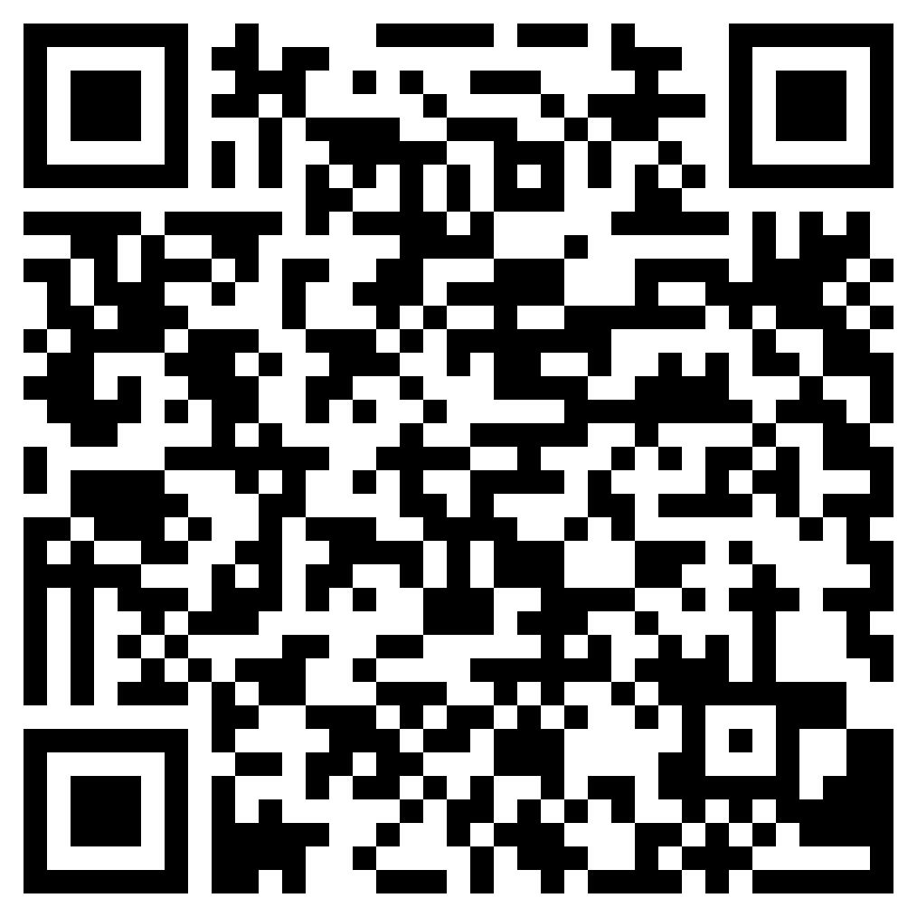
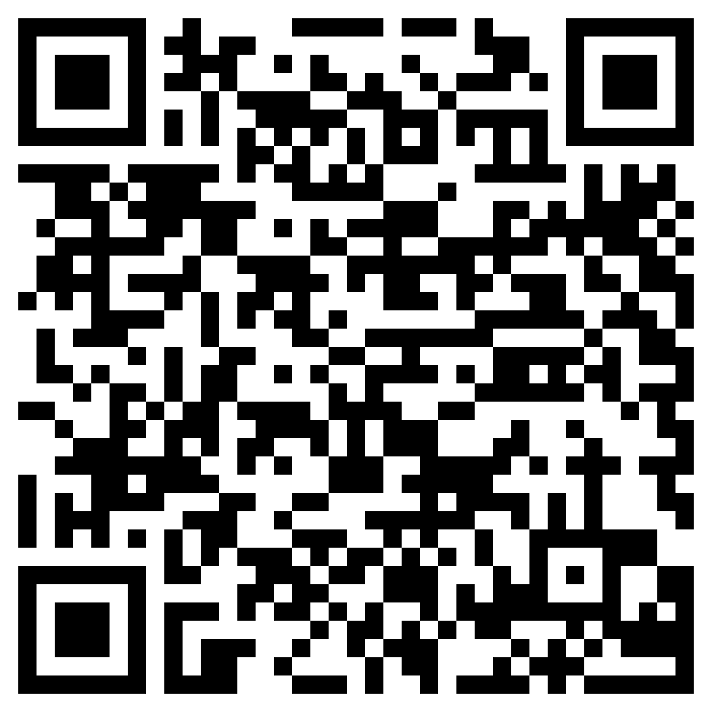
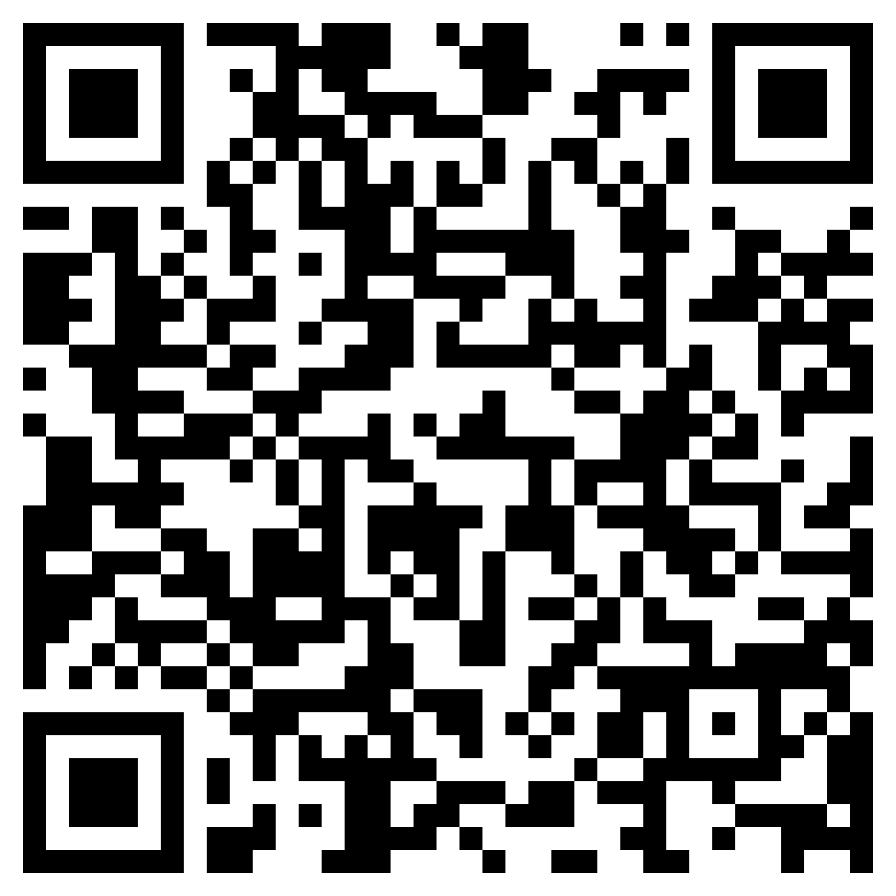
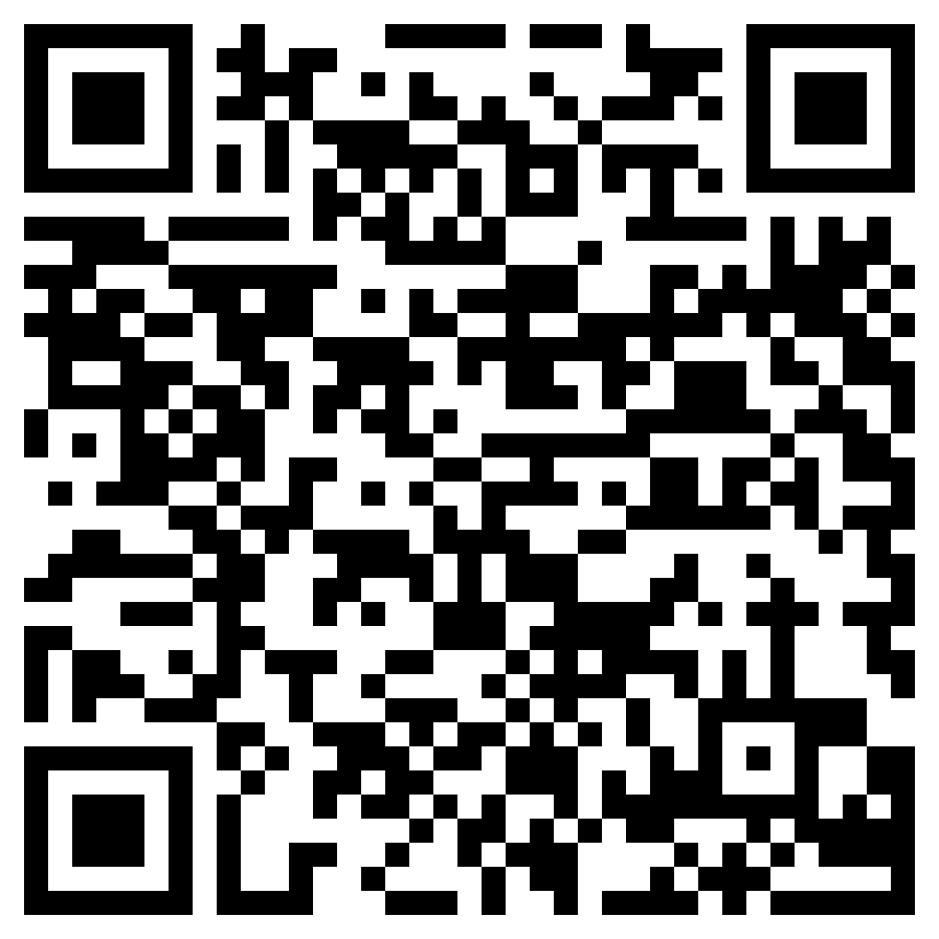
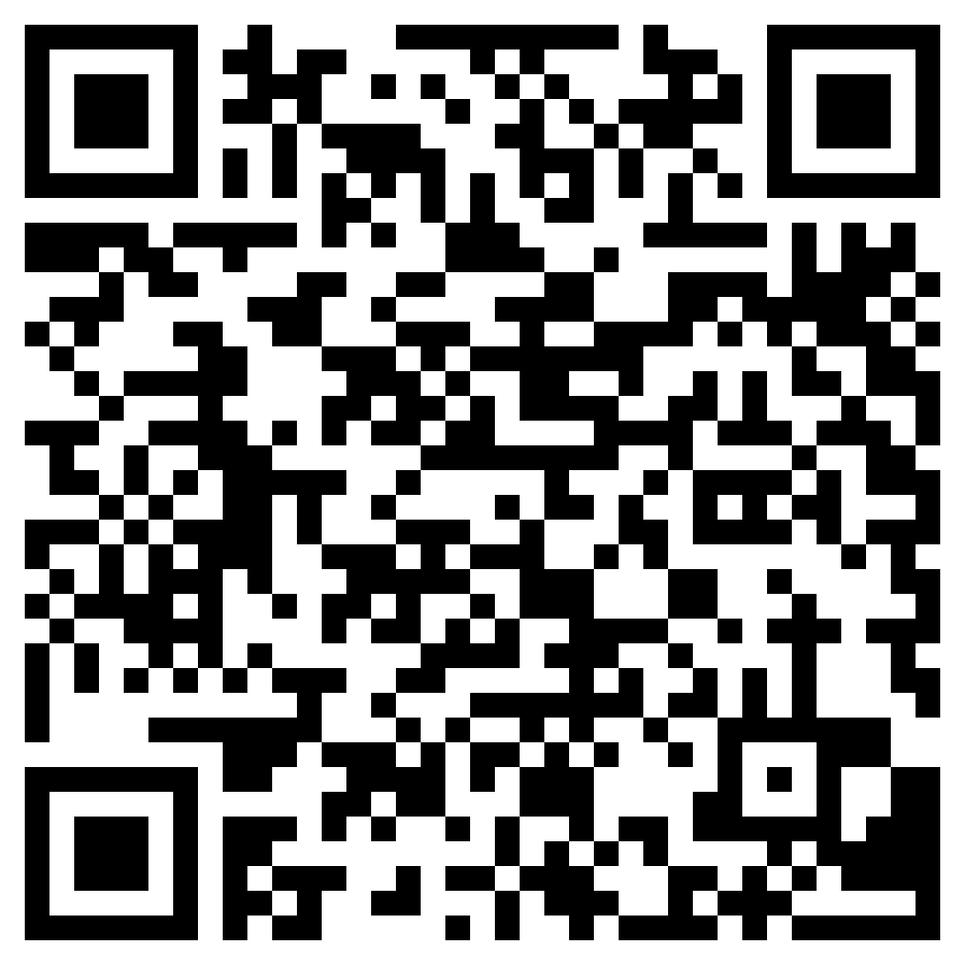
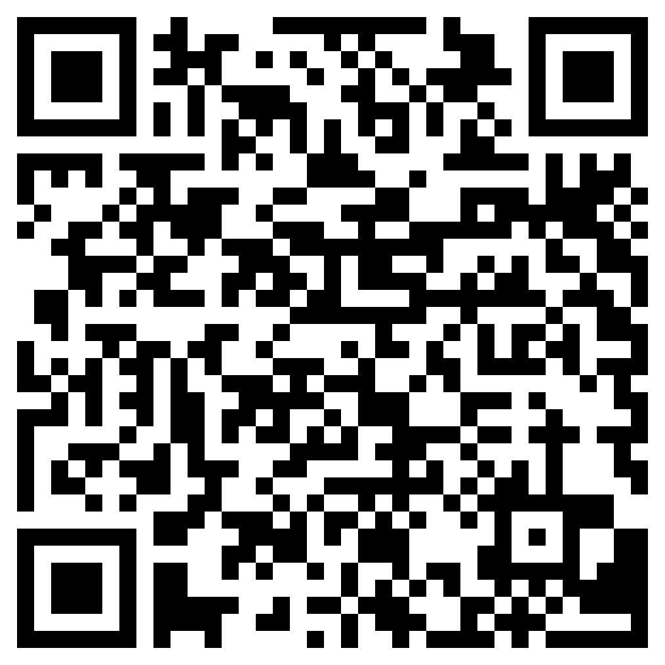
Hausaufgaben
10.1.1.6 new vocabulary
10.1.1.6 revisited vocabulary (10.1.1.3)
Thematic revisited vocabulary
Foundation
Higher
Foundation
Higher
Foundation
Higher
Notes:
Timing: 1 minute Aim: to remind students of the vocabulary they are learning and revisiting this week. Procedure: 1. Display the slide. Explain the tasks. 2. Post this slide or its information for students, using the usual school system for this.
Notes: A regular feature of the scheme of work (as for KS3) is that students spend time learning the vocabulary for the following week’s lessons. This can be done using any platform. We provide the words on Quizlet. Most lists are also available (free to all schools, not just subscribers) on LanguageNut. Teachers may of course create their own versions of vocabulary learning activities in any of the different platforms available. At KS4, there are several sets for learning/revisiting: 1. The new vocabulary for the following week. 2. The systematic revisiting (at +3 and +9 weekly intervals) of new vocabulary. 3. The revisited thematic vocabulary (from KS3 SOW) assigned to the week.
In the KS4 SOW every word from the GCSE vocabulary list has been tracked to ensure that: 1. New words are introduced, revisited twice at intervals during the course, and once again during the final 9-week revision phase. 2. KS3 revisited thematic vocabulary is revisited twice during the course, and once again during the final 9-week revision phase. 3. KS3 function words (listed as R(equired) on Annex E of the GCSE Subject Content are all revisited multiple times (Column D on the KS4 SOW) and the revisits are also tracked on the KS4 Vocabulary tracker.
We anticipate that students will spend on average 2 hours on homework per week at KS4. As a general rule, one hour would be assigned to vocabulary learning (and ideally this time will be spread across the week). The aim at KS3 was to establish a ‘little and often’ approach to vocabulary learning, using an app to facilitate this. This learning habit will hopefully continue into KS4. The 2nd hour will generally include additional reading, listening, speaking tasks. Teachers will be best placed to decide whether to include extended writing tasks for homework. However, given the availability of online translation tools and the strong temptation to use them, such tasks might best be undertaken in class, where teachers can replicate the conditions for written language production that will apply for students at GCSE.

