Slide 1
Talking about what you are doing today vs what you did yesterday
present vs perfect tense irregular verbs (taking avoir): faire and dire (je) SSC [-gn-]
Y8 French
Term 1.2 - Week 1 - Lesson 15
Stephen Owen / Natalie Finlayson
Artwork by: Chloé Motard
Date updated: 09/07/21
Notes:
Artwork by Chloé Motard. All additional pictures selected are available under a Creative Commons license, no attribution required.
Learning outcomes (lesson 1):
Introduction of SSC [-gn-]
Introduction of perfect tense constructions (with past simple equivalent) with avoir as auxiliary in the 1st person
Introduction of past participles of faire and dire
Word frequency (1 is the most frequent word in French):
8.1.2.1 (introduce) apporter [329], dit [dire 37], envoyer [526], fait [faire 25], utiliser [345], maintenant [192 ], hier [872], appartement [2323], banque [774], marché [280], passé [501]
8.1.1.2 (revisit) avocat [1188], bureau² [273], directeur¹ [640], emploi¹ [517], facteur [1264], secrétaire [920], ambitieux [2905], prudent [1529], travailleur, travailleuse [1341], assez [321]
7.3.2.3 (revisit) devenir [162], partir [163], pars [163], part [163], revenir [184], avenir [471], match [1906], madame [294], monsieur [79], encore¹ [51], en retard [7/1278], tôt [513]
Source: Londsale, D., & Le Bras, Y. (2009). A Frequency Dictionary of French: Core vocabulary for learners London: Routledge.

Slide 2
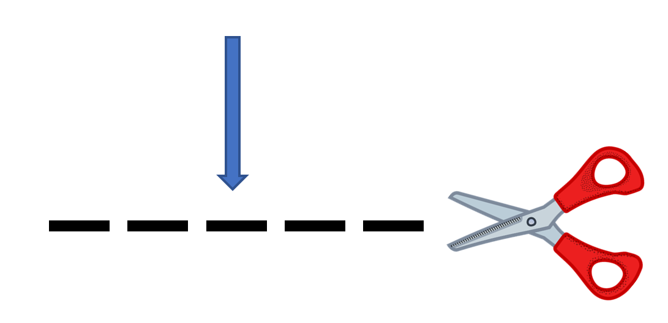
-gn-
ligne
Notes:
Timing: 1 minute
Aim: To introduce SSC [-gn-]
Procedure: 1. Present the letter(s) and say the [-gn-] sound first, on its own. Students repeat it with you. 2. Bring up the word ”ligne” on its own, say it, students repeat it, so that they have the opportunity to focus all of their attention on the connection between the written word and its sound.
3. A possible gesture for this would be to draw a line in the air with your finger, 4. Roll back the animations and work through 1-3 again, but this time, dropping your voice completely to listen carefully to the students saying the [-gn-] sound, pronouncing ”ligne” and, if using, doing the gesture.
Word frequency (1 is the most frequent word in French):
ligne [342]
Source: Londsale, D., & Le Bras, Y. (2009). A Frequency Dictionary of French: Core vocabulary for learners London: Routledge.

Slide 3
-gn-
ligne
Notes:
With sound and no pictures to focus all attention on the sound-symbol correspondence.

Slide 4
-gn-
ligne
Notes:
Without sound to elicit pronunciation (without first hearing the teacher).
Teacher to elicit pronunciation by asking “Comment dit-on …”

Slide 5
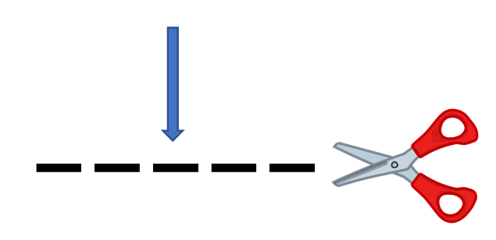
-gn-
gagner
montagne
[to win]
espagnol
ligne
Allemagne
ignorer
[to not know]
Notes:
Timing: 2 minutes
Aim: To introduce SSC [-gn-]
Procedure:
Introduce and elicit the pronunciation of the individual SSC [-gn-] and then the source word again ‘ligne’ (with gesture, if using). Then present and elicit the pronunciation of the five cluster words. The cluster words have been chosen for their high-frequency, from a range of word classes, with the SSC (where possible) positioned within a variety of syllables within the words (e.g. initial, 2nd, final etc.). Additionally, we have tried to use words that build cumulatively on previously taught SSCs (see the Phonics Teaching Sequence document) and do not include new SSCs. Where new SSCs are used, they are often consonants which have a similar symbol-sound correspondence in English.
Word frequency (1 is the most frequent word in French): ligne [342]; gagner [258]; ignorer [639]; espagnol [1666]; montagne [1734]; Allemagne [N/A]. Source: Londsale, D., & Le Bras, Y. (2009). A Frequency Dictionary of French: Core vocabulary for learners London: Routledge.

Slide 6
-gn-
gagner
montagne
espagnol
ligne
Allemagne
ignorer
Notes:
With sound and no pictures to focus all attention on the sound-symbol correspondence.

Slide 7
-gn-
gagner
montagne
espagnol
ligne
Allemagne
ignorer
Notes:
Without sound to elicit pronunciation (without first hearing the teacher).
Teacher to elicit pronunciation by asking “Comment dit-on …”

Slide 8
Phonétique
écouter / écrire
 | What do you hear? | [gn] | [n]/[nn]
 | poignée
 | accompagne
 | innocent
 | éloigner
 | anniversaire
 | baigner
 | What do you hear? | [gn] | [n]/[nn]
 | me n er
 | dessi n er
 | souligner
 | campagne
 | gouver n er
6
_
1
_
[to lead]
7
_
2
_
[to accompany]
8
_
3
_
[to underline]
9
_
4
_
[to take away]
[countryside]
10
_
[birthday]
5
_
[to rule]
11
_
[to bathe]
Notes:
Timing: 5 minutes
Aim: Aural differentiation between [gn] and [n].
Procedure:
1. Click numbers to hear words.
2. Students tick whether they think the word needs [gn] or [n]/[n] to fill the gap.
3. On clicks the answers are revealed.
Transcript:
mener
dessiner
souligner
campagne
gouverner
poignée
accompagne
innocent
éloigner
anniversaire
baigner
Word frequency (1 is the most frequent word in French): mener [4040], dessiner [2086], souligner [816], campagne [666], gouverner [2063], poignée [3208], accompagne [727], innocent [2059], éloigner [1541], anniversaire [2043], baigner [4608],
Source: Londsale, D., & Le Bras, Y. (2009). A Frequency Dictionary of French: Core vocabulary for learners London: Routledge.

Slide 9
Vocabulaire
lire / parler
 | Word | English meaning
1 | apporter | to bring
2 | dit | said (pp)
3 | envoyer | to send
4 | fait | made (pp)
5 | utiliser | to use
6 | maintenant | now
7 | hier | yesterday
8 | un appartement | appartment, flat
9 | la banque | bank
10 | le marché | market
11 | le passé | past
60
With envoyer, the y changes to an i in the present tense forms (apart from nous and vous):
j’envoie
tu envoies
0
DÉBUT
Notes:
Timing: 5 minutes Aim: To reactivate and strengthen vocabulary knowledge. Note: Students in Y8 pre-learn their vocabulary on Quizlet, additionally completing several tasks to build their knowledge. This task assists recall of the new vocabulary. Procedure: Round 1: Look at the French, recall the English meanings, saying them aloud. [1 minute] Round 2: Look at the English, recall the French meanings, saying them aloud. [1 minute] Repeat for two further minutes, to speed up recall.

Slide 10
Le passé composé
grammaire
To say what we did in the past, we use the perfect tense (passé composé):
j’ai fait – I did/made j’ai dit – I said
Look at the differences between the present and perfect (past) tense forms of these verbs:
Present Perfect (past)
je dis → j’ai dit
(I say) (I said)
je fais → j’ai fait
(I do/make) (I did/made)
In the perfect tense
we use j’ai (‘I have’),
rather than je (‘I’).
The –s and –t at the end of the verbs are silent final consonants (SFCs).
The only difference we hear between present and past tense forms is the j’ai.
The forms of the main verb look different!
(i.e. dit – said; fait – made)
These forms are called past participles.
Notes:
Timing: 4 minutes
Aim: To introduce the formation of the perfect tense with two verbs for which there is no audible difference between the present tense for je and the past participle.
Procedure:
1. Click to animate the explanation.
2. Point out the use of the auxiliary, the past participle and the fact that the latter sounds the same as the present tense je form for these verbs, as per the speech bubbles.
3. Check students’ understanding at each stage.
Word frequency (1 is the most frequent word in French):
8.1.1.5 (introduce) dit [dire 37], fait [faire 25]
Source: Londsale, D., & Le Bras, Y. (2009). A Frequency Dictionary of French: Core vocabulary for learners London: Routledge.

Slide 11
Au présent
écouter
je dis
I say, I am saying
Notes:
Timing: 1 minute for 4 slides
Aim: to introduce the concept of an auxiliary verb to show past tense.
Procedure:
Listen and repeat.

Slide 12
Au passé
écouter
j’ai dit
I said

Slide 13
Au présent
écouter
je fais
I do, I make

Slide 14
Au passé
écouter
j’ai fait
I made, I did

Slide 15
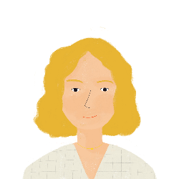
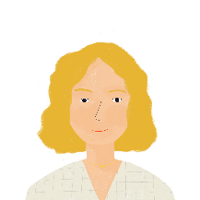
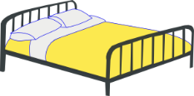
Ma routine - Aurélie
* la nuit
= night
parler / écouter
Amandine, c’est la mère de la famille. Elle parle de sa routine. Elle dit:
Maintenant ... Hier...
Bonjour !
Je dis bonjour à ma famille.
J’ai dit bonjour à ma famille.
Je fais mon lit.
J’ai fait mon lit.
Je fais le ménage dans mon appartement.
J’ai fait le ménage dans mon appartement.
Je fais les courses au marché.
J’ai fait les courses au marché.
Je fais mon travail.
J’ai fait mon travail.
Je dis bonne nuit !
J’ai dit bonne nuit !
Notes:
Timing: 5 minutes
Aim: To provide further listening and reading input of the perfect tense with two verbs for which there is no audible difference between the present tense for je and the past participle.
Note: The listening input is provided to help students to realise that the audible difference in the tenses for these verbs lies solely with the presence of the auxiliary verb, and thus to focus upon that.
Procedure:
Students predict how each sentence will sound in the perfect tense and try to say it.
Click to reveal each solution. The audio plays upon the appearance of each item.
Students repeat.
Check students’ understanding at each stage.
Word frequency of unknown words (1 is the most frequent word in French): nuit [580], routine [4120]
Source: Londsale, D., & Le Bras, Y. (2009). A Frequency Dictionary of French: Core vocabulary for learners London: Routledge.

Slide 16
Ma routine - Léa
* le café
= coffee
écouter
Je parle de ma routine !
Je fais quoi maintenant ?
J’ai fait quoi hier ?
 | hier | maintenant
1
2
3
4
5
6
7
8
Notes:
Timing: 5 minutes
Aim: To provide listening input practice in recognising the presence of the auxiliary in the perfect tense, thereby distinguishing this from the present.
Procedure:
1. Click on audio buttons to play sentences.
2. Students listen and tick whether the sentence refers to yesterday, or now (i.e. the present).
3. Click to reveal the animated answers.
Transcript:
1. J’ai fait mon lit.
2. J’ai fait mes devoirs.
3. Je fais une activité.
4. Je dis bonjour à ma famille.
5. J’ai fait une pizza.
6. Je fais un café.
7. J’ai dit bonjour à Antoine.
8. Je fais une promenade.
Word frequency (1 is the most frequent word in French): dit [dire 37], fait [faire 25], maintenant [192 ], hier [872], activité [452], devoirs [39], lit [1837], ménage [2326], café [1886], pizza [>5000], promenade [>5000]
Source: Londsale, D., & Le Bras, Y. (2009). A Frequency Dictionary of French: Core vocabulary for learners London: Routledge.

Slide 17
Hier ou en ce moment ?
lire
Léa écrit à Amir. C’est hier ou en ce moment ?
1. Léa: Je fais la cuisine en ce moment / hier.
4. Léa: J’ai fait un café en ce moment / hier.
7. Léa: Je fais le ménage en ce moment / hier.
2. Amir: J’ai fait les courses en ce moment / hier.
5. Amir: Je fais une pizza en ce moment / hier.
8. Amir: J’ai fait une activité en ce moment / hier.
3. Léa: Je dis bonjour à Antoine en ce moment / hier.
6. Léa: J’ai fait mon lit en ce moment / hier.
9. Léa: J’ai dit bonjour à Élodie en ce moment / hier.
Notes:
Timing: 5 minutes
Aim: To provide reading input practice in recognising the difference between the past participle and the present tense form for je.
Procedure:
1. Students read the sentences with the pronoun je or pronoun plus auxiliary j’ai obscured..
2. Students write 1-8 and whether the sentence refers to yesterday, or the present moment.
3. Click to reveal the animated answers.

Slide 18
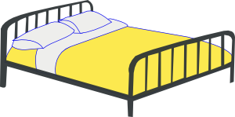
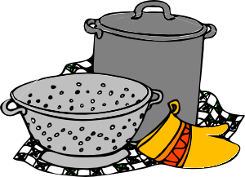
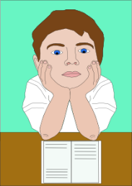
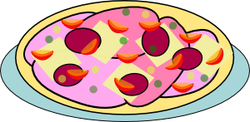
Hier ou maintenant?
parler
3 hier
Bonjour !
1 hier
4 hier
1 maintenant
dire bonjour
faire mon lit
faire mon petit déjeuner
faire les courses
au marché
5 maintenant
3 maintenant
Au revoir !
4 maintenant
faire le ménage
dans l’appartement
dire au revoir
5 hier
2 hier
2 maintenant
faire la cuisine
faire un café
faire une pizza
faire mes devoirs
Notes:
Timing: 5 minutes
Aim: To provide production practice (speaking) with the perfect versus the present tense with je.
Procedure:
1. Partner B turns to face away from the board where this side is being displayed.
2. Click on the mouse to bring up the first selection of five items (shown in orange). These are for Partner A. ‘Hier’ or ‘maintenant’ is indicated for each item.
3. Partner A produces the appropriate sentence in French for each item, using the perfect or present tense as required (in the first person form).
4. Partner B writes whether Partner A is speaking about ‘yesterday’ or ‘now’.
5. Swap roles so that Partner A now faces away and Partner B says the next set of five items, which appear on the next click of the mouse (shown in blue).
6. Partner A writes whether Partner B is speaking about ‘yesterday’ or ‘now’.
7. Both partners check their answers.
Word frequency (1 is the most frequent word in French): dit [dire 37], fait [faire 25], maintenant [192 ], hier [872], appartement [2323], marché [280], devoirs [39], lit [1837], ménage [2326], café [1886], pizza [>5000], courses [1289], cuisine [2618], petit déjeuner [138/368]
Source: Londsale, D., & Le Bras, Y. (2009). A Frequency Dictionary of French: Core vocabulary for learners London: Routledge.

Slide 19
Hier ou maintenant?
écrire
3 hier
Bonjour !
1 hier
4 hier
1 maintenant
dire bonjour
faire mon lit
faire mon petit déjeuner
faire les courses
au marché
5 maintenant
3 maintenant
Au revoir !
4 maintenant
faire le ménage
dans l’appartement
dire au revoir
5 hier
2 hier
2 maintenant
faire la cuisine
faire un café
faire une pizza
faire mes devoirs
Notes:
Timing: 5 minutes (this slide and the next slide)
Aim: To provide production practice (writing) with the perfect versus the present tense with je.
Procedure:
1. Students use the prompts on the previous slide (continue to display this while they are working) to reconstruct the sentences said to them by their partner in the speaking phase of this exercise (i.e. by the end of this task, they will have produced all of the sentences – half in speech and the other half in writing).
2. Click on the mouse to bring up the correct answers, one by one, on the next slide.
Word frequency (1 is the most frequent word in French): dit [dire 37], fait [faire 25], maintenant [192 ], hier [872], appartement [2323], marché [280], devoirs [39], lit [1837], ménage [2326], café [1886], pizza [>5000], courses [1289], cuisine [2618],
Source: Londsale, D., & Le Bras, Y. (2009). A Frequency Dictionary of French: Core vocabulary for learners London: Routledge.

Slide 20
Grammaire
écrire
B
1. Hier j’ai fait mon lit.
2. Maintenant je fais un café.
3. Hier j’ai dit bonjour.
4. Maintenant je fais la cuisine.
5. Hier j’ai fait une pizza.
A
1. Maintenant je fais mon petit déjeuner.
2. Hier j’ai fait mes devoirs.
3. Maintenant je fais le ménage dans l’appartement.
4. Hier j’ai fait les courses au marché.
5. Maintenant je dis au revoir.

Slide 21
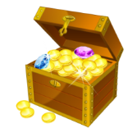
Trouve le trésor !
écrire
0
+5
+10
+15
+ 25
 | 1 | 2 | 3 | 4
A
B
C
D
the desk
a job
the secretary
quite
le bureau
un emploi
le/la secrétaire
assez
to become
to leave
(you, sing.) leave
(il/elle) part
devenir
partir
(tu) pars
(he/she) leaves
to come back
the match
madame
revenir
a future
le match
Miss
un avenir
Sir
again
late
tôt
monsieur
encore
en retard
early
Notes:
Timing: 5 minutes Aim: This ‘treasure hunt’ activity revisits key vocabulary to consolidate knowledge (in the written modality). As well as meaning, the focus is on form and spelling. Procedure:
1. Work individually, in pairs or in small groups. Each row (A-D) represents one round. 2. Write 1-4 in exercise books or mini whiteboards, and write the French for each number. 3. Click the blue box to reveal and check answers. 4. Click the yellow box to reveal the points for each correct answer (these are randomly allocated for an element of chance) – tally the total.
Word frequencies:
8.1.1.1 (revisit) bureau² [273], emploi [517], secrétaire [920], assez [321]
7.3.2.3 (revisit) devenir [162], partir [163], pars [163], part [163], revenir [184], avenir [471], match [1906], madame [294], monsieur [79], encore¹ [51], en retard [7/1278], tôt [513]

Slide 22
Talking about what you are doing today vs what you did yesterday
present vs perfect tense regular -ER verbs (taking avoir) (je)
SSC [-gn]
Y8 French
Term 1.2 - Week 1 - Lesson 16
Stephen Owen / Natalie Finlayson
Artwork by: Chloé Motard
Date updated: 09/07/21
Notes:
Artwork by Chloé Motard. All additional pictures selected are available under a Creative Commons license, no attribution required.
Learning outcomes (lesson 1):
Consolidation of SSC [-gn-]
Consolidation of perfect tense constructions (with past simple equivalent) with avoir as auxiliary in the 1st person
Consolidation of past participles of faire and dire
Introduction of past participle formation with regular –ER verbs
Word frequency (1 is the most frequent word in French):
8.1.2.1 (introduce) apporter [329], dit [dire 37], envoyer [526], fait [faire 25], utiliser [345], maintenant [192 ], hier [872], appartement [2323], banque [774], marché [280], passé [501]
8.1.1.2 (revisit) avocat [1188], bureau² [273], directeur¹ [640], emploi¹ [517], facteur [1264], secrétaire [920], ambitieux [2905], prudent [1529], travailleur, travailleuse [1341], assez [321]
7.3.2.3 (revisit) devenir [162], partir [163], pars [163], part [163], revenir [184], avenir [471], match [1906], madame [294], monsieur [79], encore¹ [51], en retard [7/1278], tôt [513]
Source: Londsale, D., & Le Bras, Y. (2009). A Frequency Dictionary of French: Core vocabulary for learners London: Routledge.

Slide 23
Phonétique
lire / parler
chinois
signe
60
ministre
règne
significatif
[reign]
[significant]
compagnie
signal
[company]
témoignage
[testimony]
secondes
minime
généreux
[minimal]
raisonnable
signature
détenir
0
dignité
ignorance
Canada
DÉBUT
Notes:
Timing: 5 minutes for three slides
Aim: Written recognition and oral production of SSC [gn] in cognate or near-cognate words.
Procedure:
1. Click début to start timer
2. Students pronounce all words (mixture of [gn] and [n]/[nn]). Students work in pairs and listen to each other’s attempts. If a student mispronounces [gn] (they may pronounce it the English way and say a ‘g’ or ‘n’ sound) or [n] (they may overapply the rule and say [gn]) they must repeat the word three times before moving on.
3. Following slides have shorter timer to increase challenge
Word frequency (1 is the most frequent word in French): généreux [2015], raisonnable [2021], dignité [2171], signe [707], compagnie [775], signal [978], témoignage [1548], règne [3649], significatif [2292], minime [2030], détenir [2056], Canada [n/a], ministre [204], chinois [1914], signature [2187], ignorance [4055]
Source: Londsale, D., & Le Bras, Y. (2009). A Frequency Dictionary of French: Core vocabulary for learners London: Routledge.

Slide 24
Phonétique
lire / parler
chinois
signe
45
ministre
règne
significatif
[reign]
[significant]
compagnie
signal
[company]
témoignage
[testimony]
secondes
minime
généreux
[minimal]
raisonnable
signature
détenir
0
dignité
ignorance
Canada
DÉBUT
Notes:
45 seconds

Slide 25
Phonétique
lire / parler
chinois
signe
30
ministre
règne
significatif
[reign]
[significant]
compagnie
signal
[company]
témoignage
[testimony]
secondes
minime
généreux
[minimal]
raisonnable
signature
détenir
0
dignité
ignorance
Canada
DÉBUT
Notes:
30 seconds

Slide 26
Vocabulaire
parler
 |  | masculin | féminin
nom
adjectif
avocat directrice travailleur factrice
ambitieuse avocate directeur travailleuse
prudente facteur ambitieux prudent
Notes:
Timing: 5 minutes
Aim: To revisit and categorise the vocabulary from 8.1.1.1 and its associated grammar point (masculine/feminine agreement of nouns and adjectives).
Procedure:
1. Students categorise these known words in accordance with their part of speech (noun or adjective) and their gender, completing the table (there are three words to go in each box).
2. The answers are shown on the following slide.

Slide 27
Vocabulaire - réponses
parler
 |  | masculin | féminin
nom |  | avocat directeur facteur | directrice factrice avocate
adjectif |  | travailleur ambitieux prudent | ambitieuse travailleuse prudente
avocat directrice travailleur factrice
ambitieuse avocate directeur travailleuse
prudente facteur ambitieux prudent
Notes:
These are the answers to the task on the previous slide.

Slide 28
envoyer
[to send | sending]
e is added to the stem in the il/elle/on form
envoie
[sends | is sending]
envoyons
[send | are sending]
Notes:
Timing: 4 minutes for sequence of eight slides
Aim: to introduce the verb envoyer more explicitly. Both long form (infinitive) and short form (3rd person singular) are introduced in order to familiarise students with various forms of the same verb.
Procedure
Bring up the word envoyer on its own, say it, students repeat it, and remind them of the phonics.
Try to elicit the meaning from the students. Students have had explicit teaching that the present tense in French communicates two different present tense meanings in English. This reinforces that learning. Emphasise the two meanings for the short form, reminding students that French only has one form and does not have a direct equivalent of the grammar for ‘is + ing’, the continuous form (as covered in previous weeks).
Bring up the picture, and, if using gestures, a possible gesture would be to mime stamping and posting a letter
Then bring up the English translations. Emphasise the two meanings for the infinitive.
Bring up the first short form envoie, say it, students repeat it. Draw attention to spelling change
Bring up the second short form pesons, say it, students repeat it.
Try to elicit the meaning from the students. Emphasise the two meanings for the short forms.
Bring up the info bubble to introduce the stem-change. NB: This is not a grammar point that students are expected to produce at this stage and will not feature in any NCELP tests. It is showcased here for awareness and passive understanding only.

Slide 29
envoyer
[to send | sending]
envoie
[sends | is sending]
envoyons
[send | are sending]
Notes:
Cycle through the long and short forms again.

Slide 30
envoie
[sends | is sending]
Il envoie une lettre.
[He sends | is sending a letter.]
Notes:
Introduce the first short form in a sentence.

Slide 31
envoyons
[send | are sending]
Nous envoyons une lettre.
[We send | are sending a letter.]
Notes:
Introduce the second short form in a sentence.

Slide 32
envoyer
sending
Il doit envoyer une lettre.
[He has to send a letter.]
Notes:
Introduce the long form in a sentence.

Slide 33
envoie
[sends | is sending]
envoie
Il une lettre.
[He sends | is sending a letter.]
Notes:
Cycle through the first short form in context again.

Slide 34
envoyons
[send | are sending]
envoyons
Nous une lettre.
[We send | are sending a letter.]
Notes:
Cycle through the second short form in context again.

Slide 35
envoyer
[to send | sending]
envoyer
Il doit une lettre.
[He has to send a letter.]
Notes:
Cycle through the long form in context again.

Slide 36
Regular –ER verbs in the perfect tense
grammaire
As you know, verbs change to show that we are talking about the past. To make the perfect tense, we do two things:
1. add the present tense of avoir after the pronoun (j’ai)
2. add the past participle of the main verb:
You already know the past participles of two irregular verbs:
j’ai fait – I did/made j’ai dit – I said
Regula -ER verbs all make their past participles by changing the -er ending to -é:
Present Perfect (past)
j’apporte → j’ai apporté
(I’m bringing) (I brought)
___
___
We use the past participle with j’ai
(‘I have’),
rather than je (‘I’).
The –er on the infinitive is replaced by –é
(this sounds the same
as the infinitive!)
Notes:
Timing: 4 minutes
Aim: To introduce the formation of the past participle of regular –ER verbs (je form).
Procedure:
1. Click to animate the explanation.
2. Point out that the auxiliary is still used, and the formation of the past participle, as per the speech bubbles.
3. Check students’ understanding at each stage.
Word frequency (1 is the most frequent word in French):
dit [dire 37], fait [faire 25] travaillé [travailler 290] joué [jouer 219]
Source: Londsale, D., & Le Bras, Y. (2009). A Frequency Dictionary of French: Core vocabulary for learners London: Routledge.

Slide 37
La semaine d’Amir
lire
J’ai passé une excellente semaine !
J’ai regardé un bon film au cinéma.
J’ aime les films drôles !
J’ apporte mes livres à l'école.
J’ai envoyé un message à Abdel.
J’ai joué au football avec des amis.
Je gagne parfois.
Je travaille bien à l’école.
J’ai écouté le professeur en classe.
dans le passé
dans le passé
maintenant
maintenant
dans le passé
dans le passé
maintenant
maintenant
dans le passé
Notes:
Timing: 6 minutes
Aim: To provide reading input practice in distinguishing between past participle and present tense (je form) for known –ER verbs.
Procedure:
1. Students read the sentences and state whether each is ‘dans le passé’ or ‘maintenant’, by considering whether there is a present tense verb ending or a past participle. The pronoun, or pronoun plus auxiliary, is obscured.
2. Click to reveal the pronoun, or pronoun plus auxiliary, together with the correct answers, one by one.
Word frequency of cognates used (1 is the most frequent word in French): message [792]
Source: Londsale, D., & Le Bras, Y. (2009). A Frequency Dictionary of French: Core vocabulary for learners London: Routledge.

Slide 38
La semaine d’Abdel
lire
J’ai aimé l’école aujourd’hui !
J’aime étudier l’histoire.
J’ai étudié le français aussi !
J’ai apporté le déjeuner à mon père.
J’envoie un email en anglais.
Je parle avec mes amis.
J’ai mangé le déjeuner à l’école.
J’ai posé des questions en classe.
J’écoute bien les réponses.
dans le passé
maintenant
dans le passé
dans le passé
maintenant
maintenant
dans le passé
dans le passé
maintenant
Notes:
Timing: 6 minutes
Aim: To provide reading input practice in distinguishing between the use of the pronoun je (here signifying present tense) and the pronoun plus auxiliary (signifying perfect tense)
Procedure:
1. Students read the sentences and state whether each is ‘dans le passé’ or ‘maintenant’, by considering whether there is the pronoun only, or the pronoun plus auxiliary verb. The last letter of the verb (present tense or past participle) is obscured.
2. Click to reveal the pronoun, or pronoun plus auxiliary, together with the correct answers, one by one.
Word frequency (1 is the most frequent word in French): aimer [242] faire [25] écouter [429] étudier [960] manger [1338] parler [106] poser [218] ami [467] déjeuner [2724] école [477] classe [778] français [251] histoire [263] matière [562] question [144] réponse [456] sport [2011] intéressant [1244] mes [mon 60] aujourd’hui [233] bien [47] aussi [44] avec [23] à [4] en [3]
Source: Londsale, D., & Le Bras, Y. (2009). A Frequency Dictionary of French: Core vocabulary for learners London: Routledge.

Slide 39
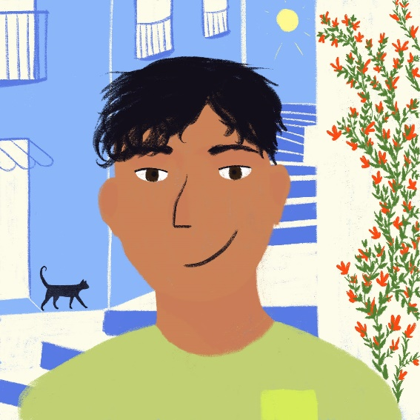
J’aime ou j’ai fait ?
écouter
 |  | something he likes to do | something he did in the past
 | j’aime poser
 | j’ai travaillé
 | j’ai écouté
 | j’aime regarder
 | j’aime porter
 | j’ai préparé
 | j’ai trouvé
 | j’aime passer
1
2
3
4
J’ai fait quoi ?
Qu’aime-je faire ?
5
6
7
8
Notes:
Timing: 6 minutes
Aim: to provide practice in distinguishing aurally between j’ai with past participle and j’aime with infinitive
Procedure:
1. Click on the audio buttons to play the sentences.
2. Students listen and tick the appropriate column, also noting the activity in English.
3. Click on the mouse to show the correct ticks, along with the verb phrases from the sentences.
Transcript:
1. J’aime poser des questions.
2. J’ai travaillé à l’école.
3. J’ai écouté la radio.
4. J’aime regarder un film.
5. J’aime porter mon uniforme.
6. J’ai préparé le déjeuner.
7. J’ai trouvé la solution.
8. J’aime passer une semaine en vacances.

Slide 40
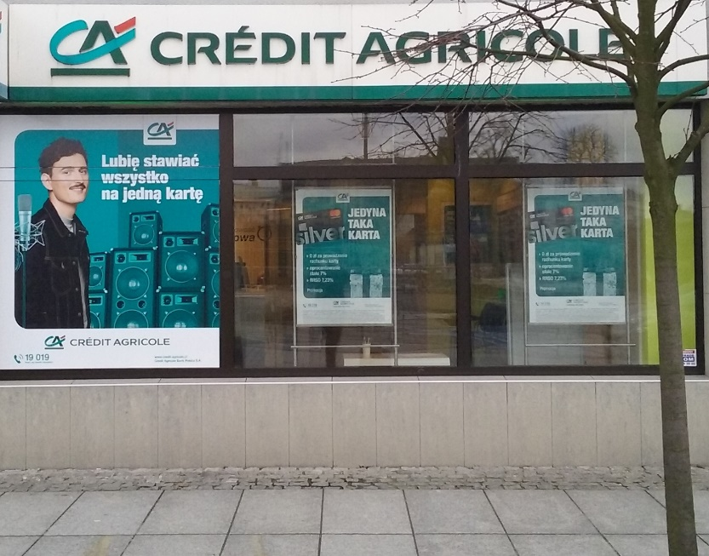
Maintenant ou dans le passé ?
Le Crédit Agricole est une banque Française.
écrire
Je 1: travaille [to work] en ville à la banque.
Aujourd’hui j’ai 2: utilisé [to use] l’ordinateur au bureau.
J’ 3: aime [to like] travailler à l’ordinateur.
Hier j’ai 4: préparé [to prepare] une présentation.
J’ai 5: mangé [to eat] mon déjeuner – une pizza.
J’ai 6: aimé [to like] la pizza !
Je 7: parle [to speak] au telephone aussi.
Aujourd’hui j’ai 8: apporté [to bring] un café au directeur.
J’ 9: envoie [to send] souvent des emails.
______
_____
____
______
_____
____
____
______
______
Notes:
Timing: 6 minutes
Aim: to provide production (writing) practice in the use of the present tense verb form (with je) or the past participle as appropriate, with known –ER verbs.
Procedure:
1. Students read the sentences and put the appropriate form (present tense or past participle) of the verb indicated in brackets into the gap in each, considering whether or not the auxiliary verb is present.
2. Click to reveal the answers, one by one.
Word frequency (1 is the most frequent word in French): presentation [1723], pizza [>5000], telephone [1366]
Source: Londsale, D., & Le Bras, Y. (2009). A Frequency Dictionary of French: Core vocabulary for learners London: Routledge.

Slide 41
C’est à vous!
écrire / parler
What are you doing today? What did you do yesterday?
Écris six phrases et parle avec un(e) partenaire.
Aujourd’hui je ….
Hier j’ai …
Notes:
Timing: 8 minutes
Aim: To provide production practice (speaking and writing) in distinguishing between j’ai with past participle and j’aime with infinitive
Procedure:
1. Partner A chooses 3 things to say s/he did yesterday, and 3 things to say s/he likes doing (s/he may need to note these down for reference).
2. Partner A says the 6 sentences implied by the above to Partner B, in random order.
3. Partner B lists, in English, the things Partner A did and the things Partner A likes doing.
4. Partners check answers collaboratively, then swap roles and repeat.

Slide 42
Gaming Grammar
Gaming Grammar
Relevant mini game(s):
Verbs (present): 1st person singular/plural
Notes:
This slide links to Gaming Grammar login screen. The appropriate mission can then be selected from the menu page.
Students will progress through the game at their own rate; teachers should use the teacher interface to check progress. This will help to inform future lesson planning.

Slide 43
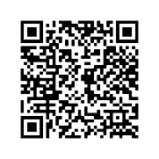
Devoirs
Vocabulary Learning Homework (Y8, Term 1.2, Week 2)
Audio file
Audio file QR code:
Student worksheet
Quizlet link
In addition, revisit: Y8 Term 1.1 Week 4
Y7 Term 3.2 Week 4
Notes:
The answer sheet for the Y8, Term 1.2, Week 2 vocabulary learning HW is here: https://resources.ncelp.org/concern/resources/j6731428s?locale=en

