Slide 1



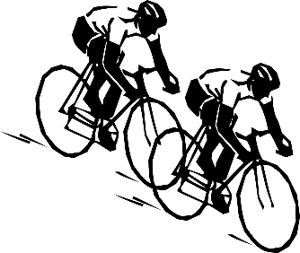

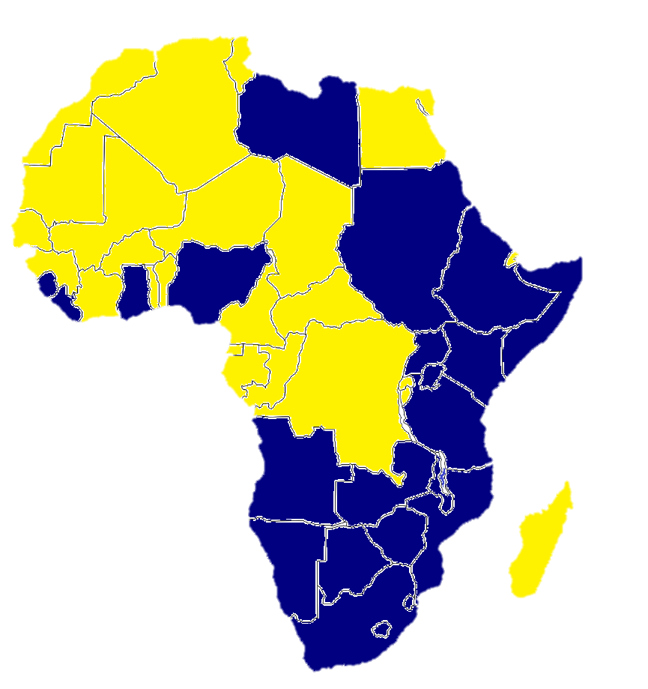
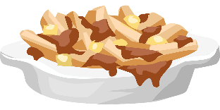
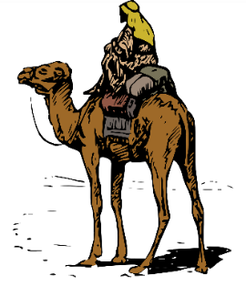
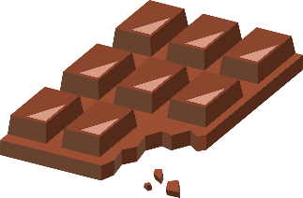

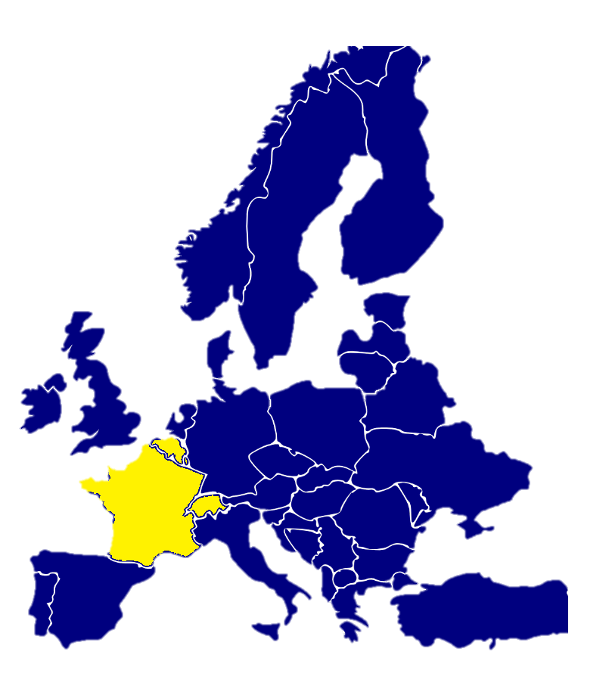
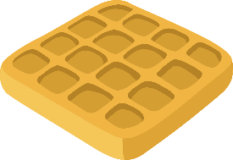
Français
Year 7 Language Guide
Nom: …………………………………………..
Professeur/Professeure: ……………………
Last updated: 18/03/21

Slide 2
Themes overview
 | 2 | FAIRE [nous, vous] Saying what people do | 32
Phonics | 3-6 | Possessive articles (my and your) Talking about belongings | 33
ÊTRE [to be], adjectives Describing a thing or person | 7 | ALLER [to go], à (to) Where people go (places) | 34-35
ÊTRE [to be], intonation questions Describing a thing or person [2] | 8-9 | Saying ‘to the’ [à, en, chez] Where people go (on holiday) | 35-36
AVOIR [to have], indefinite articles Saying what people have | 10 | Extended reading Familiale | 37
AVOIR, adjectives following nouns Describing what people have | 11-12 | ALLER [nous, vous, ils/elles], Where people go (countries) | 38-39
AVOIR vs ÊTRE Distinguishing having and being | 13-14 | -ER regular verbs, saying ‘at the’ Talking about people’s lives | 40-41
Definite articles, plural nouns Talking about a thing or person | 15-16 | Inversion questions, PRENDRE, DIRE Asking and answering questions | 42-43
FAIRE [to do, to make] Talking about doing and making | 17 | Inversion questions, SORTIR, VENIR Asking questions about others | 44-45
Extended reading Sept couleurs magiques | 18 | Inversion questions (question words) Using question words | 46-47
FAIRE meaning ‘go’ Saying what people do | 19-20 | Ne…pas Talking about what isn’t happening | 48
-ER regular verbs [je, tu, il/elle] Saying what people like to do | 21-22 | Negation before nouns: ne…pas de Talking about what isn’t there | 49
-ER regular verbs [je, tu, il/elle] Saying what people do to others | 23 | Adjectives before nouns Describing more things and people | 50
-ER regular verbs [nous], à Saying what you do with others | 24 | ALLER + infinitive [je, tu, il/elle] Expressing future intentions | 51-52
-ER regular verbs [ils, elles] Saying what others do | 25 | ALLER + inf. [nous, vous, ils/elles] Asking about future intentions | 53-54
-ER regular verbs [vous] Saying ‘you’ - singular and plural | 26 | DEVOIR and VOULOIR [je, tu, il/elle] What you want and have to do | 55-56
Il y a [+ numbers + nouns] Saying how many there are | 27 | POUVOIR and SAVOIR What you can and can’t do | 57-58
ÊTRE [nous,vous], plural adjectives Describing your family | 28-29 | Extended reading L'homme qui te rassemble | 59-60
AVOIR [nous, vous] Saying what people have | 30-31 | Spelling Bee | 61-66

Slide 3
Overview
 | Theme / Topic
Autumn Term 1 | Describing a thing or person Asking yes/no questions with raised intonation Saying what people have Describing what people have Distinguishing between having and being Talking about a thing or person Talking about doing and making things
Autumn Term 2 | Saying what people do/like to do Saying what people do to others Saying what you do with others Saying what others do Saying ‘you’ to one and more than one person
Spring Term 1 | Saying how many there are Describing your family Talking about belongings
Spring Term 2 | Saying where people go (places, holidays, countries) Saying where you are and where you are going Talking about people’s lives
Summer Term 1 | Asking and answering questions Using question words Talking about what isn’t happening Talking about what isn’t there Describing more things and people
Summer Term 2 | Expressing future intentions Asking about future intentions Talking about what people want and have to do Talking about people can and can’t do
2

Slide 4


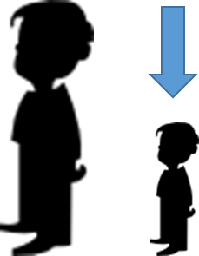
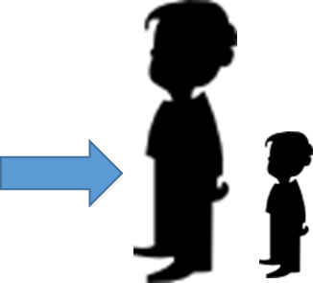


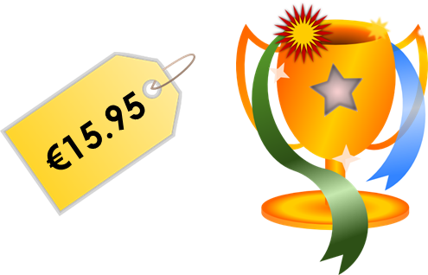


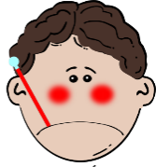





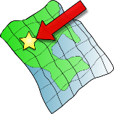
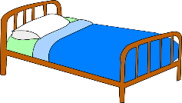
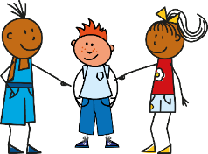




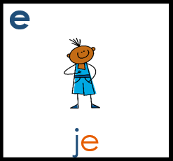
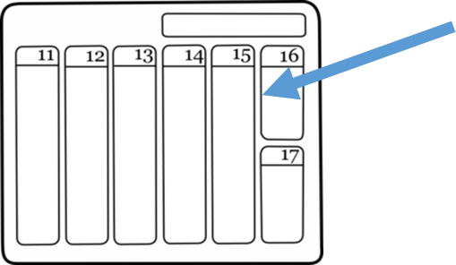
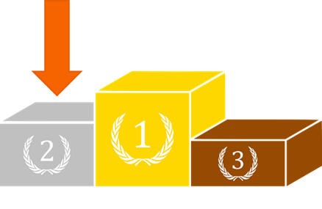
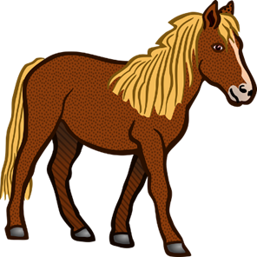





Phonics
Learning these SSC (Sound-spelling correspondences) will help you to pronounce written French more confidently and to recognise and spell words you hear.
Silent final consonant [SFC)
Something that makes French sound different from English is that some consonants at the ends of words are silent. This means you don’t pronounce them at all!
petit
grand
mot
mais
prix
table
malade
mal
sac
ça va ?
petit
ici
lit
il
qui?
[a little]
[place]
feu
jeu
jeudi
un peu
lieu
[that]
[to have to]
samedi
second
cela
cheval
devoir
[also]
faux
beau
aussi
bateau
eau
3
Notes:
The cluster words have been chosen for their high-frequency, from a range of word classes, with the SSC (where possible) positioned within a variety of syllables within the words(e.g. initial, 2nd, final etc.., although not, of course with SFC!). Additionally, we have tried to use words that build cumulatively on previously taught SSCs (see the Phonics Teaching Sequence document) and do not include new SSCs. Where new SSCs are used, they are often consonants which have a similar symbol-sound correspondence in English.
Source: Londsale, D., & Le Bras, Y. (2009). A Frequency Dictionary of French: Core vocabulary for learners London: Routledge.
Word frequency rankings (1 is the most common word in French):
dans [11]; petit [138] prix [310]; mot [220]; mais [30]; grand [59]
ça va?[54 (cela), 53 (aller)]; malade [1066] mal [277]; table [1019]; sac [2343]; animal [1002]
petit [138]; lit [1837] ici [167]; il[13]; qui [14]; midi [2483]
jeudi[1112]; lieu [117] feu [786]; un peu [138/91]; jeu [291]; deux [41]
samedi [1355]; cela [54] second [379]; devoir [39]; cheval [2220]; je [22]
gauche [607]; aussi [44]; faux[555] photo [1412]; beau [393]; eau [475]

Slide 5





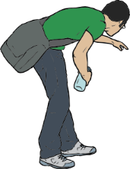





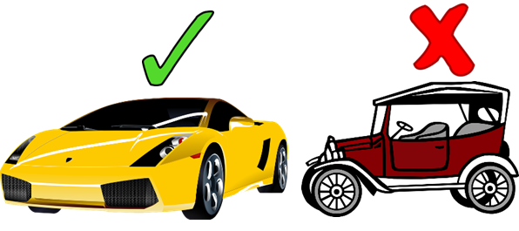




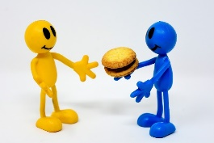



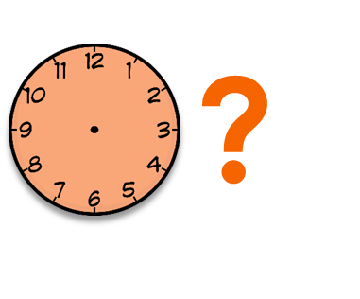
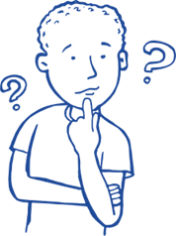

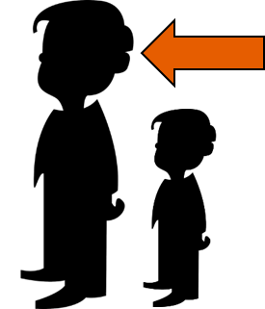


SSCs
You will sometimes learn these SSC in pairs.
This helps you to distinguish between two very similar sounds.
[on]
[to use]
Salut!
vue
amusant
sur
utiliser
[always;
still]
trouver
jouer
Bonjour!
toujours
douze
[life]
monde
moderne
centre
vie
douze
bébé
aller
donner
nez
parler
[to take]
grand
quand
penser
prendre
encore
[to show]
[at the
back]
[to continue]
onze
continuer
monde
montrer
au fond
4
Notes:
tu [112]; salut ! [2205] vue [191]; sur [16]; amusant [4695]; utiliser [345]
nous [31]; trouver [83] jouer [219]; bonjour [1972]; toujours [103]; douze [1664]
timide [3835]; monde [77]; moderne [1239] centre [491]; vie [132]; douze [1664]
écrire [382]; bébé [>5000]; aller [55] donner [46]; et [6]; parler [106]
enfant [126]; grand [59]; quand [119] penser [116]; prendre[43]; encore [51];
non [72]; onze [2447]; continuer [113] monde [77]; montrer [108]; au fond [553];

Slide 6






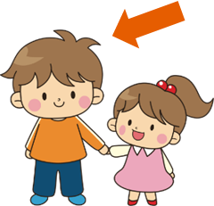


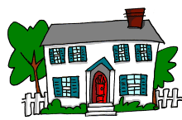







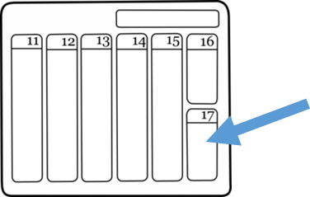

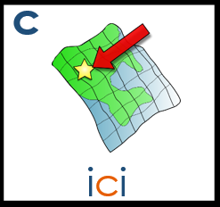




SSCs
These words have been especially chosen for their high-frequency. This means words that are used a lot when you speak French, and therefore that they are very useful words for you to know!
[end]
[now]
fin
matin
vingt
maintenant
main
[problem]
[to be]
fête
frère
collège
problème
être
[reason]
[bad]
[to do]
[week]
maison
raison
mauvais
faire
semaine
[to have]
[why?]
droite
avoir
au revoir
pourquoi ?
trois
[field]
dimanche
chanter
bouche
champ
chat
[to decide]
français
garçon
cinéma
décider
cinq
5
Notes:
train [232]; fin [111]; matin [442] vingt[1273]; maintenant [192]; main [418]
tête [343]; fête [1490]; frère [1043] collège [2116]; problème [188]; être[5]
vrai [292]; maison [325]; raison [72] mauvais [274]; faire [25]; semaine [245]
voir [69]; droite [1293]; avoir [8] au revoir [n/a]; pourquoi[193]; trois[115]
chercher [336]; dimanche [1235]; chanter [1820] bouche [1838]; champ [847]; chat [3138]
ici [167]; français [251]; garçon [1599]; cinéma [1623]; décider [165]; cinq [288]

Slide 7








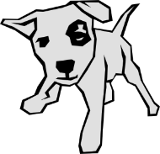
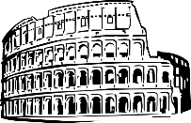



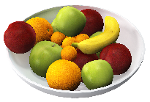
SSCs
[to explain]
[to miss;
be missing]
[unique;
only]
quatre
musique
expliquer
manquer
unique
[I have]
[subject]
[already]
[never]
j’ai
génial
sujet
déja
jamais
population
action
situation
international
solution
[nothing]
[soon]
chien
rien
bientôt
ancien
combien ?
Des virelangues pour pratiquer. (Some tongue twisters to practise).
1 Trois gros rats gris dans trois gros trous très creux.
1 Three big grey rats in three big, very deep holes.
2 Ce ver vert va vers le verre vert.
2 This green worm goes towards the green glass.
3 Fruits frais, fruits frits, fruits cuits, fruits crus.
3 Fresh fruits, fried fruits, cooked fruits, raw fruits.
6
Notes:
question[144]; quatre[283]; musique [1139] expliquer [252]; manquer [583]; unique [402]
jour [78]; j’ai [8 - avoir]; génial [3872] sujet [353]; déjà [58]; jamais [179];
attention [482]; population [509]; action [355] situation [223]; international [282]; solution [608];
bien [47]; chien [1744]; rien [168] bientôt [1208]; ancien [392]; combien? [800];
un [3]; quelqu’un [772]; lundi [1091]
Fruit image: Wolfgang Eckert en Pixabay

Slide 8


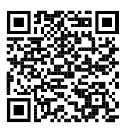
T1.1 Semaine 1
Grammaire
ÊTRE - to be, being
The verb être means to be / being.
Verb ÊTRE [to be, being]
je suis | I am
tu es | you are
Je suis anglais. → I am English. Tu es petit. → You are small.
Adjectives
In French when an adjective describes a feminine noun, the adjective’s spelling and sometimes its sound change.
The most common change is an ‘e’ on the end of the adjective.
(for adjectives not already ending in ‘e’.)
Je suis petit → I am short (m). Je suis petite → I am short (f).
Describing a thing or person
Vocabulaire
vb
vb
vb
vb
vb
vb
vb
pron
pron
être | to be / being
je suis | I am
tu es | you are
écouter | to listen, listening
écrire | to write, writing
lire | to read, reading
parler | to speak, speaking
je | I
tu | you
adj
adj
adj
adj
conj
anglais(e) | English (m/f)
français(e) | French (m/f)
grand(e) | tall (m/f)
petit(e) | short (m/f)
et | and
au revoir | goodbye
bonjour | hello
7

Slide 9
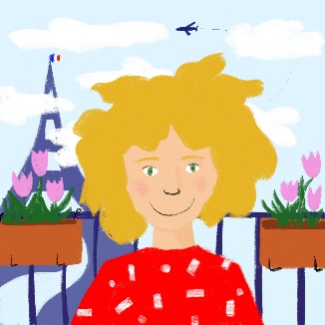

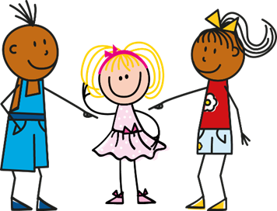
T1.1 Semaine 2
Grammaire
ÊTRE - to be, being
The verb être means to be / being.
Verb ÊTRE [to be, being]
il est | he is
elle est | she is
Il est content. → He is pleased. Elle est triste. → She is sad.
Adjectives
When an adjective describes a feminine noun, the adjective’s spelling and sometimes its sound change.
The most common change is an ‘e’ on the end of the adjective.
(for adjectives not already ending in ‘e’.)
masculine
Il est intelligent. He is intelligent.
Je suis petit. I (a boy) am short.
The ‘t’ is not pronounced (SFC).
feminine
Elle est intelligente. She is intelligent.
Je suis petite. I (a girl) am short.
The ‘t’ is pronounced The ‘e’ is not pronounced.
Yes/no questions (raised intonation)
In French, change a statement into a question by raising your voice at the end:
Statement
Elle est malade. She is ill.
Question
Elle est malade ? Is she ill?
8

Slide 10
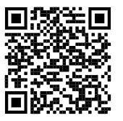
Describing a thing or person [2]
Vocabulaire
vb
vb
pron
pron
adj
adj
adj
adj
adj
adj
adj
conj
conj
il est | he is
elle est | she is
il | he
elle | she
amusant(e) | funny (m/f)
calme | calm, quiet
content(e) | glad, pleased (m/f)
intelligent(e) | intelligent (m/f)
malade | ill
méchant(e) | mean (m/f)
triste | sad
mais | but
ou | or
merci | thank you
Write these adjectives in the feminine form.
Tick those that change their pronunciation.
 | funny
 | quiet
 | glad, pleased
 | excellent
 | intelligent
 | ill
 | mean
 | sad
9

Slide 11
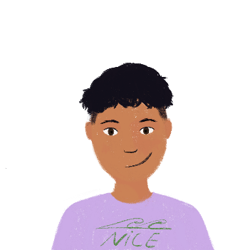
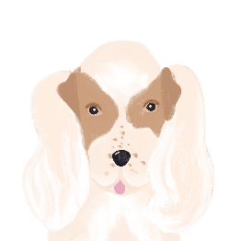
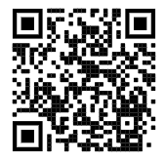
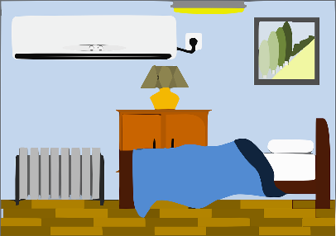
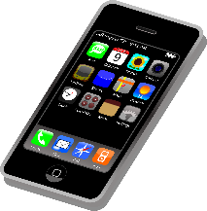
T1.1 Semaine 3
Grammaire
Using the verb AVOIR
To talk in French about what you have, use the verb avoir.
avoir to have / having
j’ai I have
il a he has
elle a she has
The pronoun
je is j’
before a vowel.
J’ai un animal. I have an animal (i.e., pet).
Il a un chien. He has a dog.
Elle a une idée. She has an idea.
Saying what people have
Vocabulaire
vb
vb
vb
vb
pron
pron
nm
nf
nm
nf
nf
nm
nf
adj
det
det
avoir | to have, having
j’ai | I have
il a | he has
elle a | she has
ce / c’ | this, that
qui ? | who
un animal | an animal, a pet
une chambre | a bedroom
un chien | a dog
une chose | a thing
une idée | an idea
un portable | a mobile phone
une règle | a ruler
bon | good (m)
un | a / an (masculine nouns)
une | a / an (feminine nouns)
10

Slide 12
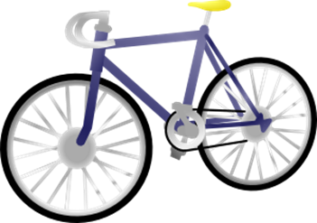

T1.1 Semaine 4
Grammaire
Using the verb AVOIR
Remember, the verb avoir is French for have.
Do not say the final ‘s’ →
SILENT FINAL CONSONANT
avoir to have / having
j’ ai I have
tu as you have
il a he has
elle a she has
J’ ai un chien. I have a dog.
Elle a un chien. She has a dog.
Tu as un chien. You have a dog.
In English, the adjective comes before the noun.
Using adjectives
Many adjectives come after the noun:
un ordinateur modern a modern computer
un vélo cher an expensive bike
une voiture rapide a fast car
Note: The adjective changes its spelling and sound to match feminine nouns!
cher → chère
Liaison
Prononciation
Normally, the –t in c’est is a Silent Final Consonant (SFC).
C’est bon ! C’est triste !
Before a vowel, the –t is pronounced. This is called liaison.
C’est un vélo cher ! C’est une voiture rapide !
11

Slide 13
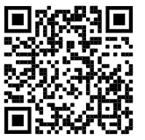

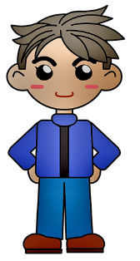

Describing what people have
Vocabulaire
vb
nm
nm
nm
nf
nf
adj
adj
prep
tu as | you have
un livre | a book
un ordinateur | a computer
un vélo | a bike, a bycicle
une voiture | a car
cher / chère | expensive (m/f)
moderne | modern
rapide | fast, quick
voici | here is
oui | yes
non | no
comment ça s'écrit ? | how do you spell it?
Revisit vocab 1.1.1
l’alphabet français
A a | J gee | S ess
B bé | K ka | T té
C sé | L elle | U uuu
D dé | M emm | V vé
E eu | N enn | W dooble-vé
F eff | O oh | X eeks
G zhé | P pé | Y ee greque
H ash | Q koo | Z zed
I ee | R air | Go to p.57
Go to p.57 for Spelling Bee Stage 1 word list
R - A - P - I - D - E
‘rapide’, comment ça s'écrit ?
12
Notes:
Imagen de Annalise Batista en Pixabay

Slide 14


T1.1 Semaine 5
Grammaire
Using avoir and être
Remember, to talk in French about having something, use the verb avoir.
avoir to have / having
e.g. il a he has
elle a she has
... and to talk in French about being something, use the
verb être.
être to be / being
e.g. il est he is
elle est she is
Elle a un chien. She has a dog.
Elle est grande. She is tall.
‘Il’ and ‘elle’ meaning ‘it’
As you know, we use il/elle to say he/she in French:
Amir a un livre. Léa a une règle. → Il a un livre. Elle a une règle.
Amir has a book. Léa has a ruler.→ He has a book. She has a ruler.
We also use il/elle to mean ‘it’, referring to things:
Le livre est bon. Il est bon → It (masculine) is good.
La règle est petite. Elle est petite. → It (feminine) is short.
Masculine and feminine job titles
Many job titles have different masculine and feminine forms.
Il est chanteur. He’s a singer. (masculine)
Elle est chanteuse. She’s a singer. (feminine)
Il est professeur. He’s a teacher. (masculine)
Elle est professeure. She’s a teacher. (feminine)
13

Slide 15
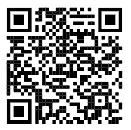

Distinguishing between having and being
Vocabulaire
pron
pron
nm
nf
nm
nf
nm
nf
nf
nm
adj
adj
adj
il | he, it
elle | she, it
un ami | a friend (m)
une amie | a friend (f)
un chanteur | a singer (m)
une chanteuse | a singer (f)
un professeur | a teacher (m)
une professeure | a teacher (f)
une femme | a woman
un homme | a man
drôle | funny
intéressant(e) | interesting (m/f)
sympa, sympathique | nice
vrai | true
faux | false
Revisit vocab 1.1.2
Vocabulary learning involves knowing different aspects of a word.
Use this checklist:
1. I have seen this word before.
2. I know what the word means.
3. I can read the word aloud.
4. I can spell the word correctly.
5. I can use the word in a sentence.
6. For nouns, I know the gender and the correct word for ‘a’/‘the’.
14

Slide 16

T1.1 Semaine 6
Grammaire
Gender and singular nouns
We already know that all nouns (e.g., words for things, people,
countries) have a gender in French.
All nouns are either masculine or feminine.
masculine
feminine
un chien
le chien
a dog
the dog
une chambre a bedroom
la chambre the bedroom
To say a or an before a noun, use un or une, according to whether the noun is masculine or feminine.
To say the before a noun, use le or la, according to whether the noun is masculine or feminine.
Making nouns and articles plural
To make a noun plural, i.e. to talk about more than one thing, we add an s (most of the time), just the same as in English:
masculine
feminine
les chiens the dogs
les livres the books
les chambres the bedrooms
les choses the things
‘The’ also changes to ‘les’, to match the plural noun.
‘Les’ (the) is the same for both masculine and feminine nouns.
You do not pronounce the –s on the end of the words.
It is a silent final consonant (SFC).
Liaison
Prononciation
Normally, the –s in les is a Silent Final Consonant (SFC).
Les chiens Les filles
Before a vowel, the –s is pronounced. This is called liaison.
Les ordinateurs Les actrices
15

Slide 17


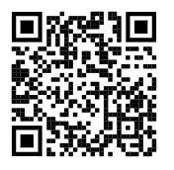
Talking about a thing or person
Vocabulaire
nm
nf
nm
nm
nf
nm
nm
nf
nm
nf
nf
det
det
det
prep
l'acteur (m) | actor (m)
l’actrice (f) | actor (f)
l’anglais (m) | English language
le français (m) | French language
la fille | girl
le garçon | boy
le médecin | doctor (m)
la médecin | doctor (f)
le mot | word
la personne | person
la phrase | sentence
le | the (m)
la | the (f)
les | the (pl)
en | in
Revisit vocab 1.1.3
16
Notes:
Imagen de Alejandra Jimenez en Pixabay
Imagen de Kevin Phillips en Pixabay

Slide 18

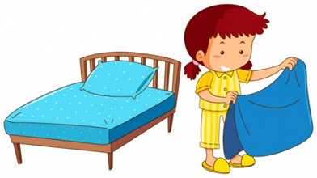
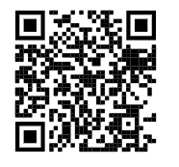
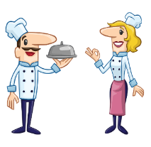

T1.1 Semaine 7
Grammaire
The verb faire: to do / to make
In French we use the verb faire to say to do and to make.
je fais I do / make
il fait he does / makes
elle fait she does / makes
Talking about doing and making things
Vocabulaire
vb
vb
vb
vb
vb
pron
nf
npl
nf
nmpl
nm
nm
nm
faire | to do, make / doing, making
je fais | I do, I make / I am doing, I am making
tu fais | you do, you make / you are doing, you are making
il fait | he does, he makes / he is doing, he is making
elle fait | she does, she makes / she is doing, she is making
ça | that
l'activité (f) | activity
les courses (fpl) | food shopping
la cuisine | cooking
les devoirs (mpl) | homework
le lit | bed
le ménage | housework
le modèle | model
quoi ? | what?
Revisit vocab 1.1.4
To form a question with quoi (what), put it after the verb. This is different from English.
What is she doing?
Elle fait quoi ?
17
Notes:
Imagen de GraphicMama-team en Pixabay
Imagen de LillyCantabile en Pixabay

Slide 19



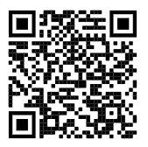
T1.2 Semaine 1
Reading
nm
nf
nm
nm
nf
nm
nf
adj
adj
adj
adj
adv
le ciel | sky
la couleur | colour
le poème | poem
le poète | poet (m)
la poète | poet (f)
le rêve | dream
la vague | wave
bleu(e) | blue (m/f)
jaune | yellow
rouge | red
vert(e) | green (m/f)
comme | like
Revisit vocab 1.1.5
18

Slide 20






T1.2 Semaine 2
Grammaire
FAIRE - meaning ‘go’
Reminder: in French we use the verb faire to say to do and to make.
verb FAIRE [to do, make]
Je fais | I do
Tu fais | you do
Il / elle fait | he/she/it does
Je fais la cuisine. I do the cooking.
Tu fais le lit. You make the bed.
Il fait le ménage.
He does the housework.
However, faire is used with many other meanings in French:
faire un voyage
to go on a journey
faire une promenade
to go for a walk/ride
faire une visite de
to go on a tour of
faire les magasins
to do the shopping
faire beau
to be nice weather
faire mauvais
to be bad weather
19

Slide 21
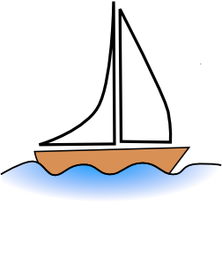



Saying what people do
Vocabulaire
nm
nm
nm
nf
nf
nf
nm
nm
adj
adj
prep
prep
le bateau | boat, ship
le magasin | shop
le numéro | number
la promenade | walk
la question | question
la réponse | answer, response
la visite | visit, tour
le voyage | trip, journey
beau | beautiful (m)
mauvais(e) | bad (m/f)
de | of
en | in, by
Paris | Paris
Londres | London
Revisit vocab 1.1.6 & 1.1.1
Vocabulary learning involves knowing different aspects of a word.
Use this checklist:
1. I have seen this word before.
2. I know what the word means.
3. I can read the word aloud.
4. I can spell the word correctly.
5. I can use the word in a sentence.
6. For nouns, I know the gender and the correct word for ‘the’.
Encore une fois!
20
Notes:
Imagen de kropekk_pl en Pixabay

Slide 22
T1.2 Semaine 3
Grammaire
-er verbs: 1^{st,} 2nd and 3rd person singular
English has two present tense forms.
For example:
I make the bed every week.
I am making the bed at the moment.
French has one present tense only. The BE + -ing form does not exist.
For example:
Je fais le lit chaque semaine.
Je fais le lit en ce moment.
In French, the present simple is used with all verbs.
In French, regular verb endings change to match pronouns.
To say ‘I’, ‘he’ or ‘she’ + regular -ER verb in French, the verb is in the short form and ends in -e.
aimer
To say ‘you (singular)’ + regular –ER verb in French, the verb is in the short form and ends in -es.
J’aime le professeur.
Il aime l’actrice.
Elle aime le chien.
J’aime = Je + aime
Je → J’
before a vowel
→ Tu aimes le professeur.
Write in French:
1 I like the present.
2 You wear a uniform.
3 He likes the computers.
4 She likes the car.
21

Slide 23


Saying what people like to do
Two-verb structures (aimer + infinitive)
When we use a verb in a sentence with je, tu, il or elle, we use the short form of the verb, with an ending that matches the pronoun:
J’aime le professeur.
Tu aimes le professeur.
If the sentence has two verbs, the second verb is in the long form:
J’aime écouter le professeur.
Tu aimes écouter le professeur.
In English, the second verb can be in the ‘to’ infinitive or the –ing form:
I like to listen to the teacher. I like listening to the teacher.
Vocabulaire
vb
vb
vb
vb
vb
vb
nm
nm
nf
nf
nm
adj
prep
prep
aimer | to like, liking
cocher | to tick, ticking
passer | to spend time, spending time
porter | to wear, wearing
rester | to stay, staying
trouver | to find, finding
l’école (m) | school
le moment | moment
la semaine | week
la solution | solution
l’uniforme (m) | uniform
chaque | every
à | at
avec | with
Revisit vocab 1.1.2 & 1.1.7
22
Notes:
Imagen de OpenClipart-Vectors en Pixabay
Imagen de Clker-Free-Vector-Images en Pixabay

Slide 24



T1.2 Semaine 4
Grammaire
à with certain verbs (at vs to)
The preposition à sometimes means ‘at’:
Il reste à l’école. → He stays/is staying at school.
À can also mean ‘to’ with certain verbs:
Bilal parle à Amir. → Bilal speaks / is speaking to Amir.
Sometimes, we leave out the ‘to’ in English. This cannot happen in French.
Bilal donne un cadeau à Amir. →
Bilal gives / is giving a present to Amir.
OR Bilal gives / is giving Amir a present.
Saying what people do to others
Vocabulaire
vb
vb
vb
vb
nm
nm
demander | to ask, asking
donner | to give, giving
montrer | to show, showing
penser | to think, thinking
le cadeau | present
l'exemple (m) | example
nf
adv
adv
conj
prep
la raison | reason
aujourd’hui | today
normalement | normally
que | that
à | to, at
penser à | to think about
Revisit vocab 1.2.1 & 1.1.3
23

Slide 25



T1.2 Semaine 5
Grammaire
-er verbs: 1st person plural
To say ‘we’ + verb, the verb ends with -ons.
Nous regardons.
We watch (or we are watching).
Nous travaillons.
We work (or we are working).
Write in French:
1 We like the car.
2 We are watching a film.
Saying what you do with others
Vocabulaire
vb
vb
vb
vb
vb
pron
nm
nm
nf
nm
nf
nf
adv
prep
marcher | to walk, walking
manger | to eat, eating
préparer | to prepare, preparing
regarder | to watch, watching
travailler | to work, working
nous | we
le déjeuner | lunch
le film | film
la maison | house
le partenaire | male partner
la partenaire | female partner
la télé | television
dehors | outside
préféré(e) | favourite (m/f)
manger →
nous mangeons
We keep the ‘e’ in the nous form so that the [g] is still soft.
Revisit vocab 1.2.2 & 1.1.4
24
Notes:
Imagen de Annalise Batista en Pixabay

Slide 26





T1.2 Semaine 6
Grammaire
-er verbs: 3rd person plural
In French, regular verb endings change to match pronouns.
To say ‘they’ + verb, use ils/elles + verb ending with -ent.
NB: This ending is all silent!
For either a group of boys or a mixed group.
Ils jouent.
They play.
For a group of girls only.
Elles jouent.
They play.
Saying what others do
Vocabulaire
vb
vb
vb
pron
pron
nm
nf
nf
nm
nf
adv
chanter | to sing, singing
étudier | to study, studying
jouer | to play, playing
elles | they (f)
ils | they (m, m/f)
un élève | pupil (m)
une élève | pupil (f)
l’histoire (f) | history
le fruit | fruit
la radio | radio
ensemble | together
Revisit vocab 1.2.3 & 1.1.5
25

Slide 27


T1.2 Semaine 7
Grammaire
-er verbs: 2nd person plural
In French, regular verb endings change to match pronouns.
To say ‘you (plural)’ + regular -ER verb in French, the verb is the short form and ends in -ez.
‘You’ to one person → ‘You’ to more than one person
jouer
tu joues → vous jouez
manger
tu manges → vous mangez
Saying ‘you’ meaning more than one person
Vocabulaire
vb
vb
pron
nf
nf
nf
nf
nf
nm
nm
adv
fermer | to close, closing
regarder | to watch, to look at
vous | you (plural)
la chemise | shirt
la classe | class
la fenêtre | window
la porte | door
la salle | room
le silence | silence
le tableau | board
bien | good, well
Revisit vocab 1.2.4 & 1.1.6
26
Notes:
Imagen de OpenClipart-Vectors en Pixabay

Slide 28

T2.1 Semaine 1
Grammaire
il y a – ‘there is’ and ‘there are’
These three words each have their own separate meaning, but when used together, they mean "There is... / there are…"
Il y a un livre.
→ There is a book.
Remember:
un/une also means
‘one’, so this can be translated as ‘there
is one book’!
Il y a une maison.
→ There is a house.
des – ‘some’ (plural)
Il y a des films.
→ There are some films.
Il y a des maisons.
→ There are some houses.
As in English, we add –s to the end of the noun to make it plural.
des is the plural form of the indefinite article (=some)
un/une are the singular forms of the indefinite article (=one, a, an)
How many…?
To say how many of something there are,
use ‘il y a’ + number (or the plural article ‘des’ = some):
Il y a deux livres. There are two books.
Il y a trois maisons. There are three houses.
Il y a des voitures. There are some cars.
Saying how many there are
Vocabulaire
un | 1
deux | 2
trois | 3
quatre | 4
cinq | 5
six | 6
sept | 7
huit | 8
neuf | 9
dix | 10
onze | 11
douze | 12
adv
det
il y a | there is/are…
des | some
Revisit vocab 1.2.5 & 1.1.7
27

Slide 29





T2.1 Semaine 2
Grammaire
Using the verb “être” – to be (singular & plural)
Verb ÊTRE [to be, being]
Je suis | I am
Tu es | you are
Il / elle est | he/she/it is
Nous sommes | we are
Vous êtes | you all are
Ils/elles sont | they are
Nous sommes contents.
We are happy.
Vous êtes français.
You are all French.
Ils/elles sont jeunes.
They are young.
Describing more than one thing
We add –s to make nouns plural: un livre = a book
deux livres = two books
Adjectives also have to match their nouns, adding –s for plural:
Il y a des livres chers. = There are some expensive books.
This is adjective agreement (like the –e on feminine forms).
*The –s is not pronounced – it’s a silent final consonant (SFC).
28

Slide 30




Describing your family
Vocabulaire
vb
vb
vb
vb
nm
nm
nf
adj
adj
adj
adj
adj
adj
nous sommes | we are, we are being
vous êtes | you are, you are being (plural)
ils sont | they are, they are being (m/mf)
elles sont | they are, they are being (f)
le frère | brother
le parent | parent
la sœur | sister
grand(e) | tall, big (m/f)
jeune | young
ouvert(e) | open (m/f)
petit(e) | short, small (m/f)
sage | wise/well-behaved
strict(e) | strict (m/f)
Write in French:
1 The sisters are young.
2 You are all well-behaved.
3 The parents are strict.
4 We are happy.
5 The schools are open!
Revisit vocab 1.2.6 & 1.2.1
29
Notes:
Vincent Le Moign / CC BY (https://creativecommons.org/licenses/by/4.0)

Slide 31






T2.1 Semaine 3
Grammaire
Using the verb “avoir” – to have (singular & plural)
Verb AVOIR [to have, having]
J’ai | I am
Tu as | you are
Il / elle a | he/she/it is
Nous avons | we are
Vous avez | You all are
Ils/elles ont | they are
Nous avons un enfant.
We have a child.
Vous avez un problème.
You are have a problem.
Ils/elles ont des chiens.
They have some dogs.
Liaison
Prononciation
We don’t usually pronounce the –s at the end of a word, but if it’s followed by a vowel we pronounce it like a -z.
Similarly, the –t is not silent if followed by a vowel.
We call this « la liaison ».
30

Slide 32




Saying what people have
Vocabulaire
vb
vb
vb
vb
nm
nf
nf
nm
adj
adv
adv
conj
prep
prep
nous avons | we have, we are having
vous avez | you have, you are having (pl)
ils ont | they have, they are having (m, m/f)
elles ont | they have, they are having (f)
un enfant | a child (m)
une enfant | a child (f)
la famille | family
le problème | problem
difficile | difficult
ici | here
très | very
aussi | also
pour | for
dans | in, inside
Vocabulary learning involves knowing different aspects of a word.
Use this checklist:
1. I have seen this word before.
2. I know what the word means.
3. I can read the word aloud.
4. I can spell the word correctly.
5. I can use the word in a sentence.
6. For nouns, I know the gender and the correct word for ‘the’.
Revisit vocab 1.2.7 & 1.2.2
31

Slide 33


T2.1 Semaine 4
Grammaire
faire - ‘to do/make’ and ‘doing/making’ (singular & plural)
Verb FAIRE [to do, doing]
Je fais | I do
Tu fais | you do
Il / elle fait | he/she/it does
Nous faisons | we do
Vous faites | You all do
Ils/elles font | they do
Nous faisons le lit.
We make/are making the bed.
Vous faites un effort.
You all make/are making an effort.
Ils font la cuisine.
They do/are doing the cooking.
Elles font un exercice.
They do/are doing an exercise.
Saying what people do
Vocabulaire
vb
vb
vb
vb
nf
nm
nm
nf
nf
nous faisons | we do, we make
vous faites | you do, you make (pl)
ils font | they do, they make (m/mf)
elles font | they do, they make (f)
l’attention (f) | attention
l'effort (m) | effort
l'exercice (m) | written exercise
la fête | party
la liste | list
d’accord | okay, alright
Revisit vocab 2.1.1 & 1.2.3
32

Slide 34
T2.1 Semaine 5
Grammaire
Talking about belongings
Possessive adjectives (mon, ma, mes, ton, ta, tes)
All nouns in French are either masculine or feminine, and there are different words for ‘the’ because of this:
le frère (m) → the brother la sœur (f) → the sister
For the same reason, there are also different words for my and your:
mon frère (m) → my brother ma sœur (f) → my sister
ton frère (m) → your brother ta sœur (f) → your sister
If a noun begins with a vowel or h-, we use mon or ton for both masculine and feminine:
mon ami → my friend (m) mon amie → my friend (f)
ton homme → your man ton idée → your idea
If a noun is plural, we use mes or tes for masculine and feminine:
mes amis → my friends (m) mes amies → my friends (f)
tes parents → your parents tes filles → your girls
T2.1 Semaine 6: Assessment
33

Slide 35

T2.2 Semaine 1
Grammaire
The verb aller - ‘to go’ and ‘going’ (singular)
Verb ALLER [to go, going]
je vais | I go
tu vas | you go
il / elle va | he/she/it goes
Je vais à la poste.
I go/am going to the post office.
Tu vas au collège.
You go/are going to (the) school.
Elle va au parc.
She goes/is going to the park.
Liaison
Tu vas dehors. You go outside.
The final –s in vas is a Silent Final Consonant.
But remember, when -s is followed by a vowel, pronounce it like -z.
Je vais à Londres. I go to London.
Tu vas à la caisse. You go to the checkout.
Saying ‘to (the)…’ in French
To say ‘to…’ in French before a town/city, use à – je vais à Paris.
When we say ‘to (the)…’ in French before a noun, we use:
au – if the noun is masculine à la – if the noun is feminine
This can also mean ‘at the’.
e.g. Je vais au collège. Je suis au collège.
I go to (the) school I am at (the) school.
Asking questions with intonation
Remember, we can use intonation to form questions in French.
E.g., Tu as un animal ? Do you have an animal?
Literally: You have an animal? ‘Do’ is not used in French!
We can add a question word at the end, too:
e.g. Elle va au parc comment ? How is she going to the park?
Tu vas où ? Where are you going?
Il va à Londres quand ? When is he going to London?
34

Slide 36




Where people go (places)
Vocabulaire
vb
vb
vb
vb
vb
nf
nm
nm
nm
nf
nm
nm
adv
adv
adv
aller | to go, going
je vais | I go, I am going
tu vas | you go, you are going
il va | he goes, he is going
elle va | she goes, she is going
la caisse | checkout
le collège | secondary school
le jour | day
le parc | park
la poste | post office
samedi (m) | Saturday
le train | train
comment ? | how
où ? | where
quand ? | when
Revisit vocab
2.1.2 & 1.2.4
Write in French:
1 She is going to the checkout.
2 The train is going to the school.
3 Where are you going?
4 I am going to the park.
5 When is she going to the post office?
35

Slide 37










T2.2 Semaine 2
Grammaire
Saying ‘to (the)…’ in French [2]
When we say ‘to (the)…’ before a noun that begins with a vowel, we use à l’ for masculine and feminine:
à l’aéroport (to the airport) - à l’université (to the university)
If the noun is plural, we use aux for masculine and feminine:
aux États-Unis (to the USA) - aux îles (to the islands)
Liaison: as the -x in aux is followed by a vowel, pronounce is as ‘z’.
Saying where people go (on holiday)
Vocabulaire
nm
nm
nm
nf
nf
adv
adv
l'aéroport (m) | airport
l'étranger (m) | abroad
l'hôtel (m) | hotel
l’île (f) | island
l'université (f) | university
rarement | rarely
souvent | often
les États-Unis | USA
Revisit vocab
2.1.3 & 1.2.5
36

Slide 38





T2.2 Semaine 3
Reading
Familiale - Jacques Prévert [1945]
Familiale
Vocabulaire
vb
nfpl
nm
nf
nf
nm
nf
adj
adj
adj
adj
adv
prep
tuer | to kill, killing
les affaires (fpl) | business
le fils | son
la guerre | war
la mère | mother
le père | father
la vie | life
naturel | natural (m)
naturelle | natural (f)
heureux | happy (m)
heureuse | happy (f)
absolument | absolutely
contre | against
Revisit vocab
2.1.4 & 1.2.6
37
Notes:
Attribution:
Image a: Pink knitting in front of pink sweatshirt by Johntex under the Creative Commons Attribution-Share Alike 3.0 Unported license
Image b: Marine dashes through Japanese machine gun fire by Pvt. Bob Bailey is in the public domain
Image c: Business to Business Agreement by Onyxxo is licensed under the Creative Commons Attribution-Share Alike 4.0 International license
Image d: Headstones in Banville-la-Campagne war cemetery, Normandy by Londonclanger is licensed under the Creative Commons Attribution-Share Alike 4.0 International license

Slide 39

T2.2 Semaine 4
Grammaire
The verb aller - ‘to go’ and ‘going’ (plural)
You already know how to use the verb ‘aller’ to talk about ‘I’ (je), ‘you’ (tu) and ‘he’ / ‘she’ (il/elle).
Check week 2.2.1!
verb ALLER [to go, going]
nous allons | we go / we are going
vous allez | you (all) go / you are (all) going
ils vont | they go / they are going (male/mixed)
elles vont | they go / they are going (all female)
Liaison: ‘nous allons’ and ‘vous allez’ sound like one word – because the next word starts with a vowel, pronounce the final ‘s’, but like a ‘z’!
Saying where people go
The following noun is… | ‘to the’=
f. singular | à la…
m. singular | au…
plural (m/f) | aux…
Starts with vowel/ ‘h’ | à l’…
Remember: there are four ways to say ‘to the’ in French.
The one you use depends on the gender (m/f) and number (singular/plural) of the noun that follows.
There are also different ways to say ‘to’ + a place.
Note: ‘à’ means ‘at’ or ‘in’, as well as ‘to’.
You are going to… | ‘to’ = | Examples:
a village / a town / a city | à | Je vais à Londres. Nous allons à Paris,
town / on holiday / a feminine country | en | Tu vas en ville. Ils vont en vacances, Vous allez en Écosse
someone’s house / someone’s place | chez | Ils vont chez Marie, Je vais chez le médecin.
38

Slide 40


Saying where people go (countries)
Vocabulaire
vb
vb
vb
vb
nf
nf
nf
nf
nf
nm
nfpl
prep
prep
nous allons | we go, we are going
vous allez | you go, you are going (plural)
ils vont | they go, they are going (m, m/f)
elles vont | they go, they are going (f)
l'Angleterre (f) | England
l'Écosse (f) | Scotland
la France | France
la ville | town
l'année (f) | year
le mois | month
les vacances (fpl) | holidays
chez | to (the place of)
en | in, by, to
Saying where people go
How would you say the following in French? Remember to carefully check the verb form that you need AND how to say ‘to’!
They are going to Marc’s house (to the place of Marc).
I rarely go to the post office.
She goes to the doctor every month.
Are you (all) going on holiday?
She often goes to London.
They (f) go to the park when it’s nice weather.
I am going on holiday to London.
Do you (sing) go to Scotland on holiday every year?
We often go to town.
Are they (mixed) going to school today?
Revisit vocab 2.2.1 & 1.2.7
39

Slide 41

T2.2 Semaine 5
Grammaire
Saying ‘to’ and ‘in’
Remember: to say ‘to’ when using the verb aller (to go), use the preposition ‘à’ for a town/village/city, and the preposition ‘en’ for feminine countries.
Je vais à Paris. – I am going to Paris.
Je vais en Écosse. – I go to Scotland.
‘aller’ is a verb that shows movement towards a place.
‘à’ and ‘en’ can also mean ‘in’, when used with the verbs expressing location such as arriver (to arrive) and habiter (to live).
J’arrive à Londres. – I am arriving in London.
J’habite en Angleterre. – I live in England.
‘arriver’ and ‘habiter’ are verbs that show location in a place.
Saying ‘of’
To say ‘of’ in French, use the preposition ‘de’:
le president de la France - the president of France
la reine d’Angleterre – the queen of England
le monde de la mode – the world of fashion
Sometimes we don’t translate the ‘de’ directly, and it sounds more natural in English to swap the nouns around:
le prof de maths – the maths teacher (teacher of maths)
le magasin de vêtements – the clothes shop (shop of clothes)
‘De’ is also used to show possession and translates the English -’s:
l‘enfant de mon cousin – my cousin’s child
la famille de Marie – Marie’s family
la maison de ma sœur – my sister’s house
40

Slide 42

Talking about people’s lives
Vocabulaire
vb
vb
vb
vb
vb
nm
nm
nf
nmpl
prep
prep
prep
arriver | to arrive, arriving
changer | to change, changing
créer | to create, creating
gagner | to win, winning
habiter | to live, living (somewhere)
le monde | world
le pays | country
la politique | politics
les vêtements (mpl) | clothes
à | to, at, in
chez | to (the place of), at (the place of)
comme | like, as
Revisit vocab 2.2.2 & 2.1.1
Test yourself!
How would you change the infinitives from this week’s vocabulary list to talk about different people? Complete the table.
 | je/j’ | tu | il | elle
arriver
changer
créer
gagner
habiter
Remember that je → j’ when the next words starts with a vowel (AEIOU) or ‘h’
41

Slide 43


T3.1 Semaine 1
Grammaire
Verbs like prendre (apprendre, comprendre) and the verb dire
These verbs end in –RE instead of –ER. The endings are different:
prendre to take, taking
je prends
tu prends
il prend
elle prend
dire to say, saying
je dis
tu dis
il dit
elle dit
apprendre
and comprendre have the same endings as prendre:
These verb forms
all sound the same!
The –s and –t are
silent final consonants (SFC)
Intonation questions (revision)
Change a statement into a question by raising your voice at the end:
Statement
Tu comprends. You understand.
Question
Tu comprends ? Do you understand?
Subject-verb inversion questions
To ask a question, swap the subject and the verb around:
Question
Comprends-tu ? Do you understand?
Swapping round the subject and verb is called inversion. We add a hyphen between them.
There are no question words for ‘do’ and ‘are’ in French!
Inversion tells us these are questions.
42

Slide 44


Asking and answering questions
Using the verb dire
In English, we can’t use the verb ‘say’ on its own in a sentence. You have to say something.
In French, the verb dire works in the same way:
We call these words the object: they ‘receive’ the action of the verb.
Elle dit la phrase. She says the sentence.
Elle dit la vérité. She tells the truth.
Verbs that need an object are called transitive (vt). Verbs that don’t need an object are call intransitive (vi).
Il parle. He is speaking.
Vocabulaire
vb
vb
vb
vb
vb
vb
vb
vb
vb
vb
vb
vb
nf
nf
adj
apprendre | to learn, learning
comprendre | to understand, understanding
dire | to say, saying
je dis | I say, I am saying
tu dis | you say, you are saying
il dit | he says, he is saying
elle dit | she says, she is saying
prendre | to take, taking
je prends | I take, I am taking
tu prends | you take, you are taking
il prend | he takes, he is taking
elle prend | she takes, she is taking
l’erreur (f) | mistake
la vérité | truth
facile | easy
Revisit vocab 2.2.3 & 2.1.2
43
Notes:
http://clipart-library.com/

Slide 45
T3.1 Semaine 2
Grammaire
Verbs like sortir and verbs like venir
These verbs end in –IR instead of –ER. The endings are different:
venir - note the stem change from ‘e’ to ‘ie’.
sortir to go out, going out
je sors
tu sors
il sort
elle sort
venir to come out, coming out
je viens
tu viens
il vient
elle vient
These verb forms
all sound the same!
The –s and –t are
silent final consonants (SFC)
This -s, -s, -t, -t pattern of endings is common in French verbs like sortir and venir! You have seen this before with dire.
Subject-verb inversion questions with ‘il’ and ‘elle’
Il dit la verité. He’s telling the truth.
Don’t pronounce the ‘t’ → SFC
Dit-il la verité ? Is he telling the truth?
Pronounce the ‘t’ here!
Prépare-t-il le déjeuner ? Is he preparing lunch?
When verbs end in a vowel, add a ‘t’ between two hyphens!
A-t-elle une voiture ? Does she have a car?
Subject-verb inversion questions with two verbs
If the sentence has two verbs, swap the subject and the first verb:
Tu aimes sortir. You like going out.
The subject goes before the verb.
Aimes-tu sortir ? Do you like going out?
44

Slide 46


Asking questions about others
Saying ‘of’ and ‘from’ in French
Remember! To say ‘of’ in French, we use the preposition de:
Je travaille à l’université de Paris. I work at the University of Paris.
This preposition can also mean ‘from’:
Je viens de Paris. I come from Paris.
Vocabulaire
vb
vb
vb
vb
vb
vb
vb
vb
vb
vb
vb
vb
nm
adj
adj
adj
prep
sortir | to go out, going out
je sors | I go out, I am going out
tu sors | you go out, you are going out
il sort | he goes out, he is going out
elle sort | she goes out, she is going out
venir | to come, coming
je viens | I come, I am coming
tu viens | you come, you are coming
il vient | he comes, he is coming
elle vient | she comes, she is coming
devenir | to become, becoming
revenir | to come back, coming back
l'Algérie (f) | Algeria
algérien | Algerian (m)
algérienne | Algerian (f)
important(e) | important (m/f)
de | of, from
Alger | Algiers
Revisit vocab 2.2.4 & 2.1.3
revenir
and devenir have the same endings as venir.
45
Notes:
http://clipart-library.com/

Slide 47
T3.1 Semaine 3
Grammaire
Question words with subject-verb inversion
Remember, to form a question, we can swap the pronoun and the verb:
These questions are asking for a yes/no answer.
Comprends-tu ? Do you understand?
As-tu la réponse ? Do you have the answer?
We can also add a question word at the beginning of the question:
Que comprends-tu ? What do you understand?
Combien de réponses as-tu ? How many answers do you have?
These questions are asking for information.
When we do this, we also need the pronoun-verb swap!
Remember, we can also use the question word at the end of the sentence with raised intonation:
Tu vas en vacances quand ? When are you going on holiday?
Quand vas-tu en vacances ? When are you going on holiday?
The meanings are the same in English.
Saying ‘what’ in French
We have seen that the words quoi and que both mean ‘what’.
We use quoi when making a question with raised intonation:
Tu fais quoi ce weekend ? What are you doing this weekend?
We use que when making a question with inversion:
Que fais-tu ce weekend ? What are you doing this weekend?
46

Slide 48










Using question words
Vocabulaire
pron
nf
nmpl
nf
nf
nf
nm
adj
adj
adv
adv
conj
que ? | that, what?
la langue | language
les maths (mpl) | maths
la matière | subject
la musique | music
la science | science
le nom | full name
quel ? | which? (m)
quelle ? | which? (f)
combien ? | how much? / how many?
pourquoi ? | why?
parce que | because
Revisit vocab 2.2.5 & 2.1.4
Question words
où ? – where? comment ? – how?
quoi ? que ? – what? quand ? – when?
qui ? - who? pourquoi ? - why?
quel ? quelle ? – which? combien (de) ? – how much?
how many?
47
Notes:
http://clipart-library.com/

Slide 49



T3.1 Semaine 4
Grammaire
In English: Add ‘do not’ before the verb.
In French: Add ‘ne’ before and ‘pas’ after the verb.
Negation - ne…pas
In front of a vowel, ne → n’
Similar to je → j’, or le → l’
Ce n’est pas facile.
Elle n’a pas la réponse.
I speak.
I do not speak.
Je parle.
Je ne parle pas.
Verbs (singular) like sortir: dormir
dormir - to sleep, sleeping
je dors | il dort
tu dors | elle dort
This -s, -s, -t, -t pattern of endings is common in French verbs like dire, venir and sortir.
Talking about what isn’t happening
Vocabulaire
vb
vb
vb
vb
vb
nf
nm
adv
prep
prep
dormir | to sleep, sleeping
je dors | I sleep, I am sleeping
tu dors | you sleep, you are sleeping
il dort | he sleeps, he is sleeping
elle dort | she sleeps, she is sleeping
l'équipe (f) | team
le bureau (m) | desk
parfois | occasionally
sous | under
sur | on
Revisit vocab 3.1.1 & 2.2.1
48

Slide 50


T3.1 Semaine 5
Grammaire
Negation - before a noun
We know that we can talk about things that aren’t happening by adding ne…pas around a verb.
Sometimes, we want to talk about things there aren’t. To do this, we use ne…pas followed by the article de.
J’ai un train.
Je n’ai pas de train.
Add ne…pas as normal.
Change ‘un’ for ‘de’.
J’ai des trains.
Je n’ai pas de train.
Plural noun?
Change ‘des’ for ‘de’
Plural noun becomes singular.
Negation of ‘il y a’
This is also the case with ‘il y a’. Ne…pas surrounds the ‘y a’ part:
Il y a un train. There is a train.
Il y a des trains. There are some trains.
Il n’y a pas de train. There is no train
There are no trains.
Talking about what isn’t there
Vocabulaire
nm
nm
nf
nf
prep
prep
prep
le café | café
le cinéma | cinema
la plage | beach
la rue | street
derrière | behind
devant | in front of
entre | between
Revisit vocab 3.1.2 & 2.2.2
49

Slide 51

T3.1 Semaine 6
Grammaire
Adjectives that go before the noun
As you know, many adjectives go after the noun, in French:
une maison moderne a modern house
une voiture rapide a fast car
However some adjectives come before the noun.
These adjectives refer to SIZE or GOODNESS:
une belle maison a beautiful house
une vieille église an old church
un bon pont a good bridge
un petit batîment a small building
B beauty
A age
G goodness
S size
Remember! Before or after the noun, adjectives still need to match the noun they describe: une nouvelle voiture, un nouveau vélo.
Describing more things and people
Vocabulaire
nm
nf
nm
nm
adj
adj
adj
adj
adj
adj
adj
le batîment | building
l’église (f) | church
le pont | bridge
le jardin | garden
belle | beautiful (f)
bonne | good (f)
haut(e) | high (m/f)
nouveau | new (m)
nouvelle | new (f)
vieille | old (f)
vieux | old (m)
Revisit vocab 3.1.3 & 2.2.3
T3.2 semaine 1 & 2:
Revision and assessment
50

Slide 52



T3.2 Semaine 3
Grammaire
Using aller + infinitive to say what you are going to do
To state a future intention, use the present tense of aller plus an infinitive verb:
aller - to go, going
je vais | I go, I am going
tu vas | you go, you are going
il va | he goes, he is going
elle va | she goes, she is going
Which form of the English present of ‘go’ do we use for future intentions? The simple present or the present continuous?
Je vais devenir prof.
I am going to become a teacher.
Tu vas partir en retard.
You are going to leave late.
Il va revenir.
He is going to come back.
Elle va gagner le match !
She is going to win the match!
Negation - ne…pas with two verbs
In sentences with two verbs, ne … pas surrounds the first verb, which is in short form.
J’aime parler français.
Je n’aime pas parler français.
I like speaking French.
I don’t like speaking French.
Tu vas à la plage.
Tu ne dois pas faire les devoirs.
You have to do homework.
You don’t have to do homework.
Remember! The verb that follows a modal verb is always an infinitive verb.
51

Slide 53


Verbs (singular) like sortir: partir
partir to leave, leaving
je pars
tu pars
il part
elle part
This -s, -s, -t, -t pattern of endings is common in French verbs like dire, venir and sortir.
These verb forms
all sound the same!
The –s and –t are
silent final consonants (SFC)
Expressing future intentions
Vocabulaire
vb
vb
vb
vb
vb
vb
nm
nf
nm
nm
adv
adv
adv
partir | to leave, leaving
je pars | I leave, I am leaving
tu pars | you leave, you are leaving
il part | he leaves, he is leaving
elle part | she leaves, she is leaving
l'avenir (m) | future
madame | Miss, Mrs, Ms, madam
le match | match
monsieur | Sir, Mr
encore | again
en retard | late
tôt | early
à l'avenir | in the future
Revisit vocab 3.1.4 & 2.2.4
52

Slide 54
T3.2 Semaine 4
Grammaire
Using aller + infinitive to express future intentions (plural)
verb ALLER [to go, going]
nous allons | we go / we are going
vous allez | you (all) go / you are (all) going
ils vont | they go / they are going (male/mixed)
elles vont | they go / they are going (all female)
Remember: ‘nous allons’ and ‘vous allez’ sound like one word – as the next word starts with a vowel, pronounce the final ‘s’, but like a ‘z’!
Nous allons écrire une lettre.
We are going to write a letter.
Vous allez visiter Berlin.
You are all going to visit Berlin.
Ils vont apprendre l’allemand.
They are going to learn German.
Elles vont aller en Allemagne.
They are going to go to Germany.
Question words with inversion and two verbs
Remember, to form an inversion question, in a sentence with two verbs, we swap the pronoun and the first verb, which is in short form:
Aiment-ils chanter ? Do they like singing?
These questions are asking for a yes/no answer.
Allez-vous sortir ? Are you all going to go out?
We can also add a question word at the beginning of the question:
Où aiment-ils chanter ? Where do they like singing?
Quand allez-vous sortir ? When are you all going out?
These questions are asking for information.
When we do this, we also need the pronoun-verb swap!
53

Slide 55


Asking about future intentions
Vocabulaire
nm
nm
nf
adj
adj
adj
adv
adv
adv
l’allemand (m) | German
l’avion (m) | aeroplane
la lettre | letter
allemand | German nationality (m)
allemande | German nationality (f)
différent(e) | different (m/f)
prochain(e) | next (m/f)
bientôt | soon
demain | tomorrow
Revisit vocab 3.1.5 & 2.2.5
54

Slide 56


T3.2 Semaine 5
Grammaire
Using modal verbs with infinitives
We use modal verbs to talk about necessity (must) and wants. Use devoir and vouloir followed by an infinitive verb to say what you must and want to do.
devoir - must, to have to
je dois | I must, I have to
tu dois | you must, you have to
il doit | he must, he has to
elle doit | she must, she has to
necessity
Je dois dormir.
I must sleep.
vouloir - to want to
je veux | I want to
tu veux | you want to
il veut | he wants to
elle veut | she wants to
Je veux dormir.
I want to sleep.
Note: The ‘je’ and ‘tu’ forms are the same.
Pronunciation:
All four singular forms of modal verbs are pronounced the same, because of the SFC (Silent Final Consonants).
Write in French:
1 He can eat.
2 You want to speak.
3 She has to work.
55

Slide 57

Saying what you want and have to do
Vocabulaire
vb
vb
vb
vb
vb
vb
vb
vb
vb
vb
vb
vb
vb
devoir | must, to have to
je dois | I must, I have to
tu dois | you must, you have to
il doit | he must, he has to
elle doit | she must, she has to
dormir | to sleep, sleeping
visiter | to visit, visiting
vouloir | to want (to), wanting (to)
je veux | I want (to), I am wanting (to)
tu veux | you want, you are wanting (to)
il veut | he wants (to), he is wanting (to)
elle veut | she wants (to), she is wanting (to)
le billet | ticket
When followed by a noun vouloir just means ‘want’.
What is Léa thinking?
Je veux un chien !
Revisit vocab 3.1.6 & 3.1.1
56

Slide 58




T3.2 Semaine 6
Grammaire
Using modal verbs with infinitives [2]
We also use modal verbs to talk about ability (can, able to, know how to). To talk about an activity which does not require specific skills or knowledge, use pouvoir (can / be able to).
To talk about an activity which does require specific skills or knowledge, use savoir (can / know how to).
pouvoir - can, to be able to
je peux | I can, I am able to
tu peux | you can, you are able to
il peut | he can, he is able to
elle peut | she can, she is able to
ability
Je peux dormir.
I can / am able to sleep.
savoir - to know how to
je sais | I know
tu sais | you know
il sait | he knows
elle sait | she knows
ability
You have seen this -s, -s, -t, -t pattern of endings before, e.g., sortir, partir, dormir, venir.
Je sais parler français.
I know how to speak French.
Negation with modal verbs
We know that ne … pas surrounds the first verb, which is in short form, in sentences containing two verbs. So, if one of these verbs is a modal verbs, ne…pas surrounds it.
Je peux parler français.
Je ne peux pas parler français.
I can speak French.
I cannot speak French.
Il sait lire.
Il ne sait pas faire les devoirs.
He knows how to read.
He doesn’t know how to read.
Remember! The verb that follows a modal verb is always an infinitive verb.
57

Slide 59


Questions with modal verbs
Remember, to form an inversion question, in a sentence with two verbs, we swap the pronoun and the first verb, which is in short form.
So, if one of these verbs is a modal verbs, it swaps with the pronoun:
Sais-tu gagner? Do you know how to win?
We can also add a question word at the beginning of the question:
Quand peux-tu travailler ? When can you work?
Saying what you can and can’t do
Vocabulaire
vb
vb
vb
vb
vb
vb
vb
vb
vb
vb
vb
vb
vb
nm
adj
adj
adv
aider | to help, helping
chercher | to look for, looking for
partager | to share, sharing
pouvoir | can, to be able to
je peux | I can, I am able to
tu peux | you can, you are able to
il peut | he can, he is able to
elle peut | she can, she is able to
savoir | to know how to, knowing how to
je sais | I know how to
tu sais | you know how
il sait | he knows how to
elle sait | she knows how to
le projet | plan
désolé | sorry (m)
désolée | sorry (f)
peut-être | maybe
Revisit vocab 3.2.3 & 3.1.2
58

Slide 60



T3.2 Semaine 7
Reading
L’homme qui te ressemble
(René Philombé)
Vers 1
Vers 2
Vers 3
Link to full poem text
59

Slide 61



T3.2 Semaine 7 (cont’d)
Vocabulaire
Vers 4
Vers 5
vb
vb
vb
nm
nm
adj
adj
adj
adv
conj
ressembler à | to look like, looking like
frapper | to knock, knocking
frapper à | to knock on
le cœur | heart
le temps | time
blanc | white (m)
blanche | while (f)
noir(e) | black (m/f)
pour | for, in order to
si | if
Revisit vocab 3.2.4 & 3.1.3
60

Slide 62

The Foreign Language Spelling Bee - Stage 1: Class competition
You can pass at any time, but must say pass in French. Accents and other punctuation (note: not question marks) must be spelt in the following way:
accent | what you say
â ê î ô û | accent circonflexe
ç | cédille
é | accent aigu
è | accent grave
ë ï ö ü | tréma
space – blanc / espace
pass – je passe
hyphen – trait d’union
apostrophe - apostrophe
1 | être | to be|being
2 | est | is
3 | français | French
4 | anglais | English
5 | petit | small
6 | grand | big
7 | je | I
8 | il | he
9 | aimer | to like, love
10 | aime | likes, loves
11 | et | and
12 | elle | she
13 | non | no
14 | oui | yes
15 | Bonjour! | Hello!
16 | Salut! | Hi!
17 | Je suis… | I am, I'm…
18 | Et toi? | And you?
19 | Comment dit-on …? | How do you say?
20 | Je ne sais pas | I don't know
21 | encore | again
22 | Je ne comprends pas | I don't understand
23 | faux | false
24 | vrai | true
25 | présent | present
26 | absent | absent
27 | ça va? | how is it going?
28 | bien | well, good
29 | mal | badly
30 | merci | thank you
31 | Au revoir! | Goodbye!
32 | mais | but
33. | le prix | price, prize
34 | le mot | word
35 | la table | table
36 | le sac | bag
37 | content | pleased, happy
38 | méchant | naughty
39 | calme | calm
40 | malade | ill, sick
41 | jeune | young
42 | amusant | amusing, entertaining
43 | intelligent | intelligent
44 | aimable | nice, kind
45 | une chose | a thing
46 | avoir | to have|having
47 | a | has
48 | une idée | an idea
49 | un animal | an animal
50 | aussi | also
61

Slide 63
Stage 2: School competition
51 | un chien | a dog
52 | un chat | a cat
53 | un portable | a mobile phone
54 | une tablette | a tablet
55 | ici | here
56 | un ordinateur | a computer
57 | une voiture | a car
58 | rapide | fast
59 | cher | expensive
60 | moderne | modern
61 | puissant | powerful
62 | cela | that, it
63 | une question | a question
64 | le livre | book
65 | intéressant | interesting
66 | la vue | view
67 | la photo | photo
68 | gauche | left
69 | droite | right
70 | très | very
71 | sur | on
72 | un enfant | a child
73 | maintenant | now
74 | un homme | a man
75 | un jour | a day
76 | un mois | a month
77 | un an | a year
78 | une semaine | a week
79 | une femme | a woman
80 | unique | only, single
81 | une personne | a person
82 | le lit | bed
83 | faire | to do|doing
84 | fait | does|is doing
85 | les devoirs | homework
86 | samedi | Saturday
87 | le voyage | trip, journey
88 | les courses | shopping
89 | la cuisine | kitchen, cooking
90 | une activité | activity
91 | bleu | blue
92 | jaune | yellow
93 | vert | green
94 | rouge | red
95 | blanc | white
96 | noir | black
97 | beau | fine, beautiful
98 | mauvais | bad
99 | le père | mother
100 | la mère | father
62

Slide 64
Stage 2: Cont’d
101 | le frère | brother
102 | la sœur | sister
103 | trouver | to find|finding
104 | trouve | finds|is finding
105 | passer | to pass, spend (time)
106 | passe | passes, spends
107 | donner | to give|giving
108 | donne | gives|is giving
109 | porter | to wear, carry
110 | porte | wears, carries
111 | la famille | family
112 | mercredi | Wednesday
113 | vendredi | Friday
114 | une fois | one time, once
115 | avec | with
116 | le groupe | group
117 | penser | to think|thinking
118 | pense | thinks|is thinking
119 | parler | to speak|speaking
120 | parle | speaks|is speaking
121 | demander | to ask|asking
122 | demande | asks|is asking
123 | rester | to stay|staying
124 | reste | stays|is staying
125 | montrer | to show|showing
126 | montre | shows|is showing
127 | le centre | centre
128 | le cinéma | cinema
129 | par exemple | for example
130 | nous | we
131 | regarder | to watch|watching
132 | regarde | watches | is watching
133 | marcher | to walk|is walking
134 | marche | walks|is walking
135 | travailler | to work|working
136 | travaille | works|is working
137 | préparer | to prepare| preparing
138 | prépare | prepares| is preparing
139 | sans | without
140 | le garçon | boy
141 | la fille | girl
142 | jouer | to play | playing
143 | joue | plays|is playing
144 | écouter | to listen|listening
145 | écoute | listens|is listening
146 | chanter | to sing|singing
147 | chante | sings|is singing
148 | manger | to eat|eating
149 | mange | eats|is eating
150 | le déjeuner | lunch
63

Slide 65
Stage 3: Regional competition
151 | étudier | to study| studying
152 | étudie | studies| is studying
153 | toujours | still, always
154 | mettre | to put | putting
155 | met | puts | is putting
156 | la chanson | song
157 | différent | different
158 | tôt | early
159 | deux | two
160 | un peu | a little
161 | le lieu | place
162 | jeudi | Thursday
163 | le jeu | game
164 | trois | three
165 | quatre | four
166 | cinq | five
167 | six | six
168 | sept | seven
169 | huit | eight
170 | neuf | nine
171 | dix | ten
172 | onze | eleven
173 | douze | twelve
174 | pouvoir | to be able, can
175 | peut | is able, can
176 | vouloir | to want | wanting to
177 | veut | wants
178 | devoir | to have to | having to
179 | doit | has to | must
180 | second | second
181 | premier | first
182 | dernier | last
183 | une histoire | a story, history
184 | le tableau | board, picture
185 | le cheval | horse
186 | difficile | difficult
187 | une école | a school
188 | décider | to decide | deciding
189 | expliquer | to explain | explaining
190 | un ami | a friend (male)
191 | une amie | a friend (female)
192 | aller | to go|going
193 | va | goes|is going
194 | chaque | each, every
195 | les vacances | holidays
196 | le matin | morning
197 | le soir | evening
198 | la musique | music
199 | un sujet | a subject
200 | un objet | an object
64

Slide 66
Stage 4: National competition
201 | aujourd’hui | today
202 | lundi | Monday
203 | dimanche | Sunday
204 | souvent | often
205 | quitter | to leave | leaving
206 | arriver | to arrive | arriving
207 | les parents | parents
208 | la chambre | bedroom
209 | vite | quickly
210 | dire | to tell, say
211 | dit | says, tells
212 | venir | to come | coming
213 | vient | comes | is coming
214 | prendre | to take | taking
215 | prend | takes | is taking
216 | comprendre | to understand | understanding
217 | comprend | understands | is understanding
218 | écrire | write | writing
219 | écrit | writes | is writing
220 | lire | to read | reading
221 | lit | reads | is reading
222 | apprendre | learn | learning
223 | apprend | learns | is learning
224 | choisir | to choose | choosing
225 | choisit | chooses | is choosing
226 | la tête | head
227 | chercher | to look for | looking for
228 | peut-être | perhaps
229 | mieux | better
230 | Attention ! | Look out!
231 | facile | easy
232 | qui ? | who?
233 | comment ? | how?
234 | où ? | where?
235 | quand ? | when?
236 | que ? | what?
237 | pourquoi ? | why?
238 | quel ? | which?
239 | combien ? | how much?, how many?
240 | dans | in
241 | demain | tomorrow
242 | bon | good
243 | vieux | old
244 | frais | fresh
245 | mardi | Tuesday
246 | la situation | situation
247 | vous | you (formal or plural)
248 | le partenaire | partner
249 | le professeur | teacher
250 | le problème | problem
65

Slide 67
Stage 4: Cont’d
251 | refuser | to refuse | refusing
252 | voir | to see | seeing
253 | voit | sees | is seeing
254 | la vie | life
255 | la ville | town
256 | au fond | at the bottom
257 | continuer | to continue | continuing
258 | la fin | end
259 | aider | to help|helping
260 | aide | helps|is helping
261 | génial | great, inspired
262 | déjà | already
263 | après | after
264 | avant | before
265 | commencer | to begin | beginning
266 | le marché | market
267 | vingt | twenty
268 | trente | thirty
269 | quarante | forty
270 | cinquante | fifty
271 | cent | one hundred
272 | mille | one thousand
273 | un million | a million
274 | dormir | sleep | sleeping
275 | dort | sleeps | is sleeping
276 | courir | run | running
277 | court | runs | is running
278 | sortir | go out | going out
279 | sort | goes out | is going out
280 | la main | hand
281 | la fête | celebration, holiday
282 | la maison | house
283 | la raison | reason
284 | la bouche | mouth
285 | le champ | field
286 | ancien | ancient, former
287 | quelqu'un | someone
288 | loin | far
289 | près | near
290 | utiliser | to use|using
291 | le train | train
292 | la condition | condition
293 | beaucoup | a lot
294 | le fils | son
295 | le monde | world
296 | bientôt | soon
297 | la campagne | countryside
298 | l'argent | money
299 | le pays | country
300 | l'équipe | team
66

