Slide 1
NCELP Residential 3 Phonics, Vocabulary and Grammar testing: Principles, Design, and Creation
Date updated: 02/03/20

Slide 2
NCELP Phonics Assessments Principles, design, creation
NCELP Residential 3
Robert Woore
Date updated: 02/03/20

Slide 3
Phonics assessment team effort!
Nick Avery
Rachel Hawkes
Giulia Bovolenta
Robert Woore
Inge Alferink
Native speakers (checking & audio)
Natalie Finlayson
All the NCELP team!
Emma Marsden

Slide 4
Outline
Principles of Phonics assessment
1.1 What are we trying to test?
1.2 How can we test it, validly and practically?
2. Question types
2.1 Task design
2.2 Item selection
Scoring
3.1 What do we mean by ‘accurate’ decoding?
3.2 How the scoring works

Slide 5
1. Principles of Phonics assessment
Objectives
To test knowledge of Symbol-Sound Correspondences (SSC) covered to date in Y7 (i.e. a syllabus-based achievement test)
Why are we testing this?
SSC knowledge is used
when reading aloud (including ‘inner voice’) – linked to reading comprehension, vocabulary acquisition (inter alia)
when listening (segmentation) and writing (spelling)
Testing is bidirectional: both sound → print and print → sound
transcription reading aloud

Slide 6
Skill acquisition theory
Practice with control, with awareness.
Errors happen, speed is variable.
Practice requires less awareness
Less error, faster, less variability in speed.
Declarative knowledge may be lost.
proceduralisation
automatisation
Declarative knowledge
Procedural knowledge
Automatised knowledge
Ultimate goal!
Fluent, accurate decoding

Slide 7
Accuracy and fluency
< Wagen >
/ v ɑː ɡ ə n /
Fluency and accuracy – both are important in L2 learning
Accuracy: allows correct spoken and written forms of words to be learnt and used effectively in communication
Fluency: reduces burden on working memory, thus allowing other ‘higher-level’ processes to be carried out more easily (e.g. inferencing when reading; conceptualizing ideas and formulating language when writing).
BUT fluency presupposes accuracy. There is no point automatizing incorrect knowledge!
→ Primacy of accuracy at this stage

Slide 8
Accuracy and fluency
<w> → / v /
<a> → / ɑ ː /
/ v ɑː ɡ ə n /
L1 ‘interference’ and its impact on fluency / accuracy:
< Wagen >
/ w a ɡ ə n /
More accurate L2 decoding associated with longer response times: Erler, 2003 (Year 7 learners of French in the UK); Li, 2019 (Chinese university students learning English)
Speeded tests may make pupils more likely to fall back on L1 knowledge
Main target of our phonics testing in Year 7 = accuracy
Ideally, untimed (‘unspeeded’) tests. But practical constraints → time limit

Slide 9
a. Print to sound
A number of different formats have been used to measure print-to-sound decoding
Rhyme judgment task (Erler & Macaro, 2012); Sound-Alike Task (SALT) (Woore et al., 2018 – but French only)
We believe the most valid method of assessing this is a ‘reading aloud task’ (RAT) (Woore 2006)
Cf. Year 1 ‘Phonics Screening Check’ (DfE)
But – trade-off between validity and ease of administration and scoring!
Screenshot from Phonics Screening Check training video, DfE. www.youtube.com/watch?v=IPJ_ZEBh1Bk
Scales image: by scott_kirkwood, openclipart.org.

Slide 10
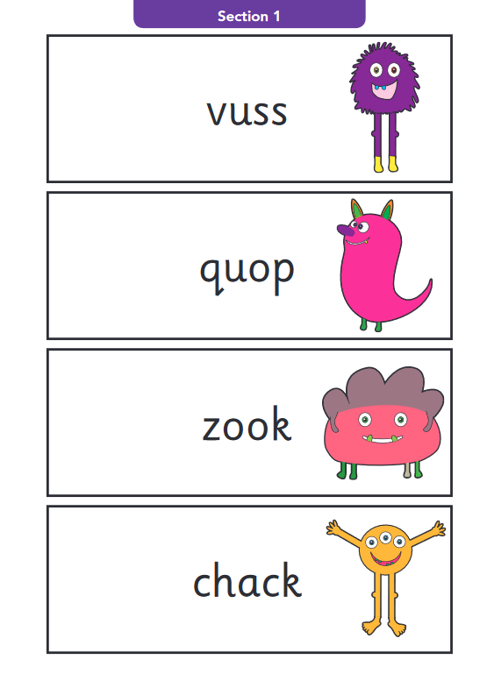
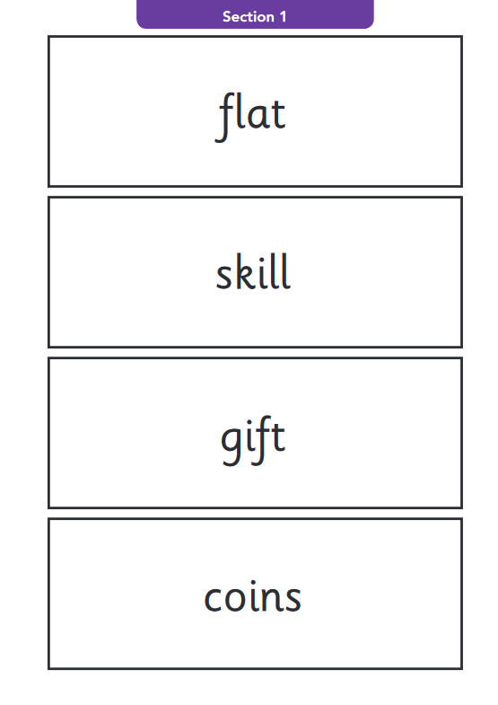
a. Print to sound
Standards and Testing Agency, 2018: 2018 key stage 1 phonics screening check: pupils’ materials
Year 1 ‘Phonics Screening Check’ (DfE):
Real words and pseudowords
What’s the difference? Why include pseudowords?
Pseudowords:
By definition, unknown to the learners
Learners cannot draw on existing knowledge of the words’ pronunciations
→ A ‘pure’ measure of their knowledge of symbol-sound correspondences
Unfamiliar real words
Low frequency
Not in SoW to date
However, we considered pseudowords problematic:
Ethically / pedagogically
In terms of validity (Papagno, Valentine & Baddeley, 1991)

Slide 11
a. Print to sound
Familiar versus unfamiliar words
Woore (2018) – compared Y10 MFL pupils’ pronunciation of familiar / unfamiliar French words
For each participant, a set of orthographically matched word pairs was created. On average, 14 words pairs per participant.
Each pair consisted of 1 word they knew and 1 word they didn’t know (as shown by a vocab test), sharing the same spelling body
Unit of analysis = spelling body (phonological rime)
…thus controlling for word-level variables
pain
grain
trois
chois

Slide 12
a. Print to sound
p < .001, d = 0.33
<pain> - /pæ̃/
<grain> - /ɡɹɛɪn/
<chat> - /ʃa/
<fat> - /fat/

Slide 13
a. Print to sound
Summary so far
Reading Aloud Test
Administered individually
Unfamiliar words to test SSC knowledge (to stop them using existing knowledge of whole word pronunciations)

Slide 14
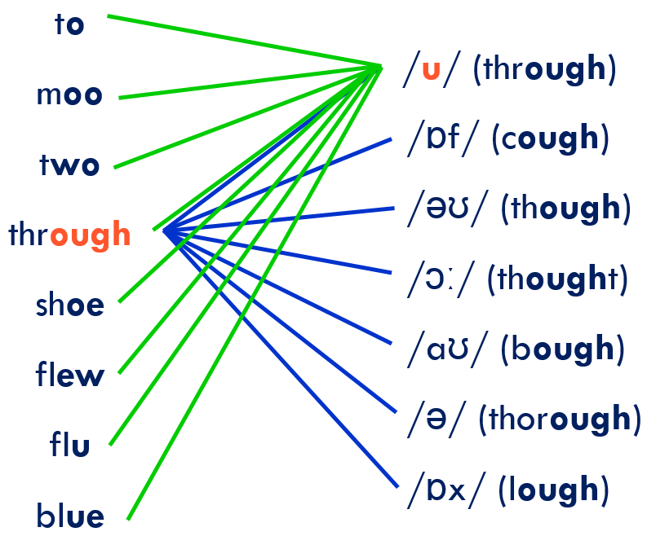
b. Sound to print
Transcription task – can they write what they hear?
However… languages vary in “orthographic depth”:

Slide 15
a. Print to sound
So, in French particularly → multiple possible spellings for a given sound
For unfamiliar words: proliferation of ‘correct’ answers
ver, vers, verre, verres, vert, verts, vair
* vaire, * vaires, * verd, * verds, * vère, * vères, * vaîre, * vaîres …
So, we tweaked the response format to constrain possible responses
Blanks for individual letters.
E.g. “ v _ _ ”

Slide 16
2. Item selection
For each language:
We listed all the target SSC covered in the SoW
For each SSC, we identified 3 low-frequency words (>5000 frequency ranking for French and Spanish, >4037 for German) and ensured not covered in SoW
Therefore, pupils very unlikely to know them!
Where possible, we controlled for orthographic and phonological length – i.e. short monosyllabic words (French and German) or mostly 2 syllables (Spanish)
We tried to avoid words that look like English words (interlingual homographs), taboo words, etc.!

Slide 17
SSC in French
SSC | French 1 | French 2 | French 3
SFC –x | toux | poux | houx
SFC -d | jard | lard | dard
SFC –t | prit | vit | mit
SFC –s | bris | gis | spis
a | nase | prase | jase
i | brime | cime | trime
eu | yeuse | beuse | Meuse
e | reloge | remous | recel
o | lot | plot | trot
eau | veau | seau | sceau
au | chaule | gaule | taule
u | cossu | cornu | crépu
ou | zou | clou | flou
é | pré | dé | ré
en | ment | sent | gent
French SSC | French 1 | French 2 | French 3
an | flan | cran | ban
on | pond | tond | gond
SFe | rame | crame | lame
in | crin | clin | pin
ain | tain | nain | zain
è | sème | pèse | sève
ê | vête | blême | bêche
ai | daine | raine | gaine
oi | aloi | coi | aboi
ch | croche | hoche | loche
ç | glaçon | maçon | pinçon
qu | quinte | quine | quille
j | jauge | jonc | joug
-tion | dation | rection | brution
-ien | salien | jovien | danien

Slide 18
2. Item selection
How many items in the test?
Completeness of coverage for individual pupils – diagnostic feedback
Testing burden and time demands – aim to fit tests within a single lesson!
We don’t want assessment to soak up too much teaching and learning time!
Scales image: by scott_kirkwood, openclipart.org.

Slide 19
2. Item selection
15 items per pupil
On-line test: random selection of SSC for both the reading aloud and dictation components. Random selection (1 of three items) for each SSC
Class as a whole should cover all the SSC, but individual pupils do not
✓
Takes less time for individuals to complete
Prevents copying – all individuals have a different selection of items
Diagnostic feedback (to inform teaching) at whole class level
✗
Incomplete diagnostic feedback for individuals
But – these are summative tests.
Diagnostic tests are already available – teacher- / self- / peer-assessment

Slide 20
Sample items – reading aloud

Slide 21
Sample items – reading aloud
→ Time limit = compromise!

Slide 22
Sample items – reading aloud
t
15 items to read aloud

Slide 23
Sample items – dictation
→ Time limit = compromise!
Number of items?

Slide 24
Sample items – dictation

Slide 25
Examples of tests
Pen-and-paper tests:
Pre-selection of 15 items

Slide 26
3. Scoring – reading aloud
This is our focus for the phonics assessment!
A note on ‘foreign accent’. Two dimensions to accuracy in reading aloud:
Accuracy of SSC knowledge: how graphemes / symbols are mapped onto L2 phonemes / sounds
Accuracy of pronunciation of L2 phonemes / sounds.
< v e a u >
/ vjʉ / / viː əʊ /
✗
✓
✓
/ vəʊ /
/ vo /
A foreign accent is hard to shift even for the most dedicated learner (even if they want to)
You can be intelligible (and comprehensible) with a foreign accent.
We are testing SSC knowledge (phonics) rather than native-like pronunciation (phonetics).

Slide 27
3. Scoring – reading aloud
1 mark / item = max. 15 marks in total
0 marks: Incorrect pronunciation based on English SSC. 1 mark: Correct knowledge of target SSC, but pronunciation with an English accent. 1 mark: Correct pronunciation of target SSC Notes: Give marks for correct pronunciation of target SSC in bold even if other parts of the word are mispronounced / not attempted. Be lenient when scoring. If you think the students have decoded the symbol (graphemes) to the correct sound (phonemes), then you can allow for some degree of foreign accent in pupils’ pronunciation of the target sounds. A foreign accent is hard to shift even for the most dedicated learner after years of practice; and people are perfectly intelligible with a foreign accent. In our teaching and in our phonics, we are targeting SSC knowledge (phonics) rather than native-like pronunciation (phonetics).

Slide 28
3. Scoring
Dictation task – automatically scored by the software platform ☺
Reading aloud task – marked individually by teachers (☹?)
Workload implications – need to make individual decisions about this.
One option would be to sit with individuals as they complete the speaking part of the test, and mark it in ‘real time’ as they go along.

Slide 29
SOW-based vocabulary testing for NCELP Y7
Principles, design, creation
NCELP Residential 3
Natalie Finlayson / Emma Marsden
Date updated: 02/03/20

Slide 30
Outline
Vocab testing team
Principles of vocabulary testing
2.1 Breadth of knowledge testing
2.2 Depth of knowledge testing
Question types
Scoring
Summary

Slide 31
1. Vocab testing team
Test leads: Natalie Finlayson & Emma Marsden
French
Test developer
Kirsten Somerville
Proofreader
Ivan Avaca
Spanish
Test developer
Ivan Avaca
Proofreaders
Nick Avery
Pep Mateos Gonzalez
German
Test developers
Inge Alferink
Natalie Finlayson
Proofreaders
Inge Alferink
Natalie Finlayson
With huge thanks to: Giulia Bovolenta, Victoria Hobson, Stephen Owen, Helen Thomas, Catherine Morris, Ciaran Morris, Jack Peacock, Laurence Anthony

Slide 32
2. Vocab testing principles
Objectives
To test breadth and depth of knowledge of vocabulary studied in Y7 Terms 1.1.1 - 2.1.1
Considerations
Syllabus-based achievement test
Productive vs receptive knowledge
Recall vs recognition
Oral and written modalities

Slide 33
2.1 Breadth of knowledge
Objective 1: To find out how many words students know
Sample size
Target time: 12 minutes
Pilot testing indicates students can comfortably answer one question in 9 seconds
720 / 9 = 80 total test items (split equally between L, R, W & S)
SOW coverage:
French: 43%* Spanish: 35% German: 35%

Slide 34
2.1 Breadth of knowledge
Objective 1: To find out how many words students know
Item pool
To test overall knowledge of words in SOW – words distributed amongst students
Words are equally likely to be selected from randomised pools
All words in the SOW appear in the test once only
Part of speech ratios (noun : verb : other) broadly upheld within different question types
(French: 2:1:2; Spanish: 3:1:3; German: 2:1:3)

Slide 35
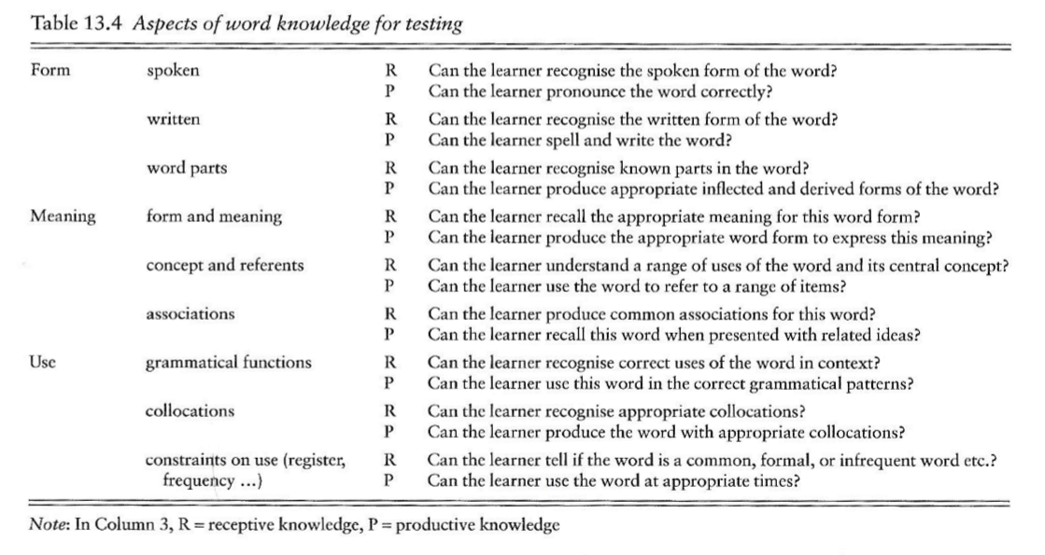
2.2 Depth of knowledge
Nation 2013, p. 538
Objective 2: To find out how well students know target words
Year 8+
tested separately
Year 8+

Slide 36
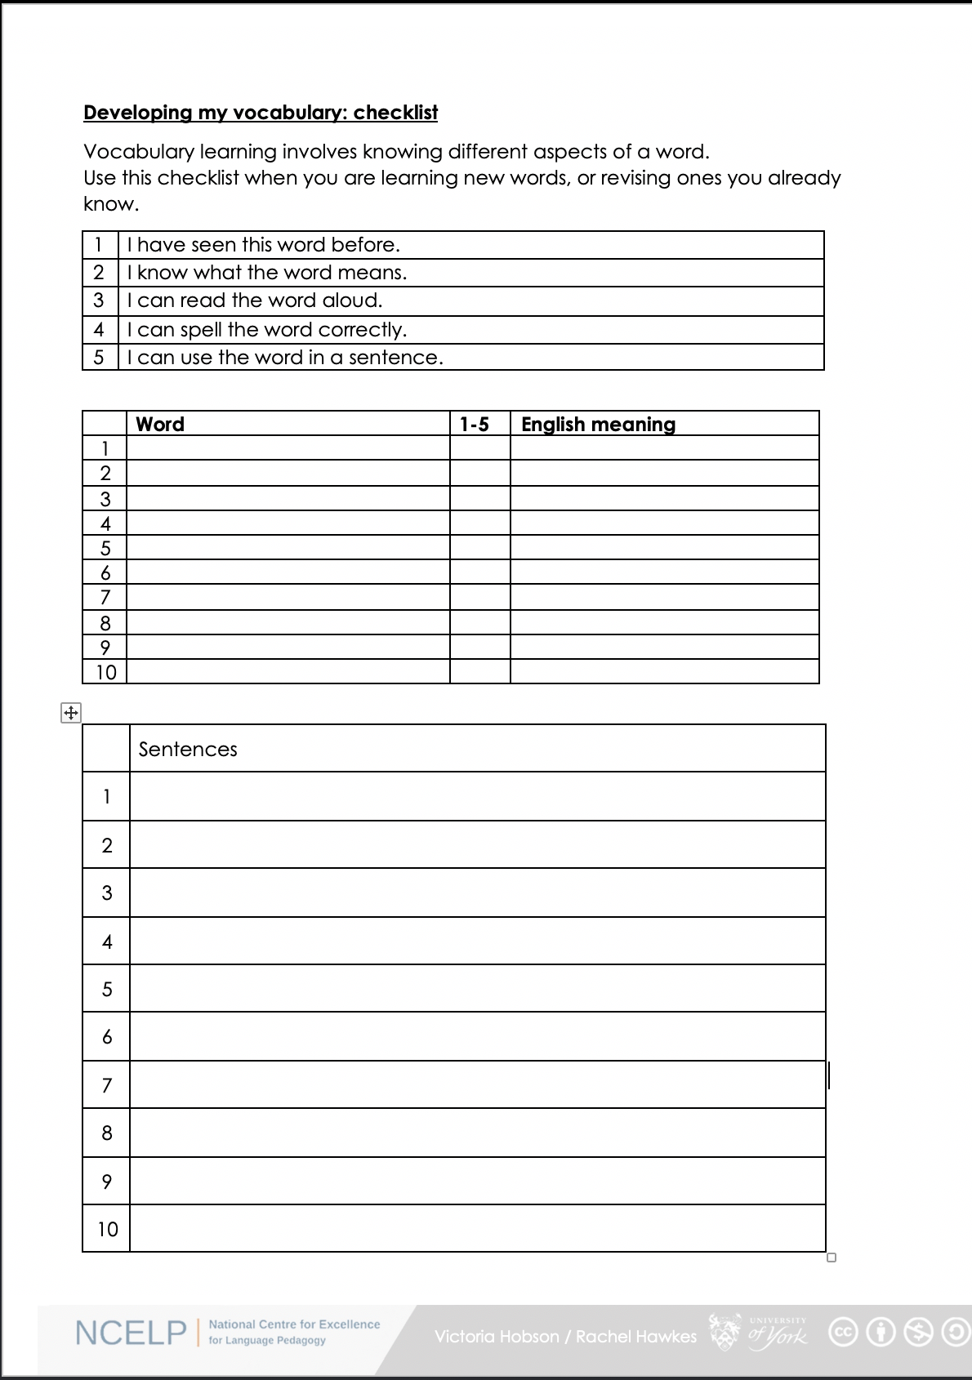
2.2 Depth of knowledge
How well do you know the words we have learned so far?
1. I have seen this word before.
2. I know what the word means.
3. I can read the word aloud.
4. I can spell the word correctly.
5. I can use the word in a sentence.
6. I know the gender of nouns.

Slide 37
2.2 Depth of knowledge
Recognition tests
multiple choice activities whereby learners select or guess the correct response from the alternatives given
such tests may strengthen any existing memory traces (McDaniel & Mason, 1985)
Recall
demands the production of responses from memory
more difficult than recognition because learners must search for the correct response within their mental representation of the newly experienced information (Cariana & Lee, 2001; Glover, 1989; McDaniel & Mason, 1985).
Definitions adapted from Jones (2004)

Slide 38
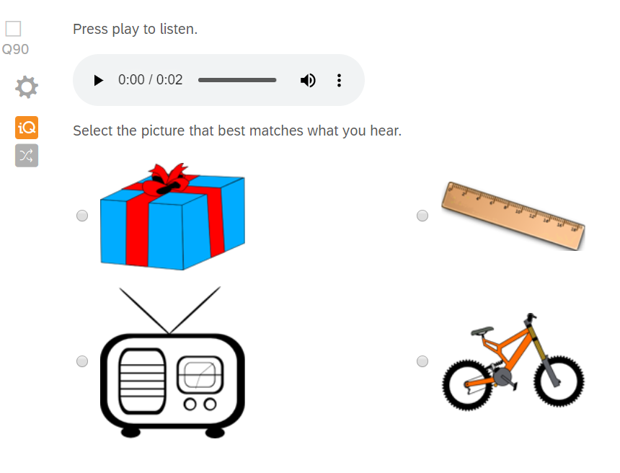
3. Question type 1
Read 2000, Chapter 3
Modality
Listening
Type of activity
Spoken meaning recognition
Knowledge tested
Meaning (definition)

Slide 39
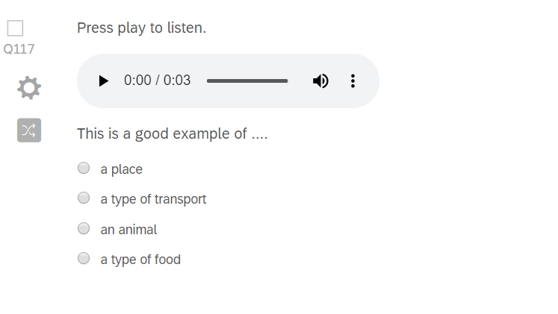
3. Question type 2
Read 2000, Chapter 3
Modality
Listening
Type of activity
Spoken meaning recognition
Knowledge tested
Meaning (definition) Meaning (association)

Slide 40
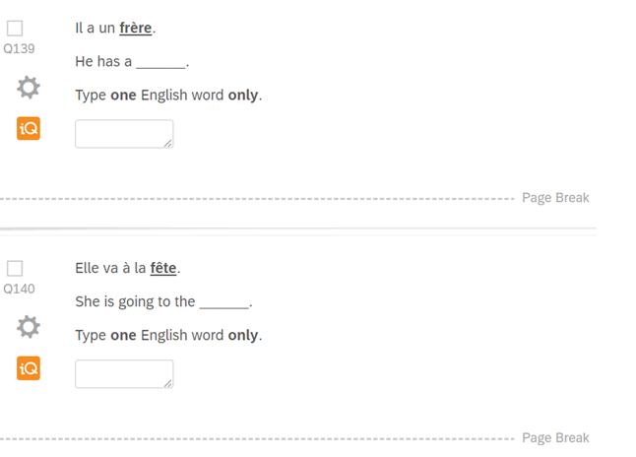
3. Question type 3
Read 2000, p. 163
Modality
Reading
Type of activity
Written meaning recall
Knowledge tested
Meaning (definition)

Slide 41
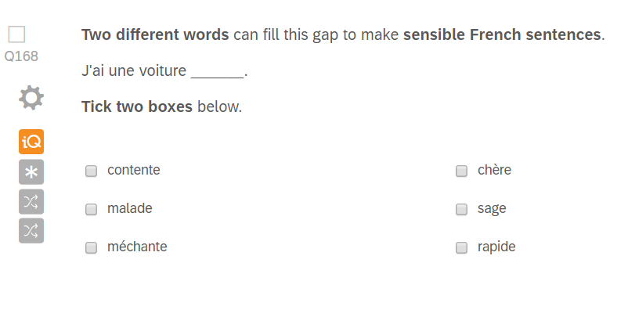
3. Question type 4
Modality
Reading
Type of activity
Written meaning recall
Knowledge tested
Meaning (definition)
Use (collocation)

Slide 42
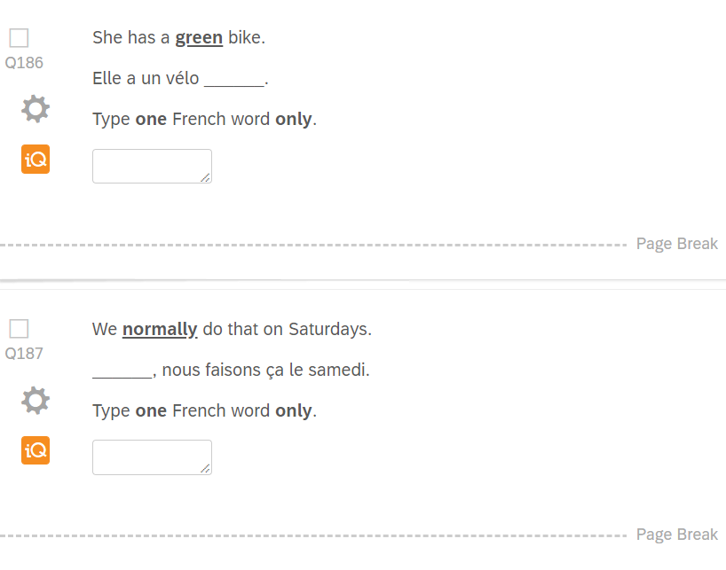
3. Question type 5
Modality
Writing
Type of activity
Written form recall
Knowledge tested
Form (written)
Meaning (definition)

Slide 43
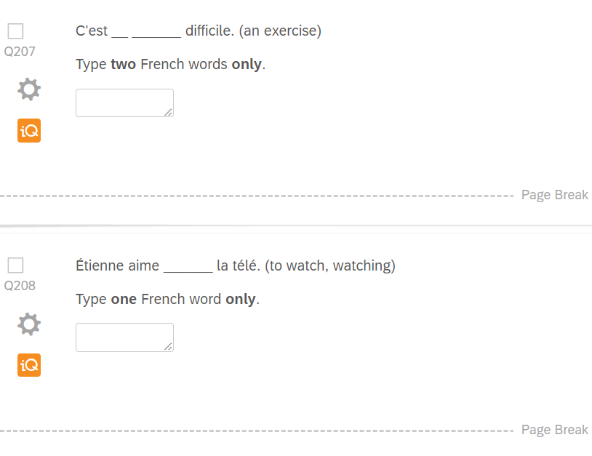
3. Question type 6
Laufer & Nation 1995
Modality
Writing
Type of activity
Written form recall
Knowledge tested
Form (written)
Meaning (definition)
Use (collocation)

Slide 44
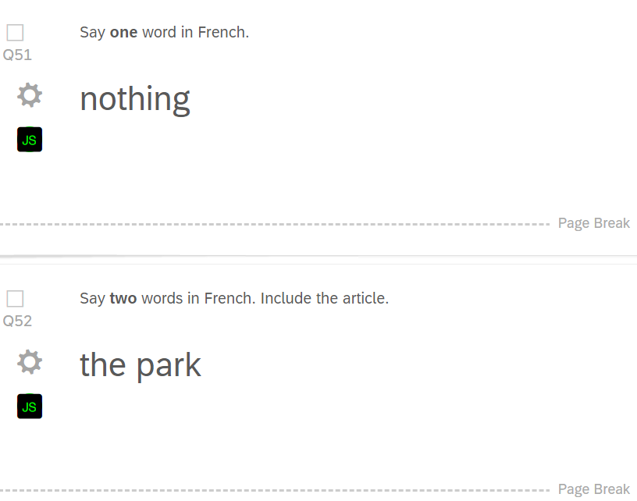
3. Question type 7
Modality
Speaking
Type of activity
Spoken form recall
Knowledge tested
Form (spoken)
Meaning (definition)

Slide 45
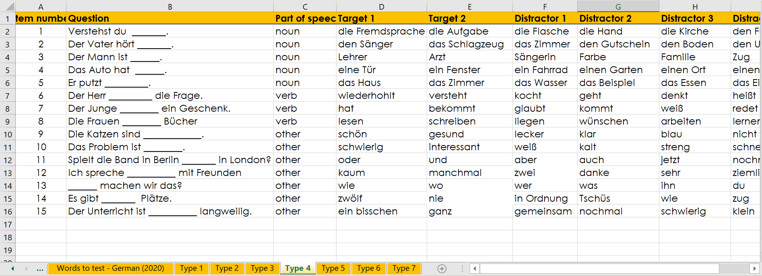
3. Question types

Slide 46
3. Question types
80 x test items
Listening
20 x spoken meaning recognition
Reading
20 x written
meaning recall
Writing
20 x written
form recall
Speaking
20 x spoken
form recall
40 x receptive
40 x productive
Bias towards recall:
encourages active vocabulary building from the beginning
minimises use of multi-choice format - average score increase of 16.7% due to guessing in a 6-choice format (Stewart & White, 2011) and up to 25% in 4-choice (Stewart 2014)

Slide 47
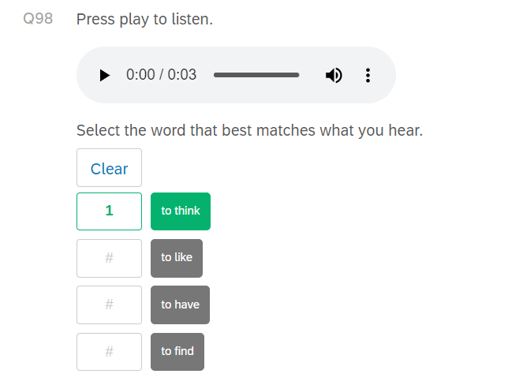
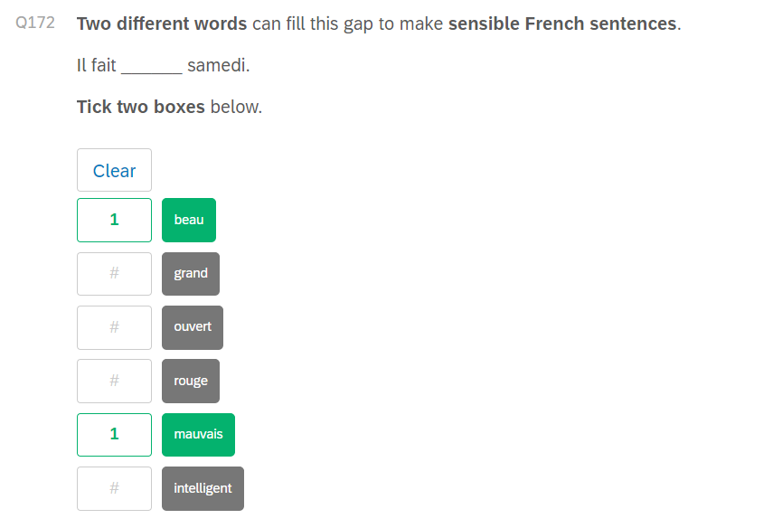
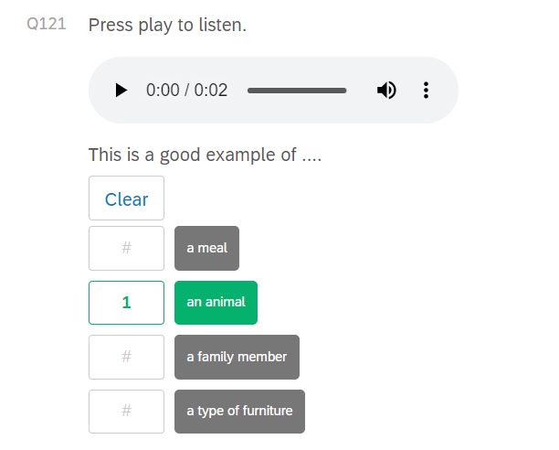
4. Scoring (binary)

Slide 48
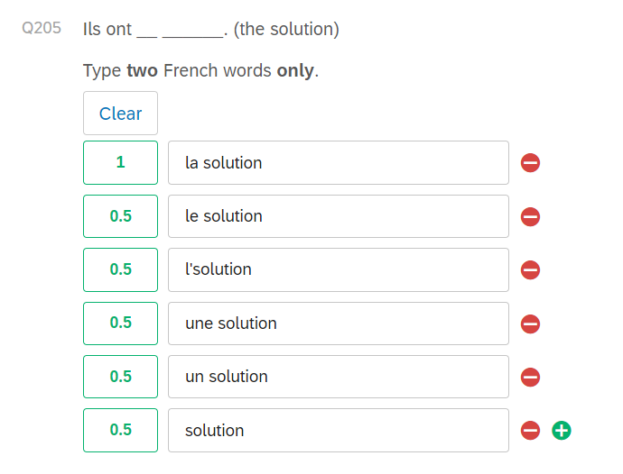
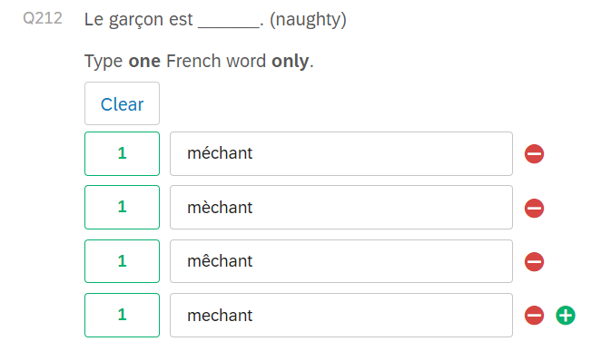
4. Scoring (tolerance)
For now, after 18 weeks of lessons, we are tolerant of accent errors and semi-tolerant of article errors
if lemma (word) is correct
For now, after 18 weeks lessons, we are semi-tolerant of article and accent errors,
if lemma (word) is correct

Slide 49
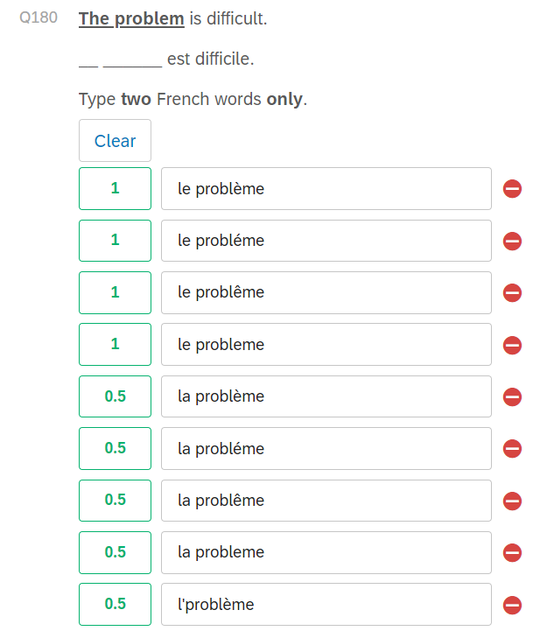
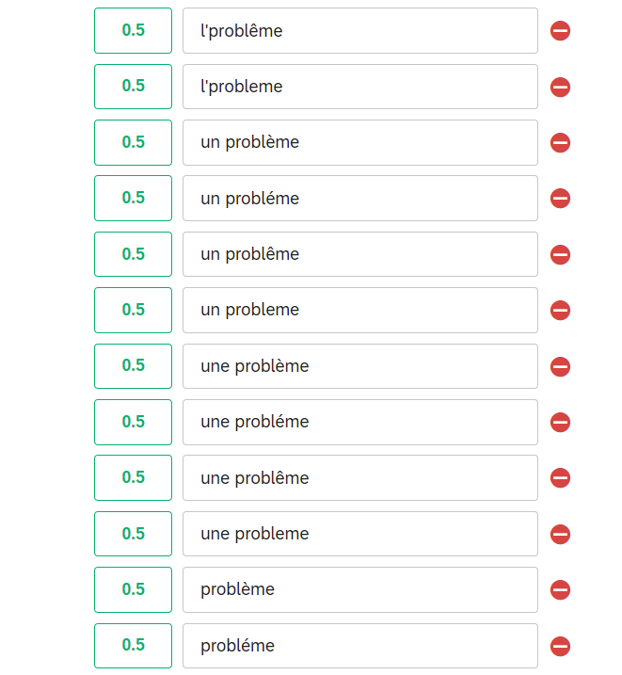
4. Scoring (tolerance)

Slide 50
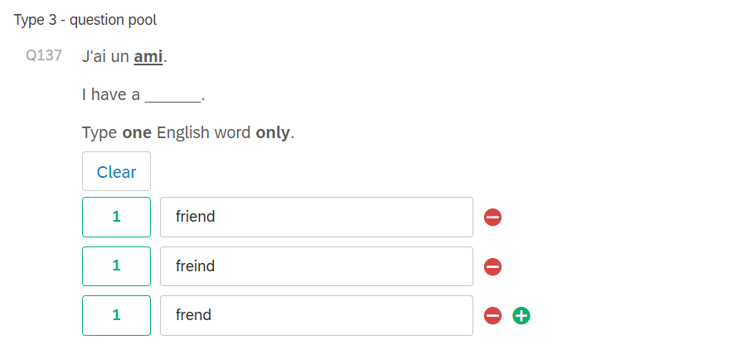
4. Scoring (tolerance)

Slide 51
5. Summary
The NCELP Y7 vocabulary test …
is a syllabus-based vocabulary test designed to measure vocabulary breadth and depth
provides a highly reliable snapshot of student achievement in a manageable timeframe
tests all words featured in the SOW tested by distributing randomly amongst students
tests recognition and recall skills across four modalities
thoroughly tests different elements of word knowledge tested, in line with aspects taught
provides automated scoring of 6/7 question types

Slide 52
References
Cariana, R. B., & Lee, D. (2001). The effects of recognition and recall study tasks with feedback in a computer-based vocabulary lesson. Educational Technology Research & Development 49 (3), pp. 23-36.
Glover, J. A. (1989). The "testing" phenomenon: Not gone but nearly forgotten. Journal of Educational Psychology, 81(3), 392-399.
Jones, L. (2004). Testing L2 vocabulary recognition and recall using pictorial and written test items. Language Learning & Technology 8 (3), pp. 122-143.
Laufer, B., & Nation, P. (1995). Vocabulary Size and Use Lexical Richness in L2 Written Production. Applied Linguistics, 16, pp. 307-322.
McDaniel, M. A., & Mason, M. E. J. (1985). Altering memory representations through retrieval. Journal of experimental psychology. Learning, Memory and Cognition 11, pp. 371-385.
Nation, I. S. P. (2013). Learning vocabulary in another language. Cambridge: Cambridge University Press
Read, J. (2000). Assessing Vocabulary. Cambridge: Cambridge University Press.
Stewart, J. (2014). Do Multiple-Choice Options Inflate Estimates of Vocabulary Size on the VST? Language Assessment Quarterly, 11(3), pp. 271–282. doi:10.1080/15434303.2014.922977
Stewart, J., & White, D. A. (2011). Estimating guessing effects on the vocabulary levels test for differing degrees of word knowledge. TESOL Quarterly, 45 (2), pp. 370–380. doi:10.5054/tq.2011.254523

Slide 53
Questions?
Thanks for listening!
Any questions?
natalie_eloise

Slide 54
SOW-based grammar testing for NCELP Y7
Principles, design, creation
NCELP Residential 3
Rowena Kasprowicz / Nicholas Avery / Stephen Owen
Last updated: 02/03/20

Slide 55
Outline
Grammar testing team
Principles of grammar testing
Coverage of grammar (by language)
4. Test creation and example items
5. Scoring

Slide 56
1. Grammar testing team
Test lead: Rowena Kasprowicz
French
Test developers
Stephen Owen
Rowena Kasprowicz
Proofreader
Ivan Avaca
Spanish
Test developers
Nicholas Avery
Rowena Kasprowicz
Proofreader
Amanda Izquierdo
German
Test developers
Stephen Owen
Rowena Kasprowicz
Proofreaders
Inge Alfernik
Natalie Finlayson
With huge thanks to: Giulia Bovolenta, Victoria Hobson, Chloé Motard, Geraldine Bengsch

Slide 57
2. Grammar testing principles
Objective
To test receptive and productive knowledge of grammar studied in Y7 Terms 1.1.1-2.1.6
Considerations
Isolating grammatical knowledge; disassociating from lexical knowledge
Ensuring coverage of the range of grammar features taught (including relevant morphology and syntax)
Receptive knowledge (recognising meaning as well as form)
Productive knowledge (accuracy of production)
Written and oral modalities

Slide 58
3. Coverage of grammar: GERMAN
Grammar feature | Reading | Listening | Writing | Speaking
Present continuous formation Two forms in English vs. one in TL | - | - | 4 items | 6 items
Question formation Subject-verb inversion; do-aux in English vs. TL | 4 items | 4 items
Subject-verb agreement (weak) 1st / 2nd / 3rd singular | 3 items | 3 items
Subject-verb agreement (irregular) haben / sein (1st, 2nd, 3rd sing, 1st pl); mögen (1st, 2nd, 3rd sing) | 3 items | 3 items | 4 items | 4 items
Article agreement Def / indef; gender; number; case (nom/acc) | 4 items | - | 4 items
Plural noun formation -en; umlaut + -e; -e | - | - | 3 items | -
Negation nicht + verb; nicht + adjective | 4 items | - | - | -
Subject and object pronoun agreement Gender; number; case (nom/acc) | 4 items | - | 3 items | 3 items

Slide 59
3. Coverage of grammar: FRENCH
Grammar feature | Reading | Listening | Writing | Speaking
Present continuous formation Two forms in English vs. one in TL | - | - | 8 items | 6 items
Question formation Intonation; do-aux in English vs. TL | - | -
Subject-verb agreement (regular -ER) 1st / 2nd / 3rd singular; 1st / 2nd / 3rd plural | 10 items | -
Subject-verb agreement (irregular) être (all persons); avoir (all persons); faire (all persons); aller (1st, 2nd, 3rd sing) | 8 items | - | 4 items | 4 items
Article & adjective agreement Def / indef; gender; number | 4 items | - | 4 items
Adjectival word order Post-nominal | 4 items | - | -
Preposition “to” + article | - | 4 items | 4 items | 3 items
“il y a” vs. “est” vs. “a” | 4 items | - | - | -

Slide 60
3. Coverage of grammar: SPANISH
Grammar feature | Reading | Listening | Writing | Speaking
Present continuous formation Two forms in English vs. one in TL | - | - | 6 items | 6 items
Question formation Intonation; do-aux in English vs. TL | - | -
Subject-verb agreement (regular -AR) 1st / 2nd / 3rd singular | 4 items | 4 items
Subject-verb agreement (irregular) estar (1st, 2nd, 3rd sing); ser (1st, 2nd, 3rd sing / 3rd pl); tener (1st, 2nd, 3rd sing / 1st, 3rd pl); querer (1st, 2nd, 3rd sing); hacer (1st, 2nd, 3rd sing); dar (1st, 2nd, 3rd sing) | 6 items | 6 items | 4 items (all) | 4 items (tener, querer)
Article & adjective agreement Def / indef; gender; number | 4 items | - | 4 items
Adjectival word order Post-nominal | 4 items | - | -
Negation no + verb | 4 items | - | - | 3 items (-AR)
“hay” vs. “tiene” | 4 items | - | - | -

Slide 61
4. Test creation process
Each question tests a specific grammatical feature (or combination of features)
Size of the test
Target time: 15 minutes (R/L/W); 4 minutes (S)
50 test items (R/L/W); 13 items (S)
Question item pool
Items created using vocabulary from SoW (reviewed to ensure no clash with vocabulary test)
Each pool contains an equal number of instances of each structure taught
(e.g. equally likely to be tested on 1st person singular as 2nd person singular in subject-verb
agreement questions, etc.)
Variation between languages in weighting of different modes / modalities, due to variation in nature of grammar features being tested in each language.

Slide 62
4. Test creation: examples items
Multiple choice options appear in a random order for each item
(Avoid position indicating correct answer)
Testing written and aural receptive knowledge
Testing ability to recognise meaning as well as form
Multiple choice; here matching to English equivalent

Slide 63
4. Test creation: examples items
Testing written and aural receptive knowledge
Testing ability to recognise meaning as well as form
Multiple choice; here matching to TL alternative
Isolating recognition of gender and number

Slide 64
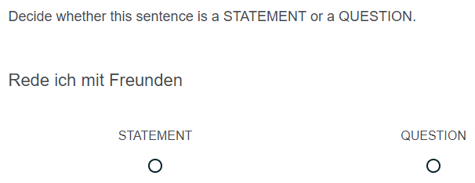
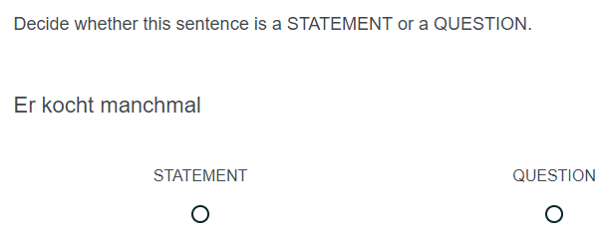
4. Test creation: examples items
Remove punctuation
(Avoid . or ? indicating answer)
Including variety of ‘subjects’
(Avoid reliance on ‘du’ to indicate question)
Isolating receptive knowledge of syntax
Recognising function (statement / question) indicated by word order

Slide 65
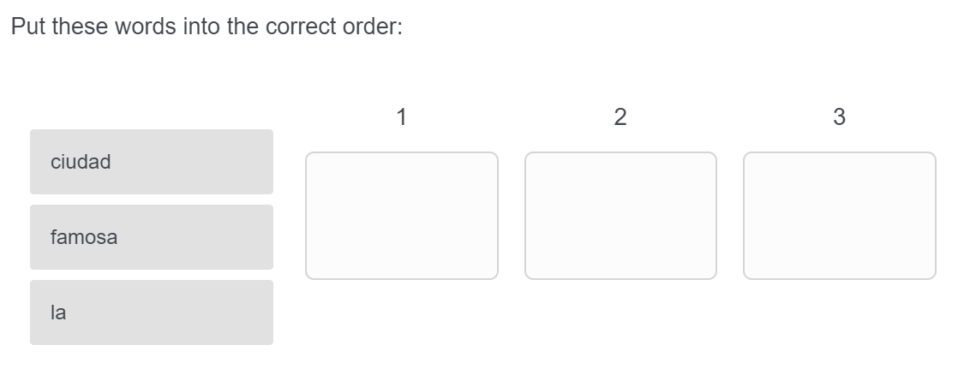
4. Test creation: examples items
Article / noun / adjective appear in a random (vertical) order for each item.
(Ensures learner is paying attention to each element and its correct position)
Isolating productive knowledge of syntax
Drag-and-drop into correct order

Slide 66
4. Test creation: examples items
Testing written productive knowledge
Testing ability to accurately produce the structure
Open text box
Testing understanding of question formation
(Check pupils understand that ‘do’ auxiliary is not needed)
Isolating grammatical knowledge by providing verb infinitive
(Avoid missing answers due to lack of lexical knowledge)

Slide 67
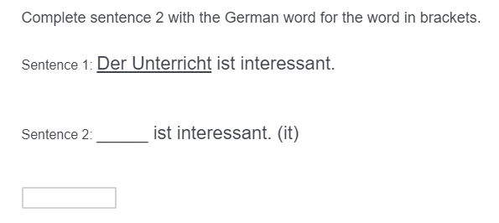
4. Test creation: examples items
Testing written productive knowledge
Testing ability to accurately produce the structure
Open text box
Isolating grammatical knowledge by indicating gender (directly or via article).
(Ensure that pupils are not reliant on recalling gender of a specific lexical item)

Slide 68
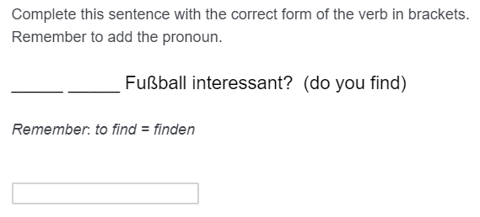
4. Test creation: examples items
Testing syntax alongside subject-verb agreement.
Half of the pool included verbs in present continuous form
(Check pupils’ understanding that there is one present tense structure for simple and continuous meanings)
Testing written productive knowledge
Testing ability to accurately produce the structure
Open text box

Slide 69
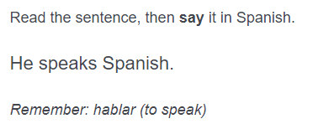
4. Test creation: examples items
Testing oral productive knowledge
Testing ability to accurately produce the structure(s)
Combining a number of structures within each item
Testing subject-verb agreement and question formation.
Isolating grammatical knowledge by providing verb infinitive
(Avoid missing answers due to lack of lexical knowledge)
Note: glosses not provided for other elements of the sentence which are not being tested (e.g. object)

Slide 70
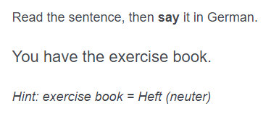
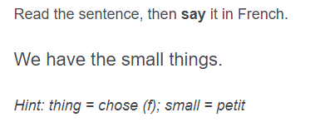
4. Test creation: examples items
No gloss provided for irregular verbs
(Irregular verb forms taught as individual lexical items, rather than transforming from the infinitive)
Isolating knowledge of gender / number (& case) agreement for articles (& adjectives)
(Noun form provided and gender indicated)
Testing oral productive knowledge
Testing ability to accurately produce the structure(s)
Combining a number of structures within each item

Slide 71
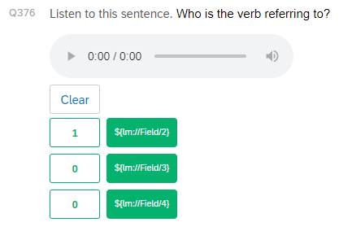
5. Scoring
Items testing written and oral receptive knowledge = multiple choice
One correct answer
Automated scoring
Correct option
Incorrect options

Slide 72
5. Scoring
Items testing written productive knowledge = open text response
Possible answers manually coded
1 mark per structure tested
Partial marks accounted for different elements of a structure being tested
e.g. article agreement (gender / number / case / definiteness)
subject-verb agreement (pronoun / verb ending)
Accents dealt with systematically
Tolerated, where absence does not alter the meaning (e.g. préparer vs. preparer) → no marks deducted
Semi-tolerant, where absence does alter the meaning (e.g. à la vs. a la) → 0.5 mark deducted
→ Not possible to account for any other spelling errors (note: target words provided in glosses)
Pilot phase: data from first round of testing will help to identify common learner errors

Slide 73
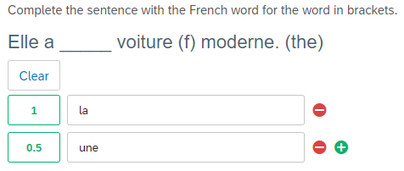
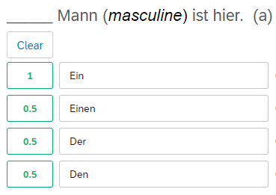
5. Scoring
Examples of partial marking
Examples of partial marking
0.5 mark for incorrect indefinite article (but gender correct)
0.5 mark for incorrect case
(but gender correct)
0.5 mark for incorrect indefinite article (but gender correct)
0.5 mark for incorrect case and indefinite article (but gender correct)

Slide 74
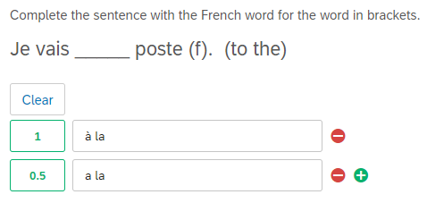
5. Scoring
Examples of partial marking
Examples of partial marking
0.5 mark deducted for missing accent (changes meaning)
0.5 mark deducted for missing accent (changes meaning)

Slide 75
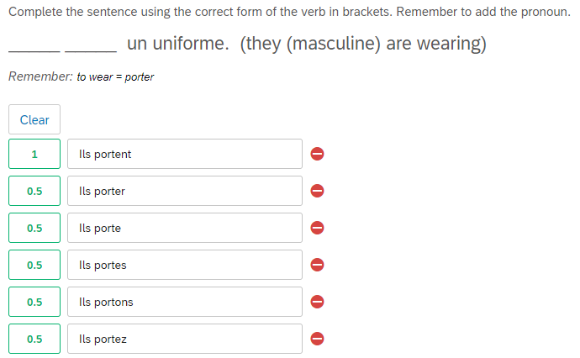
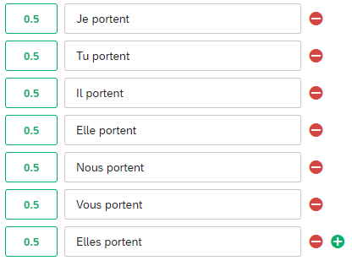
5. Scoring
Examples of partial marking
Examples of partial marking
0.5 mark for correct pronoun
0.5 mark for correct verb ending
0.5 deducted for incorrect verb ending
0.5 deducted for incorrect pronoun

Slide 76
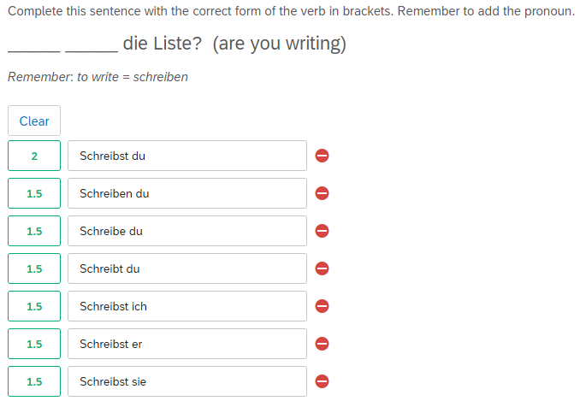
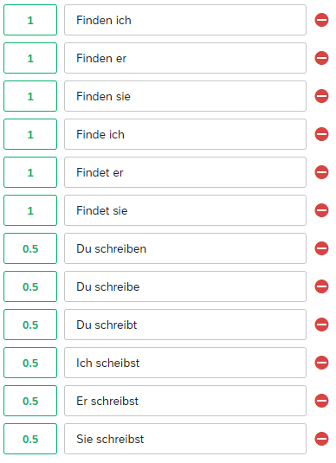
5. Scoring
Examples of partial marking
Examples of partial marking
0.5 deducted for incorrect verb ending
0.5 deducted for incorrect pronoun
1 mark for correct word order
1 mark for correct subject-verb agreement
0.5 deducted for incorrect verb ending
1 deducted for incorrect WO
0.5 deducted for incorrect verb ending
0.5 deducted for incorrect pronoun
1 deducted for incorrect WO
0.5 deducted for incorrect pronoun
1 deducted for incorrect WO

