Slide 1
Motivation matters
Residential 2 September 2019
Rachel Hawkes, with Emma Marsden

Slide 2
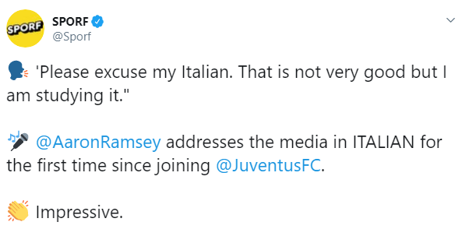
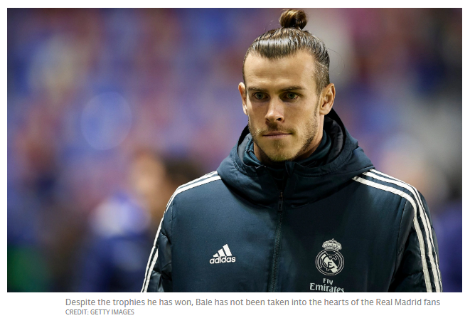
https://www.telegraph.co.uk/football/2019/07/22/departing-gareth-bale-has-found-language-barrier-real-madrid/
https://twitter.com/Sporf/status/1151144459578617859/video/1
Notes:
Slides 2-14: 15 minutes
In the news from this summer Two footballers, two very different stories! Football is not enough… What sort of motivation is on display here from Aaron Ramsey?

Slide 3
Session aims
review (briefly!) the evidence for language learning motivation in England
identify key motivational drivers for students in language learning
explore the relationship between phonics, vocabulary and grammar (PVG) and language learning motivation
tease out how to build long-lasting engagement in language learning at KS3 and KS4
Notes:
2 mins

Slide 4
Why is language learning motivation important?

Slide 5
With a long-term learning process such as the mastery of a second language, learners' ultimate success will depend heavily on their level of motivation.
(Dörnyei, 2014)

Slide 6
What is the level of motivation for language learning of pupils in England? (as expressed by the participation rates at KS4 and beyond)

Slide 7
Participation in language learning at KS4 and beyond
< 50% Year 11 pupils takes a GCSE language
and of those, pass rate is approx. 70%
< third of pupils achieved a good language GCSE in 2017
4.4% in more than one language - 2016
Regional disparity
62% in London, 40% in the North East, 29% in Middlesborough
Numbers taking A level language down by 1/3 since 1996
entries heavily skewed towards girls (64%) and independent sector
Tinsley, T. & Doležal, N. (2018). Language Trends Survey
Modern Foreign Language Pedagogy Review (2016)

Slide 8
When does motivation for language learning decline?

Slide 9
Brief synthesis of L2 motivation studies of language learning in UK
Motivation and enjoyment of foreign language learning are high in the primary phase (Courtney, 2014; Martin, 2012)
Transition from primary to secondary is a more complex picture – reports of ‘increased boredom’ (Courtney, 2014; Graham et al., 2016) versus ‘learning properly’ (Chambers, 2016)
Motivation dips by the end of Y7 but it is not clear why (Deckner, 2017) or whether this is specific to languages
Overall, students are poorly motivated at secondary level (Evans & Fisher, 2009; Lanvers, 2016; Taylor and Marsden, 2014) and students have lower self-efficacy in languages than other curriculum subjects (Graham, Macfayden & Richards, 2012)
(For further information, see Lanvers, 2017)

Slide 10
Why does motivation for language learning decline?

Slide 11
Factors that influence motivation (1): usually somewhat beyond teachers’ control
Sociocultural / environmental factors - English is global lingua franca - which language do English-speakers need? - England’s insularity and rejection of ‘European-ness’ - Disinterest → xenophobia of the press (Coleman, 2009) - Negative reputation of British as language learners (Graham and Santos, 2015; Lanvers and Coleman, 2013)
Education policy - Languages for All -> 100% optional -> Ebacc…
Individual learner differences - gender, ability, personality, anxiety, learner ‘selves’ (Dörnyei, 2005, 2009, 2014)
Notes:
First, we look at some factors that are usually beyond the teachers’ control, they work at macro levels, of politics, educational policy, national and international societal views and trends, and personal factors that influence individual learners in different ways.

Slide 12
Language Trends Survey 2019
Cont’d: Factors that influence motivation (1): usually somewhat beyond teachers’ control
Many schools are working hard to maintain take-up at
GCSE and A level but overwhelmingly cite the ‘nature
and content of external exams’ as the major barrier
to increasing numbers. p.18
Examinations
Harsh grading
the ‘Brexit’ effect
…schools feel pressure to get results, and achieving a good grade in a language is seen as harder than in other subjects. p.17
When asked specifically whether Brexit has had
an impact on pupils’ attitudes towards language
learning, 25% say that there has been a negative
impact either on motivation to learn a European
language or motivation to learn languages in general. p.15
Notes:
In this year’s Language Trends Survey, teachers cited these factors………….

Slide 13
Factors that influence motivation (2): teachers can often do something about these
Pedagogy and classroom factors
Teacher, grouping, curriculum, assessment, methods, lack of challenge/meaningful communication
Wingate (2016)
Perceptions of ‘ease’ and sense of ‘achievement following effort’ lead to increased motivation
Graham (2004)
Just telling learners “FLs are useful” does not influence uptake;
perceptions of lessons, ‘ease of learning’ & personal relevance count the most
Taylor & Marsden (2014) OASIS summary
Not being able to ‘sound out’ words is de-motivating
Erler & Macaro (2012) OASIS summary
Notes:
We will go in to more details in to some of these later.

Slide 14
Session aims
review (briefly!) the evidence for language learning motivation in England
identify key motivational drivers for students in language learning
explore the relationship between phonics, vocabulary and grammar (PVG) and language learning motivation
tease out how to build long-lasting engagement in language learning at KS3 and KS4
Notes:
Slides 15-15 minutes (including 7 mins reading and 5 mins feedback)

Slide 15
Theories of motivation
Socio-education model (Gardner & Lambert, 1972)
Instrumental and integrative orientations
Self-determination theory (Deci & Ryan, 1995)
Intrinsic and extrinsic motivation
3 needs for self-determination: competence, autonomy and relatedness
L2 Motivational Self-System (Dörnyei & Ushioda, 2011)
3 primary sources of L2 learner motivation
ideal L2 self (learner’s vision of him/herself as effective L2 speaker)
ought-to L2 self (social pressure from the learner’s environment)
learner’s experiences (group and individual)
Notes:
There are areas of overlap in all of these theories, although the concepts don’t map exactly. However, the key messages to absorb are that:
1. Intrinsic motivation is a more powerful motivator of behaviour – i.e. if someone really enjoys something they will be motivated to do it, put more effort in, experience more success, feel more confident and less anxious. Doing something purely for the satisfaction one derives from the activity itself keeps you engaged for longer and makes you less likely to give up in the face of difficulty. 2. Intrinsic motivation doesn’t impact directly on achievement, but indirectly via motivated action/effort and self-confidence 3. Teaching that is to motivate needs to deliver competence, autonomy and relatedness. Competence – progress, feel yourself getting better, (i.e. learning useful words! Being able to remember them), understand what you are doing, not feeling confused, not feeling anxious Autonomy – we mustn’t confuse this with notions of independence, or a simple teacher-led vs pair work polarity. Ryan and Deci (2009), working from their self-determination theory perspective, describe working in a self-directed way as independence, and view autonomy as concerned with volition and self-regulation, meaning that learners may be autonomously dependent, for example when a student chooses to follow the guidance of an adult. These authors underline the psychological basis for autonomy by talking about a ‘feeling of choice’: “One can have many options and not feel autonomy, but instead feel overwhelmed and resentful at the effort entailed in the decision making. Alternatively, one could have only one option (which functionally means no choice) and yet feel quite autonomous so long as one truly endorses that option.” (Ryan & Deci, 2006, p.157).
Autonomy, then, is less about specific teaching methods and more about how individual learners feel about their learning. We might think about situations in which we might give choices that increase the feeling of autonomy, without overwhelming our learners. We also might consider the relationship between autonomy and competence – those learners who genuinely do want to be independent – giving them the knowledge to enable independent language production, which leads to a sense of progress. 4. Relatedness – the importance of interpersonal relationships. In the context of classroom-based L2 learning, teacher-student and student-student relationships matter most, but opportunities to interact with native speakers, and peripheral encouragement from parents and others can also have a role to play. 5. As the reference to Ryan and Deci’s work highlighted, we must acknowledge the highly personal nature of motivation. All learners are NOT the same as each other. 6. Finally, studies have found that motivation is situational and dynamic (i.e. experience / situation-related). – it is not fixed and can therefore be impacted (for better or worse!)
Teaching and Researching: Motivation (Applied Linguistics in Action) Dörnyei, Z. & Ushioda, E. (2013) Full text version:
https://archive.org/details/ilhem_20151031_1015/page/n19

Slide 16
What makes a positive impact on motivation?
What are the key motivational drivers for students in language learning?
Notes:
Important for us to focus on KS3 age as far as possible, as this is where motivation = uptake in the current England context.
Give 7 minutes to read the summary and discuss the main points of interest/findings, in table groups.
Summary 1: Taylor, F. & Marsden, E. (2014). Perceptions, attitudes, and choosing to study foreign languages in England: An experimental intervention. The
Modern Language Journal, 98(4), 902-920. https://doi.org/10.1111/modl.12146

Slide 17
OASIS Summary 1: Main findings
perceptions of personal importance or ease of the subject correlate with higher motivation/intention to continue
negative perceptions of lessons (i.e. work is hard / learning less) correlate negatively with intention to continue
short interventions within the year of uptake (Oct-Feb) are unlikely to have a positive impact on uptake figures
instrumental reasons (e.g. future job prospects, good grade) for language learning may be less important to adolescent learners than intrinsic reasons (i.e. personal enjoyment or success)
(Taylor & Marsden, 2004)
Notes:
3-4 minutes
Take feedback from tables first, then add in these four bullets.
Summary 1: Taylor, F. & Marsden, E. (2014). Perceptions, attitudes, and choosing to study foreign languages in England: An experimental intervention. The
Modern Language Journal, 98(4), 902-920. https://doi.org/10.1111/modl.12146

Slide 18
What makes a positive impact on motivation?

Slide 19
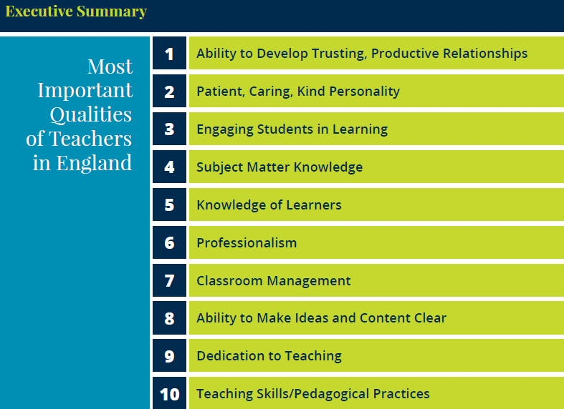
England: What makes an effective teacher?
Start
60 seconds
60
45
30
15
Katherine McKnight, PhD, Pearson
Lacey Graybeal, Jessica Yarbro, & John Graybeal, George Mason University
0
Notes:
Slide 19: 5 minutes total
Let’s just take a moment and come at this from the angle of a different piece of research, a more general study looking at What makes an effective teacher. Note: This study focuses on teachers of all subjects, not specifically languages teachers. Large numbers of participants from three stakeholder groups (teachers, students, parents) were asked, and the results aggregated. It’s a study that was replicated in 50 countries, and there are separate reports for each country’s results. Perhaps unsurprisingly, there was unanimity about the top 3 responses in all/most of the countries. Let’s see if you can predict what they are… Talk to the person next to you.
Give 1-2 minutes for discussion. Then take responses. (3 minutes) Then look at the answers with them. As well as the importance of relationships, look also at the importance of subject knowledge and learner knowledge. This leads us into the next point.

Slide 20
MFL Pedagogy Review Report November 2016
Research supports the Ofsted finding that factors other than a subject’s ‘usefulness’ or importance for future life or work influence pupil choice. Intrinsic motivation, which comes from a sense of progress, growing knowledge and understanding, and achievement, is a prime factor for pupils when they are asked to exercise choice about subjects to be pursued. That sense of real progress in inextricably linked to the way in which the subject matter of the course is planned, sequenced and taught. (p.7)
Notes:
Slides 20 – 27: 15 minutes (including reading time for summaries 2 & 3) A good sized body of research shows that a robust and useful kind of motivation is 'intrinsic' - when people feel good about what they are doing, that they are making progress and understand what they are learning - rather than the 'instrumental' kind of motivation - when people do something to obtain something (e.g. a qualification or to please someone else). So, helping learners to notice a sense of their own learning and progression (e.g., when i want to talk about the past, I feel I can) is likely to have a positive effect. There is a risk with the 'this is important for your exam' approach that some learners just end up saying 'but i don't really care about the exam'.
Of course, pupils in all subjects can't always be intrinsically interested in everything!
And of course a mix of both strands of motivation is likely to be best!!! - "it's important for exams AND it's important because it makes a difference to meaning and communication."

Slide 21
Cognition and affect A lot of thinking and feeling!
Cognitive
Engagement & Motivation
Affective
Notes:
Synthesising both of these general findings (i.e. the Pearson teaching study and the PR statement) might lead us to summarise that motivational language learning is essentially about doing a lot of thinking and feeling….! And that where the cognitive and the affective overlap, that is where you find engagement / motivation. That is, the cognitive processes involved in learning feed directly into the affective.

Slide 22
What are the key motivational drivers for students in language learning?

Slide 23
OASIS Summary 2: Main findings
Even when students expected good exam results, they had low levels of confidence in their language ability/proficiency
GCSE students (and 1st year A level) tended to attribute success to ability rather than effort
Lower achieving students more likely to blame lack of ability or subject difficulty for their lack of learning success
Those who intended to continue (from GCSE to A level) were more likely to attribute success to effort rather than ability
(Graham, 2004)
Notes:
Handouts 2 & 3: Time to read summaries
3-4 minutes
Take feedback from tables first, then add in these four bullets.
NB: Despite the fact that this is a fairly old study now, and education policy has moved on, there are some important messages in it that resonate with other UK into language learning motivation in the UK, so it’s worth drawing those out here, before we look at potentially fruitful avenues for advocacy and intervention.
Important points:
1. Perceived difficulty of the subject emerges again as a major demotivating factor, and reason not to continue. 2. Attributing success to ability is problematic, as ‘ability’ is seen as a fixed trait 3. Encouraging learners to associating success with effort much earlier (i.e. Y7 and earlier!) should be an important aim for any language learning programme. 4. Ensuring that we have a pedagogy that is ‘fit for purpose’ i.e. that uses its limited time as efficiently as possible such the highest number of students of all abilities can experience learning success is clearly a vital piece of the motivation puzzle.
Summary 2: Graham, S. (2004) Giving up on Modern Foreign Languages? Students' Perceptions of Learning French. The Modern Language Journal, Vol. 88, No. 2, pp. 171-191 https://doi.org/10.1111/j.0026-7902.2004.00224.x
Wagstaffe, J.P.; Graham, S. (2019) Why do so few UK high school students study foreign languages to an advanced level? OASIS Summary of Graham (2004) in The Modern Language Journal https://oasis-database.org

Slide 24
OASIS Summary 3: Main findings
developing an ‘idealised future self’ helps students to regulate their learning behaviour for academic success
maintaining an idealised self over time is challenged by perceived difficulty
socio-economically disadvantaged backgrounds can increase the likelihood that students abandon their idealised self
an intervention (twice weekly for seven weeks) to strengthen idealised future selves, normalise difficulty and provide action plans and specific strategies led to greater self-regulation, more academic success and less depression
intervention took place in Y8 equivalent, results measured at the end of Y8 and Y9
(Oyserman, Bybee & Terry, 2006)
Notes:
3-4 minutes NB: Whilst the study focuses on our target age range (12-14), this study focused on general academic ideal selves and academic outcomes more generally, it is not a language-specific study.
Nevertheless, it is a useful study for several reasons: 1) fairly large sample 2) across 3 different schools 3) longitudinal 4) targeted purposively those students that typically have less success in school (and these are also those that typically experience very poor motivation in general, but also for languages specifically), 5) there is a control group 6) there are some successful outcomes from a relatively modest intervention
Take feedback from tables first, then add in these four bullets.
Handout 3
Summary 3: Oyserman, D. Bybee, D. & Terry, K. (2006). Possible Selves and Academic Outcomes: How and When Possible Selves Impel Action. Journal of Personality and Social Psychology, 91(1), 188 –204. DOI: 10.1037/0022-3514.91.1.188
Wagstaffe, J.P.; Oyserman, D. Bybee, D. & Terry, K (2019) Can middle students be taught to develop a sense of an ‘idealised future academic self’? OASIS Summary of Oyserman, D. Bybee, D. & Terry, K (2006) in Journal of Personality and Social Psychology https://oasis-database.org
The intervention produced measurable change in PSs (potential selves), and change in PSs predicted change in behavioral self-regulation— going to school rather than skipping, behaving
and participating in class, and spending time on homework; self-regulation not only improved academic outcomes but, equally importantly, reduced risk of depression. Oyserman, Bybee & Terry (2006, p.201)
Whether focused on positive expected or feared PSs, self-regulation fails when individuals do not realize that a particular action is antithetical to goal achievement, when PSs do not provide
clear standards of what to attain or avoid, or when PSs are not linked with self-regulatory behaviors
The authors conclude: Our results demonstrate the real-world power of a social psychological conceptualization of the self as a motivational resource.

Slide 25
Conclusions from research (so far)
Beginner language learners tend to be motivated
Perceived difficulty and lack of progress are big demotivators
If pupils attribute success to ‘innate ability’, this is not motivating
Learner motivation can change over time
Classroom experiences are very important for motivation
Certain interventions may have value, e.g., those that strengthen learner ideal selves, normalise difficulty, associate success with effort, provide practical ways to increase learning success, allow learners to experience progress and achievement

Slide 26
Session aims
review (briefly!) the evidence for language learning motivation in England
identify key motivational drivers for students in language learning
summarise the relationship between phonics, vocabulary and grammar (PVG) and language learning motivation
tease out how to build long-lasting engagement in language learning at KS3 and KS4
Notes:
Slides 27-28: 5 mins

Slide 27
Motivation and PVG
Phonics
Vocabulary
Grammar
Students who can decode successfully are more likely to rate themselves as competent, to have positive feelings about the language, and more likely to opt to continue with the subject in the future (Erler & Macaro, 2011).
Motivational power of a) learning the most useful words (i.e. those that speakers of that language most often use to communicate) and b) using effective methods to retain and revisit those words, (e.g., revisit in the week, month, term, and year).
Research (into interaction, sentence-processing, and cognitive linguistics) shows benefits of teaching the meaningfulness and function of grammar.
Notes:
So how does all this relate to phonics, vocabulary and grammar? Essentially, for high levels of motivation we are looking at the importance of successful pedagogy, i.e., the extent to which learners are learning, making progress, and perceive it. This ties back in to both individual learner and group learning experiences in the classroom, and to the intrinsic motivation that comes from enjoying learning. Don’t forget that we have already read research that suggests a link between motivation and phonics knowledge (i.e. that students without the ability to decode are demotivated).
Erler, L., & Macaro, E. (2011). Decoding ability in French as a foreign language and language learning motivation. The Modern Language Journal, 95 (4), 496–518. http://dx.doi.org/10.1111/j.1540-4781.2011.01238.x
And in terms of vocabulary, it’s important to think about motivational power of a) learning the most useful words (i.e. those that speakers of that language most often use to communicate) and b) using effective methods to retain and revisit those words, (i.e., four-stage strategy – revisit in the week, month, term and year)
And making the grammar matter is at the core of our approach, i.e. making it indispensable for communicating the meaning in any given tasks highlights its importance and the purpose for learning it.
This comes down to increasing the depth of processing that we require learners to do; increasing the challenge (perhaps), but at the same time, making transparent the purpose for everything students learn and giving them tools that enable them ultimately to put language together independently, to use language independently (whether it is reading aloud, taking notes in the target language, recognising meanings in multiple contexts, or creating new sentences. As we’ll look at in the Meaningful Practice II session later today, the PVG pedagogy’s principles of making language task essential; providing desirable difficulty/challenge in the recall, production or application, and deepening knowledge through use of language in multiple contexts, using the full range of word meanings, resonate with the theory of ‘Involvement Load’ and its principles of need (How necessary is it to know this word to complete the task? How much does the learner ‘need’or really choose to do the task?), search (How hard does the learner have to work to find the meaning of the word?) and evaluate (How much does the learner have to think about how to use this word in different contexts or about different aspects of its meaning?)
Laufer, B. Hulstijn, J. (2001) Incidental vocabulary acquisition in a second language: the construct of task-induced involvement. Applied Linguistics, 22 (1), 1–26, https://doi.org/10.1093/applin/22.1.1
There is plenty of research evidence to support us emphasising to teachers the importance of using activities that foreground the usefulness of grammar (in terms of its meaningfulness and function). That understanding the function of that tiny difference between 'je fais' and 'j'ai fait' and being able to relate this to a moment in life when this just might matter - does benefit learning. There is research by 'interaction' researchers (Long, Mackey, Philp) and sentence processing researchers (VanPatten, Jackson, Henry, Morgan-Short, me, & Rowena!) and cognitive linguists (Cadierno, Tyler) that has provided robust evidence, from different angles.
Making the grammar matter for communication ('simulating' that it matters by helping learners to think of when, in which contexts, it might matter, even if the contexts are a bit crazy or unusual) is likely to be helpful.

Slide 28
Session aims
review (briefly!) the evidence for language learning motivation in England
identify key motivational drivers for students in language learning
explore the relationship between phonics, vocabulary and grammar (PVG) and language learning motivation
tease out how to build long-lasting engagement in language learning at KS3 and KS4
Notes:
Slides 29 - 35: 30 mins This includes time to read handouts 4 & 5, discuss own motivation practice, and look at any of the motivation resources.

Slide 29
Key motivational drivers (that we as teachers can impact)
Learners’ views of themselves as future language users
The social expectations that learners experience and perceive in relation to language learning
Individuals’ classroom experiences and sense of progress
Group learning experiences in the classroom

Slide 30
Digital mentoring project
5 – session intervention (mix of face-to-face and online)
Mentors who are language undergraduate students
Aims to increase GCSE uptake by:
raising the profile of languages and language study,
broadening horizons (focusing on an holistic future self using languages rather than solely a future career self)
strengthening resilience for language learning
Award ceremonies take place at university
Phase 2 results (2019), out of 868 Y8 or Y9 students
Baseline: 29% students intended to take GCSE,
After intervention: 50% opted to continue
Notes:
This is a project that started in Wales, initially developed at the university of Cardiff, and run with local secondary schools. It has since run a further pilot project in Sheffield with local schools there. The findings from that pilot are being compiled into a report which is due summer 2019.
The study presents some nice ideas about how we might talk about languages more generally to our pupils.
However, we should acknowledge here, that as yet this study hasn’t been published in a peer-reviewed publication as far as we are aware.
There might therefore be some threats to the generalisability of the findings, for example,
the extent to which the pupils were self-selecting or teacher-selected is not clear (rather than an entirely ‘whole class’ approach which is the most practical in reality)
the intervention is quite time and resource heavy – can this be sustained on a national level? Constant need to train up mentors annually, for example.
So far, the studies have been carried out in quite linguistically rich regions (Wales, and then Sheffield (heritage languages)) – this might means pupils have an existing ‘leaning’ towards being aware and accepting of linguistic diversity and by extension possibly language learning itself.
The outcome measures are numbers choosing to take GCSE, not actual learning gains or more fine-grained measures of motivation
If class time is taken away from actually teaching languages (PVG), does this have an adverse effect on knowledge (this wasn’t investigated as far as we are aware)

Slide 31
Lluvia de ideas
What would/do you put into an intervention that aims to improve motivation and increase uptake? And how would you know if it is effective?
Notes:
Handouts 4 & 5: Summary of ideas for intervention resources / Summary cognitive benefits of language learning Decide whether to ask teachers to discuss first what they would or already do have in any interventions that they run that they feel have an impact on motivation for uptake.
There are six sessions that have been written in PPT – time allowing, we can dip into these, after teachers have had a look at the overview and had the chance to contribute their practice and ideas.
At the end of the session, after the majority of the input, gather in from teachers their most motivational practice (potentially follow up and fruitful areas for DfE case studies).

Slide 32
Beyond the classroom learning
Spanglovision
Spelling Bee
Translation Bee
Language Leaders
Linguamaths
Language Futures
Trips / Exchanges
Project days

Slide 33
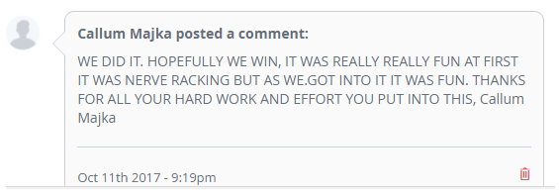

Slide 34
Long-term engagement in language learning
building cumulative language knowledge with a focus on phonics, vocabulary and grammar
strong interpersonal relationships
strong cultural content
autonomy and choice, where appropriate to learners
powerful advocacy based on intrinsic enjoyment, personal relevance, and sense of progression
maximal opportunities to engage with language learning beyond the classroom
Notes:
Concluding slides

Slide 35
Session aims
review (briefly!) the evidence for language learning motivation in England
identify key motivational drivers for students in language learning
explore the relationship between phonics, vocabulary and grammar (PVG) and language learning motivation
tease out how to build long-lasting engagement in language learning at KS3 and KS4
Notes:
Concluding slides

Slide 36
The smallest changes can sometimes make the greatest of differences.
No puedo. → No, puedo.

Slide 37
References Board, K., & Tinsley, T. (2017). Language trends 2016/17
https://www.britishcouncil.org/sites/default/files/language_trends_survey_2017_0.pdf Chambers, G. (2016). Pupils’ perceptions of Key Stage 2 to Key Stage 3 transition in modern foreign languages. The Language Learning Journal. Published Online 7 June 2016, https://doi.org/10.1080/09571736.2016.1172331. Coleman, J.A. (2009) Why the British do not learn languages: myths and motivation in the United Kingdom, The Language Learning Journal, 37:1, 111-127, DOI:10.1080/09571730902749003 Courtney, L. M. (2014). Moving from primary to secondary education: An investigation into the effect of primary to secondary transition on motivation for language learning and foreign language proficiency. (Unpublished doctoral dissertation). University of Southampton, United Kingdom. De Cecco, J., & Shaw, Margaret. (2008). Boys’ motivation towards the learning of modern foreign languages. Paper presented at the British Educational Research Association Annual Conference, Heriot-Watt University, Edinburgh, 3-6 September 2008. Accessed October 2017: http://www.leeds.ac.uk/educol/documents/174575.pdf Deckner, S.E. (2017). Quantitative evidence of the occurrence of a motivational dip in language learning in year 7, The Language Learning Journal, DOI:10.1080/09571736.2017.1351482 Dörnyei, Z. (2005). The psychology of the language learner: Individual differences in second language acquisition. Mahwah, NJ: Lawrence Erlbaum. Dörnyei, Z. (2009). The L2 Motivational Self System. In Z. Dörnyei & E. Ushioda (Eds.), Motivation, language identity and the L2 Self System (pp. 9–42). Bristol, UK: Multilingual Matters. Dörnyei, Z. (2014). Motivation in second language learning. In M. Celce-Murcia, D. M. Brinton & M. A. Snow (Eds.), Teaching English as a second or foreign language (4th ed., pp. 518-531). Boston, MA: National Geographic Learning/Cengage Learning. Evans, M., & Fisher, L. (2009). Language learning at Key Stage 3: The impact of the key stage 3 modern foreign languages framework and changes to the curriculum on provision and practice. Accessed at http://dera.ioe.ac.uk/11170/1/DCSFRR091.pdf Graham, S., & Santos, D. (2015). Language learning in the public eye: An analysis of newspapers and official documents in England. Innovation in Language Learning and Teaching, 9, 72–85. Graham, S., Macfadyen, T., & Richards, B. (2012). Learners’ perceptions of being identified as very able: Insights from modern foreign languages and physical education. Journal of Curriculum Studies, 44, 323–348. Graham, S., Courtney, L., Tonkyn, A., & Marinis, T. (2016). Motivational trajectories for early language learning across the primary–secondary school transition. British Educational Research Journal. https://doi.org/10.1002/berj.3230. Hiver, P., & Al-Hoorie, A. H. (2019). Reexamining the role of vision in second language motivation: A preregistered conceptual replication of You, Dörnyei, and Csizér (2016). Language Learning. https://doi.org/10.1111/lang12371

Slide 38
Lanvers, U. (2016). Teaching languages ‘for the love of learning’? A 360 degree view of student, teacher and school management perspectives on language learning in England. In A. Hahn (Ed.), Proceedings of the 2015 Anglistentag (pp. 319–329). Trier, Germany: Wissenschaftlicher Verlag. Lanvers, U. (2017). Language learning motivation, Global English and study modes: A comparative study. The Language Learning Journal, 45, 220–244. Lanvers, U., & Coleman, J. A. (2013). The UK language learning crisis in the public media: A critical analysis. The Language Learning Journal 1–23. Published Online 11 Oct. 2013, https://doi.org/10.1080/09571736.2013.830639.
Martin, C. (2012). Pupils’ perceptions of foreign language learning in the primary school: Findings from the key stage 2 language learning pathfinder evaluation. Education 3–13, 40, 343–362.
McKnight, K. et al. (2016). England: What makes an effective teacher? Executive summary. Pearson. Published online at: https://www.pearson.com/content/dam/one-dot-com/one-dot-com/global/Files/efficacy-and-research/schools/global-survey/reports/RINVN9283_UK_July_ExecSum.pdf Modern Foreign Languages Pedagogy Review (2016). Teaching Schools Council. https://www.tscouncil.org.uk/wp-content/uploads/2016/12/MFL-Pedagogy-Review-Report-2.pdf
Noels, K.A., Pelletier, L.G., & Vallerand, R. (2000). Why are you learning a second language? Motivational orientations and self-determination theory. Language Learning 50:1, 57-85. Noels, K. A., Clément, R., & Pelletier, L. G. (1999). Perceptions of teachers’ communicative style and student’ intrinsic and extrinsic motivation. The Modern Language Journal, 83, 23-34. Oyserman, Bybee, & Terri (2006). Possible Selves and Academic Outcomes: How and When Possible Selves Impel Action. Journal of Personality and Social Psychology, 91(1),188 –204
Pae, T.I. (2008). Second Language Orientation and Self-Determination Theory: A Structural Analysis of the Factors Affecting Second Language Achievement. Journal of Language and Social Psychology, Vol.27, 1, 5-27
Taylor, F., & Marsden, E. J. (2014). Perceptions, attitudes, and choosing to study foreign languages in England: An experimental intervention. Modern Language Journal, 98, 902–920. TSC (Teaching Schools Council). (2016). Modern Foreign Languages Pedagogy Review. Published online November 2016, https://www.tscouncil.org.uk/wp-content/uploads/2016/12/MFL-Pedagogy-Review-Report-2.pdf Wingate, U. (2016). Lots of games and little challenge: A snapshot of modern foreign language teaching in English secondary schools. The Language Learning Journal. Published Online 7 June 2016, https://doi.org/10.1080/09571736.2016.1161061 Woll, B., & Wei, L. (2018). Cognitive Benefits of Language Learning: Broadening our perspectives. Final Report to the British Academy

