Slide 1
How things are and how they were
The comparative
SSC [-ich] vs [-isch]
Y8 German
Term 2.1 - Week 6 - Lesson 37
Author name(s): Inge Alferink / Rachel Hawkes
Artwork: Steve Clarke
Date updated: 7 / 7 / 27
Notes:
Artwork by Steve Clarke. All additional pictures selected are available under a Creative Commons license, no attribution required.
Learning outcomes (lesson 1):
Contrasting SSC [-ich] and [-isch]
Introduction to word pattern German [-isch] meaning [-ical] in English
Word frequency (1 is the most frequent word in German):
8.2.1.5 (introduce) besser [201] billig [1738] gefährlich [1211] häufig [407] lang [97] mehr [52] sicher [265] teuer [950] noch²³ [33] als² [22]
8.2.1.1 (revisit) antworten [826] danken [1276] kriegen [724] schenken [1614] dir [244] ihm [91] ihr [27] eigen [166] für [17]
8.1.2.1 revisit) enthalten [562] sterben [475] nichts [109] Bevölkerung [1018] Prozent [172] Unterstüzung [1141] nur [39] vierzig [2907] fünfzig [2390] sechzig [2448] siebzig [2609] achtzig [3301] neunzig [3028] hundert [1107]
Source: Jones, R.L & Tschirner, E. (2019). A frequency dictionary of German: Core vocabulary for learners. London: Routledge.
The frequency rankings for words that occur in this PowerPoint which have been previously introduced in NCELP resources are given in the NCELP SOW and in the resources that first introduced and formally re-visited those words.
For any other words that occur incidentally in this PowerPoint, frequency rankings will be provided in the notes field wherever possible.

Slide 2
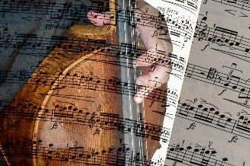
English → German → English
Note that ‘c’ is almost always ‘k’ in German, too.
Words ending in –ical
often change to -isch in German.
The music is classical.
Die Musik ist klassisch.
What would the following words be in German?
biological
geographical
practical electrical Choose one and write a sentence in German.
Translate these sentences.
1. Die Kirche ist sehr historisch.
2. That is typical (for England)!
Notes:
Timing: 7 minutes (two slides) Aim: To develop knowledge of word patterns within German.
Procedure: 1. Click to present the pattern and examples. 2. Given students time to complete the six short tasks. 3. Answers and further tasks on the next slide.
Word frequency: klassisch [882] historisch [901] typisch [1109] biologisch [2416] geographisch [3640] praktisch [840] elektrisch [1090] katholisch [2932] demokratisch [1788] politisch [304] technisch [656] chemisch [761] kritisch [1241] statistisch [1590] komisch [1875] Other -isch adjectives, that do not have the exact English-German pattern, but can be more easily recognised, once students know the pattern: elektronisch [1784] medizinisch [920] literarisch [2083] musikalisch [3565] künstlerisch [2222] It is also worth considering that this is how many adjectives of nationality are created in German: europäisch [335] amerikanisch [836] englisch [662] französisch [816] italienisch [1593] britisch [1419] spanisch [1919] türkisch [1531] russisch [831] österreichisch [1511] bayrisch [1383] chinesisch [1154] griechisch [1486]
Source: Jones, R.L. & Tschirner, E. (2019). A frequency dictionary of German: core vocabulary for learners. Routledge

Slide 3
ANTWORTEN
Die Kirche ist sehr historisch.
That is typical (for England)!
biological
geographical
practical
electrical
The church is very historical.
Das ist typisch (für England)!
biologisch
geografisch
praktisch
elektrisch
Note that ‘c’ becomes ‘k’.
Pronounce the words.

Slide 4
Phonetik [1/2]
lesen / sprechen
Partner/Partnerin A sagt die Wörter mit [-ich]. Partner/Partnerin B sagt die Wörter mit [-isch].
12
wirklich | sportlich | musikalisch | monatlich | praktisch | historisch | kritisch
1
Partner/Partnerin A sagt die Wörter mit [-isch]. Partner/Partnerin B sagt die Wörter mit [-ich].
politisch | technisch | komisch | glücklich | ähnlich | katholisch | wöchentlich
2
0
LOS!
Notes:
Timing: 3 minutes (2 slides)
Aim: Oral production of [-ich] and [-isch] adjectives. A mixture of near-cognates and previously taught words is used. The addition of a time constraint prompts students to increase their speed of oral production.
Procedure:
1. Students partner up and label themselves A and B.
2. They then treat the table row as a script but have to say words in tandem, A saying [-ich] words and B saying [-isch] words.
3. Click 12-second timer to start round 1.
4. Click action button to hear native audio for comparison.
6. Clarify meaning of the cognate words.
Word frequency (1 is the most frequent word in German): All words are in the top 2000. Source: Jones, R.L. & Tschirner, E. (2019). A frequency dictionary of German: core vocabulary for learners. Routledge

Slide 5
Phonetik [2/2]
The audio has the Austrian pronunciation of ‘chemisch’. How would a German typically say it?
lesen / sprechen
8
Partner/Partnerin A sagt alle Wörter. Partner/Partnerin B hört ihm/ihr zu.
elektrisch | biologisch | möglich | jährlich | demokratisch | natürlich | chemisch
1
Partner/Partnerin B sagt alle Wörter. Partner/Partnerin A hört ihm/ihr zu.
russisch | täglich | amerikanisch | plötzlich | freundlich | statistisch | literarisch
2
0
LOS!
Notes:
Procedure:
1. This time, Partner A says all the words in their row (1). The timer is set for 8 seconds.
2. The listening student (Partner B) notes any pronunciation errors and gives their partner a score out of 7.
3. Click for Round 2, where students swap roles: B says all the words in their row while A listens and gives a score.

Slide 6
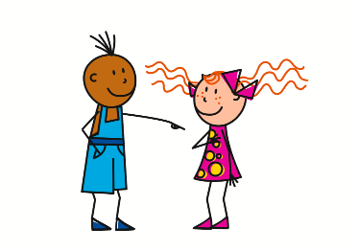
Vokabeln [1/2]
schreiben
Schreib 1-8 und die Wörter auf Deutsch.
1
2
3
4
[own]
d
t
i l l i g
e u e r
e
b
a n k e n
i g e n
5
6
7
8
?
[frequently]
(row 3)
n t w o r t e n
ä u f i g
i r
e f ä h r l i c h
a
h
d
g _
Notes:
Timing: 10 minutes (2 slides) Aim: To retrieve vocabulary items and practise them in the written modality. Procedure: 1. Write down 1-8.
2. For each item write the word that fits the meaning / the picture and the initial letter.
3. Click to reveal and check answers.
Word frequency (1 is the most frequent word in German): 8.2.1.5 (introduce) billig [1738] gefährlich [1211] häufig [407] teuer [950]
8.2.1.1 (revisit) antworten [826] danken [1276] dir [244] eigen [166
Source: Jones, R.L. & Tschirner, E. (2019). A frequency dictionary of German: core vocabulary for learners. Routledge

Slide 7
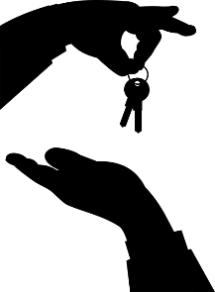
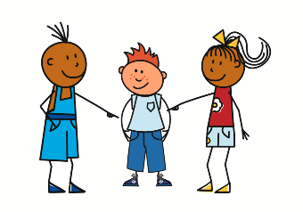
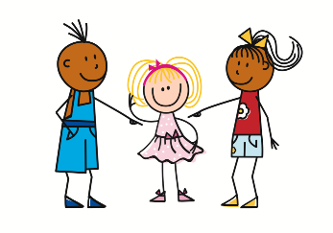
Vokabeln [2/2]
schreiben
Schreib 1-8 und die Wörter auf Deutsch.
1
2
3
4
[for]
e s s e r
k
e h r
ü r
b
r i e g e n
m
f
5
6
7
8
(row 3)
(row 3)
i c h e r
h m
h r
s
s
i
i
c h e n k e n
Notes:
Timing: 10 minutes (2 slides) Aim: To retrieve vocabulary items and practise them in the written modality. Procedure: 1. Write down 1-8.
2. For each item write the word that fits the meaning / the picture and the initial letter.
3. Click to reveal and check answers. Word frequency (1 is the most frequent word in German): 8.2.1.5 (introduce) besser [201] mehr [52] sicher [265]
8.2.1.1 kriegen [724] schenken [1614]] ihm [91] ihr [27] für [17]
Source: Jones, R.L. & Tschirner, E. (2019). A frequency dictionary of German: core vocabulary for learners. Routledge

Slide 8
der Komparativ [1/3]
Grammatik
Spelling differences: -e → -er – müde → müder -el → -ler – dunkel → dunkler -er → -rer – teuer → teurer (if -er preceded by a vowel).
Add -er to an adjective or adverb to form the comparative:
Das Auto ist billig.
Dieses Auto ist billiger.
The car is cheap.
This car is cheaper.
Das Haus ist teuer.
Dieses Haus ist teurer.
Note: English uses ‘more’ to make the comparative with longer adjectives. German always adds -er.
The house is expensive.
This house is more expensive.
To compare two things, use als to mean than:
Die Stadt ist sicherer als damals.
The town is safer than back then.
Ich verstehe mehr als früher.
I understand more than in former times/before.
Use mehr (more) on its own as an adverb but never before an adjective.
Notes:
Timing: 5 minutes (2 slides) Aim: To explain and illustrate the use of comparatives in German and to highlight differences between German and English. Procedure: 1. Click on the mouse to animate the explanation.
2. Ensure student understanding at each stage.
Word frequency (1 is the most frequent word in German): 8.2.1.5 (introduce) billig [1738] mehr [52] sicher [265] teuer [950] als² [22]
Source: Jones, R.L. & Tschirner, E. (2019). A frequency dictionary of German: core vocabulary for learners. Routledge

Slide 9
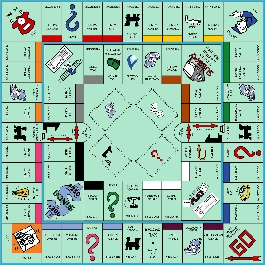
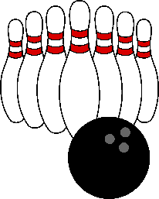
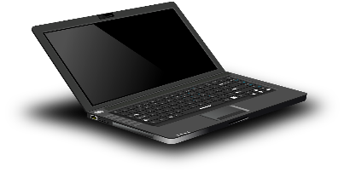
der Komparativ [2/3]
Most single syllable adjectives and adverbs do this: oft, alt, jung, kalt, warm, kurz, nah.
Grammatik
Some comparatives add an umlaut to the vowel (a, o, u):
Das Spiel ist lang .
Dieses Spiel ist länger.
The game is long.
This game is longer.
Der Berg ist groß .
Dieser Berg ist größer.
The mountain is big.
This mountain is bigger.
Four comparatives are completely different:
Der Laptop ist gut.
Dieser Laptop ist besser.
gut → besser viel → mehr hoch → höher gern → lieber
The computer is good.
This computer is better.
Ich lerne viel.
Ich lerne mehr.
I learn much / a lot.
I learn more.
Notes:
Timing: 3 minutes Aim: To explain and illustrate the typical form of comparatives in German and to highlight some exceptions. Procedure: 1. Click on the mouse to animate the explanation.
2. Ensure student understanding at each stage.
Word frequency (1 is the most frequent word in German): 8.2.1.5 (introduce) besser [201] lang [97] mehr [52] Source: Jones, R.L. & Tschirner, E. (2019). A frequency dictionary of German: core vocabulary for learners. Routledge

Slide 10
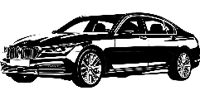
Deutschland - Statistik
lesen
1. | Die Donau ist länger als der Rhein.
2. | Köln ist größer als Frankfurt.
3. | Der Winter im Süden ist kälter als im Norden.
4. | Sebastian Vettel ist jünger als Jürgen Klopp.
5. | Belgien ist England näher als Italien.
6. | Volkswagen ist billiger als BMW.
7. | Obst ist gesünder als Fleisch.
8. | Formel 1 ist gefährlicher als Skifahren.
Schreib Komparativsätze 1-8.
_________
_________.
der Rhein: 1.041Km
die Donau: 2.811Km
_________
_________.
Frankfurt Bevölkerung : 648.000
Köln Bevölkerung : 965.000
________
im Süden: 3 Grad
im Norden: 5 Grad
________.
___________
___________
Sebastian Vettel –
geboren: 1987
Jürgen Klopp – 1967
_______
Belgien 380 km
Italien 1504 km
______
______
BMW – ££££
Volkswagen – ££
___________
_______
Fleisch: 10-15 Prozent Fett
Obst: 0 Prozent Fett
____
____
_____
_________
Formel 1 – 1 von 100 stirbt
Skifahren – 1 von 1,4 Millionen stirbt
Notes:
https://www.dailyinfographic.com/sports-fatality-rates
Timing: 5 minutes Aim: To practise comparatives in a sentence context. This activity uses real-world information. Procedure: 1. Write 1-8.
2. Complete each sentence by putting the information in the right gap.
3. Click to reveal and check answers.
Word frequency (1 is the most frequent word in German): 8.2.1.5 (introduce) billig [1738] gefährlich [1211] lang [97] als² [22]
8.1.2.1 revisit) enthalten [562] sterben [475] Bevölkerung [1018] Prozent [172] Source: Jones, R.L. & Tschirner, E. (2019). A frequency dictionary of German: core vocabulary for learners. Routledge

Slide 11
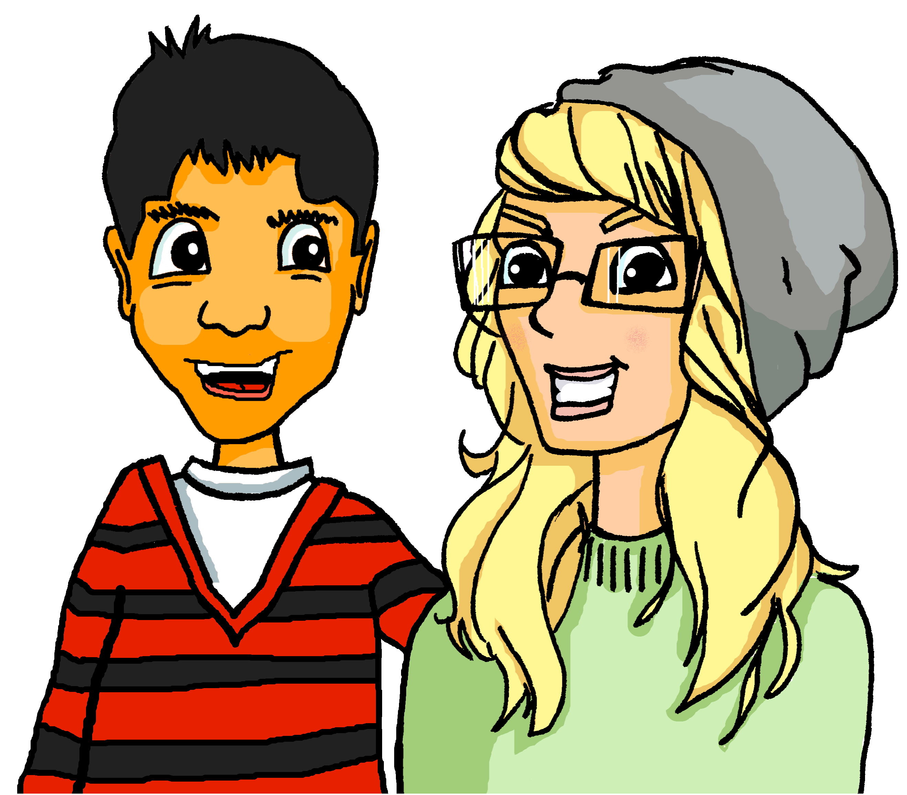
Mehmet redet über die Schule
hören
Hör zu. Is Mehmet describing his current school or comparing it to his previous school?
 |  | Description | Comparison
 | Die Schüler sind freundlich.
 | Der Unterricht ist interessanter.
 | Englisch ist schwierig.
 | Wir machen häufiger Sport.
 | Das Essen ist billiger.
 | Die Schule ist sicher.
 | Die Lehrer sind jünger.
 | Die Gebäude sind moderner.
1
2
3
4
5
6
7
8
Notes:
Timing: 5 minutes Aim: To practise listening for and attending to comparatives by distinguishing between comparisons and descriptions. Procedure: 1. Write 1 to 8.
2. Click on a number to play the recording.
3. For each item say whether it is a comparison or a description.
4. Click to reveal and check answers.
Transcript: 1. Die Schüler sind freundlich. 2. Der Unterricht ist interessanter. 3. Englisch ist schwierig. 4. Wir machen häufiger Sport. 5. Das Essen ist billiger. 6. Die Schule ist sicher. 7. Die Lehrer sind jünger. 8. Die Gebäude sind moderner. Word frequency (1 is the most frequent word in German): 8.2.1.5 (introduce) besser [201] billig [1738] häufig [407] sicher [265] Source: Jones, R.L. & Tschirner, E. (2019). A frequency dictionary of German: core vocabulary for learners. Routledge

Slide 12
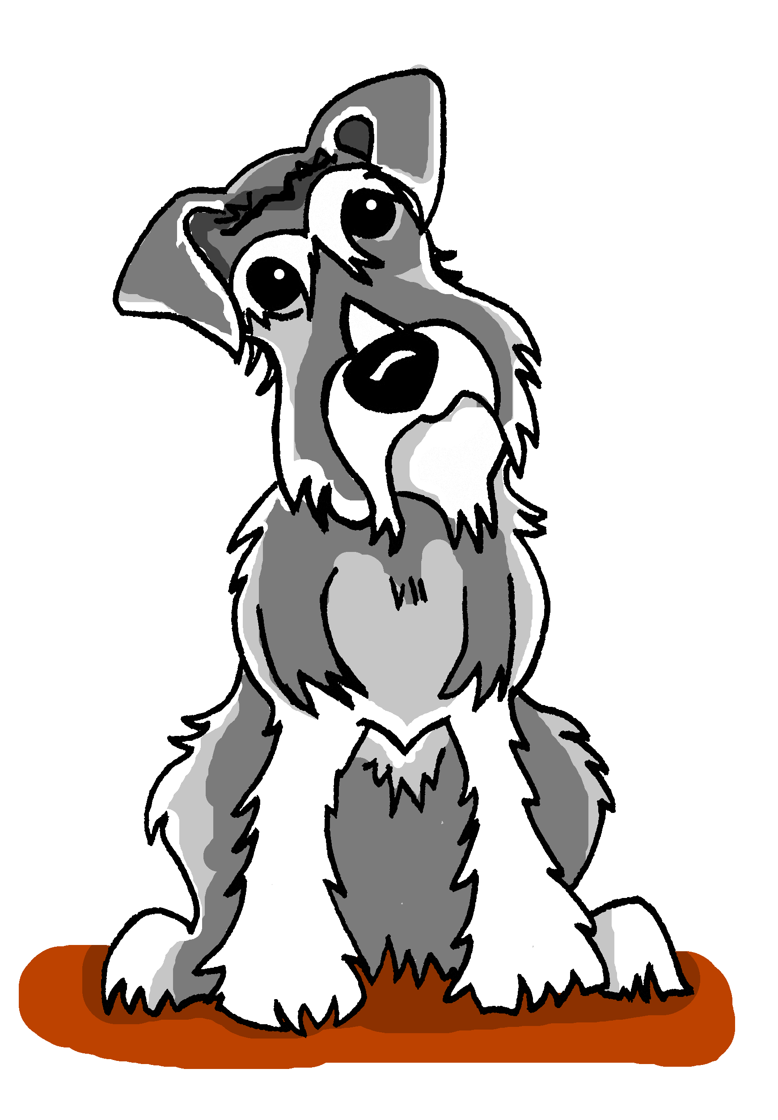
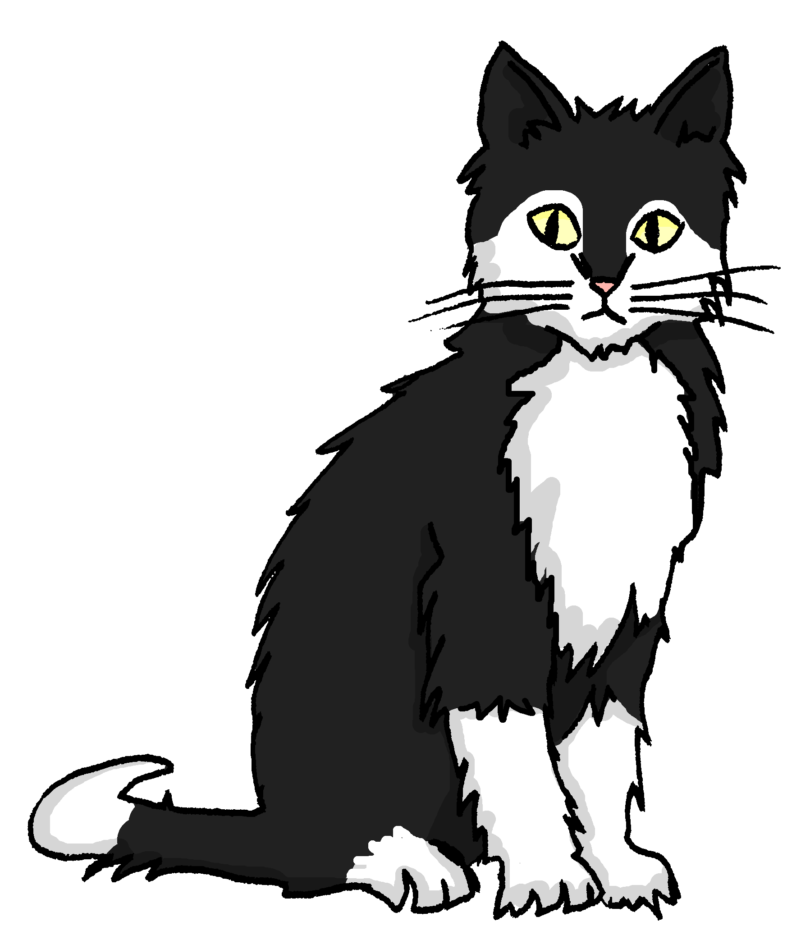
der Komparativ [3/3]
Grammatik
So, where there is difference we compare like this:
Einstein ist größer als Mieze.
Einstein is bigger than Mieze.
You already know other meanings for so (so, in that way) and wie (how).
Where two things are the same, we compare like this:
Einstein ist so groß wie Mieze.
Einstein is as big as Mieze.
genau (exactly) is often added to so, especially in speech.
Einstein läuft genauso schnell wie Mieze.
Einstein runs (just) as fast as Mieze.
Notes:
Timing: 3 minutes Aim: To explain and illustrate comparisons when things are different and when things are the same.
Procedure: 1. Click on the mouse to animate the explanation.
2. Ensure student understanding at each stage.
Word frequency (1 is the most frequent word in German): 8.2.1.5 (introduce) billig [1738] mehr [52] sicher [265] teuer [950] als² [22]
Source: Jones, R.L. & Tschirner, E. (2019). A frequency dictionary of German: core vocabulary for learners. Routledge

Slide 13
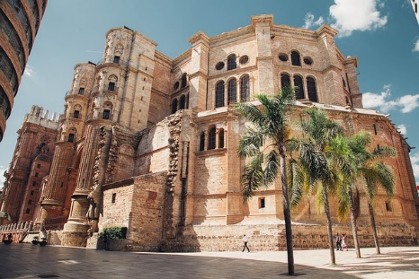
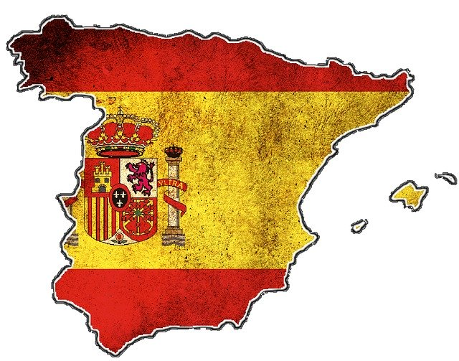
Heidis Urlaub in Spanien
hören
 | Der Sommer ist dort so warm wie hier.
 | Die Tage in Málaga sind länger als hier.
 | Ich habe dort das Essen leckerer gefunden als in Deutschland.
 | In Spanien fährt man genauso schnell wie in Deutschland.
 | Die Leute dort reden schneller als hier.
 | Die Straßen in Spanien sind so sicher wie hier.
 | Die Häuser in Málaga sind schöner als in Berlin.
 | Dort habe ich öfter getanzt als hier zu Hause.
Hör zu. Was fehlt? Schreib 1-8 und wie oder als.
1
1
2
2
3
3
4
4
5
5
6
6
7
7
8
8
Notes:
Timing: 5 minutes Aim: To practise the contrast between wie and als in a sentence context. Students will need to attend to comparative forms (so ….. wie / xxx-er als) in the sentence. Procedure: 1. Click on a number to play the audio recording.
2. For each sentence say whether wie or als fits in the gap.
3. Click to reveal and check answers.
4. A final click brings up a new set of audio with the full sentences.
Transcript: 1. Der Sommer ist dort so warm [wie] hier. 2. Die Tage in Málaga sind länger [als] hier. 3. Ich habe dort das Essen leckerer gefunden, [als] in Deutschland. 4. In Spanien fährt man genauso schnell [wie] in Deutschland. 5. Die Leute dort reden schneller [als] hier. 6. Die Straßen in Spanien sind so sicher [wie] hier. 7. Die Häuser in Málaga sind schöner [als] in Berlin. 8. Dort habe ich öfter getanzt, als hier zu Hause. Word frequency (1 is the most frequent word in German): 8.2.1.5 (introduce) besser [201] billig [1738] gefährlich [1211] häufig [407] lang [97] mehr [52] sicher [265] teuer [950] noch²³ [33] als² [22]
8.2.1.1 (revisit) antworten [826] danken [1276] kriegen [724] schenken [1614] dir [244] ihm [91] ihr [27] eigen [166] für [17]
8.1.2.1 revisit) enthalten [562] sterben [475] nichts [109] Bevölkerung [1018] Prozent [172] Unterstüzung [1141] nur [39] vierzig [2907] fünfzig [2390] sechzig [2448] siebzig [2609] achtzig [3301] neunzig [3028] hundert [1107]
Source: Jones, R.L. & Tschirner, E. (2019). A frequency dictionary of German: core vocabulary for learners. Routledge

Slide 14
Welches Land? Welche Stadt? Welcher Fluss?
sprechen
Partner B chooses one of the eight rivers. Partner(in) A stellt Fragen mit Komparativen. Partner(in) B antwortet ‘ja’ oder ‘nein’.
(klein)
84,000 km²
357,000 km²
41,000 km²
Salzburg Bevölkerung: 152.367
Koblenz Bevölkerung: 112.586
München Bevölkerung: 1.472.000
Zürich Bevölkerung: 341.730
Bern Bevölkerung: 121.631
(groß)
die Saalach 106 km
die Würm 50 km
die Emme 80 km
(lang)
die Elz 59km
die Mosel 544 km
die Isar 295 km
die Limmat 36 km
die Reuss 164 km
die Aare 292 km
Notes:
Timing: 7-8 minutes (2 slides) Aim: To practise comparatives in a sentence context in speech using real-life information. No printing needed. There is no modelling slide for this activity as the slide can be used multiple times. Teacher to model a full round of the activity with ‘die Würm’: Frage 1: Ist das Land kleiner als Österreich? Nein. Frage 2: Ist die Bevölkerung größer als in Salzburg? Ja. Frage 3: Ist der Fluss länger als die Saalach? Nein Procedure: 1. Work in pairs.
2. One student is Partner(in) A and one student is Partner(in) B.
3. Person B picks a river.
4. Person A asks questions comparing two options in the flow chart using the comparative forms of the adjectives provided.
5. Person B answers yes or no (ja oder nein)
Word frequency (1 is the most frequent word in German): 8.2.1.5 (introduce) lang [97] als² [22]
8.2.1.1 (revisit) antworten [826
8.1.2.1 revisit) Bevölkerung [1018] fünfzig [2390] achtzig [3301]
Source: Jones, R.L. & Tschirner, E. (2019). A frequency dictionary of German: core vocabulary for learners. Routledge

Slide 15
Welches Land? Welcher See? Welche Temperatur?
sprechen
Partner A chooses one of the eight temperatures. Partner(in) B stellt Fragen mit Komparativen. Partner(in) A antwortet ‘ja’ oder ‘nein’.
(groß)
84,000 km²
357,000 km²
41,000 km²
Steiermark Erlaufsee 38 m
Bayern Königssee 98 m
Hessen Grüner See 12 m
Zürich Greifensee 34 m
Bern Thunersee 215 m
(tief)
heute 22 Grad
17 Grad
18 Grad
(warm)
19 Grad
23 Grad
21 Grad
24 Grad
20 Grad
25 Grad
Notes:
Timing: 7-8 minutes (2 slides) Aim: To practise comparatives in a sentence context in speech using real-life information. No printing needed. This activity works in the same way as the previous one, but using different adjectives / comparatives. Procedure: 1. Person A and B swap roles.
2. Person A picks a temperature.
3. Person A asks questions comparing two options in the flow chart using the comparative forms of adjectives provided.
4. Person B answers yes or no (ja oder nein)
Word frequency (1 is the most frequent word in German): 8.2.1.5 (introduce) als² [22]
8.2.1.1 (revisit) antworten Source: Jones, R.L. & Tschirner, E. (2019). A frequency dictionary of German: core vocabulary for learners. Routledge

Slide 16
What you did and what you used to do
The comparative
SSC [zw-] vs [schw-]
Y8 German
Term 2.1 - Week 6 - Lesson 38
Author name(s): Inge Alferink / Rachel Hawkes
Artwork: Steve Clarke
Date updated: 7 / 7 / 21
Notes:
Artwork by Steve Clarke. All additional pictures selected are available under a Creative Commons license, no attribution required.
Learning outcomes (lesson 2):
Contrasting SSC [zw] and [schw]
Word frequency (1 is the most frequent word in German):
8.2.1.5 (introduce) besser [201] billig [1738] gefährlich [1211] häufig [407] lang [97] mehr [52] sicher [265] teuer [950] noch²³ [33] als² [22]
8.2.1.1 (revisit) antworten [826] danken [1276] kriegen [724] schenken [1614] dir [244] ihm [91] ihr [27] eigen [166] für [17]
8.1.2.1 revisit) enthalten [562] sterben [475] nichts [109] Bevölkerung [1018] Prozent [172] Unterstüzung [1141] nur [39] vierzig [2907] fünfzig [2390] sechzig [2448] siebzig [2609] achtzig [3301] neunzig [3028] hundert [1107]
Source: Jones, R.L & Tschirner, E. (2019). A frequency dictionary of German: Core vocabulary for learners. London: Routledge.
The frequency rankings for words that occur in this PowerPoint which have been previously introduced in NCELP resources are given in the NCELP SOW and in the resources that first introduced and formally re-visited those words.
For any other words that occur incidentally in this PowerPoint, frequency rankings will be provided in the notes field wherever possible.

Slide 17
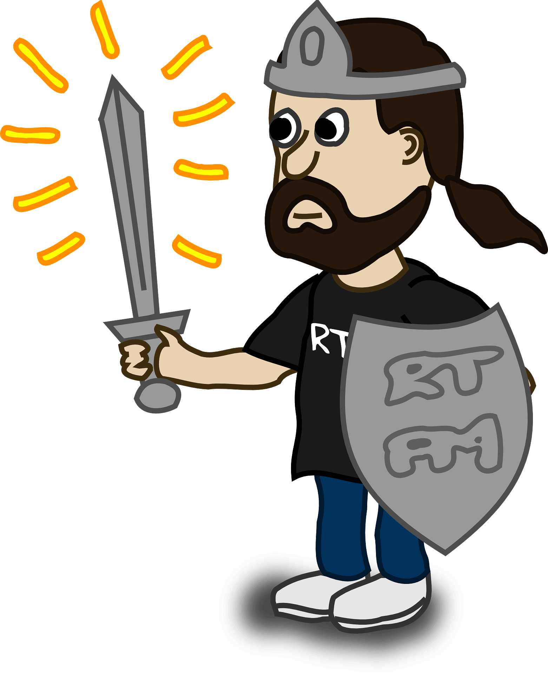
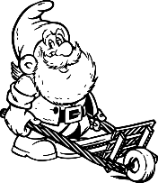
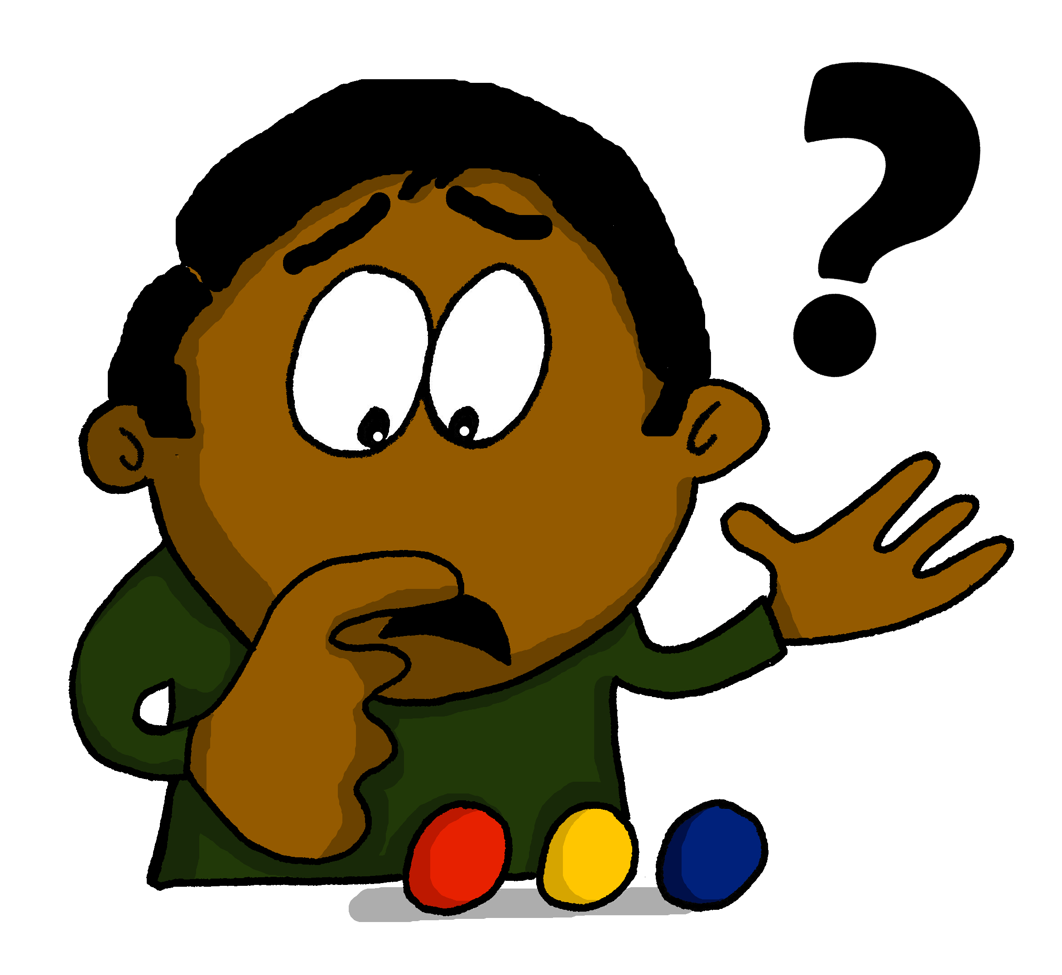
Phonetik
hören / schreiben
Hör zu. Schreib zw- oder schw-
ə
[indeed]
1
schwingen
4
Schwa
zwar
zwingen
____
_____
_____
____
[to force]
[to wield]
[schwa]
[indeed]
2
schwang
5
Schwert
Zwang
____
Zwerg
____
____
____
[swung]
[dwarf]
[sword]
[force/coercion]
3
Schwenken
6
Zwenken
zweifeln
____
____
schweifen
_____
_____
[type of grass]
[pivoting]
[to ramble]
[to doubt]
Notes:
Attributions: To force: Abu badali, based on public domain Aiga’s icons / CC BY-SA
Timing: 5 minutes Aim: to practise differentiating the SSC [zw-] and [schw-], first by transcribing correctly, then by indicating which SSC is said and heard, under increasing time pressure.
Procedure: 1. Students listen and write each SSC correctly (or the full word each time, if preferred)
2. Check answers, using animations.
3. Teacher says one of each pair again, and students lift right or left arm up, to show recognition.
4. Speed of input and responses can be increased to speed up processing.
Transcript: 1. zwingen, schwingen 2. Zwang, schwang
3. Zwenken, schwenken
4. schwa, zwar
5. Zwerg, Schwert
6. schweifen, zweifeln Word frequency (1 is the most frequent word in German): zwingen [1212] schwingen [3130] Zwang [3902] schwang [3130] zwenken [>5009] schwenken [>5009] schwa [>5009] zwar [206] Zwerg [4318] Schwert [>5009] schweifen [>5009] zweifeln [4149] Source: Jones, R.L. & Tschirner, E. (2019). A frequency dictionary of German: core vocabulary for learners. Routledge

Slide 18
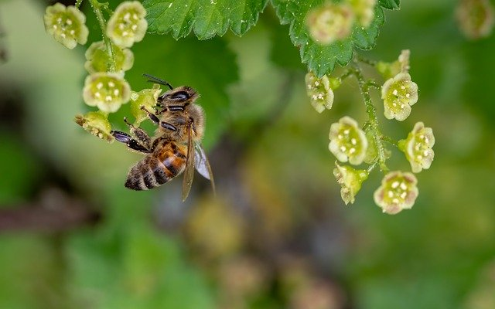
Insekten in Gefahr
retten = to save, saving
die Botschaft - message die Unterschrift = signature
lesen
Die Natur braucht Unterstützung
Das Insektensterben ist heute ein großes Thema für die Weltbevölkerung. Bienen und viele andere Insekten sind in Gefahr. Es ist möglich, dass fünfzig Prozent aller Insekten bis 2050 aussterben.
Wildbienen in Deutschland
Es gibt über 550 Wildbienenarten in Deutschland.
Wildbienen leben solitär.
75% nisten im Boden oder in Pflanzen.
Sie produzieren keinen Honig aber sie sind ganz wichtig für die Biodiversität.
Jedes Jahr am 20. Mai ist Weltbienentag. Viele Leute planen konkrete Aktionen. Die Petition “Rettet die Bienen”
enthält eine wichtige Botschaft und hat
bisher 1,7 Millionen Unterschriften.
Notes:
Timing: 8 minutes Aim: To consolidate revisited vocabulary and see it used in the context of a longer text. Procedure: 1. Read the German text and translate it into English.
2. Check the translation on the next slide.
Word frequency (1 is the most frequent word in German): enthalten [562] sterben [475] Bevölkerung [1018] Prozent [172] Unterstüzung [1141] fünfzig [2390]
Source: Jones, R.L. & Tschirner, E. (2019). A frequency dictionary of German: core vocabulary for learners. Routledge

Slide 19
Antworten
lesen
Nature needs support
The extinction of insects is currently a big issue for the world population. Bees and many other insects are in danger. It is possible that fifty percent of all insects will go extinct between now and 2050.
Wild bees in Germany
There are over 500 types of wild bees in Germany.
Wild bees live by themselves.
75% nest in the ground or in plants.
They don’t produce honey but are very important for biodiversity.
Every year on the 20th of May it is World Bee Day. Many people plan concrete actions. The petition “Save the bees”
contains an important message and has
to date 1.7 million signatures.

Slide 20
Using früher with the perfect tense
Grammatik
Use the perfect tense to say what you did or have done:
PAST (PERFECT)
Wir haben häufig getanzt.
We often danced.
We have often danced.
Use the adverb früher with the perfect tense to say what you used to do:
PAST (PERFECT) + früher
Wir haben früher häufig getanzt.
We often used to dance.
Notes:
Timing: 2 minutes Aim: To explain and illustrate how früher (in former times) is used in combination with the past tense. Procedure: 1. Click on the mouse to animate the explanation.
2. Ensure student understanding at each stage.
Word frequency (1 is the most frequent word in German): häufig [407] Source: Jones, R.L. & Tschirner, E. (2019). A frequency dictionary of German: core vocabulary for learners. Routledge

Slide 21
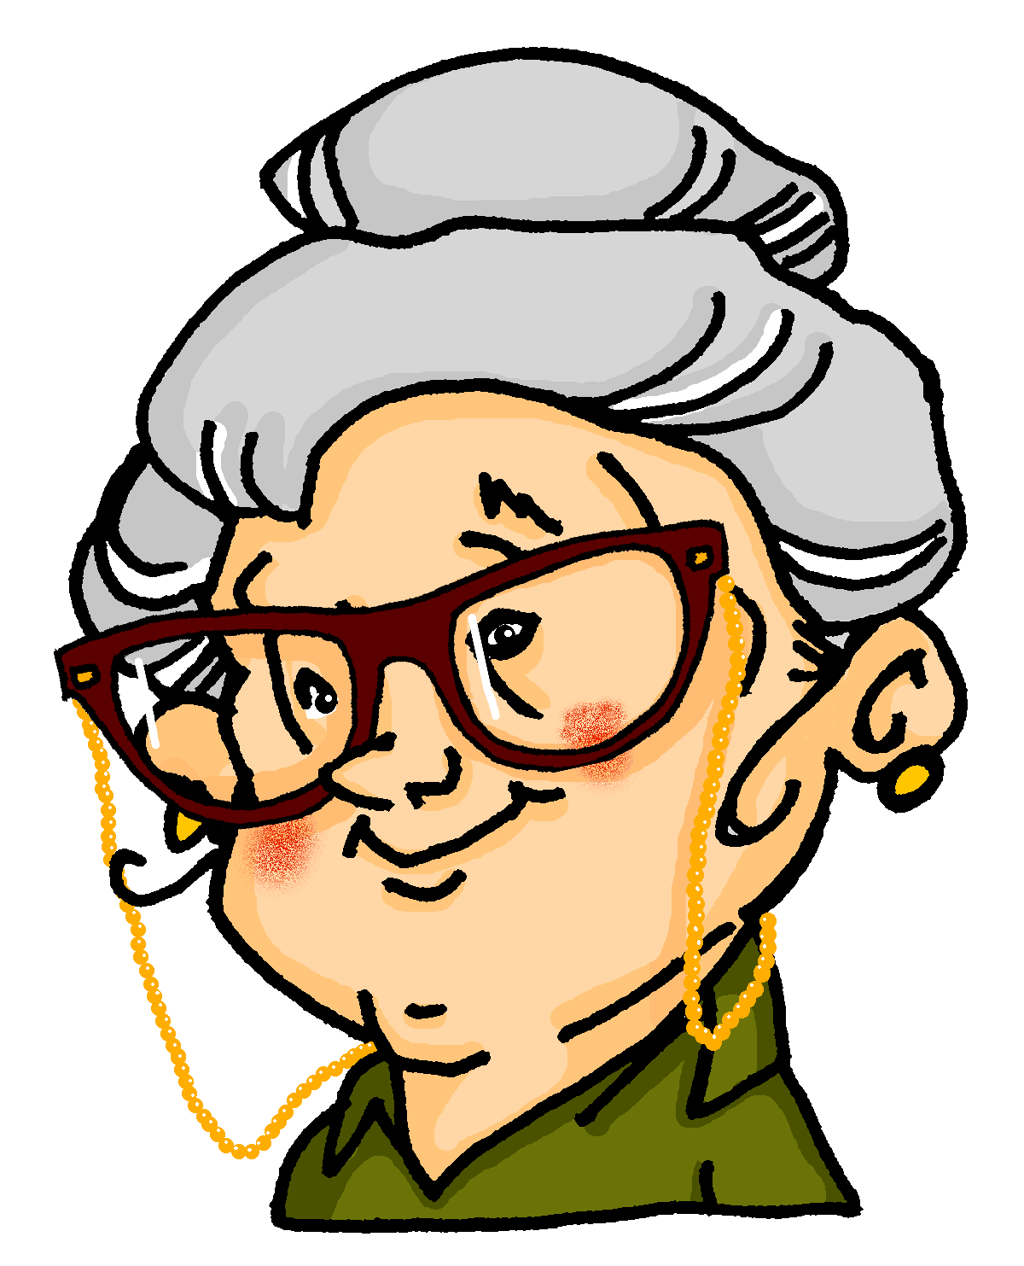
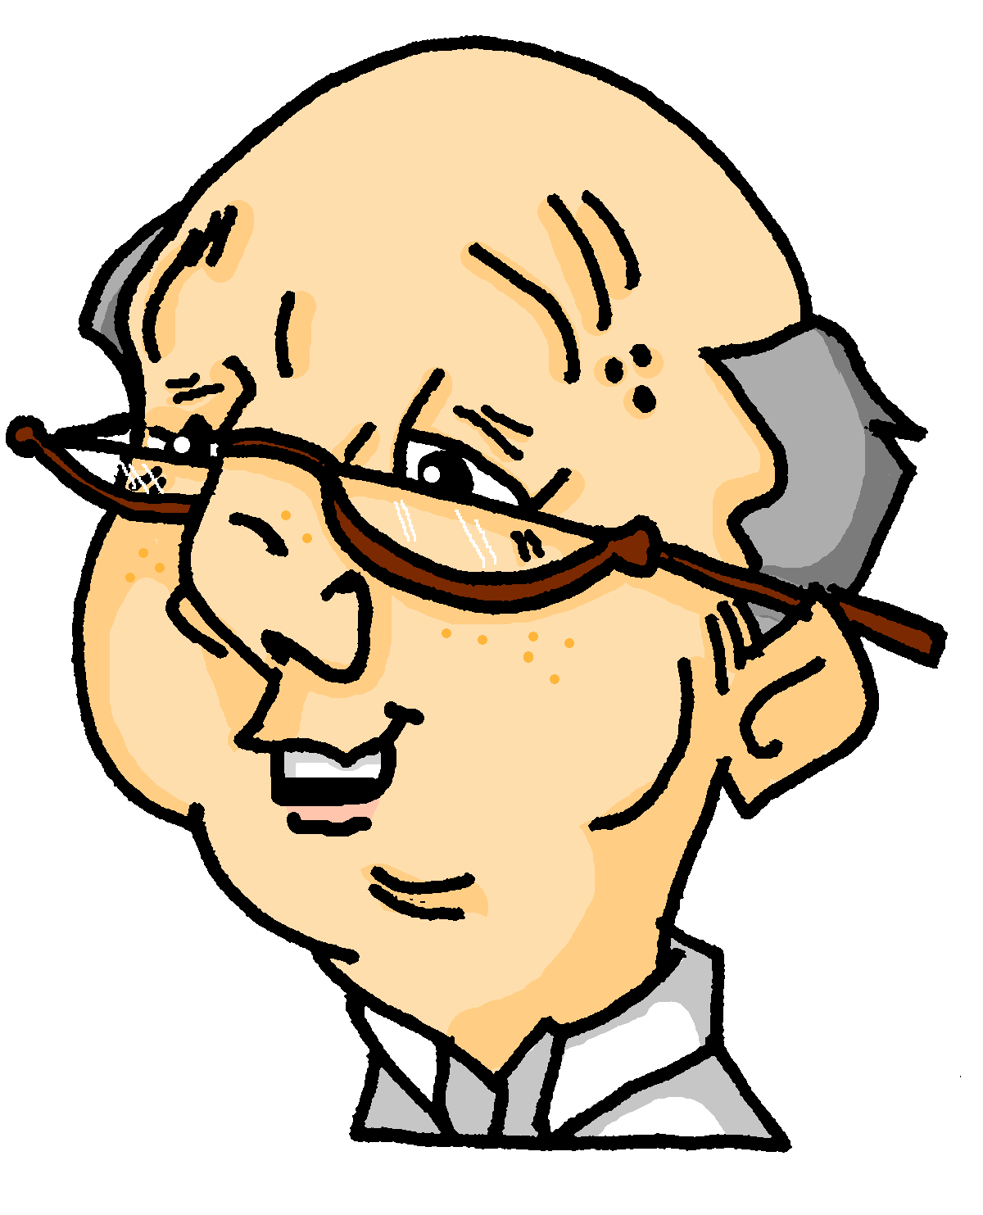
Dieses Jahr oder früher?
hören
Hör zu. Haben Oma und Opa das dieses Jahr oder früher gemacht?
 | dieses Jahr | früher
 | We often went to the cinema. | We often used to go to the cinema.
 | We often walked to the park. | We often used to walk to the park.
 | You played your own music. | You used to play your own music.
 | I wrote you lots of letters. | I used to write you lots of letters.
 | We often read books. | We used to read books often.
 | We only travelled rarely. | We used to travel only rarely.
 | We sometimes swam in the lake. | We used to swim in the lake sometimes.
 | You found summer a bit too hot. | You used to find summer a bit too hot.
1
2
3
4
5
6
7
8
Notes:
Timing: 5 minutes Aim: To practise listening out for früher and subtle meaning difference in past tense use. Procedure: 1. Click on a number to play the audio recording.
2. For every item say whether it happened earlier this year (dieses Jahr) or in former times (früher).
3. Click to reveal and check answers.
Transcript: 1. Früher sind wir häufig ins Kino gegangen. 2. Wir sind oft in den Park gegangen. 3. Du hast früher deine eigene Musik gespielt. 4. Früher habe ich dir viele Briefe geschrieben. 5. Wir haben häufig Bücher gelesen. 6. Wir sind früher nur selten gereist. 7. Wir sind manchmal im See geschwommen. 8. Du hast den Sommer ein bisschen zu heiß gefunden. Word frequency (1 is the most frequent word in German): 8.2.1.5 (introduce) besser [201] billig [1738] häufig [407] sicher [265] Source: Jones, R.L. & Tschirner, E. (2019). A frequency dictionary of German: core vocabulary for learners. Routledge

Slide 22
Using noch
Vokabeln
Sometimes immer is added for emphasis. immer noch = still
You know that noch means still:
1
Hast du noch Hunger?
Are you still hungry?
You have also used noch nicht to mean not yet (literally, still not):
2
Ich habe es noch nicht gehört.
I have not yet heard it.
Use noch + comparative to mean even (literally, still better):
3
Das ist noch besser!
That is even better!
Use noch + indefinite article to mean another (literally, still a…):
4
Ich will noch ein Eis!
I want another ice-cream!
Notes:
Timing: 3 minutes Aim: To explain and illustrate the various meanings and uses of noch. Procedure: 1. Click on the mouse to animate the explanation.
2. Ensure student understanding at each stage.
Word frequency (1 is the most frequent word in German): besser [201], noch²³ [33 Source: Jones, R.L. & Tschirner, E. (2019). A frequency dictionary of German: core vocabulary for learners. Routledge

Slide 23
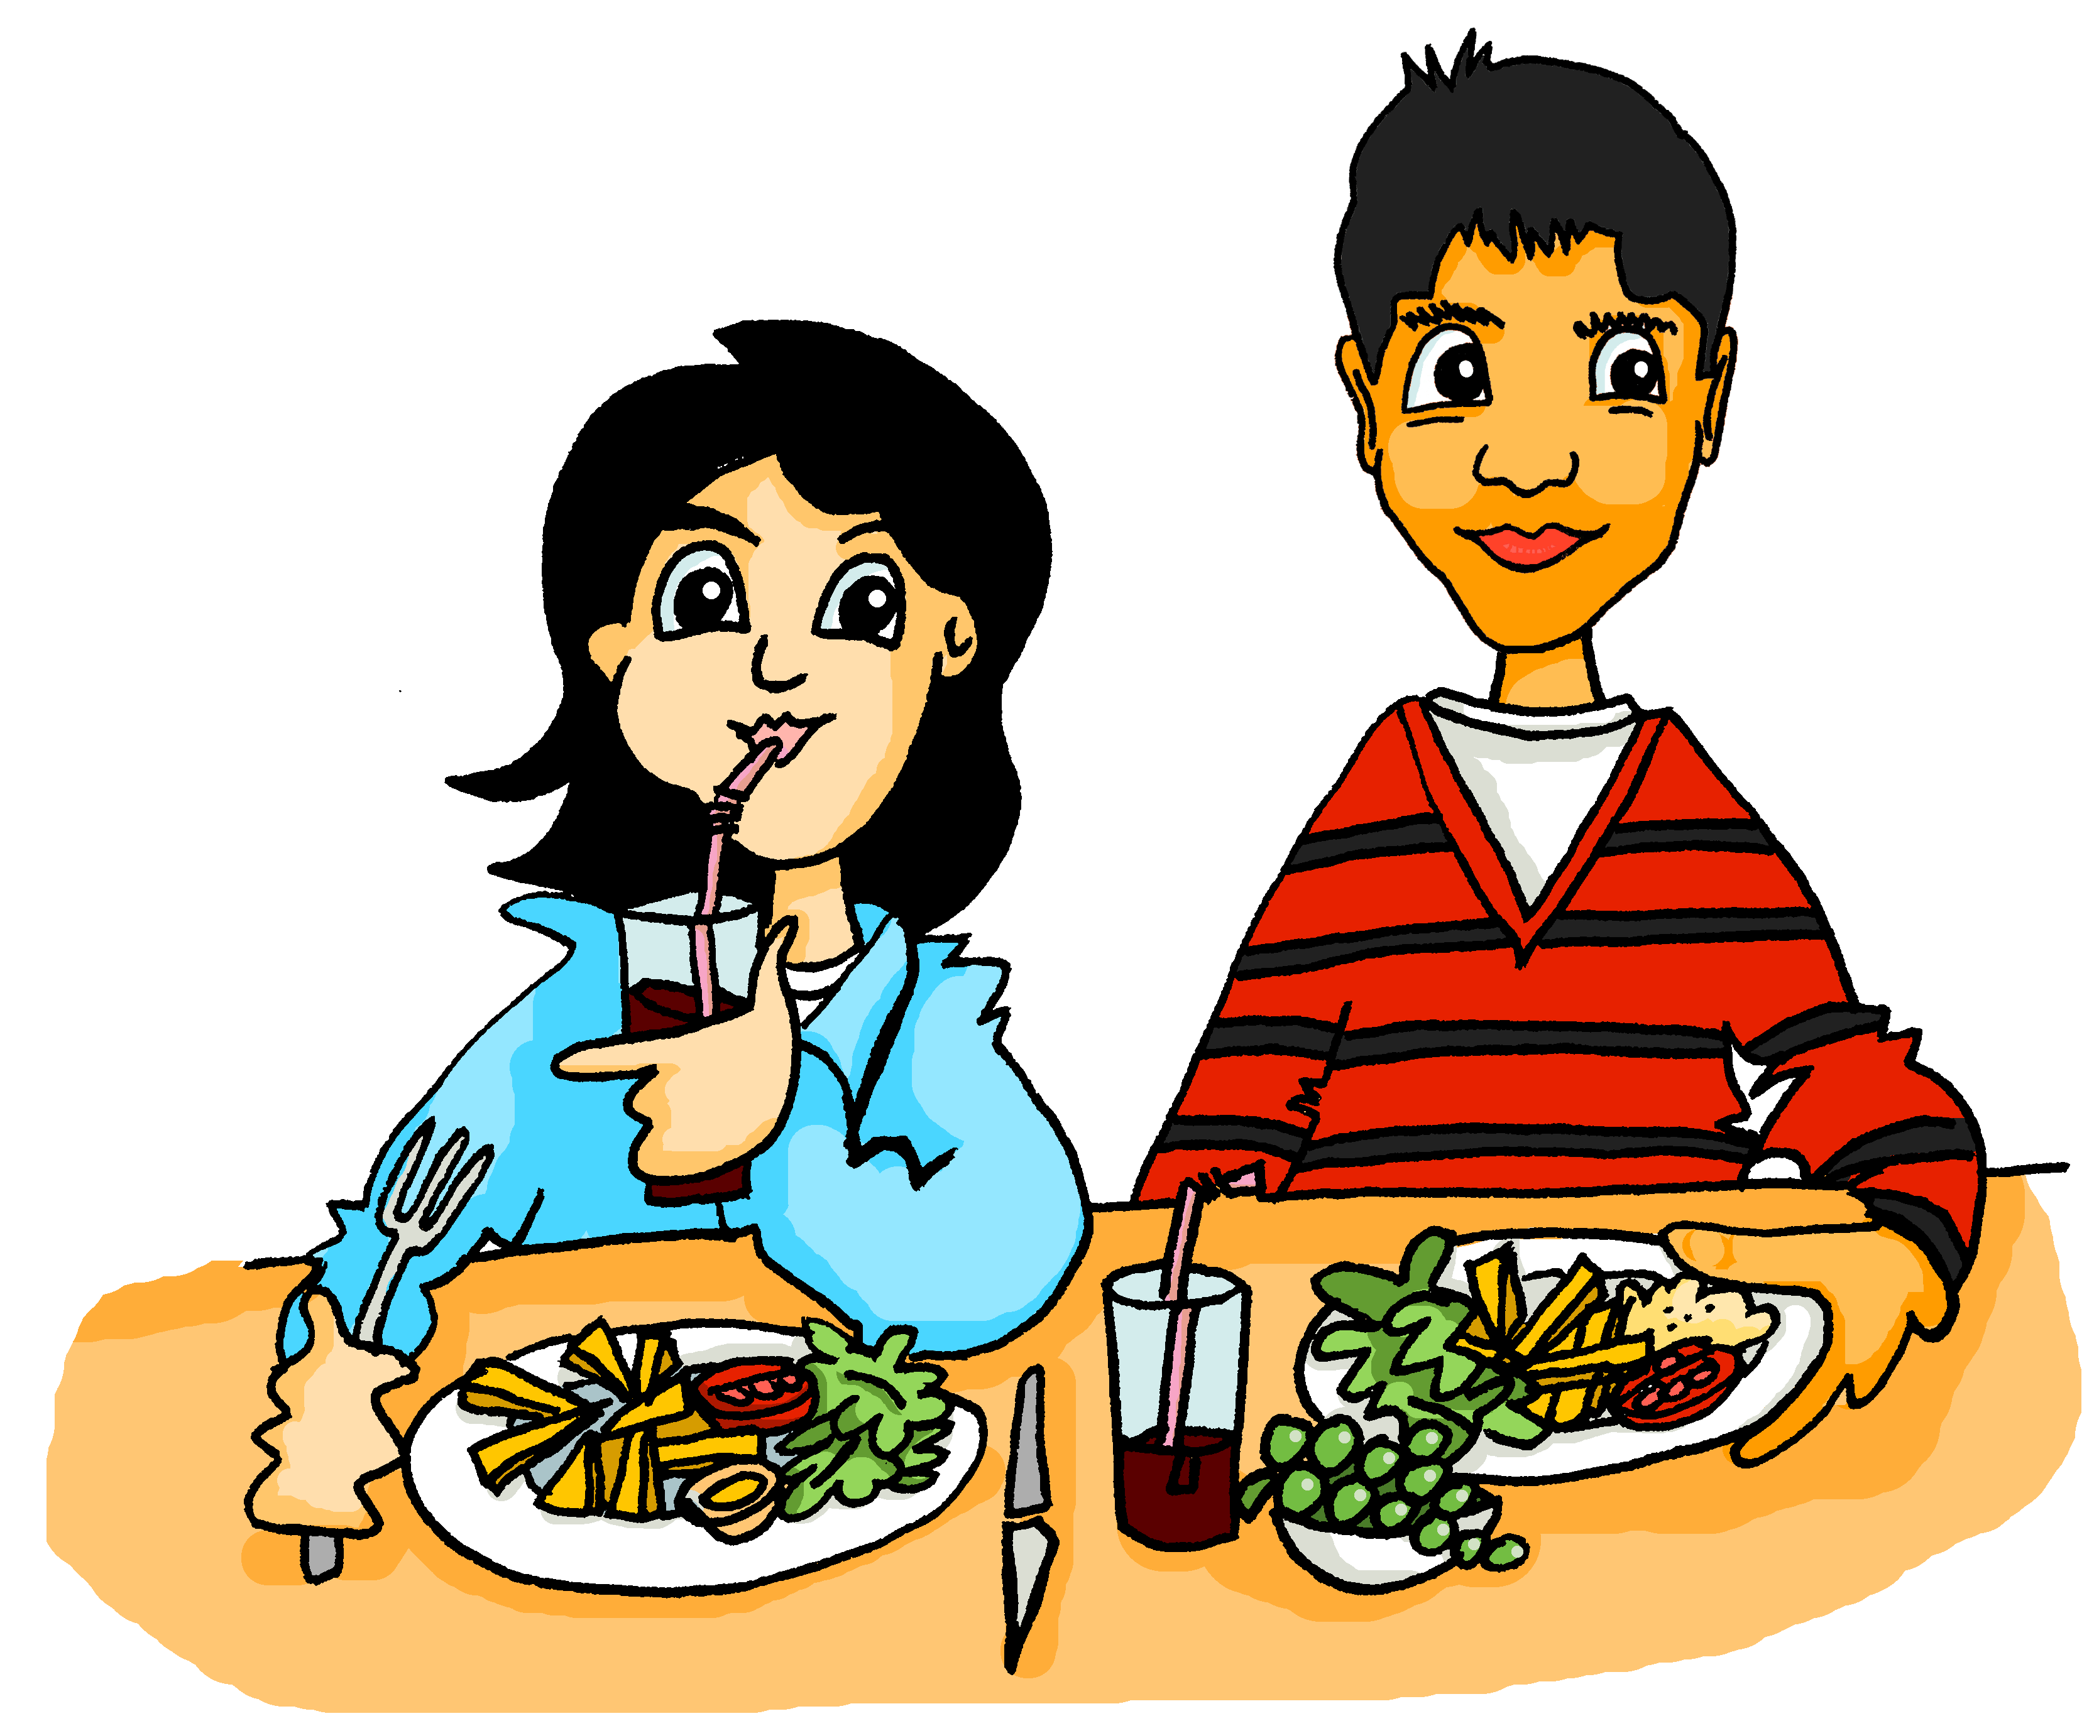
In der Kantine
lesen
Lies den Dialog. Wie heißt noch auf Englisch?
Mia, hast du noch Zeit?
Ja, klar. Ich habe noch nicht gegessen.
Wie geht’s? Hast du schon bei dem neuen Lehrer Biologie gehabt?
Nein, ich habe ihn noch nicht gesehen.
Er ist noch strenger als Herr Weber!
Oh je! Das darf nicht wahr sein!
Willst du noch ein Stück Obst?
Nee, ich habe noch, danke.
Notes:
Timing: 5 minutes Aim: To use the various meanings of noch within the context of a dialogue. Procedure: 1. Read the dialogue. (The boxes are ordered vertically – i.e. start at the top and work down).
2. For each noch say how it could be translated: 1) still, 2) not yet, 3) even, or 4) another
3. Now click on a speech bubble to hear sentence spoken out loud.
4. Translate the sentence into English orally.
Word frequency (1 is the most frequent word in German): noch²³ [33] als² [22]
Source: Jones, R.L. & Tschirner, E. (2019). A frequency dictionary of German: core vocabulary for learners. Routledge

Slide 24
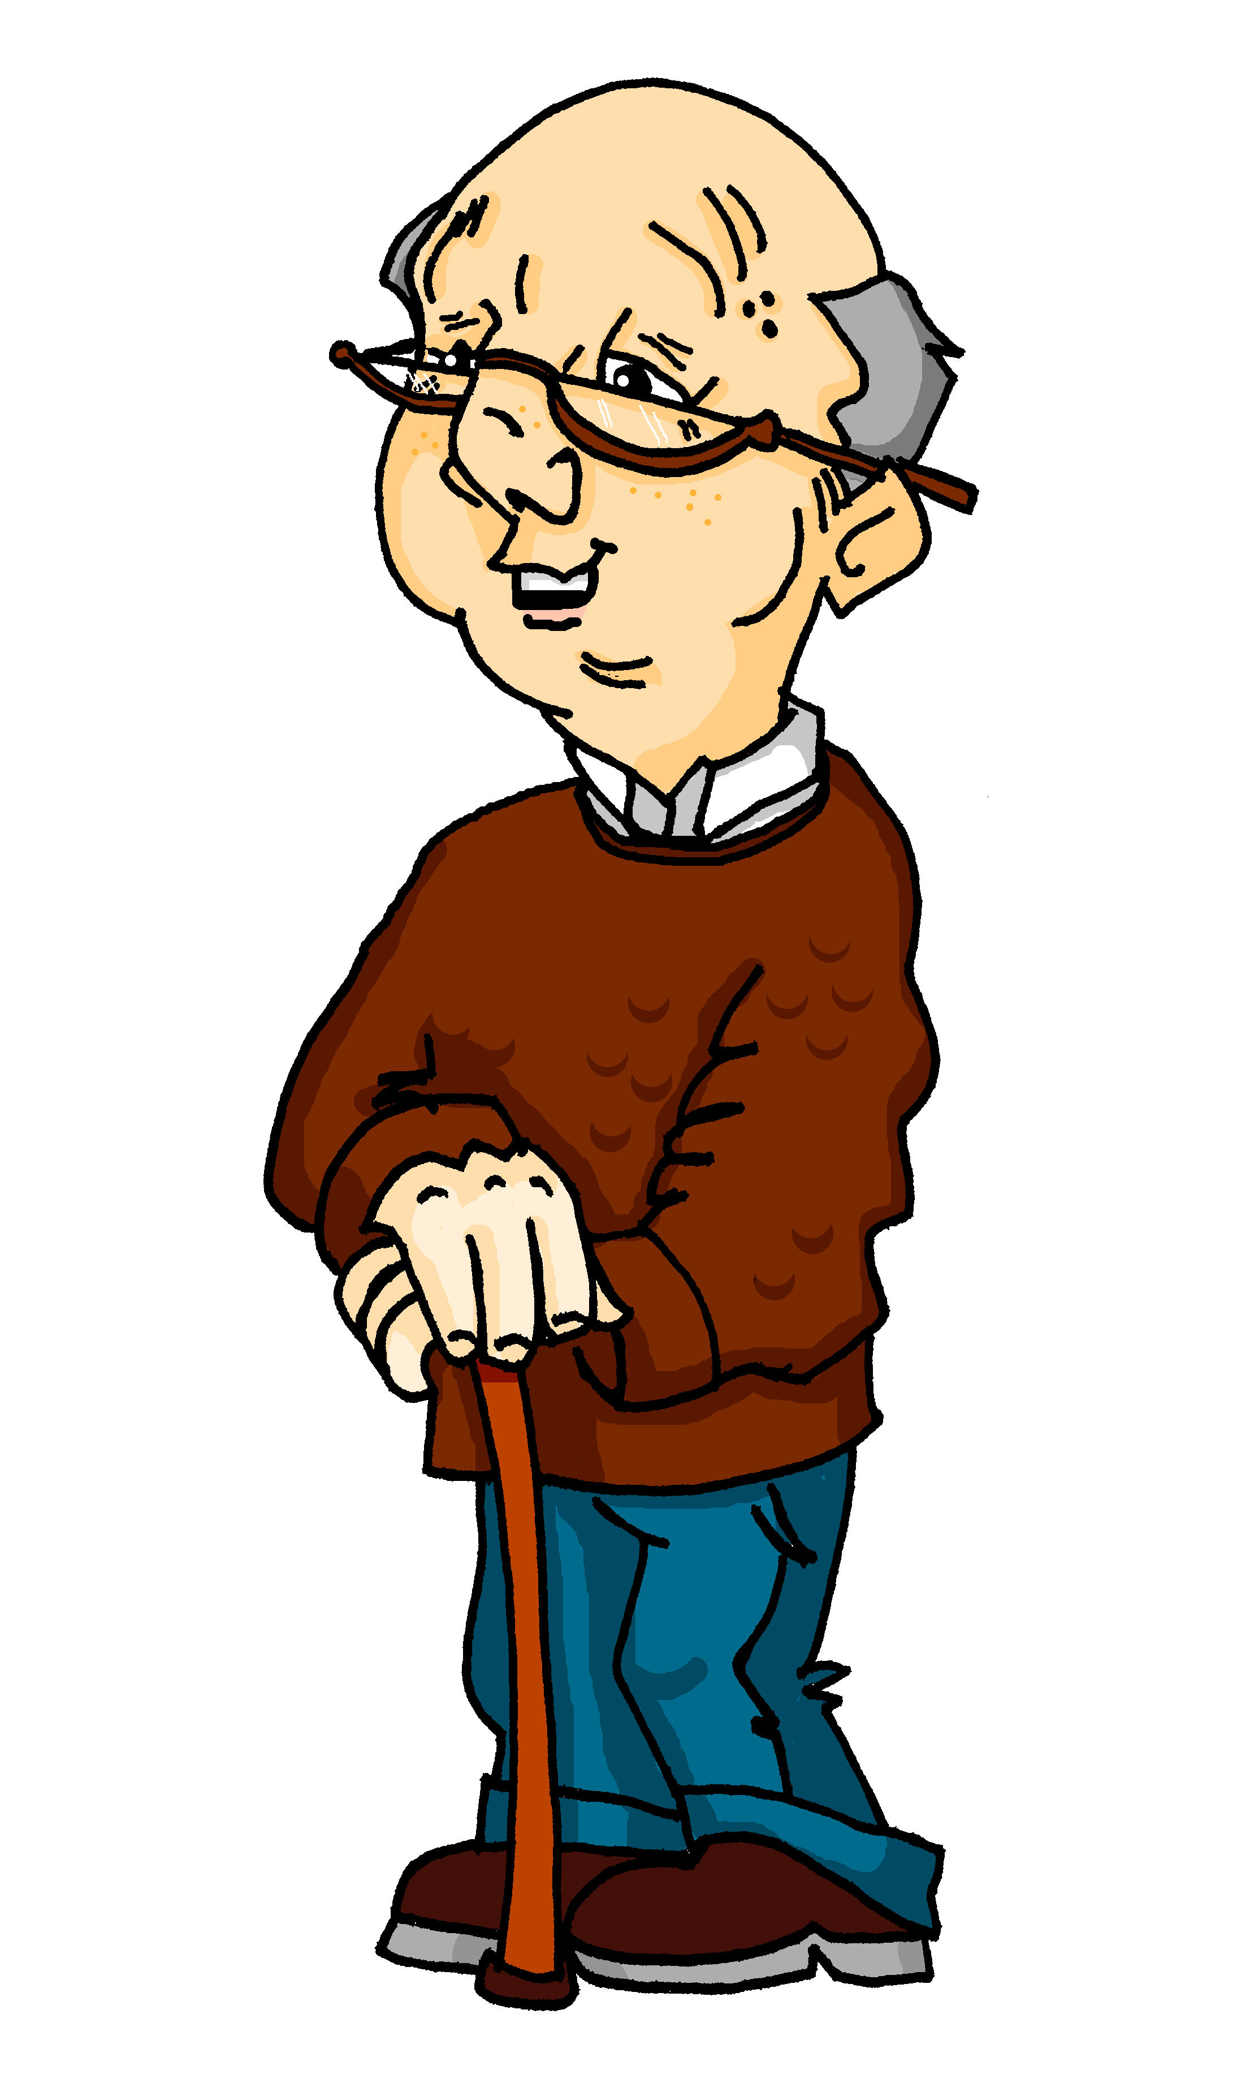
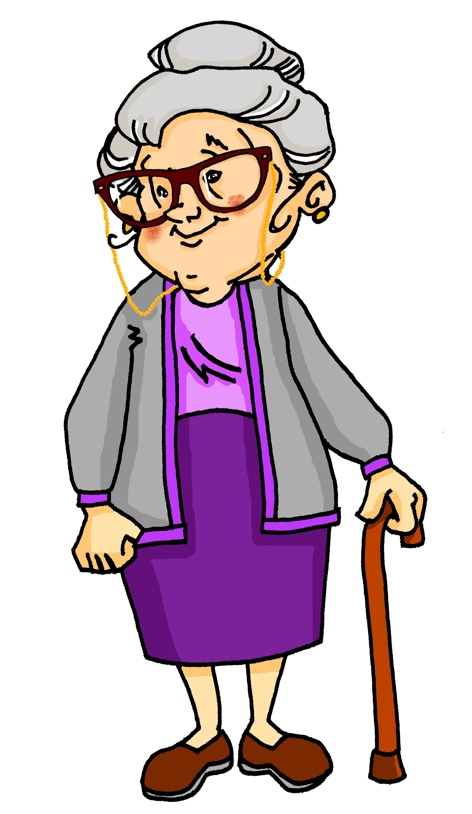
Ein Liebesbrief
schreiben
Schreib den Text auf Deutsch.
* das Fotoalbum – photo album
Dear Hans,
I found an old photo album*. Back then we were still so young. You were nicer and more beautiful than the other boys!
Your hair is greyer now, and your legs are slower, but your eyes are as clear as in earlier times and you are as fun as back then.
We always used to have a lot of fun. This summer with you (and Mia and Wolfgang) was also wonderful.
I loved you back then and I still love you now!
Johanna
Notes:
Timing: 15 minutes Aim: To practise writing the grammar and some vocabulary introduced in this sequence in a wider context. Procedure: 1. Read the text and translate it into German.
2. Check the translation against the one suggested on the next slide.
Word frequency (1 is the most frequent word in German):
noch²³ [33] als² [22] dir [244] vierzig [2907]
Source: Jones, R.L & Tschirner, E. (2019). A frequency dictionary of German: Core vocabulary for learners. London: Routledge.

Slide 25
Antwort
schreiben
Lieber Hans,
Ich habe ein altes Fotoalbum gefunden. Damals waren wir noch so jung. Du warst netter und schöner als die anderen Jungen!
Dein Haar ist jetzt grauer und deine Beine sind langsamer, aber deine Augen sind so klar wie früher und du bist noch so lustig wie damals.
Wir haben früher immer viel Spaß gehabt. Dieser Sommer mit dir (und Mia und Wolfgang) war auch wunderbar.
Ich habe dich damals geliebt und ich liebe dich immer noch!
Johanna

Slide 26
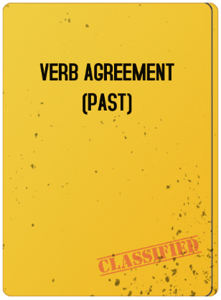
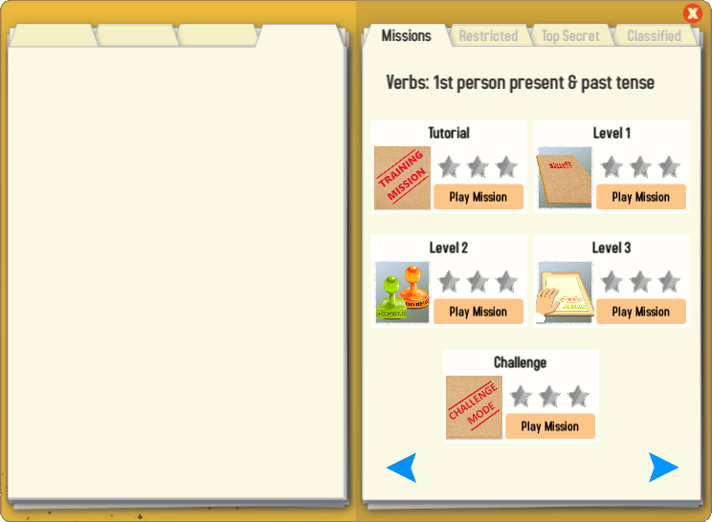
Gaming Grammar
Try the following Gaming Grammar missions to practise:

Slide 27
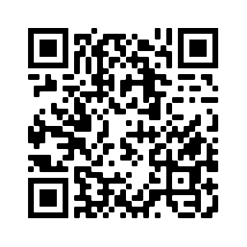
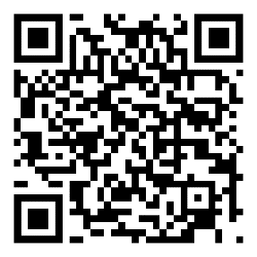
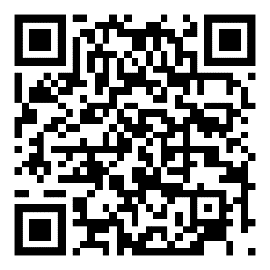
Hausaufgaben
Pre-learning for lesson: Year 8 German Term 2.2 Week 1
Revisit 1: [Year 8 German Term 2.1 Week 2]
Revisit 2: [Year 8 German Term 1.2 Week 2]

Slide 28
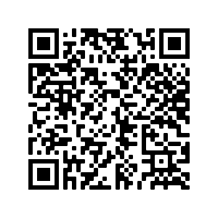
Hausaufgaben
Vocabulary Learning Homework (Y8, Term 2.2, Week 1)
Audio file
Audio file QR code:
Student worksheet
Quizlet link
In addition, revisit: Y8 Term 2.1 Week 2
Y8 Term 1.2 Week 2
Notes:
The answer sheet to this week’s Vocabulary Learning Homework can be found here: https://resources.ncelp.org/concern/resources/dn39x215z?locale=en

