Slide 1
Giving opinions about school
Gustar-type verbs [revisited]
SSC [silent h] [revisited]
Y8 Spanish
Term 2.2 - Week 4 – Lesson 45
Amanda Izquierdo / Nick Avery / Mollie Bentley-Smith Artwork: Mark Davies
Date updated: 24/03/21
Notes:
Artwork by Mark Davies & Steve Clarke. All additional pictures selected are available under a Creative Commons license, no attribution required.
Native-speaker teacher feedback provided by Blanca Román. Thanks to Rachel Hawkes for comments.
Learning outcomes:
Consolidation of gustar-type verbs
Consolidation of indirect object pronouns (me, te, le)
Consolidation of object-first word order
Consolidation of SSC ‘silent h’
Vocabulary to revisit from Y7: a veces [vez-59]; tranquilo [1073]; coche [1190]; también [49]; alegre [2081]; parque [1354]; con [14]; bueno [98]; idioma [1159]; solo/a [95]; pequeño [202]; calle [269]; si [36]; rico [398]; cámara [903]; aunque [131]; famoso [997]; barco [1384]; normalmente [1696]; feo [2373]; clase [320]; siempre [96]; aburrido [3917]; ventana [752]; bastante [308]; perdido [1899]; puerta [274]; seguro [407]; mesa [525]; nervioso [1521]; regalo [1986]; tonto [2379]; libro [230]; alto [231]; actividad [344]; bajo [236]; simpático [3349]; guapo [4192]; activo [1278]; barato [2164]; amiga [1172]; caro [2179]; amigo [210]; antiguo [446]; autor/a [513]; otro [35]; profesor/a [501]; claro [1923]; director/a [592]; moreno [3304]; caballo [907]; amarillo [1381]; chico [727]; chica [1129]; señor [201]; señora [509]; gato [1728] animal [322]; compañero [551]; pájaro [1607]

Slide 2
Fonética
escribir
Escribe las palabras en español.
¿Cuál tiene una vocal y cuál tiene [silent h] + vocal?
[hello]
[computer]
ho
__la
__rdenador
o
Notes:
Phonics and vocabulary [1/8] Timing: 30 seconds per slide (activity total: 4 minutes)
Aim: to revise SSC knowledge and practise vocabulary at the same time.
Procedure: 1. Students write down both words in Spanish. They decide which one only has a vowel and which one has silent ‘h’ + vowel.
Notes:
1. All words used in the activity have been previously taught. Students are expected to recall the spelling here.
2. There is no audio for the activity because students are not using the sound to distinguish between the two words. However, accurate pronunciation of the two words can still modelled by the teacher as part of feedback.

Slide 3
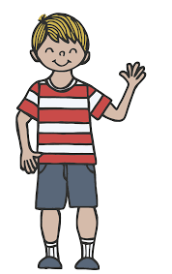
Fonética
escribir
Escribe las palabras en español.
¿Cuál tiene una vocal y cuál tiene [silent h] + vocal?
[German]
[see you later!]
__lemán
a
¡ __sta luego!
ha
Notes:
Phonics and vocabulary [2/8]

Slide 4
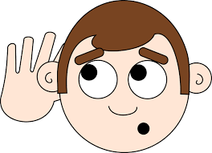
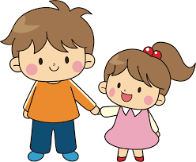
Fonética
escribir
Escribe las palabras en español.
¿Cuál tiene una vocal y cuál tiene [silent h] + vocal?
[to listen, listening]
[brother]
e
__scuchar
he
__rmano
Notes:
Phonics and vocabulary [3/8]

Slide 5
Fonética
escribir
Escribe las palabras en español.
¿Cuál tiene una vocal y cuál tiene [silent h] + vocal?
[to forget, forgetting]
[man]
o
ho
__lvidar
__mbre
Notes:
Phonics and vocabulary [4/8]

Slide 6
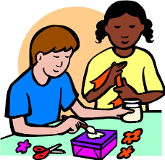
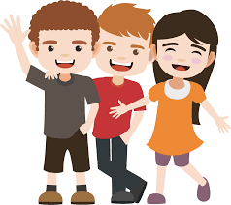
Fonética
escribir
Escribe las palabras en español.
¿Cuál tiene una vocal y cuál tiene [silent h] + vocal?
[to do, to make]
[friend]
ha
__cer
__migo
a
Notes:
Phonics and vocabulary [5/8]

Slide 7
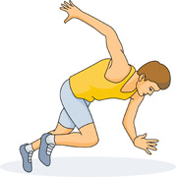
Fonética
escribir
Escribe las palabras en español.
¿Cuál tiene una vocal y cuál tiene [silent h] + vocal?
[beautiful]
[to start, starting]
he
__rmoso
__mpezar
e
Notes:
Phonics and vocabulary [6/8]

Slide 8
Fonética
escribir
Escribe las palabras en español.
¿Cuál tiene una vocal y cuál tiene [silent h] + vocal?
[opinion]
[today]
o
__pinión
ho
__y
Notes:
Phonics and vocabulary [7/8]

Slide 9
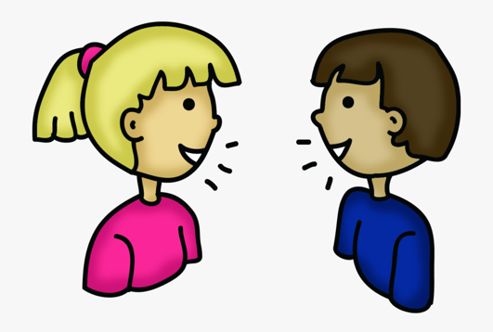
Fonética
escribir
Escribe las palabras en español.
¿Cuál tiene una vocal y cuál tiene [silent h] + vocal?
[to speak, to talk]
[open]
ha
__blar
__bierto
a
Notes:
Phonics and vocabulary [8/8]

Slide 10
Vocabulario
hablar
hablar
feo, fea
famoso, famosa
rico, rica
barato, barata
pequeño, pequeña
bajo, baja
alto, alta
seguro, segura
small
cheap
short, low
ugly
rich
sure, safe
tall, high
famous
Notes:
Vocabulary [slide 1/3]
Timing: 4 minutes (do either slides 10 and 12 OR 11 and 12)
Aim: to consolidate students’ knowledge of Y7 vocabulary through recognition (slides 10-11) and then productive recall (slide 12)
Procedure:
Click to reveal the English.
Students say out loud the word in Spanish from the selection.
Notes: teachers may wish to proceed to slide 12 if they think that students will immediately be able to recall this Year 7 vocabulary from memory.
Note that ‘seguro’ includes the additional meaning of ‘safe’ which was introduced early in Year 8.

Slide 11
leer
rich
famous
ugly
cheap
small
tall, high
short
sure, safe
rico, rica
feo, fea
alto, alta
rich
ugly
barato, barata
tall
bajo, baja
famoso, famosa
seguro, segura
cheap
pequeño, pequeña
short
famous
safe
small
Notes:
Vocabulary [slide 2/3]
Procedure:
1. Give students 30 seconds to consider the options, then remove these with a click of the mouse
2. Students write the translation into English of the 8 words.

Slide 12
Vocabulario
change
escribir
rich
cheap
ugly
famous
barato, barata
famoso, famosa
rico, rica
feo, fea
small
tall, high
short
sure, safe
pequeño, pequeña
seguro, segura
alto, alta
bajo, baja
Notes:
Vocabulary [slide 3/3]
Procedure:
1. Students write the word in Spanish for the eight vocabulary items.

Slide 13
Saying who is affected by the verb: Indirect object pronouns ‘me’, ‘te’, ‘le’
gramática
Remember that an indirect object is the person or thing that is indirectly affected by the verb.
me
If the person affected by the action is ‘me’, use _____.
If the person affected by the action is ‘you’, use ____.
te
If the person affected by the action is ‘him, ‘her’ or ‘it’, use ___.
le
before
In Spanish, indirect object pronouns go __________ a conjugated verb.
Notes:
Grammar recap (slide 1/2)
Timing: 1 minute
Aim: to recap indirect object pronouns ‘me’, ‘te’, ‘le’.
Procedure:
Go through the grammar explanation with students, revealing each new sentence on a mouse click.

Slide 14
Describing one vs more than one thing -AR verbs in 3rd person [revisited]
gramática
Sometimes the subject is singular (e.g. ‘it’). Sometimes it is plural (‘they’).
-a
To refer to ‘it’ with a present tense –ar verb, use the verb ending ______.
-an
To refer to ‘they’ with a present tense –ar verb, use the verb ending _____.
Compare:
El coche me interesa.
The car interests me.
Los coches me interesan.
The cars interest me.
As you know, verbs like ‘interesar’ are very often used with an indirect object pronoun!
Notes:
Grammar recap (slide 2/2)
Timing: 2 minutes
Aim: to recap the rules on the use of the –a vs –an endings for singular vs plural subjects.
Procedure:
Go through the grammar explanation with students, revealing each new sentence on a mouse click.
After revealing the final callout, see if students can remember any of the other verbs introduced last week (8.2.2.3). These include: gustar, encantar, alegrar, importar, molestar, preocupar.

Slide 15
Daniel da su opinión sobre cosas en la escuela. Nadia también.
leer
Completa la frase con ‘a’ o ‘b’ y el pronombre en inglés.
sujeto | ¿Cómo termina la frase? | me | you | him/her/it
1. Los profesores nerviosos... | me preocupa a veces. me preocupan a veces.
2. Tu amiga guapa... | le interesa porque le da ideas. le interesan porque le dan ideas.
3. Las personas aburridas... | te molestan siempre. te molesta siempre.
4. ¡El director simpático... | me encantan! me encanta!
5. Los libros perdidos... | le preocupa porque le importa le preocupan porque le importan.
6. El chico tonto... | te gusta. te gustan.
Notes:
Timing: 8 minutes.
Aim: to consolidate understanding of subject-verb agreement and indirect object pronouns ‘me’, ‘te’ and ‘le’ in the written modality
Procedure: 1. Students read each sentence and decide which option is correct depending on the subject.
2. Students also decide whether the action affects ‘me’, ‘you’ or ‘him/her/it’. In giving instructions for this part, the teacher should check that students understand that the English pronoun is based on the Spanish pronoun in the sentence ending (not any of the people mentioned as subjects in the first column).
3. Understanding of the sentences can be checked via oral translation into English or by using the next two slides, which display the English translation.
4. Use slide 17 to introduce the new, additional translations of ‘gustar’ and ‘encantar’.

Slide 16
Las traducciones de las frases
leer
[1/2]
Español | Inglés
1. Los profesores nerviosos me preocupan a veces.
2. Tu amiga guapa le interesa porque le da ideas.
3. Las personas aburridas te molestan siempre.
(The) nervous teachers worry me / are a worry for me sometimes.
Your good-looking friend (f) interests him/her because she gives him/her ideas.
(The) boring people always annoy you.
Notes:
Slide 2/2
See previous slide for full instructions.

Slide 17
Las traducciones de las frases
leer
[2/2]
Español | Inglés
4. ¡El director simpático me encanta!
5. Los libros perdidos le preocupan porque le importan.
6. El chico tonto te gusta.
The nice headteacher delights me!
OR I love the nice headteacher!
You can also use ‘to love’ to translate ‘encantar’. The object of ‘encantar’ (e.g. ‘me’) is the subject of ‘to love’ in English (e.g. I).
The lost books worry him/her because they matter to him/her.
The silly boy pleases you.
OR You like the silly boy.
You can also use ‘to like’ to translate ‘gustar’. The object of ‘gustar’ is the subject of ‘to like’.
Notes:
Slide 3/3
See slide 15 for full instructions
Note: students will immediately be practising translation of ‘gustar’ and ‘encantar’ in subsequent activities, so a concise explanation here is sufficient.

Slide 18
Nadia habla sobre la escuela
Doy mi opinión.
escuchar
[1/2]
Escucha las frases y elige ‘A’ o ‘B’ según el verbo.
Luego, escucha otra vez. Traduce la frase al inglés.
 |  | A | B
 | It pleases me (I like it). | la clase de alemán | las clases de alemán
 | They delight me (I love them). | los idiomas | el idioma
 | They don’t interest me / aren’t of interest to me. | la clase de música | las clases de música
 | She doesn’t worry me / isn’t a worry for me. | la profesora | las profesoras
1
2
3
4
Notes:
Slide 1/2
Timing: 7 minutes
Aim: to consolidate understanding of subject-verb agreement in listening; to consolidate understanding of gustar-type verbs and how they translate into English
Procedure:
Students write 1-4 in their books.
They listen and write ‘A’ or ‘B’ depending on the verb form they hear.
They listen again and translate the sentence that they hear. This encourages them to consider the new translations of ‘gustar’ and ‘encantar’ and to practise changing the word order from English to Spanish. The subject in column A or B also shows students the biological gender of the subject (e.g. la profesora in item 4 shows that ‘she’ is needed in the translation, rather than ‘he’ or ‘it’).
Clicking reveals the answer ‘A’ or ‘B’, and then reveals the translation of the opinion. It may be useful to draw students’ attention to the fact that they are hearing full sentences (e.g. ‘Me gusta’ as ‘I like it’). This is an aspect of cross-linguistic difference between English and Spanish.
Click to bring up the next slide (items 5-8 of the same activity).
Notes: the indirect object pronoun is ‘me’ in items 1-4 and ‘le’ in 5-8, so that students can practise translating two different pronouns. The teacher may wish to draw attention to this by using the speech bubbles and titles. The activity also leads into the following activity (slide 21) by using extracts from it.
Transcript (items 5-8 on next slide):
1. Me gusta.
2. Me encantan.
3. No me interesan.
4. No me preocupa.

Slide 19
Nadia da la opinión de Daniel
Ahora hablo sobre Daniel.
escuchar
[2/2]
 |  | A | B
 | They interest him / are of interest to him. | la clase de francés | las clases de francés
 | They annoy him / bother him. | las actividades de pronunciación | la actividad de pronunciación
 | They aren’t important to him / don’t bother him. | el profesor aburrido | los profesores aburridos
 | He makes him happy. | los compañeros simpáticos | un compañero simpático
5
6
7
8
Notes:
Slide 2/2
Transcript
5. Le interesan.
6. Le molestan.
7. No le importan.
8. Le alegra.

Slide 20
Subject and object-first sentences
gramática
Remember, in Spanish the subject (‘the doer’) can either come at the start or at the end of the sentence.
For example:
Me gusta la actividad.
The activity pleases me.
(I like the activity)
La actividad me gusta.
The meaning of the two sentences is the same. There is just a little more emphasis on ‘activity’ in the second one.
Notes:
OPTIONAL
The text on the next slide contains subject and object-first sentences, as does the final speaking activity. Although both word orders were covered in recent weeks of the SoW, teachers may wish to very briefly recap this here.
The example can also be used to reinforce understanding of how ‘gustar’ may translate as ‘like’.

Slide 21
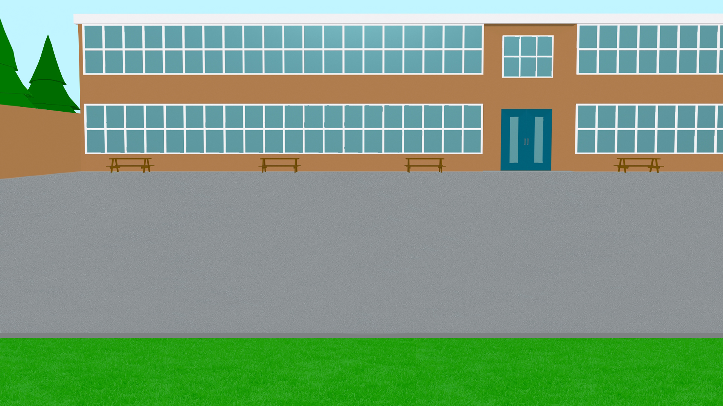
leer
Nadia habla sobre la escuela. Primero da su propia opinión y luego da la opinión de Daniel. Lee el texto y contesta las preguntas de tu profesor/a.
Mi opinión:
Me gusta la clase de alemán porque me encantan los idiomas. Las clases de música no me interesan, aunque la profesora no me preocupa porque normalmente está muy alegre.
La opinión de Daniel:
Las clases de francés le interesan mucho, pero le molestan las actividades de pronunciación porque son difíciles. No le importan los profesores aburridos porque un compañero simpático le alegra. Le gusta la mesa al lado de la ventana, siempre está allí porque le encantan los pájaros.
Notes:
Timing: 6 minutes.
Aim: to understand gustar-type verbs and vocabulary in a longer, more detailed text
Procedure: 1. To ensure understanding of the information in the text, do one of the following or use another preferred task: i. whole class oral English translation, phrase by phrase ii. Individual summary of the text, with the instruction – Note two key facts from the first paragraph and three from the second paragraph about school. ii. Ask direct questions to elicit the key information. 1. What does Nadia say about German lessons? (why does she think this?) 2. How does Nadia feel about the music teacher? Why? 3. How does Daniel feel about French classes? Which parts are hard? 4. Why aren’t boring teachers a problem? 5. What do we find out about where Daniel sits? 6. What reason does he give?

Slide 22
escribir
¡Cambiamos el texto! Puedes elegir palabras de la lista para cambiar las palabras del texto.
Lista de palabras
español inglés arte es/son activo/a tranquilo/a vocabulario fácil/fáciles divertidos/as bueno puerta árboles no
Me gusta la clase de alemán porque me encantan los idiomas. Las clases de música no me interesan, aunque la profesora me gusta mucho porque normalmente está muy alegre.
Las clases de francés le interesan mucho, pero le molestan las actividades de pronunciación porque son difíciles. No le importan los profesores aburridos porque un compañero simpático le alegra. Le gusta la mesa al lado de la ventana, siempre está allí porque le encantan los pájaros.
Notes:
Timing: 8 minutes.
Aim: to consolidate understanding of Y7 vocabulary items by using them to alter the text; to apply known gender and number agreement rules to nouns and adjectives.
Procedure: 1. Students substitute words in the text using the words on the list (or other words), making sure that gender and number agreement is correct.
2. This is a creative activity with a number of possible answers, so an answer slide is not given. However, some possible replacements are listed below.
3. The teacher may also wish to encourage students to change the verbs used (e.g. gustar for encantar) and consider how this affects meaning (whether the rest of the sentence is still sensible).
Possible replacements in text 1:
Me gusta la clase de español/inglés.
Las clases de arte no me interesan, aunque la profesora me gusta mucho porque normalmente está muy activa/tranquila.
Possible replacements in text 2:
No le molestan las actividades de vocabulario porque son divertidas/fáciles.
No le importan los profesores aburridos porque un buen compañero le alegra.
Le gusta la puerta al lado de la ventana, siempre está allí porque le encantan los árboles.

Slide 23
hablar
Leemos un texto con opiniones de la escuela.
Estudiante A: lee el texto, debes cambiar las frases de inglés a español.
Estudiante B: completa la tabla.
Ejemplo:
Estudiante A
Estudiante B
_________________ las clases de español porque ______________ la pronunciación.
Completa las frases
Spanish classes _______ ___. (I _______________________.)
2. The pronunciation ________ ___. (I ________________________.)
[They delight me]
delight me
[it pleases me]
love Spanish classes
pleases me
like the pronunication
Notes:
Timing: 10 min
Aim: to produce ‘gustar’-type verbs in the oral modality; to recap Y7 vocabulary.
Procedure:
In pairs, student A reads out the text translating the English phrases into Spanish.
Student B listens and completes the table.
Students swap roles.
Feedback can be given using slide 26. Each English translation appears on a click. The feedback slide includes both the Spanish sentence that students hear and the English answer, to allow for comparison.

Slide 24
hablar
Estudiante A
_____________________ la clase de alemán porque _______________ los idiomas. Las clases de ciencias ___________________, aunque la profesora _________________ mucho porque normalmente no está alegre. Las clases de francés __________________ porque __________________ las actividades de pronunciación.
Completa las frases
1. (The) nice teachers…
2. A boring classmate (m)…
3. Texts in English…
4. Activities in German… OR He…
5. The table near the window… OR…
6. (The) nature…
[It makes me happy]
[they interest me]
[they don’t worry me]
[she annoys me]
[they delight me]
[they please me]
Notes:
DO NOT DISPLAY DURING THE TASK This is the printable handout for Student A.

Slide 25
hablar
Estudiante B
________________ los profesores simpáticos aunque un compañero aburrido ________________. Los textos en inglés ________________, pero las actividades de alemán ________________. La mesa cerca de la ventana ___________________, siempre está allí porque ______________________ la naturaleza.
Completa las frases
1. The German class...
2. Languages…
3. Science classes…
4. The teacher (f)…
5. French classes… OR I…
6. Pronunciation activities… OR I…
[They interest him]
[he annoys him]
[they worry him]
[they delight him]
[it pleases him]
[it makes him happy]
Notes:
DO NOT DISPLAY DURING THE TASK This is the printable handout for Student B.

Slide 26
Solución
Estudiante A - Solución
Estudiante B - Solución
1. (The) nice teachers interest him/her.
1. The German class makes me happy.
Le interesan los profesores simpáticos.
Me alegra la clase de alemán.
2. A boring classmate (m) annoys him/her.
2. Languages interest me.
Un compañero aburrido le molesta.
Me interesan los idiomas.
3. (The) texts in English worry him/her.
3. Science classes don’t worry me.
Los textos en inglés le preocupan.
Las clases de ciencias no me preocupan.
4. (The) activities in German delight him/her.
4. The teacher (f) annoys me.
OR
S/he loves (the) German activities.
La profesora me molesta.
Las actividades en alemán le encantan.
5. French classes delight me.
5. The table near the window pleases him/her.
OR
I love French classes.
OR
S/he likes the table near the window.
Las clases de francés me encantan.
La mesa cerca de la ventana le gusta.
6. (The) pronunciation activities please me.
6. (The) nature makes him/her happy.
OR
I like (the) pronunciation activities.
Le alegra la naturaleza.
Me gustan las actividades de pronunciación.
Notes:
SOLUCIÓN

Slide 27
Saying who does what to whom
Object-first word order
SSC [silent h] [revisited]
Y8 Spanish
Term 2.2 - Week 4 – Lesson 46
Amanda Izquierdo / Nick Avery / Victoria Hobson Artwork: Mark Davies
Date updated: 24/03/21
Notes:
Artwork by Mark Davies & Steve Clarke. All additional pictures selected are available under a Creative Commons license, no attribution required.
Native-speaker teacher feedback provided by Blanca Román. Thanks to Rachel Hawkes for comments.
Learning outcomes:
Consolidation of gustar-type verbs
Consolidation of indirect object pronoun ‘le’
Consolidation of object-first word order
Consolidation of SSC ‘silent h’
Vocabulary to revisit from Y7: a veces [vez-59]; tranquilo [1073]; coche [1190]; también [49]; alegre [2081]; parque [1354]; con [14]; bueno [98]; idioma [1159]; solo/a [95]; pequeño [202]; calle [269]; si [36]; rico [398]; cámara [903]; aunque [131]; famoso [997]; barco [1384]; normalmente [1696]; feo [2373]; clase [320]; siempre [96]; aburrido [3917]; ventana [752]; bastante [308]; perdido [1899]; puerta [274]; seguro [407]; mesa [525]; nervioso [1521]; regalo [1986]; tonto [2379]; libro [230]; alto [231]; actividad [344]; bajo [236]; simpático [3349]; guapo [4192]; activo [1278]; barato [2164]; amiga [1172]; caro [2179]; amigo [210]; antiguo [446]; autor/a [513]; otro [35]; profesor/a [501]; claro [1923]; director/a [592]; moreno [3304]; caballo [907]; amarillo [1381]; chico [727]; chica [1129]; señor [201]; señora [509]; gato [1728] animal [322]; compañero [551]; pájaro [1607]

Slide 28
Un mensaje
hablar / escuchar / escribir
Persona A: Lee el texto a tu compañero.
Persona B: Sin mirar la pizarra*, escucha y escribe cada palabra con [silent h].
*board
Persona A
Persona B
¡Hola, amigo! Hoy en la escuela tengo clases de idiomas, hablamos alemán y español. Quiero hacer deporte también pero ¡el profesor está en el hospital! Sufrió un accidente.
¿Qué haces Hugo? Es un día hermoso. ¿Vas a escuchar música y comer helados en la playa con los amigos? Es una idea muy buena. ¡Hasta luego!
Notes:
Timing: 6 minutes
Aim: a paired read aloud task to practise oral production and recognition of words containing the SSC [silent h] at text level.
Procedure:
1. Ask the students to read the instructions and check their understanding. At this point, advise student B to turn away from the board.
2. Click to bring up the text for student A.
3. Student A reads the text to student B who writes all the words containing SSC [silent h].
4. Click again to hide the text that was just used.
5. Students then swap roles.
6. Teachers can use the answer slide (next slide) to bring the activity to a close. Elicit the meanings of the target words in English.
7. Teachers may also want to ask students to consider the meanings of the texts as a whole before moving on. Give pairs a minute per text and then take feedback.
Note: ‘hospital’ was used as a Y7 phonics word. ‘Pizarra’ has not been taught in the SoW so a gloss is provided.
Frequency of unknown/glossed words:
hospital [1050]; pizarra [>5000]

Slide 29
Solución
hablar / escuchar / escribir
Persona A
Persona B
haces
hola
Hugo
hoy
hermoso
hablamos
helados
hacer
hasta luego
hospital
Notes:
Answer slide.

Slide 30
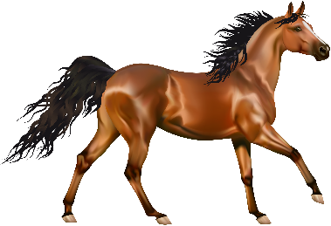
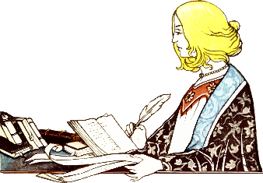
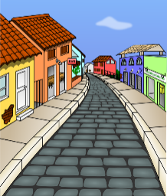
¿Cómo se dice en español?
el b_ _ _ _
7.
el barco
barato
1.
b_ _ _ _ _
[cheap]
solo
8.
s_ _ _
[alone]
el caballo
2.
el c_ _ _ _ _ _ _
el s_ _ _ _
c_ _ _ _
9.
el señor
[Mr., man]
3.
claro
[clear]
[dark-haired/skinned, tanned]
la autora
m_ _ _ _ _
10.
la a_ _ _ _ _
moreno
[author (f)]
4.
a _ _ _ _ _ _ _
otro
amarillo
11.
o_ _ _
[another]
5.
[yellow]
la calle
la c_ _ _ _
s_
6.
[street]
12.
si
[if]
Notes:
Vocabulary recall activity
Timing: 5 min.
Aim: To recall previously taught vocabulary, including words from lesson 1, that will be used in this lesson.
Procedure:
1. The teacher asks students to try to say the word in Spanish represented by each image/English word. To encourage learners to recall this vocabulary only the first letter of each word is provided.
2. Students can be prompted to provide both the masculine and feminine forms of moreno, amarillo, solo and otro.

Slide 31
Vocabulario
Opciones
Escribe las palabras en español en la frase correcta.
¡Atención! No necesitas todas las palabras.
yellow
alone
moreno
1. Daniel va mucho a la playa, así que está _________.
cheap
clear
calle
2. El teatro y la escuela están en la misma __________.
tanned
Mr., man
caballo
3. El __________ es un animal muy fuerte.
other
if
claro
4. Hoy no hay lluvia y el cielo está __________.
author (f)
street
barco
5. Siempre viajamos a la isla en __________.
horse
boat
autora
6. La __________ escribe muchos libros.
barato
7. Compra un móvil __________ porque no tiene mucho dinero.
solo
8. Hugo y Nadia no estudian juntos, Hugo siempre estudia ______.
Notes:
Vocabulary recall activity
Timing: 5 min.
Aim: to recall previously taught vocabulary and use it in the correct sentence.
Procedure:
1. Students write the most appropriate word from the previous activity in each gap.

Slide 32
Saying who is affected by the verb Indirect object pronoun ‘le’
gramática
If the person indirectly affected by the verb is ‘him’, ‘her’ or ‘it’, use ___.
le
They matter to her/him/it.
Le importan.
They scare him/her/it.
Le dan miedo.
In context, we normally know who this person is! For example, we might hear a person’s name in a previous sentence.
Notes:
Timing: 2 minutes
Aim: to recap meanings and function of the indirect object pronoun ‘le’.
Procedure:
Click to bring up each part of the explanation.
In the examples, the English sentence appears first so that teachers can elicit the translation from students.
Note: In Year 9, students will also learn about the use of disjunctive object pronouns to make the referent of ‘le’ clear (e.g. A ella le da miedo). Because students have so far only studied ‘él’ and ‘ella’ as subject pronouns, we leave further explanation of this until later.

Slide 33
Object-first word order and personal ‘a’ [revisited]
gramática
subject
object
As you know, Spanish sentences can start with the _________ or with the ________.
SUBJECT
VERB
OBJECT
El chico
la chica
_________ le trae chocolate a __________.
The boy brings the girl chocolate.
la chica
el chico
A _________ le trae chocolate _________.
OBJECT
VERB
SUBJECT
Remember, this ‘le’ has no translation in English.
Remember, the personal ‘a’ is used before / after the object when it is a living thing.
Notes:
Timing: 2 minutes
Aim: to recap object-first word order and personal ‘a’.
Procedure:
The teacher goes through the grammar explanation with students, revealing each new sentence on a mouse click.
Answers can be elicited from students where there are gaps or answers to circle.

Slide 34
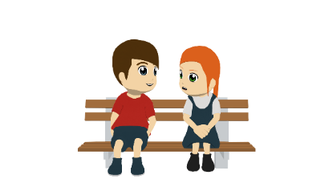
Cosas de hermanos
leer
Lee las frases sobre Lucía y Daniel.
¿Cuál es la opción correcta? Escribe por qué.
[1/2]
 | Frases | Opciones | ¿Por qué (en inglés)?
1 | A veces a Daniel le molesta Lucía. Le tira agua y le quita el móvil. | Daniel annoys Lucía. Lucía annoys Daniel.
2 | Lucía le preocupa a Daniel porque no va a lugares seguros. | Lucía worries Daniel. Daniel worries Lucía.
3 | A Daniel le alegra Lucía porque siempre le ofrece ayuda con los deberes. | Daniel makes Lucía happy. Lucía makes Daniel happy.
4 | A Lucía le interesa Daniel porque le enseña cómo usar la cámara antigua. | Daniel interests Lucía. Lucía interests Daniel.
Because she throws water at him and takes his phone away.
Because she doesn’t go to safe places.
Because she always offers him help with homework.
Because he teaches her how to use the old camera.
Notes:
Timing: 8 minutes (slides 34-35)
Aim: to direct attention to personal ‘a’ to work out subject and object roles in SVO and OVS sentences; to understand other vocabulary in the sentences.
Procedure:
The teacher can ask students what they think ‘cosas de hermanos’ might refer to. ‘Hermanos’ here refers to ‘brothers and sisters’. The image can be used to highlight this.
Students read each sentence in Spanish and try to figure out the correct option for each one, ‘A’ or ‘B’.
Students write the reason why in English in the third column.
Notes: teachers may wish to either keep or remove the images, depending on the group. They provide some support for the translation part.

Slide 35
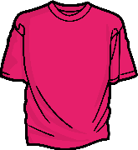
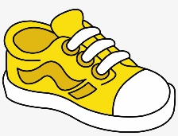
Cosas de hermanos
leer
[2/2]
 | Frases | Opciones | ¿Por qué (en inglés)?
5 | A Daniel le alegra Lucía porque le regala ropa cara y zapatos. | Daniel makes Lucía happy. Lucía makes Daniel happy.
6 | Daniel le da rabia a Lucía porque nunca le compra regalos. | Lucía makes Daniel angry. Daniel makes Lucía angry.
7 | A Daniel le molesta Lucía porque no le permite escuchar música fuerte. | Lucía annoys Daniel. Daniel annoys Lucía.
8 | Daniel le da risa a Lucía porque le dice cosas divertidas. | Lucía makes Daniel laugh. Daniel makes Lucía laugh.
Because she gives expensive clothes and shoes to him (as a gift).
Because he never buys her gifts.
Because she does not allow him to listen to loud music.
Because he says funny things to her.
Notes:
Slide 2/2

Slide 36
escuchar / leer
Ahora escucha las frases.
Marca la opción correcta y completa la frase.
[1/2]
 | a) Daniel makes Lucía laugh. b) Lucía makes Daniel laugh.
 | a) Lucía gives Daniel encouragement. b) Daniel gives Lucía encouragement.
 | a) Lucía worries Daniel. b) Daniel worries Lucía.
 | a) Daniel makes Lucía sad. b) Lucía makes Daniel sad.
¿Cómo termina la frase?
1
…porque no le habla.
3
…porque a veces olvida su cumpleaños.
4
2
…porque le hace gestos graciosos en clase.
1
3
4
…si no gana el partido.
2
Notes:
Timing: 8 minutes
Aim: to focus students’ attention on personal ‘a’ to determine subject and object roles; to consolidate understanding of vocabulary
Procedure:
1. Teachers clicks the number trigger to play the audio.
2. Students listen to each phrase and decide which is the correct option, ‘A’ or ‘B’.
3. They then match the sentence starter to the the correct ending. 4. During feedback, teachers can elicit the English meaning of the sentence endings.
Transcript:
A Daniel le da risa Lucía.
Lucía le da ánimo a Daniel.
A Lucía le preocupa Daniel.
Daniel le da tristeza a Lucía.

Slide 37
escuchar / leer
[2/2]
 | a) Daniel annoys Lucía. b) Lucía annoys Daniel.
 | a) Daniel makes Lucía happy. b) Lucía makes Daniel happy.
 | a) Lucía makes Daniel sleepy. b) Daniel makes Lucía sleepy.
 | a) Daniel makes Lucía embarrassed. b) Lucía makes Daniel embarrassed.
¿Cómo termina la frase?
…porque a veces le da regalos.
6
5
…porque le envía comentarios tontos en las redes sociales.
6
8
…cuando habla sobre cosas aburridas.
7
7
8
…porque le quita el ordenador.
5
Notes:
Slide 2/2
Transcript:
5) A Daniel le molesta Lucía.
6) Lucía le alegra a Daniel.
7) A Daniel le da sueño Lucía.
8) Daniel le da vergüenza a Lucía.

Slide 38
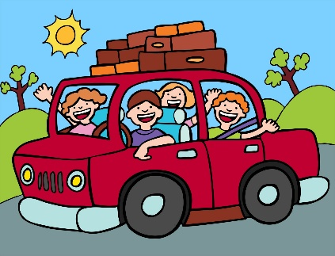
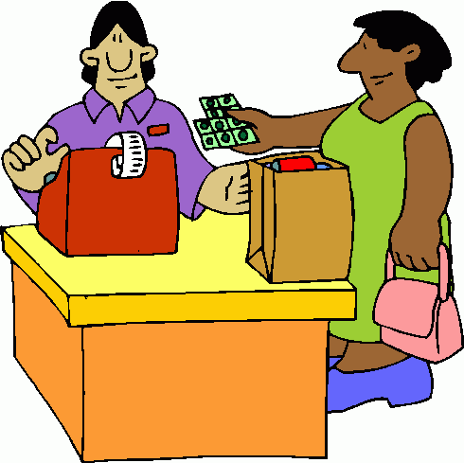
¿Cómo se dice en español?
A
[trip]
B
C
to look after, looking after
to organise, organising
el viaje
cuidar
organizar
D
E
F
la camisa
la ropa
comprar
[clothes]
[to buy, buying]
G
H
I
during
durante
el regalo
to bring, bringing
traer
Notes:
Timing: 2 minutes
Aim: to encourage productive recall of vocabulary items that will appear in the final production activity.
Procedure:
Elicit each Spanish word from students by using the prompts.
Each click brings up the Spanish word in alphabetical order.
Note: These vocabulary items were all previously taught in the SoW but did not appear earlier in this lesson.

Slide 39
hablar
Daniel y Lucía viajan en España con su clase. Lucía viaja a Málaga en marzo y Daniel viaja a Galicia en abril. ¿Qué hace cada uno?
Estudiante A habla: lee las frases en español. Debes empezar las frases con ‘Lucía...’ o ‘a Lucía...’.
Use ‘Lucía…’ if she is the ‘doer’.
Use ‘a Lucía…’ if she is the ‘receiver’.
Estudiante B escucha: escribe la información en la tabla.
Ejemplo:
Lucía le envía fotos a Daniel.
Estudiante A
Estudiante B
1) Lucía sends photos to Daniel.
What Lucía does to Daniel | What Daniel does to Lucía
Lucía sends photos to Daniel
¿Cómo empiezas la frase: ‘Lucía...’ o ‘a Lucía...’?
Notes:
Timing: 12 min.
Aim: to produce and understand OVS and SVO sentences with ‘personal a’ in the oral modality.
Procedure:
Student A reads out the 8 cards in Spanish, considering whether or not to use ‘personal a’ at the start of the sentence. Sentences must start with ‘Lucía...’ or ‘A Lucía...’.
Student B notes down the information in the correct column.
Students swap roles.
Student B reads out the 8 cards in Spanish, considering the use of the ‘personal a’ where necessary. Sentences must start with ‘Daniel...’ or ‘A Daniel...’.
Use slides 42-43 for feedback. The feedback slide includes both the Spanish sentence that students hear and the English answer, to allow for comparison.

Slide 40
Estudiante A
¿Cómo empiezas la frase: ‘Lucía...’ o ‘a Lucía...’?
What Lucía does to Daniel | What Daniel does to Lucía
1) Lucía sends photos to Daniel.
2) Daniel writes to Lucía.
3) Lucía buys gifts for Daniel.
4) Daniel looks after the cat for Lucía.
5) Lucía annoys Daniel a lot.
6) Daniel gives Lucía ideas for the trip.
7) Daniel organises a party for Lucía.
8) Lucía brings back a shirt for Daniel.
Notes:
PROMPT CARDS - DO NOT DISPLAY DURING ACTIVITY
1. Lucía le envía fotos a Daniel.
2. A Lucía le escribe Daniel.
3. Lucía le compra regalos a Daniel.
4. A Lucía le cuida el gato Daniel.
5. Lucía le molesta mucho a Daniel.
6. A Lucía le da ideas para el viaje Daniel.
7. A Lucía le organiza una fiesta Daniel.
8. Lucía le trae una camisa a Daniel.

Slide 41
Estudiante B
¿Cómo empiezas la frase: ‘Daniel...’ o ‘a Daniel...’?
What Lucía does to Daniel | What Daniel does to Lucía
1) Daniel sends photos to Lucía.
2) Lucía writes to Daniel.
3) Daniel buys gifts for Lucía.
4) Lucía looks after the cat for Daniel.
5) Daniel annoys Lucía a lot.
6) Lucía gives Daniel ideas for the trip.
7) Lucía organizes a party for Daniel.
8) Daniel brings back clothes for Lucía.
Notes:
PROMPT CARDS - DO NOT DISPLAY DURING ACTIVITY
1. Daniel le envía fotos a Lucía.
2. A Daniel le escribe Lucía.
3. Daniel le compra regalos a Lucía.
4. A Daniel le cuida el gato Lucía.
5. Daniel le molesta mucho a Lucía.
6. A Daniel le da ideas para el viaje Lucía.
7. A Daniel le organiza una fiesta Lucía.
8. Daniel le trae ropa a Lucía.

Slide 42
Estudiante A Solución
What Lucía does to Daniel | What Daniel does to Lucía
Lucía writes to Daniel.
Daniel sends photos to Lucía.
A Daniel le escribe Lucía.
Daniel le envía fotos a Lucía.
Lucía looks after the cat for Daniel.
Daniel buys gifts for Lucía.
A Daniel le cuida el gato Lucía.
Daniel le compra regalos a Lucía.
Lucía gives Daniel ideas for the trip.
Daniel annoys Lucía a lot.
A Daniel le da ideas para el viaje Lucía.
Daniel le molesta mucho a Lucía.
Lucía organises a party for Daniel.
Daniel brings back clothes for Lucía.
A Daniel le organiza una fiesta Lucía.
Daniel le trae ropa a Lucía.
Notes:
ANSWERS – Display during Feedback
Sentences corresponding to Student A answers:
Daniel le envía fotos a Lucía.
A Daniel le escribe Lucía.
Daniel le compra regalos a Lucía.
A Daniel le cuida el gato Lucía.
Daniel le molesta mucho a Lucía.
A Daniel le da ideas para el viaje Lucía.
A Daniel le organiza una fiesta Lucía.
Daniel le trae ropa a Lucía.

Slide 43
Estudiante B Solución
What Lucía does to Daniel | What Daniel does to Lucía
Lucía sends photos to Daniel.
Daniel writes to Lucía.
Lucía le envía fotos a Daniel.
A Lucía le escribe Daniel.
Lucía buys gifts for Daniel
Daniel looks after the cat for Lucía.
Lucía le compra regalos a Daniel.
A Lucía le cuida el gato Daniel.
Lucía annoys Daniel a lot.
Daniel gives Lucía ideas for the trip.
Lucía le molesta mucho a Daniel.
A Lucía le da ideas para el viaje Daniel.
Lucía brings back a shirt for Daniel.
Daniel organizes a party for Lucía.
Lucía le trae una camisa a Daniel.
A Lucía le organiza una fiesta Daniel.
Notes:
ANSWERS – Display during Feedback
Sentences corresponding to Student B answers:
Lucía le envía fotos a Daniel.
A Lucía le escribe Daniel.
Lucía le compra regalos a Daniel.
A Lucía le cuida el gato Daniel.
Lucía le molesta mucho a Daniel.
A Lucía le da ideas para el viaje Daniel .
A Lucía le organiza una fiesta Daniel.
Lucía le trae una camisa a Daniel.

Slide 44
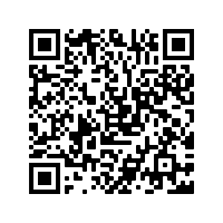
Deberes
Vocabulary Learning Homework (Term 2.2, Week 5)
Audio file
Audio file QR code:
Student worksheet
Quizlet link
In addition, revisit: Term 2.1 Week 2
Term 2.2 Week 1

