Slide 1
Talking about exchanging gifts
Using verbs with indirect objects
Short and long [i], and [ie] - revisited
Y8 German
Term 2.1 - Week 1 - Lesson 29
Author name(s): Stephen Owen / Rachel Hawkes
Artwork: Steve Clarke
Date updated: 21/07/21
Notes:
Artwork by Steve Clarke. All additional pictures selected are available under a Creative Commons license, no attribution required.
Learning outcomes (lesson 1):
Consolidation of SSC short and long [i] and [ie]
Introduction of verbs that take indirect objects (e.g. helfen, glauben, antworten, danken)
Word frequency (1 is the most frequent word in German):
8.2.1.1 (introduce) antworten [826] danken [1276] kriegen [724] schenken [1614] dir [244] ihm [91] ihr [27] Uhr² [348] eigen [166] für [17]
8.1.2.4 (revisit) erfahren [690] geblieben [113] geschwommen [1863] gestiegen [325] klettern [2601] küssen [2644] steigen [325] wandern [1803] Berg [934] Erfahrung [619] Fahrt [1569] Luft [487] Wald [1028] frisch [1260] durch [55] ach [587]
8.1.1.5 (revisit) begreifen [1346] duschen [>5009] Blick [306] Dezember [1527] Jahreszeit [4818] Mal [82] März [987] Pflanze [1667] Schuh [1678] Wechsel [2525] bequem [3369] freundlich [1566] wieder [74]
The frequency rankings for words that occur in this PowerPoint which have been previously introduced in NCELP resources are given in the NCELP SOW and in the resources that first introduced and formally re-visited those words.
For any other words that occur incidentally in this PowerPoint, frequency rankings will be provided in the notes field wherever possible.

Slide 2
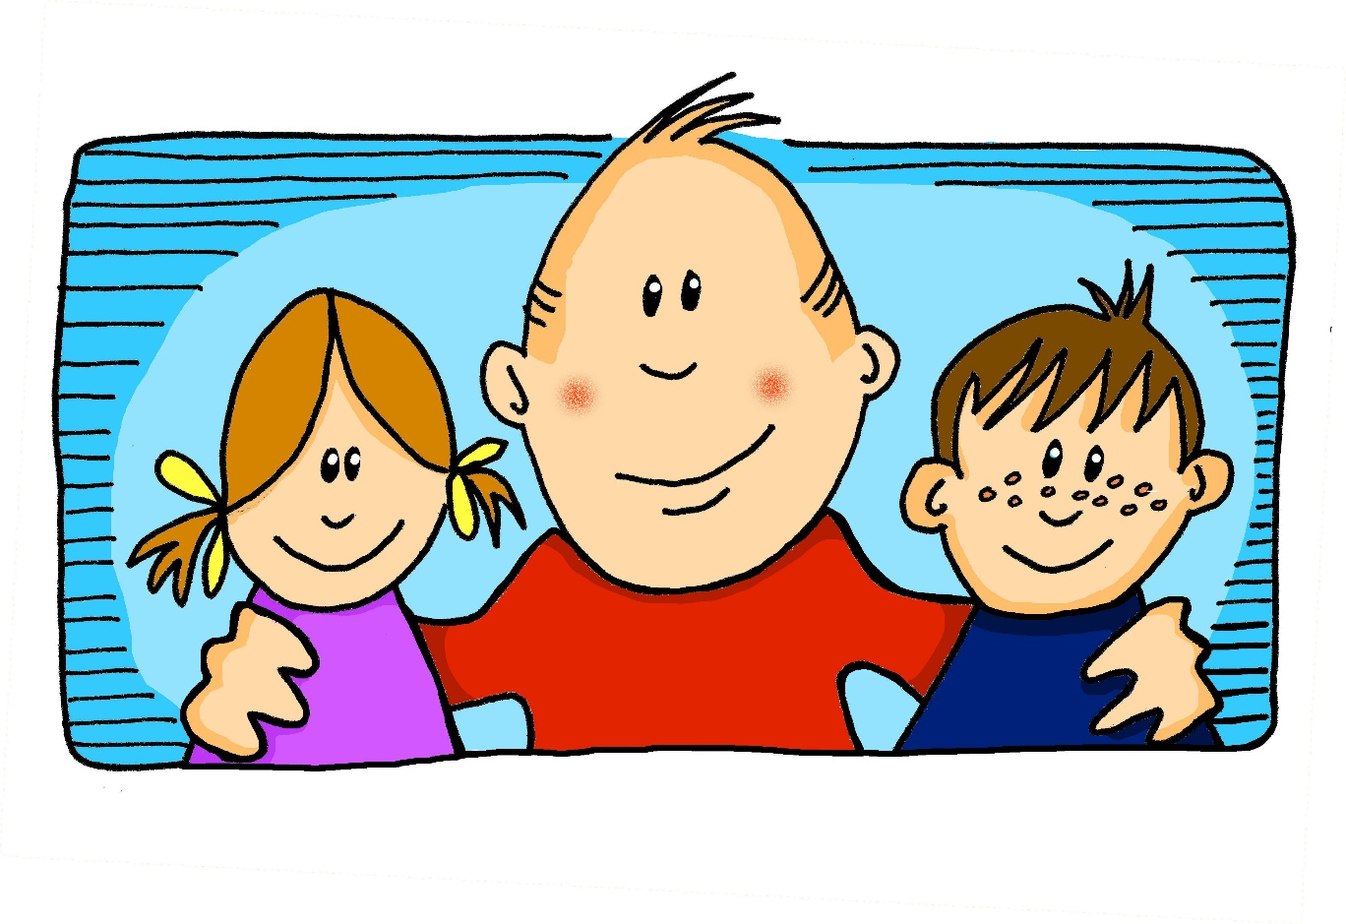
i
wir
Notes:
Timing: 1 minute
Aim: To introduce/consolidate SSC [i]
Procedure: 1. Present the letter(s) and say the [i] sound first, on its own. Students repeat it with you. 2. Bring up the word ”wir” on its own, say it, students repeat it, so that they have the opportunity to focus all of their attention on the connection between the written word and its sound.
3. A possible gesture for this would be to mime putting your arms around two people, one on either side.
4. Roll back the animations and work through 1-3 again, but this time, dropping your voice completely to listen carefully to the students saying the [i] sound, pronouncing ”wir” and, if using, doing the gesture. Word frequency (1 is the most frequent word in German): wir [31]
Source: Jones, R.L. & Tschirner, E. (2006). A frequency dictionary of German: core vocabulary for learners. Routledge

Slide 3
i
wir
Notes:
With sound and no pictures to focus all attention on the sound-symbol correspondence.

Slide 4
i
wir
Notes:
Without sound to elicit pronunciation (without first hearing the teacher).
Teacher to elicit pronunciation by asking “Wie sagt man…”

Slide 5
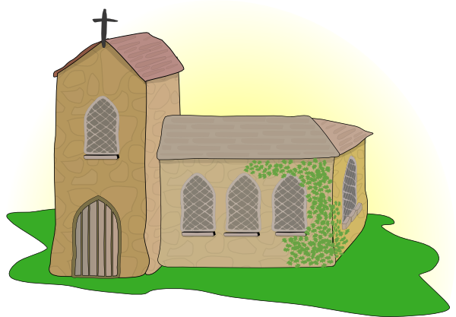
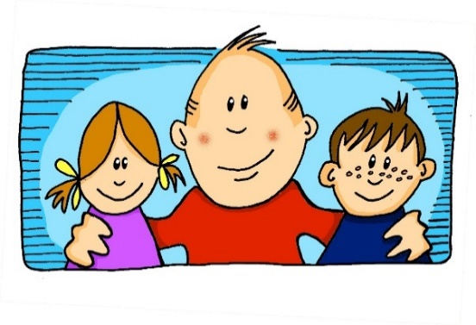
i
Kirche
Familie
wir
Linie
ihr
privat
Notes:
Timing: 2 minutes
Aim: To introduce/consolidate SSC [i]
Procedure:
Introduce and elicit the pronunciation of the individual SSC [i] and then the source word again ‘wir’ (with gesture, if using).
Then present and elicit the pronunciation of the five cluster words.
The cluster words have been chosen for their high-frequency, from a range of word classes, with the SSC (where possible) positioned within a variety of syllables within the words (e.g. initial, 2nd, final etc.). Additionally, we have tried to use words that build cumulatively on previously taught SSCs (see the Phonics Teaching Sequence document) and do not include new SSCs. Where new SSCs are used, they are often consonants which have a similar symbol-sound correspondence in English.
Word frequency (1 is the most frequent word in German): wir [31]; Kirche [519] Familie [310]; Linie [897]; privat [665]; ihr [26]. Source: Jones, R.L. & Tschirner, E. (2006). A frequency dictionary of German: core vocabulary for learners. Routledge

Slide 6
i
Kirche
Familie
wir
Linie
ihr
privat
Notes:
With sound and no pictures to focus all attention on the sound-symbol correspondence.

Slide 7
i
Kirche
Familie
wir
Linie
ihr
privat
Notes:
Without sound to elicit pronunciation (without first hearing the teacher).
Teacher to elicit pronunciation by asking “Wie sagt man…”

Slide 8
i
finden
Notes:
Timing: 1 minute
Aim: To introduce/consolidate SSC [i]
Procedure: 1. Present the letter(s) and say the [i] sound first, on its own. Students repeat it with you. 2. Bring up the word ”finden” on its own, say it, students repeat it, so that they have the opportunity to focus all of their attention on the connection between the written word and its sound.
3. A possible gesture for this would be to mime looking by holding a magnifying glass in your left hand, and pointing to what you’ve found with your right hand.
4. Roll back the animations and work through 1-3 again, but this time, dropping your voice completely to listen carefully to the students saying the [i] sound, pronouncing ”finden” and, if using, doing the gesture. Word frequency (1 is the most frequent word in German): finden [110]
Source: Jones, R.L. & Tschirner, E. (2006). A frequency dictionary of German: core vocabulary for learners. Routledge

Slide 9
i
finden
Notes:
With sound and no pictures to focus all attention on the sound-symbol correspondence.

Slide 10
i
finden
Notes:
Without sound to elicit pronunciation (without first hearing the teacher).
Teacher to elicit pronunciation by asking “Wie sagt man…”

Slide 11
i
mit
bitte
finden
Hilfe
wissen
[to know]
interessant
[interesting]
Notes:
Timing: 2 minutes
Aim: To introduce/consolidate SSC [i]
Procedure:
Introduce and elicit the pronunciation of the individual SSC [i] and then the source word again ‘finden’ (with gesture, if using).
Then present and elicit the pronunciation of the five cluster words.
The cluster words have been chosen for their high-frequency, from a range of word classes, with the SSC (where possible) positioned within a variety of syllables within the words (e.g. initial, 2nd, final etc.). Additionally, we have tried to use words that build cumulatively on previously taught SSCs (see the Phonics Teaching Sequence document) and do not include new SSCs. Where new SSCs are used, they are often consonants which have a similar symbol-sound correspondence in English.
Word frequency (1 is the most frequent word in German): finden [110]; mit [13] bitte [547]; wissen [79]; interessant [531]; Hilfe [737]. Source: Jones, R.L. & Tschirner, E. (2006). A frequency dictionary of German: core vocabulary for learners. Routledge

Slide 12
i
mit
bitte
finden
Hilfe
wissen
interessant
Notes:
With sound and no pictures to focus all attention on the sound-symbol correspondence.

Slide 13
i
mit
bitte
finden
Hilfe
wissen
interessant
Notes:
Without sound to elicit pronunciation (without first hearing the teacher).
Teacher to elicit pronunciation by asking “Wie sagt man…”

Slide 14
Phonetik
As you know, German vowels can be long or short.
Vowels followed by more than one consonant are short.
Other vowels are long.
sprechen / hören
Sag die deutschen Wörter. Ist das [i] wie im Englischen oder anders?
anders
anders
 | Finger
 | britisch
 | Kilogramm
 | Ticket
 | Familie
 | Instrument
 | Musik
 | Maschine
1
5
2
6
3
7
4
8
Notes:
Timing: 2 minutes Aim: This activity highlights similarities and differences in the English and German pronunciation of the SSC [i], using cognates and near-cognates (most of which have not been previously taught). Students apply the rule about long and short [i] to recognise when the German and English pronunciations of [i] are the same and different. Procedure: 1. Students say the words aloud in German, (following the rule that German vowels followed by more than one consonant are short. Other vowels are long.)
2. They compare how the words sound with the pronunciation of their English equivalents.
3. They note down for each whether the [i] sound is the same as in English or different.
4. Click to listen and check the German pronunciation.
Transcript: 1. Finger 2. britisch 3. Kilogramm 4. Ticket 5. Familie 6. Instrument 7. Musik 8. Maschine Word frequency (1 is the most frequent word in German): Finger [1019] britisch [1419] Kilogramm [1280] Ticket [4769] Familie [329] Instrument [1572] Musik [509] Radio [2575] Source: Jones, R.L. & Tschirner, E. (2019). A frequency dictionary of German: core vocabulary for learners. Routledge

Slide 15
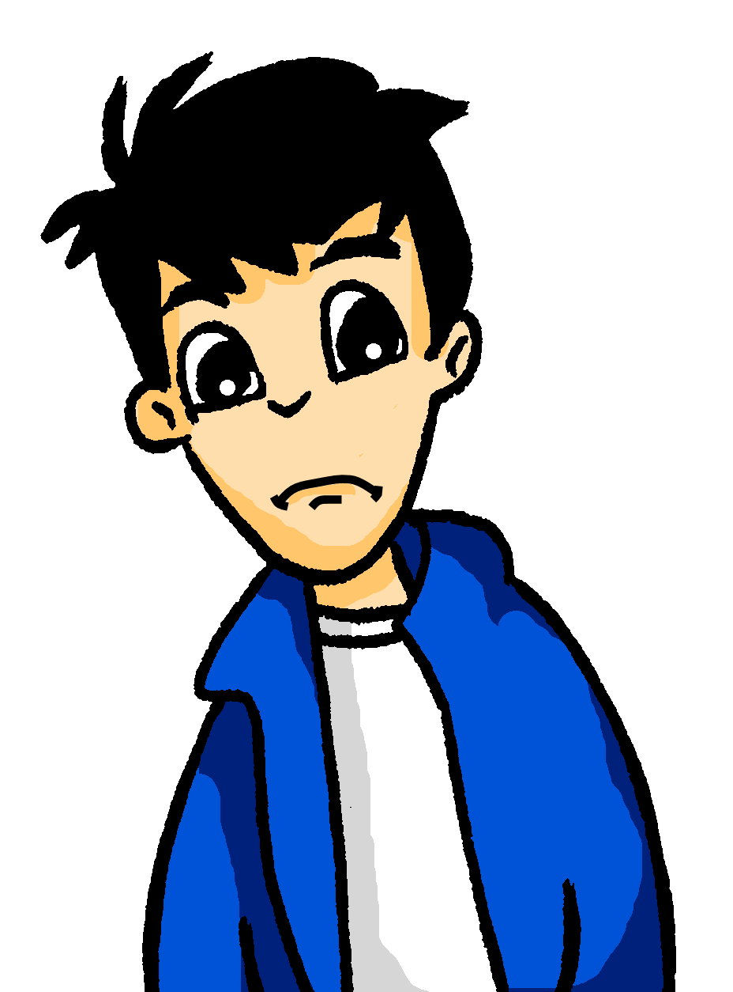
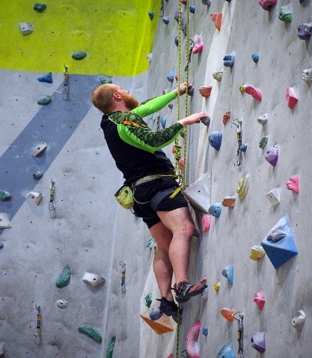
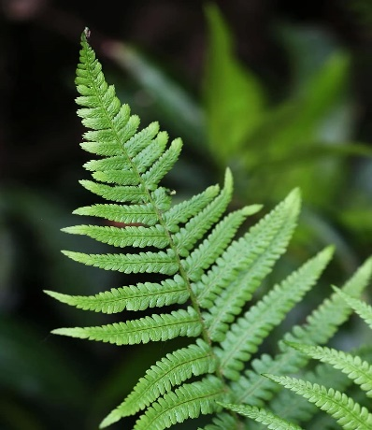
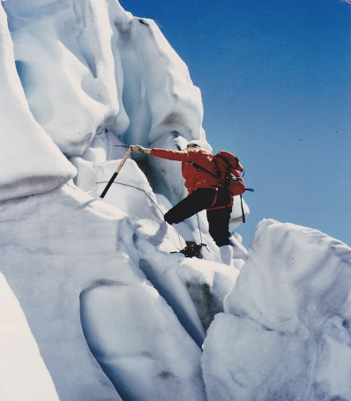
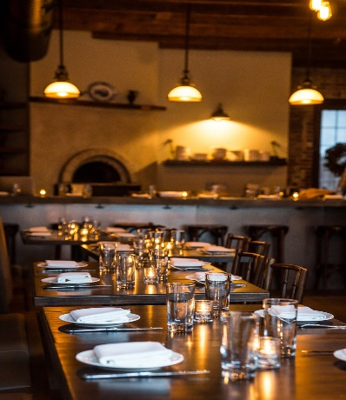
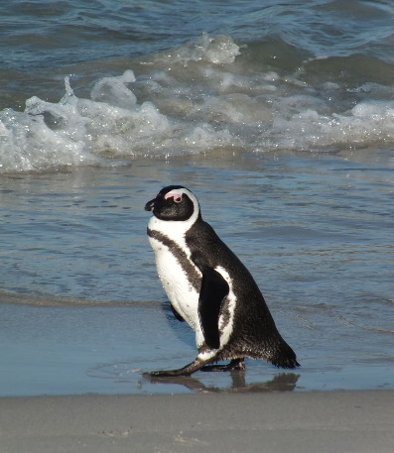
Vokabeln
Was schenke ich…?
lesen
MeineErlebnisgeschenke.de*
Wolfgang sucht Ideen im Internet. Welches Geschenk ist das? Schreibt 1-8 und A-H.
A klettern
B bequem essen
C den Wald erfahren
D eine Luftballonfahrt machen
E Schneeschuh wandern
F bergsteigen
G mit Pinguinen schwimmen
H alles über Pflanzen lernen
1
D
2
E
3
A
4
H
5
F
6
B
7
C
8
G
*das Erlebnis = experience, adventure
Notes:
Timing: 5 minutes
Aim: To practise receptive recall of some of this week’s vocabulary in the written modality. Procedure: 1. Elicit meaning of the title MeineErlebnisgeschenke.de – clarify that it is a website and -.de stands for Deutschland. ‘Erlebnis’ – they have previously learnt ‘erleben’ so encourage them to make the link. Erlebnisgeschenke - concept of ‘gift experiences’ may or may not be familiar to them, so ensure it is understood.
2. Students read A-H and match to pictures 1-8.
3. Click to reveal answers in numerical order.
Word frequency (1 is the most frequent word in German): 8.2.1.1 (introduce) schenken [1614]
8.1.2.4 (revisit) klettern [2601] steigen [325] wandern [1803] Berg [934] Fahrt [1569] Luft [487] Wald [1028] Erfahrung [619] (NB: verb ‚erfahren‘ used but students have also previously learnt this).
8.1.1.5 (revisit) Pflanze [1667] Schuh [1678] bequem [3369] Source: Jones, R.L. & Tschirner, E. (2019). A frequency dictionary of German: core vocabulary for learners. Routledge

Slide 16
Vokabeln
hören
Schreib die Wörter auf Deutsch und auf Englisch!
 | danken | to thank, thanking
 | dir | (to) you
 | schenken | to give, giving (as a present)
 | ihm | (to) him
 | eigen | own
 | ihr | (to) her
 | antworten | to answer, answering
 | kriegen | to get, getting
 | für | for
1
2
3
4
5
6
7
8
9
Notes:
Timing: 8 minutes Aim: To practise transcribing and recalling the meaning of this week’s new vocabulary Procedure: 1. Click on the numbered buttons to play the audio.
2. Students listen and transcribe the German words.
3. They then write the English meaning next to each.
4. Click to reveal the spelling of the German words in one block, and again to reveal the English meanings.
Transcript: 1. danken
2. dir
3. schenken
4. ihm
5. eigen
6. ihr
7. antworten
8. kriegen
9. für
Word frequency (1 is the most frequent word in German): 8.2.1.1 (introduce) antworten [826] danken [1276] kriegen [724] schenken [1614] dir [244] ihm [91] ihr [27] eigen [166] für [17] Source: Jones, R.L. & Tschirner, E. (2019). A frequency dictionary of German: core vocabulary for learners. Routledge

Slide 17
Pronomen
Grammatik
As you know, we use pronouns to replace nouns that we do not need to repeat.
When the pronoun refers to a person it is also called a personal pronoun.
Remember that a pronoun may change, depending on whether it is the subject or object of the sentence:
The subject case is also called Row 1 or nominative.
Remember: The object case is also called Row 2 or accusative.
SUBJECT
VERB
OBJECT
Ich
suche
dich.
I look / am looking for you.
Du
suchst
mich.
You look / are looking for me.
Er
sucht
sie.
He looks / is looking for her.
Sie
sucht
ihn.
She looks / is looking for him.
Notes:
Timing: 3 minutes Aim: To revisit grammar knowledge previously taught, in preparation for the introduction of Row 3 (dative) pronouns Procedure: 1. Click to animate the explanation.
2. Ensure students’ understanding at each stage.

Slide 18
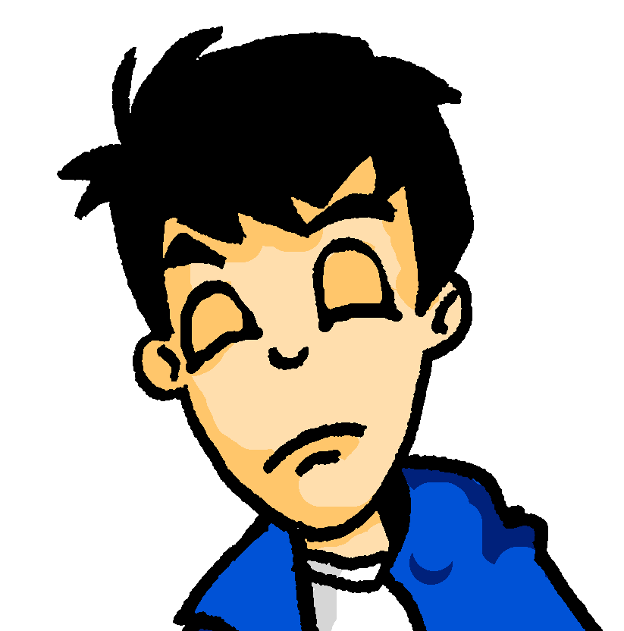
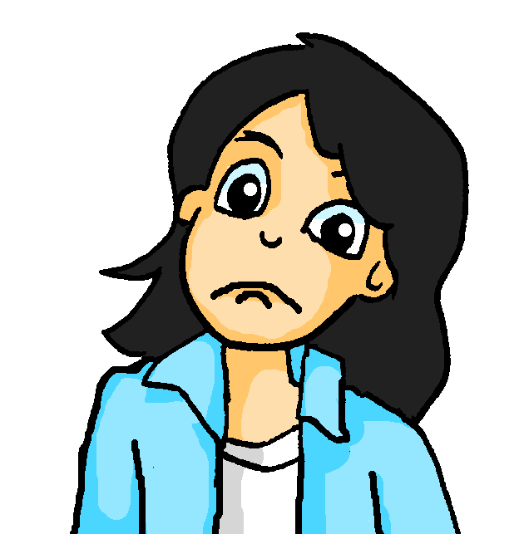
Pronomen [R3 – Dativ]
Grammatik
The verb fragen is always followed by Row 2 (accusative – or direct object); antworten is always followed by Row 3 (dative – or indirect object).
After certain verbs, use indirect object pronouns instead:
Compare:
SUBJECT
VERB
OBJECT
Ich
frage
dich.
I ask / am asking you.
Ich
antworte
dir.
I answer / am answering you.
Du
antwortest
mir.
Sometimes these R3 (dative) pronouns mean ‘to me’, ‘to you’ etc., but they can just mean ‘me’, ‘you’, ‘him’, ‘her’ ‘it’.
You answer / are answering me.
Ich
antworte
ihm.
I answer / am answering him/it.
Ich
antworte
ihr.
I answer / am answering her.
Mutti, ich frage sie!
Mia, ich frage dich!
Mutti, ich antworte ihm!
Ja, Wolfgang, und ich antworte dir!
Notes:
Timing: 3 minutes Aim: To introduce the Row 3 (dative) pronouns dir, ihm, and ihr. Procedure: 1. Click to animate the explanation. First draw out the difference between the first two examples.
2. Ensure students’ understanding at each stage.
Transcript:
-Mia, ich frage dich!
-Ja Wolfgang, und ich anworte dir!
-Mutti, ich frage sie!
-Mutti, ich antworte ihm!

Slide 19
Fragen oder antworten?
hören
Was fehlt? Heißt das fragen oder antworten? Schreib das Verb in der richtigen Form!
 |  | fragen | antworten
 | fragst
 | fragt
 | frage
 | antwortet
 | fragt
 | antwortet
 | antwortest
 | antwortet
1
1
2
2
3
3
4
4
5
5
6
6
7
7
8
8
Notes:
Timing: 5 minutes Aim: To practise recognition of the Row 3 pronoun, as opposed to Row 2 Procedure: 1. Click on the numbered buttons to play the audio (the verb in each sentence is obscured).
2. Students listen and determine the correct verb, ‘fragen’ or ‘antworten’, based upon the object pronoun heard, ticking the appropriate column.
3. Students additionally write the correct form of the verb, based upon the subject pronoun heard.
4. Click to reveal first the correct tick, then the correct spelling of the verb, for each item. 5. Finally, click for a 2nd set of action buttons, which has the full audio for each utterance, for additional reinforcement.
Transcript: 1. Du [fragst] mich. 2. Er [fragt] ihn. 3. Ich [frage] sie. 4. Sie [antwortet] mir. 5. Man [fragt] dich. 6. Er [antwortet] ihr. 7. Du [antwortest] ihm. 8. Sie [antwortet] dir. Word frequency (1 is the most frequent word in German): 8.2.1.1 (introduce) antworten [826] dir [244] ihm [91] ihr [27]
fragen [153] mir [63] man [32] mich [65] dich [217] ihn [92] sie [7] Source: Jones, R.L. & Tschirner, E. (2019). A frequency dictionary of German: core vocabulary for learners. Routledge

Slide 20
Mias Tagebuch
To identify whether a verb is a R3 (dative) verb, it can help to ask, ‘Can you do or give this to/for someone else?’
E.g. Ich danke ihm - I thank him = I give thanks to him.
But you may find it better just to learn these R3 verbs as a set.
lesen
Morgen ist Opas Geburtstag.
Mia schreibt im Tagebuch...
 |  | Row 2 (accusative) | Row 3 (dative)
1. | Wir schenken ihm eine Uhr.
2. | Und Oma - ich habe sie nicht vergessen.
3. | Wir geben ihr eine schöne Pflanze.
4. | Ach, Alastair! Ich hoffe, du vergisst mich nicht.
5. | Ich will dich küssen!
6. | Ich schreibe dir, oder?
7. | Ich rufe dich morgen nach der Party an. Ja, toll!
8. | Morgen muss Wolfgang mir helfen.
9. | Ich verstehe ihn nicht. Er ist wieder so unfreundlich!
Notes:
Timing: 3 minutes Aim: To practise recognising the use of the Row 3 pronoun, as opposed to Row 2
Procedure: 1. Students read the sentences.
2. For each, they decide whether the Row 2 or the Row 3 pronoun is used, ticking the appropriate column.
3. Click to animate the answers.
Word frequency (1 is the most frequent word in German): 8.2.1.1 (introduce) schenken [1614] dir [244] ihm [91] ihr [27]
8.1.2.4 (revisit) küssen [2644] ach [587]
8.1.1.5 freundlich [1566] wieder [74]
Source: Jones, R.L. & Tschirner, E. (2019). A frequency dictionary of German: core vocabulary for learners. Routledge

Slide 21
Mias Tagebuch
Schreib es auf Englisch.
lesen
Wir schenken ihm eine Uhr.
Und Oma - ich habe sie nicht
vergessen.
We’re giving him a watch.
And Grandma – I haven’t forgotten her.
Wir geben ihr eine schöne Pflanze.
We’re giving her a nice plant.
Ach, Alastair! Ich hoffe, du vergisst
mich nicht. Ich will dich küssen!
Ich schreibe dir, oder?
Oh Alastair! I hope you don’t forget me. I want to kiss you!
I’ll write to you, shall I?
Ich rufe dich morgen nach der Party
an. Ja, toll!
I’ll call you tomorrow after the party. Yes, great!
Morgen muss Wolfgang mir helfen.
Wolfgang has to help me tomorrow..
Ich verstehe ihn nicht. Er ist
I don’t understand him. He is so unfriendly again!
wieder so unfreundlich!
Notes:
Timing: 10 minutes Aim: To practise translating from the German into English
Procedure: 1. Students translate the sentences into English.
2. Click to bring up the English sentences, one/two at a time, for checking.
Word frequency (1 is the most frequent word in German): 8.2.1.1 (introduce) schenken [1614] dir [244] ihm [91] ihr [27]
8.1.2.4 (revisit) küssen [2644] ach [587]
8.1.1.5 freundlich [1566] wieder [74]
Source: Jones, R.L. & Tschirner, E. (2019). A frequency dictionary of German: core vocabulary for learners. Routledge

Slide 22
Wer sagt was?
hören / lesen / schreiben / sprechen
Partner A
Partner B
1
Ich muss ihm _________
1
fragen | helfen
Ich muss ihm helfen.
Englisch:
I have to help him.
Notes:
SLIDE TO MODEL THE ACTIVITY STUDENTS WILL NEED THE SEPARATE HANDOUT TO COMPLETE THE TASK. ANSWERS FOLLOW ON THE NEXT SLIDE.
Timing: 5 minutes Aim: To practise using verbs with correct R2 (accusative) and R3 (dative) pronouns in spoken and written modalities. Procedure: 1. Partner A has four sentence starters. She/he says the first part of his first sentence. Partner B listens and completes the sentence with the correct verb.
2. Partner A writes the missing verb and the full sentence in English.
3. Partner A then says the sentence in English. Partner B says it (translates it orally) into German.
4. Repeat for items 2-4.
5. Then swap roles for Partner B’s four sentences.

Slide 23
Wer sagt was? [1/2]
hören / lesen / schreiben / sprechen
Partner A
Partner B
1
Ich muss ihm _________
1
fragen | helfen
Englisch:
Ich muss ihm helfen.
I have to help him.
2
Wir wollen dir _________
1
viel Spaß wünschen | sehen
We want to wish you a lot of fun.
Wir wollen dir viel Spaß wünschen.
Englisch:
3
Er will mich _________
1
organisieren | danken
Englisch:
Er will mich organisieren.
He wants to organise me.
4
Du kannst ihr_________
1
antworten | verstehen
Englisch:
Du kannst ihr antworten.
You can answer her.
Notes:
DO NOT DISPLAY UNTIL CLASS FEEDBACK STAGE
Timing: 5 minutes (both slides) Aim: To practise using verbs with correct R2 (accusative) and R3 (dative) pronouns in spoken and written modalities. Procedure: 1. Partner A has four sentence starters. S/he says the first part of his/her first sentence. Partner B listens and completes the sentence with the correct verb.
2. Partner A writes the missing verb and the full sentence in English.
3. Partner A then says the sentence in English. Partner B says it (translates it orally) into German.
4. Repeat for items 2-4.
5. Then swap roles for Partner B’s four sentences.
Word frequency (1 is the most frequent word in German): orgaisieren [1295] wünschen [630] Source: Jones, R.L. & Tschirner, E. (2019). A frequency dictionary of German: core vocabulary for learners. Routledge

Slide 24
Wer sagt was? [2/2]
hören / lesen / schreiben / sprechen
Partner B
Partner A
1
Ich kann dich nicht_____
1
schreiben | hören
Englisch:
Ich kann dich nicht hören.
I cannot hear you.
1
Sie will ihr _________
1
vergessen | gratulieren
She wants to congratulate her.
Sie will ihr gratulieren.
Englisch:
1
Du musst ihn _________
1
suchen | danken
You must look for him.
Du musst ihn suchen.
Englisch:
1
Er will sie _________
1
finden | helfen
Englisch:
Er will sie finden.
He wants to find her.
Notes:
DO NOT DISPLAY UNTIL CLASS FEEDBACK STAGE This is the continuation of the activity of the previous slide, students now having swapped roles. Word frequency (1 is the most frequent word in German): Source: Jones, R.L. & Tschirner, E. (2019). A frequency dictionary of German: core vocabulary for learners. Routledge

Slide 25
Talking about exchanging gifts
Using prepositions von and für Possessive adjectives in R2 (accusative) and R3 (dative)
Short and long [i], and [ie] revisited
Y8 German
Term 2.1 - Week 1 - Lesson 30
Author name(s): Stephen Owen / Rachel Hawkes
Artwork: Steve Clarke
Date updated: 21/07/21
Notes:
Artwork by Steve Clarke. All additional pictures selected are available under a Creative Commons license, no attribution required.
Learning outcomes (lesson 2):
Consolidation of SSC short and long [i] and [ie]
Introduction of prepositions von and für with possessive adjectives (mein, dein, sein, ihr) and with pronouns (mich, dich, ihn, sie vs mir, dir, ihm, ihr) Introduction to variants of wer (für wen, von wem)
Word frequency (1 is the most frequent word in German):
8.2.1.1 (introduce) antworten [826] danken [1276] kriegen [724] schenken [1614] dir [244] ihm [91] ihr [27] Uhr² [348] eigen [166] für [17]
8.1.2.4 (revisit) erfahren [690] geblieben [113] geschwommen [1863] gestiegen [325] klettern [2601] küssen [2644] steigen [325] wandern [1803] Berg [934] die Erfahrung [619] Fahrt [1569] Luft [487] Wald [1028] frisch [1260] durch [55] ach [587]
8.1.1.5 (revisit) begreifen [1346] duschen [>5009] Blick [306] Dezember [1527] Jahreszeit [4818] Mal [82] März [987] Pflanze [1667] Schuh [1678] Wechsel [2525] bequem [3369] freundlich [1566] wieder [74]
The frequency rankings for words that occur in this PowerPoint which have been previously introduced in NCELP resources are given in the NCELP SOW and in the resources that first introduced and formally re-visited those words.
For any other words that occur incidentally in this PowerPoint, frequency rankings will be provided in the notes field wherever possible.

Slide 26
ie
Liebe
Notes:
Timing: 1 minute
Aim: To introduce/consolidate SSC [ie]
Procedure: 1. Present the letter(s) and say the [ie] sound first, on its own. Students repeat it with you. 2. Bring up the word ”Liebe” on its own, say it, students repeat it, so that they have the opportunity to focus all of their attention on the connection between the written word and its sound.
3. A possible gesture for this would be to fold both hands over your heart, and smile!
4. Roll back the animations and work through 1-3 again, but this time, dropping your voice completely to listen carefully to the students saying the [ie] sound, pronouncing ”Liebe” and, if using, doing the gesture. Word frequency (1 is the most frequent word in German): Liebe [843]
Source: Jones, R.L. & Tschirner, E. (2006). A frequency dictionary of German: core vocabulary for learners. Routledge

Slide 27
ie
Liebe
Notes:
With sound and no pictures to focus all attention on the sound-symbol correspondence.

Slide 28
ie
Liebe
Notes:
Without sound to elicit pronunciation (without first hearing the teacher).
Teacher to elicit pronunciation by asking “Wie sagt man…”

Slide 29
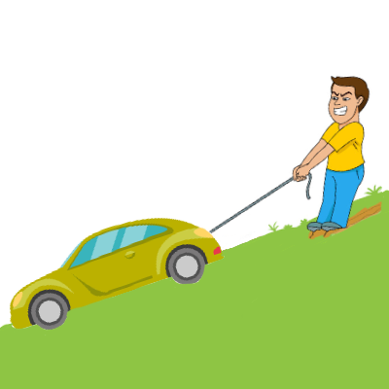
ie
ziehen
sie
Liebe
tief
Brief
liegen
2000 Kilometer
Notes:
Timing: 2 minutes
Aim: To introduce/consolidate SSC [ie]
Procedure:
Introduce and elicit the pronunciation of the individual SSC [ie] and then the source word again ‘Liebe’ (with gesture, if using).
Then present and elicit the pronunciation of the five cluster words.
The cluster words have been chosen for their high-frequency, from a range of word classes, with the SSC (where possible) positioned within a variety of syllables within the words (e.g. initial, 2nd, final etc.). Additionally, we have tried to use words that build cumulatively on previously taught SSCs (see the Phonics Teaching Sequence document) and do not include new SSCs. Where new SSCs are used, they are often consonants which have a similar symbol-sound correspondence in English.
Word frequency (1 is the most frequent word in German): Liebe [843]; ziehen[266] sie [10]; tief [506]; liegen [118]; Brief [813].
Source: Jones, R.L. & Tschirner, E. (2006). A frequency dictionary of German: core vocabulary for learners. Routledge

Slide 30
ie
ziehen
sie
Liebe
tief
Brief
liegen
Notes:
With sound and no pictures to focus all attention on the sound-symbol correspondence.

Slide 31
ie
ziehen
sie
Liebe
tief
Brief
liegen
Notes:
Without sound to elicit pronunciation (without first hearing the teacher).
Teacher to elicit pronunciation by asking “Wie sagt man…”

Slide 32
Phonetik
hören / schreiben
Hör zu. Welches Wort hat das SSC [ie]? Schreib 1-4 und a) oder b).
1
3
a) b i tten | b) b ie ten
[rent] | [middle]
a) M ie te | b) M i tte
[to ask for]
[to offer]
__
__
__
__
2
[crooked] | [ship, boat]
a) sch ie f | b) Sch i ff
4
[silence] | [stems, stalks]
b) St i lle | b) St ie le
__
__
__
__
Notes:
Timing: 5 minutes (for two slides)
Aim: Aural differentiation between SSC [ie] and short [i] in minimal pairs.
Procedure:
1. Click the numbers to play the audio.
2. Students write 1-8 and decide which word contains [ie], and write down a) or b). If they wish, they can write down both words in full.
3. Click to reveal the answers.
4. Students sound out the pairs of words.
Transcript:
1. a) bitten b) bieten
2. a) schief b) Schiff
3. a) Miete b) Mitte
4. a) Stille b) Stiele
Word frequency (1 is the most frequent word in German): bitten [491] bieten [531] schief [3021] Schiff [1176] Miete [3488] Mitte [711] Stille [2753] Stiele [>5000] Source: Jones, R.L. & Tschirner, E. (2019). A frequency dictionary of German: core vocabulary for learners. Routledge

Slide 33
Phonetik
hören / schreiben
Hör zu. Welches Wort hat das kurze [i]? Schreib 5-8 und a) oder b).
5
7
a) R i sse | b) R ie se
[within] | [bees]
a) b i nnen | b) B ie nen
[cracks]
[giant]
__
__
__
__
6
[to sit] | [to address someone as ‘Sie’]
a) s i tzen | b) s ie zen
8
[hall] | [dill]
b) D ie le | b) D i lle
__
__
__
__
Notes:
NB: No 7 audio is currently wrong – we are changing to match the transcript below!
This is the continuation of the activity on the previous slide but note that students now listen out for the short [i].
Transcript:
5. a) Risse b) Riese
6. a) sitzen b) siezen
7. a) binnen b) Bienen
8. a) Diele b) Dille Word frequency (1 is the most frequent word in German): Riss [>5000] Riese [4585] sitzen [231] siezen [>50000] binnen [>4171] Biene [>5000] Diele [>5000] Dille [>5000] Source: Jones, R.L. & Tschirner, E. (2019). A frequency dictionary of German: core vocabulary for learners. Routledge

Slide 34
Vokabeln 1 [1/2]
sprechen
1. für
3. geschwommen (pp)
1. for
3. swam (pp)
5. gestiegen (pp)
5. climbed (pp)
2. stayed (pp)
4. fresh
2. geblieben (pp)
4. frisch
7. to experience
9. die Erfahrung
7. erfahren
9. experience
6. eigen
6. own
8. to get, getting
8. kriegen
10. to climb
10. steigen
Notes:
Timing: 5 minutes (two slides) Aim: To practise productive recall of some of this week’s new and revisited vocabulary in the spoken modality Procedure: 1. Click to animate the slide. One by one, English words flash on the screen.
2. Partner A faces the screen and says each word aloud in German.
3. Partner B writes down what they hear.
4. Click to reveal the German so they can check answers.
5. Swap roles using the next slide.
Word frequency (1 is the most frequent word in German):
8.2.1.1 (introduce) kriegen [724] eigen [166] für [17]
8.1.2.4 (revisit) erfahren [690] geblieben [113] geschwommen [1863] gestiegen [325] steigen [325] die Erfahrung [619] frisch [1260]
Source: Jones, R.L. & Tschirner, E. (2006). A frequency dictionary of German: core vocabulary for learners. Routledge

Slide 35
Vokabeln 1 [2/2]
sprechen
3. December
1. das Mal
3. Dezember
1. time
5. duschen
5. to shower
2. again
4. through
2. wieder
4. durch
7. die Jahreszeit
7. season
9. March
9. März
6. der Wechsel
6. change
8. to understand
8. begreifen
10. view
10. der Blick
Notes:
This is the continuation of the activity on the previous slide
Word frequency (1 is the most frequent word in German):
8.1.2.4 (revisit) durch [55]
8.1.1.5 (revisit) begreifen [1346] duschen [>5009] Blick [306] Dezember [1527] Jahreszeit [4818] Mal [82] März [987] Wechsel [2525] wieder [74]
Source: Jones, R.L. & Tschirner, E. (2006). A frequency dictionary of German: core vocabulary for learners. Routledge

Slide 36
Vokabeln 2 [1/2]
lesen / schreiben
1. Ein Synonym für bekommen
2. Der letzte Monat im Jahr
3. Ich bin zu Hause …
4. Ein anderes Wort für verstehen
5. Ein Synonym für nochmal
6. Das ist nicht grün
7. Das ist eine Erfahrung
erfahren
kriegen
werden
Dezember
März
Januar
gestiegen
geschwommen
geblieben
begreifen
steigen
eigen
Mal
wieder
für
Pflanze
Wald
Luft
Berg
Fahrt
Schuh
Notes:
Timing: 7 minutes (2 slides) Aim: to practise productive recall of all of this week’s new and revisited vocabulary in the written modality. Procedure: 1. Click for the first word to appear and then disappear. Repeat for 2nd and 3rd words for number 1.
2. Students write down their answer for number 1.
3. Click again for the answer to number 1.
4. Continue with the remainder of the questions on this slide, providing item-by-item feedback.
Word frequency (1 is the most frequent word in German):
8.2.1.1 (introduce) kriegen [724] eigen [166] für [17]
8.1.2.4 (revisit) erfahren [690] geblieben [113] geschwommen [1863] gestiegen [325] steigen [325] Berg [934] die Erfahrung [619] Fahrt [1569] Luft [487] Wald [1028]
8.1.1.5 (revisit) begreifen [1346] Dezember [1527] Jahreszeit [4818] Mal [82] März [987] Pflanze [1667] Schuh [1678] Wechsel [2525] wieder [74]
Source: Jones, R.L. & Tschirner, E. (2019). A frequency dictionary of German: core vocabulary for learners. Routledge

Slide 37
Vokabeln 2 [2/2]
lesen / schreiben
8. Sommer ist eine…
9. Ein Synonym für geben
10. Ach! Dieses Obst ist so…
11. Ich werfe einen Blick …das Fenster
12. Ein Synonym für steigen
13. Nicht fragen…
14. Ich schenke Mia ein Buch.
Jahreszeit
August
Wechsel
danken
schenken
antworten
freundlich
frisch
bequem
durch
für
von
kriegen
küssen
klettern
antworten
duschen
wandern
ihm
ihr
dir
Notes:
Continuation of the previous activity.
Word frequency (1 is the most frequent word in German):
8.2.1.1 (introduce) antworten [826] danken [1276] kriegen [724] schenken [1614] dir [244] ihm [91] ihr [27] für [17]
8.1.2.4 (revisit) klettern [2601] küssen [2644] steigen [325] wandern [1803] frisch [1260] durch [55] ach [587]
8.1.1.5 (revisit) duschen [>5009] Blick [306] Jahreszeit [4818] Wechsel [2525] bequem [3369] freundlich [1566] Source: Jones, R.L. & Tschirner, E. (2019). A frequency dictionary of German: core vocabulary for learners. Routledge

Slide 38
Ein → mein
Grammatik
As you know, the indefinite article ein (a/an) changes according to gender:
Possessive adjectives (mein, dein, sein, ihr) follow the same pattern:
masculine
Row 1: Das ist ein Vater.
(a father)
Row 2: Ich sehe einen Vater
(a father)
feminine
Row 1: Das ist eine Mutter.
(a mother)
Row 2: Ich sehe eine Mutter
(a mother)
neuter
Row 1: Das ist ein Handy.
(a mobile phone)
Row 2: Ich sehe ein Handy.
(a mobile phone)
mein
meine
mein
my
my
my
meinen
meine
mein
my
my
my
Das ist für meinen Vater.
Das ist für meine Mutter.
Das ist für mein Handy.
Remember - after many verbs other than sein we use Row 2 (accusative). The preposition für is always followed by Row 2 (accusative) as well.
Notes:
Timing: 3 minutes Aim: To introduce the Row 2 (accusative) possesive adjective forms (using mein as an example)
Procedure: 1. Click to animate the explanation. Remind students that they have already learnt this pattern with ein.
2. Ensure students’ understanding at each stage.

Slide 39
Ein → mein
Wer (who) also changes: Für wen? (For whom?) R2 (accusative) Von wem? (From whom?) R3 (dative)
Grammatik
As you know, the preposition ‘von’ (from/of) is always followed by R3 (dative).
This changes the possessive adjective like this:
masculine
Row 1: Das ist ein Vater
(a father)
Row 2: Ich sehe einen Vater
(a father)
Row 3: Das ist von meinem Vater
feminine
Row 1: Das ist eine Mutter
(a mother)
Row 2: Ich sehe eine Mutter
(a mother)
Row 3: Das ist von meiner Mutter
neuter
Row 1: Das ist ein Handy
(a mobile phone)
Row 2: Ich sehe ein Handy
(a mobile phone)
Row 3: Das ist von meinem Handy
mein
meine
mein
my
my
my
meinen
meine
mein
my
my
my
Notes:
Timing: 3 minutes Aim: To introduce the Row 3 (dative) possessive adjective forms, using mein as an example
Procedure: 1. Click to animate the explanation. First draw out the difference between the first two examples.
2. Ensure students’ understanding at each stage.

Slide 40
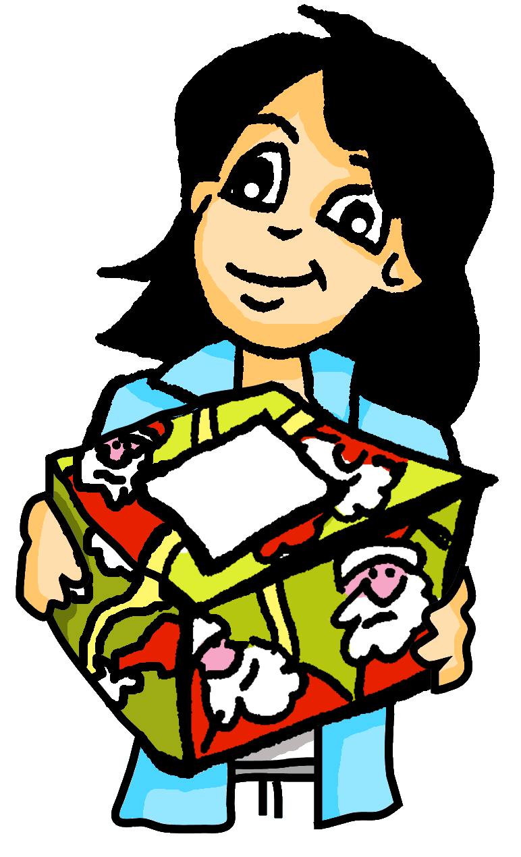
Für wen ist das? Von wem ist das?
lesen
Man gibt viele Geschenke!
 |  | für (+Row 2) | von (+ Row 3) | what? | For / from whom?
1. | Das Handy ist für ihre Mutter. |  |  | mobile | her mother
2. | Das Auto ist von meinem Vater. |  |  | car | my father
3. | Das Buch ist von deiner Schwester. |  |  | book | your sister
4. | Das Spiel ist für seinen Bruder. |  |  | game | his brother
5. | Die Jacke ist von meinem Opa. |  |  | jacket | my grandad
6. | Der Hut ist für deinen Freund. |  |  | hat | your friend
7. | Die Uhr ist für seine Schwester. |  |  | watch | his sister
8. | Das Fahrrad ist von ihrem Bruder. |  |  | bike | her brother
____
____
____
____
____
____
____
____
Notes:
Timing: 5 minutes Aim: To practise recognition of the Row 2 and Row 3 pronouns and possessive adjective forms (reading) Procedure: 1. Elicit the meanings of the two questions in the title of this slide from students, to consolidate their understanding of R2 and R3 versions of wer.
2. Students read the sentences and decide from the pronoun/possessive which word must be missing, für or von.
3. To practise vocabulary recall, students that write down what was given, and to/from whom.
4. Click to reveal the answers one by one.

Slide 41
Was machen sie?
hören
Welches Verb fehlt? Schreib 1-8 und das Verb.
 |  | Verb
 | Ich besuche meine Mutter. | besuche / helfe
 | Du gratulierst deinem Vater. | gratulierst / siehst
 | Er antwortet seinem Bruder. | fragt / antwortet
 | Sie fragt ihre Mutter. | antwortet / fragt
 | Ich helfe meinem Freund. | helfe / mag
 | Du magst meinen Hund. | hilfst / magst
 | Er hat meine Flasche. | hat / gibt
 | Sie dankt mir. | sieht / dankt
1
1
2
2
3
3
4
4
5
5
6
6
7
7
8
8
Notes:
Timing: 5 minutes Aim: To practise recognition of the Row 2 and Row 3 forms of possessive adjectives and object pronouns (listening) Procedure: 1. Students read the sentences and decide from the pronoun/possessive form heard which verb must be missing from the choice presented.
2. Click to reveal the answers, followed by the written form of the sentences, one by one. 3. Finally, click for a 2nd set of audio buttons, which contain the full sentence audio, for reinforcement, as desired.
Transcript (words in brackets are obscured):
1. Ich [besuche] meine Mutter 2. Du [gratulierst] deinem Vater. 3. Er [antwortet] seinem Bruder.
4. Sie [fragt] ihre Mutter. 5. Ich [helfe] meinem Freund. 6. Du [magst] meinen Hund. 7. Er [hat] meine Flasche. 8. Sie [dankt] mir.

Slide 42
Alastair schreibt Mia
This ‘my’ follows für (‘for’). Do you need the Row 2 or Row 3 ending?
schreiben
Alastair will Mia schreiben. Hilf ihm!
Schreib die Sätze 1-6 auf Deutsch.
Hallo Mia!
Was hast du zu Weihnachten gemacht?
(1) I bought a book for my sister.
(2) I also gave her a CD.
(3) I got a voucher from her.
(4) What did Wolfgang give you?
(5) She bought clothes for her friend.
(6) My friend gave me a game. xx Alastair
Is this doing something for / giving to someone else? Which word for ‘her’ do you need?
This ‘her’ follows von (‘from’). Which word for ‘her’ do you need here?
Think carefully about the object pronouns and possessive adjective ending in sentences 4-6.
Is it Row 2 or Row 3 in each case?
Notes:
Timing: 10 minutes Aim: To practise written production of the Row 2 and Row 3 pronoun and possessive adjective forms in sentences as required Procedure: 1. Students translate sentences 1-6 into German. Click to bring up the four reminder bubbles, and go through these before they start, leaving them on the screen during the exercise.
2. The answers are animated on the next slide.

Slide 43
Antworten
schreiben
(1) I bought a book for my sister.
(2) I also gave her a CD.
(3) I got a voucher from her.
(4) What did Wolfgang give you?
(5) She bought clothes for her friend.
(6) My friend gave me a game.
(1) Ich habe ein Buch für meine Schwester gekauft.
(2) Ich habe ihr auch eine CD geschenkt.
(3) Ich habe einen Gutschein von ihr bekommen.
(4) Was hat Wolfgang dir geschenkt?
(5) Sie hat Kleidung für ihre Freundin /
ihren Freund gekauft.
(6) Mein Freund hat mir ein Spiel geschenkt.
Notes:
Timing: 10 minutes Aim: To provide the answers to the activity on the previous slide Procedure: 1. Click to bring up the suggested answers one by one.

Slide 44
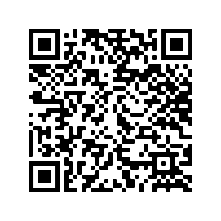
Hausaufgaben
Vocabulary Learning Homework (Y8, Term 2.1, Week 2)
Audio file
Audio file QR code:
Student worksheet
Quizlet link
In addition, revisit: Year 8 Term 1.2 Week 4
Year 8 Term 1.1 Week 5
Notes:
Link to Student Worksheet answers: https://resources.ncelp.org/concern/resources/s7526c966?locale=en

