Slide 1
(H) indirect object pronouns 'nos' and 'os'
Year 10 Term 1.1 Week 4
Louise Caruso / Amanda Izquierdo
Mollie Bentley-Smith / Emily Cutts
Artwork: Mark Davies
Date updated 08/02/23
Notes:
Artwork by Mark Davies. All additional pictures selected are available under a Creative Commons license, no attribution required.
With thanks to Rachel Hawkes for her input on the lesson material and Jo Cairns for teacher feedback.
Learning outcomes (lesson 1):
present '-ER' verbs (1st, 2nd and 3rd person plural)
present tense -er/-ir verbs in 3rd person singular and plural (-e, -en);
verbs like pedir (e>i) (1st, 2nd and 3rd person singular and plural)
indirect object pronouns 'me', 'te', 'le’ in one-verb constructions (e.g. me escriben);
syntax of interesar-like verbs (object vs subject-first word order)
word order of direct and indirect object pronouns
Phonics:
Strong and weak vowels together (diphthongs)
[ia], [ie], [ai], [ei], [ue]
Word frequency (1 is the most frequent word in Spanish):
New vocabulary: doler [1629]; recomendar [1247]; repetir [512]; alumno [862]; boca [465]; cita¹ (appointment) [2002]; cuello [1298]; derecho [1334]; diente [1365]; error [886]; espalda [942]; hospital [1050]; rodilla [1839] (13) /H only: asegurar [497]; exigir [854]; nos [52]; os [695]; hombro [1146]; nariz [1570]; justo [1782] (7)
Thematic revisited vocabulary: entregar [626]; accidente [1661]; pierna [776]; brazo [470]; mano [135]; cabeza [265]; dolor [591]; médico [692]; mañana [779]; regla [1380]; bolígrafo [>5000]; tarea [295]; demasiado [494]; deberes [2187]; gritar [691]; tiempo [80]; contar [172]; historia [186] x2 meanings; mandar [588] explicar [304]; interesar [27]; clase [320]; baño [1340]; cierto [159]; otra vez [n/a]; casi [166]; beneficio [1169]; opinión [578]; falso [1599]; correcto [1467]; estudiante [795]; ¡perdón! [1729]; libro [230]; rápido [87]; enseguida [2866]; colegio [628]; pero [30] (37)
Spaced repetition: almorzar [4018]; pegar¹ (to stick) [1135]; quemar [1648]; reservar [3067]; calidad [637]; las Fallas [n/a]; hotel [1163]; pescado [3449]; RENFE [n/a]; algún [51]; alguno [51]; aprobar [1248]; examen [2005]; hoja [916]; imagen [384]; nota [1141] (16) /H only: colgar [1669]; secar [2239]; arquitectura [1627]; entorno [1891]; instante [992]; puerto [1077]; lindo [1332]; fecha límite [límite-1194]; objetivo [657] (9) Revisited function words: me [22]; te [48]; le [25]; les [25]; hacer [26]; pedir [217] (6)
Source: Davies, M. & Davies, K. (2018). A frequency dictionary of Spanish: Core vocabulary for learners (2nd ed.). Routledge: London
The frequency rankings for words that occur in this PowerPoint which have been previously introduced in NCELP resources are given in the NCELP SOW and in the resources that first introduced and formally re-visited those words.
For any other words that occur incidentally in this PowerPoint, frequency rankings will be provided in the notes field wherever possible.

Slide 2
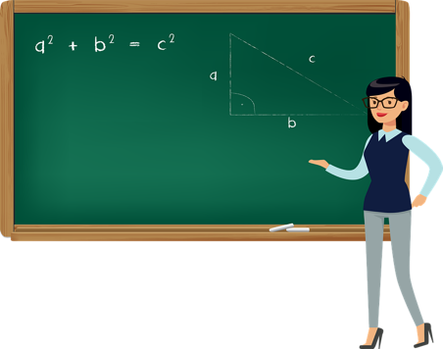
Saying who is affected by the verb Indirect object pronouns ‘le’ and ‘les
gramática
Higher
There are two other indirect object pronouns used for plural persons.
nos
If the person affected by the verb is ‘we’ use ____.
Hello
Nos da muchos beneficios aprender inglés.
Learning English gives us lots of benefits.
os
If the person affected by the verb is ‘you (plural)’, use ____.
Os explico los objetivos de la clase.
I explain to you (pl) the lesson objectives.
Like other pronouns, they come before the verb or attach to the second verb in two verb constructions
You need to hand in to us the task tomorrow.
Nos debéis entregar la tarea mañana.
Notes:
Timing: 2 minutes
Aim: to introduce indirect pronouns ‘nos’ and ‘os’.
Procedure:
Go through the grammar explanation with students, revealing each new sentence on a mouse click.
Use the callouts to remind students of the word order of pronouns and the verb endings for singular vs plural 3rd person subjects.

Slide 3
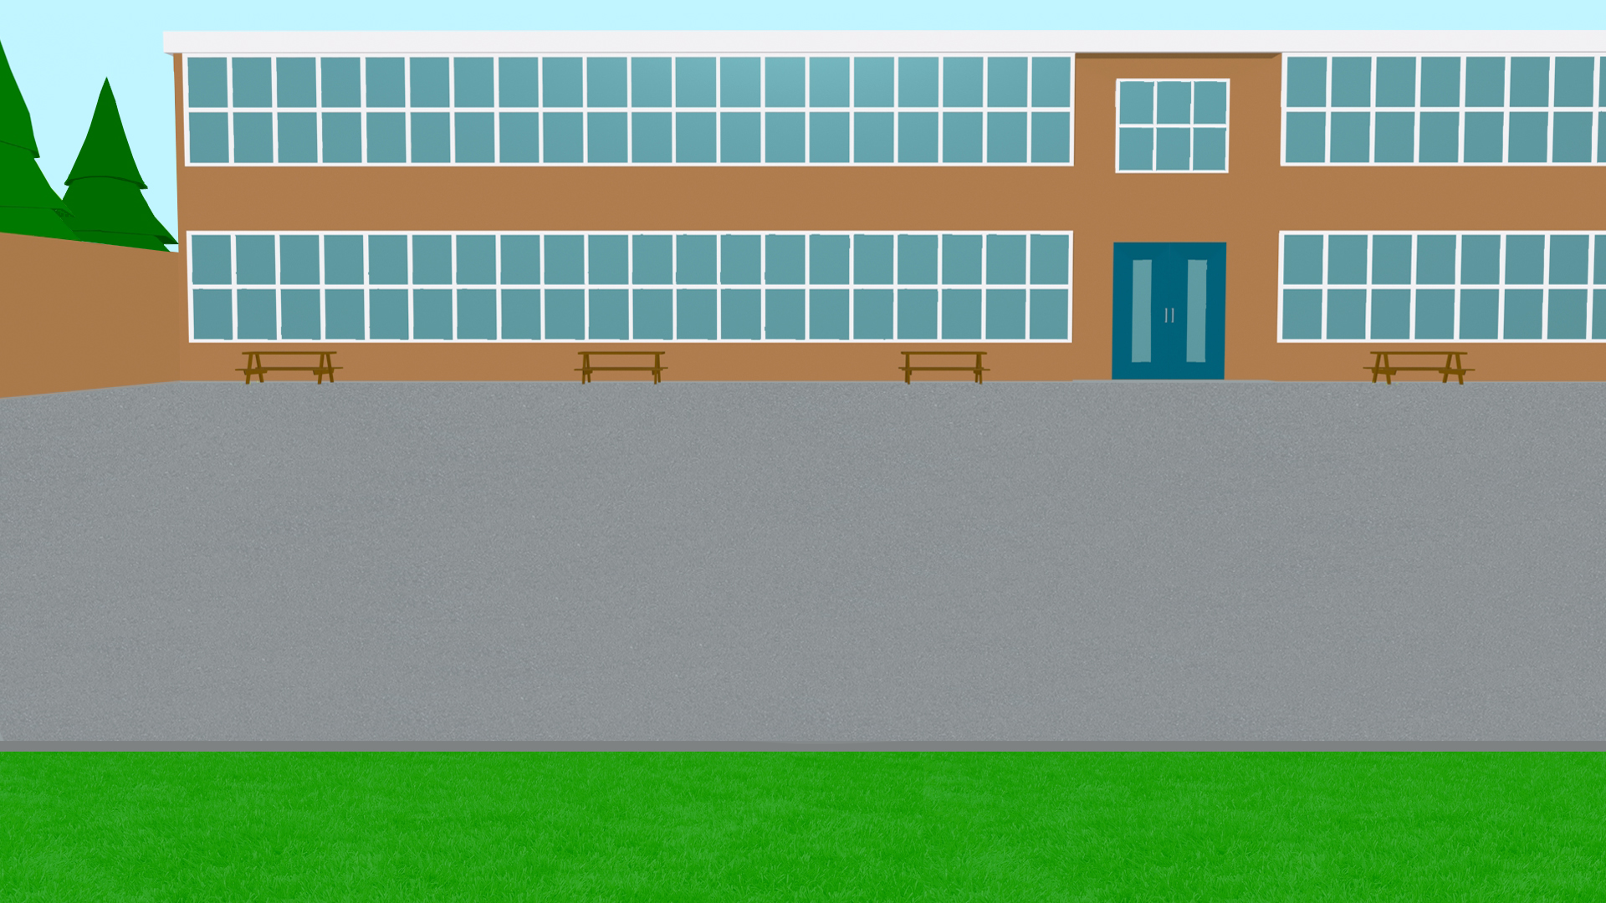
Aquí tienes una selección de frases de conversaciones a la puerta del colegio. ¿Puedes completar las traducciones?
leer
Me quiere dar una buena nota.
tell you
1. I have to _____ ____ a story.
Te quiere llamar más tarde.
send you
2. They must _____ ____ a message.
recommend them
Deben mandarte un mensaje.
3. She can ____________ _____ a film.
Les puede recomendar una película.
call you
4. S/he wants to _____ ____ later.
assure you (pl)
5. I can ______ _______ they are coming tomorrow.
give me
Os puedo asegurar que vienen mañana.
6. She wants to _____ ____ a good grade.
Tengo que contarte una historia.
hand us
7.You have to _____ ____ the work before the deadline.
Nos tienes que entregar el trabajo antes de la fecha límite.
Debes repetirles la dirección de la fiesta.
repeat to them
8. You must _______ __ _____ the address of the party.
Notes:
Timing: 7 minutes
Aim:
i) to understand the meaning of indirect object pronouns and how they are used in two-verb constructions.
ii) (H) to recognise indirect object pronouns ‘os’ and ‘nos’.
Procedure:
Read each speech bubble and complete the corresponding English translation.
Click to reveal the answers.
If time allows, students can try to say the phrase putting the indirect object pronoun in its other possible position e.g. Te quiere llamar más tarde / Quiere llamarte más tarde.

Slide 4
Ahora escucha unas frases más. ¿Cuál es la traducción correcta?
escuchar
You must ask him for permission.
He must ask you for permission.
1
She has to bring you the videogame.
He has to bring me the video game.
2
Can you give me five euros?
Can you give her five euros?
3
He has to assure you (pl) that the exam is easy.
He has to assure us that the exam is easy.
I want to ask them a favour.
I want to ask him a favour.
7
4
He must books tickets for him.
He must books tickets for them.
5
They want to demand more tasks from us.
They want to demand more tasks from you (pl).
8
I can lend you the phone.
I can lend her the phone..
6
Notes:
This activity practices this week’s new grammar features alongside revisited grammar features and this week’s vocabulary sets.
Timing: 8 minutes
Aim: to understand the meaning of indirect object pronouns in spoken text
Procedure:
Listen to each recording and choose the correct English translation.
Click to reveal the answers.
Note that questions 7 and 8 contain higher only vocabulary.
Transcript:
Le debes pedir permiso.
Tiene que traerte el videojuego.
¿Me puedes dar cinco euros?
Quiero pedirle un favor.
Les debe reservar unas entradas.
Puedo prestarte el móvil.
Nos tiene que asegurar que el examen es fácil.
Quieren exigirnos más tareas.

Slide 5
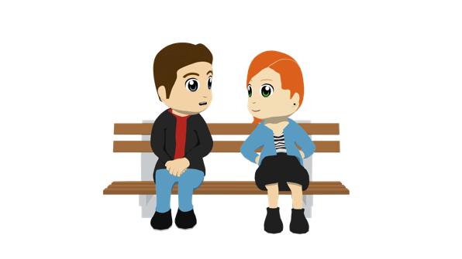
Comentarios en el colegio
hablar
Trabajamos en parejas:
El estudiante A lee la primera parte de su frase en español al estudiante B.
El estudiante B escucha y mira sus opciones. Debe decir la frase correcta según la persona.
Entonces, los estudiantes A y B escriben la frase completa en inglés.
Puedes elegir el orden que quieres usar:
“Quiero agradecerles…” OR “Les quiero agradecer…”
Ejemplo:
Estudiante B
Estudiante A
to him/her
to them
“Quiero agradecerles el favor”
the help
the favour
I want to thank them (for)…
I want to thank them for the favour
Notes:
This activity practices this week’s new grammar features alongside revisited grammar features and this week’s vocabulary sets.
Timing: 8 minutes
Aim: to practise spoken production of sentences using indirect object pronouns in two verb constructions and –er verb endings for singular persons in the present tense, without reference to notes, but with English translations as support. Procedure:
Student A reads the first part of phrase 1 in Spanish.
Student B listens and identify which pronoun has been used ‘le’ (to him/her) or ‘les’ (to them)
Student B selects the correct option to finish the phrase, and says the word in Spanish.
After completely the 6 phrases, students swap roles

Slide 6
Habla con tu pareja
hablar
Comentarios en el colegio
Estudiante B termina la frase con la opción correcta.
Estudiante A empieza la frase
To him/to her | To them
information | help
the homework | the task
useful books | Interesting films
later | again
pen | bag
sweets | some drinks
us (H) some benefits | you (pl) (H) some advice
1 I have to ask him (for)...
2 He has to send them…
3 I usually recommend her….
4. I can call them…
5 Do you want to hide his (to him)…?
6 She wants to offer them…
7 (H) I can tell you all…
Escribe las respuestas en inglés con tu pareja
Notes:
CARD FOR STUDENT A – DO NOT SHOW DURING THE ACTIVITY

Slide 7
Habla con tu pareja
hablar
Comentarios en el colegio
Estudiante B termina la frase con la opción correcta.
Estudiante B empieza la frase
To him/to her | To them
an appointment | help
a letter | a message
the image | my opinion
a sheet | a bag
now/right away (H) | again
all the options | all the rules
us (H) a lot of work | you (pl) (H) a lot of effort
1 I can ask him (for)...
2 He usually writes him…
3 I must give them….
4 She can bring her…
5 Do you have respond to him…
6 I want to repeat to them…
7 (H) He has to demand from us…
Escribe las respuestas en inglés con tu pareja
Notes:
CARD FOR STUDENT B – DO NOT SHOW DURING THE ACTIVITY

Slide 8
Habla con tu pareja
hablar
Comentarios en el colegio - RESPUESTAS
Estudiante A – FRASES COMPLETAS
1 Le debo pedir(le) información.
2 Les debe mandar(les) la tarea.
3 Le suelo recomendar(le) libros útiles
4. Les puedo llamar(les) otra vez.
5 ¿Le quieres esconder(le) el bolígrafo?
6 Les quiere ofrecer(les) unas/algunas bebidas.
7 Os puedo decir algunos beneficios.
Notes:
ANSWERS FOR STUDENT A – DO NOT SHOW DURING THE ACTIVITY

Slide 9
Habla con tu pareja
hablar
Comentarios en el colegio - RESPUESTAS
Estudiante B empieza la frase
1 Le puedo pedir(le) una cita.
2 Le suele escribir(le) una carta.
3 Les debo dar(le) mi opinión.
4 Le puede traer(le) una hoja.
5 Le tienes que responder(le) ahora/enseguida.
6 Le quiero repetir(le) todas las reglas.
7 Nos debe exigir mucho trabajo.
Notes:
ANSWERS FOR STUDENT B – DO NOT SHOW DURING THE ACTIVITY

