Slide 1
Vocabulary
Nick Avery & Rachel Hawkes
Date updated: 21/11/2019

Slide 2
 | Español | Inglés
1 | el | the (masculine, singular)
2 | la | the (feminine, singular)
3 | el museo | museum
4 | el banco | bank
5 | el teatro | theatre
6 | el centro | centre
7 | el mercado | market
8 | la tienda | shop
9 | la plaza | square
10 | la iglesia | church
11 | la escuela | school
12 | entre | between
13 | lejos | far
14 | cerca | near
Vocabulario
60
Segundos
0
INICIO
Notes:
Vocabulary practice slide Pupils either work by themselves or in pairs, reading out the words and recapping their English meaning (1 minute). Then the English meanings are removed and they try to recall them, looking at the Spanish (1 minute). Then the Spanish meaning are removed and they to recall them, looking at the English (1 minute) Further rounds of learning can be facilitated by one pupil turning away from the board, and his/her partner asking him/her the meanings. This activity can work from L2 → L1 or L1 → L2.
Vocabulary frequency rankings (1 is the most common word in Spanish):
museo [1114]; banco [728]; teatro [605]; centro [316]; mercado [487]; tienda [1515]; plaza [806]; iglesia [437]; escuela [424]; entre [63]; el [1]; la [1]; cerca [1042]; lejos [833]
Source: Davies, M. & Davies, K. (2018). A frequency dictionary of Spanish: Core vocabulary for learners (2nd ed.). London: Routledge.

Slide 3
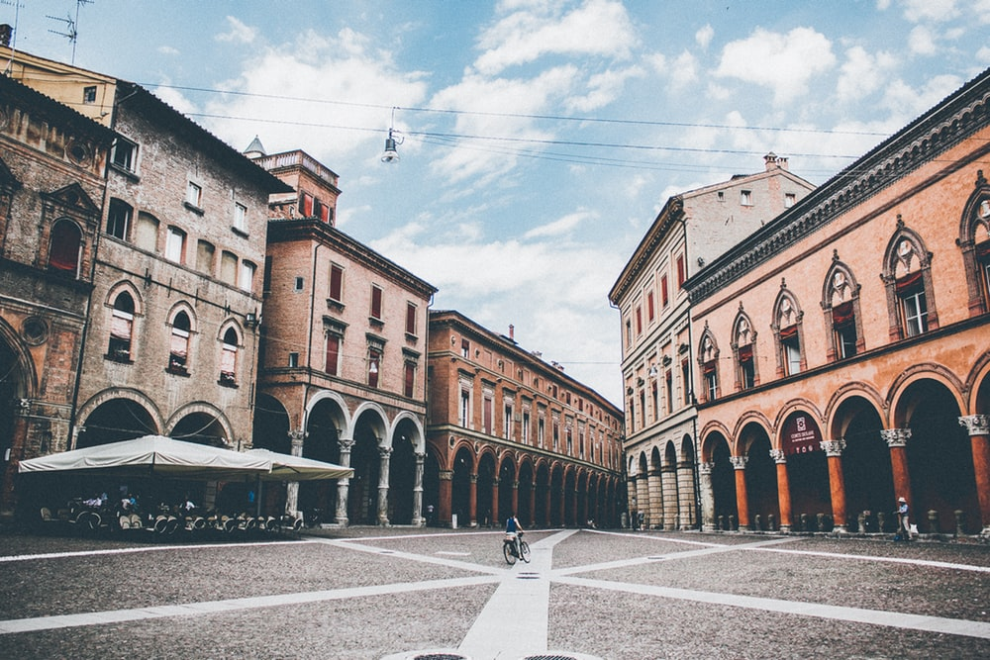
plaza
el
la
Notes:
Photo by Thaddaeus Lim on Unsplash (freely usable images)
You can use these slides to elicit the correct definite article for each noun that has just been presented.

Slide 4
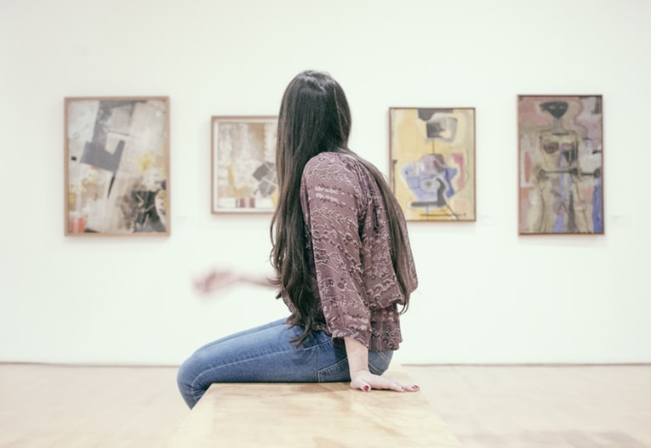
museo
el
la
Notes:
Photo by gilber franco on Unsplash (freely usable images)

Slide 5
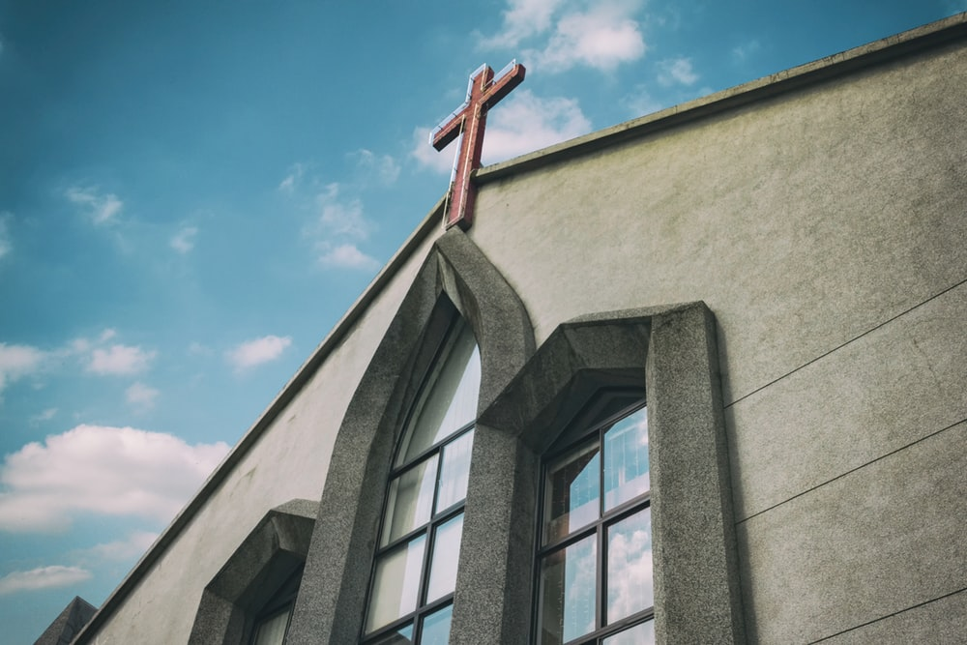
iglesia
el
la
Notes:
Photo by Daniel Tseng on Unsplash (freely usable images)

Slide 6
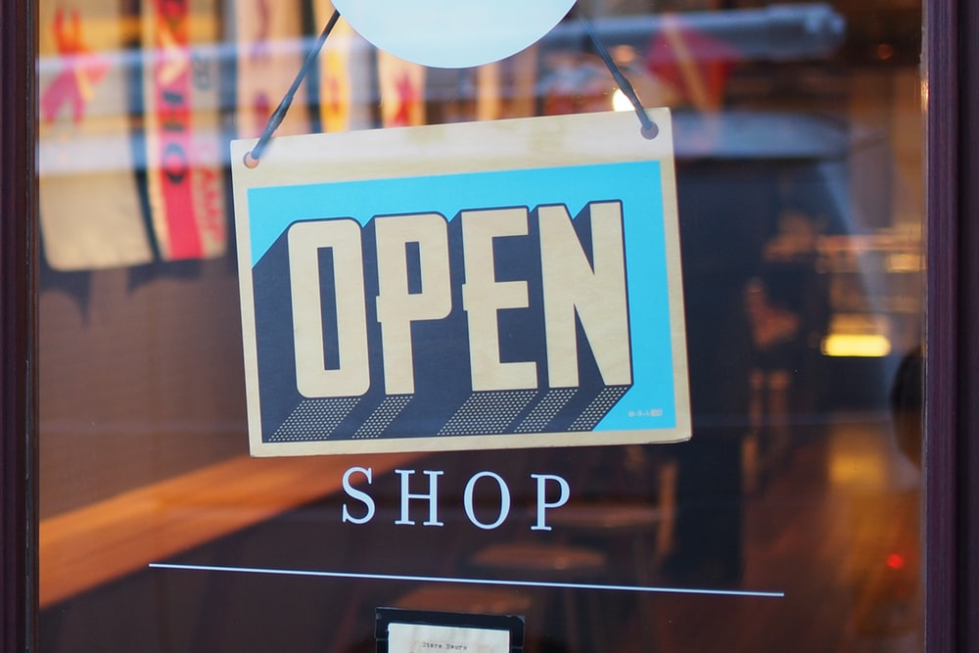
tienda
el
la
Notes:
Photo by Mike Petrucci on Unsplash

Slide 7
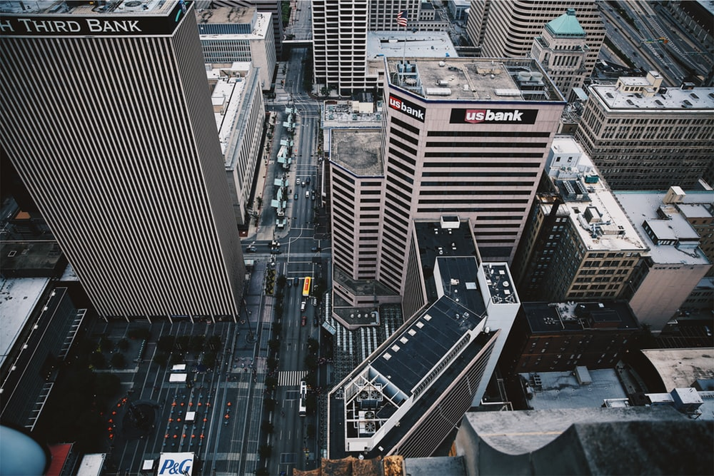
banco
el
la
Notes:
Photo by Jordan on Unsplash

Slide 8
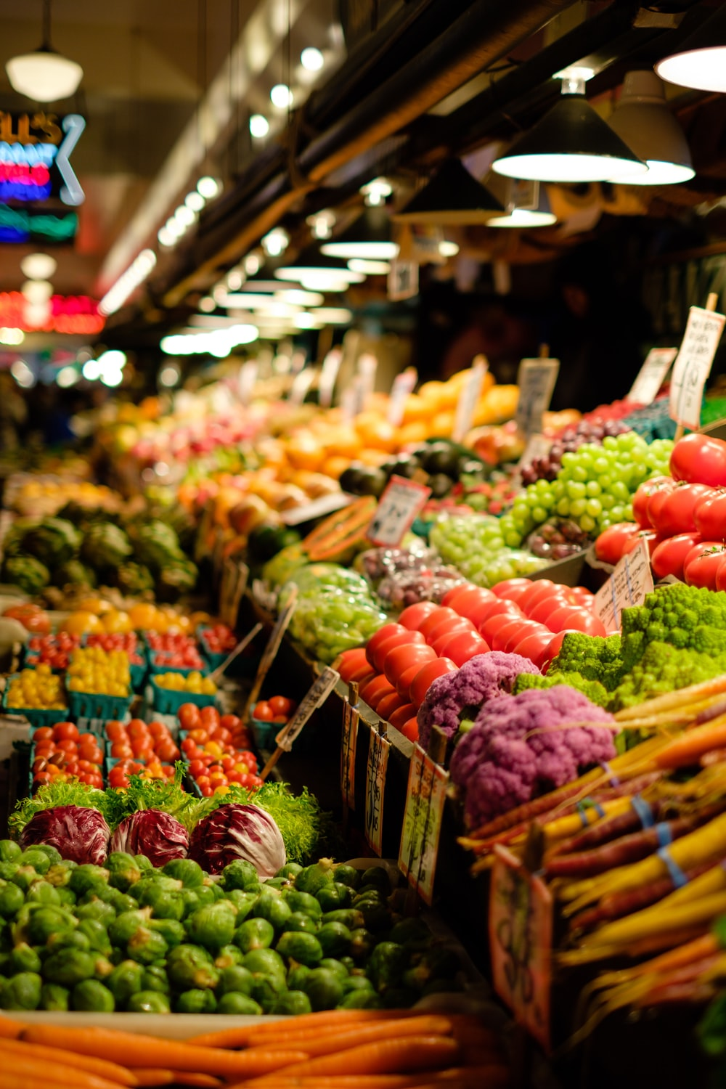
mercado
el
la
Notes:
Photo by Thomas Le on Unsplash

Slide 9
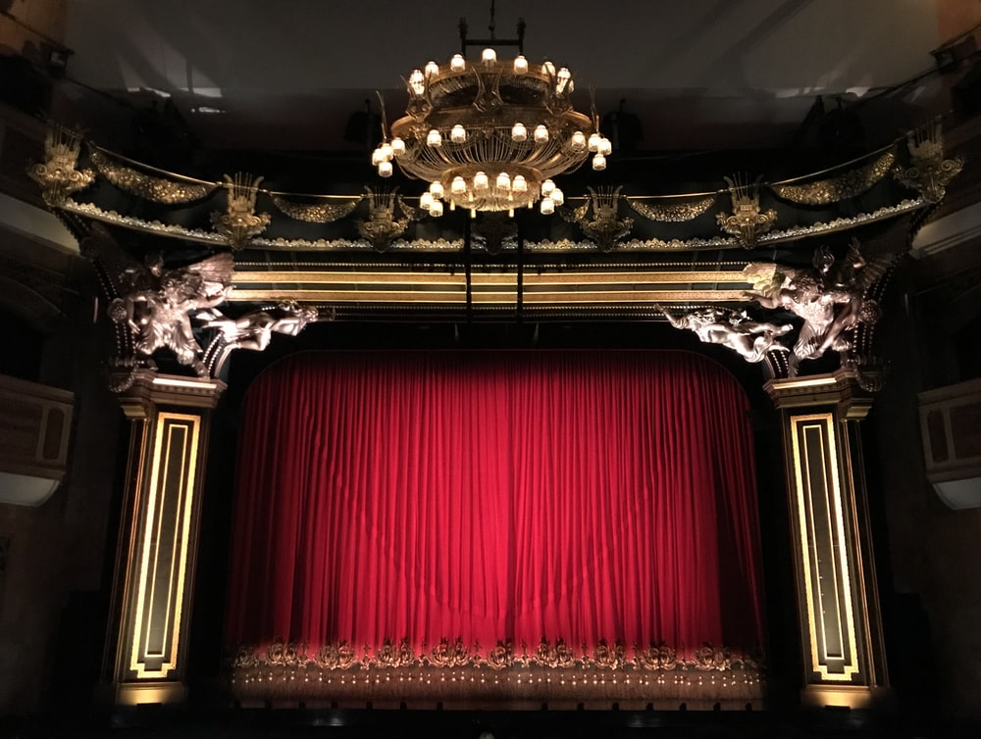
teatro
el
la
Notes:
Photo by Gwen Ong on Unsplash

Slide 10
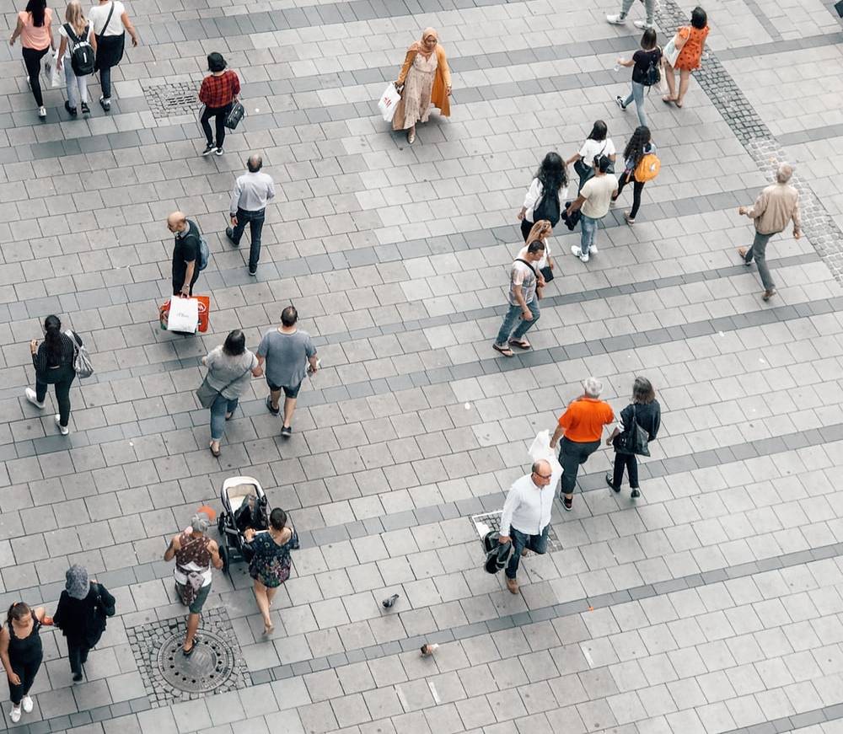
centro
el
la
centre
Notes:
Photo by Jan Kolar / VUI Designer on Unsplash

Slide 11
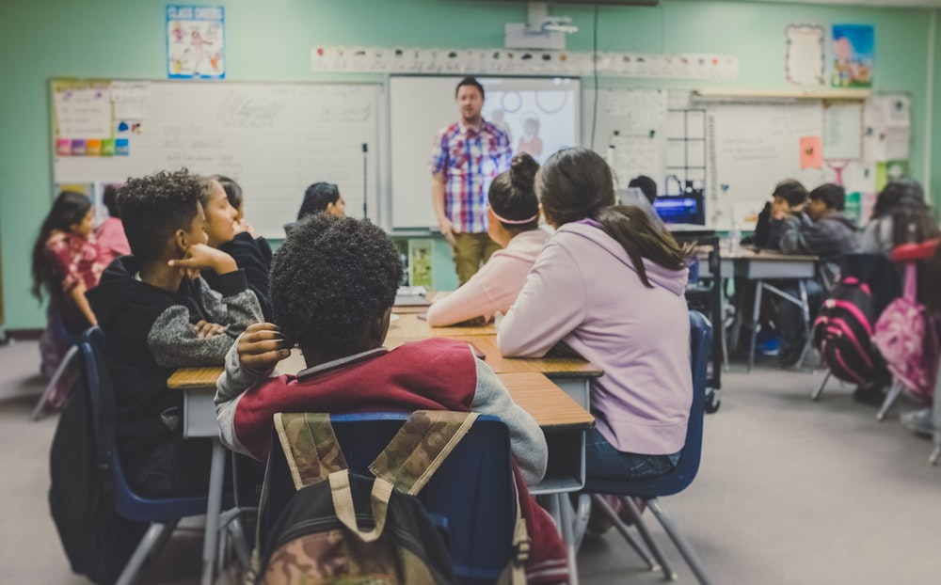
escuela
el
la
Notes:
Photo by NeONBRAND on Unsplash

Slide 12
la i _ _ _ _ _ _
la iglesia
el m_ _ _ _ _ _
c_ _ _ _
el c_ _ _ _ _
la t_ _ _ _ _
el t_ _ _ _ _
e_ _ _ _
el b_ _ _ _
la e _ _ _ _ _ _
l_
el m_ _ _ _
l _ _ _ _
e_
la p _ _ _ _
Notes:
Vocabulary revision
Click on the picture to reveal the answer

Slide 13
la i _ _ _ _ _ _
el m_ _ _ _ _ _
c_ _ _ _
el c_ _ _ _ _
el centro
la t_ _ _ _ _
el t_ _ _ _ _
e_ _ _ _
el b_ _ _ _
la e _ _ _ _ _ _
centre
l_
el m_ _ _ _
l _ _ _ _
e_
la p _ _ _ _
Notes:
Vocabulary revision
Click on the picture to reveal the answer

Slide 14
la i _ _ _ _ _ _
el m_ _ _ _ _ _
c_ _ _ _
el c_ _ _ _ _
la t_ _ _ _ _
el t_ _ _ _ _
e_ _ _ _
far
el b_ _ _ _
la e _ _ _ _ _ _
l_
el m_ _ _ _
l _ _ _ _
lejos
e_
la p _ _ _ _
Notes:
Vocabulary revision
Click on the picture to reveal the answer

Slide 15
la i _ _ _ _ _ _
el m_ _ _ _ _ _
c_ _ _ _
el c_ _ _ _ _
la t_ _ _ _ _
el t_ _ _ _ _
e_ _ _ _
la e _ _ _ _ _ _
el b_ _ _ _
la escuela
l_
el m_ _ _ _
l _ _ _ _
e_
la p _ _ _ _
Notes:
Vocabulary revision
Click on the picture to reveal the answer

Slide 16
la i _ _ _ _ _ _
el m_ _ _ _ _ _
c_ _ _ _
el c_ _ _ _ _
la t_ _ _ _ _
la tienda
el t_ _ _ _ _
e_ _ _ _
el b_ _ _ _
la e _ _ _ _ _ _
l_
el m_ _ _ _
l _ _ _ _
e_
la p _ _ _ _
Notes:
Vocabulary revision
Click on the picture to reveal the answer

Slide 17
la i _ _ _ _ _ _
el m_ _ _ _ _ _
c_ _ _ _
el c_ _ _ _ _
la t_ _ _ _ _
el t_ _ _ _ _
e_ _ _ _
the (masculine, singular)
el b_ _ _ _
la e _ _ _ _ _ _
l_
el m_ _ _ _
l _ _ _ _
e_
el
la p _ _ _ _
Notes:
Vocabulary revision
Click on the picture to reveal the answer

Slide 18
la i _ _ _ _ _ _
el m_ _ _ _ _ _
c_ _ _ _
el c_ _ _ _ _
la t_ _ _ _ _
el t_ _ _ _ _
e_ _ _ _
el b_ _ _ _
la e _ _ _ _ _ _
l_
el m_ _ _ _
l _ _ _ _
e_
la p _ _ _ _
la plaza
Notes:
Vocabulary revision
Click on the picture to reveal the answer

Slide 19
la i _ _ _ _ _ _
el m_ _ _ _ _ _
c_ _ _ _
el c_ _ _ _ _
la t_ _ _ _ _
el t_ _ _ _ _
e_ _ _ _
entre
between
el b_ _ _ _
la e _ _ _ _ _ _
l_
el m_ _ _ _
l _ _ _ _
e_
la p _ _ _ _
Notes:
Vocabulary revision
Click on the picture to reveal the answer

Slide 20
la i _ _ _ _ _ _
el m_ _ _ _ _ _
el mercado
c_ _ _ _
el c_ _ _ _ _
la t_ _ _ _ _
el t_ _ _ _ _
e_ _ _ _
el b_ _ _ _
la e _ _ _ _ _ _
l_
el m_ _ _ _
l _ _ _ _
e_
la p _ _ _ _
Notes:
Vocabulary revision
Click on the picture to reveal the answer

Slide 21
la i _ _ _ _ _ _
el m_ _ _ _ _ _
c_ _ _ _
el c_ _ _ _ _
la t_ _ _ _ _
el t_ _ _ _ _
e_ _ _ _
the (feminine, singular)
el b_ _ _ _
la e _ _ _ _ _ _
l_
el m_ _ _ _
la
l _ _ _ _
e_
la p _ _ _ _
Notes:
Vocabulary revision
Click on the picture to reveal the answer

Slide 22
la i _ _ _ _ _ _
el m_ _ _ _ _ _
c_ _ _ _
el c_ _ _ _ _
la t_ _ _ _ _
el t_ _ _ _ _
e_ _ _ _
el b_ _ _ _
la e _ _ _ _ _ _
el m_ _ _ _
l_
el museo
l _ _ _ _
e_
la p _ _ _ _
Notes:
Vocabulary revision
Click on the picture to reveal the answer

Slide 23
la i _ _ _ _ _ _
el m_ _ _ _ _ _
c_ _ _ _
cerca
el c_ _ _ _ _
la t_ _ _ _ _
el t_ _ _ _ _
e_ _ _ _
near
el b_ _ _ _
la e _ _ _ _ _ _
l_
el m_ _ _ _
l _ _ _ _
e_
la p _ _ _ _
Notes:
Vocabulary revision
Click on the picture to reveal the answer

Slide 24
la i _ _ _ _ _ _
el m_ _ _ _ _ _
c_ _ _ _
el c_ _ _ _ _
la t_ _ _ _ _
el t_ _ _ _ _
e_ _ _ _
el b_ _ _ _
la e _ _ _ _ _ _
el banco
l_
el m_ _ _ _
l _ _ _ _
e_
la p _ _ _ _
Notes:
Vocabulary revision
Click on the picture to reveal the answer

Slide 25
la i _ _ _ _ _ _
el m_ _ _ _ _ _
c_ _ _ _
el c_ _ _ _ _
la t_ _ _ _ _
el teatro
el t_ _ _ _ _
e_ _ _ _
el b_ _ _ _
la e _ _ _ _ _ _
l_
el m_ _ _ _
l _ _ _ _
e_
la p _ _ _ _
Notes:
Vocabulary revision
Click on the picture to reveal the answer

