Slide 1
Grammar
Word order with adverbs of time and location
Y7 German
Term 3.1 - Week 6
Natalie Finlayson/ Rachel Hawkes
Date updated: 21/05/20

Slide 2
Adverbs of time and place – WO1
Grammatik
As you know, the order of words in a simple German sentence is:
But what if we also want to say where Mia plays the clarinet?
If you want to use both a time adverb and a place adverb in a sentence, the time comes first.
T.P. – time, place
Mia
spielt
dienstags
Klarinette
Word order
1
SUBJECT
VERB
TIME ADVERB
OBJECT
im Orchester
Word order
1
PLACE ADVERB
Notes:
Scaffolded introduction to the TMP rule (the ‘M’ element will be introduced in Year 8)

Slide 3
Adverbs of time and place – WO2
Grammatik
You can move either the time adverb or the place adverb to the start for emphasis.
This triggers word order 2. The subject moves after the verb to make space for the adverb.
Mia
spielt
dienstags
im Orchester
Klarinette
Word order
1
SUBJECT
VERB
TIME ADVERB
PLACE ADVERB
OBJECT
Dienstags
spielt
Mia
im Orchester
Klarinette
TIME ADVERB
VERB
SUBJECT
PLACE ADVERB
OBJECT
Word order
2
Im Orchester
spielt
Mia
dienstags
Klarinette
PLACE ADVERB
VERB
SUBJECT
TIME ADVERB
OBJECT

Slide 4
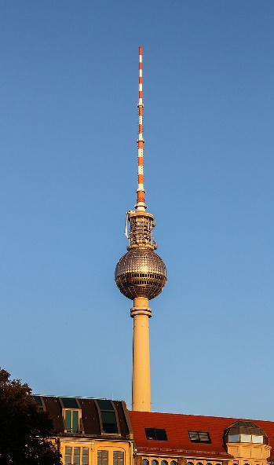
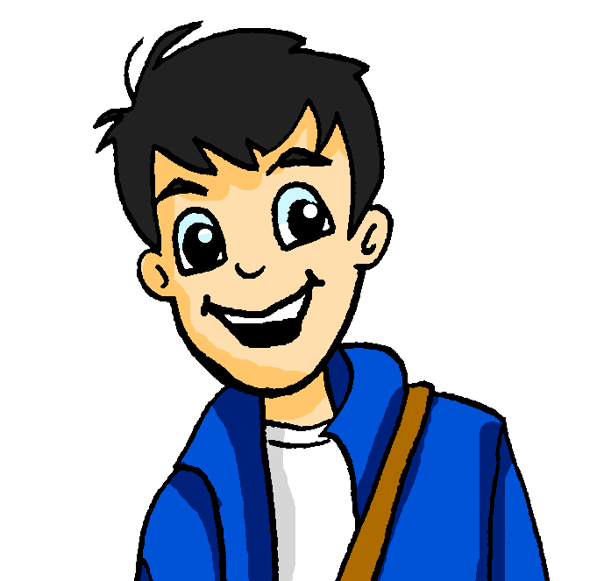
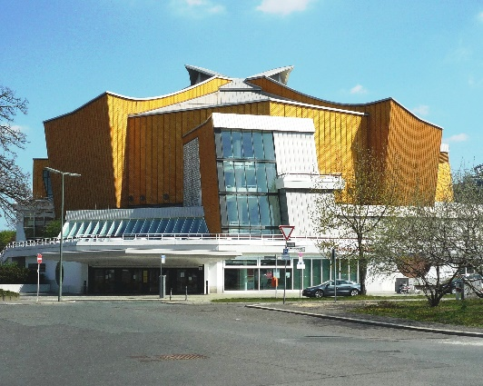
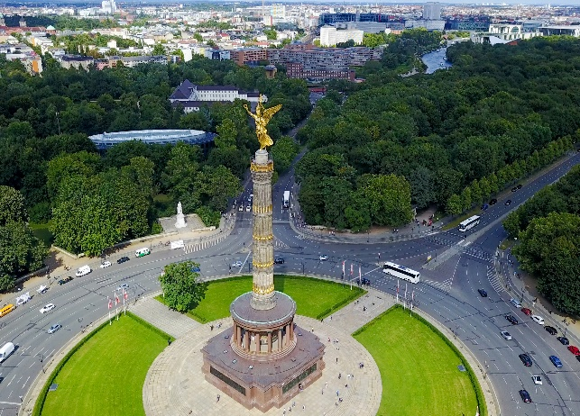
Was gibt es in Berlin?
lesen
Currywurst
Wolfgang macht Pläne für Alastairs Woche in Berlin.
Was sagt er? Schreib T (Tag), V (Verb) oder O (Ort).
der Berliner Fernsehturm
1. Am Montag lernen wir in der Schule Deutsch.
2. Wir gehen am Dienstag am Tiergarten in den Zoo.
3. Am Alexanderplatz sehen wir am Mittwoch den Fernsehturm.
4. Wir bleiben am Donnerstag zu Hause und chillen.
5. Am Freitag gibt es in der Philharmonie ein Konzert.
6. Im Restaurant essen wir am Samstag Currywurst.
7. In der Stadt suchen wir am Sonntag Souvenirs.
1
2
3
4
5
6
7
8
9
10
11
12
13
14
die Berliner Philharmonie
Tiergarten
Notes:
This slide practises word order in complex sentences with adverbs of both time and place.
Each sentence contains a verb, a day of the week, and a place in Berlin. Two of the three sentence components are blocked out in each case. Students must use their knowledge of word order (time before place in WO1, WO2 if sentence starts with a time or place) and process of elimination to work out what types of words are missing from the sentences.
On clicks, numbered tiles disappear one by one to reveal the answers.
As a follow-up activity, elicit translations of full sentences to give students a flavour of cultural highlights in Berlin. Students can use the pictures and their knowledge of German and their knowledge of English to help them work out the meanings of the place names!

Slide 5
Wer, was, wo und wann?
sprechen
SUBJECT
VERB
TIME ADVERB
PLACE ADVERB
OBJECT
ich
spielen
am Montag
in der Schweiz
einen Hut
du
essen
nie
in der Bibliothek
das Auto
er
suchen
immer
im Theater
eine Hose
sie
sehen
jeden Tag
im Zug
einen Hund
die Katze
hören
manchmal
in der Stadt
Gitarre
wir
bekommen
samstags
zu Hause
Musik
sie (plural)
putzen
oft
im Garten
ein Butterbrot
die Tiere
tragen
jede Woche
auf der Party
Kekse
Notes:
Classroom version (a self-study listening extension for this activity may be found on slide 34.)
NB: A more complex version of this activity, in which the adverbs of place are in both dative and accusative case, can be found on slide 35.
In this oral activity, students revise the vocabulary in this weeks’ revisiting sets and practise building sentences using word order 1 and 2 with adverbs of time and place.
Suggested procedure
1/ Teacher begins by asking students to identify what the words in each column have in common – what type of words are they? What role do they play in the sentence? Column headings are revealed on clicks.
2/ Check students recognise the case forms in the yellow and pink columns (all Row 3 [dative] in this version for the yellow column).
3/ Students work in pairs. Teacher instructs students that they are going to orally build sentences containing one word from each column, and say these out loud to their partners. They can pick any word from the column – nonsense sentences are okay and even encouraged, as long as students can translate what they have said correctly! They must say use a different set of words from their partner.
4/ Teacher starts the game by saying ‘create a sentence beginning with a pronoun’. Remind students of the need to agree the verb with the pronoun they choose, and the correct word order. Students say their sentences while teacher circulates. Teacher elicits examples from students.
5/ Teacher continues the game by saying ‘create a different sentence beginning with a time adverb’. Remind students of the need to agree the verb with the pronoun they choose, and the correct word order. Students say their sentences while teacher circulates. Teacher elicits examples from students.
6/ Teacher finishes the game by saying ‘create a different sentence beginning with a place adverb’. Remind students of the need to agree the verb with the pronoun they choose, and the correct word order. Students say their sentences while teacher circulates. Teacher elicits examples from students.
7/ Continue as many times as desirable/necessary!
Option: teachers may wish to print this slide can cut out the words, creating a set of cards to each pair. This is worth the extra effort because students are able to physically move the words around and see the colour order change, getting a real feel for sentence structure.

Slide 6
Wer, was, wo und wann?
hören
Mia macht auch Sätze. Ihre Sätze sind ziemlich komisch!* Was sagt sie? Schreib auf Englisch.
Look at your notes. Would it sound better to change the word order in English?
1
The cat always listens to music in the library.
________________________________________________
2
He often looks for a hat in town.
________________________________________________
3
I’m eating a sandwich in the theatre on Monday.
________________________________________________
4
You never wear trousers at home on Saturdays!
________________________________________________
5
We sometimes see a dog at the party!
________________________________________________
The position of adverbs is different in English! Time adverbs are often the last idea in the sentence.
6
They clean the car in the garden every day.
________________________________________________
7
She plays the guitar in the train every week.
________________________________________________
8
The animals in Switzerland often receive/get biscuits!
________________________________________________
Notes:
NB: This is the home-learning follow-up activity to the speaking exercise on slide 33. It can also be used for additional in-class listening practice.
Transcript
1. Die Katze hört immer in der Bibliothek Musik.
2. Oft sucht er in der Stadt einen Hut.
3. Am Montag esse ich im Theater ein Butterbrot.
4. Samstags trägst du nie zu Hause eine Hose !
5. Manchmal sehen wir auf der Party einen Hund!
6. Jeden Tag putzen sie im Garten das Auto.
7. Im Zug spielt sie jede Woche Gitarre.
8. In der Schweiz bekommen die Tiere oft Kekse.

Slide 7
Wer, was, wo und wann?
sprechen
SUBJECT
VERB
TIME ADVERB
PLACE ADVERB
ich
schwimmen
am Montag
in die Schweiz
du
fahren
nie
in die Bibliothek
er
gehen
immer
im Theater
sie
tanzen
jeden Tag
im Zug
die Katze
reden
manchmal
in die Stadt
wir
bleiben
samstags
zu Hause
sie (plural)
springen
oft
nach Schottland
die Tiere
schlafen
jede Woche
auf der Party
Notes:
Classroom version (a self-study listening extension for this activity may be found on slide 36.)
NB: A less complex version of this activity, in which all place adverbs are in dative case, can be found on slide 33.
In this oral activity, students revise the vocabulary in this weeks’ revisiting sets and practise building sentences using word order 1 and 2 with adverbs of time and place.
Suggested procedure
1/ Teacher begins by asking students to identify what the words in each column have in common – what type of words are they? What role do they play in the sentence? Column headings are revealed on clicks.
2/ Check students recognise the cases in the yellow column, and whether or not these need to go with verbs of movement.
3/ Students work in pairs. Teacher instructs students that they are going to orally build sentences containing one word from each column, and say these out loud to their partners. They can pick any word from the column – nonsense sentences are okay and even encouraged, as long as students can translate what they have said correctly! They must say use a different set of words from their partner.
4/ Teacher starts the game by saying ‘create a sentence beginning with a pronoun’. Remind students of the need to agree the verb with the pronoun they choose, the correct word order, and the need to think about verb and case. Students say their sentences while teacher circulates. Teacher elicits examples from students.
5/ Teacher continues the game by saying ‘create a different sentence beginning with a time adverb’. Remind students of the need to agree the verb with the pronoun they choose, the correct word order, and the need to think about verb and case. Students say their sentences while teacher circulates. Teacher elicits examples from students.
6/ Teacher finishes the game by saying ‘create a different sentence beginning with a place adverb’. Remind students of the need to agree the verb with the pronoun they choose, the correct word order, and the need to think about verb and case. Students say their sentences while teacher circulates. Teacher elicits examples from students.
7/ Continue as many times as desirable/necessary!
Option: teachers may wish to print this slide can cut out the words, creating a set of cards to each pair. This is worth the extra effort because students are able to physically move the words around and see the colour order change, getting a real feel for sentence structure.

Slide 8
Wer, was, wo und wann?
hören
Mia macht auch Sätze. Ihre Sätze sind ziemlich komisch!* Was sagt sie? Schreib auf Englisch.
Look at your notes. Would it sound better to change the word order in English?
1
I jump into the library every day!
________________________________________________
2
You swim to Scotland every day!
________________________________________________
3
The cat sleeps in the theatre on Saturdays.
________________________________________________
4
The animals are dancing at the party on Monday.
________________________________________________
5
He sometimes goes to school …
________________________________________________
The position of adverbs is different in English! Time adverbs are often the last idea in the sentence.
6
She always stays at home!
________________________________________________
7
We go to Switzerland every week.
________________________________________________
8
They never speak in the train.
________________________________________________
Notes:
NB: This is the home-learning follow-up activity to the speaking exercise on slide 35. It can also be used for additional in-class listening practice.
1. Ich springe oft in die Bibliothek!
2. Du schwimmst jeden Tag nach Schottland!
3. Samstags schläft die Katze im Theater.
4. Am Montag tanzen die Tiere auf der Party.
5. Manchmal geht er in die Schule …
6. Zu Hause bleibt sie immer !
7. In die Schweiz fahren wir jede Woche.
8. Im Zug reden sie nie.

