Slide 1
German – Word order
Questions vs statements

Slide 2
Asking questions in German
grammar explanation
Word order
One way of asking questions in German is by moving the verb into first position in the sentence.
Du | bist | intelligent.
Bist | du | intelligent?
Du | kannst | mir helfen.
Kannst | du | mir helfen?
Der Junge | sieht | den Hund
Sieht | der Junge | den Hund?
Inge Alferink / Rachel Hawkes / Emma Marsden
Notes:
Teacher note: Short grammar explanations can never be fully complete. (For example, of course, some verbs don’t follow this pattern as they are irregular). But the aim is to get pupils to learn a ‘default’, main pattern and then introduce the complexities and exceptions to the rule later. In any case, evidence suggests that it is the practice activities that are most helpful for learning (rather than these grammar explanations). But … these short grammar explanations do seem to speed up some learners in becoming accurate in the practice activities that follow.

Slide 3
Asking questions in German
grammar explanation
Word order
Learners of German might not be aware of this.
Why?
Intonation gives away whether a sentence is a statement or a question as questions go up at the end.
In written language the question mark or full stop already tells you if a sentence is a question or a statement.
It is therefore easy to ignore word order.
The following activities will help you learn to pay attention to word order in statements and questions.
Inge Alferink / Rachel Hawkes / Emma Marsden

Slide 4
Traumfrau
lesen
Austen Schmitts Traumfrau
Journalist Jörg interviewed Austen Schmitt. He asked the film star about his perfect woman. However, Jörg was very excited and did not take notes properly. Now he cannot decide which of the sentences were his actual questions and which were Austen's answers.
Can you help Jörg out by looking at the word order?
Put "?" for questions and "." for statements.
Remember!
Verbs come first in questions and second in statements!
Inge Alferink / Rachel Hawkes / Emma Marsden

Slide 5
Reading
1. | Ist sie schön |  | 11. | Hat sie grüne Augen
2. | Hat sie Humor |  | 12. | Sie hat braune Augen
3. | Sie hat schwarze Haare |  | 13. | Sie ist sehr lustig
4. | Sie liebt Kinder |  | 14. | Ist sie sportlich
5. | Sie ist sehr intelligent |  | 15. | Ist sie freundlich
6. | Ist sie Schauspielerin |  | 16. | Sie kocht gern
7. | Mag sie Tiere |  | 17. | Sie geht gern ins Kino
8. | Kann sie singen |  | 18. | Sie ist freundlich
9. | Sie spielt Klavier |  | 19. | Hat sie eine Schwester
10. | Sie liest gern |  | 20. | Sie ist keine Schauspielerin
Inge Alferink / Rachel Hawkes / Emma Marsden
Notes:
TASK SLIDE Students can simply do the task by writing numbers 1-20 and recording ? or . next to each. Alternatively, if needed for particular students, this slide could be printed.
This activity uses the third person singular
Frequency rankings
Verbs: sein (3), haben (7), lieben (816), mögen (151), spielen (197), lesen (323), kochen (1005), gehen (69), singen (979)
Nouns: Haar (792), Kind (106), Schauspieler (3646), Tier (670), Klavier (2775), Auge (236), Kino (1825), Schwester (776)
Other: schön (164), humor (>5000), schwarz (451), intelligent (3465), gern (235), grün (556), braun (2178), lustig (2262), sehr (70), sportlich (1902), Freundlich (1552)
Source: Jones, R.L., & Tschirner, E. (2006 ). A Frequency Dictionary of German. Routledge

Slide 6
Reading
Antworten
1. | Ist sie schön | ? | 11. | Hat sie grüne Augen | ?
2. | Hat sie Humor | ? | 12. | Sie hat braune Augen | .
3. | Sie hat schwarze Haare | . | 13. | Sie ist sehr lustig | .
4. | Sie liebt Kinder | . | 14. | Ist sie sportlich | ?
5. | Sie ist sehr intelligent | . | 15. | Ist sie freundlich | ?
6. | Ist sie Schauspielerin | ? | 16. | Sie kocht gern | .
7. | Mag sie Tiere | ? | 17. | Sie geht gern ins Kino | .
8. | Kann sie singen | ? | 18. | Sie ist freundlich | .
9. | Sie spielt Klavier | . | 19. | Hat sie eine Schwester | ?
10. | Sie liest gern | . | 20. | Sie ist keine Schauspielerin | .
Inge Alferink / Rachel Hawkes / Emma Marsden
Notes:
ANSWER SLIDE Answers revealed on individual clicks.
Frequency rankings
Verbs: sein (3), haben (7), lieben (816), mögen (151), spielen (197), lesen (323), kochen (1005), gehen (69), singen (979)
Nouns: Haar (792), Kind (106), Schauspieler (3646), Tier (670), Klavier (2775), Auge (236), Kino (1825), Schwester (776)
Other: schön (164), humor (>5000), schwarz (451), intelligent (3465), gern (235), grün (556), braun (2178), lustig (2262), sehr (70), sportlich (1902), Freundlich (1552)
Source: Jones, R.L., & Tschirner, E. (2006 ). A Frequency Dictionary of German. Routledge

Slide 7
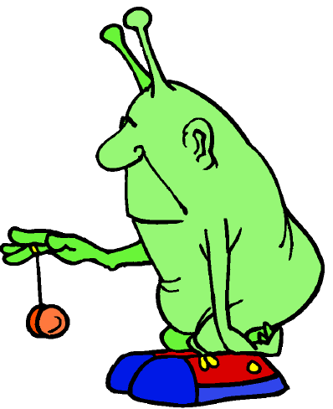
Aliens
hören
Remember!
Verbs come first in questions and second in statements.
Marcella comes from Mars. She has absorbed German but not yet learned how to use question intonation.
Listening to her word order, can you decide
• which of the following sentences are questions about humans?
• which ones are statements she is making about Martians?
Put "?" for questions and "." for statements.
Inge Alferink / Rachel Hawkes / Emma Marsden
Notes:
Teacher note: this activity uses third person plural, whereas the previous activity used third person singular. As the focus is on word order and not person / number this shouldn’t detract too much from the grammar target.

Slide 8
Aliens
Beispiel
hören
?
1
2
3
4
5
6
7
8
9
10
11
12
Inge Alferink / Rachel Hawkes / Emma Marsden
Notes:
NB: This slide is an example to do first with students and correct. The next slide has all the audio, and the following slide has the answers. Transcript
1. Haben sie Haare
2. Sie haben zwei Beine
3. Sind sie groß
4. Sie sind grün
5. Haben sie zwei Augen
6. Sie haben keine Haare
7. Sie lesen gern
8. Können sie lesen
9. Können sie fliegen
10. Sie sprechen viele Sprachen
11. Sie sind sehr intelligent
12. Sind sie Freundlich
Frequency rankings
Verbs: haben (7), sein (3), lessen (323), können (23), fliegen (930), sprechen (157)
Nouns: Haar (792), Bein (940), Auge (236), Sprache (367)
Other: groß (74), grün (556), gern (235), viel (60), sehr (70), intelligent (3465), Freundlich (1552)

Slide 9
Aliens
hören
?
1
2
3
4
5
6
7
8
9
10
11
12
Inge Alferink / Rachel Hawkes / Emma Marsden
Notes:
Transcript
1. Haben sie Haare
2. Sie haben zwei Beine
3. Sind sie groß
4. Sie sind grün
5. Haben sie zwei Augen
6. Sie haben keine Haare
7. Sie lesen gern
8. Können sie lesen
9. Können sie fliegen
10. Sie sprechen viele Sprachen
11. Sie sind sehr intelligent
12. Sind sie Freundlich
Frequency rankings
Verbs: haben (7), sein (3), lessen (323), können (23), fliegen (930), sprechen (157)
Nouns: Haar (792), Bein (940), Auge (236), Sprache (367)
Other: groß (74), grün (556), gern (235), viel (60), sehr (70), intelligent (3465), Freundlich (1552)

Slide 10
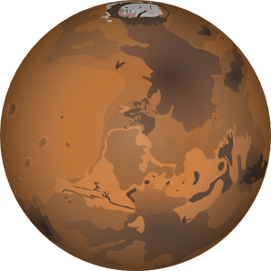
Aliens
Antworten
hören
.
?
?
1
2
3
.
.
?
4
5
6
.
?
?
7
8
9
.
.
?
10
11
12
Inge Alferink / Rachel Hawkes / Emma Marsden

Slide 11
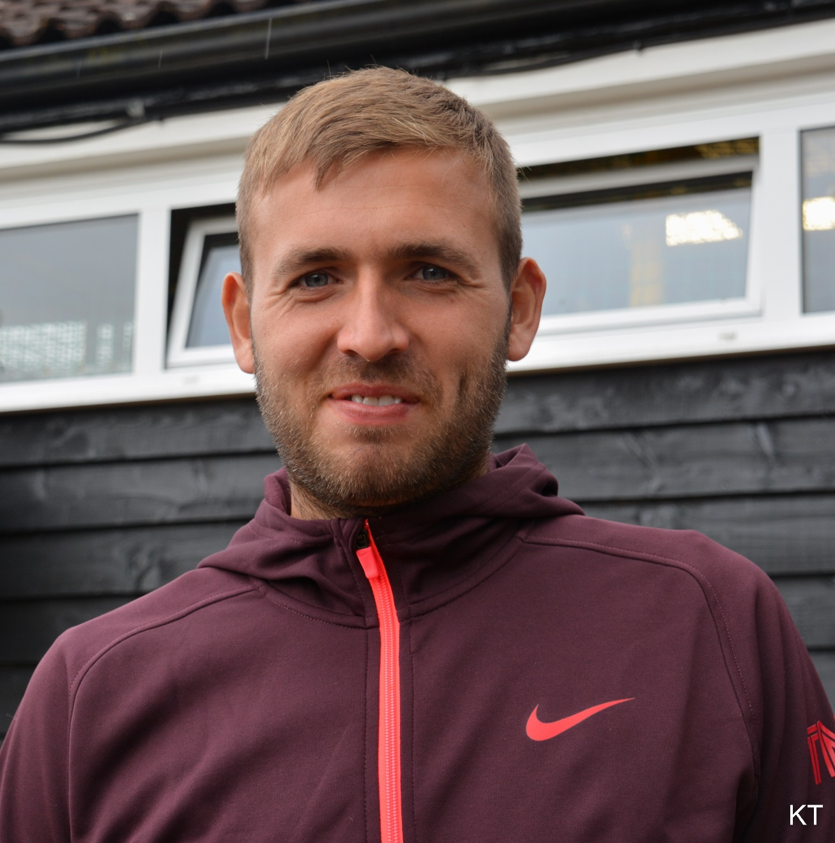
Carine06 from UK [CC BY-SA 2.0 (https://creativecommons.org/licenses/by-sa/2.0)]
Notes:
Note: If students would benefit from further practice before the speaking and writing pair activity on slides 13 - 15 , they could do a listen and write task with a mixture of questions and statements, then add the punctuation to them, and check their answers by putting any that they recorded as questions to the teacher who will answer them. The task statements and questions could be selected to focus on a photo, where some of the information is available (i.e. it can be see that the person is wearing glasses and has grey hair) but that other information cannot be seen. The teacher will have ‘answers’ to those questions. The students only see the photo during the ‘feedback’ phase. This slide is an example of this sort of activity.
Teacher dictates. Students write, and add punctuation. They can ask questions about meaning or spelling. When all 9 are complete, reveal the photo (click on the image to reveal the photo of Dan Evans underneath). Elicit the statements and questions from students, referring to the photo they can now see. The statements are things that can be seen. The questions are things that can’t be seen and only the teacher can answer, providing an information gap.
E.g. Er hat blonde Haare. Ja, das ist richtig, nicht? Er hat blonde Haare. OK, Nummer zwei? Teacher transcript: 1 Er hat blonde Haare. 2 Er trägt keine Brille. 3 Trägt er Sportschuhe?
4 Mag er Fußball? 5 Er hat blaune Augen. 6 Er trägt einen Kapuzenpulli. 7 Wohnt er in England? 8 Ist er dreißig Jahre alt?
9 Er hat blaue Augen.
ANSWERS to the questions for the teacher to answer: Das ist Dan Evans, britisher Tennisspieler. 3 Ja, er trägt Sportschuhe. 4 Ja, aber er liebt Tennis. Er ist Tennisprofi / Tennisspieler. 7 Ja, er wohnt in Birmingham, in England. 8 Nein, er ist 29 Jahre alt. Sein Geburtstag ist am 23. Mai. Er ist in 1990 geboren.

Slide 12
Ja oder Nein!
sprechen / schreiben
Instructions
You each have a picture of a person. Don’t show it to your partner!
Ask each other questions to find out what the person looks like and what their interests are.
Partner A asks the questions first and circles the answers on their picture grid. Partner B must begin their answer with ‘Ja’ or ‘Nein’ (yes / no!). If they answer ‘nein’ they must provide the correct statement.
Then, swap round.
After you have both collected the information, write it in the last column using full sentences.
Inge Alferink / Rachel Hawkes / Emma Marsden
Notes:
Yes / No game! Picture description task on the same topic, i.e. personal characteristics (Hat sie grüne Augen? Trägt sie eine Jeans).
Each student has a picture and a question grid. Using the question grid they take it in turns to ask each other questions about the other person’s picture. Encourage them to do the following:
When asking questions, use a variety of verbs, so not just haben, but also tragen, and mögen.
The person answering has to start their answer with Yes or No.
If they answer no, then they must provide the correct information.
Answer in a full sentence. Hat sie blaue Haare? Ja, sie hat blaue Haare. Nein, sie hat grüne Haare. This will help contrast question and statement word order.
Write down the whole sentence and not just the noun
Vocab frequencies:
Braun (2178)
Blau (1016)
Grün (556)
Schwarz (451)
Blond (3559)
Auge (236)
Haar (792)
Jeans (>5000)
T-shirt (>5000)
Kleid (1682)
Mantel (2544)
Hut (2689)
Brille (3423)
Hijab (>5000)
Musik (469)
Film (524)
Buch (295)
Tennis (2948)
Fußball (1497)
Schwimmen (1832)

Slide 13
1
2
3
4
5
6
Inge Alferink / Rachel Hawkes / Emma Marsden
Notes:
Question grid. Use the illustrations to form questions about the other person’s picture. Next, write a sentence with the correct feature in the last box on each line.

Slide 14
Bild A
sprechen / schreiben
Inge Alferink / Rachel Hawkes / Emma Marsden
Notes:
Picture A

Slide 15
Bild B
sprechen / schreiben
Inge Alferink / Rachel Hawkes / Emma Marsden
Notes:
Picture B

Slide 16
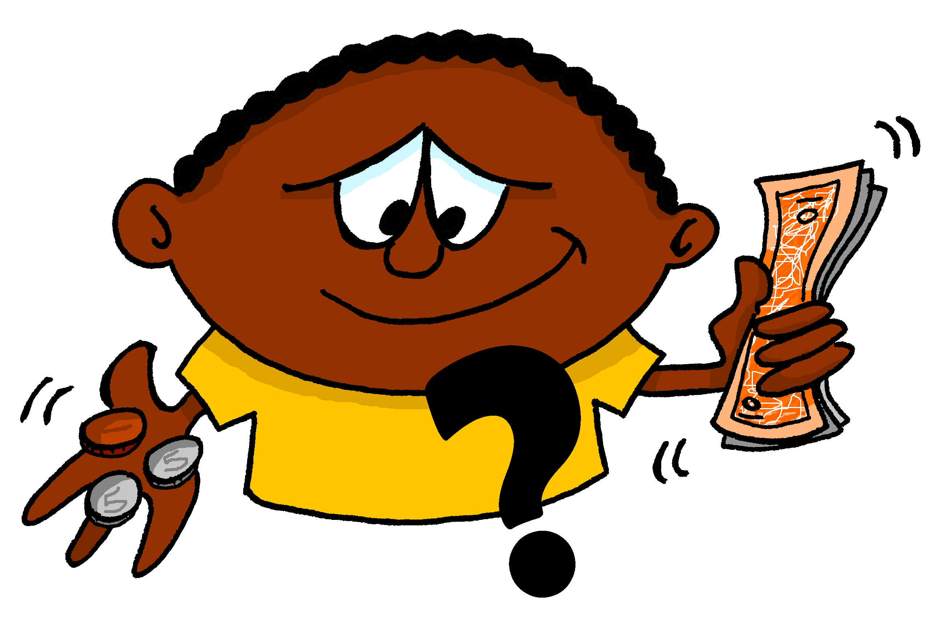
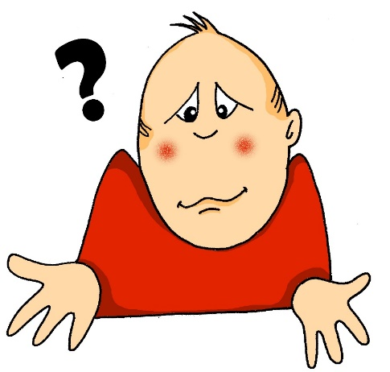
A | B | C
D | E | F
G | H | I
Images - Steve Clarke
Rachel Hawkes
Notes:
Revise questions words in preparation for the next activity if teacher thinks it is necessary.
Use the images to elicit the question words and/or a whole question

Slide 17
Wie ist die Frage?
Wie gehst du zur Schule?
Wo ist Niko?
Wann kommt der Zug?
Wer ist dein Mathelehrer?
Was denkst du?
Warum sagst du das?
Welcher Sport ist der beste?
Wie viel kostet das?
Wie viele Wörter gibt es?
Rachel Hawkes
Notes:
Revise questions words in preparation for the next activity if teacher thinks it is necessary.
Click on a cloud to reveal the question word underneath.
Frequency rankings
wie (28)
wo (94)
wer (173)
was (39)
wann (583)
welch (138)
warum (246)

Slide 18
Wir treffen uns
schreiben
Wir treffen uns…
You are arranging by chat to meet up with a friend.
Write each other messages using the information on your cards. When you have agreed on an activity, day, time, and location, fill in the details in your calendar.
Make sure each person uses at least 4 questions and 4 statements.
Inge Alferink / Rachel Hawkes / Emma Marsden
Notes:
Meaningful practice – this writing exercise is designed to practise using questions and statements while allowing for more freedom and flexibility in language production. The activity includes questions that use subject-verb inversion, but also has the potential to bring in questions formed by using question words. Pupils will have learned those previously. This is a sentence level production activity in an interactive setting.
The scenario imagines using chat, but in a classroom setting pupils could write messages on pieces of paper.

Slide 19
Wir treffen uns
schreiben
Person A
You:
Love going to the cinema, but can’t stand concerts
Are especially interested in romantic comedies, dramas, and action films
Are free all week except Wednesday
Work until 16:30
Can take the train into town
Person B
You:
Love going to the concerts and the cinema
Are especially interested in sci-fi, horror, and action films
Already have plans for Monday, Tuesday, and Friday
Work until 18:00
Live in the city centre
Inge Alferink / Rachel Hawkes / Emma Marsden

Slide 20
Kalender
schreiben
____________________
____________________
____________________
____________________
____________________
Inge Alferink / Rachel Hawkes / Emma Marsden
Notes:
Wann? When: Day and time
Was? What to do? cinema or concert? Welcher? Which film? (some negotiation of type will take place and lead to the selection of a current film.
Wo? – Where? where to see the film?

