Slide 1
Present vs Perfect tense(avoir)
1st person singular [I]

Slide 2
Things that have happened in the past: The Perfect Tense (for most verbs!)
To talk about an event in the past, pay attention to the verb.
Before the main verb (which expresses the meaning of the verb), there is another verb, an ‘auxiliary’. This auxiliary tells us that the event was completed in the past.
The auxiliary is often a small sound that is difficult to hear or notice when you are reading!
Here’s how you talk about the past:
Je = I
‘The first person singular’
Present (now) Completed in the past
je fais (I do / make)
je dis (I say / tell)
→ j’ai fait (I did / made)
→ j’ai dit (I said / told)
Emma Marsden / Victoria Hobson

Slide 3
Things that have happened in the past: The Perfect Tense (for most verbs!)
The main verb (expressing the actual meaning) also has to change.
Present (now) Completed in the past
regarde (watch) → regardé (watched)
regardons (we watch) → regardé (watched)
But the é at the end of main verbs is not enough. It does not tell us the event is in the past.
We need the auxiliary to tell us the event is in the past and complete.
Emma Marsden / Victoria Hobson

Slide 4
Écouter
Quand?
Listen to these people talking about what they normally do at the weekend and what they did last weekend. Decide whether each sentence is about the past or the present (what normally happens now). The only clue is whether you hear: ‘je’ (I + something that happens regularly), or j’ai (I + past event).
 | Normalement |  | Le weekend dernier
 | Normalement |  | Le weekend dernier
 | Normalement |  | Le weekend dernier
 | Normalement |  | Le weekend dernier
 | Normalement |  | Le weekend dernier
 | Normalement |  | Le weekend dernier
1
2
3
4
5
6
Emma Marsden / Victoria Hobson
Notes:
Note to teacher: Notice that these main verbs (past participles) do not sound any different in the present (fais) or past (fait) – so the only cue that the learners have is the difference between ‘je’ and ‘j’ai’.
Click each orange number to activate the audio. Each sentence is said twice. You can click the number again to hear again.
Answers appear on each mouse click. To complete the task, students can either write 1-6 and either N for Normalement and WD for weekend dernier OR teachers can print out the following slides for them to use.
Verb frequency rankings (1 is the most common word in French): faire (25); dire (37); finir (534);
Source: Londsale, D., & Le Bras, Y. (2009). A Frequency Dictionary of French: Core vocabulary for learners London: Routledge.
Transcript
Je fais les devoirs
Je dis bonjour
J’ai fini les activités
J’ai dit au revoir
Je finis à cinq heures
J’ai fait de l’exercice

Slide 5
Écouter
Quand?
For 7-12, the main verb can’t be heard! Remember: if you hear ‘je’, the person is talking about something they do regularly in the present. If you hear ‘j’ai’, they are talking about something that they did in the past.
 | Normalement |  | Le weekend dernier
 | Normalement |  | Le weekend dernier
 | Normalement |  | Le weekend dernier
 | Normalement |  | Le weekend dernier
 | Normalement |  | Le weekend dernier
 | Normalement |  | Le weekend dernier
7
8
9
10
11
12
Notes:
Transcript
7) Je … dans un restaurant
8) J’ai … un film au cinema
9) J’ai … un concert
10) Je … au hockey
11) Je … beaucoup de sports
12) J’ai … avec mes amis

Slide 6
Écouter
Quand?
Listen to these people talking about what they normally do at the weekend and what they did last weekend. Decide whether each sentence is about the past or the present (what normally happens now). The only clue is whether you hear: ‘je’ (I + something that happens regularly), or j’ai (I + past event).
1 | Normalement |  | Le weekend dernier
2 | Normalement |  | Le weekend dernier
3 | Normalement |  | Le weekend dernier
4 | Normalement |  | Le weekend dernier
5 | Normalement |  | Le weekend dernier
6 | Normalement |  | Le weekend dernier
Emma Marsden / Victoria Hobson
Notes:
Slides to print for student activity, if required. Print two to a slide (5 & 6) for both parts of the task.

Slide 7
Quand?
For 7-12, the main verb can’t be heard! Remember: if you hear ‘je’, the person is talking about something they do regularly in the present. If you hear ‘j’ai’, they are talking about something that they did in the past.
7 | Normalement |  | Le weekend dernier
8 | Normalement |  | Le weekend dernier
9 | Normalement |  | Le weekend dernier
10 | Normalement |  | Le weekend dernier
11 | Normalement |  | Le weekend dernier
12 | Normalement |  | Le weekend dernier
Emma Marsden / Victoria Hobson

Slide 8
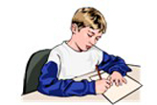
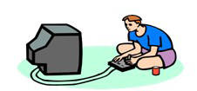
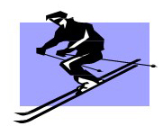
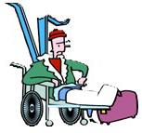
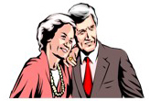
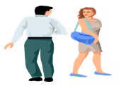
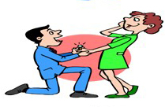
ANSWERS
Lire
Decide which picture the person is talking about. The first picture shows an event happening NOW. The second picture shows an event that has been completed in the PAST. Write A or B for every picture.
1 | A Oui, j'ai fait les devoirs!
 | B Je fais les devoirs.
2 | A J'ai fait du ski.
 | B Je fais du ski.
3 | A Je dis ‘bonjour’.
 | B J'ai dit ‘bonjour’ en 1972!!
4 | A J'ai dit 'oui'!
 | B Je dis 'oui‘.
B
A
B
A
A
B
B
A
Emma Marsden / Victoria Hobson
Notes:
ANSWERS appear on mouse clicks. Emphasise that the picture on the left shows what is happening now.
Verb frequency rankings (1 is the most common word in French): faire (25); dire (37); donner (46); pêcher (4223 ); travailler (290).
Source: Londsale, D., & Le Bras, Y. (2009). A Frequency Dictionary of French: Core vocabulary for learners London: Routledge.

Slide 9
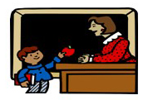
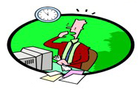
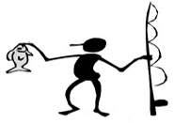
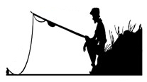
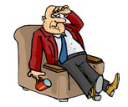
ANSWERS
5 | A J'ai donné une pomme à la prof
 | B Je donne une pomme à la prof
6 | A Je finis
 | B J’ai fini
7 | A Je pêche
 | B J'ai pêché
8 | A J'ai travaillé beaucoup
 | B Je travaille beaucoup
B
A
A
B
A
B
B
A

Slide 10
Decide which picture the person is talking about. The first picture shows an event happening NOW. The second picture shows an event that has been completed in the PAST. Write A or B for every picture.
1 | A Oui, j'ai fait les devoirs! |  | 5 | A J'ai donné une pomme à la prof.
 | B Je fais les devoirs. |  |  | B Je donne une pomme à la prof.
2 | A J'ai fait du ski. |  | 6 | A Je finis.
 | B Je fais du ski. |  |  | B J’ai fini.
3 | A Je dis ‘bonjour’. |  | 7 | A Je pêche.
 | B J'ai dit ‘bonjour’ en 1972!! |  |  | B J'ai pêché.
4 | A J'ai dit 'oui'! |  | 8 | A J'ai travaillé beaucoup.
 | B Je dis 'oui‘. |  |  | B Je travaille beaucoup.
Emma Marsden / Victoria Hobson
Notes:
Printable student copy. Select print 2 slides to a page. (Slides 9 &10).

Slide 11
Decide which picture the person is talking about. The first picture shows an event happening NOW. The second picture shows an event that has been completed in the PAST. Write A or B for every picture.
1 | A Oui, j'ai fait les devoirs! |  | 5 | A J'ai donné une pomme à la prof.
 | B Je fais les devoirs. |  |  | B Je donne une pomme à la prof.
2 | A J'ai fait du ski. |  | 6 | A Je finis.
 | B Je fais du ski. |  |  | B J’ai fini.
3 | A Je dis ‘bonjour’. |  | 7 | A Je pêche.
 | B J'ai dit ‘bonjour’ en 1972!! |  |  | B J'ai pêché.
4 | A J'ai dit 'oui'! |  | 8 | A J'ai travaillé beaucoup.
 | B Je dis 'oui‘. |  |  | B Je travaille beaucoup.
Emma Marsden / Victoria Hobson
Notes:
Printable student copy. Select print 2 slides to a page. (Slides 9 &10).

Slide 12
Écrire
Write four sentences about what activities you usually do and four sentences about what you did last weekend. Use a different verb in each sentence.
Normalement
1
2
3
4
Le weekend dernier
5
6
7
8
Emma Marsden / Victoria Hobson

Slide 13
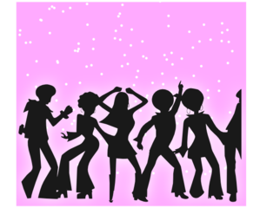
Parler et écouter
Partner A
Say a sentence to your partner about each picture. Make it clear whether it is something you normally do (in the present) or something you did in the past. Your partner has to make a note of this information.
1 |  | 4
2 |  | 5
3 |  | 6
Emma Marsden / Victoria Hobson
Notes:
Note to teacher: Teachers may decide that some learners will need the prompts with the infinitive verbs and nouns etc. Ideally, the vocabulary would have been practised first. But… do not worry too much if the learners do not produce all the other parts of the sentence perfectly correctly – the aim now is for them to produce the auxiliary - ‘je’ and ‘j’ai’ - to communicate ‘past completeness’. They should also be able to produce the main verb (the lexical verb carrying the meaning, even if this is sometimes in the infinitive form). The nouns etc might need more scaffolding, with frames or vocabulary lists.
Verb frequency rankings (1 is the most common word in French): danser (2934); jouer (219); faire (25); écouter (429) regarder (425); manger (1338).
Source: Londsale, D., & Le Bras, Y. (2009). A Frequency Dictionary of French: Core vocabulary for learners London: Routledge.

Slide 14
Need help?
Vocabulaire
danser | to dance
jouer au foot | to play football
faire les devoirs | to do homework
écouter de la musique | to listen to music
faire du ski | to go skiing
regarder un film | to watch a film
Emma Marsden / Victoria Hobson
Notes:
Re-order the slides or duplicate as necessary to print the combination of slides you want. Printing 2 to a page means that, once cut, they are the correct size to glue into exercise books and cuts down on the number of pages needed since 2 fit to a page.

Slide 15
Parler et écouter
Partner B
Response Grid. Listen to what your partner is telling you about activities s/he does and did. Make notes in English.
 | Activity? | Normally (now, in the present) or in the past?
1
2
3
4
5
Emma Marsden / Victoria Hobson

Slide 16
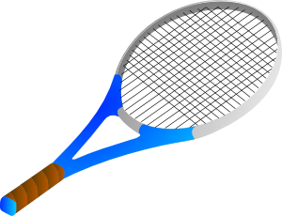
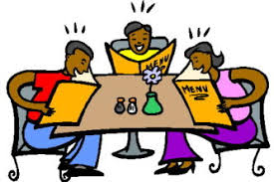
Parler et écouter
Partner B
Say a sentence to your partner about each picture. Make it clear whether it is something you normally do (in the present) or something you did in the past. Your partner has to make a note of this information.
1 |  | 4
2 |  | 5
3 |  | 6
Emma Marsden / Victoria Hobson
Notes:
Note to teacher: Teachers may decide that some learners will need the prompts with the infinitive verbs and nouns etc. Ideally, the vocabulary would have been practised first. But… do not worry too much if the learners do not produce all the other parts of the sentence perfectly correctly – the aim now is for them to produce the auxiliary - ‘je’ and ‘j’ai’ - to communicate ‘past completeness’. They should also be able to produce the main verb (the lexical verb carrying the meaning, even if this is sometimes in the infinitive form). The nouns etc might need more scaffolding, with frames or vocabulary lists.

Slide 17
Need help?
Vocabulaire
faire de l’exercice | to do exercise
regarder un film | to watch a film
faire les devoirs | to do homework
jouer au tennis | to play tennis
écouter de la musique | to listen to music
manger dans un restaurant | to eat in a restaurant
Emma Marsden / Victoria Hobson

Slide 18
Parler et écouter
Partner A
Response Grid. Listen to what your partner is telling you about activities s/he does and did. Make notes in English.
 | Activity? | Normally (now, in the present) or in the past?
1
2
3
4
5
Emma Marsden / Victoria Hobson

