Slide 1
Phonics at KS3 and KS4
Practical ideas for teaching and practising phonics knowledge
Presenter: Rachel Hawkes @RachelHawkes60 www.rachelhawkes.com
Notes:
This is a 45-minute workshop for secondary teachers on the topic “teaching phonics at KS3 and KS4”. This workshop will be conducted on Saturday 26 November 2022 from 11:00 to 11:45 at the Institut français du Royaume-Uni, 17 Queensberry Place, London, SW7 2DT. During this practical session, Dr Hawkes focuses on activities for the secondary French classroom which develop secure, robust phonics knowledge that in turn supports vocabulary learning, spoken confidence, oral and written comprehension, and written accuracy. She will also consider the teaching implications of the new GCSE requirement to assess phonics knowledge.

Slide 2
13 reasons for teaching phonics
Explicit phonics teaching develops students’ ability to decode (the ability to sound out accurately), and without explicit phonics teaching, decoding is limited.
motivation
supports vocabulary learning
autonomy
supports grammar learning
For the full details, refer to the summary rationale for teaching phonics document on the NCELP Portal.
Notes:
As a useful overview for now,
[Cue animation]
Naturally, explicit phonics teaching improves students’ ability to decode – this meaning of ‘decode’ is not about deciphering meaning, it’s the ability to sound out written words accurately.
[Cue animation]
The ability to decode is associated positively with motivation – without it, pupils often feel demotivated, that French is a mystery, random without patterns to hook their attempts at pronunciation on.
[Cue animation]
Phonics teaching supports vocabulary learning, which is key to making progress in language learning.
[Cue animation]
Decoding enables learners to access new language autonomously; learners can engage with vocabulary learning more successfully in and beyond the classroom, even ahead of the lesson (flipped learning), allowing more lesson time to focus on language practice and use.
[Cue animation]
It supports not only vocabulary but grammar as well. Teaching phonics teaches phonemes and each phoneme carries meaning; the function of the different sounds really matters. (e.g., distinguishing reliably and consistently between je and j’ai).
We have summed these up in the rationale for teaching phonics document on the NCELP Portal.

Slide 3
Explicit phonics teaching
Notes:
We are not really dealing any further with the ‘why’ today, but there is a dedicated CPD session that’s free to all teachers that goes into greater depth about the evidence base and rationale for teaching phonics explicitly. I’ll share the link for that at the end of the session. At the end of the day, the fact that the sound-writing relationship will be tested in the new GCSE will be reason enough to begin incorporating phonics teaching into SOW for most of us, even those that have not been big on teaching phonics to date!
The AOs have just published their draft SAMS so we can see their initial designs for dictation / transcription and read aloud tasks.
Of course we’ll want to take a look at these, if we haven’t already, but we need to be cautious about drawing too many conclusions from them as they are just draft at the moment.
It’s probably wiser to stick to what the Subject Content says about phonics and how it will be tested. For example, we do know exactly which SSC will be tested because there is a list of them for each of the three languages in the Subject Content grammar annexes.
So, when we want to think about how best to teach this knowledge to our students and practise it, where can we start?

Slide 4
Teaching phonics
Select sound-symbol correspondences (SSCs) to be taught and add them to your KS3/4 SOW
Gather ideas and resources for introducing and practising them
Identify additional sounds of the language (e.g., liaison) and resources
Apply a systematic practice schedule
Assess phonics knowledge
Notes:
The focus for us today is on these practical steps to support the teaching of phonics.
[Cue animation]
Select the sound-symbol correspondences to be taught and add them to the SOW so we identify the what and when and record this information in the SOW for essential consistency among all the teachers in a department.
[Cue animation]
Gather ideas and resources for practising them
[Cue animation]
Identify additional sounds of the language (for example – liaison, word stress) and resources for those
[Cue animation]
Apply a systematic practice schedule which is the umbrella architecture of language retention - introduce, revisit 1, revisit 2 etc.. so that we don’t allow the knowledge to be lost along the way (the students of phonics that have been done in our context – i.e. languages classrooms in England) have shown that phonics knowledge is particularly vulnerable to decay.
[Cue animation]
Assess phonics knowledge – if we’re teaching is at KS3 and we know it will be tested at KS4, we will want to know how students are doing with it, so we will want to assess it.

Slide 5
Sequencing of SSC
We lack clear research evidence on the optimal order in which to teach particular SSC
We based our sequencing on a ‘bang for buck’ principle, drawing on evidence concerning:
Frequency – how often the SSC occur in the language
Difficulty – how hard it is for students to decode the SSC accurately
Teacher expertise and judgment
We also adopted a ‘cumulative’ principle in ordering sounds and their ‘source words’
Notes:
In terms of the sequencing of the SSC, it might be helpful for you to hear how we went about this within our schemes of work.
[Cue animation]
There isn’t definitive evidence suggesting a best order in which to teach the different SSC so we made our decisions based on evidence concerning:
[Cue animation]
frequency – so our SOW prioritise the most frequently-occurring correspondences, even when these are tricky for students (e.g., Silent Final Consonant).
[Cue animation]
We also considered difficulty, so how hard it is for students, particularly English-speaking students to decode particular SSCs. We based that on some empirical evidence of the SSCs that learners most frequently mispronounce. Unless over-ridden by the frequency imperative, more complex correspondences are taught later.
[Cue animationx2]
We also drew on teacher expertise and judgment when devising the order of teaching.

Slide 6
Y7 phonics
Teaching order | Frequency order | SSC | Teaching order | Frequency order | SSC
1 | 1 | SFC | 13 | 12 | -in / -ain
2 | 2 | a | 14 | 13 | è / ê
3 | 3 | i | 15 | 13 | ai (ais / ait)
4 | 5 | eu | 16 | 15 | oi
5 | 5 | e | 17 | 19 | ch
6 | 8 | o /eau / au | 18 | 20 | ç (and soft -c)
7 | 9 | u | 19 | 14 | qu
8 | 11 | ou | 20 | 17 | j
9 | 4 | SFe | 21 | 18 | -tion
10 | 6 | é | 22 | 21 | -ien
11 | 7 | en / an | 23 | 16 | un
12 | 10 | on
Notes:
This is the NCELP teaching order for Year 7 French SSC. The remaining SSC are taught in Y8 and the SSC taught in Y7 are also systematically re-visited.
Just in case you are unsure: SFC is Silent Final Consonant and SFe is Silent Final e.

Slide 7
GCSE SSC in French
French, German and Spanish GCSE Subject Content
Annex A
silent final consonant
a
i/y
eu
e
au/eau/closed o/ô
ou
u
silent final e
é (-er, -ez)
en/an/em/am
on/om
ain/in/aim/im
è/ê/ai
oi/oy
ch
ç (and soft 'c')
qu
j
-tion
-ien
s-liaison
t-liaison
n-liaison
x-liaison
h
um/un
-gn-
r
open eu/œu
open o
-s-
th
-ill-/-ille
-aill-/ail
Notes:
These are the SSC listed in the new GCSE Subject Content for French.
The list specifies key differences in sound-spelling correspondences between French and English which students will need to learn at GCSE to be able to read out loud and transcribe with sufficient accuracy at this level.

Slide 8
Teaching phonics
Select sound-symbol correspondences (SSCs) to be taught and add them to your KS3/4 SOW
Gather ideas and resources for introducing and practising them
Identify additional sounds of the language (e.g., liaison) and resources
Apply a systematic practice schedule
Assess phonics knowledge

Slide 9
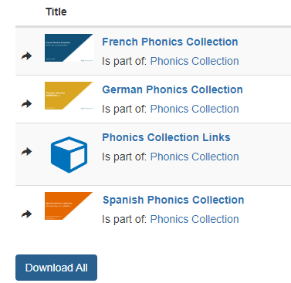
Phonics resources
Add the sound-symbol correspondences to SOW
Gather ideas and resources for practising them
Notes:
A really useful point of departure for this is the NCELP Portal.
For those not following our SOW, we have put together a specific phonics collection, where we have curated and organised all of the resources that have been created to teach each SSC.
For easy reference, there is an excel spreadsheet within the collection with separate tabs for each language, with a list of each of the SSC and hyperlinks to each resource.
There are resources for all of the SSC in the new subject content.

Slide 10
Early stages
Present the SSC with a ‘source’ word (and gesture, if desired)
Practise pronouncing a small set of ‘cluster’ words
Listen to distinguish the SSC (from (an)other similar SSC) in familiar and unfamiliar words
Minimal pairs
Odd one out
Silence !
Identifie la SSC Tally
Read aloud to practise decoding using familiar and unfamiliar words
Prediction
Find the rhyme
Using cognates

Slide 11
ou
nous
Notes:
Timing: 1 minute
Aim: To introduce/consolidate SSC [ou]
Procedure: 1. Present the letter(s) and say the [ou] sound first, on its own. Students repeat it with you. 2. Bring up the word ”nous” on its own, say it, students repeat it, so that they have the opportunity to focus all of their attention on the connection between the written word and its sound.
3. A possible gesture for this would be to have both hands draw semi-circles out away from the body. Hands start by the sides of the body, circle swiftly outwards and join up again in front, indicating the inclusion of the self in a larger group. 4. Roll back the animations and work through 1-3 again, but this time, dropping your voice completely to listen carefully to the students saying the [ou] sound, pronouncing ”nous” and, if using, doing the gesture.
Word frequency (1 is the most frequent word in French):
nous [31]
Source: Londsale, D., & Le Bras, Y. (2009). A Frequency Dictionary of French: Core vocabulary for learners London: Routledge.

Slide 12
ou
nous
Notes:
With sound and no pictures to focus all attention on the sound-symbol correspondence.

Slide 13
ou
nous
Notes:
Without sound to elicit pronunciation (without first hearing the teacher).
Teacher to elicit pronunciation by asking “Comment dit-on …"

Slide 14
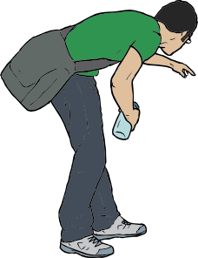
ou
trouver
jouer
Bonjour !
nous
douze
toujours
[always; still]
Notes:
Timing: 2 minutes
Aim: To introduce/consolidate SSC [ou]
Procedure:
1. Introduce and elicit the pronunciation of the individual SSC [ou] and then the source word again ‘nous’ (with gesture, if using). 2. Then present and elicit the pronunciation of the five cluster words.
The cluster words have been chosen for their high-frequency, from a range of word classes, with the SSC (where possible) positioned within a variety of syllables within the words (e.g. initial, 2nd, final etc.). Additionally, we have tried to use words that build cumulatively on previously taught SSCs (see the Phonics Teaching Sequence document) and do not include new SSCs. Where new SSCs are used, they are often consonants which have a similar symbol-sound correspondence in English.
Word frequency (1 is the most frequent word in French): nous [31]; trouver [83] jouer [219]; bonjour [1972]; toujours [103]; douze [1664].
Source: Londsale, D., & Le Bras, Y. (2009). A Frequency Dictionary of French: Core vocabulary for learners London: Routledge.

Slide 15
ou
trouver
jouer
Bonjour !
nous
douze
toujours
Notes:
With sound and no pictures to focus all attention on the sound-symbol correspondence.

Slide 16
ou
trouver
jouer
Bonjour !
nous
douze
toujours
Notes:
Without sound to elicit pronunciation (without first hearing the teacher).
Teacher to elicit pronunciation by asking “Comment dit-on …"

Slide 17
Early stages
Present the SSC with a ‘source’ word (and gesture, if desired)
Practise pronouncing a small set of ‘cluster’ words
Listen to distinguish the SSC (from (an)other similar SSC) in familiar and unfamiliar words
Minimal pairs
Odd one out
Silence !
Identifie la SSC
Tally
Read aloud to practise decoding using familiar and unfamiliar words
Prediction
Find the rhyme
Using cognates

Slide 18
prononcer
. Écoute les noms des animaux. C’est [ien] ou [(a)in]?
Écoute. C’est [u] ou [ou] ?
c
One of the chests contains buried treasure. All the others contain poison!
Listen carefully to the secret code and follow the arrows to find the treasure.
w
vue
pull
vue
vous
poule
vous
h
z
tu
bouche
roue
v
tout
bûche
rue
bouche
poule
roue
tu
vue
bûche
pull
rue
tout
vous
k
vue
bouche
roue
pull
vue
i
vous
bûche
rue
poule
vous
every-thing
vue
pull
roue
pull
vue
r
vous
poule
rue
poule
vous
vue
1
y
j
q
vous
Notes:
Slide 1 of 3
Timing: 5 minutes (three slides)
This slide and the two that follow are three versions of the activity with different solutions.
The game makes use of minimal pairs of unknown words (unknown words are used so that pupils focus on the sound. Definitions are given on a later slide).
Starting on the red square, pupils listen to the words and decide whether they hear /u/ or /ou/. They follow the arrows indicated by their choice to finish at one of the chests. There is only one correct route per slide, so pupils must correctly identify all words to find the treasure. The order or /u/ and /ou/ changes (i.e. sometimes /u/ is on the white square and sometimes on the blue) so the pupils must read the spellings.
Pupils can follow the slide on the projector, or the slide can be printed so they can trace the route with a pen/finger.
Teacher clicks on the chests they say to reveal treasure (or not!)
Audio plays on clicking the pink play button. Pupils will probably need to hear the audio at least three times.
Note: Each treasure chest is triggered to reveal what is underneath. You see a hand icon appear when you mouse over it – click and the chest disappears. Each slide only has one treasure chest – the rest reveal skulls.
Transcript:
tu, bouche, roue, poule, vous
Treasure is located in chest W.
Word frequency (1 is the most frequent word in French): bouche [1838] bûche [n/a] pull [n/a] poule [4321] roue [3916] rue [598] tout [24] tu [122] vous [50] vue [191]
Source: Londsale, D., & Le Bras, Y. (2009). A Frequency Dictionary of French: Core vocabulary for learners London: Routledge.
18

Slide 19
prononcer
. Écoute les noms des animaux. C’est [ien] ou [(a)in]?
Écoute. C’est [u] ou [ou] ?
c
One of the chests contains buried treasure. All the others contain poison!
Listen carefully to the secret code and follow the arrows to find the treasure.
w
vue
pull
vue
vous
poule
vous
h
z
tu
bouche
roue
v
tout
bûche
rue
bouche
poule
roue
tu
vue
bûche
pull
rue
tout
vous
k
vue
bouche
roue
pull
vue
i
vous
bûche
rue
poule
vous
every-thing
vue
pull
roue
pull
vue
r
vous
poule
rue
poule
vous
vue
2
y
j
q
vous
Notes:
[2/3]
Transcript:
tout, bûche, rue, poule, vous
Treasure is located in chest Y.
Word frequency (1 is the most frequent word in French): bouche [1838] bûche [n/a] pull [n/a] poule [4321] roue [3916] rue [598] tout [24] tu [122] vous [50] vue [191]
Source: Londsale, D., & Le Bras, Y. (2009). A Frequency Dictionary of French: Core vocabulary for learners London: Routledge.
19

Slide 20
prononcer
. Écoute les noms des animaux. C’est [ien] ou [(a)in]?
Écoute. C’est [u] ou [ou] ?
c
One of the chests contains buried treasure. All the others contain poison!
Listen carefully to the secret code and follow the arrows to find the treasure.
w
vue
pull
vue
vous
poule
vous
h
z
tu
bouche
roue
v
tout
bûche
rue
bouche
poule
roue
tu
vue
bûche
pull
rue
tout
vous
k
vue
bouche
roue
pull
vue
i
vous
bûche
rue
poule
vous
every-thing
vue
pull
roue
pull
vue
r
vous
poule
rue
poule
vous
vue
3
y
j
q
vous
Notes:
[3/3]
Transcript:
tu, bûche, rue, pull, vue
Treasure is located in chest R.
Word frequency (1 is the most frequent word in French): bouche [1838] bûche [n/a] pull [n/a] poule [4321] roue [3916] rue [598] tout [24] tu [122] vous [50] vue [191]
Source: Londsale, D., & Le Bras, Y. (2009). A Frequency Dictionary of French: Core vocabulary for learners London: Routledge.
20

Slide 21
prononcer
Follow up 1:
You may hear soft [g/j], hard [g] or [gn], which sounds like the ‘gn’ in lasagne.
Écoute. L’intrus, c’est quoi ?
 | rouge | gris | orange
 | partager | voyager | organiser
 | la gymnastique | le golf | le rugby
 | la montagne | la plage | la campagne
 | grand | génial | grave
 | le village | le magasin | l’église
1
2
3
4
5
6
Notes:
Timing: 5 minutes
Aim: To practise aural distinction of French words with the SSC [j/soft g] and hard [g] in sets of three words. Some words are known, others are cognates, some will be taught later in the SOW.
Procedure:
Do the first one to model the task.
Click to listen.
Pupils try to note down (in French) the odd one out.
Click to reveal the answer, drawing pupils’ attention to the soft ‘g’ in rouge and orange and the hard ‘g’ in gris, which makes it the odd one out.
Continue with items 2-7.
Elicit answers from pupils and click to confirm the answers.
21

Slide 22
Follow up 1:
nous
[ou]
tu
[u]
1
2
3
4
5
6
7
8
9
écouter
[u]
[ou]
Notes:
Timing: 5 minutes
Aim: to practise aural distinction between the SSC [u] and [ou]; to provide the additional opportunity to practise written transcription of whole words.
Procedure:
Click on each number to listen to the word.
Write [u] or [ou] (and / or the full word).
After all items 1-9 have been heard, elicit the response from pupils (i.e. they say [u] or [ou] and/or the full word).
Click to reveal the written word.
Click again for it to disappear into the corresponding pacperson’s mouth.
Transcript 1. soupe 2. couleur 3. culture 4. souvenir 5. urgent 6. aventure 7. publicité 8. groupe
9. calculer
Frequency of unknown words and cognates:
aventure [209] calculer [2331] couleur [1211] culture [913] groupe [187] publicité [2110] soupe [4563] souvenir [616] urgent [2179]
Source: Londsale, D., & Le Bras, Y. (2009). A Frequency Dictionary of French: Core vocabulary for learners London: Routledge.

Slide 23
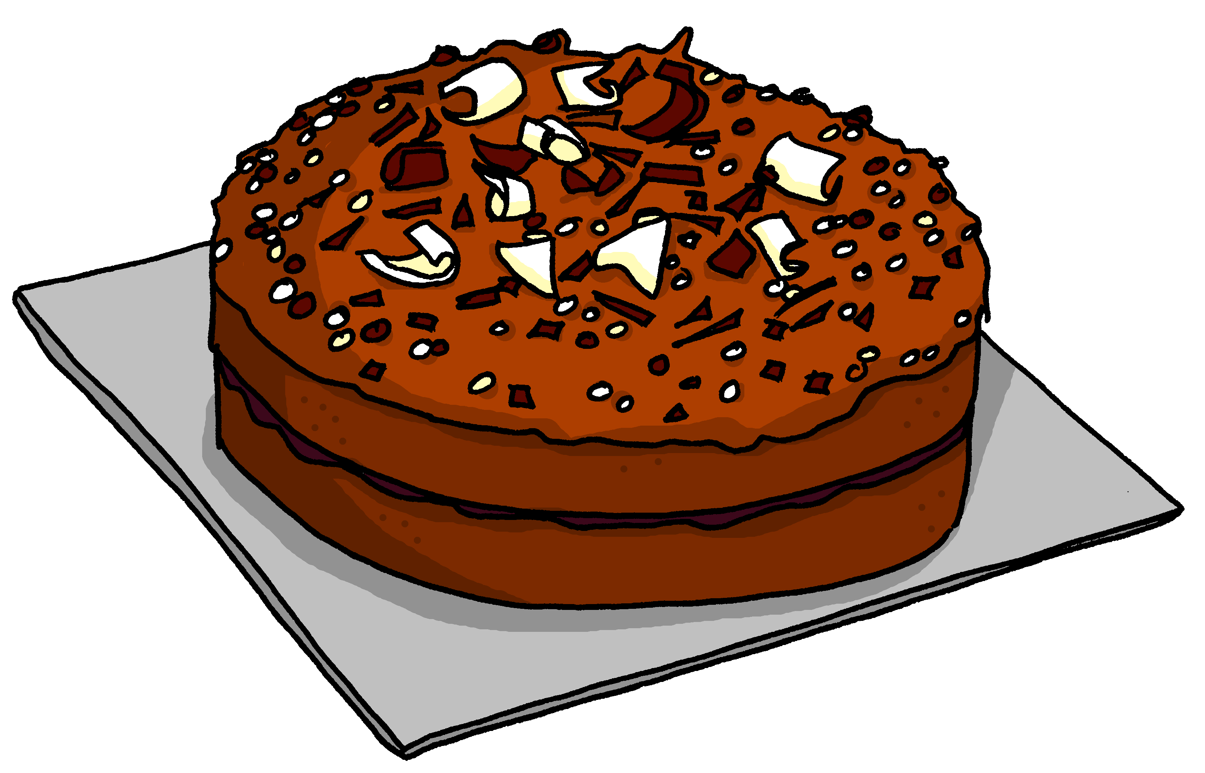
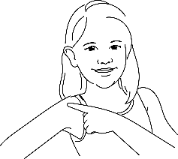
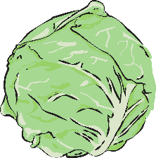
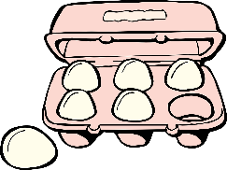
Follow up 1:
. Écoute les noms des animaux. C’est [ien] ou [(a)in]?
A Écoute et écris. [ou] ou [au] ?
B Say these words one after the other as quickly as you can. Your partner will check.
1
2
3
4
g â t e a u
c o u p e r
c h a u d
_ _
t o u r n e r
_ _
_ _
_ _
5
6
7
8
c h o u
é p a u l e
p o u l e t
_ _
o u b l i e r
_ _
_ _
_ _
9
10
11
12
c a d e a u
d r a p e a u
d o u z a i n e
_ _
_ _
j a u n e
_ _
_ _
Notes:
Timing: 5 minutes
Aim: to practise aural recognition of this week’s SSC [au] and differentiate it from [ou].
Procedure:
Click to listen. Pupils write 1-12 and [au] or [ou] for each word.
Click to reveal the missing letters.
Click to bring up the instruction for Part B.
Pupils pronounce all of the words.
Teacher circulates to listen and support, as needed.
Transcript Part A: [1] gâteau [2] couper [3] chaud [4] tourner [5] chou [6] épaule
[7] oublier [8] poulet
[9] cadeau
[10] drapeau
[11] douzaine
[12] jaune

Slide 24
.
Identifie la SSC.
caractère
1. _______________
1 | 2
3 | 4
euro
2. _______________
[é|-er|-ez]
[è|ê]
adieu
3. _______________
préparer
4. _______________
automobile
5. _______________
[eu]
[(e)au]
forêt
6. _______________
manteau
7. _______________
nez
8. _______________
Notes:
Pupils listen and write 1,2,3,4 according to the SSC they identify in the word. Transcript: caractère euro adieu préparer automobile
forêt manteau nez

Slide 25
.
Silence !
[ou]
1. culture 2. sud 3. routine
4. cousin
5. nougat
6. bambou 7. courgette
8. figure
9. capture
10. brochure 11. aventure 12. blouse
Notes:
Silence ! Pupils keep silent unless they think the word has the target SSC, and in that case they also say the word. Écoute et réponds – teacher reads a list of words and pupils raise both hands if they think the word contains the SSC. 1. culture 2. sud 3. routine
4. cousin
5. nougat
6. bambou 7. courgette
8. figure
9. capture
10. brochure 11. aventure 12. blouse

Slide 26
Phonétique
écouter
Tally how many times you hear [eu] |  | Phrases
1
Nombreux animaux vivent à la ferme.
I
A lot of animals live at the farm.
2
IIII
Ceux qui font la queue sont heureux.
Those who queue are happy.
3
Il veut être courageux, mais c’est douteux.
III
He wants to be brave, but it’s doubtful.
Notes:
Timing: 2 minutes
Aim: practising recognition of SSC [eu]
Procedure:
1. Click the numbers to play the audio.
2. Students write 1-3 and tally how many times they hear the SSC [eu].
Transcript:
Nombreux animaux vivent à la ferme.
Ceux qui font la queue sont heureux.
Il veut être courageux, mais c’est douteux.
Word frequency (1 is the most frequent word in French): nombreux [366], animal [1002], celui [45], queue [3255], heureux [764], vouloir [57], courageux [2198], douteux [>5000]
Source: Londsale, D., & Le Bras, Y. (2009). A Frequency Dictionary of French: Core vocabulary for learners London: Routledge.

Slide 27
Des virelangues !
écouter / parler
Cinq gros rats grillent dans la grosse graisse grasse
[Five fat rats are roasting in the fatty, greasy fat]
1
2
3
La roue sur la rue roule; la rue sous la roue reste.
[The wheel on the road is rolling; the road under the wheel is resting.]
1
2
3
Notes:
Use first for a tally task and then for read aloud.
Timing: 5 minutes
Aim: practising oral production of SSC [r]
Procedure:
1. Using their knowledge of the meanings of langue, ask students what they think the word virelangue might mean.
2. Click on ‘1’ to hear a tongue twister pronounced at a slow speed. Students repeat as many times a necessary.
3. If students feel confident, click on ‘2’ to hear a tongue twister pronounced at a medium speed, and repeat step 2.
4. At very advanced levels, students can try speed 3!
Transcript:
Cinq gros rats grillent dans la grosse graisse grasse.
La roue sur la rue roule; la rue sous la roue reste.

Slide 28
Early stages
Present the SSC with a ‘source’ word (and gesture, if desired)
Practise pronouncing a small set of ‘cluster’ words
Listen to distinguish the SSC (from (an)other similar SSC) in familiar and unfamiliar words
Minimal pairs
Odd one out
Silence !
Identifie la SSC
Tally
Read aloud to practise decoding using familiar and unfamiliar words
Prediction
Find the rhyme
Using cognates

Slide 29
prononcer
Follow up 1:
Prononce les mots.
30
horrible
ha ha !
héros
horizon
hôtel
S
humain
hiver
historique
hélicoptère
honorable
hésiter
habitat
0
DÉBUT
Notes:
Timing: 5 minutes
Aim: To practise pronunciation of words with [h] muet, particularly cognates which are pronounced with an audible ‘h’ in English.
Procedure:
Pupil A chooses 4 of the 12 words.
Pupil B must pronounce all 12 words correctly in the 30 second time limit in order to identity his/her partner’s 4 words.
If B pronounces a word with audible ‘h’, A can give a 3 x second penalty.
Swap roles and repeat the activity.
29

Slide 30
prononcer
Joyeux Noël !
 | Name
1 | Lilas
2 | Coco
3 | Prue
4 | Mathieu
5 | Ballou
6 | Vardon
7 | Gavroche
8 | Laurent
Joyeux Noël !
Read aloud the French name and the Christmas present with the same final sound.
You have not learnt these words so use what you know about how to pronounce French. Remember Silent Final Consonants!
un iglou
une vue
une cloche
un rat
un ange
un jeu
une chanson
un seau
Notes:
Timing: 1 minute per pupil
Aim: to assess pupils’ ability to read aloud the SSC taught this term. Procedure: 1. Give out the independent task that pupils will work on during the lesson, just prior to hearing each pupil so that the preparation time is the same for all. 2. Listen to individual pupils reading the 8 pairs of words aloud. Mark in real time, using the grid on the teacher version.
Note:
there are no follow up lessons this week, so it would be possible to continue the speaking assessments in the follow up time during this week, as needed.
if preferred, and the resources are available, pupils could record their answers (e.g. on computer or ipad) though this would involve the teacher listening back to assess them.
30

Slide 31
prononcer
Une route compliquée [1/2]
Prononce les mots.
.
couple
brochure
journal
fortune
blouse
cousin
kangourou
routine
culture
capture
mural
minute
bambou
cure
moustache
curry
courgette
figure
dune
nougat
Notes:
Timing: 5 minutes
Aim: To practise the pronunciation of French and English cognate words with the SSC [u] and [ou].
Procedure:
Pupils work in pairs to practise pronunciation.
Click to circle the start and finish points.
Pupil A says the word in English, Pupil B repeats it in French.
Click to bring up arrow to next word.
Repeat steps 3-4 for 10 words.
Click on the words to hear their French pronunciation by a native speaker.
Repeat on next slide with pupils taking opposite roles.
31

Slide 32
prononcer
Une route compliquée [2/2]
couple
brochure
journal
fortune
blouse
cousin
kangourou
routine
culture
capture
mural
minute
bambou
cure
moustache
curry
courgette
figure
dune
nougat
Notes:
[2/2]
Aim: To practise the pronunciation of French and English cognate words with the SSC [u] and [ou].
Procedure:
Pupils work in pairs to practise pronunciation.
Click to circle the start and finish points.
Pupil A says the word in English, Pupil B repeats it in French.
Click to bring up arrow to next word.
Repeat steps 3-4 for 10 words.
Click on the words to hear their French pronunciation by a native speaker.
Repeat on next slide with pupils taking opposite roles.
32

Slide 33
Saying what people have: nous and vous
Prononciation – [u] ou [ou]?
lire et parler
route
double
juste
aventure
humain
signature
occupation
publicité
tour
univers
refuser
gouvernement
toucher
courage
ouvrir
situation
jour
souvenir
ou
trouver
urgent
public
calculer
groupe
mouvement
substance
Notes:
This paired read-aloud activity builds on last week’s awareness-raising exercise on differences in pronunciation between French and English cognates, and consistency of the French spelling rules.
The words included in the exercise are either known words or cognates from within the top 5000 words, so students need not focus on meaning and can concentrate fully on decoding. Before beginning the task, the teacher should remind students that their knowledge of English will not help them here. They must look at the spelling [u] or [ou] to find information about pronunciation.
The students use different colours to play. Student A chooses one of the words and attempts to pronounce it correctly. Student B scrutinises the pronunciation. If Student A pronounces the word correctly, they cross it off in their colour (or write it in their books if not printing the slide). If pupil A says [u] instead of [ou] or vice-versa, or pronounces it the ‘English’ way, Student B can steal the point.
Student B now takes a turn with student A scrutinising. Repeat the steps until all words are circled. The pupil with the most circled words wins.
Clearly, the classroom conditions need to be right with the individual class for friendly competition.
Frequency values of words in this exercise
juste [304], double [574], route [512], occupation [2096], publicité [2110], humain [286], signature [2187], aventure [2090], gouvernement [160], courage [1431], toucher [231], univers [2112], refuser [271], tour [523], jour [78], souvenir [616], ouvrir [257], urgent [2179], ou [33], trouver [83], public [285], situation [223], calculer [2331], groupe [187], substance [2227], movement [485]
Source: Londsale, D., & Le Bras, Y. (2009). A Frequency Dictionary of French: Core vocabulary for learners London: Routledge.

Slide 34
Saying what people have: nous and vous
Prononciation – [u] ou [ou]?
lire et parler
route
double
juste
aventure
humain
signature
occupation
publicité
tour
univers
refuser
gouvernement
toucher
courage
ouvrir
situation
jour
souvenir
ou
trouver
urgent
public
calculer
groupe
mouvement
substance
Notes:
Teacher-led pronunciation practice.
On this version of the task slide, words containing [ou] are highlighted in orange for clarity.
1/ Teacher elicits pronunciation by pointing at a word, and asking Comment dit-on? Students answer chorally.
2/ Students check their pronunciation by listening to recordings, played on clicking individual words.
3/ Students repeat.

Slide 35
Early stages
Present the SSC with a ‘source’ word (and gesture, if desired)
Practise pronouncing a small set of ‘cluster’ words
Listen to distinguish the SSC (from (an)other similar SSC) in familiar and unfamiliar words
Minimal pairs
Odd one out
Silence !
Identifie la SSC
Tally
Read aloud to practise decoding using familiar and unfamiliar words
Prediction
Find the rhyme
Using cognates

Slide 36
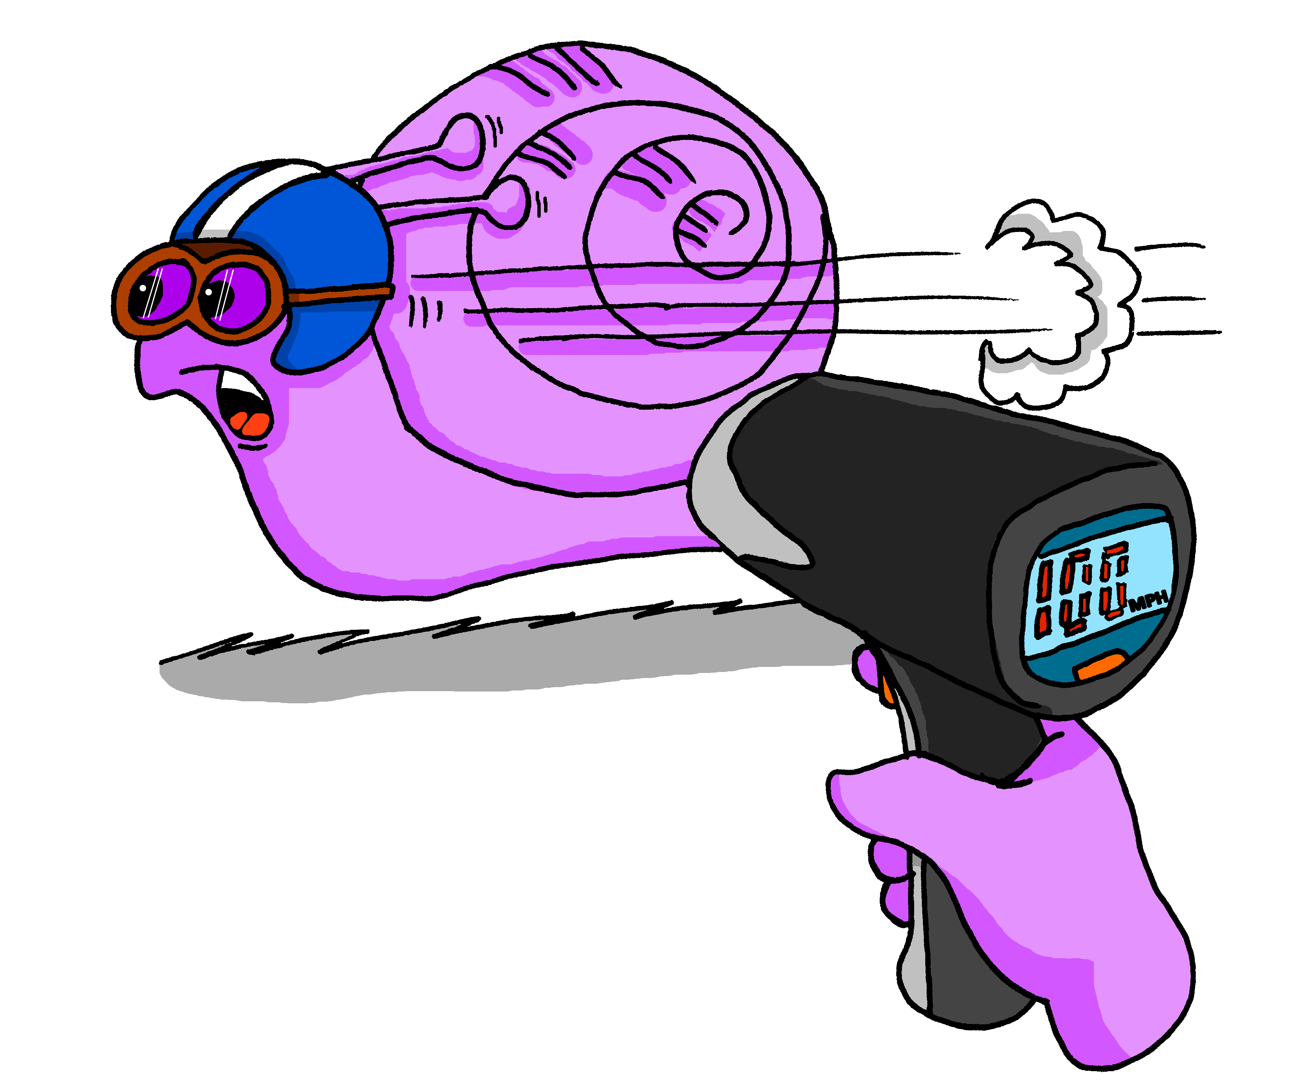
Developing the knowledge
Dictation
Pairs of / several SSC
Whole words
Whole sentences / extracts (peer working)
Read aloud
rhymes
poems
tongue twisters
song extracts
Combine with:
grammar knowledge
cultural information
vocabulary revision
difficile
lent(e)
important(e)
curieux/curieuse
sérieux/ sérieuse
jeune
prudent(e)
méchant(e)
rapide

Slide 37
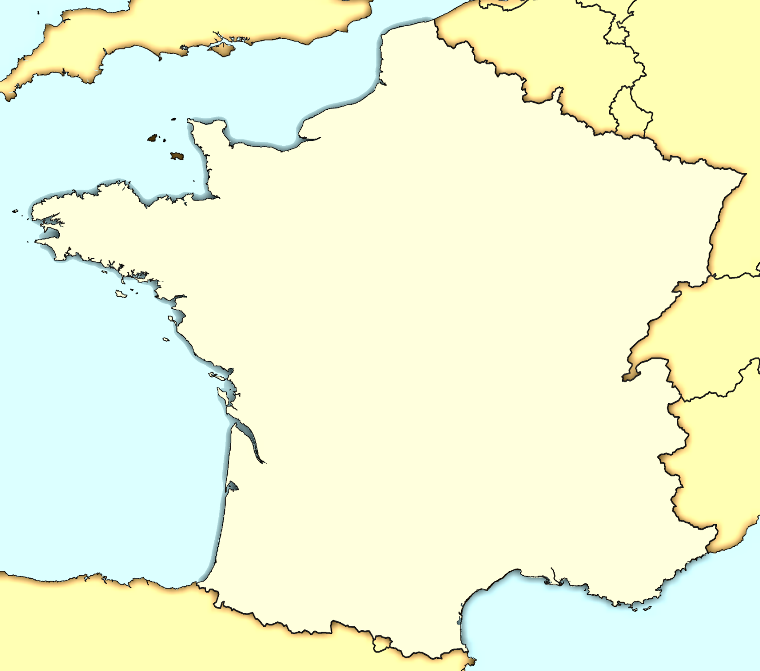
Follow up 2
Parle en français et décris le temps*
le temps - weather
1
À Calais il fait mauvais.
Calais
Liège
parler
2
À Bordeaux il fait chaud.
Rouen
Saint-Malo
3
À Blois il fait froid.
Blois
Rieux
4
À Saint Malo il fait beau.
5
À Rouen il fait du vent.
6
À Rieux il pleut.
Bordeaux
7
À Marseille il fait du soleil.
Marseille
Marseille est un nom très commun à Haïti.
8
À Liège il neige.
Notes:
Timing: 5 minutes
Aim: to practise read aloud of several SSC, noting how different letter strings are pronounced with the same SSC in French. (e.g. -eaux and –aud).
Procedure:
Teacher clarifies that the weather expressions rhyme with the place names in this task.
Pupils practise pronouncing each phrase (out loud, but individually at their own pace).
Teacher elicits a repetition of each phrase, chorally and clicks for a listen and check of each one.
Note: pupils have learnt the first four weather expressions. The remaining four are included here for pronunciation only, but some pupils may be interested enough to learn them incidentally.

Slide 38
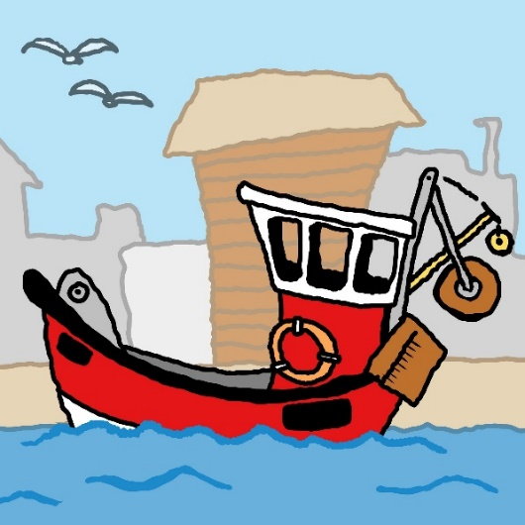
Des virelangues !
lire / parler
Le poivron rouge donne de la fièvre à la pauvre pieuvre qui dort dans le havre.
[The red pepper gives a fever to the poor octopus that sleeps in the harbour.]
1
2
3
Notes:
Timing: 6 minutes for 3 slides
Aim: Oral production of SSC [r].
Procedure:
1. Read the tongue twister.
2. Click to hear example pronunciation (1 = slow; 2 = medium; 3 = fast).
3. Click to reveal English translations.
4. Repeat on next slides (3 tongue twisters in total).
Transcript:
Le poivron rouge donne de la fièvre à la pauvre pieuvre qui dort dans le havre.
Word frequency (1 is the most frequent word in French): poivron [>5000], fièvre [4105], pauvre [699], pieuvre [>5000], havre [>5000]
Source: Lonsdale, D., & Le Bras, Y. (2009). A Frequency Dictionary of French: Core vocabulary for learners London: Routledge.

Slide 39
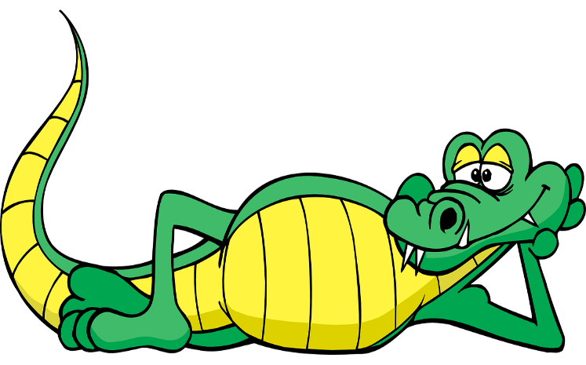
Des virelangues !
lire / parler
Le cricri de la crique crie son cri cru et critique car il craint que le crocodile ne le croque et ne le craque.
[The cricket in the creek cries its raw and critical cry because it fears that the crocodile will crunch and crack it.]
1
2
3
Notes:
Slide 3 of 3
Transcript:
Le cricri de la crique crie son cri cru et critique car il craint que le crocodile ne le croque et ne le craque.
Word frequency of cognates used (1 is the most frequent word in French): critique [909], crocodile [>5000]
Source: Lonsdale, D., & Le Bras, Y. (2009). A Frequency Dictionary of French: Core vocabulary for learners London: Routledge.
Word frequency (1 is the most frequent word in French): cri [2380], crique [>5000], crier [1950], cru [>5000], car [176], craindre [500], croquer [>5000], craquer [4893]
Source: Lonsdale, D., & Le Bras, Y. (2009). A Frequency Dictionary of French: Core vocabulary for learners London: Routledge.

Slide 40
Trapdoor
1
Lucas.
Manon.
Benoit.
Beau.
2
Laurent
Adrien
Aubin
3
et une sœur,
Aimée.
Eugénie.
Léontine.
Salut ! Je suis
J’ai un frère,
4
5
J’aime mon collège,
J’habite à
Nancy, en France.
Miragoane, à Haïti.
Gatineau, au Québec.
André Malraux.
Cite Doret
Le Tremplin
6
Fournier
Blaise
Chaput
Ma professeure préférée est Madame
7
mémorable.
merveilleux.
exceptionnel
et tout le monde est
Notes:
You can use names of people and places, and unknown words (e.g., adjectives) to ensure that pupils are practising decoding (compelled to use their knowledge of the sound-writing links rather than their memory of previously taught vocabulary). The in-built repetition in this task is helpful for reinforcing the sound-writing connections. Pupils try to work out their partner’s answers by speaking the text through. Each time there are options, the pupil makes a choice. The partner either nods to carry on or say ‘non’ and the play passes for them.
Each turn the partner must start from the beginning again – remembering the correct options s/he has already worked out. The first pupil to get through the whole text from start to finish is the winner.

Slide 41
Developing the knowledge
Dictation
Pairs of / several SSC
Whole words
Whole sentences / extracts (peer working)
Read aloud
rhymes
poems
tongue twisters
song extracts
Combine with:
grammar knowledge
cultural information
vocabulary revision
difficile
lent(e)
important(e)
curieux/curieuse
sérieux/ sérieuse
jeune
prudent(e)
méchant(e)
rapide

Slide 42
SSCs [ou] and [u]
phonétique
To talk about what we or you _{formal/plural} are doing, we need SSC [ou].
Be careful not to mix SSC [ou] and SSC [u] up!
It could be the difference between saying:
OR
OR
nous pouvons (we can, are able to)
vous pouvez (you all can, are able to)
nous (we)
nu (naked)
vous (you)
vue (view)
Notes:
Timing: 3 minutes
Aim: To differentiate between SSCs [ou] and [u] with a focus on pronouns nous and vous, as well as two new modal verb forms introduced this week which contain this SSC.
Procedure:
1. Click to reveal the explanation. Highlight that you need to use the SSC [ou] whenever you want to talk about what you and another person are doing, or when you want to address more than one person on someone you don’t know.
2. Draw attention to the difference between SSCs [ou] and [u] using the examples on the slide (click on orange words to hear them).
3. Students repeat.
Transcript:
nous pouvons
vous pouvez
nous
nu
vous
vue
Word frequency of unknown words used (1 is the most frequent word in French): nu [3207]
Source: Londsale, D., & Le Bras, Y. (2009). A Frequency Dictionary of French: Core vocabulary for learners London: Routledge.

Slide 43
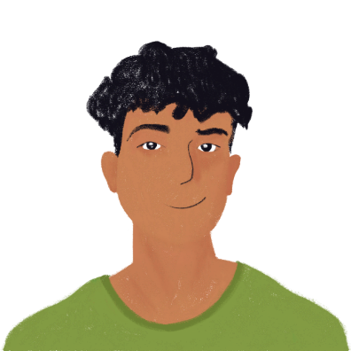
Ils cherchent des stages
écouter
Amir et Océane cherchent des stages sur internet. Ils trouvent quels emplois ?
 | stage | [ou] | [u]
 | trad u cteur [translator]
 | journaliste [journalist]
 | agric u lteur [farmer]
 | j u ge [judge]
 | nounou [nanny]
 | boulanger [baker]
 | instit u teur [primary teacher]
 | boucher [butcher]
1
__
2
__
3
__
4
__
5
__
__
6
__
7
__
8
__
Notes:
Timing: 5 minutes
Aim: To distinguish aurally between SSCs [ou] and [u].
Procedure:
1. Click to hear occupations read aloud.
2. Students must decide whether the missing SSC is [ou] or [u].
3. Elicit answers from students.
4. Click to reveal answers.
5. Replay audio. Students repeat.
Transcript:
traducteur
journaliste
agriculteur
juge
nounou
boulanger
instituteur
boucher
Word frequency of unknown words used (1 is the most frequent word in French): traducteur [>5000], journaliste [1337], agriculteur [2306], juge [1323], nounou [>5000], boulanger [>5000], instituteur [4630], boucher [4757]
Source: Lonsdale, D., & Le Bras, Y. (2009). A Frequency Dictionary of French: Core vocabulary for learners London: Routledge.

Slide 44
Leur et leurs
grammaire
You already know how to say ‘his’ and ‘her’ in French:
The words for ‘his’ and ‘her’ agree with the gender and number of the possession.
(m) noun:
(f) noun:
(m/f) before a vowel/h:
(m/f pl) noun:
son père
sa mère
son enfant
ses enfants
In French, we use leur or leurs to say ‘their’:
Attention!
leurs idées - liaison
leur choix
leur rue
leur chambre
leurs idées
their choice
their road
their room
their ideas
The words for ‘their’ agree with the number of the possession only.
Notes:
From Y9 Term 1 Week 3
Students are introduced to the possessive adjectives ‘leur’ and ‘leurs’ combined with an opportunity to practise –s liaison.
Timing: 2 minutes
Aim: To revise the third-person singular possessive adjectives son, sa and ses and introduce the third-person plural possessive adjectives leur and leurs.
Procedure:
1. Click to animate the explanation.

Slide 45
On a quoi ?
lire
In French, the possessive adjective tells us whether we are talking about one or more than one thing:
 |  | one | more than one | could be either
1. | Je veux visiter leurs pays.
2. | Elle aime bien leur cours.
3. | Tu connais leurs fils ?
4. | Je comprends leur choix.
In English, we cannot tell this from the possessive adjective alone:
 |  | one | more than one | could be either
1. | She’s watching their deer.
2. | He’s fixing their aircraft.
3. | I like their jeans.
4. | I enjoy watching their series.
Notes:
Timing: 2 minutes
Aim: Raising awareness of cross-linguistic differences (i.e., that the third-person plural possessive adjective provides information about the number of the possession in French, but not in English).
Procedure:
1. Write 1-4 and choose if the number of the possession is one or more than one. Note that the nouns are mainly direct objects and have been chosen because their plural forms are identical to the singular to avoid additional contextual clues.
2. Click to reveal the answers.
3. Repeat steps 1-2 with the English sentences.
Word frequency of cognates used (1 is the most frequent word in French): respecter [673]
Source: Londsale, D., & Le Bras, Y. (2009). A Frequency Dictionary of French: Core vocabulary for learners London: Routledge.

Slide 46
Saying ‘their’
Saying ‘their’
écouter / parler
Voici leurs vélos.
Here are their bikes.
Notes:
From Y9 Term 1 Week 3
Students are introduced to the possessive adjectives ‘leur’ and ‘leurs’ combined with an opportunity to practise –s liaison.
……………………………………………………………………………….
Timing: 2 minutes [4 slides]
Aim: To practise pronunciation with leurs + liaison
Procedure:
1. Listen and repeat.
2. Ask students to translate the sentence.
3. Reveal picture on a click, ask students to check their translations.
4. Reveal English translation on click.

Slide 47
Saying ‘their’
Saying ‘their’
écouter / parler
Leurs amis sont sympas.
Their friends are nice.

Slide 48
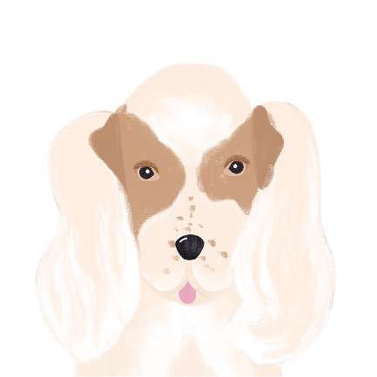
Saying ‘their’
Saying ‘their’
écouter / parler
Leurs chiens sont sages.
Their dogs are well-behaved.

Slide 49
Saying ‘their’
Saying ‘their’
écouter / parler
J’aime leurs idées.
I like their ideas.

Slide 50
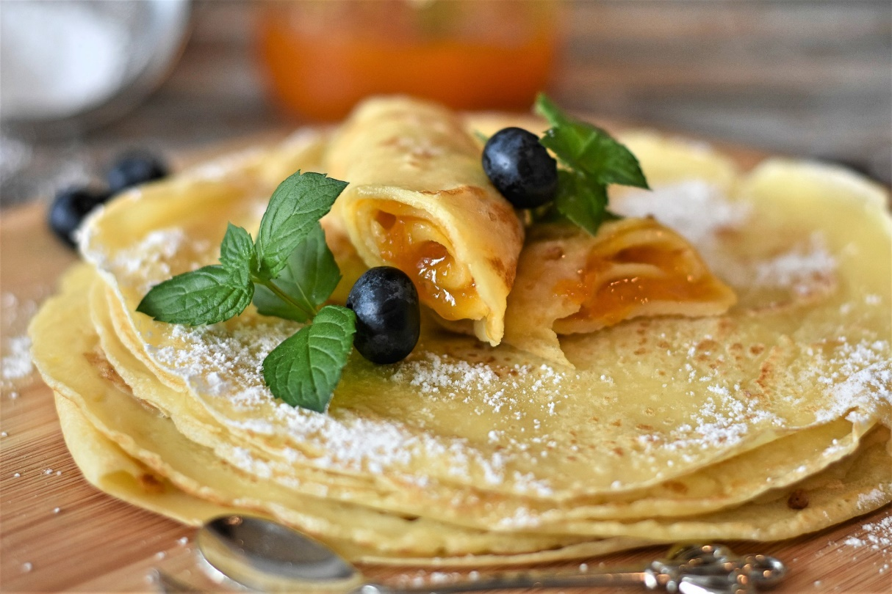
Recommandations
lire
La réceptionniste fait des recommandations.
Lis les phrases et choisis le bon mot.
la crêpe A type of very thin pancake.
J’aime bien leur / leurs crêpes.
leurs
Notes:
Timing: 8 minutes. This is slide 1/8.
Aim: To practice the written recognition of the third-person plural possessive adjectives leur and leurs and connecting these with meaning (singular and plural nouns). Written comprehension of sentences on each slide. Cultural awareness of French food specialties.
Procedure:
Discuss as a class what this French food item could be.
Click to reveal a gloss and/or information about the French food item.
Students read the sentence and choose the grammatically correct possessive adjective.
Click to reveal the answer.
Students say the sentence aloud, focusing on the presence or absence of the s-liaison in the plural forms.
Word frequency of unknown words used (1 is the most frequent word in French): crêpe [>5000], lorraine [>5000], huître [>5000], raclette [>5000], escargot [>5000], ratatouille [>5000], foie [4817], gras [4018]
Word frequency of cognates used (1 is the most frequent word in French): quiche [>5000], macarons [>5000], dessert [>5000], recommandation [>5000], réceptionniste [>5000]

Slide 51
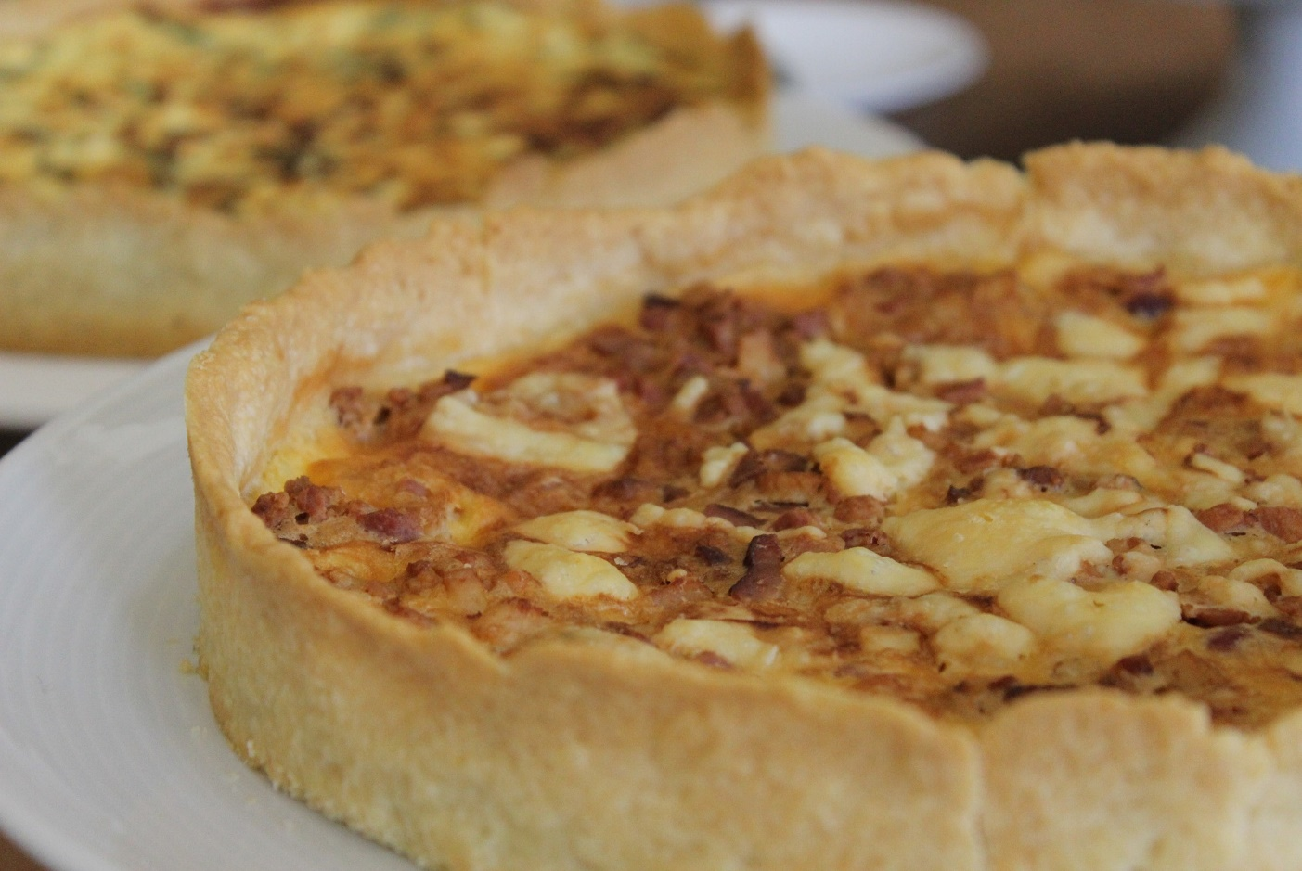
Recommandations
lire
la quiche lorraine A French tart with a pastry crust filled with custard, cheese, and bacon.
Je n’aime pas leur / leurs quiche lorraine.
leur
Notes:
This is slide 2/8.

Slide 52
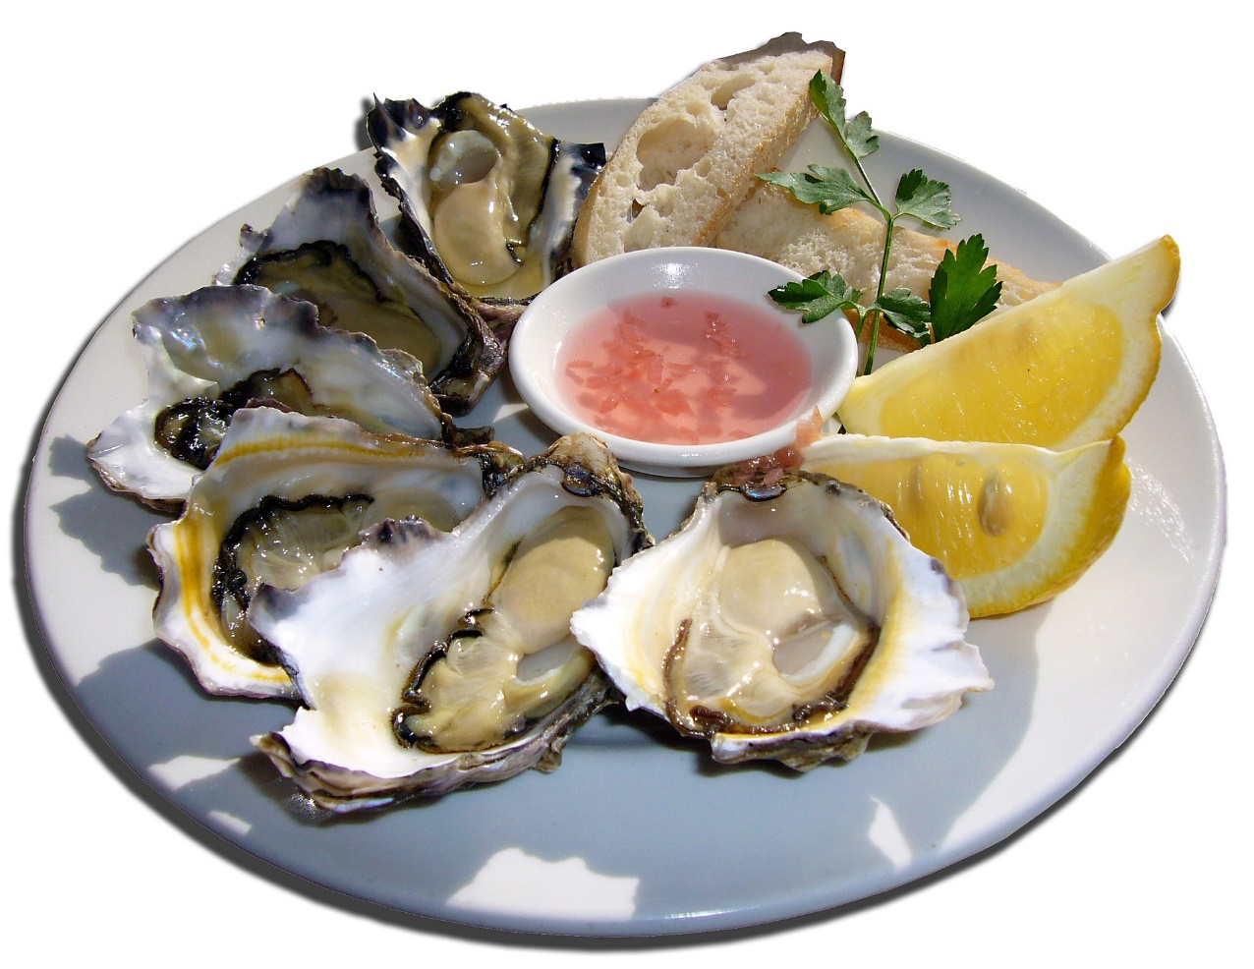
Recommandations
lire
l’huître (f.)
oyster
Leur / Leurs huîtres coûtent très chères.
Leurs
Notes:
This is slide 3/8.

Slide 53
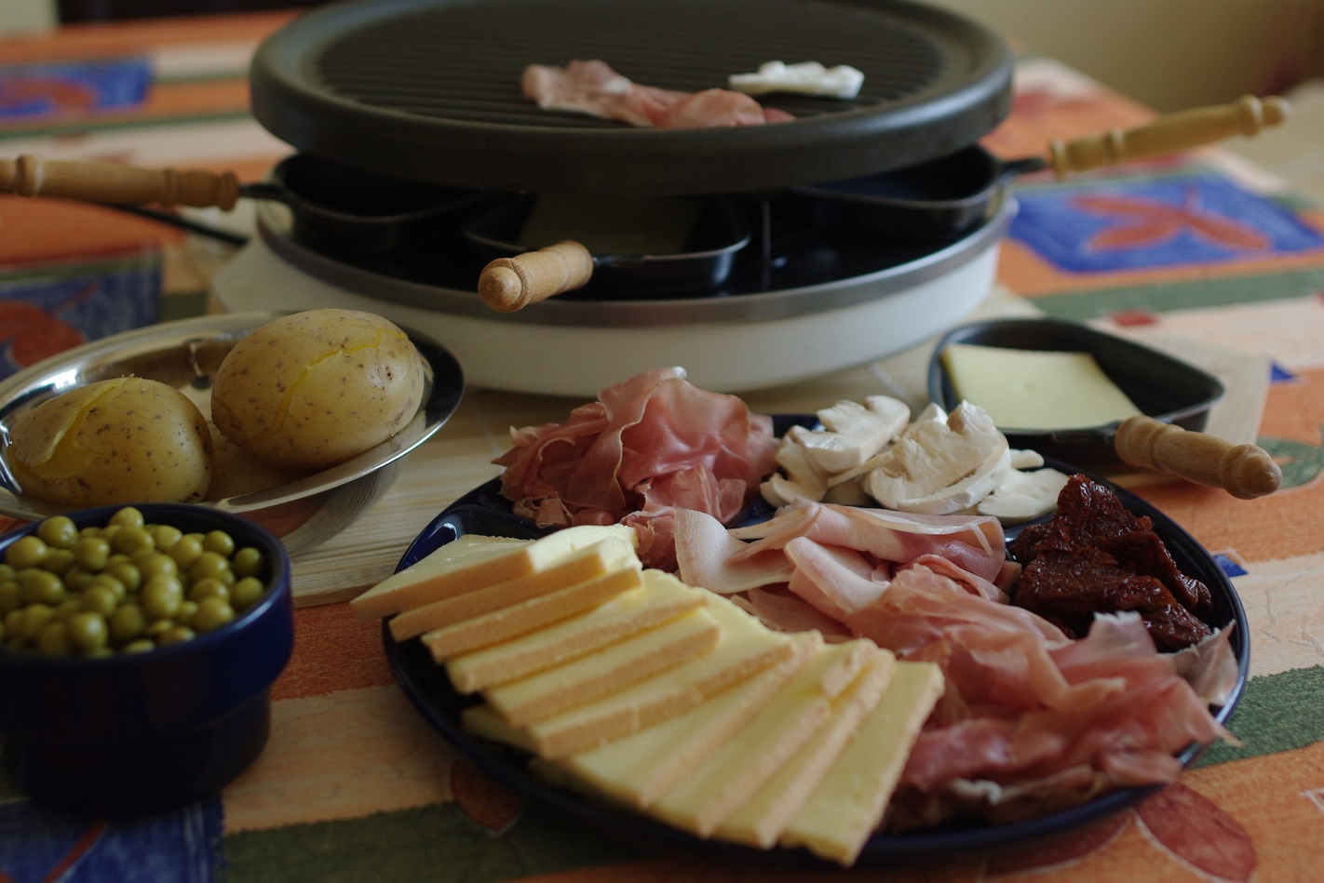
Recommandations
lire
la raclette This is a bit like cheese fondue. It involves heating the cheese and scraping off the melted part.
Il faut prendre leur / leurs raclette !
leur
Notes:
This is slide 4/8.

Slide 54
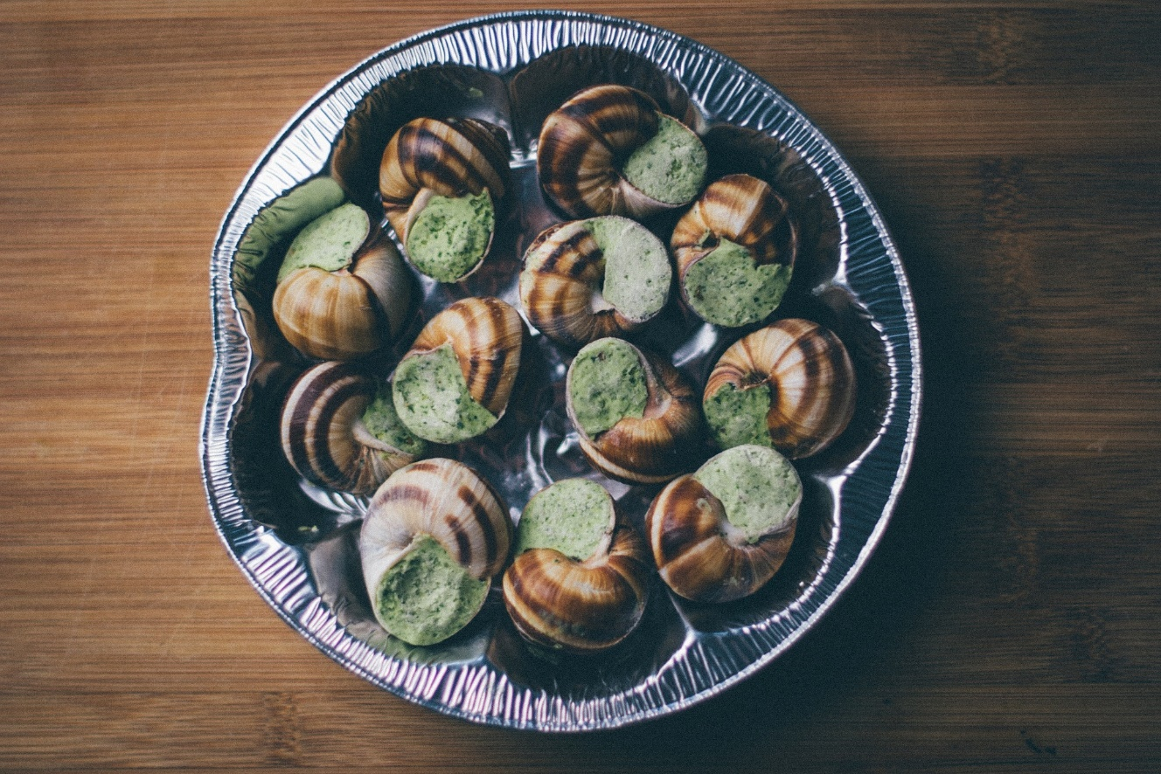
Recommandations
lire
l’escargot (m.)
snail
Tout le monde aime leur / leurs escargots.
leurs
Notes:
This is slide 5/8.

Slide 55
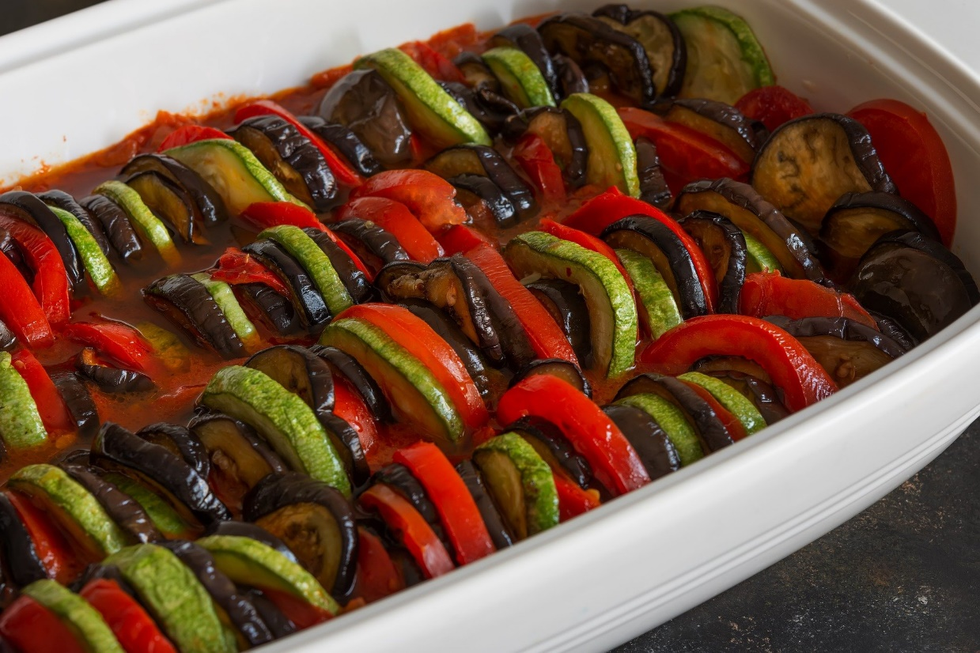
Recommandations
lire
la ratatouille
A stewed vegetable dish, typically served in the south of France.
Leur / Leurs ratatouille est délicieuse.
Leur
Notes:
This is slide 6/8.

Slide 56
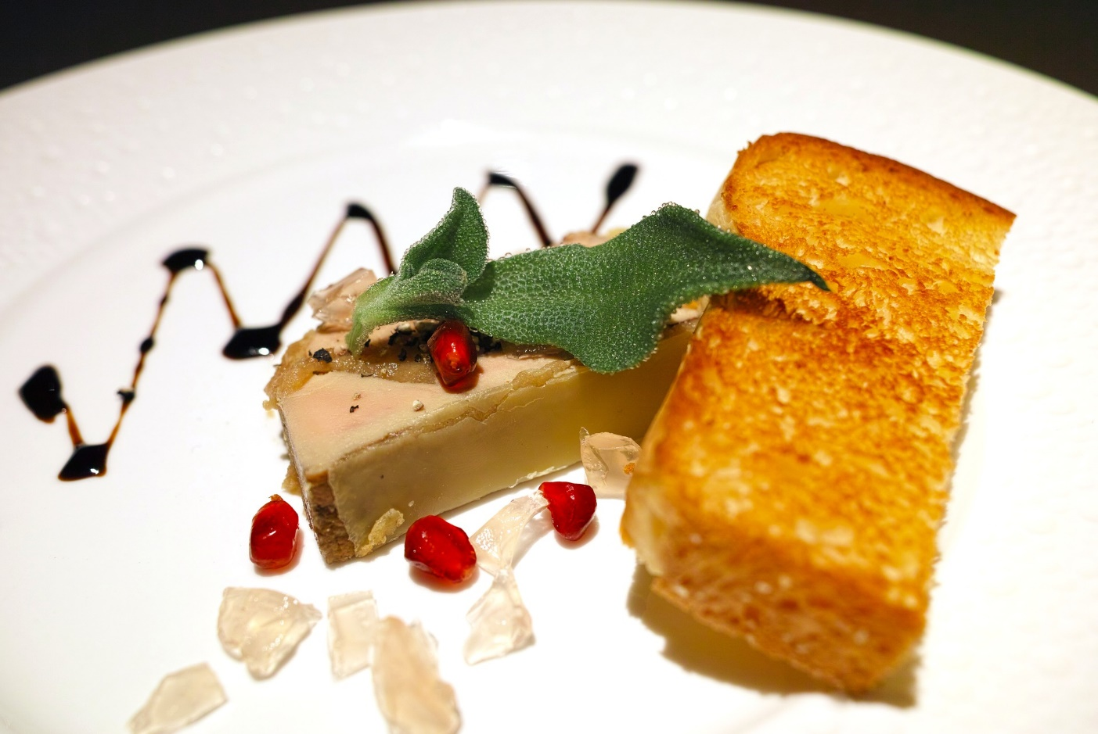
Recommandations
lire
le fois gras This means ‘fatty liver!’ It is made from the liver of a duck or goose.
Leur / Leurs foie gras ne coûte pas trop cher.
Leur
Notes:
This is slide 7/8

Slide 57
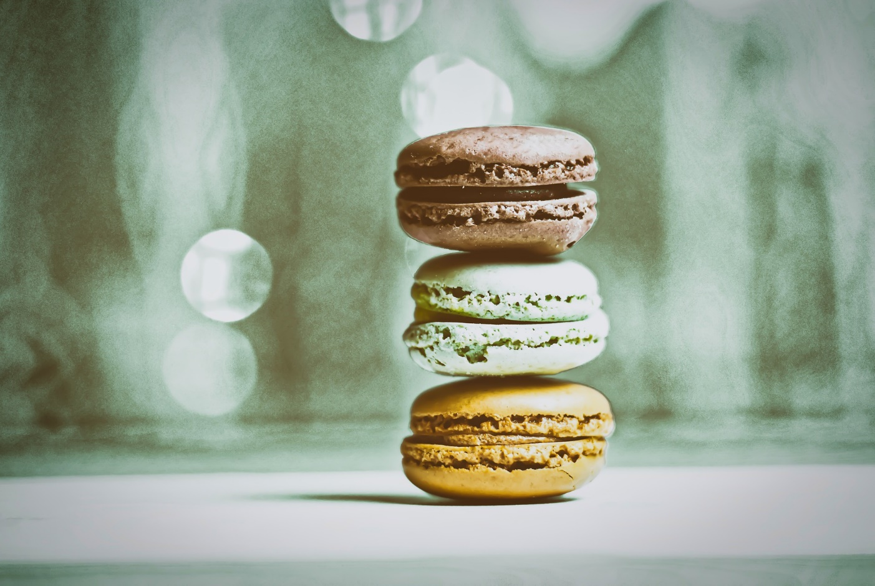
Recommandations
lire
le macaron (m) This is made from two light meringue biscuits sandwiched together with a sweet filling.
Je prends toujours leur / leurs macarons au dessert.
leurs
Notes:
This is slide 8/8.

Slide 58
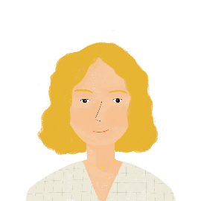
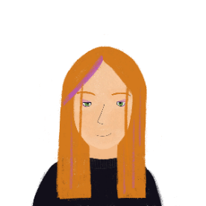
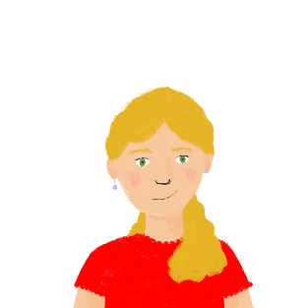
Choisir un restaurant
*les entrées = starters
écouter
Aurélie, Élodie et Léa ne peuvent pas choisir un restaurant. Écoute leur conversation. C’est quel mot?
 | idées / décisions
 | animaux / chiens
 | annonces / glaces
 | entrées* / plats
 | oiseaux / chiens
 | amis / cousins
 | enfants / parents
 | acteurs / chanteurs
Which three restaurants do they discuss?
Make notes about each option.
1. The restaurant next to the river
You can play with the animals
They have interesting ice creams.
Their starters are expensive.
Léa’s favourite dogs are on holiday.
2. The restaurant in the countryside
Their friends used to work there/don’t anymore
Their friends’ parents have a café in Spain.
3. The restaurant in front of the library
Their favourite singers are often there.
1
idées
1
2
animaux
2
3
glaces
3
4
entrées
4
5
chiens
5
6
amis
6
7
parents
7
8
chanteurs
8
Notes:
Timing: 6 minutes
Aim: Aural recognition of the possessive adjectives votre, vos, leur and leurs and connecting these with meaning (nouns beginning with vowels or consonants).
Procedure:
Click the numbered audio button of the left to listen to the audio. The noun is beeped out.
Students choose which of two options are most appropriate in the gap based on whether or not they hear the –s in the adjective.
Click to reveal the answers.
Click the numbered audio button on the right to hear the audio in full.
Click to reveal the instruction for the comprehension element. Students listen to the full audio again, taking notes in English about each of the three restaurants as they go.
Click to reveal answers.
Transcript:
1. Aurélie : Quelles sont vos [idées] alors ?
2. Léa : Je veux aller au restaurant à côté du fleuve. On peut jouer avec leurs [animaux].
3. Élodie : Leurs [glaces] sont intéressantes aussi.
4. Aurélie : Oui, mais leurs [entrées] coûtent cher.
5. Aurélie : Et vos [chiens] préférés sont en vacances.
6. Léa : Ah, c’est vrai. Est-ce que vos [amis] travaillent encore au restaurant dans la campagne ?
7. Aurélie : Non, ils ont quitté le restaurant. Leurs [parents] ont un café en Espagne .
8. Aurélie : Hmm ... vos [chanteurs] préférés sont souvent au restaurant devant la bibliothèque ?
Word frequency of unknown words used (1 is the most frequent word in French): entrée [808]
Source: Londsale, D., & Le Bras, Y. (2009). A Frequency Dictionary of French: Core vocabulary for learners London: Routledge.

Slide 59
écouter
La pétanque
*surtout - mainly
eleventh
La pétanque est un jeu de boules. C’est le onzième sport en France et c’est populaire dans beaucoup de pays, par exemple, en Espagne, en Thaïlande et en Chine.
popular
China
players
C’est un sport *surtout masculin (85% des joueurs sont des hommes), mais on organise aussi des compétitions mixtes.
men
lire
4. This sport is played by: males only| males & females together| males & females separately
1. The text is mostly about: countries | a sport | a competition
2. In France this sport is: not popular | the most popular | very popular
3. Pétanaue is played: in Asia and Europe| only in Europe| only in France
une boule
Notes:
Timing: 6 minutes
Aim: to introduce pupils to the French sport of pétanque; to practise the comprehension of previously taught language in a longer text and to begin to develop pupils’ lexical inferencing ability, guiding them to use the words they know and some cognates to infer plausible meanings of words they don’t know.
Procedure:
Read the text aloud, so pupils can follow. (Click on the text to hear the audio, if preferred).
Click for the first question.
Elicit answers from pupils and click to check the answer. Refer pupils back to the text.
Repeat steps 2-3 for the remaining 5 questions.
Click to highlight words in the text and ask pupils to suggest what they mean. Click to reveal the answers. Note that teachers should support pupils here, steering them to look at the words they know and what they have understood so far about the text and their English vocabulary.
Frequency of unknown words and cognates: pétanque [] boule [] onzième [] populaire [] Espagne [] Thaïlande [] Chine [] surtout [] masculin [] joueur [] homme [] on []compétitionn [] mixte []
Image attribution: Brunobuisson, CC BY-SA 4.0 via Wikimedia Commons Information: https://fr.wikipedia.org/wiki/P%C3%A9tanque, https://www.thelocal.fr/20200721/ten-things-you-didnt-know-about-ptanque/
59

Slide 60
Phonétique: SSC [r]
Qui va avec chaque phrase?
lire/parler
Catherine
Arthur
Rosalie
Laurent
Beatrice
Rachid
Béatrice
1
Catherine
2
Laurent
3
…veut être
une vraie actrice.
…va travailler dur
dans l’usine*.
…roule en rond*
dans le vent.
Rosalie
4
Rachid
5
Arthur
6
…a nourri un wallaby en Australie.
…est sportif et
très rapide.
…fait un dessin
pur sur le mur*.
*usine = factory, rouler en rond = ride in circles, dessin = drawing, pur = pure, mur = wall
Notes:
This activity is one SSC, the [r] in French. The activity is a read aloud at level level, with a listen and check. There is an additional element of comprehension built in. This is from Y9. Another thing to note here is the position of the SSC within the word – we try to vary this as much as possible, not just in practice activities, but in the initial selection of ‘source’ word for each SSC (that is the ‘peg’ word that each SSC is hung on) and the ‘cluster’ words, (which are the set of 4-5 additional example words that contain each SSC). The source and cluster words provide ‘hooks’ to return students do, in moments of pronunciation or transcription difficulty.
Y9 Term 3.2 Week 6
Timing: 4 minutes
Aim: Consolidation of SSC [r]
Procedure:
Students read the phrases aloud in pairs and match them to each person.
Click on buttons to play the audio.
Students listen and check their answers.
Click to reveal answers.
Transcript:
Beatrice veut être une vrai actrice.
Catherine va travailler dur dans l’usine.
Laurent roule en rond dans le vent.
Rosalie a nourri un wallaby en Australie.
Rachid est sportif et très rapide.
Arthur fait un dessin pur sur le mur.
Word frequency of cognates used (1 is the most frequent word in French): wallaby [>5000], solide [1414], pur [1643]
Source: Lonsdale, D., & Le Bras, Y. (2009). A Frequency Dictionary of French: Core vocabulary for learners London: Routledge.
Word frequency (1 is the most frequent word in French): usine [1482], rouler [2599], rond [2268], dessin [2624], mur [1335]
Source: Lonsdale, D., & Le Bras, Y. (2009). A Frequency Dictionary of French: Core vocabulary for learners London: Routledge.

Slide 61
Teaching phonics
Select sound-symbol correspondences (SSCs) to be taught and add them to your KS3/4 SOW
Gather ideas and resources for introducing and practising them
Identify additional sounds of the language (e.g., liaison) and resources
Apply a systematic practice schedule
Assess phonics knowledge

Slide 62
Revisiting: the ‘umbrella’ architecture
Notes:
[Cue animation]
This screenshot from the phonics collection links spreadsheet gives a nice visual of our systematic revisiting/practice schedule, which is the umbrella architecture of our schemes of work (for all knowledge, whether it’s vocabulary, grammar or, as here, phonics.
Here you can see the cycles of introduction and revisiting, showing how SSCs continue to be practised into Y9 as phonics knowledge is prone to decay if not regularly revisited (Porter 2014).
Porter, A.M. (2014) An early start to French literacy: Learning the spoken and written word simultaneously in English primary schools. PhD thesis, University of Southampton.

Slide 63
For GCSE
Students will be required to undertake dictation of short, spoken extracts (including some vocabulary from outside the vocabulary list) with credit for accurate spelling. (GCSE Subject Content, DfE)
Students will be required speak using clear and comprehensible language to read aloud a short, written text and undertake a short unprepared conversation relating to the text. (GCSE Subject Content, DfE)
These extracts will be a minimum of 20 words at Foundation and 30 words at Higher. (Ofqual guidance)
These texts will be a minimum of 35 words at Foundation and 50 words at Higher. (Ofqual guidance)

Slide 64
Phonics tracker
KS4 French SOW walkthrough
KS4 French Scheme of work
Notes:
With the KS4 Scheme of Work we have a tab that tracks phonics across Y10 and Y11.
At KS4 we have linked phonics to relevant grammar features.

Slide 65
SSC [ou] et [u]
Lis les phrases à ton partenaire. Fais attention aux SSC [ou] et [u]
parler
ouvrir
réunir*
couvrir
unir*
découvrir
Le petit chat ouvre la porte.
Il réunit sa famille pour célébrer son anniversaire.
Je couvre ma sœur avec une couverture*.
On unit avec les autres pays du monde.
Tu découvres de jolies choses.
*réunir = to reunite, unir = to unite,
la couverture = cover/blanket
Notes:
Timing: 2 minutes
Aim: To practise pronunciation of the SSCs [ou] and [u] in short sentences.
Procedure:
In pairs or as a whole class, read the infinitive forms of -IR verbs aloud. The words chosen alternate between [u] and [ou], forcing students to focus on the difference each time.
Students read the sentences out loud, paying particular attention to differentiating between the SSCs [ou] and [u].
Word frequency of unknown words used (1 is the most frequent word in French): réunir [824], unir [1483], couverture [1698]
Source: Lonsdale, D., & Le Bras, Y. (2009). A Frequency Dictionary of French: Core vocabulary for learners London: Routledge.

Slide 66
SSC [ou] ou [u] ?
Lis les mots en anglais et en français à ton partenaire, qui écrit le mot en français. C’est le SSC [ou] ou [u] ?
parler/écouter/écrire
dur
[hard]
_ _ _
[hard]
hard:dur
d u r
moule
[mussel]
mussel: moule
_ _ _ _ e
[mussel]
m o u l
Notes:
Timing: 5 minutes
Aim: To practise writing unknown short words containing the SSCs [ou] and [u].
Procedure:
Click to show the demonstration of the activity.
Students work in pairs: Print the role-cards. Each student receives eight cards with French and English words and eight cards with English words only.
There is a choice of cards: For Foundation level, the cards have some letters already filled in (either one of the consonants where there are double consonants, and SFE) to ensure that focus is on [ou] vs [u] (with all other consonants being obvious). For Higher level, the cards do not have letters filled in, providing an additional level of challenge, but teachers may wish to point out that three words have double consonants and many have an SFE.
Partners take it in turns to say their words in English and French. Their partner listens carefully to determine if the word contains the SSC [ou] or [u] and attempts to write the word correctly in the space on their card.
Alternative method:
This task would be suited to a whole class activity: The teacher could invite pairs or teams of students to the front of the class, with students competing against each other to write correct spellings. One student is given a card by the teacher to read. Their partner must then write the word correctly on the classroom whiteboard. Support can be provided by the first partner drawing dashes (hangman style) on the board to indicate the number of letters, and adding SFEs or one consonant from double consonants.
Word frequency of unknown words used (1 is the most frequent word in French): pull [>5000], poule [4321], juste [304], joue [3932], pur [1643], foule [1894], lutte [759], doute [362], buche [>5000], boule [4879], mur [1335], mouche [>5000], bulle [4909], roue [3916], cure [>5000], bouche [1838]
Source: Lonsdale, D., & Le Bras, Y. (2009). A Frequency Dictionary of French: Core vocabulary for learners London: Routledge.

Slide 67
Partenaire A
Partenaire B
pull
[jumper]
poule
[hen]
juste
[fair]
joue
[cheek]
_ _ l l
[jumper]
_ _ _ _ e
[hen]
_ _ _ _ e
[fair]
_ _ _ e
[cheek]
pur
[pure]
foule
[crowd]
lutte
[fight]
doute
[doubt]
_ _ _
[pure]
_ _ _ _ e
[crowd]
_ _ t t e
[fight]
_ _ _ _ e
[doubt]
_ _ _ _ e
[log]
_ _ _ _ e
[bowl]
_ _ _
[wall]
_ _ _ _ _ e
[fly]
bûche
[log]
boule
[bowl]
mur
[wall]
mouche
[fly]
_ _ l l e
[bubble]
_ _ _ e
[wheel]
_ _ _ e
[therapy]
_ _ _ _ _ e
[mouth]
bulle
[bubble]
roue
[wheel]
cure
[therapy]
bouche
[mouth]
Notes:
Role-cards for printing
Foundation version

Slide 68
Partenaire A
Partenaire B
pull
[jumper]
poule
[hen]
juste
[fair]
joue
[cheek]
_ _ _ _
[jumper]
_ _ _ _ _
[hen]
_ _ _ _ _
[fair]
_ _ _ _
[cheek]
pur
[pure]
foule
[crowd]
lutte
[fight]
doute
[doubt]
_ _ _
[pure]
_ _ _ _ _
[crowd]
_ _ _ _ _
[fight]
_ _ _ _ _
[doubt]
_ _ _ _ _
[log]
_ _ _ _ _
[bowl]
_ _ _
[wall]
_ _ _ _ _ _
[fly]
bûche
[log]
boule
[bowl]
mur
[wall]
mouche
[fly]
_ _ _ _ _
[bubble]
_ _ _ _
[wheel]
_ _ _ _
[therapy]
_ _ _ _ _ _
[mouth]
bulle
[bubble]
roue
[wheel]
cure
[therapy]
bouche
[mouth]
Notes:
Role-cards for printing
Higher version

Slide 69
Teaching phonics
Select sound-symbol correspondences (SSCs) to be taught and add them to your KS3/4 SOW
Gather ideas and resources for introducing and practising them
Identify additional sounds of the language (e.g., liaison) and resources
Apply a systematic practice schedule
Assess phonics knowledge

Slide 70
Assessing phonics
Two main approaches at KS3 and KS4:
Reading aloud
Transcription
Time consuming to administer and mark
Needs handling sensitively
Individual work with teacher, paired reading, self-recording (spoken homework)
Quick and easy to administer and mark
Cf. Year 1 Phonics Screening Check in English primary schools
Notes:
[Cue animation]
In the NCELP SOW, we use two main approaches to measure phonological decoding. [Cue animation]
On the one hand, reading aloud measures where students are asked to read aloud individual words or perhaps connected stretches of text.
[Cue animation]
Remember, we talked previously about the importance of getting students to read unfamiliar words aloud, which is a bit like what happens within the phonics screening check in primary schools, although we have taken the decision not to include any pseudo words.
[Cue animation]
Secondly, we use transcription tasks where students listen to unfamiliar words and transcribe them.
[Cue animation]
These are quick and easy to administer and mark.
[Cue animation]
Obviously, reading aloud tasks are more difficult and time consuming to administer in a whole class context, but there are ways of making that easier to do, perhaps for example getting students to work in pairs and the teacher can walk around and listen in on particular pairs.
There are also opportunities for speaking homework to be set, and there is a resource on the NCELP Resource Portal looking at speaking homework, by getting students to record themselves reading a passage at home and sending you the recording for you to listen to.
And part of the value for students is the practice.
For the teacher who is trying to gauge how well the class is progressing more generally with phonics knowledge, s/he can sample the group, e.g., listen to 1/5 recordings, 6 of the 30 students, to gain enough of an idea to adjust teaching.
Individual phonics assessments can then be completed too, but less frequently.
We have picked out a couple of examples for now, but of course on the Resource Portal you can find full examples of both of these kinds of tests.
………………………………………………………………………………………………………………………………………………………….
Additional notes for info re: Year 1 Phonics Screening Check –
The Year 1 Phonics Screening Check uses both real words and pseudo words. Some example items of the pseudo words include “vuss” “quop” “zook” and “chack” and some real words include “flat” “skill” “gift” and “coin”. Why does the test include pseudo words? The rationale for that is because pseudo words by definition are unknown to the learners so learners cannot know these words because they are made-up words. They can’t draw on existing knowledge of how those words are pronounced and so it is purer measure of their knowledge of the SSC, of the sub-lexical correspondences between written symbols and the sounds they represent so we considered also using pseudo words for our phonics reading aloud in French, German and Spanish but we felt that this was problematic in ethical pedagogical terms because after all there are so many real words that learners don’t know and it just seemed wrong to get them to interact with made-up words.
There is also some evidence that actually participants in tasks like this do treat pseudo words differently to real words if they know they are pseudo words. Of course, we have to be honest with learners and tell them what they are dealing with so in terms of validity, in terms of trying to find out how learners pronounce words and so what we do is we choose real words which we think are unfamiliar or very likely to be unfamiliar to the learners, words which they have not encountered before. In order to do that, we choose words which are low in frequency and which we know they haven’t covered to date in the NCELP Scheme of Work.

Slide 71
Section A: Listening - Phonics
This part of the test will take around 4 minutes. You will hear the French words listed below.
Complete the spelling of each word by filling in the missing letters.
Each dash (_) represents one missing letter.
For some of the words you hear, there may be more than one way of spelling them.
Just type in any one possible spelling for each word.
The aim is to see how you write the sounds that you hear. You won’t know these words. Don’t worry – just do your best!
You will hear each word twice.
absolum _ _ t
ch _ _ d
There is one mark for each item.
1
Answer: absolument
2
Answer: chaud
Notes:
Here is a transcription example from Summer Term Y7 French assessment. SSCs taught up to this point in the SOW are tested here, using unfamiliar words.
………………………………………………………………………………….
Original teacher notes
Transcript
1. absolument
2. chaud
absolument [1009] chaud [1852]
Source of frequency information:
Londsale, D., & Le Bras, Y. (2009). A Frequency Dictionary of French: Core vocabulary for learners London: Routledge.

Slide 72
SECTION D: Speaking - Phonics
The phonics part of the test will take around 2 minutes. That’s 6 seconds per word – you have time to think about each one carefully.
Read this list of French words aloud. You won't know the words. Just say them as you think they should sound. You will get marks for pronouncing the bold, underlined parts of each word correctly. If you’re not sure, don’t worry – just have a go and do your best.
niveau
2. quotidien
0 marks: Incorrect pronunciation based on English SSC.
1 mark: Correct knowledge of target SSC, but pronunciation with an English accent.
1 mark: Correct pronunciation of target SSC
Notes:
This is a read aloud example from Summer Term Y7 French phonics assessment.
This is either administered individually in class, or students use an online platform such as Vocaroo to record their answers and send this to their teacher.
…………………………………………………………………………………………………………………………
Original teacher notes
When you do this part of the test, you will probably want to record it to send to your teacher. There are many ways to record and send audio. Make sure you use the one your teacher recommends. If she or he doesn’t have a preference, there is a suggested platform to use given in the instructions on the test that you are now ready to download. Good luck for your test. Now, close the video and click next on the page to download and complete your assessment.
niveau [328] quotidien [1318]
Source of frequency information:
Londsale, D., & Le Bras, Y. (2009). A Frequency Dictionary of French: Core vocabulary for learners London: Routledge.

Slide 73
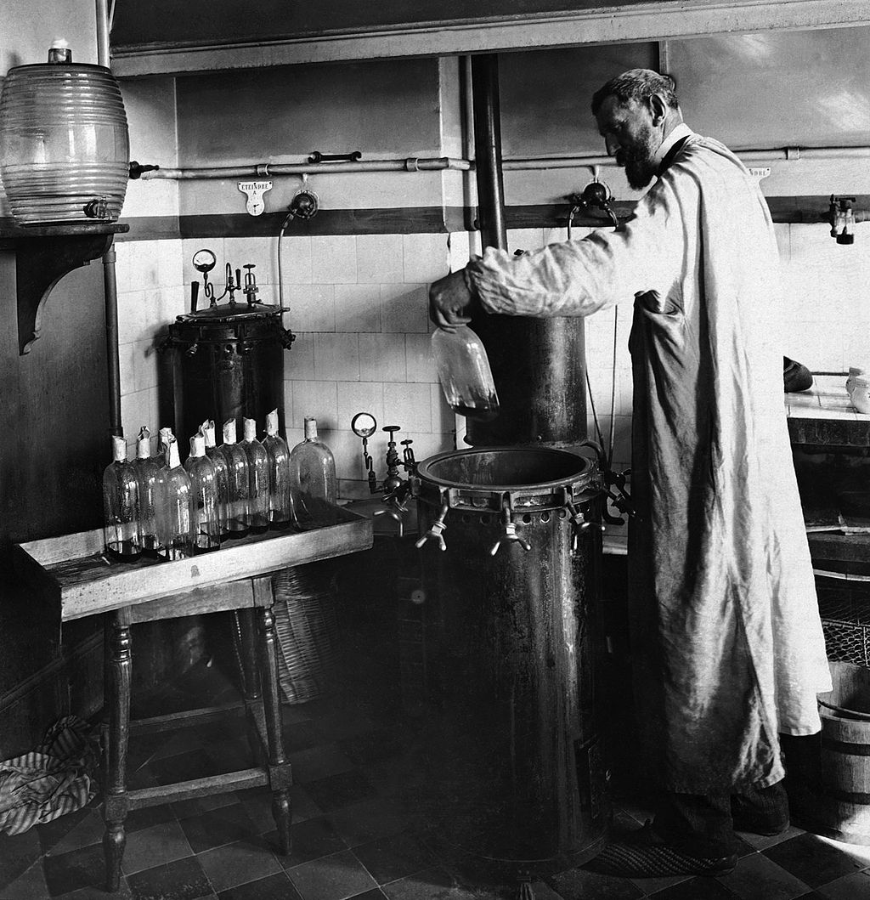
Y8 French Applying your knowledge
Read the following text aloud. You won’t know some of the words – don’t worry! Just do your best to read them aloud as you think they should sound in French.
You will get marks for understandable and fluent pronunciation.
Louis Pasteur est un scientifique français très important dans l'histoire.
Il trouve une solution pour conserver des produits périssables.
Comme résultat, on achète le lait ‘pasteurisé’ au magasin aujourd’hui.
Il crée aussi le premier vaccin contre une maladie dangereuse.
C'est pourquoi on dit qu'il est ‘le père de la médecine moderne’.
Louis Pasteur (1822-1895) dans son laboratoire
Notes:
This is an example of Y8 French Applying your knowledge test: Read aloud- where the knowledge of SSCs is brought together in sentence and paragraph-length utterances.
There are 5 ‘ideational units’ (sentences of similar length and complexity, containing roughly similar proportions of known vs unfamiliar words 80% of words in the text are in the SOW.
To be a valid test of sounds of language we have to use some language unlikely to have been met yet.
2 marks / sentence = max. 10 marks in total
…………………………………………………………………………………………………………………………………………………………………………………..
Original teacher notes
Image information: By Unknown author - Britannica Kids, Public Domain, https://commons.wikimedia.org/w/index.php?curid=28583466
https://en.wikipedia.org/wiki/Louis_Pasteur#/media/File:Louis_Pasteur_experiment.jpg

Slide 74
Y8 French Applying your knowledge
 | Idea | Notes on tolerance
1. | Louis Pasteur est un scientifique français important dans l’histoire. | liaison is required with ‘est un’
2. | Il trouve une solution pour conserver des produits périssables.
3. | Comme résultat, on achète le lait pasteurisé au magasin aujourd’hui. | liaison is required with ‘on achète’
4. | Il crée aussi le premier vaccin contre une maladie dangereuse. | ignore <cc> in ‘vaccin’
5. | C’est pourquoi on dit qu’il est ‘le père de la médecine moderne’.
Notes:
This is an example of Y8 French Applying your knowledge test: Read aloud- where the knowledge of SSCs is brought together in sentence and paragraph-length utterances.
There are 5 ‘ideational units’ (sentences of similar length and complexity, containing roughly similar proportions of known vs unfamiliar words 80% of words in the text are in the SOW.
To be a valid test of sounds of language we have to use some language unlikely to have been met yet.
2 marks / sentence = max. 10 marks in total
…………………………………………………………………………………………………………………………………………………………………………………..
Original teacher notes
Image information: By Unknown author - Britannica Kids, Public Domain, https://commons.wikimedia.org/w/index.php?curid=28583466
https://en.wikipedia.org/wiki/Louis_Pasteur#/media/File:Louis_Pasteur_experiment.jpg

Slide 75
Y8 French Applying your knowledge
For each sentence we suggest awarding 1 mark for comprehensibility and 1 mark for fluency, giving 2 points for each sentence in total. However, there must a minimum level of comprehensibility (0.5 points) before points can be awarded for fluency.
1 mark awarded where words are pronounced very clearly and comprehensibly, with all or most of the features (SSCs, liaison, stress patterns) accurately produced.
Plus 1 mark awarded where the sentence is read very fluently (with few hesitations and/or self-corrections)
Plus 0.5 mark awarded where the sentence is read quite fluently (with some hesitations and/or self-corrections).
0.5 mark awarded where words are pronounced quite clearly and comprehensibly, with most of the features (SSCs, liaison, stress patterns) accurately produced.
Plus 1 mark awarded where the sentence is read very fluently (with few hesitations and/or self-corrections).
Plus 0.5 mark awarded where the sentence is read quite fluently (with some hesitations and/or self-corrections).
0 marks awarded where words are pronounced neither clearly nor comprehensibly, with few of the features (SSCs, liaison, stress patterns) accurately produced.
0 marks awarded for fluency where the unit is not awarded any marks for comprehensibility.
Notes:
Here we have the suggested mark scheme for the ‘Applying your knowledge’ test.
It is detailed but you can already see the importance of both individual SSCs and additional features of liaison, stress patterns and fluency for example.
[Use indicator/highlighter/mouse to show the key words in mark scheme]

Slide 76
Teaching phonics
Select sound-symbol correspondences (SSCs) to be taught and add them to your KS3/4 SOW
Gather ideas and resources for introducing and practising them
Identify additional sounds of the language (e.g., liaison) and resources
Apply a systematic practice schedule
Assess phonics knowledge

Slide 77
Phonics at KS3 and KS4
Practical ideas for teaching and practising phonics knowledge
Presenter: Rachel Hawkes @RachelHawkes60 www.rachelhawkes.com
Notes:
https://docs.google.com/forms/d/e/1FAIpQLSfrDnLxtqRCBgVgepv0ZjM4EkKsBuRsGbB7gd_Qh5xj51z2PA/viewform

