Slide 1
Grammar
SER vs ESTAR [revisited]
gender agreement [revisited]
Y7 Spanish
Term 3.1- Week 3 - Lesson 53
Author names: Amanda Izquierdo / Nick Avery /
Rachel Hawkes
Date updated: 16/05/20

Slide 2
SER and ESTAR [revisited]
In Spanish, there are two ways to say ‘I am’: ________ and _______
estoy
soy
estoy
Use ‘______’ for location and temporary state/mood.
soy
Use ‘_____’ for permanent traits.
I am serious (now).
Estoy serio.
I am serious (in general).
Soy serio.
Notes:
This revision slide can be used for interactive elicitation of the target grammar forms ‘estoy’ and ‘soy’ and their functions before the subsequent activity.

Slide 3
leer
You’re playing a ‘guess who’ game with new classmates.
Lee las frases. ¿La persona es un chico, una chica o puede ser los dos? Mira el adjetivo.
¿La persona dice cómo está hoy o cómo es en general? Mira el verbo.
?
?
Chico | Chica | Puede ser chico o chica | Hoy | En general
?
Persona 1
“Soy alegre”
Persona 2
“Soy nervioso.”
Persona 3
“Soy simpática.”
Persona 4
“No estoy seria.”
Persona 5
“Soy guapo.”
Persona 6
“Estoy alegre.”
Persona 7
“Soy bastante raro.”
¿Qué significa?
Persona 8
“Estoy roja.”
Persona 9
“Soy muy tranquila.”
I am red (sunburnt)!
Persona 10
“No estoy feliz.”
Notes:
This activity revises two previously taught grammar features: gender agreement on adjectives and ser vs estar for traits vs state/mood.
‘Estoy’ and ‘soy’ were taught in Term 1.1, but introduced and practised in separate weeks to avoid overload in the first few weeks of teaching. A key aim of this activity and lesson is therefore to revisit the two verb forms together and consolidate the difference in meaning between them.

Slide 4
SER and ESTAR [revisited]
In Spanish, there are two ways to say ‘you are’: ________ and _______
estás
eres
estás
Use ‘______’ for location and temporary state/mood.
eres
Use ‘_______’ for permanent traits.
You are being strange (now).
Estás raro.
You are strange (in general).
Eres raro.
Notes:
This revision slide can be used for interactive elicitation of the target grammar forms ‘estás’ and ‘eres’ and their respective functions before the subsequent activity.

Slide 5
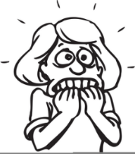
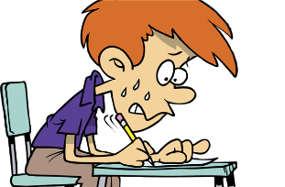
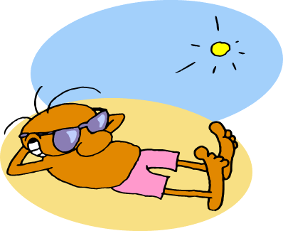
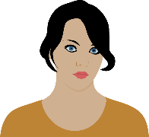
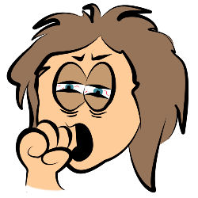
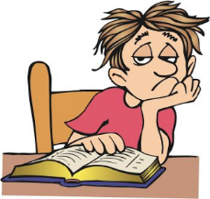
Escucha el verbo. ¿Es ‘hoy’ o ‘en general’?
escuchar
Luego, marca la imagen correcta. ¿Es ‘A’, ‘B’ o puede ser ‘A’ y ‘B’?
¿Cómo se dice ‘estás moreno’ en inglés?
 | Hoy | En general
 | Hoy | En general
A
B
A
B
You are tanned.
1
¿Cómo se dice ‘eres moreno’ en inglés?
6
You are dark-haired / dark-skinned.
2
7
silly
[boy]
silly
[girl]
3
8
¿Cómo se dice ‘estás aburrido’ en inglés?
You are bored.
nice
[girl]
nice
[boy]
4
9
¿Cómo se dice ‘eres aburrido’ en inglés?
cheerful [girl]
cheerful [boy]
5
10
You are boring.
Notes:
This listening activity practises the use of eres vs estás and gender agreement on adjectives. The grid can be copied into students’ books and completed by ticking/writing letters (‘A’, ‘B’, ‘A o B’). Ensure that students understand that sometimes both pictures may be correct (i.e. on the adjectives that don’t require gender agreement). After checking the answers, two speech bubbles appear. These can be used to elicit the translations of the two adjectives which change in English depending on use of ser/estar.
The activity allows for differentiation. Students could listen twice – the first time for estoy/soy and the second time for the gender of the adjective. Alternatively, higher ability students may be able to complete both parts of the task as they go.
Images from clipart-library.com
Transcript:
Eres nerviosa
Eres feliz
Estás aburrido
Eres guapa
Estás tranquila
Estás moreno
Eres serio.
Estás tonta.
Estás simpático
Eres alegre.

Slide 6
Escucha otra vez. Escribe la frase en inglés.
escuchar / hablar / escribir
¿Es una pregunta (P) o una afirmación (A)*?
Persona A
Escribe 6 frases con ‘eres + adjetivo’.
3 x preguntas (i.e. Are you…?)
3 x afirmaciones (i.e. You are…)
Say them aloud in random order to your partner. Use correct intonation.
Persona B: Escribe 1-6.
Escribe ‘P’ si es una pregunta.
Escribe ‘A’ si es una afirmación.
Luego, comprueba las respuestas.
¿Cómo se dice en inglés?
1
P
Are you nervous (in general)?
2
A
You are happy (in general).
3
P
Are you serious (in general)?
4
A
You are cheerful (in general).
P
Are you good-looking (in general)?
5
*afirmación = statement
Notes:
OPTIONAL
Awareness raising of L1-L2 difference in question/statement formation between Spanish and the English ‘to be’ (which uses subject-verb inversion, like the auxiliary ‘do’).
Students listen again to 5 items from the previous activity and write the English translation. Make clear that the focus here is not on ser vs estar (all items use ‘eres’) but on flat vs raised intonation for question vs statement. Remind students that the two English forms ‘you are’ and ‘are you’ map onto a single verb in Spanish and that correct intonation is needed to convey which meaning is intended.
¿Eres nerviosa?
Eres feliz
¿Eres serio?
Eres alegre
¿Eres guapa?
afirmación [2892]

Slide 7
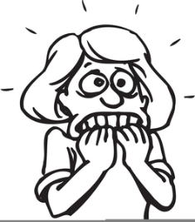
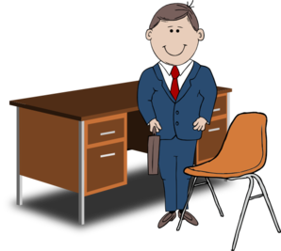
La entrevista de trabajo
hablar / escuchar
(The job interview)
Persona A
Eres el director/la directora de la escuela.
You’re interviewing candidates for a new job. Your partner is one of them!
To find out who, ask your partner questions with ‘estás’ or ‘eres’ + adjective.
Persona B
Eres el candidato/la candidata. Choose one person but don’t say who!
Answer your partner’s questions with ‘soy’ or ‘estoy’ + adjective.
Pay attention to the verb – temporary state (estoy, estás) or permanent trait (soy, eres)?
Notes:
This speaking listening activity brings together the four verbs revised in the lesson so far: estoy, estás, soy and eres. It is essentially a ‘who am I’ activity.
Students will be asking questions with ‘estás’ and ‘eres’ and will be encouraged to give full answers using ‘estoy’ and soy’ (see next slide).

Slide 8
Un ejemplo
?
Candidato/a E
Candidato/a C
?
serious – today
serious – in general
strange – today
strange – today
¡Prohibido sólo decir ‘sí’ o ‘no’!
silly – in general
silly – in general
nice – today
nice – today
nervous – in general
nervous – in general
happy – in general
happy – today
calm – today
calm – today
Persona A es el candidato E.
Persona B es el candidato C.
¿Estás serio?
No. Soy serio.
¿Eres feliz?
Sí, soy feliz.
Notes:
Encourage the person answering the questions to answer in full sentences, rather than just with ‘sí’ o ‘no’. In this way, ‘estoy’ and ‘soy’ can be practised, in addition to ‘eres’ and ‘estás’.
An alternative, if practice of 1st person singular forms is priority, is to slightly change the task design: person A simply describes him/herself to the Person B, without asking questions. So, person A would say ‘Estoy serio’ and the Person B would then listen and try to identify which card matches. Eventually, Person B can ask, e.g., ‘¿Eres el candidato C?’, based on the answers previously given.

Slide 9
Los candidatos
Candidato/a A
?
Candidato/a B
?
Candidato/a C
?
?
serious – today
serious – in general
serious – in general
strange – in general
strange – in general
strange – today
silly – today
silly – today
silly – in general
nice – today
nice – in general
nice – today
nervous – in general
nervous – today
nervous – in general
happy – in general
happy – today
happy – today
calm – today
calm – in general
calm – today
Candidato/a D
?
Candidato/a E
Candidato/a F
?
?
?
serious – today
serious – today
serious – in general
strange – in general
strange – today
strange – today
silly – today
silly – in general
silly – in general
nice – in general
nice – today
nice – in general
nervous – today
nervous – in general
nervous – today
happy – in general
happy – in general
happy – today
calm – in general
calm – today
calm – in general
Notes:
The same 7 adjectives are used on each of the cards. The only difference is whether the adjective is ‘today’ (requiring estar) or ‘in general’ (requiring ser).
In this way, the only way to complete the activity is for student A to ask questions using ‘estás’ or ‘eres’ and for student B to understand that these refer to state and trait respectively.
Encourage the person answering the questions to answer in full sentences, rather than just with ‘sí’ o ‘no’. Though this isn’t essential for task completion, it will maximise practice of the 1st person singular forms of ser and estar.

Slide 10
Grammar [2]
-AR verbs [revisited]
adverbs of location with del/de la [revisited]
Y7 Spanish
Term 3.1 - Week 3 - Lesson 54
Author names: Nick Avery / Rachel Hawkes
Date updated: 16/05/20

Slide 11
This lesson you will read a text about a Spanish family. Listen to some extracts from it. Who is being referred to?
escuchar
Talks about ‘we’
Talks about ‘s/he’
Escribe la frase en inglés.
1
We sing.
2
S/he cleans the floor.
3
S/he organises the magazines.
4
On Sundays we are at home.
5
We participate in the activities.
6
S/he enjoys (the) nature.
7
We work too.
8
We ride bikes in the countryside.
Notes:
OPTIONAL
This listening activity brings together previously taught AR verb forms that haven’t yet been practised together: -amos for ‘we’ and –a for ‘s/he’.
Both will appear in the text this lesson (see slide 13), so this serves as a lead-in activity.
Transcript
Cantamos.
Limpia el suelo
Organiza las revistas
Los domingos estamos en casa.
Participamos en las actividades.
Disfruta la naturaleza.
Trabajamos también.
Montamos en bici en el campo.

Slide 12
Organiza las frases. Trabaja con un compañero.
¿Qué hacen las personas misteriosas?
leer
?
‘I’
?
‘s/he’
?
‘we’
Lavo la ropa.
Cantamos
Saca la ropa
Bailamos.
Trabajo en la oficina de turismo.
Saco la basura.
No llegamos tarde a clase.
Disfruta la naturaleza.
Montamos en bici.
Limpia el suelo.
Trabaja en una tienda de ropa.
Preparo la comida.
Notes:
This activity also leads in to the text that students will read on slide 23.
There are 12 extracts from the text on slide 23. These include 4 examples of 1st person singular, 1st person plural and 3rd person singular. 1st and 3rd person singular were taught in Term 1.1. 1st person plural was taught in Term 2.2, so this is all revision. Students work individually or in pairs to match the sentences to the three categories. Answers are animated so that extracts move and land below the correct header.
This activity doesn’t require printing. Students could write three headers in their books, leaving space for four sentences below each one.
NB Since all features here have been previously taught and practised, and reading allows time for reflection, we include three verb forms in this activity. (When verb forms are initially introduced and practised, this should be done with pairs of features.)
This is an opportunity to build some anticipation about the characters before their identities are revealed on the next slide.

Slide 13
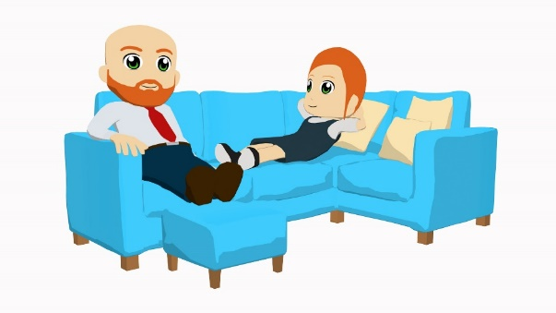
La familia López
Daniel
Ana
Diego
Lucía
Soy Daniel, de León, una ciudad antigua en el norte de España. Quiero decir unas cosas sobre mi familia. Tengo una hermana, Lucía. Es una chica simpática, aunque está rara hoy. Estudiamos en una escuela detrás del teatro. En general somos buenos estudiantes. No llegamos tarde a clase, escuchamos cuando habla otra persona, preguntamos si las cosas no están claras, y participamos en las actividades.
Pasamos tiempo juntos fuera de la escuela. Cantamos, bailamos y montamos en bici en el campo los sábados. Trabajamos también. Lucía trabaja en una tienda de regalos y yo trabajo en la oficina de turismo cerca del Museo de León. Doy información a los turistas.
Los domingos estamos en casa porque mis padres necesitan ayuda con las tareas domesticas. Yo lavo la ropa, saco la basura y preparo la comida. Lucía limpia el suelo, saca la ropa y organiza las revistas. Es un día aburrido para nosotros.
Mis padres son normales. Los dos trabajan de lunes a viernes. Descansan los sábados y domingos. Mi padre, Diego, es profesor de ciencias y camina a la escuela los martes, miércoles y jueves. Quiere ser director de la escuela un día. Mi madre, Ana, es autora de libros en inglés para niños. Disfruta la naturaleza lejos de la ciudad.
Notes:
This fully readable text uses near-100% previously taught language in the NCELP Y7 Spanish SoW. Oficina [1072], turismo [2549], turista [2824] and información [326] are near-cognates. ‘Mi(s)’ will be taught in Term 3 of Year 7.
The text is the basis for the reading activities on slides 25-26 and subsequent L1->L2 translation activities (slides 27-28),
An alternative is to use this text for a dictogloss. The teacher reads out the text (or parts of it). Working in groups, students take notes and then work together to reconstruct the same ideas. Note that when reconstructing such a text, there are changes in deictic perspective. For example, Juan talks about ‘I’ in the original, but students would refer to him as ‘he’ when reconstructing the text. Similarly, the ‘we’ form of a verb becomes ‘they’. Students have already learnt these features for ar verbs, but it would be useful to check they are aware of this before starting.

Slide 14
Busca la información en el texto sobre Daniel y Lucía.
leer
Daniel (‘I’)
Daniel y Lucía (‘we’)
Lucía (‘she’)
Have a sister.
Study in a school behind the theatre.
Is nice (in general), but is strange today.
Work in the tourist office.
Are good students.
Don’t arrive late.
Give information to tourists.
Listen when another person speaks.
Ask if things aren’t clear.
Works in a gift shop.
Wash the clothes.
Participate in activities.
Takes the clothes out.
Spend time together outside school.
Take out the rubbish.
Sing, dance and ride bikes.
Organises the magazines.
Prepare the food.
Work too.
Are at home on Sundays.
Notes:
This activity brings together knowledge of vocabulary and verbs in the 1st person singular, 3rd person singular and 1st person plural. It could be done individually or in small groups (e.g. 1 person for each sphere of the diagram).
Ask students to copy the Venn diagram into their books. Spheres will need space for up to 10 pieces of information, so this may require a full page. Students should look for all the information they can find in the text about each of the three options and then write this down in English.
Click on the rounded rectangles to reveal the answers.
Answers (from top to bottom within each sphere)
Daniel (‘I’): 1. Have a sister; 2. Work in the tourist office; 3. Give information to tourists; 4. Wash the clothes; 5. Take out the rubbish; 6. Prepare the food
Daniel y Lucía (‘we’): 1. Study in a school behind the theatre; 2. Are good students; 3. Don’t arrive late; 4. Listen when another person speaks; 5. Ask if things aren’t clear; 6. Participate in the activities; 7. Spend time together outside school; 8. Sing, dance and ride bikes (due to limitations of space, these appear as a a single line); 9. Work too; 10. Are at home on Sundays.
Lucía (‘she’): 1. Is nice (in general) but is strange today; 2. Works in a gift shop; 3. Takes the clothes out; 4. Organises the magazines

Slide 15
Busca la información en el texto sobre Ana y Diego.
leer
Ana (‘she’)
Ana y Diego (‘they’)
Diego (‘he’)
Is an author of English books for children.
Need help with tasks at home (on Sundays).
Is a science teacher.
Work from Monday to Friday.
Walks to school on Tuesdays, Wednesdays and Thursdays.
Enjoys the nature far from the city.
Rest on Saturdays and Sundays.
Notes:
This activity brings together knowledge of vocabulary and verbs in the 3rd person singular and plural. It could be done individually or in small groups.
Ask students to copy the Venn diagram into their books. Spheres will need space for up to 8 pieces of information, so this may require a full page. Students should look for all the information they can find in the text about each of the three options and then write this down in English.
Click on the rounded rectangles to reveal the answers.
Answers (from top to bottom within each sphere)
Ana (‘she’): 1. Is an author of English books for children; 2. Enjoys the nature far from the city.
Ana y Diego (‘they’): 1. Need help with tasks at home on Sundays; 2. Work from Monday to Friday; 3. Rest on Saturdays and Sundays.
Diego (‘he’): 1. Is a science teacher; 2. Walks to school on Tuesdays, Wednesdays and Thursdays.

Slide 16
escribir
Some sentences from the text are now in English.
Completa las frases en español.
1 | We don’t arrive late to class.
 | No ____________ tarde a clase.
2 | I take out the rubbish.
 | ________ la basura.
3 | She enjoys the nature far from the city.
 | _________la naturaleza lejos de la ciudad.
4 | I prepare the food.
 | _________la comida.
5 | She cleans the floor.
 | ________el suelo.
6 | We ride bikes on Saturdays.
 | ____________en bici los sábados.
7 | We study in a school behind the theatre.
 | ____________en una escuela detrás del teatro.
8 | She organises the magazines.
 | __________ las revistas.
9 | I wash the clothes on Sundays.
 | _______la ropa los domingos.
10 | She travels to the mountains.
 | ________a las montañas.
11 | I work near the Museum of León.
 | __________ cerca del Museo de León.
12 | We spent time together outside of school.
 | __________tiempo juntos fuera de la escuela.
llegamos
Estudiamos
Saco
Organiza
Disfruta
Lavo
Preparo
Viaja
Limpia
Trabajo
Montamos
Pasamos
Notes:
12 sentences from the text on slide 21 are presented in English. The sentences include an equal number of 1st person singular, 3rd person singular and 1st person plural (the same features also practised on slide 21). Students now translate back into Spanish.
As L1->L2 translation is sometimes challenging, it may be best for some students to just focus on recalling and conjugating the verbs, as above. However, some stronger students may be able to translate the whole sentence. NB this covers other previously taught vocabulary and grammar (e.g. use of del vs de la and ‘los’ + day of week). See next slide.
Since these features here have been previously taught and practised in earlier weeks, and writing activities allow time for reflection, we include three different verb forms in this activity. (When verb forms are initially introduced and practised, this should be done with pairs of features.)
Minor changes have been made to the wording of items 6, 9 and 11 to allow for a range of features to be covered, but these sentences remain factual (i.e. accurately reflecting the text).

Slide 17
escribir
Some sentences from the text are now in English.
Escribe las frases en español.
1 | We don’t arrive late to class.
2 | I take out the rubbish.
3 | She enjoys the nature far from the city.
4 | I prepare the food.
5 | She cleans the floor.
6 | We ride bikes on Saturdays.
7 | We study in a school behind the theatre.
8 | She organises the magazines.
9 | I wash the clothes on Sundays.
10 | She travels to the mountains.
11 | I work near the Museum of León.
12 | We spent time together outside of school.
No llegamos tarde a clase.
Estudiamos en una escuela detrás del teatro.
Saco la basura.
Organiza las revistas.
Disfruta la naturaleza lejos de la ciudad.
Lavo la ropa los domingos.
Viaja a las montañas.
Preparo la comida.
Limpia el suelo.
Trabajo cerca del Museo de León.
Montamos en bici los sábados.
Pasamos tiempo juntos fuera de la escuela.
Notes:
Variation of the activity on the previous slide. Students write the whole sentence. There are several previously taught features to check that students are producing correctly here:
use of del vs de la in items 3, 7, 11 and 12
use of ‘los’ + day of week in items 6 and 9
subject-verb agreement with –ar verbs (all items)
Minor changes have been made to the wording of items 6, 9 and 11 to allow for a range of features to be covered, but these sentences remain factual (i.e. accurately reflecting the text).

Slide 18
Escribe 12 frases.
escribir
- what you do (using the ‘I’ form of the verb)
- what a friend/family member does (using the ‘s/he’ form of the verb)
- what you do with your family member/friend (using the ‘we’ form)
¿Dónde y cuándo?
Puedes usar estos verbos:
hablar
comprar
bailar
llegar
el día (e.g. los lunes)
por la mañana
por la tarde
por la noche
escuchar
estudiar
trabajar
usar
fuera de
delante de
cerca de
lejos de
debajo de
detrás de
descansar
preparar
pasar
participar
cambiar
lavar
sacar
limpiar
Remember to use
del + masculine noun
de la + feminine noun
viajar
disfrutar
montar
buscar
Notes:
This activity could either be done in class or for homework.
A number of previously taught –ar verbs are provided. These are fairly ‘concrete’ actions of the kind that would plausibly occur in a specific place and at a certain time.

