Slide 1
Comparing school experiences
Possessive adjectives unser and ihr
Revisit several SSC
Y8 German
Term 2.2 - Week 4 - Lesson 45
Author name(s): Stephen Owen / Rachel Hawkes
Artwork: Steve Clarke
Date updated: 10 / 8 / 21
Notes:
Artwork by Steve Clarke. All additional pictures selected are available under a Creative Commons license, no attribution required.
Native teacher feedback provided by Stephanie Cross.
Learning outcomes (lesson 1):
Revisit several SSC Introduction of possessive adjectives unser and ihr Using present and perfect tenses
Word frequency (1 is the most frequent word in German):
8.2.2.4 (introduce) erklären [238] erlauben [963] erzählen [263] gegeben [49] geholfen [338] ihnen [125] uns [75] Geschichte² [262] Wahrheit [1156] unser [86] ihr³ [28] alleine [267] jedoch [227] ohne [120]
8.2.2.1 (revisit) alles [36] alle [36] Rock [3551] Kleid [1780] alt [138] arm [1475] einfach [131] eng [59] genau [167] hell [1411] jung [199] kurz [176] reich [1568] 8.1.2.5 (revisit) anderer, andere, anderes [59] Aktivität [1422] Hobby [3608] Jugendclub [2117/1360] Schloss [1907] Telefon [1595] langsam [526] normal [642] schnell [203] gern [278] Source: Jones, R.L & Tschirner, E. (2019). A frequency dictionary of German: Core vocabulary for learners. London: Routledge.
The frequency rankings for words that occur in this PowerPoint which have been previously introduced in NCELP resources are given in the NCELP SOW and in the resources that first introduced and formally re-visited those words.
For any other words that occur incidentally in this PowerPoint, frequency rankings will be provided in the notes field wherever possible.

Slide 2
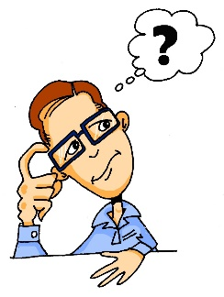
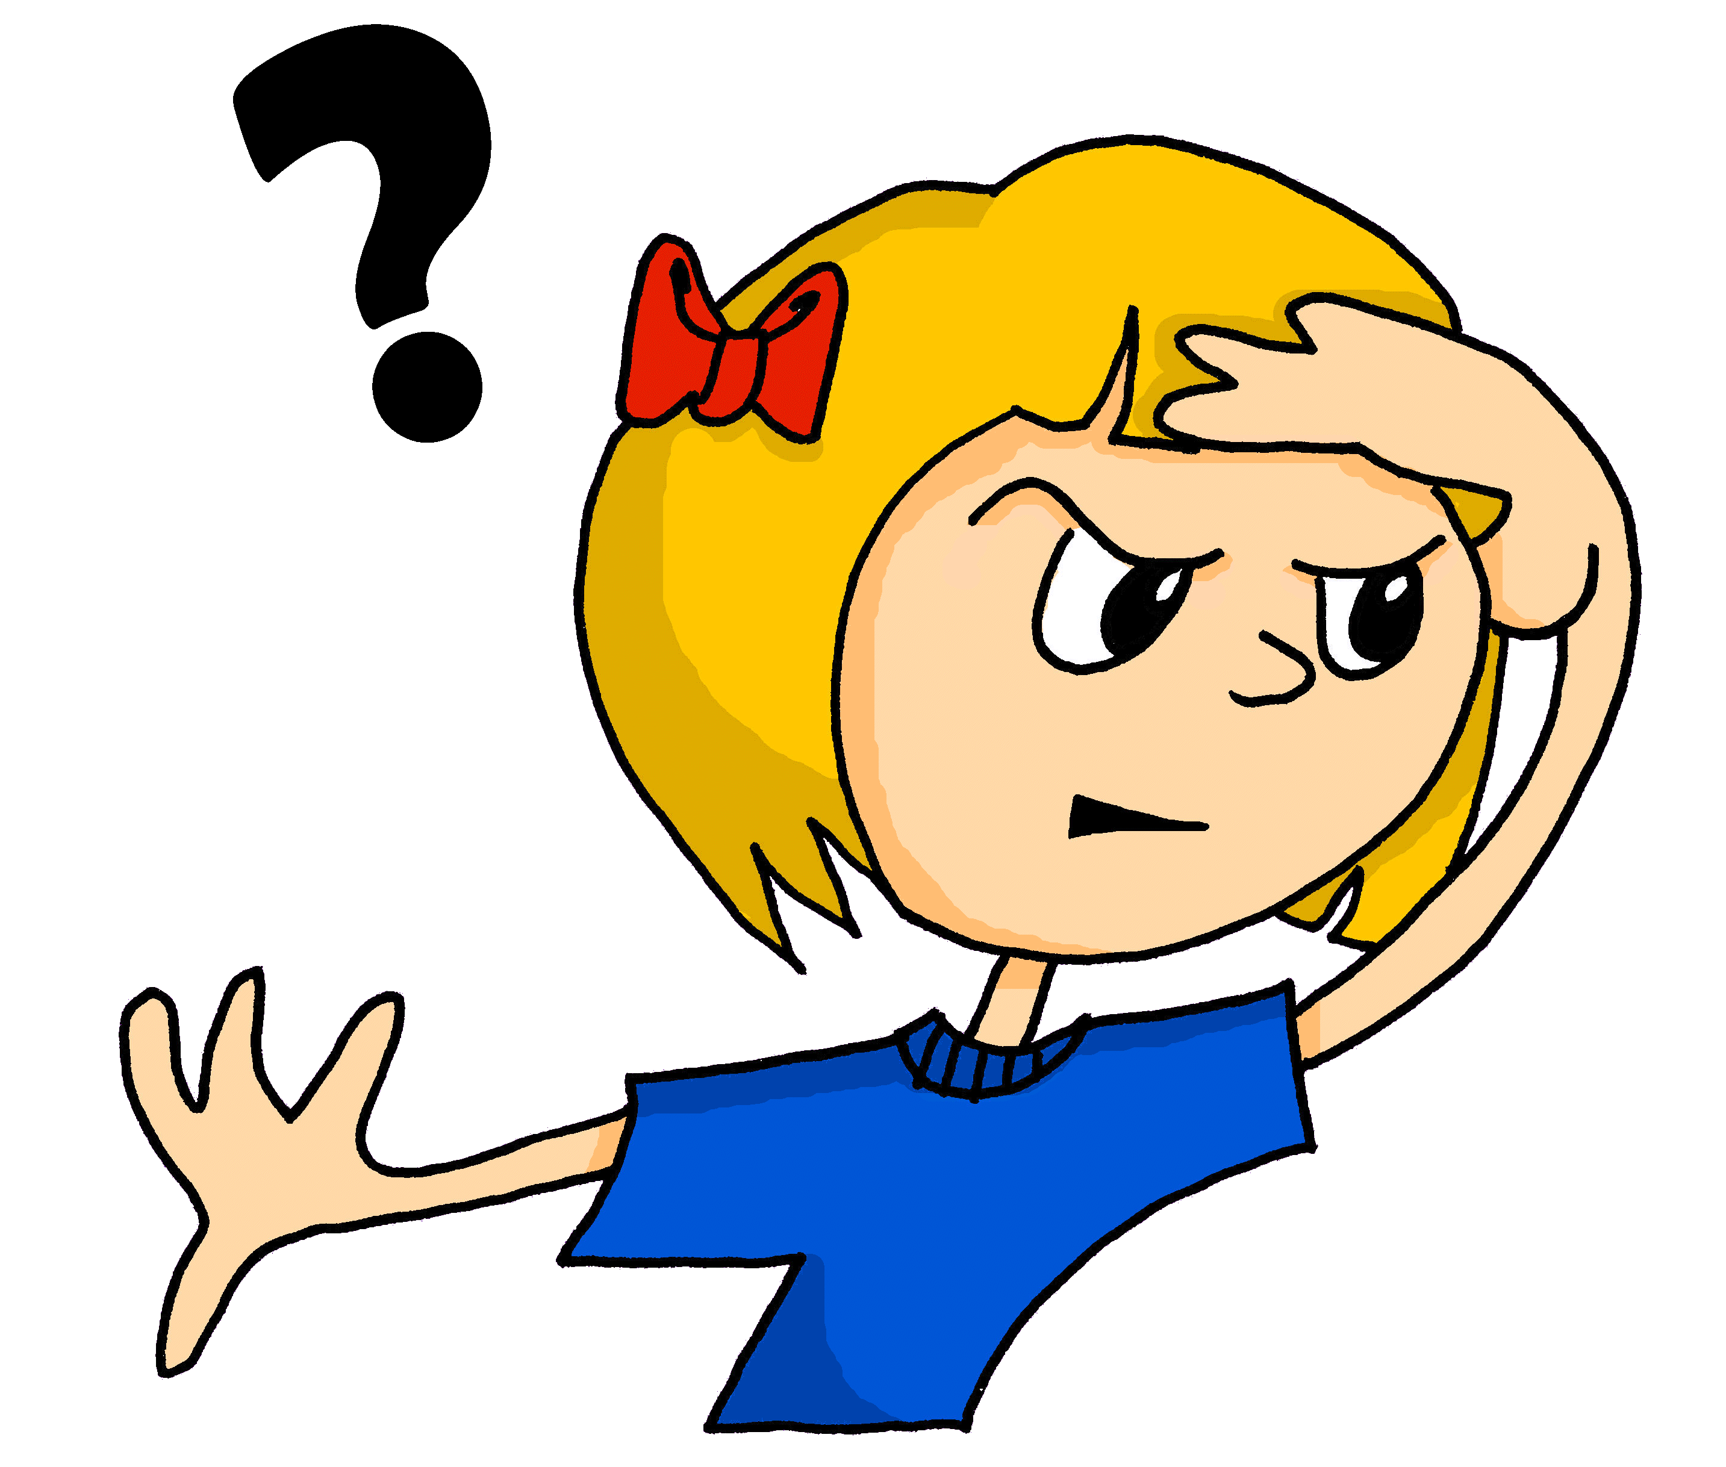
Phonetik
lesen / sprechen
Sag die Wörter. Wie viele enthalten die SSC?
[e]
[ch]
[s]
[o]
[a]
[ä]
denken
ich
sollen
Wo?
kalt
lächeln
 |  | ?
 | [e]
 | [ch]
 | [s]
 |  | ?
 | [o]
 | [a]
 | [ä]
eng – Bett – Weg
2
ohne – Telefon – Rock
2
reich – jedoch – einfach
1
alt – arm – normal
1
unser – langsam – alles
2
2
hängen – Aktivität – schnell
Notes:
Timing: 3 minutes Aim: A read aloud activity to revise 12 SSC (six explicitly, and six by contrast) using a range of new, revisited and unfamiliar vocabulary. Procedure: 1. Click on each individual SSC to hear it.
2. Elicit the source word from students, if remembered. Note that 4/6 these words have since been taught as key vocabulary (with sollen and lächeln to follow on the SOW)
3. Bring up the source words to check, and for reference for the read aloud activity.
4. Students pronounce the sets of three words, individually or in pairs, and decide how many contain the target SSC.
5. Optional – Click on the words to hear the sets of words pronounced. 6. Reveal the answers. 7. Optional – elicit the English meanings of the vocabulary.
Transcript:
eng – Bett – Weg
reich – jedoch – einfach
unser – langsam – alles
ohne – Telefon – Rock
alt – arm – normal
hängen – Aktivität – schnell
Word frequency of unknown words (1 is the most frequent word in German): hängen [580] Weg [220] Source: Jones, R.L. & Tschirner, E. (2019). A frequency dictionary of German: core vocabulary for learners. Routledge

Slide 3
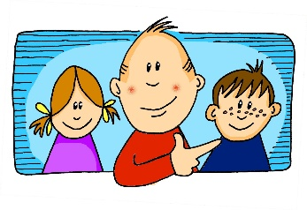
Phonetik
Hör zu. Schreib die Wörter. Wie viele enthalten die SSC?
hören / schreiben
[er-]
[-er]
[ei]
[j]
[z]
[o]
er
wieder
frei
ja
Zug
Kopf
 |  | ?
 | [er-]
 | [-er]
 | [ei]
 |  | ?
 | [j]
 | [z]
 | [o]
gern – erklären - unser
2
jung – jedoch - Jugendclub
3
alle – erzählen - anderer
1
kurz – unser - zwar
2
Kleid – weit - alleine
3
1
genau – Schloss - erlauben
Notes:
Timing: 7 minutes Aim: Transcription activity to revisit six further SSC, and to practise writing vocabulary from this week’s sets, as well as a few unknown words. As such, this is a hybrid phonics – vocabulary activity. Procedure: 1. Click on each individual SSC to hear it.
2. Elicit the source word from students, if remembered. Note that all of these words have also been taught as key vocabulary on the SOW.
3. Bring up the source words to check, and for reference for the read aloud activity.
4. Students listen to the sets of three words and transcribe them. 5. They decide how many words contain the target SSC.
6. Reveal the answers. 7. Optional – elicit the English meanings of the vocabulary.
Transcript: gern – erklären - unser
alle – erzählen - anderer
Kleid – weit – alleine
jung – jedoch – Jugendclub
kurz – unser - zwar
genau – Schloss - erlauben
Word frequency of unknown words (1 is the most frequent word in German): weit [230] zwar [227] Source: Jones, R.L. & Tschirner, E. (2019). A frequency dictionary of German: core vocabulary for learners. Routledge

Slide 4
Vokabeln
das Gedicht - poem
hören / lesen
Ein Antonymgedicht*
Wolfgang muss ein Gedicht für seine Hausaufgaben schreiben. Hör zu. Schreib 1 - 8 und die fehlenden Wörter.
Es ist dunkel, jedoch ist es auch hell.
Es ist ohne, jedoch ist es auch mit.
Es ist langsam, jedoch ist es auch schnell.
Wir sind arm, jedoch sind wir auch reich.
Es ist nichts, jedoch ist es auch alles.
Wir sind allein, jedoch sind wir auch zusammen.
Es sind keine, jedoch sind es auch alle.
Ich habe genommen, jedoch habe ich auch gegeben.
hell
ohne
langsam
reich
allein
alle
gegeben
alles
*das Antonymgedicht – opposites poem
Notes:
Timing: 5 minutes Aim: To practise recognising antonyms for various adjectives (listening/reading). Procedure: 1. Ensure students understand what ‘antonym’ means and that they are looking to match an word written on the slide with its antonym that they will hear. 2. Click on audio button to play poem. Note: full poem with bleeps has been added as a controllable player. There is also an action button version on the bottom left of the slide.
3. Students listen and write down the missing (bleeped out) words in the order in which they occur, choosing one of the options displayed at the bottom of the slide each time.
4. Click on the screen to bring up the lines of the poem one by one, with the missing word in each highlighted. The full audio is played as each line appears.
NB: Students are likely to find the first one tricky, as they conceptualise the task. If you use the player, pause it after the first line. Give students an opportunity to think about it. Then click to bring up the first line of the poem, which will give them the structure of the poem, and a clear idea of how the task will work. Then return to using the player. If students need more support, do the task line by line, correcting as you go. If students need even more support, you could turn it into a reading task by putting the lines of the poem onto the slide with a gap for the bleeped word. However, if at all possible, retain the element of aural comprehension.
Transcript: Es ist dunkel, jedoch ist es auch [hell]. Es ist [langsam], jedoch ist es auch schnell. Es ist nichts, jedoch ist es auch [alles]. Es sind keine, jedoch sind es auch [alle]. Es ist [ohne], jedoch ist es auch mit. Wir sind arm, jedoch sind wir auch [reich]. Wir sind [allein], jedoch sind wir auch zusammen. Ich habe genommen, jedoch habe ich auch [gegeben].

Slide 5
English → German → English
All German nouns ending in -heit are feminine.
Many German nouns end in -heit, often meaning -ity or -ness in English.
Security is important in London.
Die Sicherheit ist in London wichtig.
Use these words to help you understand and create the nouns: gesund (healthy), mehr (more), krank (ill), ein (one), wahr (true), vergangen (gone)
Translate these sentences.
1. Seine Krankheit ist in der Vergangenheit.
2. The truth is sad.
What would the following nouns be in German?
majority unity health Choose one and write a sentence in German.
Notes:
Timing: 5 minutes Aim: To raise awareness of the pattern of German nouns ending in -heit Procedure: 1. Cycle through the information on the slide using the animation sequence.
2. Students attempts the translation of the two sentences bottom left, and the noun-based activity on the bottom right of the siide.
3. Advance to the next slide to display the answers.
Word frequency:
Sicherheit [776] Einheit [756] Krankheit [1132] Mehrheit [1584], also Freiheit [814], Gesundheit [1851] Wahrheit [1156] Vergangenheit [1196] Gelegenheit [1658] Kindheit [2324]
Source: Jones, R.L. & Tschirner, E. (2019). A frequency dictionary of German: core vocabulary for learners. Routledge

Slide 6
ANTWORTEN
Seine Krankheit ist in der Vergangenheit!
The truth is sad.
majority
unity
health
His illness is in the past!
Die Wahrheit ist traurig.
die Mehrheit
die Einheit
die Gesundheit
You say this word, if someone sneezes, wishing them back to good health!
What do you remember about the gender of these nouns?
They are all feminine!
Don’t forget to pronounce the words!
Notes:
Timing: 2 minutes Aim: This slide displays the answers to the activity on the previous slide.
Procedure: 1. Cycle through the information on the slide using the animation sequence. The answers appear line by line.
Word frequency:
Sicherheit [776] Einheit [756] Krankheit [1132] Mehrheit [1584], also Freiheit [814], Gesundheit [1851] Wahrheit [1156] Vergangenheit [1196] Gelegenheit [1658] Kindheit [2324]
Source: Jones, R.L. & Tschirner, E. (2019). A frequency dictionary of German: core vocabulary for learners. Routledge

Slide 7
Possessive adjectives unser and ihr
Grammatik
You have already learnt some possessive adjectives:
my
mein
your
dein
ihr (her) and ihr (their) are the same word, so you need other cues to know the meaning.
ihr (her) and ihr (their) are the same word, so you need other cues to know the meaning.
his
sein
her
ihr
To mean ‘our’ use unser, and for ‘their’ use ihr:
our
unser
their
ihr
Notes:
Timing: 1 minute Aim: To introduce the possessive adjectives unser and ihr. Procedure: 1. Cycle through the information on the slide using the animation sequence.

Slide 8
Unser and ihr (R1, R2, R3)
Grammatik
As you know, possessive adjectives work like the indefinite article ein (a/an) and change according to gender and case (row):
masculine
feminine
neuter
Per Ardua Ad Astra
ihre
unsere
Row 1: Das ist ein Lehrer.
( a teacher)
Row 1:Das ist eine Direktorin.
( a principal)
ihr
unser
ihr
Row 1: Das ist ein Motto.
( a motto)
unser
our
our
their
their
our
their
unseren
ihre
Row 2: …ohne ein Motto.
(… without a motto.)
unsere
ihr
Row 2: …ohne einen Lehrer.
(… without a teacher.)
ihren
Row 2: ohne eine Direktorin.
(… without a principal.)
unser
our
their
their
their
our
our
ihrer
unserer
Row 3: … mit einem Lehrer. (… with a teacher.)
Row 3: … mit einer Direktorin. (… with a principal.)
ihrem
unserem
ihrem
Row 3: … mit einem Motto. (… with a motto.)
unserem
our
our
their
their
our
their
The preposition ohne is always followed by Row 2 (accusative) and mit always by Row 3 (dative).
Notes:
Timing: 3 minutes Aim: To present unser and ihr in examples with Row 1 (nominative), Row 2 (accusative) and Row 3 (dative). Ohne is one of this week’s words and mit has already been taught.
Procedure: 1. Click to animate the explanation. Remind students that they have already learnt this pattern with ein, and also mein, dein, sein, ihr.
2. Ensure students’ understanding at each stage. Word frequency of unknown words (1 is the most frequent word in German): Motto [2921] Source: Jones, R.L. & Tschirner, E. (2019). A frequency dictionary of German: core vocabulary for learners. Routledge NB: the English for the latin school motto example = Through adversity to the stars.

Slide 9
Vokabeln - der, die oder das?
sprechen
Essen
Kantine
Jahr
Theater
Woche
Orchester
Film
Tag
Schule
Fahrt
Klassenzimmer
Stadt
Projekt
Wochenende
m
nt
f
Notes:
Vokabeln Timing: Two minutes
Aim: To revise gender and word knowledge. Procedure: 1. 12 nouns appear on separate mouse clicks. Say the word (chorally) with its definite article. 2. On second click, the noun moves into the ‘appropriately gendered’ mouth. Word frequencies: (das) Paar [284] (der Film) [524] (die) Idee [641] (die) Hose [2422] (die) Liste [1975] (das) Wochenende [764] (die) Schule [208] (die) Form [300] (das) Problem [189] (die) Band [>4034] (das) Deutsch [105] (die) Hand [179]

Slide 10
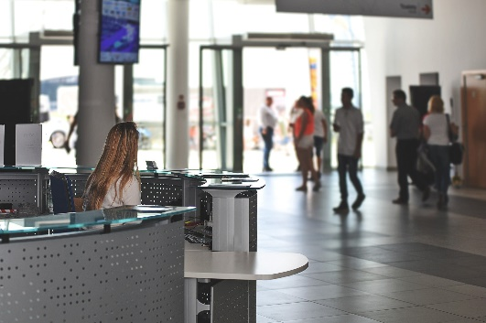
Ein Austauschprojekt*
das Austauschprojekt – exchange project
lesen
Mia und Andreas Klassen haben kurze Filme über ihre Schule getauscht. Was meint Andreas Klasse? Schreib 1- 8 und das richtige Wort oder die richtigen Wörter.
1
Ich meine, sie haben ihren Projekt / Film ganz gut gemacht.
4
Wir haben auch ihre Stadt / Schwimmbad gesehen.
6
Ihr Schulwoche / Schuljahr ist kürzer als unser Schulwoche / Schuljahr.
2
Ihr Schultag / Wochenende beginnt (und endet) früher als in England.
7
Ihre Schule / Schuldirektor ist nicht so streng wie unsere.
3
Ich finde ihr Klassenzimmer / Klassenfahrten wirklich gut.
5
Ich habe ihren Schultag / Kantine interessant gefunden.
8
Ihr Orchester / Theater gefällt mir. Es ist toll!
Both words are possible here!
Notes:
Timing: 4 minutes Aim: A referential activity to practise connecting the written forms of ihr to nouns of the correct gender. Procedure: 1. Read the title and information about the task. Ensure students are clear about the context – an exchange of short films about Mia and Andrea’s schools. The texts resemble an online wall and contain feedback on Mia’s school by Andrea’s classmates.
2. Students note the correct words 1-8. Remind students that it could be both words that are possible. This will ensure that they think harder about the gender of both words.
3. Click to correct. 2 and 9 – both words are possible.
4. The next slide requires students to show their understanding of the texts.

Slide 11
Ein Austauschprojekt*
lesen
made film v well
Was meint Andreas Klasse? Schreib Notizen auf Englisch.
school day / weekend begins and ends earlier
1
Ich meine, sie haben ihren Film ganz gut gemacht.
4
Wir haben auch ihre Stadt gesehen.
6
Ihr Schuljahr ist kürzer als unser Schuljahr.
their classroom is really good
saw their town too
2
Ihr Schultag / Wochenende beginnt (und endet) früher als in England.
found their school day interesting
7
Ihre Schule ist nicht so streng wie unsere.
school year shorter than ours
3
Ich finde ihr Klassenzimmer wirklich gut.
5
Ich habe ihren Schultag interessant gefunden.
their school not as strict as ours
8
Ihr Orchester / Theater gefällt mir. Es ist toll!
great orchestra and theatre
Notes:
Timing: 3 minutes Aim: To process the full texts for meaning. Procedure: 1. Students read the texts again and write notes in English. 2. Click to check answers. Note: alternatively this could be done orally.

Slide 12
Andreas Antworten
hören
Mias Klasse hat das Video von Andreas Klasse gesehen. Sie hatten weitere Fragen. Wie heißen die Antworten? Schreib 1-9 und das richtige Wort.
 | [Essen / Handys] |  | [Klassenzimmer / Kantine] |  | [Schuldirektor / Uniform]
 | [Klasse / Team] |  | [Test / Hausaufgaben] |  | [Schule / Schultheater]
 | [Lehrerin / Lehrer] |  | [Schultag / Schulwoche] |  | [Direktor / Motto]
1
4
7
2
5
8
3
6
9
Notes:
Timing: 5 minutes Aim: A referential activity to practise connecting the oral forms of unser to nouns of the correct gender. Procedure: 1. Listen to each sentence.
2. Decide for each which noun is correct.
3. Click to reveal answers.
4. Listen again to the full audio sentences, if desired, by clicking on the green ticks.
Transcript: 1. Wir dürfen unsere [Handys] nicht ins Klassenzimmer mitbringen. 2. Unser [Team] spielt immer freitags nach der Schule zusammen. 3. Unsere [Lehrerin / Lehrer] ist ziemlich jung.
4. Wir essen nicht in unserem [Klassenzimmer]. 5. Normalerweise machen wir unsere [Hausaufgaben] am Computer. 6. Unser [Schultag] beginnt später als in Deutschland. 7. Wir finden unsere [Uniform] zu streng. 8. Wir meinen, dass unser [Schultheater] ziemlich modern aussieht. 9. Wir finden unser [Motto] ein bisschen dumm. Word frequency of unknown words (1 is the most frequent word in German): Team [769] Motto [2921] Source: Jones, R.L. & Tschirner, E. (2019). A frequency dictionary of German: core vocabulary for learners. Routledge

Slide 13
Klassenfahrten in Deutschland
hören / schreiben
Hör zu. Schreib die Sätze auf Englisch.
German students go on a class trip once a year.
It usually lasts for three, four or five days.
A class travels together to another town or to another place.
There they learn about history, culture and nature.
Schools also have school festivals.
There there are, for example, plays or concerts.
1
Deutsche Schüler machen einmal im Schuljahr eine Klassenfahrt.
2
Sie dauert normalerweise drei, vier oder fünf Tage.
3
Eine Klasse fährt zusammen in eine andere Stadt oder einen anderen Ort.
4
Dort lernen sie über Geschichte, Kulture und Natur.
die Geschichte means ‘history’, as well as ‘story’!
5
Die Schulen machen auch Schulfeste.
6
Dort gibt es, zum Beispiel, Theaterstücke oder Konzerte.
Notes:
Timing: 5 minutes Aim: To practise aural comprehension at sentence level and learn about one aspect of German school life. There is an optional additional task which practises written production. Procedure: 1. Students listen and write the meaning of each sentence in English.
2. They may want to listen more than once to each sentence.
3. Click to reveal English meanings.
4. Optional additional task – students write/say the German from their English prompts.
Transcript: 1. Deutsche Schüler machen einmal im Schuljahr eine Klassenfahrt. 2. Sie dauert normalerweise drei, vier oder fünf Tage. 3. Eine Klasse fährt zusammen in eine andere Stadt oder einen anderen Ort. 4. Dort lernen sie über Geschichte, Kultur und Natur. 5. Die Schulen machen auch Schulfeste. 6. Dort gibt es, zum Beispiel, Theaterstücke oder Konzerte.

Slide 14
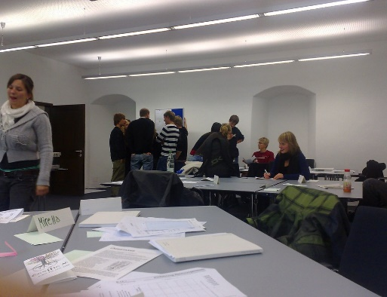
Die Schule in Deutschland
sprechen
Lies diesen Text vor:
In Deutschland gibt es eine Schulpflicht: Kinder müssen 9 Jahre lang in die Schule gehen. Ein Schuljahr beginnt normalerweise im August und dauert bis Juni. In die Grundschule gehen alle Kinder ab 6 oder 7 Jahren.
Der Unterricht beginnt zwischen 7:00 Uhr und 8:00 Uhr am Morgen. In der Grundschule endet er um 11 oder 12 Uhr. In den anderen Schulen dauert der Unterricht meistens bis 13 Uhr, manchmal auch länger.
Am Nachmittag gibt es viele Arbeitsgemeinschaften (AGs). Das sind Clubs für Sport, Kochen, Kunst, Musik und noch viel mehr.
Notes:
Timing: 3 minutes Aim: To provide more information about schools in Germany, giving students the opportunity to practise reading aloud at paragraph level and develop reading / pronunciation fluency. Note that most words are known, but that numbers are deliberately written as digits, and there are three new words for students to decode as they read aloud. Note: Full text has been added as a controllable player top right of the slide. Procedure: 1. Students read the text aloud. They may do this either individually or in pairs, taking turns each sentence, depending on the class.
2. Click to listen for additional aural reinforcement.
3. Students may additionally be given the text to translate into English as extension or for homework. See the answer slide for this at the end of this presentation.
Transcript: In Deutschland gibt es eine Schulpflicht: Kinder müssen 9 Jahre lang in die Schule gehen. Ein Schuljahr beginnt normalerweise im August und dauert bis Juni. In die Grundschule gehen alle Kinder ab 6 oder 7 Jahren. Der Unterricht beginnt zwischen 7:00 Uhr und 8:00 Uhr am Morgen. In der Grundschule endet er um 11 oder 12 Uhr. In den anderen Schulen dauert der Unterricht meistens bis 13 Uhr, manchmal auch länger. Am Nachmittag gibt es viele Arbeitsgemeinschaften (AGs). Das sind Clubs für Sport, Kochen, Kunst, Musik und noch viel mehr.
Word frequency (1 is the most frequent word in German): Schulplflicht [>5009] Grundschule [>5009] Arbeitsgemeinschaft [>5009]
Source: Jones, R.L. & Tschirner, E. (2019). A frequency dictionary of German: core vocabulary for learners. Routledge

Slide 15
Wir reden über Schulen
übersetzen – to translate derselbe – the same
sprechen
Person A liest den englischen Satz und übersetzt* den Satz ins Deutsche.
Person B liest den englischen Satz. Ist es derselbe* Satz? Ja oder nein?
Beispiel
Person A spricht:
Person B schaut den englischen Satz an.
Wir denken, unsere Schule ist ziemlich modern.
Nein! Wir denken, ihre Schule ist ziemlich modern.
1
1
We think our school is quite modern.
We think their school is quite modern.
Notes:
Timing: 4-5 minutes Aim: This is a spot the difference task to practise the new structures ihr / unser in oral production. Procedure: 1. Make sure students understand the task, using this example slide to model the activity. Note: students have learnt ‘selber’ 2. Give students the A / B handouts for the task. They are also shown on the next slide, but do not display these during the activity.
3. Student A starts by orally translating the first sentence. Student B listens and checks his/her English sentence 1 to see if the meaning is the same or different.
4. Where the sentence is the same, the students confirms this with ‘Ja’. Where different, students translate their sentence for their partner, to highlight the difference.
5. Both students make a note on their sheet of the difference.
6. They continue until all sentences have been said and all similarities / differences found.
Word frequency of unknown words (1 is the most frequent word in German): übersetzten [1765] derselbe (dieselbe, dasselbe) [635] Source: Jones, R.L. & Tschirner, E. (2019). A frequency dictionary of German: core vocabulary for learners. Routledge

Slide 16
sprechen
Person A
Person B
1
2
1
2
We find their school better than our school.
We think that our school principal is young.
We find their school better than our school.
We think that their school principal is young.
3
4
3
4
They think that our school uniform is a good idea.
We found their film interesting.
They think that our school uniform is a good idea.
We found their film interesting.
5
6
5
6
They don’t bring their phones into the classroom.
We don’t bring our phones into the classroom.
They think that their canteen is old.
They think that our canteen is old.
7
8
7
8
We know that their school day is longer than our day.
We think their school is quite modern.
We think our school is quite modern.
We know that our school day is longer than their day.
Notes:
ANSWER SLIDE DO NOT DISPLAY DURING THE ACTIVITY

Slide 17
Comparing school experiences
Pronouns uns and ihnen
Revisit several SSC
Y8 German
Term 2.2 - Week 4 - Lesson 45
Author name(s): Stephen Owen / Rachel Hawkes
Artwork: Steve Clarke
Date updated: 7 / 7 / 21
Notes:
Artwork by Steve Clarke. All additional pictures selected are available under a Creative Commons license, no attribution required.
Native teacher feedback provided by Stephanie Cross.
Learning outcomes (lesson 2):
Revisit several SSC Introduction of present tense weak verbs: 1st, 2nd, 3rd person singular.
Word frequency (1 is the most frequent word in German):
8.2.2.4 (introduce) erklären [238] erlauben [963] erzählen [263] gegeben [49] geholfen [338] ihnen [125] uns [75] Geschichte² [262] Wahrheit [1156] unser [86] ihr³ [28] alleine [267] jedoch [227] ohne [120]
8.2.2.1 (revisit) alles [36] alle [36] Rock [3551] Kleid [1780] alt [138] arm [1475] einfach [131] eng [59] genau [167] hell [1411] jung [199] kurz [176] reich [1568] 8.1.2.5 (revisit) anderer, andere, anderes [59] Aktivität [1422] Hobby [3608] Jugendclub [2117/1360] Schloss [1907] Telefon [1595] langsam [526] normal [642] schnell [203] gern [278] Source: Jones, R.L & Tschirner, E. (2019). A frequency dictionary of German: Core vocabulary for learners. London: Routledge.
The frequency rankings for words that occur in this PowerPoint which have been previously introduced in NCELP resources are given in the NCELP SOW and in the resources that first introduced and formally re-visited those words.
For any other words that occur incidentally in this PowerPoint, frequency rankings will be provided in the notes field wherever possible.

Slide 18
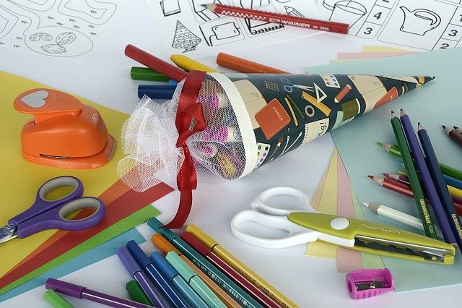
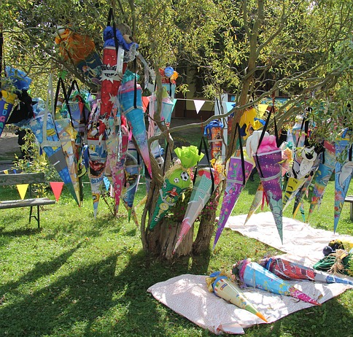
der erste Schultag
die Tüte – bag der Zucker – sugar erst – only, not until
sprechen
Mit sechs oder sieben Jahren haben deutsche Kinder ihren ersten Schultag. Normalerweise beginnt dieser wichtige Tag für Eltern und Schüler direkt an der Schule. Die älteren Kinder zeigen ein Programm, singen Lieder oder spielen ihre Instrumente. Alle Kinder bekommen eine Schultüte* oder Zucker*tüte. Ihre Schultüten kommen in vielen Farben und Designs und enthalten Schokolade, Bonbons, kleine Geschenke und Schulsachen.
Manchmal hängen die Tüten am Baum in der Schule, und die Schüler müssen nach oben klettern und ihre eigene Tüte suchen. Danach bringt der Lehrer oder die Lehrerin die Kinder ins Klassenzimmer. Sie finden dort einen Sitzplatz und spielen ein paar Spiele. Erst* später dürfen die Kinder ihre Schultüte zu Hause öffnen*! Sie müssen den ganzen Tag darauf* warten*. Dann gibt es noch ein schönes Essen oder sogar eine Party für Familie und Freunde.
öffnen – to open darauf – for it warten – to wait
Notes:
Timing: 6 minutes Aim: To revisit vocabulary in a context beyond the sentence. and to introduce some cultural knowledge about the first school day for children in Germany. To practise reading aloud and applying SSC knowledge at sentence/paragraph level. Finally, to focus attention on the forms and meaning of possessive adjective ihr. Note: with the exception of the glossed words, all vocabulary in this text has been previously taught. Procedure: 1. Read the text out loud.
2. Click the sound icon to play the audio. Ask students to listen out for any differences. (NB: the differences are that all instances of ‘ihr’ use the definite article instead). 3. Elicit any differences that students noticed. 4. Click to highlight the differences in the text. 5. Note that this text could be further exploited as a homework task.
Word frequency of unknown words(1 is the most frequent word in German): erst [132] öffnen [508] Tüte [>5009] warten [364] Zucker [2559]
Source: Jones, R.L. & Tschirner, E. (2019). A frequency dictionary of German: core vocabulary for learners. Routledge

Slide 19
Vokabeln
1 die Geschichte
unser
langsam
erzählen
gegeben
3 das Kind
das Hobby
kurz
jung
alt
lesen
A Associations.
2 dürfen
erklären
erlauben
gern
alle
4 lieber
gut
genau
geholfen
gern
Notes:
Timing: 3 minutes Aim: to revisit written comprehension of some of this week’s vocabulary. Procedure: 1. Students complete task A, choosing the word best associated in meaning with the prompt word given.
2. Check answers.
3. Elicit the English meanings of all of the words.

Slide 20
Vokabeln
schreiben
B Schreib Synonyme.
C Schreib das Adjektiv (R1).
1 | das Hobby
2 | leicht
3 | der Verein
4 | aber
5 | das Handy
6 | weitere(r,s)
1 | eine [exact] Antwort
2 | eine [narrow] Straße
3 | ein [bright] Rock
4 | ein [old] Schloss
5 | ein [normal] Telefon
6 | eine [short] Geschichte
die Aktivität
genaue
einfach
enge
der Jugendclub
heller
jedoch
altes
das Telefon
normales
andere(r,s)
kurze
Notes:
Timing: 7 minutes Aim: to revise (in written modality / productive mode) vocabulary from this week’s sets. In addition, to revisit grammar knowledge of adjective endings in R1 (nominative) after definite article. Procedure: 1. Students complete task B, writing a synonym for each of the six given words.
2. Check answers.
3. Students complete task C. Teachers to remind students that they will need to change the spelling of the adjective according to the gender of the noun.
4. Click to check (and discuss, as necessary) the answers.

Slide 21
Pronomen
Grammatik
The subject case is also called Row 1 or nominative.
You already know some personal pronouns:
Remember that a pronoun may change, depending on whether it is the subject or object of the sentence:
Remember: The object case is also called Row 2 or accusative.
SUBJECT
VERB
OBJECT
Ich
frage
dich.
I ask / am asking you.
Du
fragst
mich.
You ask / are asking me.
Er
fragt
sie.
He asks / is asking her.
Sie
fragt
ihn.
She asks / is asking him.
Use uns to mean ‘us’ and remember to use sie for them in Row 2:
Sie
fragen
uns.
They ask / are asking us.
Wir
fragen
sie.
We ask / are asking them.
Notes:
Timing: 3 minutes Aim: To revisit grammar knowledge previously taught, and introduce ‘uns’ meaning us in Row 2 (accusative). Procedure: 1. Click to animate the explanation.
2. Ensure students’ understanding at each stage.

Slide 22
Pronomen [R3 – Dativ]
Grammatik
Sometimes these R3 (dative) pronouns mean ‘to me’, ‘to you’ etc., but they can just mean ‘me’, ‘you’, ‘him’, ‘her’.
Remember: after certain verbs, use indirect object pronouns:
SUBJECT
VERB
OBJECT
Ich
antworte
dir.
I answer / am answering you.
Du
antwortest
mir.
You answer / are answering me.
Ich
antworte
ihm.
I answer / am answering him.
Ich
antworte
ihr.
I answer / am answering her.
For (to)us use uns, and (to)them, use ihnen.
Sie
antworten
uns.
They answer / are answering us.
Wir
antworten
ihnen.
We answer / are answering them.
You have learnt some verbs that always take R3 (dative) pronouns. How many can you remember?
Notes:
Timing: 3 minutes Aim: To revisit the Row 3 (dative) pronouns mir, dir, ihm, and ihr and introduce the new dative pronouns uns and ihnen. Procedure: 1. Click to animate the explanation.
2. Ensure students’ understanding at each stage.

Slide 23
Verben mit R3 (Dativ)
sprechen
R2 (Akkusativ)
R3 (Dativ)
helfen
gehören
schenken
geben
sehen
antworten
glauben
gefallen
verstehen
fragen
fehlen
danken
finden
schauen
mögen
rufen
nehmen
finden
fragen
sehen
rufen
nehmen
geben
antworten
helfen
fehlen
danken
gefallen
These three are also R3 (dative) verbs: erzählen, erlauben, erklären.
gehören
glauben
schenken
erlauben
erzählen
erklären
schauen
mögen
verstehen
Notes:
Timing: 3 minutes
Aim: To revisit previous knowledge about verbs, before introducing three new R3 verbs for this week. Procedure: 1. Click to make a verb appear in the centre of the slide.
2. Click again to make it fly either to the basket (R3 verbs) or the bin (R2 verbs).
3. Teacher to elicit meaning of all the verbs (especially the three new ones which appear at the end).

Slide 24
Andreas Mathelehrer
Andrea beschreibt ihren neuen Mathelehrer.
hören
Schreib die fehlenden Wörter auf English.
is
explain
Mia, _______ new maths teacher ___ too ________ and he doesn’t _________ anything ____ ______.
1
our
strict
to
us
doesn’t
us
2
I think, he ________ like _____.
but / though
us
He ______ _____ stupid stories, ________ he never _______ _______!
3
tells
us
helps
looks
allow
us
He never ________ at us and he doesn’t __________ ______ any __________.
4
questions
sometimes
problems
He also _________ ___________ us, that we __________ have _____________.
5
doesn’t
believe
never
asks
us
And he _______ _______ _____ for ____________ opinion.
6
our
Notes:
Timing: 8 minutes (two slides) Aim: To focus on the meanings and forms of uns (us, to us) and sie / ihnen (them, to them), initially through an aural comprehension task, which leads into a referential comprehension task in written modality. Procedure: 1. Students listen to Andreas concerns about her new maths teacher. They complete the English translation for each sentence. Note: for additional challenge, full sentences can be translated.
2. Click to check the answers.
3. Continue to the linked reading task on the next slide.
Transcript: 1. Mia, unser neuer Mathelehrer ist zu streng und er erklärt uns nichts! 2. Ich glaube, er mag uns nicht. 3. Er erzählt uns dumme Geschichten, jedoch hilft er uns nie! 4. Er schaut uns nie an und er erlaubt uns keine Fragen. 5. Er glaubt uns auch nicht, dass wir manchmal Probleme haben. 6. Und er fragt uns nie nach unserer Meinung.

Slide 25
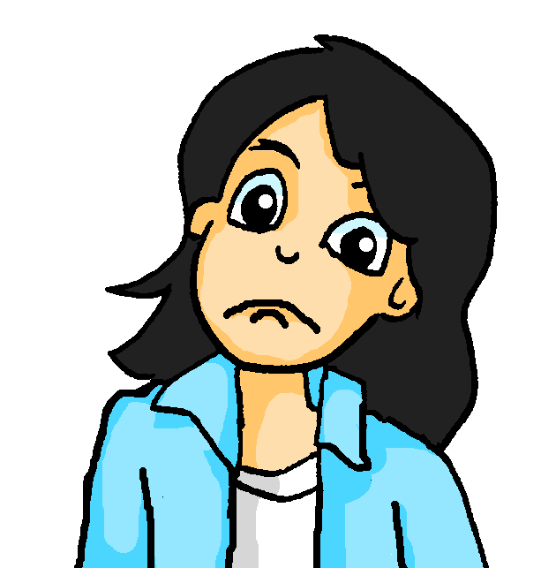
Andreas Mathelehrer
lesen
Mia erzählt ihrer Mutter die Geschichte. Ist ‘them’ sie oder ihnen?
1. Mutti, Andrea sagt, der neue Mathelehrer erklärt sie / ihnen nichts!
3. Sie sagt, er erzählt ihnen / sie dumme Geschichten, jedoch hilft er sie / ihnen nie!
5. Andrea sagt, er glaubt ihnen / sie auch nicht, dass sie manchmal Probleme haben!
2. Andrea glaubt, er mag ihnen / sie nicht.
4. Er schaut ihnen / sie nie an, und er erlaubt ihnen / sie keine Fragen!
6. Und er fragt sie / ihnen nie nach ihrer Meinung.
Notes:
Procedure: 1. Students read Mia’s Whatsapps to her mum and decide for each whether the word for ‘them’ is sie or ihnen, based on the verb used.
2. Click to check answers.
Answers:
1. Mutti, Andrea sagt, der neue Mathelehrer erklärt ihnen nichts!
2. Andrea glaubt, er mag sie nicht.
3. Sie sagt, er erzählt ihnen dumme Geschichten, jedoch hilft er ihnen nie!
4. Er schaut sie nie an, und er erlaubt ihnen keine Fragen!
5. Andrea sagt, er glaubt ihnen auch nicht, dass sie manchmal Probleme haben!
6. Und er fragt sie nie nach ihrer Meinung.

Slide 26
das Perfekt: er- Verben
Grammatik
Remember that many weak verbs form the past participle with ge- and –t around the stem:
Ich
habe
viel
gelernt.
I learnt / have learnt a lot.
Weak verbs with the prefix er- do not use ge-:
Wir
haben
unser Lernziel
erreicht.
We reached / have reached our learning goal.
Er
hat
uns
den Grund
erklärt.
He explained the reason to us.
Sie
hat
ihnen
ihre Idee
erzählt.
She explained her idea to them.
Remember, strong verbs make the past participle differently:
Sie
hat
uns
ein Geschenk
gegeben.
She gave / has given us a present.
Er
hat
uns
oft
geholfen.
He helped / has helped us often.
Notes:
Timing: 3 minutes Aim: To present the pattern for past participle formation with the prefix er-, and remind students of two highly frequent strong past participles that are part of this week’s vocabulary list. Procedure: 1. Cycle through the explanation and examples using the animated sequence. 2. Note the deliberate order of animations, some of which elicit student responses in German, others in English.
Note: It will be worth teachers playing the sequence through carefully ahead of the lesson to familiarise themselves with it, thoroughly.

Slide 27
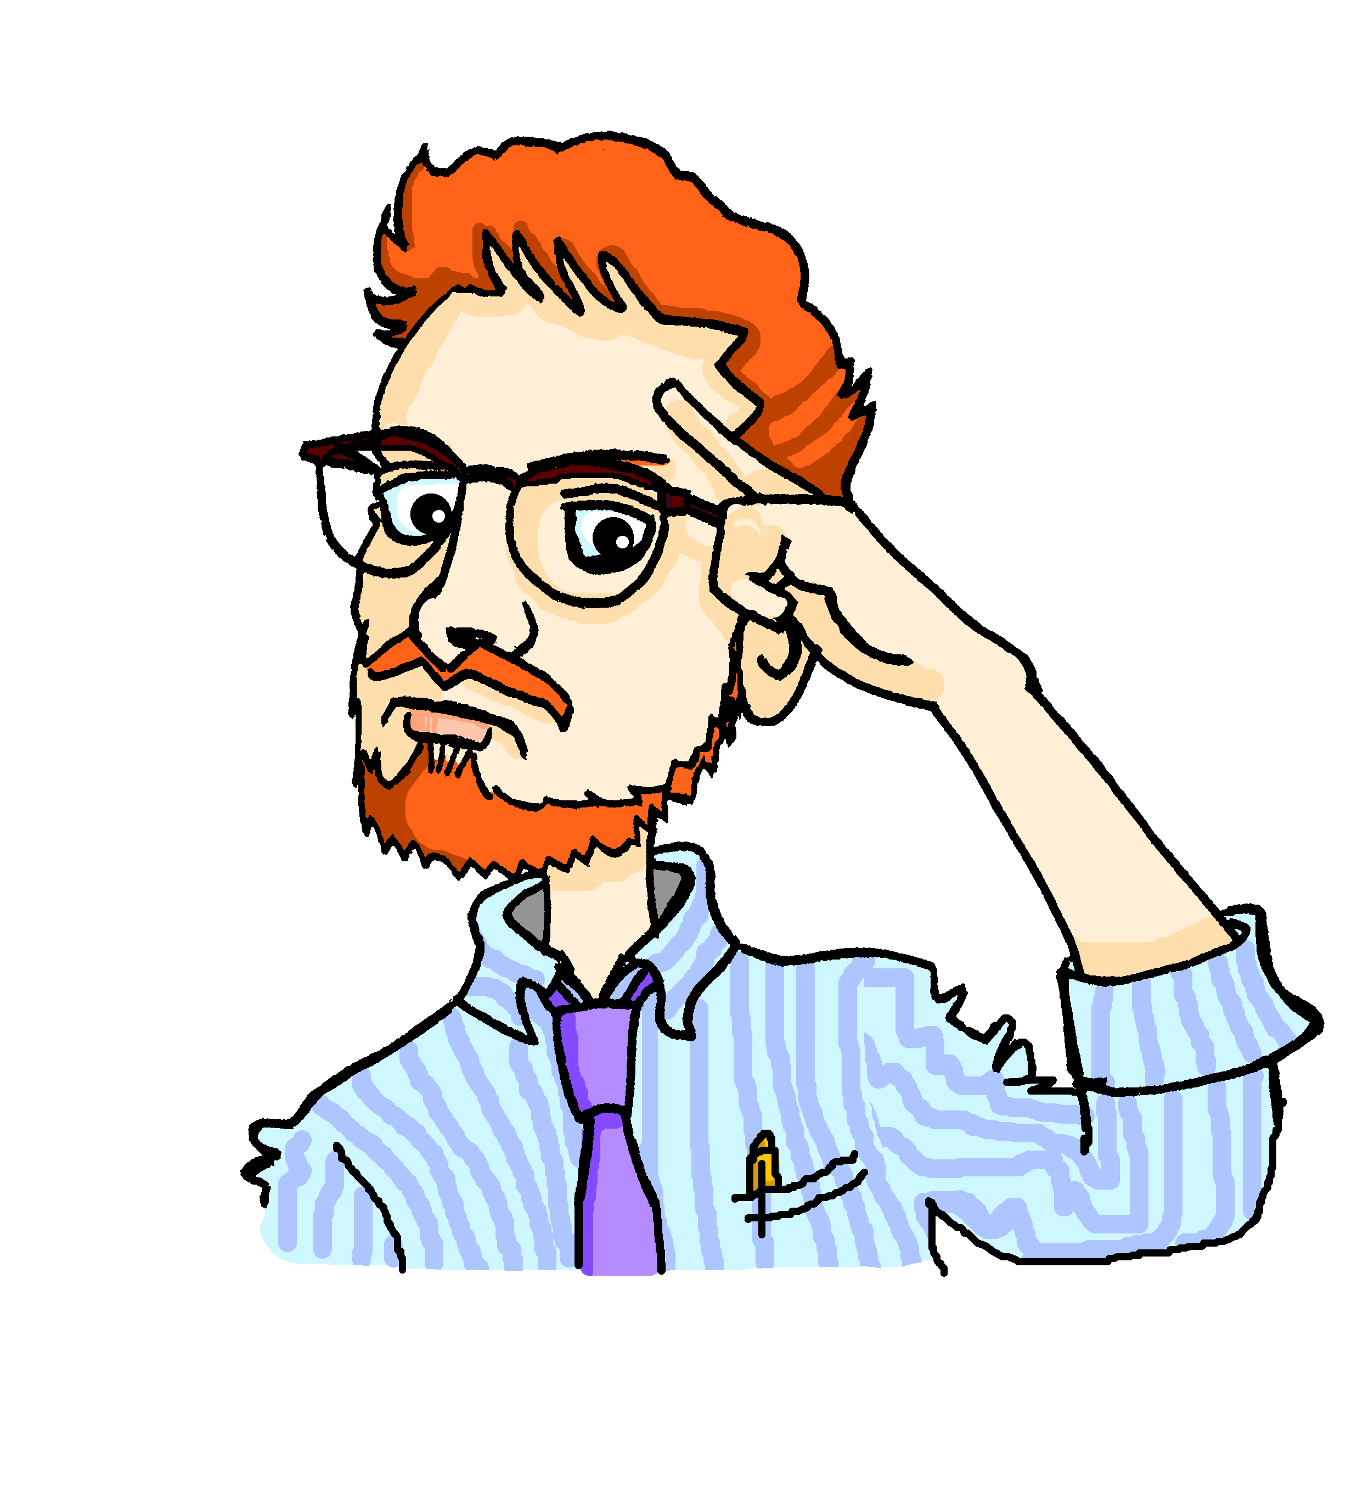
Mias neuer Lehrer
lesen
Dieses Schuljahr hat Mia bei Herrn Mürrisch Mathe. Wolfgang hatte letztes Jahr bei ihm Mathe.
Wer spricht? Mia (über dieses Jahr) oder Wolfgang (über letztes Jahr)? Schreib 1- 8 und Mia (will) oder Wolfgang (hat).
1. | Er will uns immer viele Beispiele geben.
2. | Er will uns interessante Geschichten erzählen.
3. | Er hat uns nur selten geholfen.
4. | Er hat uns nur eine kleine Pause erlaubt.
5. | Er hat uns nie Komplimente gegeben.
6. | Er will uns immer die Wahrheit sagen.
7. | Er hat uns immer zu viele Hausaufgaben gegeben.
8. | Er will uns alles ganz gut erklären.
__
Mia (will)
__
Mia (will)
__
Wolfgang (hat)
__
Wolfgang (hat)
__
Wolfgang (hat)
__
Mia (will)
__
Wolfgang (hat)
__
Mia (will)
Notes:
Timing: 5 minutes Aim: To differentiate between present and past sentences based on differentiating between past participle and infinitive verb forms. Procedure: 1. Ensure that students understand the context. Herr Mürrisch is Mia’s maths teacher this year and he was Wolfgang’s teacher last year. 2. Students write 1-8 and record the present tense sentences as Mia (will) and past tense as Wolfgang (hat)
3. Mention that Mia and Wolfgang have had different experiences. Ask whether Mia or Wolfgang has the more positive opinion of Herr Mürrisch and ask them to note down any details about the experiences.
4. Check answers orally with the class. Conclude that Mia’s experiences are much more positive.

Slide 28
Wir reden über Lehrer
sprechen
Person A sagt den ersten Satz auf Deutsch.
Person B sagt den richtigen Namen.
Beispiel
Person A spricht:
Person B schaut die Lehrer an. Wer ist das?
Sie hat uns keine Ideen erlaubt.
Das ist Frau Weber!
1
1
doesn’t allow us any ideas
[Frau Schmidt]
didn’t allow us any ideas
[Frau Weber]
She didn’t allow us any ideas.
Notes:
Timing: 4-5 minutes Aim: This is a productive speaking activity to practise using (understanding and producing) the present and past tenses. Procedure: 1. Make sure students understand the task, using this example slide to model the activity. 2. Give students the A / B handouts for the task. They are also shown on the next slide, but do not display these during the activity.
3. Student A starts by orally translating the first sentence. Student B listens and looks at the prompts and teacher names on the slide that’s displayed (next slide but one).
4. Student B makes a note of the correct teacher name. 5. Speaking continues turn by turn until all 8 prompts have been translated and teachers identified. 6. Slides to check answers are also provided.

Slide 29
HABLAR
Person A
Person B
Say: She explained everything to us.
1
Say: She explains everything to us.
1
2
Say: She gives us lots of homework.
2
Say: She gave us lots of homework.
Say: She told us the truth.
Say: She always helps us.
Say: She tells us the truth.
Say: She always helped us.
3
4
3
4
Say: She allowed us lots of questions.
Say: She always answered us.
Say: She allows us lots of questions.
Say: She always answers us.
5
6
5
6
Say: She has lots of ideas.
Say: She shows us the culture.
Say: She had lots of ideas.
Say: She showed us the culture.
7
8
7
8
Notes:
DO NOT DISPLAY DURING ACTIVITY
A printer-friendly version of these speaking cards is available with the resource.

Slide 30
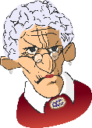
sprechen
1
2
3
explains everything to us
[Frau Müller]
explained everything to us
[Frau Klein]
gives us lots of hw
[Frau Schmidt]
gave us lots of hw
[Frau Weber]
tells us the truth
[Frau Bauer]
told us the truth
[Frau Becker]
4
5
6
always helps us
[Frau Schwarz]
always helped us
[Frau Wolf]
allows us lots of questions
[Frau Engel]
allowed us lots of questions
[Frau Graf]
always answered us
[Frau Jäger]
always answers us
[Frau Groß]
7
8
has lots of ideas
[Frau Ludwig]
had lots of ideas
[Frau Berger]
shows us the culture
[Frau König]
shows us the culture
[Frau Schulz]
Notes:
DISPLAY TO CLASS DURING ACTIVITY
While the other student reads his/her sentences aloud (see previous slide), the other student will be looking at these on the interactive whiteboard, and will decide which person is referred to for each item.
Note: Teachers can elicit the answers as teacher names and check for accurate SSC decoding.

Slide 31
sprechen
Antworten – Person A
1
2
3
explains everything to us
[Frau Müller]
explained everything to us
[Frau Klein]
gives us lots of hw
[Frau Schmidt]
gave us lots of hw
[Frau Weber]
tells us the truth
[Frau Bauer]
told us the truth
[Frau Becker]
4
5
6
always helps us
[Frau Schwarz]
always helped us
[Frau Wolf]
allows us lots of questions
[Frau Engel]
allowed us lots of questions
[Frau Graf]
always answered us
[Frau Jäger]
always answers us
[Frau Groß]
7
8
has lots of ideas
[Frau Ludwig]
had lots of ideas
[Frau Berger]
shows us the culture
[Frau König]
shows us the culture
[Frau Schulz]
Notes:
This slide shows what Person A said, and Person B understood.
ANSWER SLIDE - DO NOT DISPLAY DURING ACTIVITY
Note: Teachers can elicit the answers as teacher names and check for accurate SSC decoding.

Slide 32
sprechen
Antworten – Person B
1
2
3
explains everything to us
[Frau Müller]
explained everything to us
[Frau Klein]
gives us lots of hw
[Frau Schmidt]
gave us lots of hw
[Frau Weber]
tells us the truth
[Frau Bauer]
told us the truth
[Frau Becker]
4
5
6
always helps us
[Frau Schwarz]
always helped us
[Frau Wolf]
allows us lots of questions
[Frau Engel]
allowed us lots of questions
[Frau Graf]
always answered us
[Frau Jäger]
always answers us
[Frau Groß]
7
8
has lots of ideas
[Frau Ludwig]
had lots of ideas
[Frau Berger]
shows us the culture
[Frau König]
showed us the culture
[Frau Schulz]
Notes:
This slide shows what Person B said, and Person A understood.
ANSWER SLIDE - DO NOT DISPLAY DURING ACTIVITY
Note: Teachers can elicit the answers as teacher names and check for accurate SSC decoding.

Slide 33
Unsere Schule, mein Lehrer / meine Lehrerin
schreiben
Schreib zwei kurze Texte mit 50-60 Wörtern. Es gibt zwei Titel: (1) Unsere Schule; (2) Mein neuer Lehrer / Meine neue Lehrerin
mit
ohne
Try to use these prepositions and adverbs.
jedoch
oft
immer
selten
unser
ihr
Try to include ‘our / their’ and ‘us / them’ at least once in your texts.
uns
ihnen / sie
erzählen
geben
helfen
Try to use these verbs in the present and past tenses.
erklären
erlauben
Notes:
Timing: 10 minutes Aim: To practise present and perfect tense in a free writing context. This activity also brings in the recently-learned vocabulary.
Procedure: 1. Discuss the aim and title themes with the students.
2. Cycle through the information on the slide using the animation sequence. Leave slide on display for reference during the task itself.
3. There is a 50-word template on the next slide, to assist students with their word count as they attempt each task (printable version on the NCELP Resource Portal with this resource sequence).

Slide 34
Unsere Schule, mein Lehrer / meine Lehrerin
schreiben
Notes:
50-word writing template to assist with word count (write one word per cell).

Slide 35
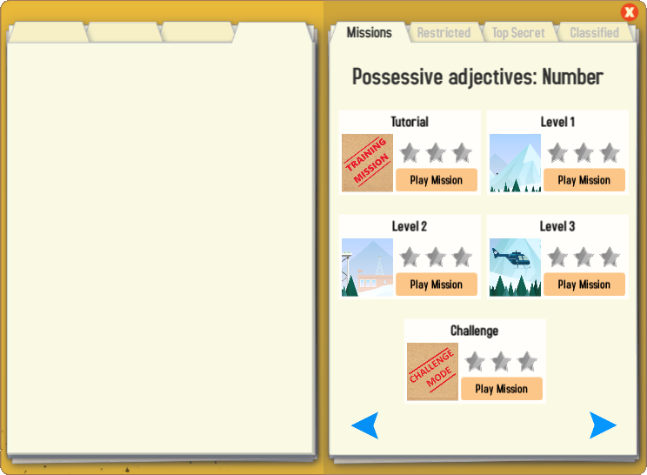
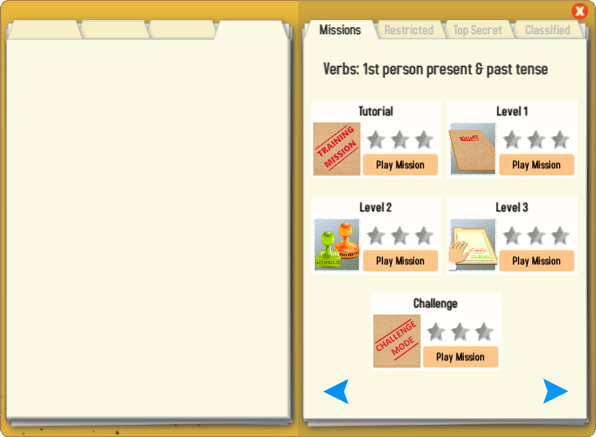
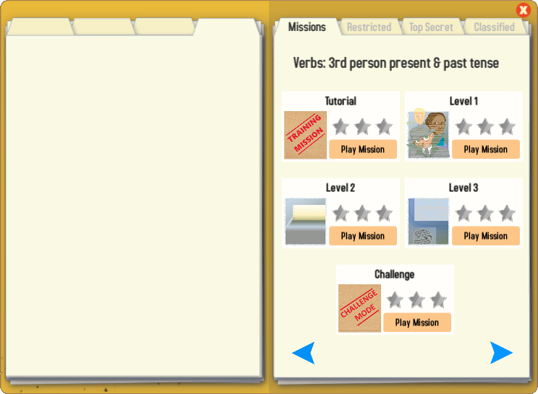
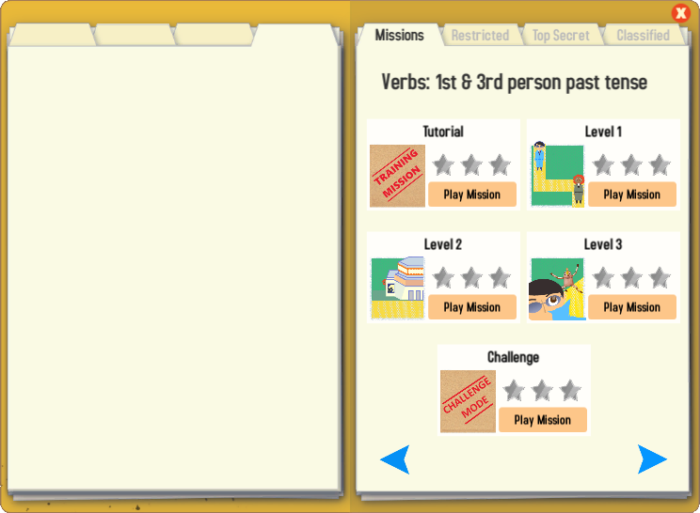
Gaming Grammar
Try the following Gaming Grammar missions to practise:
Notes:
Y8 T2.2 W4

Slide 36
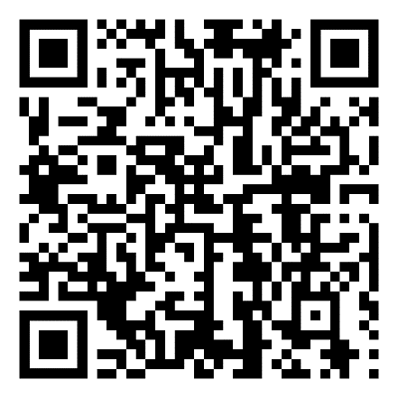
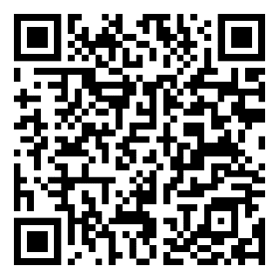
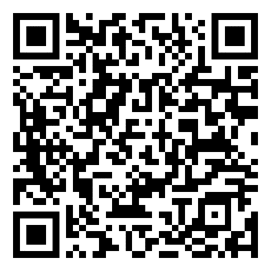
Hausaufgaben
Pre-learning for lesson: Year 8 German Term 2.2 Week 5
Revisit 1: [Year 8 German Term 2.2 Week 2]
Revisit 2: [Year 8 German Term 1.2 Week 7]
Notes:
This is the HW slide for the Oak Academy videoed lesson. Don’t upload to the portal with this slide, but do save a separate version on the Google drive and send link to RH, when complete.

Slide 37
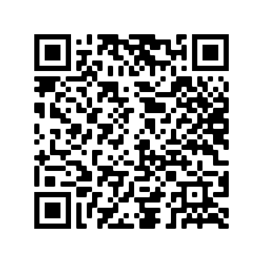
Hausaufgaben
Vocabulary Learning Homework (Y8, Term 2.2, Week 5)
Audio file
Audio file QR code:
Student worksheet
Quizlet link
In addition, revisit: Term 2.2 Week 2
Term 1.2 Week 7
Notes:
Link to answers: https://resources.ncelp.org/concern/resources/1g05fc252?locale=en

Slide 38
Die Schule in Deutschland
sprechen
In Deutschland gibt es eine Schulpflicht: Kinder müssen 9 Jahre lang in die Schule gehen. Ein Schuljahr beginnt normalerweise im August und dauert bis Juni. In die Grundschule gehen alle Kinder ab 6 oder 7 Jahren. Der Unterricht beginnt zwischen 7:00 Uhr und 8:00 Uhr am Morgen. In der Grundschule endet er um 11 oder 12 Uhr. In den anderen Schulen dauert der Unterricht meistens bis 13 Uhr, manchmal auch länger. Am Nachmittag gibt es viele Arbeitsgemeinschaften (AGs). Das sind Clubs für Sport, Kochen, Kunst, Musik und noch viel mehr.
In Germany there is compulsory schooling: children must attend school for 9 years. A school year normally begins in August and lasts until June. All children attend primary school from 6 or 7 years old. Lessons begin between 7:00 and 8:00 in the morning. In primary school, lessons end at 11:00 or 12:00 noon. In other schools lessons mostly continue until 1:00 pm, sometimes longer still. In the afternoon there are lots of work groups (AGs). These are clubs for sport, cooking, art, music and many other things.
"Klassenzimmer" by Oliver V. Müller is licensed under CC BY-NC-SA 2.0
Notes:
Suggested translation of German text on Slide 14.

