Slide 1
French SSC (symbol-sound correspondences)
Source Words
Date updated: 21/11/19
Notes:
All pictures selected are available under a Creative Common license, no attribution required. This is the full set of SSC (Symbol-sound correspondence) SOURCE words. This PPT is to be used in combination with the cluster words presentation. There is a suggested teaching order document, and there are many supporting resources for the teaching and consolidation of each individual SSC, also on the portal.
NB: Each SFC is presented twice, on two slides. The first is accompanied by a visual image, the second without the image. Teachers can elicit meanings or gestures to reinforce the word-meaning connection. Seeing just the SFC and source word on the slide also focuses attention closely on the symbol-sound relationship.

Slide 2
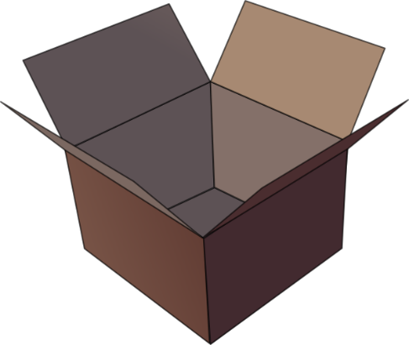
SFC
Silent final consonant
dans
X
Stephen Owen / Rachel Hawkes
Notes:
Explanation in English, if desired: Something that makes French sounds very different from English is that some consonants at the ends of words are silent. This means you don’t pronounce/sound them out at all. As in the word ‘dans’ in French. Say and repeat the word. Ensure pupils know the meaning (use usual routine for this – e.g. C’est quoi en anglais ‘dans’? ‘In’, oui, c’est ça. A possible gesture to accompany this SSC would be to hold ones finger to ones lips to indicate ‘Shhhh!’

Slide 3
SFC
Silent final consonant
dans
X
Stephen Owen / Rachel Hawkes
Notes:
Explanation in English, if desired: Something that makes French sounds very different from English is that some consonants at the ends of words are silent. This means you don’t pronounce/sound them out at all. As in the word ‘dans’ in French. Say and repeat the word. Ensure pupils know the meaning (use usual routine for this – e.g. C’est quoi en anglais ‘dans’? ‘In’, oui, c’est ça. A possible gesture to accompany this SSC would be to hold ones finger to ones lips to indicate ‘Shhhh!’

Slide 4
… except for
c r f l
Be c a r e f u l with these!
Stephen Owen / Rachel Hawkes

Slide 5
a
animal
Stephen Owen / Rachel Hawkes
Notes:
Introduce and elicit the pronunciation of the individual SSC ‘a’ and then present and practise the pronunciation of the source word ‘animal’. A possible gesture for this source word would be to mimic an animal’s motion, perhaps holding ones arms and hands close to the chest as ‘paws’

Slide 6
a
animal
Stephen Owen / Rachel Hawkes
Notes:
Introduce and elicit the pronunciation of the individual SSC ‘a’ and then present and practise the pronunciation of the source word ‘animal’. A possible gesture for this source word would be to mimic an animal’s motion, perhaps holding ones arms and hands close to the chest as ‘paws’

Slide 7
i
midi
Stephen Owen / Rachel Hawkes
Notes:
Introduce and elicit the pronunciation of the individual SSC ‘i’ and then present and practise the pronunciation of the source word ‘midi’. A possible gesture for this source word would be to draw a circle representing a clock face with one hand, with the other arm and hand pointing straight up (representing the hands on 12) within the circle

Slide 8
i
midi
Stephen Owen / Rachel Hawkes
Notes:
Introduce and elicit the pronunciation of the individual SSC ‘i’ and then present and practise the pronunciation of the source word ‘midi’. A possible gesture for this source word would be to draw a circle representing a clock face with one hand, with the other arm and hand pointing straight up (representing the hands on 12) within the circle

Slide 9
eu
deux
Stephen Owen / Rachel Hawkes
Notes:
Introduce and elicit the pronunciation of the individual SSC ‘EU’ and then present and practise the pronunciation of the source word ‘deux’. A possible gesture for this source word would be to hold up two fingers (N.B. palm of the hand facing the class!)

Slide 10
eu
deux
Stephen Owen / Rachel Hawkes
Notes:
Introduce and elicit the pronunciation of the individual SSC ‘EU’ and then present and practise the pronunciation of the source word ‘deux’. A possible gesture for this source word would be to hold up two fingers (N.B. palm of the hand facing the class!)

Slide 11
e
je
Stephen Owen / Rachel Hawkes
Notes:
Introduce and elicit the pronunciation of the individual SSC ‘e’ and then present and practise the pronunciation of the source word ‘je’. A possible gesture for this source word would be to point to oneself.

Slide 12
e
je
Stephen Owen / Rachel Hawkes
Notes:
Introduce and elicit the pronunciation of the individual SSC ‘e’ and then present and practise the pronunciation of the source word ‘je’. A possible gesture for this source word would be to point to oneself.

Slide 13
au
[au / eau / o]
gauche
Stephen Owen / Rachel Hawkes
Notes:
Introduce and elicit the pronunciation of the individual SSC ‘AU’ and then present and practise the pronunciation of the source word ‘gauche’. A possible gesture for this source word would be to point to the students’ left (teacher’s right!) to indicate this direction.

Slide 14
au
[au / eau / o]
gauche
Stephen Owen / Rachel Hawkes
Notes:
Introduce and elicit the pronunciation of the individual SSC ‘AU’ and then present and practise the pronunciation of the source word ‘gauche’. A possible gesture for this source word would be to point to the students’ left (teacher’s right!) to indicate this direction.

Slide 15
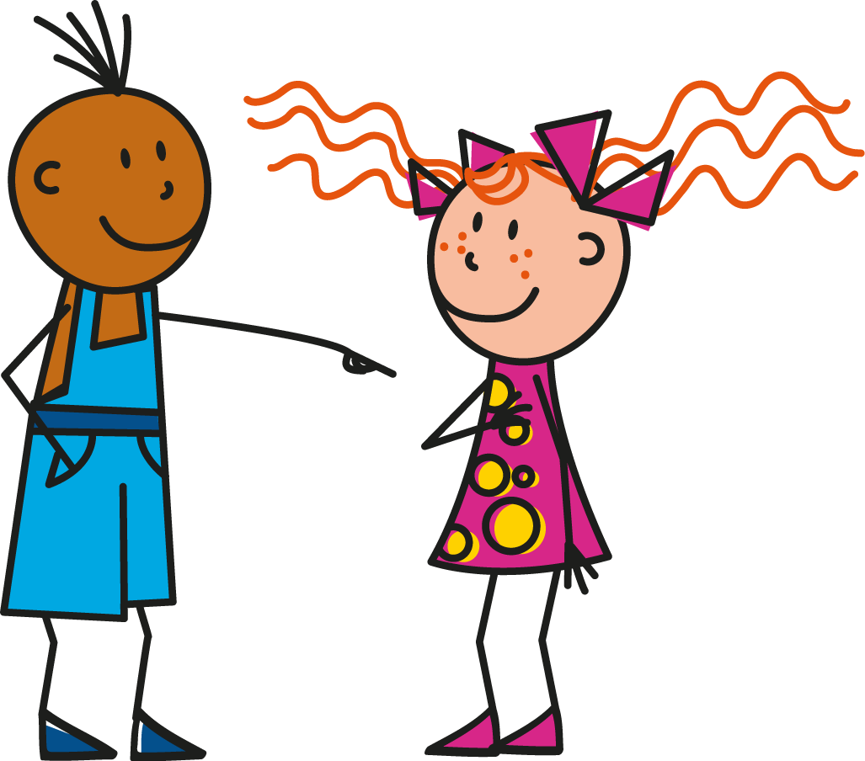
u
tu
Stephen Owen / Rachel Hawkes
Notes:
Introduce and elicit the pronunciation of the individual SSC ‘U’ and then present and practise the pronunciation of the source word ‘tu’. A possible gesture for this source word would be to point to someone else as though addressing him/her ‘you’.

Slide 16
u
tu
Stephen Owen / Rachel Hawkes
Notes:
Introduce and elicit the pronunciation of the individual SSC ‘U’ and then present and practise the pronunciation of the source word ‘tu’. A possible gesture for this source word would be to point to someone else as though addressing him/her ‘you’.

Slide 17
ou
nous
Stephen Owen / Rachel Hawkes
Notes:
Introduce and elicit the pronunciation of the individual SSC ‘OU’ and then present and practise the pronunciation of the source word ‘nous’.
A possible gesture for this source word would be to have both hands draw semi-circles out away from the body. Hands start by the sides of the body, circle swiftly outwards and join up again in front, indicating the inclusion of the self in a larger group.

Slide 18
ou
nous
Stephen Owen / Rachel Hawkes
Notes:
Introduce and elicit the pronunciation of the individual SSC ‘OU’ and then present and practise the pronunciation of the source word ‘nous’.
A possible gesture for this source word would be to have both hands draw semi-circles out away from the body. Hands start by the sides of the body, circle swiftly outwards and join up again in front, indicating the inclusion of the self in a larger group.

Slide 19
SFE
Silent final -e
[shy]
timide
Stephen Owen / Rachel Hawkes
Notes:
A possible gesture for this source word would be to cower and cover one’s face slightly, simulating shyness

Slide 20
SFE
Silent final -e
timide
Stephen Owen / Rachel Hawkes
Notes:
A possible gesture for this source word would be to cower and cover one’s face slightly, simulating shyness

Slide 21
é
[é / -er / et]
écrire
Stephen Owen / Rachel Hawkes
Notes:
Introduce and elicit the pronunciation of the individual SSC ‘é’ and then present and practise the pronunciation of the source word ‘écrire’. A possible gesture for this source word would be to mime the act of writing (onto the palm of the other hand perhaps)

Slide 22
é
écrire
[é / -er / et]
Stephen Owen / Rachel Hawkes
Notes:
Introduce and elicit the pronunciation of the individual SSC ‘é’ and then present and practise the pronunciation of the source word ‘écrire’. A possible gesture for this source word would be to mime the act of writing (onto the palm of the other hand perhaps)

Slide 23
en/an
enfant
Stephen Owen / Rachel Hawkes
Notes:
Introduce and elicit the pronunciation of the individual SSC ‘en/an’ and then present and practise the pronunciation of the source word ‘enfant’.
A possible gesture for this source word would be to mime patting a child on the head/back

Slide 24
en/an
enfant
Stephen Owen / Rachel Hawkes
Notes:
Introduce and elicit the pronunciation of the individual SSC ‘en/an’ and then present and practise the pronunciation of the source word ‘enfant’.
A possible gesture for this source word would be to mime patting a child on the head/back

Slide 25
on
non!
Stephen Owen / Rachel Hawkes
Notes:
Introduce and elicit the pronunciation of the individual SSC ‘on’ and then present and practise the pronunciation of the source word ‘non’.
A possible gesture for this source word would be to shake ones head whilst waggling one’s index finger, to indicate ‘no!’

Slide 26
on
non!
Stephen Owen / Rachel Hawkes
Notes:
Introduce and elicit the pronunciation of the individual SSC ‘on’ and then present and practise the pronunciation of the source word ‘non’.
A possible gesture for this source word would be to shake ones head whilst waggling one’s index finger, to indicate ‘no!’

Slide 27
ain/in
train
Stephen Owen / Rachel Hawkes
Notes:
Introduce and elicit the pronunciation of the individual SSC ‘ain/in’ and then present and practise the pronunciation of the source word ‘train’.
A possible gesture for this source word would be to move both arms simultaneously forwards and back in a circular motion, simulating the motion of train wheel connecting rods

Slide 28
ain/in
train
Stephen Owen / Rachel Hawkes
Notes:
Introduce and elicit the pronunciation of the individual SSC ‘ain/in’ and then present and practise the pronunciation of the source word ‘train’.
A possible gesture for this source word would be to move both arms simultaneously forwards and back in a circular motion, simulating the motion of train wheel connecting rods

Slide 29
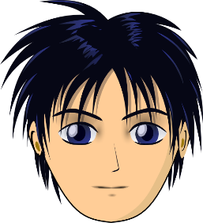
ê/è
tête
Stephen Owen / Rachel Hawkes
Notes:
Introduce and elicit the pronunciation of the individual SSC ‘ê/è’ and then present and practise the pronunciation of the source word ‘tête’.
A possible gesture for this source word would be to point to one’s head.

Slide 30
ê/è
tête
Stephen Owen / Rachel Hawkes
Notes:
Introduce and elicit the pronunciation of the individual SSC ‘ê/è’ and then present and practise the pronunciation of the source word ‘tête’.
A possible gesture for this source word would be to point to one’s head.

Slide 31
ai
vrai
Stephen Owen / Rachel Hawkes
Notes:
Introduce and elicit the pronunciation of the individual SSC ‘ai’ and then present and practise the pronunciation of the source word ‘vrai’.
A possible gesture for this source word would be to mime a ‘tick’.

Slide 32
ai
vrai
Stephen Owen / Rachel Hawkes
Notes:
Introduce and elicit the pronunciation of the individual SSC ‘ai’ and then present and practise the pronunciation of the source word ‘vrai’.
A possible gesture for this source word would be to mime a ‘tick’.

Slide 33
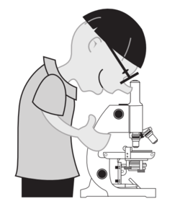
oi
voir
Stephen Owen / Rachel Hawkes
Notes:
Introduce and elicit the pronunciation of the individual SSC ‘oi’ and then present and practise the pronunciation of the source word ‘voir’.
A possible gesture for this source word would be to put one’s hand above one’s brow (as if to shade one’s view) and pretend to be seeing something far off.

Slide 34
oi
voir
Stephen Owen / Rachel Hawkes
Notes:
Introduce and elicit the pronunciation of the individual SSC ‘oi’ and then present and practise the pronunciation of the source word ‘voir’.
A possible gesture for this source word would be to put one’s hand above one’s brow (as if to shade one’s view) and pretend to be seeing something far off.

Slide 35
ch
chercher
Stephen Owen / Rachel Hawkes
Notes:
Introduce and elicit the pronunciation of the individual SSC ‘ch’ and then present and practise the pronunciation of the source word ‘chercher’.
A possible gesture for this source word would be to mime looking for something everywhere.

Slide 36
ch
chercher
Stephen Owen / Rachel Hawkes
Notes:
Introduce and elicit the pronunciation of the individual SSC ‘ch’ and then present and practise the pronunciation of the source word ‘chercher’.
A possible gesture for this source word would be to mime looking for something everywhere.

Slide 37
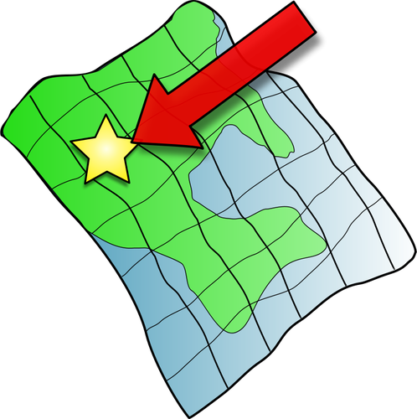
ç/c
ici
Stephen Owen / Rachel Hawkes
Notes:
Introduce and elicit the pronunciation of the individual SSC ‘i’ and then present and practise the pronunciation of the source word ‘ici’.
A possible gesture for this source word would be to point to the spot on which one is standing / indicate the room in which the lesson is taking place with a sweeping motion of one’s index finger.

Slide 38
ç/c
ici
Stephen Owen / Rachel Hawkes
Notes:
Introduce and elicit the pronunciation of the individual SSC ‘i’ and then present and practise the pronunciation of the source word ‘ici’.
A possible gesture for this source word would be to point to the spot on which one is standing / indicate the room in which the lesson is taking place with a sweeping motion of one’s index finger.

Slide 39
qu
?
question
Stephen Owen / Rachel Hawkes
Notes:
Introduce and elicit the pronunciation of the individual SSC ‘qu’ and then present and practise the pronunciation of the source word ‘question’.
A possible gesture for this source word would be to raise one’s eyebrows and look intently, as if querying something.

Slide 40
qu
question
Stephen Owen / Rachel Hawkes
Notes:
Introduce and elicit the pronunciation of the individual SSC ‘qu’ and then present and practise the pronunciation of the source word ‘question’.
A possible gesture for this source word would be to raise one’s eyebrows and look intently, as if querying something.

Slide 41
j
X
jour
Stephen Owen / Rachel Hawkes
Notes:
Introduce and elicit the pronunciation of the individual SSC ‘j’ and then present and practise the pronunciation of the source word ‘jour’.
A possible gesture for this source word would be to mime waking up at daybreak, by stretching out ones arms and yawning

Slide 42
j
jour
Stephen Owen / Rachel Hawkes
Notes:
Introduce and elicit the pronunciation of the individual SSC ‘j’ and then present and practise the pronunciation of the source word ‘jour’.
A possible gesture for this source word would be to mime waking up at daybreak, by stretching out ones arms and yawning

Slide 43
-tion
Attention!
Stephen Owen / Rachel Hawkes
Notes:
Introduce and elicit the pronunciation of the individual SSC ‘tion’ and then present and practise the pronunciation of the source word ‘attention’.
A possible gesture for this source word would be to wave one’s hand in front of oneself to indicate not to proceed.

Slide 44
-tion
Attention!
Stephen Owen / Rachel Hawkes
Notes:
Introduce and elicit the pronunciation of the individual SSC ‘tion’ and then present and practise the pronunciation of the source word ‘attention’.
A possible gesture for this source word would be to wave one’s hand in front of oneself to indicate not to proceed.

Slide 45
ien
bien
Stephen Owen / Rachel Hawkes
Notes:
Introduce and elicit the pronunciation of the individual SSC ‘ien’ and then present and practise the pronunciation of the source word ‘bien’.
A possible gesture for this source word would be to give a thumbs up sign.

Slide 46
ien
bien
Stephen Owen / Rachel Hawkes
Notes:
Introduce and elicit the pronunciation of the individual SSC ‘ien’ and then present and practise the pronunciation of the source word ‘bien’.
A possible gesture for this source word would be to give a thumbs up sign.

Slide 47
un
un
Stephen Owen / Rachel Hawkes
Notes:
Introduce and elicit the pronunciation of the individual SSC ‘un’ and then present and practise the pronunciation of the source word ‘un’.
A possible gesture for this source word would be to hold up one (index) finger.

Slide 48
un
un
Stephen Owen / Rachel Hawkes
Notes:
Introduce and elicit the pronunciation of the individual SSC ‘un’ and then present and practise the pronunciation of the source word ‘un’.
A possible gesture for this source word would be to hold up one (index) finger.

