Slide 1
Grammatik
Y7 German
Term 3.1 - Week 3
Mel Yates / Stephen Owen / Rachel Hawkes
Date updated: 04/05/20
Notes:
Learning outcomes (lesson 1)
Introduction of SSC [st]
Introduction of prepositions in and auf + R2 (acc) + movement, R3(dat) + location
Frequency rankings of vocabulary introduced this week (1 is the most common word in German):
3.1.3 - in [4], auf [17] springen [1468] fallen [278] das Kino [1825] die Stadt [186] das Konzert [1721] das Geschäft [663] das Museum [1360] angenehm [1748]
die Party [3634] die Straße [355] der Markt [508]
Frequency rankings of vocabulary revisited this week (1 is the most common word in German):
2.2.4 - Rad fahren [2156/169] am Nachmittag [1426] am Abend [313] am Wochenende [764] mit wem? [13/173] heute [121] Fleisch [1624] Gemüse [3450] Eis [2818] die Tasche [1638]
2.1.3 - mag [151] mögen [151] ihn (him/it) [93] sie (her/it) [10] die Fremdsprache [1791] die Kunst [468] die Naturwissenschaft [3772] das Schulfach [208/698] die Mathematik [1827] Deutsch [105]
Additional known vocabulary or cognates to recycle:
der Boden [445] der Park [>4034] die Stadt [188] die Schule [208] das Klassenzimmer [609/619] das Café [2345] die Bibliothek [927] das Theater [725] kommen [61] stehen [87] sitzen [261] still [1405]

Slide 2
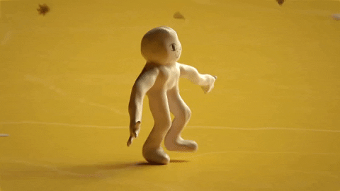
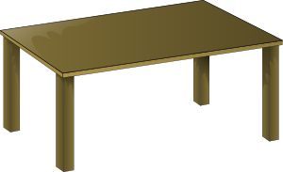
Talking about where something or someone is moving to
‘in das ‘ is often shortened to ‘ins’:
→ ich gehe ins Kino.
Note: the masculine word for the (definite article) changes:
Grammatik
To say where something or someone is moving to, use the prepositions ‘in’ (into) and ‘auf’ (onto):
der Park
die Stadt
das Kino
Ich gehe…
in den Park
in die Stadt
in das Kino
der Tisch
die Zeitung
das Heft
Die Katze springt...
auf den Tisch
auf die Zeitung
auf das Heft
These are the Row 2 (or accusative case) forms of the definite article.
Notes:
Note: Students have been taught definite (and indefinite) article in Row 2 (accusative) in Term 1.1 Weeks 5 & 6.
This explanation expands the students’ knowledge of the Row 2 (accusative) definite article to their use following these two high-frequency prepositions.
Teachers should elicit the English meanings of each sentence from students, stressing the directional movement involved: ‘I go / I’m going’ and ‘The cat jumps / is jumping’.
A listening and reading activity to practise this will follow.

Slide 3
Talking about where something is
Grammatik
To say where something or someone is located, use the same prepositions ‘in’ (in) and ‘auf’ (on), but change the word for the (definite article):
der Park
die Stadt
das Kino
Ich bin…
in dem Park
in der Stadt
in dem Kino
‘in dem ‘ is often shortened to ‘im’:
→ ich bin im Park. → ich bin im Kino.
der Tisch
die Zeitung
das Heft
Das Buch ist…
auf dem Tisch
auf der Zeitung
auf dem Heft
These are the Row 3 (dative case) forms of the definite article.
Notes:
Note: This explanation expands the students knowledge of the definite article to the dative (Row 3).
Teachers should elicit the English meanings of each sentence from students, stressing the static position implicated by ‘I am’ and ‘The book is’, as well as the difference in prepositional meaning between ‘into’ and ‘in’, ‘onto’ and ‘on’.
A listening and reading activity to practise this will follow.

Slide 4
R2 and R3: summary
Grammatik
Row 2 is used when describing motion into/onto something
Changes to the definite article:
Row 1:
der Park
die Stadt
das Kino
ins Kino
Row 2:
Ich gehe…
in den Park
in die Stadt
in das Kino
im Park
in dem Park
in der Stadt
im Kino
Row 3:
Ich bin…
in dem Kino
Row 3 is used when describing location in or on something
fallen is a strong verb
Which row is this? Why?
Er fällt ins Wasser!
What gender is ‘Wasser’?
Notes:
This slide summarises the changes to the article for Row 2 and Row 3, reiterating when to use each.

Slide 5
Mia sendet Katja eine SMS*
lesen
*die SMS - text message (stands for ‘Short Message Service’)
...aber keine Fotos! ☹ Es gibt ein Problem mit dem Handy.
Welches Verb ist richtig?
Mia: Hier sind einige Fotos. Mieze sitzt / springt auf den Boden!
Hier ist Wolfgang im Urlaub! Er fällt / steht ins Wasser!
Hier geht / ist Mehmet in den Garten…
Hier ist / geht Wolfgang auf dem Markt…
1
3
5
7
…und Einstein sitzt / springt auf dem Tisch!
und Mehmt steht / fällt im Wasser.
Auf diesem Foto bist / gehst du in der Schule.
…und ich gehe / bin in die Stadt.
2
4
6
8
Notes:
This reading activity requires students to pay attention to the case used for the definite article, in order to choose the correct verb – location or motion.
The answers are animated and appear upon successive clicks of the mouse.

Slide 6
Ich gehe oder ich bin?
hören
ich gehe
ich bin
ich gehe
ich bin
1
7
2
8
3
9
4
10
5
11
6
12
Notes:
This listening activity requires students to pay attention to the case used for the definite article, in order to choose the correct verb – location or motion. Students need only write 1-8 and either gehe or bin.
The answers are animated and appear upon successive clicks of the mouse.
Transcript
1. Ich [gehe] ins Kino.
2. Ich [bin] im Konzert.
3. Ich [bin] in der Bibliothek.
4. Ich [gehe] in den Park.
5. Ich [bin] im Museum.
6. Ich [gehe] in die Stadt.
7. Ich [gehe] in den Garten.
8. Ich [bin] im Theater.
9. Ich [gehe] ins Café.
10. Ich [gehe] in die Schule.
11. Ich [bin] im Klassenzimmer.
12. Ich [gehe] ins Geschäft.

Slide 7
Using auf to mean ‘at’ or ‘to’
Grammatik
We use the preposition ‘auf’ to mean ‘on’ or ‘onto’, e.g.:
Der Hund sitzt auf dem Tisch.
Die Katze springt auf den Boden.
(location)
(motion)
But ‘auf’ can also sometimes mean ‘at’ or ‘to’:
Ich bin…
auf dem Markt
Often, as in these examples, the use of auf is for open spaces or events. For example, also use auf for an open air or pop concert.
(location)
auf der Party
auf dem Festival
Ich gehe…
auf den Markt
auf die Party
(motion)
auf das Festival
Notes:
This slide explains the use of auf to mean ‘at’ or ‘to’ (we have previously seen it meaning ‘on’ or ‘onto’).
New vocabulary
die Party [3634] die Straße [355] der Markt [508]

Slide 8
Saying ‘to’ and ‘in’ in French
lesen
The different meanings of auf
Remember! The translation of auf is ‘onto’ or ‘to’ with verbs of movement Row 2 article) and ‘on’ or ‘at’ with verbs of location (Row 3 article).
What is the correct translation in each case below?
 |  | ‘on’ | ‘onto’ | ‘at’ | ‘to’
1. | Ich gehe auf die Party.
2. | Ich bin auf dem Festival.
3. | Das Buch is auf dem Tisch.
4. | Die Katze springt auf den Tisch.
Notes:
This reading activity practises the different translation of the preposition auf with verbs of movement and location.
Attention should be drawn to the fact that the same preposition can be translated differently depending on the context.

Slide 9
Saying ‘to’ and ‘in’ in French
lesen
The different meanings of auf [2]
Remember! The translation of auf is ‘onto’ or ‘to’ with verbs of movement Row 2 article) and ‘on’ or ‘at’ with verbs of location (Row 3 article).
What is the correct translation in each case below?
 |  | ‘on’ | ‘onto’ | ‘at’ | ‘to’
5. | Ich bin auf der Party.
6. | Ich gehe auf den Markt.
7. | Ich springe auf den Boden.
8. | Der Hund sitzt auf dem Boden.
Notes:
This is a continuation of the previous slide.

Slide 10
Wolfgang und Mia gehen shoppen
normal
langsam
multimodal
Am Samstagnachmittag gehen Wolfgang und Mia in die Stadt. Sie brauchen Gemüse. Wolfgang isst Fleisch aber Heidi ist Vegetarierin. Am Sonntagabend kocht Wolfgang für sie zu Hause. Mia braucht auch eine Tasche.
Zuerst gehen sie ins Geschäft. Dort gibt es sehr viel Gemüse! Dann gehen sie auf den Markt. Mia sieht eine Tasche. Sie mag sie sehr!
Sie gehen danach ins Café, und dann in den Park. Heidi ist im Park! Wolfgang findet das toll! Sie reden über die Schule. Mias Lieblinsfach ist Deutsch, aber Wolfgang und Heidi mögen Naturwissenschaften und Kunst. Sie finden Mathematik beide schwierig.
Sie gehen gemeinsam ins Kino. Mehmet sitzt auch im Kino! Er isst ein Eis – mmm, lecker! Die vier Freunde finden den Film sehr lustig. Mehmets Lieblingsschauspieler spielt im Film mit! Danach springt Mehmet auf sein Rad und fährt nach Hause.
Mia, Wolfgang und Heidi gehen auch nach Hause. Am Abend gibt Mia in der Schule ein Konzert.
_____
_______
___
__________
__________
_______
________________________
_______
___
___
___________
_______
die Vegetarierin – vegetarian (f); für – for; sein – his; der Schauspieler - actor
Notes:
This segmentation exercise, which consists of known words and cognates, with a small number of (glossed) exceptions, can be treated as a reading exercise, a listening exercise, or a multimodal exercise, as described below. N.B. The word Schauspieler features in next week’s vocabulary list. Teachers should flag the compounds for times of day – e.g. Samstagnachmittag, Sonntagabend, reminding students to try to break down longer words into more familiar single words.
1/ Teacher presses play. Students listen to the audio and read along. Alternatively the teacher can read the text him/herself.
2/ Teacher pauses the audio before the gaps.
3/ Students and teacher summarise the meaning of what has come before as a class.
4/ Students are then given 10 seconds to propose a sensible word (or phrase) which could come next, and to write it down.
5/ Teacher elicits suggestions from the class. Multiple suggestions are possible. Students should be encouraged to be creative, and recap vocabulary from previous learning.
6/ Teacher reveals the written solution by clicking on the gap, and presses play to continue.
If time permits, students can write a summary from audio only, or work with the written text to produce a summary or full translation.

Slide 11
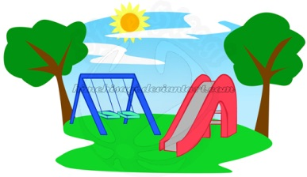
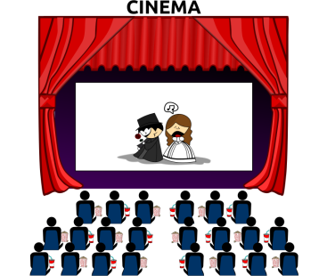
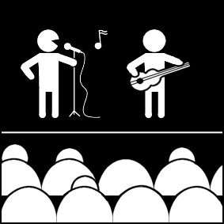
Wo ist er/sie? Wohin geht er/sie?
sprechen
Partner A/B
going to
already at
going to
already at
1
e.g. Festival
4
e.g. Schule
2
5
3
6
Wohin? - Where…to?
Notes:
This activity requires partners to listen to the information from each other about where Wolfgang and Mia (a) are going, and (b) are already situated. Partners have complementary information, making this a genuine information-gap exercise.
Partners note the answers in English on the printed version of the exercise (which shows the different information for each partner) – this is available to download as a Word file from the NCELP Resource Portal.
N.B. The table is blank, apart from the examples, in the version on this slide. This is to avoid giving away the answers, which are shown on slide 48.
E.g., ‘1. Er ist auf dem Festival’; ‘4. Sie geht in die Schule’.
The student speaking is thus compelled to select the correct preposition, case and use the correct article, whilst the listener is processing the vocabulary meaning.

Slide 12
Self-study version
sprechen
Partner A
going to
already at
going to
already at
1
4
2
5
3
6
Wohin? - Where…to?
Notes:
This is a self-study version of the task. The information that Partner B has is recorded and activated by clicking on each number. Students listen and record the answers in the correct part of the table, depending on whether Wolfgang and meaning are already somewhere or going somewhereuse the prompts to give their information in German for each question, and then click to hear Partner B’s information, which they then write down. After that, they can use the details on the Partner A pairwork sheet to give their information in German.

Slide 13
Wo ist er/sie? Wohin geht er/sie?
sprechen
Partner A/B
going to
already at
going to
already at
1
shop
concert
4
town
theatre
2
café
library
5
park
museum
3
market
cinema
6
school
classroom
Wohin? - Where…to?
Notes:
These are the answers to the acitivity on the previous slide.

Slide 14
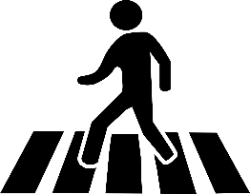
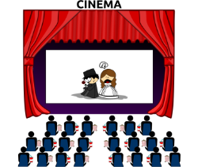
Wo bist du? Wohin gehst du?
schreiben
Wolfgang and Heidi are trying to meet up, but they are so busy! Sie schreiben SMS: “Ich bin... aber ich gehe jetzt…”Schreib drei SMS für Wolfgang oder Heidi.
“Ich bin... aber ich gehe jetzt…”
Wohin? – Where (to)?
Notes:
Students write the sentences implied by the pictures in each thought bubble, taking care to use the Row 2 and Row 3 articles correctly.
Each student writes three extended sentences, choosing to be either Wolfgang OR Heidi.
Note: they won’t all be the same sentences as students can choose which combination of places to talk about in each sentence.
Students can be encouraged to share their texts with each other. They can orally translate these into English, and peer check answers for meaning.
Clearly, teachers will want to circulate as students are writing to check accuracy of Row 2/Row 3 articles.

