Slide 1
Examples
production
(Freer) production tasks eliciting personal response

Slide 2
Schreib eine Filmszene
schreiben
Write sentences in German based on these words. You may add other words. Choose the words for the carefully.
Mann/trinkt
Haus/ist
Mädchen/spielt
Nacht/ist
Junge/liest
Mutter/spielt
Der Mann trinkt Wasser.
Das Haus ist klein/groß/neu/offen/schön.
Das Mädchen spielt Fußball (mit einem Freund).
Die Nacht ist lang und dunkel.
Der Junge liest ein Buch.
Die Mutter spielt Tennis.
Notes:
7.1.2.5
Timing: 14 minutes (including 2 minutes to set homework) Aim: To practise writing sentences using the vocabulary presented.
Procedure: 1. Students create sentences in German, based on the prompt words. They should add known source or cluster words if they want to add more detail.
2. Click to reveal some suggested sentences one by one, also eliciting students’ own examples/variations.

Slide 3
Weihnachtsgeschenke
schreiben
Und was denkst du? Give opinions on four Christmas presents.
Beispiel: Ich habe jetzt eine Jacke. Ich denke, sie ist super!
1.
2.
3.
4.
Notes:
7.2.1.1
Timing: 5 minutes
Aim: To practise sentence production (writing) using pronouns of the appropriate gender for ‘it’.
Procedure:
1. Students work alone to create four sentences about having and thinking.
2. They should be encouraged to use a noun in the first sentence, and a pronoun in the second.
3, The activity is then used as the basis for a transcription exercise on the following slide.

Slide 4
Weihnachtsgeschenke
sprechen, hören, schreiben
Now, read your sentences to a partner.
Was hat dein(e) Partner(in)? Was denkt er/sie? Schreib 4 Sätze.
Beispiel: Mark hat jetzt einen Computer. Er denkt, er ist ganz toll.
1.
2.
3.
4.
Notes:
7.2.1.1
Timing: 5 minutes
Aim: To practise sentence production (speaking) using pronouns of the appropriate gender for ‘it’, along with transription in the third person.
Procedure:
1. Students listen to their partner’s sentences about having and thinking in the first person, then transcribe them in the third person.
2. Teacher can elicit answers from pupils in the third person by asking e.g. ‘Was hat Mark? Was denkt Mark?’

Slide 5
Ein Dialog
sprechen
Essen?
Aha, interessant!
Toll!
Echt?
Ach so!
Uniform?
Hausaufgaben?
Unterricht?
Lehrer?
Notes:
7.2.1.4
Timing: 7 minutes (task timing is flexible 2-20 minutes)
Aim: To practise question production (speaking) to elicit opinions using finden; to practise answering such questions using direct object pronouns and adjectives learnt.
Note: this task is open-ended and can last two minutes or 20, depending on how long you have. If you have more than two minutes, it makes sense to move students so that they repeat the task with new partners.
Procedure: 1. Encourage students not to ask about each aspect of school life in order. 2. Remind them that they need to use the correct R2 article after FINDEN, depending on the gender of all these nouns. 3. If necessary, elicit the definite article of each, as follows: das Essen die Uniform die Hausaufgaben (ask if singular or plural) der Unterricht (prompt them for the R2 → den) der / die Lehrer (prompt them to tell you what it would mean if you asked ‘Wie findest du den Lehrer?’ (What do you think of the male teacher (singular) and if you asked ‘Wie findest du die Lehrer?’ (What do you think of the teachers (plural)? Use this as an opportunity to stress the importance of getting the articles correct.
4. The teacher might also want to elicit the words for ‘it’ and ‘them’ that students will need to reply with, if not to need to repeat the noun, e.g.: Wie findest du das Essen? Ich finde das Essen toll. But in order not to repeat ‘das Essen?’ → Ich finde [beep] toll. → Ich finde es toll.

Slide 6
Zusammen oder allein?
schreiben
Und was machst du mit Freunden zusammen? Was machst du allein? Finde Verben im Wörterbuch und schreib Sätze mit ich und wir!
Beispiel: Wir sitzen zusammen im Garten.
Ich lese allein im Zimmer.
1. Ich … 4. Wir …
2. Wir … 5. Ich …
3. Ich … 6. Wir …
Zusammen and allein are adverbs. Use them after the verb.
Notes:
7.2.2.1
Timing: 5 minutes
Aim: To provide dictionary practice.
Procedure: 1. First, ask students to use the dictionary to find the meaning of the example sentences given.
2. Then encourage students to find German translations for things they do alone and with friends. Students know that if they are using the wir form, verbs may be used as they are found in the dictionary. If they are using the ich form, they must change the ending appropriately.
3. Teacher can elicit some examples from the class by asking students ‘Was machst du mit Freunden zusammen?’ ‘Was machst du allein?’
Note: Students are safe to use the vast majority of verbs that they find in the dictionary, as strong verbs don’t change their stems in the ‘ich’ or ‘wir’ forms. They will be learning about strong verbs in the 2nd half of the spring term (Term 2.2 Week 3). Whilst students should be encouraged to use a dictionary for the verbs, teachers will probably want to insist that they draw on their own, known vocabulary for the remainder of the sentence.

Slide 7
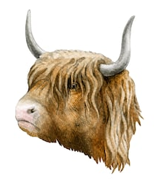
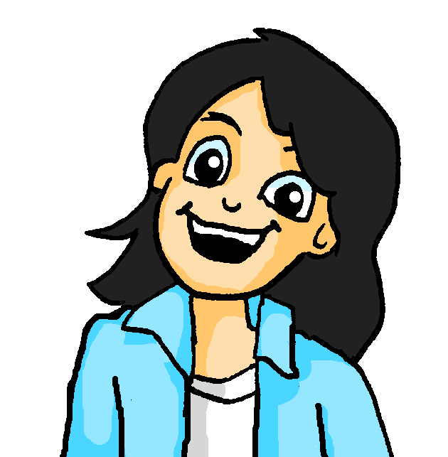
Was gibt es in Schottland?
schreiben
Mia findet Schottland toll! Was sind ihre Gründe?
Schreib drei Sätze in WO1 und drei Sätze in WO2.
Katja! Können wir bitte, bitte, bitte, den Austausch in Schottland machen?
In Schottland …
Dort …
In Glasgow …
Die Leute …
Notes:
7.3.1.6
Timing: 8 minutes
Aim: to practise written production of WO1 and WO2 with locations. Students use their notes from the previous listening activity to write sentences about Scotland.
Procedure:
1. Some suggested sentence beginnings are given. Elicit further examples from students and write them here.
Note: der Grund [230] was taught in 1.1.6. Students may not recognise it immediately in its plural form. Ensure that the meaning is clear, and ask students to identify which plural rule this is. Answer: Rule 1 - der/das nouns +Umlaut+e.
Word frequency (1 is the most frequent word in German):
Austausch [2744]
Source: Jones, R.L & Tschirner, E. (2011). A frequency dictionary of German: Core vocabulary for learners. London: Routledge.

Slide 8
eine Geschichte schreiben
schreiben
Schreib einen Text mit 50 Wörtern. Benutze die zwei Verben SEIN und HABEN.
Notes:
7.3.2.1
OPTIONAL ADDITIONAL TASK
Timing: 10 minutes
Aim: To practise written production of sentences using the verbs SEIN and HABEN in a more open-ended task. Teachers ask students to write a text (it can be a fictional story or factual text) of 50 words using only the verbs SEIN and HABEN, plus nouns, adjectives, adverbs of choice. The 50-word grid is to help students with their planning. It is also available as a printable handout (3 x 50-word grids per student, as they often want to draft it more than once).
Procedure:
1. Teacher explains task and distributes 50-word handout grid if desired.
2. Students write their 50-word text.

Slide 9
Was planst du?
sprechen / schreiben
Schreib deine Pläne für nächste Woche, nächsten Monat, nächstes Jahr! Benutz die Vokabeln. Partnerarbeit: Sag deine Sätze.
machen
meine Hausaugaben
spielen
Fußball mit Freunden
fahren
eine Party
nach London
gehen
geben
in die Stadt
Jetzt schreib deine eigene* Sätze!
*eigen- - own
Notes:
7.3.2.5
Timing: 15 minutes
Aim: To provide productive practice with the grammar features covered in this lesson.
Note: This writing/speaking task requires students first to write, then say aloud to their partner, sentences similar to those encountered in the reading and listening exercises this lesson. Useful verbs and possible complements are provided giving the parameters for structured practice in the first instance. The verbs are given in the infinitive, so students need to put them into the first person singular form, adding one of the time adverbials and remembering to use Word Order 2. Upon the next mouse click, students are challenged to create some similar sentences using vocabulary of their choice, as an extension task.
Procedure:
1. Use the prompts on the slide as a stimulus to elicit some example sentences from students.
2. Click to bring up the next instruction: students write their own sentences.
3. They then read their sentences to their partner.
Word frequency (1 is the most frequent word in German):
eigen [166]
Source: Jones, R.L & Tschirner, E. (2011). A frequency dictionary of German: Core vocabulary for learners. London: Routledge.

Slide 10
Deine Urlaubspläne
schreiben
Schreib 50-60 Wörter über deine Urlaubspläne für nächstes Jahr. (It can be imaginary!).
Wo? Wie? Wie lange dauert das? Was machst du, und wann?
Contrast this with what you normally do every year, as Mehmet and Mia did in their conversation on the previous slide.
Use the vocabulary you have learned and revised this lesson.
Use a dictionary, for up to five new words, if you want to.
Notes:
7.3.2.5
Timing: 10 minutes
Aim: To practise written production of the language this week in a freer task, to communicate about future holiday plans and compare these with usual holiday activities.
Procedure:
1. Students write freely, following the prompts on the slide.

Slide 11
Schreib ein Gedicht
schreiben
1. Choose five to seven nouns. 2. Choose a movement and a location verb. 3. Choose a preposition ‘in’ or ‘auf’. 4. Write between 12 and 16 lines.
das Gedicht - poem
Notes:
7.3.2.7
Timing: 10-20 minutes
Aim: To practise written production of nouns, present tense verbs of location and/or movement, prepositions in a more open-ended task.
Procedure:
1. Students folllow the prompts on the slide to write their own poem.
Word frequency (1 is the most frequent word in German):
Gedicht [1897]
Source: Jones, R.L & Tschirner, E. (2011). A frequency dictionary of German: Core vocabulary for learners. London: Routledge.

