Slide 1
What is it like? Describing attributes
Adjective endings with definite articles R2 (acc)
SSC [eu] [äu] [revisited]
Y8 German
Term 3.1 - Week 5 - Lesson 57
Catherine Morris / Natalie Finlayson / Rachel Hawkes
Artwork: Steve Clarke
Date updated: 21/07/21
Notes:
Artwork by Steve Clarke. All additional pictures selected are available under a Creative Commons license, no attribution required.
Native teacher feedback provided by Stephanie Cross.
Learning outcomes (lesson 1):
Introduction of SSC [eu] and [äu]
Consolidation of adjective endings with indefinite articles in the nominative and accusative
Consolidation of kein, revisit WO2 with multiple elements
Word frequency (1 is the most frequent word in German):
8.3.1.5 (introduce) beschreiben [435] wohin [1811] Beruf [1036] Dame [702] Foto [633] Nachbar [1283] Raum [403] Sachen [318] Stoff [702] bester beste bestes [314] weiß [472]
8.3.1.1 (revisit) hängen [590] schützen [996] verdienen [835] Angriff [1489] Daten [574] Euro [207] Gesetz [578] Milliarde [453] Million [209] Unternehmen [236] Wand [828] an² [19] gegen [104] laut [835]
8.2.1.6 (revisit) besser [201] billig [1738] gefährlich [1211] häufig [407] lang [97] mehr [52] sicher [265] teuer [950] noch³ [33] als² [22]
Source: Jones, R.L & Tschirner, E. (2019). A frequency dictionary of German: Core vocabulary for learners. London: Routledge.
The frequency rankings for words that occur in this PowerPoint which have been previously introduced in NCELP resources are given in the NCELP SOW and in the resources that first introduced and formally re-visited those words.
For any other words that occur incidentally in this PowerPoint, frequency rankings will be provided in the notes field wherever possible.

Slide 2
eu
Deutschland
Notes:
Timing: 1 minute
Aim: To introduce/consolidate SSC [eu]
Procedure: 1. Present the letter(s) and say the [eu] sound first, on its own. Students repeat it with you. 2. Bring up the word ”Deutschland” on its own, say it, students repeat it, so that they have the opportunity to focus all of their attention on the connection between the written word and its sound.
3. A possible gesture for this would be to act as though you are addressing Germany, saying ‘Oy! Deutschland!’ and jabbing your finger into the air (joyfully) twice, once on ‘Oy!’ and once on the first syllable of Deutschland.
4. Roll back the animations and work through 1-3 again, but this time, dropping your voice completely to listen carefully to the students saying the [eu] sound, pronouncing ”Deutschland” and, if using, doing the gesture. Word frequency (1 is the most frequent word in German): Deutschland [N/A proper noun]
Source: Jones, R.L. & Tschirner, E. (2006). A frequency dictionary of German: core vocabulary for learners. Routledge

Slide 3
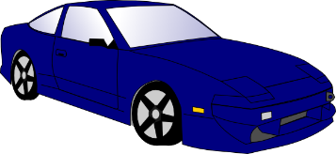
eu
Euro
heute
[today]
Deutschland
Freund
Leute
neu
Notes:
Timing: 2 minutes
Aim: To introduce/consolidate SSC [eu]
Procedure:
Introduce and elicit the pronunciation of the individual SSC [eu] and then the source word again ‘Deutschland’ (with gesture, if using).
Then present and elicit the pronunciation of the five cluster words.
The cluster words have been chosen for their high-frequency, from a range of word classes, with the SSC (where possible) positioned within a variety of syllables within the words (e.g. initial, 2nd, final etc.). Additionally, we have tried to use words that build cumulatively on previously taught SSCs (see the Phonics Teaching Sequence document) and do not include new SSCs. Where new SSCs are used, they are often consonants which have a similar symbol-sound correspondence in English.
Word frequency (1 is the most frequent word in German): Deutschland [N/A proper noun]; Euro [333] heute [121]; Freund [327]; neu [80]; Leute[163].
Source: Jones, R.L. & Tschirner, E. (2006). A frequency dictionary of German: core vocabulary for learners. Routledge

Slide 4
äu
Mäuse
Notes:
Timing: 1 minute
Aim: To introduce/consolidate SSC [äu]
Procedure: 1. Present the letter(s) and say the [äu] sound first, on its own. Students repeat it with you. 2. Bring up the word ”Mäuse” on its own, say it, students repeat it, so that they have the opportunity to focus all of their attention on the connection between the written word and its sound.
3. A possible gesture for this would be to mime whiskers, holding your fingers up to the side of your mouth.
4. Roll back the animations and work through 1-3 again, but this time, dropping your voice completely to listen carefully to the students saying the [äu] sound, pronouncing ”Mäuse” and, if using, doing the gesture. Word frequency (1 is the most frequent word in German): Mäuse [3757] Source: Jones, R.L. & Tschirner, E. (2006). A frequency dictionary of German: core vocabulary for learners. Routledge

Slide 5
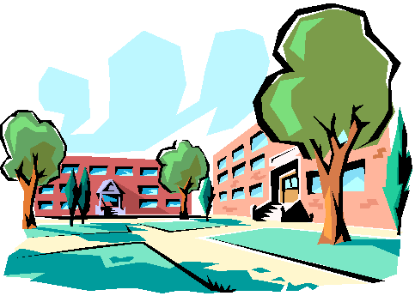
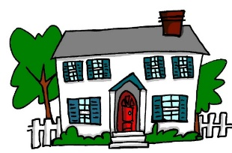
äu
Bäume
häufig
Mäuse
träumen
Gebäude
Häuser
Notes:
Timing: 2 minutes
Aim: To introduce/consolidate SSC [äu]
Procedure:
Introduce and elicit the pronunciation of the individual SSC [äu] and then the source word again ‘Mäuse’ (with gesture, if using).
Then present and elicit the pronunciation of the five cluster words.
The cluster words have been chosen for their high-frequency, from a range of word classes, with the SSC (where possible) positioned within a variety of syllables within the words (e.g. initial, 2nd, final etc.). Additionally, we have tried to use words that build cumulatively on previously taught SSCs (see the Phonics Teaching Sequence document) and do not include new SSCs. Where new SSCs are used, they are often consonants which have a similar symbol-sound correspondence in English.
Word frequency (1 is the most frequent word in German): Mäuse [3757]; Bäume [994] häufig [432]; träumen [1907]; Häuser [159]; Gebäude[1202]. Source: Jones, R.L. & Tschirner, E. (2006). A frequency dictionary of German: core vocabulary for learners. Routledge

Slide 6
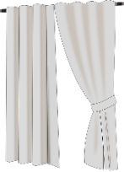
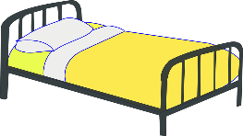
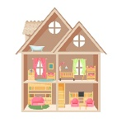
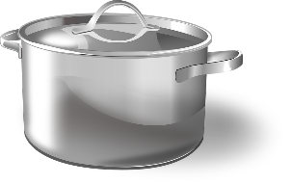
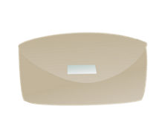
Was packt Wolfgang ein*?
hören / schreiben
Die Familie zieht um*. Es gibt nicht viel Platz im Auto! Wolfgang darf nur die Sachen mit [eu] und [äu] mitnehmen. Welche sind das?
das Bettzeug
die Leuchte
__
__
die Vorh ä nge
__
die Puppenhäuser
die Handt ü cher
der Kl ei derschrank
__
__
__
die T ö pfe
die Fäustlinge
__
__
das Spielzeug
__
__
*einpacken = to wrap up, box
*umziehen = to move house
der Geldbeutel
der Fotor a hmen
__
Notes:
Timing: 5 minutes Aim: Aural recognition of SSCs [eu] and [äu]. Raising awareness that this sound corresponds to two spelling patterns. Procedure: 1. Check students understand the context and task instructions. They haven’t come across the word mitnehmen before but should be able to work out its meaning using their knowledge of mit and nehmen.
2. Begin with Bettzeug in the top left. Click on picture to hear the word said aloud.
3. Students decide whether they hear the target sound or not. Ask: Hörst du SSC eu? Students respond ja/nein, or the teacher could ask ‘Wer denkt ja/nein?’ to take a vote. At advanced levels, students could volunteer the correct SSC where they answer nein.
4. Click to reveal the missing SSC. Where a different SSC is revealed, click again to make the item disappear as Wolfgang doesn’t pack it!
5. Continue for the others, working from left to right.
Transcript: das Bettzeug
die Leuchte
die Vorhänge
die Puppenhäuser
die Handtücher
der Kleiderschrank
die Töpfe
die Fäustlinge
das Spielzeug
der Geldbeutel
der Fotorahmen Word frequency of unknown words used (1 is the most frequent word in German): Bettzeug [>5000], Vorhang [3513], Topf [4136], Geldbeutel [>5000], Leuchte [>5000], Spielzeug [>5000], Handtücher [>5000], Fäustling [>5000], Kleiderschrank [>5000], Fotorahmen [633/753], Puppenhaus [4676/147], mitnehmen [1459], einpacken [>5000], umziehen [>5000] Source: Jones, R.L. & Tschirner, E. (2019). A frequency dictionary of German: core vocabulary for learners. Routledge

Slide 7
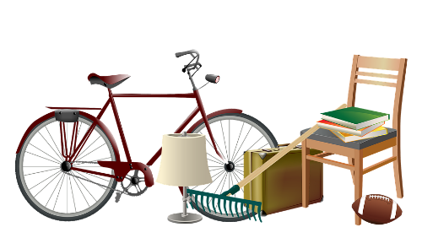
Was packt Mia nicht ein?
Was bringt Mia mit? Lies die Wörter laut vor.
Mia darf keine Sachen mit diesen SSC mitbringen. Was packt sie nicht ein? Lies die Wörter laut vor.
lesen / sprechen
die Zukäufe
[additional purchases]
die Seife
der Zaun
das Kreuz
das Brettspiel
die sauren Gurken
das Zeug
[stuff]
die Eule
die Werkzeuge
das Zeugnis
die Gläser
die Kräuter
Notes:
Timing: 5 minutes Aim: Written recognition of SSCs pronounced liked [eu]. Oral production of these and a selection of other SSCs. Procedure: 1. Click to bring up the first task. Say the target SSC aloud to remind students what to look for.
2. Students work in pairs and decide which words contain the target SSC. They practise saying these aloud for 2 minutes.
3. Elicit answers by asking: Was packt Mia nicht ein?
4. Click on the pictures representing words containing [eu] and [äu] to hear them said aloud.
5. Click to remove these words, as Mia is not packing them.
6. Click to bring up the second task. Students practise saying the words for 1 minute.
7. Click on the pictures to hear the remaining words said aloud. Students repeat.
Transcript: die Zukäufe
der Zaun
die Seife
das Zeug
das Kreuz
das Zeugnis
die Gläser
die saure Gurken
das Brettspiel
die Kräuter
die Werkzeuge
die Eule
Word frequency of unknown words used (1 is the most frequent word in German): Kräuter [>5000], Eule [>5000], Schlagzeuge [>5000], Werkzeug [3681], Zeugnis [4456], Brettspiel [>5000], Zukauf [>5000], Kreuz [2358], Zeug [3069], Zaun [3279], Brettspiel [4845/328], Glas [885], mitnehmen [1459], einpacken [>5000] Source: Jones, R.L. & Tschirner, E. (2019). A frequency dictionary of German: core vocabulary for learners. Routledge

Slide 8
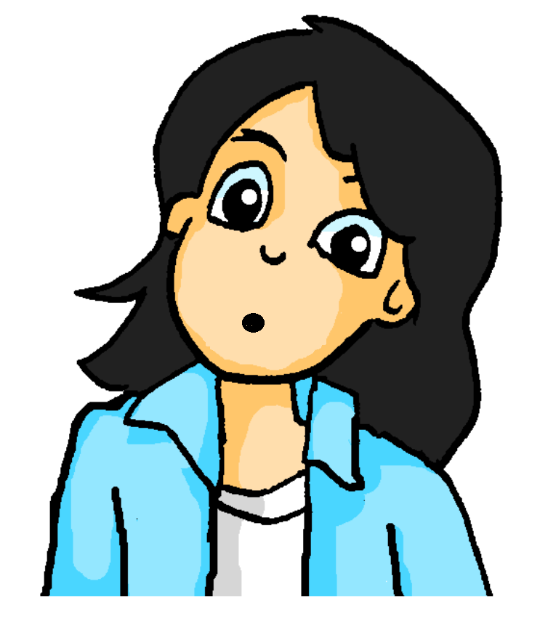
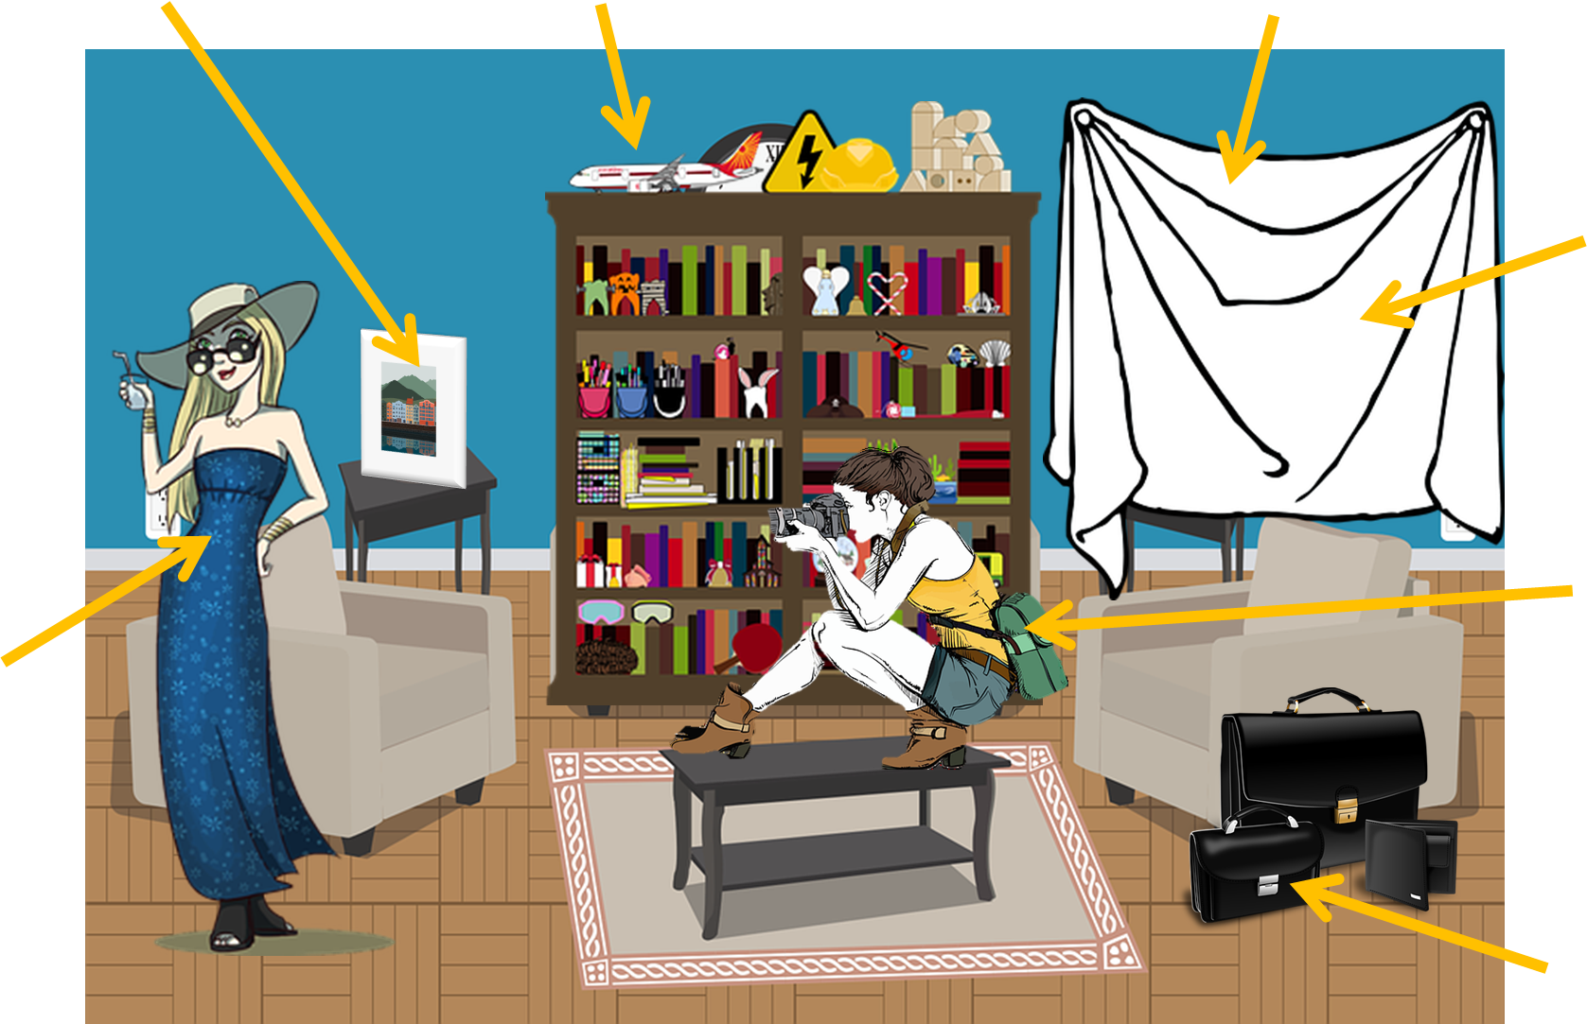
Mias neue Nachbarin
Use ‘Zimmer’ to talk about private rooms, e.g. das Badezimmer, das Wohnzimmer.
Use ‘Raum’ to talk about public rooms,
e.g. der Konferenzraum (conference room).
Mia sieht ihre neue Nachbarin durchs Fenster! Was sieht sie noch?
lesen
6
weiß
4
3
5
1
der Raum
3
das Foto
ein Foto machen
= to take a picture
Ich mache ein Foto.
6
7
die beste Freundin
4
die Sachen
7
2
8
der Beruf
The plural word ‘Sachen’ means the same as ‘Dinge.’
5
der Stoff
1
8
2
die Dame
Notes:
Timing: 3 minutes Aim: Written recognition of new vocabulary. Procedure: 1. Students copy the list of words and number them 1-8 in line with the things in the picture they best represent.
2. Elicit answers from students.
3. Click to reveal answers.
4. Say the words aloud. Students repeat.
5. Click to bring up bubbles highlighting usage notes about this week’s words.
6. Use the opportunity to introduce the idea of compound nouns representing rooms in a house. Students have not yet learned Badezimmer and Wohnzimmer as vocabulary items, but should be able to work out the meaning from their knowledge of Bad, wohnen and Zimmer.
Word frequency of unknown words used (1 is the most frequent word in German): Badezimmer [>5000] Wohnzimmer [2555] Source: Jones, R.L. & Tschirner, E. (2019). A frequency dictionary of German: core vocabulary for learners. Routledge

Slide 9
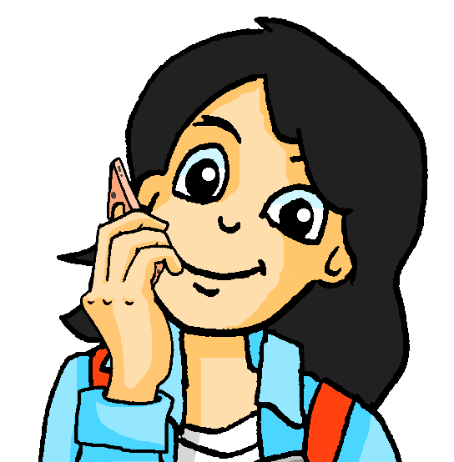
Mias neue Nachbarschaft
lesen / sprechen / hören
Mia spricht mit Katja am Telefon. Sag den Satz zu einem Partner/einer Partnerin. Der Partner/die Partnerin schreibt den Satz auf Englisch.
1. UnsereWohnunginBerlinwarsehrteuer.
2. DasneueHausistvielbesserweilmeinZimmergroßist.
3. DieStadtkanngefährlichseinundhieristessicherer.
4. EsgibthäufigBusseindieStadt.
5. SokannichjedenTagmeinebesteFreundinsehen!
6. MeineSachensindhieralsomussichschnellputzen.
Notes:
Timing: 6 minutes [7 slides]
Aim: Segmentation of written text in the oral modality.
Procedure:
1. Focus on the word Nachbarschaft (neighbourhood) in the title. Ask if they can guess its meaning using their knowledge of Nachbar. Depending on the level of the group, you could explain that –schaft is a common noun ending which means a group of people or things. Compare with Naturwissenschaft (group of knowledge) which they already know. They might also have come across Mannschaft.
2. Students take it in turns to say the sentences to their partner, pausing between words.
3. The partner who is listening gives the translation in English.
4. Lead feedback using the next 6 slides in which every sentence is dealt with individually.
Word frequency of unknown words used (1 is the most frequent word in French): Nachbarschaft [4065]
Source: Londsale, D., & Le Bras, Y. (2009). A Frequency Dictionary of French: Core vocabulary for learners London: Routledge.

Slide 10
Mias neue Nachbarschaft
lesen / sprechen / hören
1. UnsereWohnunginBerlinwarsehrteuer.
Our apartment/flat in Berlin was very expensive.
1

Slide 11
Mias neue Nachbarschaft
lesen / sprechen / hören
2. DasneueHausistvielbesserweilmeinZimmergroßist.
The new house is much better because my room is big.
2

Slide 12
Mias neue Nachbarschaft
lesen / sprechen / hören
3. DieStadtkanngefährlichseinundhieristessicherer.
The city can be dangerous
and it is safer here.
3

Slide 13
Mias neue Nachbarschaft
lesen / sprechen / hören
4. EsgibthäufigBusseindieStadt.
There are frequent(ly) buses into the city.
4

Slide 14
Mias neue Nachbarschaft
lesen / sprechen / hören
5. SokannichjedenTagmeinebesteFreundinsehen!
This way, I can see my best (female) friend every day!
5

Slide 15
Mias neue Nachbarschaft
lesen / sprechen / hören
6. MeineSachensindhieralsomussichjetztputzen.
My things are here so I have to clean now.
6

Slide 16
Falsche Freunde
Vokabeln
Four words in this week’s vocabulary set look like English words:
der Stoff
das Foto
der Raum
die Dame
Two of these words share a meaning with the English words they look like:
das Foto - photo
der Raum - room
This type of word is called a cognate and can be very useful for learning!
The others have different meanings from the words they look like:
der Stoff - material, cloth (not ‘stuff’)
die Dame - lady (not ‘dame’)
These are called false friends and we have to be careful with them!
Notes:
Timing: 2 minutes Aim: To introduce the concept of false friends and cognates using examples from this week’s new vocabulary set. Procedure: 1. Cycle through the information point by point.

Slide 17
Falsche Freunde (1/8)
lesen
Falscher Freund oder Kognat?
das Handy
falscher Freund
Kognat
Notes:
Timing: 2 minutes [8 slides] Aim: To recall meanings of a set of known vocabulary items and categorise them as cognates or false friends. Procedure: 1. Students match the word to one of the pictures, thereby classing it as either a cognate or false friend.
2. Click to reveal answer.
3. Where a false friend is identified, clarify the English translation.

Slide 18
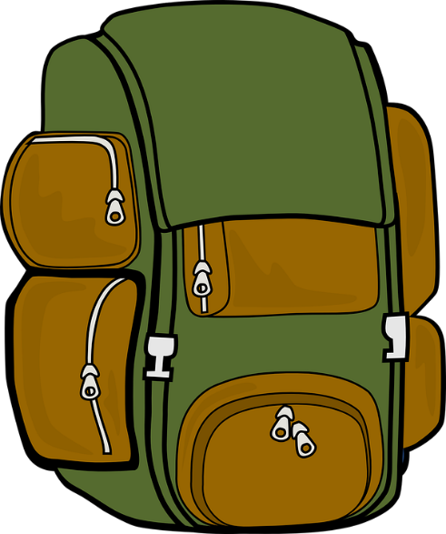
Falsche Freunde (2/8)
lesen
Falscher Freund oder Kognat?
die Musik
falscher Freund
Kognat

Slide 19
Falsche Freunde (3/8)
lesen
Falscher Freund oder Kognat?
der Hut
falscher Freund
Kognat

Slide 20
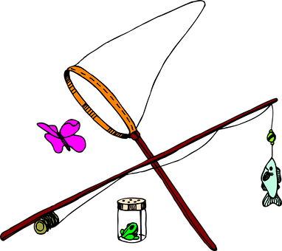
Falsche Freunde (4/8)
lesen
Falscher Freund oder Kognat?
nett
falscher Freund
Kognat

Slide 21
Falsche Freunde (5/8)
lesen
Falscher Freund oder Kognat?
die Fahrt
falscher Freund
Kognat

Slide 22
Falsche Freunde (6/8)
lesen
Falscher Freund oder Kognat?
der Film
falscher Freund
Kognat

Slide 23
Falsche Freunde (7/8)
lesen
Falscher Freund oder Kognat?
das Wasser
falscher Freund
Kognat

Slide 24
Falsche Freunde (8/8)
lesen
Falscher Freund oder Kognat?
das Kind
falscher Freund
Kognat

Slide 25
Falsche Freunde
lesen
Mia zeigt Katja das neue Haus. Schreib die Sätze auf Englisch.
Vorsicht vor* den falschen Freunden!
Deutsch | Englisch
Das Haus liegt am See. | The house is near the lake.
Wir sind fast da! | We are nearly there!
Ich will das große Zimmer haben! | I want to have the big room!
Es gibt in jedem Raum Stoff. | There is material in every room.
Ich brauche eine neue Hose. | I need new trousers.
Mutti ist streng, also keine Schuhe im Haus! | Mum is strict, so no shoes in the house!
Die Dame nebenan* verdient viel! | The lady next door earns a lot!
*Vorsicht vor
= watch out for
*nebenan
= next door
Notes:
Timing: 5 minutes Aim: To automatise the correct translation of new and revisited false friends by presenting them in new contexts and practising speed translation. Procedure:
1. At lower levels, explain to students that the words in bold are false friends and they need to be careful of these. At higher levels, remove the bold, and simply tell students that some words are false friends and they should try to spot them while translating.
2. Students translate the first sentence into English. They hold up their English translations on paper/mini whiteboards and try to be one of the first students to complete the translation successfully.
3. Click to reveal a suggested translation. Draw attention to the false friend and English equivalent.
4. Click to move to the next example. Repeat steps 1-5.
5. If necessary, revisit the activity in lesson 2 to consolidate meaning. Word frequency of unknown words used (1 is the most frequent word in German): Vorsicht [3443], nebenan [4567] Source: Jones, R.L. & Tschirner, E. (2019). A frequency dictionary of German: core vocabulary for learners. Routledge
Word frequency of cognates used (1 is the most frequent word in German): cool [>5000] Source: Jones, R.L. & Tschirner, E. (2019). A frequency dictionary of German: core vocabulary for learners. Routledge

Slide 26
Adjektivendungen – R1 und R2
Grammatik
As you know, adjectives add endings when they come in front of a noun.
You already know the endings for adjectives before an indefinite article in R1/R2:
R1:
ein langer Raum
eine nette Dame
ein neues Gesetz
_
_
_
R2:
einen langen Raum
eine nette Dame
ein neues Gesetz
_
_
_
You also know the endings for adjectives before a definite article in R1:
Only the masculine ending is different in R2!
R1:
der lange Raum
die nette Dame
das neue Gesetz
die alten Züge
_
_
_
_
Here are the endings for adjectives before a definite article in R2:
R2:
den langen Raum
die nette Dame
das neue Gesetz
die alten Züge
Notes:
Timing: 2 minutes Aim: To present pronominal adjective agreement in R2 (accusative) with definite articles. Procedure: 1. Click and present the knowledge in small steps as per animation.
2. Remind students that it is the position of the adjective in relation to the noun that determines if there is an ending or not.

Slide 27
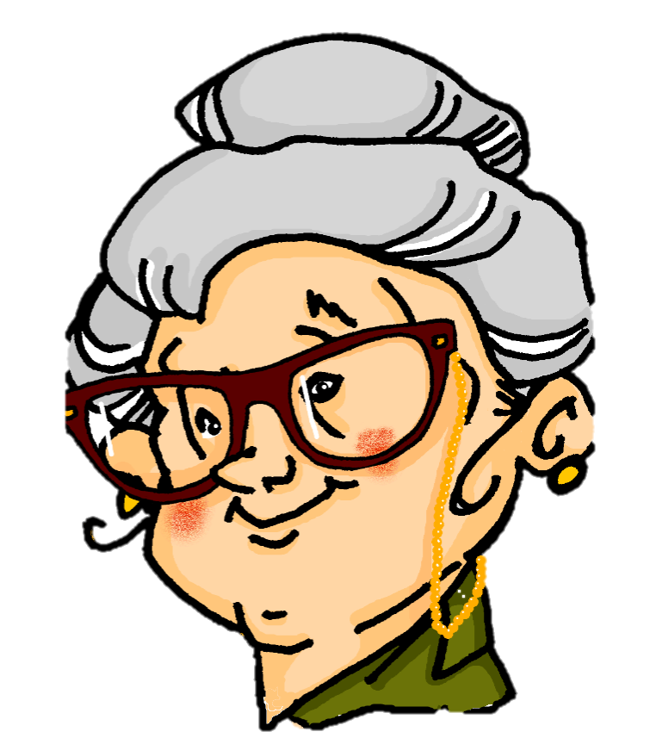
Eine Notiz von Katrin
lesen
Katrin trinkt zu viel Kaffee! Was schreibt sie?
Hallo Mama! Willkommen im neuen Haus! Ich bin kurz zum Supermarkt gefahren. Hier ein Paar Notizen für dich! - Katrin
1. Den besten Raum …
bekommst du.
ist unten links.
/
2. Der blaue Stoff …
/
werde ich im Supermarkt kaufen.
ist sehr bequem.
3. Den hässlichen Hut …
liegt auf dem Tisch.
/
will Wolfgang haben.
4. Der schöne See …
/
gefällt mir.
kann man in 10. Minuten erreichen.
5. Den billigen Kaffee …
steht in der Küche.
/
soll man nicht trinken.
6. Der neue Boden …
/
kommt am Montag.
schütze ich gegen den Hund!
7. Der besten Blick auf den See …
/
gibt es von oben.
ist von oben.
8. Den grüne Wald …
/
sieht toll aus.
werden wir am Samstag besuchen.
Notes:
Timing: 6 minutes Aim: Written recognition of masculine adjectives in nominative and accusative after definite articles, and connecting these with meaning (sentence subject and object). Procedure: 1. Explain to students that they are going to read a series of statements about things in and around the house. In some sentences, the thing is the subject of the sentence In others, it is the object. The definite article is hidden, so students must rely on the adjective ending (-e or -en) to decide whether the thing is doing something or having something done to it.
2. Students complete the sentence by filling in the correct definite article in R1(nominative) or R2(accusative) and writing the corresponding sentence ending.
3. Click to reveal the answers (first the ending of the sentence, then the article).
4. Oral translation of full sentences.
Word frequency of cognates used (1 is the most frequent word in French): Notiz [4519], willkommen [2519], Supermarkt [3218]
Source: Londsale, D., & Le Bras, Y. (2009). A Frequency Dictionary of French: Core vocabulary for learners London: Routledge.

Slide 28
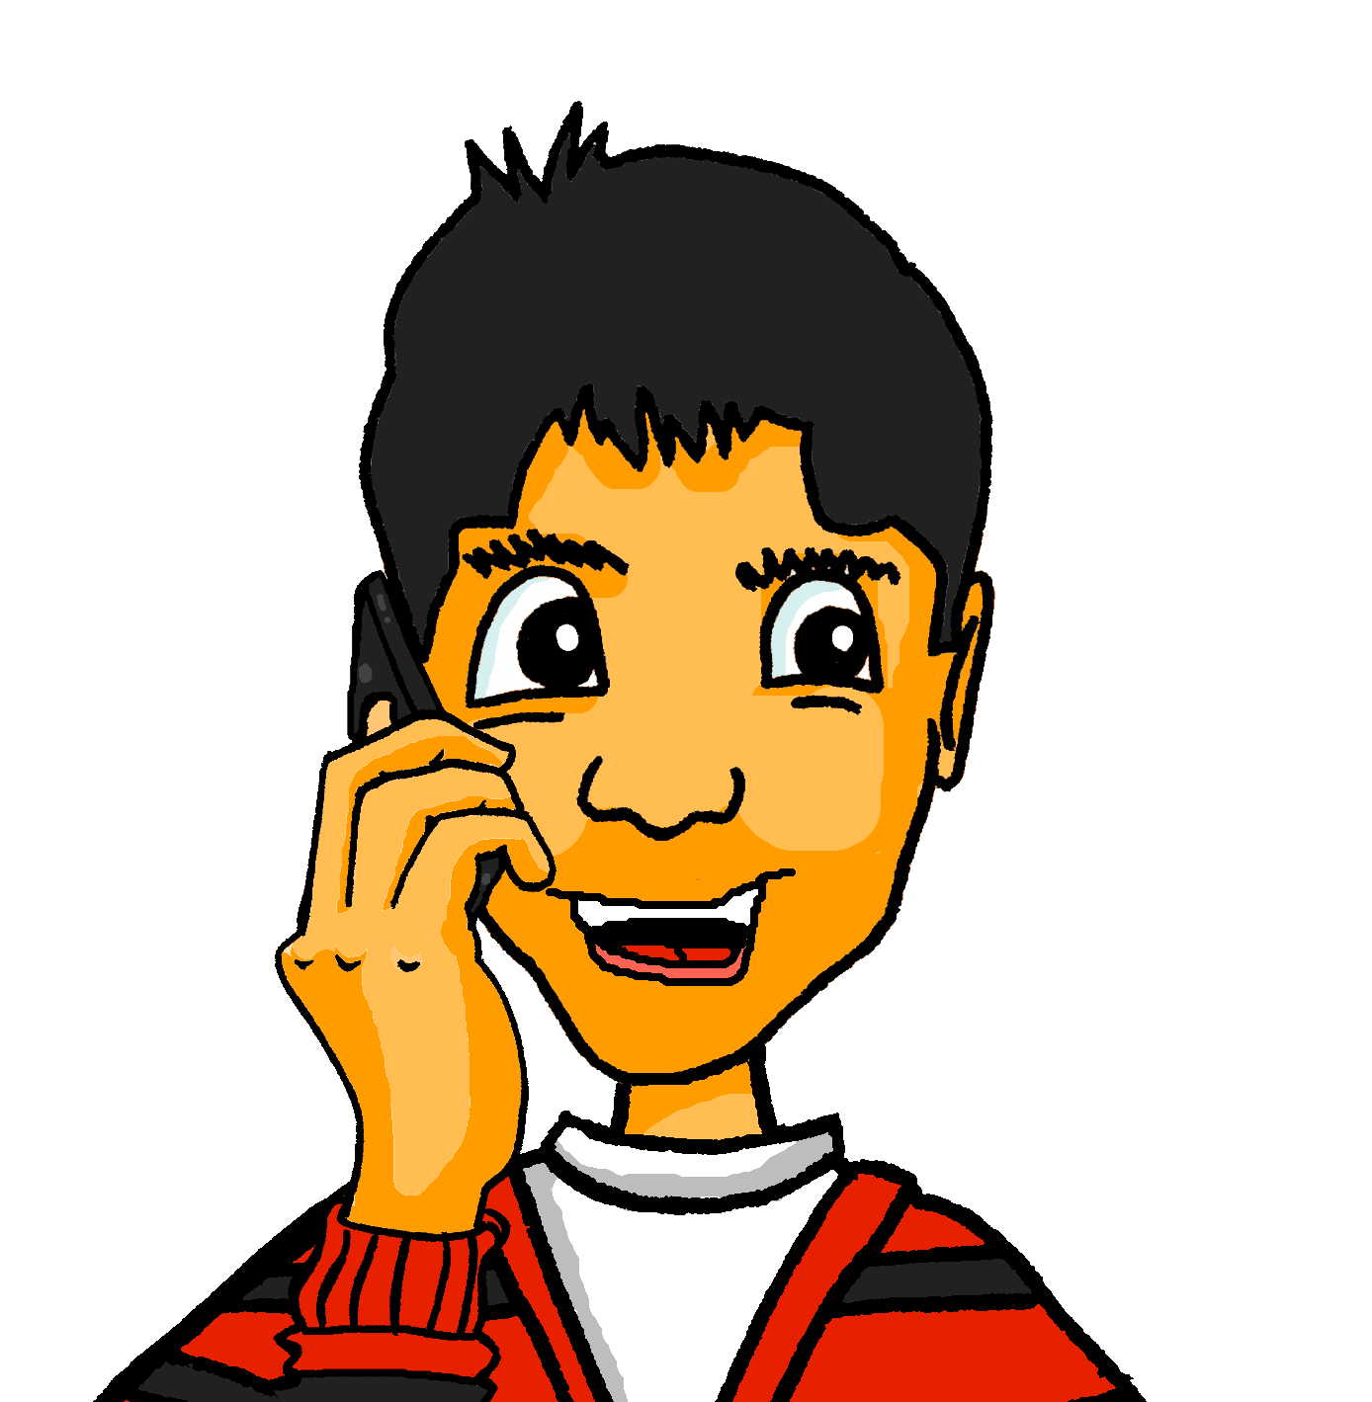
Wolfgang beschreibt die Zimmer
hören
Wolfgang ruft Mehmet an. Was sagt er über die Zimmer?
Sind diese Sätze richtig oder falsch?
 |  |  | das/kein | R/F
 |  | Mia’s got the big room. | das | R
 |  | Wolfgang’s got the other big room. | kein | F
 |  | Mia’ got the expensive drum kit in her room. | kein | F
 |  | Mia’s got the private bathroom. | kein | F
 |  | Mia’s got the small window. | das | R
 |  | Mia can’t see the beautiful water from her room. | kein | R
 |  | Wolfgang is letting the pet sleep in his room. | kein | F
 |  | You can use the room without getting hair on your clothes. | das | R
1
A
2
A
3
A
4
A
5
A
6
A
7
A
8
A
Notes:
Timing: 6 minutes Aim: Aural recognition of neuter adjectives after definite and indefinite articles, and connecting these with meaning (affirmative and negative statements). Procedure: 1. Explain to students that they are going to hear a series of statements about Wolfgang and Mia’s rooms, some of which will be affirmative statements with das and some of which will be negative sentences with kein. Das and kein will be obscured, so students will have to rely on the adjective ending (-e or -es) to decide whether they are hearing affirmative or negative sentences.
2. Click on a number to hear a sentence with the article obscured. Student listen to the adjective which comes directly after the beep, and decide whether they think the missing article is das or kein based on the ending.
3. Click once to reveal all of the English sentences. Students then read them and decide, using their das/kein answer, whether they think the sentence is true or false. More proficient learners may be able to complete both of these stages simultaneously.
4. Click to reveal the answers (first the article, then R/F).
5. Click on the ‘A’ buttons to hear full sentences with the article included.
Transcript: 1. Mia hat [das] große Zimmer.
2. Ich habe [kein] großes Zimmer. Und das ist in Ordnung.
3. Mia hat [kein] teures Schlagzeug in ihrem Zimmer.
4. Sie hat auch [kein] eigenes Bad!
5. Mia hat auch [das] kleine Fenster.
6. Sie kann also [kein] schönes Wasser von ihrem Zimmer sehen.
7. Ich lasse [kein] weißes Haustier bei mir schlafen.
8. Man kann also [das] neue Zimmer benutzen, ohne weiße Haare auf die Kleidung zu kriegen!

Slide 29
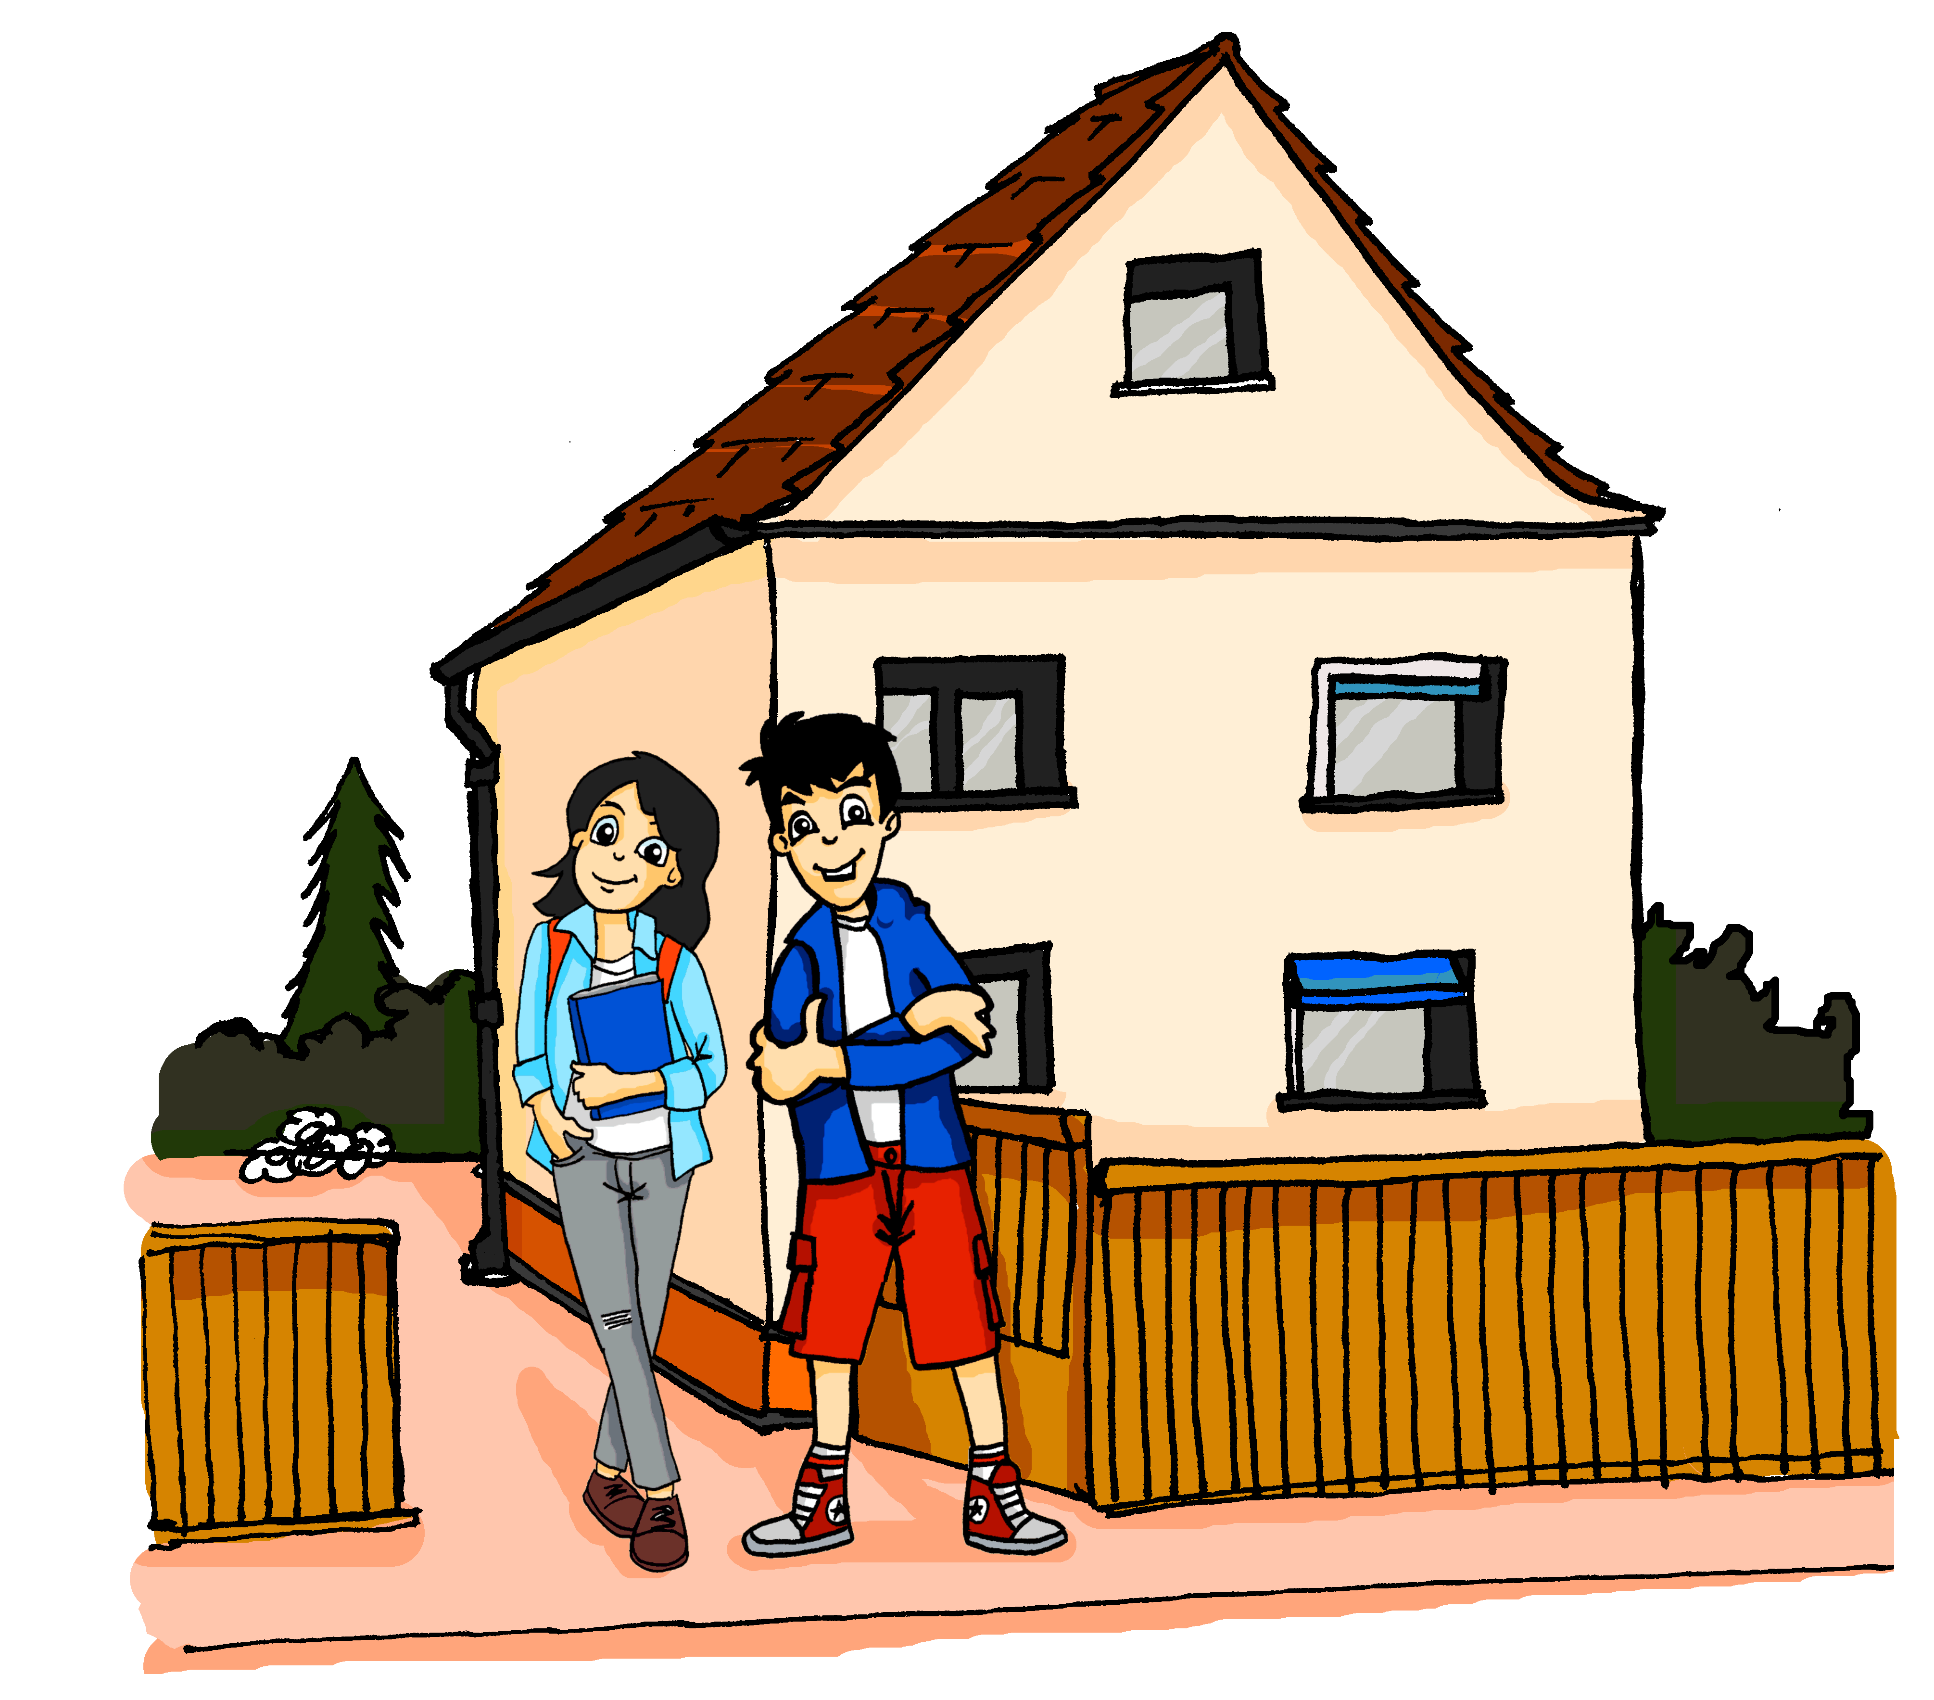
Mein Haus ist wunderbar!
schreiben
_
Hallo Heidi! Das neue Haus ist super! Laut unseren Daten ist der nette Ort ganz sicher - es gibt keine gefährlichen Angriffe wie in der Stadtmitte. Es gibt einen tiefen See und wir wollen dort schwimmen gehen! Ich habe ein besseres Zimmer als Mia. Die blauen Wände sind toll, und ich habe ein kleines Bad.
_
_
_
_
_
_
_
Ein teurer Computer steht bei mir auf dem Schreibtisch. Mia hat den alten Computer bekommen. Der gelbe Stoff für das neue Sofa ist hässlich , aber das ist nicht so wichtig. Hier ist ein tolles Bild von dem Haus. LG, Wolf
_
_
_
_
_
Notes:
Timing: 6 minutes
NB: a differentiated version of this activity for higher levels in which students have to provide the whole adjective may be found on the next slide. Aim: Written production of pre- and post-nominal adjective endings in R1 (nominative) and R2 (accusative). Procedure: 1. Ensure students understand the meaning of the text. The oral translation could be carried out prior to beginning the grammar activity. This allows teachers to focus on the position of each adjective (pre- or postnominal), the function of the noun phrase (subject or direct object) and the type of article (definite or indefinite) so that students have this information in mind when completing the exercise. Students have not yet formally met the compound noun Schreibtisch, but should be able to work out its meaning from their knowledge of schreiben and Tisch.
2. Students fill the gaps by writing the appropriate adjective ending (-er, -en, -e, -es or no ending).
3. Answers revealed on clicks.
Word frequency of unknown words used (1 is the most frequent word in German): Schreibtisch [2646]
Source: Londsale, D., & Le Bras, Y. (2009). A Frequency Dictionary of French: Core vocabulary for learners London: Routledge.
Word frequency of cognates used (1 is the most frequent word in German): super [1772], Computer [1252], Sofa [3572]
Source: Londsale, D., & Le Bras, Y. (2009). A Frequency Dictionary of French: Core vocabulary for learners London: Routledge.

Slide 30
Mein Haus ist wunderbar!
schreiben
[new]
Hallo Heidi! Das neue Haus ist super! Laut den Daten ist der nette Ort ganz sicher - es gibt keine gefährlichen Angriffe wie in der Stadtmitte. Es gibt einen tiefen See und wir wollen dort schwimmen gehen! Ich habe ein besseres Zimmer als Mia. Die blauen Wände sind toll, und ich habe ein kleines Bad.
[nice]
[safe]
[dangerous]
[deep]
[better]
[blue]
[little]
Ein teurer Computer steht bei mir auf dem Schreibtisch. Mia hat den alten Computer bekommen. Der gelbe Stoff für das neue Sofa ist hässlich, aber das ist nicht so wichtig. Hier ist ein tolles Bild von dem Haus. LG, Wolf
[expensive]
[old]
[yellow]
[ugly]
[great]
Notes:
Timing: 6 minutes
NB: a differentiated version of this activity for lower levels in which students have to provide the adjective ending only may be found on the previous slide. Aim: Written production of adjectives in pre- and post-nominal position and in R1 (nominative) and R2 (accusative) forms. Procedure: 1. Ensure students understand the meaning of the surrounding text. The oral translation could be carried out prior to beginning the grammar activity. This =allows teachers to focus on the position of each adjective (pre- or postnominal), the function of the noun phrase (subject or direct object) and the type of article (definite or indefinite) so that students have this information in mind when completing the exercise. Students have not yet met the compound noun Schreibtisch, but should be able to work out its meaning from their knowledge of schreiben and Tisch.
2. Students fill the gaps by writing the appropriate adjective ending (-er, -en, -e, -es or no ending).
3. Answers revealed on clicks.
Word frequency of unknown words used (1 is the most frequent word in German): Schreibtisch [2646]
Source: Londsale, D., & Le Bras, Y. (2009). A Frequency Dictionary of French: Core vocabulary for learners London: Routledge.
Word frequency of cognates used (1 is the most frequent word in German): super [1772], Computer [1252], Sofa [3572]
Source: Londsale, D., & Le Bras, Y. (2009). A Frequency Dictionary of French: Core vocabulary for learners London: Routledge.

Slide 31
What is it like? Describing attributes
an/auf + R2 (acc) vs R3 (dat) [revisited]
Word order 2 [revisited]
Fluency development
Y8 German
Term 3.1 - Week 5 - Lesson 57
Catherine Morris / Natalie Finlayson / Rachel Hawkes
Artwork: Steve Clarke
Date updated: 21/07/21
Notes:
Artwork by Steve Clarke. All additional pictures selected are available under a Creative Commons license, no attribution required.
Native teacher feedback provided by Stephanie Cross.
Learning outcomes (lesson 2):
Introduction of SSC [eu] and [äu]
Introduction of haupt- prefix
Consolidation of adjective endings with indefinite articles in the nominative and accusative
Consolidation of kein, revisit WO2 with multiple elements
Consolidation of an/auf +R2 (acc) vs R3 (dat)
Word frequency (1 is the most frequent word in German):
8.3.1.5 (introduce) beschreiben [435] wohin [1811] Beruf [1036] Dame [702] Foto [633] Raum [403] Nachbar [1283] Sachen [318] Stoff [702] bester beste bestes [314] weiß [472]
8.3.1.1 (revisit) hängen [590] schützen [996] verdienen [835] Angriff [1489] Daten [574] Euro [207] Gesetz [578] Milliarde [453] Million [209], Unternehmen [236] Wand [828] an² [19] gegen [104] laut [835]
8.2.1.6 (revisit) besser [201] billig [1738] gefährlich [1211] häufig [407] lang [97] mehr [52] sicher [265] teuer [950] noch³ [33] als² [22]
Source: Jones, R.L & Tschirner, E. (2019). A frequency dictionary of German: Core vocabulary for learners. London: Routledge.
The frequency rankings for words that occur in this PowerPoint which have been previously introduced in NCELP resources are given in the NCELP SOW and in the resources that first introduced and formally re-visited those words.
For any other words that occur incidentally in this PowerPoint, frequency rankings will be provided in the notes field wherever possible.

Slide 32
Phonetik
lesen / sprechen
Partner A’s Sentences:
1. Er träumt von einstürzenden Gebäuden.
2. Der Verkäufer ist über die häufigen Diebstähle enttäuscht.
3. Der europäische Zeuge täuscht den Richter, und kommt ins
Gefängnis.
 | Tally of [eu] [äu] heard
1
2
3
Partner B’s Sentences:
4. Das Fräulein seufzt, denn das ganze Zeug ist weg.
5. Heutzutage werden viele Leute
neunzig Jahre alt.
6. Man hat vor Kurzem ein neues Gebäude gebaut.
 | Tally of [eu] [äu] heard
4
5
6
Notes:
DO NOT DISPLAY THIS SLIDE Printable version is provided.
Timing: 5 minutes [2 slides].
Aim: Fluency development. Procedure: 1. Students work in pairs.
2. Partner A reads a sentence containing a mixture of known and unknown words.
3. Partner B tallies the number of [eu/äu] SSCs they hear. Hence there is a joint responsibility to get the answer right.
4. Native speaker recordings are provided on the following slides. Students can use these to check their tallies.
5. Answers and translations are also provided on the following slide.
Word frequency of unknown words used (1 is the most frequent word in German): träumen [1793], einstürzend [>5000], Gebäude [1386], Verkäufer [2374], enttäuschen [2042], Diebstahl [>5000], wenn [42], Zeug [3069], Richter [2286]. Täuschen [3613], Europäer [2750], Gefängnis [2523], Fräulein [3265], seufen [>5000], weg [965], heutzutage [3356], erscheinen [408] Source: Jones, R.L. & Tschirner, E. (2019). A frequency dictionary of German: core vocabulary for learners. Routledge

Slide 33
Phonetik
lesen / sprechen
 | Er träumt von einstürzenden Gebäuden. | He dreams of falling buildings.
 | Der Verkäufer ist über die häufigen Diebstähle enttäuscht. | The salesman is disappointed by the frequent thefts.
 | Der europäische Zeuge täuscht den Richter und kommt ins Gefängnis. | The European witness deceives the judge and goes to prison.
 | Das Fräulein seufzt, denn das ganze Zeug ist weg. | The young lady is sighing because all the stuff is gone.
 | Heutzutage werden viele Leute neunzig Jahre alt. | Nowadays a lot of people live to be ninety.
 | Ein neues Gebäude ist vor kurzer Zeit erschienen. | A new building has recently appeared.
1
2
3
4
5
6
Notes:
Answers for the activity on the previous slide.
Procedure: 1. Click numbers to hear sentence pronounced by native speaker.
2. Click to reveal transcript with highlighted SSCs.
3. Click again to reveal translation of sentence.
Transcript: 1. Er träumt von einstürzenden Gebäuden.
2. Der Verkäufer ist über die häufigen Diebstähle enttäuscht.
3. Der europäische Zeuge täuscht den Richter und kommt ins Gefängnis.
4. Das Fräulein seufzt, denn das ganze Zeug ist weg.
5. Heutzutage werden viele Leute neunzig Jahre alt.
6. Man hat vor Kurzem ein neues Gebäude gebaut.
Word frequency of unknown words used (1 is the most frequent word in German): träumen [1793], einstürzend [>5000], Gebäude [1386], Verkäufer [2374], enttäuschen [2042], Diebstahl [>5000], wenn [42], Zeug [3069], Richter [2286]. Täuschen [3613], Europäer [2750], Gefängnis [2523], Fräulein [3265], seufen [>5000], weg [965], heutzutage [3356], erscheinen [408] Source: Jones, R.L. & Tschirner, E. (2019). A frequency dictionary of German: core vocabulary for learners. Routledge

Slide 34
Über mein neues Haus
schreiben / sprechen
Wolfgang schreibt an seinen Freunden über das neue Haus. Sag oder schreib die Sätze auf Deutsch.
next door = nebenan
überall = everywhere
1. Mein neues Haus ist das beste Haus!
1. My new house is the best house!
4. Es gibt überall Stoff.
4. There is material everywhere.
2. Die Dame nebenan hat einen Hund! Er ist weiß.
2. The lady next door* has a dog. It is white.
5. Ich mache ein Foto, statt es zu beschreiben.
5. I’ll take a picture instead of describing it.
3. Meine Nachbarin hat einen interessanten Beruf.
3. My neighbour (f) has an interesting job.
Notes:
Timing: 5 minutes Aim: Oral or written translation of new vocabulary items in context (depending on the needs of the class). Procedure: 1. Give students time to work together to translate the messages into German and say them aloud/write them down.
2. Elicit answers from students.
3. Click on speech bubbles to bring up German translation. Word frequency of unknown words used (1 is the most frequent word in German): nebenan [4567], überall [758] Source: Jones, R.L. & Tschirner, E. (2019). A frequency dictionary of German: core vocabulary for learners. Routledge

Slide 35
Etwas von Beruf sein
Vokabeln
X von Beruf sein roughly translates to ‘being X by trade’, or ‘I’m in this line of work, this is my profession’.
zum Beispiel:
Ich bin Lehrer von Beruf.
= I am a teacher by trade.
Teaching is my profession.
Remember!
Do not put an article before a job title.
Add –in to the end of feminine job titles.
Notes:
Timing: 1 minute Aim: To introduce usage of the structure von Beruf sein to say what you do for a living. To recap –in ending on feminine nouns. Procedure: 1. Click to bring up information.

Slide 36
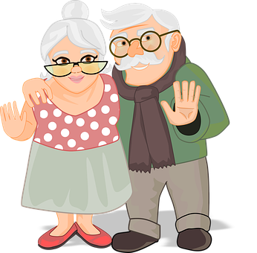
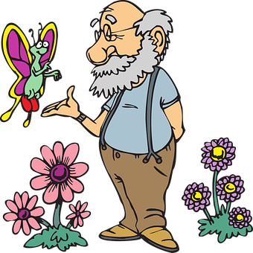
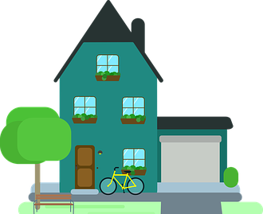
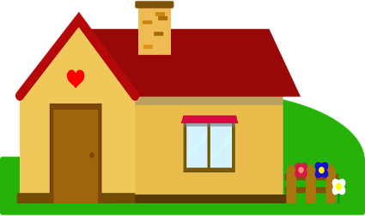
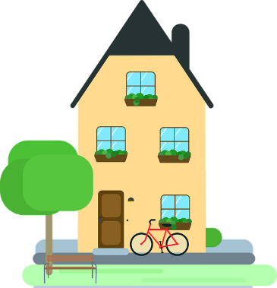
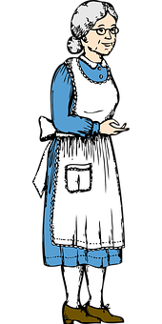
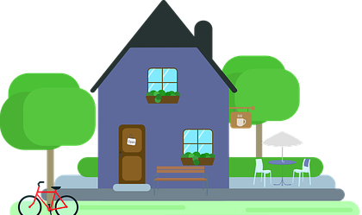
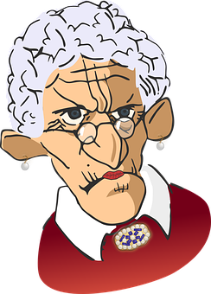
Wer ist was von Beruf ?
Grammatik
Wolfgang und Mia treffen die neuen Nachbarn. Wer ist was von Beruf?
1
2
3
4
Herr Müller
Die Pfeiffers
Frau Weber
Herr und Frau Fischer
5
6
7
8
Die Schreibers
Die Schusters
Herr Kohler
Frau Becker
Notes:
Timing: 6 minutes [2 slides] Aim: Aural recognition of forms of sein and masculine and feminine job titles.
Procedure: 1. Explain that in conversational register, it’s now common in German to refer to married couples and/or families as ‘die +surname+-s’, as we do in English (e.g., the Smiths, the Walkers etc..).
2. Click numbers to hear sentences with the names blanked out.
3. Students use both the form of sein and the form of the noun to work out who the sentence refers to. Students should be made aware that the past tense form war is used to indicate that someone is retired, i.e. this will refer to someone older. Otherwise, singular forms of sein indicate a single person and plural forms a couple. The noun ending should then be used to identify the gender of the person and give the answers. Since there are two comprehension elements here, the students may need to hear the recordings several times.
4. Students note down the job and who it relates to. Job titles are either known nouns or nominal forms of known verbs.
5. Answers on next slide. Note: Teacher will likely want to display the next slide briefly to support students to lay out their work, numbering 1-8 with three column headings.
Transcript: 1. [Frau Weber] ist Lehrerin von Beruf.
2. [Die Schreibers] sind Ärzte von Beruf.
3. [Herr Müller] war Musiker von Beruf.
4. [Herr Kohler] ist Fußballspieler von Beruf.
5. [Herr und Frau Fischer] waren Künstler von Beruf.
6. [Die Pfeiffers] sind Schauspielerinnen von Beruf.
7. [Die Schusters] waren Lehrerinnen von Beruf.
8. [Frau Becker] war Sängerin von Beruf.
Word frequency (1 is the most frequent word in German): Musiker [2577], Fußballer [>5000], Künstler [789] Source: Jones, R.L. & Tschirner, E. (2019). A frequency dictionary of German: core vocabulary for learners. Routledge

Slide 37
Wer ist was von Beruf ?
Antworten
Grammatik
Wer | Was | auf Englisch
Frau Weber | Lehrerin | teacher
Die Schreibers | Ärzte | doctors
Herr Müller | Musiker | musician
Herr Kohler | Fußballer | footballer
Herr und Frau Fischer | Künstler | artists
Die Pfeiffers | Schauspielerinnen | actresses
Die Schusters | Lehrerinnen | teachers
Frau Becker | Sängerin | singer
1
2
3
4
5
6
7
8
Notes:
Answers Procedure: 1. Elicit answers from students by asking Wer ist was von Beruf?
2. Click to reveal name, job and English translation one by one for each question. Students may need a bit of extra help with Musik+er (Q3), Fußballspiel+er and Kunst → Künstler (Q5).
3. Click numbers to hear full sentences.
Transcript: 1. Frau Weber ist Lehrerin von Beruf.
2. Die Schreibers sind Ärzte von Beruf.
3. Herr Müller war Musiker von Beruf.
4. Herr Kohler ist Fußballspieler von Beruf.
5. Herr und Frau Fischer waren Künstler von Beruf.
6. Die Pfeiffers sind Schauspielerinnen von Beruf.
7. Die Schusters waren Lehrerinnen von Beruf.
8. Frau Becker war Sängerin von Beruf.
Word frequency (1 is the most frequent word in German): Musiker [2577], Fußballer [>5000], Künstler [789]. Source: Jones, R.L. & Tschirner, E. (2019). A frequency dictionary of German: core vocabulary for learners. Routledge

Slide 38
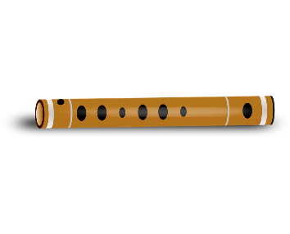
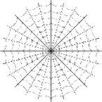
Deutsche Nachnamen
Kultur
Did you notice anything about the names in the previous exercise?
Lots of the most common German surnames are job titles!
Can you think which jobs these very common surnames are?
1. | Müller | miller | 5. | Schreiber | writer
2. | Pfeiffer | piper | 6. | Schuster | shoe-maker
3. | Weber | weaver | 7. | Kohler | charcoal-maker
4. | Fischer | fisher | 8. | Becker | baker
Notes:
Timing: 3 minutes Aim: Introduce cultural information about origins of common German surnames. Reading comprehension. Procedure: 1. Check that students understand the meaning of Nachname. They should use their knowledge of nach and the English ‘name’ to work it out.
2. Click to bring up information. Mention that this is also true of English surnames and elicit a couple of examples: Smith, Baker, Miller.
3. Give students time to think about possible name meanings. As these are very traditional surnames, it may be helpful to ask them to think about jobs people have been doing for a very long time.
4. Pictorial clues appear on a click.
6. Click to reveal answers one by one.

Slide 39
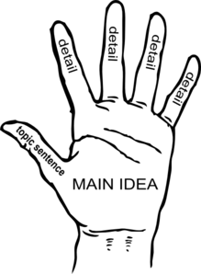
German ←→ German
Note the gender: die Idee → die Hauptidee.
Add Haupt- to nouns to mean ‘main.
That is the main idea.
Das ist die Hauptidee.
What would the following nouns be in German?
main train station main (high) street main role main reason Choose one and write a sentence in German.
Translate these sentences.
1. Wien ist die Hauptstadt von Österreich!
2. That is the main problem.
Notes:
Timing: 5 minutes
Aim: Introduce the prefix H/haupt- and practise written comprehension and production of compound nouns using it.
Procedure:
1. Click through the presentation and elicitation steps. 2. Correct answers on the following slide. 3. Then pronounce the words.
Word frequency: Hauptstadt [1694] Idee [451] Stadt [204] Rolle [385] Problem [210] Grund [249] Bahnhof [2027] Straße [391]
Other high frequency words that combine with H/haupt-: Wort [195] Ziel [320] Fach [1731]
Source: Jones, R.L. & Tschirner, E. (2019). A frequency dictionary of German: core vocabulary for learners. Routledge

Slide 40
ANTWORTEN
For main city we say ‘capital’ city
Wien ist die Hauptstadt von Österreich!
That is the main problem.
main train station
main (high) street
main role
main reason
Vienna is the capital city of Austria!
Das ist das Hauptproblem.
der Hauptbahnhof
die Hauptstraße
die Hauptrolle
der Hauptgrund
What do you notice about the gender of these nouns?
They are the gender of the final noun.
Don’t forget to pronounce the words!

Slide 41
Nummern 21+
hören
In English numbers with double digits, we say the big digit first:
big → twenty-one ← small
In German, we say the small digit first:
small → einundzwanzig ← big
To make sure you don’t get confused:
write the first digit you hear at the end of the number.
Let’s practise!
a
23
b
57
c
98
d
34
Notes:
Timing: 2 minutes Aim: Reminder of construction of numbers 21-100. Practising aural recognition of numbers 21-100. Procedure: 1. Click to bring up information.
2. Click on boxes to listen to practise numbers. Encourage students to get used to the idea that the first digit they hear is the last part of the number.
3. Elicit answers.
4. Click to reveal answers a-d.
Transcript: a. dreiundzwanzig
b. siebenundfünfzig
c. achtundneunzig
d. vierunddreißig

Slide 42
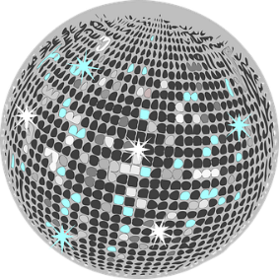
Einkaufen übers Internet
hören
Wolfgang und Mia suchen Sachen für ihr neues Haus.
Was kosten diese Dinge?
Was | Wie viel
eine Jacht
ein Planschbecken
eine Lavalampe
eine Discokugel
das Bild
neue Töpfe
eine Eismaschine
eine Privatinsel
1
eine Million €
2
€45
3
€23
4
€32
5
€87
6
€64
7
€79
8
eine Milliarde €
Notes:
Timing: 5 minutes Aim: Oral recognition of numbers 21-99, million and billion. Procedure: 1. Click numbered boxes to hear sentences.
2. Students write down the numbers, applying the ‘first digit last’ rule practised on the previous slide.
3. Elicit answers.
4. Click to reveal answers.
Transcript: 1. (Mia) Ich will eine Jacht! Aber sie kostet eine Million Euro.
2. (Wolfgang) Hmm. Besser und billiger ist ein Planschbecken. Es kostet nur 45 Euro.
3. (Mia) Okayyy. Ooh diese Lavalampe ist cool! Und kostet nur 23 Euro!
4. (Wolfgang) Ich will eine Discokugel. Sie kostet 32 Euro.
5. (Mia) Mutti mag moderne Kunst. Das Bild kostet 87 Euro.
6. (Wolfgang) Wir brauchen neue Töpfe. Dieses Set kostet 64 Euro.
7. (Mia) Langweilig… Ich nehme lieber eine Eismaschine für 79 Euro.
8. (Mia) Eine Freundin sagt, dass eine Privatinsel eine Milliarde Euro kostet! Haben wir genug Geld?
Word frequency of unknown words used: Jacht [>5000], Planschbecken [>5000], Lavalampe [>5000], Discokugel [>5000], Topf [4136], Set [>5000], Eismaschine [1874/1237], Privatinsel [746/1029] Source: Jones, R.L. & Tschirner, E. (2019). A frequency dictionary of German: core vocabulary for learners. Routledge

Slide 43
Wo oder wohin?
Grammatik
‘Wo’ is a dative question word. It asks about where something is located.
Answers to ‘wo’ questions need an answer in R3 (dative).
Wo liegt das Foto? Wo stehen die Sachen?
Das Foto liegt auf dem Boden. Die Sachen stehen an der Tür.
‘Wohin’ is an accusative question word. It asks about where something is going.
Answers to ‘wohin’ questions need an answer in Row 2 (accusative).
Wohin kommt das Foto? Wohin kommen die Sachen?
Das Foto kommt auf den Boden. Die Sachen kommen an die Tür.
‘Wo’ questions contain verbs of location.
R3 dative = located in
‘Wohin’ questions contain verbs of movement.
R2 accusative = moving to
Notes:
Timing: 1 minute Aim: To recap uses of R3 (dative) and R2 (accusative) with prepositions auf and an to show movement towards or location in somewhere.
Procedure:
1. Click through the information.
2. Say the mnemonic a few times with the students, stressing the ‘oo’ sound in accusative/movement/to and the ‘ay’ sound in dative/located in.

Slide 44
Schon da oder kommt noch?
Remember!
Accusative = moving to
Dative= located in
hören
Katrin beschreibt das perfekte Wohnzimmer.
Es ist fast komplett!
Does she say where (wo) the thing already is or where (wohin) it is going to?
der Stuhl = chair
der Sessel = armchair
1
stehen / kommen
2
steht / kommt
3
steht / kommt
4
liegt / kommt
5
hängt / kommt
6
liegt / kommt
7
hängt / kommt
8
liegt / kommt
Notes:
Timing: 5 minutes Aim: Aural recognition of nouns in dative and accusative after auf and an and connecting these with meaning (movement towards or location in somewhere). Procedure: 1. Ensure understanding of the context and title. Explain to students that the picture represents Katrin’s dream living room, which she has almost finished setting up. They are going to hear sentences about things that are already in place, and things that are still to be put in place. Students have not yet encountered the compound Wohnzimmer, but should be able to infer the meaning from their knowledge of wohnen and Zimmer.
2. Click on the numbers to hear sentences with the noun beeped out.
3. Students listen to the form of the definite article and decide whether the item is already located somewhere [dative] or coming later [accusative].
4. Answers revealed on clicks. A thumbs up indicates that the item is already there. A disappearing item indicates it is still in Katrin’s imagination.
Transcript: 1. Meine Schuhe [kommen] an die Tür.
2. Der Kaffee [steht] auf dem Tisch.
3. Das Essen [kommt] auf den Tisch.
4. Das Spiel [liegt] auf dem Boden.
5. Die Jacke [hängt] an der Tür.
6. Die Zeitung [liegt] auf dem Sessel.
7. Der Stoff [kommt] an das Fenster.
8. Der Brief [kommt] auf den Stuhl. Word frequency of unknown words used (1 is the most frequent word in German): Sessel [3999], Stuhl [1661], komplett [1215], Wohnzimmer [2555] Source: Jones, R.L. & Tschirner, E. (2019). A frequency dictionary of German: core vocabulary for learners. Routledge
Word frequency of cognates used (1 is the most frequent word in German): perfekt [1567] Source: Jones, R.L. & Tschirner, E. (2019). A frequency dictionary of German: core vocabulary for learners. Routledge

Slide 45
Mehrfamilienhäuser (1/2)
*manche = some
hören
Wolfgang und Mia wohnen jetzt in einem Mehrfamilienhaus in Zehlendorf, Berlin. Was heißt das?
Ein Mehrfamilienhaus ist ein Haus für mehr als eine Familie oder Generation.
1
Jede Familie hat ihre eigene Wohnung mit Küche, Bad und Schlafzimmer.
2
Normalerweise wohnen zwei, drei oder vier Familien in einem Mehrfamilienhaus, aber manche* Häuser sind viel größer.
3
In Wolfgang und Mias Haus wohnen Oma und Opa unten. Wolfgang, Mia, Katrin und die Haustiere wohnen oben.
4
Notes:
Timing: 8 minutes
Aim: Dictagloss – Reconstruct a text from notes
Procedure: 1. Ask students what they think the word Mehrfamilienhaus means. This is a compound constructed from three known words! Ask students to identify its gender. Then, ask them to consider what a one- or two-family house might be called (this primes for the appearance of the word Einfamilienhaus in the last sentence).
2. Ensure students are comfortable with the sound of the word bauen, as it is key to the understanding of points 6 and 7.
3. Students write 1-8 in their notebooks and leave plenty of space for each point.
4. Students listen to the presentation and take notes about each point. They may need a bit of help with the names of the decades (sechziger oder neunziger Jahren) in point 7. Encourage them to listen for familiar numbers and think about what would make sense in context.
5. Play the audio clips again if necessary. The number of times depends on the class and ability level and is up to the teacher’s judgment.
6. Based on their notes, students reconstruct the monologue (this could be done in pairs/groups of four).
7. Click to reveal transcriptions of each dialogue.
8. Students then either summarise the whole text in English or share three things they found interesting/surprising/different from home.
Differentiation: There is a steady increase in difficulty from sentences 1-8. One suggestion therefore is to complete 1-4 as a dictogloss, and 5 – 8 as a read aloud, listen AND read, then oral translation task. This is likely to work best for the majority of students.
Transcript:
1. Ein Mehrfamilienhaus ist ein Haus für mehr als eine Familie oder Generation.
2. Jede Familie hat ihre eigene Wohnung mit Küche, Bad und Schlafzimmer.
3. Normalerweise wohnen zwei, drei oder vier Familien in einem Mehrfamilienhaus, aber manche Häuser sind viel größer.
4. In Wolfgang und Mias Haus wohnen Oma und Opa unten. Wolfgang, Mia, Katrin und die Haustiere wohnen oben.
5. Etwa 31% der Wohnungen und Häuser in Deutschland sind Mehrfamilienhäuser.
6. Viele Familien bauen* ihre Mehrfamilienhäuser selber.
7. Viele haben ihre Mehrfamilienhäuser in den sechziger oder neunziger Jahren gebaut*.
8. Oft ist es billiger, in einem Mehrfamilienhaus zu wohnen, als in einem Einfamilienhaus. Word frequency of unknown words (1 is the most frequent word in German): Mehrfamilienhaus [52/329/147], Schlafzimmer [3738], manche [433], Oma [2175], Opa [2776], sechziger [sechzig 2448], neunziger [neunzig 3028], wurden [sein 4] Source: Jones, R.L. & Tschirner, E. (2019). A frequency dictionary of German: core vocabulary for learners. Routledge
Word frequency of cognates (1 is the most frequent word in German): Generation [1153] Source: Jones, R.L. & Tschirner, E. (2019). A frequency dictionary of German: core vocabulary for learners. Routledge

Slide 46
Mehrfamilienhäuser (2/2)
*bauen = to build
hören
Etwa 31% der Wohnungen und Häuser in Deutschland sind Mehrfamilienhäuser.
5
Viele Familien bauen* ihre Mehrfamilienhäuser selber.
6
Viele haben ihre Mehrfamilienhäuser in den sechziger oder neunziger Jahren gebaut*.
7
Oft ist es billiger, in einem Mehrfamilienhaus zu wohnen, als in einem Einfamilienhaus.
8

Slide 47
Emphasising ideas
Grammatik
As you know, German word order is very flexible! You can start a sentence with a subject, time, manner, place or object. This can be very helpful if you want to emphasise a particular idea!
Jede Familie hat ihre eigene Wohnung mit Küche, Bad und Schlafzimmer.
In this sentence, the focus is on the subject. It answers questions about the subject, like: ‘Wer hat ihre eigene Wohnung mit Küche, Bad und Schlafzimmer?‘
How could it change to emphasise the answer to: ‘Was hat jede Familie?’
Ihre eigene Wohnung mit Küche, Bad und Schlafzimmer hat jede Familie.
Here, the focus is on the object. The object and subject swap places (WO2).
‘Was’ asks about an object, and the emphasis is on the object in the answer.
‘Wer’ asks about a subject, and the emphasis is on the subject in the answer.
Notes:
Timing: 2 minutes
Aim: To revise use of word order 2 in sentences starting with time phrases, manner phrases, place phrases and direct object phrases. Introduction of the idea of manipulating word order to create emphasis.
Procedure: 1. Click to bring up each point.
2. Give students a minute to consider how to change the example sentence to emphasise the relevant information in the answer to Was hat jede Familie?
3. Stress that this is not a rule, rather an example of how WO2 can be used to create emphasis – in answer to a question about a particular idea.

Slide 48
Emphasising ideas
Grammatik
Which question word would you use to get information about …
a place?
a time?
a manner?
a sentence subject?
a sentence object?
Wie?
Wo/wohin?
Wer?
Wann?
Was?
Notes:
Timing: 1 minute
Aim: To revise question words and the ideas they elicit in preparation for the speaking exercises on the slides that follow.
Procedure: 1. Students match the ideas with the relevant questions, either individually in writing or orally in pairs/as a whole class activity.
2. Click to reveal the answers.

Slide 49
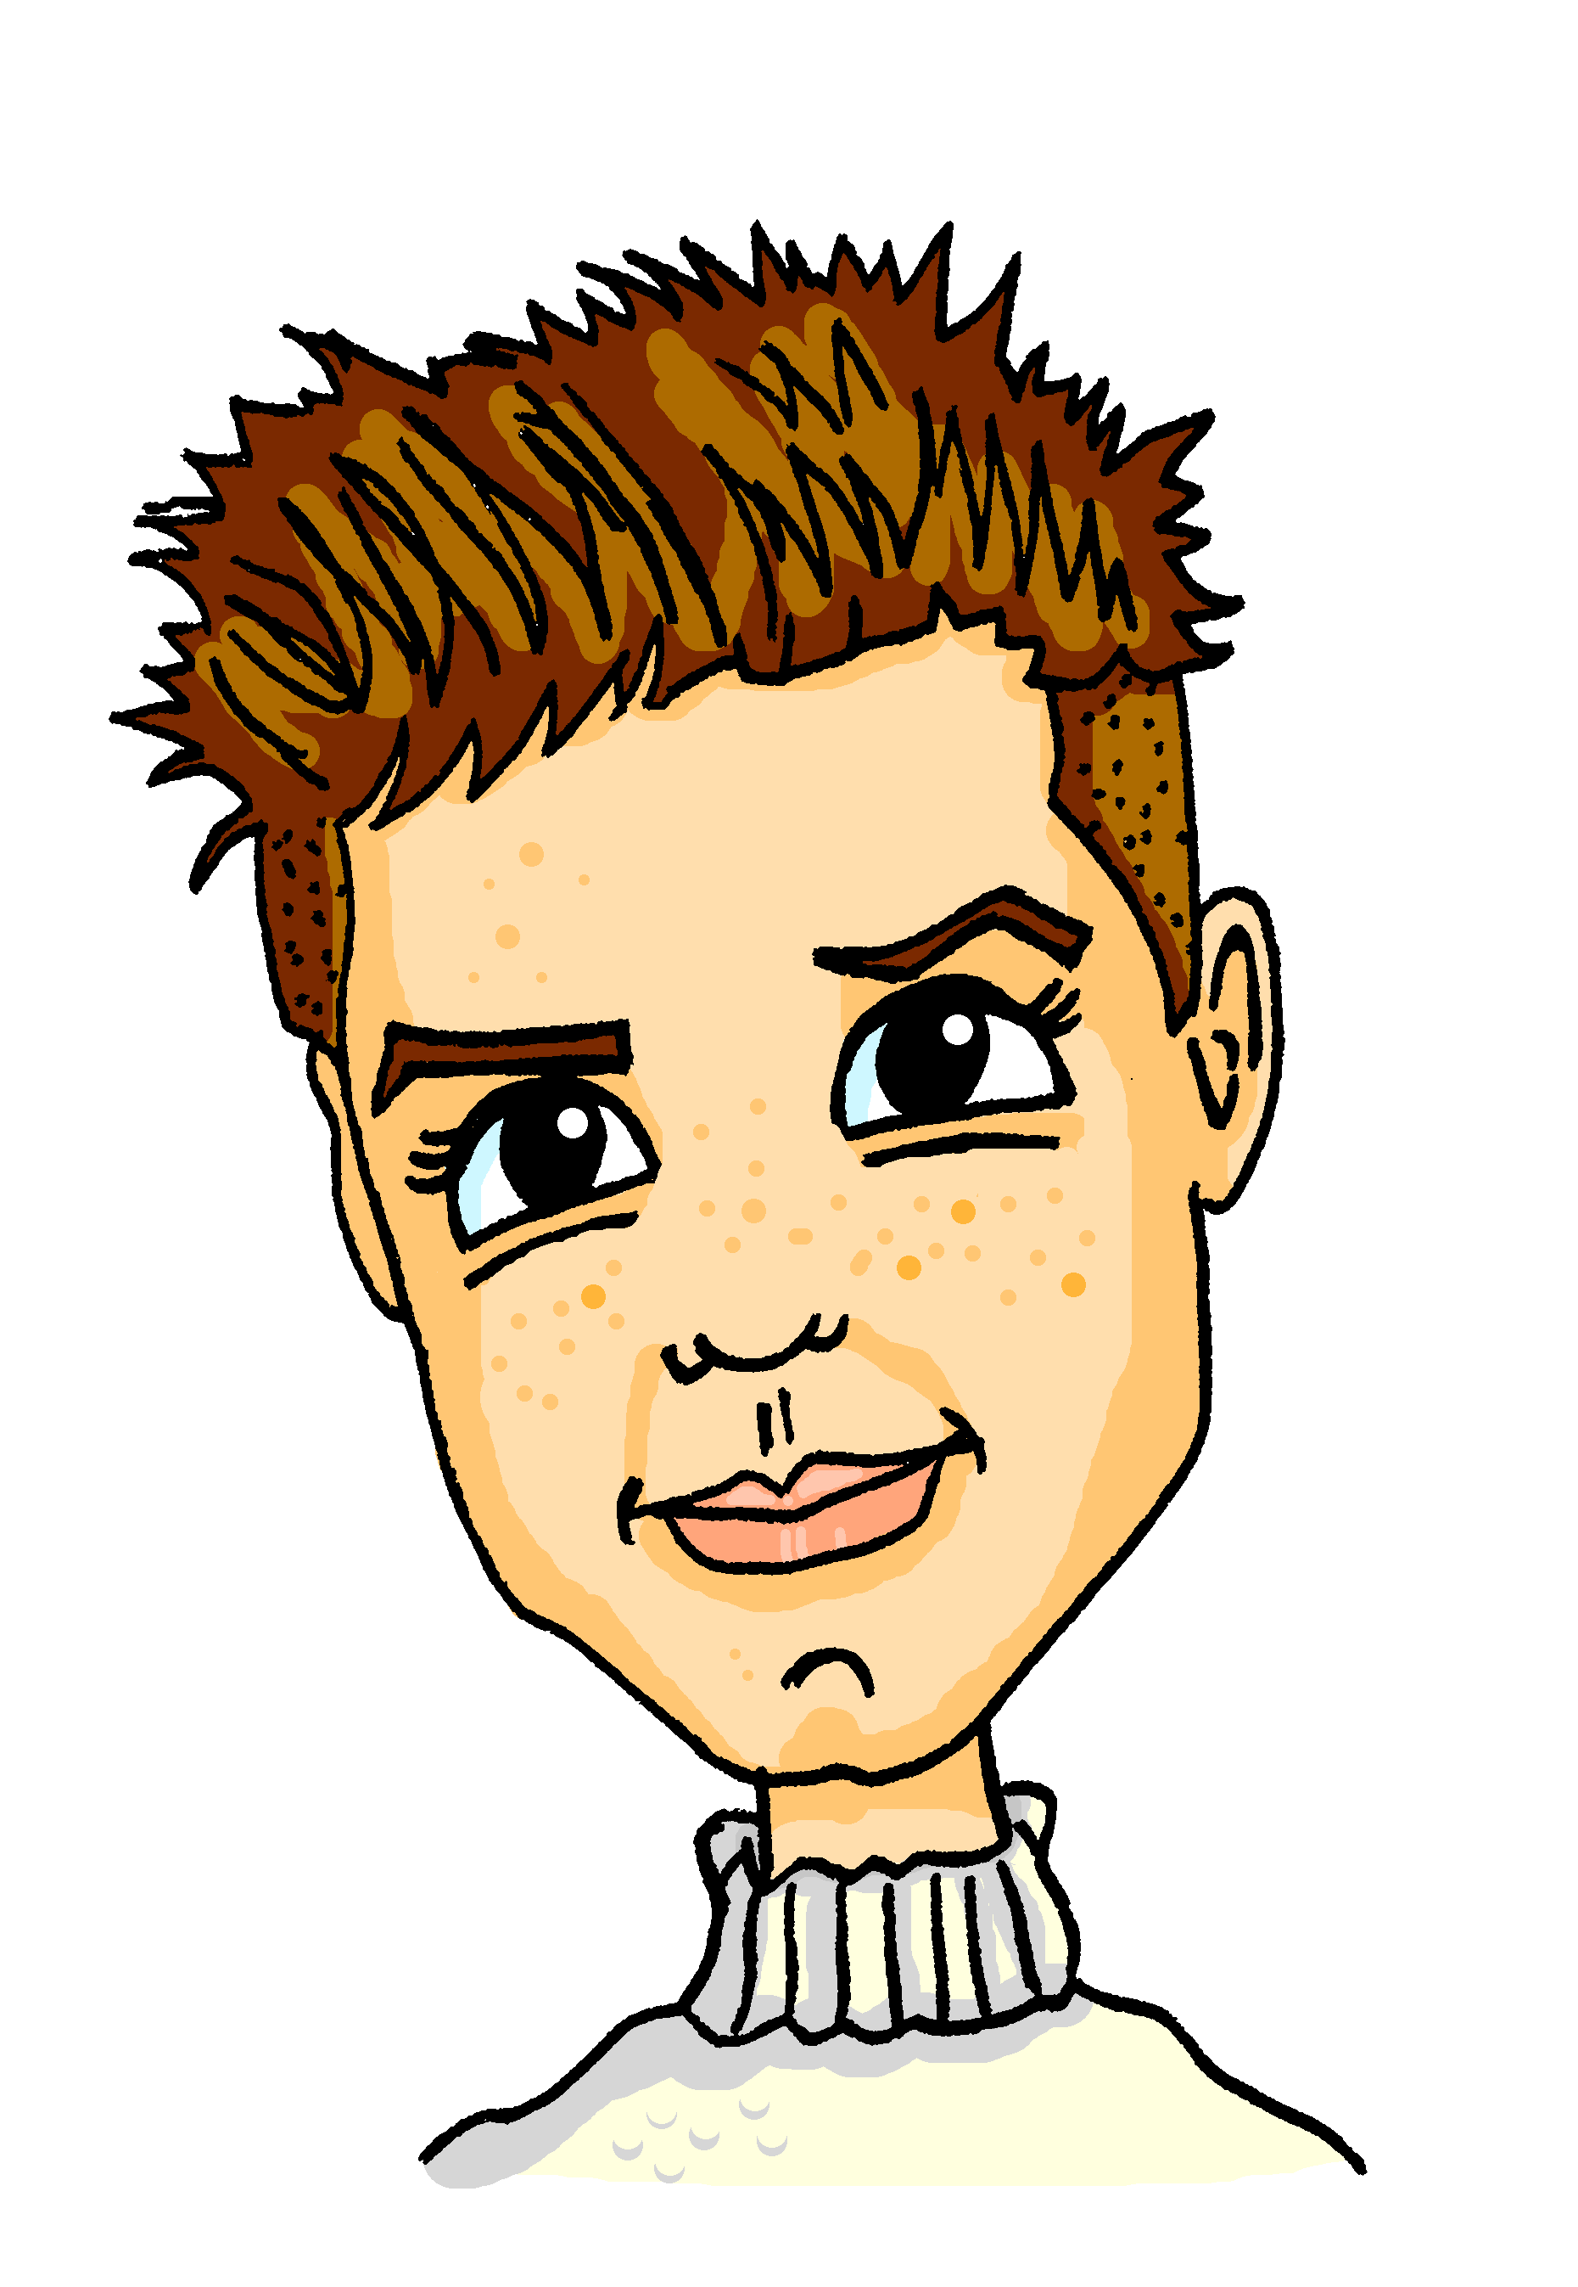
Emphasising ideas (1/6)
sprechen
Alastair is curious about Mehrfamilienhäuser! He has lots of questions for Mia.
How would you change the sentences in the dictagloss to place emphasis on the part he is curious about?
Wer wohnt in einem Mehrfamilienhaus?
Zwei, drei oder vier Familien wohnen normalerweise in einem Mehrfamilienhaus, aber manche Häuser sind viel größer.
Normalerweise wohnen zwei, drei oder vier Familien in einem Mehrfamilienhaus, aber manche Häuser sind viel größer.
Notes:
Timing: 6 minutes [6 slides]
Aim: Spoken production of sentences using word order 2 to emphasise subject, time phrases, manner phrases, place phrases and direct object phrases in response to questions about these ideas.
Procedure: 1. Use this slide as an example. Explain to students that they are going to change Mia’s sentence to emphasise the information that Alastair is interested in.
2. Ask the students what kind of information the question word refers to (a subject).
3. Ask students how Mia’s answer could change to reflect this (subject moves to the front).
4. Ask students to find the subject of the sentence. Use the opportunity to remind them that ‘ideas’ in a sentence (subjects, times, manners, places and objects) can consist of many words as well as just one word.
5. Click to reveal the answers.
6. Over the course of the next 6 slides, students work in pairs and take turns to be Alastair and Mia. The student who is Alastair simply reads his question aloud. The student who is Mia responds with a version of her sentence with the emphasised idea moved to the beginning.
7. Click to reveal answers on each slide before moving to the next.

Slide 50
Emphasising ideas (2/6)
sprechen
Alastair is curious about Mehrfamilienhäuser! He has lots of questions for Mia.
How would you change the sentences in the dictagloss to place emphasis on the part he is curious about?
Wie bauen viele Familien ihre Mehrfamilienhäuser?
Viele Familien bauen ihre Mehrfamilienhäuser selber.
Selber bauen viele Familien ihre Mehrfamilienhäuser.

Slide 51
Emphasising ideas (3/6)
sprechen
Alastair is curious about Mehrfamilienhäuser! He has lots of questions for Mia.
How would you change the sentences in the dictagloss to place emphasis on the part he is curious about?
Wer wohnt unten in deinem Haus?
Oma und Opa wohnen unten in meinem Haus.
In meinem Haus wohnen unten Opa und Oma wohnen.

Slide 52
Emphasising ideas (4/6)
sprechen
Alastair is curious about Mehrfamilienhäuser! He has lots of questions for Mia.
How would you change the sentences in the dictagloss to place emphasis on the part he is curious about?
Wo wohnen Wolfgang, Mutti, die Haustiere und du?
Oben wohnen Wolfgang, Mutti, die Haustiere und ich.
Wolfgang, Mutti, die Haustiere und ich wohnen oben.

Slide 53
Emphasising ideas (5/6)
sprechen
Alastair is curious about Mehrfamilienhäuser! He has lots of questions for Mia.
How would you change the sentences in the dictagloss to place emphasis on the part he is curious about?
Wann wurden viele Mehrfamilienhäuser gebaut?
In den sechziger oder neunziger Jahren hat man viele Mehrfamilienhäuser gebaut.
Man hat viele Mehrfamilienhäuser in den sechziger oder neunziger Jahren gebaut.

Slide 54
Emphasising ideas (6/6)
sprechen
Alastair is curious about Mehrfamilienhäuser! He has lots of questions for Mia.
How would you change the sentences in the dictagloss to place emphasis on the part he is curious about?
Wo genau ist dein Haus?
In Zehlendorf ist unser Haus.
Es ist billiger, in einem Mehrfamilienhaus zu wohnen.

Slide 55
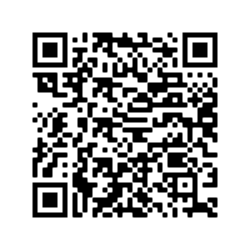
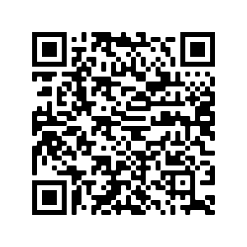
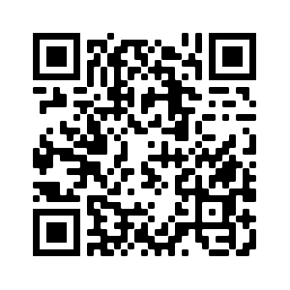
Hausaufgaben
Pre-learning for lesson: Year 8 German Term 3.1 Week 6
Revisit 1: [Year 8 German Term 3.1 Week 3]
Revisit 2: [Year 8 German Term 2.2 Week 1]
Notes:
This is the HW slide for the Oak Academy videoed lesson. Don’t upload to the portal with this slide, but do save a separate version on the Google drive and send link to RH, when complete.

Slide 56
Hausaufgaben
Vocabulary Learning Homework (Y8, Term 3.1, Week 6)
Audio file
Audio file QR code:
Quizlet link
In addition, revisit: Term 3.1 Week 3
Term 2.2 Week 1
Notes:
Link to student learning homework answers: https://resources.ncelp.org/concern/resources/6969z150x?locale=en

