Slide 1
Things I like and things that make me happy
Adjective agreement
SSC [ai] vs [ei]
Y8 German
Term 1 - Week 5 - Lesson 9
Author name(s): Rachel Hawkes
Artwork: Steve Clarke
Date updated: 21 / 07 / 21
Notes:
Learning outcomes (lesson 1):
Introduction of SSCs [ai], [ei]
Introduction of pre-nominal adjectival agreement - definite and indefinite articles R1 (nominative)
Word frequency (1 is the most frequent word in German):
8.1.1.5 (introduce) begreifen [1346] duschen [>5009] Blick [306] Dezember [1527] Jahreszeit [4818] Mal [82] März [987] Pflanze [1667] Schuh [1678] Wechsel [2525] bequem [3369] freundlich [1566] wieder [74]
8.1.1.1 (revisit) besuchen [820] erleben [570] kaufen [506] August [1929] Ferien [3448] Juli [1544] Kleidung [2820] Kultur [594] Spaß [1045] Tour [2640] Türkei [922] dieser, diese, dieses [24] letzter, letzte, letztes [152/53] schon [61]
7.3.2.5 (revisit) das Dorf [684] die Großstadt [74/188] das Jahr [53] der Monat [306] das Schwimmbad [>4034/1579] der See [1167] der Strand [2047] nächste [249] nächstes [249] nächsten [249] nächstes Jahr [249/53] nächsten Monat [249/306] nächste Woche [249/211]

Slide 2
ei
frei
Notes:
Timing: 1 minute
Aim: To introduce/consolidate SSC [ei]
Procedure: 1. Present the letter(s) and say the [ei] sound first, on its own. Students repeat it with you. 2. Bring up the word ”frei” on its own, say it, students repeat it, so that they have the opportunity to focus all of their attention on the connection between the written word and its sound.
3. A possible gesture for this would be to stretch both arms up in the air (pointing outwards slightly to make a Y shape with your body), and smile!
4. Roll back the animations and work through 1-3 again, but this time, dropping your voice completely to listen carefully to the students saying the [ei] sound, pronouncing ”frei” and, if using, doing the gesture. Word frequency (1 is the most frequent word in German): frei [318] Source: Jones, R.L. & Tschirner, E. (2006). A frequency dictionary of German: core vocabulary for learners. Routledge

Slide 3
ai
Haifisch
Notes:
Timing: 1 minute (slides 2 and 3)
Aim: To introduce SSC [ai] and link it to SSC [ei] which has the same pronunciation.
Procedure: 1. Present the letter(s) and say the [ai] sound first, on its own. Students repeat it with you. 2. Bring up the word ”Haifisch” on its own, say it, students repeat it, so that they have the opportunity to focus all of their attention on the connection between the written word and its sound.
3. A possible gesture for this would be [to use the right hand to make a shark fin and put it on top of your head]
4. Roll back the animations and work through 1-3 again, but this time, dropping your voice completely to listen carefully to the students saying the [ai] sound, pronouncing ”Haifisch” and, if using, doing the gesture. Word frequency (1 is the most frequent word in German): Haifisch [>5000] Source: Jones, R.L. & Tschirner, E. (2006). A frequency dictionary of German: core vocabulary for learners. Routledge

Slide 4
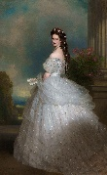
Auf Deutsch und auf Englisch
sprechen / hören
same [ai]
different [ai]
same [ai]
different [ai]
1
Detail
6
trainieren
2
Mai
7
Puffmais
3
Haifisch
8
Kaiserin
4
E-Mail
9
unfair
5
Mainz
10
Taiwaner
Notes:
*Put pics in
Timing: 2 minutes Aim: This activity highlights similarities and differences in the English and German pronunciation of the SSC [ai], using near-cognates which have not been previously taught. Images are provided to aid recognition. The activity aims to show that the pronunciation of [ai] changes in German, depending on whether the word is a word ‘borrowed’ from English.
Procedure: Students write 1-10 in their exercise books and decide if the [ai] in the German word sounds the same as in English, or different from the English. They then listen to the words and check their answers.
TRANSCRIPT:
Detail
Mai
Haifisch
E-Mail
Mainz
trainieren
Puffmais
Kaiserin
unfair
Taiwaner
Word frequency (1 is the most frequent word in German):
E-Mail [2172] trainieren [2256] Mai [1048] Haifisch [>5000] Detail [1787] fair [1803] Kaiserin [2563] Puffmais [>5000] Taiwaner [>5000] Source: Jones, R.L. & Tschirner, E. (2006). A frequency dictionary of German: core vocabulary for learners. Routledge

Slide 5
Vokabeln
lesen
das Mal
wieder
begreifen
duschen
bequem
der Wechsel
die Pflanze
again
December
change
look
season
I understand
friendly
to understand
March
time (occasion)
shoe
to shower
plant
comfortable
der Blick
März
Dezember
die Jahreszeit
freundlich
der Schuh
Ich begreife
Notes:
Timing: 3 minutes
Aim: To practise recognition and cued productive recall of new vocabulary.
Procedure:
1. Students supply the German for the word which appears in English. The aim is to be able to give the German before the teacher counts drei – zwei – eins.
Notes:
The activity can be repeated, clicking faster through the animations to increase speed of recall.
Teachers may wish to give students 30 seconds to look at the German words before showing the English prompts
Word frequency (1 is the most frequent word in German): begreifen [1346] duschen [>5009] Blick [306] Dezember [1527] Jahreszeit [4818] Mal [82] März [987] Pflanze [1667] Schuh [1678] Wechsel [2525] bequem [3369] freundlich [1566] wieder [74]
Source: Jones, R.L. & Tschirner, E. (2006). A frequency dictionary of German: core vocabulary for learners. Routledge

Slide 6
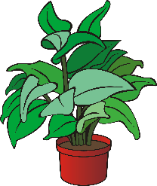
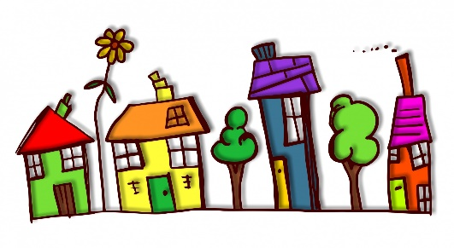
Adjektive – definite articles
Grammatik
In German, when adjectives come after the verb ‘to be’ they don’t change:
Der See ist schön.
Die Pflanze ist schön.
Das Dorf ist schön.
Adjectives in front of a noun add endings:
Der schöne See ist dort.
Die schöne Pflanze ist dort.
Das schöne Dorf ist dort.
R1 (nominative) singular endings for definite articles are all ‘e’
Notes:
Timing: 2 minutes Aim: To explain pronominal adjective agreement in R1(nominative) with definite articles. Procedure: 1. Click and present the knowledge in small steps as per animation.
2. Elicit the key understanding that it is the position of the adjective in relation to the noun that determines if there is an ending or not.

Slide 7
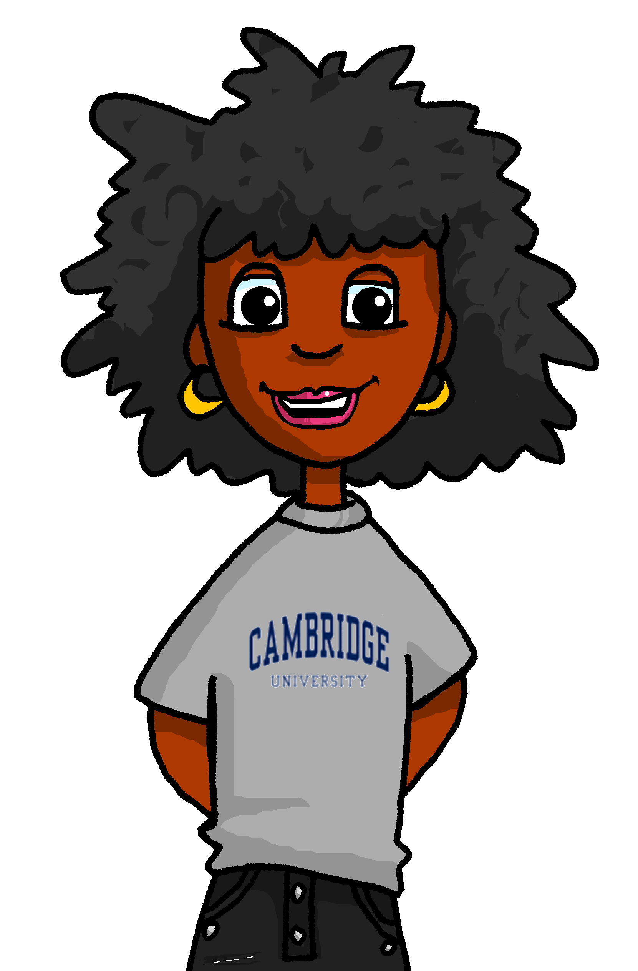
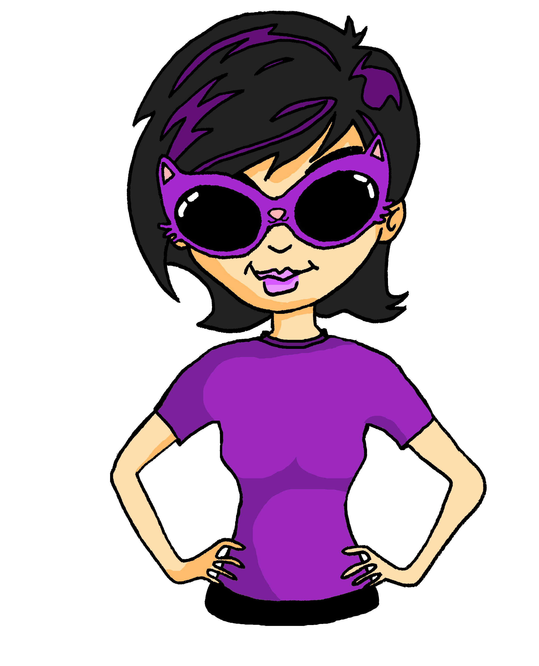
Lieblingssachen
Was sind deine Lieblingssachen, Andrea?
lesen
Schreib 1a-5b. Welches Adjektiv ist das?
Zu Hause in England? OK... [1a] die ________ Pizza. Meine Mutti macht sie immer so [1b] _________. Und [2a] der __________ Ort im Garten, wo ich lese. Dort ist es sehr [2b] ______________. Hier in Deutschland? [3a] Der ________ Dezember. Ich denke, der Schnee ist [3b]____________. Und [4a] die ___________ Mieze. Sie ist so [4b] _______ und lieb*. Was noch? Oh ja, [5a] das ____________ Wasser bei Mia. Ich dusche hier so [5b] _________.
frische
lecker
ruhige
bequem
kalte
toll
schwarze
klein
warme
schön
1 lecker / frische | 2 ruhige / bequem | 3 toll / kalte | 4 klein / schwarze | 5 schön / warme
*lieb = dear
Notes:
Timing: 5 minutes Aim: A referential activity to practise recognition of adjective endings. Semantically both adjectives could fit into the each pair of spaces, so students cannot rely on word meaning alone to fill the gaps. Procedure: 1. Ensure students are clear about the task. Then give students time to complete the first pair of gaps.
2. Check answers, and English meanings. Apart from this lesson’s new vocabulary, the remainder was learnt in Y7.
3. Depending on the class, students might complete the rest of the task independently, and then check answers at the end.
Word frequency (1 is the most frequent word in German): lieb [897]
Source: Jones, R.L. & Tschirner, E. (2006). A frequency dictionary of German: core vocabulary for learners. Routledge

Slide 8
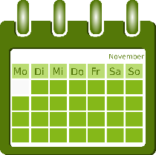
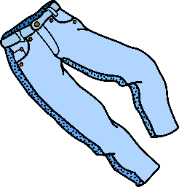
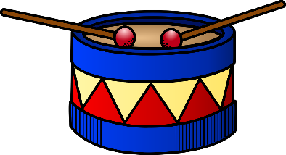
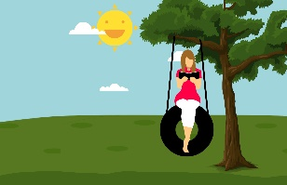
Adjektive – indefinite articles
Grammatik
Remember, when adjectives come after the verb ‘to be’ they don’t change:
Was ist ruhig?
Was ist blau?
Was ist laut?
Ein Sonntag ist ruhig.
Eine Hose ist blau.
Ein Schlagzeug ist laut.
Adjectives after the indefinite article ‘ein’ (and‘kein’) have these endings:
Ein ruhiger Sonntag ist gut.
Das ist eine blaue Hose.
Ein lautes Schlagzeug ist schrecklich.
der Sonntag
die Hose
das Schlagzeug
R1 (nominative) singular endings for indefinite articles have the same final letter as their matching definite articles:
Notes:
Timing: 2 minutes Aim: To explain pronominal adjective agreement in R1(nominative) with definite articles. Procedure: 1. Click and present the knowledge in small steps as per animation.
2. Elicit the key understanding that it is the position of the adjective in relation to the noun that determines if there is an ending or not.

Slide 9
ein Problem
lesen
Andrea findet Adjektivendungen schwierig! Kannst du helfen? Ist es der / das oder ein / ein?
 |  | [der / das] | [ein / ein]
 | _____ großer Spaß
 | _____ warmes Jahr
 | _____ kalte Juli
te | _____ schöne Dorf
 | _____ grüner Schuh
 | _____ nächste Mal
 | _____ bequemes Haus
 | _____ freundliche Blick
1
ein
2
ein
3
der
4
das
5
ein
6
das
7
ein
8
der
Notes:
Timing: 5 minutes Aim: To practise in written modality the pattern of Row 1 (nominative0 adjective endings for definite and indefinite articles. Procedure: 1. Students write der/das or ein for each of the items 1-8.
2. Click for answers.
Word frequency (1 is the most frequent word in German): 8.1.1.5 (introduce) Blick [306] Mal [82] Schuh [1678] bequem [3369] freundlich [1566]
8.1.1.1 (revisit) Juli [1544] Spaß [1045]
7.3.2.5 (revisit) das Dorf [684]] das Jahr [53] nächste [249]
Source: Jones, R.L. & Tschirner, E. (2006). A frequency dictionary of German: core vocabulary for learners. Routledge

Slide 10
Eine Lösung
hören
Mia hilft Andrea wieder. Jetzt geht es besser.
Welches Wort ist richtig? Oder sind beide richtig? Wie heißt das auf Englisch?
 |  | Englisch
 | März / Jahreszeit
 | Schwimmbad / Tour
 | Dorf / Kultur
 | Monat / Woche
 | Wechsel / Blick
 | Hose / Schuh
 | August / März
 | Jahr / Tag
1
a warm season
2
a big pool
3
a great culture
4
a pleasant month
5
small change/look
6
comfy trousers
7
a lovely August/March
8
a long day
Notes:
Timing: 5 minutes The solution is lots of practice!
Aim: to practise understanding of adjective agreement patterns in the oral modality. Procedure: 1. Listen and decide which noun is being described from the article and adjective ending. Note that knowledge of the gender of these words is also being tested / practised here.
2. Correct as item-by-item or do one example together and then 2-8. Elicit the English, too.
Transcript: 1. eine warme [Jahreszeit] 2. ein großes [Schwimmbad] 3. eine tolle [Kultur] 4. ein angenehmer [Monat] 5. ein kleiner [Wechsel] or [Blick] 6. eine bequeme [Hose] 7. ein schöner [August] or [März] 8. ein langer [Tag] Word frequency (1 is the most frequent word in German): Source: Jones, R.L. & Tschirner, E. (2006). A frequency dictionary of German: core vocabulary for learners. Routledge

Slide 11
Katjas Lieblingssachen
sprechen
Katja denkt an ihre Lieblingssachen. Was sind sie?
lang
schön
perfekt
neu*
bequem
groß
blau
modern
4
ein ______ Hotel
ein ______ See
3
ein ______ Strand
______ Kleidung
2
5
ein ______ Urlaub
eine ______ Großstadt
1
6
*neu - new
Notes:
Timing: 3 minutes Aim: to combine gender knowledge and adjective ending in spoken practice. Procedure: 1. Tell students there can be a variety of answers. (Note that there are therefore no answers)
2. Students can work in pairs – saying six combinations of Katja’s favourite things
3. Partners listen and simultaneously translate what their partner says.

Slide 12
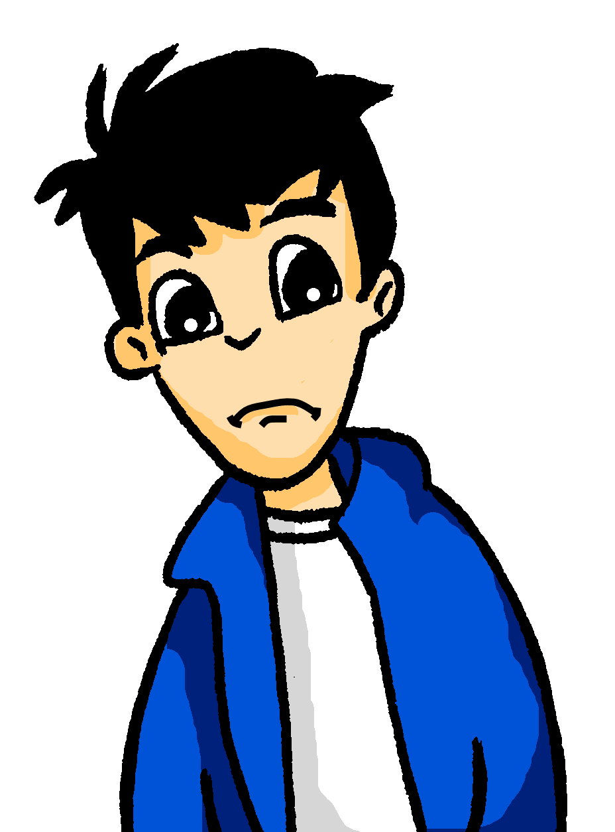
Ein Geschenk für Mia
schreiben
Andrea will ein Geschenk für Mia kaufen. Sie schreibt ihre Liste auf Englisch. Schreib 1-8 und die Liste auf Deutsch.
Hallo Wolfgang,
Hier ist meine Liste. Wie findest du sie? 1. a Turkish book 2. the last Harry Potter film
3. a big photo of* Scotland
4. the black jacket
5. a nice bag
Mm... was ist das auf Deutsch?
6. a small game 7. a green cinema
voucher
8. a great ticket for* her favourite band
*of = von
*for = für
Notes:
Timing: 10-12 minutes Aim: To practise adjective endings in the productive mode, written modality. The vocabulary is drawn from previous learning. Procedure: 1. Students write 1-10 and translate the list.
2. Answers on the next slide.

Slide 13
Ein Geschenk für Mia
schreiben
Andrea will ein Geschenk für Mia kaufen. Sie schreibt ihre Liste auf Englisch. Schreib 1-8 und die Liste auf Deutsch.
Hallo Wolfgang,
Hier ist meine Liste. Wie findest du sie? 1. a Turkish book 2. the last Harry Potter film
3. a big photo of* Scotland
4. the black jacket
5. a nice bag
Mm... was ist das auf Deutsch?
ein türkisches Buch
6. a small game 7. a green cinema voucher
8. a great ticket for* her favourite band
ein kleines Spiel
der letzte HP Film
ein grüner Kinogutschein
ein großes Foto von Schottland
eine tolle Karte für ihre Lieblingsband
die schwarze Jacke
eine nette Tasche
*of = von
*for = für
Notes:
ANSWERS

Slide 14
Things I like and things that make me happy
Adjective agreement
SSC [ai] & [ei] vs [ie]
Y8 German
Term 1 - Week 5 - Lesson 10
Author name(s): Rachel Hawkes / Eva Lamb
Artwork: Steve Clarke
Date updated: 21 / 07 / 21
Notes:
Learning outcomes (lesson 2):
Consolidation of SSC [ai] [ei] vs [ie]
Consolidation of pre-nominal adjectival agreement - definite and indefinite articles R1 (nominative)
Word frequency (1 is the most frequent word in German):
8.1.1.5 (introduce) begreifen [1346] duschen [>5009] Blick [306] Dezember [1527] Jahreszeit [4818] Mal [82] März [987] Pflanze [1667] Schuh [1678] Wechsel [2525] bequem [3369] freundlich [1566] wieder [74]
8.1.1.1 (revisit) besuchen [820] erleben [570] kaufen [506] August [1929] Ferien [3448] Juli [1544] Kleidung [2820] Kultur [594] Spaß [1045] Tour [2640] Türkei [922] dieser, diese, dieses [24] letzter, letzte, letztes [152/53] schon [61]
7.3.2.5 (revisit) das Dorf [684] die Großstadt [74/188] das Jahr [53] der Monat [306] das Schwimmbad [>4034/1579] der See [1167] der Strand [2047] nächste [249] nächstes [249] nächsten [249] nächstes Jahr [249/53] nächsten Monat [249/306] nächste Woche [249/211]

Slide 15
Phonetik - Kalendar
lesen / sprechen
Wie heißen die Monate?
60
Januar
F _ _ _ _ _ _
_ _ _ _
April
Februar
März
April
erste
zweite
dritte
vierte
M _ _
J _ _ _
_ _ _ _
_ _ _ _ _ _
Sekunden
Mai
Juni
Juli
August
fünfte
sechste
siebte
achte
September
Oktober
November
_ _ _ _ _ _ _ _
Dezember
0
neunte
zehnte
elfte
zwölfte
LOS!
Notes:
Timing: 3 minutes Aim: To bring together months that have been learnt with others that are cognates to practise their pronunciation. Procedure: 1. Students say the months in order, with a partner (the cues vary depending on prior knowledge, explicit learning.
2. Click to hear each month pronounced.
3. Revise ordinal numbers (students met these towards the end of Y7). They are unlikely to remember ‘dritte’ as it has not yet been thoroughly practised. Bring up the word ‘erste’. Say Januar ist der erste Monat. (Make explicit to students that this is the adjective ending pattern that they learnt last lesson. Monat is ‘der’ and so the ending is ‘e’ on each number.
4. Elicit the first three with students, pointing out ‘dritte’ irregularly, and then proceed chorally with the whole class (in time with you, rather than repeating what you say, as they will be able to put their knowledge into practice, here)
Transcript: Januar Februar März April Mai Juni Juli August September Oktober November Dezember Word frequency (1 is the most frequent word in German): Source: Jones, R.L. & Tschirner, E. (2006). A frequency dictionary of German: core vocabulary for learners. Routledge

Slide 16
English → German → English
Change English ‘c’ to ‘k’ to create many German words.
October is a month.
Oktober ist ein Monat.
What would the following words be in German?
discussion (f) contact (m) article (m) costs (pl) product (nt) Choose one and write a sentence in German.
Translate these sentences.
1. Der Zug fährt direkt.
2. I love music and I’m doing a project.
Notes:
Timing: 6 minutes Aim: to reinforce, revisit, extend vocabulary knowledge, as well as revisit key basic grammar knowledge (parts of speech, capital letters on nouns, definite articles/gender, plural rules) and apply their phonics knowledge when they sound out the new words they've created. Procedure:
1. Follow instructions on slide. Answer slide follows.
Word frequency: Oktober [757] Musik [469] die Diskussion [850] direkt [370] das Projekt [605] die Kosten [722] der Kontakt [700] der Artikel [903] das Produkt [643]
Source: Jones, R.L. & Tschirner, E. (2019). A frequency dictionary of German: core vocabulary for learners. Routledge

Slide 17
ANTWORTEN
Der Zug fährt direkt.
I love music and I‘m doing a project.
discussion (f)
contact (m)
article (m)
costs (pl)
product (nt)
The train goes direct(ly).
Ich liebe Musik und ich mache ein Projekt.
die Diskussion
der Kontakt
der Artikel
die Kosten
das Produkt
In German ‘el’ replaces English ‘le’
‘en’ is a common plural ending (Rule 3)
What do you notice about the gender of these nouns?
Don’t forget to pronounce the words.
Notes:
Source: Jones, R.L. & Tschirner, E. (2019). A frequency dictionary of German: core vocabulary for learners. Routledge

Slide 18
Vergnügungen*
hören
Ein Gedicht von Bertolt Brecht
Der erste Blick aus dem Fenster am Morgen
Das wiedergefundene alte Buch
Begeisterte Gesichter
Schnee, der Wechsel der Jahreszeiten
Die Zeitung
Der Hund
Die Dialektik
Duschen, Schwimmen
Alte Musik
Bequeme Schuhe
Begreifen
Neue Musik
Schreiben, Pflanzen
Reisen
Singen
Freundlich sein.
Hör zu. Welche Wörter verstehst du? Schreib die Wörter.
Vergnügungen - pleasures
Notes:
Timing: 15 minutes (three slides) Aim: To listen to a poem that contains mostly familiar language, with a few unfamiliar words, to put SSC knowledge into practice via transcription. Procedure: 1. Listen to a reading of the poem.
2. Write down any words you understand.
3. Feedback answers (brainstorm on the board or use the following slide, which has all of the words that are known to students from Y7 and Y8 so far.

Slide 19
Vergnügungen*
hören
erste
Blick
Fenster
Morgen
Der erste Blick aus dem Fenster am Morgen
Das wiedergefundene alte Buch
Begeisterte Gesichter
Schnee, der Wechsel der Jahreszeiten
Die Zeitung
Der Hund
Die Dialektik
Duschen, Schwimmen
Alte Musik
Bequeme Schuhe
Begreifen
Neue Musik
Schreiben, Pflanzen
Reisen
Singen
Freundlich sein.
Buch
Wechsel
Jahreszeit
Zeitung
Hund
Duschen
Schwimmen
Musik
bequem
Schuhe
Begreifen
Schreiben
Pflanzen
Reisen
Singen
freundlich
sein
Vergnügungen - pleasures
Notes:
Aim: To reactivate known vocabulary, encountered in a new context. Procedure: 1. First, students compare the words they noted with a partner and enlarge their list.
2. Elicit orally from students any words they heard (they put their phonics knowledge into action by reading their words aloud) 3. Click to bring up the words that we anticipate they may know. (Reassure students as necessary that they will not have noted them all but in the whole class students may have noted these, and possibly, additional unknown words.
4. Clarify meanings of these words with students. 5. One the next slide, ask students to consider the theme and shape/form of the poem. What is this poem about? (e.g. a list of the poet’s pleasures, special moments, favourite things)

Slide 20
Vergnügungen*
hören
Der erste Blick aus dem Fenster am Morgen
Das wiedergefundene alte Buch
Begeisterte Gesichter
Schnee, der Wechsel der Jahreszeiten
Die Zeitung
Der Hund
Die Dialektik
Duschen, Schwimmen
Alte Musik
Bequeme Schuhe
Begreifen
Neue Musik
Schreiben, Pflanzen
Reisen
Singen
Freundlich sein.
aus – out of
alt - old
begeistert - excited
das Gesicht - face
der Schnee - snow
die Dialektik - dialectic
neu - new
Vergnügungen - pleasures
Notes:
Aim: To deepen vocabulary knowledge Procedure: 1. Students to consider the theme and shape/form of the poem. What is this poem about? (e.g. a list of the poet’s pleasures, special moments, favourite things)
2. Elicit the meanings of each line. Bring up the gloss of new words as they become necessary. 3. Ask students to consider if their list of favourite moments would have anything in common with the poet’s list.
Most of the unknown words will be taught explicitly in Y8 (in bold, below). Several have already been met as SSC source / cluster words. Word frequency: aus [37] alt [138] begeistert [>5009] Gesicht [346] Schnee [1760] Dialektik [>5009] neu [84] Definition: Dialectic - a discourse between two or more people holding different points of view about a subject but wishing to establish the truth through reasoned methods of argumentation.

Slide 21
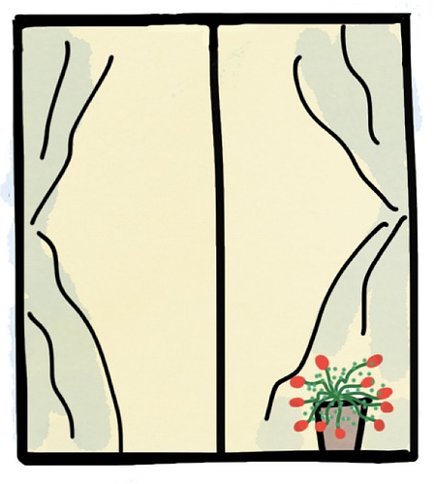
Welche Adjektivendung?
Grammatik
As you know, when adjectives come before the noun, they have different endings.
The endings depend on the type of article:
masculine
der große Tisch
(the big table)
ein großer Tisch
(a big table)
feminine
die gelbe Flasche
(the yellow bottle)
eine gelbe Flasche
(a yellow bottle)
neuter
das kleine Fenster
(the small window)
ein kleines Fenster
(a small window)
______
_____
______
______
_____
______
Notes:
Timing: 2 minutes Aim: To recap the forms and uses of adjective endings in row 1 (nominative) from last lesson. Precedure: 1. Click through and elicit the endings one by one from students.

Slide 22
im Plural?
Note: we use ‘keine’ for the indefinite as you can’t say ‘a big tables’!
Grammatik
When adjectives come before plural nouns, the ending is –en:
masculine
die großen Tische
(the big tables)
keine großen Tische
(no big tables)
feminine
die gelben Flaschen
(the yellow bottles)
keine gelben Flaschen
(no yellow bottles)
neuter
die kleinen Fenster
(the small windows)
keine kleinen Fenster
(no small windows)
_______
_______
_______
_______
_______
_______
Plural nouns are often used without an article. In this case, the ending is -e:
_______
gelbe Flaschen
(yellow bottles)
kleine Fenster
(small windows)
große Tische
(big tables)
_______
_______
Notes:
Timing: 2 minutes Aim: To introduce the plural adjective endings in row 1 (nominative). Precedure: 1. Click through and elicit the endings one by one from students. 2. Bring to the fore the straightforwardness of the plural endings! 3. Remind students that the definite article for all plural nouns is die (they learnt this in Y7).

Slide 23
Vergnügungen*
hören
Der erste Blick aus dem Fenster am Morgen
Das wiedergefundene alte Buch
Begeisterte Gesichter
Schnee, der Wechsel der Jahreszeiten
Die Zeitung
Der Hund
Die Dialektik
Duschen, Schwimmen
Alte Musik
Bequeme Schuhe
Begreifen
Neue Musik
Schreiben, Pflanzen
Reisen
Singen
Freundlich sein.
aus – out of
Der erste Blick aus dem Fenster am Morgen
Das wiedergefundene alte Buch
Begeisterte Gesichter
Schnee, der Wechsel der Jahreszeiten
Die Zeitung
Der Hund
Die Dialektik
Duschen, Schwimmen
Alte Musik
Bequeme Schuhe
Begreifen
Neue Musik
Schreiben, Pflanzen
Reisen
Singen
Freundlich sein.
alt - old
begeistert - excited
das Gesicht - face
der Schnee - snow
die Dialektik - dialectic
neu - new
Vergnügungen - pleasures
Notes:
Aim: To develop knowledge of adjective agreement Procedure: 1. Students identify all the adjectives.
Most of the unknown words will be taught explicitly in Y8 (in bold, below). Several have already been met as SSC source / cluster words. Word frequency: aus [37] alt [138] begeistert [>5009] Gesicht [346] Schnee [1760] Dialektik [>5009] neu [84] Definition: Dialectic - a discourse between two or more people holding different points of view about a subject but wishing to establish the truth through reasoned methods of argumentation.

Slide 24
English → German → English
You can often make nouns from the infinitive of verbs.
He likes to swim / swimming. Swimming is easy.
Er mag schwimmen. Schwimmen ist leicht.
Translate these sentences.
1. Lernen ist interessant.
2. Cooking is my favourite hobby.
What would the following words be in German?
travel / travelling
singing
writing
Choose one and write a sentence in German.
All nouns made from infinitive verbs are ‘das’. However, they are usually used without the indefinite article, as in English.
Notes:
Timing: 8 minutes (two slides) Aim: To develop knowledge of word patterns within German, using examples from the poem. Procedure: 1. Click to present the pattern and examples. 2. Given students time to complete the five short tasks. 3. Answers and further tasks on the next slide.
Word frequency: wissen [78] lernen [288]; schreiben [184]; reisen [933]; lachen [444]; wandern [1803] leben [98] essen [323] schwimmen [1863] kochen [1481] singen [1063] vergessen [584] verstehen [211] plus many, many more!
Source: Jones, R.L. & Tschirner, E. (2019). A frequency dictionary of German: core vocabulary for learners. Routledge
Note: This would combine well with the introduction of ‘Spaß machen’ (8.1.1.1) and also the verb ‘tun’ [123]: Das Singen tut gut. Das Laufen macht fit. Das Vergessen ist normal. Das Mitmachen ist freiwillig. Das Stehen tut weh.

Slide 25
ANTWORTEN
Lernen ist interessant.
Cooking is my favourite hobby.
travelling
singing
writing
Learning is interesting.
Kochen ist mein Lieblingshobby.
(das) Reisen
(das) Singen
(das) Schreiben
…but some don’t. What do these mean? das Leben das Wissen das Essen
These words often end in –ing in English…
What do you notice about the gender of these nouns?
to forget → forgetting
vergessen → Vergessen (ist normal!)
Don’t forget to pronounce the words.
Notes:
das Leben [life/living], das Wissen [knowledge/knowing], das Essen [food/eating] Note: in the 2019 edition of the frequency dictionary, verb nouns are not listed separately, whereas in 2006 edition they are. Source: Jones, R.L. & Tschirner, E. (2019). A frequency dictionary of German: core vocabulary for learners. Routledge

Slide 26
Adaption
Note: When nouns are used without an article, the adjective ending is the same as for the indefinite article: e.g kaltes Duschen
schreiben
Schreib die Adjektiven hin.
1 __________ Duschen
2 __________ Schwimmen
3 __________ Begreifen
4 __________ Schreiben
5 __________ Pflanzen
6 __________ Reisen
7 __________ Singen
8 __________ Essen
interessant | ruhig | warm | neu | lecker
glücklich | angenehm | gesund | praktisch | lustig
Notes:
Timing: 4 minutes Aim: to apply grammatical knowledge to several noun verbs from the poem by adding adjectives. Procedure: 1. Ask students to add their choice of adjective to each noun verb.
2. Elicit their suggestions. (Note: no answers are provided, as different combinations are possible).
3. Check that students understand that the ending ‘-es’ comes from the gender ‘das’ and from the indefinite article pattern.

Slide 27
Optionen
schreiben / sprechen
Option 1: Schreib eine Adaption. Schreib Adjektive für das Gedicht.
Option 2: Schreib dein Gedicht ‘Vergnügungen’.
Der erste Blick aus dem Fenster am Morgen
Das wiedergefundene alte Buch
Begeisterte Gesichter
Schnee, der Wechsel der Jahreszeiten
Die Zeitung
Der Hund
Die Dialektik
Duschen, Schwimmen
Alte Musik
Bequeme Schuhe
Begreifen
Neue Musik
Schreiben, Pflanzen
Reisen
Singen
Freundlich sein.
Notes:
Timing: 10 minutes (plus continuation as appropriate, for homework) Aim: to develop personal expression through application of knowledge of adjective endings R1 (nominative) with a range of nouns. Procedure: 1. Explain the options for this activity.
2. Students either add additional adjectives to the Brecht poem, to describe nouns that are without adjectives. Or, they write their own ‘Pleasures’ poem – a list of their special moments, favourite things. They should include some adjectives in front of the noun.

Slide 28
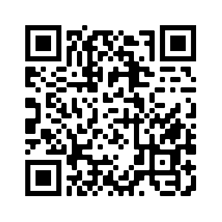
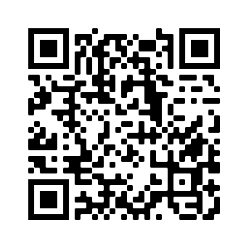
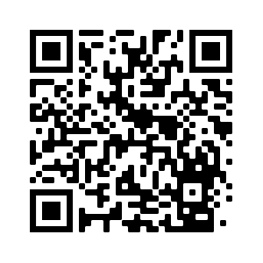
Hausaufgaben
Pre-learning for lesson: Year 8 German Term 1.1 Week 6
Revisit 1: Year 8 German Term 1.1 Week 2
Revisit 2: Year 7 German Term 3.1 Week 4
Notes:
Answer sheets for the learning HW with the link to the HW sheets are here: https://resources.ncelp.org/concern/resources/k3569489x?locale=en

Slide 29
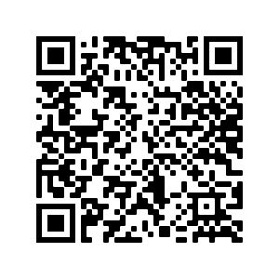
Hausaufgaben
Vocabulary Learning Homework (Y8, Term 1.1, Week 6)
Audio file
Audio file QR code:
Student worksheet
Quizlet link
In addition, revisit: Year 8 Term 1.1 Week 2
Year 7 Term 3.1 Week 4
Notes:
Answer sheets for the learning HW with the link to the HW sheets are here: https://resources.ncelp.org/concern/resources/k3569489x?locale=en

