Slide 1
Talking about what, when, where and why you celebrate
construction rule for numbers 13-31
SSCs [em/am], [e] and [a]
Y8 French
Term 1.1 - Week 4 - Lesson 5
Kirsten Somerville / Natalie Finlayson / Catherine Morris
Artwork by: Chloé Motard
Date updated: 09/07/21
Notes:
Learning outcomes (lesson 1):
Introduction of SSC [em/am]
Introduction of construction rule for numbers 13-31
Word frequency (1 is the most frequent word in French):
8.1.1.4 (introduce) célébrer [2170], préférer [597], avril [1022], date [660], événement [573], février [1136], janvier [939], juin [931], mars [868], mai [943], tradition [1371], premier, première [56], vingt [1273], trente [1646], on [29]
7.3.2.6 (revisit) aider [413], chercher [336], partager [527], peut [20], peux [20], pouvoir [20], sais [67], sait [67], savoir1 [67], plan [164], désolé [désoler - 2081], peut-être [190]
7.3.1.5 (revisit) café1 [1886], cinéma [1623], plage [2693], rue [598], devant [198], derrière [805], entre [55]
Source: Londsale, D., & Le Bras, Y. (2009). A Frequency Dictionary of French: Core vocabulary for learners London: Routledge.

Slide 2
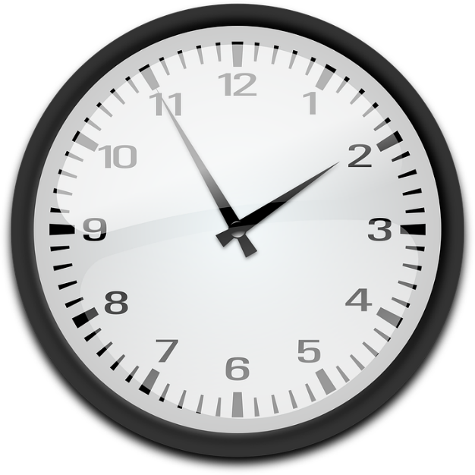
em/am
[time]
temps
Notes:
Timing: 1 minute
Aim: To introduce SSC [em/am]
Procedure: 1. Present the letter(s) and say the [em/am] sound first, on its own. Students repeat it with you. 2. Bring up the word ”temps” on its own, say it, students repeat it, so that they have the opportunity to focus all of their attention on the connection between the written word and its sound.
3. A possible gesture for this would be to look at your wrist as though checking your watch. 4. Roll back the animations and work through 1-3 again, but this time, dropping your voice completely to listen carefully to the students saying the [em/am] sound, pronouncing ”temps” and, if using, doing the gesture.
Word frequency (1 is the most frequent word in French):
temps [65]
Source: Londsale, D., & Le Bras, Y. (2009). A Frequency Dictionary of French: Core vocabulary for learners London: Routledge.

Slide 3
em/am
temps
Notes:
With sound and no pictures to focus all attention on the sound-symbol correspondence.

Slide 4
em/am
[time]
temps
Notes:
Without sound to elicit pronunciation (without first hearing the teacher).
Teacher to elicit pronunciation by asking “Comment dit-on …”

Slide 5
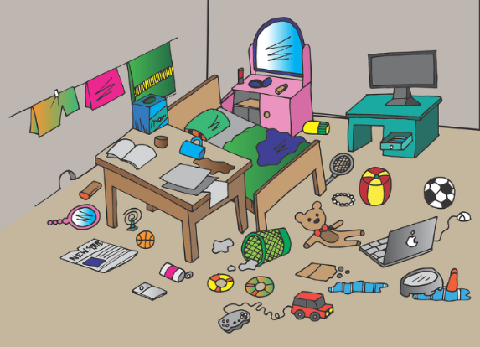
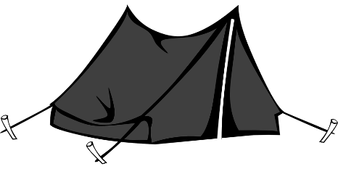
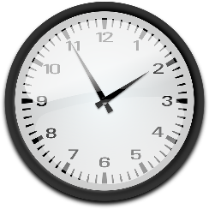
em/am
camp
chambre
ensemble
[time]
printemps
temps
[together]
[spring]
ressembler (à)
[to look like]
Notes:
Timing: 2 minutes
Aim: To introduce SSC [em/am]
Procedure:
Introduce and elicit the pronunciation of the individual SSC [em/am] and then the source word again ‘temps’ (with gesture, if using). Then present and elicit the pronunciation of the five cluster words. The cluster words have been chosen for their high-frequency, from a range of word classes, with the SSC (where possible) positioned within a variety of syllables within the words (e.g. initial, 2nd, final etc.). Additionally, we have tried to use words that build cumulatively on previously taught SSCs (see the Phonics Teaching Sequence document) and do not include new SSCs. Where new SSCs are used, they are often consonants which have a similar symbol-sound correspondence in English.
Word frequency (1 is the most frequent word in French): camps [1084]; chambre [633] ensemble [124]; printemps [1288]; temps [65]; ressembler [1398]. Source: Londsale, D., & Le Bras, Y. (2009). A Frequency Dictionary of French: Core vocabulary for learners London: Routledge.

Slide 6
em/am
camp
chambre
ensemble
[time]
printemps
temps
ressembler (à)
Notes:
With sound and no pictures to focus all attention on the sound-symbol correspondence.

Slide 7
em/am
camp
chambre
ensemble
[time]
printemps
temps
ressembler (à)
Notes:
Without sound to elicit pronunciation (without first hearing the teacher).
Teacher to elicit pronunciation by asking “Comment dit-on …”

Slide 8
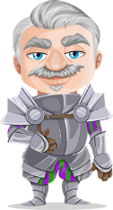
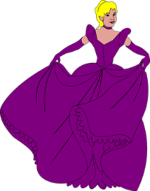
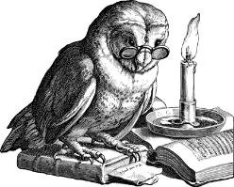
Phonétique
If there is an [m] after either of these vowels, it makes an identical nasal sound.
écouter
C’est quelle SSC ?
1
le champ
_
[a]
[am/em]
[e]
2
le carn a val
_
3
le ch e valier
_
le champ
le chevalier
4
les b a ls
_
le carnaval
rec e voir
5
_
l’emballage
recevoir
l’ emballage
6
_
[packaging]
[to receive]
les bals
7
la p e luche
_
la tempête
8
la s a gesse
_
la sagesse
la tempête
l‘ampoule
la peluche
9
_
10
l'ampoule
_
Notes:
Timing: 6 minutes
Aim: aural recognition of SSCs [a], [e] and [em/am]; raising awareness of the fact that although SSCs [a] and [e] sound different, [em] and [am] sound identical.
Procedure:
1. Students sketch the Venn diagram in their books.
2. Click on the numbers to hear the words said aloud.
3. Students decide whether the missing sound is [a], [am/em] or [e] and write the word in full in the correct section of the diagram.
4. Click to reveal missing sounds. As the missing letters are revealed, the words pop up in the appropriate places in the Venn diagram. Displaying the words in this way should help students visualise the crossover. On their own, letters [e] and [a] represent different SSCs. When followed by an ‘m’, [e] and [a] enter into an identical nasal sound.
5. Click to reveal pronunciation rule: [e]/[a] + m = nasal [em/am].
Transcript:
1. le champ
2. le carnaval
3. le chevalier
4. les bals
5. recevoir
6. l’emballage
7. la peluche
8. la sagesse
9. la tempête
10. l’ampoule
Word frequency (1 is the most frequent word in French): champ [847], carnaval [>5000], chevalier [>5000], bal [>5000], recevoir [199], emballage [>5000], peluche [>5000], sagesse [2998], tempête [2695], ampoule [>5000]
Source: Londsale, D., & Le Bras, Y. (2009). A Frequency Dictionary of French: Core vocabulary for learners London: Routledge.

Slide 9
C'est quel genre de mot ?
écouter
1
2
3
4
5
6
7
8
9
10
11
12
13
14
15
16
17
18
19
20
numbers
2. quatorze
3. trente
5. seize
9. treize
10. premier
14. quinze
17. vingt
20. première
verbs
6. préférer
15. célébrer
nouns
1. la tradition
8. l’événement
19. la date
months
4. avril
7. mai
11. février
12. juin
16. janvier
18. mars
pronouns
13. on
What do you notice about these two words?
l’événement
janvier
[en] and [em] sound exactly the same!
What do you notice about these two words?
événement
janvier
i
ii
Notes:
Timing: 7 minutes
Aim: Categorisation of words in this week’s new vocabulary set by word type (listening).
Procedure:
1. Students sketch the grid.
2. Click on the number buttons to hear the words said aloud.
3. Students write the numbers which correspond to each word in the correct column.
4. Click to reveal answers and French transcription.
5. Students translate words orally into English.
6. Click to reveal callout drawing students’ attention to SSCs [en] and [an] in événement and janvier, which sound identical to the new SSCs [em] and [am] which students have just encountered. This observation primes for the four SSCs being brought together at the start of lesson 2.
Transcript:
1. la tradition
2. quatorze
3. trente
4. avril
5. seize
6. préférer
7. mai
8. l’événement
9. treize
10. premier
11. février
12. juin
13. on
14. quinze
15. célébrer
16. janvier
17. vingt
18. mars
19. la date
20. première
i. évènement
ii. janvier
Word frequency of cognates used (1 is the most frequent word in French): genre [556]
Source: Londsale, D., & Le Bras, Y. (2009). A Frequency Dictionary of French: Core vocabulary for learners London: Routledge.

Slide 10
célébrer
[to celebrate | celebrating]
The é in the stem changes to è in all forms except nous and vous.
célèbre
[celebrates | is celebrating]
célébrons
[celebrate | are celebrating]
Notes:
Timing: 4 minutes
Aim: to introduce the verb célébrer more explicitly. Both long form (infinitive) and short form (3rd person singular) are introduced in order to familiarise students with various forms of the same verb.
Procedure
Bring up the word célébrer on its own, say it, students repeat it, and remind them of the phonics.
Try to elicit the meaning from the students. Students have had explicit teaching that the present tense in French communicates two different present tense meanings in English. This reinforces that learning. Emphasise the two meanings for the short form, reminding students that French only has one form and does not have a direct equivalent of the grammar for ‘is + ing’, the continuous form (as covered in previous weeks).
Bring up the picture, and, if using gestures, a possible gesture would be to do jazz hands.
Then bring up the English translations. Emphasise the two meanings for the infinitive.
Bring up the first short form célèbre, say it, students repeat it. Draw attention to different pronunciation of [è] vs [e].
Bring up the second short form célébrons, say it, students repeat it. Draw attention to different pronunciation of [è] vs [e].
Try to elicit the meaning from the students. Emphasise the two meanings for the short forms.
Bring up the info bubble to introduce the stem-change. NB: This is not a grammar point that students are expected to produce at this stage and will not feature in any NCELP tests. It is showcased here for awareness and passive understanding only.

Slide 11
célébrer
[to celebrate | celebrating]
célèbre
[celebrates | is celebrating]
célébrons
[celebrate | are celebrating]
Notes:
Cycle through the long and short forms again.

Slide 12
célèbre
[celebrates | is celebrating]
Elle célèbre le 14 juillet.
[She celebrates | is celebrating the 14 July.]
Notes:
Introduce the first short form in a sentence.

Slide 13
célébrons
[celebrate | are celebrating]
Nous célébrons le 14 juillet.
[We celebrate | are celebrating the 14 July.]
Notes:
Introduce the second short form in a sentence.

Slide 14
célébrer
[to celebrate | celebrating]
Elle veut célébrer le 14 juillet.
[she wants to celebrate the 14 July.]
Notes:
Introduce the long form in a sentence.

Slide 15
célèbre
[celebrates | is celebrating]
Elle le 14 juillet.
célèbre
[She celebrates | is celebrating the 14 July.]
Notes:
Cycle through the first short form in context again.

Slide 16
célébrons
[celebrate | are celebrating]
célébrons
Nous le 14 juillet.
[We celebrate | are celebrating the 14 July.]
Notes:
Cycle through the second short form in context again.

Slide 17
célébrer
[to celebrate | celebrating]
célébrer
Elle veut le 14 juillet.
[She wants to celebrate the 14 July.]
Notes:
Cycle through the long form in context again.

Slide 18
C’est quel mois ?
*tout = all
lire
janvier
January
A. C’est la fête des Pères (en Angleterre et en France).
juin
février
February
B. C’est le mois qu’Amir et Léa préfèrent… on mange des chocolats tout* le week-end.
avril
mars
March
C. Il y a un grand événement… la nouvelle année.
janvier
The infinitives of these verbs are préférer and célébrer - the é changes to an è in all forms apart from nous and vous. You will meet some other verbs with this pattern!
avril
April
D. Il y a une tradition romantique… la Saint Valentin.
février
mai
E. On célèbre la fête des mères en Angleterre, mais la date est différente en France !
May
mars
mai
F. On célèbre la fête des mères en France.
juin
June
Notes:
Timing: 8 minutes
Aim: written comprehension of this week’s new vocabulary
Procedure:
1. Introduce the months one by one with the English equivalent. Teacher says the French, students repeat.
2. Click to remove the English and show the clues for each month.
3. Students write A-F and choose the month that meets the description. (F will likely be a process of elimination!)
4. Click to reveal the answers. Teacher to highlight that capital letters are not used for months in French.
Word frequency of new vocabulary (1 is the most frequent word in French): célébrer [2170], préférer [597], avril [1022], date [660], événement [573], février [1136], janvier [939], juin [931], mars [868], mai [943], tradition [1371], on [29]
Source: Londsale, D., & Le Bras, Y. (2009). A Frequency Dictionary of French: Core vocabulary for learners London: Routledge.
Word frequency of cognates used (1 is the most frequent word in French): chocolat [4556], week-end [2475], entier [455], romantique [4884]
Source: Londsale, D., & Le Bras, Y. (2009). A Frequency Dictionary of French: Core vocabulary for learners London: Routledge.

Slide 19
Les numéros 13-31
grammaire
We have already learnt how to say the numbers 1-12 in French.
The numbers 13-16 are as follows :
treize
thirteen
quatorze
fourteen
quinze
fifteen
seize
sixteen
The numbers 17-31 are made up of a combination of numbers in French:
dix-sept
seventeen
dix-huit
eighteen
dix-neuf
nineteen
Add a hyphen between the numbers.
vingt
twenty
vingt-deux
twenty-two
trente
thirty
trente et un
thirty-one
Add et before un.
Notes:
Timing: 3 minutes
Aim: introducing numbers 13-31, including the construction rule for numbers 17-31

Slide 20
Les nombres
écouter / écrire
a
17
dix-sept
i
29
vingt-neuf
b
21
vingt-et-un
j
13
treize
c
28
vingt-huit
k
31
trente-et-un
d
14
quatorze
l
22
vingt-deux
e
30
trente
m
18
dix-huit
f
25
vingt-cinq
n
24
vingt-quatre
g
16
seize
o
20
vingt
h
23
vingt-trois
p
19
dix-neuf
Notes:
Timing: 5 minutes
Aim: aural recognition and spelling of numbers 13-31
Procedure:
1. Click on a letter to hear a number said aloud.
2. Students write down numbers in digits.
3. Click to reveal answer.
4. Students write the number in full.
5. Click to reveal answer.
6. Repeat steps 105 for each number.
Transcript:
a. dix-sept
b. cingt-et-un
c. vingt-huit
d. quatorze
e. trente
f. vingt-cinq
g. seize
h. vingt-trois
i. vingt-neuf
j. treize
k. trente-et-un
l. vingt-deux
m. dix-huit
n. vingt-quatre
o. vingt
p. dix-neuf
Word frequency of near-cognates used (1 is the most frequent word in French):
nombre [249]
Source: Londsale, D., & Le Bras, Y. (2009). A Frequency Dictionary of French: Core vocabulary for learners London: Routledge.

Slide 21
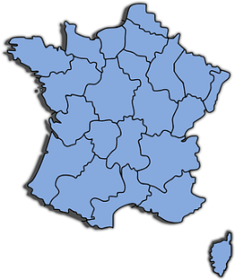
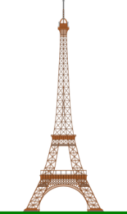
La France en chiffres !
*le chiffre = figure
*était = was
*le roi = king
écrire
Réécris les nombres en lettres.
Le français est la langue officielle de vingt-neuf pays.
Le français est la langue officielle de 29 pays.
Il y a 18 régions administratives en France.
Louis 19 était* roi* de la France pour 20 minutes.
Paris a 11 millions d’habitants.
French is the official language of 29 countries.
Il y a dix-huit régions administratives en France.
There are 18 administrative regions in France.
Louis dix-neuf était* Roi* de France pour vingt minutes.
Louis 19 was king of France for 20 minutes.
Paris a onze millions d’habitants.
Paris has 11 million inhabitants.
Notes:
Timing: 5 minutes
Aim: written production of numbers; written recognition of new and revisited vocabulary.
Procedure:
1. Students read sentences and re-write them with numbers in full.
2. Click to reveal.
3. Students translate sentences into English to check understanding of these facts.
4. Click to reveal translations.
Word frequency of unknown words used (1 is the most frequent word in French):
chiffre [749], roi [1364], habitant [1333], réécrire [>5000]
Source: Londsale, D., & Le Bras, Y. (2009). A Frequency Dictionary of French: Core vocabulary for learners London: Routledge.
Word frequency of cognates used (1 is the most frequent word in French):
minute [375], million [307], officiel [996]
Source: Londsale, D., & Le Bras, Y. (2009). A Frequency Dictionary of French: Core vocabulary for learners London: Routledge.

Slide 22
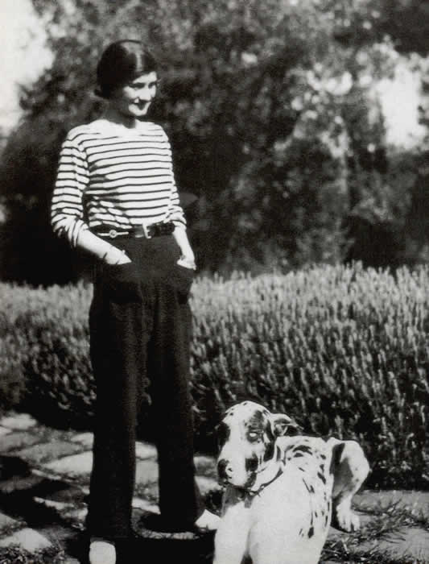
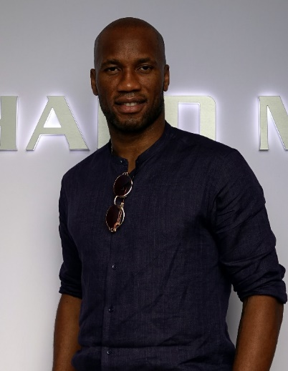
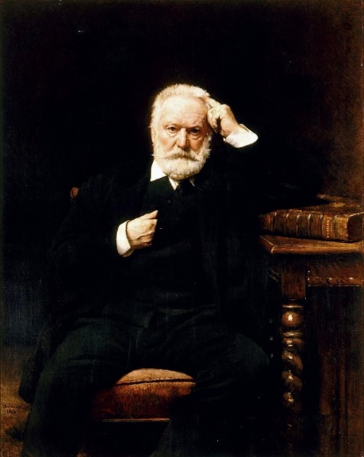
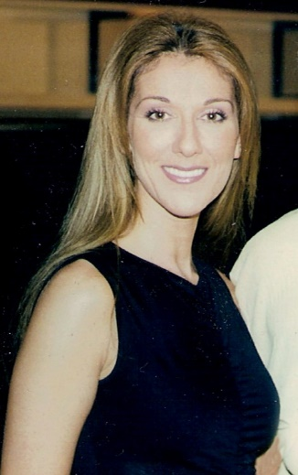
Ils ont quel âge ? (A)
écouter / parler
Les célébrités font les choses à quel âge ? Dis l’âge à un(e) partenaire.
Coco Chanel,
créatrice de vêtements
Première boutique:
Didier Drogba,
footballeur
Premier contrat professionnel:
26
21
Victor Hugo,
poète et auteur
Premier livre:
Céline Dion,
chanteuse
Premier album:
20
13
Notes:
Timing: 8 minutes. This is slide 1/2.
Aim: practising aural comprehension / oral production of this week’s new vocabulary
Procedure:
1. As a class, ensure students understand the facts about the celebrities.
2. Partner B turns away from the board.
3. Click to reveal the ages.
4. Partner A reads aloud the information in each box.
5. Partner B listens and writes down the number they hear.
6. Partner B turns back to the board to check answers.
7. Partners swap roles (see next slide).
Word frequency of cognates used (1 is the most frequent word in French): âge [502], célébrité [>5000], créateur [2613], boutique [3791], footballeur [>5000], contrat [832], professionnel [1000], auteur [762], album [2874]
Source: Londsale, D., & Le Bras, Y. (2009). A Frequency Dictionary of French: Core vocabulary for learners London: Routledge.
Source of images: Coco Chanel: Par Auteur inconnu — [1], Domaine public, https://commons.wikimedia.org/w/index.php?curid=35430968
Didier Drogba: By Y.Leclercq© - Own work, CC BY-SA 4.0, https://commons.wikimedia.org/w/index.php?curid=85583925
Victor Hugo: Par Léon Bonnat — http://www.histoire-image.com/site/oeuvre/analyse.php?liste_analyse=299, Domaine public, https://commons.wikimedia.org/w/index.php?curid=1422859
Céline Dion: Par Linda Bisset — Celine Dion, CC BY-SA 2.0, https://commons.wikimedia.org/w/index.php?curid=20023503

Slide 23
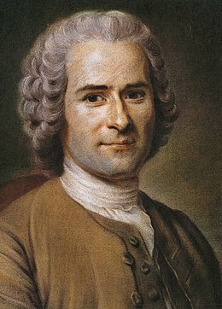
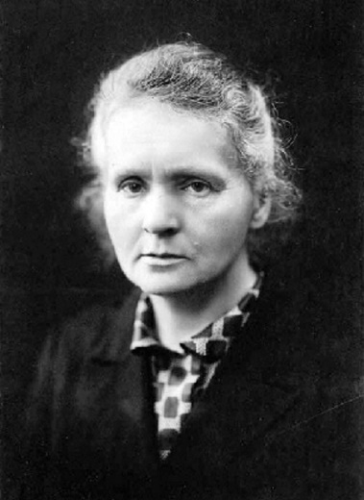
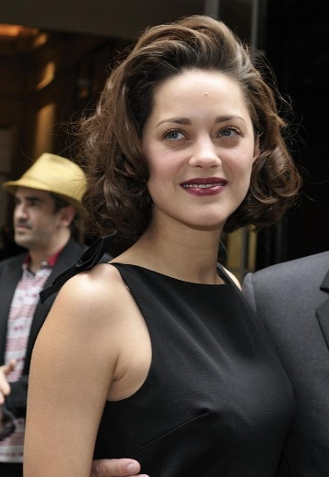
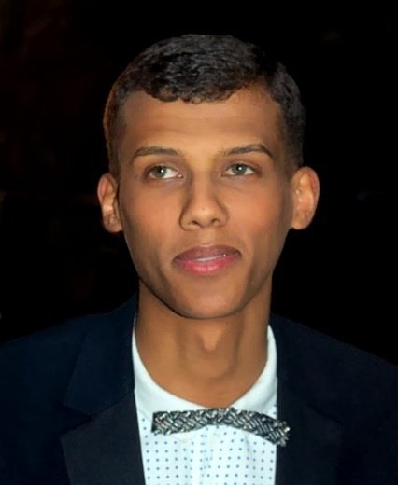
Ils ont quel âge ? (B)
écouter / parler
Les célébrités font les choses à quel âge ? Dis l’âge à un(e) partenaire.
Jean-Jacques Rousseau,
philosophe
Premier essai:
Marie Curie,
scientifique
Premier diplôme:
30
25
Marion Cotillard,
actrice
Premier film:
Stromae,
rappeur
Premier album numéro un:
18
24
Notes:
This is slide 2/2.
Word frequency of cognates used (1 is the most frequent word in French): philosophe [3609], essai [1475], scientifique [950], rappeur [>5000], album [2874]
Source: Londsale, D., & Le Bras, Y. (2009). A Frequency Dictionary of French: Core vocabulary for learners London: Routledge.
Source of images: Jean-Jacques Rousseau: Par Maurice-Quentin de La Tour — Source inconnue, Domaine public, https://commons.wikimedia.org/w/index.php?curid=24158
Marie Curie: Par Henri Manuel — Christie's, [1], Domaine public, https://commons.wikimedia.org/w/index.php?curid=15472203
Marion Cotillard: Par nicogenin — Flickr, CC BY-SA 2.0, https://commons.wikimedia.org/w/index.php?curid=7240817
Stromae: By Georges Biard, CC BY-SA 3.0, https://commons.wikimedia.org/w/index.php?curid=16072224

Slide 24
Talking about what, when, where and why you celebrate
‘est-ce que’ after question words
SSC [em/am] and [en/an]
Y8 French
Term 1.1 - Week 4- Lesson 6
Kirsten Somerville / Natalie Finlayson / Catherine Morris
Artwork by: Chloé Motard
Date updated: 09/07/21
Notes:
Learning outcomes (lesson 2):
Consolidation of SSCs [em/am] and [en/an]
Introduction of est-ce que after question words
Word frequency (1 is the most frequent word in French):
8.1.1.3 (introduce) célébrer [2170], préférer [597], avril [1022], date [660], événement [573], février [1136], janvier [939], juin [931], mars [868], mai [943], tradition [1371], premier, première [56], vingt [1273], trente [1646], on [29]
7.3.2.6 (revisit) aider [413], chercher [336], partager [527], peut [20], peux [20], pouvoir [20], sais [67], sait [67], savoir1 [67], plan [164], désolé [désoler - 2081], peut-être [190]
7.3.1.5 (revisit) café1 [1886], cinéma [1623], plage [2693], rue [598], devant [198], derrière [805], entre [55]
Source: Londsale, D., & Le Bras, Y. (2009). A Frequency Dictionary of French: Core vocabulary for learners London: Routledge.

Slide 25
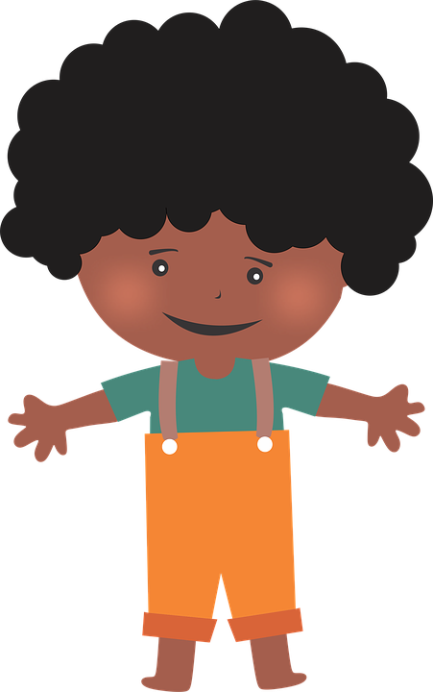
en/an
enfant
Notes:
Timing: 1 minute
Aim: To consolidate SSC [en/an]
Procedure: 1. Present the letter(s) and say the [en/an] sound first, on its own. Students repeat it with you. 2. Bring up the word ”enfant” on its own, say it, students repeat it, so that they have the opportunity to focus all of their attention on the connection between the written word and its sound.
3. A possible gesture for this would be to mime patting a child on the head/back 4. Roll back the animations and work through 1-3 again, but this time, dropping your voice completely to listen carefully to the students saying the [en/an] sound, pronouncing ”enfant” and, if using, doing the gesture.
Word frequency (1 is the most frequent word in French):
enfant [126]. Source: Londsale, D., & Le Bras, Y. (2009). A Frequency Dictionary of French: Core vocabulary for learners London: Routledge.

Slide 26
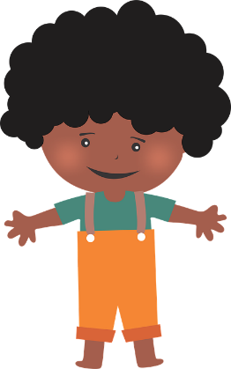
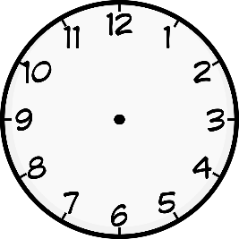
en/an
grand
quand ?
?
enfant
penser
encore
prendre
[to take]
Notes:
Timing: 1 minute
Aim: To consolidate SSC [en/an]
Procedure:
1. Introduce and elicit the pronunciation of the individual SSC [en/an] and then the source word again ‘enfant’ (with gesture, if using). 2. Then present and elicit the pronunciation of the five cluster words.
The cluster words have been chosen for their high-frequency, from a range of word classes, with the SSC (where possible) positioned within a variety of syllables within the words (e.g. initial, 2nd, final etc.). Additionally, we have tried to use words that build cumulatively on previously taught SSCs (see the Phonics Teaching Sequence document) and do not include new SSCs. Where new SSCs are used, they are often consonants which have a similar symbol-sound correspondence in English.
Word frequency (1 is the most frequent word in French): grand [59]; quand [119] penser [116]; prendre[43]; encore [51]; enfant [126]. Source: Londsale, D., & Le Bras, Y. (2009). A Frequency Dictionary of French: Core vocabulary for learners London: Routledge.

Slide 27
Phonétique
écouter
What do you notice about these four sounds?
temps
chambre
penser
grand
SSC [em/am] is the same sound as SSC [en/am], which you already know.
When this nasal sound appears in front of the letters p or b, it is spelled [em/am] instead of [en/an].
Notes:
Timing: 2 minutes
Aim: Raising awareness of the identical sound in SSCs [em], [am], [en] and [an].
For a reminder of Year 7 SSC [en/an], see the two slides that follow.

Slide 28
Phonétique
lire / parler
facile
lampe
45
orange
champion
éléphant
secondes
ambition
amplifier
chimpanzee
ambassade
0
difficile
DÉBUT
Notes:
Timing: 3 minutes for 3 slides.
Aim: Oral production of SSC [an/am] in words of varying degrees of complexity in decreasing amounts of time.
Procedure:
Students pair up.
Explain that students are going to work their way down the ‘ladder’ by correctly pronouncing cognates containing [an/am], starting with simple words and building up to more complex words. Starting with lampe, Partner A works their way down the ladder. Partner B listens for correct pronunciation of [an/am]. If Partner A makes a mistake, e.g.tries to pronounce words the ‘English’ way by adding an ‘m’ after the vowel, they must return to the top of the ladder.
Students swap roles. Re-start the timer.
Whoever is furthest down the ladder when the timer stops is the winner!
Click on the words to hear them said aloud by a native speaker. Students repeat.
Move on to the next slide.
Transcript and word frequency (1 is the most frequent word in French):
orange [3912], lampe [4699], champion [2443], ambassade [3327], chimpanzee [>5000], éléphant [>5000], amplifier [4537], ambition [2280]

Slide 29
Phonétique
lire / parler
facile
lampe
30
orange
champion
éléphant
secondes
ambition
amplifier
chimpanzee
ambassade
0
difficile
DÉBUT
Notes:
As previous but with 15 fewer seconds on the timer.

Slide 30
Phonétique
lire / parler
facile
lampe
15
orange
champion
éléphant
secondes
ambition
amplifier
chimpanzee
ambassade
0
difficile
DÉBUT
Notes:
As previous but with 15 fewer seconds on the timer still.

Slide 31
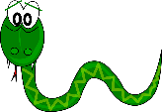
Phonétique
lire / écouter
 |  | [en/em] | [an/am]
 | campagne [countryside]
 | serpent
 | vent [wind]
j | jambon
 | vendredi [Friday]
 | ampoule
 | pantalon
 | emmener [to take]
 | jambe
 | tempête [storm]
Comment ça s'écrit ?
Avec [en/an] ou [em/am] ?
Complète et dis les mots !
1
_ _
2
_ _
3
_ _
4
_ _
5
_ _
6
_ _
7
_ _
8
_ _
9
_ _
10
_ _
Notes:
Timing: 7 minutes
Aim: Applying awareness of the spelling rules governing SSCs [em], [am], [en] and [an], and production of all four SSCs.
Procedure
Student read the wordsand decide based on the presence of absence of a ‘p’ or ‘b’ after the gap when [en/em] or [an/am] is needed.
Click to check.
Now, students are challenged to say all ten words and pronounce the SSCs in the same way each time. It will be tempting for students to add an ‘n’ or ‘m’ after the vowel! Students should work in pairs and monitor each other for this.
Click to hear the words pronounced by a native speaker.
Word frequency of unknown words used (1 is the most frequent word in French): campagne [666], serpent [>5000], vent [1387], jambon [>5000], vendredi [1086], ampoule [>5000], pantalon [4670], emmener [2098], jambe [2472], tempête [2695]
Source: Londsale, D., & Le Bras, Y. (2009). A Frequency Dictionary of French: Core vocabulary for learners London: Routledge.
Word frequency of cognates used (1 is the most frequent word in French): compléter [2034]
Source: Londsale, D., & Le Bras, Y. (2009). A Frequency Dictionary of French: Core vocabulary for learners London: Routledge.

Slide 32
Question words with ‘est-ce que’
grammaire
As we have learnt, we can ask yes/no questions by adding est-ce que:
Est-ce que tu manges des fruits ?
Est-ce que tu demandes un cadeau ?
To ask information questions, the question word goes before est-ce que :
Combien de fruit est-ce que tu manges ?
Qu’est-ce que tu demandes ?
Remember – the subject and verb stay in the same order with est-ce que (there is no inversion.)
Do you eat fruit ?
Are you asking for a present ?
How much fruit do you eat?
What are you asking for ?
Que → qu’ before a vowel
Notes:
Timing: 3 minutes
Aim: introducing word order with est-ce que + question words, contrasting with inversion questions

Slide 33
La francophonie
lire
*le Maghreb = North Africa
Le 20 mars, Léa célèbre la Journée internationale de la francophonie.
Elle fait une interview. La question est est-ce que ou qu’est-ce que ?
Est-ce que tu vas étudier ?
Oui, je vais étudier l’histoire de la langue française.
Qu’est-ce que tu vas apprendre ?
Je vais apprendre où on parle français dans le monde, et pourquoi.
Qu’est-ce que tu vas lire ?
Je vais lire un poème français de chaque continent.
Est-ce que tu vas écrire ?
Oui, je vais écrire des messages à des élèves à l’étranger.
Qu’est-ce que tu vas manger ?
Je vais manger une tajine, un déjeuner traditionnel au Maghreb*.
Est-ce que tu vas chanter ?
Oui, je vais chanter dans une compétition internationale.
Qu’est-ce que tu vas préparer ?
Je vais préparer un poème… Désolée, c’est un secret !
Est-ce que tu vas gagner ?
Peut-être… c’est ça mon projet ! Je sais bien chanter.
[1] __________
[5] __________
[2] __________
[6] __________
[3] __________
[7] __________
[4] __________
[8] __________
Notes:
Timing: 8 minutes
Aim: practising written recognition of information questions with est-ce que and qu’est-ce que
Procedure:
1. Write 1-8 and choose est-ce que or qu’est-ce que to complete each question, based on the answer given (yes/no or information).
2. Click to reveal the answers.
3. Elicit oral translations into English, focusing on the questions (‘are you going to’ vs ‘what are you going to’ and the use of aller + infinitive.
Word frequency of cognates used (1 is the most frequent word in French): francophonie [>5000], journée [587], international [282], interview [3186], continent [2388], message [792], tajine [>5000], Maghreb [n/a], compétition [2651], secret [796]
Source: Londsale, D., & Le Bras, Y. (2009). A Frequency Dictionary of French: Core vocabulary for learners London: Routledge.

Slide 34
Yennayer
écouter
En Algérie, le 12 janvier, c’est la nouvelle année traditionnelle – Yennayer.
Amir a des questions pour Abdel.
Que dit-il ? Écris a ou b.
 | a | b | R
 | Quel jour | Quel jour est-ce que
 | Pourquoi | Pourquoi est-ce que
 | Quelle date | Quelle date est-ce que
 | Quand | Quand est-ce que
 | Où | Où est-ce qu’
 | Que | Qu’est-ce que
 | Comment | Comment est-ce que
 | Que | Qu’est-ce que
1
1
2
2
3
3
4
4
5
5
6
6
7
7
8
8
Notes:
Timing: 8 minutes. This is slide 1/2.
Aim: aural recognition of word order with est-ce que + question words
Procedure:
Recap word order with inversion questions and compare with word order in est-ce que questions.
Click the numbers to play the audio. The beginning of the questions are obscured by beeps.
Write 1-8 and choose ‘a’ or ‘b’ to complete each question. Use the presence or absence of beeps to
Answers and full audio (without beeps) play on the numbers in the R (réponses) column.
Students listen again and translate the questions into English.
Answers on slide 35.
Transcript:
[…] fait-on la fête ?
[…] on célèbre le 12 Janvier ?
[…] préfères-tu, le premier ou le 12 ?
[…] Yennayer devient une fête nationale officielle ?
[…] on célèbre Yennayer dans le monde ?
[…] prépare-t-on pour le déjeuner ?
[…] tu aides ?
[…] manges-tu ?
Word frequency of cognates used (1 is the most frequent word in French): national [227], officiel [996]
Source: Londsale, D., & Le Bras, Y. (2009). A Frequency Dictionary of French: Core vocabulary for learners London: Routledge.

Slide 35
Yennayer
écouter
Qu'est-ce qu'il demande ?
 | Français | Anglais
 | Quel jour | (On) which day do people celebrate?
 | Pourquoi est-ce que | Why do people celebrate the 12th of January?
 | Quelle date | Which date do you prefer, the first or the 12th?
 | Quand est-ce que | When did Yennayer become an official bank holiday?
 | Où est-ce que | Where do people celebrate Yennayer in the world?
 | Que | What do people prepare for lunch?
 | Comment est-ce que | How do you help?
 | Que | What do you eat?
1
2
3
4
5
6
7
8
Notes:
This is slide 2/2.

Slide 36
Le Festival de Cannes
écrire
En mai, c’est le Festival de Cannes, un festival de cinéma important.
Tu fais une interview avec un acteur. Écris les questions avec est-ce que.
Je viens au Festival de Cannes parce que c’est l’événement de l’année ! (why)
Aujourd’hui, je regarde des films, et je fais une fête sur la plage. (what)
En ce moment, je vais au cinéma. (where)
Je vais arriver au cinéma en retard ! (when)
Je vais regarder trois films. (how many)
Je trouve la ville de Cannes excellente. Les cafés et les plages sont sympas. (how)
J’aime le café derrière le cinéma. (which)
Je préfère la Plage du Festival, entre l’hôtel Marriott et l’hôtel Carlton. (which)
Notes:
Timing: 8 minutes. This is slide 1/2.
Aim: practising written production of word order with est-ce que + question words
Procedure:
1. Write 1-8 and write a question for each answer using est-ce que + question word.
2. Suggested answers are provided on the next slide.
Word frequency of cognates used (1 is the most frequent word in French): festival [3858], interview [3186]
Source: Londsale, D., & Le Bras, Y. (2009). A Frequency Dictionary of French: Core vocabulary for learners London: Routledge.

Slide 37
Le Festival de Cannes
Réponses
écrire
En mai, c’est le Festival de Cannes, un festival de cinéma important.
Tu fais un interview avec un acteur. Écris les questions avec est-ce que.
Pourquoi est-ce que tu viens au Festival de Cannes ?
Qu’est-ce que tu fais aujourd’hui ?
Où est-ce que tu vas en ce moment ?
Quand est-ce que tu vas arriver au cinéma ?
Combien de films est-ce que tu vas regarder ?
Comment est-ce que tu trouves la ville de Cannes ?
Quel café est-ce que tu aimes ?
Quelle plage est-ce que tu préfères ?
Notes:
This is slide 2/2.
Procedure:
1. Click to reveal suggested answers.
2. English translations can also be elicited.

Slide 38
Tu fais quoi ? [1]
Don’t say the words in brackets!
parler
Partenaire A
 | Questions
1.
2.
3.
4.
5.
6.
Que [prépares-tu le 12 janvier ?]
Combien d’événements [regardes-tu le 27 février ?]
Quelle langue est-ce que [tu parles le 20 mars ?]
Pourquoi est-ce que [tu aimes les farces le premier avril ?]
Où est-ce que [tu vas le 11 mai ?]
Quand [pars-tu le 21 juin ?]
Notes:
Timing: 9 minutes. This is slide 1/6.
Aim: practising aural production of word order with est-ce que + question words
Procedure:
1. Partner A reads out the beginning of 6 questions using the question words in bold.
2. Partner B completes the question, choosing from the word order options presented on the role card on the next slide.
3. Peer- correction of answers.
4. Partners swap roles and repeat steps 1-4.
5. Optional extension: students write possible answers to questions (suggestions given on the slide after next).
Word frequency of cognates used (1 is the most frequent word in French): farce [4285]
Source: Londsale, D., & Le Bras, Y. (2009). A Frequency Dictionary of French: Core vocabulary for learners London: Routledge.

Slide 39
Tu fais quoi ? [1]
parler
Remember! The presence or absence of est-ce que tells you which word order is needed.
Partenaire B
 | Questions
1. | ________ prépares-tu / tu prépares le 12 janvier ? (what)
2. | ________ regardes-tu / tu regardes le 27 février ? (how many events)
3. | ________ parles-tu / tu parles le 20 mars ? (which language)
4. | ________ aimes-tu / tu aimes les farces le premier avril ? (why)
5. | ________ vas-tu / tu vas le 11 mai ? (where)
6. | ________ pars-tu / tu pars le 21 juin ? (when)
Notes:
This is slide 2/6.
Answers revealed on clicks.

Slide 40
Tu fais quoi ? [1]
écrire
 | Réponses
1. | Je prépare un grand déjeuner.
2. | Je regarde deux événements.
3. | Je parle français.
4. | J’aime les farces parce que c’est amusant.
5. | Je vais à Cannes.
6. | Je pars en retard.
Notes:
This is slide 3/6.
Suggested answers for possible written extension to previous activity.

Slide 41
Tu fais quoi ? [2]
Don’t say the words in brackets!
parler
Partenaire A
 | Questions
1.
2.
3.
4.
5.
6.
Qu’est-ce que [tu fais le 12 janvier ?]
Où est-ce que [tu passes le 27 février ?]
Pourquoi [étudies-tu l’histoire le 20 mars ?]
Quelle phrase [dis-tu le premier avril ?]
Combien de cafés [visites-tu le 11 mai ?]
Comment est-ce que [tu dors le 21 juin ?]
Notes:
This is slide 4/6.

Slide 42
Tu fais quoi ? [2]
parler
Remember! The presence or nascence of est-ce que tells you which word order is needed.
Partenaire B
 | Questions
1. | ________ fais-tu / tu fais le 12 janvier ? (what)
2. | ________ passes-tu / tu passes le 27 février ? (where)
3. | ________ étudies-tu / tu étudies l’histoire le 20 mars ? (why)
4. | ________ dis-tu / tu dis le premier avril ? (which sentence)
5. | ________ visites-tu / tu visites le 11 mai ? (how many cafés)
6. | ________ dors-tu / tu dors le 21 juin ? (how)
Notes:
This is slide 5/6.

Slide 43
Tu fais quoi ? [2]
écrire
 | Réponses
1. | Je fais une fête.
2. | Je passe le 27 février à Nice.
3. | J’étudie l’histoire parce que c’est intéressant.
4. | Je dis « poisson d’avril » !
5. | Je visite quatre cafés.
6. | Je ferme la fenêtre pour dormir.
Notes:
This is slide 6/6.
Suggested answers for possible written extension to previous activity.

Slide 44
Gaming Grammar
Gaming Grammar
Relevant mini game(s):
Questions: subject-verb inversion (Question formation)
Notes:
This slide links to Gaming Grammar login screen. The appropriate mission can then be selected from the menu page.
Students will progress through the game at their own rate; teachers should use the teacher interface to check progress. This will help to inform future lesson planning.

Slide 45
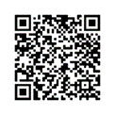
Devoirs
Vocabulary Learning Homework (Revise Y8, Term 1.1, Week 4)
Audio file
Audio file QR code:
Student worksheet
Quizlet link
In addition, revisit: Y7 Term 3.2 Week 6
Y7 Term 3.1 Week 5
Notes:
The answer sheet for the Y8, Term 1.1, Week 4 vocabulary learning HW is here: https://resources.ncelp.org/concern/resources/4j03d022r?locale=en

