Slide 1
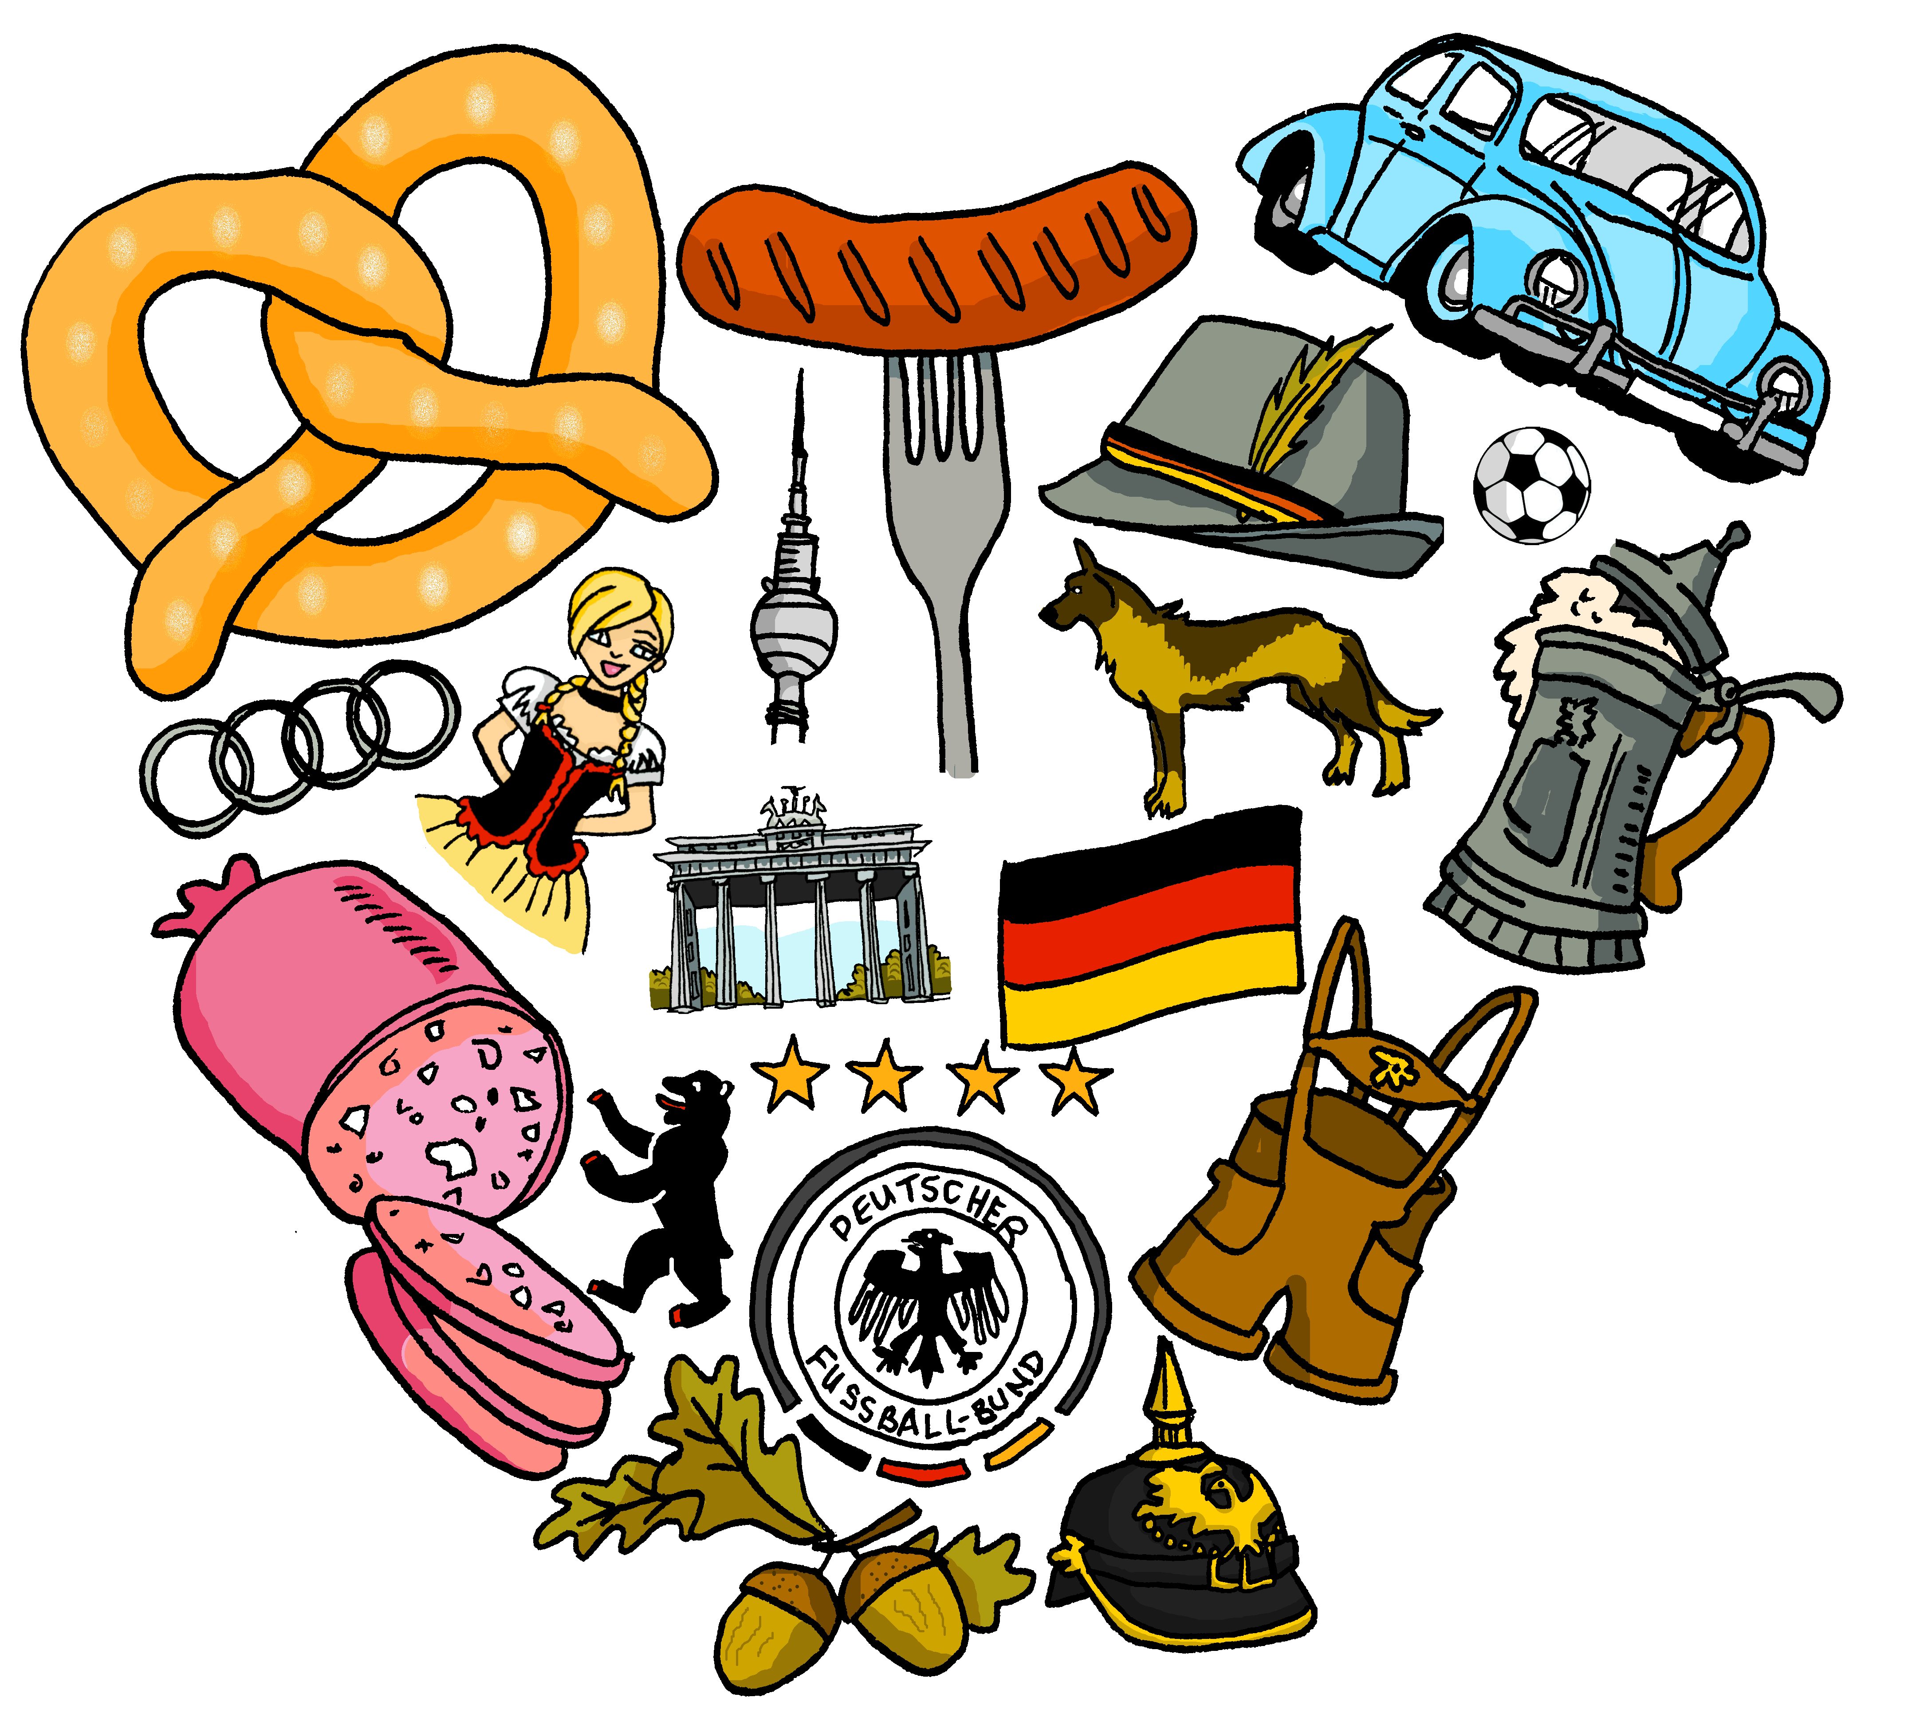
Deutsch
Year 7 Language Guide
Name: …………………………………………..
Lehrer/Lehrerin: ……………………
Last updated: 08/01/21

Slide 2
Themes overview | 2
Phonics | 3 -8
Definite articles (words for ‘the’) Wo? SEIN [to be, being] -ist Talking about where something is | 9
Definite articles (der, die, das) Was? SEIN (bin, bist) Asking and stating what something is (existence) | 10
Indefinite articles (words for ‘a’) Wie? Describing things | 11-12
Negation: nicht, kein, keine, kein What something is not, and is not like | 13-14
HABEN [to have, having] Wer? What people have (possession) | 15-16
‘the’ vs ‘a’ - definite/indefinite (R2-acc) The only one or one of many | 17-18
Subject-verb inversion questions Asking about possessions | 19
Present tense: weak verbs I, you, s/he What people do (in school /at home) | 20-22
WH-questions (wo, was, wer, wie) Talking about activities at home | 23-24
Present : working from infinitive verbs Saying what people do | 25
Definite articles (revisited) Narrating a plot / storyline | 26
Plural nouns (rules 1 and 2) Wie viele? Describing Christmas TEXT | 27
Plural nouns (rule 3) SEIN (sind) Talking about presents you wish for | 28
Subject pronouns ‘it’ and ‘they’ What you have, what it’s like | 29-30
Es gibt, numbers 1-12, plural (rule 4) Talking about more than one thing | 31
MÖGEN [to like] object pronouns Talking about likes and dislikes | 32-33
FINDEN [to find, finding] Exhanging views (on school life) | 34-35
Present tense: weak verbs (revisited) Talking about self, to and about someone else | 36-37
Present tense: weak verbs (we) Saying what we do | 38
KÖNNEN [can, to be able to], TEXT What people can and cannot do | 39-40
Present tense: strong verbs (I,s/he) Comparing lifestyles | 41
Present tense: strong verbs (I,you) Talking about out of school | 42
Present tense: strong verbs (s/he, they) Saying what others do | 43
Word order 2 When you and others do things | 44
Word order 2, Wann? Asking and answering questions | 45
Prepositions ‘in’ and ‘auf’ Going into/onto vs being in/on | 46-47
Possessive adjectives: my, your, his, her Talking about family | 48
Present tense: revisited, possessives A day in my life | 49
Word order 2 (revisited) Saying what there is, where | 50-51
Present tense: revisited, SEIN/HABEN Happens usually / happening now | 52
MÜSSEN, DÜRFEN, WOLLEN What people must, may, want to do to improve their lifestyle | 53-54
Modal verbs cont’d Explaining the rules of a game | 55
Present tense: future meaning Usual holidays vs plans for this summer | 56
Present tense: future meaning Talking about going to places | 57-58
Prepositions ‘auf’, plurals: revisited TEXT | 59
Spelling Bee lists | 60-65

Slide 3
Overview | Theme / Topic
Autumn Term 1 | Asking and stating where something is (location) Asking and stating what something is (existence) Saying what something is like (description) Saying what something is not, and is not like (negation) Saying what people have (possession) Asking and answering questions about what you have
Autumn Term 2 | Saying what people do (in school and at home) Asking and answering questions about activities (at home) Narrating a simple plot /storyline Talking about one or many (Christmas)
Spring Term 1 | Saying what you and others have (and what it is/they are like) Talking about more than one, numbers Asking and stating your likes and dislikes Asking for and giving views (on school life) Talking about yourself, to and about someone else
Spring Term 2 | Saying what we do Saying what I and others can and cannot do Comparing lifestyles Talking about life outside school Narrating other people’s actions
Summer Term 1 | Saying when you and others do things Talking about movement into, and location in, places Asking and answering questions (about family) Describing one day in your life Saying what is where (in German-speaking countries)
Summer Term 2 | Saying what happens usually and what is happening now Saying what people can/must/want to do to improve their lifestyle Explaining the rules of a game Comparing usual activities with future summer plans Talking about going to places

Slide 4
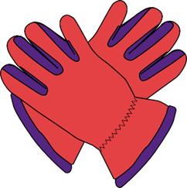
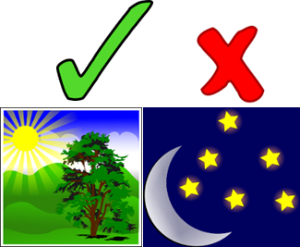
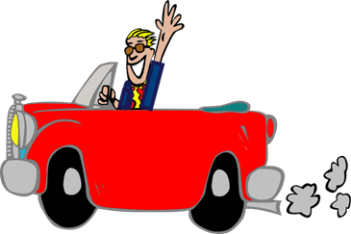
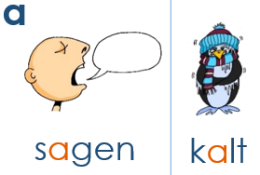
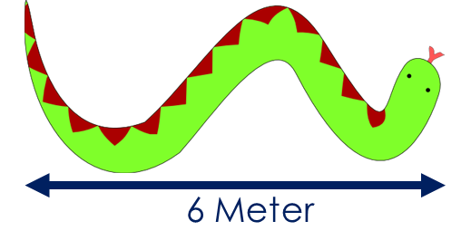
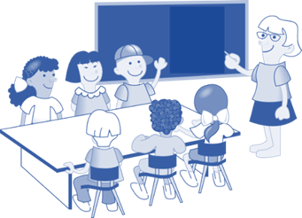
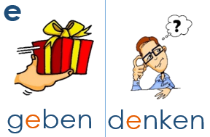
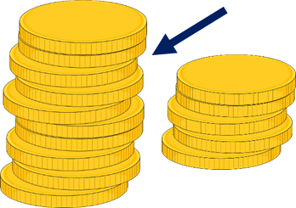
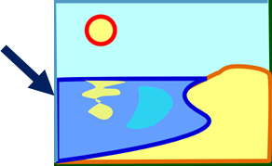
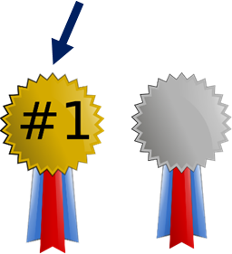
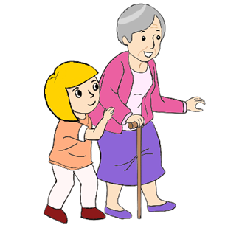
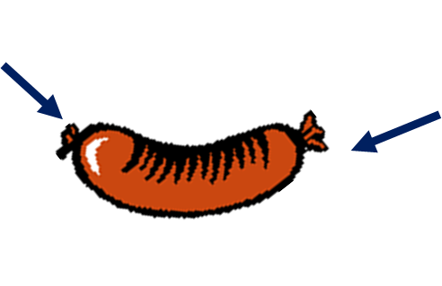
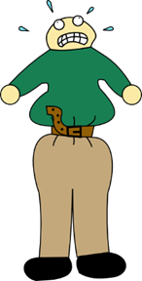
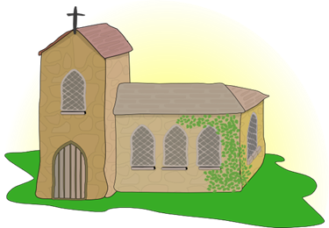
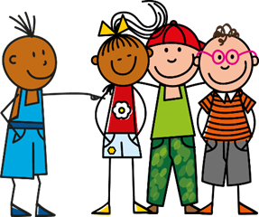
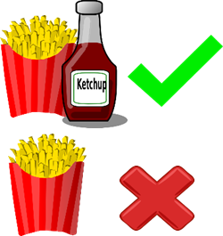
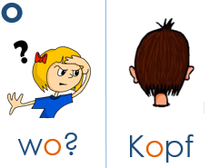
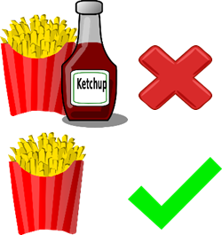
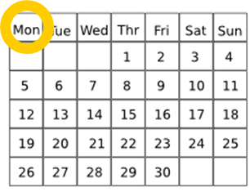
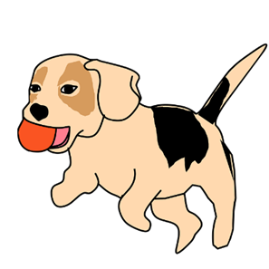
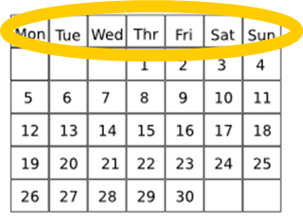
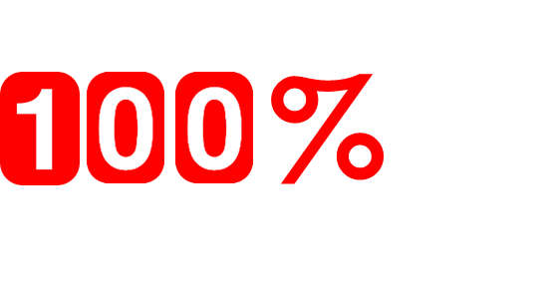
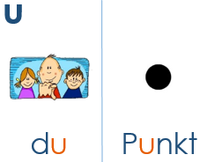
Phonics
German vowels German vowels can be short or long. Vowels are short when followed by more than one consonant, e.g., Mann, Gast. Vowels are long when:
there is a double vowel, e.g., Paar,
or when followed by the letter ‘h’, e.g., fahren,
or by a single consonant, e.g., sagen.
NB: German final ‘e’ is not silent, but very short, e.g., danke, Klasse.
Paar
haben
klar
Tag
fahren
[guest]
lang
Mann
Klasse
Gast
danke
[life]
mehr
sehen
Meer
Leben
Idee
besser
helfen
Bett
Ende
eng
Kirche
Linie
privat
Familie
ihr
mit
[to know]
[interesting]
wissen
interessant
bitte
Hilfe
wohnen
ohne
Million
Montag
holen
[still]
wollen
offen
noch
Woche
kommen
[to do]
absolut
Minute
tun
gut
Schule
[to use]
unten
nutzen
dunkel
3
Meinung
Mutter
Notes:
The cluster words have been chosen for their high-frequency, from a range of word classes, with the SSC (where possible) positioned within a variety of syllables within the words(e.g. initial, 2nd, final etc..) and additionally, we have tried to use words that build cumulatively on previously taught SSCs (see the Phonics Teaching Sequence document) and do not include new SSCs. Where new SSCs are used, they are often consonants which have a similar symbol-sound correspondence in English. Source: Jones, R.L. & Tschirner, E. (2006). A frequency dictionary of German: core vocabulary for learners. Routledge
Word frequency rankings (1 is the most common word in German): sagen [46]; Paar [284] haben [7]; fahren [169]; klar [255]; Tag [108]
kalt [875]; lang [95] Mann [131]; Klasse [619]; Gast [675]; danke [778]
geben [57]; mehr [58] Leben [220]; sehen [81]; Meer [977]; Idee [641]
denken [124]; besser [231] Ende [204]; helfen [406]; Bett [654]; eng [591]
wir [31]; Kirche [519] Familie [310]; Linie [897]; privat [665]; ihr [26]
finden [110]; mit [13] bitte [547]; wissen [79]; interessant [531]; Hilfe [737]
wo? [94]; wohnen [380] Montag [794]; ohne [119]; Million [206]; holen [640]
Kopf [279]; wollen [65] Woche [209]; offen [382]; noch [37]; kommen [61] du [52]; absolut [993] gut [78]; Minute [361]; tun [140]; Schule [208] Punkt [427]; unten [590] dunkel [819]; Meinung [636]; nutzen [463]; Mutter [227]

Slide 5
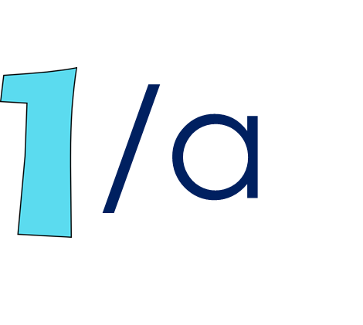
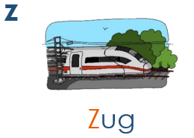
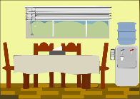
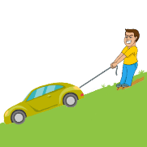
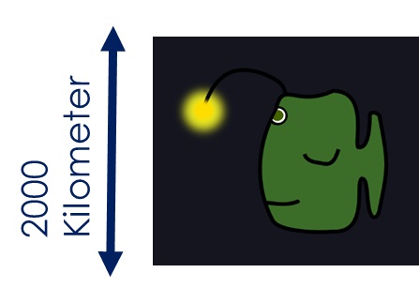
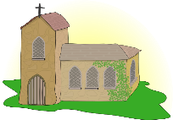
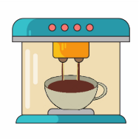
You will practise some SSC in pairs. This helps you to distinguish between two very similar sounds. E.g., ei vs ie.
[unfortunately]
[to be]
leider
klein
sein
ein
allein
Zimmer
Arzt
Platz
zehn
sitzen
Wasser
Was?
antworten
wahr
gewinnen
ziehen
tief
liegen
sie
Brief
[finally]
[sometimes]
Licht
endlich
manchmal
Kirche
nicht
machen
acht
Fach
nochmal
Nacht
4
Notes:
Word frequency rankings (1 is the most common word in German): frei [318]; leider [642] ein [5]; klein [114]; sein [3]; allein [258] Zug [613]; Zimmer [609] zehn [314]; Arzt [614]; Platz [344]; sitzen [261] Welt [190]; Wasser [297] wahr [662]; Was? [39]; antworten [804]; gewinnen [410] Liebe [843]; ziehen[266] sie [10]; tief [506]; liegen [118]; Brief [813] ich [8]; Licht [503] Kirche [519]; endlich [496]; manchmal [394]; nicht [12] Buch [195]; machen [49] nochmal [773]; acht [458]; Fach [698]; Nacht [335].
Source: Jones, R.L. & Tschirner, E. (2006). A frequency dictionary of German: core vocabulary for learners. Routledge

Slide 6
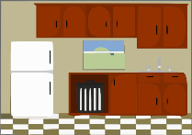
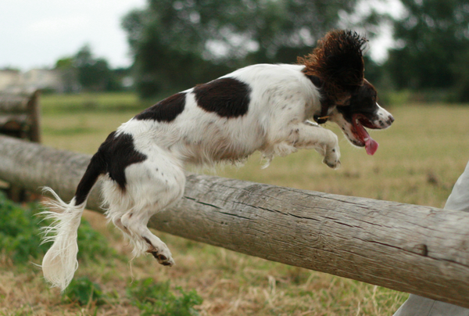
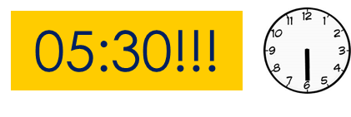
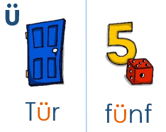
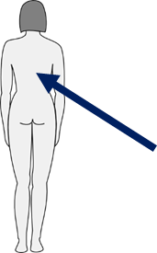
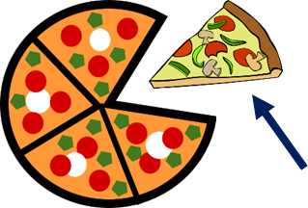
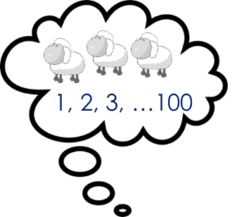
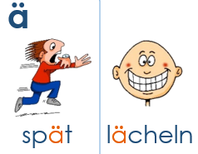
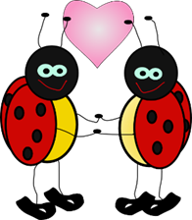
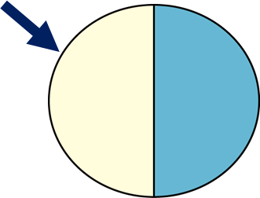
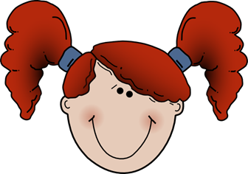
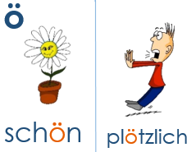
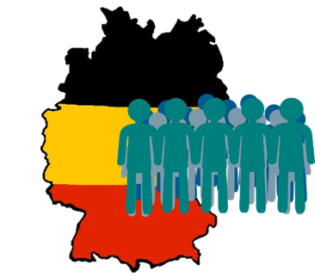
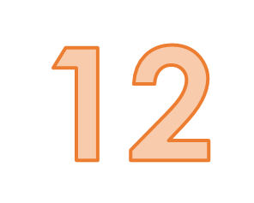
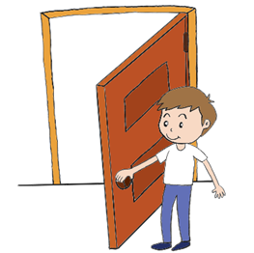
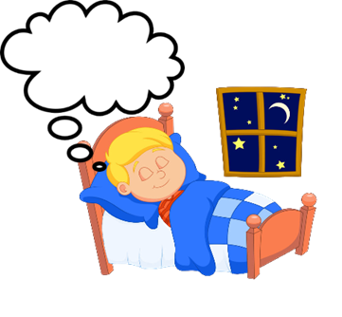
Notice that some of these words have capital letters. Why? They are nouns. All nouns are written with capital letters in German, even in the middle of a sentence! → Die Tür ist blau!
fühlen
Küche
früh
grün
über
[luck/ happiness]
[must, to have to]
[to wish]
Rücken
Glück
müssen
wünschen
Stück
[to explain]
zählen
Nähe
erklären
ähnlich
wählen
[relationship]
[constant(ly)]
Verhältnis
Hälfte
ständig
Mädchen
ändern
[solution]
[possible]
[to like]
Lösung
französisch
möglich
mögen
Körper
[public]
Bevölkerung
völlig
öffentlich
zwölf
öffnen
Bäume
träumen
Häuser
häufig
Gebäude
5
Notes:
Word frequency rankings (1 is the most common word in German):
Tür [400]; fühlen [419] grün [556]; Küche [960]; früh [322]; über [48] fünf [272]; Rücken [914] wünschen [684]; Glück [763]; müssen [45]; Stück [417] spät [171]; zählen [680] ähnlich [429]; Nähe [795]; erklären [250]; wählen [64] lächeln [793]; Verhältnis [517] Mädchen [537]; Hälfte [972]; ständig [612]; ändern [476] schön [164]; Lösung [620] mögen [151]; französisch [644]; möglich [156]; Körper [617] plötzlich [459]; Bevölkerung [769] völlig [462]; öffentlich [399]; zwölf [882]; öffnen [538] Mäuse [3757]; Bäume [994] häufig [432]; träumen [1907]; Häuser [159]; Gebäude[1202].
Source: Jones, R.L. & Tschirner, E. (2006). A frequency dictionary of German: core vocabulary for learners. Routledge

Slide 7
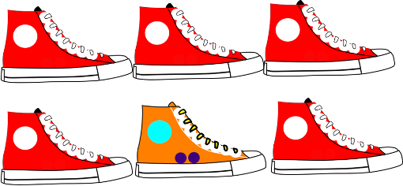
Learning these SSC (sound-spelling correspondences) will help you to pronounce written German more confidently and to recognise and spell words you hear.
[fast]
falsch
zwischen
Mensch
schnell
schwarz
[fun (noun)]
Spaß
sprechen
Sport
Sprache
Spiel
Gesetz
reisen
langsam
Seite
Satz
Fußball
heißen
damals
ein bisschen
lassen
schwer
Herz
erst
wer?
lernen
Eltern
anders
hundert
aber
oder
6
Notes:
Word frequency rankings (1 is the most common word in German): schreiben [245]; falsch [638] schnell [233]; zwischen [115]; Mensch [104]; schwarz [451] spielen [197]; Spaß [666] Sprache [367]; sprechen [157]; Sport [845]; Spiel [500] sollen [63]; Gesetz [552] Seite[217]; reisen [978]; langsam [604]; Satz [582] groß [74]; Fußball [1497] ein bisschen [194]; heißen [123]; damals [271]; lassen [82] er [20]; schwer [256] wer? [173]; Herz [699]; erst [126]; lernen [203] wieder [75]; Eltern [351] aber [32]; anders [306]; hundert [945]; oder [30].
Source: Jones, R.L. & Tschirner, E. (2006). A frequency dictionary of German: core vocabulary for learners. Routledge

Slide 8
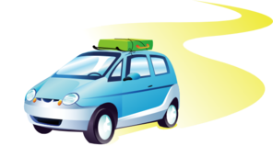
positiv
bevor
vergessen
voll
Vater
[exact(ly)]
[to believe]
[to go out]
genau
glauben
ausgehen
auch
auf
Regel
warum?
Reise
rot
Beruf
Markt
Kultur
dort
Morgen
Wort
Euro
Freund
neu
heute
Leute
7
Notes:
Word frequency rankings (1 is the most common word in German): vor [55]; positiv [690] voll [357]; bevor[541]; vergessen [595]; Vater [216] Haus [159]; genau [183] auch [16]; glauben [143]; ausgehen [493]; auf [17] reden [356]; Regel [484] rot[381]; warum? [246]; Reise [786]; Beruf [477] Uhr [349]; Markt [508] Morgen [311]; Kultur [593]; dort [104]; Wort [243] Deutschland [N/A proper noun]; Euro [333] heute [121]; Freund [327]; neu [80]; Leute[163].
Source: Jones, R.L. & Tschirner, E. (2006). A frequency dictionary of German: core vocabulary for learners. Routledge

Slide 9
[theory]
[topic]
[method]
Theorie
Apotheke
Thema
Methode
Bibliothek
[to understand]
[certain(ly)]
Straße
verstehen
bestimmt
stehen
Stadt
[reason]
rund
Hand
Grund
Land
Kind
[necessary]
[ready]
[difficulty]
[important]
[little, not much]
notwendig
fertig
Schwierigkeit
wichtig
wenig
[someone]
[now]
Junge
jemand
jetzt
Jahr
jung
8
Notes:
Word frequency rankings (1 is the most common word in German): Theater [725]; Theorie [>4034] Methode [835]; Apotheke [>4034]; Thema [328]; Bibliothek [927]
stark [207]; Straße [355] stehen [87]; verstehen [222]; bestimmt [226]; Stadt [186] und [2]; rund [316] Land [146]; Hand [179]; Grund [230]; Kind [106] richtig [211]; notwendig [168] wichtig [177]; fertig [717]; Schwierigkeit [866]; wenig [102] ja [27]; Junge [630] Jahr [51]; jemand [397]; jetzt [62]; jung [184]
Source: Jones, R.L. & Tschirner, E. (2006). A frequency dictionary of German: core vocabulary for learners. Routledge

Slide 10
T1.1 Woche 1
Grammatik
Nouns and definite articles: the words for ‘the’
German has three words for the:
masculine
feminine
neuter
der Tisch
die Flasche
das Fenster
English speakers might find this tricky because English only uses the.
Every noun has a gender in German, but grammatical gender is not the same as biological gender, as you can see.
All German nouns start with a capital letter, wherever they are in the sentence: Der Tag ist kalt. The day is cold. Only proper nouns do this in English. E.g., London, March, Emily.
Talking about where something is
Vokabeln
vb
vb
pron
nnt
nf
nnt
nf
nm
adv
adv
sein | to be, being
ist | is (BE)
wo? | where?
das Fenster | window
die Flasche | bottle
das Heft | exercise book
die Tafel | board
der Tisch | table
da | there
hier | here
det
det
det
der | the (m)
die | the (f)
das | the (nt)
Hallo | Hello
Tschüs | Bye
9

Slide 11
T1.1 Woche 2
Vokabeln
Definite articles: the words for ‘the’, ‘der,die,das’
Asking and stating what something is
vb
vb
pron
nf
nnt
nm
nm
adj
adj
conj
sagen | to say, tell
sagt | says, tells
was? | what?
die Klasse | class
das Paar | pair
der Mann | man
der Tag | day
richtig | right, correct
falsch | false
oder | or
nein | no
ja | yes
nicht | not
Ist das klar? | Is that clear?
Write in English:
Wo ist das Fenster?
Das ist richtig.
Das ist falsch.
Die Flasche ist da.
Ist die Tafel hier oder da?
10

Slide 12
T1.1 Woche 3
Grammatik
Indefinite articles: the words for ‘a’,’an’
As you know, German has three words for the:
masculine
feminine
neuter
der Tisch
die Flasche
das Fenster
It also has different words for a:
masculine
feminine
neuter
ein
Tisch
Flasche
ein
Fenster
eine
Keep the idea of three genders, even though two of them share the same word for ‘ein’
/a
‘ein’ and ‘eine’ can also mean ‘one’ so ‘ein Tisch’ means ‘a table’ or ‘one table’
Write in German:
a bottle |  | a glass
a board |  | a pair
a man |  | a day
a window |  | a guest
a table |  | an exercise book
11

Slide 13
Describing things: saying what something is like
Vokabeln
vb
nnt
nf
nm
adj
adj
adj
adj
adj
adj
adv
conj
det
det
ich bin | I am (BE)
das Ding | thing
die Form | form, shape
der Mensch | human being
blau | blue
gelb | yellow
groß | big, large
gut | good
klein | small
rot | red
wie? | how?
und | and
ein | a,an (m, nt)
eine | a, an (f)
bitte | please
danke | thanks
Wie geht’s? | How is it going?
Wie ist….?
Write in German:
1. die Flasche ist ____________ . 2.
das Heft ist
___________ .
3.
der Mann ist
_____________
und _________ .
Wie geht’s?
gut
ja, es geht.
nicht so gut
12

Slide 14
T1.1 Woche 4
Grammatik
Negation : nicht, kein, keine, kein
In German, to say ‘not’ with adjectives, use ‘nicht’:
Das ist rot.
That is red.
Das ist nicht rot.
That is not red. / That isn’t red.
We sometimes use ‘no’ in English, too: That’s no problem! Das ist kein Problem!
To say ‘not a’ with nouns, use ‘kein’:
‘kein’ works like ‘ein’ and matches the gender of the noun.
Das ist kein Mensch.
That is not a human being.
Das ist keine Form.
That is not a shape.
That is not a thing.
Das ist kein Ding.
Sein - to be
In German, the verb sein means to be.
Verb SEIN [to be, being]
ich bin | I am
du bist | you are
er/sie/es ist | he/she/it is
Ich bin klein. I am small. Ich bin nicht groß. I am not tall. Du bist hier. You are here. Das Heft ist rot. The exercise book is red.
Bist du klein?
Nein, ich bin groß!
Ja!
13

Slide 15
What something is not, and is not like
Vokabeln
vb
vb
pron
pron
nf
nf
nm
nnt
conj
du bist | you are
wissen | to know, knowing
du | you
kein | no
die Farbe | colour
die Nummer | number
der Ort | place
das Tier | animal
aber | but
ich weiß nicht | I don’t know
wie sagt man..? | how do you say…?
wie schreibt man…? | how do you write..?
Revisit vocab 1.1.1
Go to p.59 for Spelling Bee Stage 1 word list
das Alphabet
A ah | J yot | S ess
B bay | K kaa | T tay
C tsay | L ell | U ooo
D day | M emm | V faoh
E ay | N enn | W vay
F eff | O oh | X eeks
G gay | P pay | Y oopsilon
H haa | Q koo | Z tsett
I ee | R ayrrh | Go to p.59
Wie schreibt man ‘Tier’?
T - I - E - R
14

Slide 16
T1.1 Woche 5
Grammatik
Definite articles: Row 2 (accusative)
den = ‘the’ after a verb
You already know three words for ‘the’:
masculine
feminine
neuter
der Tisch
die Flasche
das Fenster
After a verb the masculine word for ‘the’ changes:
Only the masculine changes. Feminine and neuter words for ‘the’ stay the same!
Niko hat den Tisch.
Niko hat den Rucksack.
Niko hat den Tisch.
This change happens after most verbs but not SEIN / ist (BE) / is).
Haben - to have
In German, the verb HABEN means to have.
Verb HABEN [to have, having]
ich habe | I have
du hast | you have
er/sie hat | he/she has
Wer hat den Fußball? Who has the football? Ich habe den Fußball. I have the football. Du hast die Flasche. You have the bottle. Er/sie hat das Heft. She/he has the exercise book.
15

Slide 17
What people have
Vokabeln
vb
vb
pron
pron
pron
nm
nm
nnt
nnt
nm
nnt
nf
nnt
adj
haben | to have, having
hat | has (HAVE)
er | he
sie | she
wer? | who?
der Freund | friend
der Fußball | football
das Haus | house
das Haustier | pet
der Lehrer | male teacher
das Wasser | water
die Welt | world
das Wort | word
wahr | true
nicht wahr? | Isn’t it?
Revisit vocab 1.1.2
Write in English:
Was?
Wer?
Wie?
Wo?
Keep practising!
Write 4 questions in German and English:
der Gast
Was Wie Wer wo
ist
das Ding
der Mann
die Flasche
1.
2.
3.
4.
16

Slide 18
T1.1 Woche 6
Grammatik
Indefinite articles : Row 2 (accusative)
einen = ‘a’ after a verb
As you know, German has three words for ‘a’:
masculine
feminine
neuter
ein Tisch
eine Flasche
ein Fenster
After a verb the masculine word for ‘a’ changes:
Niko hat einen Tisch.
Only the masculine changes. Feminine and neuter words for ‘a’ stay the same!
Niko hat einen Rucksack.
Niko hat einen Grund.
This change happens after most verbs but not SEIN / ist (BE) / is).
Write in German:
1 I have a question.
2 She has a problem.
3 He has a rucksack.
4 You have a reason.
5 The woman has a school.
?
reason
17
Notes:
Imagen de Gerd Altmann en Pixabay

Slide 19
Talking about possessions (‘the’ or ‘a’)
Vokabeln
vb
vb
nnt
nm
nf
nnt
nf
nf
nm
nf
nm
nnt
nf
ich habe | I have
du hast | you have
das Beispiel | example
der Erste | the first one (m)
die Erste | the first one (f)
das Erste | the first one (nt)
die Frage | question
die Frau | woman, Mrs.
der Grund | reason, basis
die Hand | hand
der Herr | Mr., man
das Problem | problem
die Schule | school
Vocabulary learning involves knowing different aspects of a word. Use this checklist: 1. I have seen this word before.
2. I know what the word means.
3. I can read the word aloud.
4. I can spell the word correctly.
5. I can use the word in a sentence.
Revisit vocab 1.1.3
Keep practising!
6. For nouns, I know the gender and the correct word for ‘the’
18

Slide 20
T1.1 Woche 7
Grammatik
Asking and answering questions about having
To ask a ‘yes/no’ question in English, ‘do you..’ is followed by a verb:
Statement
You | have | a football.
Question
Do you | have | a football?
In German, just swap the verb and subject (e.g. ‘du’ (you):
Statement
Du hast einen Fußball
Question
Hast du einen Fußball?
Note that when you hear questions, you get an extra clue from the intonation, and when you read, you see the question mark.
Asking and answering questions about what people have
Vokabeln
German often adds ‘-in’ to male person nouns to make them female. What would ‘female friend’ be?
nf
nnt
nm
nf
nnt
nm
nf
nnt
adv
die Band | band
das Buch | book
der Film | film
die Lehrerin | female teacher
das Lied | song
der Sänger | male singer
die Sängerin | female singer
Lieblings- | favourite..
leider | unfortunately
Revisit vocab 1.1.4
der Freund = male friend die Freundin = female friend.
19

Slide 21
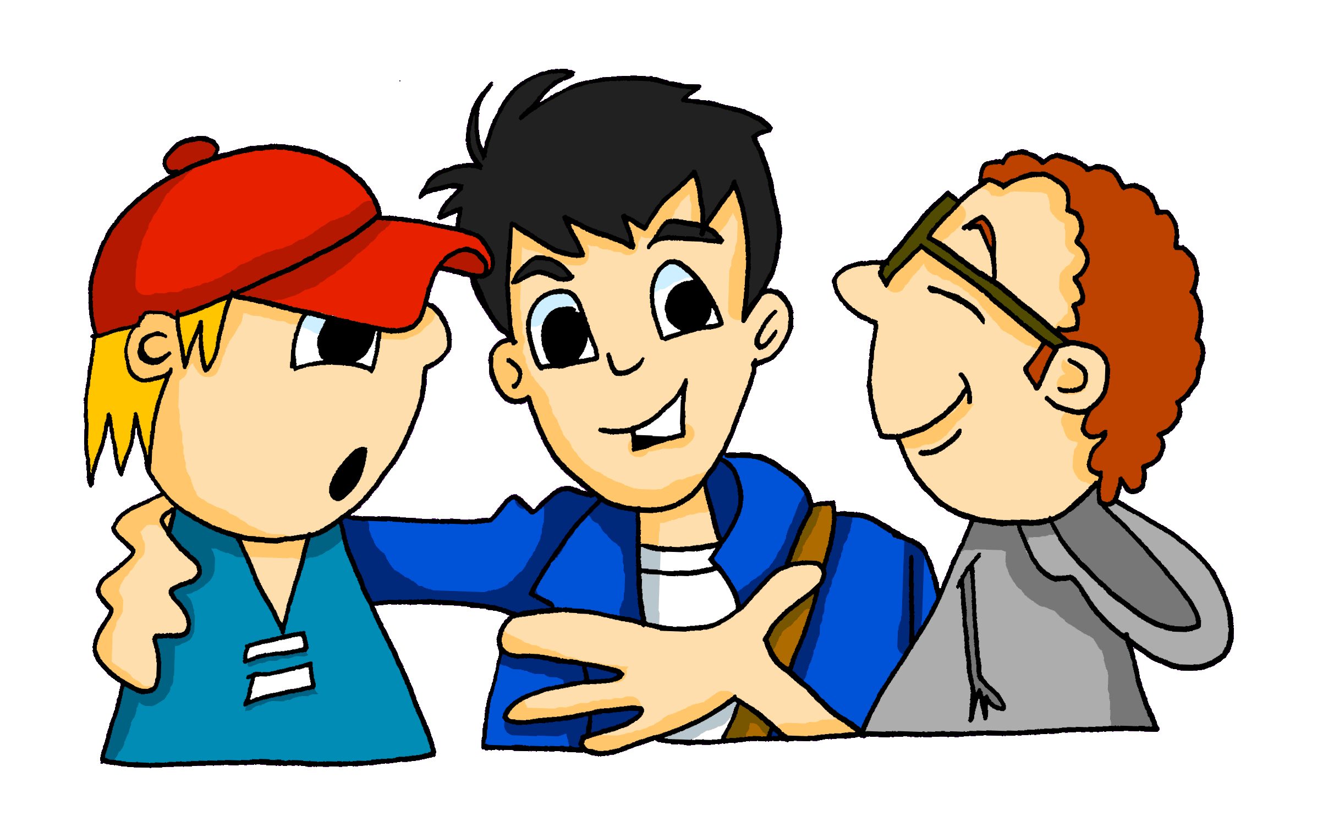
T1.2 Woche 1
Grammatik
Present tense: weak verbs Infinitive + he/she form (3rd person singular) – weak verbs
The infinitive form of a verb is the form you see in a dictionary.
In English, this is often written ‘to + verb’.
In German, the infinitive of the verb usually ends in –en.
For example: wohnen - to live lernen - to learn
To say what he/she does or is doing, use er (he), sie (she) and change the ending from -en to -t:
wohnen – Er wohnt in Berlin. (He lives in Berlin / He is living in Berlin.)
lernen – Sie lernt Gitarre. (She learns guitar / She is learning guitar.)
reden – Er redet mit Freunden. (He talks / He is talking with friends.)
This part of the verb minus the ‘en’ is called the ‘stem’
If the stem of the verb ends in ‘d’ or ‘t’ an extra ‘e’ is added to make the verb easier to pronounce.
Note: There is only one present tense in German! In English we can say ‘he plays’ or ‘he is playing’.
Write in German:
He is learning German
She lives in Hamburg
She is talking with friends.
He writes in German.
She is playing in the lesson.
He is doing an exercise.
20

Slide 22
Saying what people do (at school)
Vokabeln
vb
vb
vb
vb
vb
vb
nf
nnt
nm
nm
prep
lernen | to learn, learning
machen | to do, make
reden | to talk, talking
schreiben | to write, writing
spielen | to play, playing
wohnen | to live, living
die Aufgabe | task, assignment, job
das Klassenzimmer | classroom
der Montag | Monday
der Unterricht | lesson
mit | with
im Klassenzimmer | in the classroom
in der Schule | in school
mit Freunden | with friends
im Unterricht | in the lesson, in class
Vocabulary learning involves knowing different aspects of a word. Use this checklist: 1. I have seen this word before.
2. I know what the word means.
3. I can read the word aloud.
4. I can spell the word correctly.
5. I can use the word in a sentence. 6. For nouns, I know the gender and words for ‘the’ and ‘a’.
Revisit vocab 1.1.5
21

Slide 23
T1.2 Woche 2
Grammatik
Present tense: weak verbs, 1^{st and} 3rd person singular
Most German verbs end in –en in the infinitive.
The verb ending changes depending on who the verb refers to:
To say ‘I’, remove the –en from the infinitive and add -e:
singen ich singe
Remember: this part of the verb minus the ‘en’ is called the ‘stem’.
Sie singt she sings / she is singing
Ich singe I sing / I am singing
What people do (at home)
Vokabeln
vb
vb
vb
vb
nnt
nm
nm
nf
nnt
adv
arbeiten | to work, working
kochen | to cook, cooking
putzen | to clean, cleaning
sitzen | to sit, sitting
das Auto | car
der Boden | ground, floor
der Garten | garden
die Liste | list
das Zimmer | room
nochmal | again
zu Hause | at home
Ich verstehe nicht | I don’t understand
Revisit vocab 1.1.6
Keep practising!
22

Slide 24
T1.2 Woche 3
Grammatik
Present tense weak verbs, 1^{st and} 2nd persons singular
We know that the verb ending changes depending on who the verb refers to.
Verb SINGEN [to sing, singen]
ich singe | I sing, I am singing
du singst | you sing, you are singing
er/sie singt | he/she sings, he/she is singing
For the ‘du’ (you) form, remove the ‘en’, then add ‘st’ to the stem.
Note: If the stem ends in ‘z’ then add only ‘t’.
tanzen tanz- du tanzt – you dance / you are dancing
Open (wh-) questions
We know that closed (yes/no) questions are formed by swapping subject and verb:
Statement
Du schreibst ein Buch. You are writing a book.
Question
Schreibst du ein Buch? Are you writing a book?
To ask an open question, put a question word in front of the verb:
Wo schreibst du das Buch? Where are you writing the book?
Translate the following questions into English:
Wer spielt Gitarre?
Wie oft tanzt du?
Was machst du am Montag?
Wo hörst du Musik?
23

Slide 25
Talking about activities at home
Vokabeln
vb
vb
vb
adv
adv
adv
adv
adv
gehen | to go, going
hören | to hear, hearing
tanzen | to dance, dancing
kaum | hardly
manchmal | sometimes
nie | never
oft | often
sehr | very
einmal die Woche | once a week
jeden Tag | every day
German often combines two (or more!) nouns to create a new, compound noun. The gender of the new noun is the gender of the final noun.
Beispiel: favourite group → Lieblings- + Band → die Lieblingsband favourite film → Lieblings- + Film → der Lieblingsfilm favourite book → Lieblings- + Buch → das Lieblingsbuch
What do these nouns mean?
What is their gender?
Haustier = _______________
Hausaufgaben = ______________
Wochentag = _________________ Lieblingsfarbe = __________________ Klassenzimmer = ____________________
Sometimes, extra letters join the two nouns to make the new noun easier to say: -s-, -es-, -e-, -n-, -en-, -(e)r-
Remember: the gender is the gender of the final noun.
Revisit vocab 1.1.7 & 1.1.1
24

Slide 26
T1.2 Woche 4
Grammatik
Present tense: weak verbs, 1^{st ,} 2nd and 3rd persons singular
A simple German sentence has a subject and verb with an ending:
Ich spiele du spielst Mia spielt
I play/am playing you play/are playing Mia plays/is playing
Order of words in a sentence
To extend a sentence, you can add a noun:
Ich spiele Fußball. Du spielst Gitarre. Mia spielt Tennis.
I play football. You play guitar. Mia plays tennis.
Adverbs add detail about when, where or how events happen. The adverb normally comes after the verb; it splits up the verb and noun.
Ich spiele mit Freunden Fußball. I play football with friends.
Du spielst zu Hause Gitarre. You play guitar at home.
Mia spielt manchmal Tennis. Mia sometimes plays tennis.
So, if a sentence has an adverb, the word order is different from English.
In questions, only the verb and subject swap places. The adverb and noun stay in the same position.
Wie oft spielst du zu Hause Gitarre? How often do you play guitar at home?
Who does what? Classroom instructions
Vokabeln
vb
vb
vb
vb
vb
nf
adj
lesen | to read, reading
sprechen | to speak, speaking
wiederholen | to repeat, repeating
zeigen | to show, showing
zuhören | to listen, listening
die Antwort | answer, reply
freiwillig | voluntary
Revisit vocab 1.2.1 & 1.1.2
25
Notes:
www.needpix.com

Slide 27
T1.2 Woche 5
Grammatik
Definite articles (revisited) - how to say ‘the’ in German
German nouns are divided into three different groups. Each group has its own gender and its own word for ‘the’
masculine | der | (eg) Zug (the train)
feminine | die | (eg) Familie (the family)
neuter | das | (eg) Haus (the house)
When you learn a new noun in German, always learn its grammatical gender.
Test your knowledge of gender so far by writing the noun and gender for each of the pictures below:
______ _____ _______ ______ _____
Narrating a plot or story line
Vokabeln
vb
vb
nm
nm
nm
nnf
nf
nf
nf
nm
adj
kommen | to come, coming
stehen | to stand, standing
der Junge | boy
der Kopf | head
der Körper | body
das Mädchen | girl
die Mutter | mother
die Nacht | night
die Tür | door
der Vater | father
dunkel | dark
der Großvater = ___________ die Großmutter = __________
Revisit vocab 1.2.2 & 1.1.3
26

Slide 28
T1.2 Woche 6
Grammatik
Plural masculine and neuter nouns – rules 1 and 2
Rule 1
Most masculine nouns add either –e at the end…
der Tisch die Tische
90% masculine plurals work like this.
or an –e at the end and an umlaut on the vowel.
der Zug die Züge
Rule 2
Words ending in -EL or -EN or -ER are often the same in singular and plural:
der Engel die Engel
der Lehrer die Lehrer
das Mädchen die Mädchen
The word for ‘the’ is ‘die’ for all plural nouns.
Describing Christmas
Vokabeln
vb
vb
pron
nm
nm
nnf
nnt
nm
adj
conj
es gibt | there is/there are
wünschen | to want, wish
wie viele? | how many?
der Arzt | doctor
der Platz | place, room
das Spiel | game
das Stück | piece
der Zug | train
grün | green
auch | also
Keep practising!
Revisit vocab 1.2.3 & 1.1.4
27
Notes:
Imagen de Alejandra Jimenez en Pixabay

Slide 29
T1.2 Woche 7
Grammatik
Plural feminine nouns – rule 3
Rule 3
Most feminine nouns add either -n or -en at the end to form the plural:
die Flasche die Flaschen
die Frau die Frauen
Remember: the word for ‘the’ is ‘die’ for all plural nouns.
SEIN – to be: ist (ist), sind (are)
Die Kerze ist schön. Die Kerzen sind schön.
The candle is beautiful. The candles are beautiful.
Die Ideen sind gut.
Die Kugeln sind rot.
Die Kirchen sind klein.
What do these three sentences mean?
Talking about presents you wish for
Vokabeln
vb
vb
nf
nm
nf
nf
nf
nf
adj
adj
adj
sind | are (they)
bekommen | to get, receive
die Familie | family
der Hund | dog
die Idee | idea
die Katze | cat
die Kirche | church
die Woche | week
früh | early
schön | beautiful, pleasant, good
spät | late
Ich wünsche mir | I wish for/am wishing for
Revisit vocab 1.2.4 & 1.1.5
28

Slide 30
T2.1 Woche 1
Grammatik
Subject pronoun (it)
The subject of a sentence is the person or thing doing a verb.
The subject can be a noun: The woman is reading a book.
The noun can be replaced by a pronoun: She is reading a book.
In English, the subject pronoun tells us whether the subject is a male person (he), a female person (she), or a thing (it).
In German, subject pronouns tell us the grammatical gender of the subject:
er (masculine): der Gutschein ist toll! Er ist toll. It is great.
sie (feminine): die Jacke ist gelb. Sie ist gelb. It is yellow.
es (neuter): das Fahrrad ist groß. Es ist groß. It is big.
So, German has three words for ‘it.’ The word for ‘it’ reflects the gender of the noun.
der Hund → er ist groß.
die Katze → sie ist klein.
das Fahrrad → es ist toll.
Look! The ending of the word for ‘it’ is the same as the ending of the word for ‘the’.
Subject pronoun (they)
To say ‘they’ in German ‘sie’ is used in all genders:
Die Gutscheine sind toll! Sie sind toll! They are great.
Die Jacken sind gelb. Sie sind gelb. They are yellow.
Die Fahrräder sind groß. Sie sind groß. They are big.
Note that sie means both ‘it (feminine)’ and ‘they’. The verb form tells you what is being talked about.
Sie ist gelb. It is yellow.
Sie sind gelb. They are yellow.
29

Slide 31
What you have and what it’s like
Vokabeln
vb
pron
pron
pron
nnt
nnt
nm
nnt
nf
adj
adj
adv
adv
adv
denken | to think, thinking
er | he, it (m)
es | it (nt)
sie | she, it (f)
das Fahrrad | bicycle
das Geschenk | gift
der Gutschein | voucher
das Handy | mobile phone
die Jacke | jacket
hässlich | ugly
toll | great, terrific
ganz | completely, totally
jetzt | now
ziemlich | quite, fairly
in Ordnung | ok
Identify the correct Christmas present from the pronoun:
1 Sie ist schön.
2 Er ist ganz toll.
3. Sie sind hässlich.
4. Er ist praktisch.
5. Es ist super!
Revisit vocab 1.2.5 & 1.1.6
Practise Stage 2 words!
30

Slide 32
T2.1 Woche 2
Grammatik
Plurals (revisited) and -er (+/-) umlaut
Rule 4
Some masculine and neuter nouns add –er at the end and an umlaut on the vowel (ä / ö / ü):
der Mann - the man die Männer - the men
das Wort - the word die Wörter - the words
das Lied - the song die Lieder - the songs
Talking about more than one thing
Vokabeln
Schreib auf Deutsch:
null | zero
eins | one
zwei | two
drei | three
vier | four
fünf | five
sechs | six
sieben | seven
acht | eight
neun | nine
zehn | ten
elf | eleven
zwölf | twelve
1 I say five words.
2 I am learning three songs.
3 She has six presents.
4 He has nine jackets.
5 You are hearing two singers.
6 I have a phone.
Remember: ‘ein’ means ‘a’ and ‘one’ and matches the gender of the noun.
/a
Revisit vocab 1.2.6 & 1.1.7
31

Slide 33
T2.1 Woche 3
Grammatik
Mögen – to like – 1st, 2nd and 3rd person singular
Mögen is an irregular verb and means ‘to like’:
Verb MÖGEN [to like, liking]
ich mag | I like
du magst | you like
er/sie/es mag | he/she/it likes
Ich mag Deutsch. I like German.
Du magst Musik. You like music. Er mag Mathe. He likes maths.
To say you don’t like something, add nicht to the end of your statement:
Ich mag Sport nicht. I don’t like sport.
Singular object pronouns - ihn, sie, es (it)
We know that subject pronouns show the gender of the nouns:
Der Unterricht ist super. Die Farbe ist schön. Das Lied ist toll.
Er ist super. Sie ist schön. Es ist toll.
After a verb, the masculine pronoun er changes to ihn. This is the object pronoun.
Der Unterricht ist super. Die Farbe ist schön. Das Lied ist toll.
Ich mag ihn. Ich mag sie. Ich mag es.
I like it. I like it. I like it.
The object of a sentence is the person or thing to whom a verb is done.
Feminine and neuter object pronouns don’t change
The verb is ‘mag’ (likes). Mia is ‘liking’, so Mia = sentence subject
Mia mag sie.
sie (die Katze)
is what is liked, so
sie = sentence object
32

Slide 34
T2.1 Woche 3 cont’d
Grammatik
Grammatik
Plural object pronouns – sie (them)
Plural subject pronouns do not show the gender of nouns:
Die Lehrer sind super. Die Farben sind schön. Die Lieder sind toll.
Sie sind super. Sie sind schön. Sie sind toll.
Plural object pronouns do not show the gender of nouns, either:
Die Lehrer sind super. Die Farben sind schön. Die Lieder sind toll.
Ich mag sie. Ich mag sie. Ich mag sie.
I like them. I like them. I like them.
Is it one feminine thing or many things? Check the verb!
Die Farbe ist schön!
Ich mag sie. I like it.
Die Farben sind schön!
Ich mag sie. I like them.
Do you like it?
Vokabeln
vb
vb
vb
vb
vb
pron
pron
nnt
nnt
nf
nf
nf
nf
mögen | to like, liking
ich mag | I like
du magst | you like
er mag | he likes
sie mag | she likes
sie | she, it, her (f)
ihn | him, it (m)
das Deutsch | German
das Fach | school subject
die Fremdsprache | foreign language
die Kunst | art
die Mathematik | mathematics
die Naturwissenschaft | science
Revisit vocab 1.2.7 & 1.2.1
33

Slide 35
T2.1 Woche 4
Grammatik
Finden – to find – 1st, 2nd and 3rd person singular
Finden is often used to seek and express an opinion:
Verb FINDEN [to find, finden]
ich finde | I find
du findest | you findest
er/sie/es findet | he/she/it finds
Note the extra ‘e’ before the ‘st’ and ‘t’ endings, to make them easier to pronounce.
Finden with object pronouns- singular and plural
Wie findest du den Lehrer? Ich finde ihn super.
How do you find the teacher? I find him super.
Wie findest du die Schule? Ich finde sie toll.
How do you find the school? I find it great.
Wie findest du das Essen? Ich finde es lecker.
How do you find the food? I find it tasty.
Wie findest du die Spiele? Ich finde sie leicht.
How do you find the games? I find them easy.
Remember: after a verb der changes to den and er to ihn
Add the correct object pronoun to the sentences below:
Wie findest du den Unterricht? Ich finde ____ leicht.
Wie findest du Hunde? Ich finde ____ toll.
Wie findest du die Uniform? Ich finde ____ hässlich
Wie findest du das Haus? Ich finde ____ zu klein
Add the correct form of the verb finden in the following examples and translate them into English:
Er _______ den Lehrer zu streng. _______________________________
Ich _______ die Lehrerin nett. _______________________________ Wie ________ du die Schule? _______________________________
34

Slide 36
What do you think of it/them? How do you find it/them?
Vokabeln
vb
pron
nnt
nf
vb
adj
adj
adj
adj
adj
adj
adj
adj
adj
prep
finden | to find, finding
ein bisschen | a little
das Essen | food
die Uniform | uniform
gesund | healthy
langweilig | boring
lecker | tasty
leicht | easy
nett | nice
praktisch | practical
schlecht | bad
schwierig | difficult, hard
streng | strict
wichtig | important
zu | too
Write your own questions and answers!
________________________________________ ________________________________________
2 _________________________________________ _________________________________________
Revisit vocab 2.1.1 & 1.2.2
35

Slide 37
T 2.1 Woche 5
Grammatik
Present tense (revisit): weak verbs – 1st, 2^{nd,} 3rd person singular
Remove the ‘en’ from the infinitive. To the stem add –e, - st, -t :
denken: (to think) denken - Ich denke du denkst sie denkt
If the stem ends in –z, just add –t for the du form : du tanzt
If the stem ends in –d or –t, add an –e in the 2nd and 3rd person singlular: du redest, er arbeitet, sie findet
Closed and open questions
For a closed question swap subject and verb: Spielst du oft Tennis?
For an open question, put the question word in front of the verb:
Wo spielst du Tennis?
Talking about yourself and someone else
Vokabeln
vb
vb
vb
vb
vb
vb
vb
vb
vb
vb
vb
nnt
prep
brauchen | to need, needing
bleiben | to stay, remain
glauben | to believe, believing
heißen | to be called
leben | to live, living
liegen | to lie, be lying (down)
reisen | to travel, travelling
verstehen | to understand, understanding
werden | to become, becoming
er wird | he becomes, is becoming
sie wird | she becomes, is becoming
Österreich | Austria
nach | to, towards
nach Hause | (to) home
Revisit vocab 2.1.2 & 1.2.3
36

Slide 38
T 2.1 Woche 6
Revision
Grammatik
This is a list of the grammar features you have learned so far. Write a short sentence using each one in your exercise book:
1 Definite articles: ‘the’ | 9 Indefinite articles: Row 2 (accusative) after verbs
2 Indefinite articles: ‘a/an’ | 10 Present tense: weak verbs (I, you, s/he)
3 Verb SEIN (to be) I, you, s/he, we, they | 11 WH-questions
4 Verb HABEN (to have) | 12 Plural rules 1,2,3,4
5 Yes/No questions | 13 Subject pronouns: ‘it’ and ‘they’
6 Using ‘nicht’ | 14 Object pronouns ‘it’ and ‘them’
7 Using ‘kein, keine, kein’ | 15 Verb MÖGEN (to like)
8 Definite articles: Row 2 (accusative) after verbs | 16 Verb FINDEN (to find)
Vokabeln
How well do you know the words we have learned so far this year?
Go back through your language guide and use this checklist for the vocabulary for the items you have learnt and revisited so far:
1. I have seen this word before.
2. I know what the word means.
3. I can read the word aloud.
4. I can spell the word correctly.
5. I can use the word in a sentence.
6. I know the gender of nouns.
This is a mash up of Term 1 & 2 vocabulary!
T2.1 Woche 6: Revision and assessment
37

Slide 39
T 2.2 Woche 1
Grammatik
Present tense weak verbs – 1st person plural
To say ‘we’ add –en to the stem of the verb:
Wir gehen jeden Tag in die Schule. We go to school every day.
Wir bleiben kaum zu Hause We rarely stay at home.
The wir form of the verb is the same as the infinitive form that you find in the dictionary
Ich spiele = I play and I am playing
Present simple or continuous?
English has two present tense forms: present simple for normal routine and continuous for ongoing (BE + ing). German has only one present tense:
Ich spiele jede Woche Schlagzeug. I play drums every week.
Ich spiele jetzt Schlagzeug. I am playing drums now.
Note: in German the adverb goes after the verb; different from English.
Talking about yourself and someone else
Vokabeln
vb
vb
pron
pron
nnt
nf
nnt
adj
adv
adv
adv
schwimmen | to swim, swimming
wir sind | we are
wir | we
beide | both
das Einzelkind | only child
die Moschee | mosque
das Schlagzeug | drums
türkisch | Turkish (adj)
gemeinsam | in common
immer | always
zusammen | together
Angst vor | fear of
Revisit vocab 2.1.3 & 1.2.4
38

Slide 40
T2.2 Woche 2
Grammatik
Modal verb können and the two verb rule
Können is an irregular verb meaning to be able to/can.
To say what you can or cannot do in German, use können with a 2nd verb in the infinitive form.
The verb form for ‘I’ and ‘s/he’ are the same, like mögen.
KÖNNEN [to be able to, can]
ich kann | I can
du kannst | you can
er/sie/es kann | he/she/it can
Ich kann singen. I can sing.
Du kannst hören. You can hear.
Er kann tanzen. He can dance.
The second verb (infinitve) goes to the end of the sentence.
Ich kann Fußball spielen. I can play football.
Du kannst oft Obst essen. You can often eat fruit.
Er kann Deutsch sprechen. He can speak German.
Note the word order difference here!
How to say cannot/can‘t in German
With verbs, add ‘nicht’ before the infinitive verb:
Sie kann nicht sehen. She can’t see.
With singular nouns, use ‘kein’ and put the noun before the verb:
Sie kann keinen Film sehen She can’t see a film.
Sie kann keine Katze sehen She can’t see a cat.
Sie kann kein Haus sehen She can’t see a house.
Use keinen, keine, kein for singular nouns and keine for plural nouns.
Write in German:
I can’t swim.
You can’t sing a song.
He can’t have a dog.
She can’t hear.
I can’t hear any music.
39

Slide 41
Saying what I and others can/cannot do
Vokabeln
Ein Mann ohne Kopf
hat viele Probleme:
Er kann nicht denken
Er kann nicht lesen
Er kann nicht singen
Er kann nicht essen
Er kann nicht hören
Und auch nicht verstehen,
dass man ohne Kopf gar nicht lieben kann.
adapted from a poem by Armando José Sequera
vb
vb
vb
vb
vb
vb
vb
vb
vb
vb
pron
nnt
nf nm nm npl nnt
benutzen | to use, using
essen | to eat, eating
können | to be able , can
ich kann | I can, I am able to,
du kannst | you can, you are able to
er kann | he is able to, he can
sie kann | she is able to, she can
sehen | to see, seeing
tragen | to carry, wear
trinken | to drink, drinking
etwas | something
das Butterbrot | sandwich
die Hose | trousers
der Hut | hat
der Keks | biscuit
die Leute | people
das Obst | fruit
Revisit vocab 2.1.4 & 1.2.5
40

Slide 42
T 2.2 Woche 3
Grammatik
Present tense strong verbs
Some German verbs, called strong verbs, change the vowel in the er / sie-form.
You need to learn which verbs are strong, but here are some rules:
Only verbs with an a or an e in their stem can be strong.
Stems with an e change to i or ie: ich gebe → er gibt
ich lese → sie liest
Stems with an a change to ä: ich fahre → er fährt
ich laufe → er läuft
Write the ‚er/sie‘ form of the following verbs:
This includes the a in au
schlafen er ________________ lesen sie _______________
geben sie _______________ sehen er _______________
vergessen er ________________ helfen sie _______________
Comparing lifestyles
Vokabeln
vb
vb
vb
vb
vb
vb
pron
nnt
nm
nf
adv
geben | to give, giving
fahren | to drive, ride
helfen | to help, helping
laufen | to run, running
schlafen | to sleep, sleeping
vergessen | to forget, forgetting
mir | to me, me
das Geld | money
der Urlaub | holiday
die Zeitung | newspaper
fast | almost
Revisit vocab 2.1.5 & 1.2.6
41

Slide 43
T 2.2 Woche 4
Grammatik
Present tense strong verbs - 1st, 2nd and 3rd person singular
We know that in the present tense, strong verbs change the vowel in the er /sie/es form. The same happens in the du form.
Remember: Only verbs with an a or an e in their stem can be strong.
geben (to give) ich gebe du gibst er gibt
lesen (to read) ich lese du liest sie liest
fahren (to drive) ich fahre du fährst er fährt
laufen (to run) ich laufe du läufst er läuft
Asking and answering questions
Remember to check the strong verbs when asking questions.
Complete the questions below in German, then write an answer:
Mit wem ________ du? (fahren) ____________________________
Was ____________ du? (Iesen) _____________________________
Wie oft __________ du? (laufen) ____________________________
Was ____________ du? (tragen) ____________________________
Talking about out of school activities
Vokabeln
vb
nnt
nnt
nnt
nf
adv
adv
adv
adv
adv
Rad fahren | to cycle, cycling
das Eis | ice cream
das Gemüse | vegetables
das Fleisch | meat, flesh
die Tasche | bag
heute | today
mit wem? | with whom?
am Abend | in the evening
am Wochenende | at the weekend
am Nachmittag | in the afternoon
Revisit vocab 2.2.1 & 1.2.7
42

Slide 44
T 2.2 Woche 5
Grammatik
Present tense strong verbs – (s)he -they
We know we change the vowel in strong verbs in the 3rd person singular: geben → er / sie / es gibt.
For the they form, the vowel change is not needed.
For weak verbs:
For ‘they’ add back ‘en’
to the stem.
Sie/er singt s/he sings
Sie singen they sing
For strong verbs
No vowel change for the ‘they’ form.
Sie/er läuft s/he runs
Sie laufen they run
The ‘they’ form is identical to the infinitive!
The ‘they’ form is identical to the infinitive!
The ‘they’ form of haben is formed in the same way:
sie haben = they have.
Write the German:
She sleeps. ________________ The bus stops. _________________
He takes the train. _____________ They eat. ___________________ They leave the car. ________________ He drives. ________________
Narrating what others do
Vokabeln
vb
vb
vb
adv
adv
adv
adv
adv
adv
halten | to stop, stopping
lassen | to leave, leaving (something)
nehmen | to take, taking
danach | after it, afterwards
dann | then
deshalb | therefore, for that reason
schließlich | in the end, finally
später | later
zuerst | first
Revisit vocab 2.2.3 & 2.1.2
43

Slide 45
T 3.1 Woche 1
Grammatik
Word Order 2 (with statements)
The order of words in a simple German sentence is:
Word order
1
SUBJECT
VERB
ADVERB
OBJECT
Sometimes, we want to start the sentence with the adverb. When we do this, the subject and adverb swap places:
Word order
2
ADVERB
VERB
SUBJECT
OBJECT
The position of the verb does not change. It is always between the subject and the adverb:
Starting with the adverb emphasises it.
Ich spiele heute Gitarre. I’m playing guitar today. Heute spiele ich Gitarre. Today I’m playing guitar.
Saying when you and others do things
Vokabeln
nf
nm
nm
nm
nm
nm
nm
nnt
nm
adv
die Bibliothek | library
Dienstag | Tuesday
Donnerstag | Thursday
Freitag | Friday
Mittwoch | Wednesday
Samstag | Saturday
Sonntag | Sunday
das Theater | theatre
der Verein | club
wann? | when
im Chor | in the choir
am Morgen | in the morning
im Orchester | in the orchestra
The article for Dienstag? → der How do we know? Because it’s ‘der Tag’!
Revisit vocab 2.2.2 & 2.1.1
44

Slide 46
T 3.1 Woche 2
Grammatik
Time phrases as nouns and adverbs
Days of the week and times of day (der Dienstag, der Nachmittag) are nouns. We add ‘am’ to talk about what we are doing on a specific day, or at a specific time of day:
Ich spiele am Dienstag im Orchester.
I’m playing in the orchestra on (this) Tuesday.
To say what we normally do when, we change the nouns into adverbs. We do this by removing the capital letter and adding –s.
Ich spiele dienstags im Orchester.
I (always) play in the orchestra on Tuesdays.
Use am Dienstag to talk about a one-off event. Use dienstags to talk about a regular event.
Word Order 2 (with W-questions)
For an open question, put a question word in front of the verb:
closed
Gehst du in die Bibliothek?
Are you going to the library?
Wann gehst du in die Bibliothek?
When are you going to the library?
open
The word order in w-questions is similar to that of statements in word order 2:
Wann gehst du in die Bibliothek?
Note: the VERB is in 2nd place.
Statement
Question
Am Donnerstag gehe ich in die Bibliothek.
There is no new vocabulary for this week, so just revisit 2.2.1 - 2.2.5
45

Slide 47
T 3.1 Woche 3
Grammatik
Prepositions ‘in’ and ‘auf’
To say where something or someone is moving to, use the prepositions ‘in’ (into) and ‘auf’ (onto):
masculine
feminine
neuter
der Park
die Stadt
das Kino
Ich gehe…
in den Park
in die Stadt
in das Kino
‘in das ‘ is often shortened to ‘ins’.
der Tisch
die Zeitung
das Heft
Die Katze springt…
auf den Tisch
auf die Zeitung
auf das Heft
Note: the masculine word for the (definite article) changes:
These are the Row 2 (or accusative case) forms of the definite article.
To say where something or someone is located, use the same prepositions ‘in’ (in) and ‘auf’ (on), but change the word for the:
Note: all words for the change.
masculine
feminine
neuter
der Park
die Stadt
das Kino
Ich bin…
in dem Park
in der Stadt
in dem Kino
‘in dem ‘ is often shortened to ‘im’.
der Tisch
die Zeitung
das Heft
Das Buch ist…
auf dem Tisch
auf der Zeitung
auf dem Heft
These are the Row 3 (or dative case) forms of the definite article.
46

Slide 48
Movement into, and location in, places
Vokabeln
vb
vb
nnt
nnt
nnt
nm
nnt
nf
nf
nf
adj
prep
prep
fallen | to fall, falling
springen | to jump, jumping
das Geschäft | shop
das Kino | cinema
das Konzert | concert
der Markt | market
das Museum | museum
die Party | party
die Stadt | city, town
die Straße | street
angenehm | pleasant
in | in, into
auf | on, onto
Stage 3, now!
Revisit vocab 2.2.4 & 2.1.3
Schreib ‘ich gehe’ oder ‘ich bin’.
1 _____________ im Park.
2 _____________ ins Kino.
3 _____________ in die Stadt.
4 _____________ in der Stadt.
5 _____________ ins Geschäft.
6 _____________ auf den Markt.
7 _____________ auf die Party.
8 _____________ auf der Straße.
‘auf’ can also sometimes mean ‘at’ or ‘to’ in English. How would you translate 6-8?
47

Slide 49
T 3.1 Woche 4
Grammatik
Possessive adjectives: mein, dein, sein, ihr
You have already learnt how to say my:
my favourite book
my favourite film
my favourite band
mein Lieblingsbuch (n)
mein Lieblingsfilm (m)
meine Lieblingsband (f)
This is a possessive adjective, as it describes the noun by saying who possesses it.
There is a possessive adjective for each of the pronouns:
dein - your
sein - his
ihr - her
Just like mein they agree with the gender of the noun that follows:
dein Lieblingsfilm (m)
seine Lieblingsband (f)
ihr Lieblingsbuch (n)
your favourite film
his favourite band
her favourite book
Note: the ending follows the gender of the noun, NOT whether it’s his or hers !
Asking and answering questions (about family)
Vokabeln
nm
npl
nnt
npl
nm
nf
adj
adj
adj
adj
prep
der Bruder | brother
die Eltern | parents
das Kind | child
die Geschwister | siblings, brothers and sisters
der Schauspieler | male actor
die Schwester | sister
dein | your
ihr | her
mein | my
sein | his
über | about
die Großeltern = ___________
Revisit vocab 2.2.5 & 2.1.4
48

Slide 50
T 3.1 Woche 5
Grammatik
Present tense: weak, strong & irregular verbs (revisited)
Put these verbs into four categories: I, you, s/he, we/they/infinitive:
ich | du | er / sie / es | wir / sie / Infinitiv
Note: a few of these forms can be in two categories!
sehen
schläft
wohnen
gibst
schreibe
findet
mag
läuft
arbeitet
denken
putzt
kochst
spielen
lernt
rede
machen
liest
hilft
fährst
wissen
vergisst
kann
mögen
zeigst
steht
komme
hörst
hat
bist
sein
Word order 2 (revisited)
Write sentences using one of the following words. Use either Word order 1 (Subject - Verb - Adverb - Other) OR Word order 2 (Adverb - Verb - Subject - Other). Write the English, too.
heute
jetzt
später
am Abend
oft
am Wochenende
samstags
Vokabeln
There is no new vocabulary for this week, but revise all the verbs you have learnt in the Y7 verbs mash up.
49

Slide 51
T 3.1 Woche 6
Grammatik
Word order 2 (with expressions of location)
We know that when we start a sentence with an adverb, the subject and adverb swap, leaving the verb still in 2nd place.
Word order
2
ADVERB
VERB
SUBJECT
OTHER
WO2
Samstags gehe ich in die Stadt.
WO1
Ich gehe samstags in die Stadt.
Compare with word order 1:
We also use WO2 when we start a sentence with an expression of place or location:
WO2
In Schottland gehe ich in die Stadt.
In Wien gibt es ein Museum.
In der Stadt sehen wir viele Geschäfte.
Write in German, using the indicated word order [1] oder [2].
1 We play in the park.
2 We see a film in the cinema.
3 She cooks at home.
4 They are standing on the street.
5 They work in the café.
6 You sleep in the lesson.
WO1
WO2
WO2
WO2
WO1
WO2
50

Slide 52
Saying what there is in different places
Vokabeln
vb
vb
vb
vb
vb
pron
pron
nnt
nf
nnt
nf
adv
fahren | to drive, ride, go (transport)
dauern | to last, take (time)
erreichen | to reach, reaching
schaffen | to manage, achieve
suchen | to search, look for
viel | much, a lot
viele | many
das Land | country
die Stunde | hour
Schottland | Scotland
die Schweiz | Switzerland
Wien | Vienna
normalerweise | normally
Revisit vocab 2.2.5 & 2.1.4
Wien ist die Hauptstadt von Österreich.
51
Notes:
Blackbird: Lobsterthermidor (talk) 12:23, 8 October 2016 (UTC) / CC BY-SA (https://creativecommons.org/licenses/by-sa/3.0)

Slide 53
T 3.2 Woche 1
Grammatik
Fill in all the verb forms.
SEIN and HABEN (revisited)
Verbs ‘to be’ and ‘to have’ are irregular in English and German:
 | to be | to have
I
you
he/she
we
they
 | SEIN | HABEN
ich
du
er / sie / es
wir
sie
You have learnt a lot of high-frequency words this year. Do you still remember what these mean? Write the English.
ziemlich |  | oder
nicht |  | viel
aber |  | sagen
etwas |  | gemeinsam
und |  | viele
allein |  | Angst vor
You know four plural rules. Check the rule and write the plural.
 | Plural | Rule
die Katze | die Katzen | 3
der Fisch |  | 1
die Maus |  | 4
das Kind |  | 4
der Freund |  | 1
der Hund |  | 1
There is no new vocabulary for this week but revise all vocabulary from this year in this Y7 mashup.
T3.1 Woche 2: Assessments
52

Slide 54
T 3.2 Woche 3
Grammatik
Modal verbs DÜRFEN, MÜSSEN, WOLLEN
These modal verbs are irregular, like KÖNNEN and MÖGEN; the forms for ‘I’ and ‘s/he’ are the same.
DÜRFEN [may, to be allowed to]
ich darf | I may
du darfst | you may
er/sie/es darf | he/she/it may
MÜSSEN [must, to have to]
ich muss | I must
du musst | you must
er/sie/es muss | he/she/it must
WOLLEN [to want to]
ich will | I want
du willst | you want
er/sie/es will | he/she/it wants
To say what you may, must or want to do in German, use dürfen, müssen, wollen with a 2nd verb in the infinitive form.
The second verb (infinitve) goes to the end of the sentence.
Ich darf Freunde besuchen. I am allowed to visit friends.
Du musst Obst essen. You have to eat fruit.
Er will früh ins Bett gehen. He wants to go to bed early.
Note the word order difference here!
How to say may/must/want not in German
With verbs, add ‘nicht’ before the infinitive verb:
Sie darf nicht ausgehen. She may not go out.
With nouns, use keinen, keine, kein for singular and keine for plural:
Du darfst keinen Sport machen. You may not do any sport.
Sie muss keine Angst haben. She must not have any fear.
Sie will kein Wasser trinken. She doesn’t want to drink any water.
53

Slide 55
Improving your lifestyle
Vokabeln
vb
vb
vb
vb
vb
vb
vb
vb
vb
vb
vb
vb
vb
vb
vb
pron
adj
adj
adj
adj
adj
dürfen | to be allowed, may
ich darf | I am allowed, may
du darfst | you are allowed, may
er darf | he is allowed, may
sie darf | she is allowed, may
müssen | must, to have to
ich muss | I must, have to
du musst | you must, have to
er muss | he must, has to
sie muss | she must, has to
wollen | to want
ich will | I want
du willst | you want
er will | he wants
sie will | she wants
man | one, you
genug | enough
glücklich | happy, fortunate
krank | sick, ill
ruhig | quiet, calm
traurig | sad
Revisit vocab 3.1.3 & 2.2.1
54

Slide 56
T 3.2 Woche 4
Vokabeln
Explaining the rules of a game
vb
vb
vb
vb
vb
vb
vb
nf
nm
nnt
adj
adj
adj
beginnen | to begin, beginning
erhalten | to receive, receiving
gewinnen | to win, winning
legen | to lay, put
mischen | to mix, blend
werfen | to throw, throwing
ziehen | to pull, pulling
die Mitte | middle
der Punkt | point
das Ziel | goal
jede | every (f)
jeder | every (m)
jedes | every (nt)
Revisit vocab 3.1.4 & 2.2.2
Write in English:
hin = there, down
1 Der Kartengeber mischt die Karten und gibt sie aus.
2 Die Mitspieler erhalten pro Person sieben Karten.
1 Jeder Spieler muss mit sieben Karten beginnen.
4 Jedes Mal will jeder Spieler eine Karte hinlegen.
5 Jeder legt eine Karte in die Mitte hin.
6 Manchmal muss man noch eine Karte ziehen.
7 Man will keine Karten mehr haben. Dann gewinnt man.
55
Notes:
UNO / Public domain

Slide 57
T 3.2 Woche 5
Grammatik
Present tense to express future meanings
Use the present tense with a future time adverbial to talk about future plans:
Nächstes Jahr fahren wir nach Österreich. Next year we are going to Austria.
present continuous
Jedes Jahr fahren wir nach Cornwall. Every year we go to Cornwall.
present simple
Write in English:
Normalerweise schwimme ich im Schwimmbad aber nächste Woche schwimme ich im See.
Note: Use ‘in’ for ‘to’ with countries that have articles: die USA, die Schweiz, die Türkei.
Using ‘nach’ to mean ‘to’
Use ‘nach’ to mean ‘to’ with: 1] countries 2] city / town names
Ich fahre nach Deutschland.
Ich fahre nach Berlin.
Usual holidays vs plans for the summer
Vokabeln
nnt
nf
nnt
nm
nnt
nm
nm
adj
adj
adj
adv
adv
adv
das Dorf | village
die Großstadt | city
das Jahr | year
der Monat | month
das Schwimmbad | swimming pool
der See | lake
der Strand | beach
nächste | next (f)
nächstes | next (nt)
nächsten | next (m, accusative)
nächstes Jahr | next year
nächsten Monat | next month
nächste Woche | next week
Revisit vocab 3.1.6 & 2.2.3
56

Slide 58
T 3.2 Woche 6
Grammatik
‘nach’ vs ‘zu’
Nach and zu can both mean ‘to’. Use ‘zu’ for places with articles. The article (word for ‘the’) changes to Row 3 (dative):
masculine
feminine
neuter
der Park
die Stadt
das Kino
Ich gehe…
zu dem Park
zu der Stadt
zu dem Kino
‘zu dem ‘ becomes ‘zum’, and ‘zu der’ becomes ‘zur’.
Also use ‘zu’ for people, professions, and events:
Ich gehe…
zu Anna.
I’m going to Anna’s (place).
Ich gehe…
zum Arzt.
I’m going to the doctor’s.
Ich gehe…
zur Party.
I’m going to the party.
Remember! Ich bin zu Hause. I am at home. Ich gehe nach Hause. I’m going (to)home.
57

Slide 59
T 3.2 Woche 6
Vokabeln
Numbers (13-31)
dreizehn | 13
vierzehn | 14
fünfzehn | 15
sechzehn | 16
siebzehn | 17
achtzehn | 18
neunzehn | 19
zwanzig | 20
einundzwanzig | 21
zweiundzwanzig | 22
dreiundzwanzig | 23
vierundzwanzig | 24
fünfundzwanzig | 25
sechsundzwanzig | 26
siebenundzwanzig | 27
achtundzwanzig | 28
neunundzwanzig | 29
dreißig | 30
einunddreißg | 31
We have seen that German often combines nouns to make a new, compound noun. Most German numbers work in the same way:
acht (8)
+
zehn (10)
=
achtzehn (18)
vier (4)
+
und (and)
+
zwanzig (20)
=
vierundzwanzig (24)
English also used say some numbers like this; think of ‘four and twenty blackbirds’!
Talking about going to places
nm
nm
nf
prep
der Bahnhof | (railway) station
der Fluss | river
die Karte | ticket
an | on
dreizehn | 13
dreißig | 30
einunddreißig | 31
zwanzig | 20
zweiundzwanzig | 22
sechzehn | 16
siebzehn | 17
Revisit vocab 3.2.3 & 2.2.4
58

Slide 60
T 3.2 Woche 7
Text
Immer höher
Here are nine assorted lines from the poem. Fill in the missing verbs;‘steigt’ or ‘steht’?
Ernst Jandl
1 Der Tisch _________ auf dem Haus.
2 Der Mann _________ auf den Tisch.
3 Der Mond __________ auf die Nacht.
4 Der Sessel __________ auf dem Tisch.
5 Der Tisch ___________ auf das Haus.
6 Das Haus ___________ auf den Berg.
7 Der Berg ___________ auf dem Mond.
8 Der Mann ___________ auf dem Sessel.
9 Der Mond ___________ auf der Nacht.
Look back at T3.1 Woche 3, p.XX to help, if needed.
Look at these plurals. Rule 1,2,3, 4 or none of the rules you know?
 | Plural | Rule
der Mann | die Männer
der Tisch | die Tische
der Sessel | die Sessel
das Haus | die Häuser
die Nacht | die Nächte
der Berg | die Berge
der Mond | die Monde
Look back at p.27, 28 and 31 for help, if needed.
There is no new vocabulary for this week, but revise all NOUNS from this year in this Y7 mashup.
Why is this one unusual?
59
Notes:
https://kunstklasse.com/wp-content/uploads/KK_MV04_ErnstJandl_01_OttosMops.pdf

Slide 61
The Foreign Language Spelling Bee - Stage 1: Class competition
You must say pass in German → ich passe.
Accents and other punctuation (not question marks) must be said like this:
Umlaut – Umlaut
ß - S-Zett / scharfes S Space - Abstand / Leerzeichen
Hyphen – Bindestrich
1 | sein | to be | being
2 | ist | is
3 | wo? | where?
4 | hier | here
5 | da | there
6 | das Heft | exercise book
7 | das Fenster | window
8 | der Tisch | table
9 | die Tafel | board
10 | die Flasche | bottle
11 | und | and
12 | Deutsch | German (noun)
13 | ja | yes
14 | nein | no
15 | sagen | to say, tell
16 | sagt | says, tells
17 | wie sagt man…? | how do you say…?
18 | ich bin | I am, I'm
19 | und du? | and you?
20 | man | one, you
21 | Hallo! | Hello!
22 | Tschüs! | Bye!
23 | kalt | cold
24 | klar | clear
25 | warm | warm
26 | das Paar | pair
27 | die Klasse | class
28 | der Tag | day
29 | was? | what?
30 | richtig | right, correct
31 | falsch | wrong, false
32 | nicht | not
33. | klein | small
34 | groß | big
35 | rot | red
36 | gelb | yellow
37 | blau | blue
38 | wie? | how?
39 | bitte | please
40 | danke | thank you
41 | haben | to have | having
42 | hat | has
43 | der Lehrer | male teacher
44 | die Lehrerin | female teacher
45 | eine Frage | a question
46 | ein Beispiel | an example
47 | ein Problem | a problem
48 | eine Sache | a thing
49 | eine Farbe | a colour
50 | wer? | who?

Slide 62
Stage 2: School competition
51 | der Fußball | football
52 | der Freund | friend
53 | das Wasser | water
54 | die Welt | world
55 | das Wort | word
56 | das Tier | animal
57 | der Mensch | human being
58 | wahr | true
59 | ein Buch | a book
60 | ein Film | a film
61 | ein Sänger | a male singer
62 | eine Sängerin | a female singer
63 | ein Lied | a song
64 | eine Band | a band
65 | wohnen | to live | living
66 | wohnt | lives | is living
67 | schreiben | to write | writing
68 | schreibt | writes | is writing
69 | spielen | to play | playing
70 | spielt | plays | is playing
71 | reden | to talk | talking
72 | redet | talks | is talking
73 | lernen | to learn | learning
74 | lernt | learns | is learning
75 | machen | to do, make
76 | macht | does, makes
77 | mit | with
78 | mit Freunden | with friends
79 | der Unterricht | lesson, teaching
80 | das Klassenzimmer | classroom
81 | die Schule | school
82 | nochmal | again
83 | ich verstehe nicht | I don't understand
84 | arbeiten | to work | working
85 | arbeitet | works | is working
86 | putzen | to clean | cleaning
87 | putzt | cleans | is cleaning
88 | kochen | to cook | cooking
89 | kocht | cooks | is cooking
90 | sitzen | to sit | sitting
91 | sitzt | sits | is sitting
92 | das Auto | car
93 | zu Hause | at home
94 | der Garten | garden
95 | der Boden | floor
96 | die Liste | list
97 | das Zimmer | room
98 | wir | we
99 | finden | to find | finding
100 | findet | finds | is finding

Slide 63
Stage 2: Cont’d
101 | jeden Tag | every day
102 | einmal | once
103 | die Woche | week
104 | nie | never
105 | kaum | hardly ever
106 | manchmal | sometimes
107 | oft | often
108 | sehr | very
109 | normalerweise | usually
110 | tanzen | to dance | dancing
111 | tanzt | dances | is dancing
112 | gehen | to go | going
113 | geht | goes | is going
114 | hören | to listen, hear
115 | hört | listens, hears
116 | die Mutter | mother
117 | der Vater | father
118 | der Junge | boy
119 | das Mädchen | girl
120 | der Kopf | head
121 | die Tür | door
122 | der Körper | body
123 | die Nacht | night
124 | dunkel | dark
125 | kommen | to come | coming
126 | kommt | comes | is coming
127 | stehen | to stand | standing
128 | steht | stands | is standing
129 | es gibt | there is, there are
130 | wie viele? | how many?
131 | der Zug | train
132 | der Platz | town square, place
133 | der Arzt | doctor
134 | das Spiel | game
135 | grün | green
136 | auch | also
137 | der Grund | reason
138 | wünschen | to wish | wishing
139 | das Stück | piece
140 | spät | late
141 | die Kirche | church
142 | die Familie | family
143 | die Idee | idea
144 | früh | early
145 | schön | lovely, nice, beautiful
146 | hässlich | ugly
147 | toll | great
148 | das Geschenk | present
149 | denken | to think | thinking
150 | denkt | thinks | is thinking

Slide 64
Stage 3: Regional competition
151 | ganz | completely, totally
152 | ziemlich | quite
153 | jetzt | now
154 | in Ordnung | ok
155 | ein Handy | a mobile phone
156 | ein Fahrrad | a bicycle
157 | ein Gutschein | a voucher
158 | ein Hund | a dog
159 | eine Katze | a cat
160 | eine Jacke | a jacket
161 | die Frau | woman, wife, Mrs
162 | der Herr | man, Mr
163 | der Bruder | brother
164 | die Schwester | sister
165 | die Eltern | parents
166 | das Kind | child
167 | zwei | two
168 | drei | three
169 | vier | four
170 | fünf | five
171 | sechs | six
172 | sieben | seven
173 | acht | eight
174 | neun | nine
175 | zehn | ten
176 | elf | eleven
177 | zwölf | twelve
178 | zwanzig | twenty
179 | dreißig | thirty
180 | hundert | a hundred
181 | tausend | a thousand
182 | die Million | a million
183 | das Jahr | year
184 | alt | old
185 | jung | young
186 | mögen | to like (nouns)
187 | mag | likes
188 | aber | but
189 | oder | or
190 | die Fremdsprache | foreign language
191 | die Kunst | art
192 | die Naturwissenschaft | science
193 | das Schulfach | school subject
194 | die Mathematik | maths
195 | das Theater | theatre, drama
196 | ihn | him/it
197 | sie | her/it
198 | zu | to,too
199 | heißen | to be called
200 | heißt | is called

Slide 65
Stage 4: National competition
201 | das Essen | food
202 | langweilig | boring
203 | praktisch | practical
204 | schwierig | difficult
205 | schlecht | bad
206 | wichtig | important
207 | ein bisschen | a little
208 | leicht | easy
209 | nett | nice
210 | streng | strict
211 | gesund | healthy
212 | lecker | tasty, delicious
213 | interessant | interesting
214 | gut | good
215 | die Uniform | uniform
216 | können | to be able | can
217 | kann | is able | can
218 | lesen | to read | reading
219 | liest | reads | is reading
220 | laufen | to run | running
221 | läuft | runs | is running
222 | essen | to eat | eating
223 | isst | eats | is eating
224 | schlafen | to sleep | sleeping
225 | schläft | sleeps | is sleeping
226 | sehen | to see | seeing
227 | sieht | sees | is seeing
228 | das Obst | fruit
229 | das Butterbrot | sandwich
230 | etwas | something
231 | trinken | to drink | drinking
232 | trinkt | drinks | is drinking
233 | glauben | to believe
234 | glaubt | believes
235 | schwimmen | to swim | swimming
236 | schwimmt | swims | is swimming
237 | liegen | to lie | lying
238 | liegt | lies | is lying
239 | zeigen | to show | showing
240 | zeigt | shows | is showing
241 | bleiben | to stay, remain
242 | bleibt | stays, remains
243 | das Haus | house
244 | wann? | when?
245 | heute | today
246 | der Morgen | morning
247 | der Nachmittag | in the afternoon
248 | der Abend | in the evening
249 | das Wochenende | at the weekend
250 | Montag | Monday

Slide 66
Stage 4: Cont’d
251 | Dienstag | Tuesday
252 | Mittwoch | Wednesday
253 | Donnerstag | Thursday
254 | Freitag | Friday
255 | Samstag | Saturday
256 | Sonntag | Sunday
257 | fahren | to drive, ride
258 | fährt | drives, rides
259 | geben | to give | giving
260 | gibt | gives | is giving
261 | sprechen | to speak | speaking
262 | spricht | speaks | is speaking
263 | helfen | to help | helping
264 | hilft | helps | is helping
265 | vergessen | to forget | forgetting
266 | vergisst | forgets | is forgetting
267 | nehmen | to take | taking
268 | nimmt | takes | is taking
269 | tragen | to wear, carry
270 | trägt | wears, carries
271 | wissen | to know | knowing
272 | weiß | knows
273 | schwarz | black
274 | weiß | white
275 | grau | grey
276 | braun | brown
277 | kurz | short
278 | lang | long
279 | dann | then
280 | schnell | fast
281 | langsam | slow
282 | die Reise | journey
283 | das Land | country
284 | die Stadt | town
285 | mein | my, mine
286 | dein | your
287 | Warum? | why?
288 | Welcher? | Which? (masculine)
289 | Wie viel? | How much?
290 | die Stunde | hour, lesson
291 | müssen | to have to | must
292 | muss | has to | must
293 | wollen | to want
294 | will | wants
295 | dürfen | to be allowed | may
296 | darf | is allowed | may
297 | werden | to become | becoming
298 | wird | becomes | is becoming
299 | lassen | to let, allow
300 | lässt | lets, allows

