Slide 1
Vocabulary
Y7 Spanish
Term 2.2 - Week 5
Victoria Hobson / Nick Avery
Date updated: 29/03/20
Notes:
Source of frequency rankings: Davies, M. & Davies, K. (2018). A frequency dictionary of Spanish: Core vocabulary for learners (2nd ed.). London: Routledge

Slide 2
Vocabulario
60
 | Español | Inglés
1 | somos | we are (permanent)
2 | moreno | brown, dark-haired, tanned
3 | claro | light, clear (for colours)
4 | oscuro | dark
5 | aburrido | bored, boring
6 | loco | crazy
7 | feliz | happy
Segundos
The spelling doesn’t change for masculine/feminine nouns, but it changes in the plural:
feliz (singular noun)
felices (plural noun)
0
You can also say ‘contento’ to say ‘happy’. This adjective is only used with estar (e.g. estoy contento).
INICIO
Notes:
A small vocabulary set is introduced this week because a number of the adjectives taught in previous weeks can be revisited with ser and estar.
These include
1.1.2: nervioso [1521]; tranquilo [1073]; serio [856]; raro [1005]; tonto [2379]; blanco [372]
1.1.3: alegre [2081]; simpático [3349]; guapo [4192]; alto [231]; bajo [236]
1.2.4 feo [2373]
2.1.3 rojo [534]
When introducing ‘feliz’ you could ask students which other adjectives they know which don’t change when used with the masculine/feminine nouns (alegre, importante, interesante).
Frequency rankings (1 is the most common word in Spanish):
somos [7-ser]; feliz [908]; moreno [3304]; claro [1923]; oscuro [802]; aburrido [3917]; loco [846]
Source: Davies, M. & Davies, K. (2018). A frequency dictionary of Spanish: Core vocabulary for learners (2nd ed.). London: Routledge

Slide 3
Identifica la palabra correcta.
puede
hablar
pedir
puedo
1
to be able to; can
2
to ask, asking
3
favour
¿Puedo ir a los servicios?
poder
4
you are able to,
you can
5
to play, playing
6
I am able to,
I can
participar
7
to change, changing
8
to ask for, asking for
9
Can I go to the toilet?
jugar
el favor
s/he is able to,
s/he can
to participate, participating
classmate
10
11
12
compañero/a
preguntar
cambiar
puedes
Notes:
This activity revises words from week 2.2.2 (revisited in the scheme of work this week).
The teacher says the number in Spanish (either in numerical or random order, to challenge students more). Students have to search the options around the edge of the box to decide which is the corresponding word. Pause for several seconds to allow students to search, then elicit the Spanish word from students in chorus.
To allow for flexibility in the order of numbers, the answers have not been animated.

Slide 4
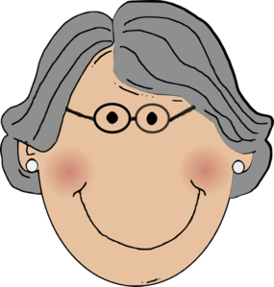
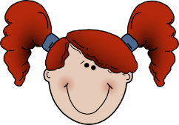
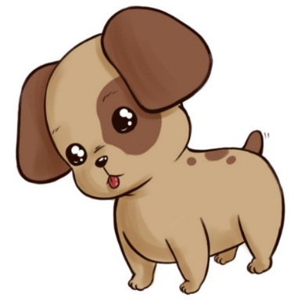
Vocabulario
Paco y Sofía
Luca y Lorena
Isobel
Chu-Chu
el abuelo
la abuela
los primos
la prima
el perro
quite active
beautiful
strong
artistic
quite strong
very active
quite artistic
active
very artistic
¿Quiénes son activos?
¿Quién es fuerte?
¿Quién es hermosa?
¿Quién es bastante artística?
¿Quién es bastante fuerte?
¿Quién es bastante activa?
¿Quién es artístico?
Notes:
Vocab revisiting – from T2.1 week 2
perro [888]; abuelo [4796]; abuela [717]; primo [1451]; prima [3051]; bastante [308]; hermoso [980]; activo [1278]; artístico [1402]; fuerte [435]
Recap the members of the family by eliciting answers in Spanish from students asking ¿Quién es / Quiénes son? Click on the box to reveal the Spanish answer.
Sentences then appear for which the students have to work out the answer. Teachers can tell students to give either the name of the family members, or say/write the words in Spanish e.g los primos
To force recall of the family members in Spanish teachers could conduct this activity with the boxes obscuring the word in Spanish. This would be a test not only of understanding the adjective but recalling/spelling the family members.
NB – as muy is not part of this vocab set, it is not used in any of the Spanish questions.

