Slide 1
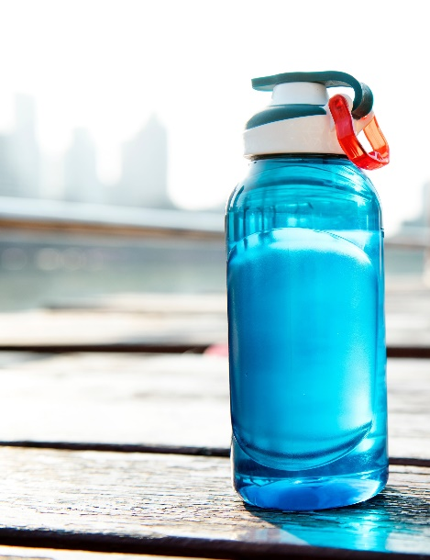
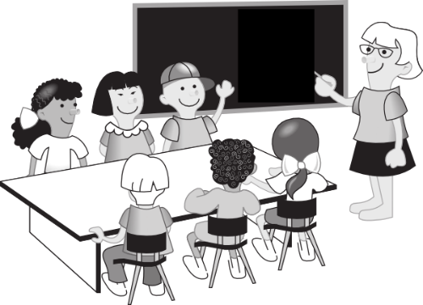
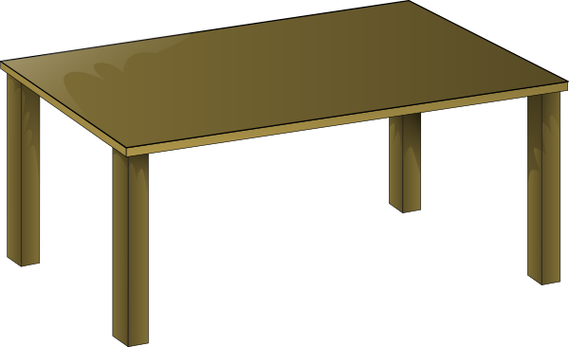
Was ist das?
ein
eine
ein
Notes:
Was ist das? Elicit ‘Das ist ein…’ This slide has pictures instead of text to elicit the recall of the nouns themselves, as well as their gender.

Slide 2
Farben Was ist rot?
Ein Apfel ist rot!
Das Blut ist rot!
Was ist gelb?
Die Sonne ist gelb!
Eine Banane ist gelb!
Was ist blau?
Der Himmel ist blau!
Das Meer ist blau!
Was ist grün?
Das Gras ist grün!
Ein Baum ist grün!
Was ist schwarz?
Die Nacht ist schwarz!
Die Tinte ist schwarz!
Was ist rosa?
Eine Rose ist rosa!
Ein Lippenstift ist rosa!
Was ist orange?
Ein Sonnenuntergang ist orange!
Was ist lila?
Eine Aubergine ist lila!
Was hat alle Farben?
Ein Regenbogen hat alle Farben!
Notes:
Farbengedicht
This poem was written by a former Y8 student after 4 weeks of learning German. The structure is simple. 65% words have been learnt previously (if following the NCELP SOW and using its resources) 47% words are cognates (some of this category overlap with known words) 74% words are in the 1000 most frequent words, 82% in the most frequent 2000 words. [There is an excel frequency sheet for this text, accompanying the lesson resource.]
This is the first longer text in German that students have been introduced to. The audio is provided and the text is animated to appear in sync with the audio, to reduce the cognitive load and support understanding. The poem can be used for: 1] Dictionary work Students identify 5 unknown words and look them up, trying then to translate the line of the poem with the unknown word Note: Several of the unknown words are a) cognates and b) inferable from the context of the poem (colours of things) and familiar words surrounding. 2] Group translation Students work in small groups to translate the poem into English, paying attention to the use of articles (both definite and indefinite appear in the poem)
3] Adaptation and creation (extension) Students write 6 lines of poem, using the same structure, changing the nouns and colours. Note: this would follow whole class discussion of the group translations, including a focus on the author’s choice of ‘a’ or ‘the’.

Slide 3
 | Word | English meaning
1 | ich | I
2 | bin | am (BE)
3 | klein | small
4 | groß | big, tall
5 | rot | red
6 | gelb | yellow
7 | blau | blue
8 | wie? | how?
9 | und | and
10 | die Form | shape
11 | der Mensch | human being
12 | das Ding | thing
60
Sekunden
0
ANFANG
Notes:
A final lesson activity can always be to review words from the week. These will be on Quizlet for students to consolidate their knowledge during the week.

Slide 4
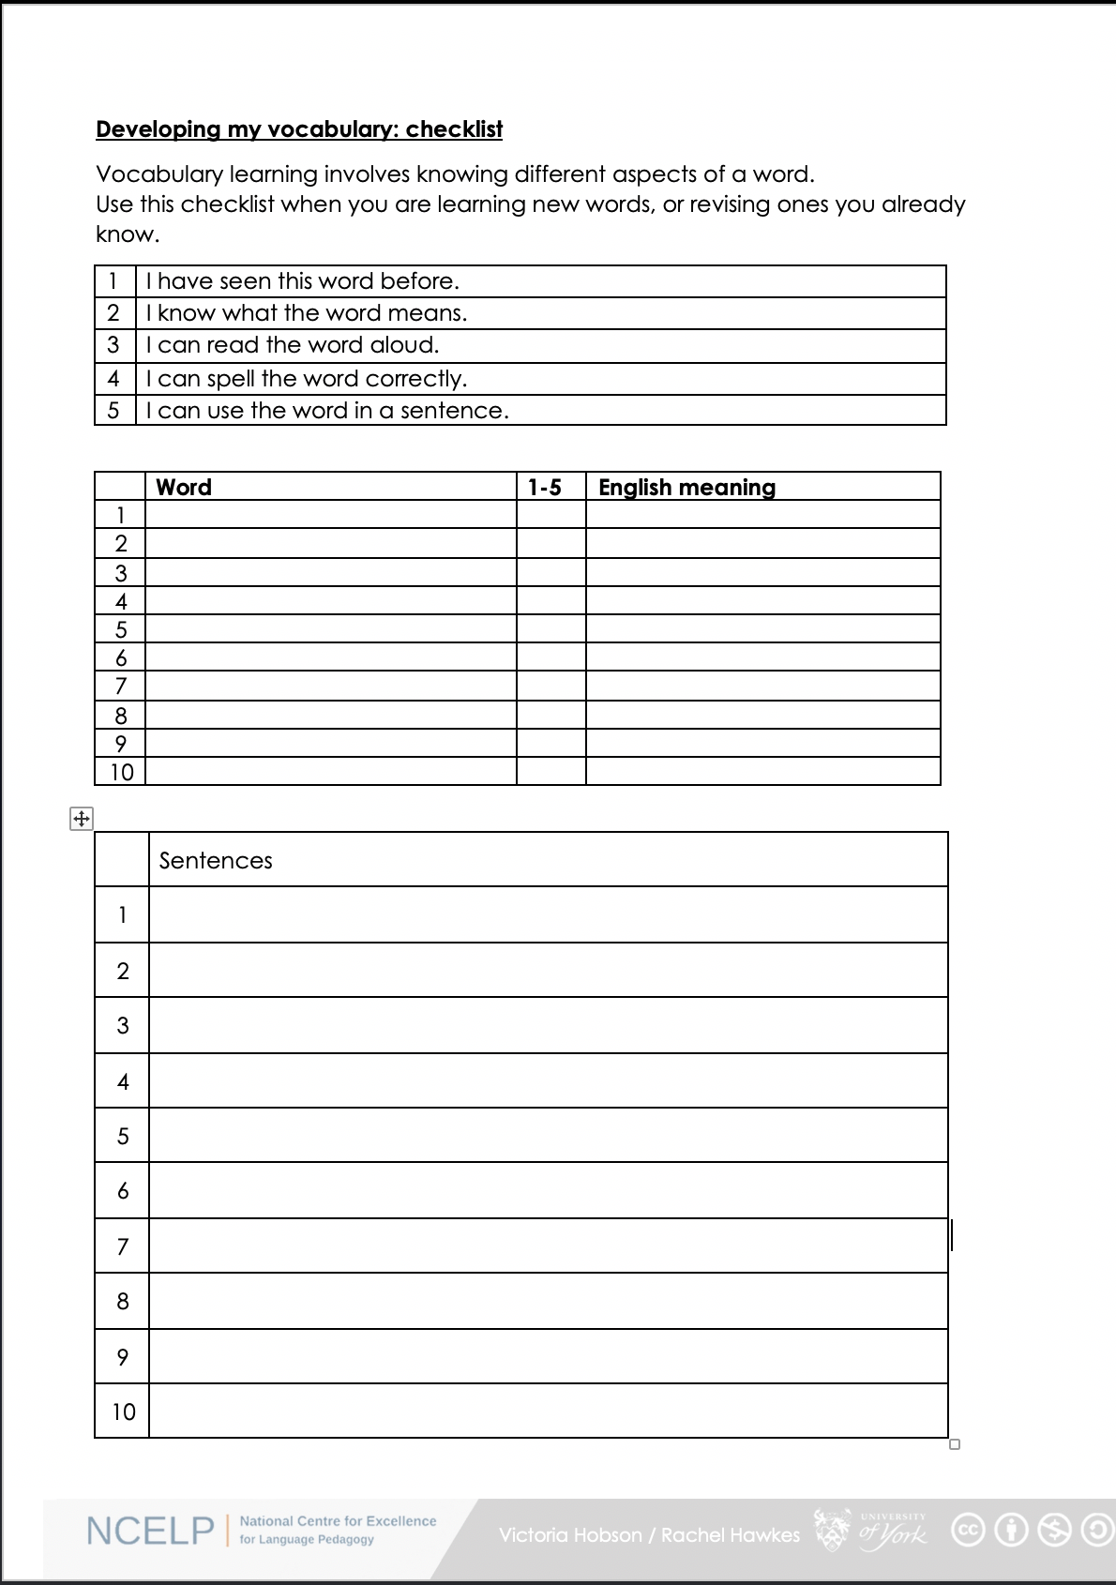
Was denkst du?
1. I have seen this word before.
2. I know what the word means.
3. I can read the word aloud.
4. I can spell the word correctly.
5. I can use the word in a sentence.
6. For nouns, I know the gender and the correct word for ‘the’
Notes:
Was denkst du? What do you think? (Elicit the meaning of this from students).
This sheet could be part of a homework task for Week 3 vocabulary, if desired.
Students have met this checklist in previous weeks.
Vocabulary learning involves knowing different aspects of a word. Students can use this checklist when to check what they know when they are learning new words, or revising ones they already know.
For each word the checklist asks students to asses whether the following statement apply:
1. I have seen this word before.
2. I know what the word means.
3. I can read the word aloud.
4. I can spell the word correctly.
5. I can use the word in a sentence.
Students then translate the word and try to use it in a sentence.
We suggest giving students a print out of the template they can refer to throughout the year.
A word template is available on the NCELP resource portal.
https://resources.ncelp.org/concern/resources/gf06g264k?locale=en

